Slide 1
An Efficient and Effective Light Gas Gun Design for Millimeter-scale Hypervelocity Testing
Scott Hull, NASA Goddard Space Flight Center
Mark Kulick, Analytical Mechanics Associates
Don Humes, NASA Langley Research Center (Retired)

Slide 2
Documenting a Unique and Elegant Design of a Light Gas Gun
History
  Designed in the early 1970’s for meteoroid impact studies
  Used for over 30 years in support of a wide variety of NASA missions
  Hardware has been donated to the National Air and Space Museum
Unique Characteristics
  Used a 220 Swift hunting rifle for the first stage (similar to CalTech SPHIR)
  Did not require a sabot: all energy went into accelerating the projectile
  Launch Tube matched to the projectile diameter
  Smaller powder charge: reduced safety concerns
  Relatively small and easy to clean and cycle: lower cycle time and cost

Slide 3
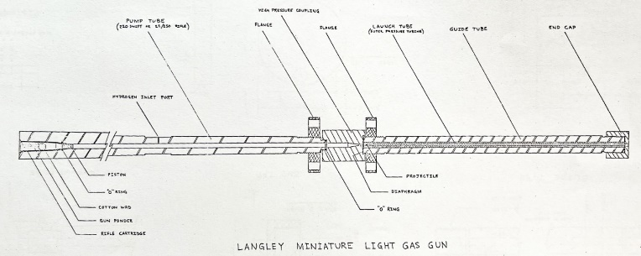
Langley Miniature Light Gas Gun
Overall Design

Slide 4
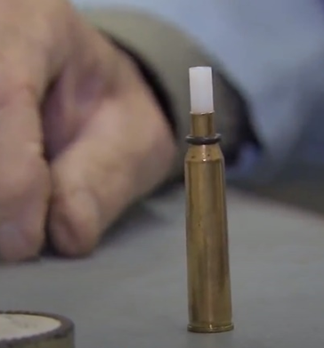
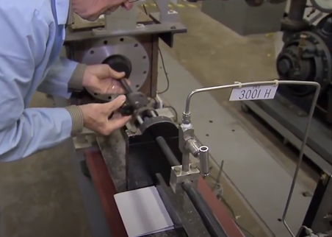
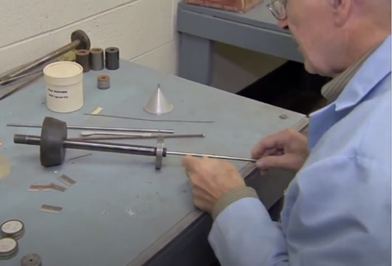
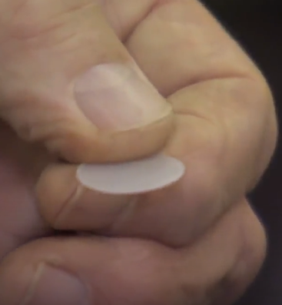
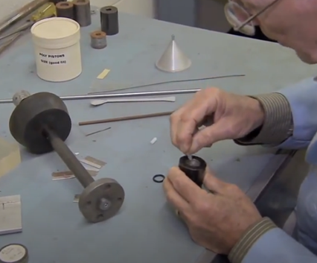
Preparation Cycle
Screen shots from
https://www.youtube.com/watch?v=7-7dVrTcgmg

Slide 5
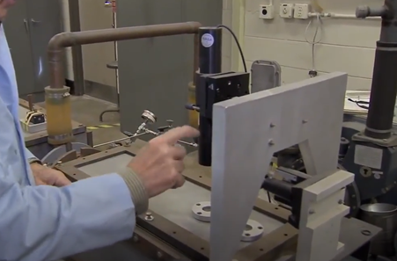
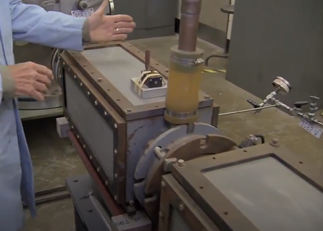
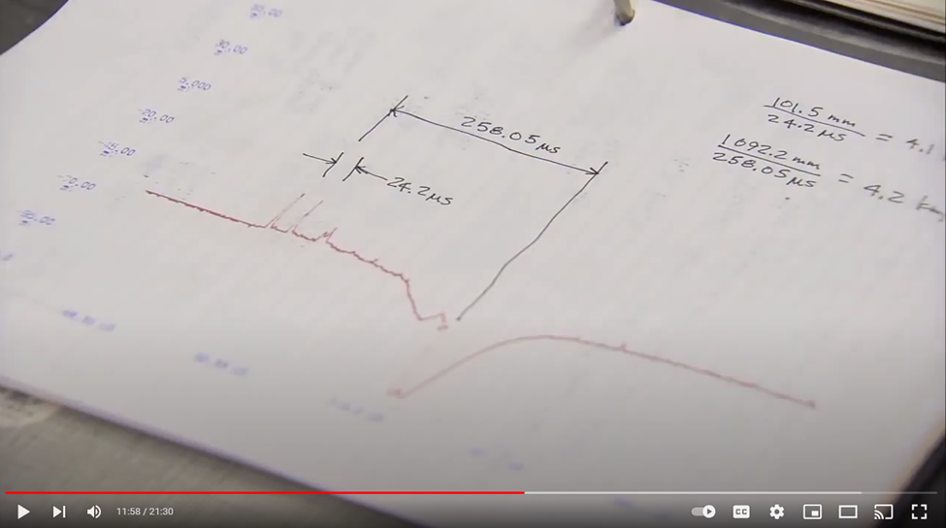
Test Chamber
Screen shots from
https://www.youtube.com/watch?v=7-7dVrTcgmg

Slide 6
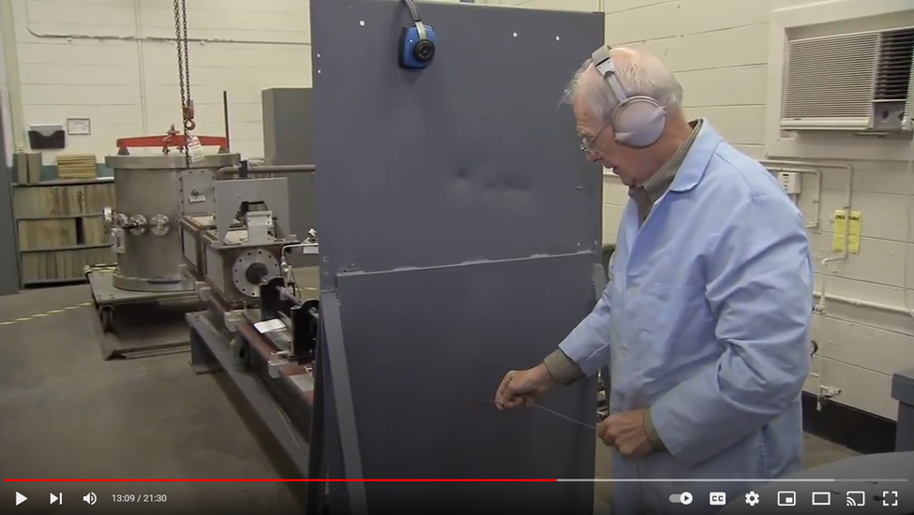
Results
Used off and on for over 30 years
  Pioneer, Voyager 1, LDEF, Lunar Orbiter, International Space Station
Most tests at 5-7 km/s, maximum when new 9.2 km/s
Spherical and cylindrical projectiles, <1to 3.2 mm diameter
Four launch tube diameters to match projectile
Nylon, glass, and stainless-steel projectiles
Estimated cost: $1.25 (1990) plus 1-hour labor per shot

Slide 7
Conclusions
Effective, efficient, and elegant design
Easily and inexpensively replaced components in wear locations
Low-cost option for small (1-3 mm) projectile testing
Limited to four diameter options, but could use cylindrical projectiles to adjust projectile mass
Operated for more than 30 years
Now retired, but elements of the design still have value for modern HVI test equipment

Slide 8
Potential Future Work
Study the physics and mechanical stresses in each component to understand safety limits
Build a new LGG from this basic design
  Optimize the powder charge, diaphragm thickness, and H₂ pressure
  Goal of safely and routinely achieving 8, 9, or even 10 km/s
  Retain cost-effectiveness to enable large sample sizes

