Slide 1
Additive Manufacture Application For Solid Rocket Motor Cases
NASA Solid Propulsion Systems & Pyrotechnic Devices Branch, ER62
Nicholas Briggs
Amit Patel

Slide 2
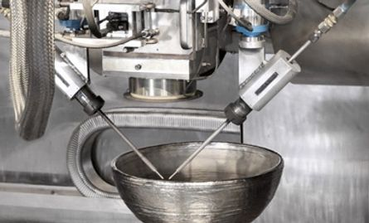
Agenda: Evaluating Material Strength for 3D-printed EBAM Titanium Spherical Designs
Objective
Background of AM Processes
Approach
  Titanium Dome Design
  Hydroburst Testing
  Tensile Testing
  Microstructure Analysis
Results and Discussion
  Hydroburst Challenges
  Tensile Test Data Statistics and Trends
  Microstructure Results
Concluding Remarks
Notes:
Change to background of AM processes

Slide 3
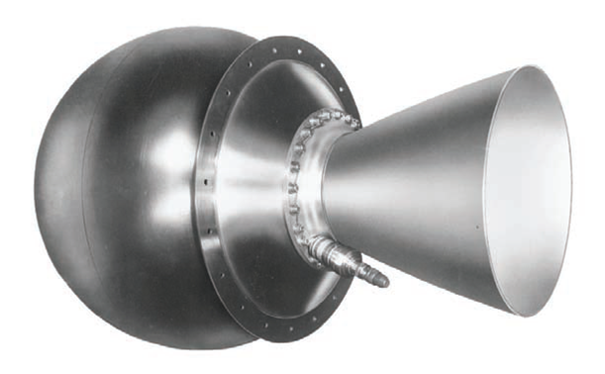
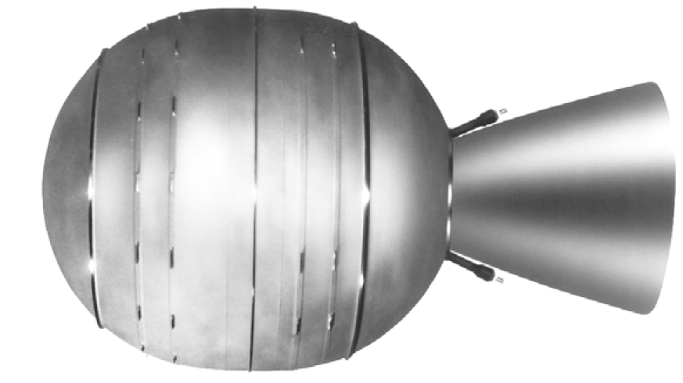
Objective: Electron Beam Additive Manufacturing of SRM Cases
Goal to reduce the procurement time of SRM cases to significantly reduce unmanned mission risks.
  Lead time for SRM manufacturing can take up to 3 years.
  Forgings can take 6-12 months to create and machine with assembly taking an additional 8 months.
  AM processes can reduce some of the manufacturing time by up to 80%.
  AM opens the door for more complex geometries without increased manufacturing costs.
Current programs that have considered using titanium case SRMs include Mars Ascent Vehicle (MAV), Europa Lander, and VIPER (moon lander).
STAR 17
STAR 48 – Europa De-Orbit Stage and VIPER Lander De-Orbit Stage
Notes:
The goal of this project was to begin laying the ground-work of applying additive manufacturing to solid rocket propulsion systems. At present, traditional manufacturing methods of forging and casting SRM cases have very lengthy timelines. Up to 1-2 year.
Long mfg lead times can bring too much schedule risk to a program.
Additive manufacturing can reduce this lead time down to just a couple of months. Opening the door for more complex geometries during the manufacturing process and reduce the need of tooling hardware.
Multiple current programs have considered using a metal SRM case, such as titanium: MAV and Europa Lander

Slide 4
Agenda: Evaluating Material Strength for 3D-printed EBAM Titanium Spherical Designs
Objective
Background of AM Processes
Approach
  Titanium Dome Design
  Hydroburst Testing
  Tensile Testing
  Microstructure Analysis
Results and Discussion
  Hydroburst Challenges
  Tensile Test Data Statistics and Trends
  Microstructure Results
Concluding Remarks
Notes:
Now I will briefly cover comparisons of different AM processes

Slide 5
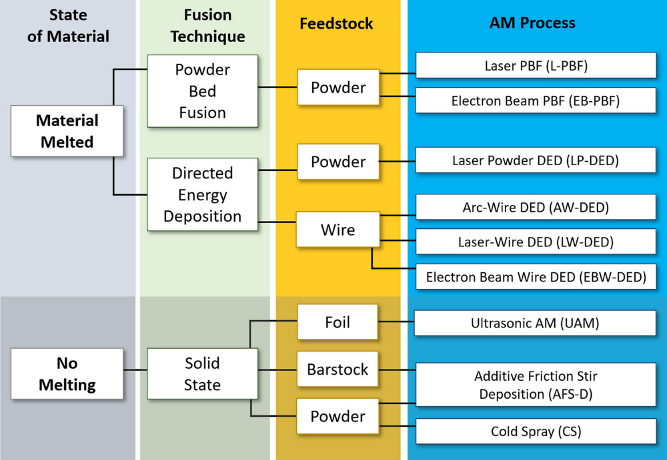
Types of AM Processes
Powder Bed Fusion (PBF) – parts fabricated using a bed of powder feedstock and a laser or electron beam as a heat source.
Directed Energy Deposition (DED) – parts are fabricated by blowing powder or feeding preheated material in a melt pool and melting with a laser or electron beam.
Solid State – uses a solid or powder feedstock fed into a rotating friction stir pin tool.
Ref: 1
Notes:
There are several AM processes that can be considered for SRM cases. On the right there is a chart them down into various categories. Currently, PBF and DED methods are being considered.
The small print space of PBF could fill a gap for small-scale SRMs for cubeSats.
Direct Energy Deposition (DED) can fill the mfg gap for larger SRM cases, such as the STAR 17 and 48 from the previous slide. DED processes also have the advantage of have developed technologies for multiple heat sources and both powder and wire as the feedstock.

Slide 6
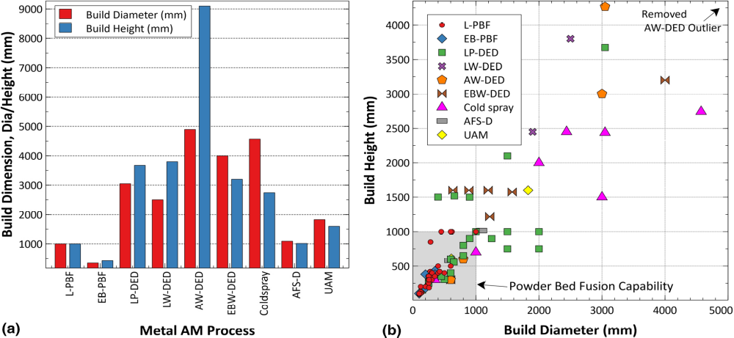
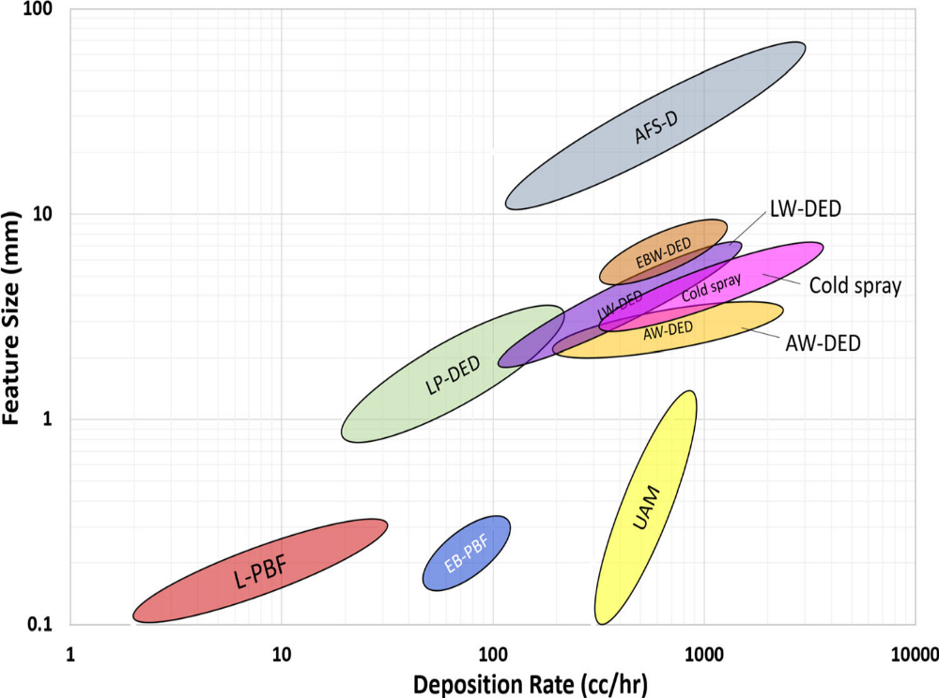
AM Process Build Platform Comparison
Build Volume:
Build Rate
Ref: 1
Notes:
While PBF can have a low deposition rate, due to the feature size that can be achieved, it works well as the resolution, or the near-net print, is very high.
For larger prints, DED achieves a high deposition rate, which will result in a lower feature resolution, leading to the need of some machining necessary post-print

Slide 7
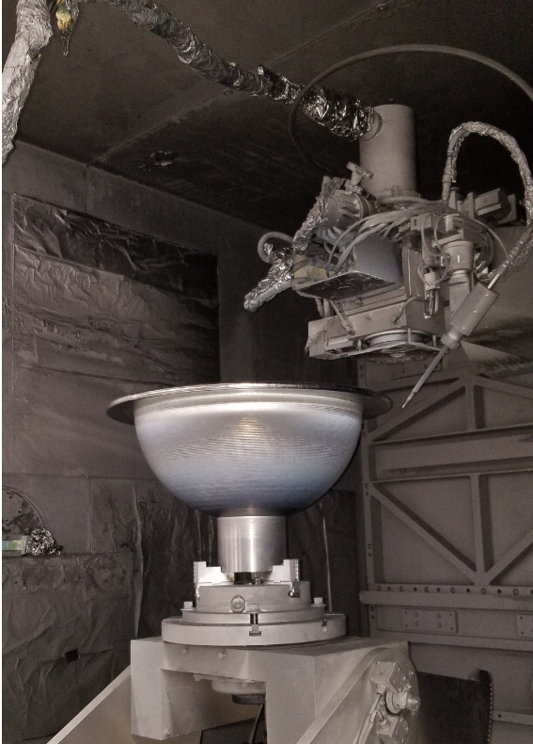
Purpose: Electron Beam Additive Manufacturing of SRM Cases
Future Additive Manufacturing Aerospace (FAMAero) is a factory service manufacturer providing: AM, heat treatment, machining.
FAMAero uses a Sciaky, Inc. Electron Beam Additive Manufacturing (EBAM) process
EBAM is an electron beam wire DED (EBW-DED) process. A stationary electron beam melts material from an off-axis wire feed onto a gimble build plate in a vacuum chamber.³
Notes:
We partnered with Future Additive Manufacturing Aerospace (FAMAero) to procure printed material for testing and analysis.
FAMAero is an AM service manufacturer that has the capability to print, heat treat and machine. The vendor uses a Sciaky electron beam additive mfg process, which is their patented version of electron beam wire direct energy deposition. Using a stationary e-beam heat source to melt material from an off-axis wire feedstock onto substrate attached to a gimble, in a vacuum chamber.

Slide 8
Agenda: Evaluating Material Strength for 3D-printed EBAM Titanium Spherical Designs
Objective
Background of AM Processes
Approach
  Titanium Dome Design
  Hydroburst Testing
  Tensile Testing
  Microstructure Analysis
Results and Discussion
  Hydroburst Challenges
  Tensile Test Data Statistics and Trends
  Microstructure Results
Concluding Remarks
Notes:
Now I will cover the dome design

Slide 9
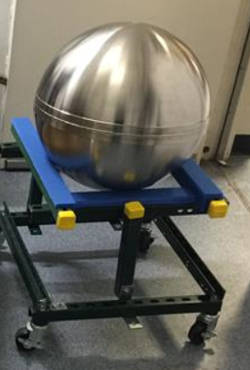
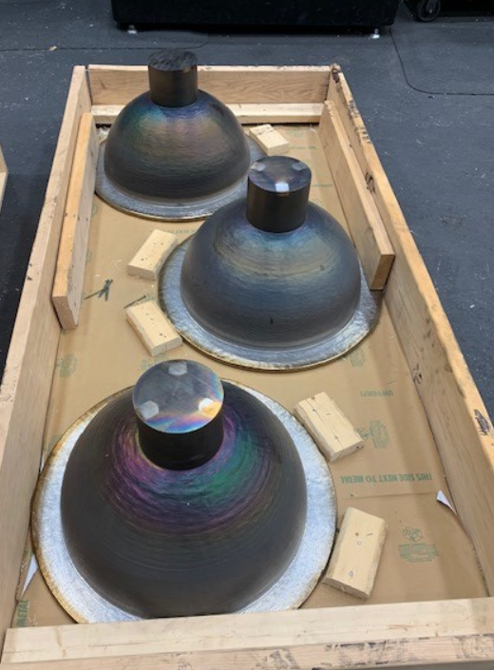
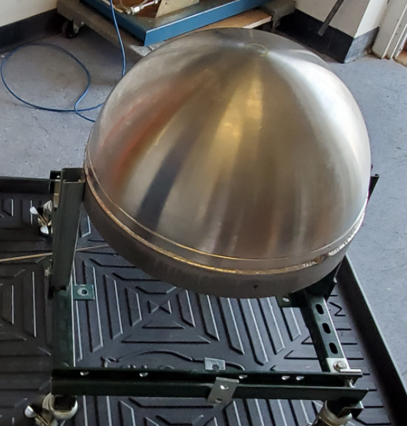
Design and Structural Analysis
Procurement:
  3 domes
  20in diameter
  0.07in wall thickness
Material: AM Ti-6Al-4V, commonly used alpha-beta titanium alloy with a high strength-to-weight ratio.
Designs:
  Dome to Dome model with two halves welded together.
  Dome to Plate model with one half welded to a Plate.
Printed Domes, Pre-machined
Completed Test Articles
Notes:
The designs were simple Ti64 titanium alloy domes with 10 radius and 70 thou wall thickness. We were able to procure 3 domes, from which we made 2 test articles:
A dome-to-dome, or spherical design, welding together two of the domes
And a dome-to-plate model welded together.
Finite element analysis was performed and predicted burst pressure at 1625 psi. FEA provided crucial insight into the test article designs.
The domes were given a thickened band to provide material and stiffening around the weldment
The plate is 2in thick. The greater thickness reduced predicted stress on the plate itself and through stress at the weldment, such that failure would be less likely to occur at the weldment prior to the expected burst pressure of the test articles.

Slide 10
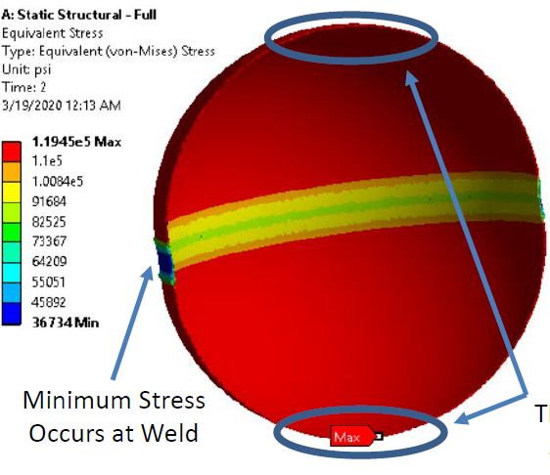
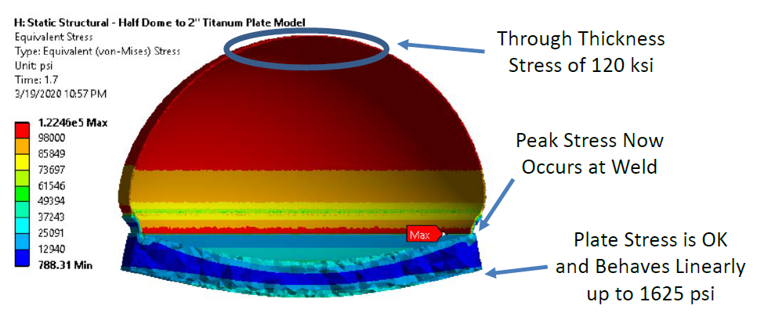
Design and Structural Analysis
Finite Element Analysis
  Burst Pressure: 1625psi
Design Concerns
  Plate Thickness
  Through stress at weldment
Through Stress of 120ksi
Notes:
Finite element analysis was performed and predicted burst pressure at 1625 psi. FEA provided crucial insight into the test article designs.
Given size and wall thickness. Would represent state of the art pressure capability
The domes were given a thickened band to provide material and stiffening around the weldment
The plate is 2in thick. The greater thickness reduced predicted stress on the plate itself and through stress at the weldment, such that failure would be less likely to occur at the weldment prior to the expected burst pressure of the test articles.

Slide 11
Agenda: Evaluating Material Strength for 3D-printed EBAM Titanium Spherical Designs
Objective
Background of AM Processes
Approach
  Titanium Dome Design
  Hydroburst Testing
  Tensile Testing
  Microstructure Analysis
Results and Discussion
  Hydroburst Challenges
  Tensile Test Data Statistics and Trends
  Microstructure Results
Concluding Remarks
Notes:
Ok, now we will discuss the hydrostatic burst testing setup

Slide 12
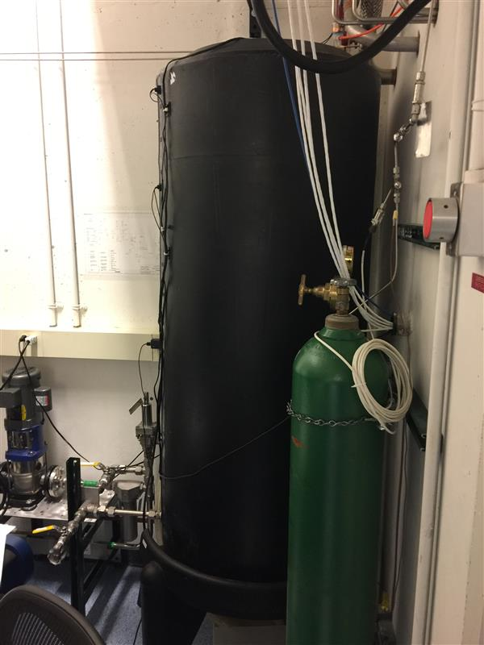
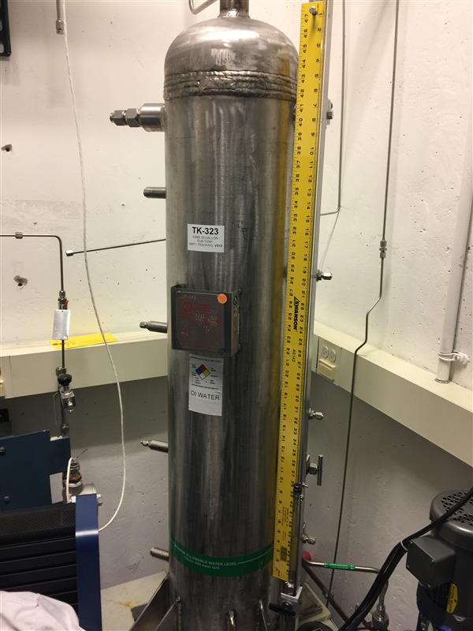
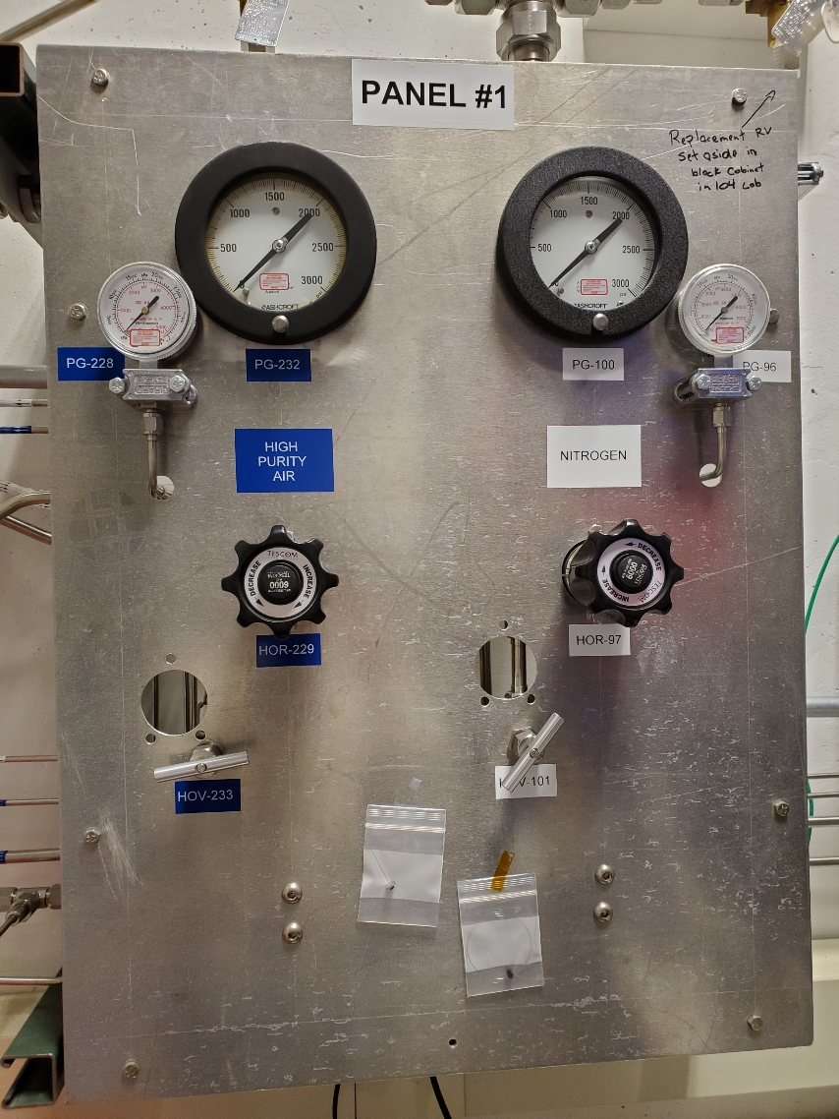
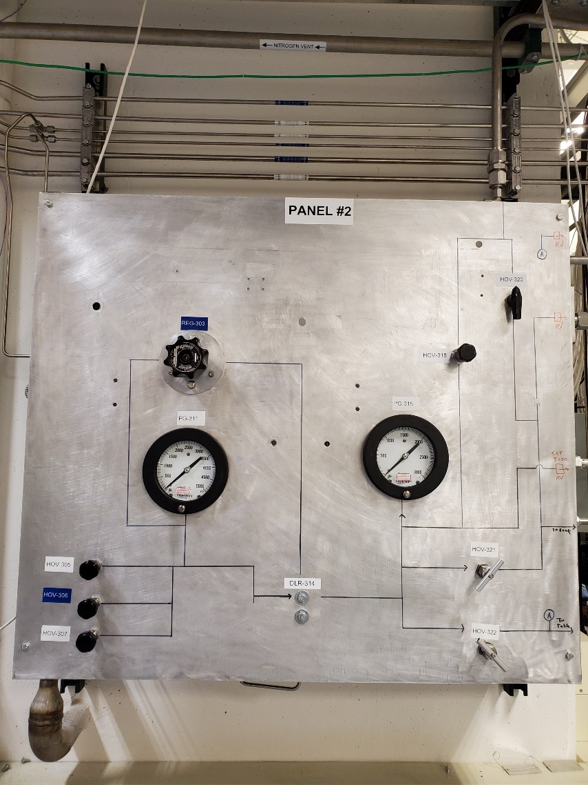
Hydro-burst Testing Set-up
The hydro-burst system consists of an Air pressure system (MAWP 3000 psig), Water supply system (V0515/TK313, MAWP 3000 psig), Pressure transducer (Honeywell, MAWP 5000 psig), and Pressure gauge (3D Instruments, MAWP 3000 psig).
Notes:
Testing was performed at building 4205 at Marshall. The test utilized an air pressure system with a max allowable working pressure of 3000 psig, a water supply system, and a pressure transducer and pressure gauge instruments with MAWPs of 5000 psig and 3000 psig respectively.
Here the images show the control panels of the pressure system, the water supply tank (black) and the pressurant tank (silver)

Slide 13
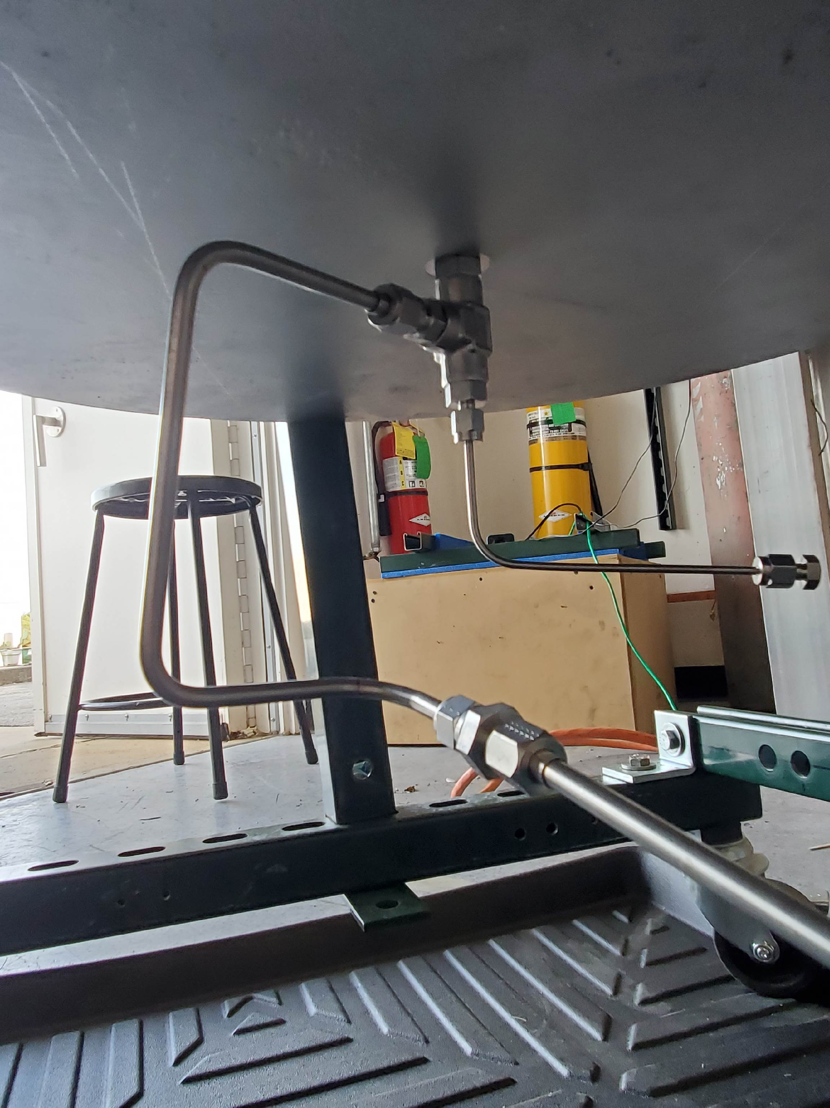
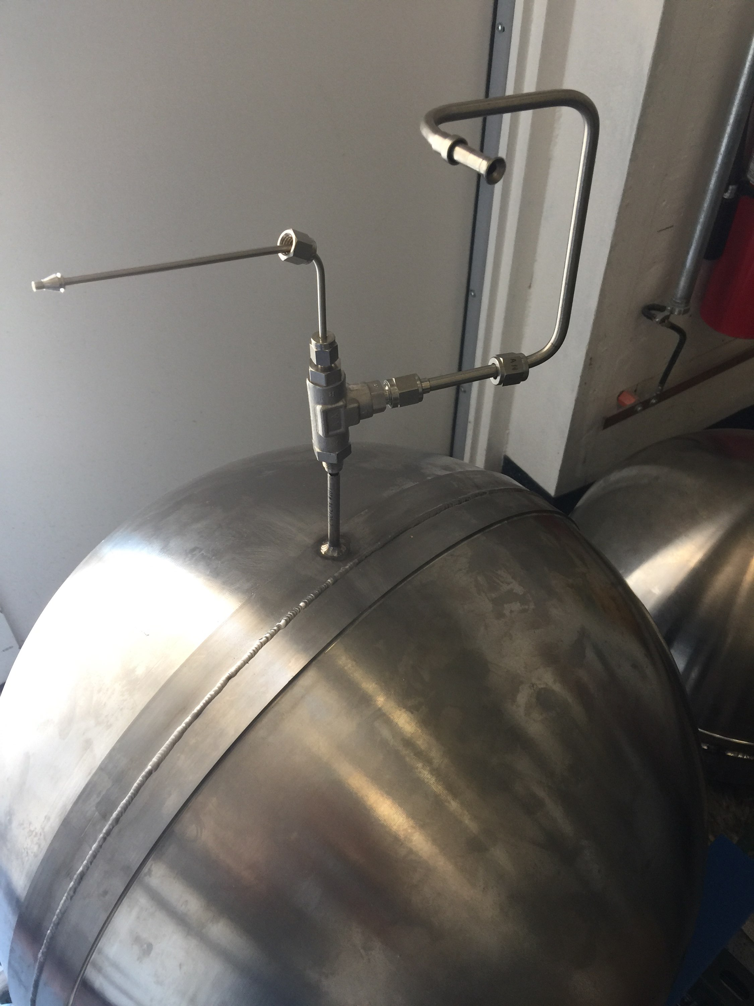
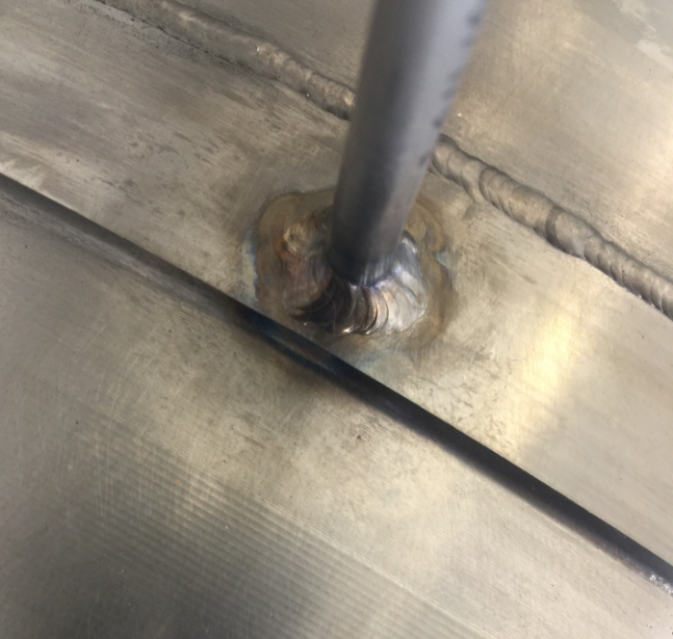
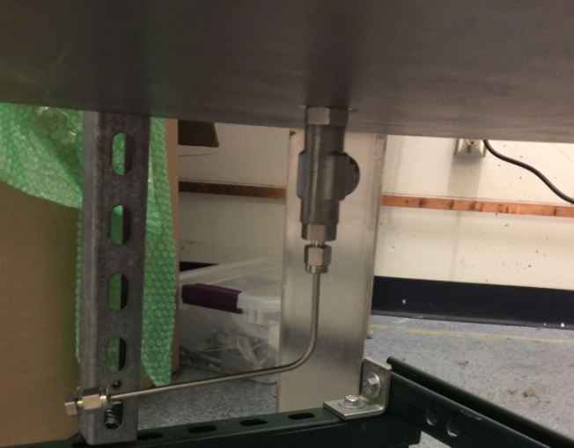
Hydro-burst Testing Set-up
For the dome-plate configuration, a port hole was machined through the face of the plate; a Swagelok T-fitting was inserted and connected to the pressure system via .25” tubing.
The sphere configuration has a port hole machined through the .140” thick titanium belt with .25” tubing welded to the sphere.
Air out
Water In
Air out
Water In
Notes:
The test articles were fitting with plumbing to supply water and remove air. The dome-to-plate design had a hole machined in the middle of the plate and then a Swagelok T-fitting was inserted and connected via .25’’ tubing. Water flows through the ¼’’ tube and air is pushed out via 1/8’’ tubing inserted into ¼’’ tubing. The air outlet is capped once a stream of water is present.
The sphere design had a hole machined through the thickened circumferential band and then a titanium tube was welded to the hole. This allowed Swagelok fittings to be attached.

Slide 14
Agenda: Evaluating Material Strength for 3D-printed EBAM Titanium Spherical Designs
Objective
Background of AM Processes
Approach
  Titanium Dome Design
  Hydroburst Testing
  Tensile Testing
  Microstructure Analysis
Results and Discussion
  Hydroburst Challenges
  Tensile Test Data Statistics and Trends
  Microstructure Results
Concluding Remarks
Notes:
Moving on to the tensile testing

Slide 15
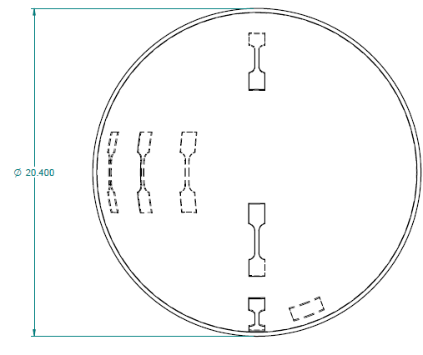
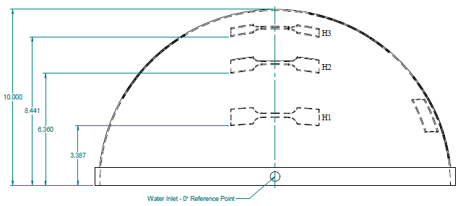
Material Testing & Analysis:
  Specimen
    6 ASTM E8 dog-bones: 3 horizontal, 3 vertical
    1 microstructure sample
V3
H1
H2
H1
H2
H3
H3
V2
M1
V1
M1
Cut plan for dog-bone samples
Notes:
Tensile testing was performed by EM22.
Without direct funding, we were able to get 1 sample for microscopy analysis and 6 dog-bone specimens: 3 vertical/perpendicular to the grain and 3 horizontal/parallel to the grain. The dog-bones were cut and tested according to the ASTM E8 standard.
Here you can see the sectioning of the dome by EM31, the dog-bones, and the cut plan.

Slide 16
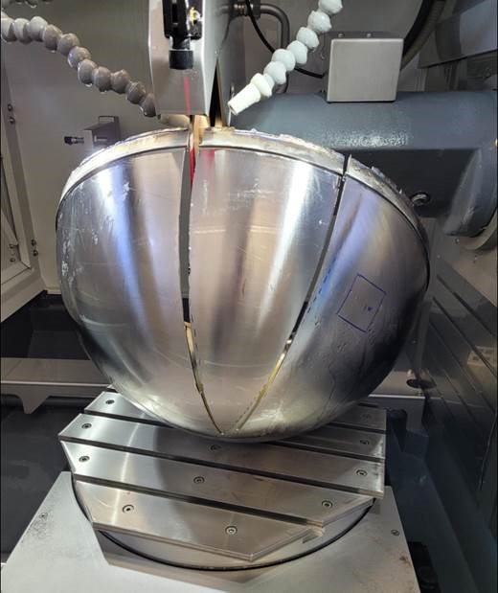
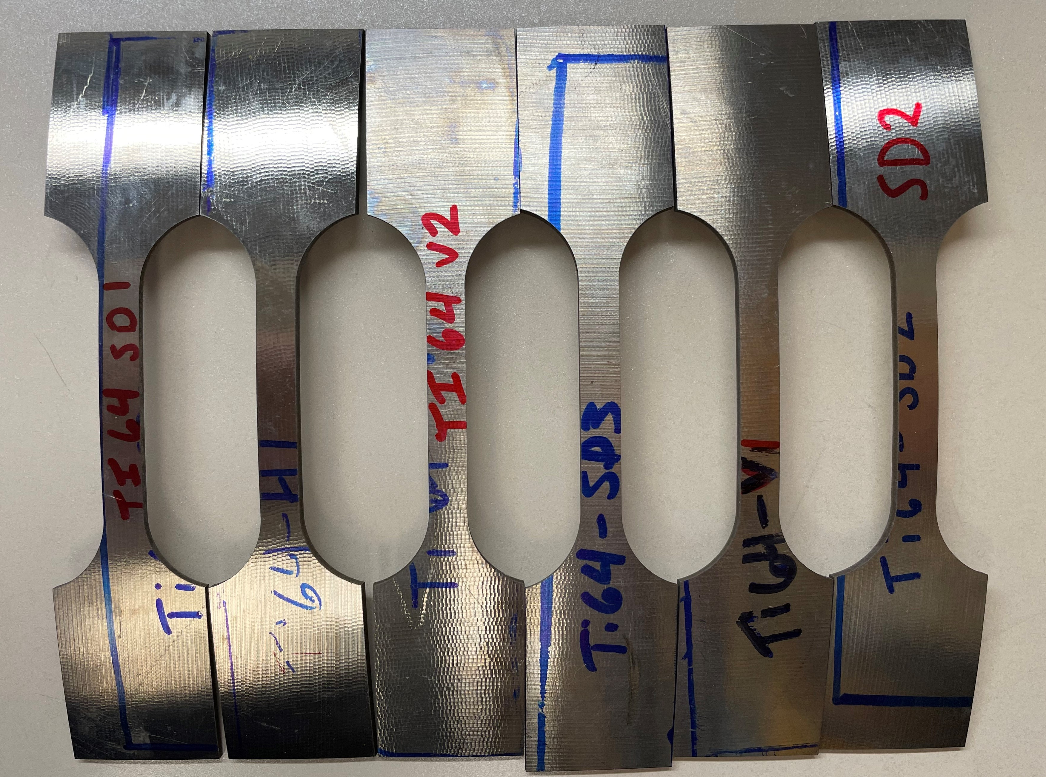
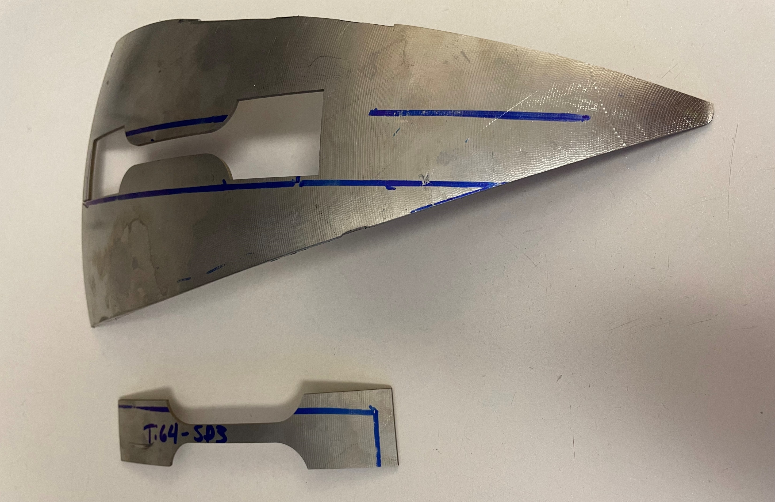
Material Testing & Analysis:
  Samples were pulled from one dome of the post-tested Spherical test article
  Dome sectioned and specimens cut by the Materials Science and Metallurgy branch
  Mechanical testing by the Materials Mechanical Test Facility
6 total samples: 3 horizontal, 3 vertical
Notes:
Tensile testing was performed by EM22.
Without direct funding, we were able to get 1 sample for microscopy analysis and 6 dog-bone specimens: 3 vertical/perpendicular to the grain and 3 horizontal/parallel to the grain. The dog-bones were cut and tested according to the ASTM E8 standard.
Here you can see the sectioning of the dome by EM31, the dog-bones, and the cut plan.

Slide 17
Agenda: Evaluating Material Strength for 3D-printed EBAM Titanium Spherical Designs
Objective
Background of AM Processes
Approach
  Titanium Dome Design
  Hydroburst Testing
  Tensile Testing
  Microstructure Analysis
Results and Discussion
  Hydroburst Challenges
  Tensile Test Data Statistics and Trends
  Microstructure Results
Concluding Remarks
Notes:
And now for the material analysis

Slide 18
Light Microscopy, Micro-Hardness, Fractography Testing
Light Microscopy
  Specimens were polished down to 0.05µm Colloidal SiC solution to achieve a mirror like finish, specimens were then etched using Keller’s Etchant (195mL H2O, 2mL HF, 3mL HCl, 5mL N) by submersion for 10 seconds followed by water rinse and ethanol rinse to remove water’s impurities. This is done to reveal the grain structure of the specimens.
  Images were taken on Leica DMI5000 M at 100x and stitched into Montage format to provide an overall image of the specimens.
Micro hardness
  Micro hardness was performed using Vicker’s indenter on a Struers DuraScan 80. 200gf and a dwell time of 10 second per indent with a space of 2mm between each indent to avoid plasticity effects from previous indents. Measurements were performed after polishing and etching to identify where in the microstructure the hardness measurements were taken from.
Cross-Section of Fracture
  Specimens were mounted and polished down to a mirror like finish using 0.05µm colloidal silica and then etched using Keller’s Etchant to reveal the microstructure. Specimens were submerged in the etchant for about 6 seconds and rinsed with water and ethanol, the etchant assisted in revealing the microstructure and build layers.
Notes:
The material analysis performed consisted of microscopy, metallography, and micro-hardness. Fractography was performed on the tensile specimens post-test.
The M1 sample and tensile specimens were polished, etched, and washed prior to analysis to remove impurities and reveal the grain structure.
Micro-hardness was performed on the M1 sample with a dwell time of 10 sec per indent at a spacing of 2mm between indents.

Slide 19
Agenda: Evaluating Material Strength for 3D-printed EBAM Titanium Spherical Designs
Objective
Background of AM Processes
Approach
  Titanium Dome Design
  Hydroburst Testing
  Tensile Testing
  Microstructure Analysis
Results and Discussion
  Hydroburst Challenges
  Tensile Test Data Statistics and Trends
  Microstructure Results
Concluding Remarks
Notes:
Now it is time to discuss the results! First the Hydroburst Test

Slide 20
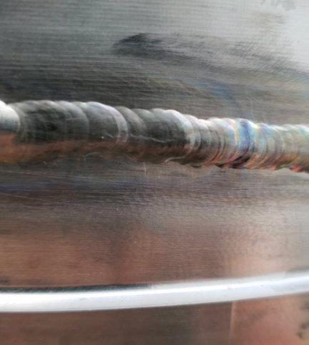
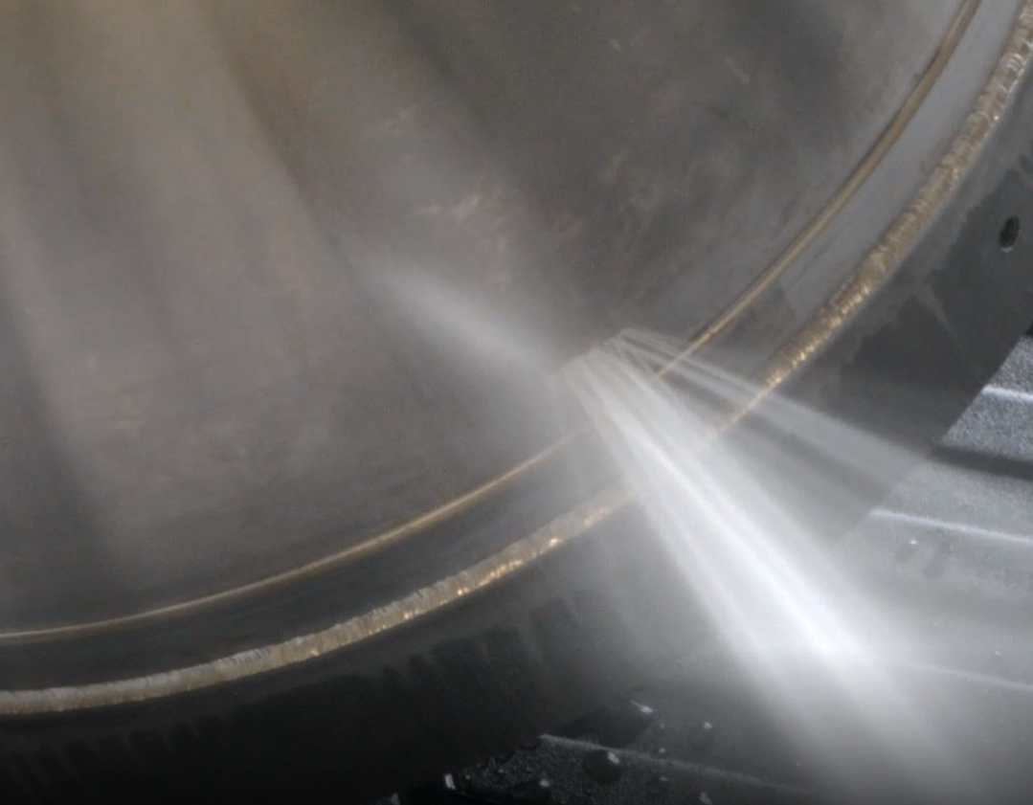
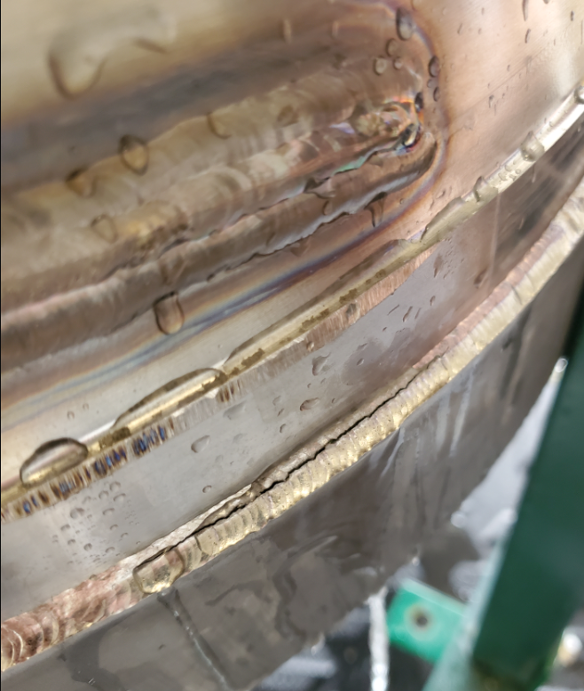
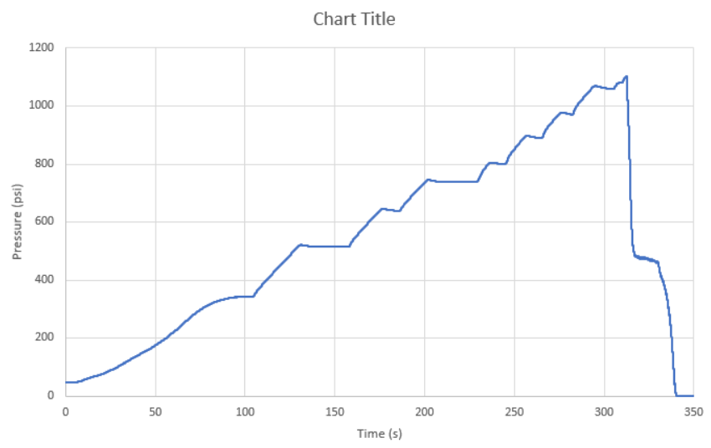
Hemisphere Hydro-burst Test Results
4 tests completed
Test #1: Dome failed along one of the print layers about 50 layers up from the circumferential band creating a 1.25” crack. The dome burst at 800 psig.
Test #2: Crack was repaired and burst at 817 psig. Failure at initial crack location.
Test #3: Failed along the circumferential weld.
Test #4: Failed along the circumferential weld at around 1100 psig.
Notes:
4 hydrostatic burst tests were performed using the dome-to-plate test article. The highest achieved burst pressure was roughly 1100psig.
Due to initial improper welding and subsequent weld issues, both test articles would fail at the weldment.
Which we would have repaired, evaluated, and then re-test. While the test articles may have experienced material fatiguing, the pressures were generally half or lower than the expected burst pressure.
The only failure that didn’t occur at the weld was the first test for the hemisphere test article, where the failure occurred in the dome at roughly 800psig. The cause is unknown, but after talking with the manufacturer it is possible aluminum that burns off during the printing process could have accumulated on the feedstock nozzle and fallen into the melt pool creating concentration of aluminum, weakening that area. Another possible cause would be a void.

Slide 21
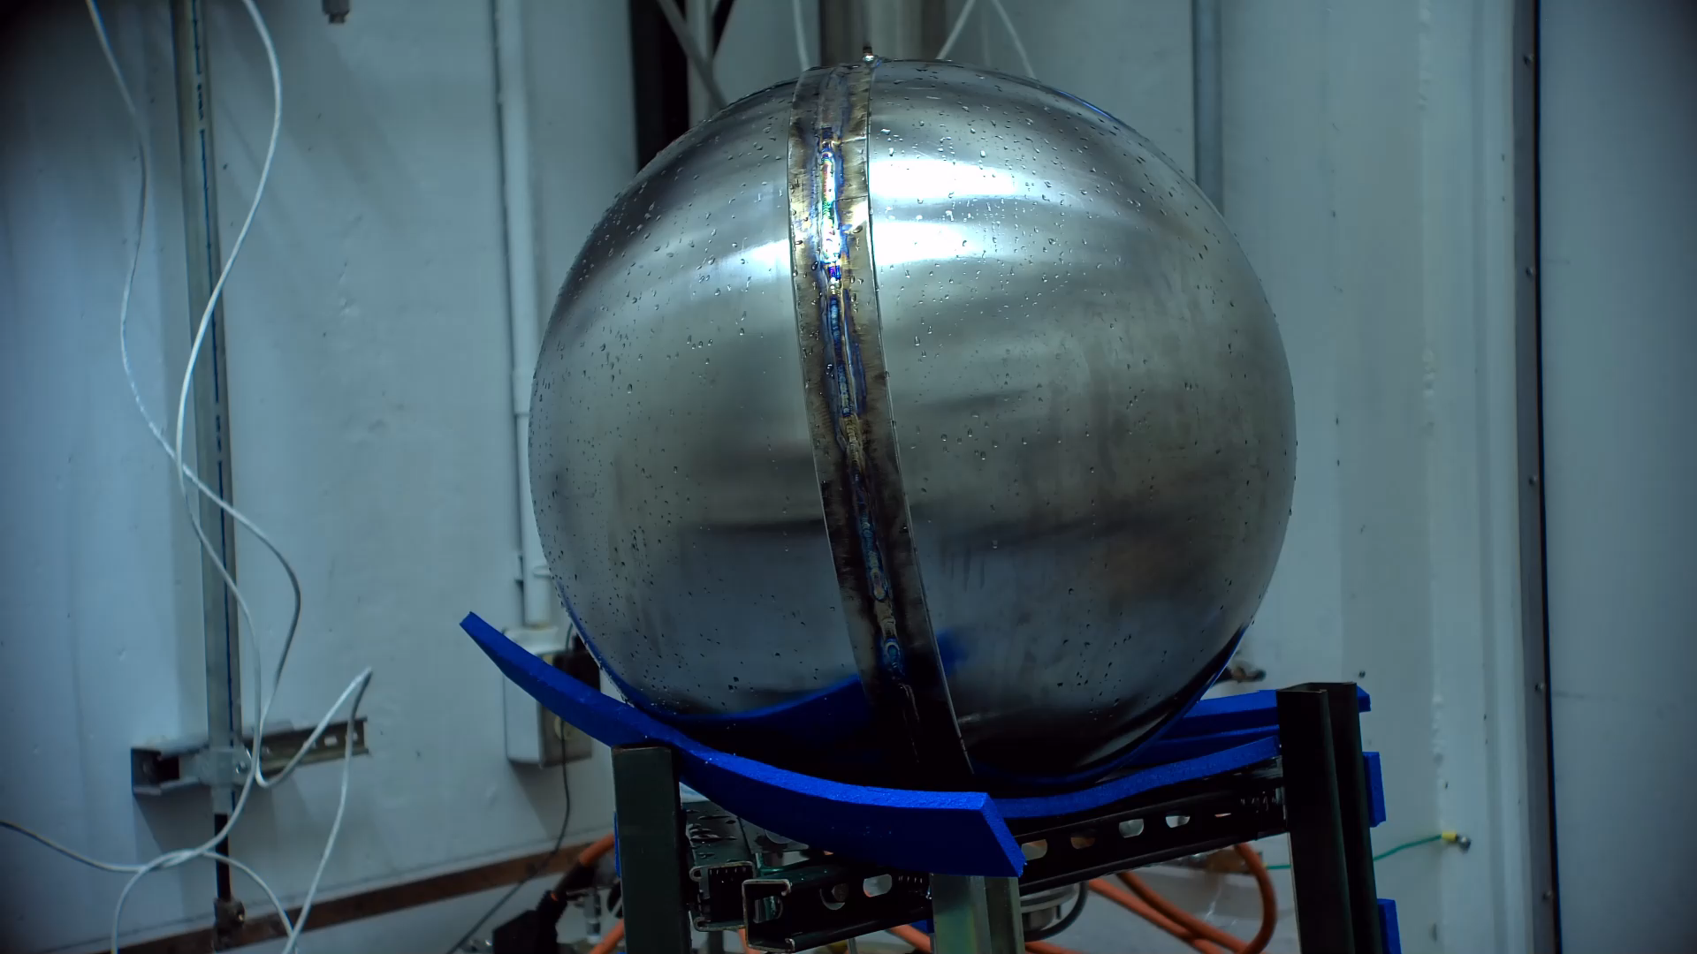
Sphere Hydro-burst Test Results
3 tests completed
Test #1: Failed along circumferential weld at ~550 psig. Weld un-zipped.
Test #2: Small crack propagation along weld. ~330 psig
Test #3: Burst and failure of the circumferential weld at an estimated burst pressure of 1580 psig.
  Almost 98% of the predicted burst pressure based on the analysis
Notes:
There were 3 test conducted with the dome-to-dome test article.
Due to poor planning on our end and improper welding by vendor, the circumferential weld was only superficial, so during the first test it completely un-zipped at 550psi. The weld was redone by an EM31 machine shop with experience welding titanium. The 2nd test exposed a flaw in the weld repair that was fixed and the 3rd test saw a burst pressure of 1580psi, roughly 3% shy of the expected burst pressure from the FEA.

Slide 22
Agenda: Evaluating Material Strength for 3D-printed EBAM Titanium Spherical Designs
Objective
Background of AM Processes
Approach
  Titanium Dome Design
  Hydroburst Testing
  Tensile Testing
  Microstructure Analysis
Results and Discussion
  Hydroburst Challenges
  Tensile Test Data Statistics and Trends
  Microstructure Results
Concluding Remarks
Notes:
Now on to the tensile test data

Slide 23
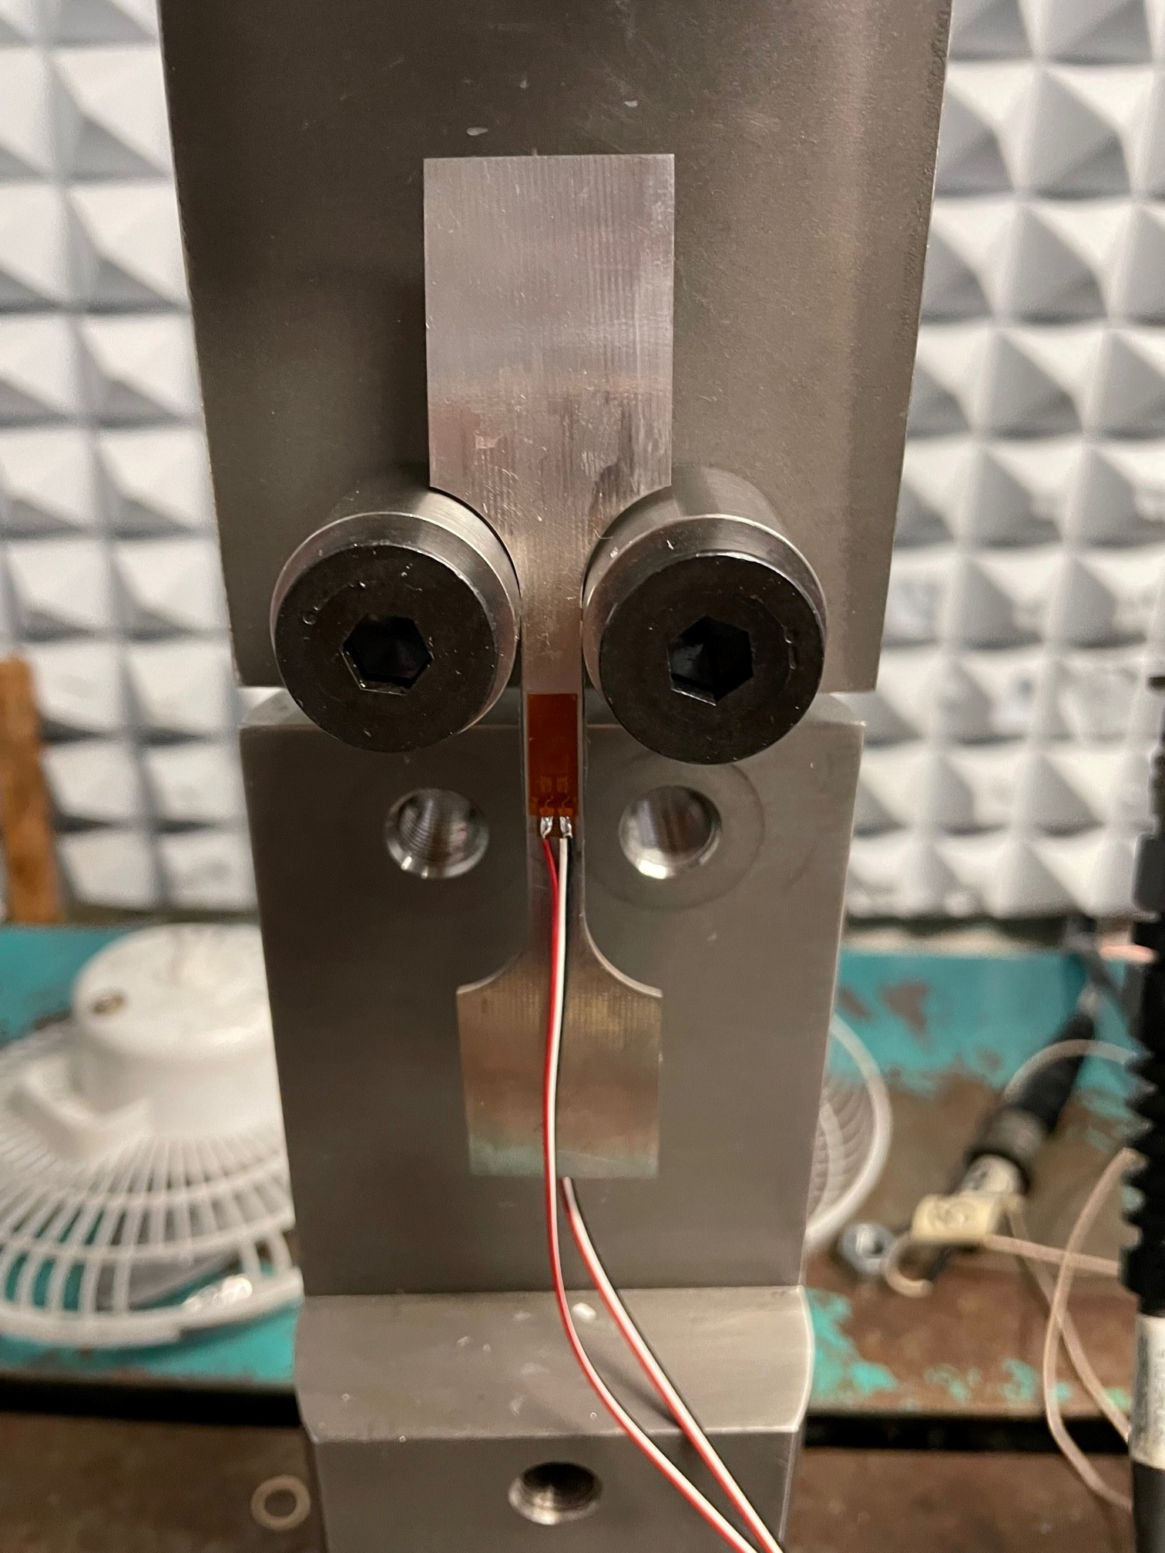
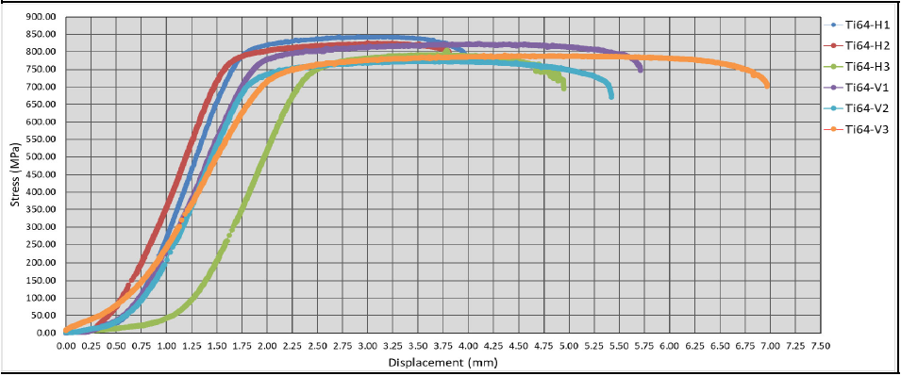
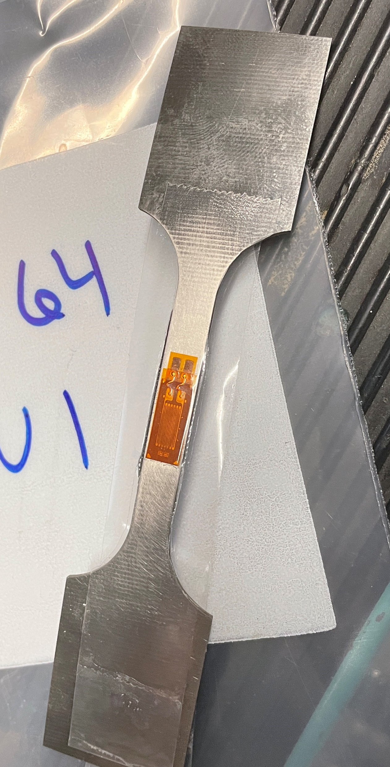
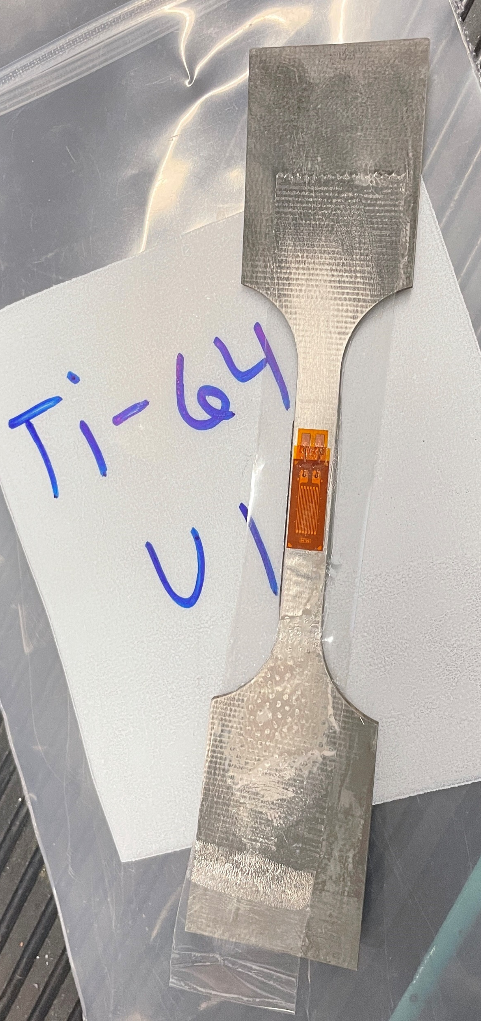
Project Results
Tensile Stress Testing:
  Strain gages were attached to the dog-bone samples
  Provided stress, strain curves and measure the displacement and load applied to each sample.
  Vertical samples had higher displacement & variation
Notes:
EM22 performed the tensile testing and provided stress/strain curves, measures of displacement and load applied to each sample

Slide 24
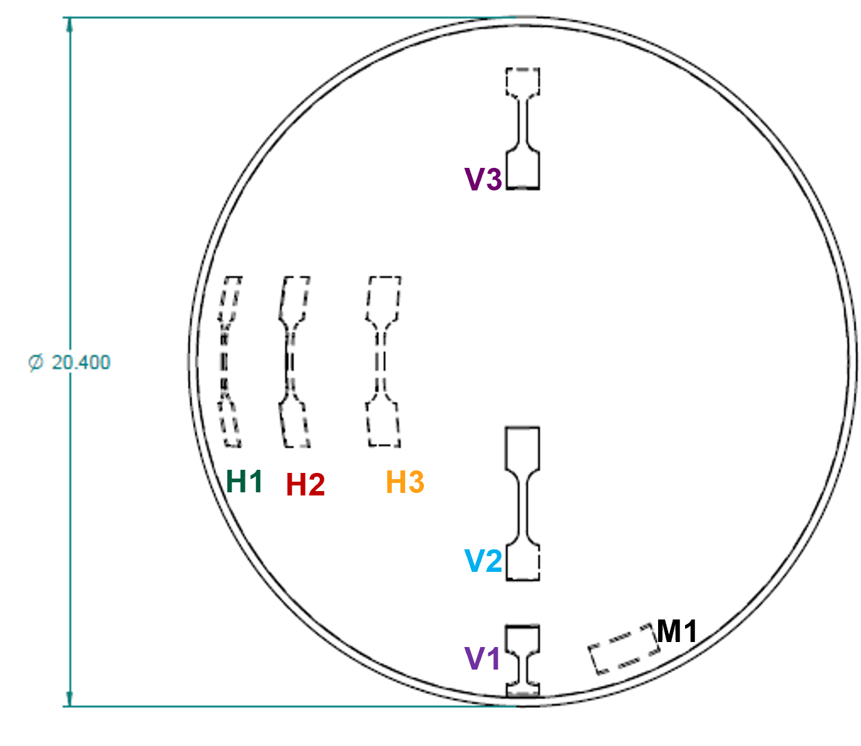
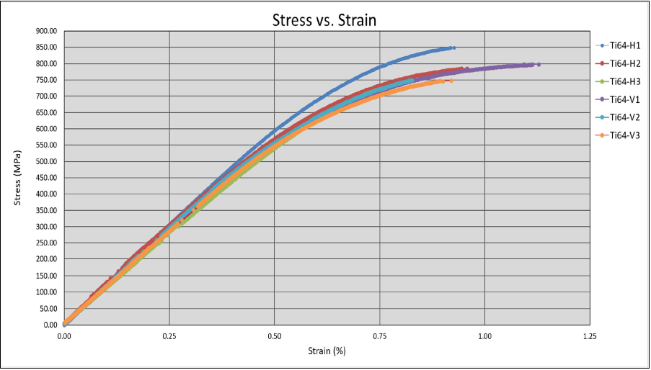
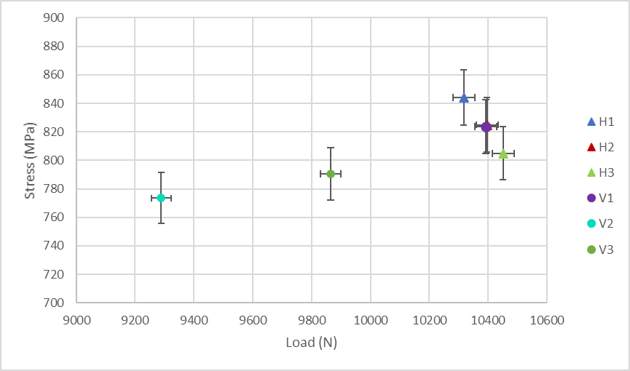
Project Results
Tensile Stress Testing:
  Stress vs. Strain profiles showed conditions were nominal for samples.
  Uncertainty in Stress vs. Load analysis showed good agreement in horizontal samples and significant differences in vertical samples.
    Points of error – sample density or inconsistencies in cross-grain characteristics
Horizontal
Vertical
Notes:
Stress vs strains showed nominal conditions for the samples
Uncertainty analysis of the stress vs load showed good agreement in the horizontal samples, but significant differences in the vertical samples
This is possibly due to sample density or inconsistencies in cross-grain characteristics, such as voids.
Point of slide 23/24 is to indicate that the sample size was small. Uncertainty analysis showed there are no concerns with the tests or the equipment. Variation comes from the samples themselves and inconsistences (voids) or damage that were present prior to testing
More useful data will come from “virgin” material

Slide 25
Agenda: Evaluating Material Strength for 3D-printed EBAM Titanium Spherical Designs
Objective
Background of AM Processes
Approach
  Titanium Dome Design
  Hydroburst Testing
  Tensile Testing
  Microstructure Analysis
Results and Discussion
  Hydroburst Challenges
  Tensile Test Data Statistics and Trends
  Microstructure Results
Concluding Remarks
Notes:
Now the results of the microscopy analysis

Slide 26
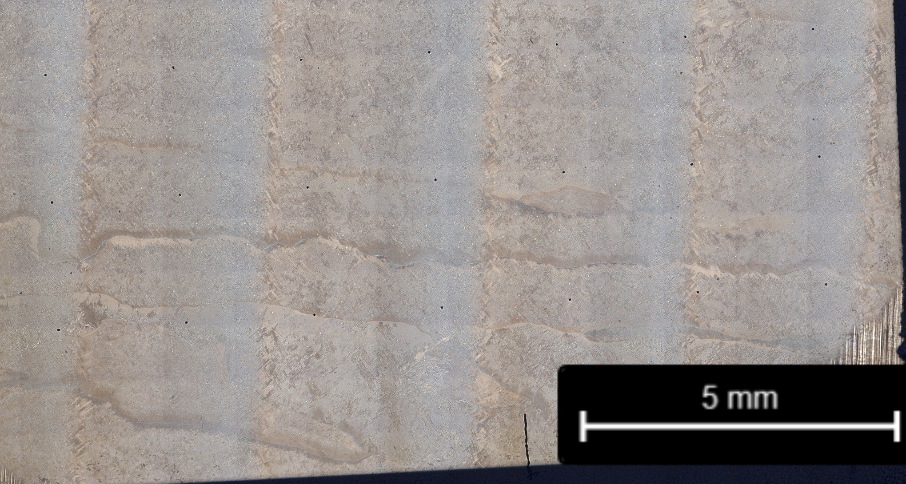
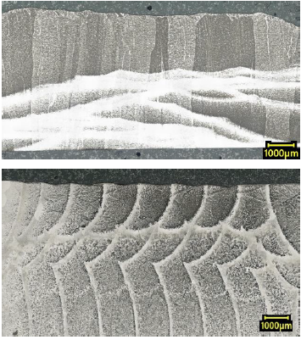
Digital Light Microscopy Results
  Materials Science and Metallurgy Branch conducted the light microscopy, micro-hardness, fractography, and metallography evaluation
  Specimens were polished down to 0.05µm Colloidal SiC solution to achieve a mirror like finish, specimens were then etched using Keller’s Etchant (195mL H2O, 2mL HF, 3mL HCl, 5mL N) by submersion for 10 seconds followed by water rinse and ethanol rinse to remove water’s impurities. - This is done to reveal the grain structure of the specimens.
  Build layers are visible and grains are elongated parallel to build direction.
  Melt pools were expected to be visible, but they could not be identified, making layer height difficult to properly measure.
A
LP-DED
Build layers
~3.4mm
LW-DED
Examples of visible weld pools from DED
Source: Effect of Stress Relief on AM Ti-6Al-4V: Geometry and Microstructure
Auburn University
Build Direction
Notes:
EM31 performed microscopy, micro-hardness, metallography, and fractography
Microscopy of the M1 sample showed the build layers are visible and grains are elongated parallel to the build direction
Melt pools were not visible. It is possible the heat treatment removed this kind of characterisitic

Slide 27
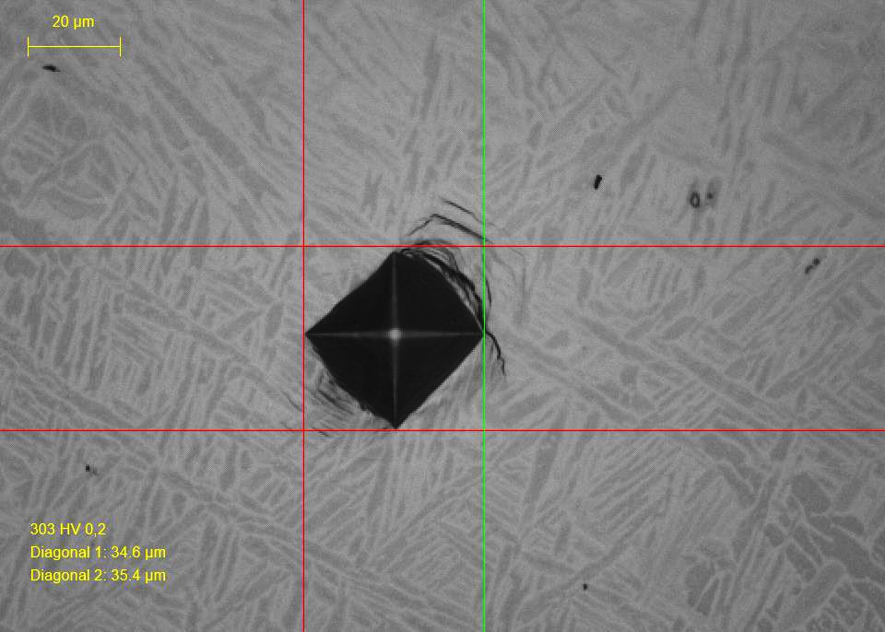
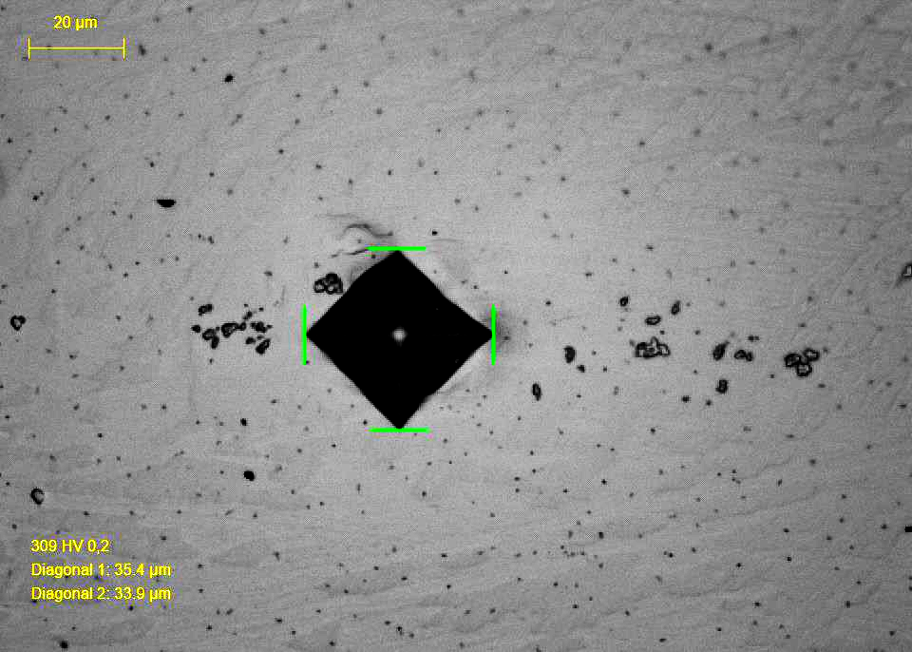
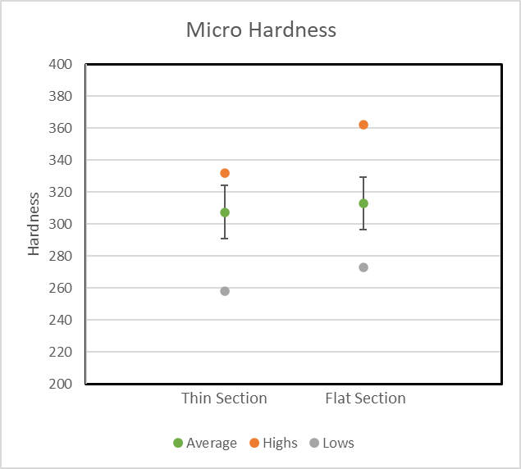
Micro Hardness Results
  Micro hardness was performed using Vicker’s indenter on a Struers DuraScan 80. 200gf was applied with a dwell time of 10 second per indent with a space of 2mm between each indent to avoid plasticity effects from previous indents. Measurements were performed after polishing and etching to identify where in the microstructure the hardness measurements were taken from.
  Microstructures are clearly visible in the front of the microstructures. Did not etch as well in the cross-sections. Microstructures appear to be composed of Widmanstätten, martensitic, and lamellar structures, but phases cannot be fully identified without further analysis.
  Hardness values were taken along grain boundaries.
Front of Specimen
Cross Section of Specimen
Notes:
Multiple microstructures were identified during the micro-hardness testing. Widmanstatten, martensitic, and lamellar. The phases of these microstructures were not identified, not without further analysis which fell outside of this initial investigation. The hardness values from the front and cross-section of the M1 samples showed good agreement. Both sides had a standard deviation of about 16.5.

Slide 28
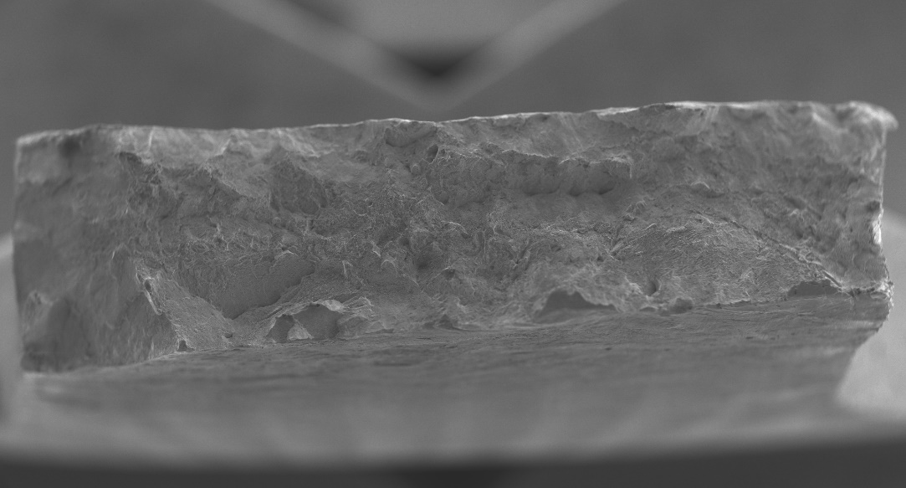
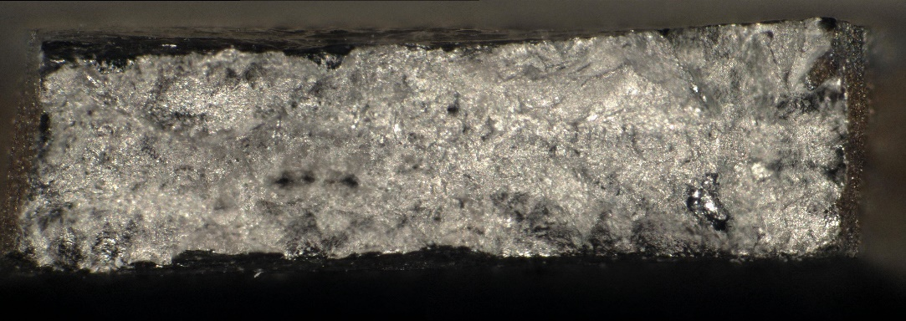
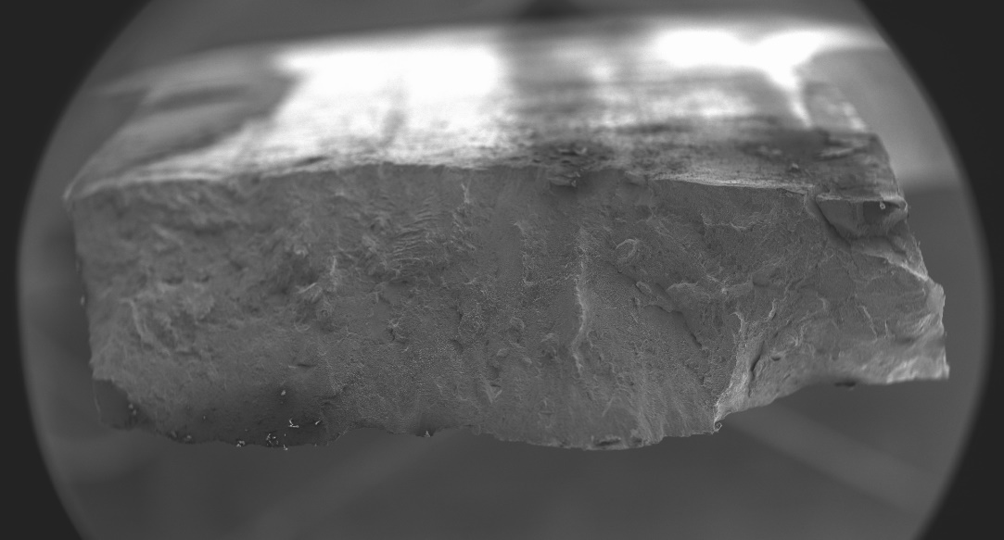
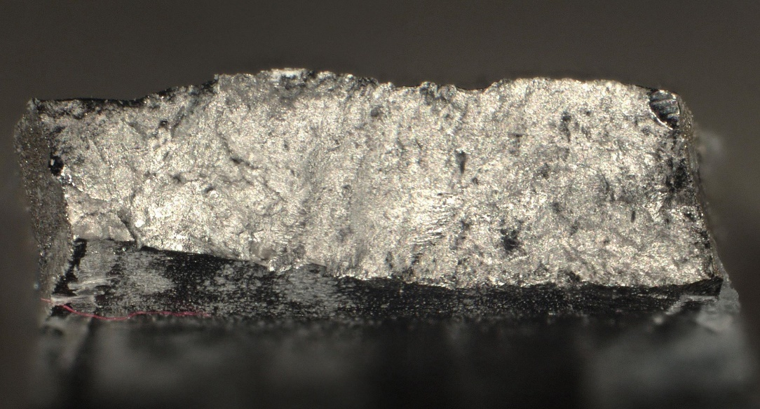
Fractography Results
H1-SEM
H1-Optical
  Optical Microscopy – one side of each fracture was clamped upright in order to optically image the fracture face.
  Scanning Electron Microscopy (SEM) – fracture surfaces were scanned using a Hitachi 3700N machine to view the topography and voids around the fracture.
  Fracture surfaces did not indicate anything unusual with specimens.
V1-SEM
V1-Optical
Notes:
2 of the fractured dog-bones were viewed at the fracture surface and the side. The fracture surfaces showed nothing unusual. The side profile showed stress cracks further away from the fracture surface. Some had rounded edges indicating they initiated around porosity.

Slide 29
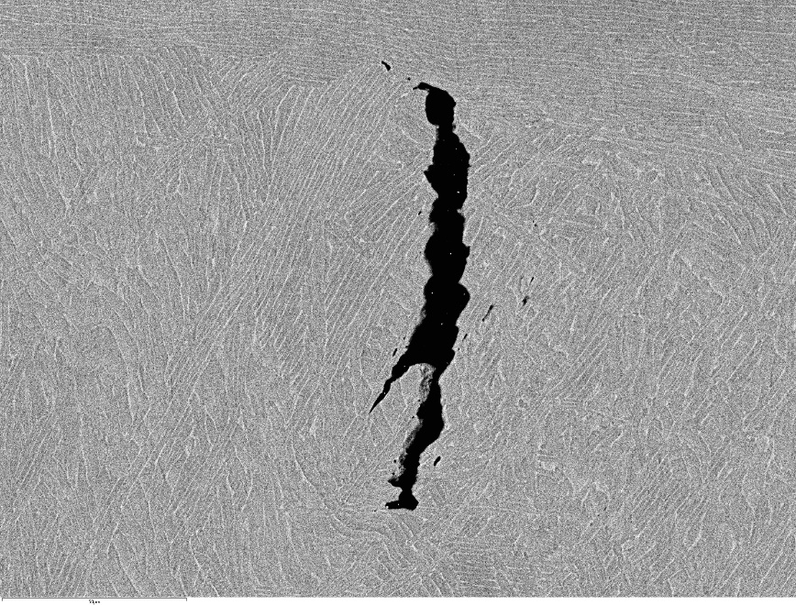
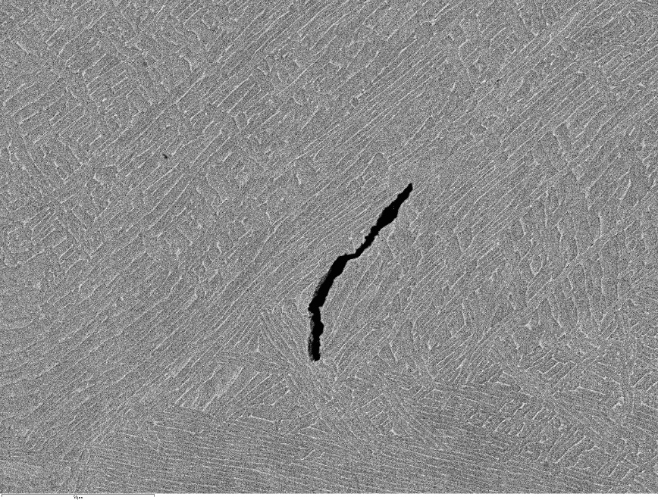
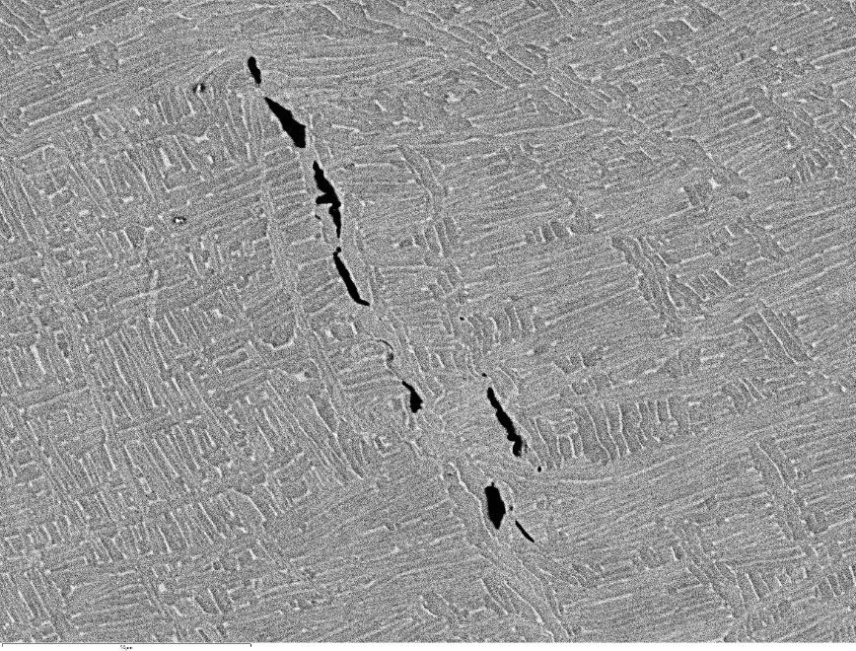
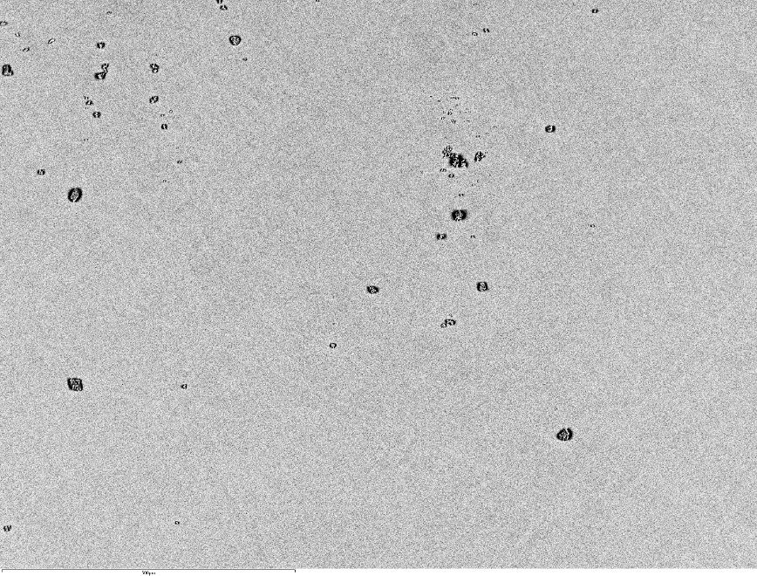
Fractography Results
Build Direction
  SEM did show stress cracks further away from fracture surface.
    Some cracks have rounded edges suggesting they initiated around porosity.
  H1 had more porosity, but less cracking
V1 BSE-600x
V1 BSE-600x
H1 BSE-750x
H1 BSE-100x
Build Direction
Notes:
2 of the fractured dog-bones were viewed at the fracture surface and the side. The fracture surfaces showed nothing unusual. The side profile showed stress cracks further away from the fracture surface. Some had rounded edges indicating they initiated around porosity.

Slide 30



Metallography of Fracture Specimens Results
H1
Metallography of cross sections showed a normal fracture for H1.
V1 shows indication of tearing possibly caused by porosity or lack of fusion extending between two layers.
  Defect not at crack initiation site for failure.
  Fracture travels between two layers.
  Could be layer separation from hydro-burst testing.
Grains are elongated along the build direction
5mm
V1
Crack initiation site
crack propagates and tears
5mm
Notes:
Metallography showed a normal fracture for H1, V1 showed indication of tearing caused by porosity or loack of fusion extending between two layers.
The defect did not appear to be at the initiation site for the failure, but traveled between 2 layers. Could be due to layer separation from the hydrostatic testing. Grains were elongated along build direction as expected.

Slide 31
Agenda: Evaluating Material Strength for 3D-printed EBAM Titanium Spherical Designs
Objective
Background of AM Processes
Approach
  Titanium Dome Design
  Hydroburst Testing
  Tensile Testing
  Microstructure Analysis
Results and Discussion
  Hydroburst Challenges
  Tensile Test Data Statistics and Trends
  Microstructure Results
Concluding Remarks

Slide 32


Lessons Learned
Early Career Experience
  Project Planning
  Design
  Additive Manufacturing
Welds
  Requires investigating interaction of welds and AM material
  Solution

Slide 33
Concluding Remarks
The current testing showed the feasibility of using the EBW-DED process to manufacture titanium domes and potential SRM cases.
The hydro-burst testing resulted in up to 1580 psig of case pressure.
Tensile test data revealed good agreement in horizontal test samples and variation of vertical test sample data.
The micro-structure evaluation found no evidence of unusual characteristics
Fractures appear to be intragranular showing that grain boundaries are not the weakest part of the material. Porosity and lack of fusion is a concern that could lower the stress capability of the samples.
Future work should encompass evaluation of other AM processes, such as, Laser Powder-Bed Fusion and EBP-DED. With follow up on other aerospace grade materials like aluminum and steel.
Long-term goal to produce solid rocket motor casing for hot-fire testing.

Slide 34
References
Northrop Grumman. (2018). Propulsion Products Catalog. Magna, UT; Northrop Grumman.
Gradl, P., Tinker, D.C., Park, A. et al. Robust Metal Additive Manufacturing Process Selection and Development for Aerospace Components. J. of Materi Eng and Perform 31, 6013–6044 (2022). https://doi.org/10.1007/s11665-022-06850-0
Stawovy, M. T. (2018). Comparison of LCAC and pm mo deposited using Sciaky EBAM™. International Journal of Refractory Metals and Hard Materials, 73, 162–167. https://doi.org/10.1016/j.ijrmhm.2018.02.009
Jones, L. H. (2020). (rep.). Structural Analysis of the ER62 TE AM Dome (pp. 1–9). MSFC, AL: ER41.
Barber, K. (2022). (rep.). 3D Printed Ti64 Dome (pp. 1–9). MSFC, AL: EM22.
Demeneghi, G., & Handley, C. (2022). (rep.). Thin AM Ti64 Dome Sample (pp. 1–19). MSFC, AL: EM31.

Slide 35

Questions

