Slide 1
Low Leakage Valves for Long Duration Missions
NASA In-Space Chemical Propulsion Technical Interchange Meeting
Presenter: Robert Walker
DATE: 9/29/2022

Slide 2
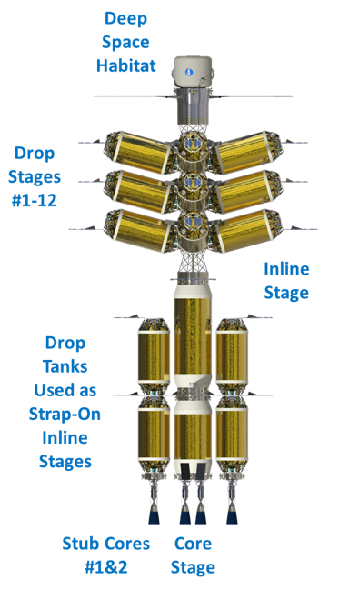
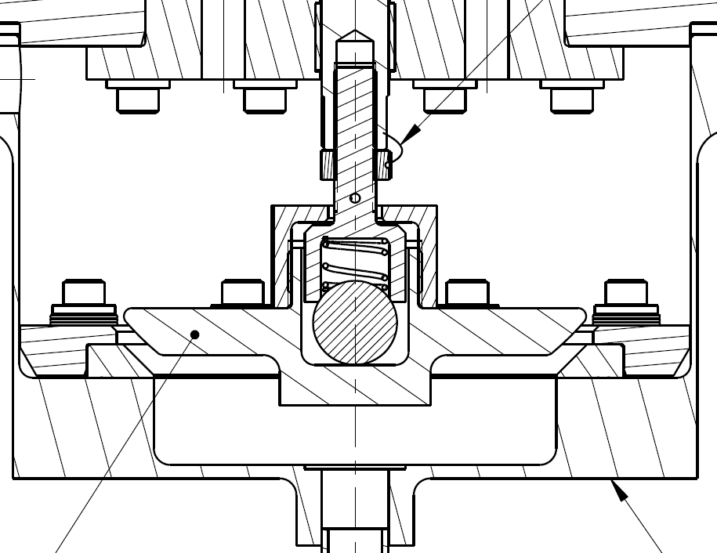
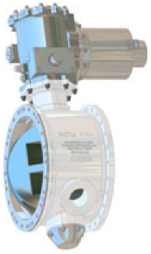
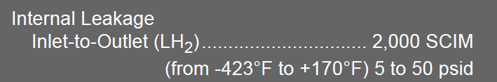
Activity Overview
Components required on a typical in-space stage:
(Not a comprehensive list…)
Engine Isolation Valve (or Pre-valve)
Relief Valve
Vent Valve
Fill / Drain Valve
2
Stage Tank
1
RV
PREVALVE
VENT
FILL / DRAIN
3
Not to scale…
4
Self-Aligning Seat and Poppet Design
Allows greater tolerance of misalignments and surface imperfections.
  Looking for internal leakage rates < 0.6 SCIM (vs. 500 SCIM or more in typical industry valves)
Mars Transportation Assessment Study
Vehicle Concept (Dec 2020)
NOTE: Technology is patent pending (SN 17/566,068)
Vendor Flysheet: VACCO V0E11000-01 (Public Data)

Slide 3
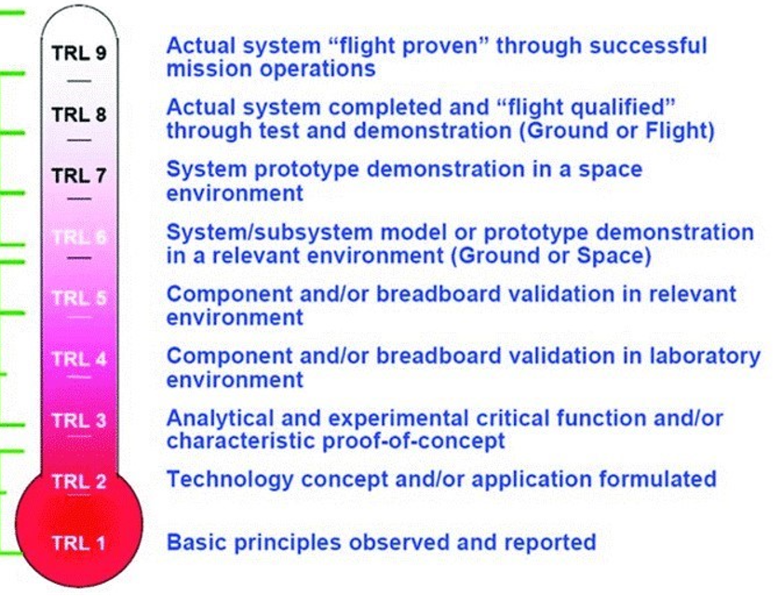
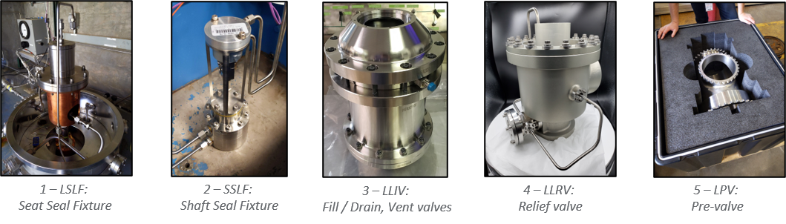
Technology Maturity history progression
The Low Leakage Valve activity consists of 5 sub-activities:
  Low Leakage Seat Seals (with irradiated seat seals)
  Low Leakage Shaft Seals (with irradiated shaft seals)
  Low Leakage Isolation Valve (3” nominal size)
  Low Leakage Relief Valve (3” nominal size)
  Low Leakage Pre-Valve (8” nominal size)
These sub-activities are being worked to demonstrate the MSFC Low Leakage Valve Technology in relevant environments and to push the TRL to 5.

Slide 4
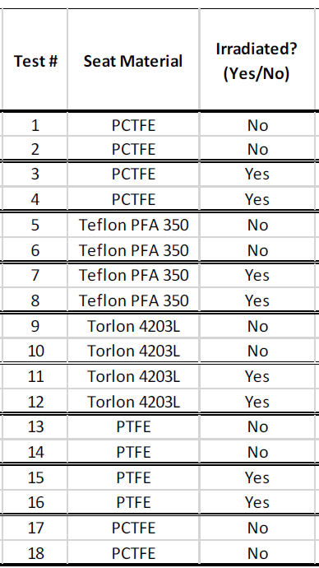
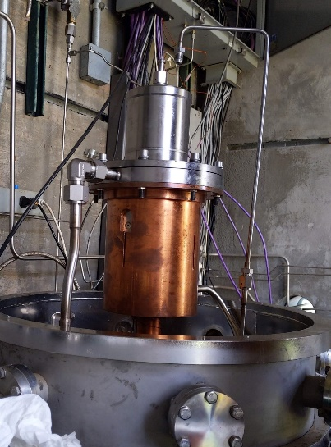
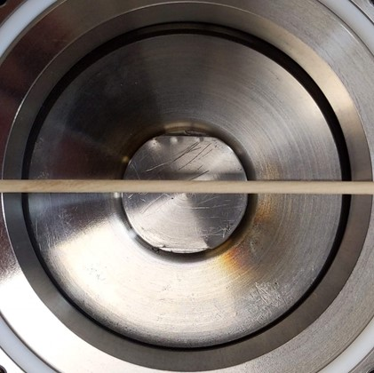
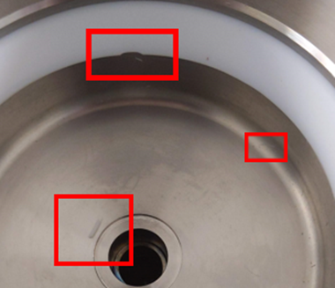
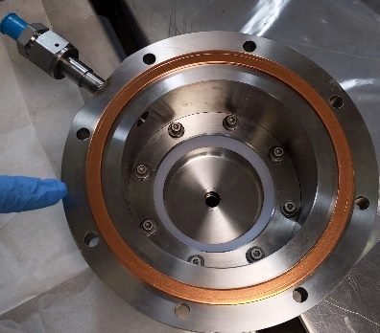
Sub-activity Status
1 - Large Scale Leakage Fixture (LSLF)
The LSLF is a test fixture intended to evaluate radiation effects on non-metallic seats for engine and main propulsion system valves.
  Non-irradiated components were tested to establish baseline results, which were then used to evaluate the performance of additional seats which have been subjected to an irradiation process.
  System was also used to evaluate the robustness of the technology through offset component testing.
  Data analysis / reporting currently underway.
All testing complete
Test article and setup
During seat changeover
“Offset” Poppet
Damaged PTFE Seat (Irradiated)

Slide 5
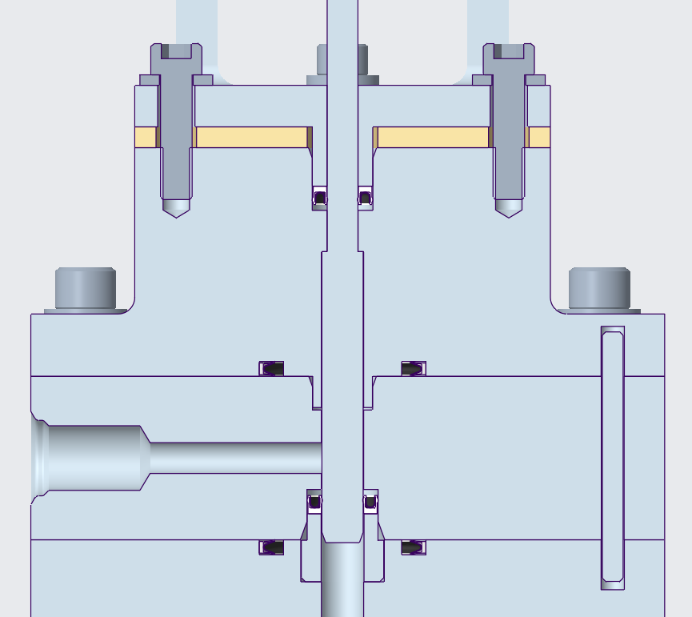

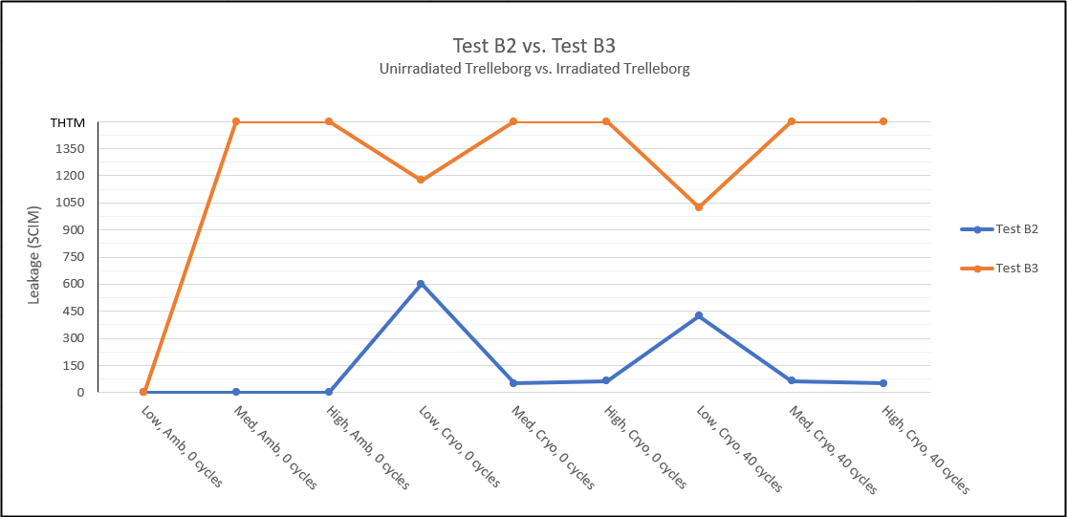
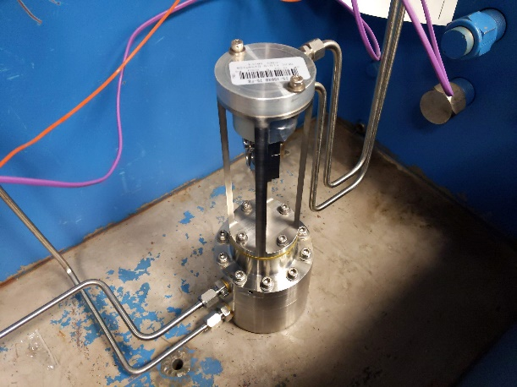
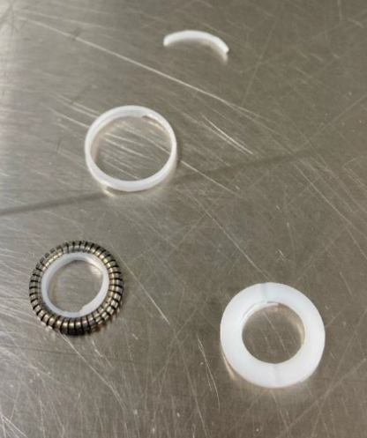
Sub-activity Status
2 – Shaft Seal Leakage Fixture (SSLF)
The SSLF is a test fixture intended to evaluate radiation effects on non-metallic materials in commercially available shaft seals for engine valves.
  Components were tested to establish baseline results, which were then used to evaluate the performance of additional shaft seals which have been subjected to an irradiation process.
  High amounts of internal leakage observed with non-irradiated seal, extreme amounts with irradiated seal. Disassembly revealed catastrophic damage to irradiated seal.
Test article cross section, test seal highlighted.
Assembled test article
Failure of Irradiated Seal
Non-Irradiated shaft seal leakage (blue) vs irradiated shaft seal leakage (orange).

Slide 6
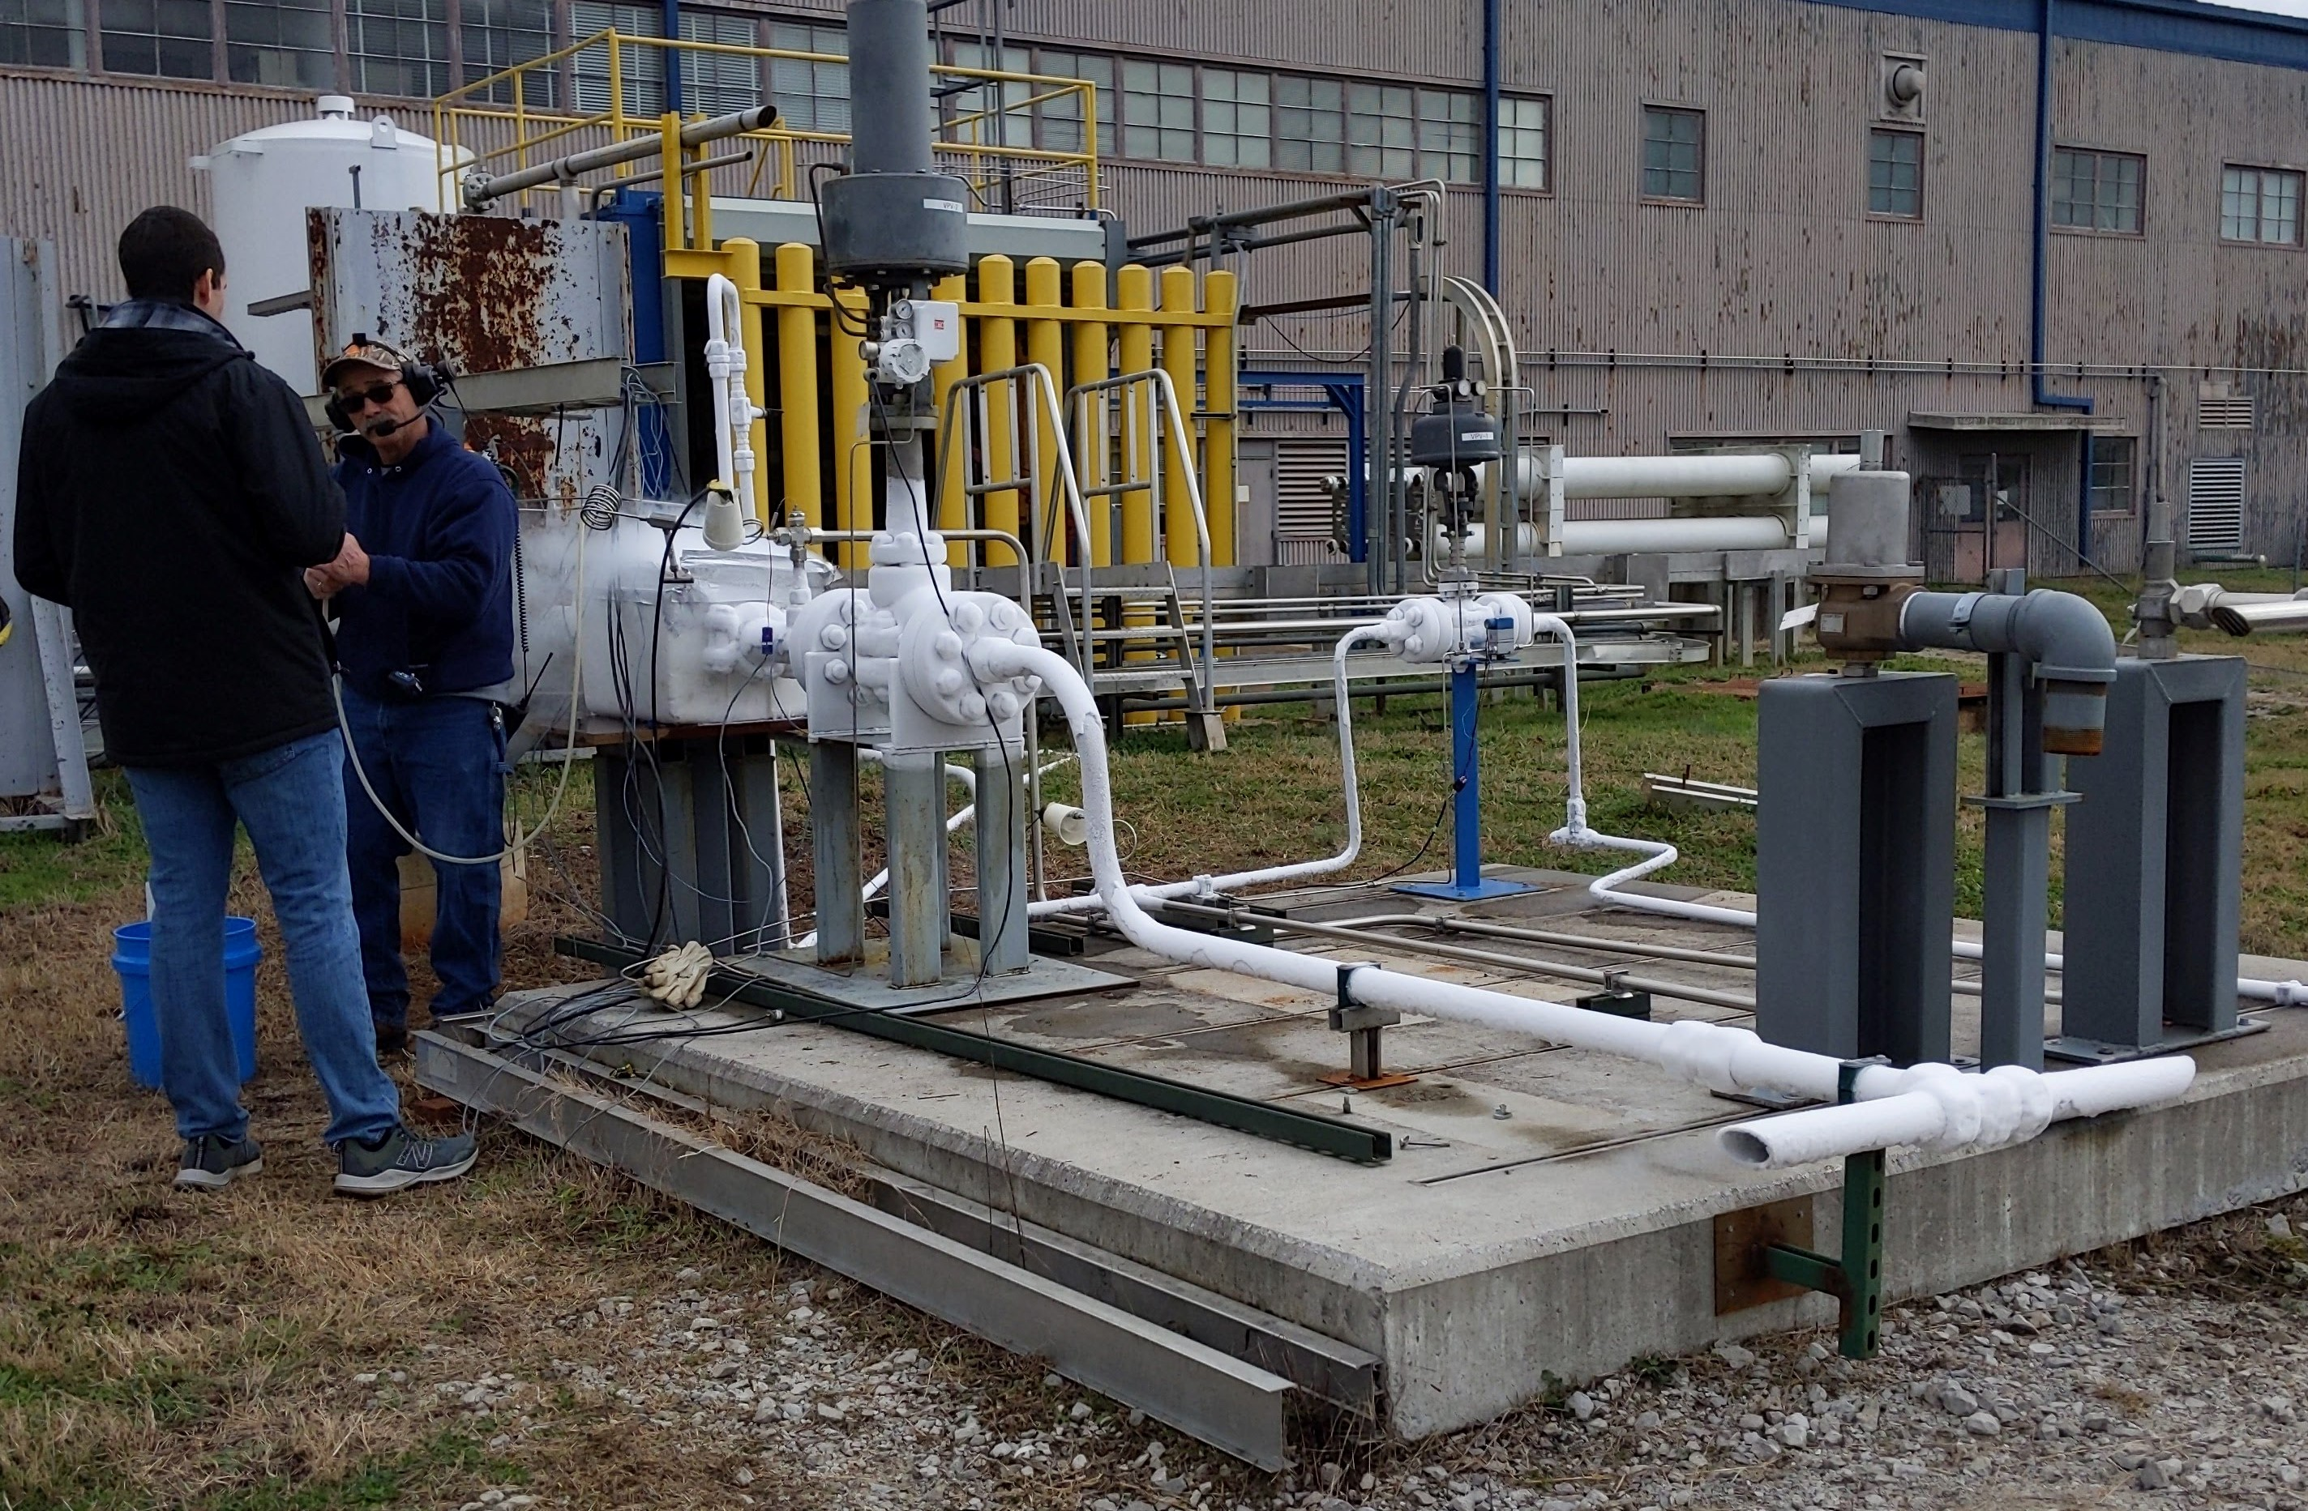
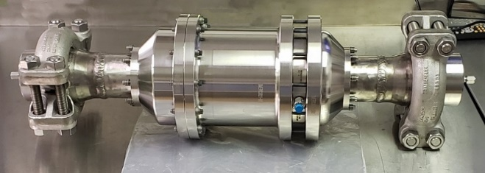
Sub-activity Status
3 – Low Leakage Isolation Valve (LLIV)
The LLIV is a test valve intended to show that the technology can be scaled to large, fully functional vent valves, and fill/drain valves.
  Leak test conducted after LN2 flow, observed excessive internal leak rates during testing.
  Follow on testing to determine potential cause is in process. Evaluating orientation, poppet stiffness, chill-in time, etc…
4
Stage Tank
RV
5
PREVALVE
VENT
FILL / DRAIN
3
3
Test Article with End Cap Adapters
Isolation Valve in Test Set-up

Slide 7
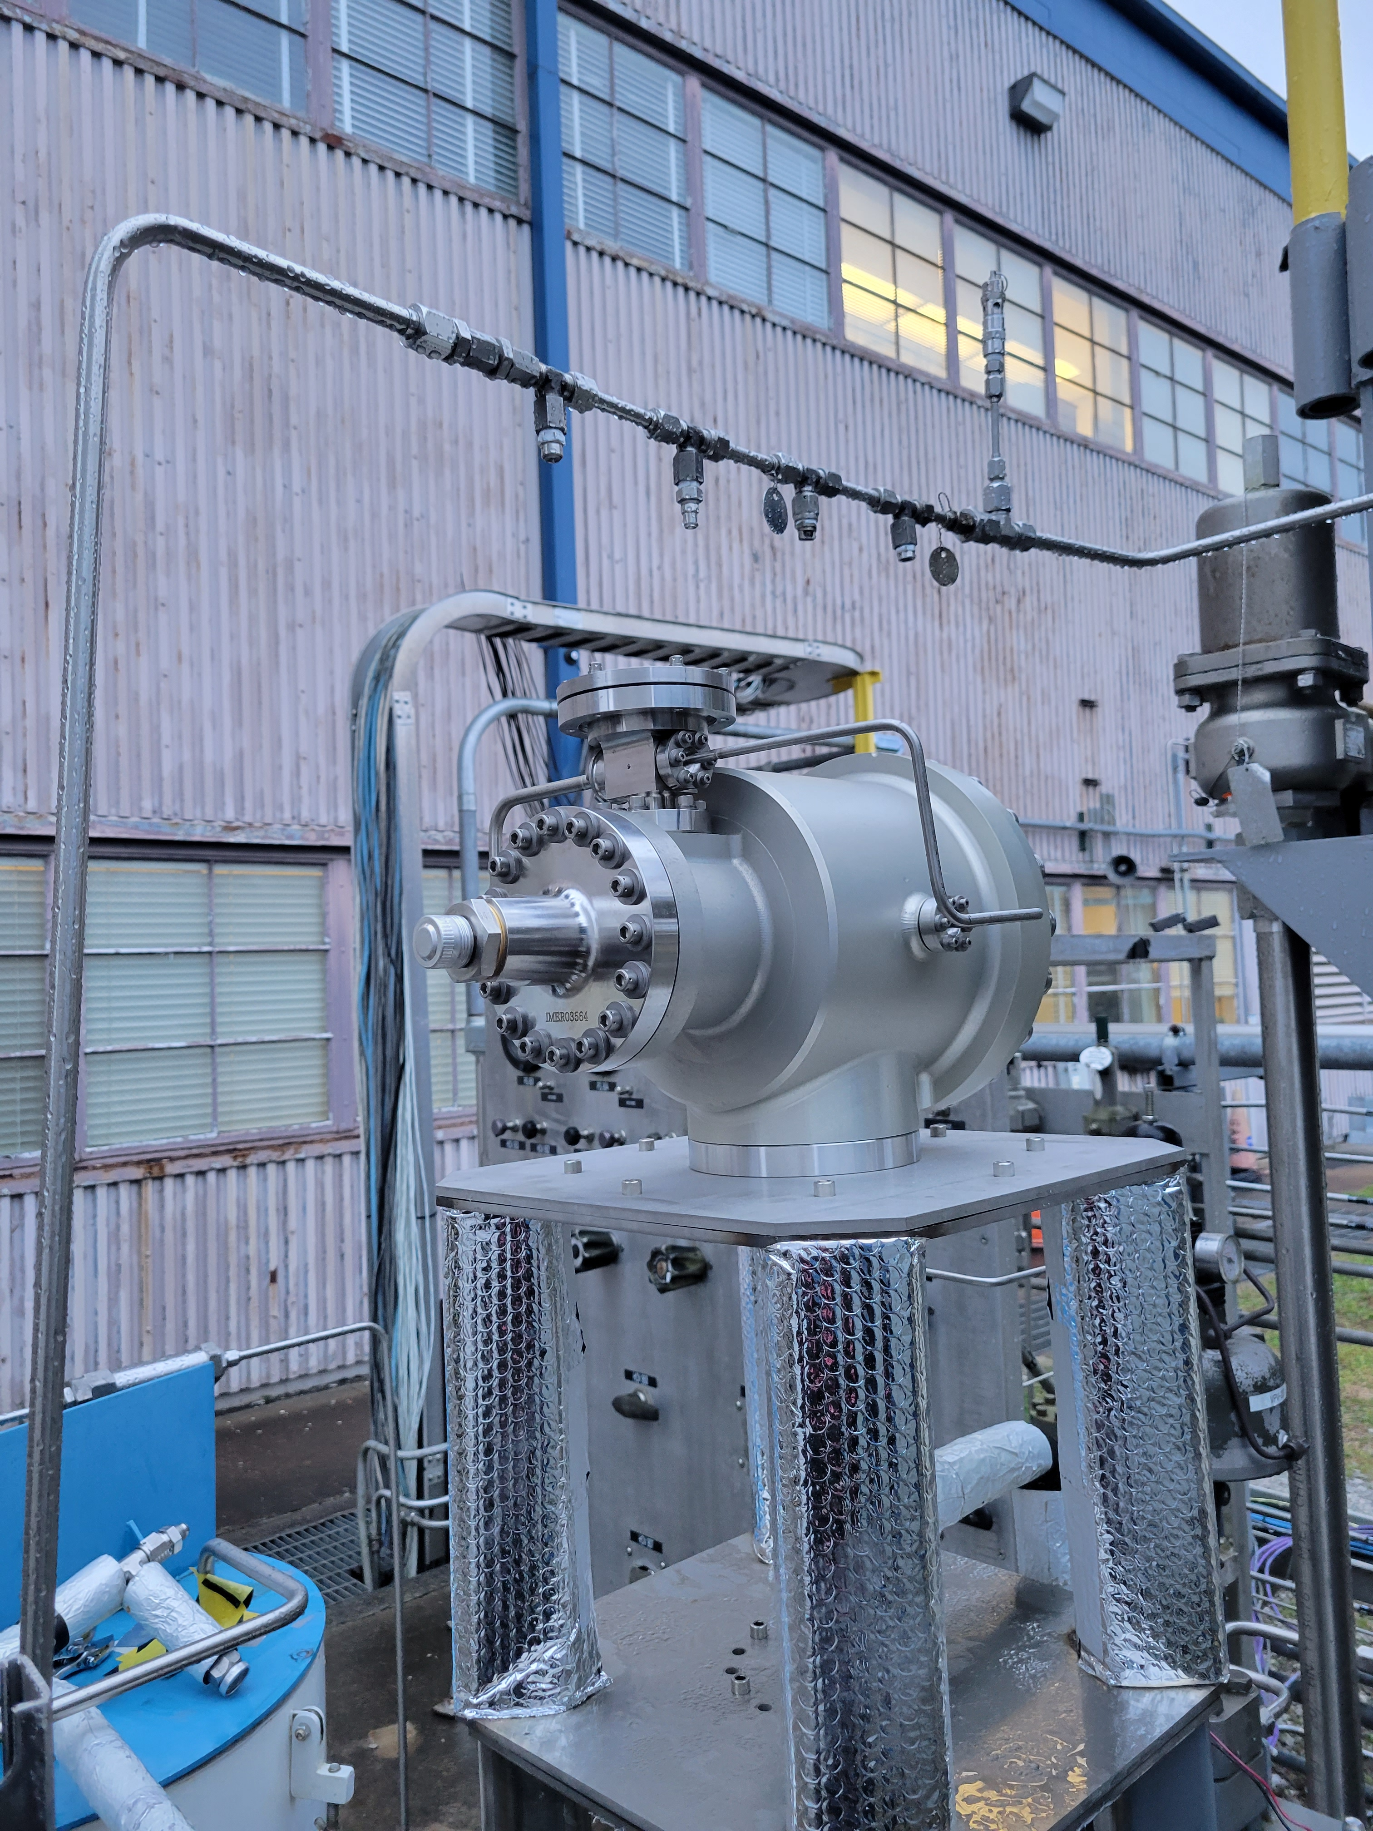
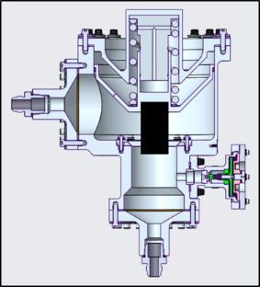
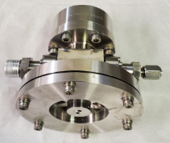
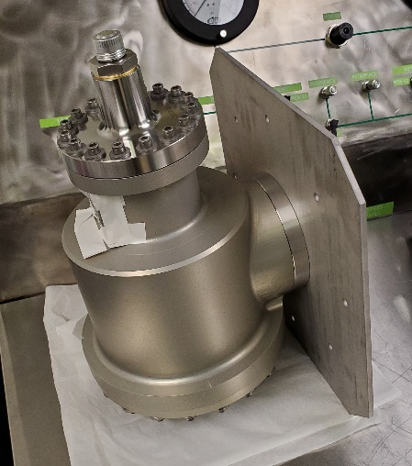
Sub-activity Status
4 – Low Leakage Relief Valve (LLRV)
The LLRV is a test valve (3” nominal) intended to show that the technology can be scaled to fully functional relief valves and used with a low leakage pilot valve.
  Ambient and cryogenic testing of fully integrated test article completed. Modifications to address temperature and cracking pressure issues were successful.
  Internal leakage at ambient temperature was 0.006 SCIM or lower. Internal leakage after cryogenic flow was below gauge’s calibrated level (0.1 SCIM or less).
  LLRV to be tested with LH2 in late 2022.
4
Stage Tank
RV
5
PREVALVE
VENT
FILL / DRAIN
3
3
Model of main relief valve with pilot
Pilot valve assembled
Main relief valve assembled (no Pilot)
Relief Valve integrated into Test Setup

Slide 8
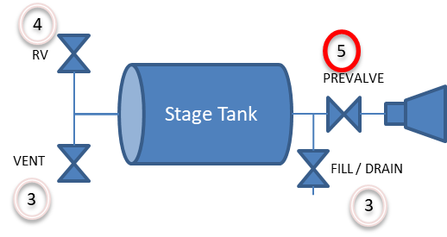
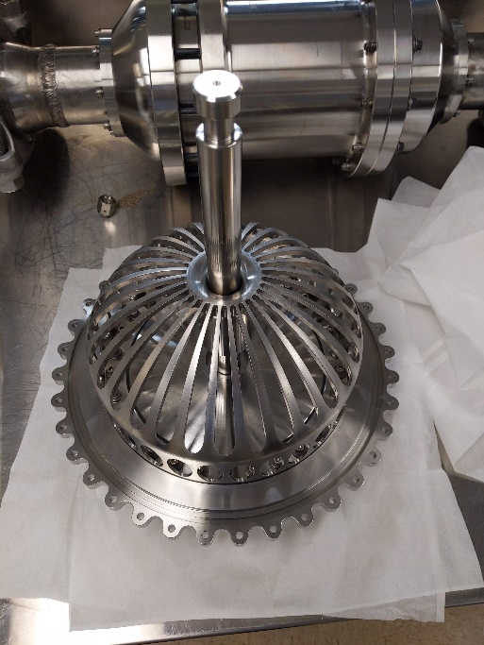
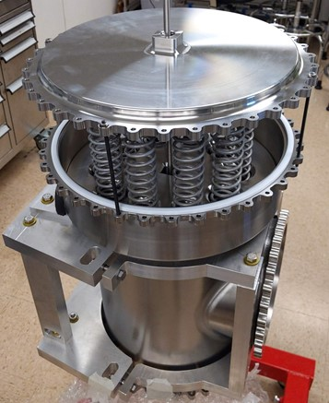
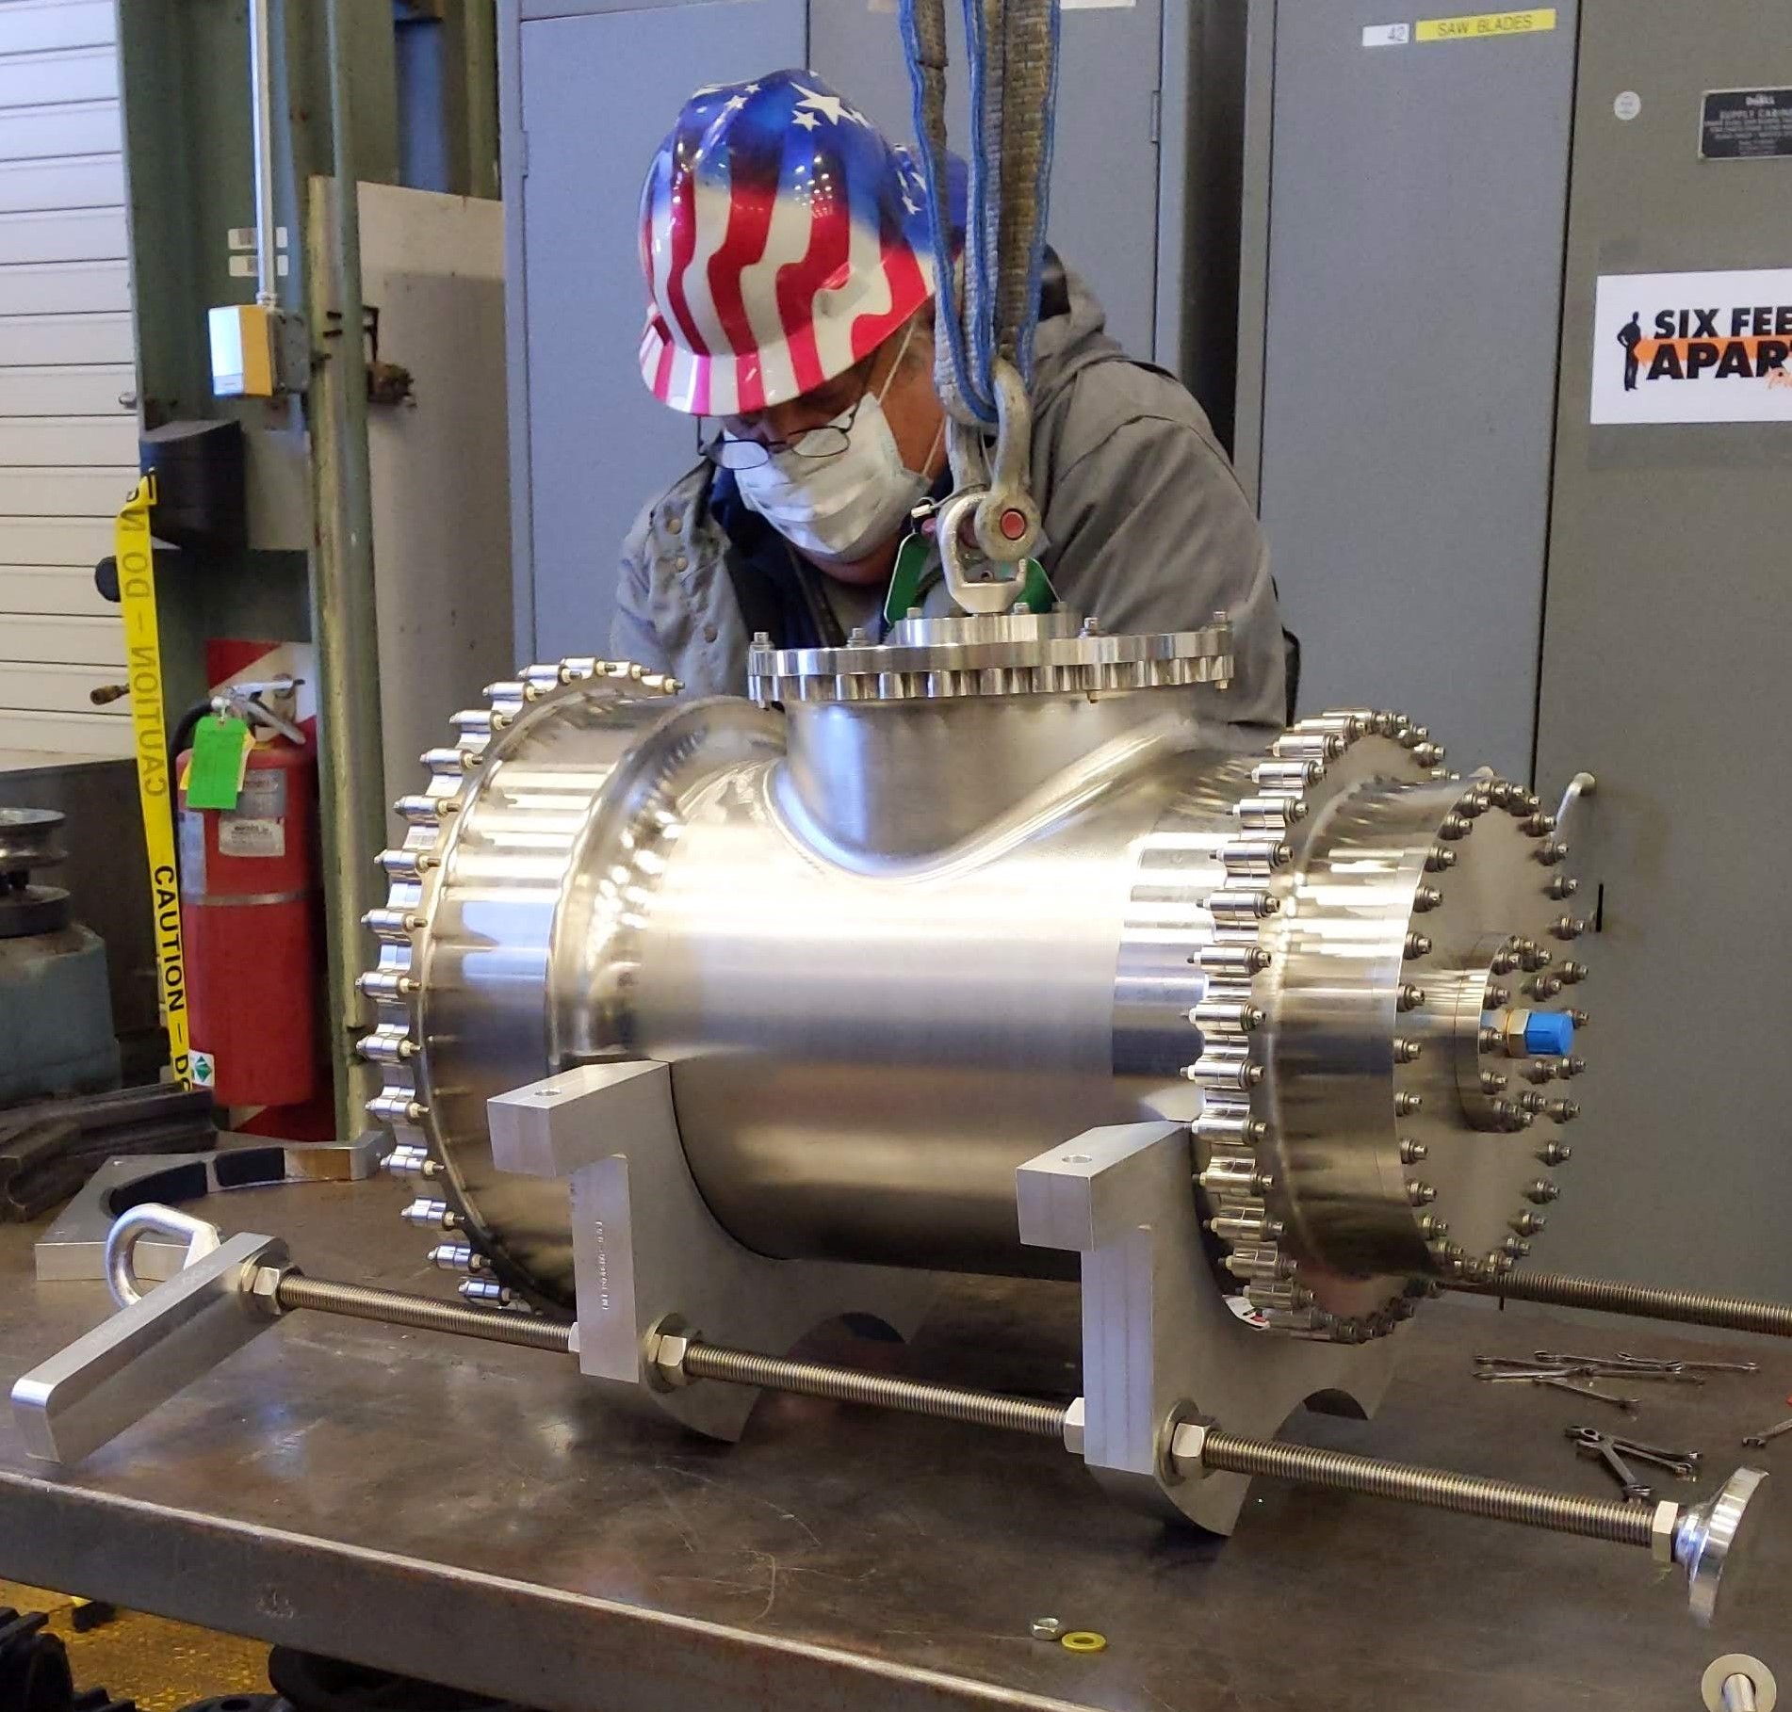
Sub-activity Status
5 – Large Pre-Valve (LPV)
The LPV is a test valve (8” nominal) intended to show that the technology can be scaled to large pre-valves.
  Component fabrication completed. Test article assembled, integrated into test stand.
  Initial testing conducted (Proof test, leak and cycle (with LN2-chilled GHe).
  Follow-on LN2 testing is planned to evaluate actuator modifications prior to LH2 testing.
LPV Poppet Assembled into Seat
LPV Actuator Assembly in Process
Integration of Assembled LPV with Test Stand

Slide 9
Summary
Challenges exist for future long duration missions seeking to utilize cryogenic propellants to meet mission requirements.
Current technology allows for internal leakage rates ranging upwards of 2,000 SCIM for 10” valves. Could account for multiple tons of propellant loss over a multi-year mission.
Most internal leakage rates can be attributed to imperfections and mis-alignments. Self-aligning seat and poppet technology allows valve to be more tolerant of imperfect contact.
Test articles have been developed and are currently being tested at LN2 temperatures. Test articles are anticipated to undergo testing at LH2 temperatures in late 2022.
NOTE: Technology is patent pending (SN 17/566,068)

Slide 10
backup
Questions

