Slide 1
DTN Virtual F2F September 13th, 2022
HOSC DTN Overview
Ivica Ristovski
Joshua Deaton
Beau Blanding
Jonathan Jackson
Rebecca Kim

Slide 2
Agenda
Current ISS DTN Implementation
Current DTNME Work
Future DTNME Work
Future ISS DTN Implementation
Key Dates

Slide 3
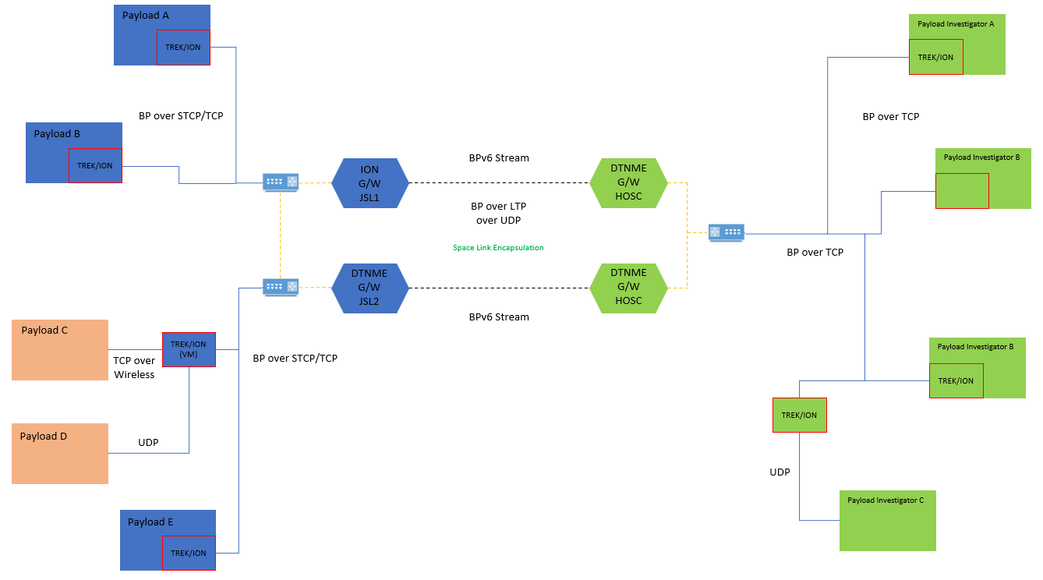
Current ISS DTN Implementation
JSL2 DTNME v0.1.1 to become operational in October 2022 timeframe.
JSL2 DTNME v1.1 to become operational in the April 2023 timeframe.
Onboard
Ground
Notes:
Note: Preparing for JSL2 to become available soon (maybe October, check dates).

Slide 4
Introduction
ISS DTN supports a multipath routing architecture between the ISS and the ground.
ISS DTN support teams are tasked with providing improvements to ISS DTN operations.
This service supports numerous payloads and reliable payload data transfers.
Potential improvements were identified and discussed at the last SCaN meeting.
This presentation describes our progress and plan to implement these improvements.

Slide 5
ISS DTN Dual Gateways
MSFC and JSC have completed the ISS DTN Dual Gateway system in preparation for the ISS DTN Dual Gateway system.
The ISS DTN Dual Gateways provides the following benefits:
  Increases ISS DTN bandwidth with the introduction of onboard DTNME (from 100 Mbps to 400 Mbps).
    Rate limitations are imposed due to available hardware.
    Lab testing of DTNME supersedes 1 Gbps.
  Introduces partial ISS DTN redundancy.
    Sets stage for fully redundant ISS DTN architecture.
  Provides use case for future space implementations.
The ISS DTN Dual Gateways also provides a path for expansion through ENCODE.
Notes:
Add HDTN slide referring to testing done with them (1GB, 4 second delay).

Slide 6
ISS DTN Dual Gateways (cont.)
MSFC and JSC are currently working on upgrading their DTNME ground and onboard nodes to DTNME v1.1.
This version includes:
  BPv7 and BPv6 support
  RHEL 8 compatibility
DTNME v1.1 will be available on Github when the release process is complete.

Slide 7
DTNME-HDTN Testing
The MSFC DTN team has been collaborating with the Glen Research Center (GRC) on the DTN component of the ENCODE project.
The participating DTN implementations were MSFC’s DTNME and GRC’s Hi-rate DTN (HDTN).
Collaborative testing has shown that rates of 1 Gbps with a 4 second delay is achievable between DTNME and HDTN.

Slide 8
Bundle Architectural Restaging Daemon (BARD)
BARD is a new DTNME technology feature that allows operations to have better control over different bundle flows within a DTN system.
BARD provides the following benefits:
  Moves bundles from DTNME to an alternate storage location
  Ingests bundles from an alternate external storage location into DTNME.
    Can override bundle timeout by generating a new bundle if needed.
  Tracks bundle storage usage within DTNME and the alternate storage location
  Allows policies to be setup to determine what causes bundles to move between DTNME and the alternate external storage location based on either source or destination EID.
    Max Storage Usage
    Minimum Storage Usage
    Max Bundle Count
    Minimum Bundle Count
    Bundle Timeout
BARD beta version is developed, currently in process for NASA Github release by Fall 2022 timeframe.
BARD is to be incorporated into ISS operations in FY23.

Slide 9
Asynchronous Management Protocol (AMP)
AMP - SCaN
  The HOSC DTN team has integrated AMP into DTNME as part of a previous SCaN activity.
AMP GUI - ISS
  An operational concept is in work, which will define the capabilities of the AMP GUI.
  This will provide authenticated users with an interactive ISS DTN topology map to perform monitoring and request additional status from AMP enabled client nodes.
Expecting ISS authorized work to be completed in FY24.

Slide 10
Interplanetary Multicast Bundle Multi-Destination (IMC-BMD)
In February 2022, the MSFC-DTN team proposed an integration for IMC-BMD.
IMC-BMD was to provide DTNME interoperability with the ION 4.1.1 Bundle Multicast implementation and provides an enhanced capability using IMC Router Nodes.
There is currently no standard for IMC-BMD, thus the DTNME implementation required examination of the ION source code to provide compatibility.
The MSFC-DTN team’s primary focus was to ensure compatibility with the BPv7 implementation of ION.
  The MSFC-DTN team also ensured compatibility with the ION BPv6 implementation.

Slide 11
MSFC DTN Improvements (Current and Future)
RTPoverDTN – CCSDS
  Allows RTP to be streamed through DTN.
  Testing with DLR is complete. CCSDS is currently going through editorials for the standard.
BPSec – CCSDS
  Allows for bundle confidentiality and bundle integrity support.
  Both RTPoverDTN and BPSec will be featured in upcoming DTNME Github releases.
Secondary Channel – ISS
  Will allow for real-time data to travel through DTN while having an alternate channel deliver the complete version of that data in non-real-time.
New DTNME library – ISS
  Will replace outdated Oasys libraries with Boost.
Schedule Aware Bundle Routing (SABR) - SCaN
  Will improve link management using planned and scheduled connectivity changes.
NACK-Oriented Reliable Multicast (NORM) Convergence layer – SCaN
  Will provide reliable multicast capability across a single link.

Slide 12
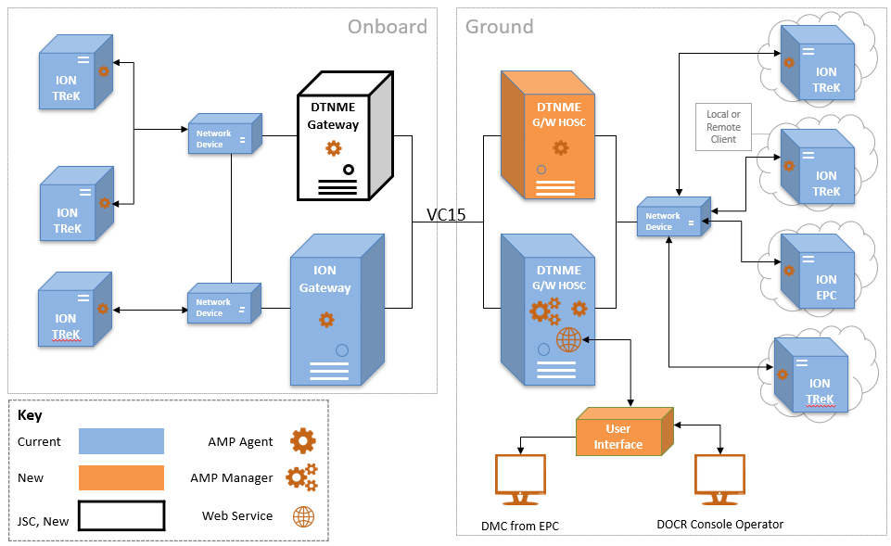
Future ISS DTN Implementation
DTNME G/W JSL1
DTNME G/W HOSC
BPv7 and BPv6/v7 compatible
------- | Future Implementation

Slide 13
Key Dates
Open Source Dates
BARD Beta Released to Github – Fall 2022
  BPv6 and BPv7
  ISS Bug fixes
DTNME v1.1 Released to Github – TBD
  RHEL 8 compatibility
IMC-BMD Beta Released to Github – TBD
  Full Bundle Multi-Destination functionality within DTNME
  BPSec within DTNME
Operational Dates
DTNME v1.1 Final* is planned for ISS operational delivery - FY23
*Final releases reflect an ISS Operational Release

Slide 14
Questions?

Slide 15
Acronyms
AMP | Asynchronous Management Protocol
BARD | Bundle Architectural Restaging Daemon
BP | Bundle Protocol
BPsec | Bundle Protocol Security
DTN | Delay Tolerant Networking
DTNME | DTN Marshall Enterprise
EID | Endpoint ID
ENCODE | Enabling Network Communication with Optical and DTN for Exploration
GRC | Glen Research Center
HDTN | Hi-rate DTN
HOSC | Huntsville Operations Support Center
IMC-BMD | Interplanetary Multicast Bundle Multidestination
ION | Interplanetary Overlay Network
ISS | International Space Station
JSC | Johnson Space Center

Slide 16
Acronyms
JSL | Joint Station LAN
LTP | Licklider Transmission Protocol
MSFC | Marshall Space Flight Center
NORM | NACK-Oriented Reliable Multicast
RHEL | Red Hat Enterprise Linux
RTPoverDTN | Real Time Protocol over DTN
SABR | Schedule Aware Bundle Routing
SCaN | Space Communications and Navigation
STCP | Simple TCP
TCP | Transmission Control Protocol
TReK | Telescience Resource Kit
UDP | User Datagram Protocol
VM | Virtual Machine

