Slide 1
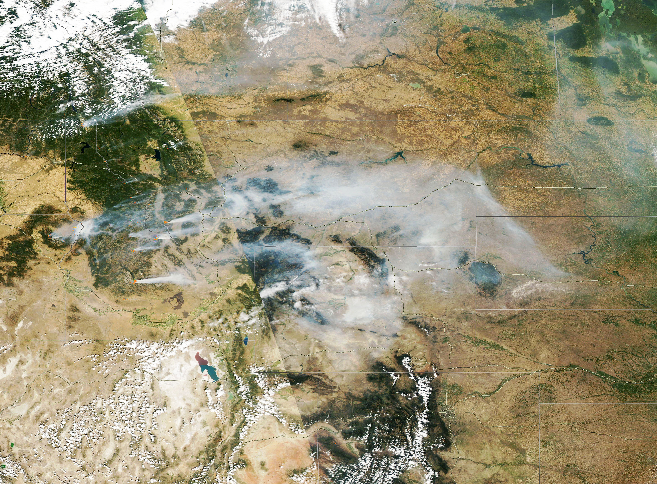
NASA Agency Report
Andrew Mitchell
Dawn Lowe
WGISS 54
October 6, 2022
September 5, 2022 - Western United States Wildfires, Idaho
Satellite: Aqua - Image Credit: MODIS Land Rapid Response Team, NASA GSFC

Slide 2



















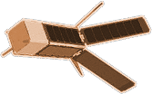



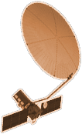



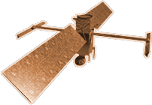


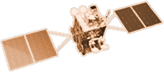







CYGNSS (8)
NISTAR, EPIC
2015
GRACE-FO (2)
SMAP
ICESAT-2
OCO-2
2020
GPM
SENTINEL-6
MICHAEL FREILICH
EARTH FLEET
GEDI
LANDSAT 8
LANDSAT-9
EMIT
SUOMI NPP
INVEST/CUBESATS
ECOSTRESS
CSIM-FD 2023
HARP 2022
CIRIS 2023
CTIM* 2022
HYTI* 2022
SNOOPI* 2022
NACHOS* 2022
NACHOS2* 2022
1995
2010
TROPICS (6)
LANDSAT 7
CALIPSO
OCO-3
TERRA
NISAR
AQUA
CLOUDSAT
SWOT
CLARREO-PF
AURA
2000
JPSS INSTRUMENTS
TSIS-1
2005
GEOCARB
LIS
OMPS-LIMB 2022
LIBERA 2027
TEMPO
SAGE III
PREFIRE (2)
MAIA
ISS INSTRUMENTS
KEY
PACE
INTERNATIONAL PARTNERS
U.S. PARTNER
ISS INSTRUMENT
JPSS INSTRUMENT
CUBESAT
LAUNCH DATE TBD
TSIS-2
GLIMR
ESO-1, 2, 3, 4
PREFORMULATION
FORMULATION
OPERATING
EXTENDED
SENTINEL-6B
MISSIONS
2025
Notes:
Cornucopia of Capability slide…. ☺

Slide 3
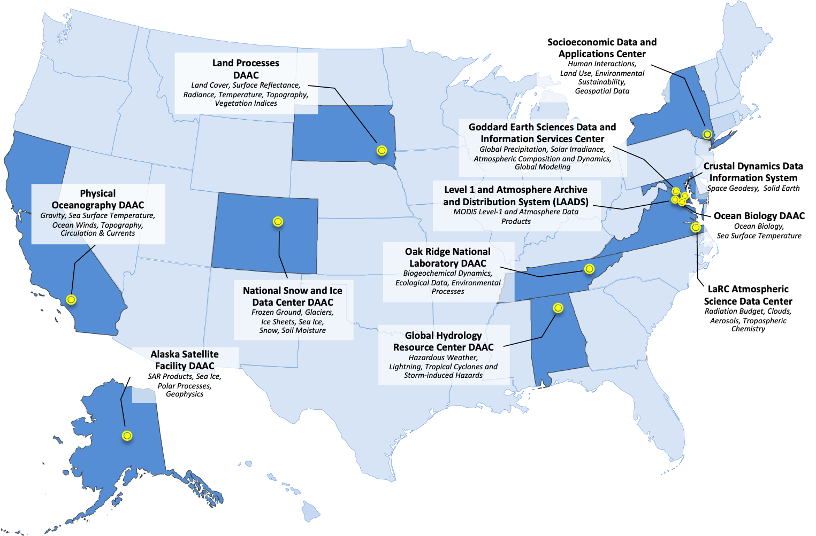

Distributed Active Archive Centers

Slide 4






EOSDIS Highlights from 2021
Number of products distributed by discipline:
LAND: 1.34 BILLION
ATMOSPHERE: 399 MILLION
OCEAN: 115 MILLION
CRYOSPHERE: 31 MILLION
OTHERS: 30 MILLION
RAW: 28 MILLION
RADIANCE: 19 MILLION
There were more than
59 PETABYTES
of Earth science data in the EOSDIS archive
EOSDIS distributed almost
2 BILLION
data products to over
1.7 MILLION
distinct data users
around the world
Our Land, Atmosphere
Near real-time Capability
for Earth Observing
System (LANCE) had
OVER 820
unique datasets,
distributed more than
125 MILLION FILES
and produced 2.57 Petabytes of data
WITHIN 3 HOURS OF A SATELLITE OBSERVATION
with over
3.56 BILLION
files in the EOSDIS archive
4

Slide 5
EOSDIS Metrics
24 PB of data (~62 million files) in Earthdata Cloud
3.4 Million files added to the cloud since April
There were more than
72 PETABYTES
of Earth science data in the EOSDIS archive
EOSDIS distributes more than 2 BILLION
data products to over
1.7 MILLION
distinct data users
around the world
Our Land, Atmosphere
Near real-time Capability
for Earth Observing
System (LANCE) had
OVER 820
unique datasets,
distributed more than
125 MILLION FILES
and produced 2.57 Petabytes of data
WITHIN 3 HOURS OF A SATELLITE OBSERVATION
with over
3.56 BILLION
files in the EOSDIS archive
5

Slide 6
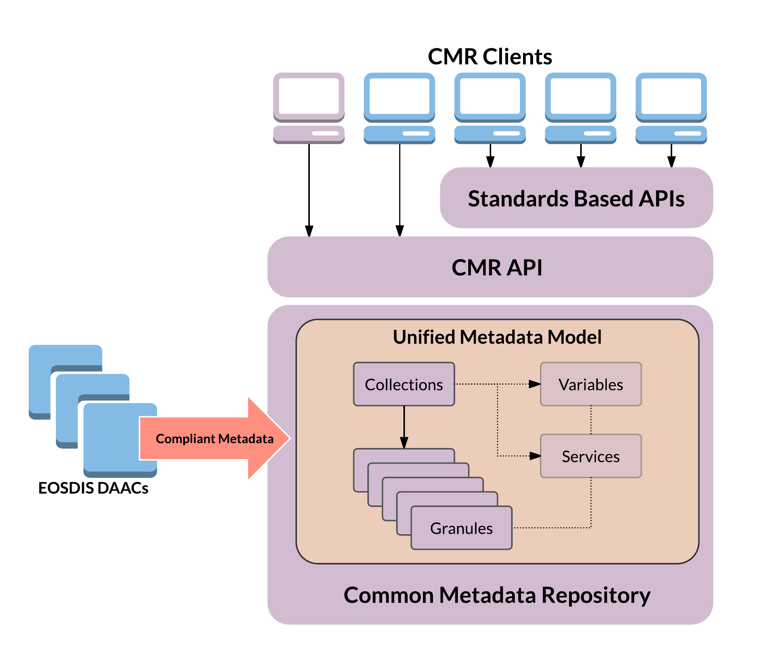
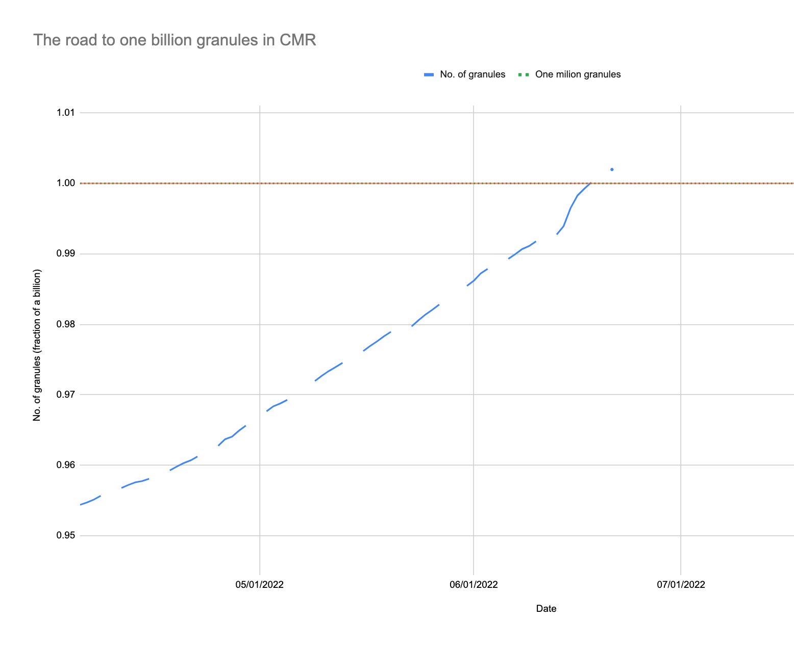
One Billion Granules of Searchable Metadata in EOSDIS Catalog!
CMR reached the 1 billion granule records mark on June 18th, 2022. This represents the ~54,000 total collections of earth science data in EOSDIS.
The EOSDIS Common Metadata Repository (CMR) is a metadata catalog and search engine used to provide discovery capabilities for NASA, other U.S. agencies, and international Earth science data holdings. Metadata describing the satellite data itself, are acquired and submitted to the CMR as collection and granule (file-level) records for indexing. CMR enables complex and responsive search capabilities, returning results on average within 550 ms for Collections and 660 ms for granules.
6

Slide 7

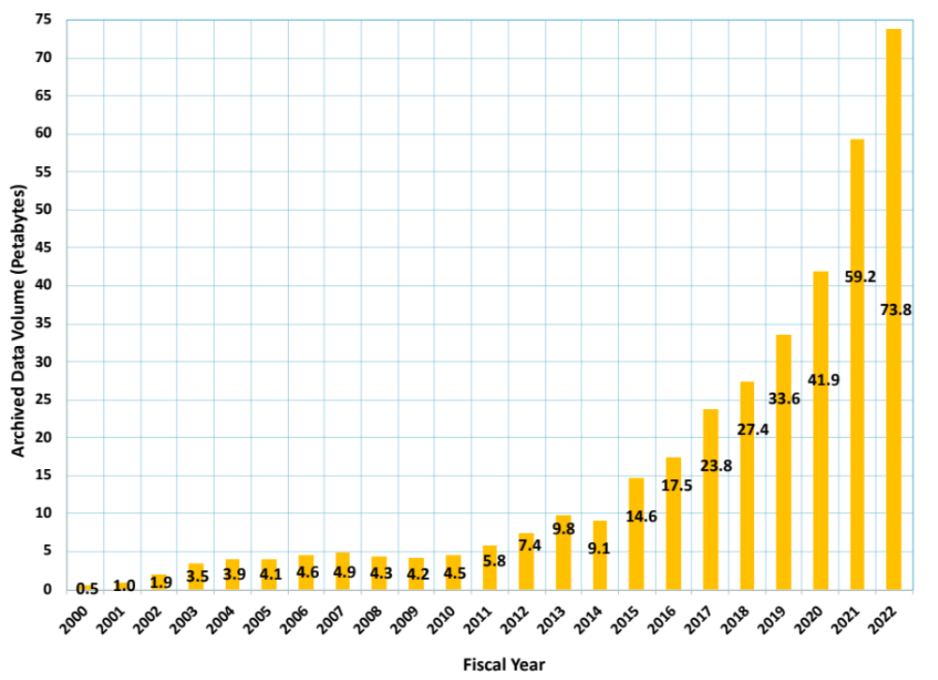
Total EOSDIS Accumulated Data Archive Volume (Petabytes)
Trend: FY2000-FY2022 (at the end of July 2022 )
Important Events
FY2003 | Addition of ICESAT product
FY2008-FY2009 | Deletion of MODIS Collection 4 products
FY2013 | Addition of AQUARIUS and ICEBRIDGE products
FY2014 | Deletion of over 10 million files (2 PB) of data by ASF as part of their consolidation and transition of data to new media
FY2015-FY2019 | Reprocessing Collection 6 & 6.1 MODIS Terra and Aqua data products
FY2016 | Addition of GPM and ALOS PALSAR products
FY2017 | Addition of OB.DAAC
Notes:
The trend data for earlier years are from EOSDIS Annual Metrics Reports.
Current fiscal year data will be updated by DAACS at the end of the fiscal year to report additional products or/and the deletion of the products that may not have been reported to EMS.

Slide 8
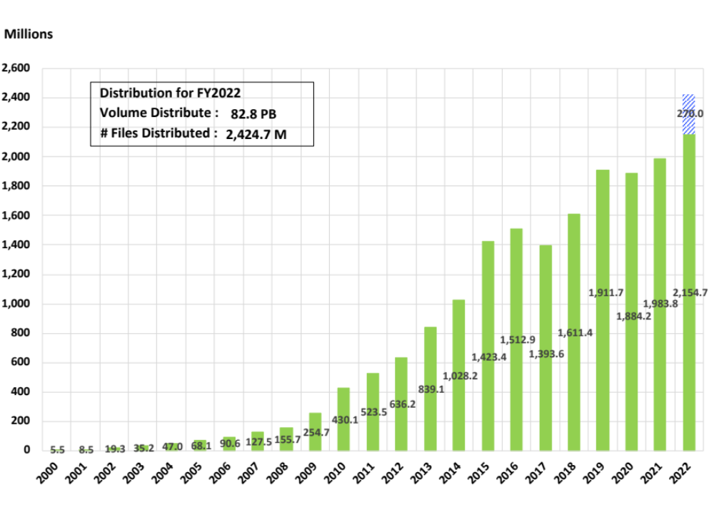
EOSDIS Products Delivered: FY00 thru July 2022
Added in June 2022
Fiscal Year
Notes:
As of Feb 2009, all historical data comes from EMS (no EDGRS annual report data for pre-2000) and OBPG data is added from the Ocean Color website statistics for FY04 through FY12.
Prior years (FY00-FY2008) products distribution data sources cover the following data centers:
ASF DAAC, LP DAAC, GES DISC, GHRC DAAC, PO.DAAC, ASDC, NSIDC DAAC, ORNL DAAC, SEDAC, including OBPG* since FY2004, LAADS DAAC since FY2006, CDDIS since FY2009 and LANCE since FY10. All data are on FY boundaries.
FY2011 data is cumulated per month for the following 11 data centers:
ASF DAAC, LP DAAC, GES DISC, GHRC DAAC, PO.DAAC, ASDC, NSIDC DAAC, ORNL DAAC, LAADS DAAC, SEDAC, CDDIS, and LANCE with OBPG* added at end of the fiscal year.
FY2012 data is cumulated per month for the following data centers:
ASF DAAC, LP DAAC, GES DISC, GHRC DAAC, PO.DAAC, ASDC, NSIDC DAAC, ORNL DAAC, LAADS DAAC, SEDAC, CDDIS and LANCE; OBPG* data included as of June 2012, the earlier months added at end of the fiscal year.
As of FY12 CALIPSO distribution is included in ASDC totals.
FY2013/14/15/16/17/18/19 data is cumulated per month for the following data centers:
ASF DAAC, LP DAAC, GES DISC, GHRC DAAC, PO.DAAC, ASDC, NSIDC DAAC, ORNL DAAC, LAADS DAAC, SEDAC, CDDIS, OB.DAAC*, LANCE
(* Beginning in October 1 2015, OBPG has been renamed to OB.DAAC)

Slide 9
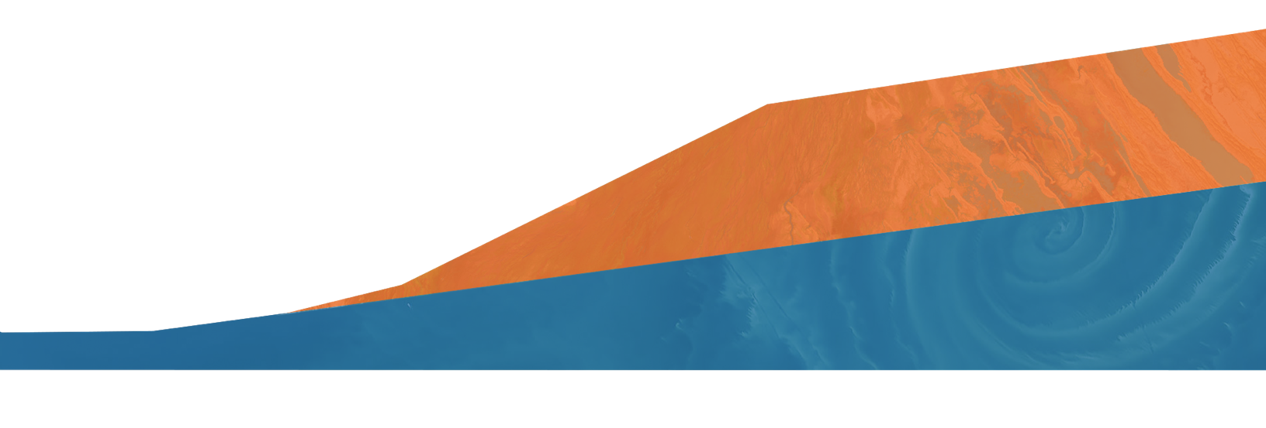
Yearly Archive Growth Projections for Current Holdings and the New Missions
(FY 2019 – FY 2029)
350
300
250
200
150
100
50
0
Current Holdings New Missions
Total Archive Volume (PB)
2019 2020 2021 2022 2023 2024 2025 2026 2027 2028 2029
Fiscal Year
Based on current launch schedules, the archive volume is expected to grow to more than 250 PB by 2025 with the addition of data from upcoming high-data-volume missions like SWOT (scheduled late 2022 launch) and NISAR (scheduled 2023 launch).
9
9

Slide 10
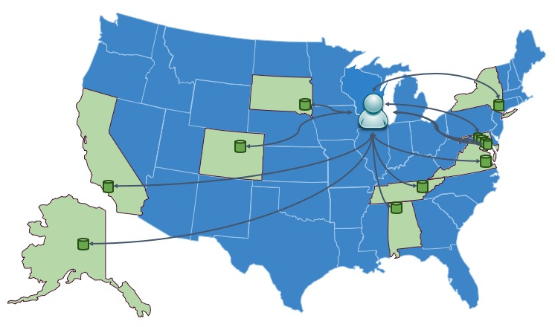
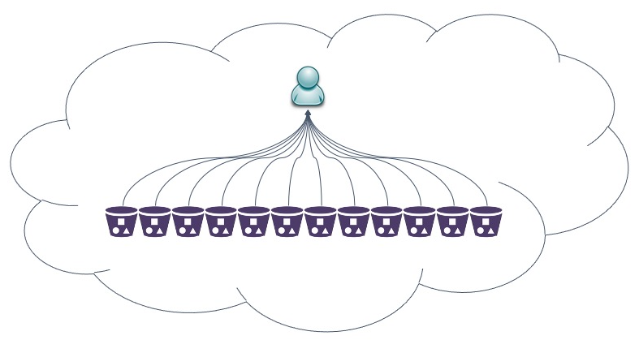

EOSDIS Transition:
DAACs moving data into the
Earthdata Cloud (EDC)
Today users seeking NASA’s data may have to visit several DAACs to fulfill their needs. Moving between data centers and interfaces can be less efficient and time consuming.
As more EOSDIS data is moved into NASA’s Earthdata Cloud, users will be increasingly able to (seamlessly) use data across traditional discipline silos – making the near future look a lot like a ‘Data Lake’.

Slide 11
For more information visit:
earthdata.nasa.gov
Notes:
Don’t forget to put your email address here!

