Slide 1

LIKED and DIARieS
Developing the next generation Heliophysics resources
R. Ringuette, A. Engell, O. Gerland, R. M. McGranaghan, and B. Thompson.
PyHC 2021 Fall Meeting
Notes:
The shapes represent the varying resources in Heliophysics, which are connected in often confusing ways to other resources, creating a maze for newcomers to work through. This represents the current situation in Heliophysics. One must navigate the maze to be able to do science!

Slide 2
Motivation
Easily discoverable data and models
Simple data and model access
Findable and interactive tutorials
Curated educational content
What infrastructure would a researcher or student new to Heliophysics, and possibly also new to programming, want to more easily brainstorm, network, and begin a new research project, even involving multiple disciplines?
Helpful and collaborative networks
Relevant software that WORKS
Intelligent connections between topics and data
Streamlined workflow assembly
Easier virtual collaboration across institutions and agencies
Notes:
In short, we want our work to be more efficient!

Slide 3
Proposed
Solution
LIKED
A LIbrary KnowledgE and Discovery online resource for discovering and implementing knowledge, data, and infrastructure resources.

Slide 4
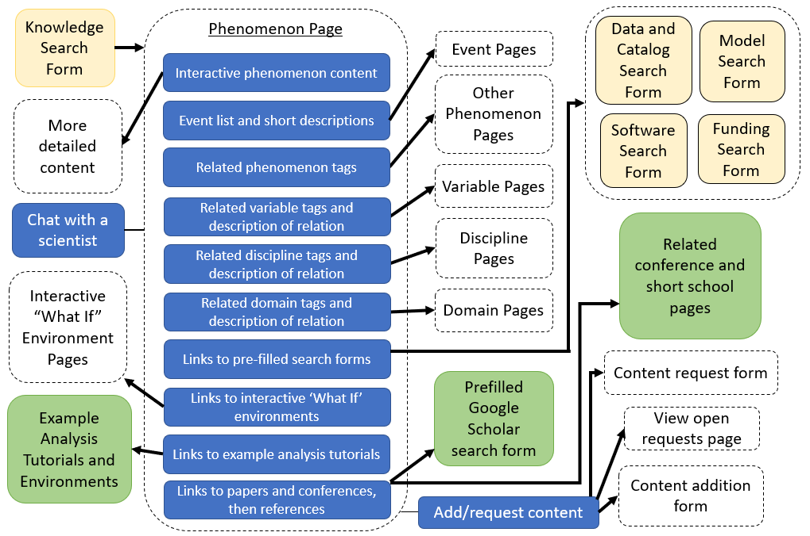
LIKED: Putting the F in FAIR
  Collaboratively build a central ideation resource
  Connect educational content to Heliophysics resources
  Encourage content discovery across research areas
  Promote and create interactive content to attract new talent
Notes:
The knowledge portion of LIKED shown here is based on the format already implemented by Wikipedia, but adds the functionality, content, and additional connections we need to discover resources and make connections more easily.
Figure 2: Diagram of the structure of the phenomenon page. Blue boxes show the page components. The ‘Chat with a scientist’ and ‘Add/request content’ components are envisioned to be on the sidebar of the page. Dashed boxes are pages maintained by the library resource website, yellow boxes are the search websites depicted in Figure 1, and green boxes are external websites. Arrows show links between the components and pages indicated. Other page types have a similar structure and linking between components and pages as appropriate for each page’s content.

Slide 5
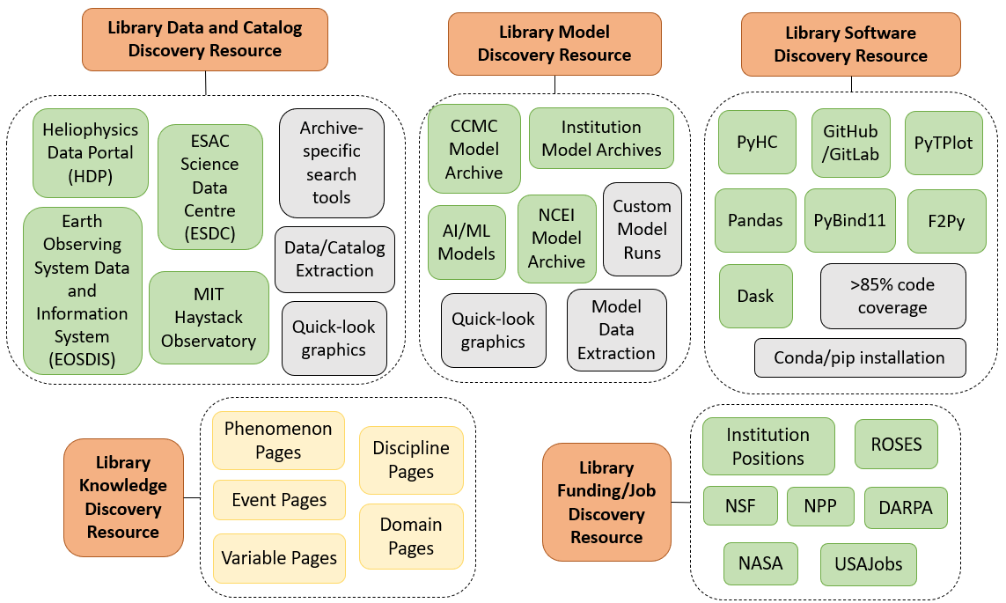
LIKED: Putting the
F in FAIR
  Build a system of systems via simplified parameters
  Efficiently leverage currently existing archives and resources
  Work towards a standard set of microservices
  Increase connections between components
  Extend to areas outside of Heliophysics
(FAIR = Findable, Accessible, Interoperable and Reusable)
Notes:
FAIR = Findable Accessible Interoperable and Reusable, in this case applied to multiple components: data, models, software, knowledge, funding, connections, ideation, and so on. Simplifying findability is one way to approach the issue of retaining talent in the field by leveling the playing field for younger members. Instead of implementing a one-size-fits-all access standard for all archives, we instead follow the lead of the Earth Science and related fields by proposing a ‘system of systems’ approach.
Figure 1: Depiction of the operational structure of the discovery sections of the online library resource. Orange boxes represent the library discovery search forms, described in the text, which are a layer on top of the boxed elements, either green or yellow, in the dashed category boxes. Green boxes indicate examples of external elements in each category, while yellow boxes are webpages maintained by the library resource website. Grey boxes are examples of suggested required microservices or capabilities provided by each element in the same category.

Slide 6
DIARieS
An ecosystem to simplify Discovery, Implementation, Analysis, Reproducibility, and Sharing of scientific results and environments.
LIKED
A LIbrary KnowledgE and Discovery online resource for discovering and implementing knowledge, data, and infrastructure resources.
Proposed
Solution
LIKED
A LIbrary KnowledgE and Discovery online resource for discovering and implementing knowledge, data, and infrastructure resources.
LIKED
A LIbrary KnowledgE and Discovery online resource for discovering and implementing knowledge, data, and infrastructure resources.
LIKED
A LIbrary KnowledgE and Discovery online resource for discovering and implementing knowledge, data, and infrastructure resources.
LIKED
A LIbrary KnowledgE and Discovery online resource for discovering and implementing knowledge, data, and infrastructure resources.
LIKED
A LIbrary KnowledgE and Discovery online resource for discovering and implementing knowledge, data, and infrastructure resources.
LIKED
A LIbrary KnowledgE and Discovery online resource for discovering and implementing knowledge, data, and infrastructure resources.
LIKED
A LIbrary KnowledgE and Discovery online resource for discovering and implementing knowledge, data, and infrastructure resources.
LIKED
A LIbrary KnowledgE and Discovery online resource for discovering and implementing knowledge, data, and infrastructure resources.
LIKED
A LIbrary KnowledgE and Discovery online resource for discovering and implementing knowledge, data, and infrastructure resources.
LIKED
A LIbrary KnowledgE and Discovery online resource for discovering and implementing knowledge, data, and infrastructure resources.
LIKED
A LIbrary KnowledgE and Discovery online resource for discovering and implementing knowledge, data, and infrastructure resources.

Slide 7
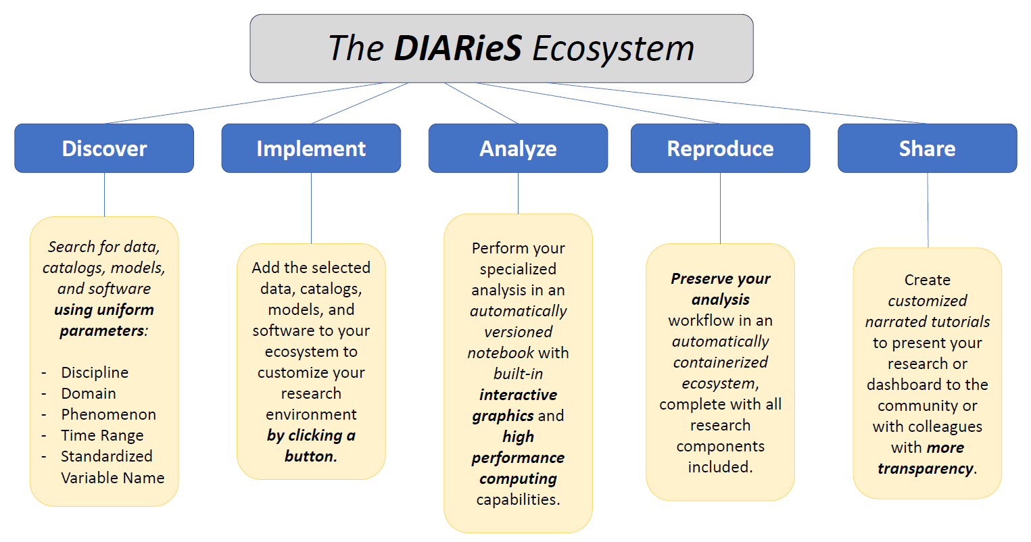

Slide 8
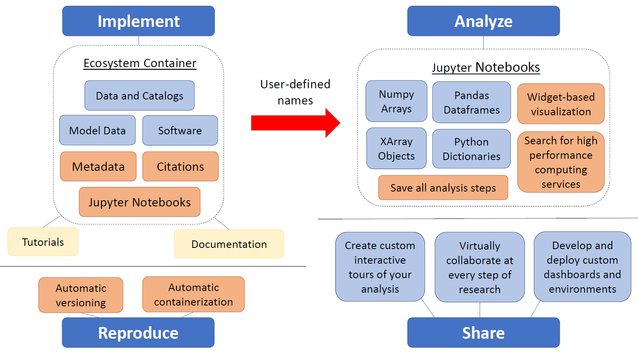
DIARieS: Simplifying AIR
Notes:
Figure 3: Diagram of the components and built-in capabilities of the Implement, Analyze, Reproduce, and Share pillars of the DIARieS ecosystem. Light blue boxes represent discovered research components implemented in the ecosystem through the discovery sections, with the exception of the Share pillar. Instead, blue boxes connected to the Share pillar indicate capabilities of the ecosystem. The dashed lines separate elements included in the container, which includes the notebooks, from linked resources accessible from but not included in the container (yellow boxes). Orange boxes show automatically included elements based on current or future capabilities of the underlying infrastructure (e.g. SPASE metadata and Jupyter Notebooks).

Slide 9
LIKED + DIARieS = FAIR Science
Develop simple but flexible connections
Focus on a standard set of microservices
Build upon current technology
How can these ideas be applied to PyHC?
Notes:
LIKED: lightbulb, a place for ideation. DIARieS: notebook, a new workflow.
The development of a resource similar to LIKED supports the development of the next generation workflow, DIARieS.

Slide 10
Application to PyHC:
Developing Standards
Develop minimum (required) standards: What standards ensure the software is relevant and usable for PyHC users?
  Minimum percentage of code coverage (possibly 80%)
  Python 3 compatibility
  Application to heliophysics and/or space weather
  Minimum documentation requirement
  Conda, pip, or git installation
Develop preferred standards:
What standards increase the usefulness of the software, especially with other PyHC software?
  Higher percentage of code coverage (possibly 90%)
  Containerized tutorials for high priority functionalities
  Interfaces/Interoperability with other PyHC software packages
  Conda and/or pip installation (not just via git)

Slide 11
Application to PyHC:
Motivating Developers
Offer services to member software packages:
  Technical support in CI/CD workflow setup when desired
  Containerize tutorials and software for each package in a publicly accessible form (e.g. BinderHub or DeepNote)
  Increase discoverability for software packages and created tutorials
  Active public promotion of each package’s features to relevant audiences
  Coordination/Funding for creating multi-package tutorials and interfaces
  Additional benefits for achieving preferred standards

Slide 12


Summary
Heliophysics currently needs a coordinated push to make our work FAIR and efficient.
Connect
our archives based on a ‘system of systems’ approach.
Build
on the successes of current efforts and technology.
Assemble educational and ideation content from ongoing work.
We call on the community to work together on this goal to launch our field into the future.
https://drive.google.com/file/d/1FBBHjgLUu4sr1JYP-10hVKnqb-fb32q_/view?usp=sharing
https://drive.google.com/file/d/1JExyj0CxGuUoRxJR4DwXqVc7ONw9OQgW/view?usp=sharing
For more details, either scan the QR codes or click the links.

