Slide 1
Interoperable Services to Mitigate Lunar Position, Navigation, and Timing Challenges
Cheryl Gramling, Goddard Senior Fellow, Assoc. Chief for Technology, Mission Engineering and Systems Analysis Division
Juan Crenshaw, Goddard Space Flight Center, Navigation and Mission Design Branch
Laurie Mann, Goddard Space Flight Center, Navigation and Mission Design Branch
73rd International Astronautical Congress, Paris, France
September 22, 2022

Slide 2
Agenda
Lunar Position, Navigation, and Timing (PNT) Challenges
Engaging Systems to Safely Navigate

Slide 3
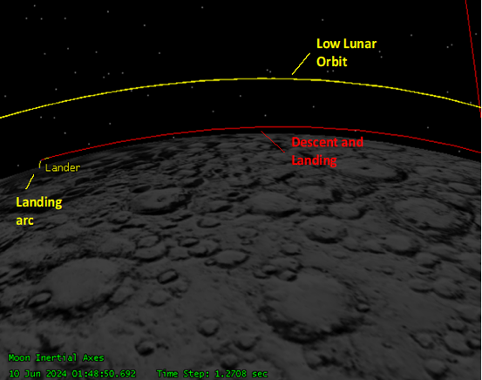
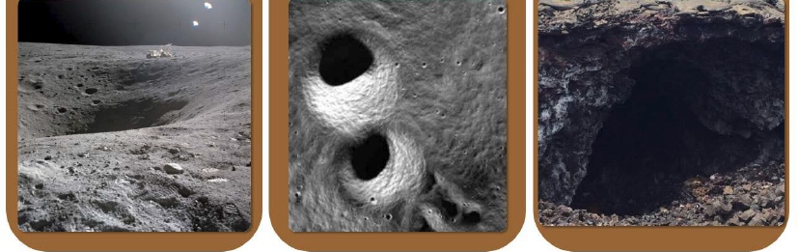
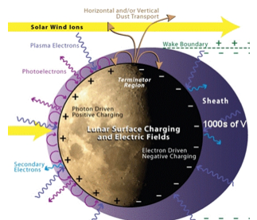
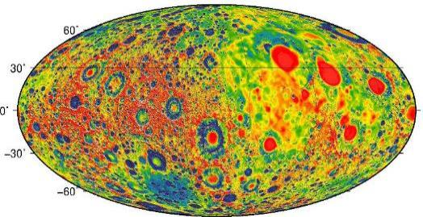

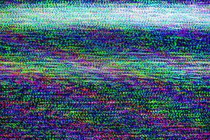



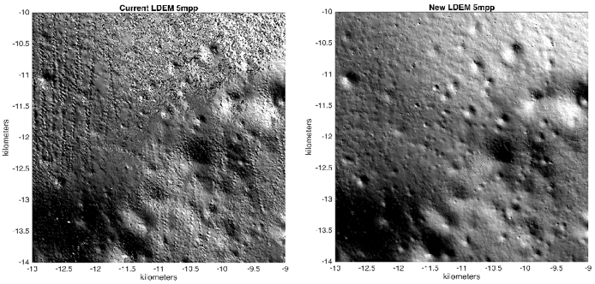
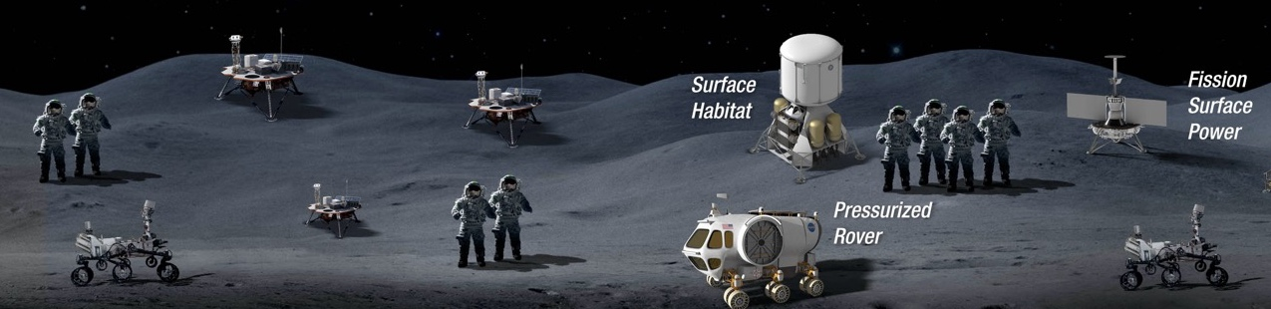
Lunar PNT Challenges
Reference System
Dynamic Conditions
Stark Lighting
Surface Environment
Interference
Fusion
Zuber et al. (2012), Lemoine et al. (2012), Lemoine et al. (2013)
“Heliophysics Science and the Moon”, NASA Advisory Council, 2007
Occulted Earth
Power, Mass, Volume

Slide 4
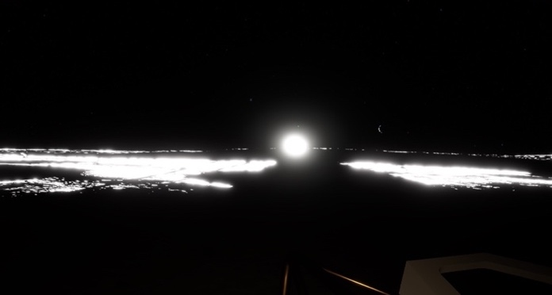
Stark lighting conditions encountered on the Moon
Notes:
This is an example from the Johnson Space Center Virtual Reality sim of the stark lighting conditions across relatively flat terrain.

Slide 5
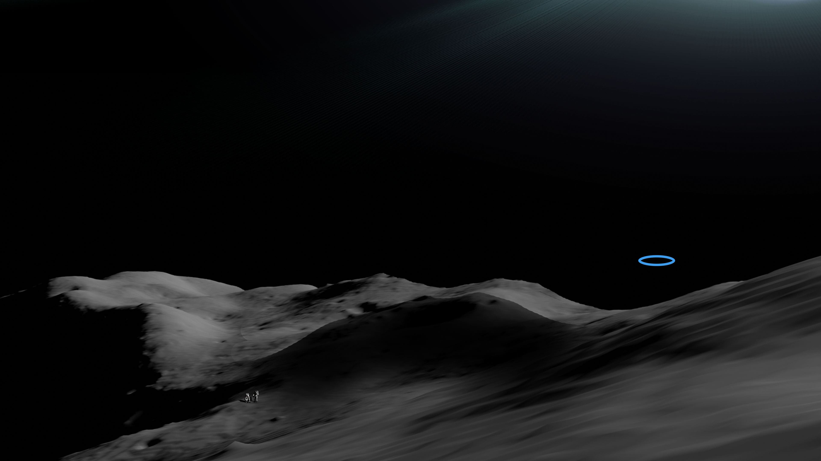
Lunar Navigation Notional Scenario
Notes:
Crew, or roving assets, need to get from current location to target location.

Slide 6
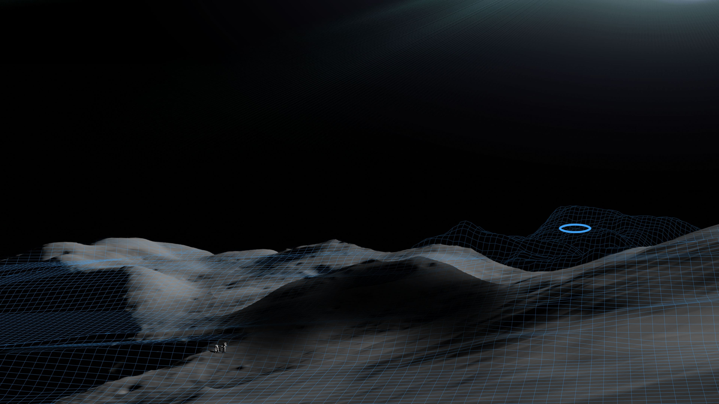
Lunar Navigation Notional Scenario
Lunar Reference System and Cartographic Products
Notes:
Lunar Reference System and LuNaMaps will provide the accurate cartographic info.

Slide 7
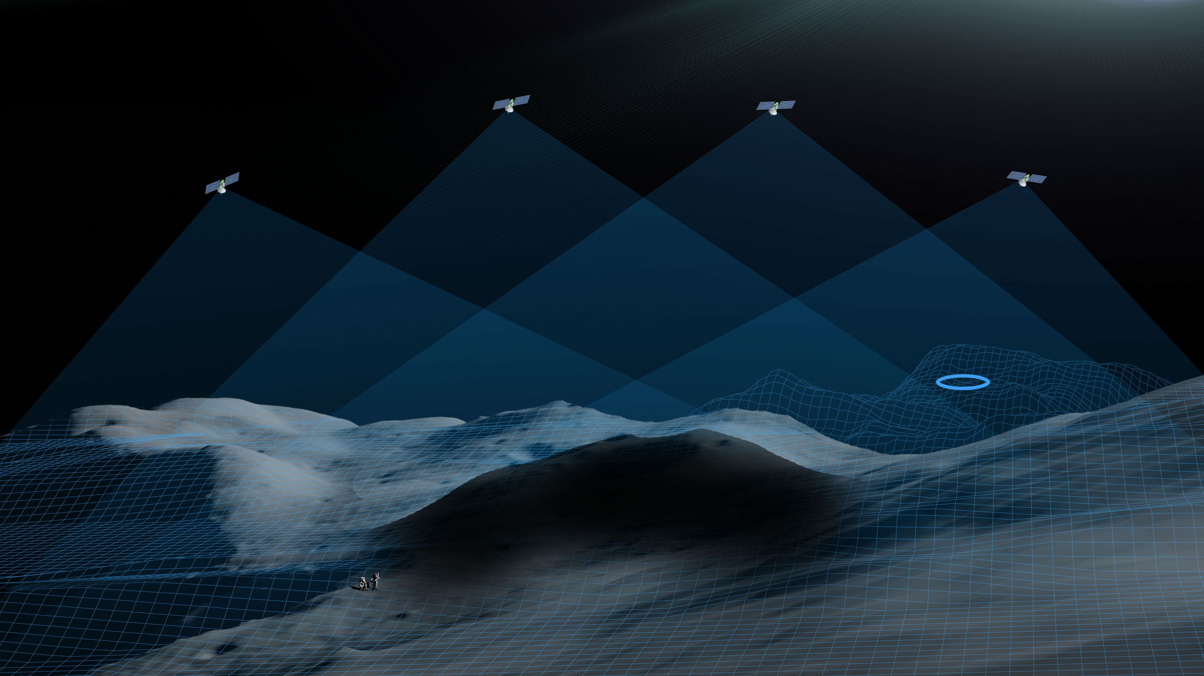
Lunar Navigation Notional Scenario
Lunar Reference System, Cartographic Products, and LunaNet PNT Services
Notes:
LunaNet PNT services enable positioning and time knowledge by receivers. These positions directly relate to the maps from the Lunar Reference System.

Slide 8

Lunar Navigation Notional Scenario
Enabled Safe Path Planning and Execution
LunaNet PNT services allow users to determine accurate position on high resolution LuNaMaps.
Notes:
LunaNet PNT services enable positioning and time knowledge by receivers. These positions directly relate to the maps from the Lunar Reference System.

Slide 9

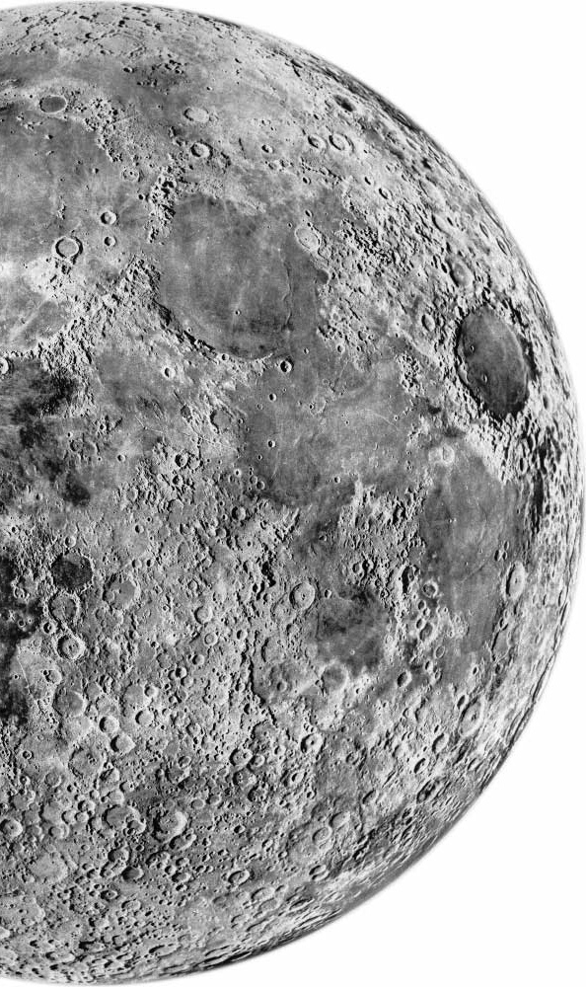

Summary
Navigating in the Artemis cislunar environment introduces scenarios that differ significantly from previous missions.
LunaNet establishes the infrastructure framework to mitigate challenges and enable accurate and timely position, velocity, and time (PVT) knowledge.
Efforts underway by NASA and international partners form the basis for safe and consistent navigation in the lunar regime.
  Focus areas include defining the Lunar Reference System, surface networks with PNT, and a user terminal for receiving and synthesizing observations into PVT solution.
Acknowledgements: Johnson Space Center Virtual Reality Simulation Facility; Chris Gnam, GSFC LuNaMaps team.

Slide 10
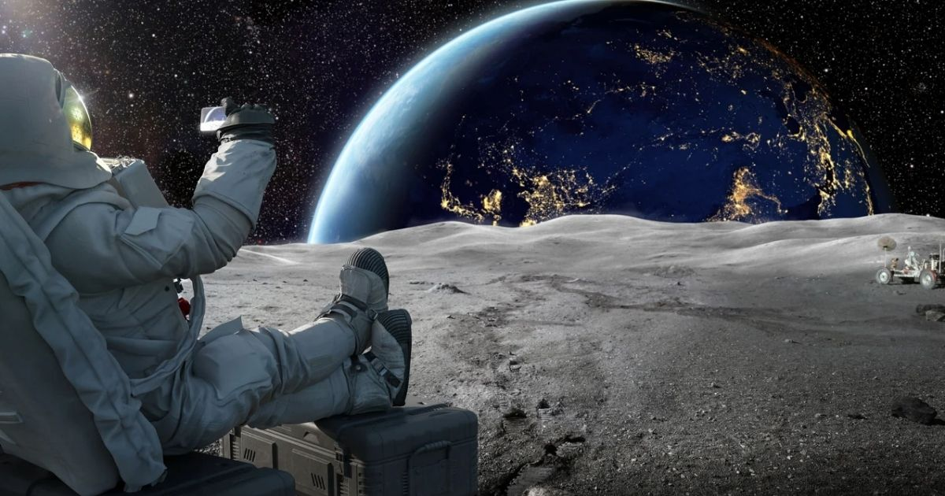
Questions?

