Slide 1
Development of a Consistent GEOsat Cloud Property Dataset for the CERES Climate Data Record
R. Palikonda¹, William L. Smith Jr.², David Painemal¹, Sarah Bedka¹, P. Minnis¹, Qing Trepte¹, Chris Yost¹, Cecilia Fleeger¹, Baojuan Shan¹

Slide 2
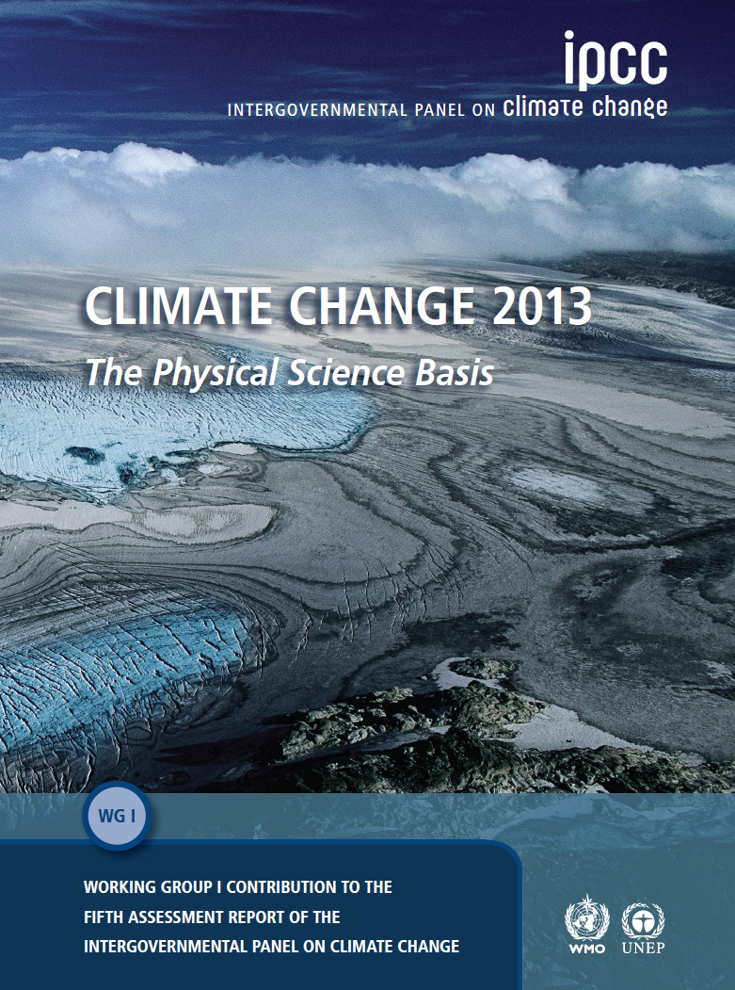
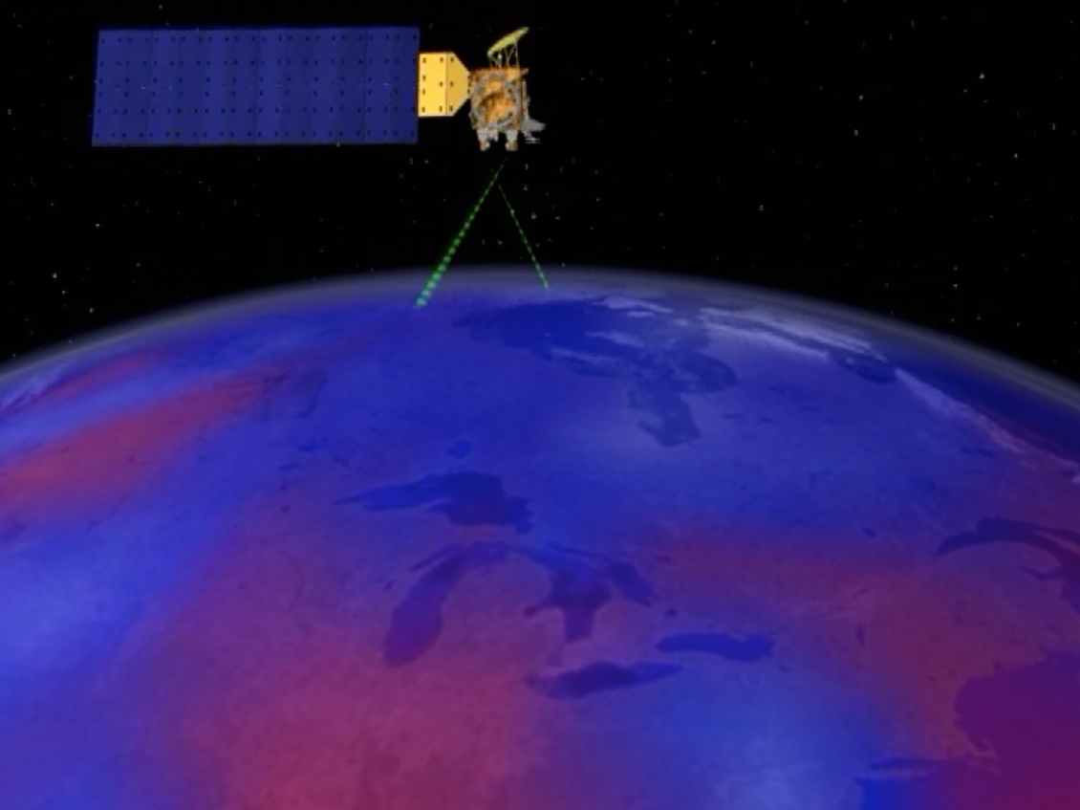
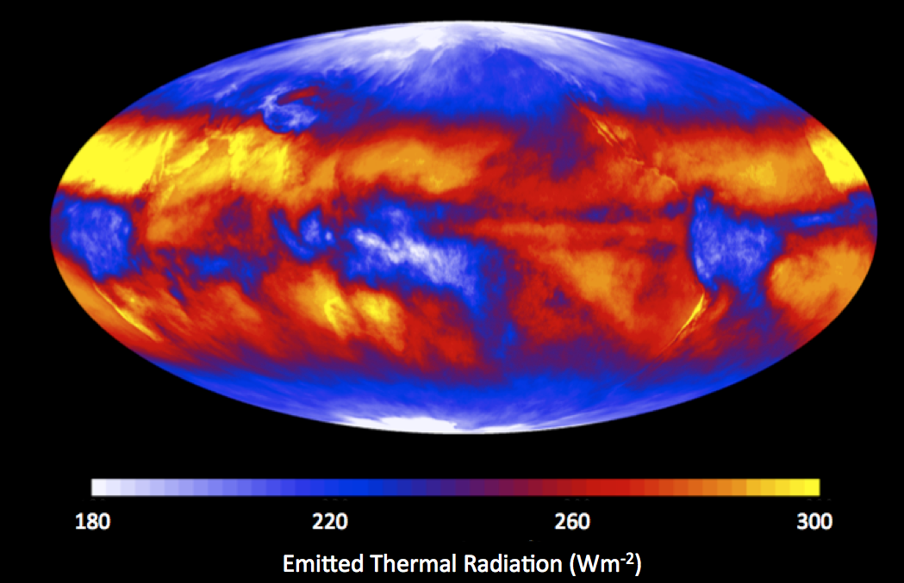
Clouds and the Earth’s Radiant Energy System (CERES)
CERES – NASA’s Earth Radiation Budget Program
Goal is to produce a long-term, integrated climate data record (CDR) for detecting decadal changes in the Earth’s radiation budget from the surface to the TOA together with the associated cloud and aerosol properties.
CDR: Timeseries of sufficient length in time, consistency and continuity to determine climate variability and change.
Notes:
The Main goal of CERES is to provide time series of CDR of suffient length , that is consistent, continuous to determine climate variability and change.

Slide 3
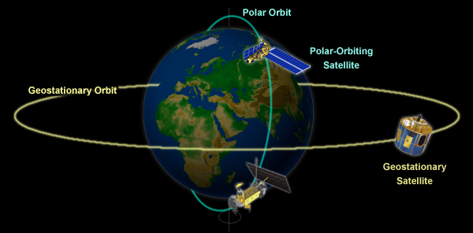
Accomplishing CERES objectives requires a high level of data fusion
During the CERES period, the team has processed data from:
  7 CERES satellite instruments
  2 MODIS imagers (Terra, Aqua)
  2 VIIRS imager (S-NPP, NOAA-20)
  20 geostationary imagers (GEO-Sat)
  Solar irradiance measurements
  Meteorological, ozone and aerosol assimilation data
  Snow/ice maps
  All are integrated to obtain climate accuracy in radiative fluxes from the TOA to the surface.
Notes:
This is achieved by high level of data fusion that include 7 CERES BB instruments, 2 MODIS imager, 2 VIIRS imager, 2o geo stationary satellite.

Slide 4
Why is GEO-Sat data needed in CERES
The Clouds and the Earth’s Radiant Energy System (CERES) Project has been monitoring the Earth’s radiation budget since 2000 using.
- Broadband radiometers on Terra, Aqua & SNPP polar orbiting satellites
- Cloud properties determined from MODIS & VIIRS on the same satellites
- Clouds used to explain TOA radiances and compute short & long wave fluxes at surface & top of
atmosphere
The equatorial crossing times for Terra and Aqua (SNPP) are 10:30 and 13:30 LT.
- Small part of daily cycle observed, missing the diurnal cycle in daily radiation budget
Hourly geostationary satellite (GEOSat) imager data used to estimate fluxes for the missing hours to capture the diurnal cycle variations.
- cloud properties retrieved hourly at 6-km / 8 -km resolution between
60°N and 60°S
- Analyzed with a version of SATCORPS adapted to CERES GEOSat.
- Properties are based on a fixed algorithm for each satellite and intercalibrated radiances.
~85 % of cloud information used in CERES processing comes from GEOsats.
Notes:
The process involves, determining cloud properties from the NB MODIS & VIIRS imager using NASA SATCORPS or SatCORPS for short.

Slide 5
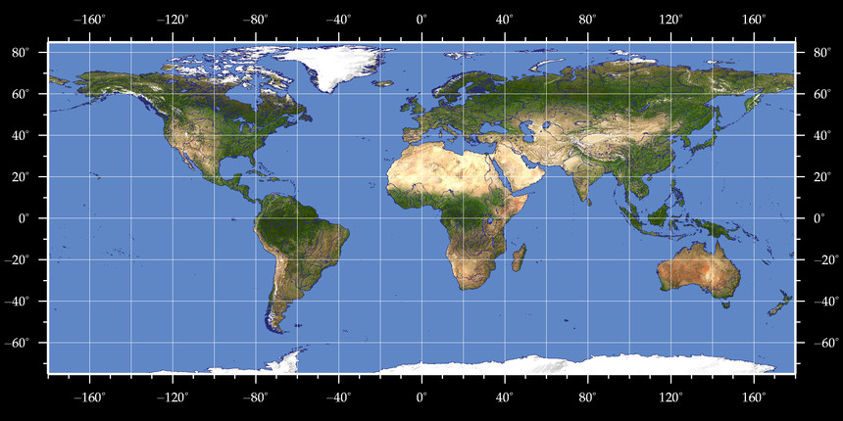
CERES record Geostationary Time Series
Terra (10:30)
Aqua (1:30)
NPP (1:30)
NOAA-20 (1:30)
JPSS-2
0°
Met-7
Met-8
Met-9
Met-10
Met-11
60°
Met-5 (63°)
Met-7 (57°)
Met-8 (41.5)
Met-9
140°
GMS-5
G-9 160
MTSAT-1R
MTSAT-2 (145°)
Himawari-8
GOES-WEST
-135°
GOES-10
GOES-11
GOES-15
GOES-17
-75°
GOES-8
GOES-12
GOES-13
GOES-16
2000
2002
2004
2006
2008
2010
2012
2014
2016
2018
2020
2022
2024
1st generation
2nd generation
3rd generation
MODIS/VIIRS

Slide 6
CERES record Geostationary Time Series
Terra (10:30)
Aqua (1:30)
NPP (1:30)
NOAA-20 (1:30)
JPSS-2
0°
Met-7
Met-8
Met-9
Met-10
Met-11
60°
Met-5 (63°)
Met-7 (57°)
Met-8 (41.5)
Met-9
140°
GMS-5
G-9 160
MTSAT-1R
MTSAT-2 (145°)
Himawari-8
-135°
GOES-10
GOES-11
GOES-15
GOES-17
GOES-EAST
-75°
GOES-8
GOES-12
GOES-13
GOES-16
2000
2002
2004
2006
2008
2010
2012
2014
2016
2018
2020
2022
2024
1st generation
2nd generation
3rd generation
MODIS/VIIRS

Slide 7
CERES record Geostationary Time Series
Terra (10:30)
Aqua (1:30)
NPP (1:30)
NOAA-20 (1:30)
GREENWICH
JPSS-2
0°
Met-7
Met-8
Met-9
Met-10
Met-11
60°
Met-5 (63°)
Met-7 (57°)
Met-8 (41.5)
Met-9
140°
GMS-5
G-9 160
MTSAT-1R
MTSAT-2 (145°)
Himawari-8
-135°
GOES-10
GOES-11
GOES-15
GOES-17
-75°
GOES-8
GOES-12
GOES-13
GOES-16
2000
2002
2004
2006
2008
2010
2012
2014
2016
2018
2020
2022
2024
1st generation
2nd generation
3rd generation
MODIS/VIIRS

Slide 8
CERES record Geostationary Time Series
Terra (10:30)
Aqua (1:30)
NPP (1:30)
NOAA-20 (1:30)
JPSS-2
0°
Met-7
Met-8
Met-9
Met-10
Met-11
INDIAN OCEAN
60°
Met-5 (63°)
Met-7 (57°)
Met-8 (41.5)
Met-9
140°
GMS-5
G-9 160
MTSAT-1R
MTSAT-2 (145°)
Himawari-8
-135°
GOES-10
GOES-11
GOES-15
GOES-17
-75°
GOES-8
GOES-12
GOES-13
GOES-16
2000
2002
2004
2006
2008
2010
2012
2014
2016
2018
2020
2022
2024
1st generation
2nd generation
3rd generation
MODIS/VIIRS

Slide 9
CERES record Geostationary Time Series
Terra (10:30)
Aqua (1:30)
NPP (1:30)
NOAA-20 (1:30)
JPSS-2
0°
Met-7
Met-8
Met-9
Met-10
Met-11
60°
Met-5 (63°)
Met-7 (57°)
Met-8 (41.5)
Met-9
WESTERN PACIFIC
140°
GMS-5
G-9 160
MTSAT-1R
MTSAT-2 (145°)
Himawari-8
-135°
GOES-10
GOES-11
GOES-15
GOES-17
-75°
GOES-8
GOES-12
GOES-13
GOES-16
2000
2002
2004
2006
2008
2010
2012
2014
2016
2018
2020
2022
2024
1st generation
2nd generation
3rd generation
MODIS/VIIRS

Slide 10
CERES GEO EDITION-4 CDR
SPECTRAL CHANNELS USED FOR CLOUDS in CERES GEO EDITION-4
1st generation satellite
2nd generation satellite
Satellite | Available Channels (µm)
MET-5 | 0.6, 11
MET-7 | 0.6, 11
GMS-5 | 0.6, 11
Satellite | Available Channels (µm)
GOES-8 | 0.6, 3.9, 6.7, 11, 12
GOES-9 | 0.6, 3.9, 6.7, 11, 12
GOES-10 | 0.6, 3.9, 6.7, 11, 12
GOES-11 | 0.6, 3.9, 6.7, 11, 12
MTSAT-1R | 0.6, 3.7, 6.7, 11, 12
MTSAT-2R | 0.6, 3.7, 6.7, 11, 12
GOES-12 | 0.6, 3.7, 6.7, 11, 13.3
GOES-13 | 0.6, 3.7, 6.7, 11, 13.3
GOES-14 | 0.6, 3.7, 6.7, 11, 13.3
GOES-15 | 0.6, 3.7, 6.7, 11, 13.3
MET-8 | 0.6, 3.9, 6.7,11, 12, 1.6, 8.7, 13.3
MET-9 | 0.6, 3.9, 6.7,11, 12, 1.6, 8.7, 13.3
MET-10 | 0.6, 3.9, 6.7,11, 12, 1.6, 8.7, 13.3
MET-11 | 0.6, 3.9, 6.7,11, 12, 1.6, 8.7, 13.3
3rd generation satellite
Satellite | Available Channels (µm)
GOES-16 | 0.6, 3.9, 6.7,11, 12, 0.8,1.6, 8.7, 13.3
GOES-17 | 0.6, 3.9, 6.7,11, 12,0.8, 1.6, 8.7, 13.3
HIMAWARI-8 | 0.6, 3.9, 6.7,11, 12, 0.8, 1.6, 8.7, 13.3
Ed4 cloud algorithms generally designed to take advantage of as many spectral channels that are available to derive cloud mask & properties as accurately as possible.
This approach works well for consistency with MODIS when using similar channels (e.g. GOES-16) but will not work to achieve consistency amongst GEOsats.
MET-5, MET-7 & GMS-5 : Two channel algorithm.

Slide 11
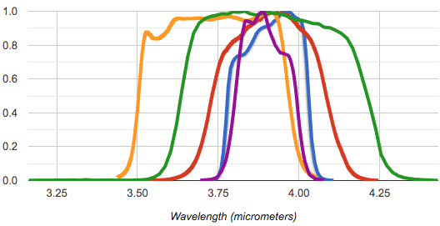
3.9 µm SRF differences for the different GEO satellites
Challenges to Achieving Continuity
3 generations of GEOsats, different resolutions, spectral bands, SRF’s, nominal calibrations
In fixed locations
  consistency depends to some degree on distribution of land/ocean, land types, heavy pollution in the various domains

Slide 12
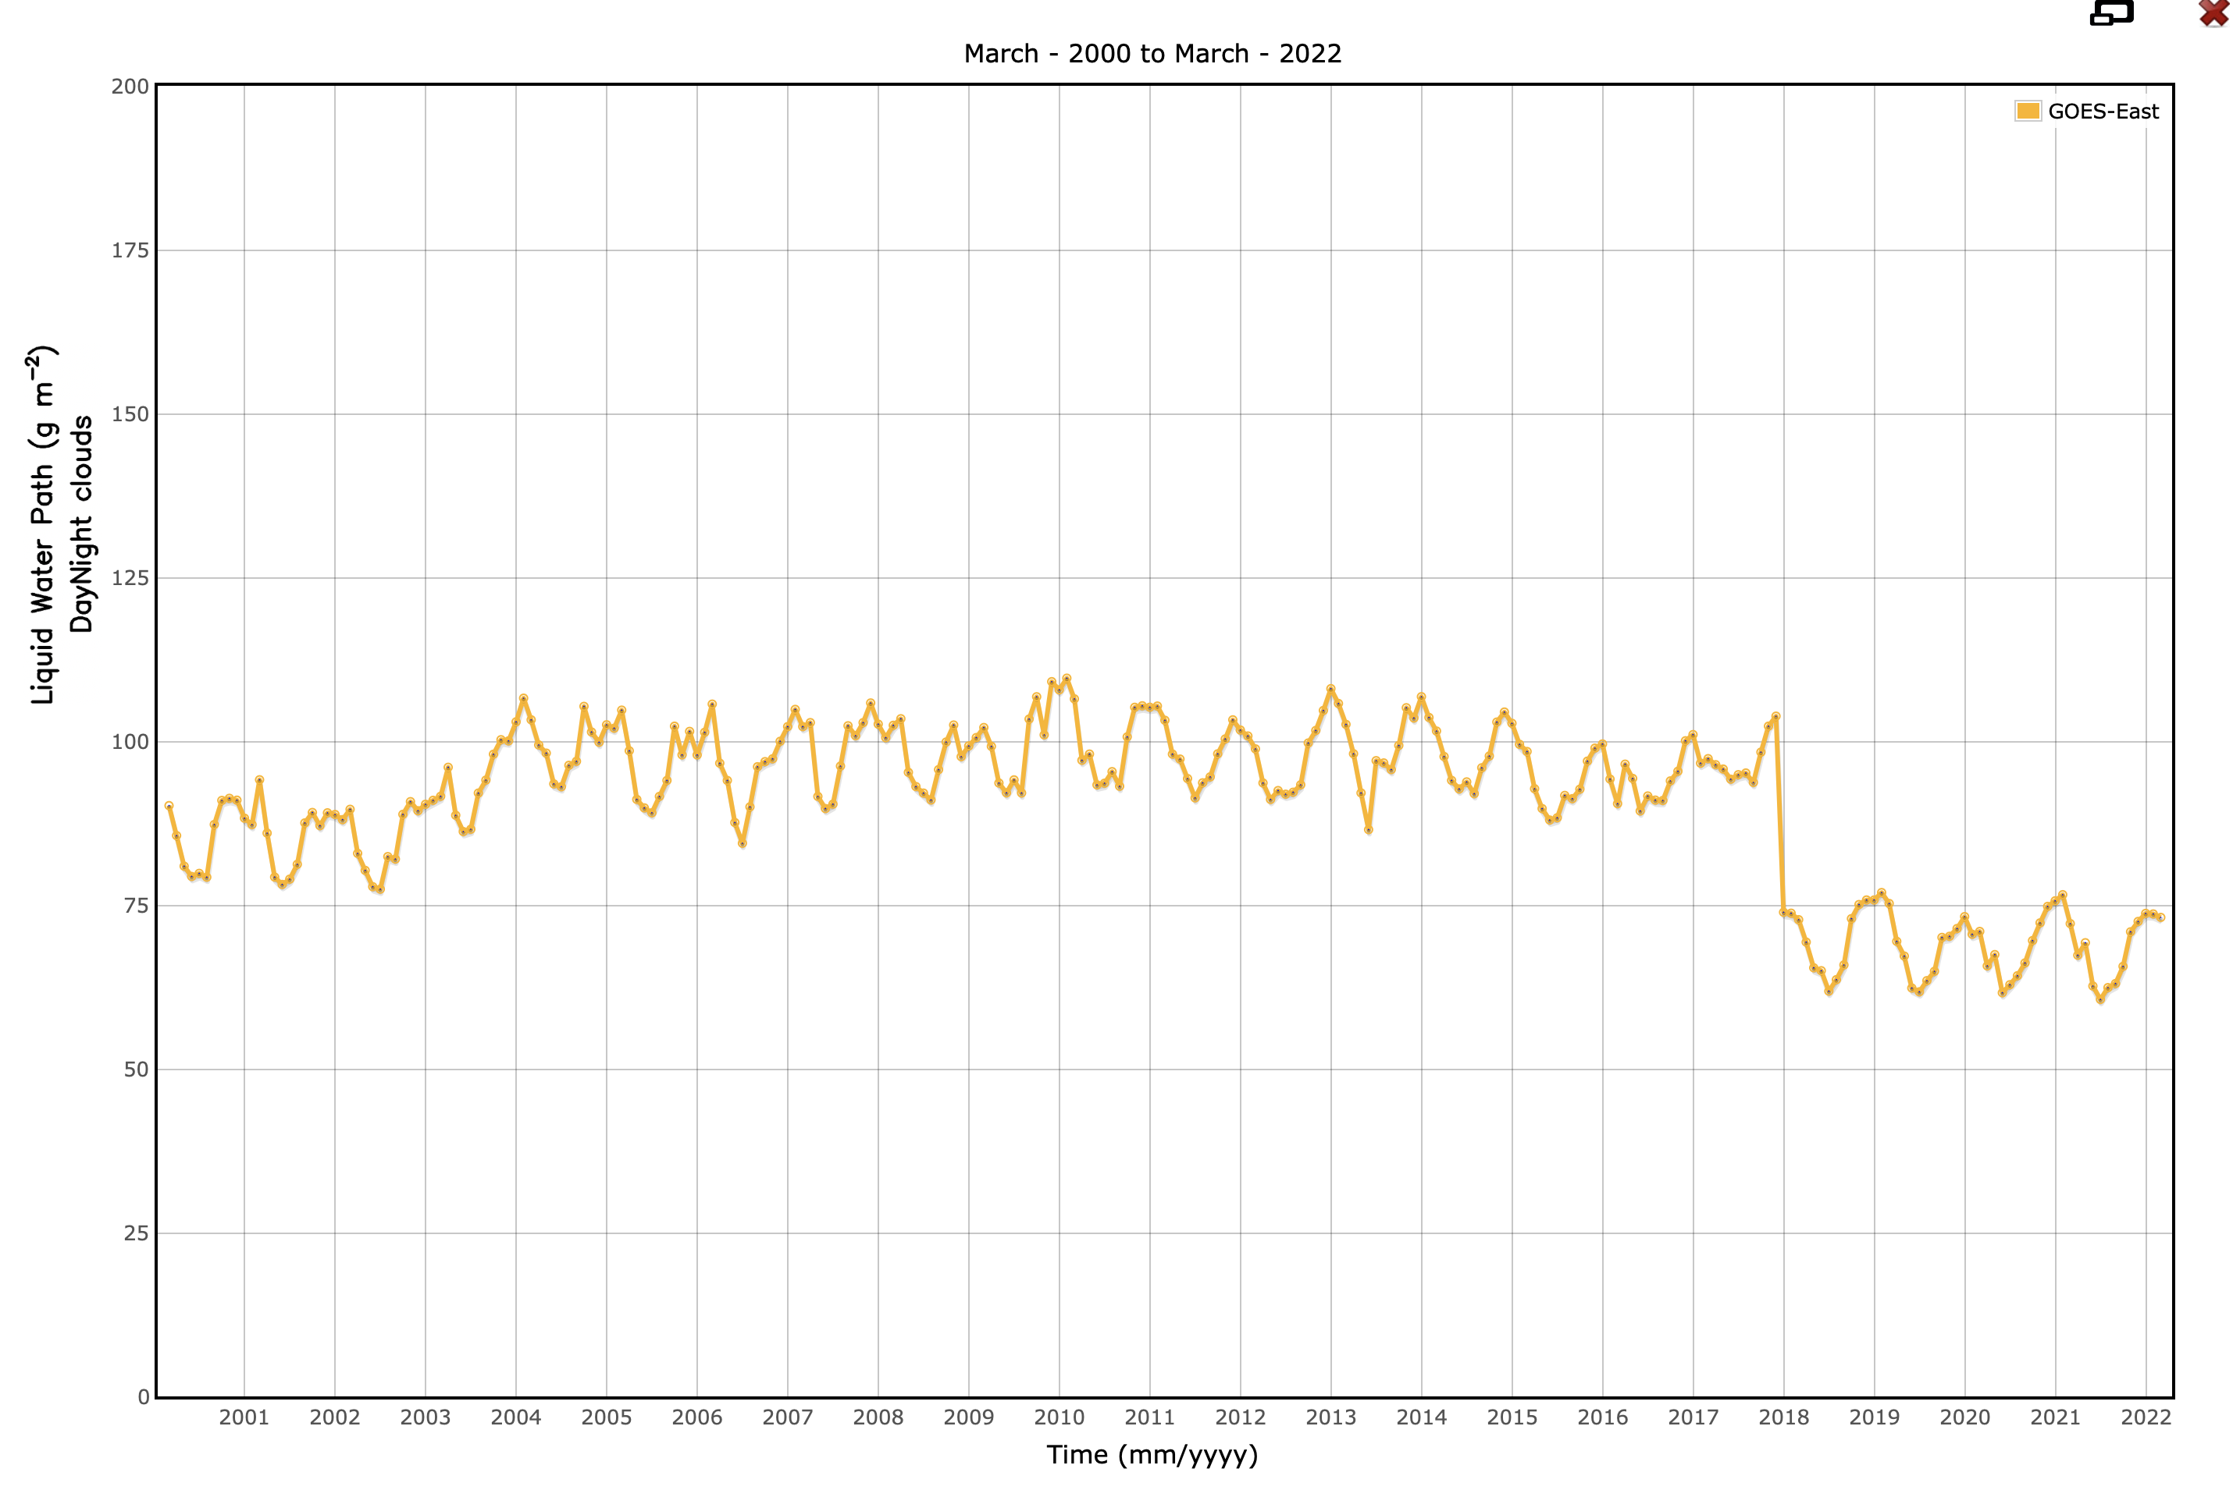
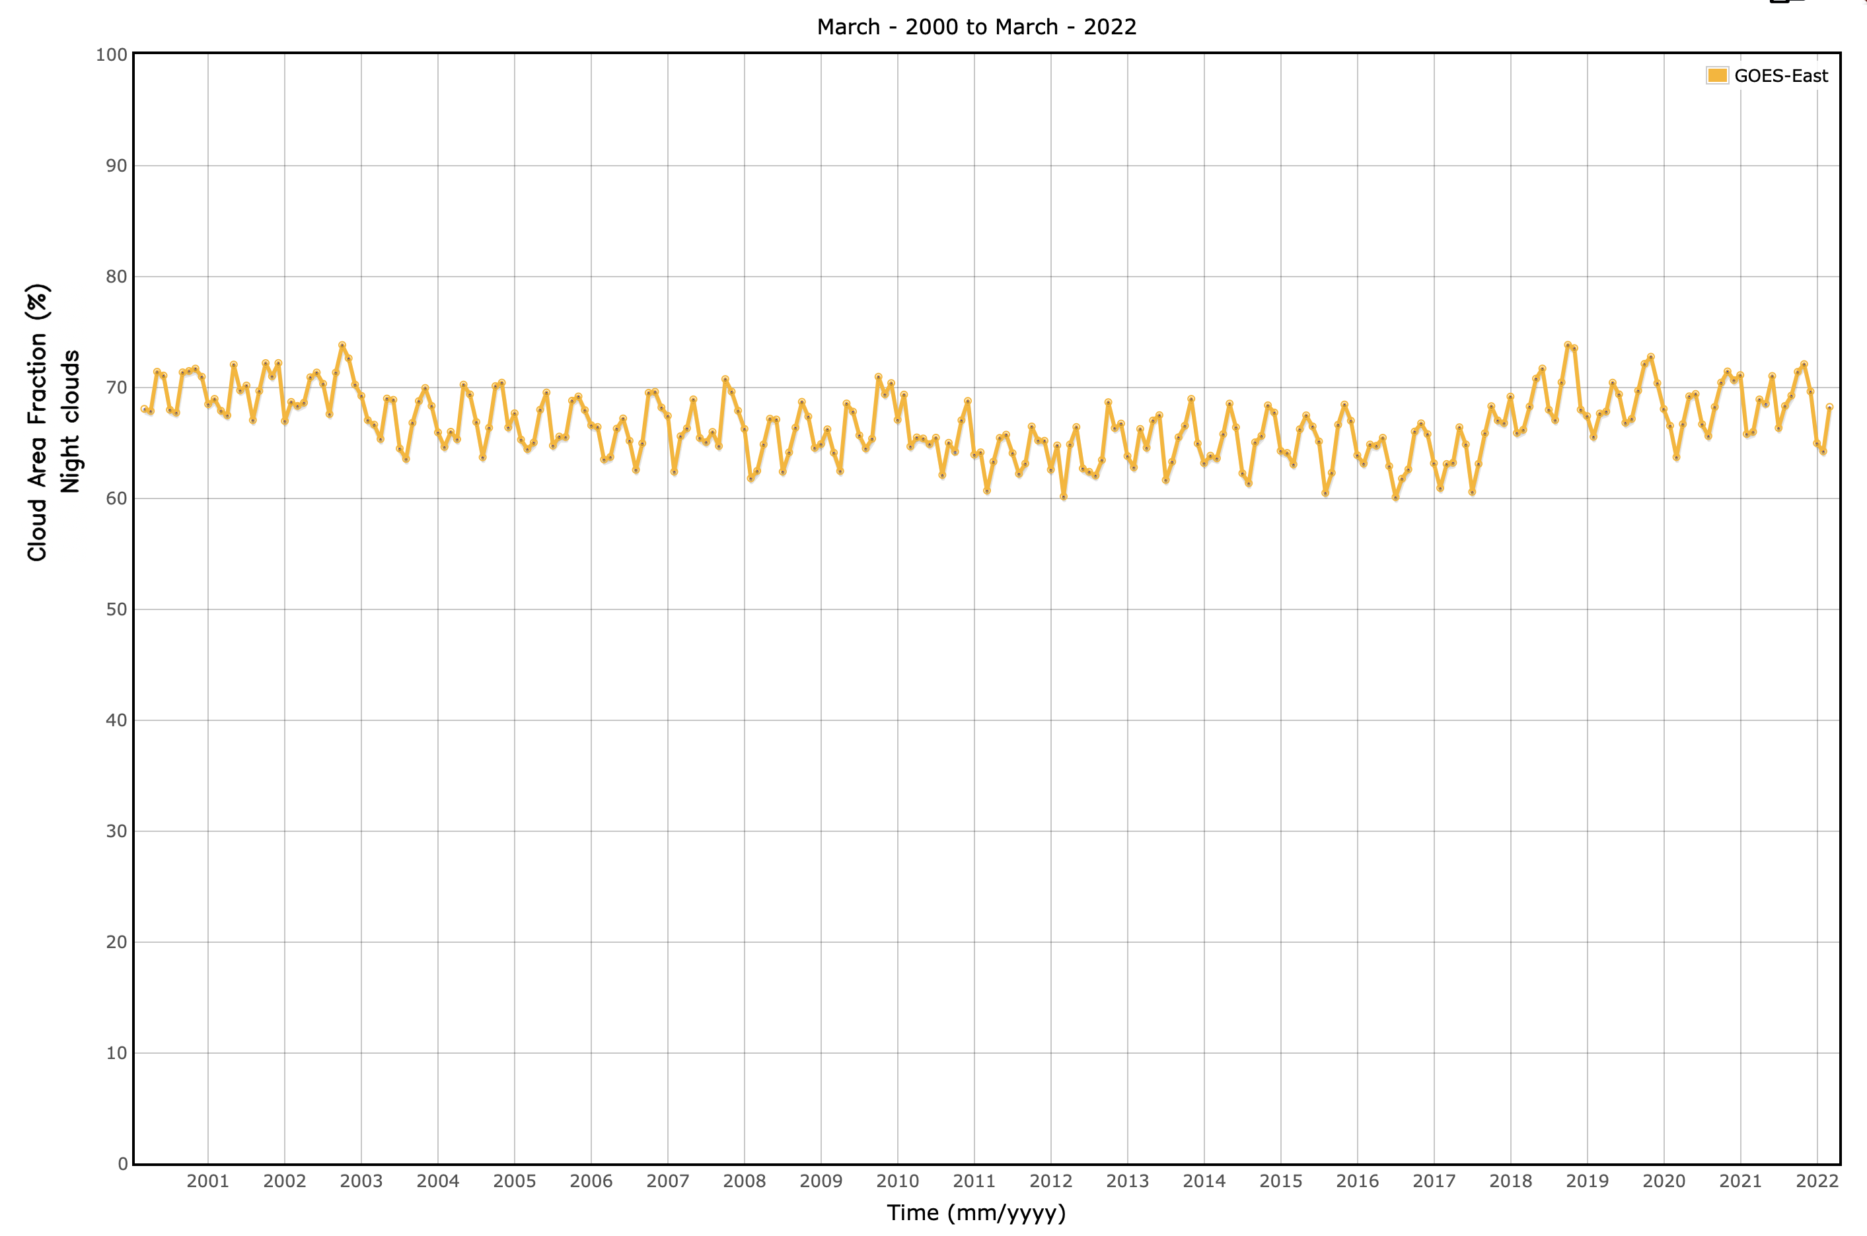
The application of dissimilar algorithms tailored for different geostationary (GEO) satellite sensors may yield inconsistent cloud retrievals, which can severely affect the continuity of the CERES climate data record (CDR).
GOES-13
GOES-16
GOES-12
GOES-13
GOES-8
GOES-16
GOES 12 & GOES-13 : No 12 um channel (13.3 )
GOES-12/13 uses 0.6, 3.7, 6.7, 11, 13.3 (µm) channels in cloud mask and retrieval compared to GOES-16 using 0.6, 3.9, 6.7,11, 12, 1.6, 8.7, 13.3 (µm)

Slide 13
A 3-channel algorithm for the CDR continuity
A new family of algorithms developed that takes advantage of 3 channels carried by most GEO imagers: 0.65, 3.9, and 11 μm (and their equivalent), with the goal of producing spatiotemporal continuous cloud observations.
Limiting the available spectral channel would lead to reduced accuracy, especially in the newer satellite with additional spectral channels available that are sensitive to thin cirrus, cloud/aerosol.
By limiting the spectral channels, a more accurate predicted clear-sky information is paramount, in the 3 limited channels, for better cloud/clear discrimination.
Several improvements were implemented in the 3ch algorithm to improve the predicted clear-sky reflectance (0.65 μm) and brightness temperatures (3.9, and 11 μm)
  Improved satellite-specific gas absorption calculations (correlated-k).
  Better closure between computed and observed clear-sky brightness temperature (Tb).
  New hourly overhead albedo maps over land.

Slide 14
Preliminary assessment
GOES-13 and GOES-16 cloud fraction from Edition 4 (Ed4) and the 3-channel algorithm (3-ch, or continuity algorithm) were compared amongst the two algorithms for consistency.
Assessment of CF accuracy was made with CALIOP comparisons.
Daytime Cloud property consistency between GOES-13 & GOES-16 with ED4 & 3CH
Results are presented for July 2017 data.

Slide 15
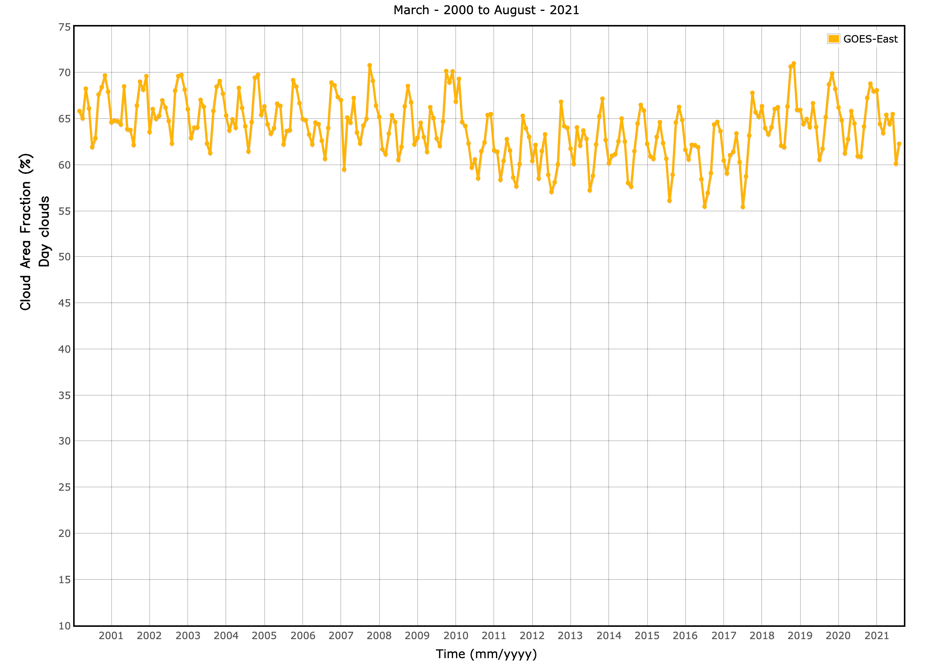
TOTAL CLOUD FRACTION
GEO Edition 4, 2000 - 2021
total cloud fraction
GOES-13
GOES-16
|△| ≈ 0.030
time [year, month]
A noticeable increase in total cloud fraction exists after the transition from GOES-13 to GOES-16 (~3%) in CERES Edition 4 dataset.

Slide 16
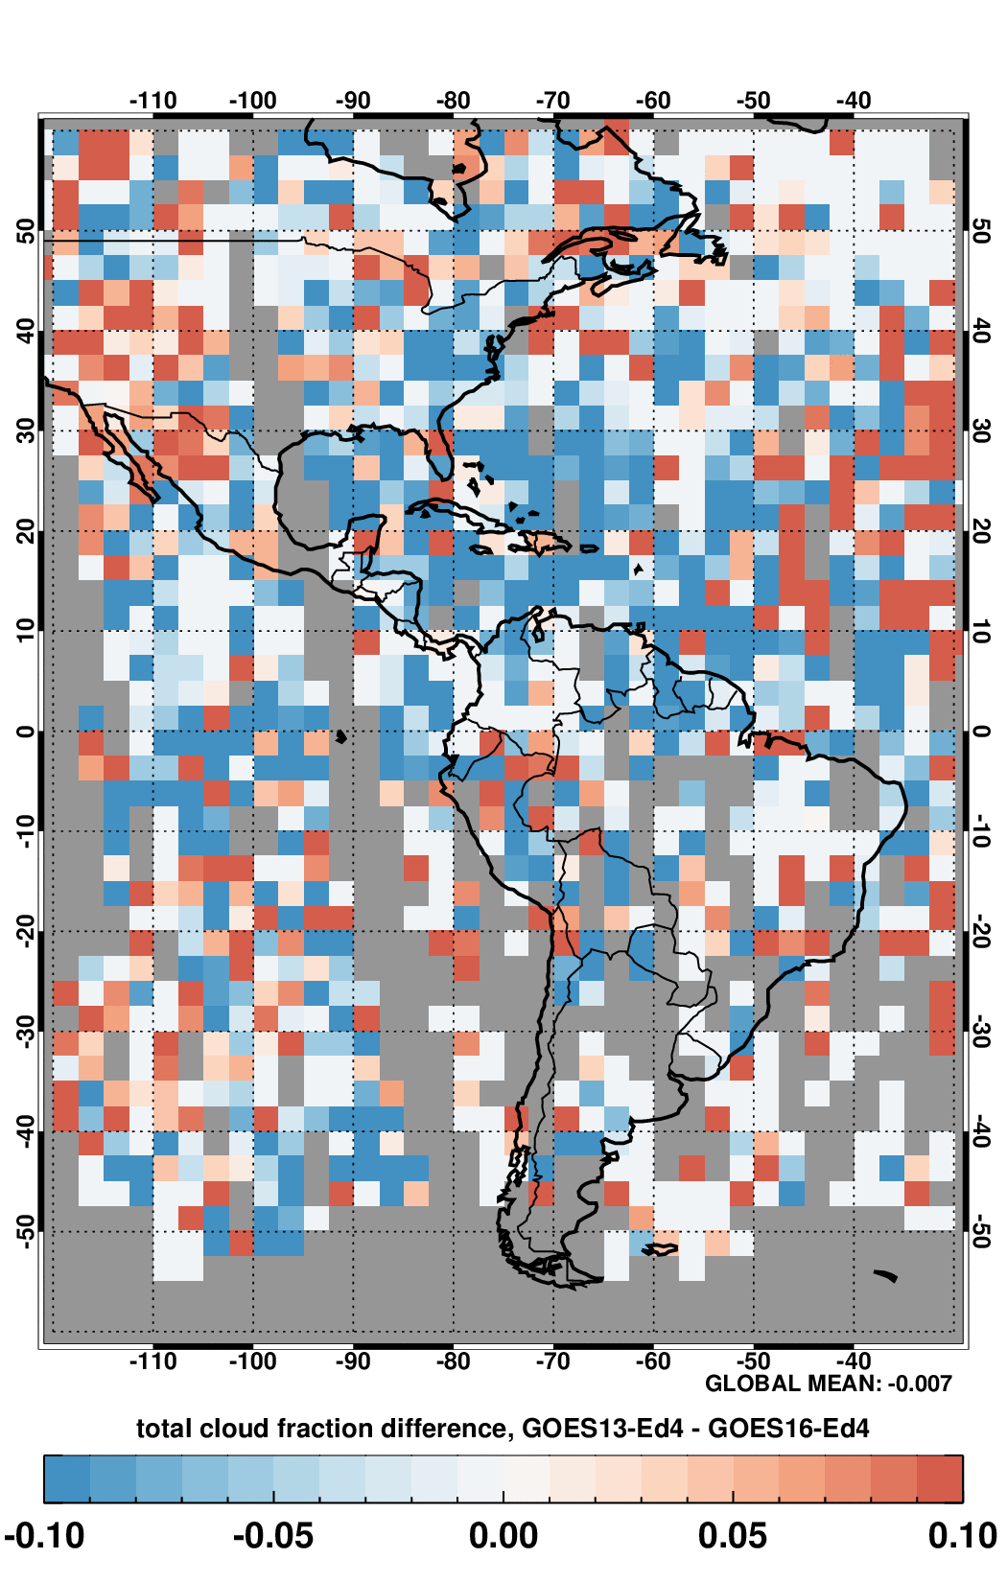
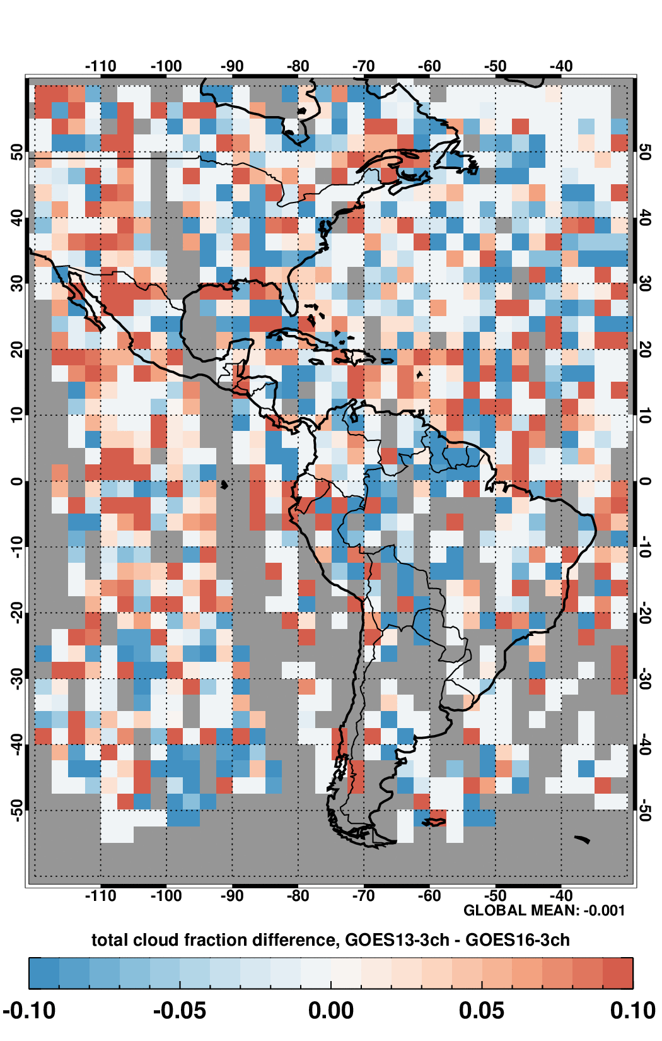
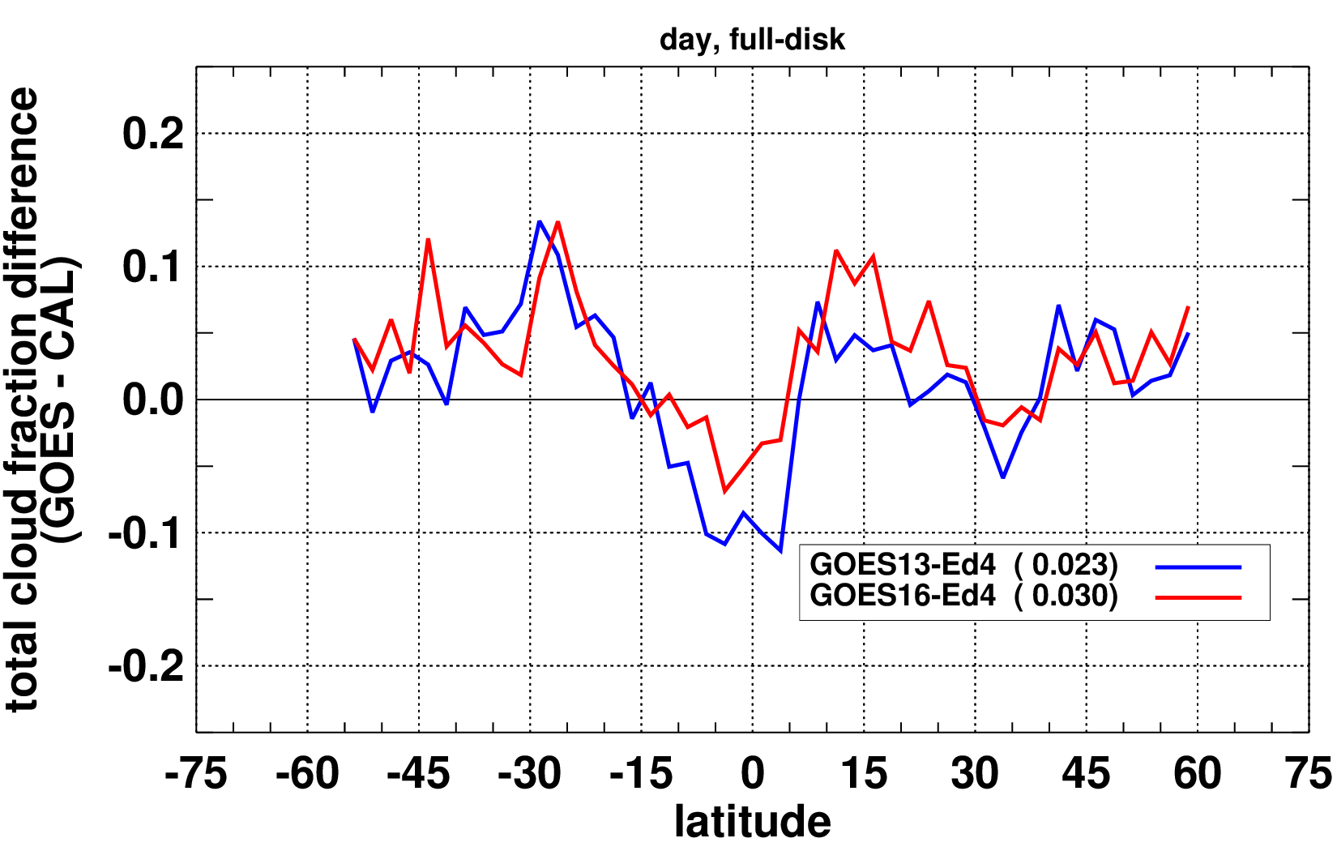
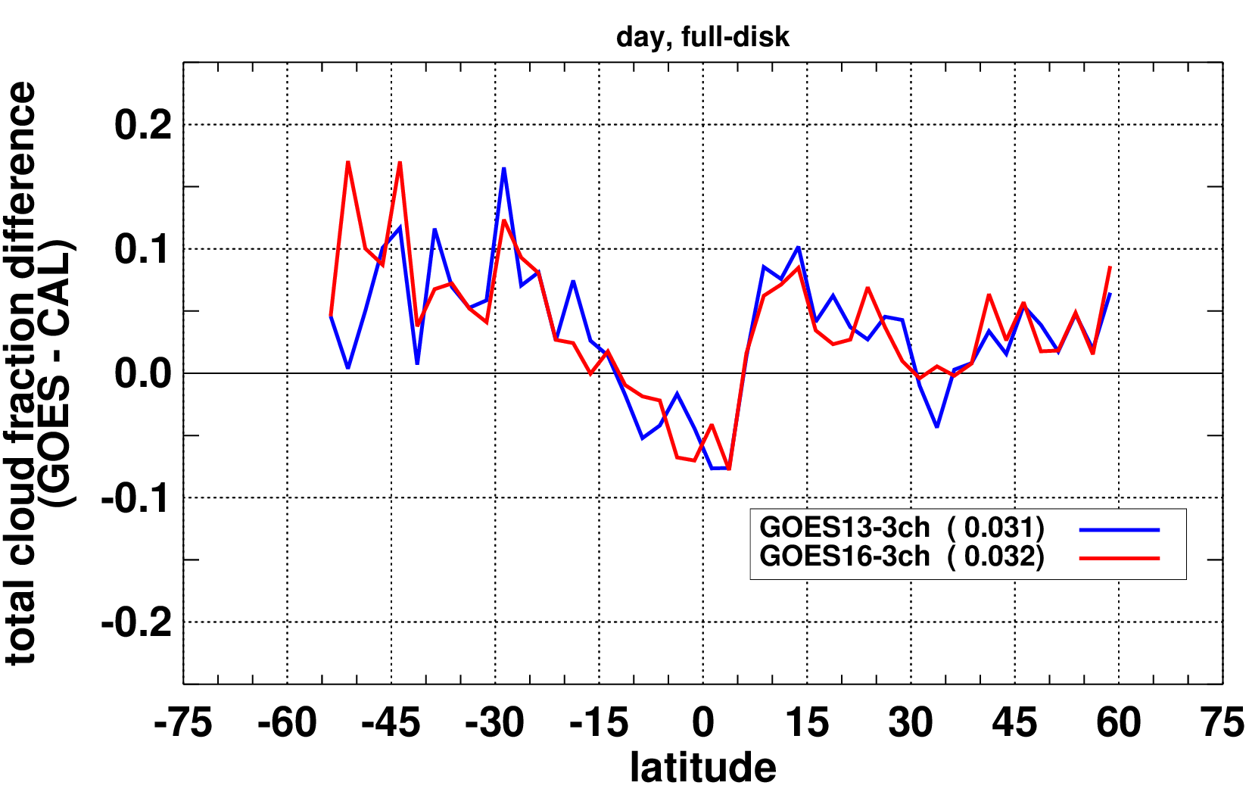
GOES13 – GOES16 regional cloud fraction (day) differences for Ed4 (left) and the 3-channel algorithm (right)
Ed4 (top) and 3-ch (bottom) zonal differences (day) with CALIOP
Mean regional differences for Ed4 (-0.007; left) and 3-ch (-0.001; right)
Overall accuracy suffered somewhat as shown by the differences with CALIOP.
July, 2021

Slide 17
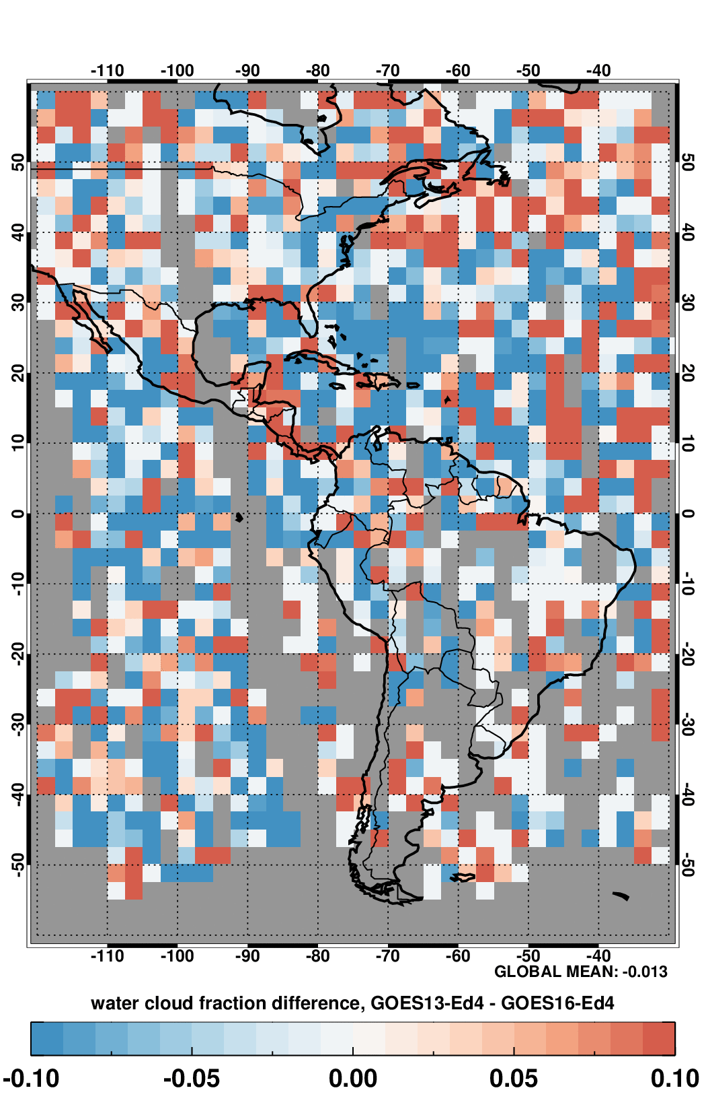
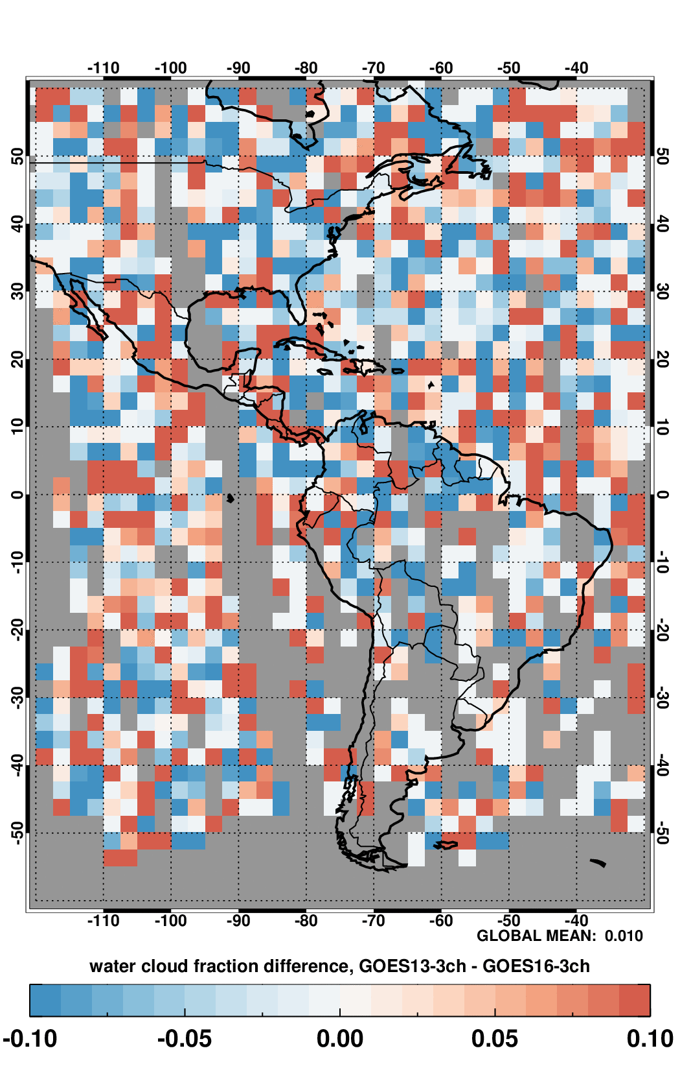
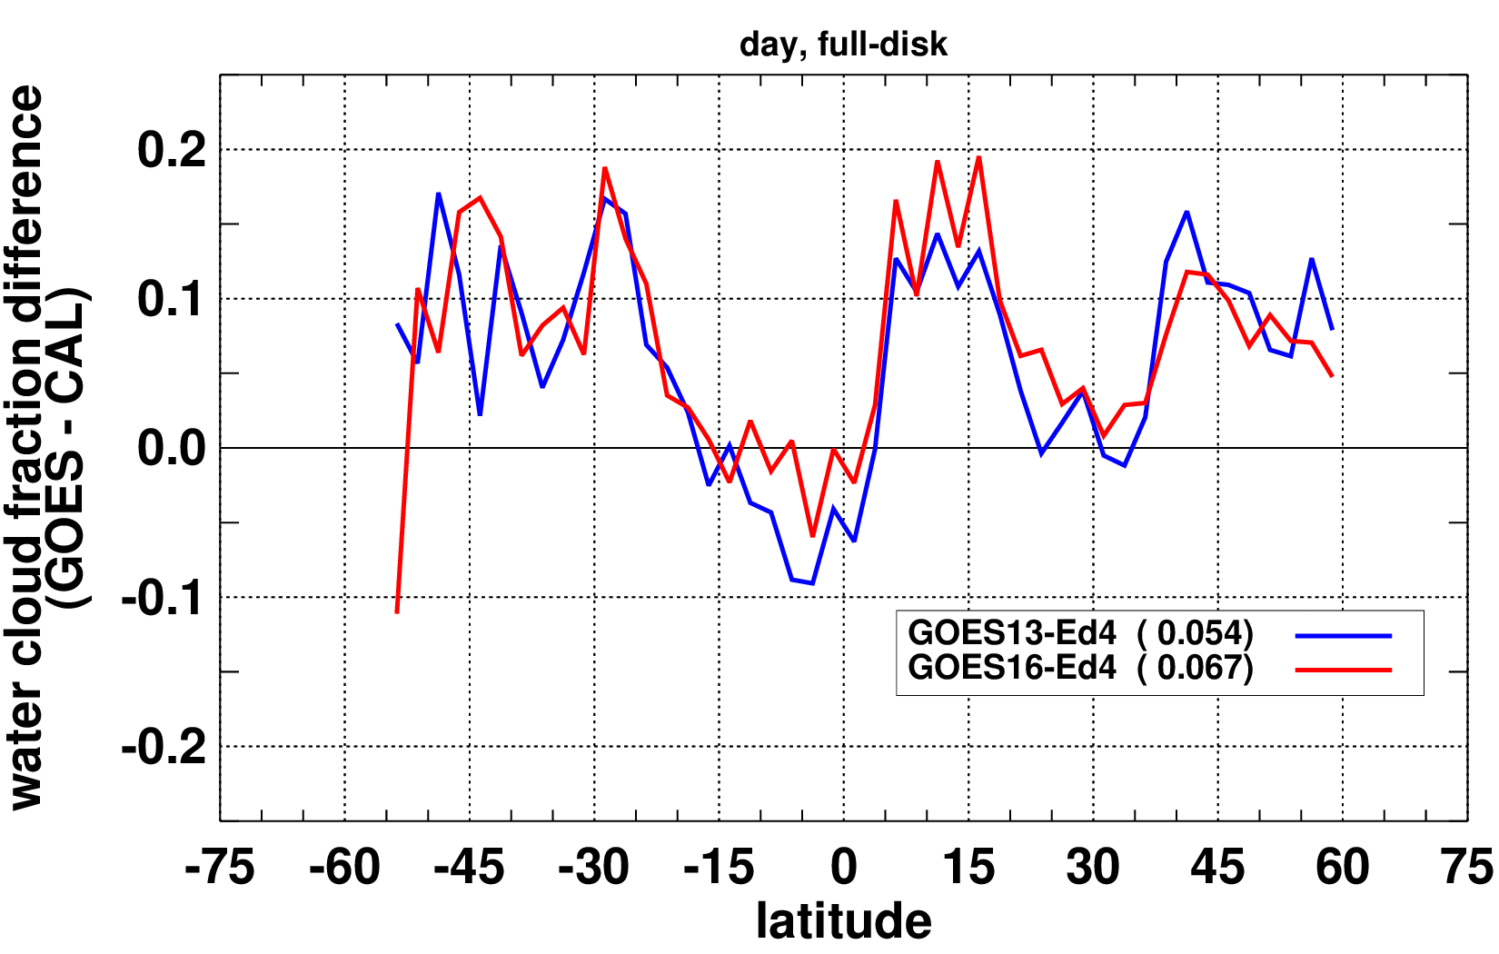
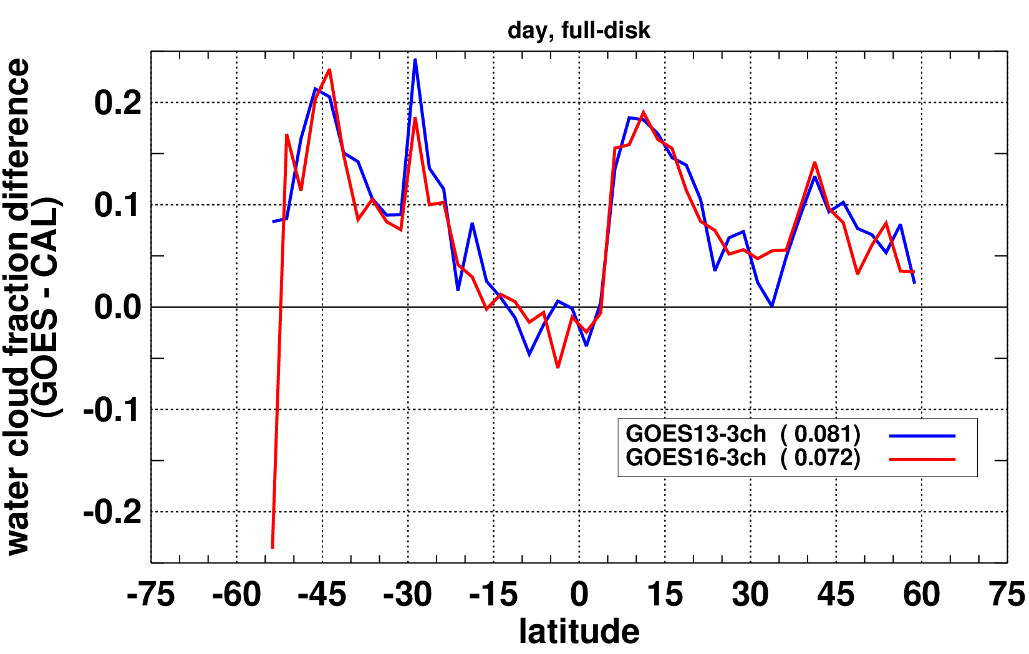
WATER CLOUD (day) FRACTION
Mean regional differences for Ed4 (-0.013; left) and 3-ch (+0.010; right)
Water cloud fraction from the 3ch algorithm shows some improvement in consistency among GOES-13 and GOES-16 but is somewhat less accurate than Ed4.

Slide 18
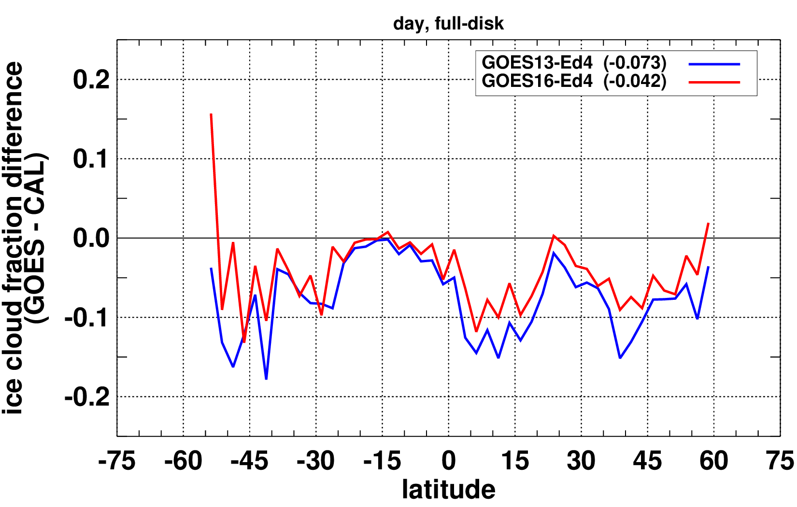
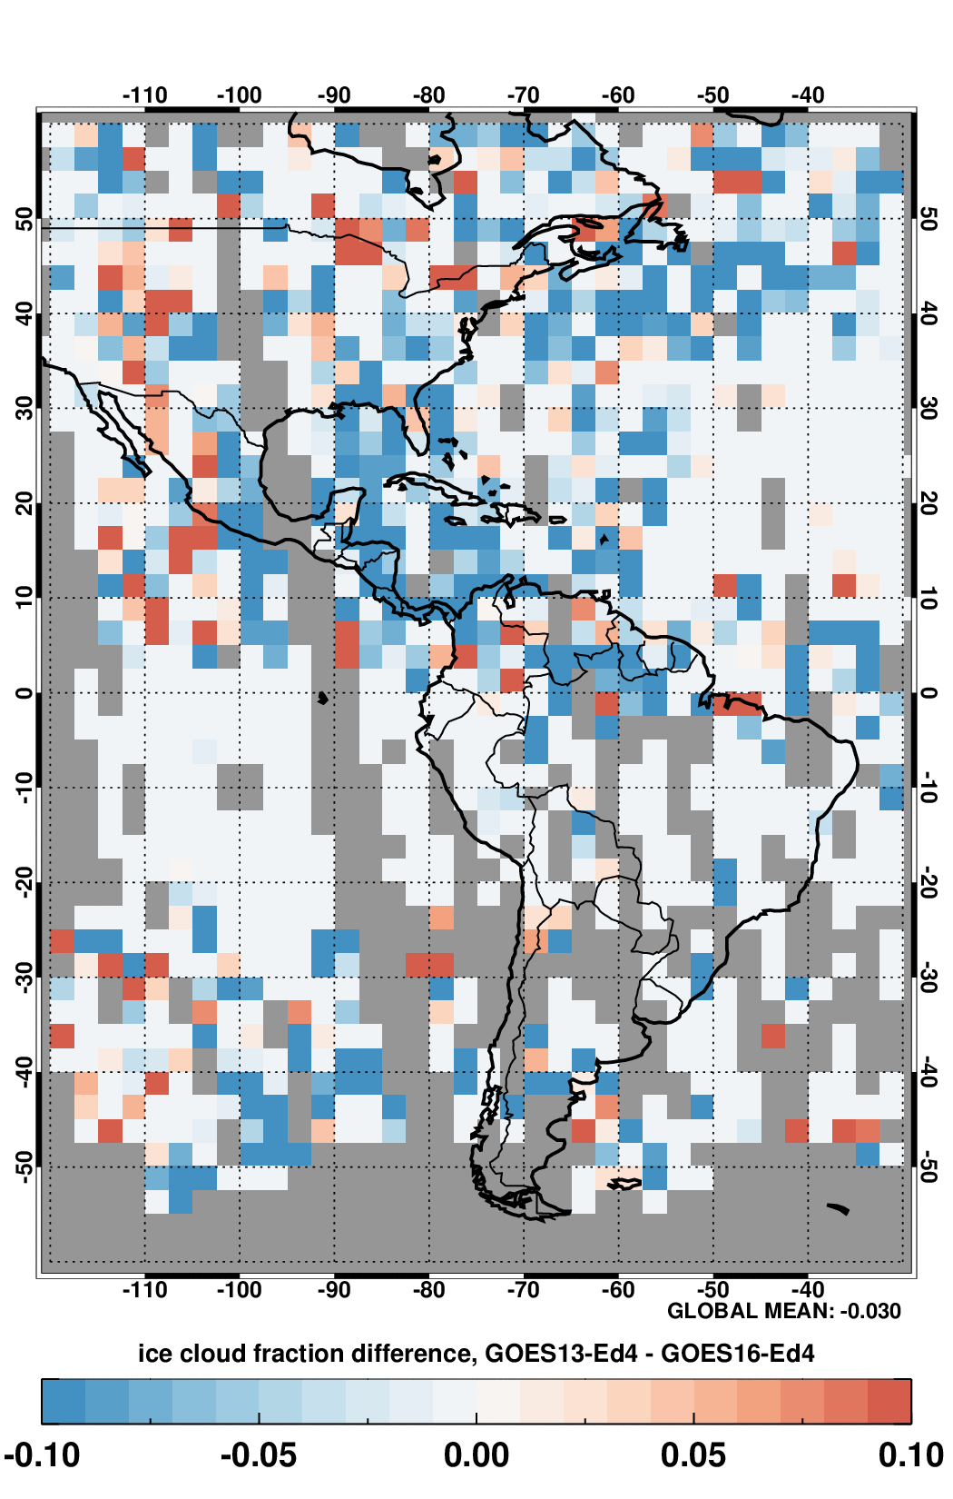
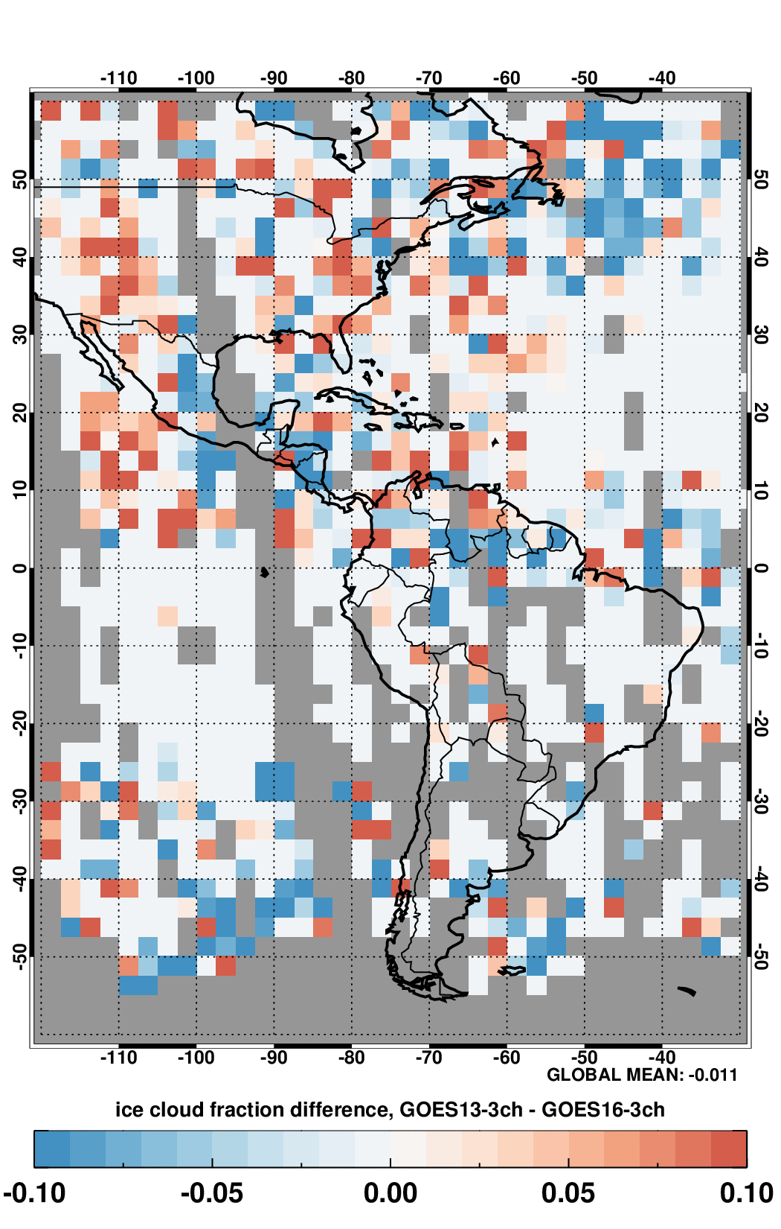
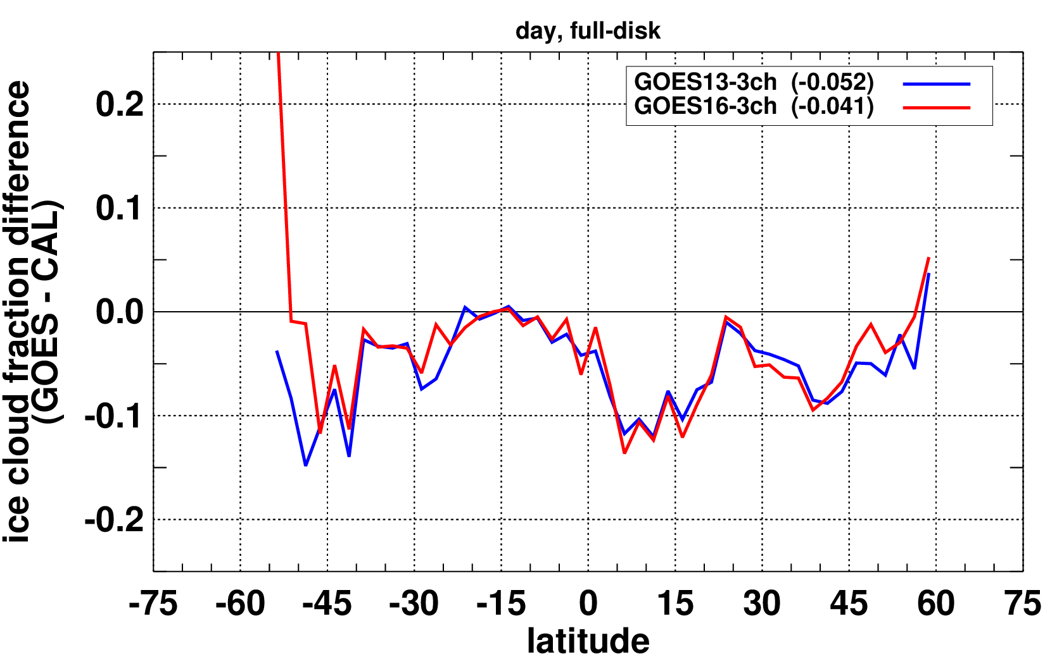
ICE CLOUD (day) FRACTION
Mean regional differences for Ed4 (-0.030; left) and 3-ch (-0.011; right)
Ice cloud fraction from the 3ch algorithm is also more consistent than from Ed4.

Slide 19
NIGHT-TIME CLOUD FRACTION ASSESMENT
For nighttime conditions when reflected solar bands are unavailable, the continuity retrieval algorithm is reduced to only two common spectral bands nominally located near 3.9 and 11 microns.
GOES13 – GOES16 regional cloud fraction differences
ZONAL MEAN DIFFERENCES WITH CALIOP
 | ED4 | 3CH
TOTAL CF | -0.039 | 0.040
WATER CF | 0.039 | 0.037
ICE CF | -0.074 | -0.001
 | ED4 |  | 3CH
 | G13 | G16 | G13 | G16
TOTAL CF | -0.025 | 0.014 | 0.050 | 0.010
WATER CF | 0.042 | 0.003 | 0.058 | 0.022
ICE CF | -0.065 | 0.009 | -0.014 | -0.012
GOES ice cloud fraction are much more consistent with the 3-channel algorithm than with Ed4 and compare well with CALIOP ice cloud fraction.
Water cloud fraction increased by roughly the same value for both GOES-13 and GOES-16 using the continuity algorithm, thus the overall differences amongst Ed4 and the continuity algorithm remained roughly the same.
During nighttime conditions, the continuity algorithm relies more heavily on the 3.9-micron channel. The differences in spectral characteristics (width and response) among GOES-13 and GOES-16 in the channel are non-negligible. Normalizing G13 to G16 is currently being investigated.

Slide 20
REGIONAL DIFFERENCES BETWEEN GOES-13 & GOES-16 CLOUD MICRO-PHYSICAL PROPERTIES
ED4
3CH

Slide 21
REGIONAL DIFFERENCES BETWEEN GOES-13 & GOES-16 CLOUD TOP
ED4
3CH

Slide 22
Improvements in the GEO climate data record

Slide 23
Summary & Concluding Remarks
The CERES data record spans over two decades and utilizes cloud property retrievals from multiple geostationary and polar-orbiting imagers with different characteristics and capabilities, e.g., different spatial resolution and different spectral channels.
A modified cloud property retrieval algorithm which relies only on spectral information common to all involved sensors is under development. The goal is to produce cloud property retrievals that are as spatiotemporally consistent as possible from sensor to sensor for the entire record to mitigate artifacts.
Daytime 3-channel cloud fraction estimates from GOES-13 and GOES-16 show greater consistency among the two sensors than was achieved with the Edition 4 retrieval algorithm although they are somewhat less accurate as demonstrated by CALIOP comparisons.
Except for ice cloud fraction, results from the nighttime continuity algorithm, a 2-channel algorithm, do not show as significant improvement in consistency as for daytime. This is likely due to increased reliance on the 3.9-micron band at night, which has notable different spectral characteristics from sensor to sensor. Normalizing to G16 3.9-micron band is currently being investigated.
The 3-channel algorithm yields improved consistencyfor cloud micro-physical properties between 2 generations of GOES-East.
Significant improvements were observed for liquid effective radius, water path, and ice height.

Slide 24
Future Work
Future work will involve application of the continuity algorithm to other geostationary sensors such as GOES-11, GOES-12, and the Meteosat and Himawari families of satellites.
Intercomparisons against MODIS & CALIOP is ongoing. Preliminary evidence does show improved consistency for effective radius.
A two-habit model for optical properties of ice clouds will be implemented.

Slide 25
THANK YOU !

