Slide 1
Role of NDE and In Situ Process Monitoring in Managing Risk of AM Space Hardware
Erin Lanigan
NASA Marshall Space Flight Center
Nondestructive Evaluation Team
ADAPT Fall 2022 Meeting
September 22, 2022

Slide 2
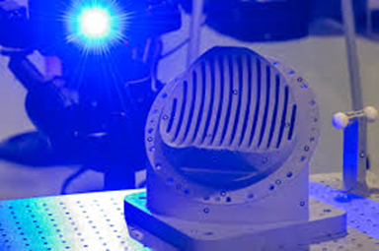
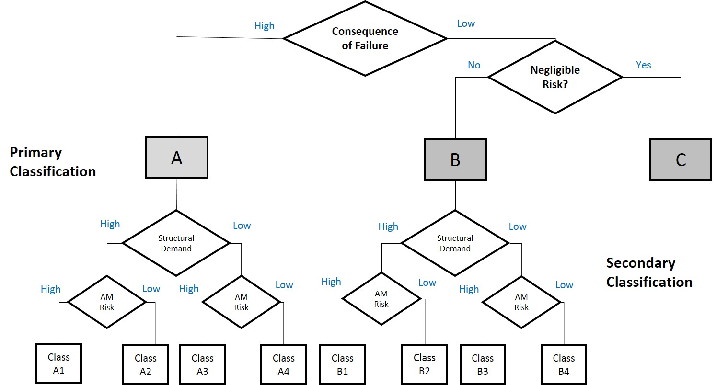
We will discuss NASA’s interest in qualifying in situ monitoring methods for certification of AM space hardware.
NASA’s involvement and approach
Qualification of
in situ monitoring
Certification framework

Slide 3
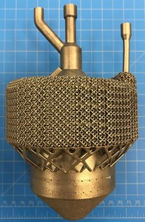
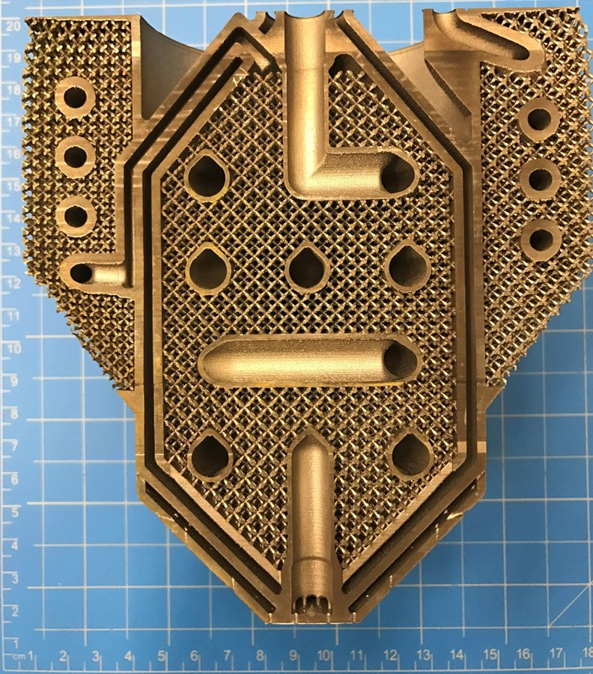
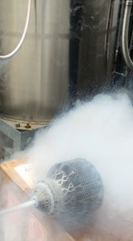
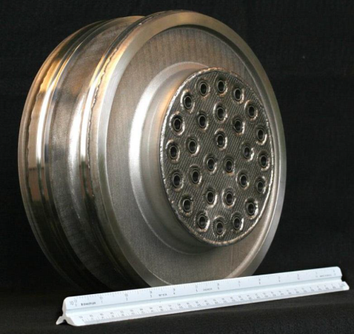
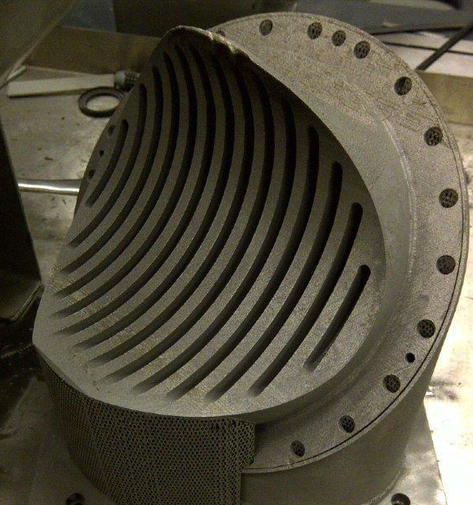
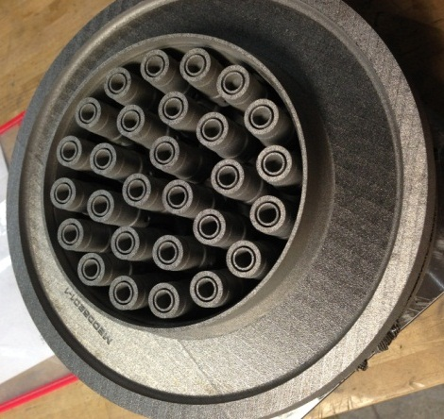
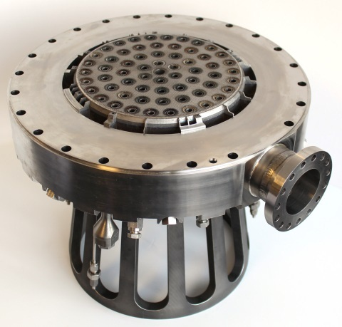
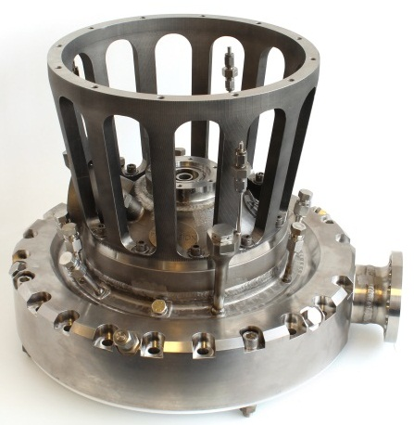
NASA is interested in qualifying in situ monitoring for complex, critical parts that are difficult to inspect using traditional NDE.
Cryogenic Heat Exchanger-Injector-Condenser Demo
28-Element Inconel® 625 Fuel Injector
Reduced 163 parts to 2
Schedule reduced from 1 year to 4 months
70% cost reduction
RS-25 Pogo Accumulator Z-Baffle
Over 100 Welds Eliminated
Nearly 35% Cost Reduction
Injector Assembly
MSFC Project with Army Air and Missile Defense (AMD)

Slide 4
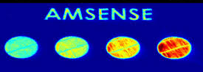
MSFC has investigated in situ process monitoring through various mechanisms.
ASTM Working Group WK73289
Small Business Innovation Research
“Standard Guide for In-Situ Monitoring of Metal Additive Manufactured Parts”
Monitoring Systems
ASTM AM Center of Excellence
EOS | Optical Tomography
& Meltpool Monitoring
ARCTOS | Thermal Tomography & High-Speed Spatter Imaging
Completed a landscape survey and workshop with road mapping session

Slide 5
There are many different in situ process monitoring technologies which observe different physical phenomena.
Electromagnetic Frequency Spectrum
Ultrasonic Frequency Spectrum
Monitor During Build Process
Inspection Between Build Layers
Passive
Infrared/near-IR
melt pool monitoring
Visual
Laser profilometry
(No external excitation)
Active
-
Laser ultrasonic
X-ray
(Added excitation)

Slide 6
There are also different additive manufacturing technologies that can be monitored.
Powder Bed Systems
Freeform Fabrication
Process:
Laser Powder Bed Fusion (L-PBF)
Electron Beam Melting (EBM)
Selective Laser Sintering (SLS)
Laser Directed Energy Deposition (DED)
Electron Beam Free Form Fabrication (EBF³)
Rapid Plasma Deposition
Additive Friction Stir Weld
Fused Filament Fabrication (FFF)
Feedstock:
Metals: Nickel alloys, copper alloys, titanium alloys, etc.
Polymers: nylon, polyamide
Metal powder/wire/chips
Filament: polymer, carbon fiber, biological, etc.

Slide 7
There are two main functions of in situ process monitoring:
Process Control Function
Part Quality Function
Real-time warning of build problems
Use to check for process drift
Monitor effects of parameter changes, spatter, etc.
Not counting on it for quantitative part quality metrics or defect detection
May help tell you where to look for a problem, but would require verification with NDE
Quantitative analysis of part quality
Requires a known correlation between indications, physics of the process, and actual defects in the finished part
Need to know probability of detection
Extra step – verify actual size, location of created defects
Need to treat it like NDE – believe and investigate every indication
Can’t dismiss anything as a false positive unless proven
vs.

Slide 8
When considering the use of in situ process monitoring for part qualification, there are a few aspects that challenge the current paradigm.
In-process vs. post-process NDE
Often, defect observations are indirect
Directly observing process variation, inferring final defect
Must understand physical basis for measured phenomena
Need to prove a causal correlation from measured indications to defect state
Probability of detection (POD) study must include secondary verification of created defects
Closed-loop process control
Current NASA qualification logic based on a locked process
For real-time parameter changes, a new approach is needed
no longer nondestructive

Slide 9
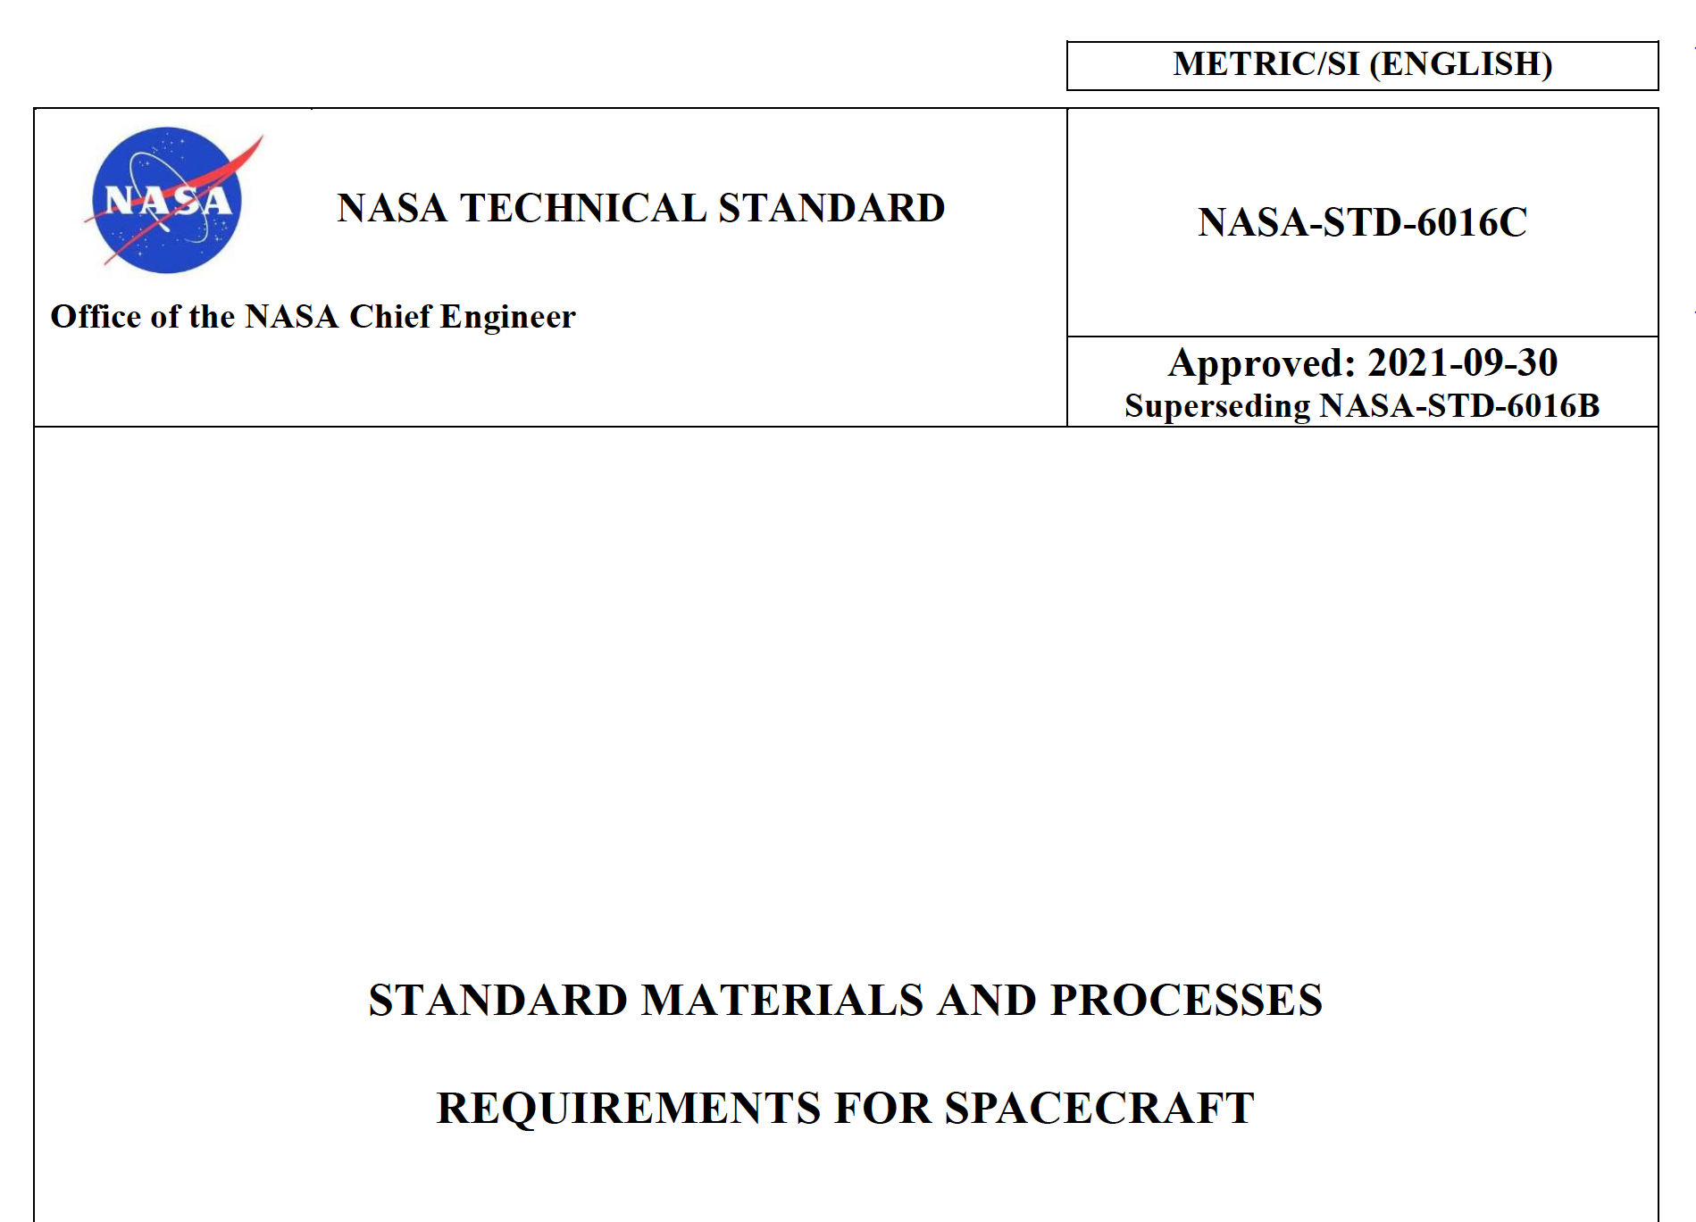
The current logic of additive manufactured part certification is outlined in NASA-STD-6016C, NASA-STD-6030, and NASA-STD-6033.
MSFC-STD-3716
MSFC-SPEC-3717
Standard for Additively Manufactured Spaceflight Hardware by Laser Powder Bed Fusion in Metals
Specification for Control and Qualification of Laser Powder Bed Fusion Metallurgical Processes
NASA-STD-6030
NASA-STD-6033
NASA Technical Standard
NASA Technical Standard
NASA-STD-6016C
Additive Manufacturing Requirements for Spaceflight Systems
Additive Manufacturing Requirements for Equipment and Facility Control
General M&P requirements
Handbook coming soon with more specifics on implementation.

Slide 10
Passive in situ process monitoring may be used as a quantitative indicator of part quality, if qualified.
Language:
“Prior to use as a quantitative indicator of part quality for part acceptance, passive in-situ process monitoring technologies shall be qualified by the CEO to the satisfaction of NASA in a manner analogous to other NDE techniques.”
Rationale:
“All processes that are used to establish quantifiable quality assurance metrics are qualified against established criteria to verify detection reliability, calibration, and implementation. If in-situ monitoring techniques are employed for such purposes, the need for such qualification is unchanged.”
(emphasis added)

Slide 11
Passive in situ process monitoring may NOT replace NDE.
Rationale (cont.):
“Certification of a passive in-situ monitoring technology relies upon a thorough understanding of the physical basis for the measured phenomena, a proven causal correlation of the measured phenomena to a well-defined defective process state, and a proven level of reliability for detection of the defective process state.”
“If qualified in the manner stated above, an in-situ process monitoring technique can be used to complement NDE in the Integrated Structural Integrity Rationale of the PPP. At this time, even a qualified in-situ process monitoring method cannot be considered a complete replacement for NDE.”
“Even if qualification is not desired, the use of in-situ process monitoring is encouraged as a source of process control data. This data can also be used to help guide targeted inspection.”
(emphasis added)

Slide 12
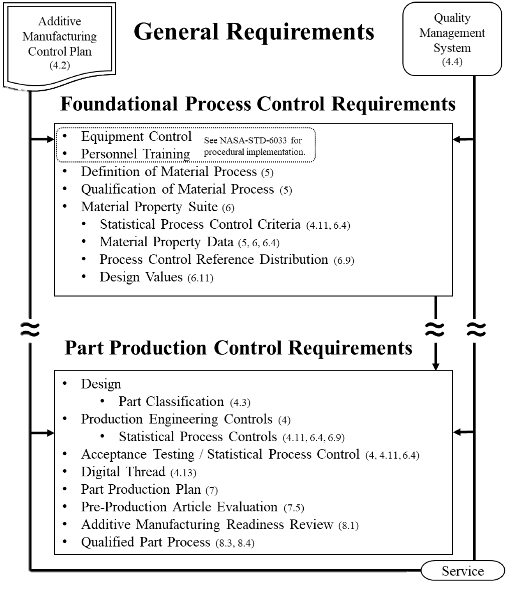
In situ monitoring can be used in several aspects of certification:
Qualification of Material Process (QMP)
Use with process development
Part Classification
Improve inspectability for better AM risk posture
Inspection process must be qualified by cognizant engineering org. (CEO)
Part Production Plan
Integrated Structural Integrity Rationale (ISIR):
Can be specified as a defect screening action
Must be qualified by CEO
Production Controls
Could develop certain metrics to track over time

Slide 13
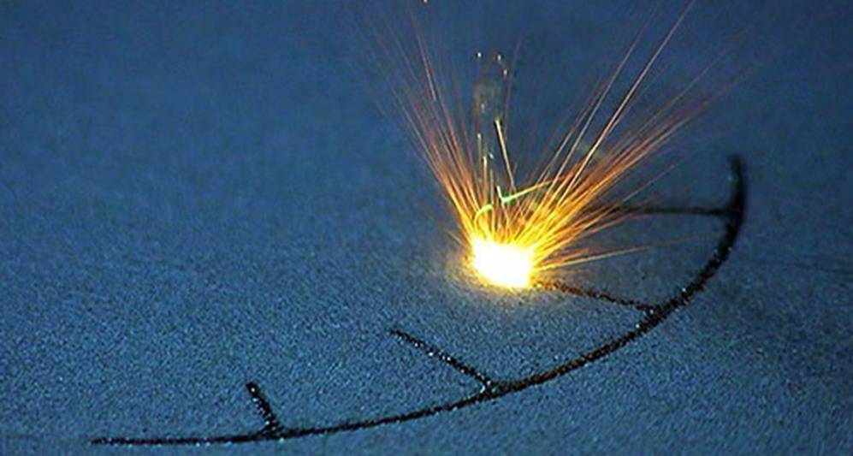
In summary, NASA wants to help enable the use of in situ monitoring in certification of AM space hardware.
Use for process monitoring is highly encouraged.
→ Will help inform, develop, and prepare for part quality function
To use for quantitative part quality function, monitoring system must be qualified.
→ Main challenge: developing correlation of indication to verified defect
Qualifying closed-loop, adaptive systems will require a new approach to the QMP.
NDE is still vital for verification of post-build quality.
Thank you for your time!
Questions?

