Slide 1
Case Study of Meteoroid Fluence on a
Mars Sample Return Mission
The Aerospace Corporation/
Astrodynamics Department
Alan B. Jenkin
Katie Steward
Glenn E. Peterson
NASA Ames Research Center
Jacob T. Needels, Peter J, Gage (Neerim Corporation)
Ken Gee, Ashley M. Coates, Todd R. White (NASA ARC)
NESC
Mike Squire

Slide 2
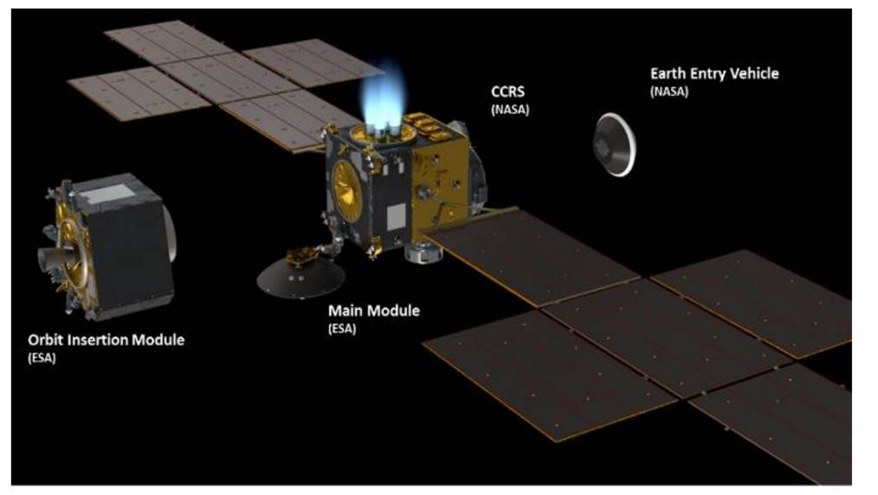
Introduction
The Mars Sample Return (MSR) Campaign must satisfy a Back Planetary Protection requirement that limits the risk of biological contamination of the Earth by Martian microbes
The Earth Return Orbiter (ERO), being developed by the European Space Agency (ESA), will carry the Capture, Containment, and Return System (CCRS)
CCRS is being developed by NASA to
  Retrieve the Orbiting Sample (OS) while in Mars orbit
  Surround the OS with two containment layers to create the Contained OS (COS)
  Transfer the COS to the Earth Entry System (EES), which will be released by the ERO to carry the samples through entry, descent, and landing at the Utah Test and Training Range
Micrometeoroid (MM) impact damage to the EES Thermal Protection System (TPS) could result in the break-up of the EES and a loss of sample containment during Earth entry
  MM damage is possible at any time during the ERO mission
  The Micrometeoroid Protection System (MMPS) will be implemented to protect the EES and limit the MM damage risk
Earth Return Orbiter (ERO)

Slide 3
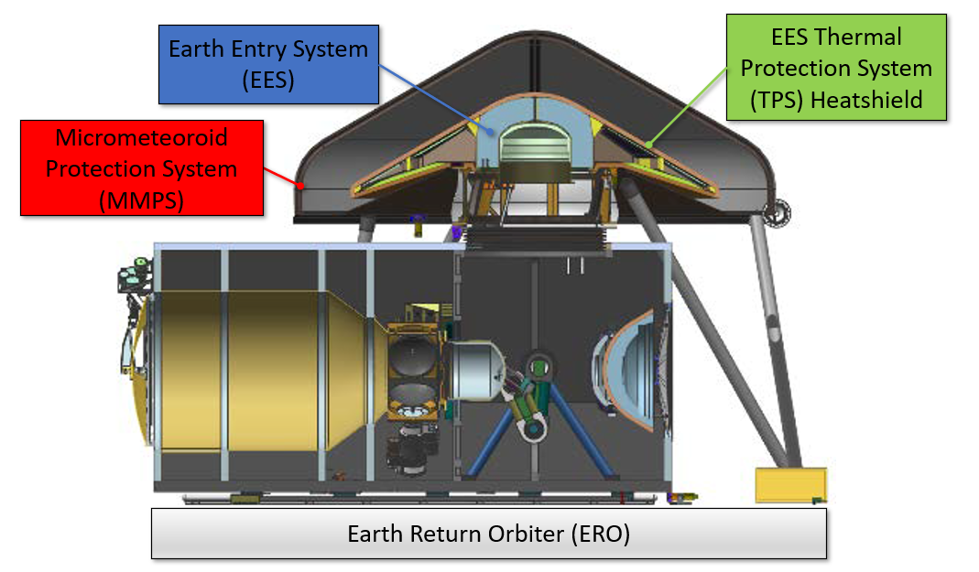
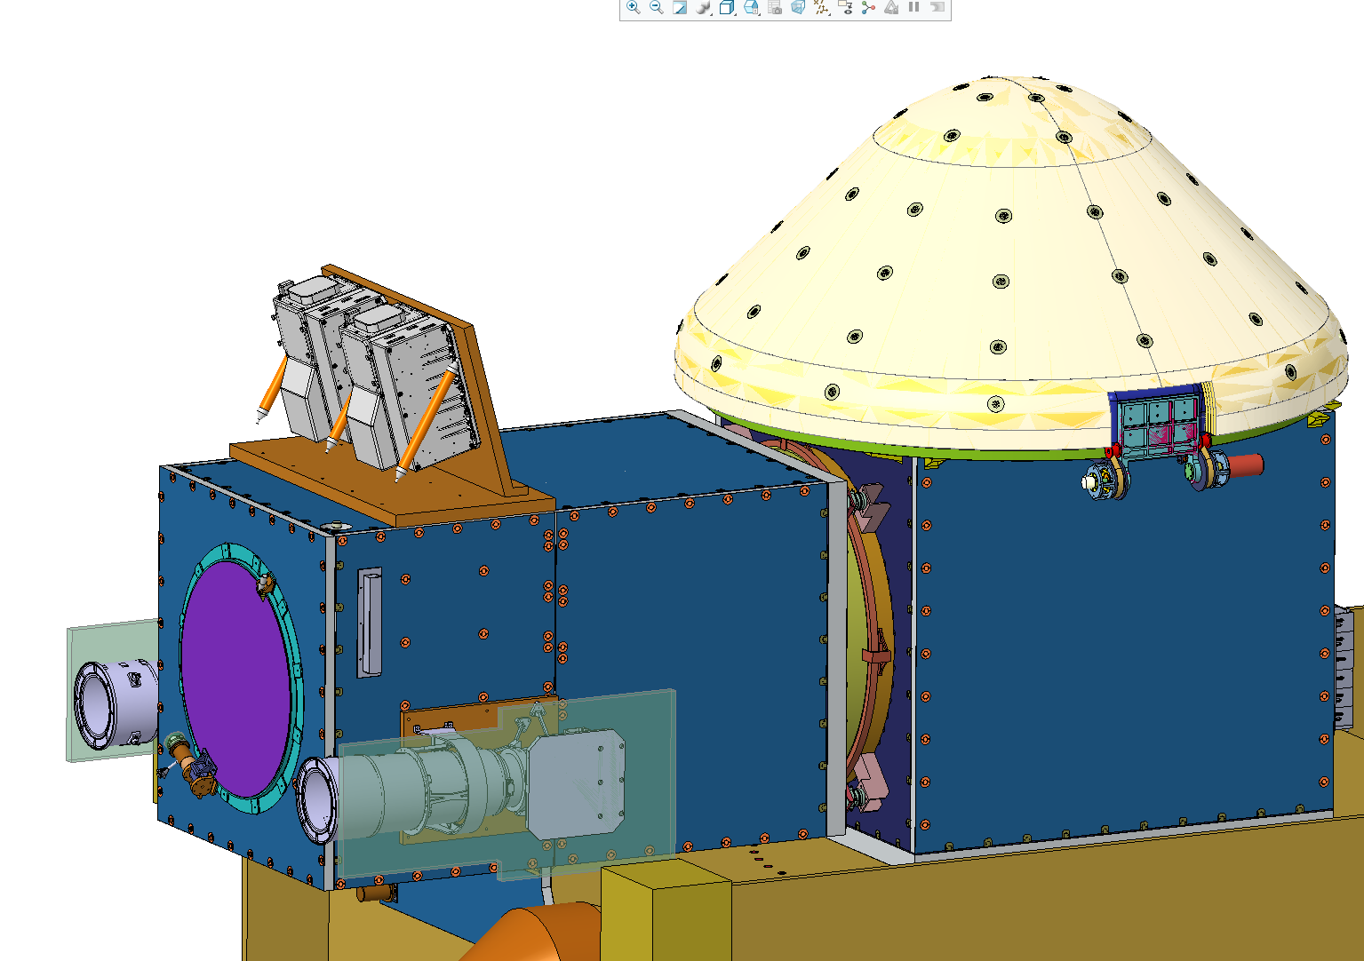
Illustration of CCRS
The MMPS is a shield covering the EES TPS to protect it from meteoroid impacts
Figure shows an illustration of the CCRS, including MMPS and TPS
MMPS
CCRS

Slide 4
CCRS and NESC Meteoroid Risk Assessment
The CCRS Project performed an extensive study in collaboration with the NASA Engineering and Safety Center (NESC) to assess the probability of damage to the MMPS and TPS by meteoroids over the entire ERO mission, including
  Computation of the meteoroid fluence on the MMPS and directly on the TPS after EES separation from the ERO
  Assessment of damage to the MMPS and TPS via hypervelocity impact tests, hydrocode simulations, and empirical damage prediction and ballistic limit equations (BLEs)
  Assessment of different MMPS options to optimize MM protection within the boundaries of the overall MSR/CCRS design
The focus of this paper is the assessment of meteoroid fluence on the MMPS over the Outbound trajectory and how it can be used to establish scenarios for hydrocode simulation and assess damage risk

Slide 5
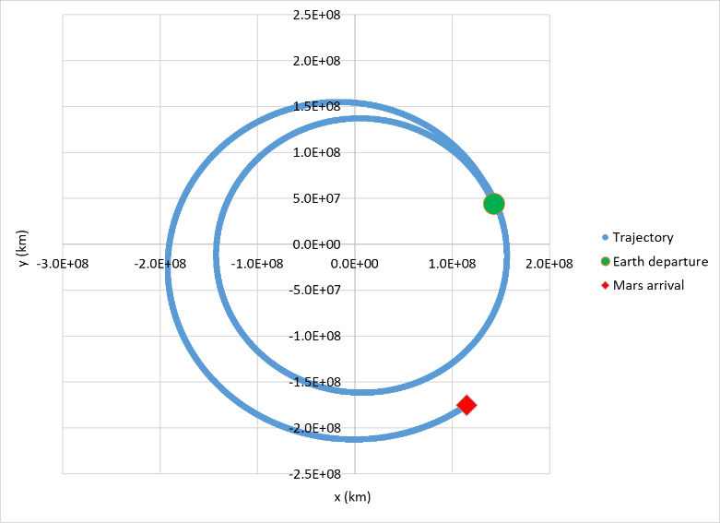

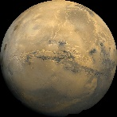
Mission Phases
The ERO mission consists of several trajectory phases
    Change of heliocentric orbital elements for these phases is accomplished via continuous low-thrust electric propulsion (EP)
The major mission phases (shown below) are : Outbound (Earth to Mars), Spiral Down at Mars, Low Mars Orbit (where the OS is retrieved), Spiral Up, and Inbound (Mars to Earth)
Results presented in this paper are for the Outbound phase trajectory
    However, the same assessments for other trajectory phases of the mission are being performed
Outbound trajectory
Outbound phase trajectory
Launch
Mars Orbit Insertion
Earth Interface Point
Pre-Launch | Earth to Mars | Spiral Down | Low Mars Orbit (Relay) | RDV and Contain | Spiral Up | Mars to Earth

Slide 6
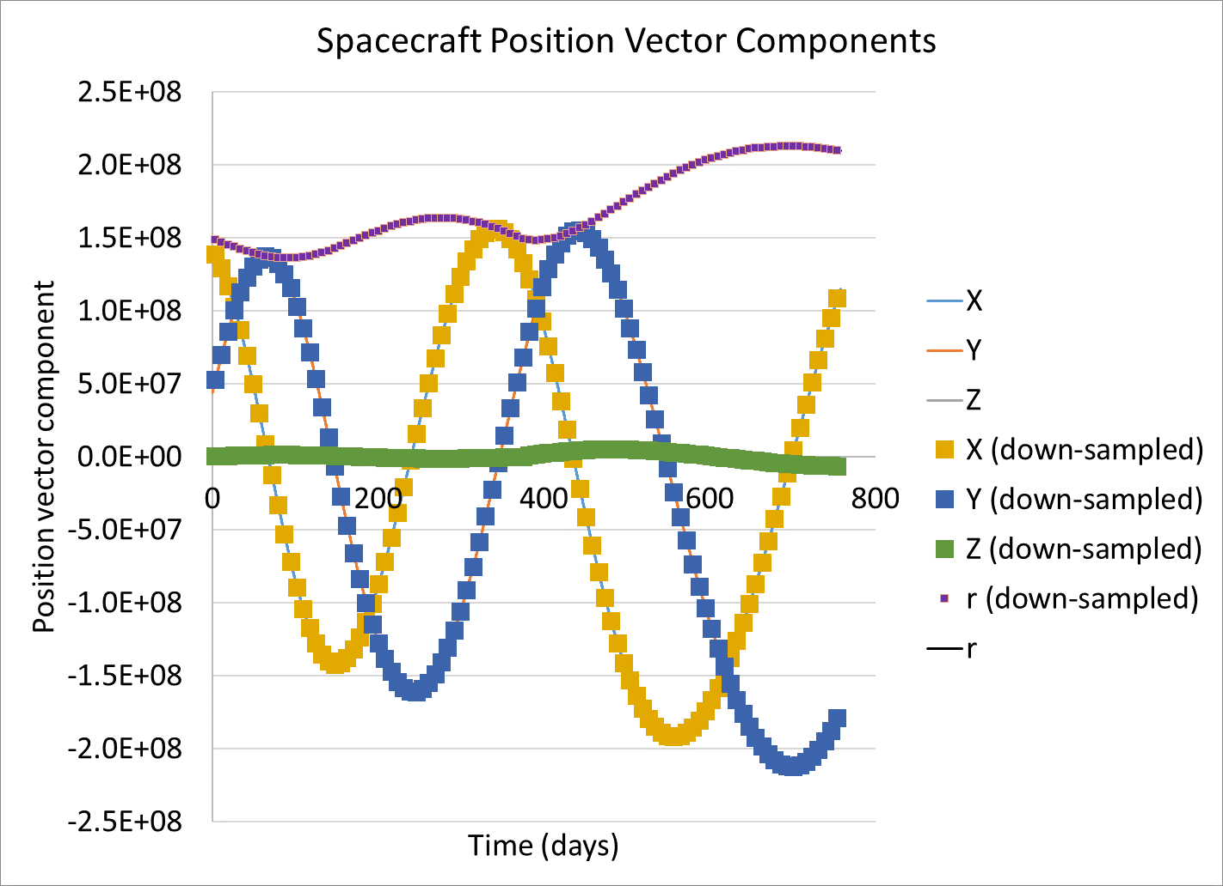
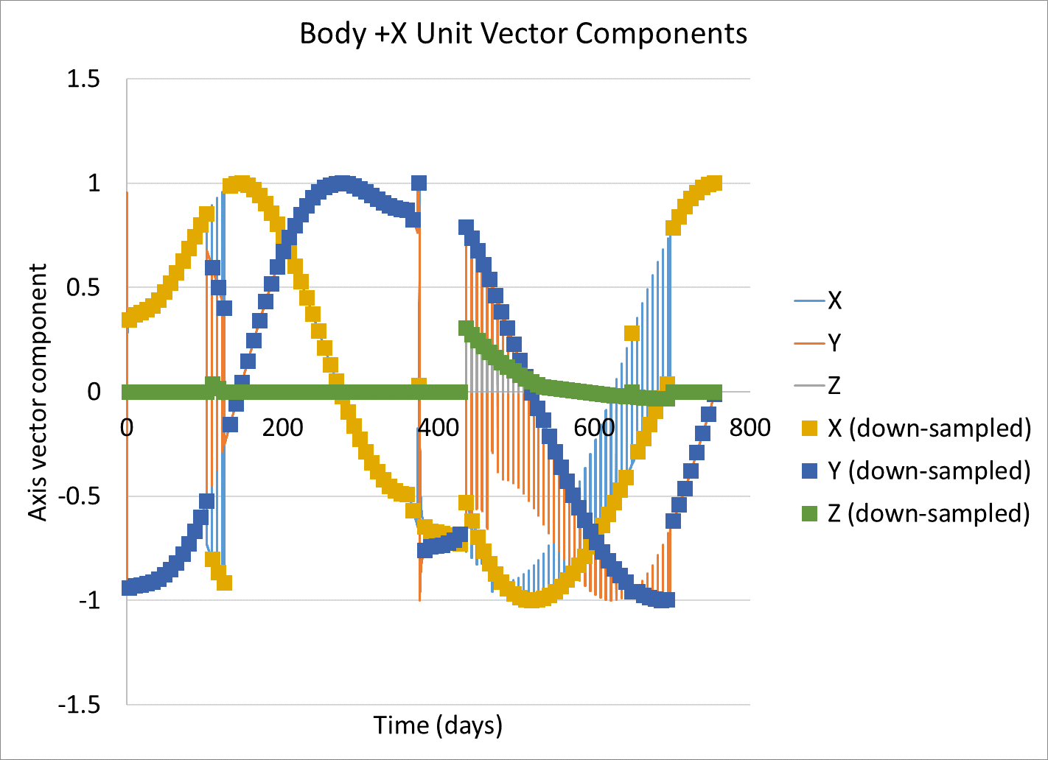
Analysis of Meteoroid Impingement Fluence over Trajectory
MODRA (Meteoroid and Orbital Debris Risk Assessment) is a probabilistic risk assessment tool for examining the risk of damage to spacecraft components by meteoroids and orbital debris
A typical analysis begins by creating a model of the MMOD environment including flux, impact velocities, and impact directionality, in this case from NASA Meteoroid Engineering Model ver. 3 (MEM3)
The ERO Outbound trajectory was down-sampled to 100 points, each representing a single segment of the trajectory
MEM3 was evaluated at the down-sampled points, producing files of impinging flux vs. relative velocity, azimuth, and elevation in the MEM3 body-fixed frame at each point
MODRA uses the ERO spacecraft attitude and MEM3 flux files at each trajectory point to compute cumulative impinging fluence (integrated flux) on the MMPS over each segment represented by each point
MMPS
Spacecraft bus x

Slide 7
MEM3 Modeled Sources
North toroidal radiant
North apex radiant
Population sources in MEM3:
  The six sources are: helion & anti-helion, north and south apex, north and south toroidal
  Model includes meteoroid impact directionality based on data from Canadian Meteor Orbit Radar survey
MEM3 produces two meteoroid populations: low density and high density
  Each has its own velocity, direction, and density distributions
  Low-density population is representative of meteoroids with a high content of ice (~1 gm/cm³)
    Associated with the toroidal and apex sources
    Typical velocities range from 5 to 70 km/sec
  High-density population is representative of stony chondritic meteoroids (~3-4 g/cm³)
    Associated with the helion and anti-helion sources
    Typical velocities are more tightly constrained than the low-density population at ~10-40 km/sec
Important point: the relative attitude of the vehicle with respect to these sources will influence the fluence on the MMPS
Velocity about Sun
MMPS
South apex radiant
Sun
South toroidal radiant
Anti-helion radiant
Velocity about Sun
MMPS
Helion radiant
Low-density radiant
Sun
High-density radiant

Slide 8
MODRA Algorithm
loop: Surface Elements and Attitudes
Convert surface unit vector from the spacecraft rotated frame into the environment model flux frame
loop: Particle Flux Component (Impact Velocity and Direction)
loop: Particle Mass
Store:
$Impinging Flux=\left(\begin{aligned}Cumulative \\ Flux\end{aligned}\right)\left(\begin{aligned}Surface \\ Element \\ Area\end{aligned}\right)\left(P\left(\begin{aligned}Flux \\ Component\end{aligned}\right)\right)\left(P\left(\begin{aligned}Rotation \\ Attitude\end{aligned}\right)\right)$
Gruen Meteoroid flux vs. mass model scaled to match the MEM3 population flux at 10⁻⁶ g
Sum impinging flux from each loop to yield total damage flux
Compute impinging fluence from total impinging flux and mission duration

Slide 9
MMPS FEM Model for MODRA
Spacecraft bus x
Section 7: 4 elements
Conical portion: Sections 2-7
Section 6: 8 elements
Section 5: 12 elements
Section 4: 12 elements
Section 3: 12 elements
Section 2: 36 elements
Section 1: 36 elements
Cylindrical portion: Section 1
Spacecraft bus z
Angle of rotation about x-axis θ
Spacecraft bus y

Slide 10
ERO Outbound BCC Cube Flux Results
Initial analysis on simple cube using ERO outbound trajectory using MEM3 software
Flux on cube faces determined with ram (+x) direction aligned along velocity vector
Ram, port, and starboard direction exhibit highest fluxes
Wake (-x) exhibits significantly lower average flux
  Preliminary indication is that alignment of CCRS in wake vs ram direction would result in decrease in risk

Slide 11
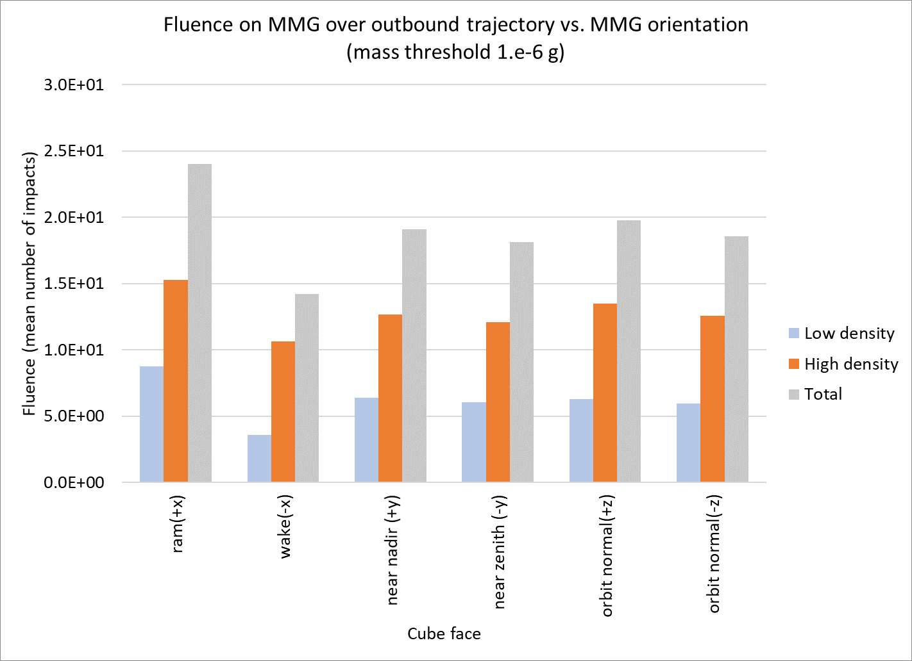
MODRA Assessment of Outbound Fluence on MMPS
To obtain a higher fidelity assessment of orientation effects, a study was conducted using the Aerospace Corporation MODRA code for the outbound trajectory
The CCRS was oriented in each of the six directions in MEM3 body-centered coordinates, and the overall fluence on the MMPS
  There is a reduction in the benefit of orientation relative to cube results, since even when the CCRS is oriented in the wake direction, it still is impacted by flux from the other directions
  Despite this, the MODRA results indicate that a ~40% reduction in fluence could be obtained by switching ERO attitude such that CCRS is oriented in the anti-velocity direction for the entirety of the cruise
  Propulsion and communication pointing requirements reduce this possible benefit by restricting the attitude profile, but this estimate serves as an upper bound to the feasible benefit obtained in shifting vehicle orientation throughout the mission

Slide 12
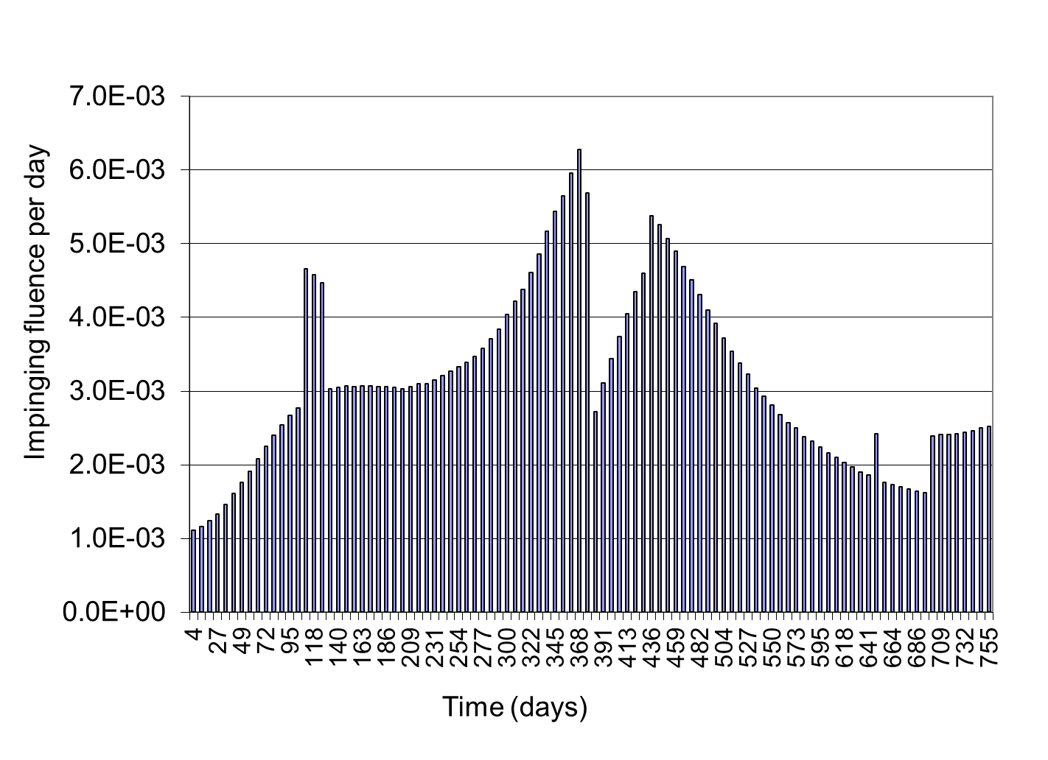
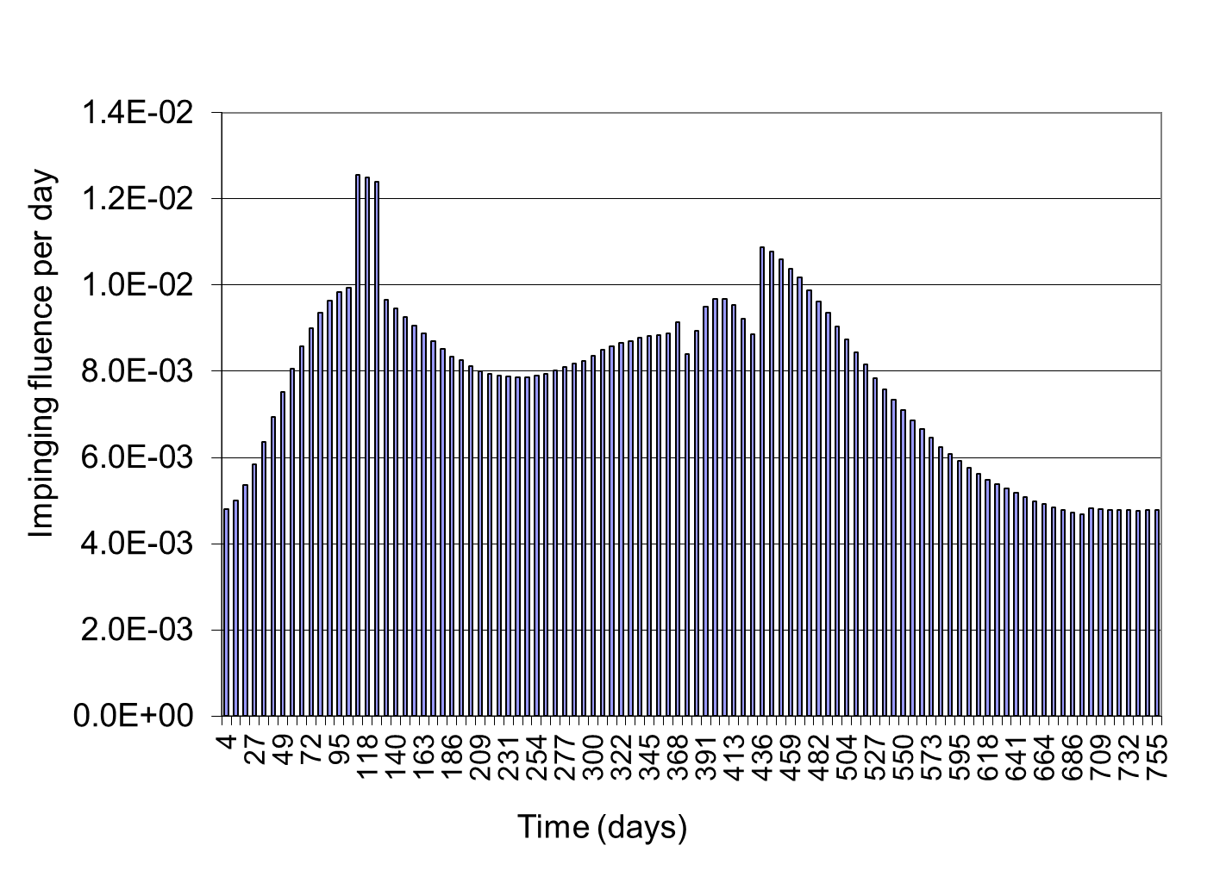
Variation of Impinging Meteoroid Fluence over Trajectory
Outbound trajectory, conical section
Plots show impinging fluence on conical portion of MMPS section per day
Variation with time follows the changes in the attitude profile
  For example, there are sudden changes in impinging fluence per day when the spacecraft is reoriented to or from the attitude required for EP thrusting
Low density
High density
Fluence is for MM mass >= 10⁻⁶ g

Slide 13
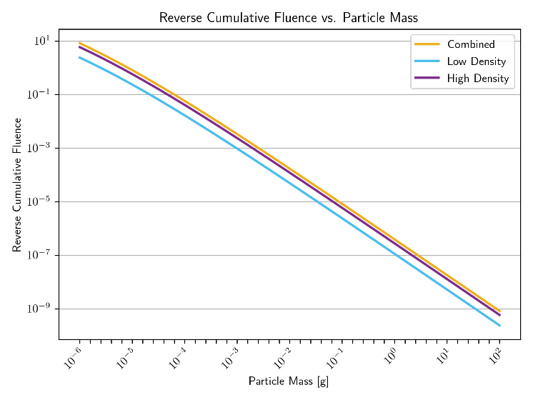
Impinging Cumulative Meteoroid Fluence vs. Impactor Mass
Outbound trajectory, conical section
Plot shows impinging fluence on conical portion of MMPS over the Outbound trajectory vs. meteoroid mass for the MEM3 low-density and high-density populations
  Reverse cumulative curves, i.e., the fluence at a given mass includes all meteoroids at that mass and larger over the Outbound trajectory
Curve is used with critical damaging mass from hydrocodes to determine damaging fluence

Slide 14
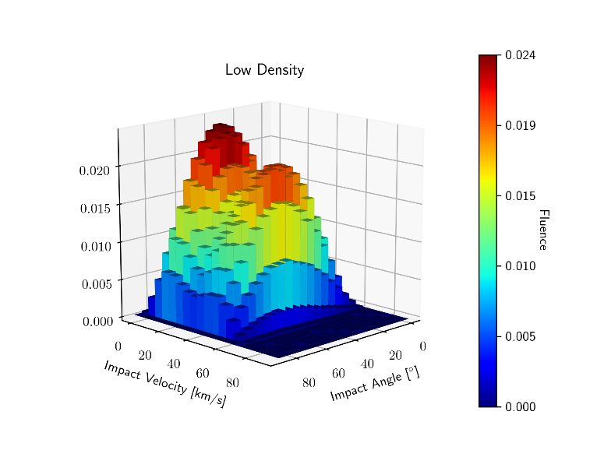
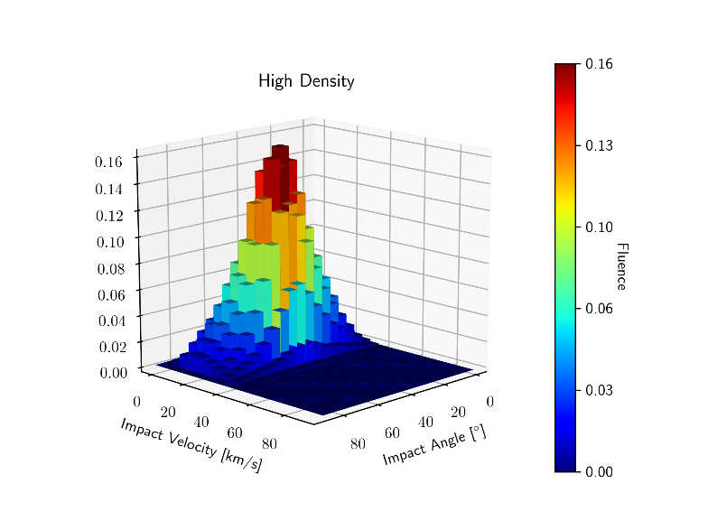
Impinging Meteoroid Fluence vs. Impact Velocity and Angle
Outbound trajectory, conical section
Plots show histograms of cumulative fluence on the conical section of the MMPS over the Outbound trajectory vs. meteoroid impact velocity and angle for the MEM3 low-density and high-density populations
Fluence is for MM mass >= 10⁻⁶ g
Broad velocity distribution from 5 to 65 km/s
Impact angle mode at ~40 deg
Impact velocity mode at ~20 km/s
Impact angle mode at ~40 deg

Slide 15
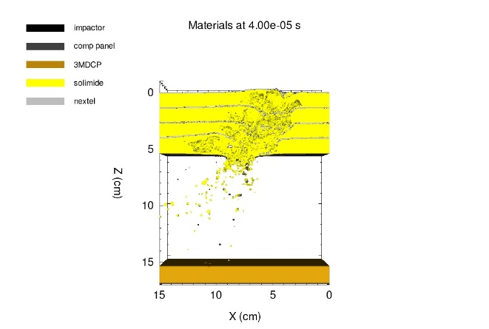
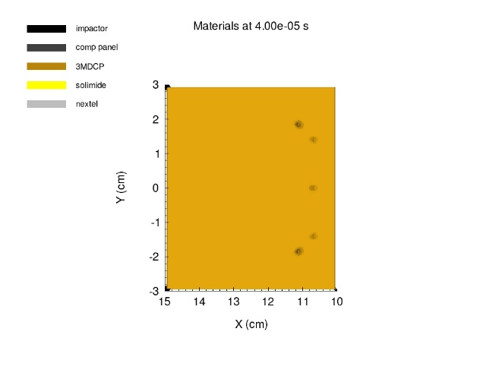
Hydrocode Simulation in Support Risk Assessment
Hydrocodes are computational models that can be used to assess material response to hypervelocity impacts
  Hydrocodes can be used to inform the impactor characteristics for which critical damage occurs, to support BUMPER/MODRA risk assessment
  Information about meteoroid fluence can be used to inform hydrocode to assess the impactors that are most likely to cause damage to the TPS
Solutions using CTH¹, an Eulerian hydrocode developed at Sandia National Laboratories, were used to determine the critical impactor that would penetrate a candidate shield design, consisting of four layers of Nextel/Solimide on top of a carbon fiber composite structural panel
  The figures show the impact through the shield cross-section (left) and the resulting craters on the TPS (right)
  In this case, the crater depths in the TPS were approximately 10% of the total TPS thickness
Impactor Parameters
Material | Dunite
Energy | 3,000 J
Mass | 0.015 g
Velocity | 20 km/s
Impact Angle | 40 deg
1. McGlaun, J. M., Thompson, S. L., Elrick, M. G., and Kaman Sciences Corp., Albuquerque, NM. 1989. "CTH: A three-dimensional shock wave physics code". United States. https://doi.org/10.1016/0734-743X(90)90071-3. https://www.osti.gov/servlets/purl/5359688.

Slide 16
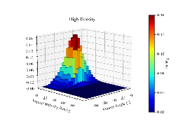
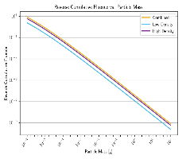

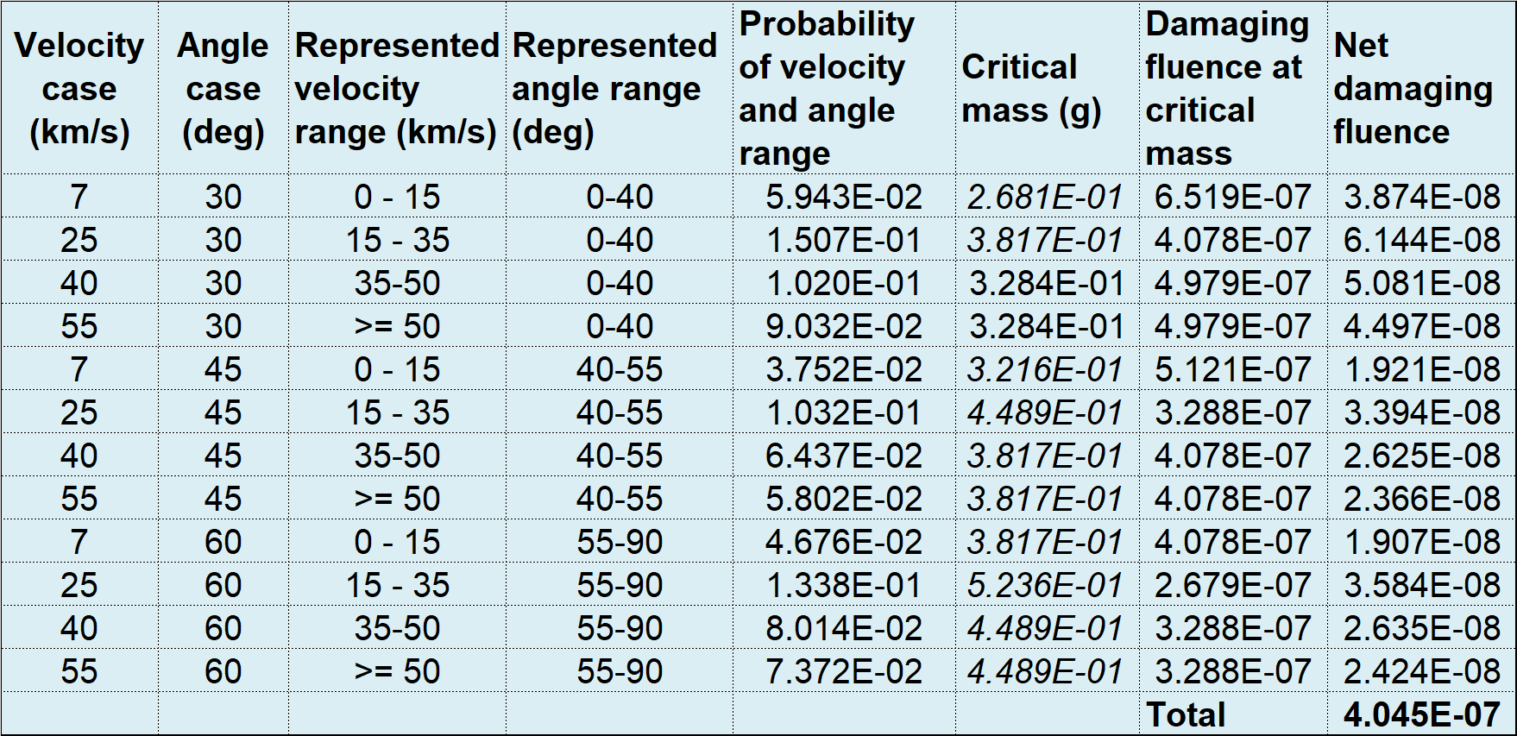
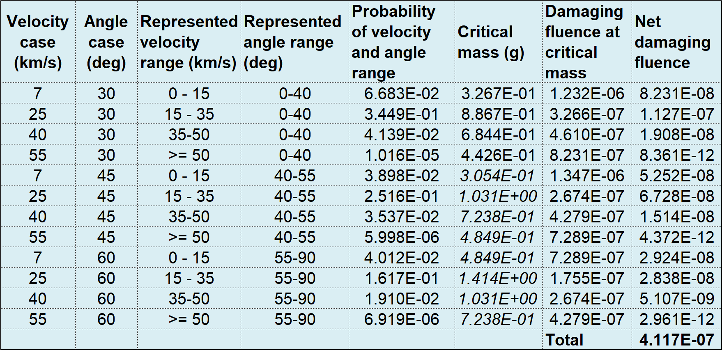
Hydrocode Cases and Corresponding MODRA Damage Fluences
Outbound trajectory, conical section
For the low-density population, the cases at angle 30 deg and velocities 40 and 55 km/s have critical masses for 12 mm TPS penetration from SPHC hydrocode runs for the NESC support to CCRS
For the high-density population, the cases at angle 30 deg and all velocities have critical masses from SPHC hydrocode runs
The other cases have hypothetical critical masses (shown in italics) selected by the Aerospace authors to illustrate the methodology
Critical mass for TPS damage from hydrocode analysis
Low density
High density

Slide 17
Conclusions
Presented results of an analysis of fluence of meteoroids impinging on the MMPS covering the TPS of the CCRS EES
  Used the MEM3 meteoroid environment model flux distributions
Results show the reduction in fluence on cube faces and on the MMPS that can be achieved by selection of an anti-velocity orientation of the MMPS
  Due to directionality of the MEM3 meteoroid environment model
Presented distributions of impinging fluence on the MMPS over velocity, direction, and mass
  Accounted for the spacecraft attitude profile over the trajectory using the MODRA code
A methodology was developed to estimate damaging fluence on the TPS from impinging fluence distributions and hydrocode results
  Presented example tables with impact velocity-angle scenarios, critical masses for TPS penetration from hydrocode analysis, resulting net damaging fluence to the TPS for each scenario from impinging fluence distributions, and the total net damaging fluence across the scenarios

Slide 18
Appendix

Slide 19
Spacecraft Trajectory
Outbound (Earth to Mars)
Left plot shows the spacecraft position in the x-y plane of the Sun-centered inertial frame (start date October 11, 2027, duration 758 days)
Right plot shows position vector components and radial distance from Sun
For this analysis, trajectory is down-sampled to 100 points to facilitate matching MEM3 outputs and spacecraft attitude

Slide 20
Spacecraft Attitude
Outbound (Earth to Mars)
Plot shows components of the spacecraft body +x vector in the Sun-centered inertial frame
  Smooth lines are from the original provided trajectories (18193 points)
  Squares are the down-sampled points (100) used in the analysis
During portions of the trajectory where EP thrusting is occurring, the spacecraft undergoes periodic brief attitude reorientations to support spacecraft maintenance activities

Slide 21
Observations from Velocity and Angle Distribution
Outbound trajectory, conical section
For the MEM3 low-density population, there is a broad velocity distribution from 5 to 65 km/s
For the MEM3 high-density population, there is a clear mode in the velocity distribution at approximately 20 km/s
For both populations, the angle distribution is broad from 0 to 80 degrees, with a mode at approximately 40 degrees
  The broadness of the angle distribution is due to the changing attitude of the spacecraft and the shape of the MMPS, both of which spread out the meteoroid flux directionality relative to the surface of the MMPS
These distributions can be used to establish a recommended set of hydrocode simulation scenarios and compute net damage fluence

Slide 22
Combining with Hydrocode Results to Estimate Damaging Fluence
Tables on previous slide in this presentation show an example set of velocity and angle scenarios for the MEM3 low and high-density populations and the Outbound trajectory
For each velocity-angle scenario, the tables show
  Represented impact velocity and angle range
  The assigned probability computed from the normalized histogram of fluence vs. impact velocity and angle
  The critical mass for TPS penetration determined from SPHC hydrocode runs for a sample MMPS design
  The damaging fluence on the conical section of the MMPS determined from the cumulative fluence vs. mass distribution
  Net damaging fluence for the velocity-angle case ( = damaging fluence x probability of velocity/impact scenario)
  Total net damaging fluence (summed across all velocity-angle scenarios)

