Slide 1
Refractory Alloy Additive Manufacture Build Optimization (RAAMBO)
JANNAF Additive Manufacturing for Propulsion Applications TIM
28 September 2022
Omar Mireles, Principal Investigator / MSFC Lead
Justin Haskins, ARC Lead
Justin Milner, GRC Lead
John Fikes, Project Manager

Slide 2
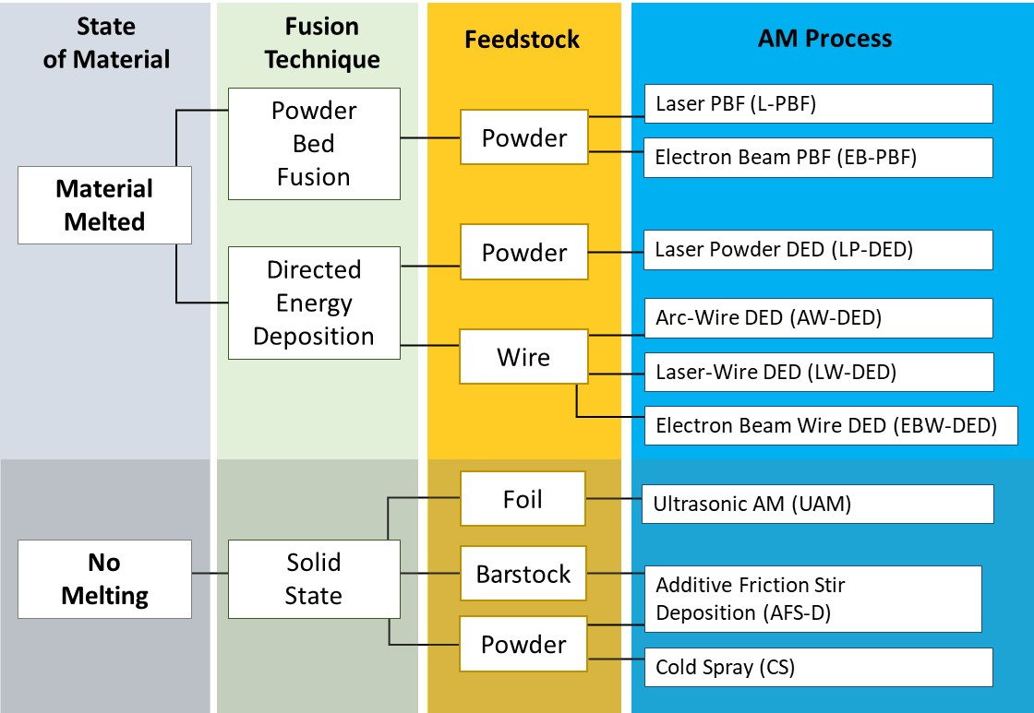
Background: Additive Manufacture (AM) Process Options
Appropriate Application
  High complexity & difficult to manufacture
  Low production rate
  Long lead time & high cost
Advantages
  Increased design flexibility
  Near net-shape complex geometry
  Part count reduction
  Performance improvement (e.g. weight reduction)
  Rapid design-fail-fix cycles
  One-off and discontinued parts
  Reduced scrap (lower buy-to-fly ratio)
  Reduced lead time and cost

Slide 3
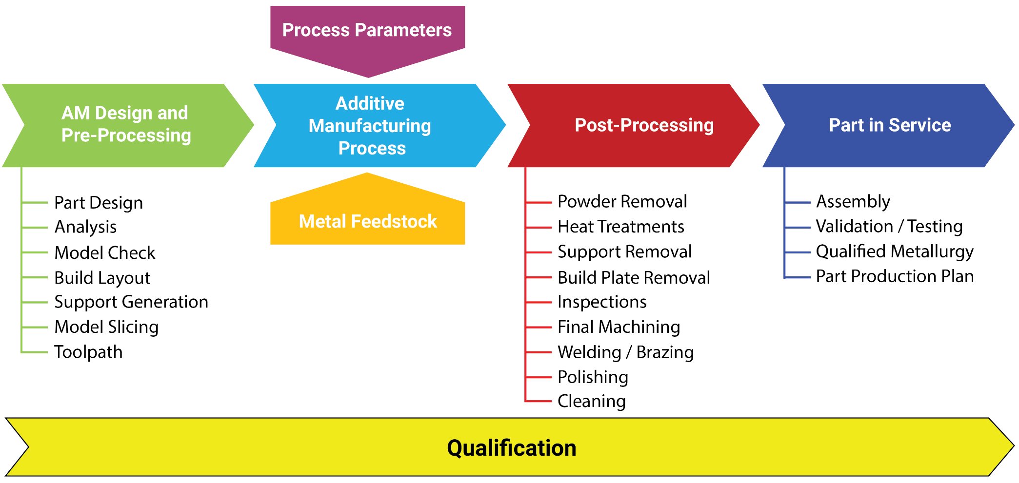
Background: AM Process
Coatings
Material Design
High Temp Properties
Iterative AM Lifecycle. Courtesy Gradl, et al., 2021.

Slide 4
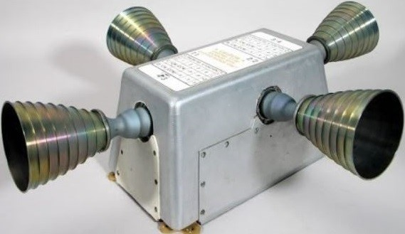
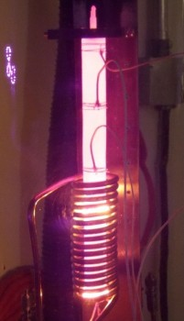
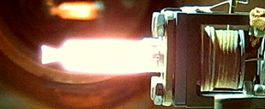
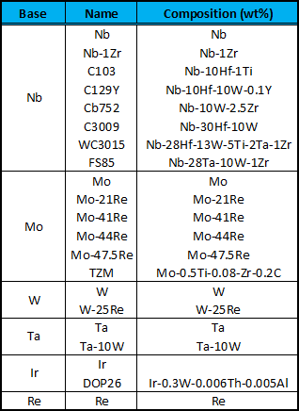
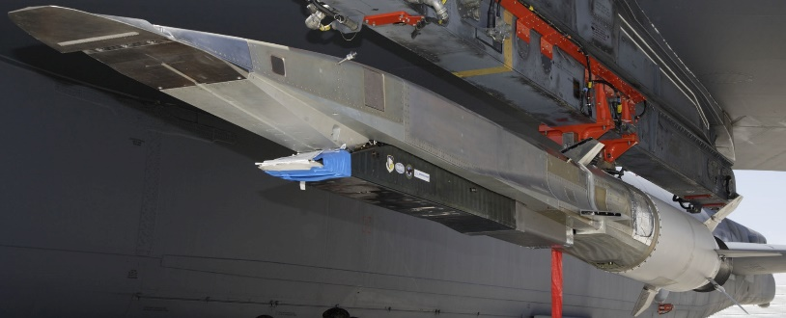
Background: Refractory Metals
Refractory metals and alloys are used for service in extreme high temperature environments:
  Reaction Control System (RCS) thrusters.
  Space Nuclear Propulsion (SNP) clad and structure.
  Hypergolic / green propulsion chambers and catalyst.
  Electric propulsion grids.
  Power conversion system heat pipes and regenerators.
  Hypersonic wing leading edges.
Refractory metals are desirable due to:
  High melt temperature (T_{m}).
  Retain strength and hardness at elevated temperature.
Aerospace refractory metal parts tend to be:
  Thin wall geometries (converging-diverging nozzles).
  Relatively simple geometries.
  High buy-to-fly ratio (20:1 to 50:1).
  Low production rate.
Apollo CSM RSC using C103. Courtesy Aerojet-Rocketdyne
Green propulsion Re thruster.
TZM alloy heat pipe. Courtesy Advanced Cooling Technologies.
X-51A hypersonic test vehicle. Courtesy USAF.
Traditional Refractory Alloys

Slide 5
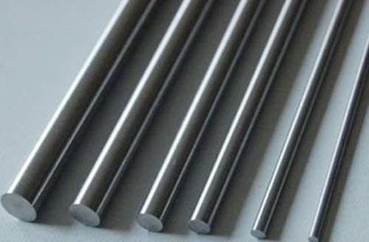
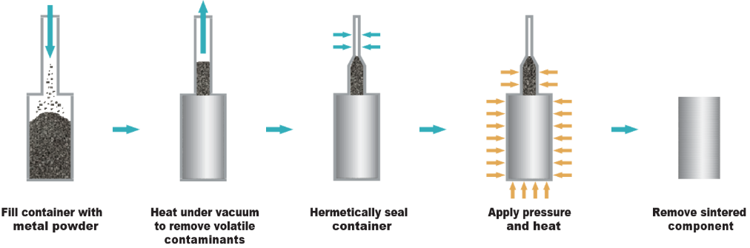
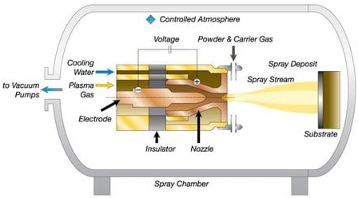
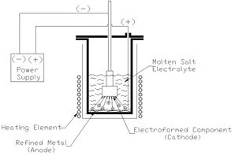
Problem
Traditional refractory manufacture is difficult and expensive:
  Bar, plate, tube, sheet stocks and sizes limited (constrains design).
  Powder feedstock are angular and not usually alloyed.
  High feedstock cost.
  Relatively difficult to form/machine (fracture prone).
  Heat treatment requires specialized facilities (O, C, N sensitive).
  Joining options limited (e-beam weld).
  Inspection options limited.
Alloys designed for traditional manufacture:
  Powder metallurgy (CIP, HIP, deposition).
  Forging.
  Wire and/or plunge EDM.
  W ($100/kg) or Mo ($80/kg) alloyed with 25-47.5 wt% Re ($2.76k/kg) to improve ductility.
Feedstock vendors limited
  Angular/unalloyed powder does not meet AM specs.
  Gas atomization methods limited by high T_{m}.
C103 forged bar stock. Courtesy ATI.
Hot Isostatic Press (HIP) process [1].
[1] https://www.malvernpanalytical.com/en/industries/advanced-manufacturing/powder-metallurgy/isostatic-pressing.
[2] https://www.neodynamiki.gr/
[3] https://plasmapros.com/processes/
Vacuum Plasma Spray (VPS) process [2].
Electro Deposition / Forming process [3].

Slide 6
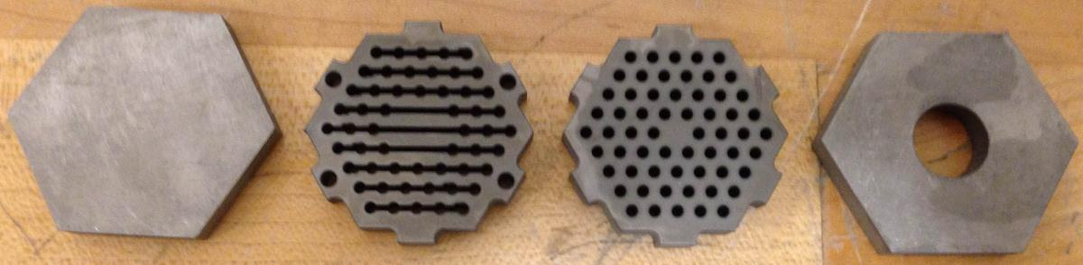
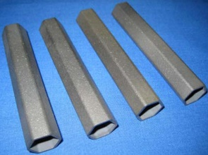
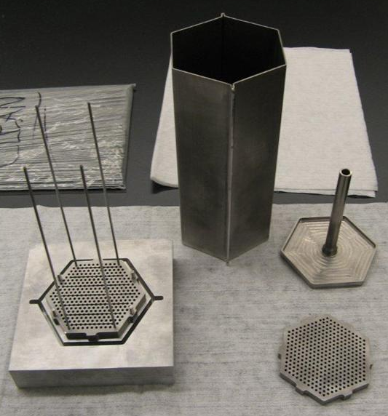
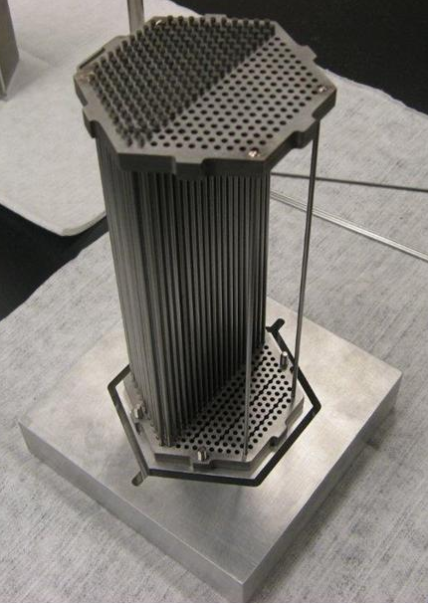
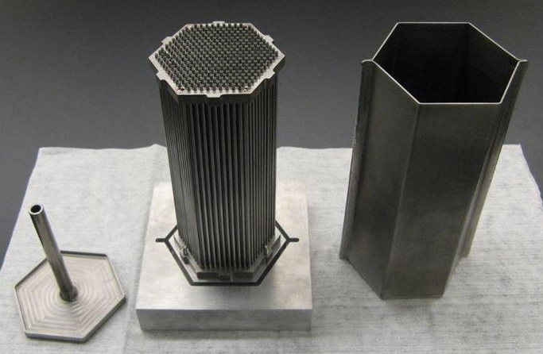
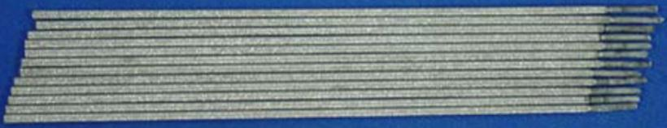
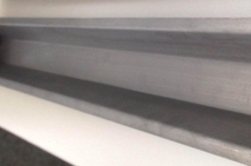
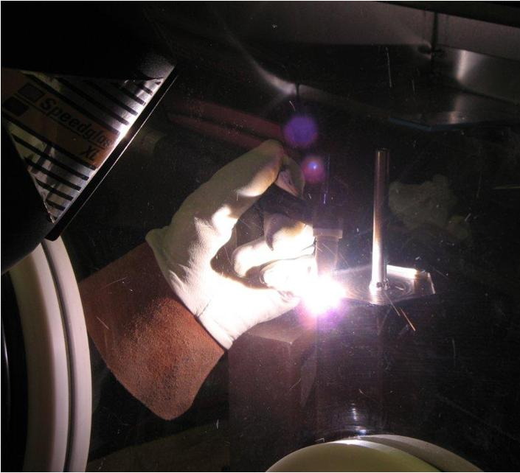
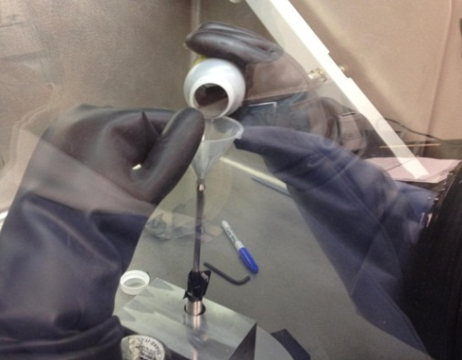
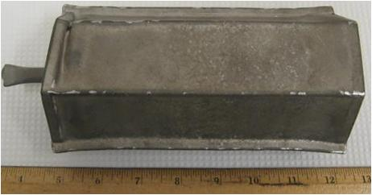
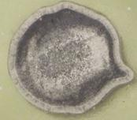
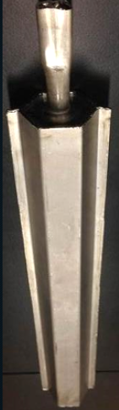
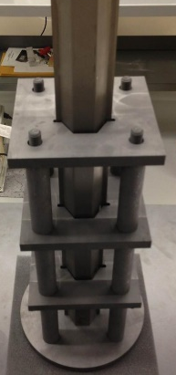
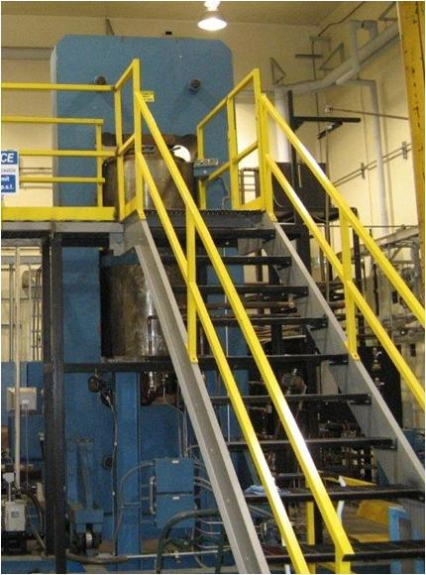
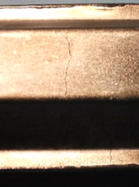
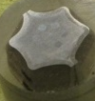
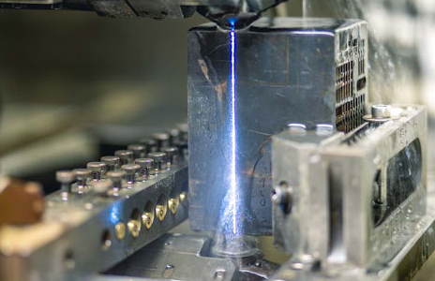
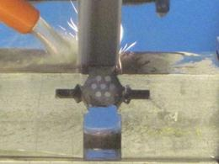
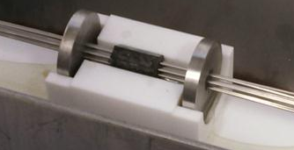
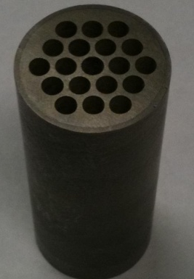
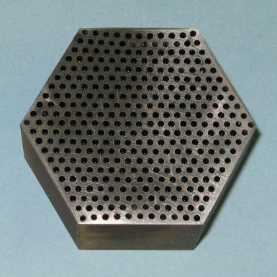
Traditional Manufacture Example: NTP Fuel
Nb can end-caps and spacer grids (water jet).
W clads (vacuum plasma spray).
HIP can tooling and assembly process.
Mo rods coated with W (electro-form).
Nb can walls (sheet metal break).
Weld end caps to walls (TIG in Ar glovebox).
Swage, leak check, powder fill (~55 %RD), evacuate, crimp/weld/cut fill stem.
Graphite tooling and HIP furnace schedule.
HIP part consolidation to >99 %RD, geometric distortion, wall cracking.
End cap and spacer grid removal (saw or wire-EDM).
HIP can removal (surface grinding).
Chemical etch to remove Mo mandrels.
Cermet fuel segment.

Slide 7
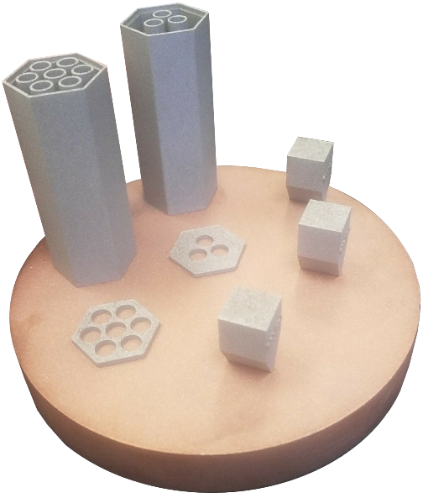
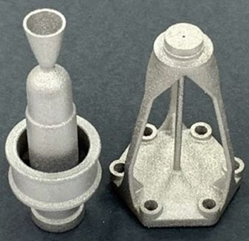
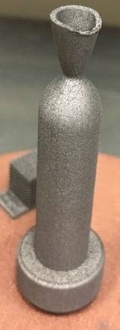
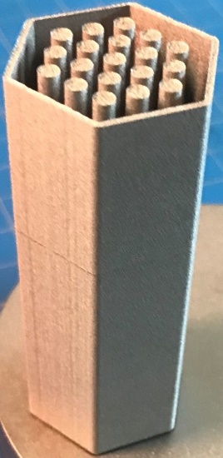
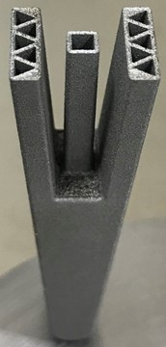
Development Evolution
Refractory manufacture at MSFC
  NTP fuel development (FY11-present)
Refractory AM demonstrated using:
  Laser powder bed fusion (L-PBF)
  Electron beam PBF (EB-PBF)
  Laser powder DED (LP-DED)
  Electron beam wire DED (EW-DED)
Previous / Ongoing AM Investments
    L-PBF AM C103 for propulsion (FY18 CAN* with Castheon).
    L-PBF AM W ultra-fine lattices for propulsion (FY18 CAN with EOS).
    Green propulsion development (FY19 CAN with UTEP).
    Binder Jet AM ZrC for NTP (FY19 CAN with UTEP).
    L-PBF AM W and Mo for NTP (FY19-FY22 GCD).
    L-PBF AM W Hypersonic WLE (FY20 ARC)
    L-PBF AM Mo Thruster & Ir Catalyst (FY21 CIF)
    L-PBF AM W, Mo, C103 1 N Green Propulsion Refractory Thrusters (FY21 TE).
    LP-DED AM C103 nozzle extension (FY21-22 GCD with RPMI).
    Refractory High Entropy Alloy Development (FY21-23 ESI & EPSCoR).
(A)
(B)
First NASA W AM build: NTP fuel clad with integrated coolant channels.
(C)
(D)
L-PBF AM (A) C103 1 N reaction chamber and thrust stand-off, (B) 1N AM W chamber, (C) AM W NTP fuel clad, (D) AM W hypersonic wing leading edge with integrated heat pipe channels.
*CAN = Cooperative Agreement Notice

Slide 8
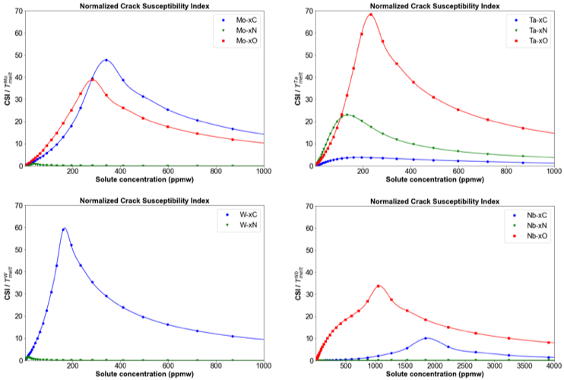
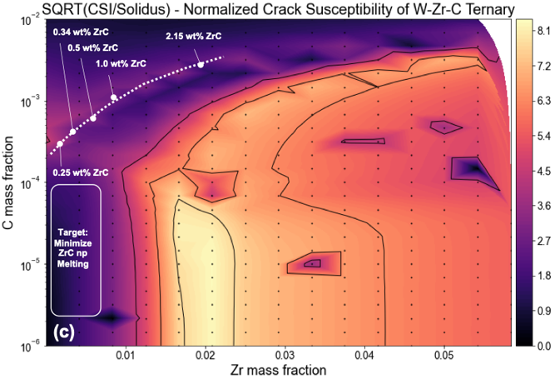
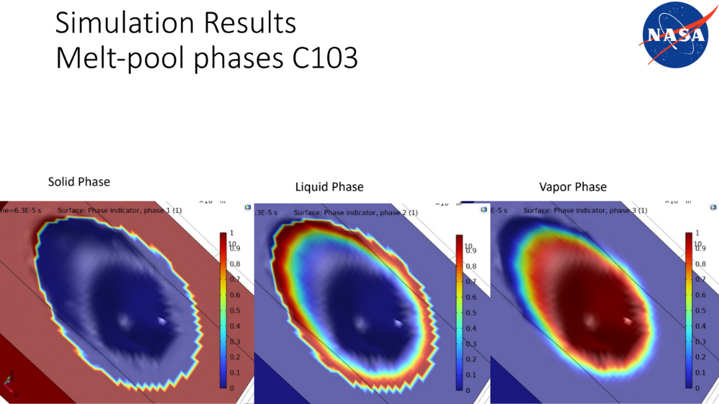
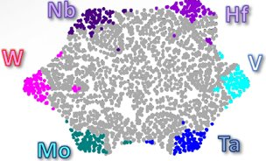
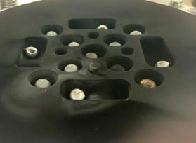
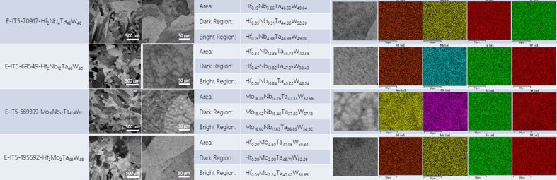
AM Optimized Material Design
Leverage AM to overcome constraints.
  Integrated Computational Materials Engineering (ICME) approach.
  Melt/solidification transformation and dynamics, crack susceptibility, AM build simulation, and property prediction.
  Increased design freedom.
  Higher feedstock utilization.
  Eliminate / minimize joining.
Material Development Objectives
  Phase 1: Utilize existing refractory metal/alloy powder: W, Mo, C103, Re, Ta.
  Phase 2: Dispersoid additions (e.g. ZrC, HfC, TiC nano-powder) to existing powder to reduce cracking and improve mechanical properties.
  Phase 3: Design AM formulations optimized AM methods with emphasis on use of cost-effective elements, printability, and properties.
Crack susceptibility modeling of various refractory metals with CDS.
L-PBF AM C103 melt pool modeling.
RHEA design space, arc melt specimens, and characterization

Slide 9
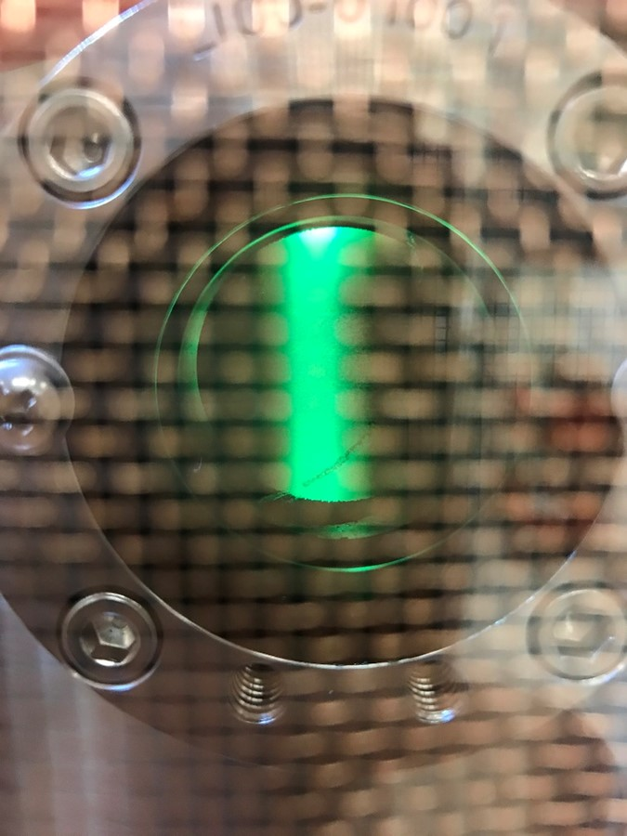
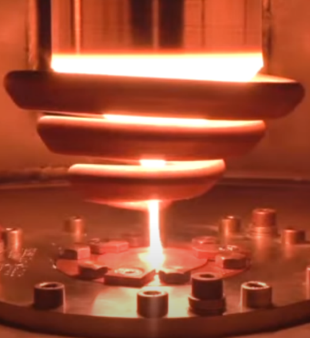
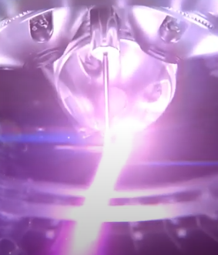
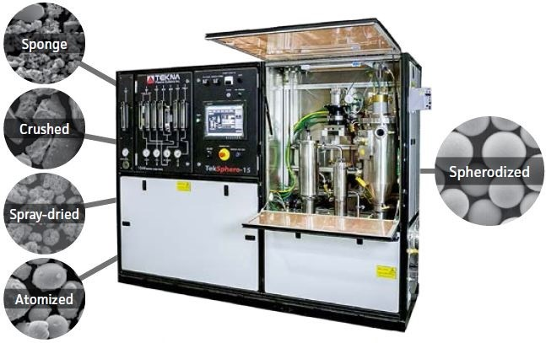
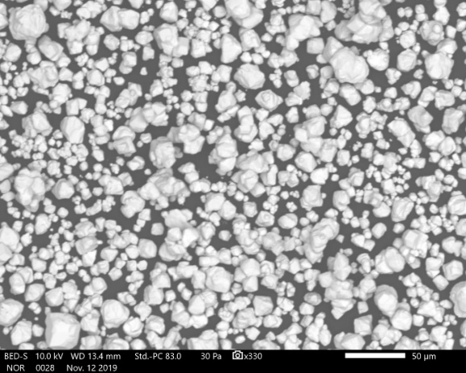
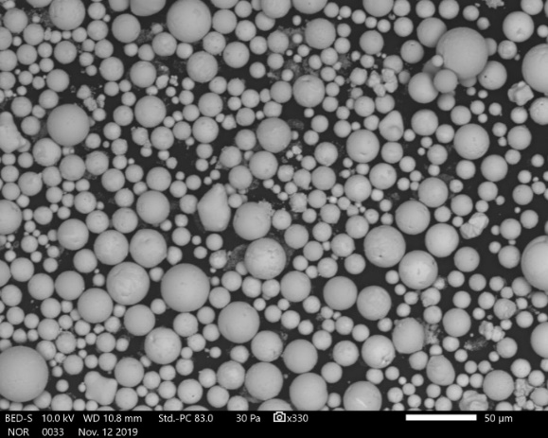
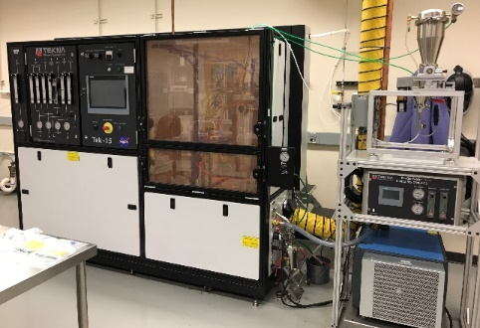


Powder Production
Refractory Metal Powder Production Options
  Nano dispersoid additions: MSFC acoustic mixing.
  Plasma spherodization: MSFC.
  Electrode Induction Gas Atomization (EIGA): Northwestern Univ.
  Reuse/Recycling: 6K Additive, MolyWorks, TBD.
AM Powder Specifications
  Alloyed elements
  Spherical morphology
  Fully dense particles (>99.9 %TD)
  Particle size distribution (PSD): 15-45 µm for L-PBF 45-105 or 150 µm for LP-DED.
AM Grade Powder Options
  Elemental: W, Mo, Nb, Ta, Re.
  Alloys: C103, FS85, WC3009 (dev), WC3015 (dev), MoxRe (dev), WxRe (dev).
Plasma (RF or microwave) spheroidization.
EIGA of ingot. Courtesy Sandvik.
Plasma wire atomization. Courtesy GE AP&C.
(A)
(B)
MSFC Tekna Tek15 Plasma Spheroidizer
SEM micrographs of (A) angular W powder, (B) plasma spheroidized W powder.
(A) C103 powder and (B) C103 particle coated in HfC nano-powder.

Slide 10








Demonstration Scale Powder Production Example
Direct Current Sinter (DCS)
  Low-cost lab scale demonstration using existing equipment.
  Process development at MSFC DCS-25.
  Production at Thermal Tech DCS-200 if required.
EIGA
  DCS billet atomized into alloyed powder.
  Northwestern University CAN.
Mixed elemental angular powder.
MSFC Thermal Tech DCS-25 furnace consolidates powder into pucks and heat treatment to solid-solution.
DCS pucks Ø40 mm x t15-25 mm (potential for >Ø60 mm).
Stacked pucks diffusion bonded via DCS into a billet.
Billet converted into powder with EIGA.
Spherical solid-solution powder.
L-PBF AM parameter development.

Slide 11






L-PBF & LP-DED AM Parameter Development
L-PBF parameter development
  Computational predictions drive experimental iteration.
  Resulting parameters fed back for build simulations.
  Small platforms minimize powder costs, easy material change, small demo part production.
LP-DED Parameter development
  RPM Inc. currently developing C103.
  UTEP CAN develop Nb and C103.
  Topology optimized nozzle extension demonstration article test via ORCA in FY23.
Refractory metals / alloys
Common AM alloys
Melt Temperature vs. L-PBF energy density map.
(A)
(B)
(C)
MSFC EOS M100 L-PBF AM Platform.
UTEP RPMI Inc 222XR LP-DED AM Platform.
1 N green propulsion chamber and stand-off demonstration articles produced via L-PBF AM from (A) W, (B) Mo, and (C) C103.

Slide 12






Heat Treatment & Joining
Heat Treatment
  Stress Relief
  HIP
  Quench HIP (vendor TBD)
  L-PBF AM C103, W, Mo, LP-DED AM C103.
  Sacrificial Ta foil wrap used due to a high melt temp and high affinity for O, N, and C.
Electron Beam Weld Development
  C103, Mo, W, and CDS variants
  L-PBF and LP-DED specimens
  Joint designs completed
  Inspection: high energy CT or dye penetrant.
  Characterize weld microstructure.
  Results shared with Electron Beam Engineering for availability to commercial space partner adoption.
Vacuum furnace.
HIP furnace.
Tensile data of L-PBF AM W at 20 °C.
HIP temperature constraints.
Condition | UTS_{m} (MPa)
As-Built | 157.65 ± 17.9
Stress-Relieved | 164.34 ± 29.7
Recrystallized | 177.30 ± 4
HIP* | 177.44 ± 81.5
Wrought | 349.26
*Furnace Tmax achieved recrystallization but insufficient to induce densification.
(A)
(B)
L-PBF AM W e-beam weld plate specimens.
(A) Thruster weld specimen designs and (B) L-PBF AM Mo weld specimens.
PTR electron beam welder.

Slide 13






Characterization
Density Measurements
  Archimedes, optical, He pycnometry
  Typical L-PBF AM cutoff 99.5 %RD
  L-PBF am W 93-95 %RD
  L-PBF AM Mo 97.9 %RD
Limited Tensile Testing options
  Ohio State University CAN awarded to modernize Gleeble (1500-2500 °C).
  Westmorland: (1200 °C, air)
  Touchstone Labs: (1500 °C, air)
  Southern Research: (2500 °C, graphite tooling)
  GRC procurement awarded for a load frame capable of high temperature (2000 °C) and high vacuum (10⁻⁶ Torr) for tensile, compression, and fatigue testing.
Creep Testing (1500-2000 °C)
  GRC study to refurbish existing test frames.
TEM micrograph of L-PBF AM as-built C103 HfO₂ precipitates.
EBSD inverse pole figure of AM C103 grain orientation in the as-built condition.
L-PBF AM C103 specimen build.
Gleeble tensile test.
C103 ambient and elevated temperature mechanical property comparison. Possible that fine distributed oxides from the L-PBF acts as a strengthener and stabilizer.

Slide 14







Surface Finish Enhancement
Surface Finish
  Characterize as-built surface roughness.
  Investigate surface enhancement methods: chemical milling, chemical mechanical polish, electropolish.
Protective Barrier Coatings
  External surfaces = possible.
  Internal surfaces = difficult.
  R512E (Si-20wt%Fe-20wt%Cr) slurry diffusion bond: Himetco.
  MoSi₂ thermal spray
Up-Facing
Down Facing
Blade Facing
Back
Surface Finish of As-Built L-PBF AM W
0°
15°
Condition | S_{a} (µm)
 | 0° (vertical) |  | 15° |  | 30° |  | 45°
 | Blade-Facing | Back | Up-Facing | Down-Facing | Up-Facing | Down-Facing | Up-Facing | Down-Facing
W As-built | 5.5 | 6.3 | 5.4 | 7.3 | 6.1 | 8.9 | 9 | 15.7
30°
45°
As-built L-PBF AM W surface finish specimens.
As-built L-PBF AM Mo surface finish specimens.
SEM micrograph and EDS maps of R512E coating on L-PBF AM C103 substrate.

Slide 15










Non-Destructive Evaluation Constraints
Traditional X-ray CT and µ-CT Limitations
  Unsuitable to high atomic number refractory metals
  Elements with high radio-opacity (high scatter, low penetration depth) resulting in poor S/N and unresolvable images.
  225 kV, 450 kV, 2 MeV sources (MSFC).
High Energy X-ray CT
  6 MeV x-ray: North Star Imaging
  6 MeV x-ray: CAN awarded to RadiaBeam.
  C103 and W demonstrated. Mo in-work.
Neutron Radiography / CT
  CAN awarded to Phoenix.
  Potential for part activation (e.g. Hf in C103) impact transport, schedule, and handling.
  National user facilities (e.g. DOE, NIST) not practical.
Destructive Evaluation
Layer-wise imaging (control data).
(A)
(B)
(A) Plate and cylinder NDE specimen designs with engineered defects. (B) L-PBF AM W, Mo, and C103 NDE specimens.
2 MeV x-ray of LPBF W. Course defect resolvable.
7 MeV x-ray of L-PBF AM W and C103. Coarse and medium defects resolvable. Courtesy RadiaBeam.
Neutron radiograph of AM W NDE specimens. Coarse and medium defects resolvable. Courtesy Phoenix.
Robomet layer-wise destructive inspection of AM W. Coarse, medium, and fine defects resolvable.

Slide 16







Integration & Test
Elevated Temperature Tests
  L-PBF AM 1 N green propulsion chambers at 0.7T_{m}.
  W: 2300 °C for 5 min.
  Mo: 1900 °C for 5 min.
  C103: 1700 °C for 5 min.
Future Tests
  NTREES
  INL Treat Reactor
  CDA RCS in vacuum
  L-PBF AM C103 ORCA nozzle extension
  LP-DED AM C103 ORCA nozzle extension
(A) L-PBF AM Mo pre-test and (B) chamber test at 1900 C.
L-PBF AM tungsten heat exchanger segment for the INL TREAT reactor supporting SNP.
(A)
(B)
L-PBF AM W - SNP NTREES test segment.
L-PBF AM W SNP setters test W-coated dUN kernels. (A) pre-test and (B) post-test to H₂ at 2300 C for 30 min.
Topology optimized ORCA nozzle extension for L-PBF AM C103.

Slide 17
Conclusions
Conclusions
  Refractory metal AM been demonstrated as viable with W, Mo, Ta, C103, as well as several refractory alloys in development.
  Substantial alloy, feedstock, AM method, and post-processing development is required to optimize refractory metal AM to the broad array of aerospace applications.
Industry Implications
  Development of AM optimized dispersoid stabilized, solid-solution, RHEAs.
  Expanded refractory AM feedstock options and commercial suppliers.
  Heat treatment schedules optimized for existing and new material options.
  NDE method evaluation.
  Surface finish enhancement evaluations.
  Coating formulations and methods evaluated.
  Elevated temperature mechanical testing commercial expansion.
  Component hot fire testing to build TRL of refractory metal AM.

Slide 18
Acknowledgements
Marvin Barnes, Jarvis Caffrey, Delphine Duquette, Lynne Ellett, John Fikes, Paul Gradl, Ron Jones, Colton Katsarelis, Lynn Machamer, Christopher McKinney, Fredrick Michael, Omar Mireles, John Peugeot, Sara Rengifo, Fernando Reyes, Jhonathan Rosales, Pat Salvail, Jeffrey Sowards, Brian Taylor, Nichole Vaughn, Kenny Webster, Jamelle Williams, and Ryan Wilkerson of NASA Marshall Space Flight Center.
Jaehyun Cho, Lauren Abbott, Justin Haskins, Keith Peterson, William Tucker, and Kevin Wheeler of NASA Ames Research Center.
Eric Brizes, Christopher Kantzos, Justin Milner, Frank Ritzert, and Aaron Thompson of NASA Glenn Research Center.
Francisco Medina, Edel Arrieta, and Brandon Colon of the University of Texas at El Paso.
Carly Romnes of the University of Illinois Urbana-Champaign.
Raymundo Arroyave and Ibrahim Karaman of Texas A&M University.
Gregory Thompson of University of Alabama.
Ian McCue of Northwestern University.
Bryan Webler of Carnegie Mellon University.
Alan Weimer of University of Colorado at Boulder
Pankaj Humar of the University of New Mexico.
Steven Adler of Tekna.
Jake Rowen of Resodyn.
Greg Peterson of Thermal Tech.
Ankit Saharan and Mahemaa Rajasekaran of EOS North America.
Youping Gao of AddMan.
Jonaaron Jones of Beehive Industries.
Tyler Blumenthal of RPM Inc.
Paul Carriere of RadiaBeam.
Camaron Lemmer of North Star Imaging.
Jim Ringer of TechMet.
Augustine Diaz of REM Surface Engineering.
Daniel Herrington of Voxel
Tim Hall of Faraday.
Charles Berger of Hitemco.
Scott O’Dell of Plasma Processes Inc.
Michael Kurth, Benjamin Johnson, and Michael Giganti of Phoenix.
The opinions expressed in this presentation are those of the author and do not necessary reflect the views of NASA or any NASA Project.

