Slide 1
High Sensitive and Low Power Nanosensors for Space and Terrestrial Applications
Jing Li
NASA Ames Research Center

Slide 2
Outline
Driving force – applications and history
Sensor Technology
Sensor performance – lab and field test
Sensor board and cell phone integration

Slide 3
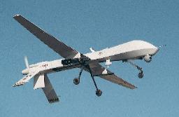




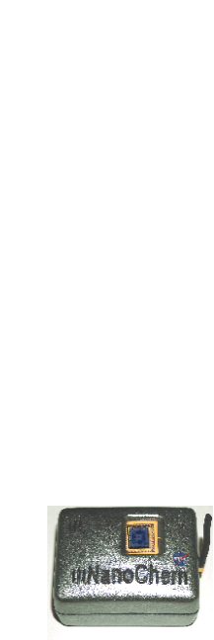

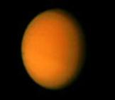
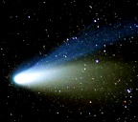
Nano Chemical Sensors for NASA Mission
Uninhabited Aircraft
Objectives
  To greatly increase science measurement capability with less mass and less power requirements for electronics and sensors.
Applications
  Fuel leak detection for launch vehicles - KSC
  Air monitoring in ISS, shuttle and CEV – JPL, JSC
  UAV surveillance of global weather and forest fire monitoring - GSFC
  New science demonstration for chemical detection in space - GSFC
  Radiation detection - JSC
Nanotech gas
sensors
Here:
Earth
There:
Space
Beyond:
Outer Space

Slide 4
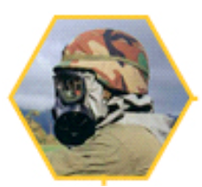
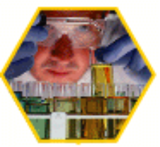


Nano Chemsensors for Terrestrial Applications
Defense &
Homeland
security
Process control
Environment
monitoring
Medical
diagnoses
Requirements: high sensitivity and selectivity,
fast response,
low power consumption,
small size,
high discrimination power.

Slide 5
Sensor Technology
Sensor type:
  Chemical sensors – air monitoring
  Chem/bio sensors – human health monitoring
  Chem/bio sensor – human/environment monitoring
Technique:
  Electronic – resistance, capacitance, FET
Platform:
  Smartphone sensors
  Portable breath and blood analyzer
  Wearable sensors
Materials:
  Carbon nanotubes, Graphene, Metal - NP, NW, Nano cage, etc., Metal oxides – NP, NW, NF, Polymers and Polymer composites
Substrates:
  Silicon, Kapton, Paper, Cloth, Ceramic, PCB board

Slide 6
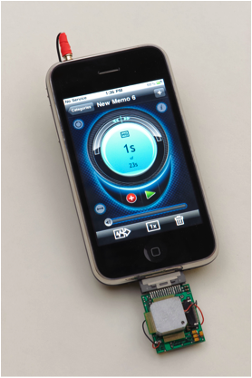
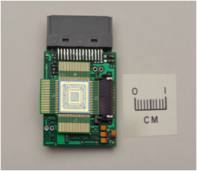
Sensor Devices
This technology won NASA Government Invention of the year Award in 2012.
A newly developed sensing device with 64-sensors for breath analysis of COVID.

Slide 7
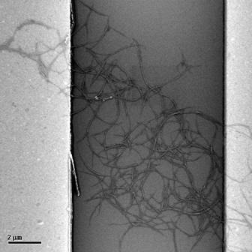
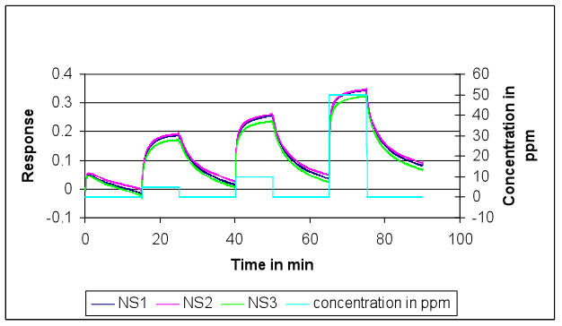
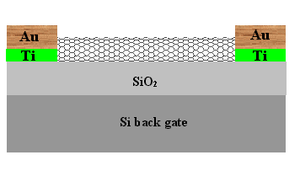
Nanosensing Principle
Gas molecules
A
A
e
e
e
e
e
e
CNT
Gas off
Gas on
A SEM image of carbon nanotubes
sitting across two electrodes
Nanosensor responded to ammonia

Slide 8
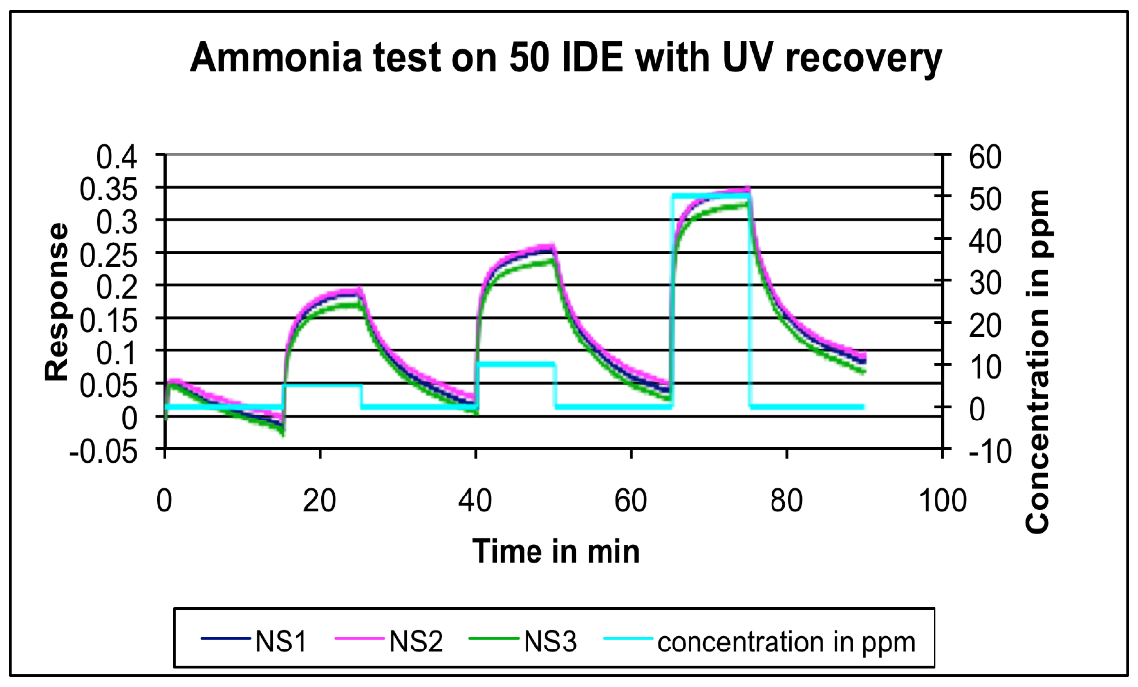
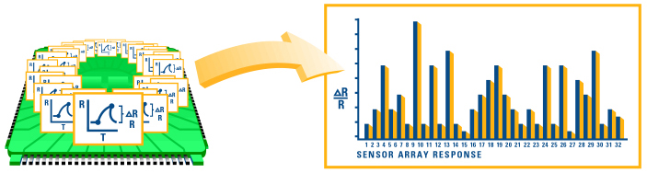
Nanosensing Technology
A
e
e
e
e
e
e
Operation:
The relative change of current or resistance is correlated to the concentration of analyte.
Array device “learns” the response pattern in the training mode.
Unknowns are then classified in the identification mode.
Using pattern matching algorithms, the data is converted into a unique response pattern

Slide 9
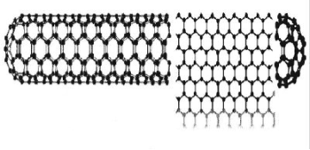
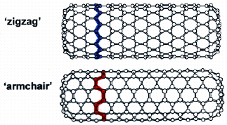
Single-Walled Carbon Nanotubes
Basic Properties:
Mechanical:
Tough and strong, Y~ 1TPa
Structural:
1-2 nm in radius;
Micron in length;
Every atom in a single-walled nanotube is on the surface and exposed environment
Thermal:
Sustain 400oC in air, 2000oC in vacuum
Electronic:
Ballistic charge transport at room temperature, Semiconducting Egap ~ 1/d
Small changes in the charge-environment of a nanotube can cause drastic changes to its electrical properties
Single Wall Carbon Nanotube: A slice of graphene sheet rolled into a nm-diameter tube

Slide 10
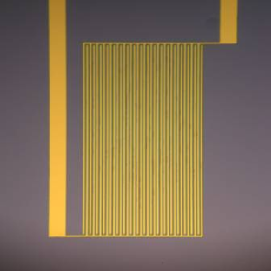
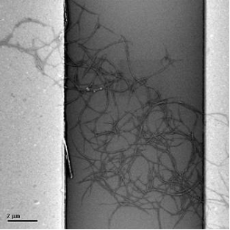
Nanostructure Integration
Sensor fabrication:
  SWCNT dispersions--Nice dispersion of CNT in DMF/H2O
2. Device fabrication--(see the interdigitated electrodes below)
3. SWCNT deposition—Casting, or in-situ growth
Electrode size and material for electrical contact and measurement.

Slide 11
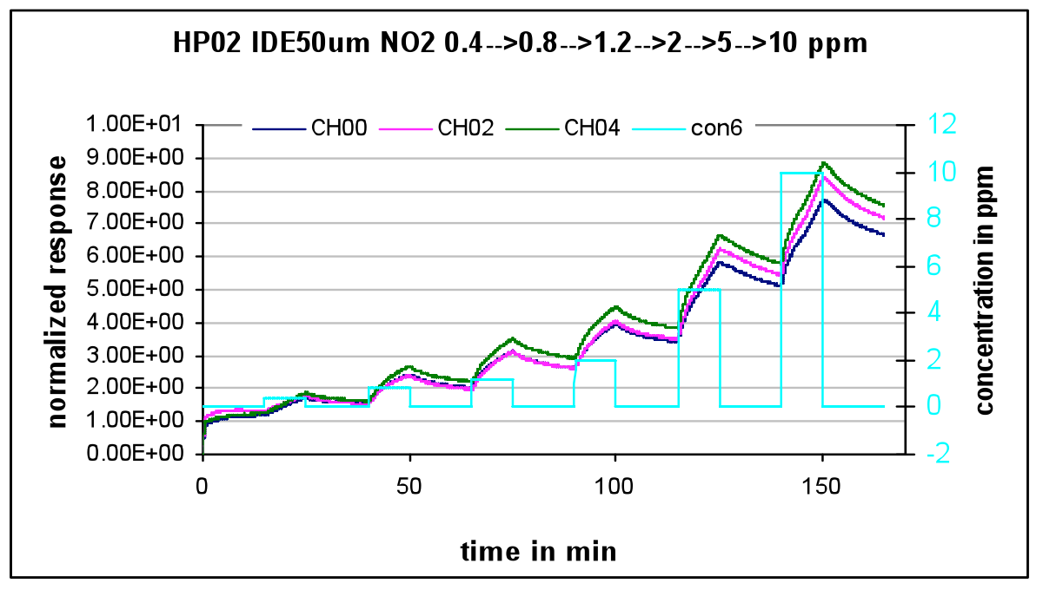
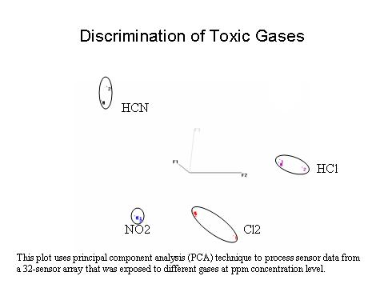
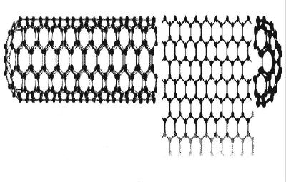
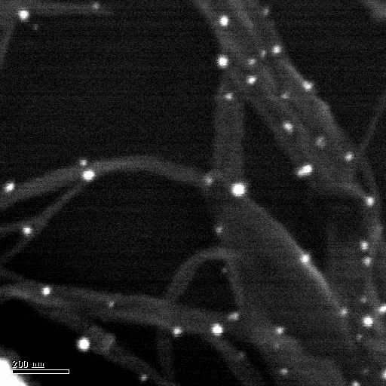
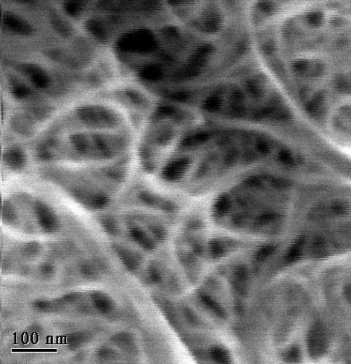
Carbon Nanotubes for Sensing
Electrodes
Pristine CNT
Doped CNT
Coated CNT

Slide 12
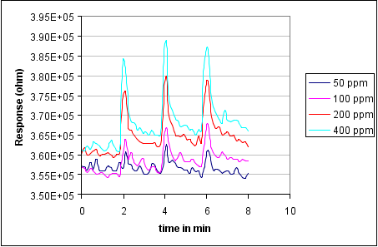
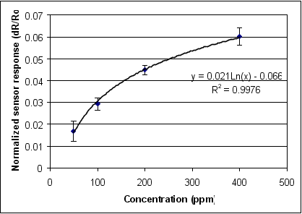
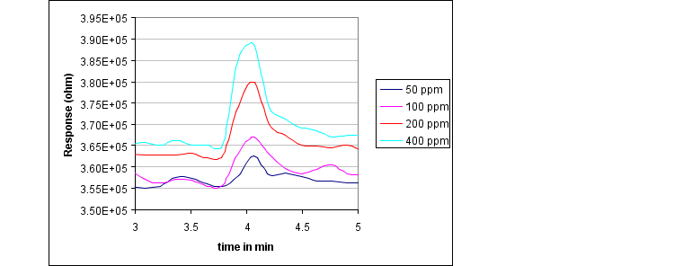
Fast Sensor Response and Recovery
(H2O2 detection)
Results:
  The sensor response time was in seconds.
  Our sensor gives clear sensing signal to 50ppm H2O2 in air at room temperature.
  Our sensor recovered very fast for reuse in the field.
  With noise reduction (on-chip electronics), our sensor should be able to detect <1ppm of H2O2 present in air.

Slide 13
Sensor Baseline Stability
Sensor #
Relative change of base resistance (Rt-Ro)/Ro
Per year
Per month
Per week
Per day
1
1.09
0.091
0.023
0.0032
2
0.53
0.044
0.011
0.0016
3
0.53
0.044
0.011
0.0016
4
0.87
0.072
0.018
0.0026
5
1.58
0.132
0.033
0.0047
6
2.37
0.197
0.049
0.0070
7
0.79
0.066
0.017
0.0024
8
0.29
0.024
0.006
0.0008

Slide 14
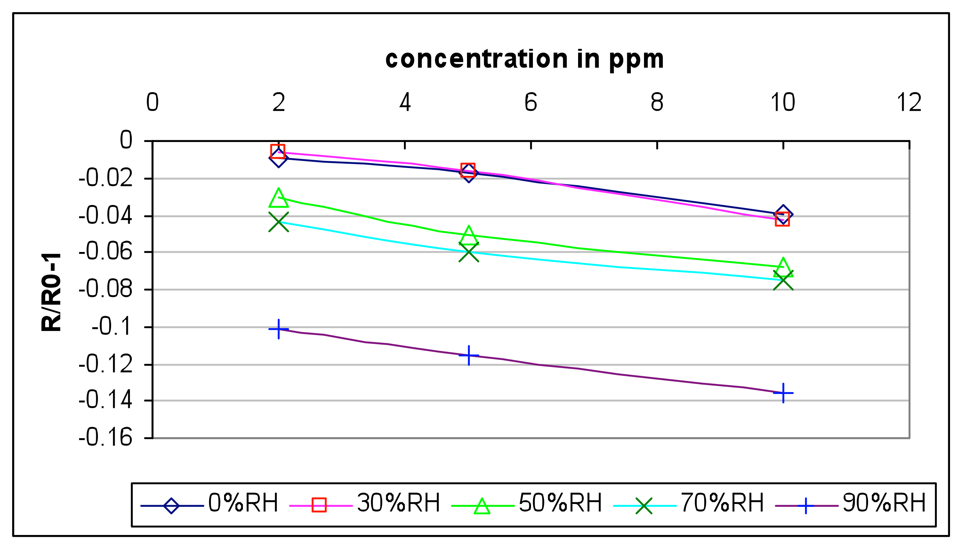
Humidity Effect on NO₂ Detection

Slide 15
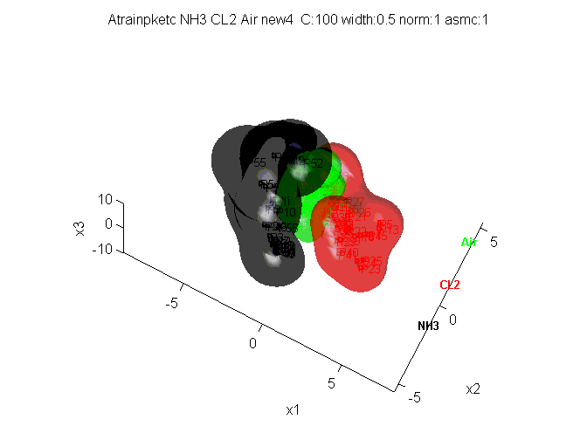
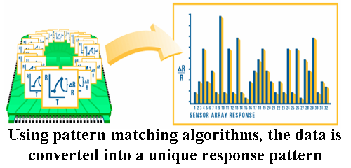
Principle of SVM
The classification in SVM is based on border points called “Support Vectors” and this branch of algorithm belongs to Machine Learning (or Statistical Learning).

Slide 16
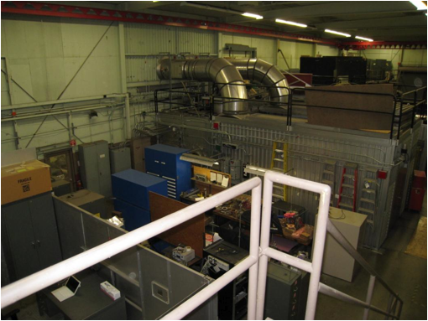
Field Test Location
Sensor and DAQ location
Facility high bay at NASA Ames Research Center

Slide 17
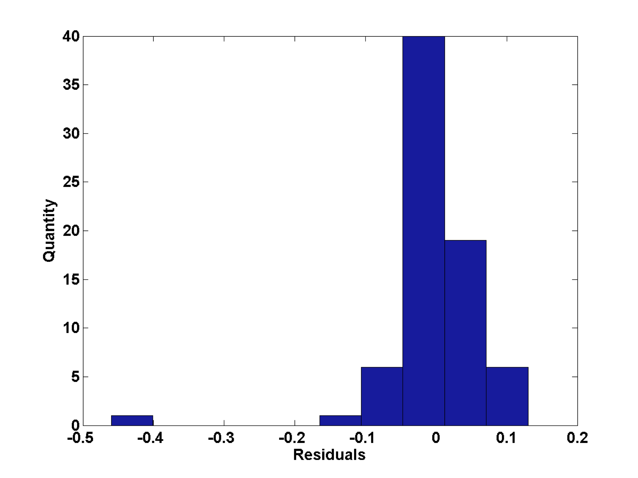
Neural Network Prediction
Histogram of errors/residuals in neural network prediction process (Total 73 lab and field tests of 20ppm ammonia and 20ppm chlorine).

Slide 18
Chemicals that have been tested
Analyte
Sensitivity/Detection limit
CH4
1ppm in air
Hydrazine
10ppb tested by KSC
NO2
4.6ppb in air
NH3
0.5ppm in air
SO2
25ppm in air
HCl
5ppm in air
Formaldehyde
10ppb in air tested by JPL
Acetone
10ppm in air
Benzene
20ppm in air
Cl2
10ppm in N2
HCN
10ppm in N2
Malathion
open bottle in air
Diazinon
open bottle in air
Toluene
1ppm in air
Nitrotoluene
256ppb in N2
H2O2
3.7ppm in air

Slide 19
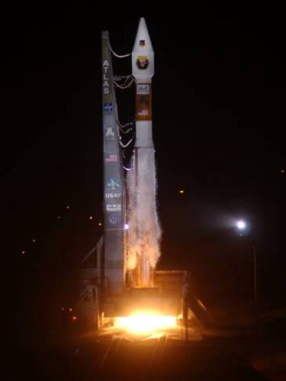
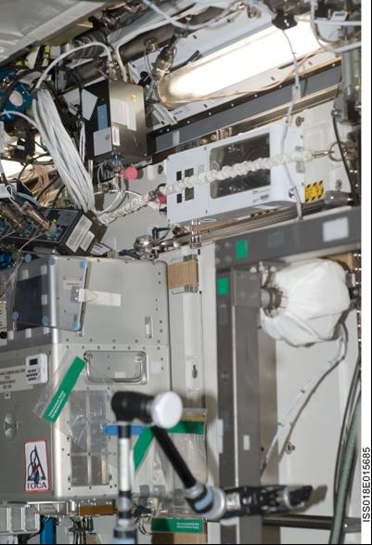
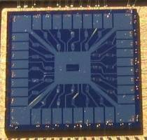
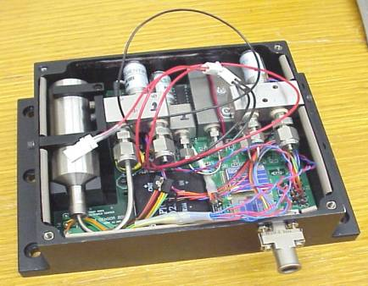
Achievements
ENose on EXPRESS Rack
First ever nanosensor device flown in space on a Navy satellite launched in 2007 for trace chemical detection.
Ames Honor Award, 2007
Two CNT sensors were on JPL ENose platform deployed on ISS for environmental monitoring of chemicals, such as alcohols, ammonia, formaldehyde, sulfur compounds, mercury, et al.
NASA Group Achievement Award, 2010

Slide 20
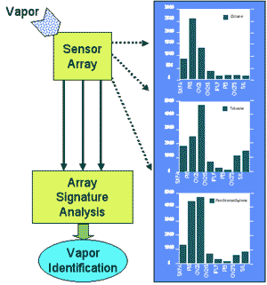
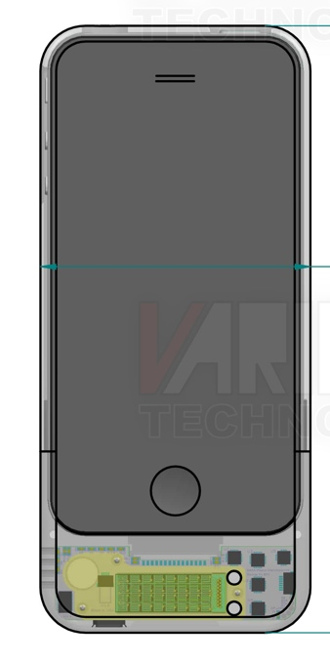
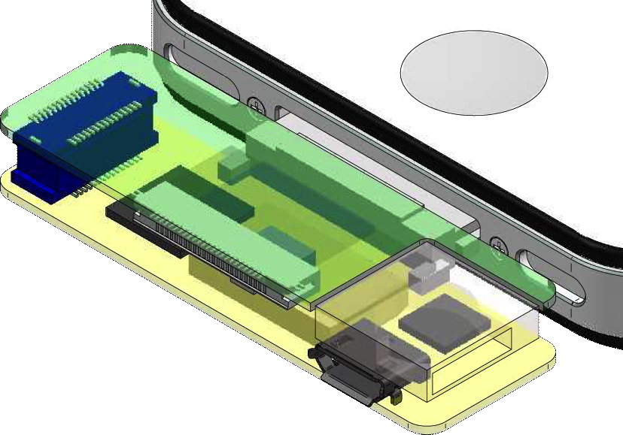
Cellphone Sensors
Chemical information transmission
*
*
Display of chemical information
Ammonia
10ppm
Signal processing
Nanosensor module
Cellphone sensor

Slide 21
Sensing Module

Slide 22
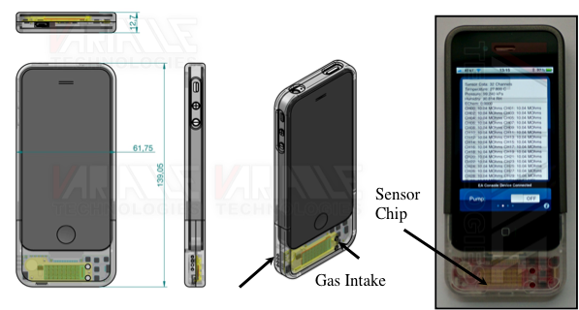
New Generation of Cellphone Sensors
Gas Out
This design and assembly is funded by DHS S&T Cell_All program to NASA Ames.
POC: Jing Li <jing.li-1@nasa.gov>

Slide 23

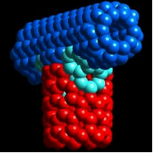
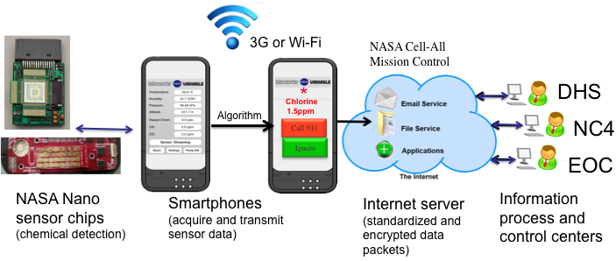

Cell phone sensor and its cloud
DHS S&T Cell-All

Slide 24
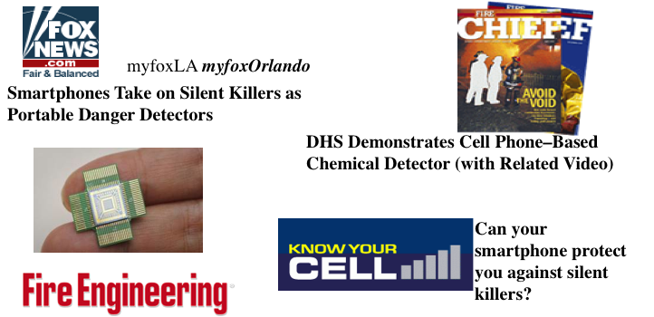

DHS S&T to Demonstrate Cell-Phone Based Sensors for Carbon Monoxide Detection

Slide 25
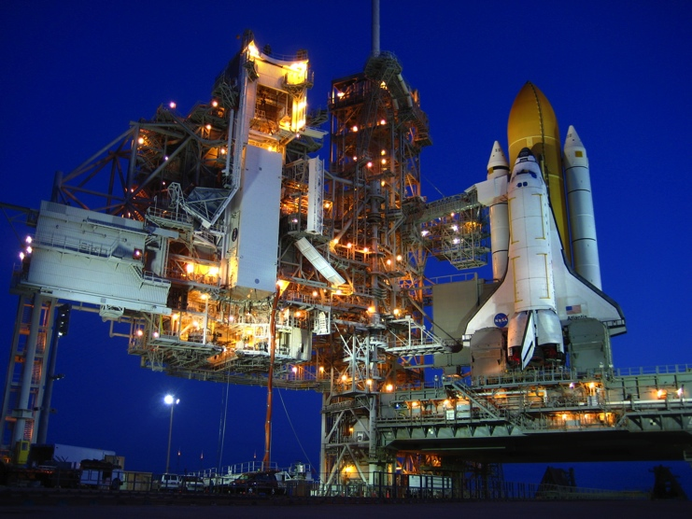
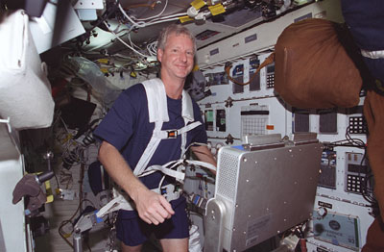
Benefit to NASA Missions
Trace chemical detection in planetary exploration (Ames 2013 CIF Award)
Life support system and environment monitoring (1 phone-sensor being tested at MSFC)
Launch pad and in-flight fuel leak detection (tested at KSC)
Engine operation monitoring
Biomarker detection for astronaut health monitoring (a new initiative being formulated in OCT)

Slide 26

Applications Beyond NASA
US Army – Missile engine propellant aging detection International Journal of Energetic Materials and Chemical Propulsion, 10 (4): 321–336 (2011)
Department of Homeland Security– Early warning of hazardous chemical events IEEE Sensor 2012 Proceeding, IEEE Xplore and Sensors and Actuators B: Chemical (2013) pp. 770-775.
DOD-DTRA – Nerve agent detection Small 7 (2011) 1714-1718 and J. Mater. Res., Vol. 26, No. 16, Aug 28, 2011
EPA (Potential) – Environmental monitoring
USDA (Potential) – Monitor air emissions from livestock operations
DOE (Potential) – Waste tank monitoring
White House – Nail salon air monitoring for worker safety

Slide 27
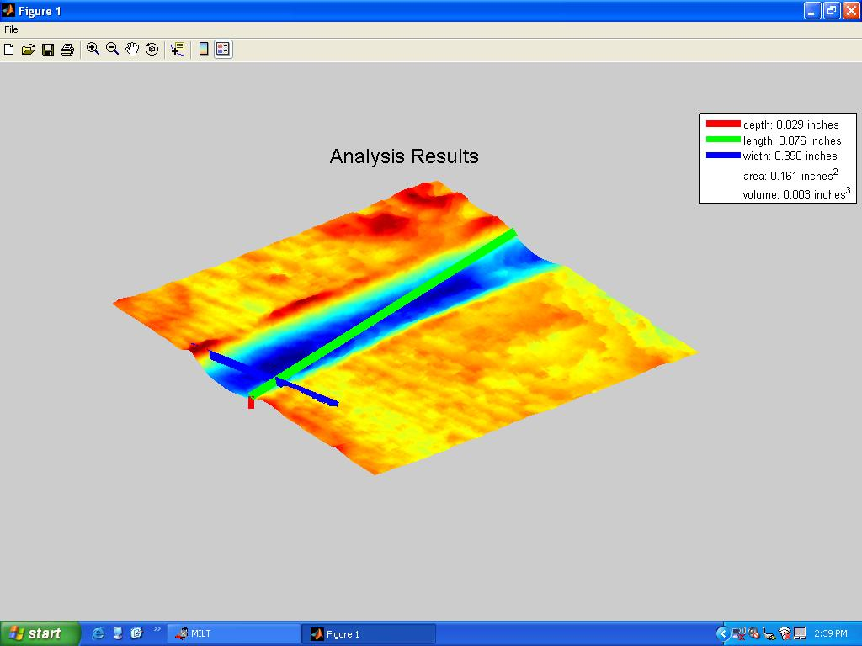

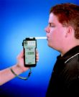
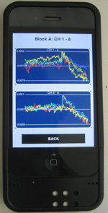

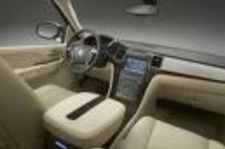
Benefit to Society
Public safety
Healthcare
Automobile industry
Forest fire detection
Buildings, tunnels and mines air monitoring
Jobs
Prediction of the sensor market is $15B in 2016 by Freedonia group market research
Notes:
Expand on this!

Slide 28
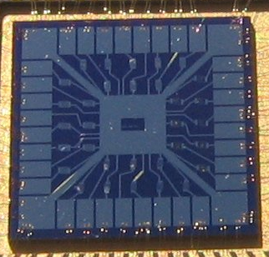
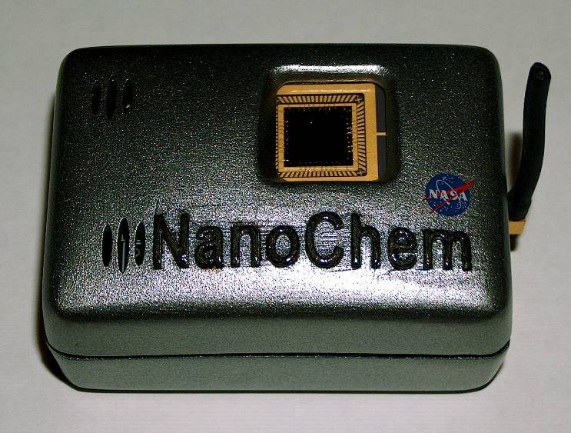
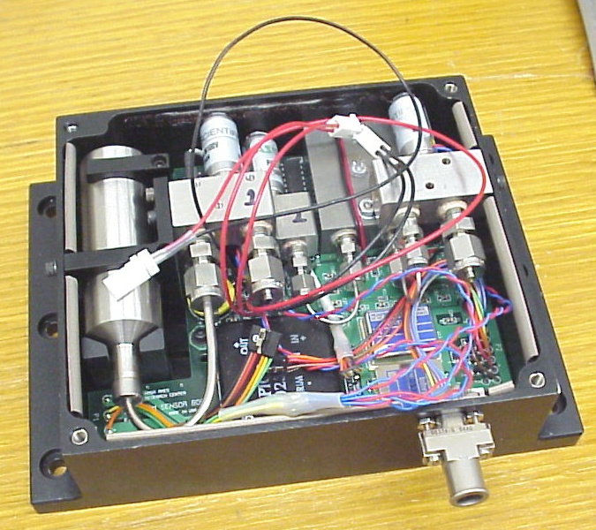

High-Sensitive and Low-Power Nanosensors
Distributed sensing
for cabin air
Surveillance
High-performance Nanosensor Capabilities:
Detection limit range: ppm to ppb
Response time in seconds at room temperature
Reproducible from sensor to sensor
Low power: μW to mW/sensor
Humidity effect is linear additive
Sensor baseline drift is negligible compared to the sensor response
Easy integration (2-terminal I/V measurement)
Sensor chip size is 1x1cm² with 12-256 channels
Badge detector
Area chemical
monitoring
Array Chip
Wireless sensing module
Space qualified for:
Plug and play test
Complementary test
First responders use
Point test and decision
Our sensors have: High sensitivity vs. polymer sensors
Low power vs. metal oxides sensors
Wider analyte spectrum vs. both above sensors
Sensing module
Handheld device
Approach:
Space quality engineering and nanotechnology
Advanced multifunctional materials/devices
Individually addressable multi-channel sensing
Integration of sampling, sensing and computing
Integrated T, P, and humidity sensing
Partnership to develop sensors for CEV
Summary
Development work at NASA Ames since 2002
Highly mature sensor; most well-developed Nano Chemical Sensor System in the world to date
  Tested aboard a US Navy Satellite in 2007
  Deployed in JPL E-Nose in the International Space Station (Cabin air quality monitor) since November 2008
  Dept. of Homeland Security funded for field-test for various threats in recent months
  Dept. of Human Health Services funded for COVID-19 detection
30+ peer-reviewed journal publications
11 US patents
Ready for mass production and commercialization
Impact:
In-situ, real time, automated measurement
High sensitivity with low power and low cost
Contact:
Jing Li, Ph.D., NASA ARC, jingli@arc.nasa.gov, 650-604-4352

