Slide 1



August 12, 2022
Backshell Radiation Analysis with US3D
Raghava S. C. Davuluri
University of Kentucky
Mentors: Brett Cruden and David Saunders
Entry Systems and Technology Division
NASA Ames Research Center

Slide 2
INTRODUCTION
Backshell Radiation Analysis with US3D

Slide 3
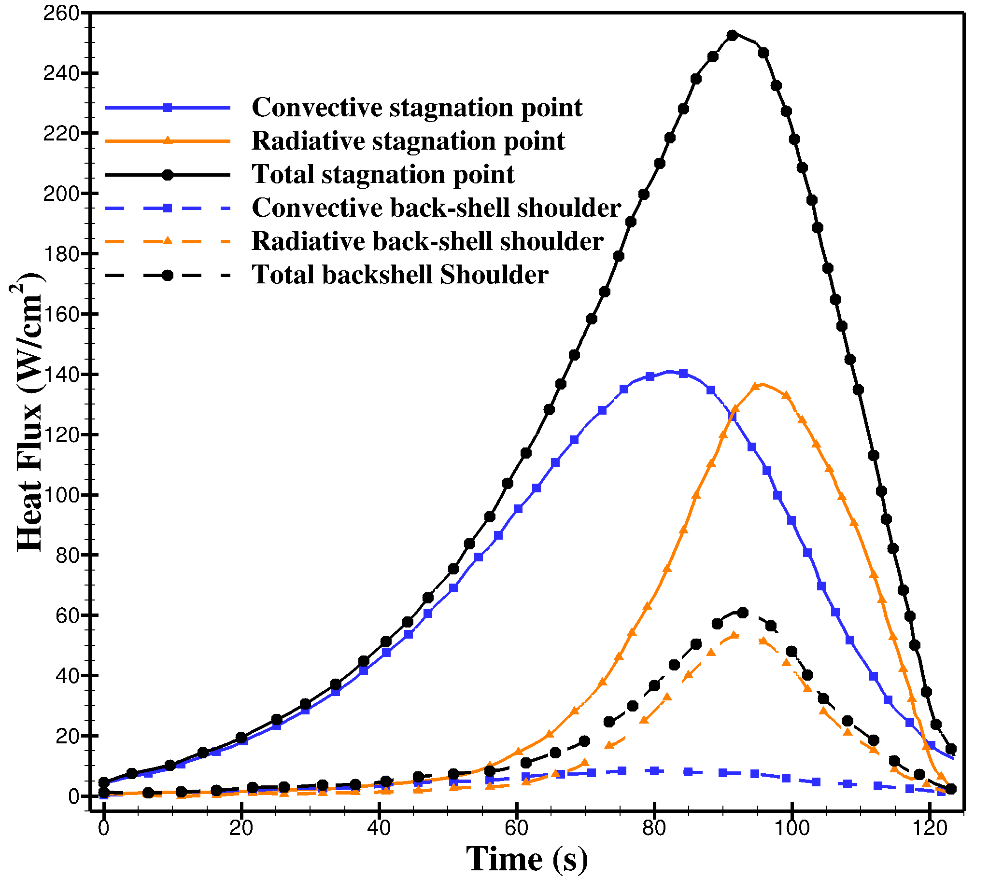
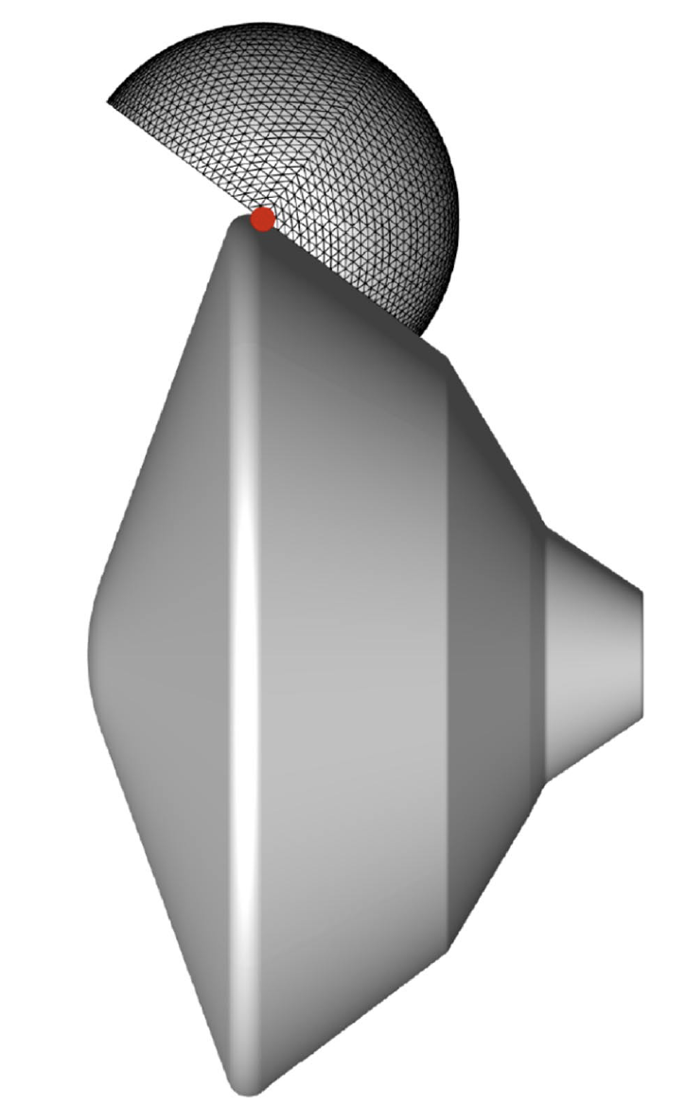
Introduction
During atmospheric entry, radiative heat flux can be a dominant heat transfer mechanism acting on the after-body of the space vehicle.
Though the magnitude of radiative heat flux is small, the materials used on the back shell are designed to accommodate smaller heat loads. Therefore, an accurate estimation of radiative heat flux is required.
For MSL, Brandis et al.¹ performed radiation analysis on the afterbody of the vehicle. They used full angular integration to accurately calculate the radiative heat flux at multiple body points.
The above analysis was performed on structured CFD solutions, and the present work applies the same type of analysis to unstructured solutions using US3D.
Heat flux histories for Dragonfly capsule
Source: Wright, M., IPPW 2019.
¹Brandis et al., JTHT, Vol. 34, No. 1, January 2020.

Slide 4
METHODOLOGY
Backshell Radiation Analysis with US3D

Slide 5
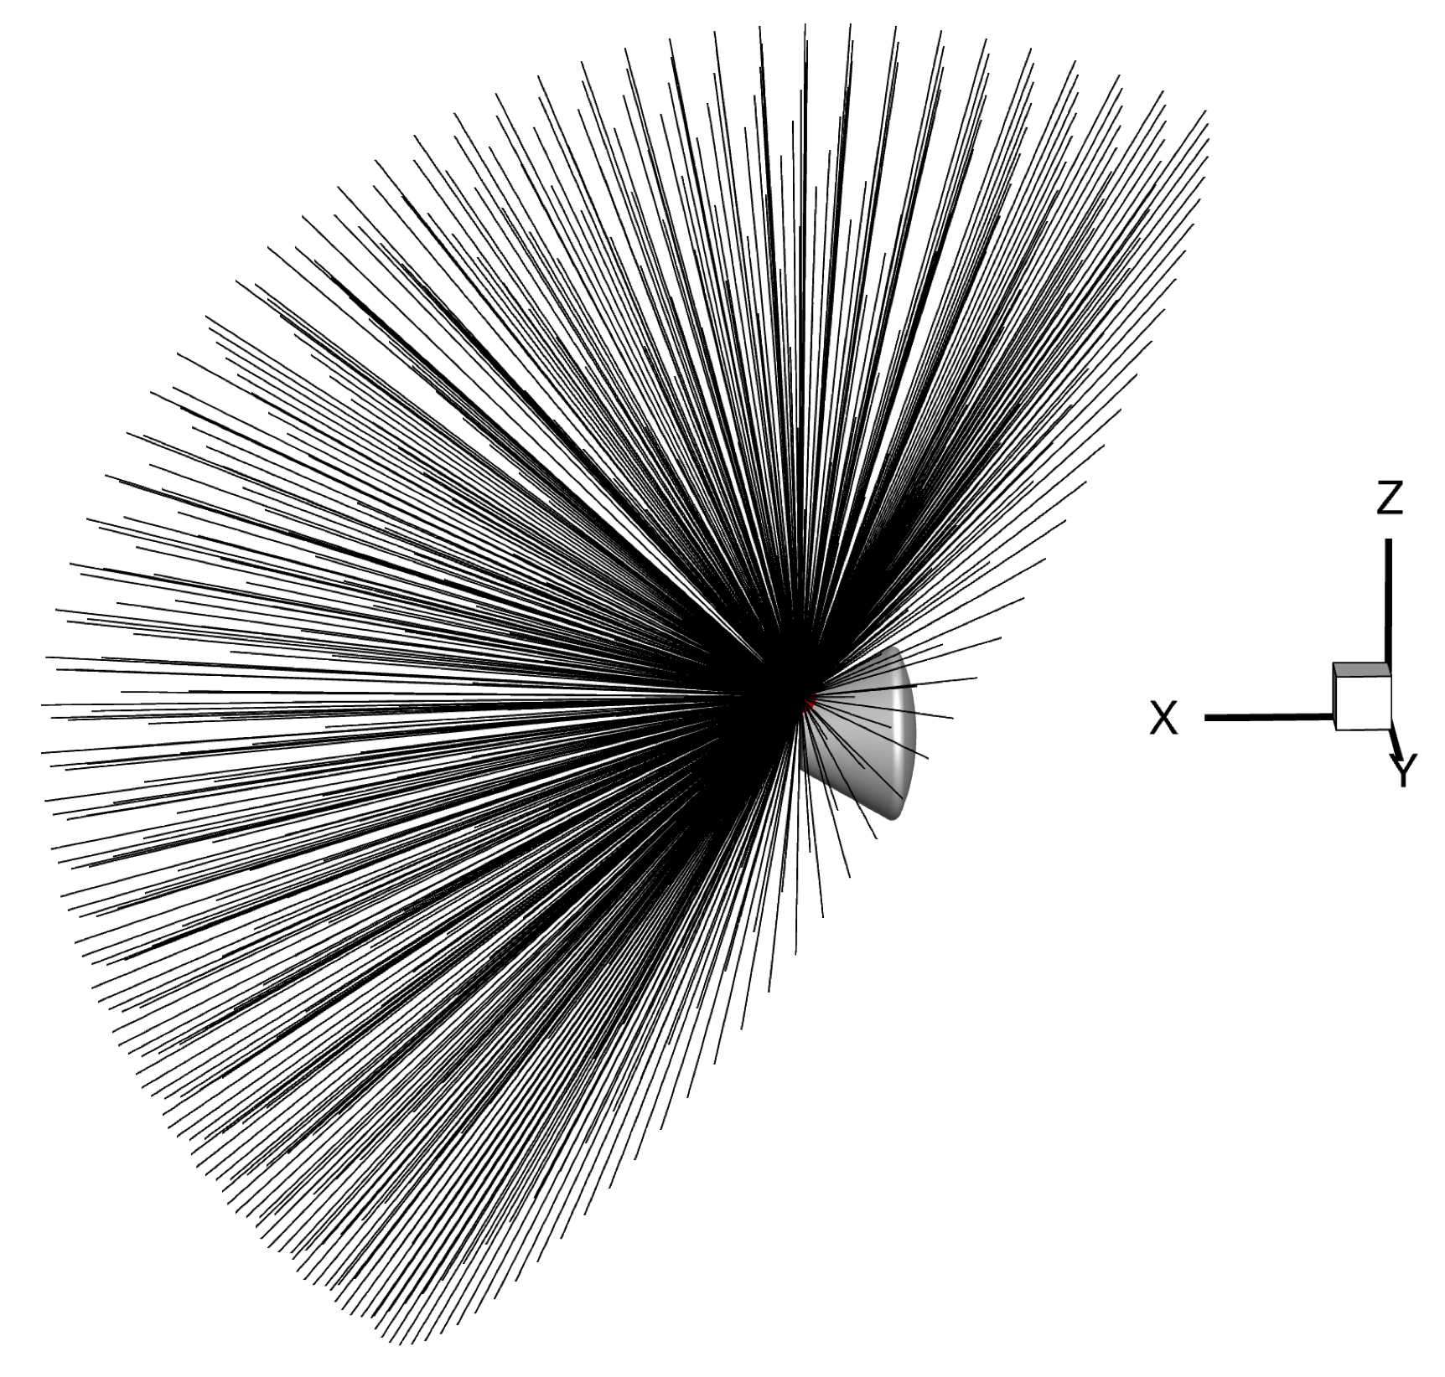
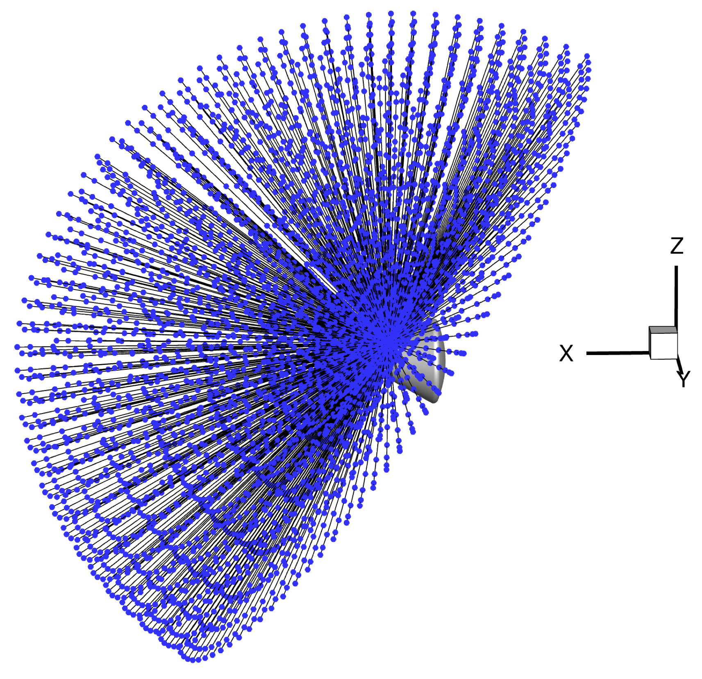
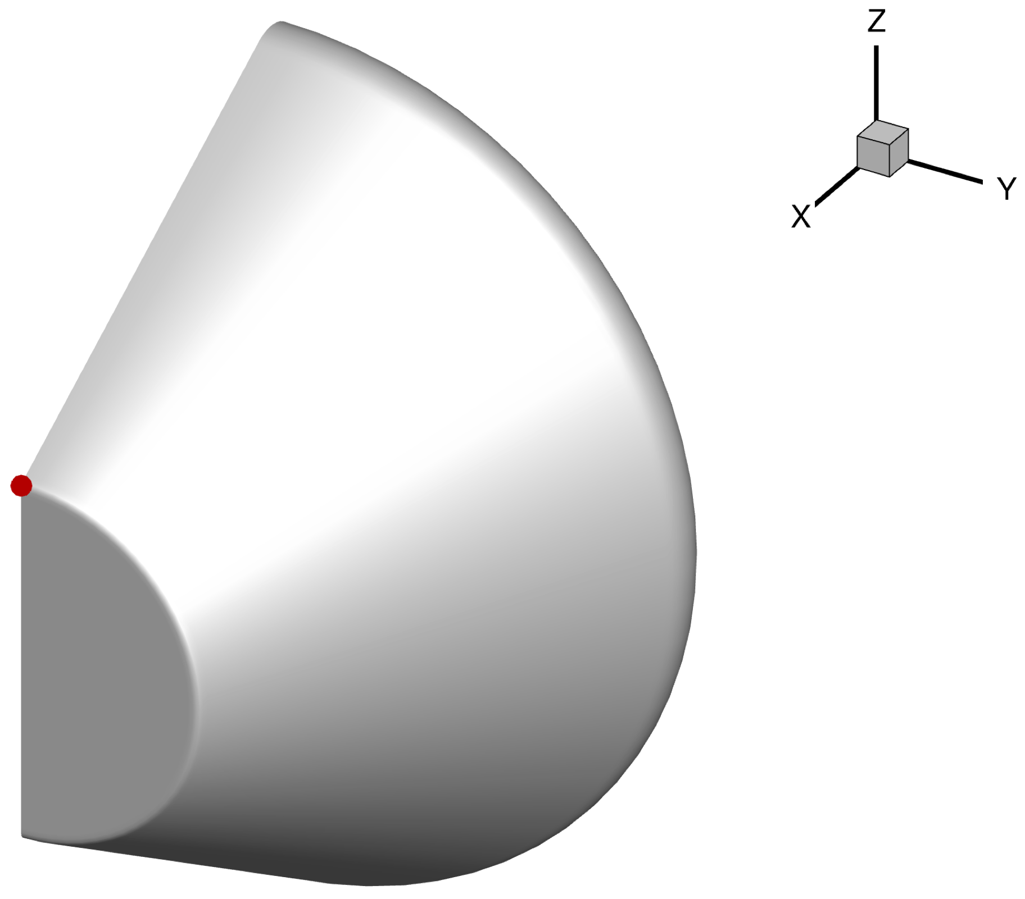
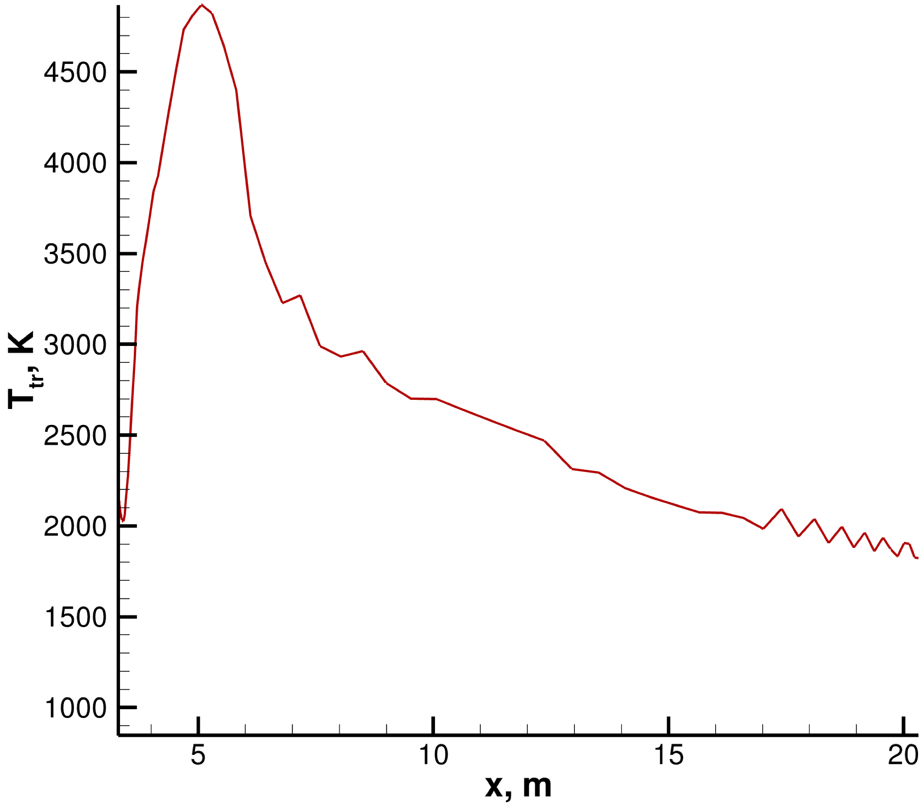
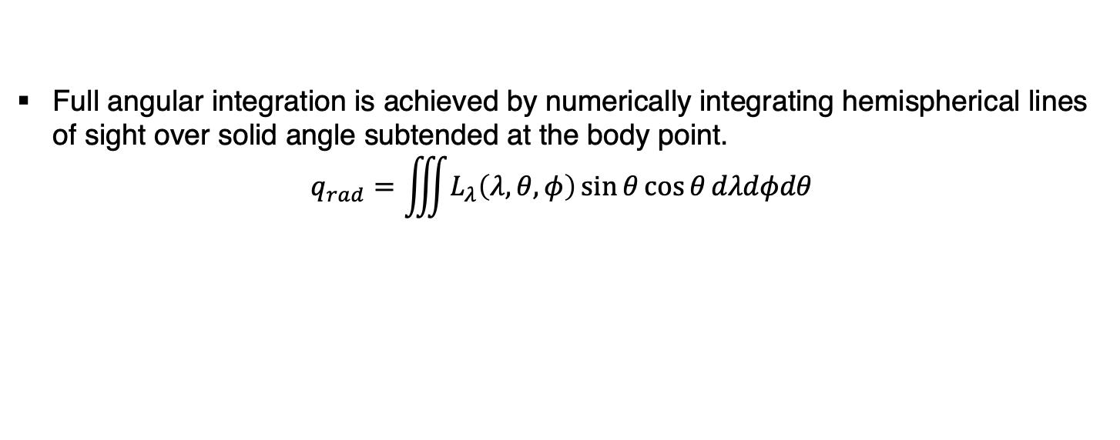
Methodology
Full angular integration is achieved by numerically integrating hemispherical lines of sight over solid angle subtended at the body point.
$$q_{rad}=\iiint{L_{λ}\left(λ,θ,φ\right)\sin{θ}\cos{θ}dλdφdθ}$$
Run USLOS
Output: los.g
Run USFLOWINTERP
Output: los.f
Run NEQAIR_DATA
Output: LOS.h5
Run NEQAIR

Slide 6
ANALYSIS
Backshell Radiation Analysis with US3D

Slide 7
Analysis
The analysis is performed by conducting three different studies:
Comparison of total radiative heat flux computed using US3D solution with DPLR solution
Comparison of total radiative heat flux computed using US3D solution with measured data
Comparison of total radiative heat flux computed using US3D solution of a hybrid mesh with measured data
All the studies were conducted for different Mars 2020 data points.

Slide 8
ANALYSIS: COMPARISON WITH DPLR
Backshell Radiation Analysis with US3D

Slide 9
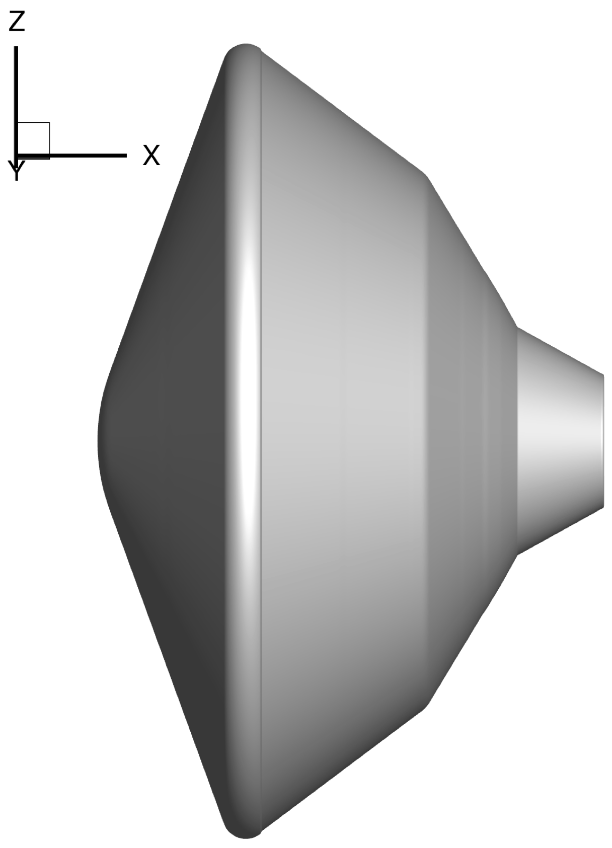
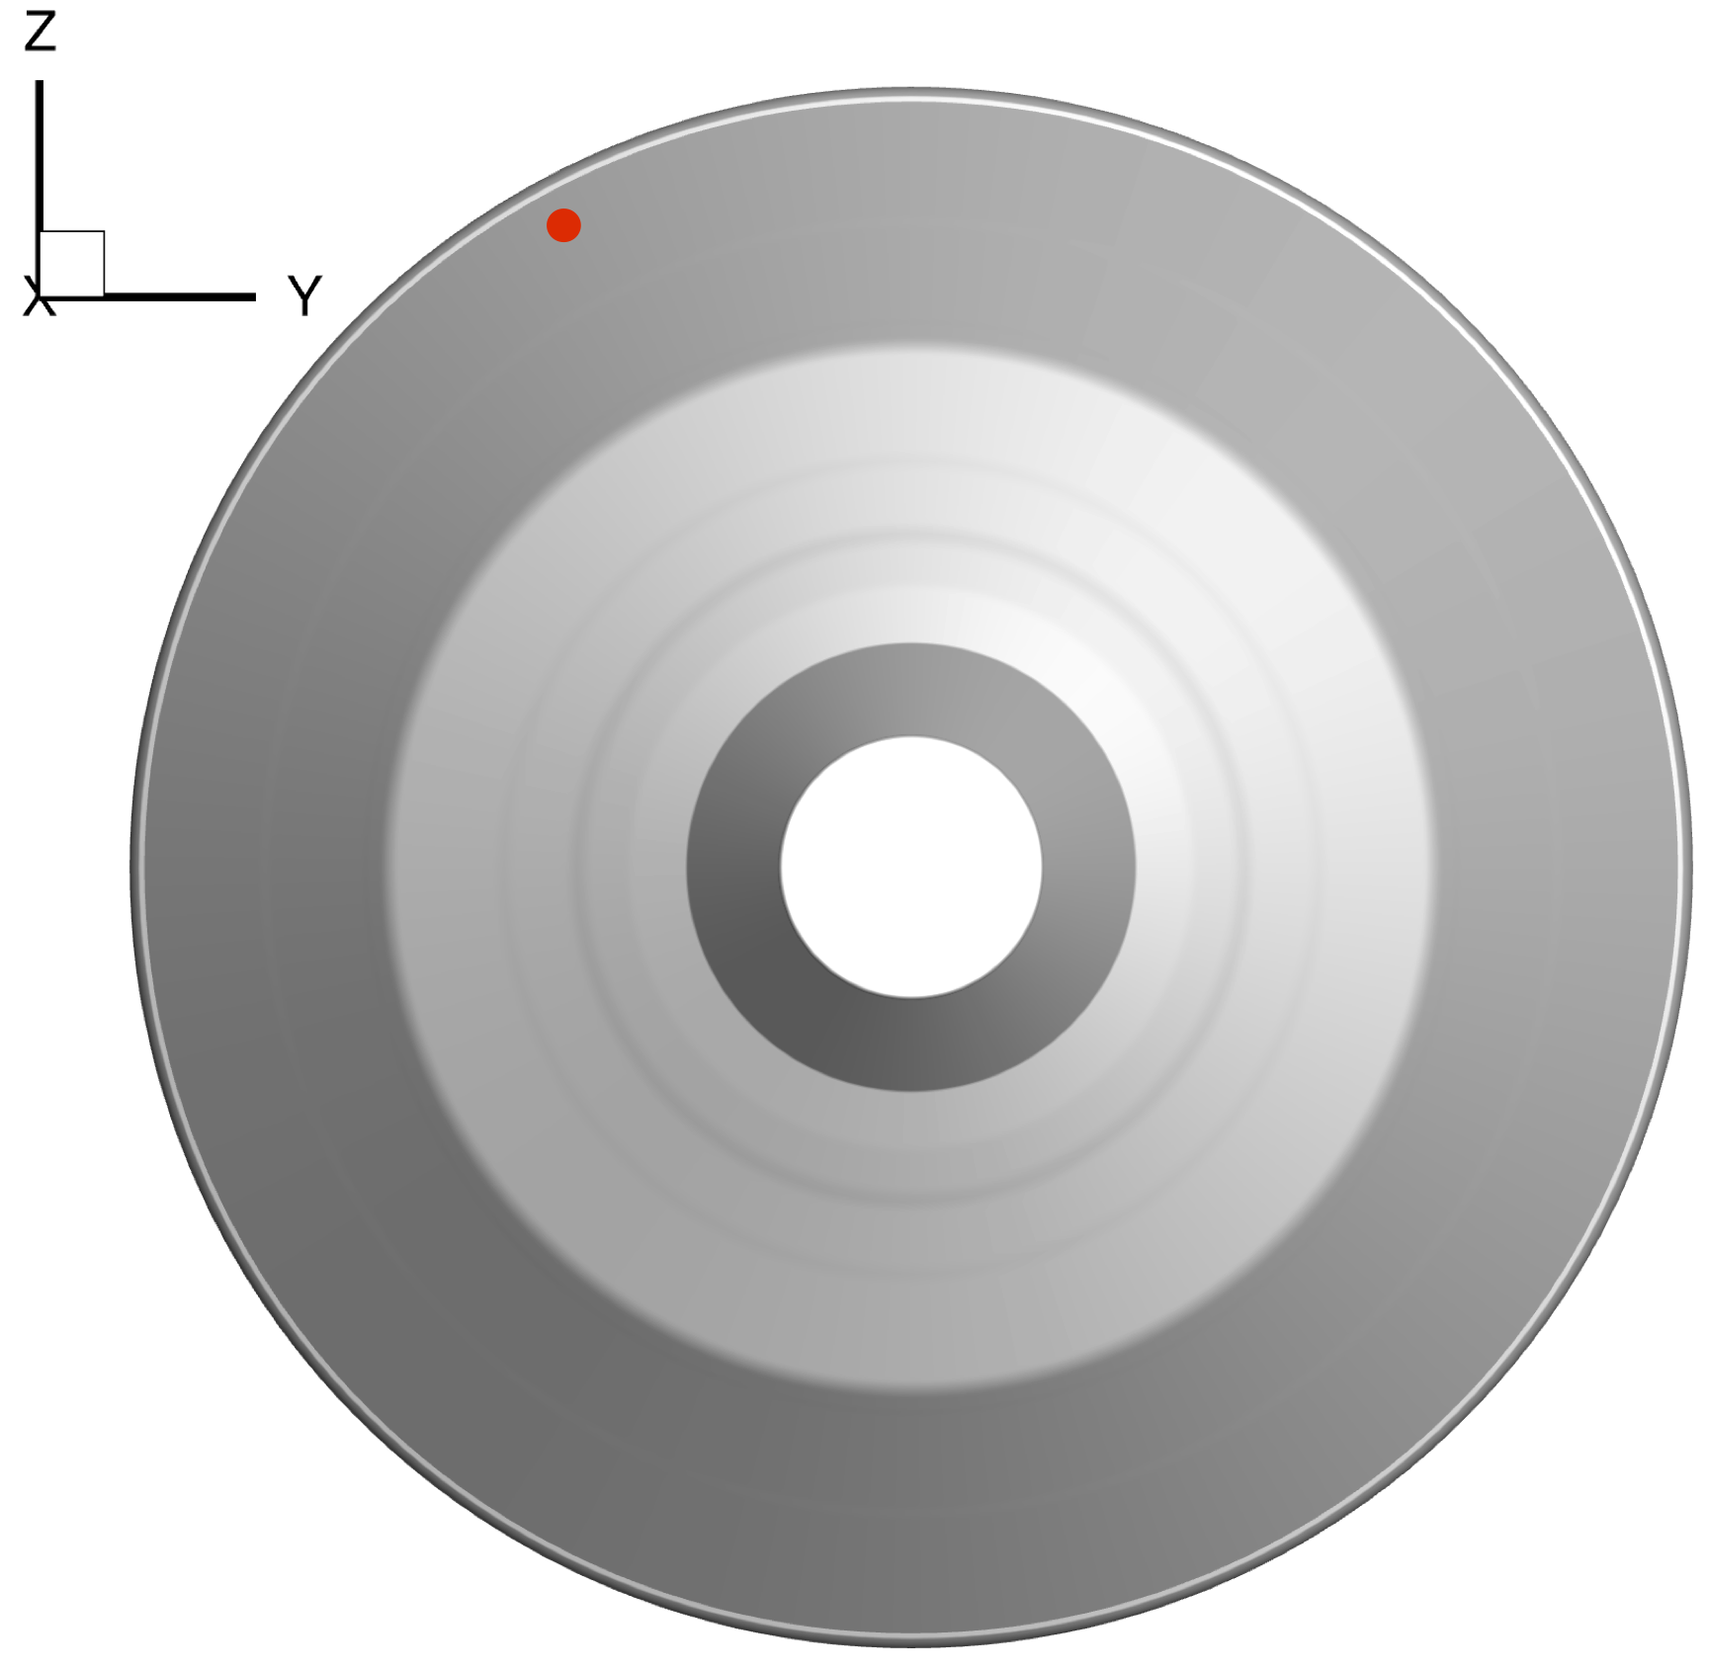
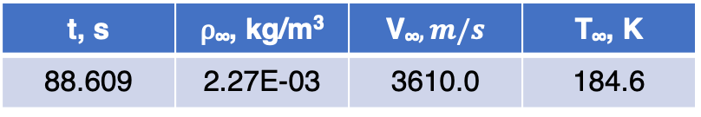
Analysis – Comparison with DPLR
Full body simulations were performed using both DPLR and US3D at trajectory point that corresponds to peak heating.
Species – CO₂, CO, N₂, O₂, NO, C, N, O.
t, s | ⍴∞, kg/m³ | V∞$, m/s$ | T∞, K
88.609 | 2.27E-03 | 3610.0 | 184.6
Mars 2020 geometry
Heat flux gauge location on the Backshell

Slide 10
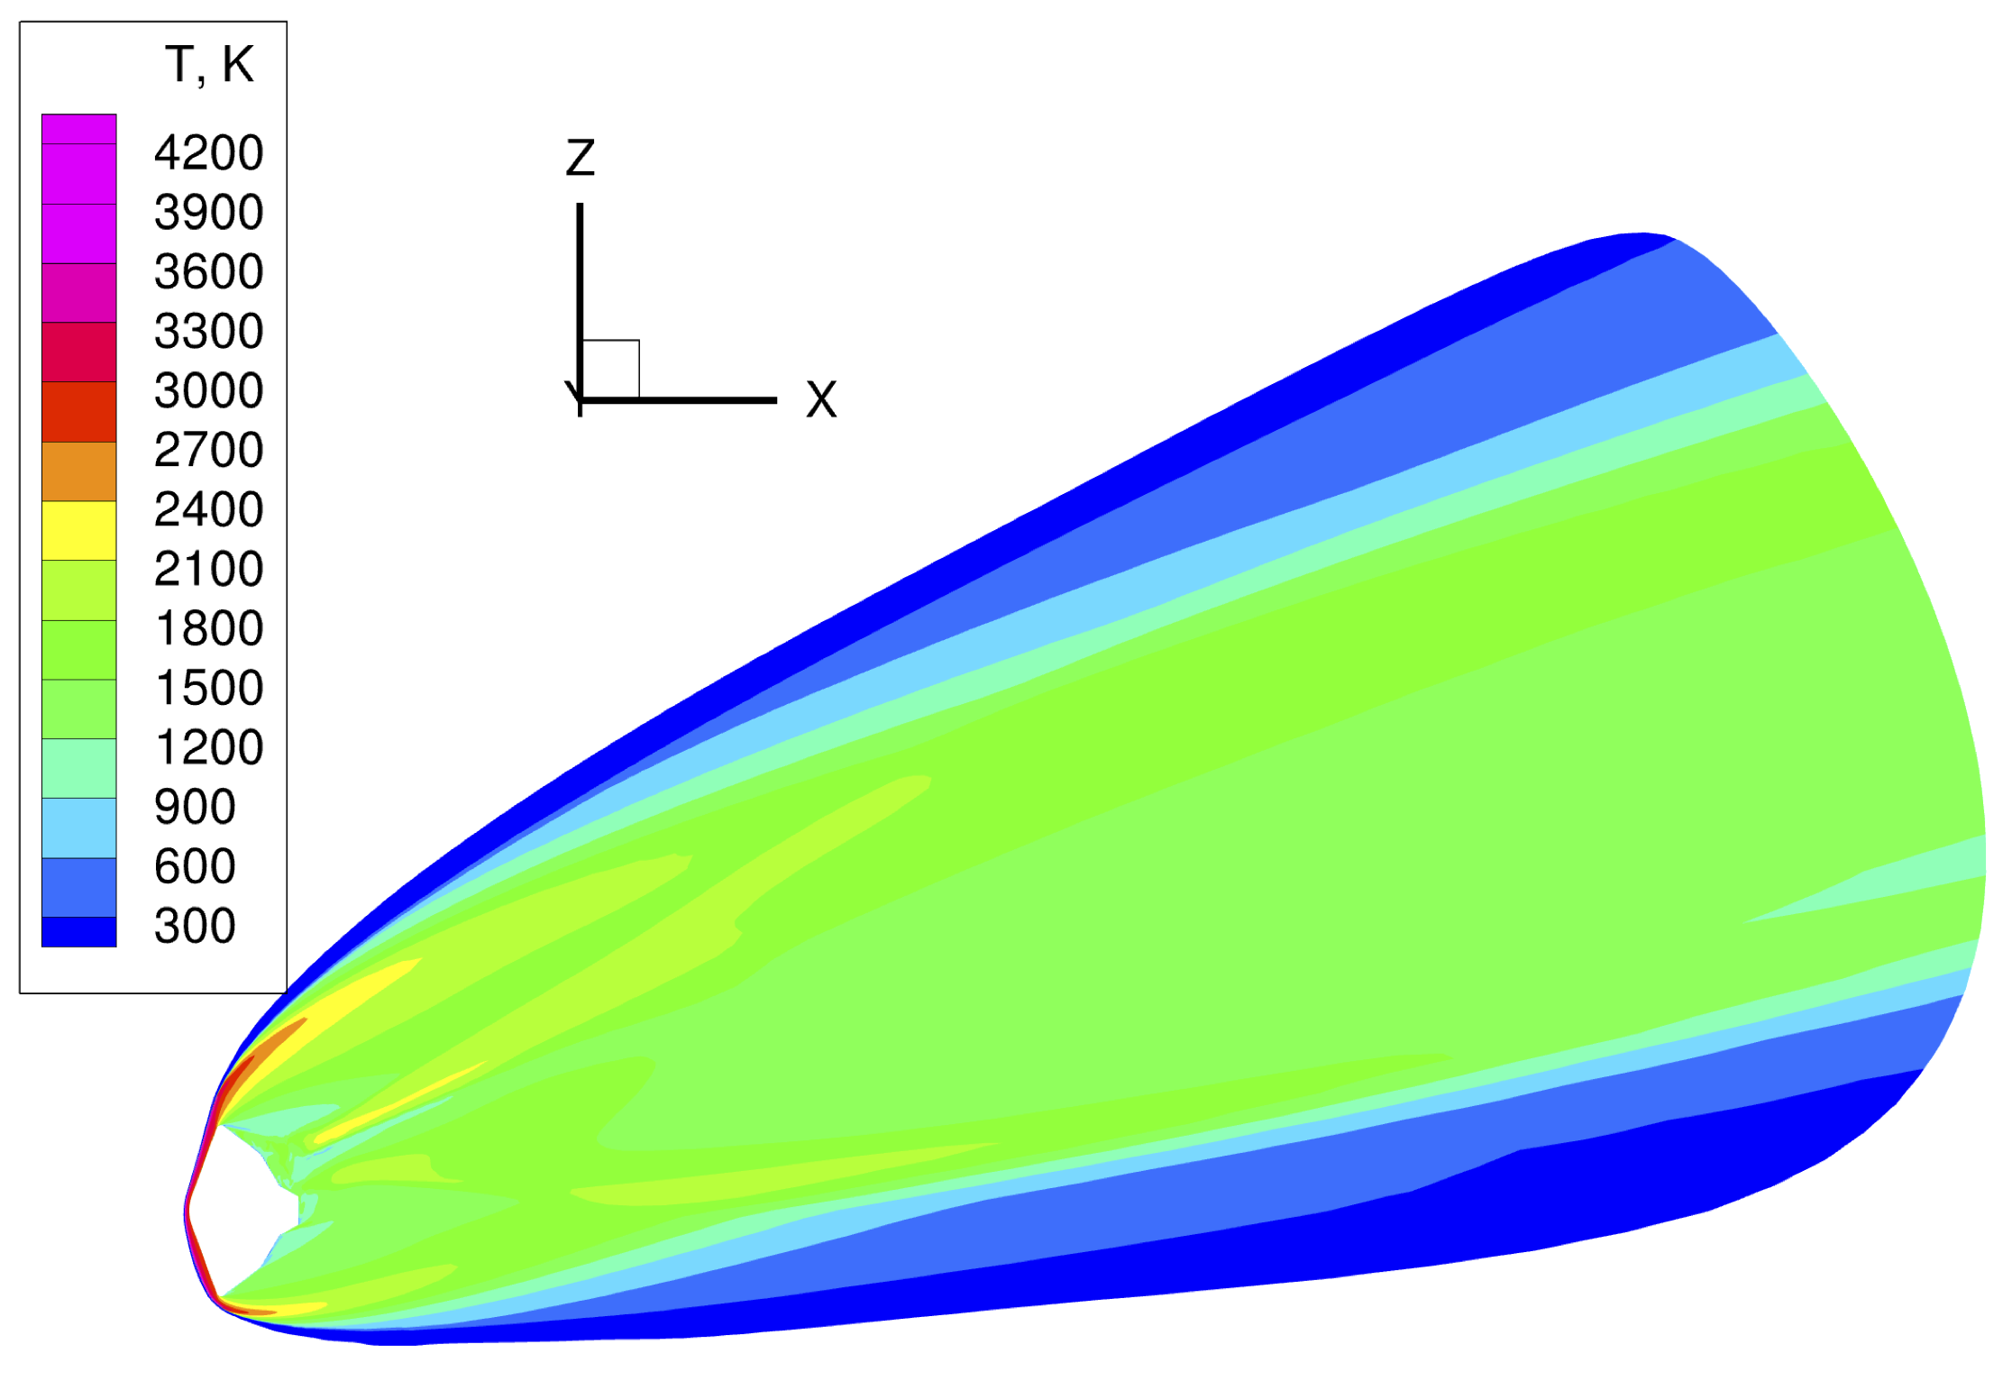
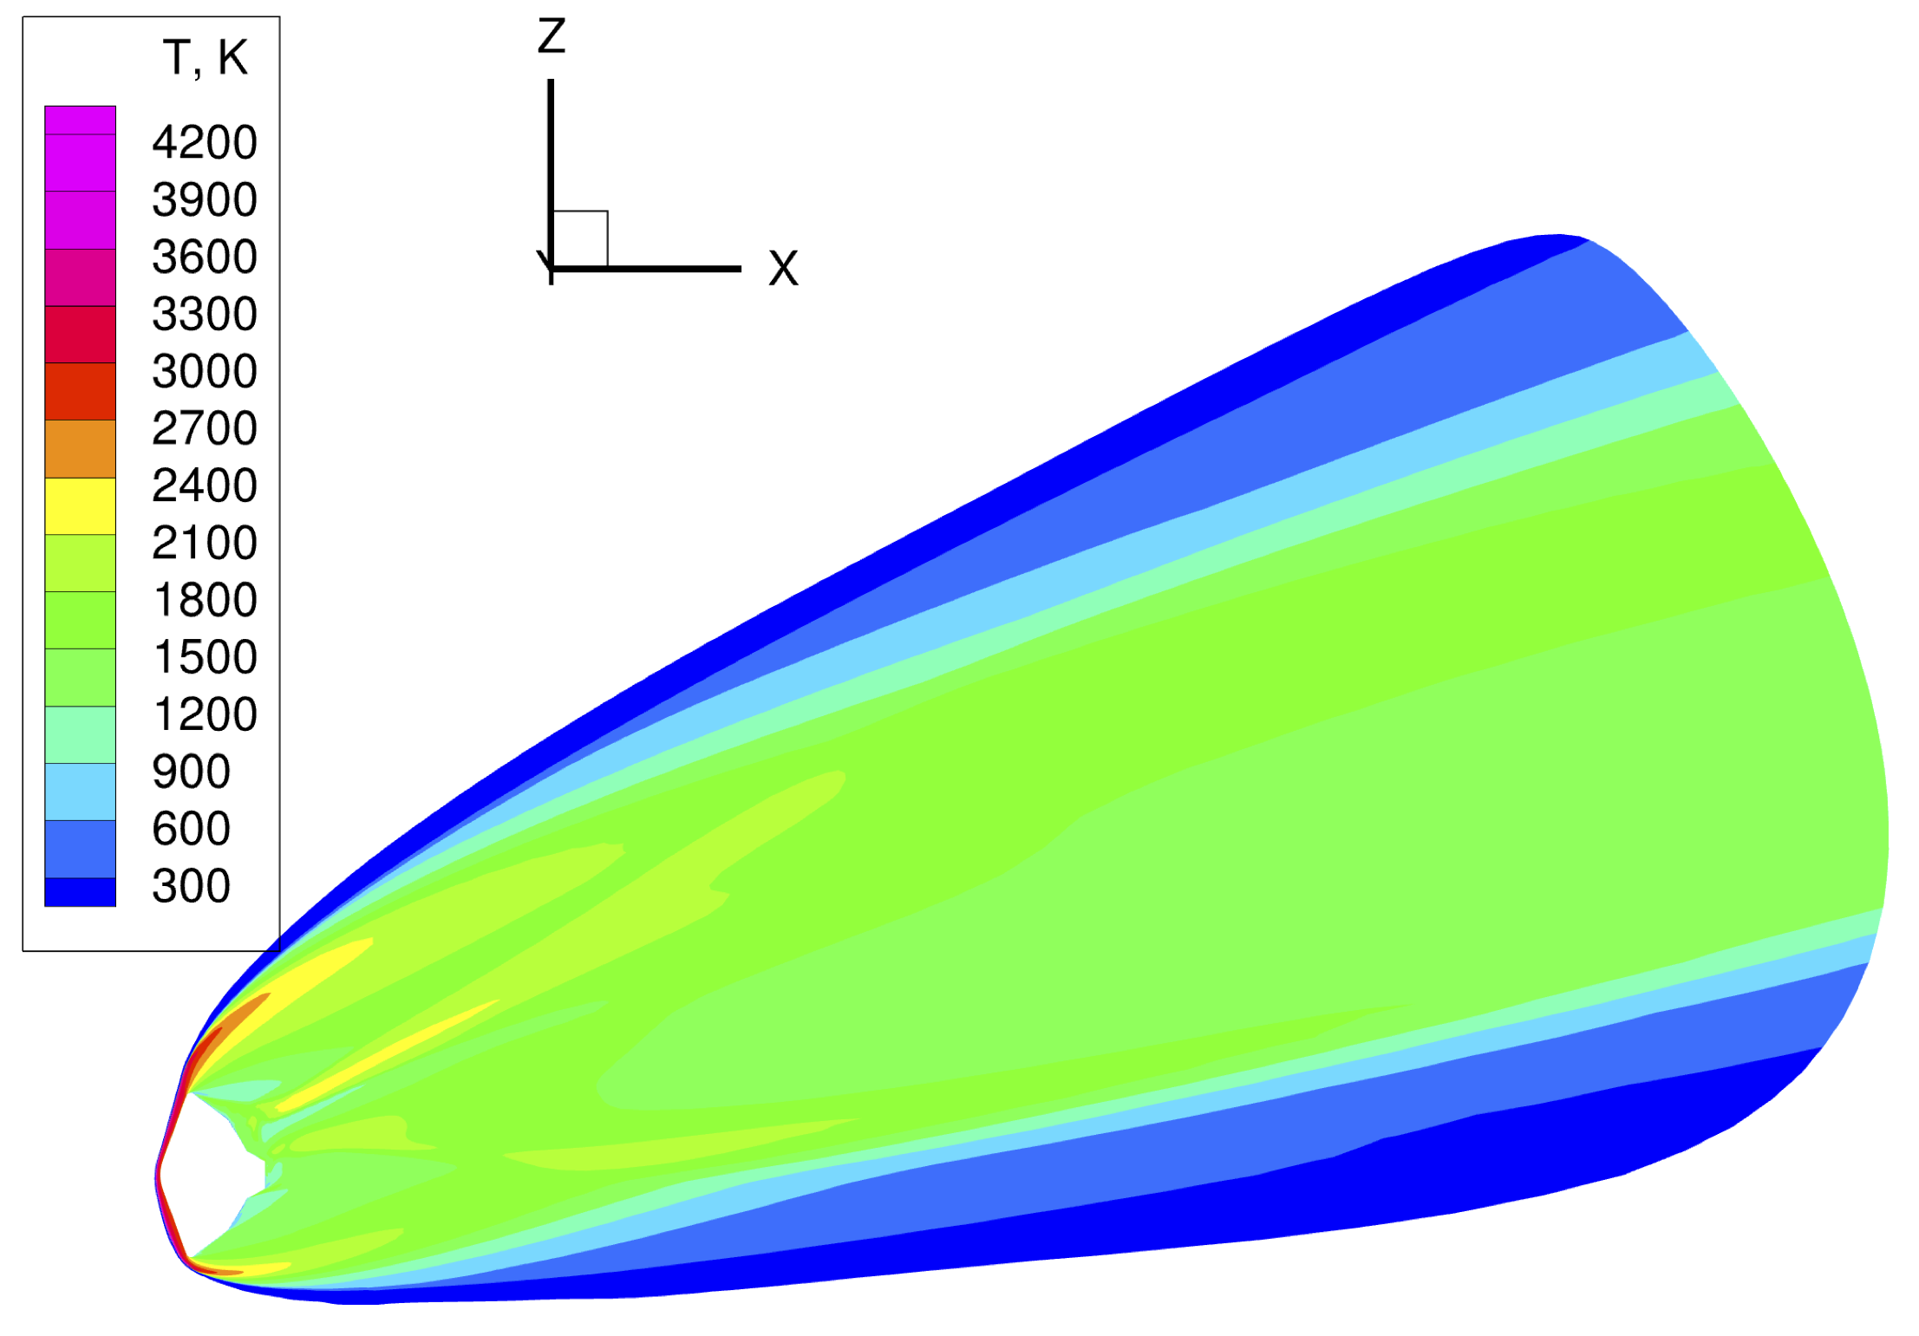
Analysis – Comparison with DPLR: CFD Solutions
DPLR
US3D
The solutions look visibly similar to each other.

Slide 11
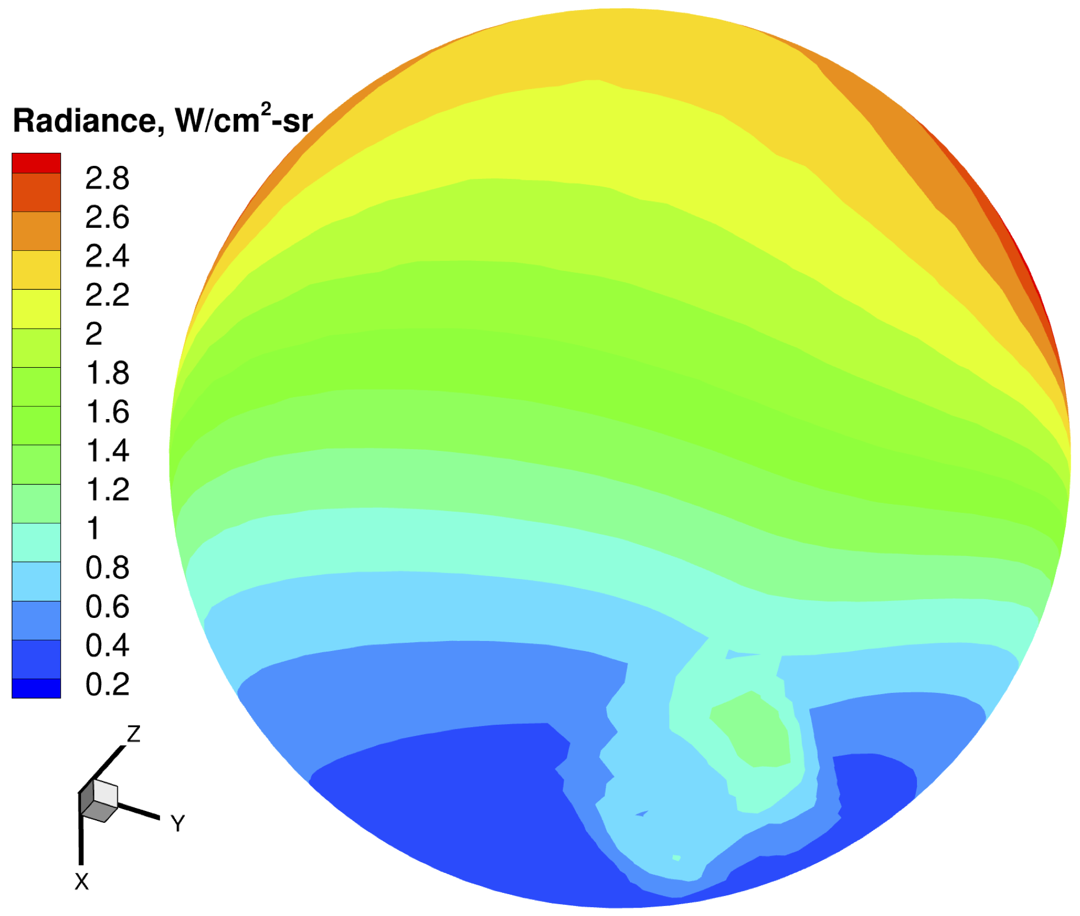
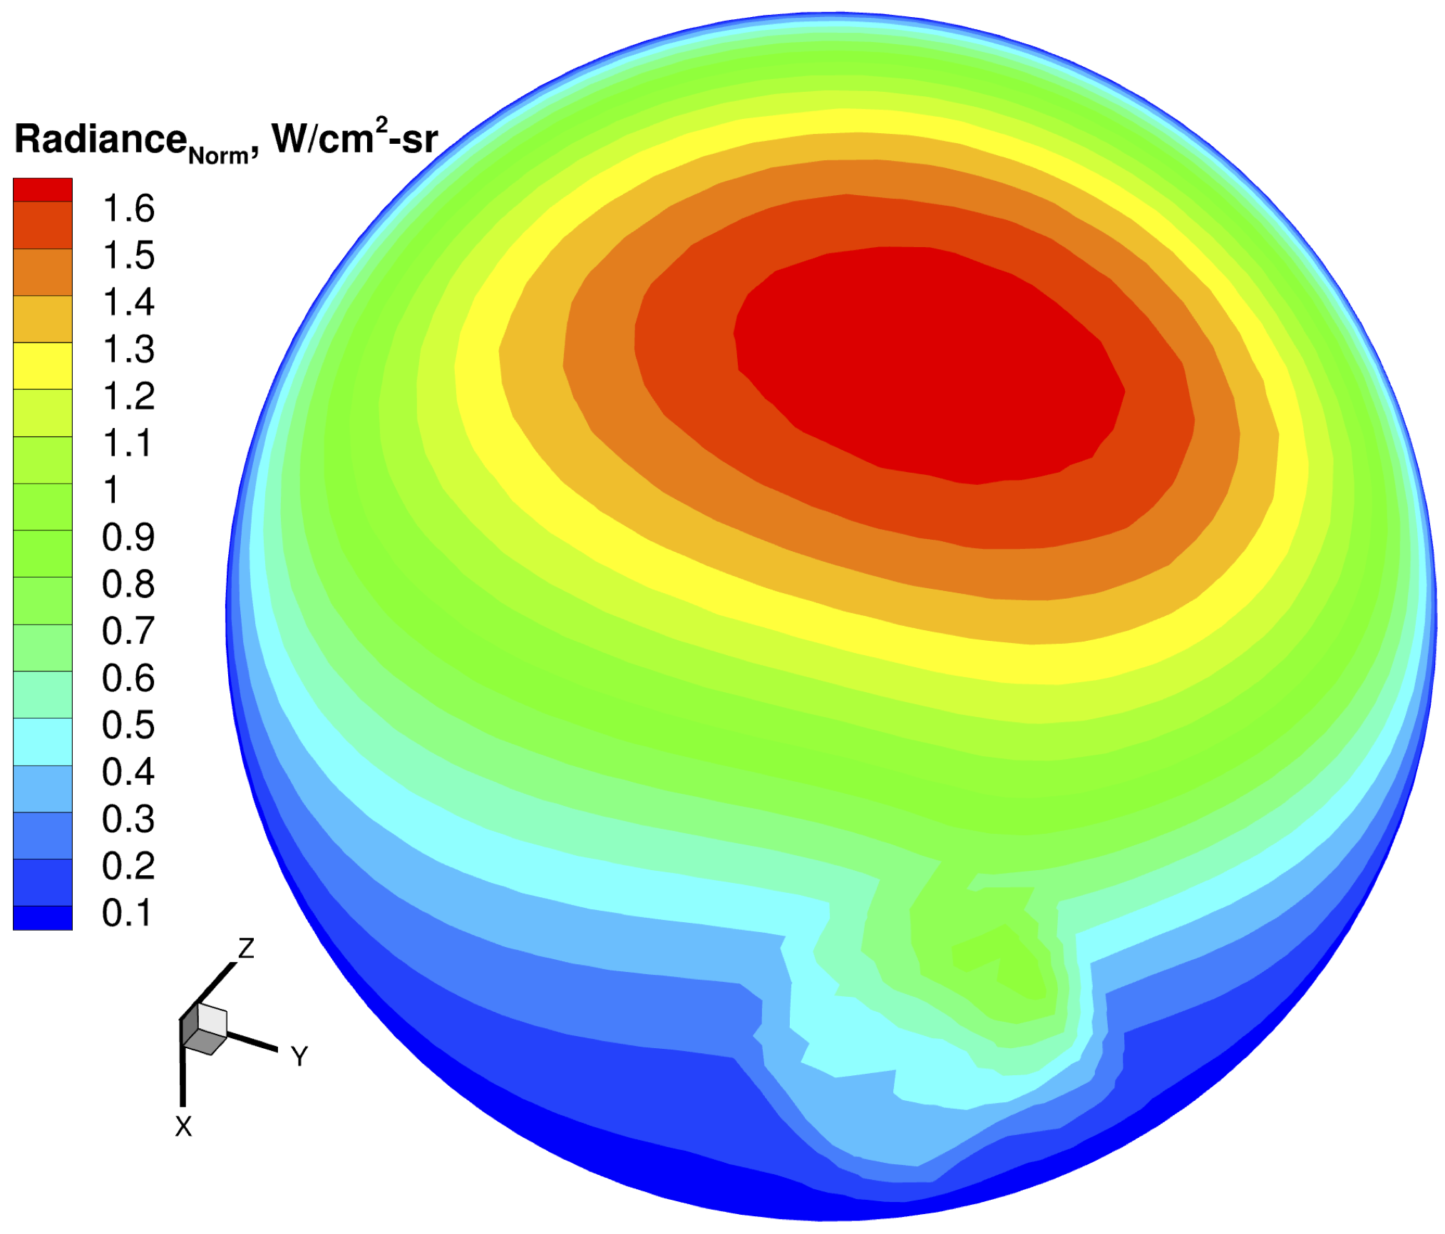


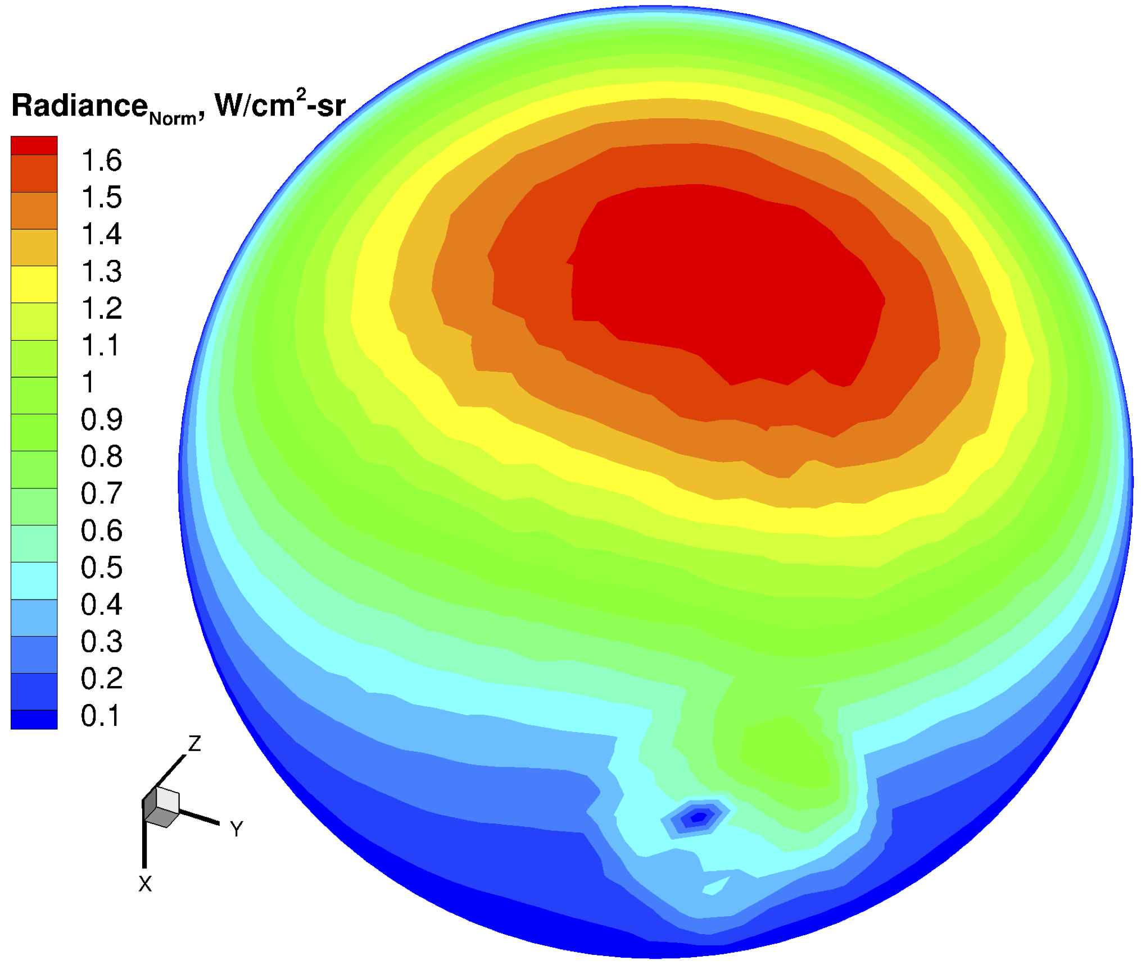
Analysis – Comparison with DPLR: Radiance
Radiance
Normal component of Radiance
DPLR
US3D

Slide 12
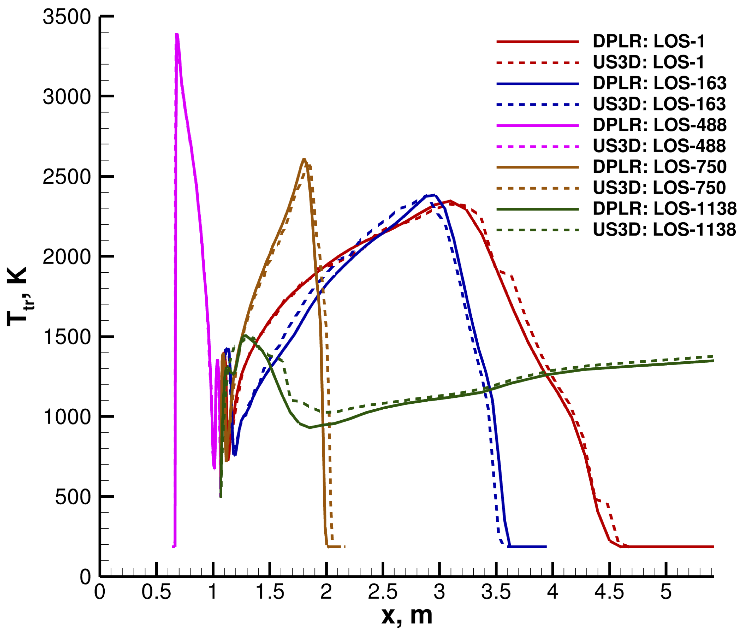
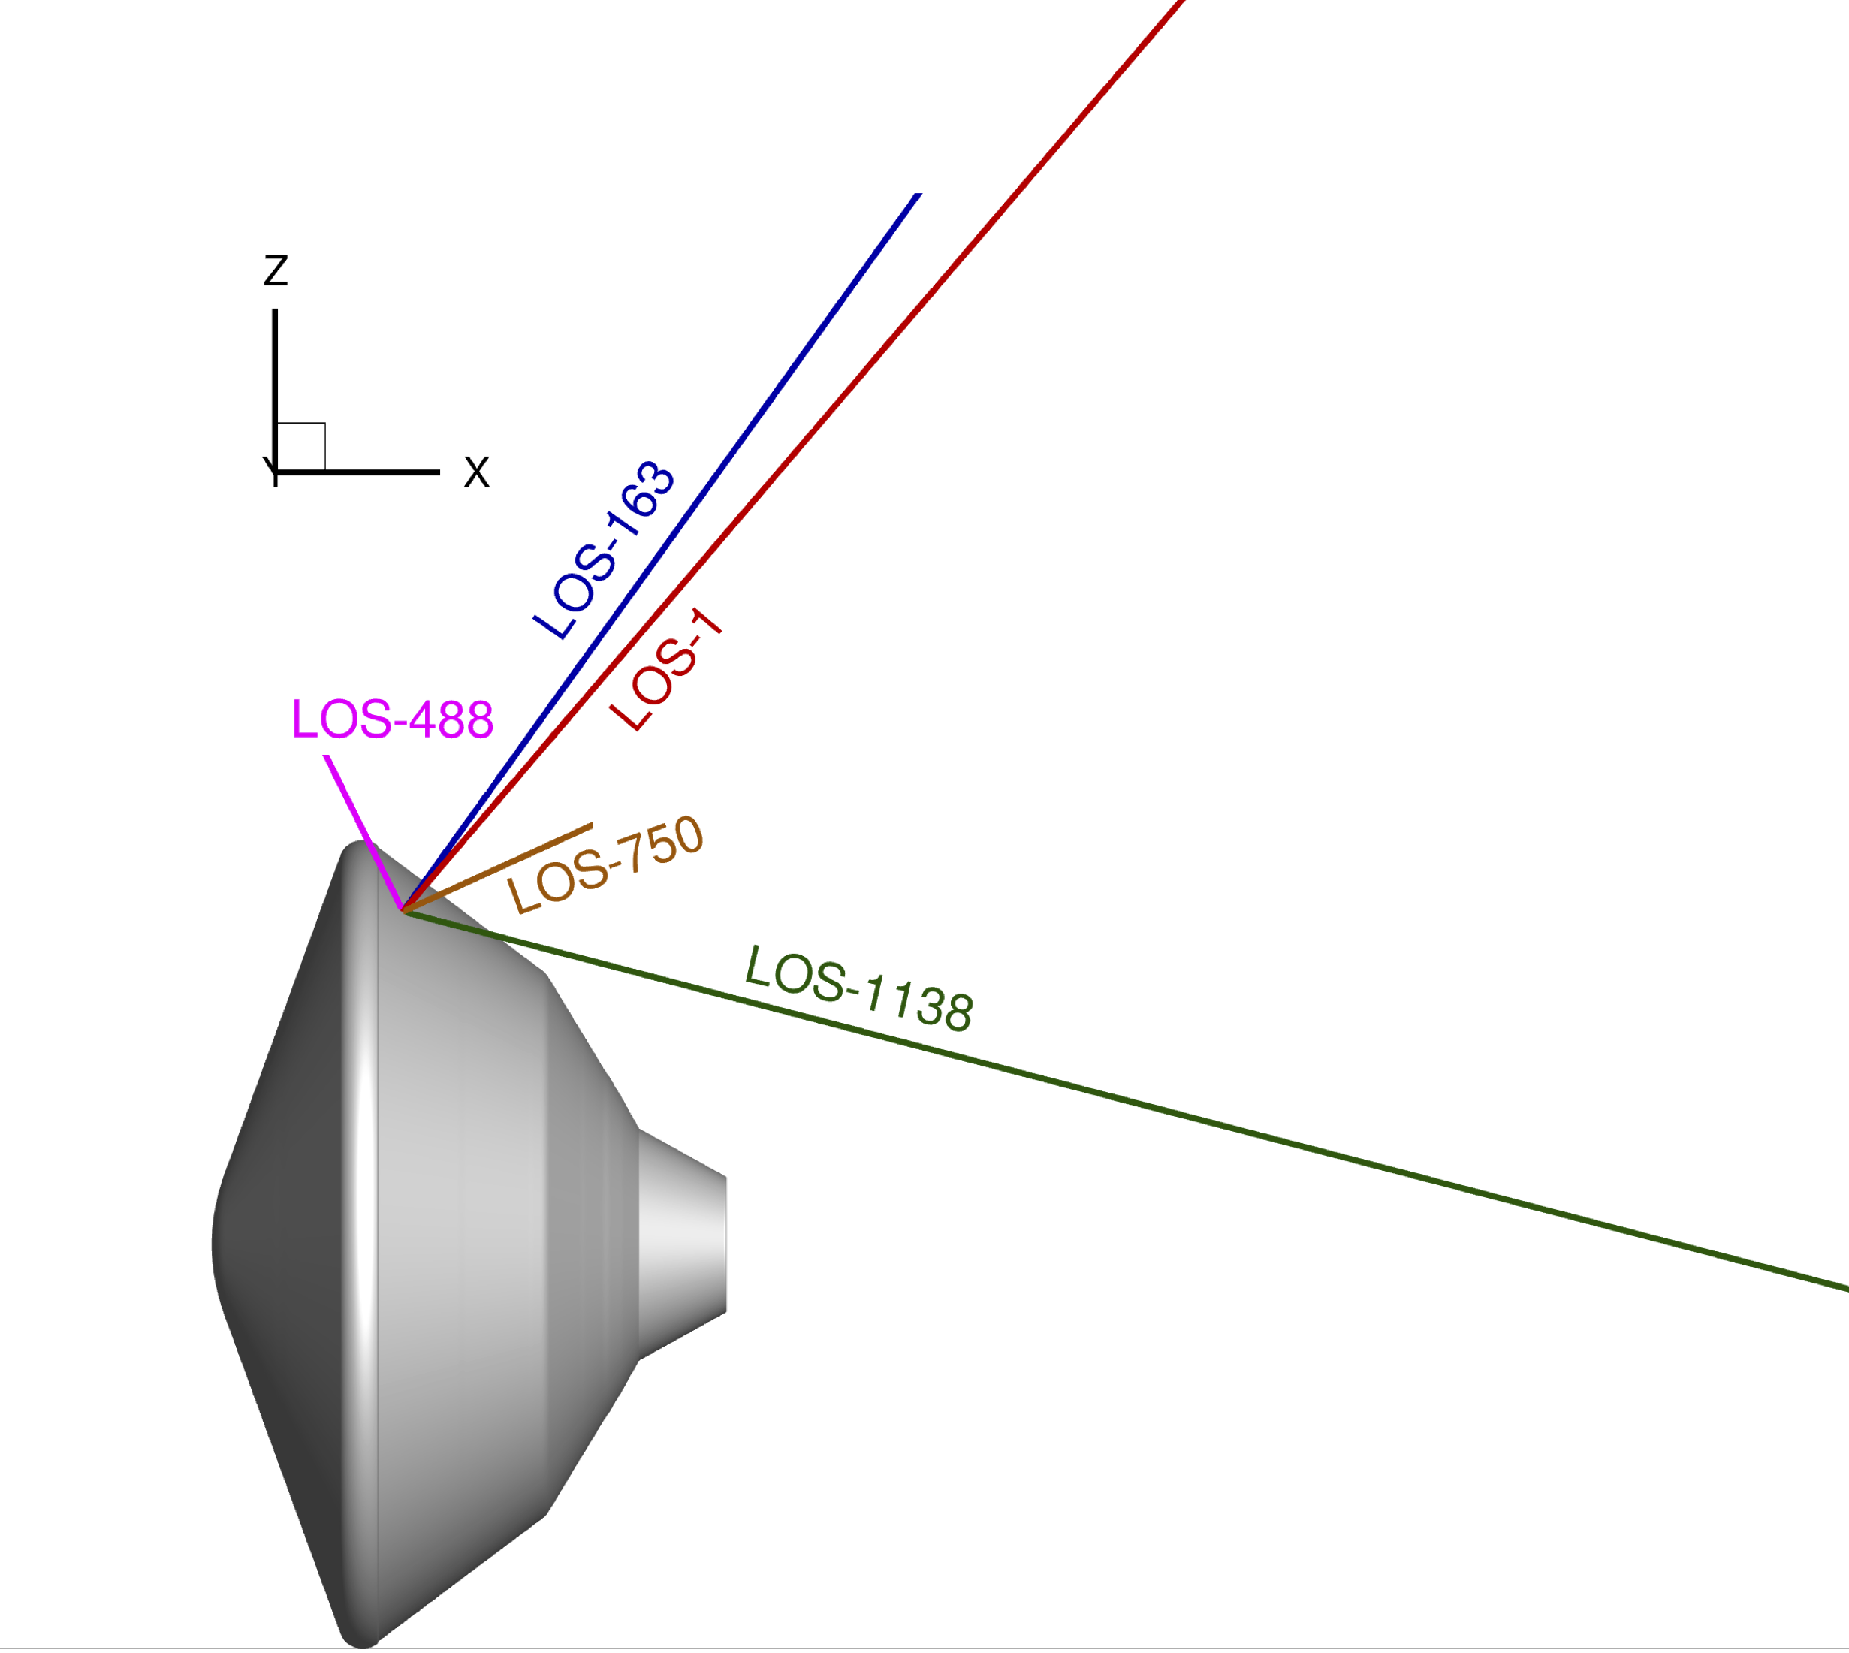
Analysis – Comparison with DPLR: Flow interpolation
Noticeable difference exist between DPLR and US3D flow interpolations, particularly for LOS in the wake region.

Slide 13
Analysis – Comparison with DPLR: Total radiance
Solver | Full angular integration heat flux (W/cm²) | NEQAIR Time, s
DPLR | 4.263 | 5117
US3D | 4.304 | 5118
The relative difference of total radiative heat flux between DPLR and US3D is around 0.9%.
The present method (brute force) uses 1300 lines of sight.
NEQAIR 15.2 provides an adaptive refinement option that calculates the total radiance with optimal lines of sight and significantly less computational time.

Slide 14
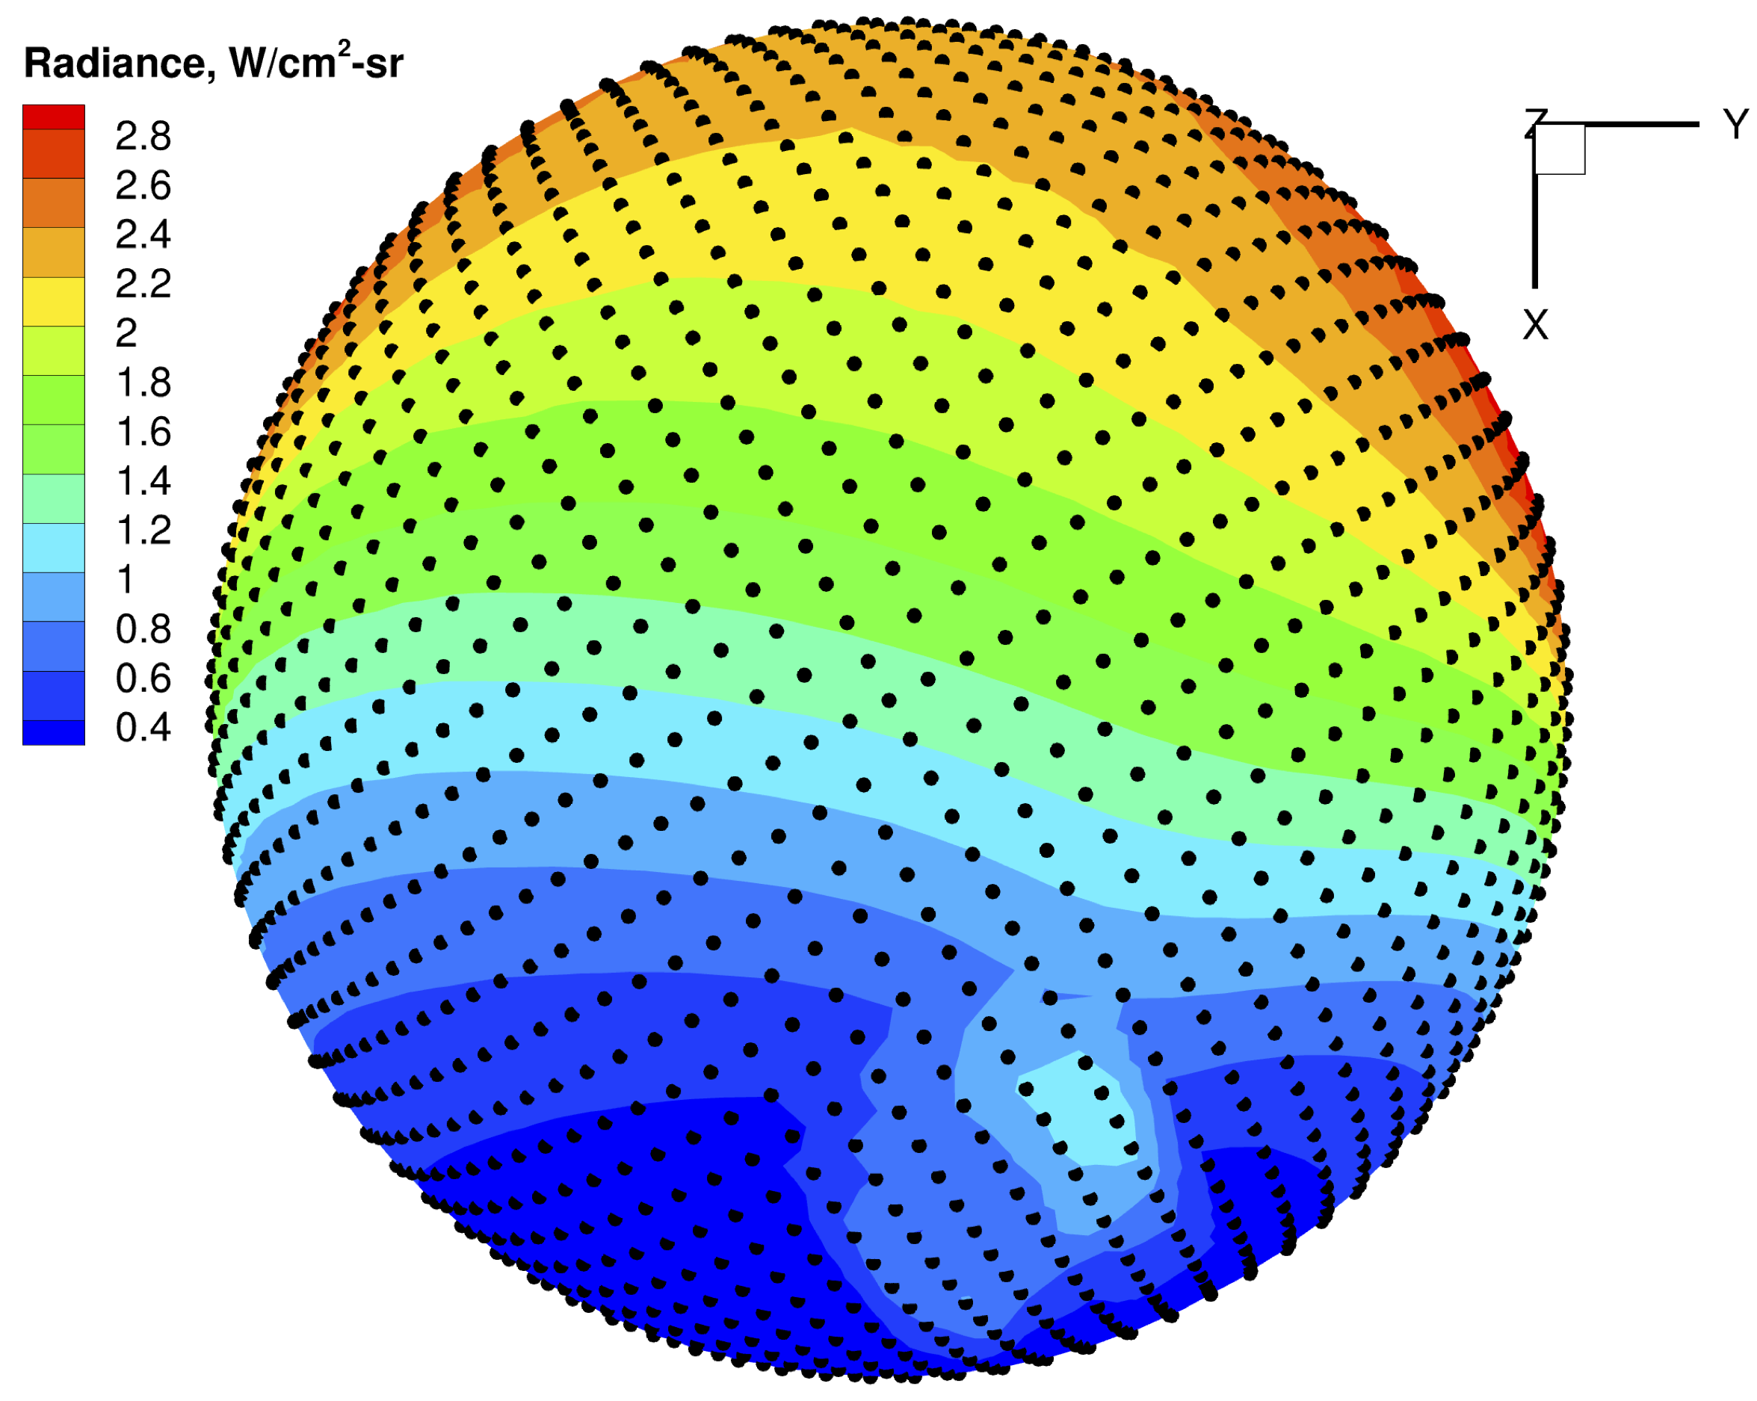
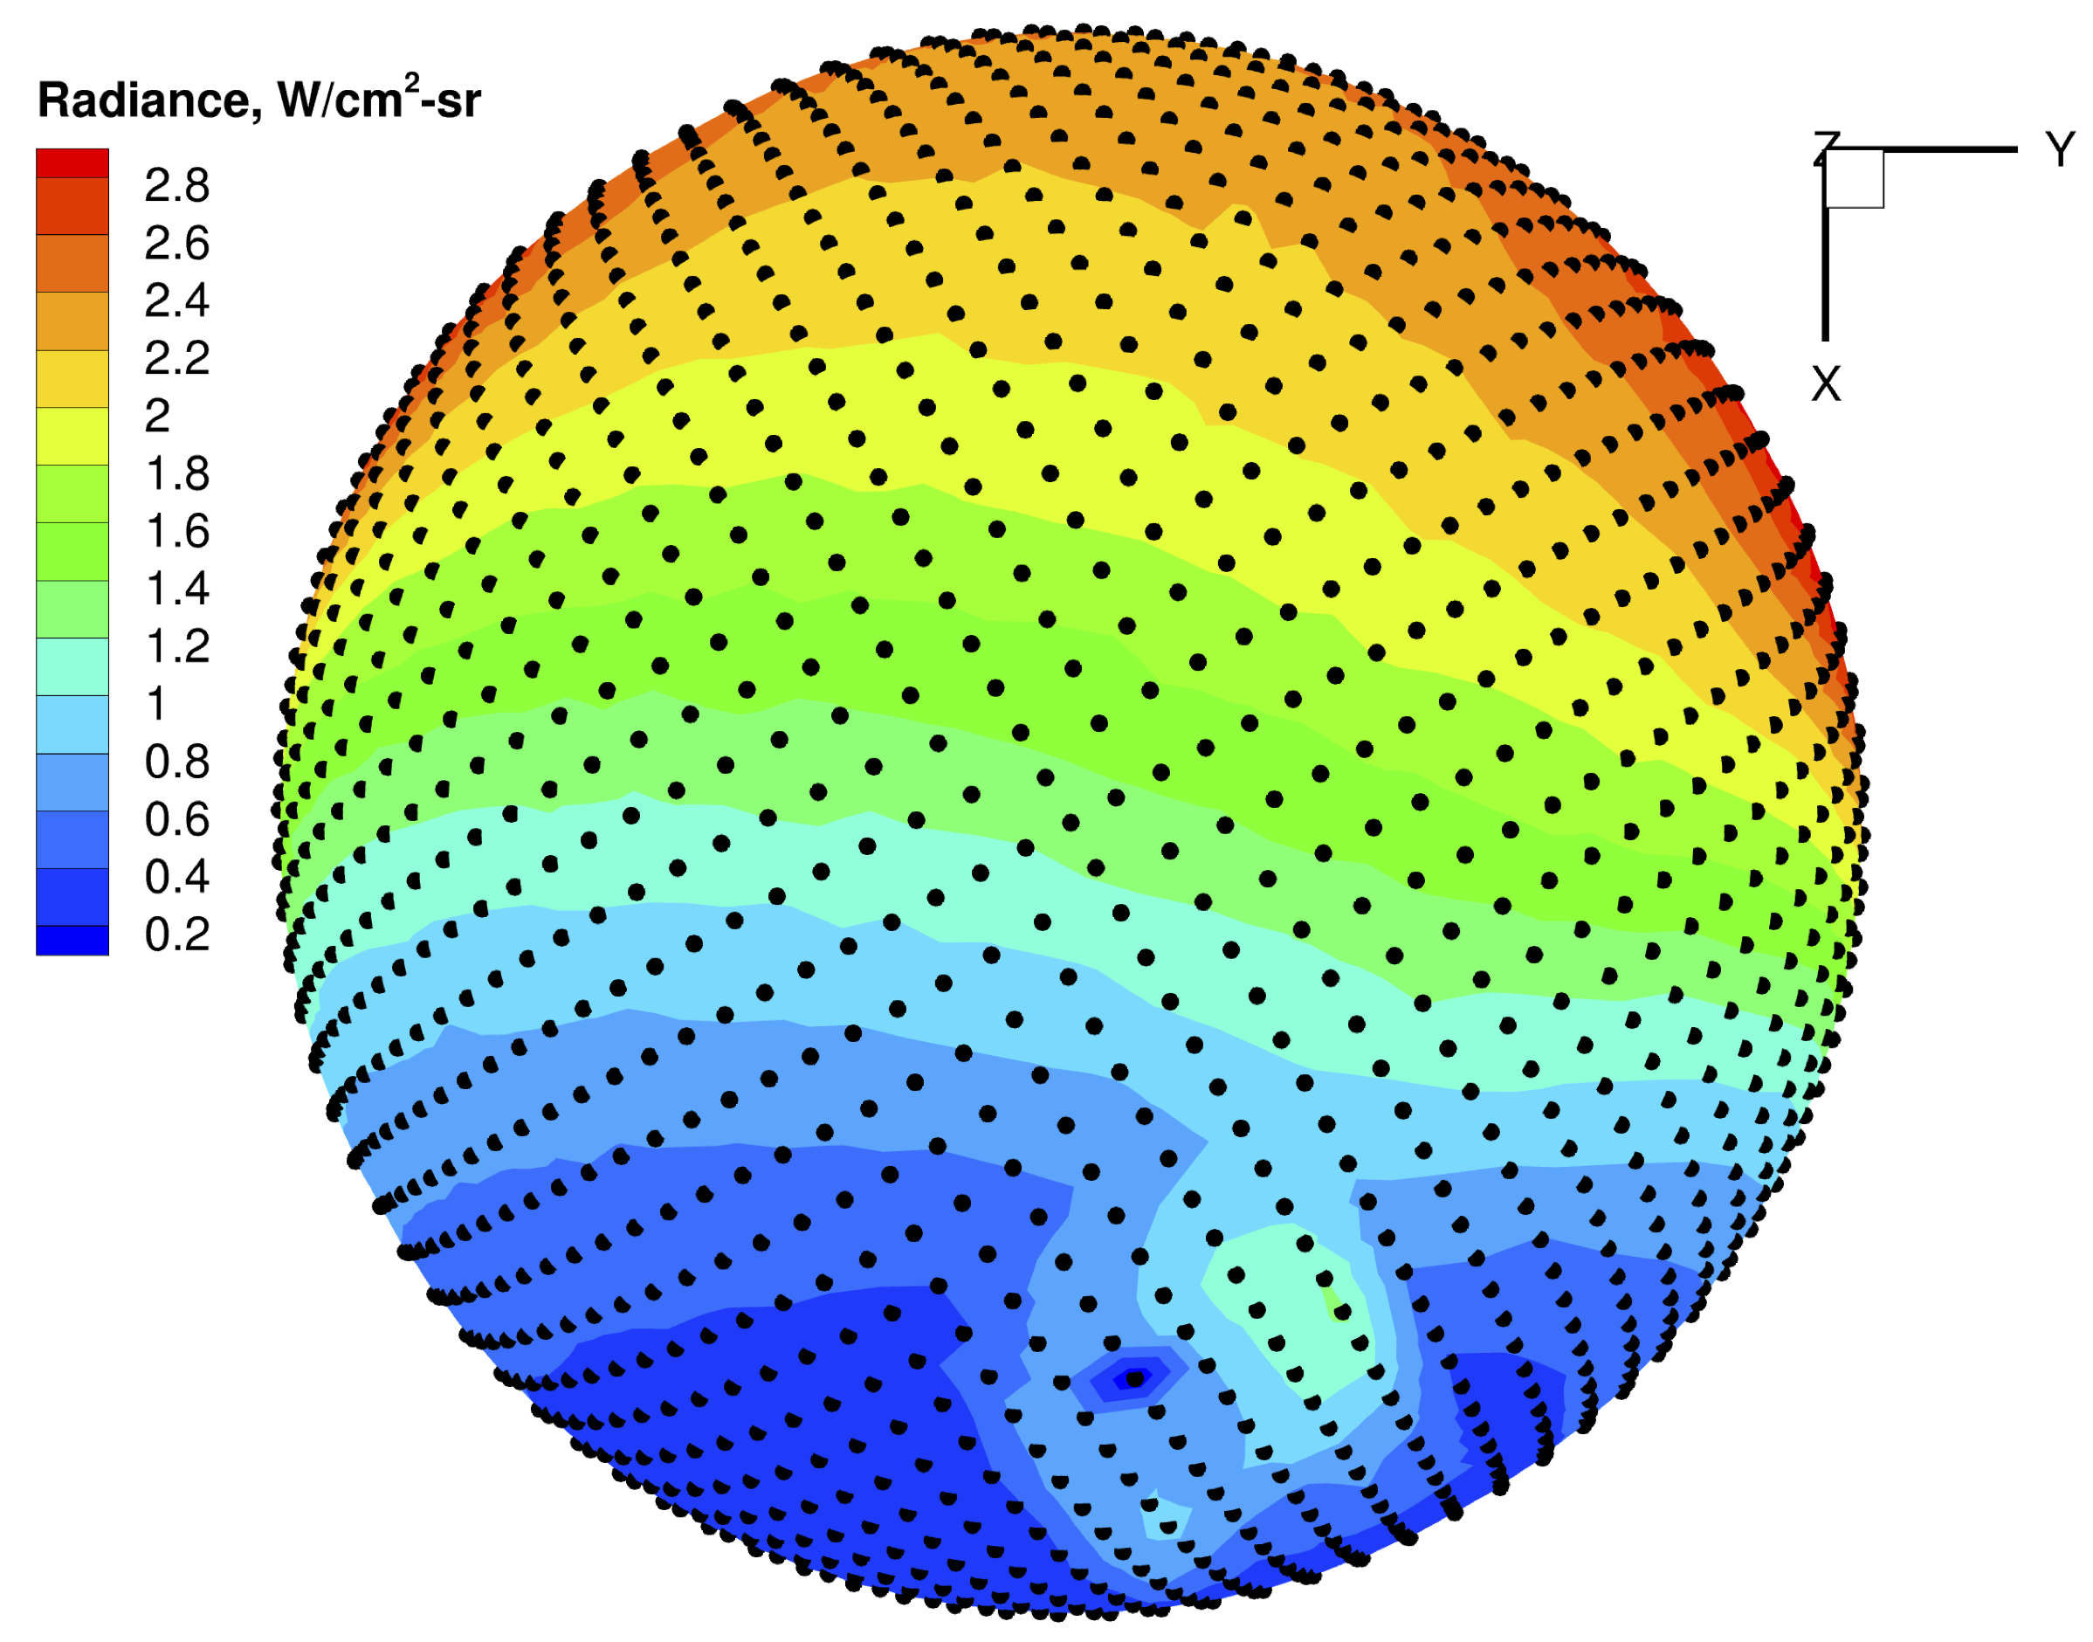
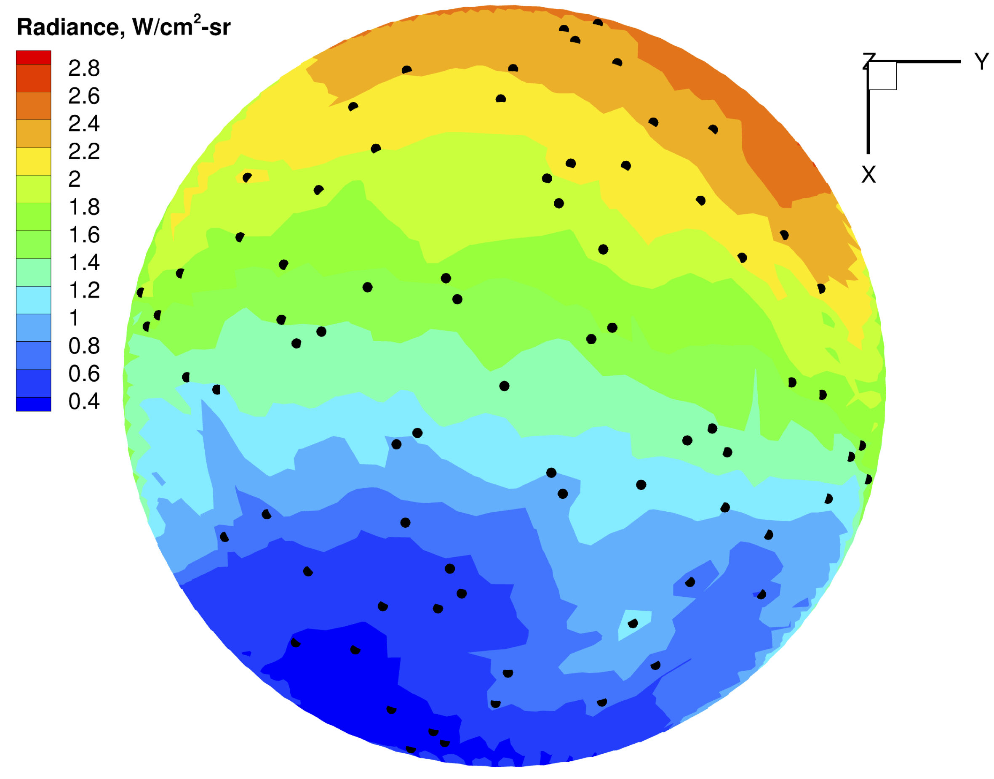
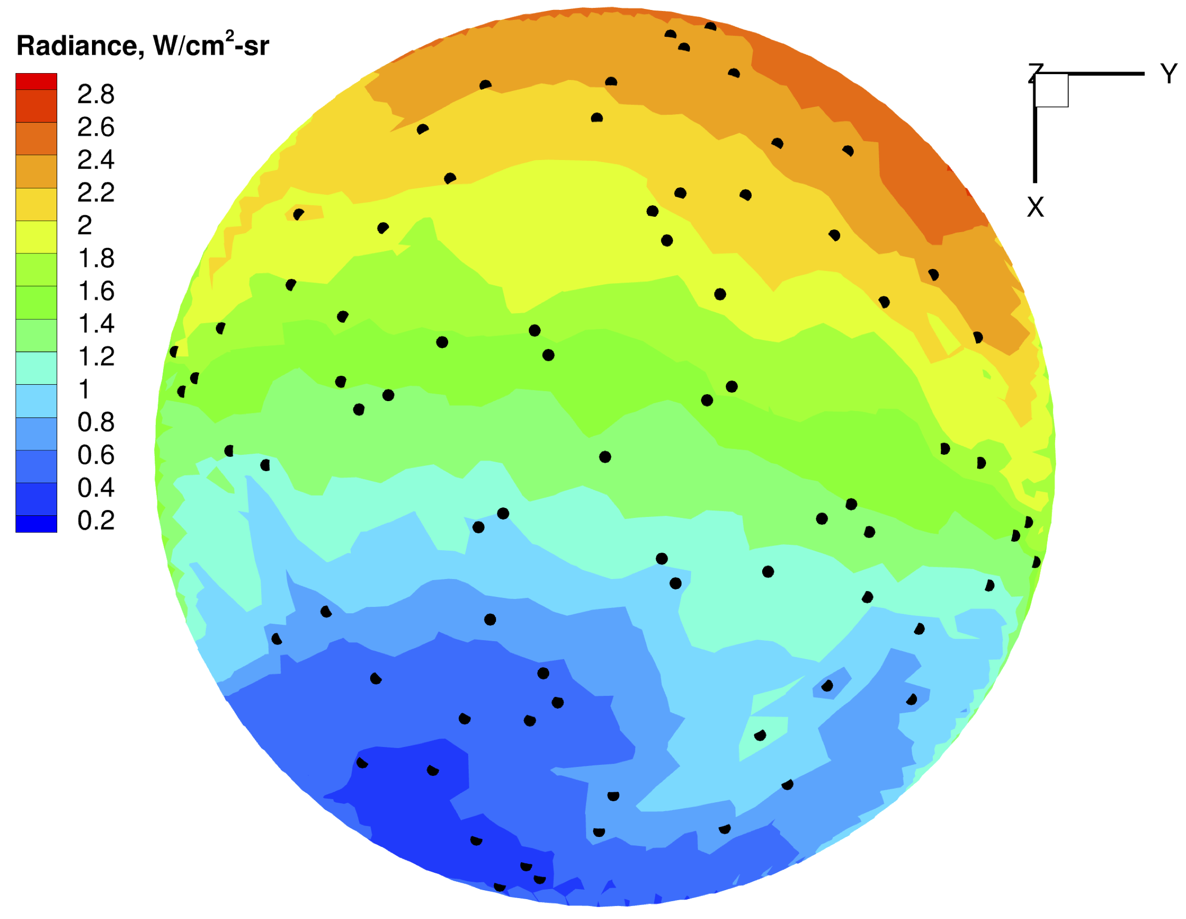
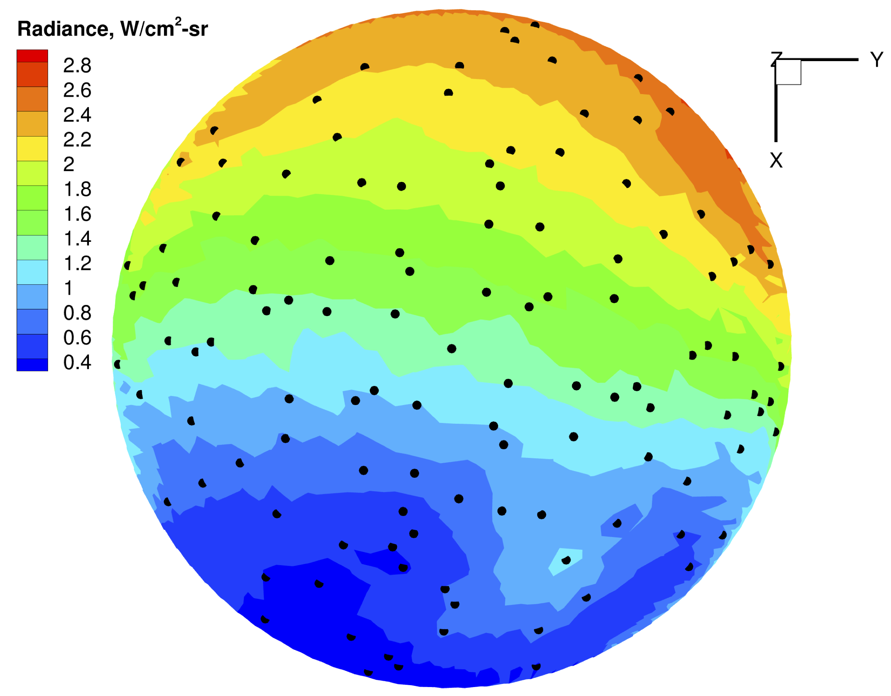
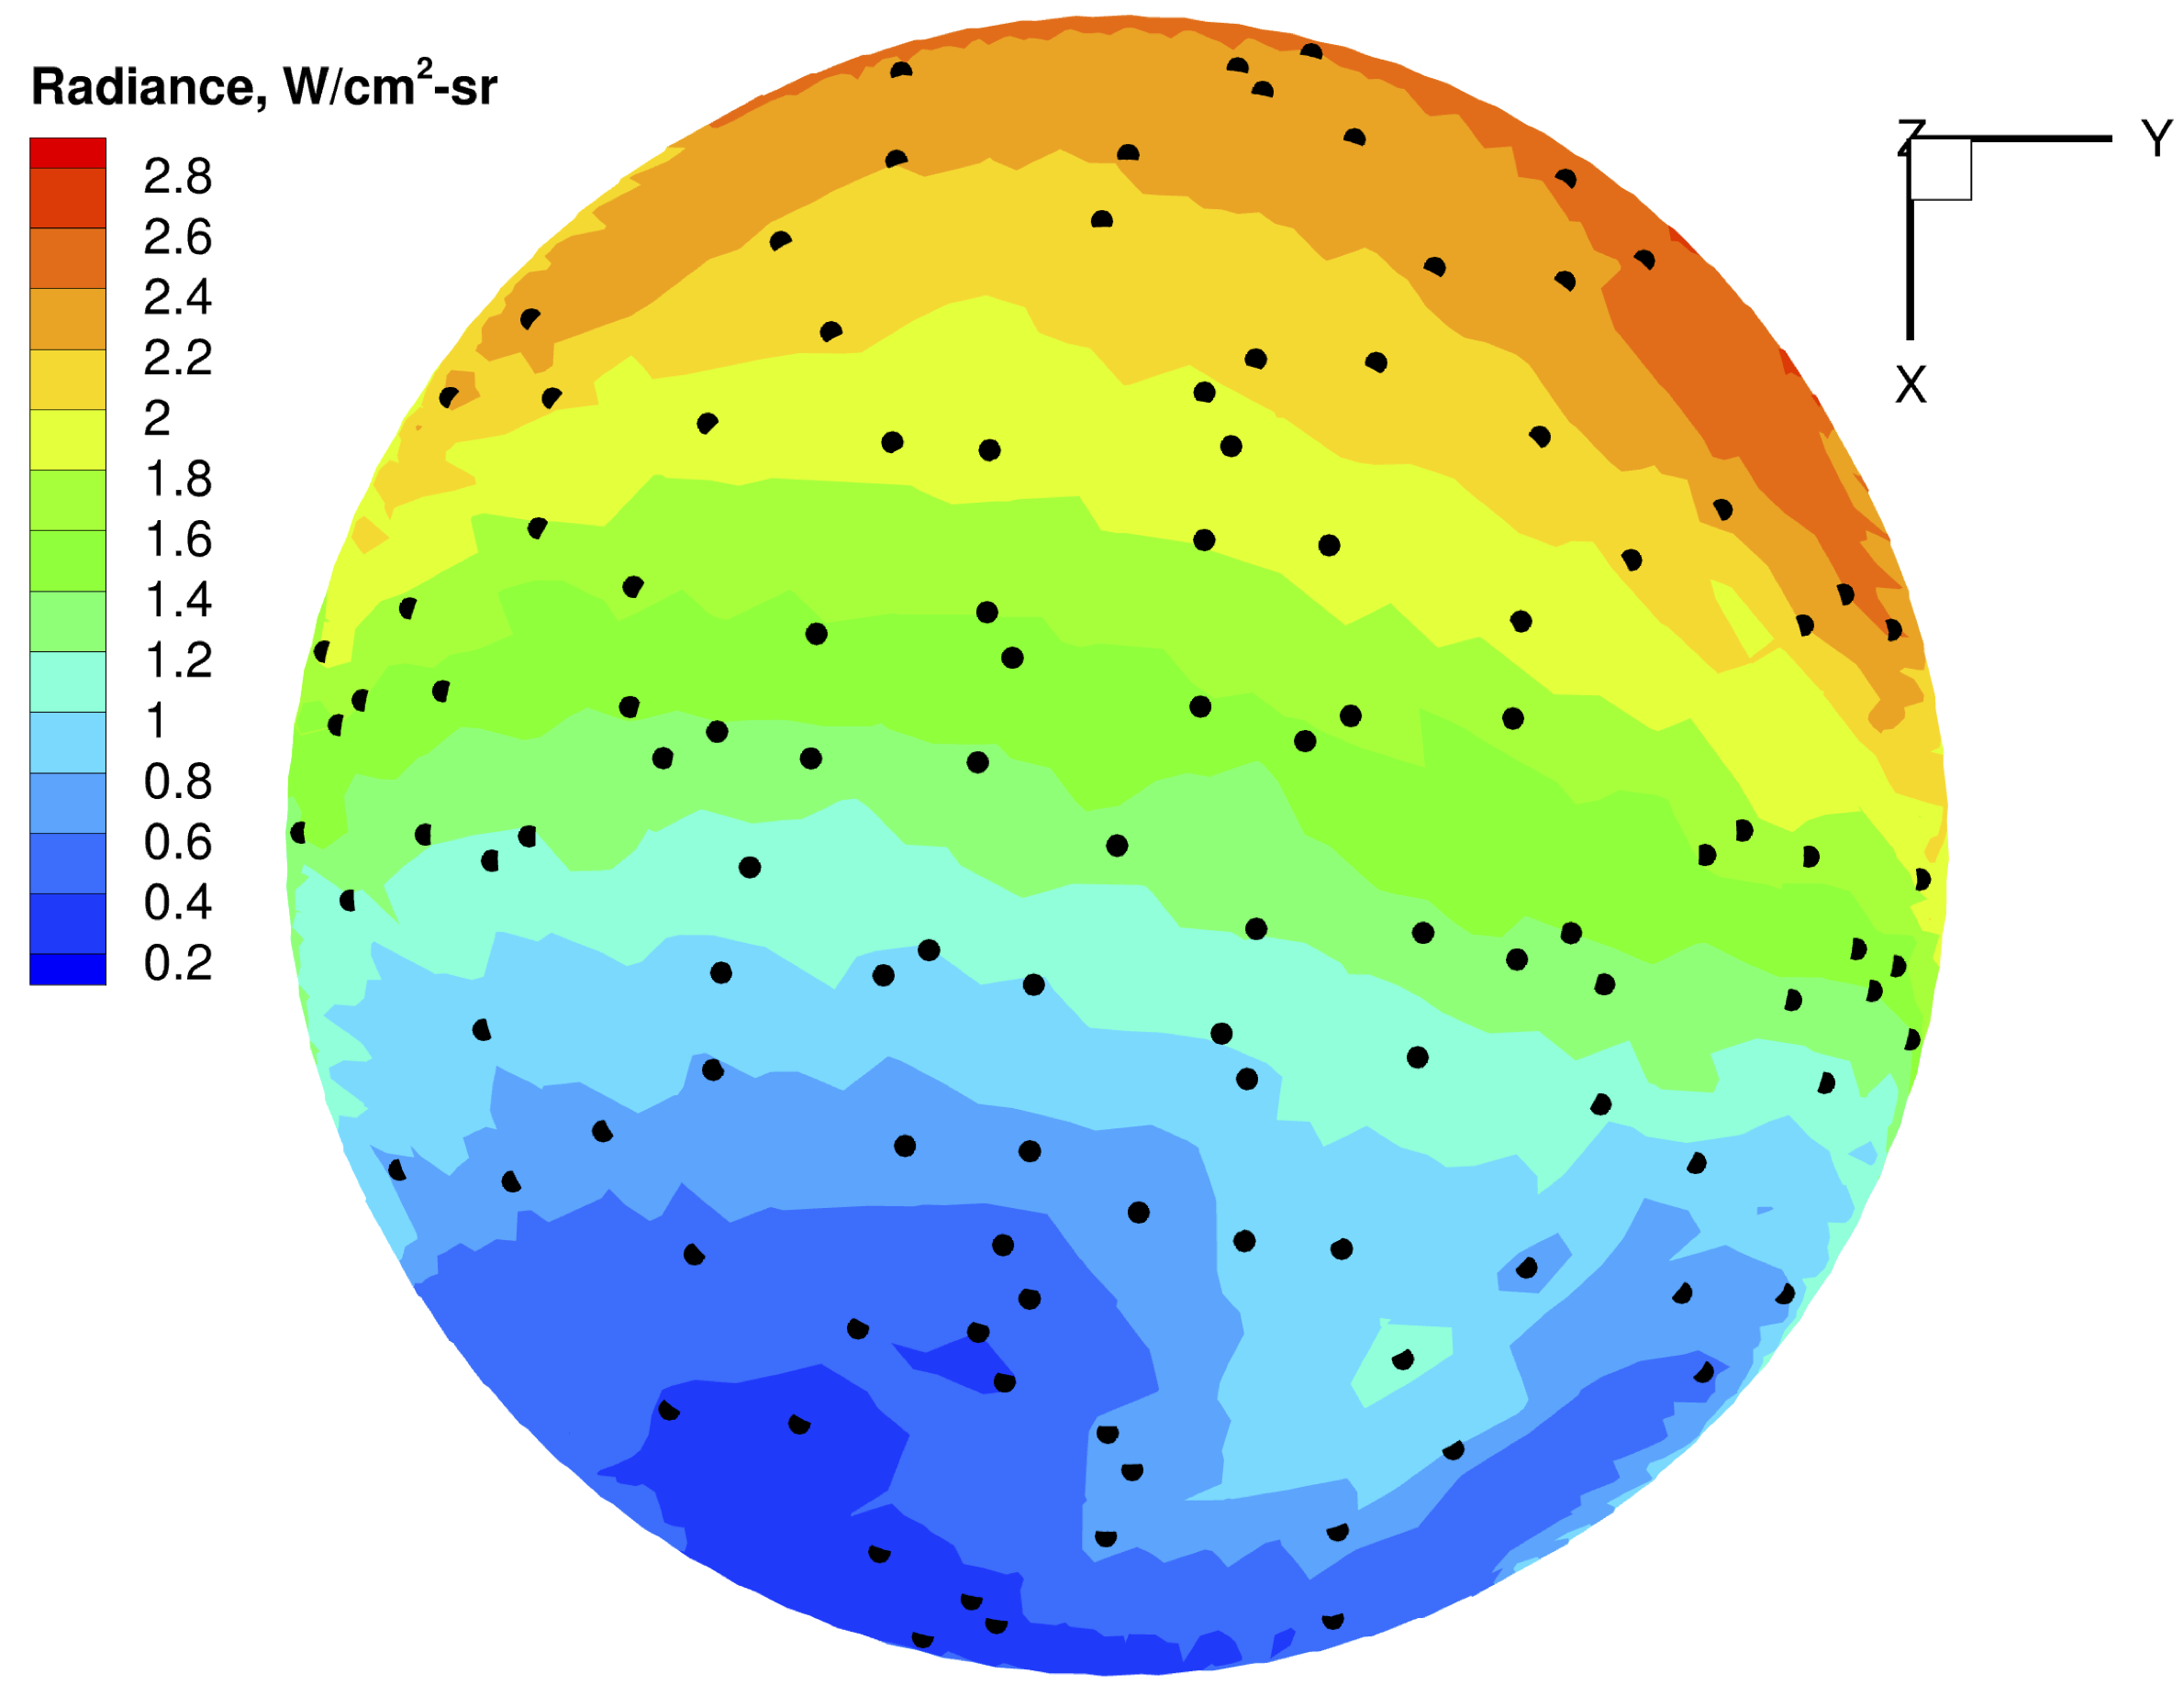
Analysis – Comparison with DPLR: Adaptive Refinement
DPLR
US3D
Full Solution
Initial Coarse Solution
One Refinement Step Solution

Slide 15
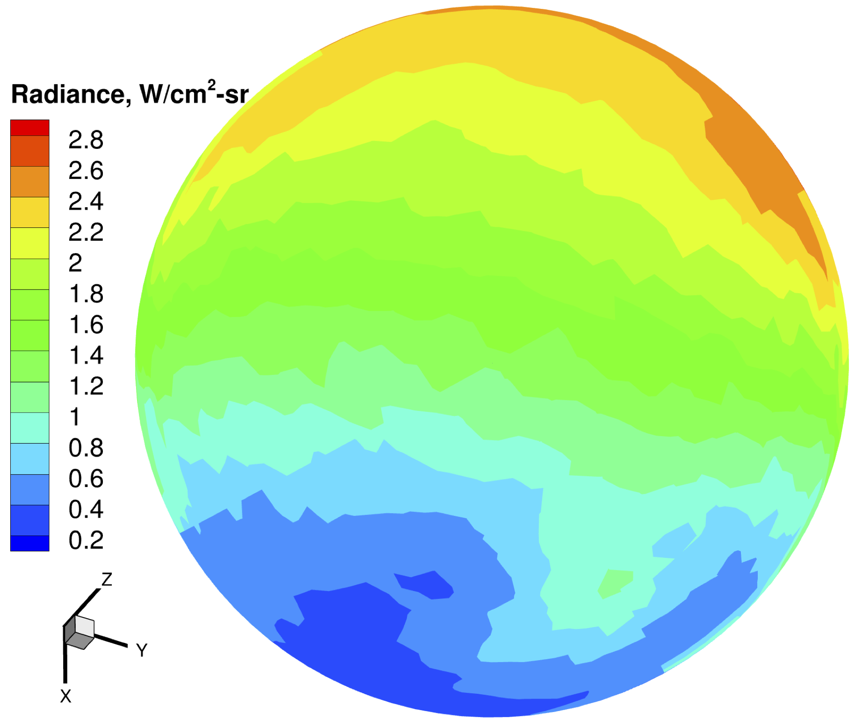
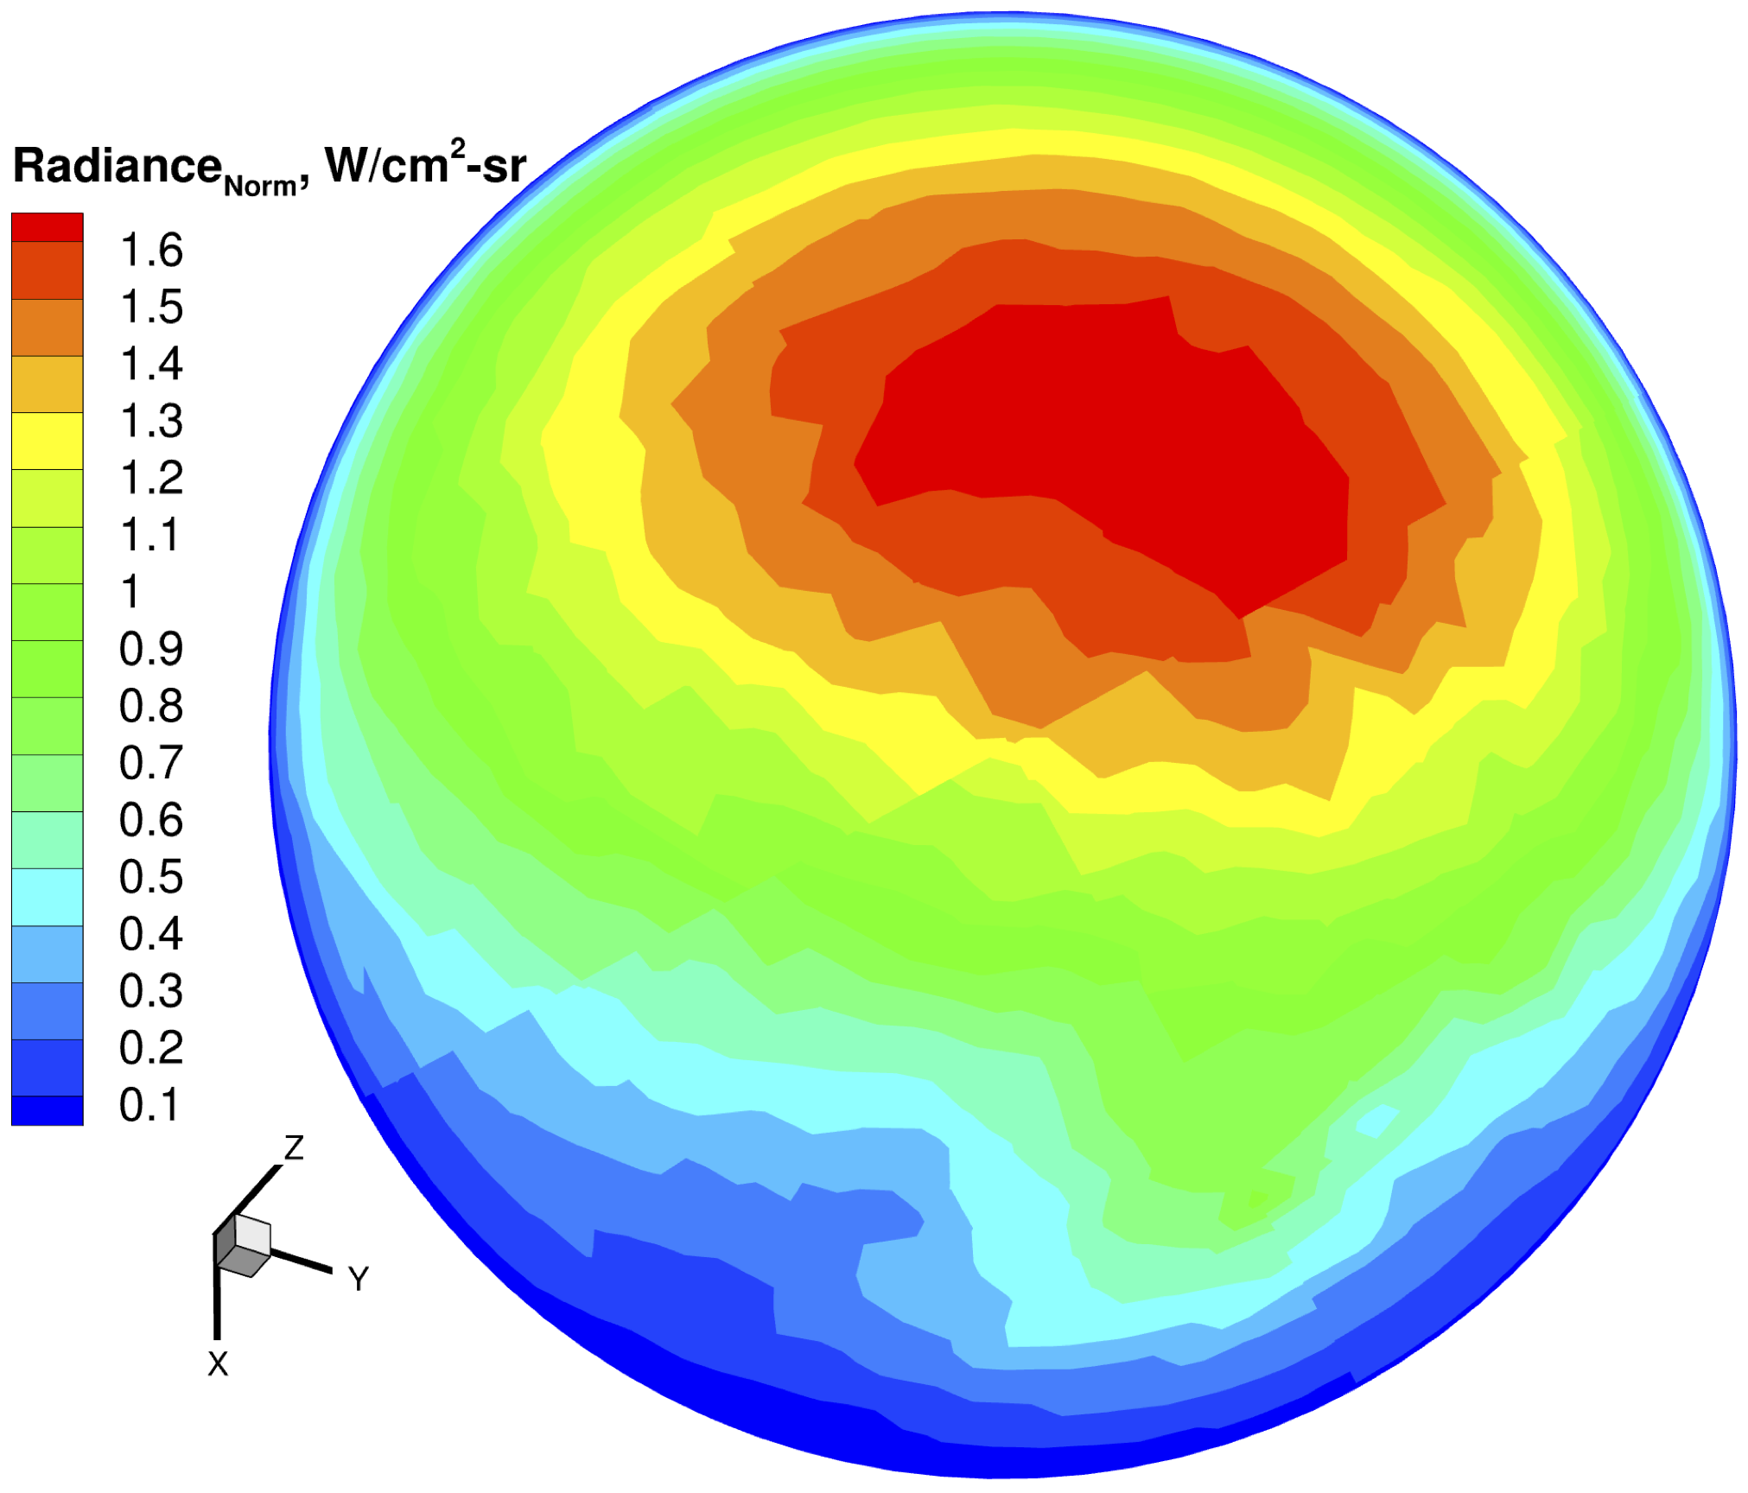
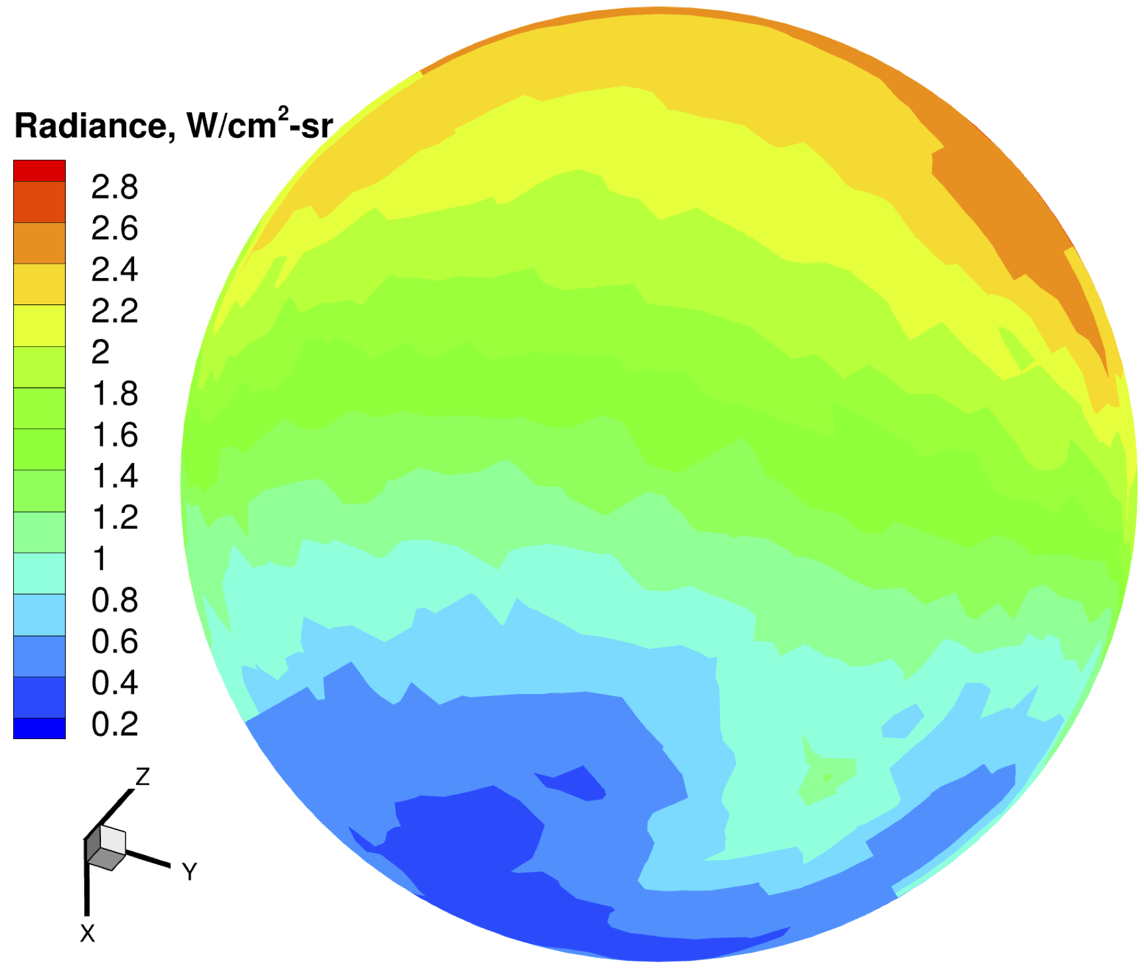
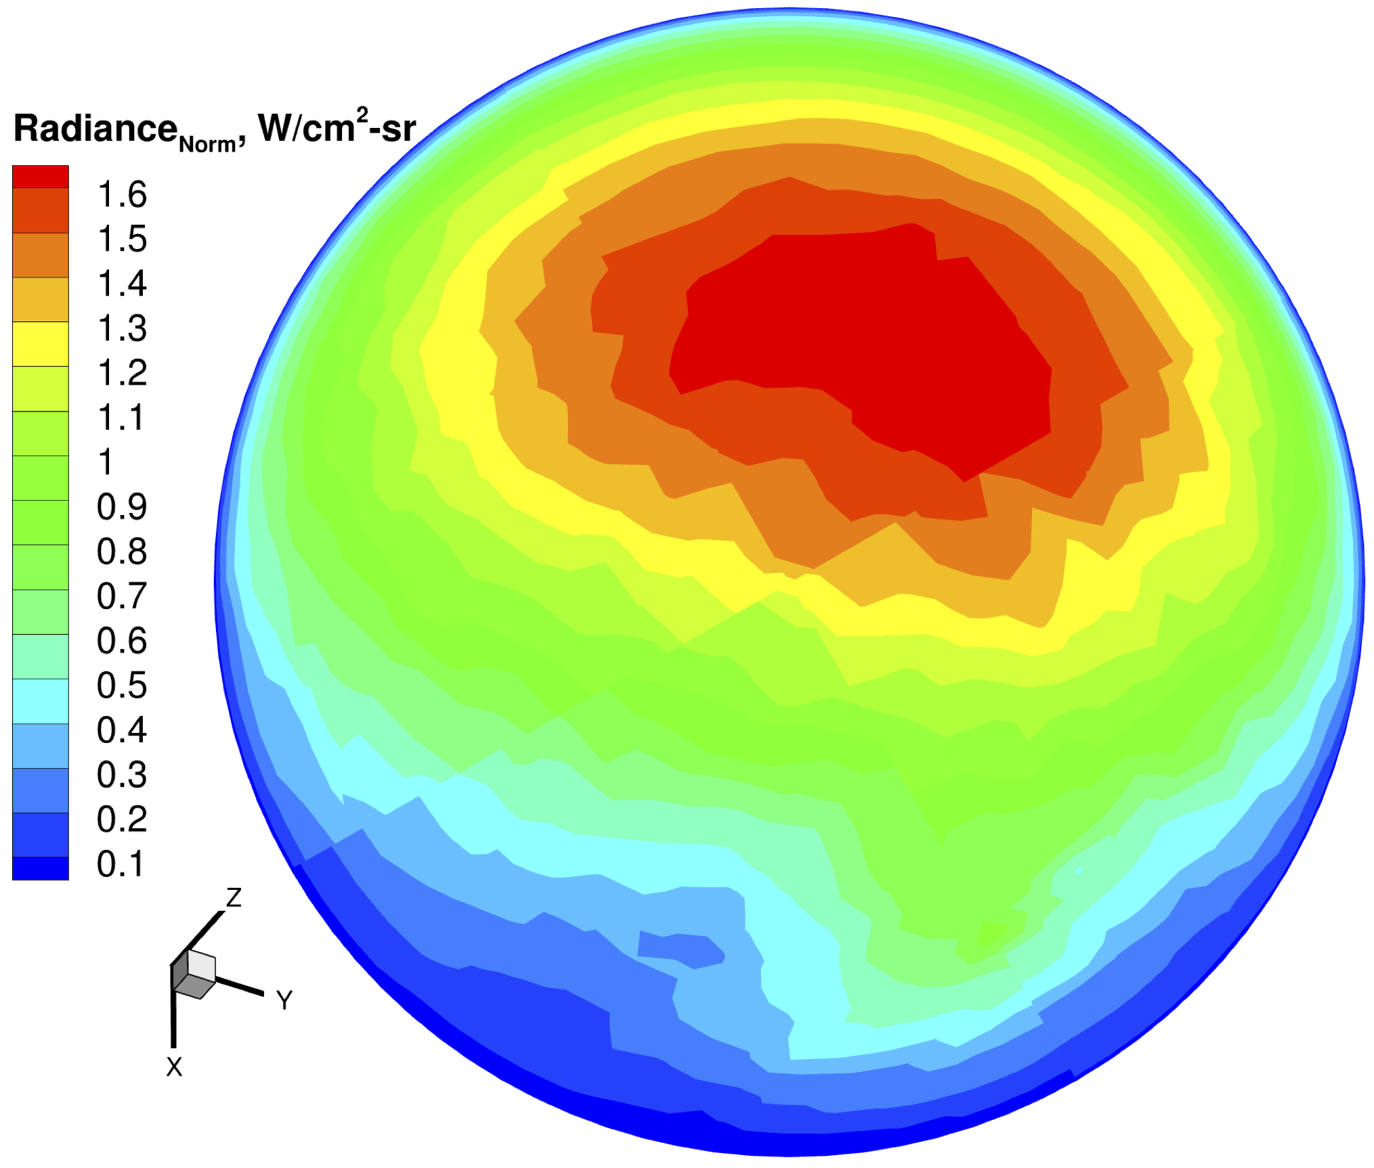
Analysis – Comparison with DPLR: Adaptive Refinement
Radiance
Normal component of Radiance
DPLR
US3D

Slide 16
Analysis – Comparison with DPLR: Error estimation
Solver | Full angular integration heat flux (W/cm²) | NEQAIR Time (s)
DPLR (1300) | 4.263 | 5117
US3D (1300) | 4.304 | 5118
DPLR – Adapted (148) | 4.283 | 562
US3D – Adapted (147) | 4.319 | 554
The relative difference of total radiance between brute force solution and adaptive refinement solution for US3D and DPLR is around 0.4% and 0.5%, respectively.
The lines of sight and computational time both reduce by 10 times for both DPLR and US3D solutions.
Unstructured workflow does not reduce the accuracy of adaptive LOS integration.

Slide 17
ANALYSIS: COMPARISON WITH MEASURED DATA
Backshell Radiation Analysis with US3D

Slide 18
Analysis – Comparison with measured data: Trajectory points
Full body simulations were performed using both DPLR and US3D at multiple trajectory points of Mars 2020.
8 Species (CO₂, CO, N₂, O₂, NO, C, N, O) flow is considered.
Same underlying mesh is used for both solvers.
A radiative equilibrium condition with same emissivities and fully catalytic condition is used as the boundary condition on the whole body.
The previously discussed case uses different emissivities and different catalytic conditions on different parts of the body.

Slide 19
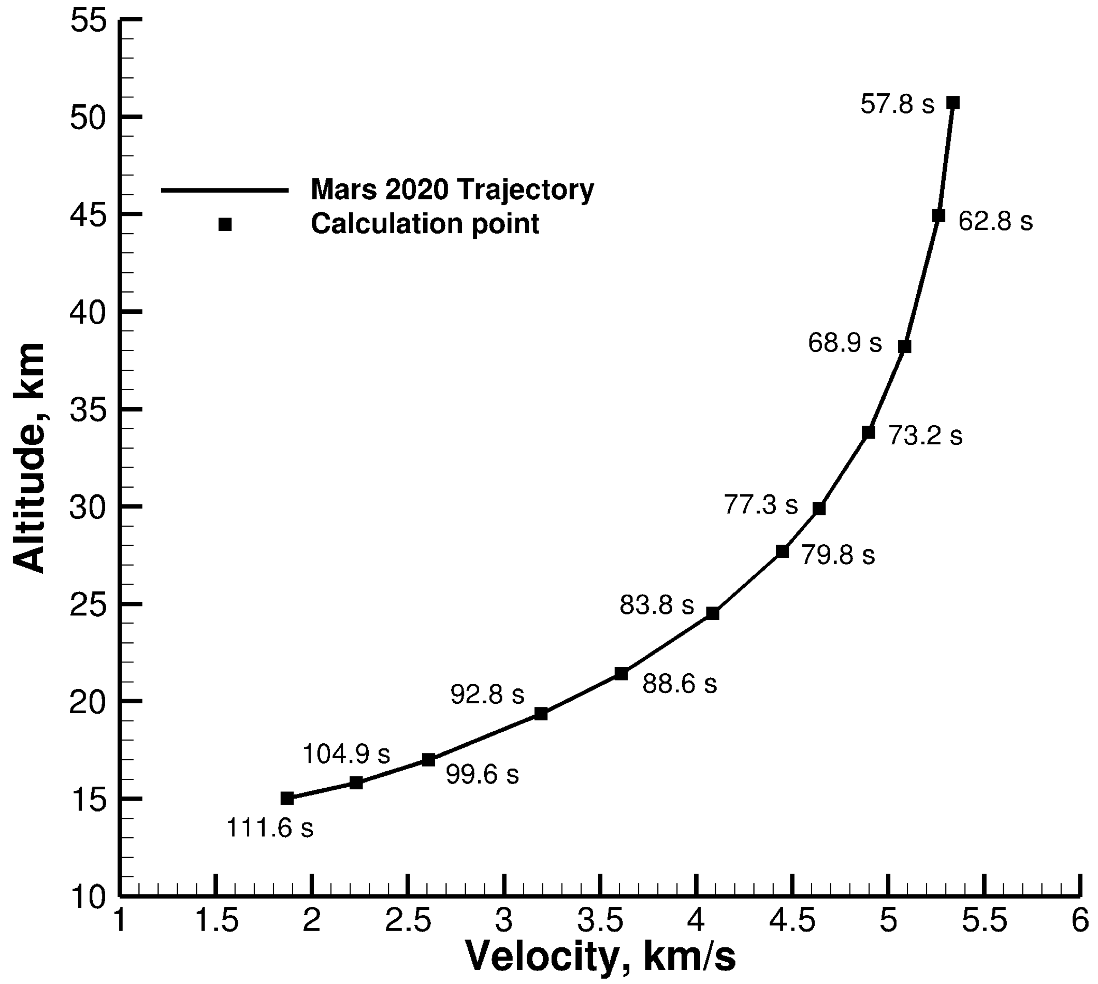
Analysis – Comparison with measured data: Trajectory points
Case # | t, s | ⍴∞, kg/m³ | V∞, m/s | T∞, K
1 | 43.359 | 1.17E-05 | 5387.7 | 157.0
2 | 51.484 | 4.15E-05 | 5379.5 | 152.6
3 | 57.859 | 1.01E-04 | 5336.7 | 155.8
4 | 62.859 | 1.99E-04 | 5261.0 | 158.5
5 | 68.984 | 4.02E-04 | 5085.5 | 174.6
6 | 73.234 | 6.36E-04 | 4896.0 | 176.5
6a | 77.359 | 9.53E-04 | 4639.8 | 179.2
7 | 79.859 | 1.20E-03 | 4448.2 | 179.2
8 | 83.859 | 1.70E-03 | 4086.2 | 178.3
9 | 88.609 | 2.27E-03 | 3610.0 | 184.6
10 | 92.859 | 2.74E-03 | 3193.2 | 188.3
11 | 99.609 | 3.43E-03 | 2608.4 | 191.0
12 | 104.984 | 3.79E-03 | 2232.0 | 194.5
13 | 111.609 | 4.08E-03 | 1871.3 | 195.4

Slide 20
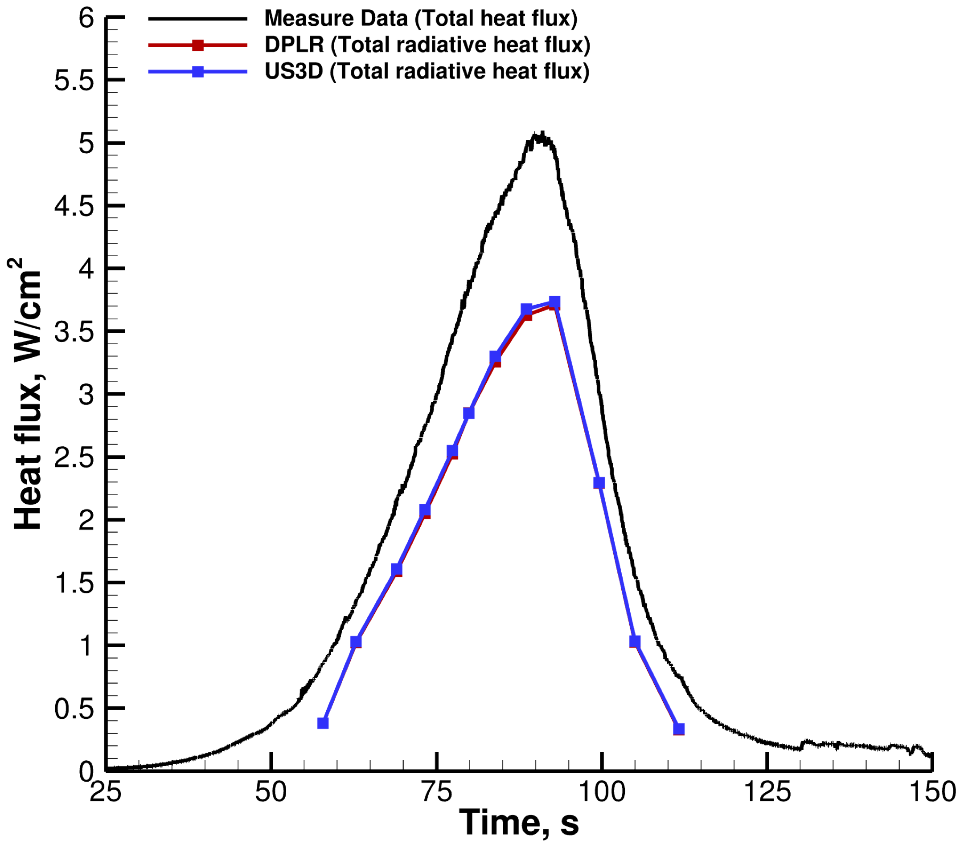
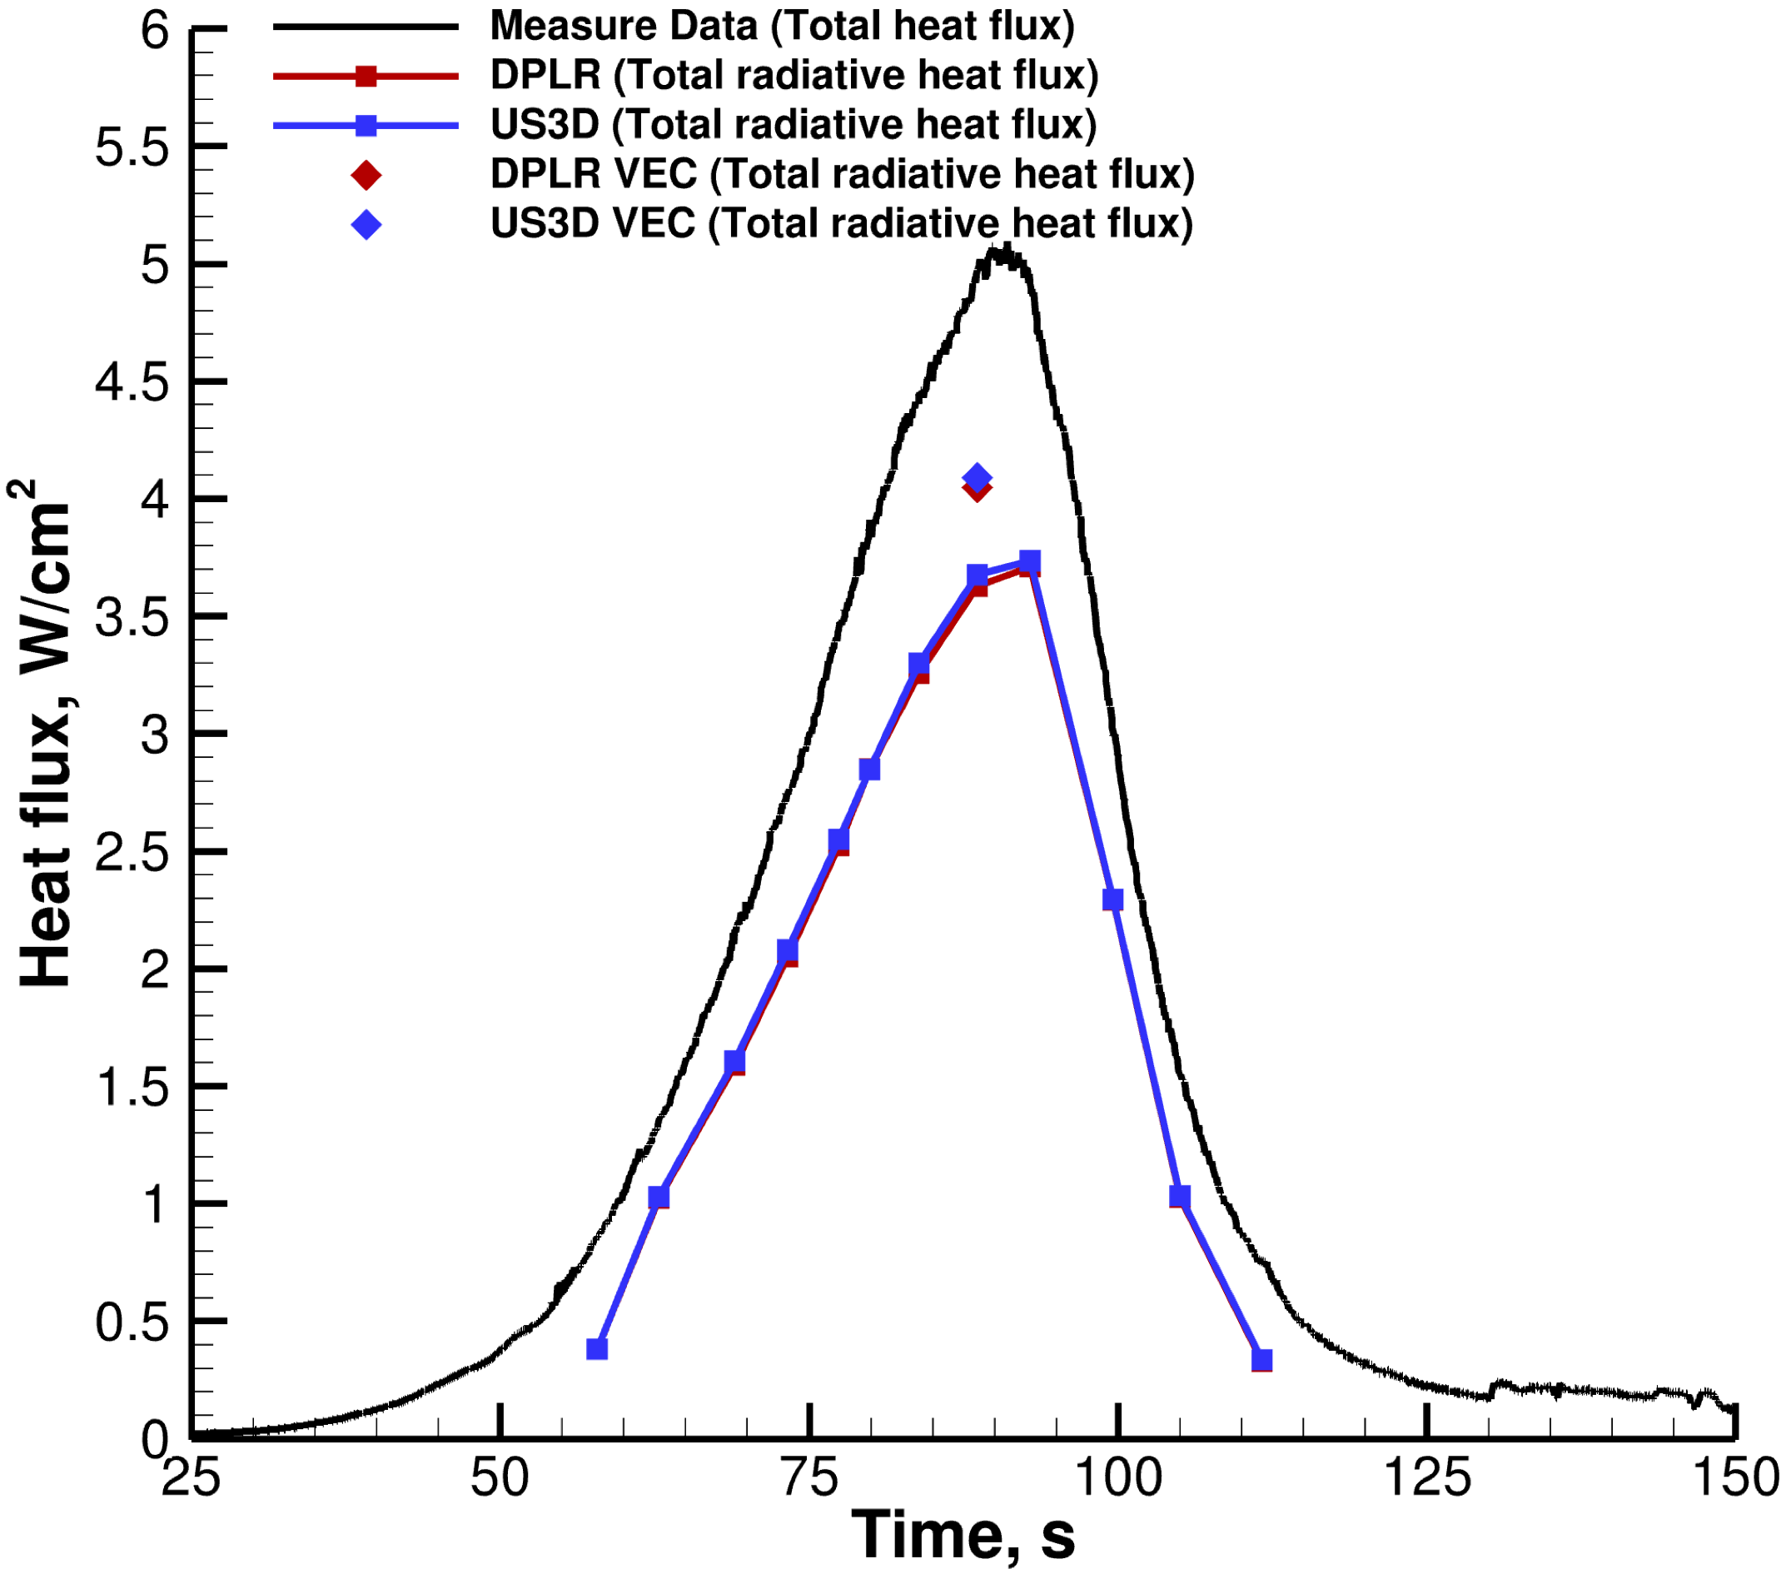
Analysis – Comparison with measured data: Results
DPLR and US3D results agree well.
The error between measured data and US3D at peak heating point is 26%.
This error also includes the convective heat flux (5-10%), solar heat flux (1%), and measurement uncertainty (5%).
With different emissivities and catalycities, the total radiative flux values predicted by US3D and DPLR boost up.
The error between measured data and US3D (for different emissivities and catalycities) comes down to 18%.

Slide 21
SUMMARY AND CONCLUSIONS
Backshell Radiation Analysis with US3D

Slide 22
Summary and Conclusions
Full angular integration method was used to compute radiative heat flux for unstructured CFD solutions computed by US3D.
The analysis was conducted by comparing the total radiative heat flux from US3D solutions to DPLR solutions, measured data, and on a hybrid mesh.
In the first study, the comparison with DPLR solution at the peak heating case shows that the total radiative heat flux predicted from the US3D solution matches well with 0.9% difference.
In the second study, the comparison with measured data at peak heating case shows that the total radiative heat flux from the US3D solution is underpredicted by 26%.
The error also includes the contributions of convective heat flux, solar heat flux, and measurement uncertainty.
It is hypothesized that considering different emissivities and catalycities for wall might lead to higher total radiative heat flux values for US3D solutions.

Slide 23
Mentoring and Support
Dr. Brett A. Cruden (AMA, Inc.)
David A. Saunders (AMA, Inc.)
Ryan D. McDaniel (NASA Ames)
Dr. Jeffrey P. Hill (NASA Ames)
Dr. Khalil Bensassi (AMA, Inc.)
Dr. Dinesh K. Prabhu (AMA, Inc.)

Slide 24
Thank You !!!
Questions ???

Slide 25
BACKUP SLIDES
Backshell Radiation Analysis with US3D

Slide 26
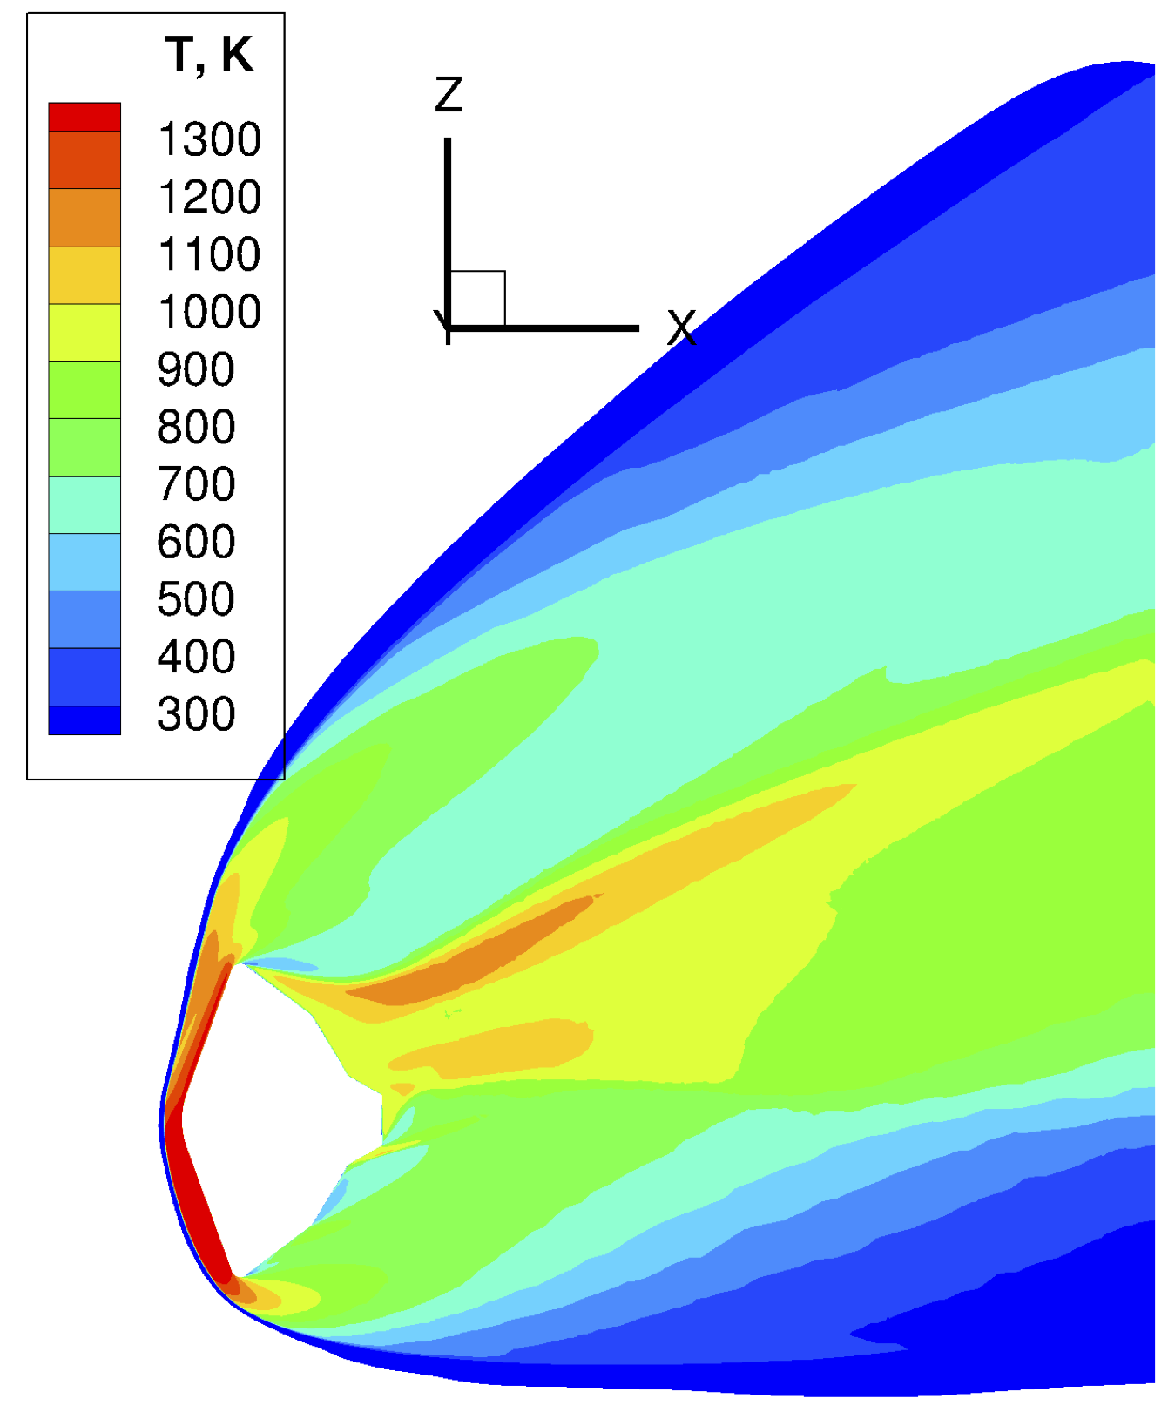
Analysis – Simulation using Hybrid Mesh: CFD solution
t, s | ⍴∞, kg/m³ | V∞, m/s | T∞, K
117.0 | 4.16E-03 | 1645.0 | 194.2

Slide 27
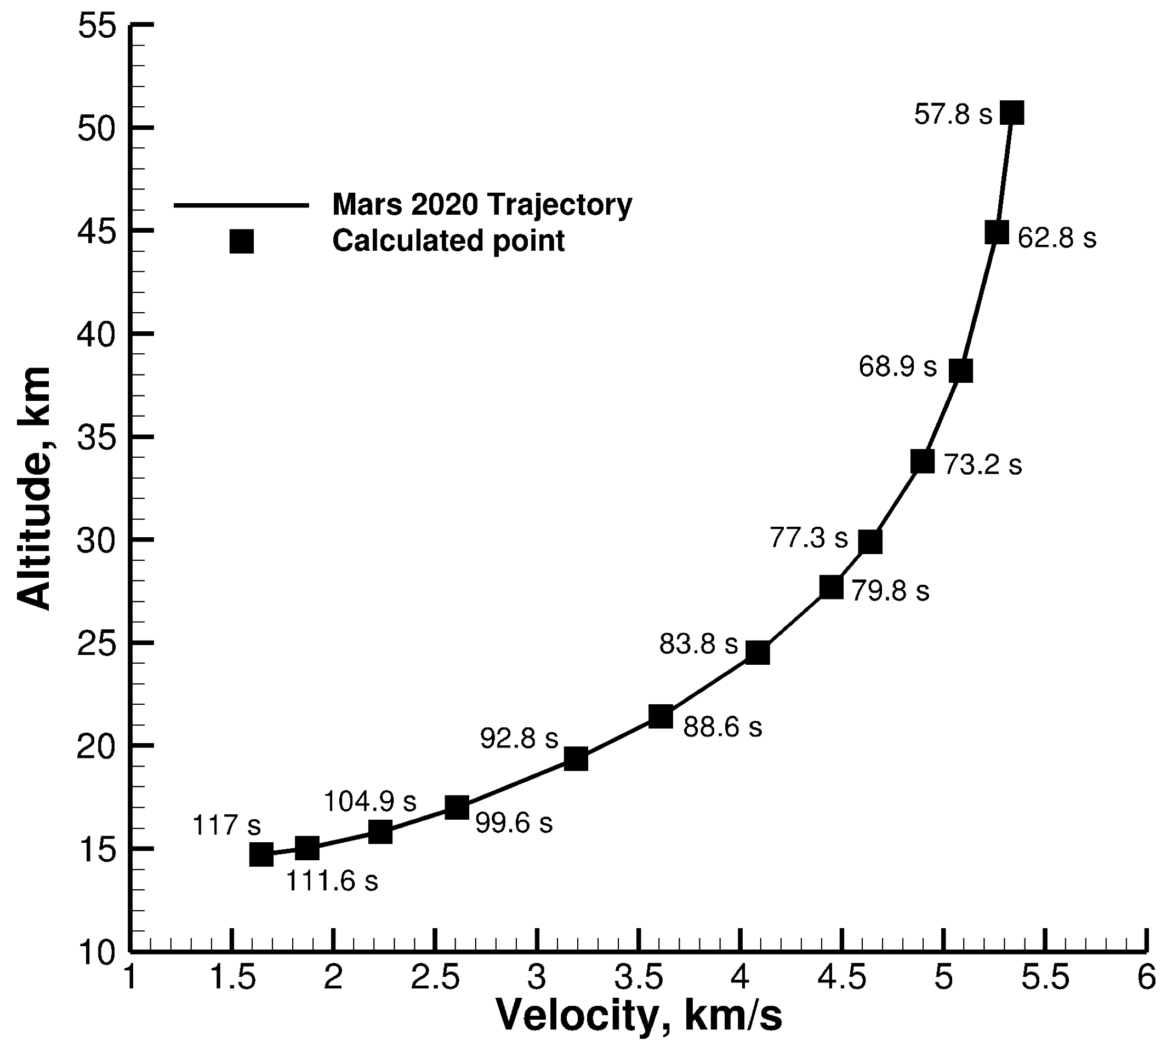
Analysis – Simulation using Hybrid Mesh: Trajectory point

Slide 28
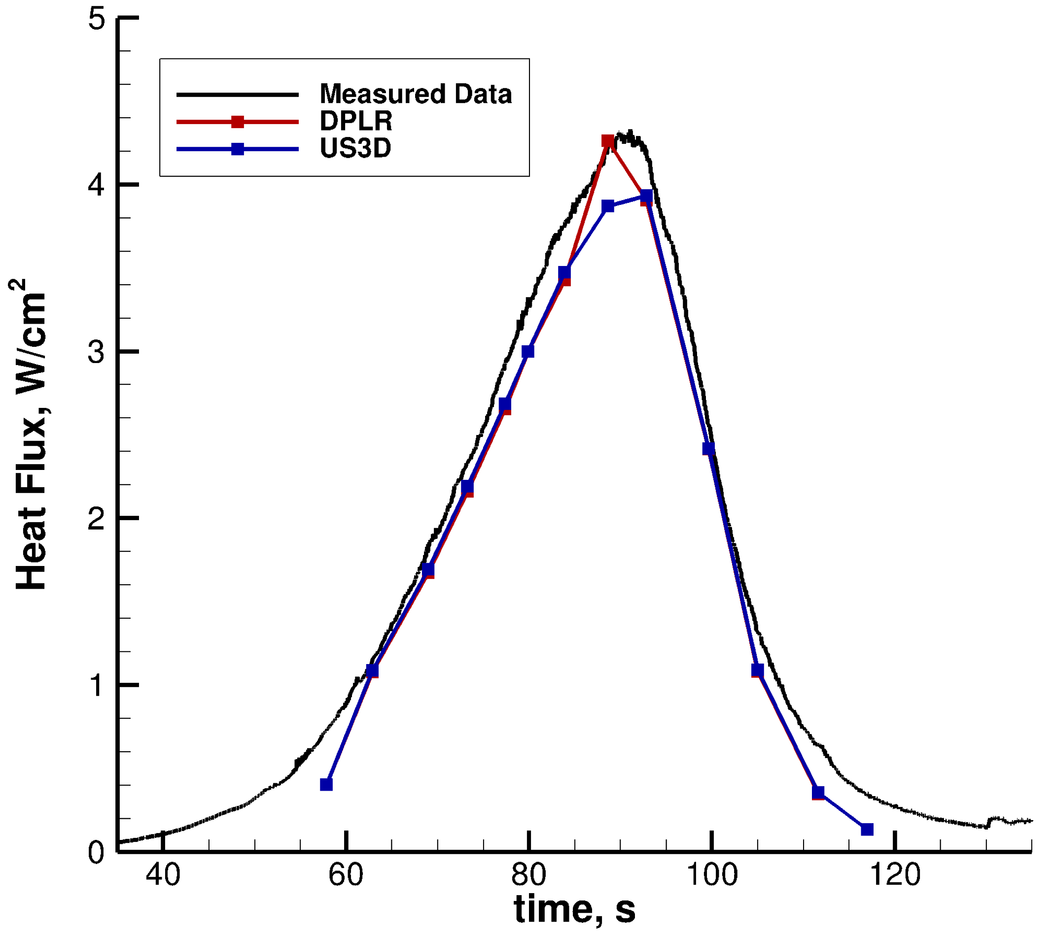
Analysis – Simulation using Hybrid Mesh: Results
The relative error between measured data and US3D solution is around 60%.

