Slide 1
FLASHFlux Working Group Status: Increasing Data Usage Through POWER-GIS Web Services
Paul Stackhouse (NASA LaRC)
PC Sawaengphokhai, Hunter Winecoff, Jay Garg (SSAI)
POWER Team: Bradley MacPherson (Booz-Allen-Hamilton)
CERES Team members: Katie Dejwakh, Dave Doelling (LaRC),
Walt Miller, Pam Mlynczak, Victor Sothcott, Cathy Nguyen (SSAI)
Tonya Davenport and Fenny Wang (Ret.) and the
Atmospheric Science Data Center Team (SSAI)
Notes:
Abstract:
The presentation reviews the progress made in the last year in the CERES FLASHFlux working group whose aim is to produce TOA and surface radiative flux and other ancillary data products within 1 week of real-time. This presentation will review the upgrades made in promoting the latest version 3A. This version features an updated instrument calibration, a new meteorological assimilation input data product and upgrade surface radiation algorithms. Examples of the new data products are shown along with some limited validation.

Slide 2
CERES FLASHFlux Overview
FLASHFlux Overview
  Uses CERES based production system through inversion
  Periodic calibration updates projected forward; running 3-day TISA
  Upgrade from S4PM production system to CATALYST
  New Data Product: NOAA-20 SSF
FLASHFlux Latency Objectives
  SSF products within 3-4 days
  Global 1x1 daily averages from FF TISA; goal: 5-7 days latency
FLASHFlux Uses
  Primarily used for applied science and education (i.e., POWER and Globe Clouds)
  Supports also QC for selected missions (e.g., NOAA NESDIS)
  TOA gridded fluxes; normalized to TOA EBAF for annual “State of the Climate” assessments .

Slide 3
FLASHFlux Operational Status
FF Production status:
  Current Status: SSF Terra: 9/23/22; SSF Aqua: 9/23/22; TISA: 9/21/22
  Updated calibration coefficients received; promoted as cc change effective 10/1/22
FF Operational Issues:
  Transitioned to DarkHorse Ingesting system on June 6
  LAADS system maintenance on August 1st delayed several input data products.
    Additional system maintenance from August 23-25, 2022.

Slide 4
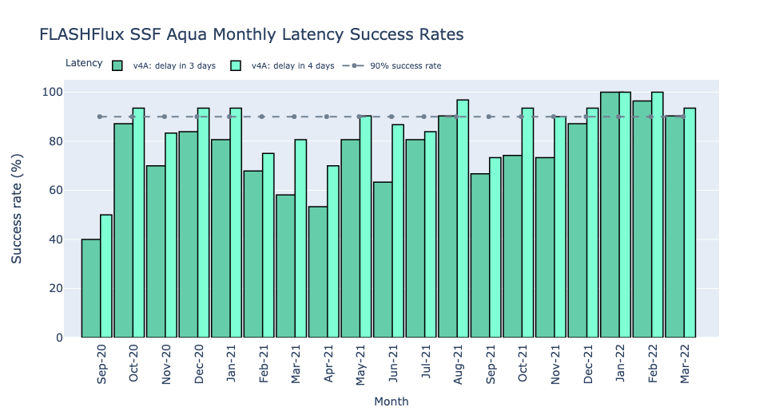
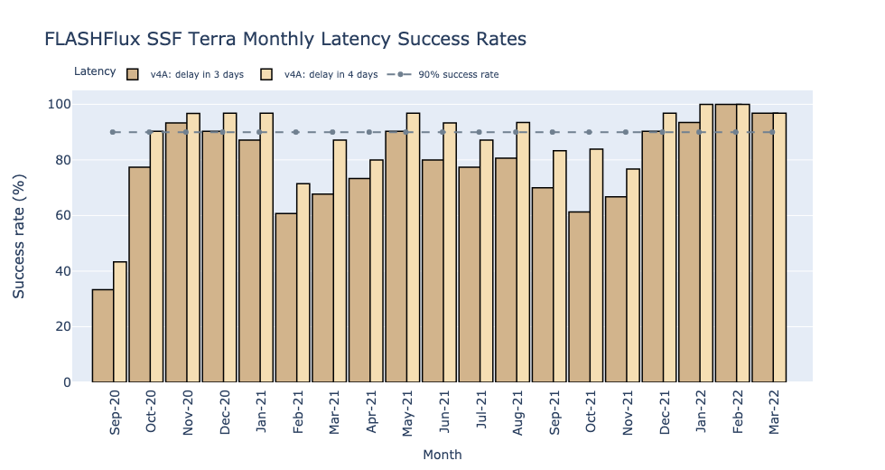
FLASHFlux (v4A) SSF Latency Assessment
Success rate % of time < 3 (dark/thick bar) or 4 days (lighter/thinner bar)
In last year, Terra had 7 months at or exceed 90% of days at 4 day latency; Aqua had 8
Jan and Feb 2022 provided all SSF within 4 days => perfect months!
Lags due to: maneuvers/ satellite issues, ASDC updates/outages
SSF utilized by GLOBE Clouds; occasional satellite algorithm comparisons (i.e., NOAA GOES ABI)
Perfect!
Outage
100%
90%
Out-age
Perfect!
100%
90%

Slide 5
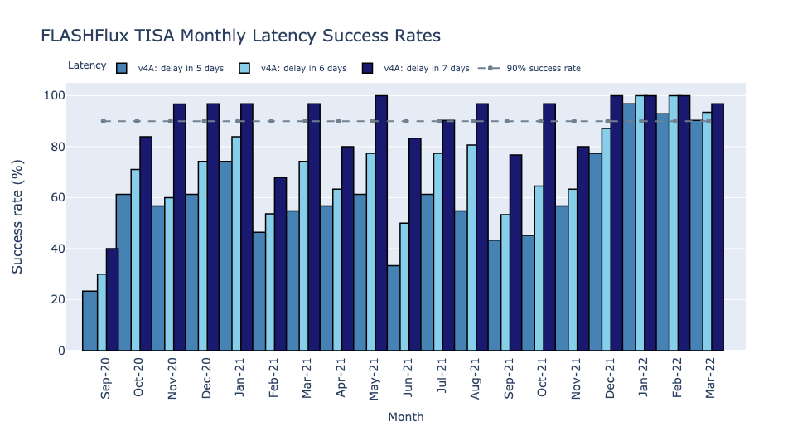
FLASHFlux TISA Latency Assessment
FF v4A
Perfect!
Success rate % of time 5 (med blue), 6 (light blue) or 7 days (dark blue) latency
Jan and Feb reached 100% at 6 day latency; 8 of 12 months at 7 day > 90%
Last 3 months reached 90% of days available at 5 day latency!
Lags due to: maneuvers, ASDC updates/outages
TISA delivered to POWER Web Services Suite
Terra/Aqua maneuvers
Aqua outage
Terra SSR
90%
Aqua outage

Slide 6
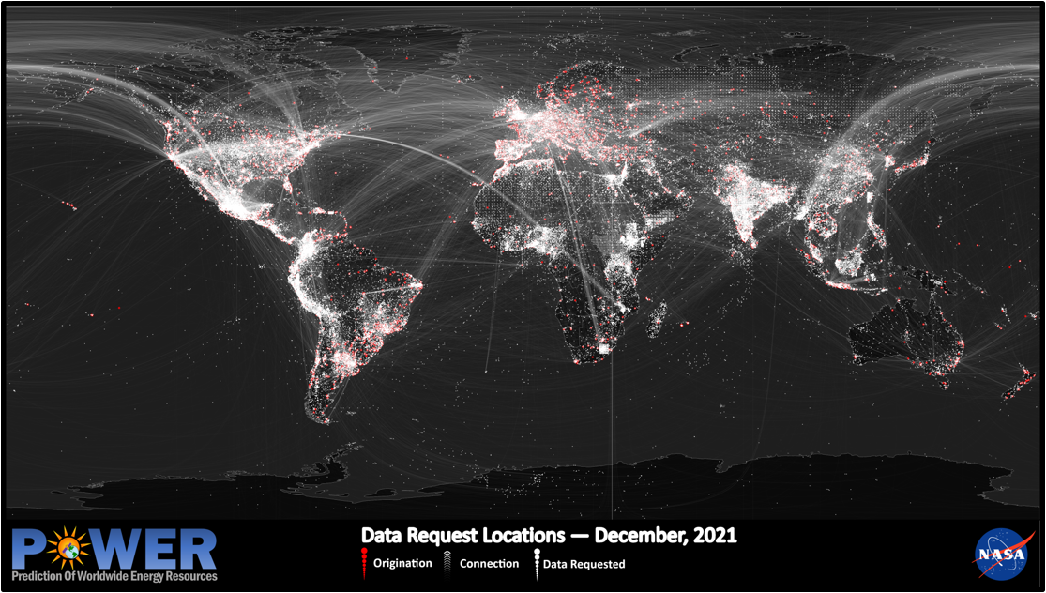
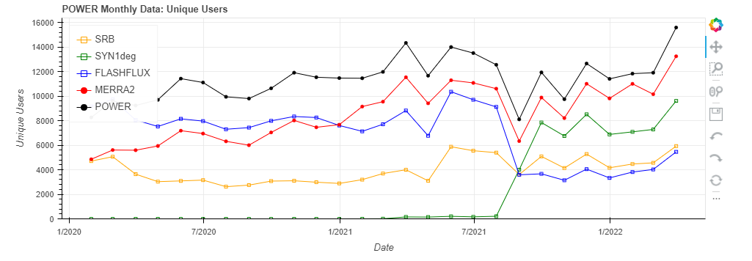
FLASHFlux Data Delivery via POWER Web Services Portal (2021/04/01 to 2022/03/31)
CERES Data Orders Delivered via POWER that include FLASHFLux Data
Dot density map showing locations of users (red) and data request locations (white). Brighter colors show larger frequency at that location.
User Location to Data Location Map
 | Total | Monthly | Avg. Last 3 Months
Unique Users IPs | ~59.2 K (64%) | ~5.6 K | ~4.4 K
Requests | ~16.3 M (70%) | ~1.36 M | ~1.28 M
CERES Data Orders Delivered via POWER including SYN1Deg Data
RevStack Services
ASDC Cloud Services
 | Total | Monthly | Avg. Last 3 Months
Unique Users IPs | ~51.6 K (56%) | ~4.9 K | ~8.0 K
Requests | ~ 13.0 M (57%) | ~1.09 M | ~2.39 M
(updated API)
Added SYN1Deg
(includes SYN1Deg from Jan 2001 through latest month released)
Notes:
Note – some orders provide date span including BOTH SYN1Deg and FF. Hourly data are only provided by SYN1Deg.

Slide 7
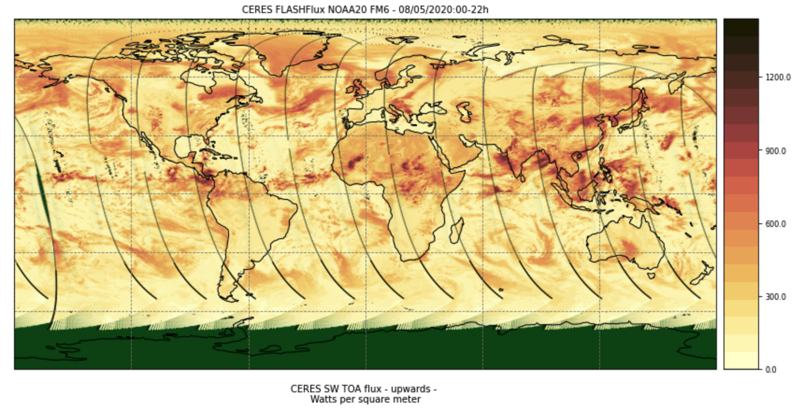
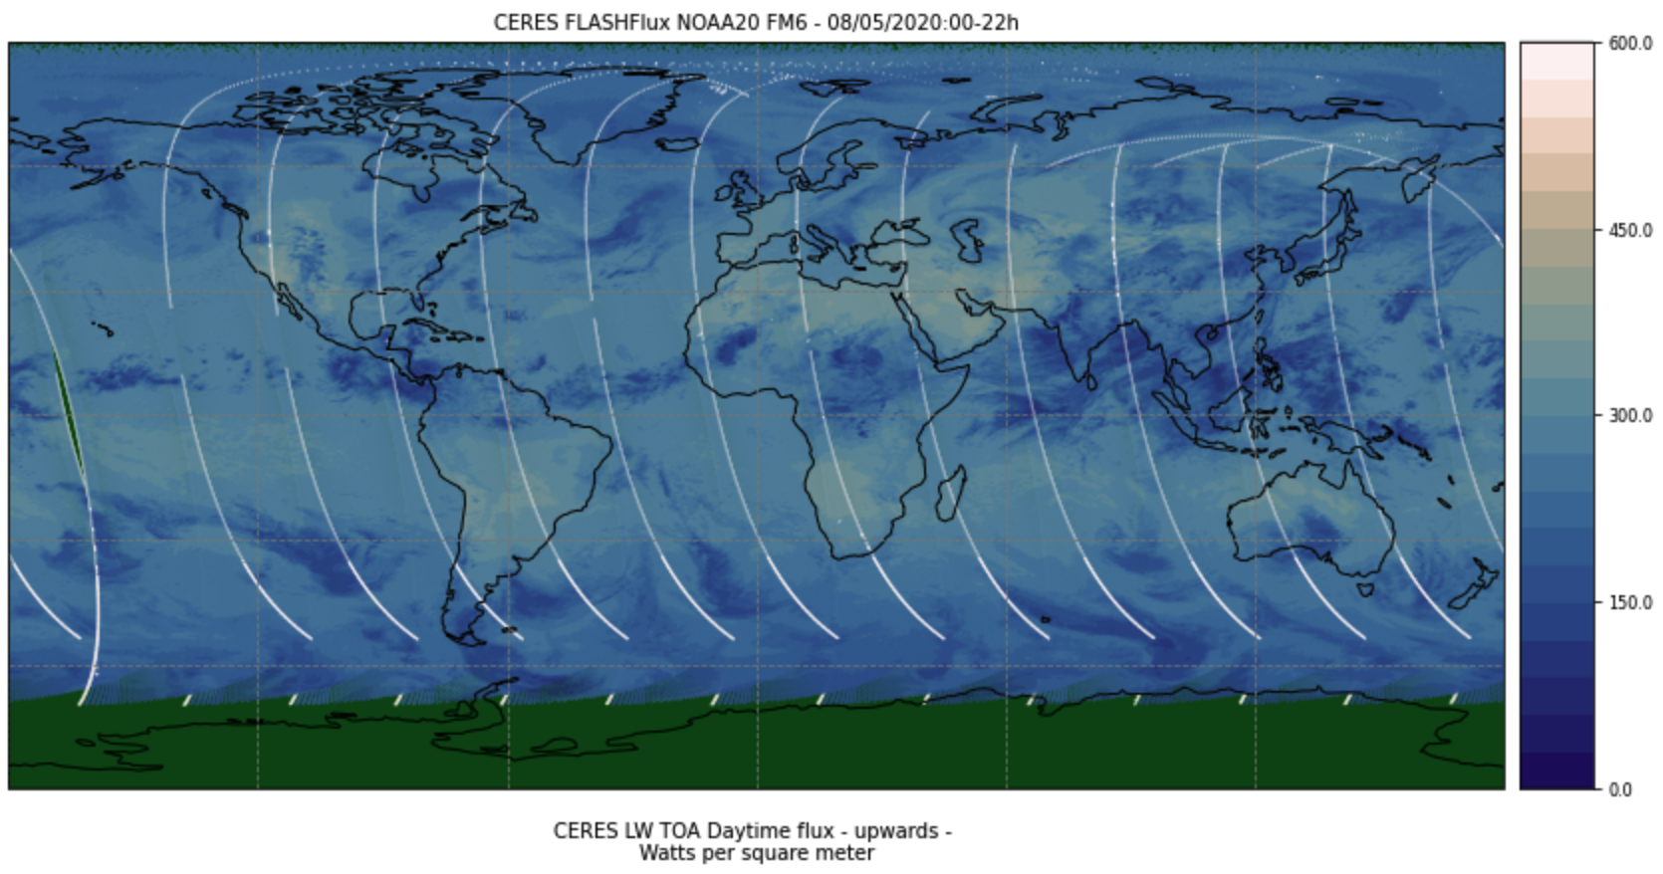
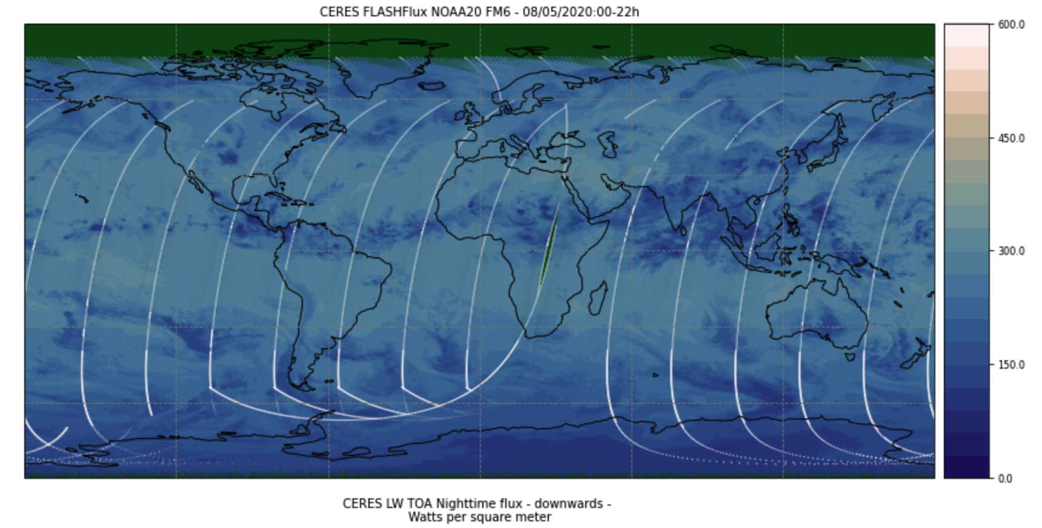
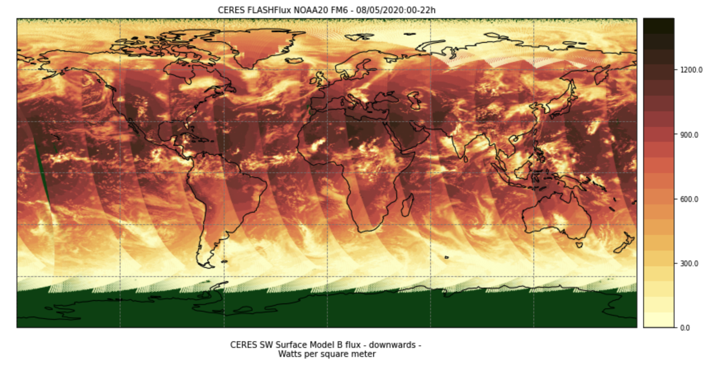
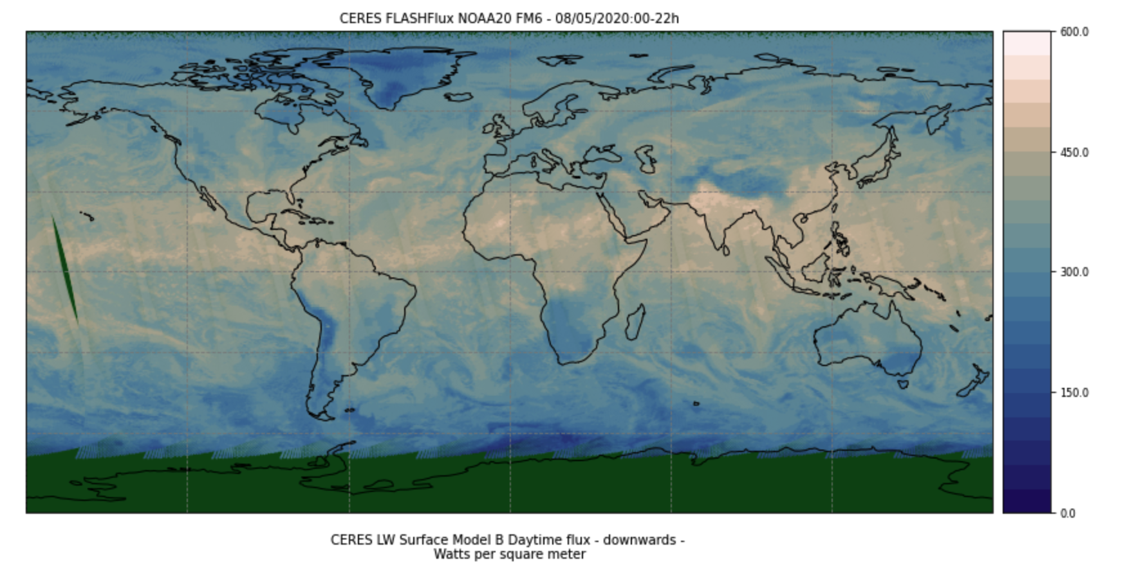
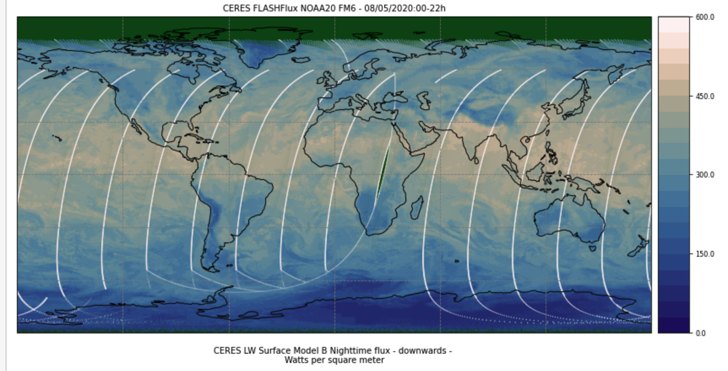
NOAA-20 SSF – FLuxes(W m⁻²)
SW TOA
LW TOA Day
LW TOA Night
SW Surface Down
LW Surface Down - Day
LW Surface Down - Night

Slide 8
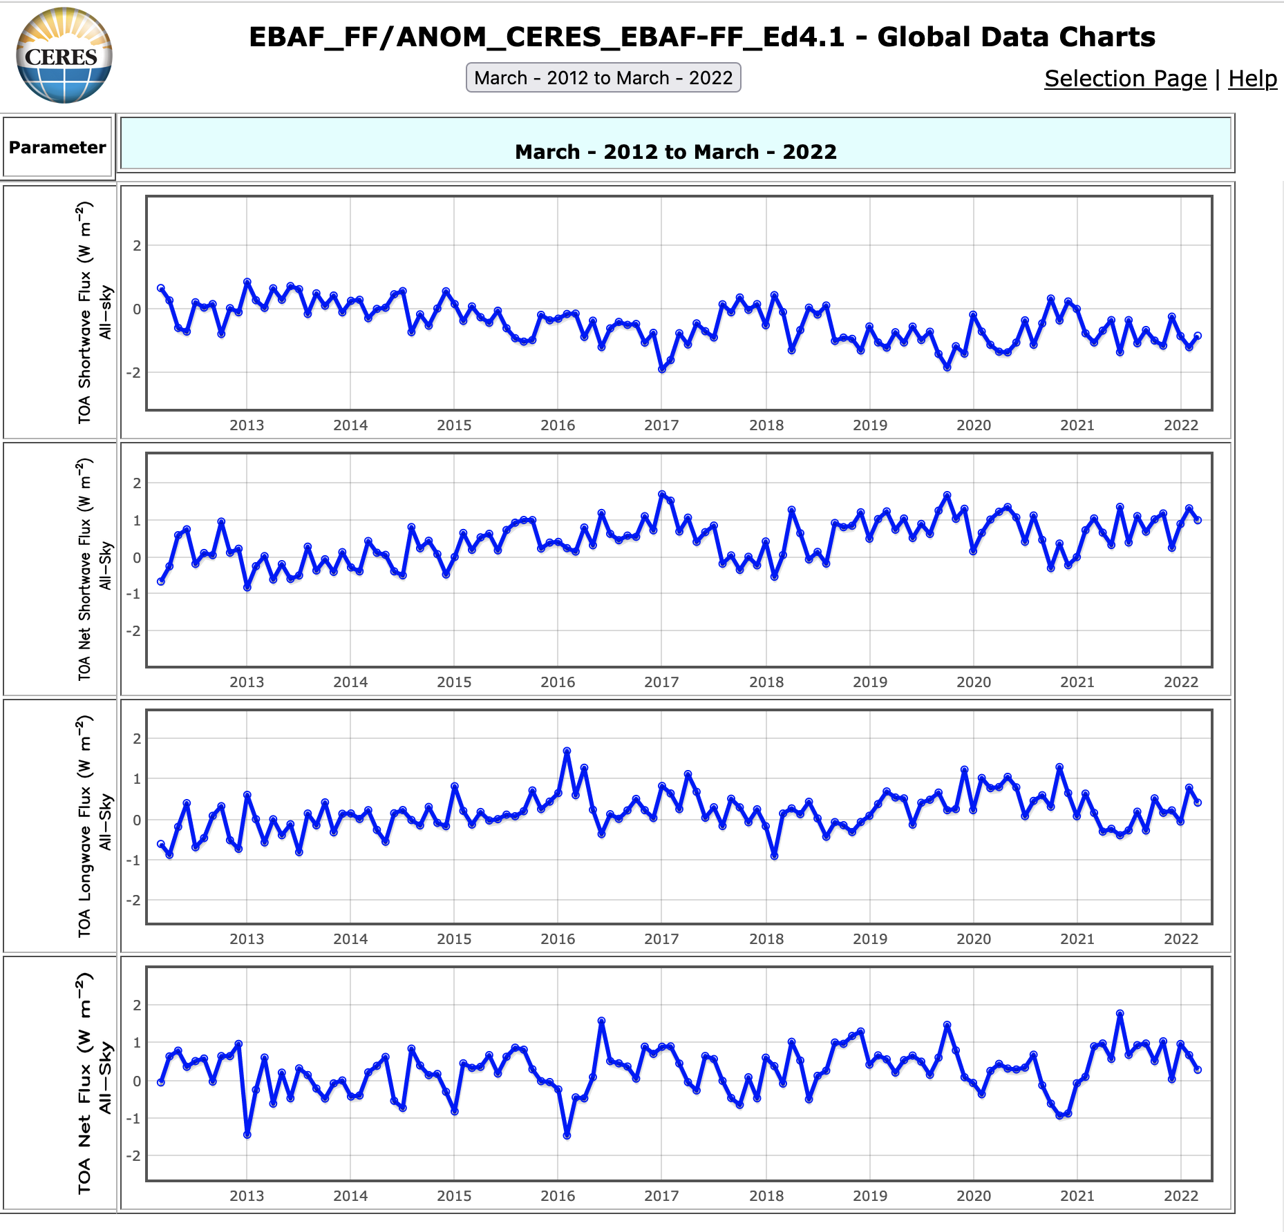
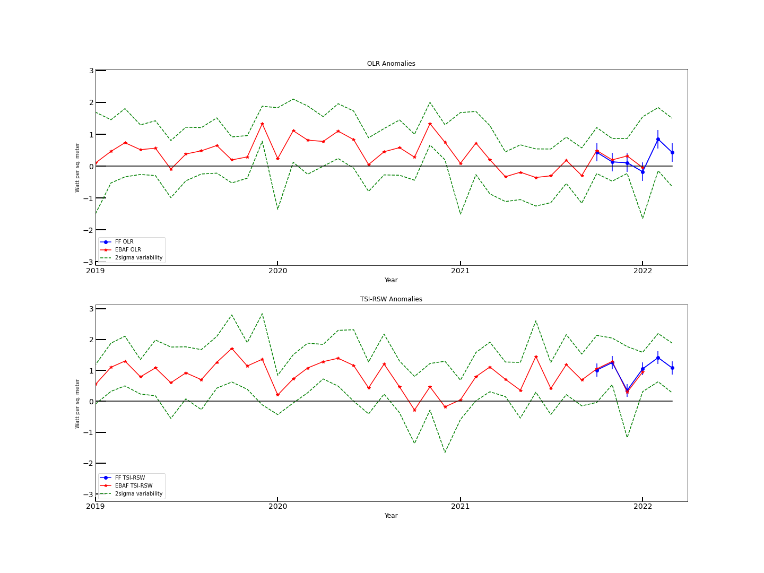
Global Anomalies: EBAF + FF (Normalized)
OLR Anomalies
TOA SW up
TOA SW net
TOA LW up
SW Net Anomalies
TOA Total net
Notes:
Estimates good to within about +/- 0.3 W m^-2

Slide 9
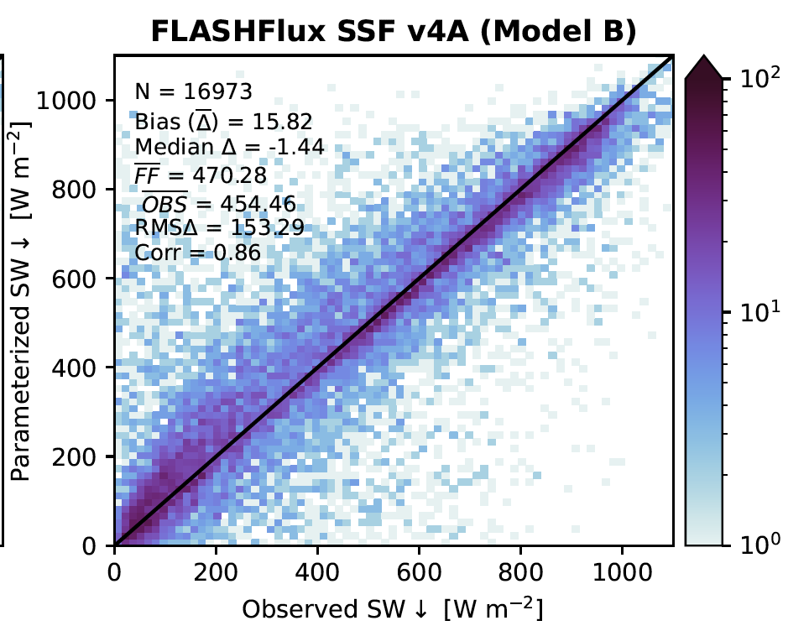
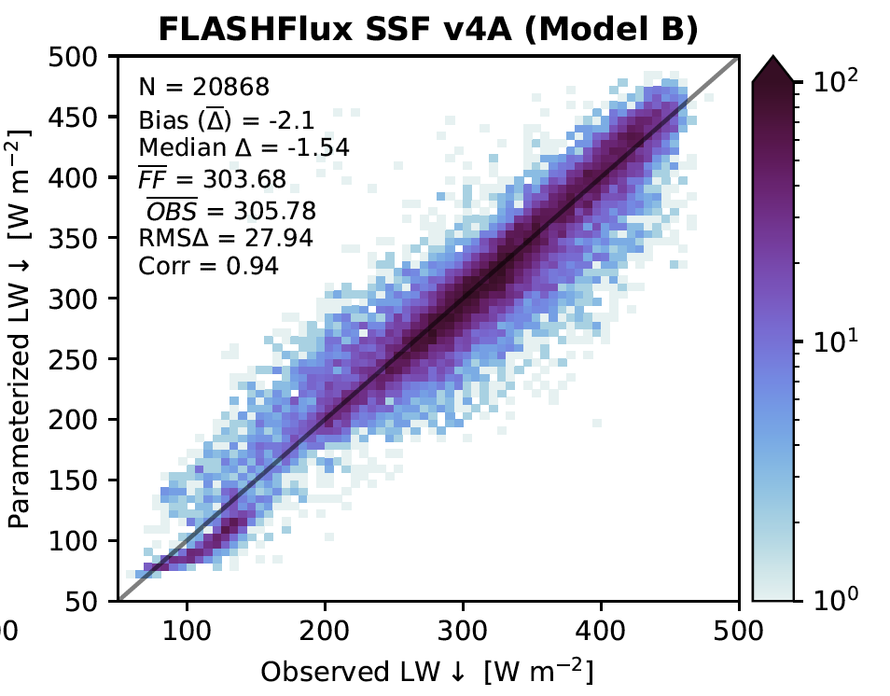
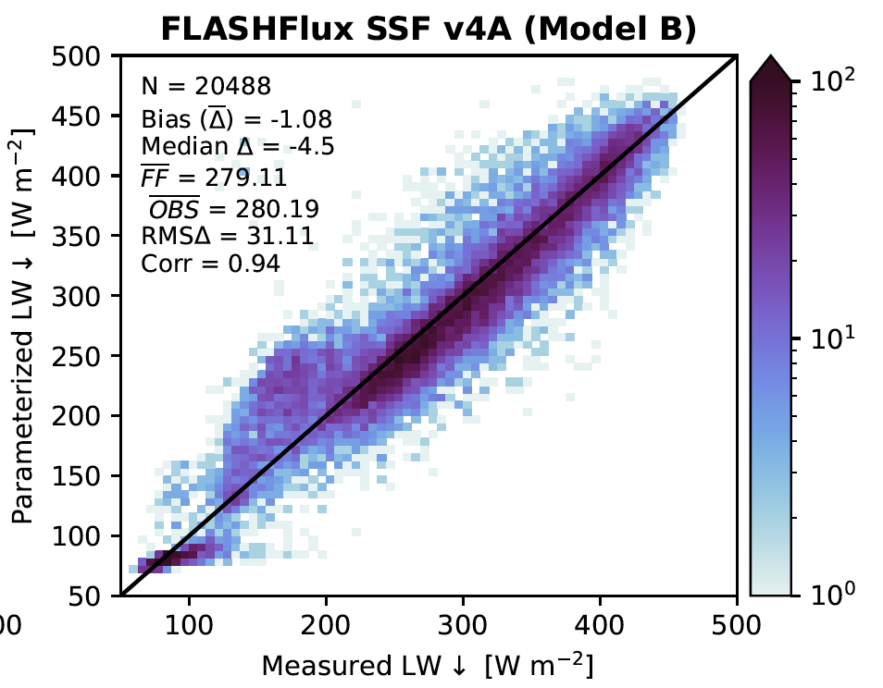
FF SSF Flux Validation: Aqua
Overpass flux validation with BSRN measurements (R. Scott):
- large SW scatter; underpredicts > ~300 W m⁻²; overestimates low
- LW night has larger scatter; instantaneous performing adequately
SW
LW Day
LW Night

Slide 10
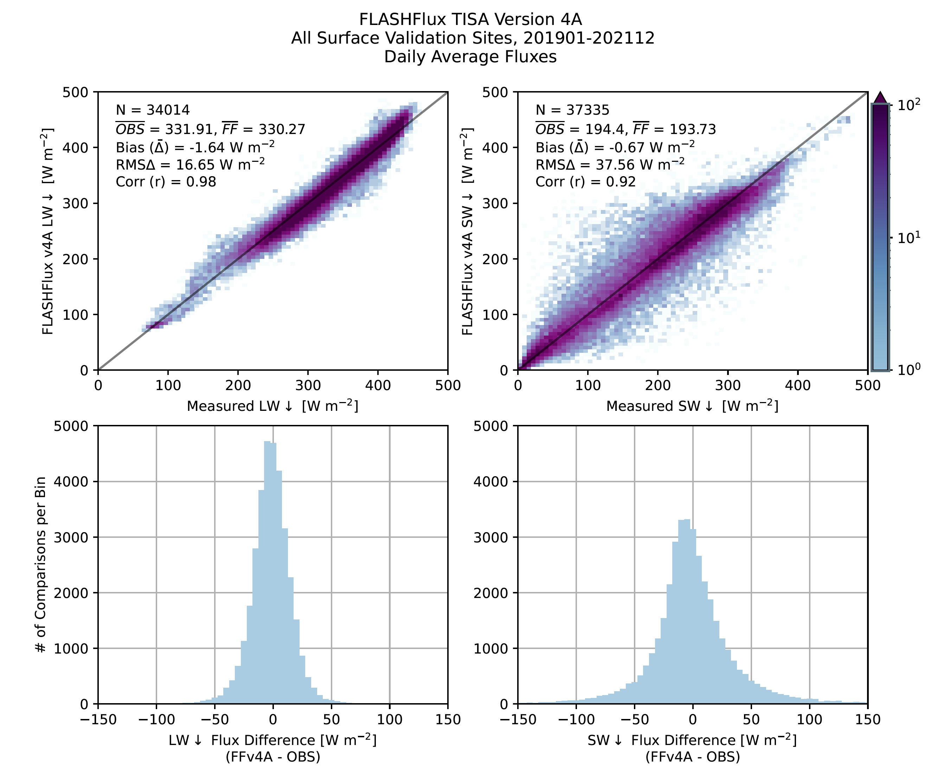
FLASHFlux TISA Validation: BSRN Fluxes
Ensemble FLASHFlux LW and SW Daily Average Comparisons to BSRN Measurements (1/2019-12/2021)
LW: Bias -1.6 W m⁻²
RMS 16.7 W m⁻²
SW: Bias -0.7 W m⁻²
RMS 37.6 W m⁻²
Histograms show peaked, relatively symmetric distributions, median bias is negative bias for SW, LW
LW
SW
LW
SW

Slide 11
FLASHFlux TISA Validation:
BSRN and Ocean Buoy Fluxes
FLASHFlux v4A TISA Daily Average Fluxes (1/2019 – 6/2021)
Region Type | LW Bias | LW RMS | # LW Pairs | SW Bias | SW RMS | # SW Pairs
All Ensemble | -1.6 | 16.7 | 34,024 | -0.7 | 37.6 | 37,335
Coastal | 0.3 | 15.0 | 7707 | -1.9 | 34.1 | 7460
Desert | -11.1 | 21.8 | 2883 | -12.1 | 28.2 | 2861
Island | 5.9 | 14.4 | 2055 | 18.5 | 46.3 | 2009
Continental | -3.6 | 17.2 | 12828 | -4.9 | 38.9 | 12755
Polar | 0.7 | 19.6 | 3505 | -7.5 | 48.3 | 2389
Ocean buoys | 1.0 | 12.4 | 5036 | 6.7 | 35.7 | 9861

Slide 12
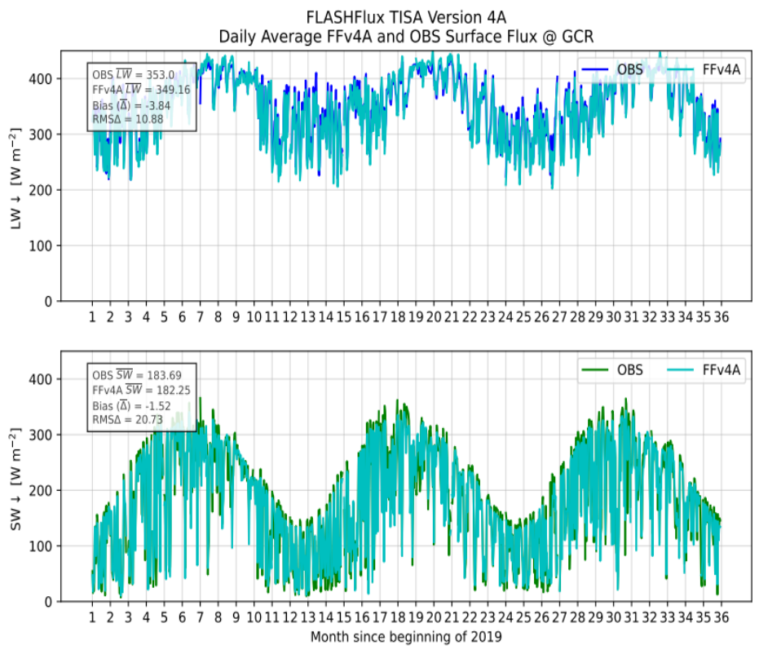
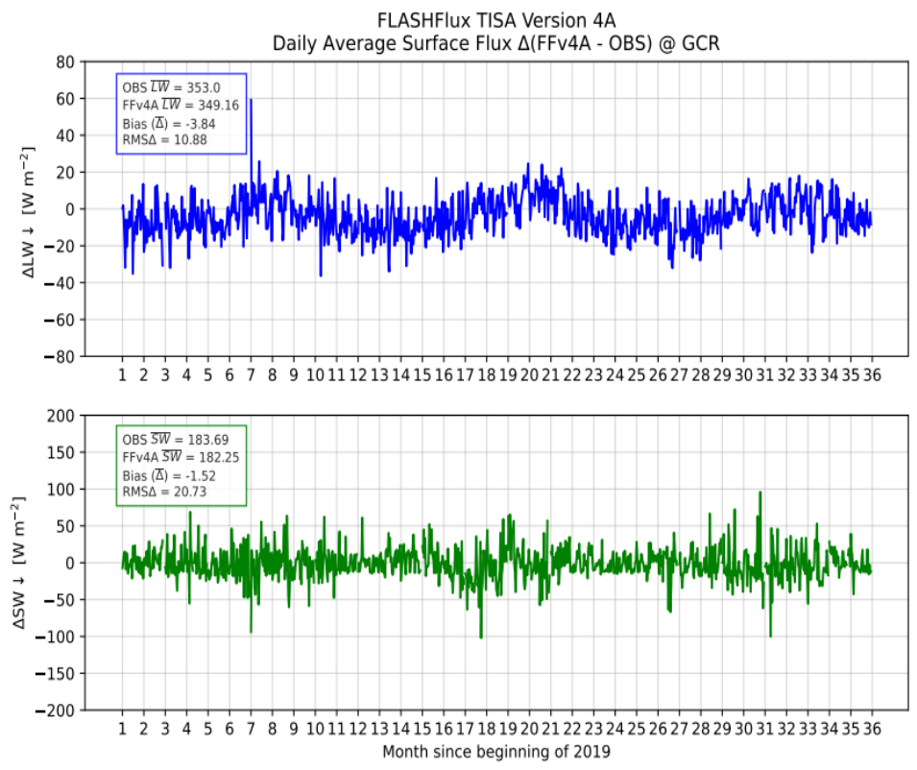
FF Time Series (Goodwin Creek, MS, USA)

Slide 13
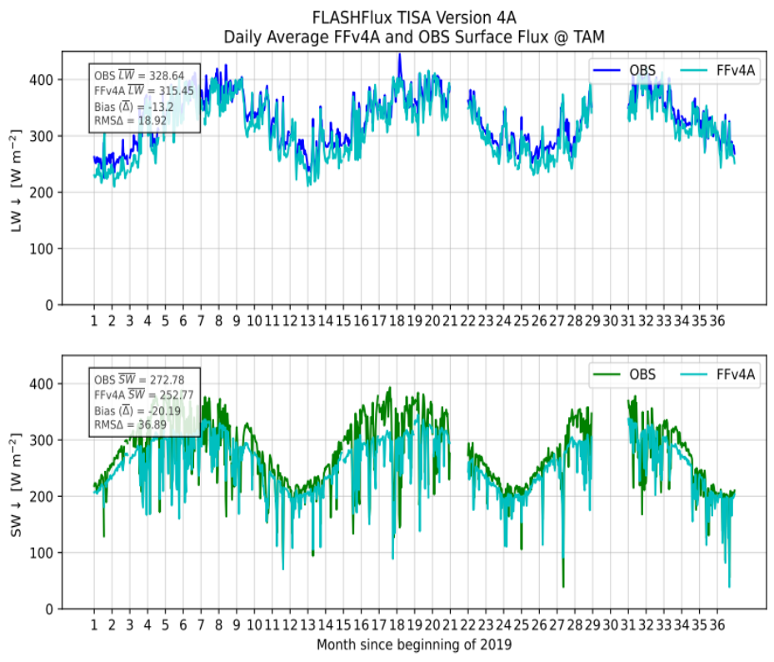
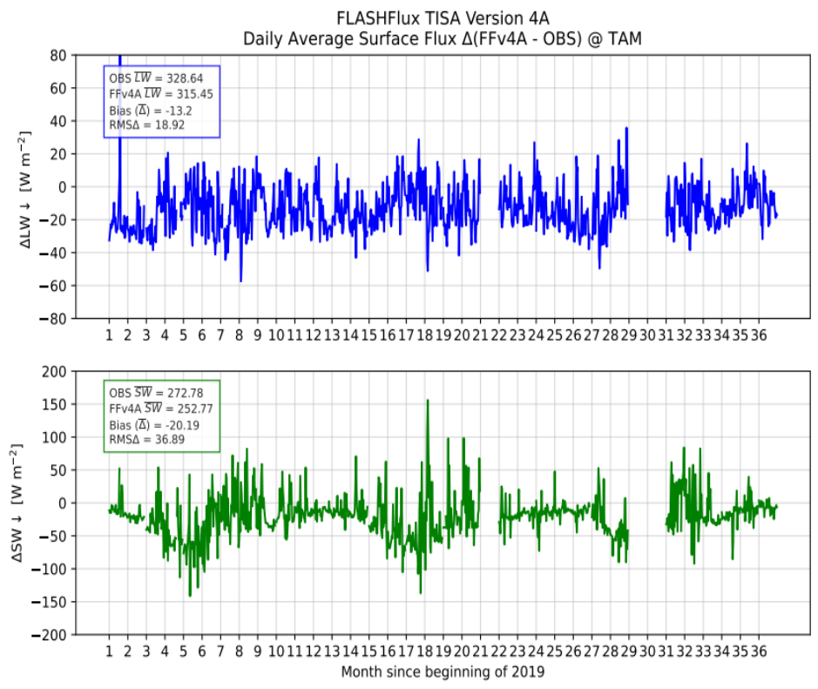
FF Time Series (Tamanrasset, Algeria)

Slide 14
FF Future Production Strategy
Both Terra and Aqua are scheduled to be turned off in 2023; production system must be modernized and adjusted to continue production
Current Plan:
June 2022
Oct 2022
Jan 2023
Apr 2023
Aug 2023
FF Production in S4P
Migrate FF Prod to CATALYST
Complete migration
Run in parallel
Promote FF NOAA-20 to CATALYST (replace Aqua in TISA)
Finalize TISA read code
Finalize GEOS-IT MOA
Update to GEOS-IT
SSF ML/NN
Upgrade SSF/TISA RT algorithms
Leverage CERES TSI (F/L)
Processing GEO for FF (replace lost morning orbit)
Leverage SatCORP Ops, CERES TSI

Slide 15
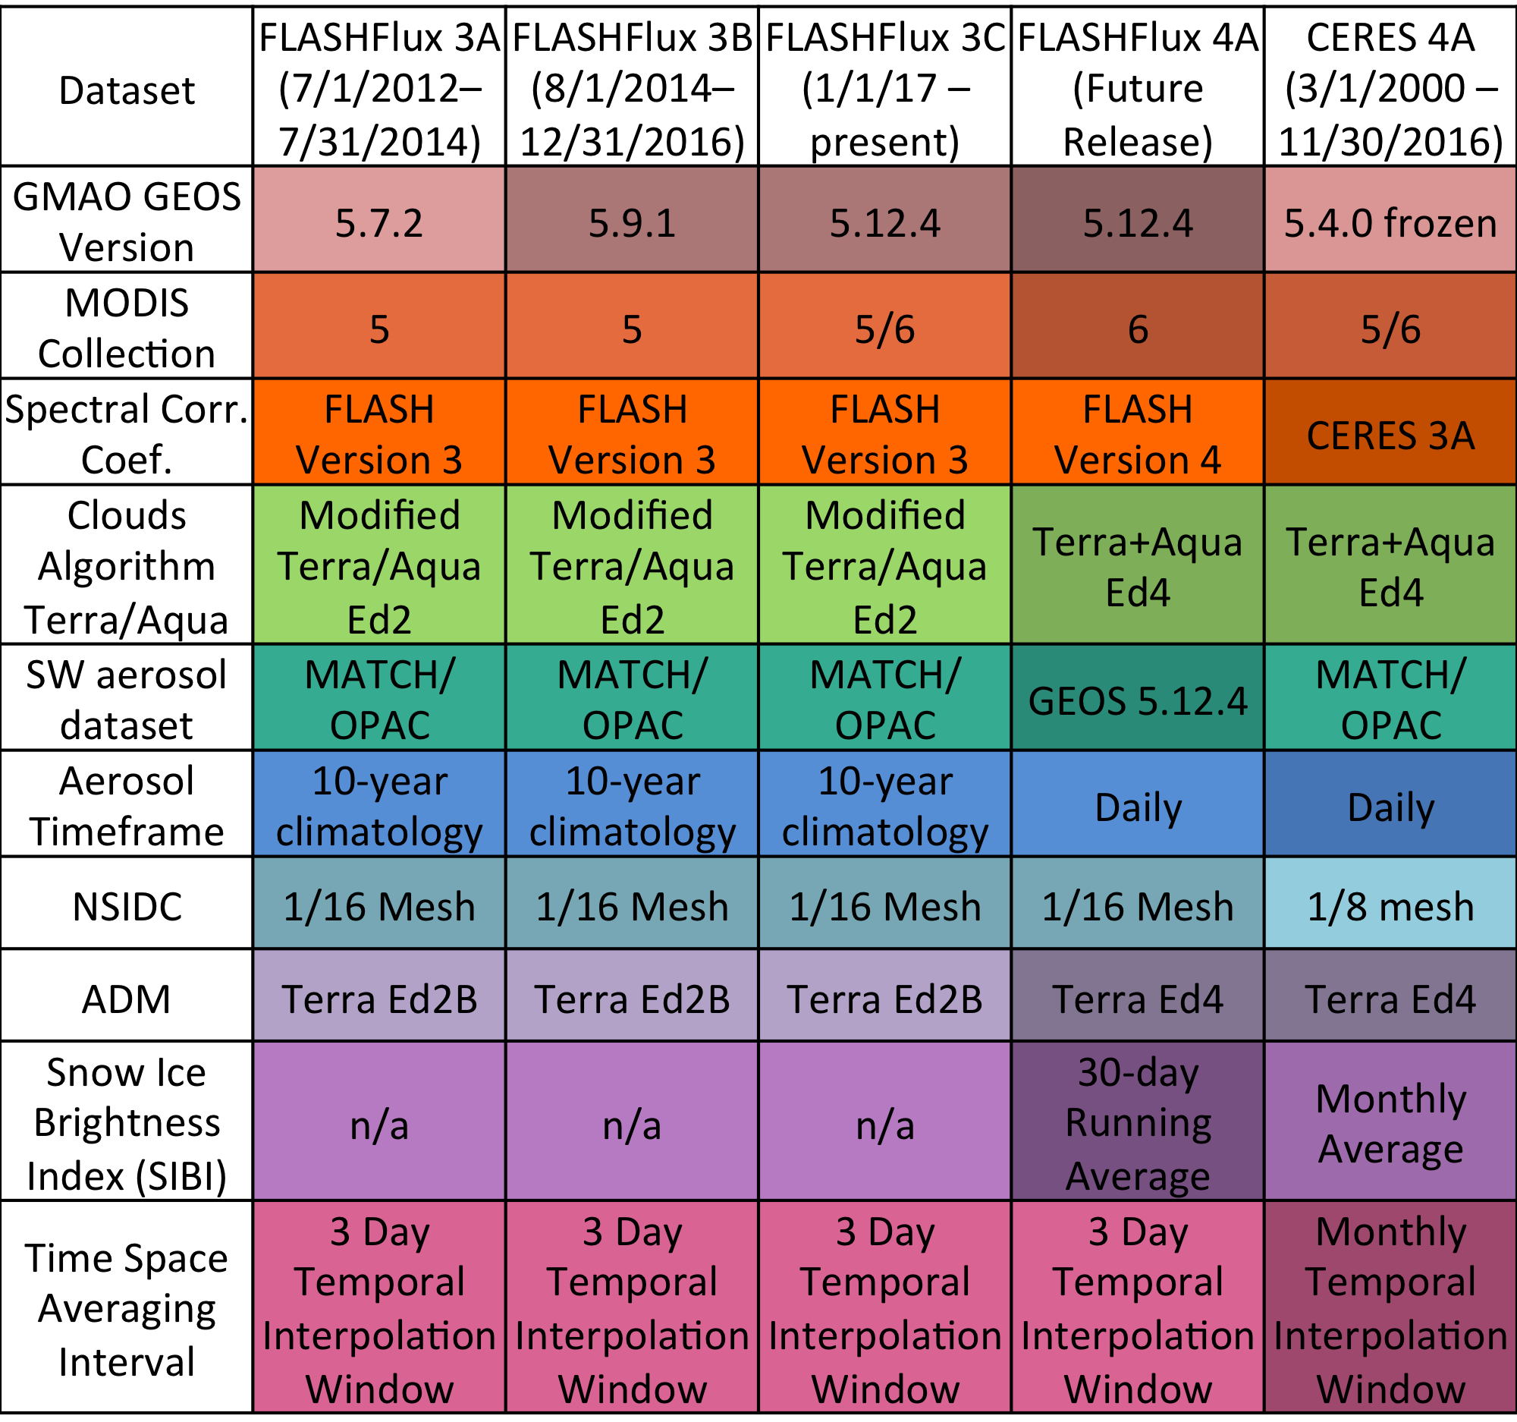
FLASHFlux Summary
Production with v4A Begun (since Aug 1, 2020)
  Operational FF v4A SSF and TISA v4A (since Jan 1, 2019): SSF Terra/Aqua through 9/23; TISA through 9/21
  New FF Gain+Spectral coefficients beginning Oct 1st, 2022.
  Production with CATALYST from June 1st, 2022. Publicly available starting on September 1st, 2022.
Validation and Assessment
  SSF relative to CRS (Beta), CERES Ed4A SSF (SOFA) and FF and BSRN
  TISA Daily averages relative to BSRN for Jan 2019 through Dec 2021 (36 months)
FLASHFlux Modernization and Updates
  Migration to CERES CATALYST reached through FF SSF (also see Katie’s talk); Completed
  NOAA-20 SSF data product; Goal Oct 2022
  Terra+NOAA-20 TISA data product; Goal Mar 2023
  New GEOS-IT sample data; first cut comparisons to FP-IT (still assessing); Goal Apr 2023
  ML based algorithms for future FF SSF data products; Goal Jul 2023
  Migrate configuration to NOAA-20 + GEO (leveraging Ed5 TSI); Goal Aug 2023
FLASHFlux Information & Data Provision Through ...
  CERES web site and subsetter both SSF and TISA, ASDC (via EarthData) and POWER
    FF POWER Distribution in last year: ~59,200 unique IPs; > 16M orders; orders >70% low latency
  2021 BAMS State of the Climate TOA Flux reports

Slide 16
FLASHFlux Web Sites https://ceres.larc.nasa.gov/data/#fast-longwave-and-shortwave-flux-flashflux
Data also served through https://power.nasa.gov

Slide 17
Extras

Slide 18
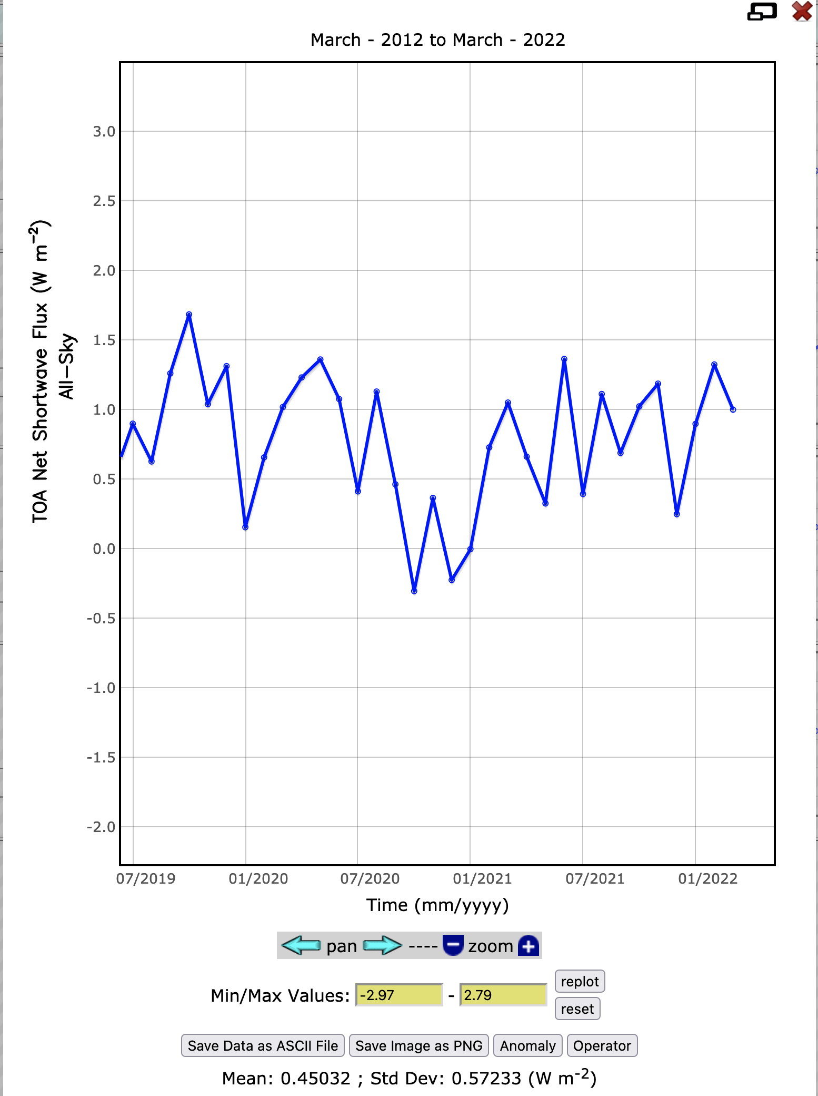
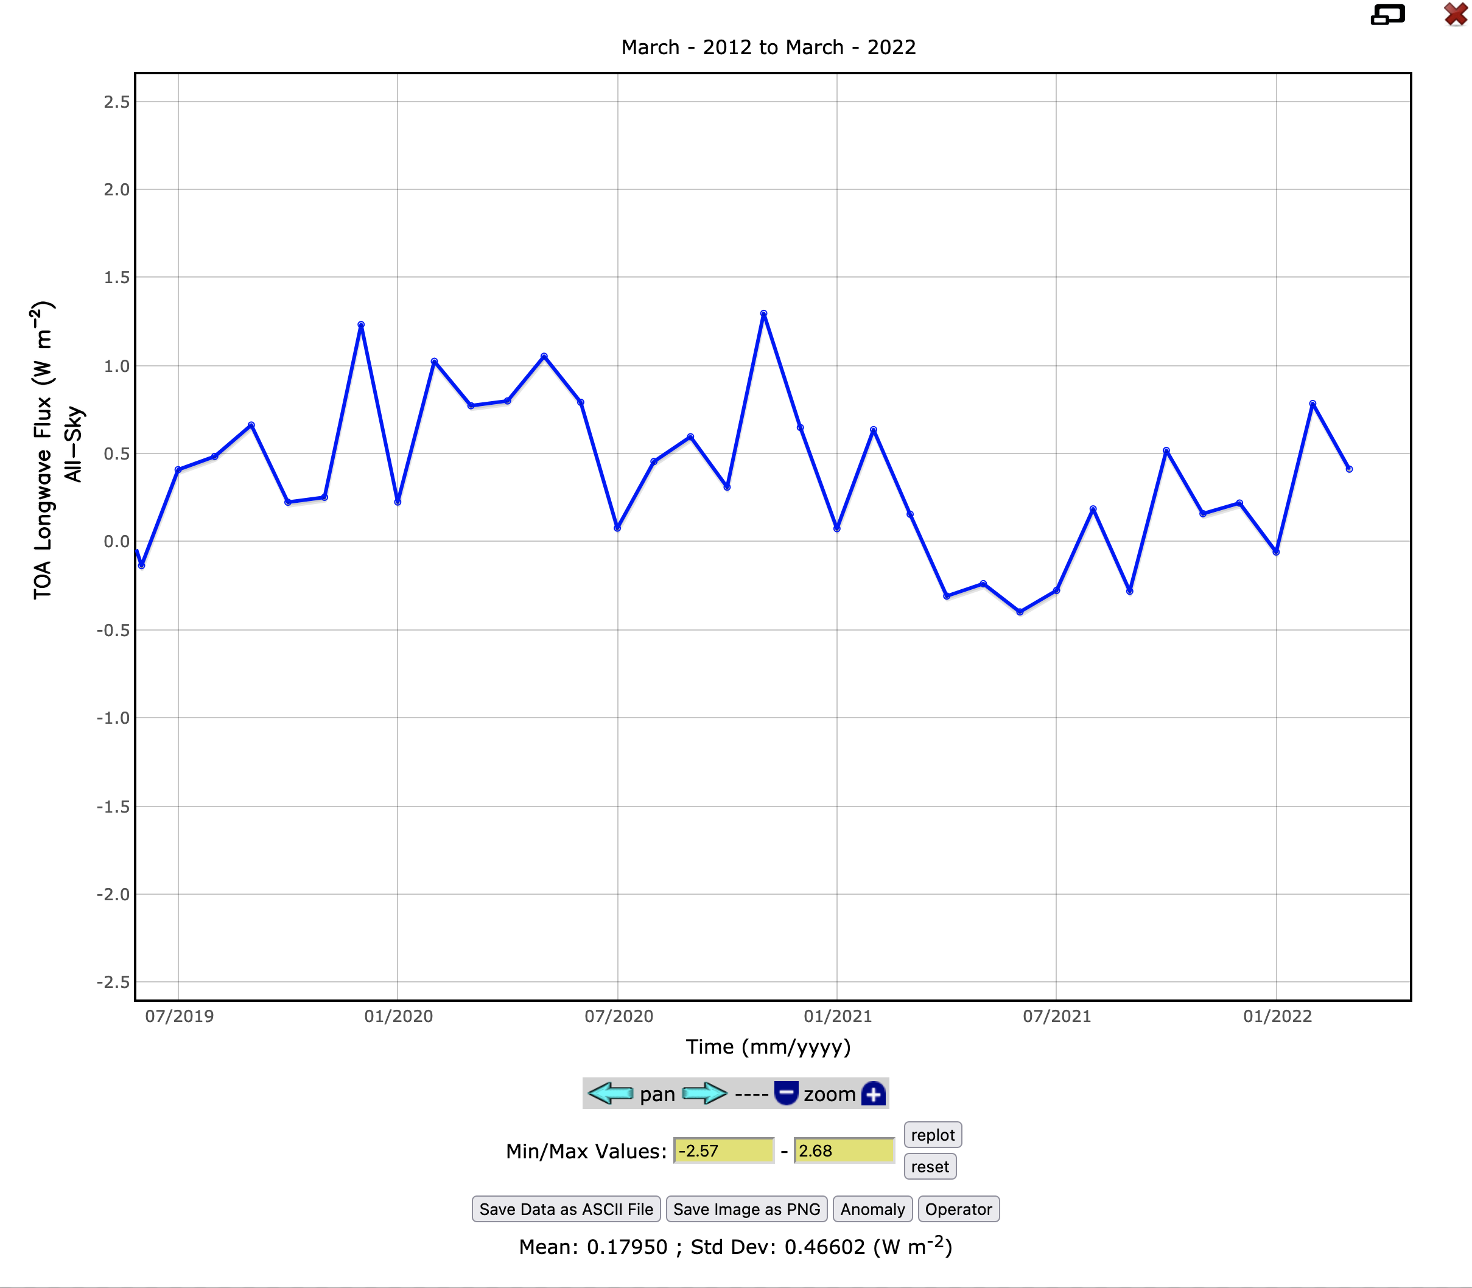
Global Anomalies: EBAF + FF (Normalized)
SW Net Anomalies
EBAF +0.9 W m⁻²
Norm FF
+ 1.3, 1.0 W m⁻²
OLR Anomalies
Norm FF
+ 0.8, 0.4 W m⁻²
EBAF -0.1 W m⁻²
Notes:
Estimates good to within about +/- 0.3 W m^-2

Slide 19
Example SSF Validation: Terra and Aqua
Overpass flux validation with BSRN measurements (R. Scott):
SW Model B implementation shows compensating clear/cloudy; errors to be assessed
LW Model B seems to underestimate day-time clear-sky more than night
Sate-lite | Spectral Band | All-sky (W m⁻²) Bias RMS |  | Clear-sky (W m⁻²) Bias RMS |  | Cloudy Sky (W m⁻²) Bias RMS
Aqua | SW | +15.8 (3.4%) | 153.3 (33.7%) | -12.8 (2.0%) | 141.7 (22.3%) | 36.6 (13.3%) | 274.6 (64.0%)
 | LW day | -2.1 (0.0%) | 27.9 (9.1%) | -14.3 (5.3%) | 33.0 (12.1%) | +1.2 (0.0%) | 30.3 (9.5%)
 | LW night | -1.1 (0.0%) | 31.1 (11.1%) | -5.4 (2.2%) | 29.6 (11.9%) | -1.7 (0.0%) | 33.7 (11.1%)

