Slide 1
Conjunction Assessment at NASA
Lauri K. Newman
NASA Conjunction Assessment Program Officer
September 21, 2022

Slide 2
Agenda
Conjunction Assessment Process Overview
Challenges of Evolving Space Environment
Future

Slide 3
Introduction
The number of objects in orbit is growing exponentially
The space environment today is very different from a decade ago and continues to evolve very rapidly
  Historically, space operations were domain of large governmental entities.
  Commercial space operators are becoming commonplace and have different business models than government actors
  CubeSats are cost effective and accessible for everyone, even down to elementary schools
Challenge in educating new space actors on best practices and availability of data and tools
Technology enabling this access has rapidly evolved, while no regulatory framework has been established to ensure that space can be used safely by all.

Slide 4
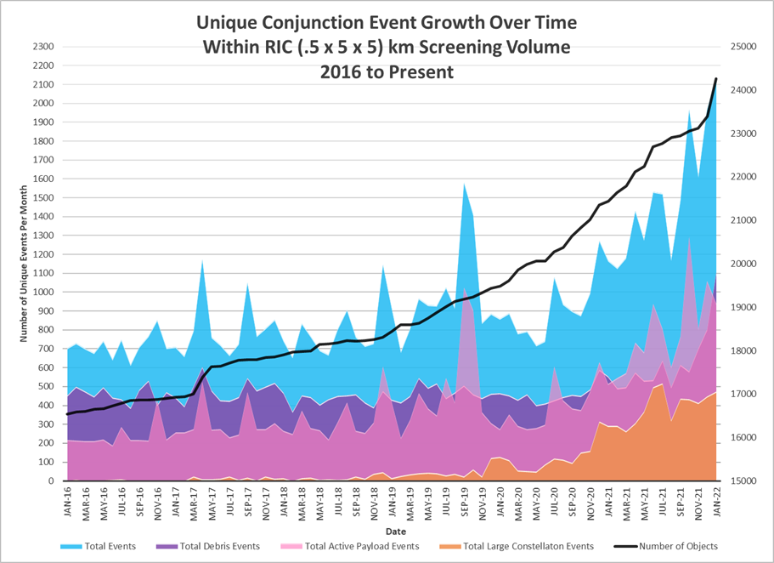
Increasing Close Approach Event Workload
30% increase since Nov
Number of events had tripled since 2018
Change in slope due to large constellation launches
Active payloads ~50% of events, requiring coordination with other Owner/Operator

Slide 5
History of CA
Conjunction Assessment was originally developed as a collaboration between NASA and DOD in the 1980s to protect the space shuttle
The catalog of space objects is maintained by the 18th Space Defense Squadron of the US Space Force using the radars, telescopes, and other sensors in the Space Surveillance Network (SSN).
  Contains orbit solutions for trackable objects: LEO objects >10 cm and GEO/MEO/HEO objects >50 cm
18 SDS performs screenings to compare the predicted trajectories for protected objects against trajectories for all other on-orbit objects in the catalog and provides Conjunction Data Messages (CDMs) to operators
  Contains state and covariance information at Time of Closest Approach (TCA)
Two Line Elements TLEs for tracked space objects of known origin are also published to the USSTRATCOM website Space-Track.org.
  These cannot be used for CA as they do not contain covariance, a needed input for a probability of collision calculation.

Slide 6
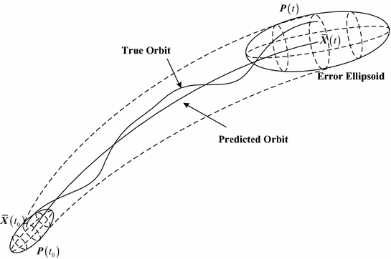
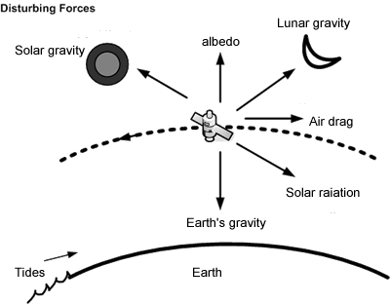

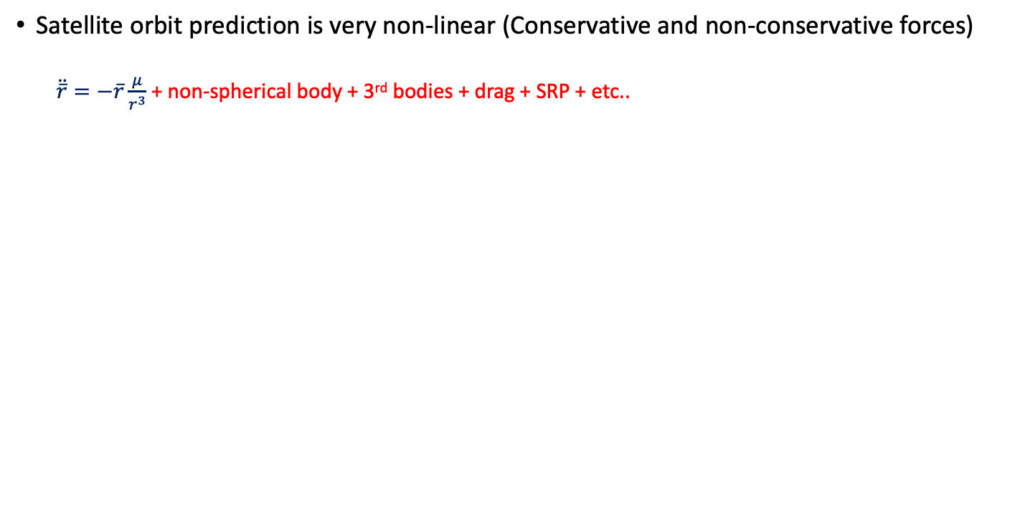
Satellite Prediction
Satellite orbit prediction is very non-linear (Conservative and non-conservative forces)
  $\ddot{\overline{r}}=−\overline{r}\frac{μ}{r^{3}}$ + non-spherical body + 3rd bodies + drag + SRP + etc..
P(t) is known as the covariance/error ellipsoid (region of uncertainty in 6-DOF)

Slide 7
CA Operations: 3-Step Process
Catalog Object i+1
Secondary Object
Secondary Object
Catalog Object i
Catalog Object i+2
Maneuver
∆V
Primary S/C
Primary S/C
Primary S/C
Conjunction Assessment (CA) is the process of identifying close approaches between two orbiting objects; sometimes called conjunction “screening”.
The 18th Space Defense Squadron (18 SDS) at Vandenberg SFB maintains the high accuracy catalog of space objects. Orbital Safety Analysts (OSAs) at VSFB screen protected assets against the catalog, perform tasking requests, and generate close approach data.
CA Risk Analysis is the process of assessing collision risk and assisting satellites in planning maneuvers to mitigate that risk, if warranted.
The NASA CARA program performs risk assessment for all NASA operational non-HSF satellites, and some partner missions.
JSC FOD performs risk assessment for all NASA HSF program assets and is the O/O for maneuver decisions and execution.
Collision Avoidance is the process of executing mitigative action, typically in the form of an orbital maneuver, to reduce collision risk.
Each satellite Owner/Operator (O/O) – mission management, flight dynamics, and flight operations – is responsible for making maneuver decisions and executing the maneuvers.

Slide 8
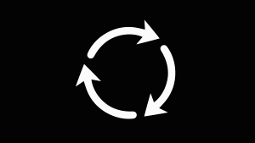
NASA CARA Process
18th SPCS- SSA
Object Catalog
Sensor
18th SPCS – CARA OSAs
Ephems
18th SPCS – CARA OSAs
Products and Analysis
Missions
*TCA= Time of Closest Approach
Screenings
CARA
CARA’s Purview
DECISION POINT:
Begin Maneuver Planning
DECISION POINT:
Maneuver Go / No-Go
Conjunction Identification
Analysis, Risk Characterization, HIE Identification & Notification
HIE analysis & Maneuver Planning
Maneuver Screening
Maneuver Execution
TCA- 7 Days
TCA- 5.5 Days
TCA- 3 Days
TCA- 2 Days
TCA- 1 Days
TCA
Routine
High-Interest Event / Non-Routine
8

Slide 9
Conjunction Risk Analysis at NASA
HSF CA performed by Flight Operations Directorate (FOD) at JSC
  ISS/visiting vehicles (VV), commercial crew and exploration missions
  Support includes risk assessment and execution of collision avoidance maneuvers if required
The NASA Conjunction Assessment Risk Analysis (CARA) program is responsible for risk assessment and mitigation support for ~100 non-human spaceflight (HSF) spacecraft
  Started in 2005 based on HSF process
  Customer-funded “middle-man” central service
CA at other central bodies (moon, Mars, etc.) supported by the MADCAP (Multi-mission Automated Deep space Conjunction Assessment Process) program at JPL

Slide 10
CARA Portfolio
CARA Operations
Pre-launch process definition
Processes messages from 18 SDS
Works with O/Os to develop mitigation plan
Conjunction Assessment Oversight at HQ
Develop and maintain CA requirements
Education and Awareness
Interagency partnerships
CARA S/W
Processing on AWS Cloud
In-house staff maintains and augments system to meet requirements
CARA R&D
Develop new methods and algorithms to meet changing need
Assist future missions with planning orbit design
Assist DOC with STM system development as requested and funded

Slide 11
CARA Outreach:
Software Development Kits (SDKs)
Method for packaging and distributing established CA algorithms for distribution to any interested user
  Follows SDK example from industry; way of packaging software for rapid integration into new/existing systems
  One SDK for each algorithm set; each kit contains
    Algorithm source code and drivers
    Test cases and validated results
    Software and technical documentation (the latter usually a conference paper)
Major capabilities presently available
  Analytic probability of collision calculation (with covariance decorrelation)
  Monte Carlo probability of collision calculation
  Single-covariance probability of collision calculation
  Collision consequence assessment
  Covariance realism assessment
https://github.com/nasa/CARA_Analysis_Tools

Slide 12
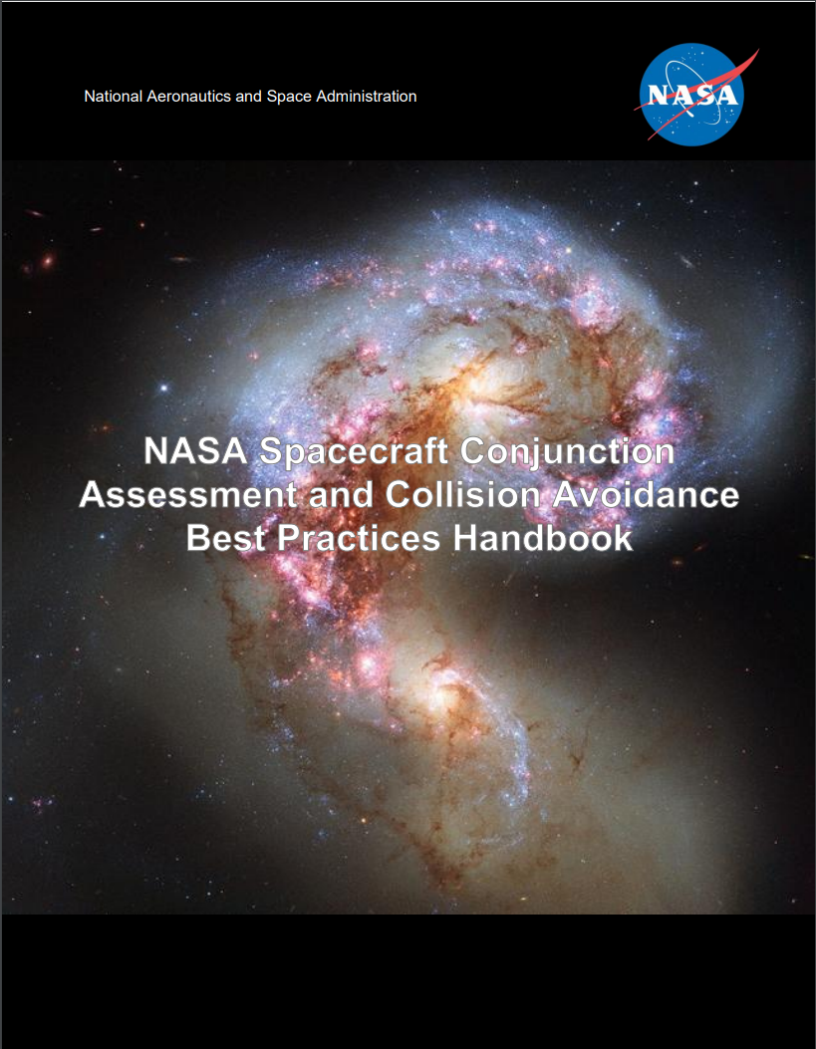
Documentation
In 2007 after the Chinese Fengyun 1C ASAT test created a large debris cloud in the crowded 800 km orbit regime, NASA formalized Conjunction Risk Analysis requirements in NASA Procedural Requirement 8715.6
  All NASA spacecraft required to perform conjunction risk assessment
  Must use CARA or JSC equivalent for Human Spaceflight
In 2020, more specific requirements were codified in a NASA Interim Directive (NID 7120.132), soon to be replaced by a CA-focused NPR.
  NASA spacecraft now required to complete pre-launch studies to ensure they consider debris-related trades during design
Accompanying best practices document released to provide additional technical background and assist other operators in maturing their practices and keeping space safe and accessible
  “NASA Spacecraft Conjunction Assessment and Collision Avoidance Best Practices Handbook” Available at https://nodis3.gsfc.nasa.gov/OCE_docs/OCE_51.pdf

Slide 13
Spacecraft Design Considerations
It is important (and efficient) to make plans for conjunction assessment during spacecraft planning and design
  CA process needs can be accommodated more easily prior to spacecraft fabrication
  Develop and validate all processes and tools well in advance of launch
Key items to consider during design:
  Orbit selection
  Trackability
  Deployment plan
  Ephemeris generation process and tools
Lesson learned example:
  A NASA spacecraft assumed that two-line elements (TLEs) would be available for use in providing acquisition data to tracking radars.
  After launch, it was discovered that the orbit was too low an inclination for DOD CA sensors to reliably track and maintain it, so TLEs were not available.
  This situation could have been prevented through pre-launch analysis

Slide 14
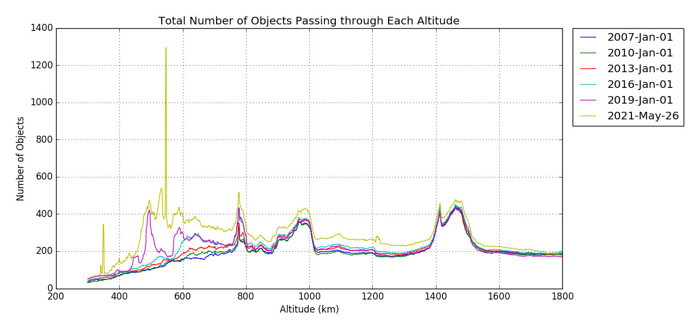
Orbit Selection
Orbit Altitude Affects Event Rate:
  Small changes in orbit altitude may make large differences in the number of close approaches
Co-Location:
  Determining in advance that there are other neighbors in the intended location of the spacecraft allows planning of communication and space sharing operations concepts.
*NASA CARA Program. (2019) Unpublished internal data.
Transiting to final orbital position can create CA complexities
  Transiting spacecraft should yield way to on-station spacecraft
  Frequent, sometimes constant, maneuvering must be modeled in ephemerides provided to 18 SDS to communicate position to neighboring spacecraft
  Transiting through constellations or large groups of active payloads requires frequent contact with other O/Os to adjudicate close approaches

Slide 15
Trackability [1 of 2]
Technology advances make possible spacecraft that are too small to be tracked by the Space Surveillance Network (SSN)
  SSN is the DOD USSF resource assigned to track all on-orbit objects
  Objects must be >10 cm to be tracked reliably in LEO
  Objects must be >50 cm to be tracked reliably in GEO
  Passive tracking not currently available beyond GEO (e.g., cis-lunar)
  CA can be performed only against well tracked objects in the catalog
Un-trackable objects on orbit pose a threat to flight safety
  Objects in low inclination orbits (fewer SSN sensors with geometric visibility)
  Objects in eccentric orbits (perigee can be away from radars and satellite can be too dim at apogee for optical sensors)

Slide 16
Trackability [2 of 2]
Potential workarounds include:
  Provide O/O ephemerides (does not work after end of operations)
  On-board tracking radio beacon to provide position and ID
  Corner cubes and an arrangement with a laser tracking facility to track and identify the payload
  Coded light signals from a light source on the exterior of the spacecraft
  Radio frequency interrogation of an exterior Van Atta array
  Passive increase of albedo
Best Practice:
  Ensure objects are large enough to be tracked passively on-orbit. This enables tracking even after the spacecraft is no longer operational, until demise.
  At injection, make sure object is placed far enough away from other deployed satellites and on-orbit objects to allow unique, unambiguous tracking

Slide 17
Deployment Plan
Issue: complex deployments create cataloguing difficulties
  Rapid child deployments proliferate deployed satellites, when parents may already be difficult to distinguish, track, and catalog depending on number of objects deployed
  Tethered deployments follow non-Keplerian trajectories; difficult to maintain orbit in catalog
Approach: attempt to simplify/prepare for situation
  Delay child deployments until 18 SDS is able to catalogue parent
  For tethered deployments, work out tracking/maintenance strategy with 18 SDS in advance of launch
Rideshare missions must rely on launch provider to protect their spacecraft by using safe deployment practices

Slide 18
Ephemeris Generation Process and Tools:
Producing a CA-Quality Ephemeris
Since close approaches are computed using predictions of future spacecraft position, those predictions must be accurate enough to enable maneuver planning.
If spacecraft is not passively trackable or if it is maneuverable, predicted trajectory information must be provided to 18 SDS to enable close approach computation.
  At least once per day
  Predicted at least 7 days into the future
  Quality modelling, especially atmospheric drag, must be used to reduce errors
  Include realistic covariances
Two Line Elements (TLEs, e.g. obtained from SpaceTrack.org) are NOT SUFFICIENT FOR CA
  1-2 km theory error is too large for maneuver planning
  No covariance available to compute probability of collision and make risk decision
Maintain Space-Track.org information,
  Contact information (24x7, since other O/Os may be in a different time zone)
  Active and maneuverable status flags

Slide 19
Challenges and Future Work

Slide 20
Satellite Autonomous Maneuvering
Becoming more common for satellites to employ autonomous maneuvering (especially large constellations)
  Current example: SpaceX’s Starlink, ~2000 active satellites operated this way
Maneuvers automatically commanded/executed
  Often ground systems do not even know of maneuvers until after execution
CA can also be executed autonomously
  Conjunction Data Messages (CDMs) for upcoming conjunctions uploaded to spacecraft
  On-board CA software can determine risk based on spacecraft’s latest position information, plan maneuvers to avoid close approaches, and execute them
  If CDMs generated with sufficiently large screening volume, then autonomous CA likely to be effective against debris

Slide 21
Autonomous Flight Dynamics:
Active-vs-Active CA Issue
Autonomous systems program maneuvers and perform CA based on CDMs uploaded as frequently as contacts allow
Co-located autonomously-controlled constellations need other solutions
  Two satellites in conjunction from different constellations may be planning mitigation actions, but neither knows what the other is planning to do
  Satellites could therefore maneuver into each other
For autonomous CA with other active satellites, latencies in information exchange cause CA problems
  Non-autonomous active satellites need to refrain from maneuvers 12-24 hours before close approaches with autonomous satellites
  Allows sufficient time for submitted ephemeris that includes their maneuver to be screened for CA and these screening results uploaded to autonomous system

Slide 22
Active-vs-Active CA Issue:
Current Resolution Efforts
NASA is part of an industry consortium to develop a pathfinder solution
  NASA experimental autonomous constellation (Starling) will be collocated with Starlink constellation, forcing the issue
  Consortium among NASA Ames, NASA CARA, SpaceX, Emergent Technologies, and UT Austin to develop and demonstrate a prototype autonomous CA approach
  “Mother May I” solution utilized
Infrastructure being built out. Ground testing underway
Department of Commerce (DOC) participates in observer status
  Designated to assume space traffic management responsibility
  Successful demonstration of approach expected to be embraced by DOC
Day-long session on this issue and investigated approaches to be presented in a conference venue this coming winter

Slide 23
Cis-lunar CA
Catalog of non-cooperatively tracked objects used in CA only available near Earth
Activity at Moon, Mars, and Libration points increasing risk of collision without screening
DOD developing cis-lunar catalog and screening capability
  Requirements not yet defined
  Implementation is many years away
NASA Multimission Automated Deepspace Conjunction Assessment Process (MADCAP) provides ephem-on-ephem screening for missions that utilize DSN
  Not Pc based; most operators do not provide covariance
  Relies on sharing of data; sharing of non-NASA data encouraged
NASA continues to work with DoD on beyond GEO SSA capabilities.

Slide 24
Future Work
Department of Commerce charged with establishing a civil-space-run CA process
  NASA and DOC in discussions to determine potential for partnerships
NASA continues to update its Best Practices document

Slide 25



Summary
Increasing congestion of space accentuates need to follow CA best practices
  Particularly/especially in LEO
Best Practices are incorporated most cheaply/efficiently when designed in from the beginning
NASA CARA committed to develop/refine appropriate best practices
  Integrate feedback from space operators
  Expand coverage to address emerging areas of interest
  Continue to focus on a safe space environment for all operators
NASA CA Handbook
CARA Tool Repository
NASA CA website

Slide 26

Questions?

Slide 27
Acronyms
18 SDS | 18th Space Defense Squadron
CA | Conjunction Assessment
CARA | Conjunction Assessment Risk Analysis
O/O | Owner/Operator
TLE | Two-Line Element
CDM | Conjunction Data Messages
SSN | Space Surveillance Network
GEO | Geostationary/Geosynchronous Orbits
LEO | Low Earth Orbits
HEO | Highly Elliptical Orbits
HASDM | High Accuracy Satellite Drag Model

