Slide 1

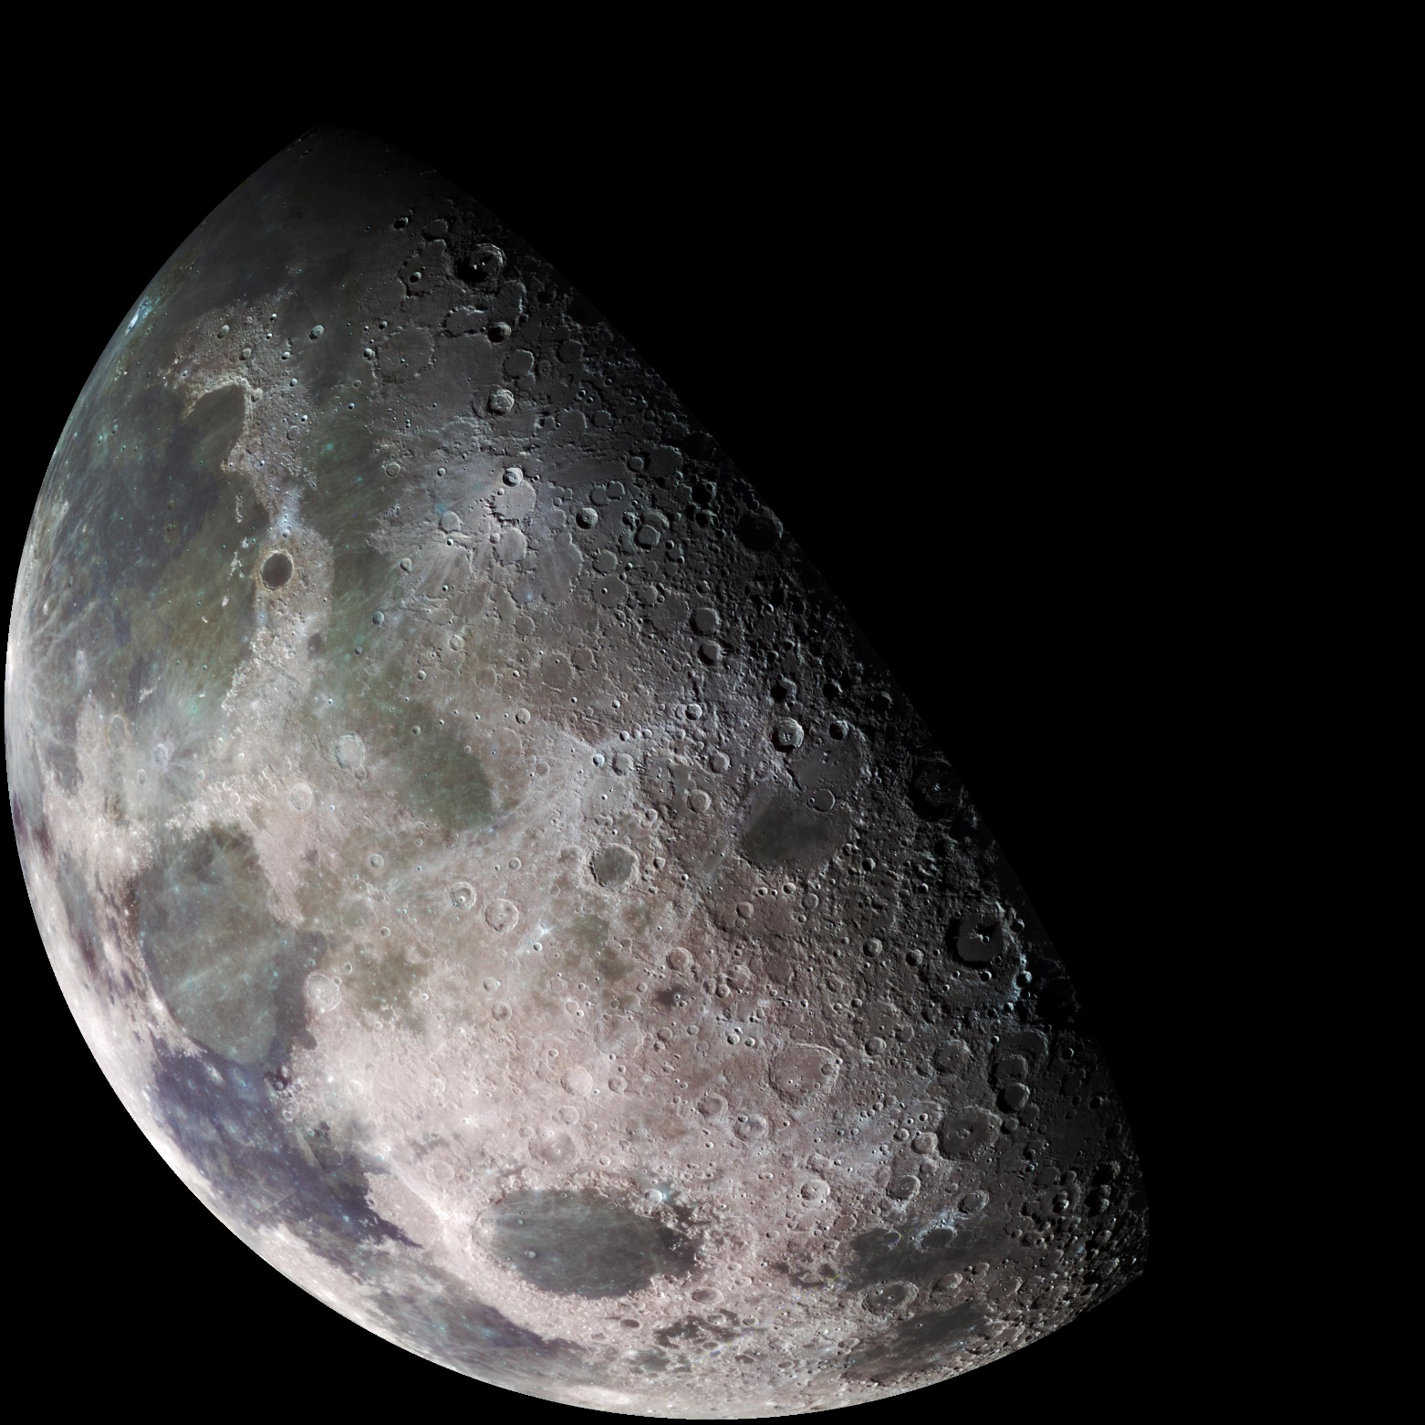
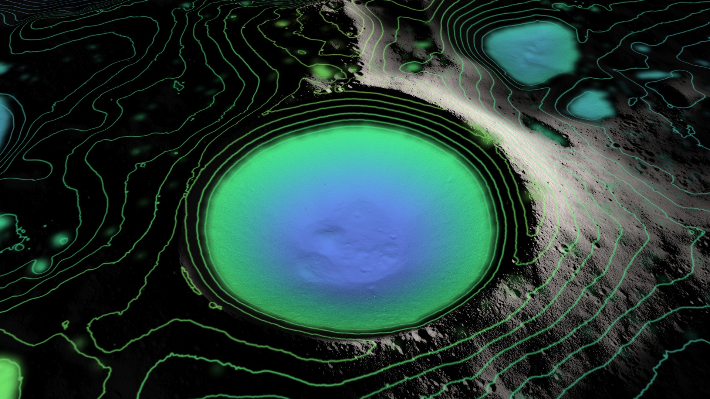
The New Moon is wet…
Not that long ago, we understood the Moon very differently…
Old beliefs were:
Surface was relative constant
Bone dry
Now we know that Water-Ice exists in Permanently Shadowed Regions at the Poles
Notes:
Moon 250x drier than the Sahara Desert (~25,000 ppm)
100 ppm = 0.01% (wt); 10,000 ppm = 1% (wt)

Slide 2
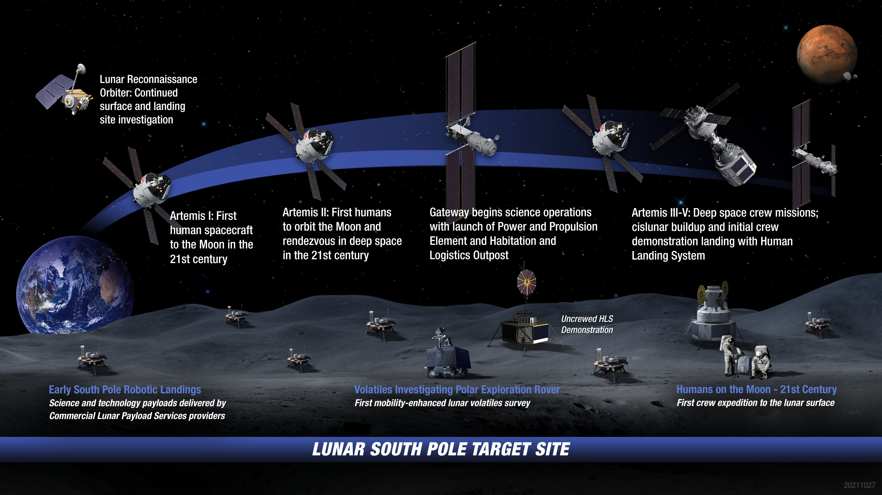
Enter Artemis: Landing Robots & Humans On the Moon

Slide 3
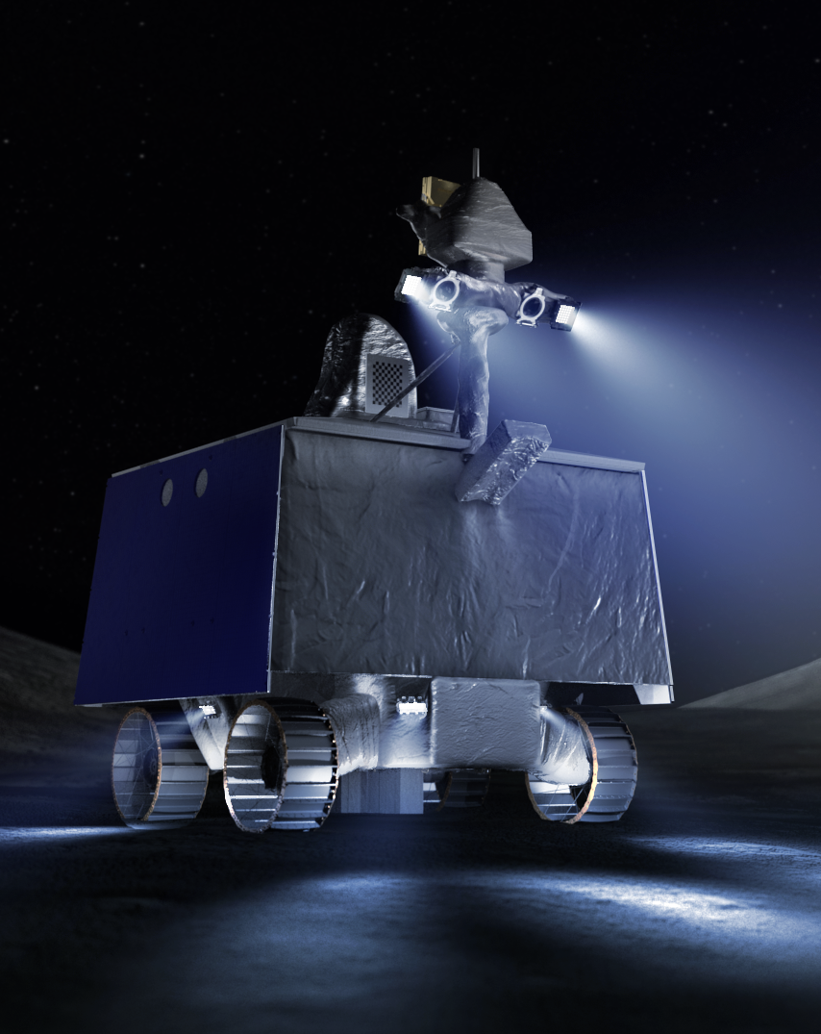

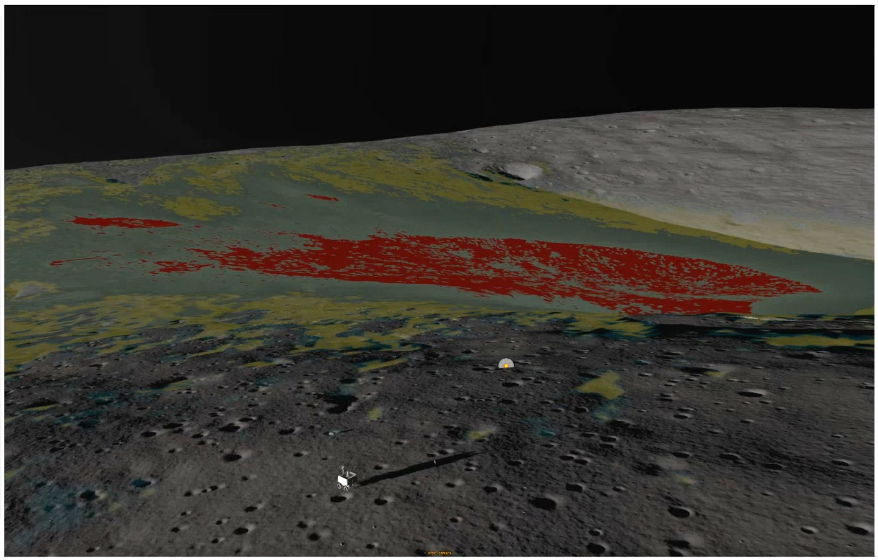
VIPER Rover and Ice Stability Regions (ISRs)
Will spend 2-3 days exploring these ISRs before heading into the permanently shadow regions
Screenshot from the VIPER Traverse Planning tool /M. Shirley
Notes:
20 cm/s (0.5 mph) ; 5x faster than Mars rovers
Mars rovers have no-real time interaction, high latency, activities are all preprogrammed
Wheels to navigate around 20 cm obstacles and up to 15 deg slopes.
Ground: DSN 34m dishes: Canberra, Goldstone, Madrid
Stereo <10 cm resolution out to 8m

Slide 4
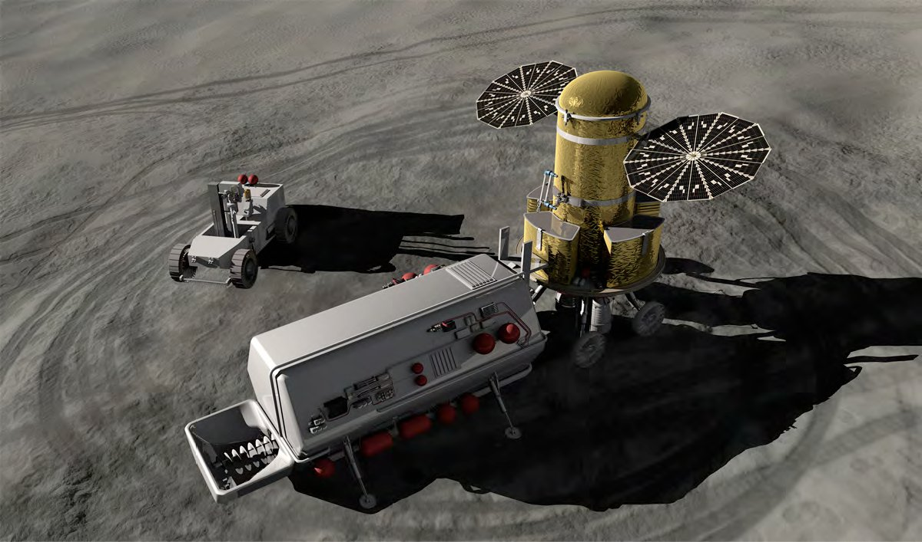
ISRU Need Cases
There may be several different needs as defined by the total amount of oxygen or hydrogen needed, or even just the total amount of water needed.
While some observations may be of science interest, they may not be relevant to most ISRU architectures (e.g., mono-layers of H₂O on dust grains or water ice at 10 meters deep).
Ore grade (water concentration) currently begin considered as viable is at a minimum 1% wt.
Refs: Duke 2006 1.5%, Charania et al. 2007 1%, Spudis & Lavoie 2010 10%, NASA Lunar Water ISRU Measurement Study 2020 1-5%
100 ppm = 0.01% (wt); 10,000 ppm = 1% (wt)
Notes:
Total water needed to produce fuel for “N” lunar ascent rockets can be very different than total water needed for habitat radiation shielding.

