Slide 1
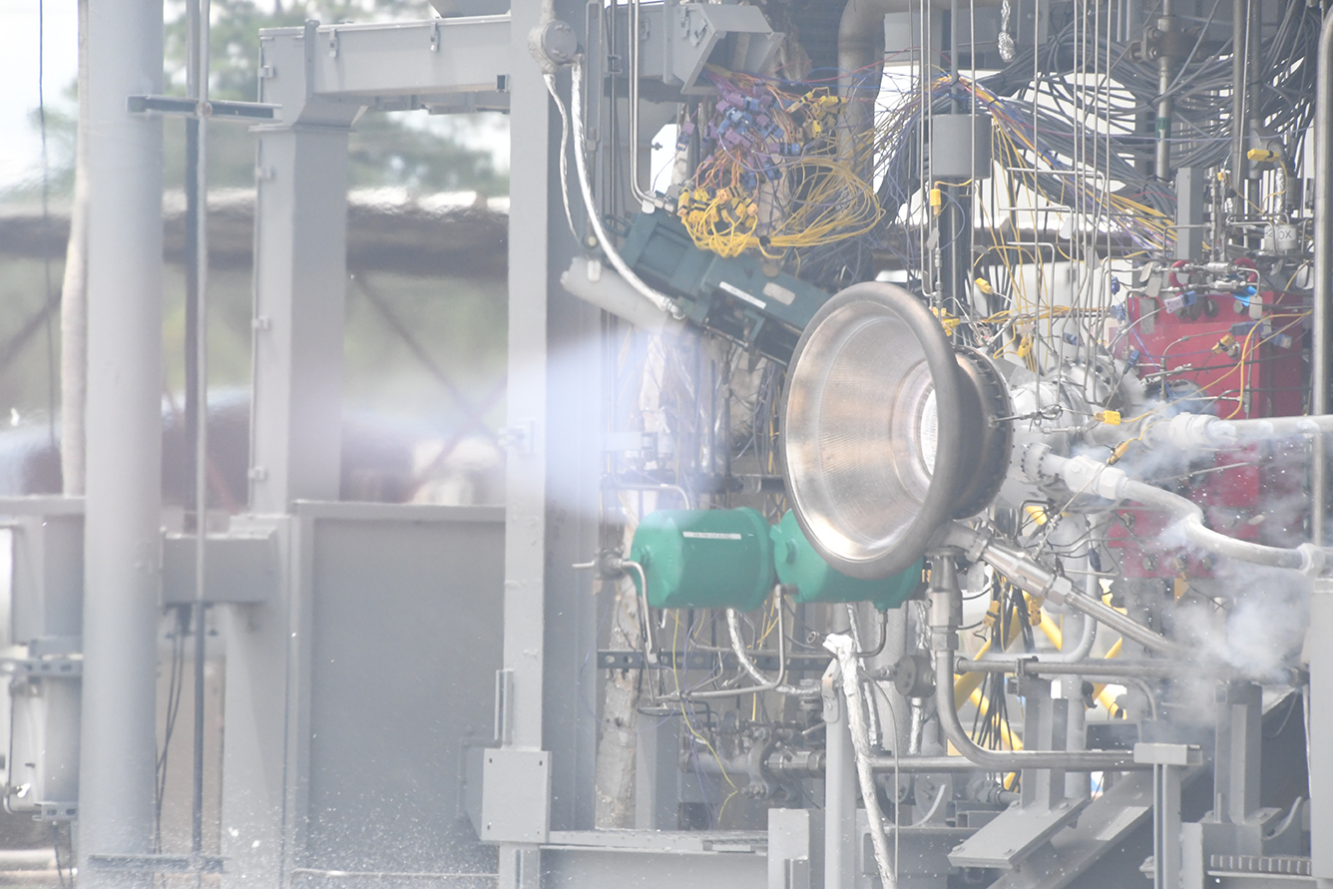
Development of Laser Powder Directed Energy Deposited NASA HR-1 to Optimize Properties for Liquid Rocket Engine Applications
Colton Katsarelis¹, Po Chen², Matt Medders¹, Paul Gradl¹
¹NASA Marshall Space Flight Center
²Jacobs Engineering, Inc., Huntsville, AL
Distribution A: Approved for public release; distribution is unlimited.

Slide 2
Acknowledgements
Pat Salvail
David Cole
Kenny Webster
Sam McLeroy
Catherine Bell
Myles Fullen
MSFC Mechanical Test Lab
Dr. Ching Hua Su
John Fikes
Matt Melis
Brian West
Will Evans
Will Tilson
Auburn University
  National Center for Additive Manufacturing Excellence (NCAME)
Mike Ogles
Dr. Nima Shamsaei
Dr. Arash Soltani Tehrani
Dr. Dave Ellis
Chris Protz
Dr. Shengmin Guo
Travis Belcher
RPM Innovations (RPMI)
NASA Liquid Engines Office (LEO) IRAD
Westmoreland Mechanical Testing

Slide 3
Overview
LP-DED NASA HR-1 Composition Adjustments
Microstructure Evolution
  Ti Segregation Issues and Heat Treat Adjustments
Mechanical Testing Results
  Tensile Tests v Temperature
  Low Cycle Fatigue v Temperature
  Comparisons of LP-DED to Wrought
  GH₂ Low Cycle Fatigue Comparison to Wrought
  Fractography
Thermal Conductivity Results
Summary and Future Work

Slide 4
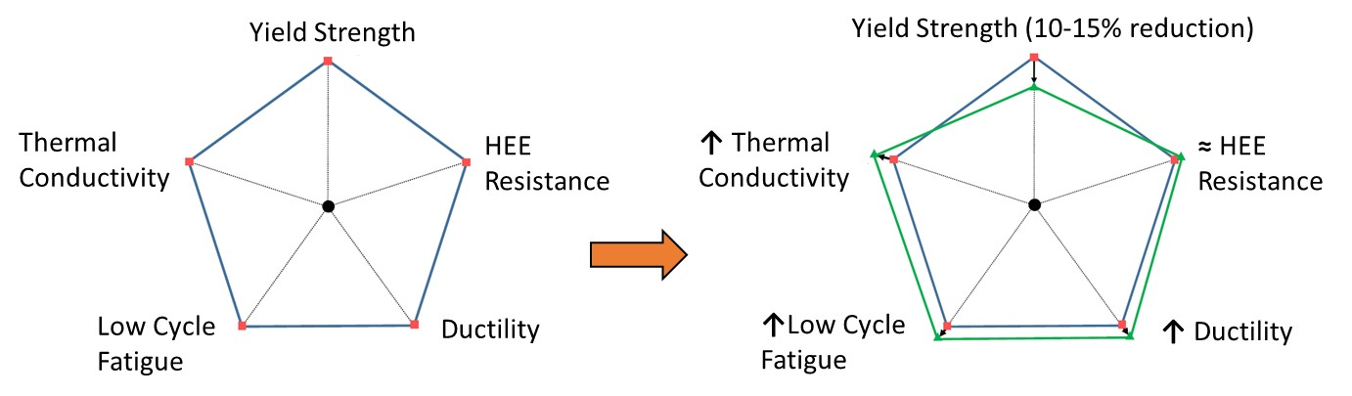
NASA HR-1 Composition Optimization for AM
Initial adjustments to NASA HR-1 composition were made to attempt to make the material more suitable to AM
  Changes from the wrought composition are expected to lead to drops in strengths
During the early characterization of LP-DED NASA HR-1, it was observed that the LP-DED process promoted Ti segregation in the material and grain boundary η-phase precipitation more than observed in wrought
  η-phase is detrimental to the ductility of the material as well as to the hydrogen environment embrittlement (HEE) resistance of the material
Chemical composition of NASA HR-1 was modified using PHACOMP analysis to help avoid η-phase formation in the AM material
Adjustments in composition are expected to drop the yield strength of the material while improving ductility and LCF life.
  HEE resistance and thermal conductivity are expected to remain similar or slightly improve
Alloy | Fe | Ni | Cr | Mo | V | W | Co | Ti | Al | Mn | Md
Wrought NASA HR-1 | 38.90 | 34.10 | 15.50 | 2.40 | 0.30 | 2.20 | 3.50 | 2.80 | 0.30 | - | 0.928
AM NASA HR-1 Initial | 39.80 | 34.00 | 15.50 | 2.20 | 0.32 | 2.10 | 3.30 | 2.50 | 0.25 | - | 0.922
AM NASA HR-1 Final | 41.20 | 34.00 | 14.60 | 1.80 | 0.30 | 1.60 | 3.80 | 2.40 | 0.25 | - | 0.913
Wrought A-286 | 55.20 | 25.00 | 15.00 | 1.30 | 0.20 | - | - | 2.00 | - | 1.50 | 0.912
Wrought JBK-75 | 51.13 | 30.20 | 14.75 | 1.25 | 0.30 | - | - | 2.10 | 0.25 | - | 0.910
Fig.: Above: Graphical representation of impact of compositional changes from revision 2 to 3 on properties of NASA HR-1;
Table: Nominal chemical compositions of NASA HR-1 and comparable alloys

Slide 5
Heat Treatment Changes for Final Revision
Original Post-Processing Heat Treatment Steps for DED NASA HR-1
LP-DED
Stress relief
Homogenization
(or HIP)
Solution heat treatment
Aging
1800 °F/1.5h
2125°F/3h
1800 °F/1h
1325°F/16h
Heat treatment development
1950 °F/1.5h - 3h
2125°F/6h - 12h
1950 °F/1h - 3h
2-step aging
(Grain size reduction)
(Ti segregation reduction)
Retard η precipitation
η-free grain boundaries
Challenges for DED NASA HR-1 development: Chemical and microstructural inhomogeneities
The as-deposited alloys exhibit varying degree of chemical segregation and microstructural gradient.
Wrought alloys can be optimized by hot/cold rolling (or forging) and heat treatments, to remove chemical segregation and microstructural inhomogeneity
But the microstructure of AM-materials can only be optimized by heat treatment
Therefore, development of appropriate heat treatment is critical to the success of AM alloy development.

Slide 6
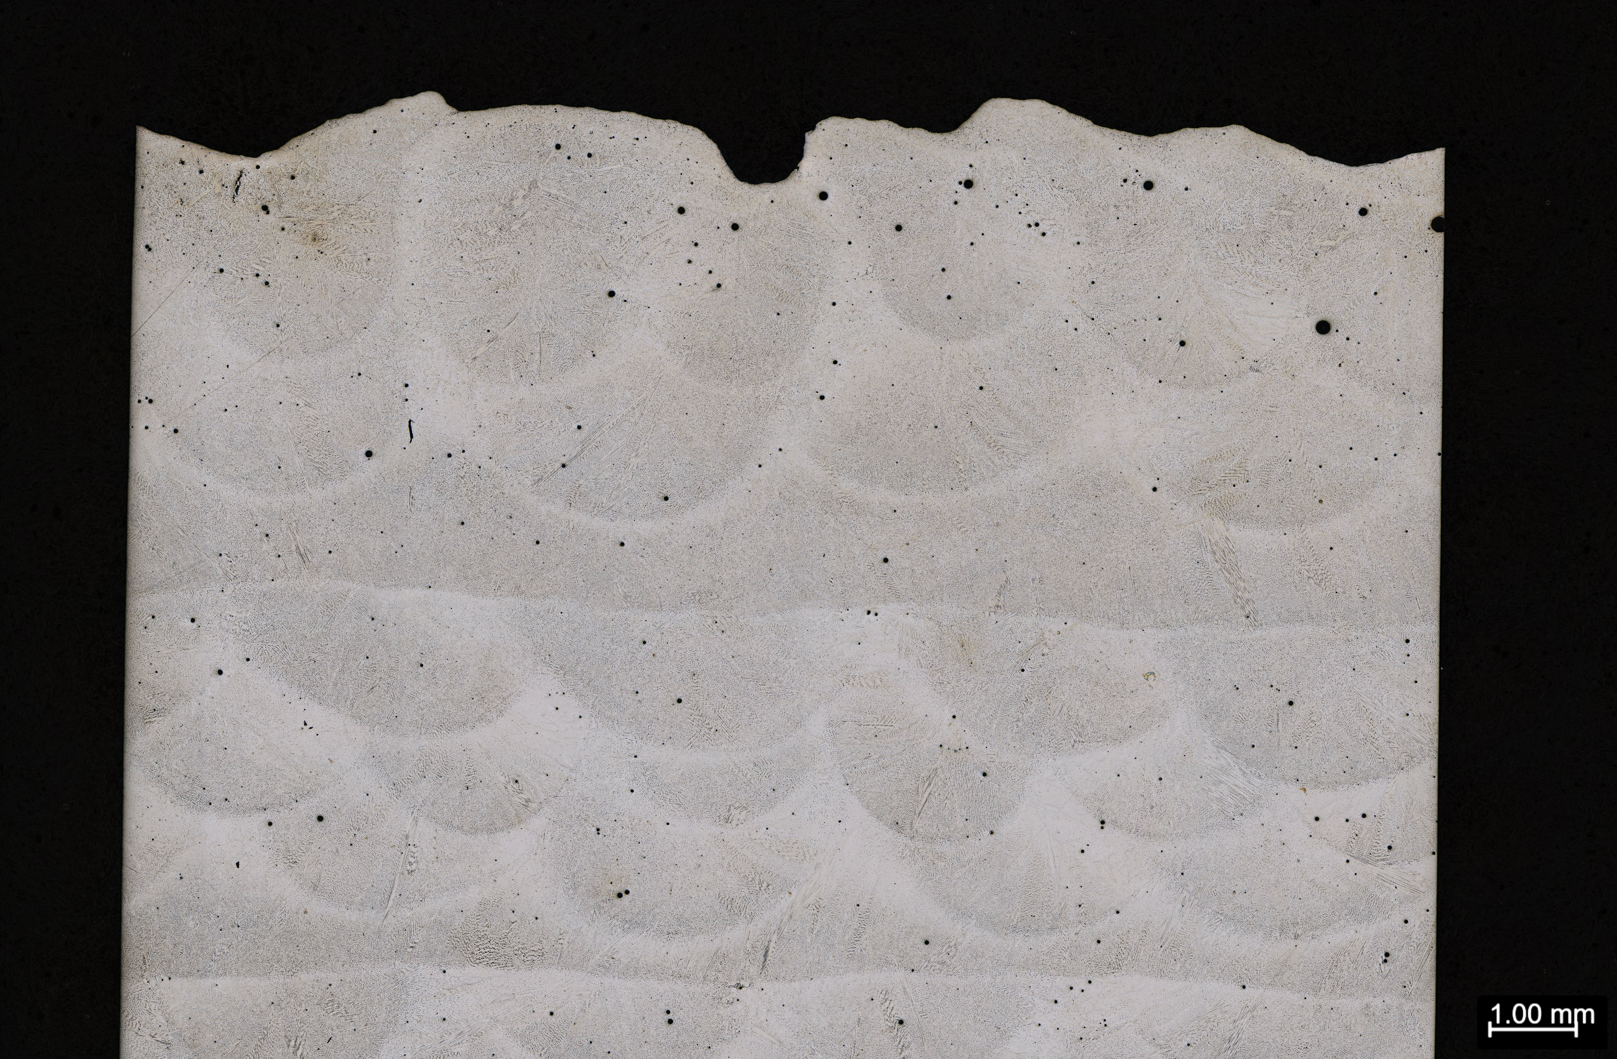
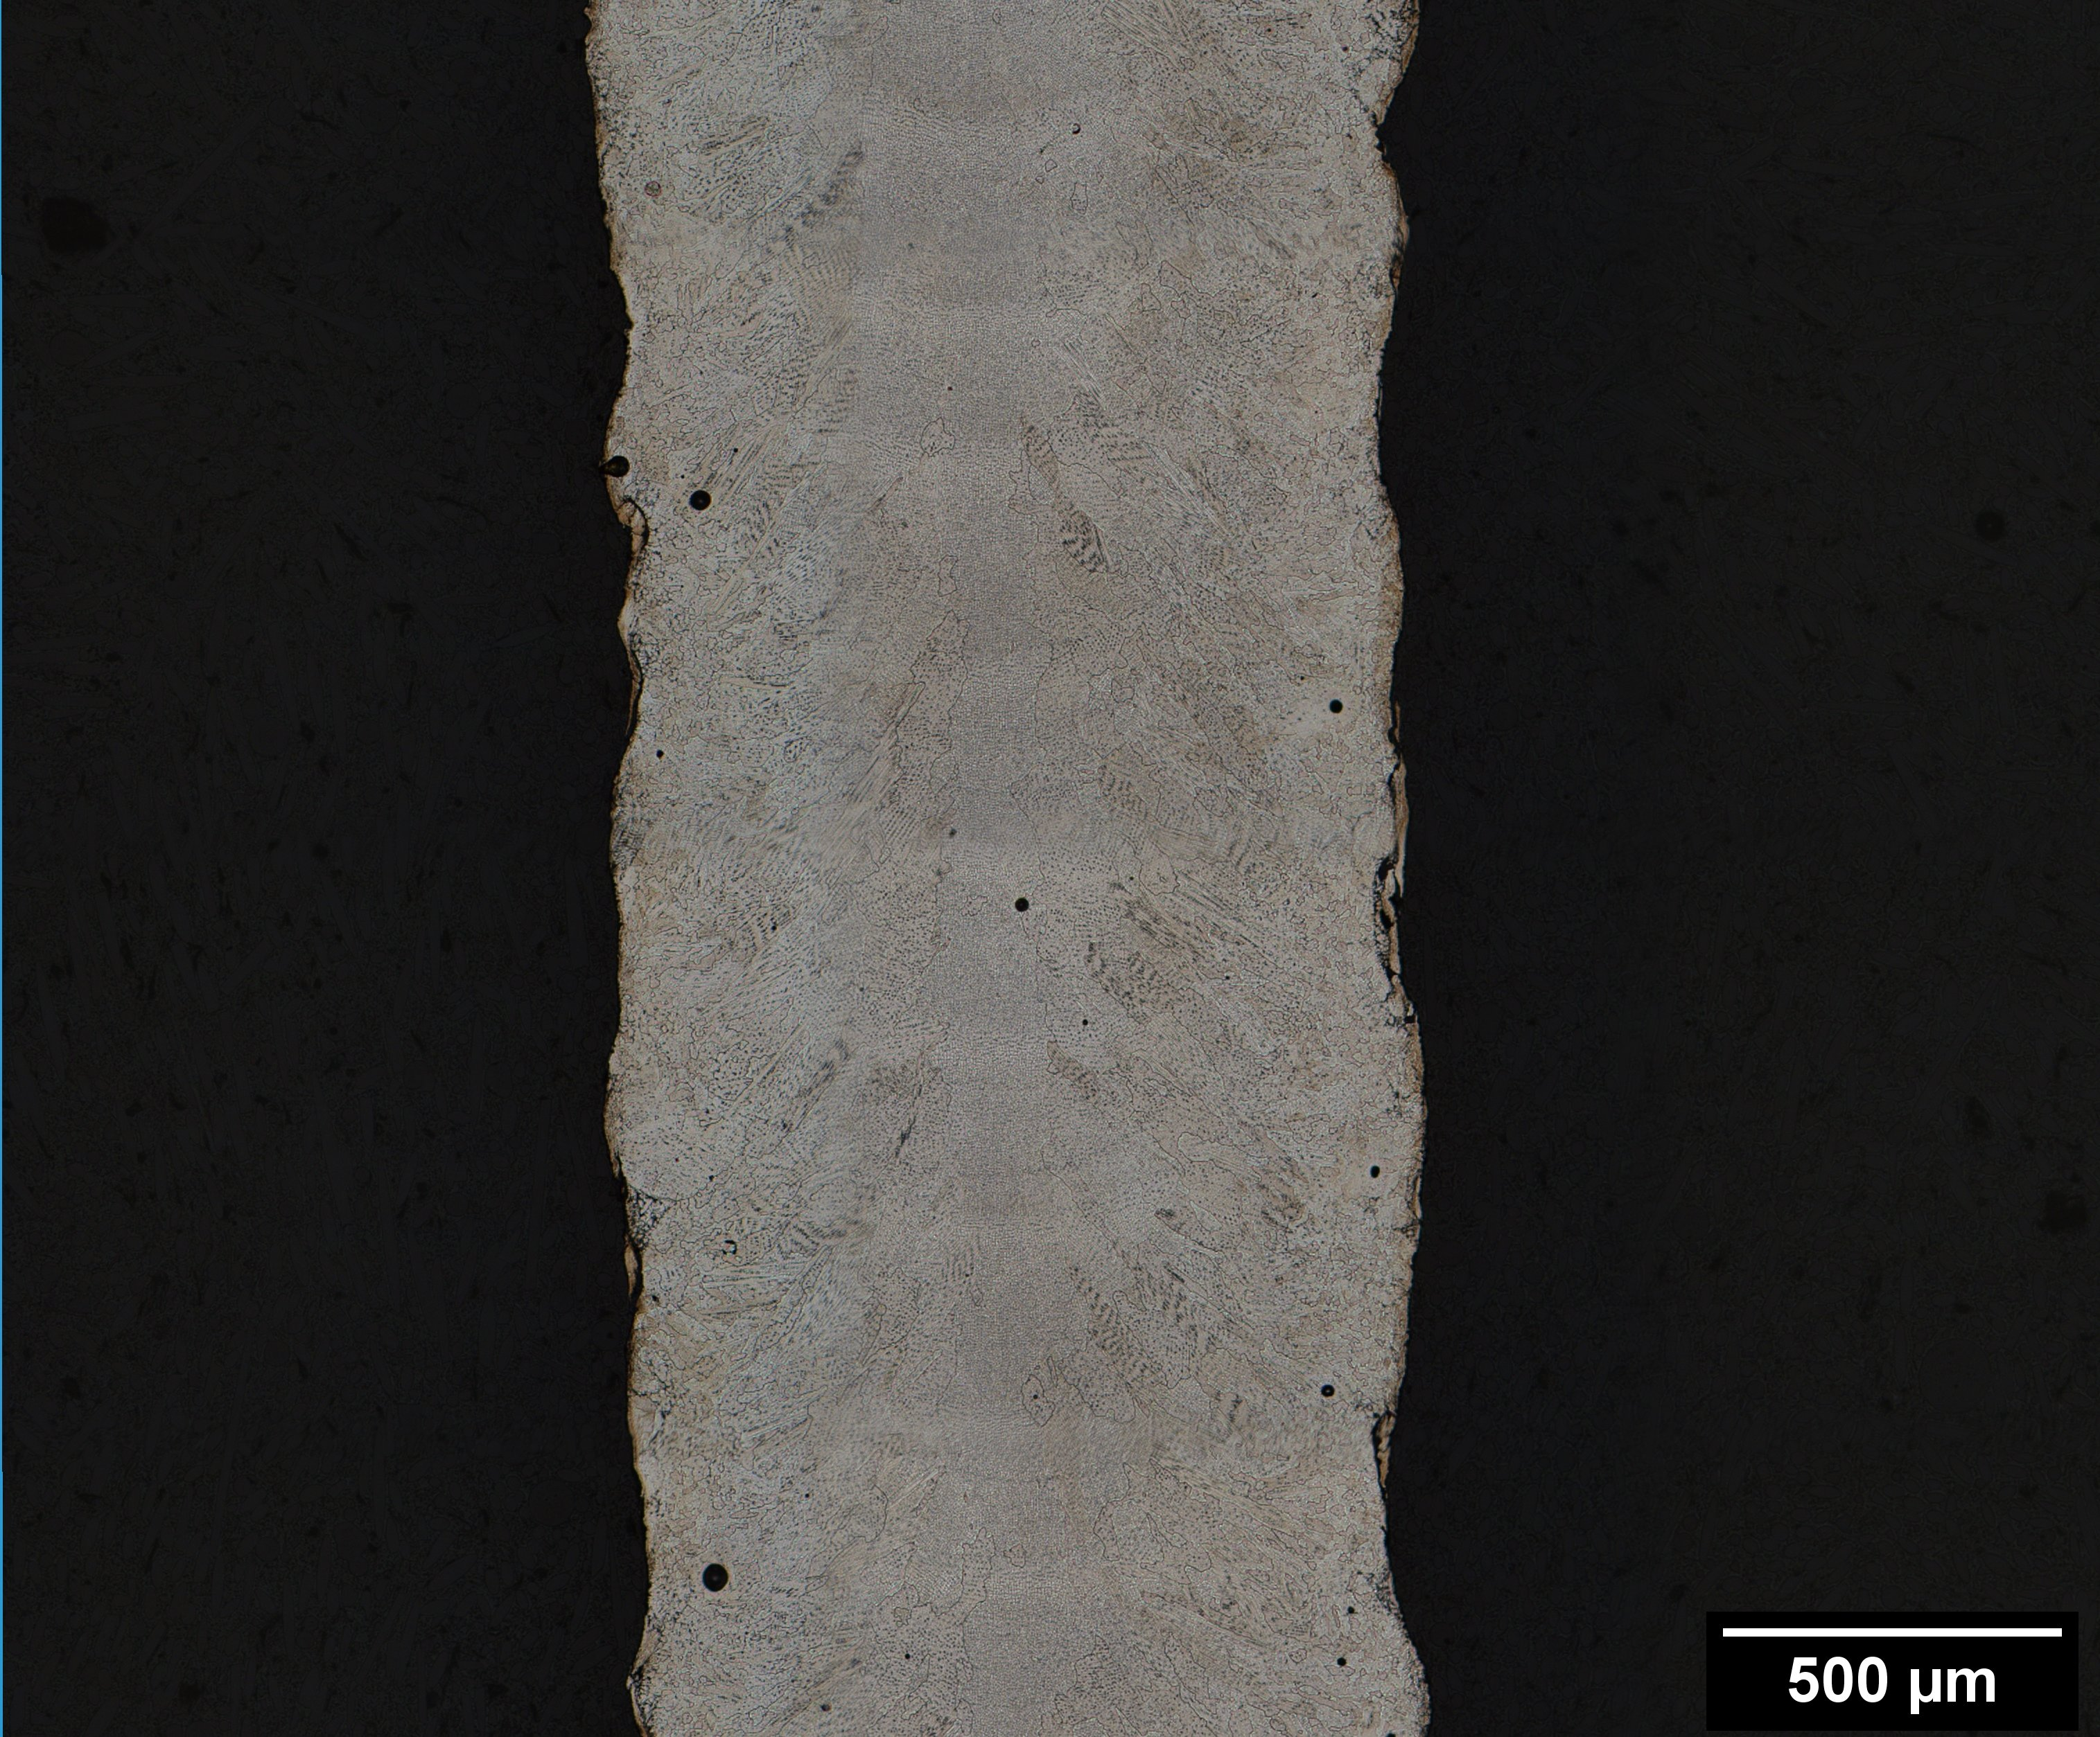
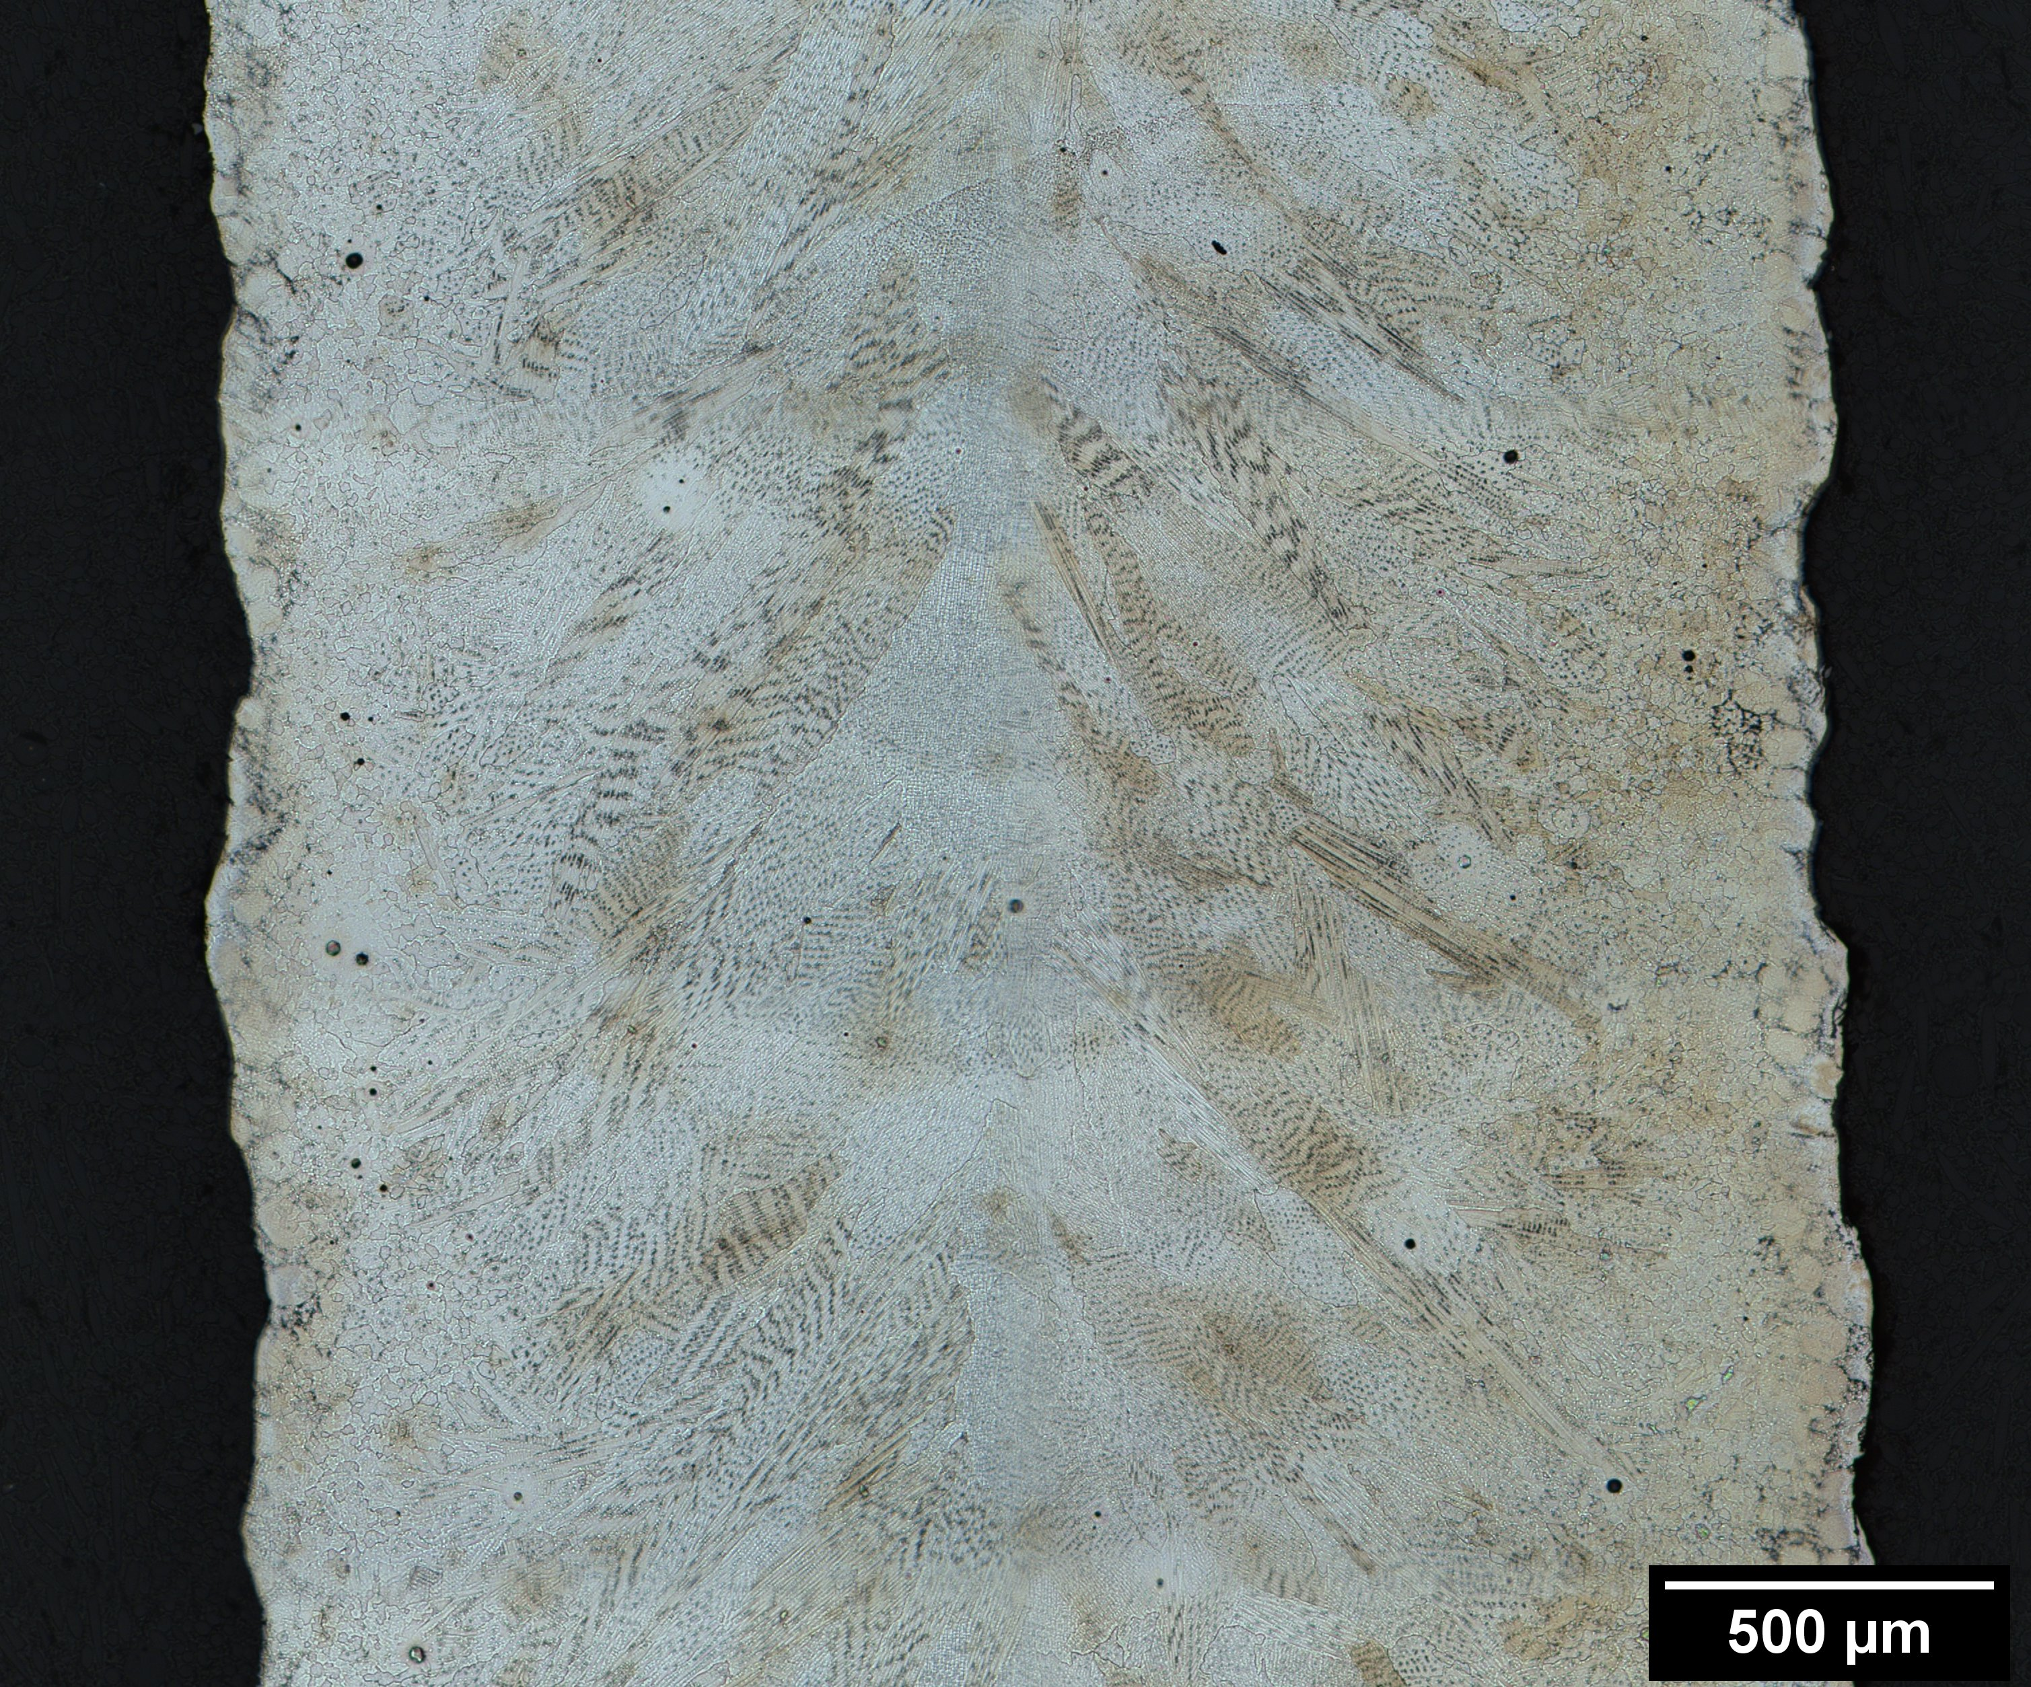
Microstructure Evolution
2620W
350W
1070W
Different laser powers were examined in the as-built condition. Single-pass walls at the 350W laser power was examined for comparison to thin wall applications. 2620W parameter examined for faster deposition for large bulk parts
With increasing laser power, as-built grain size, gas porosity, pore size all tend to increase
2620W exhibits very large pores, particularly near the top, and some micro-cracks have been observed near the top layer. Pore sizes were much smaller and no micro-cracking was observed in lower laser powers

Slide 7
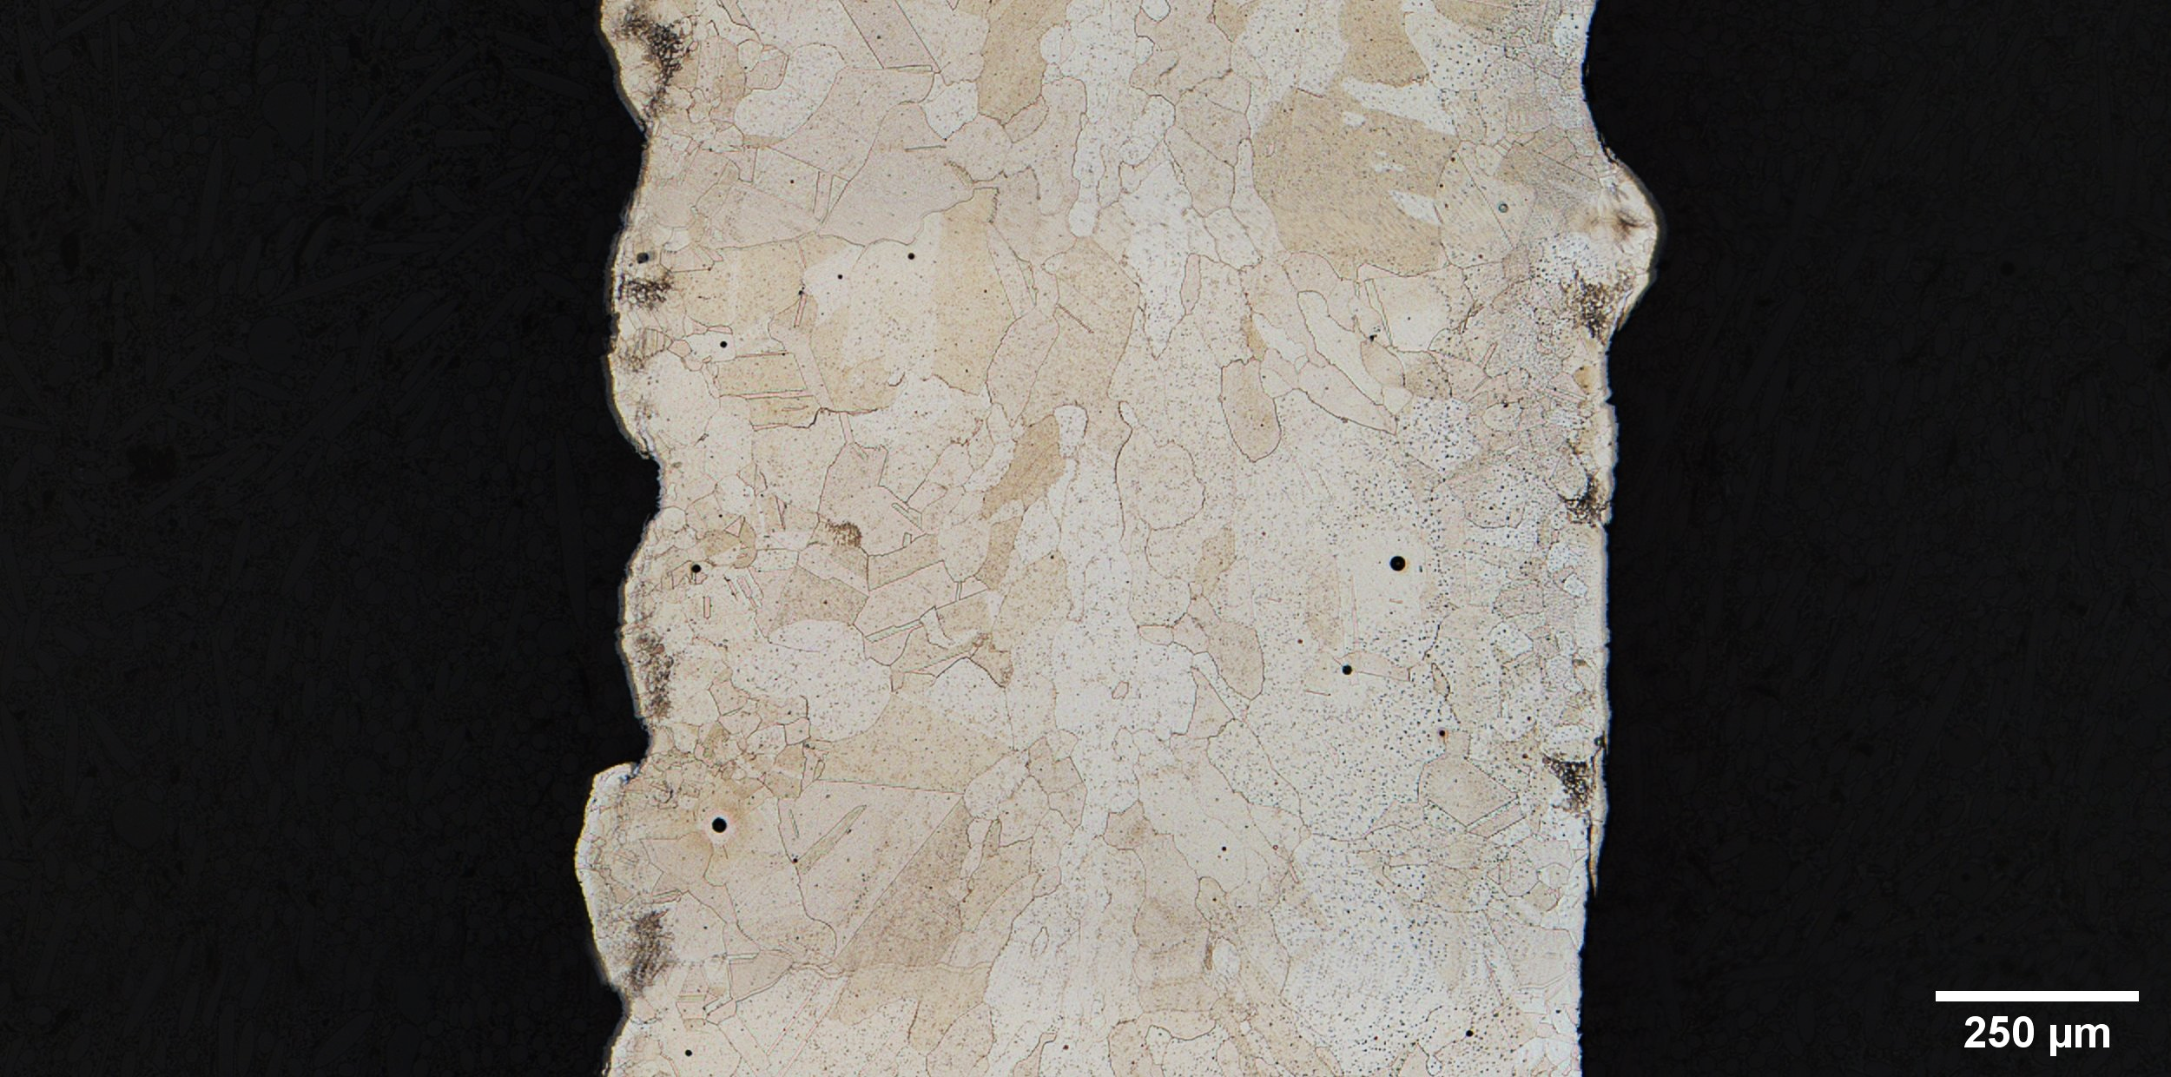
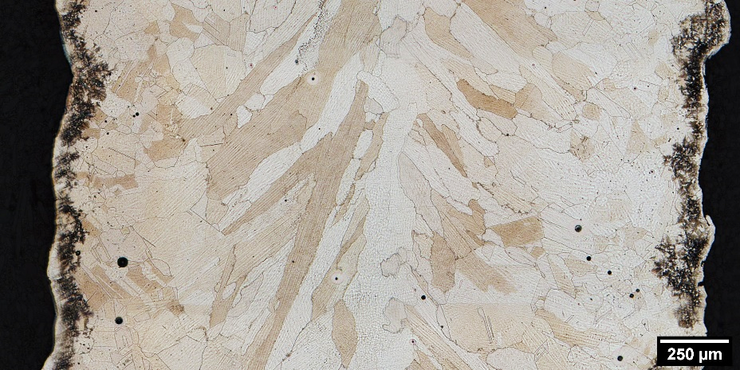
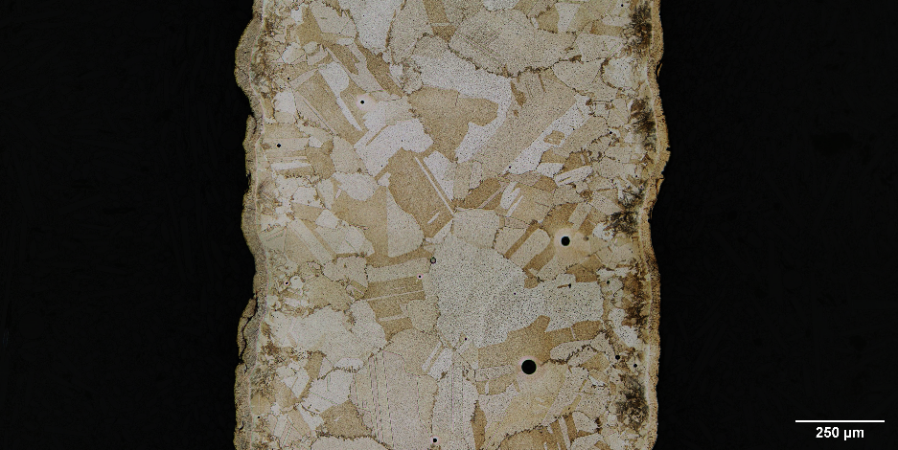
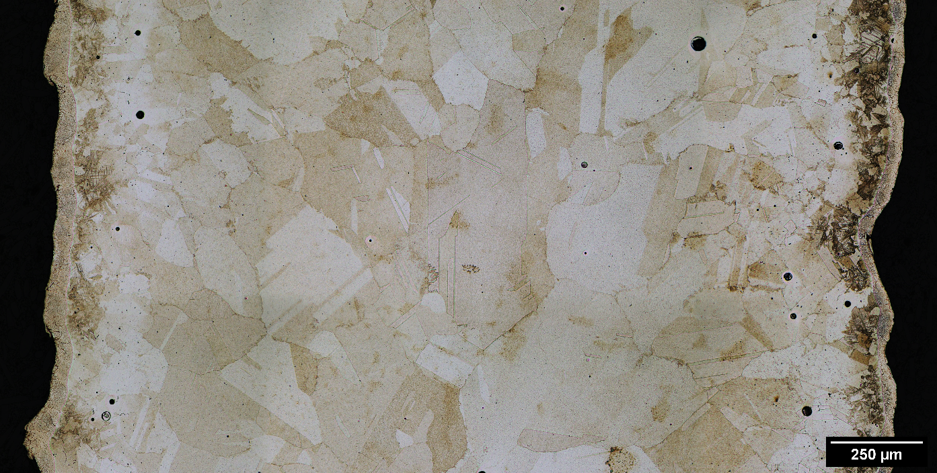
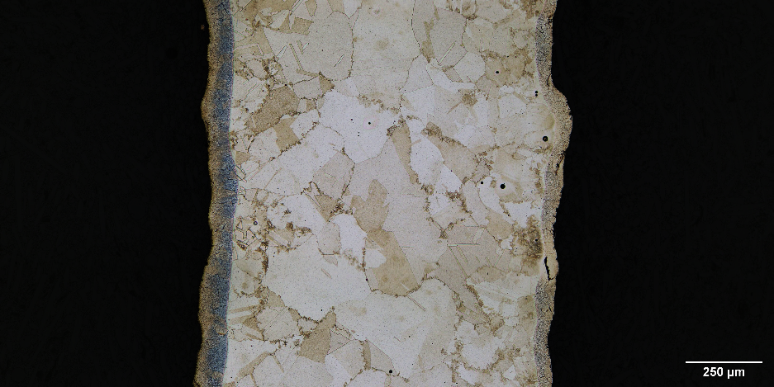
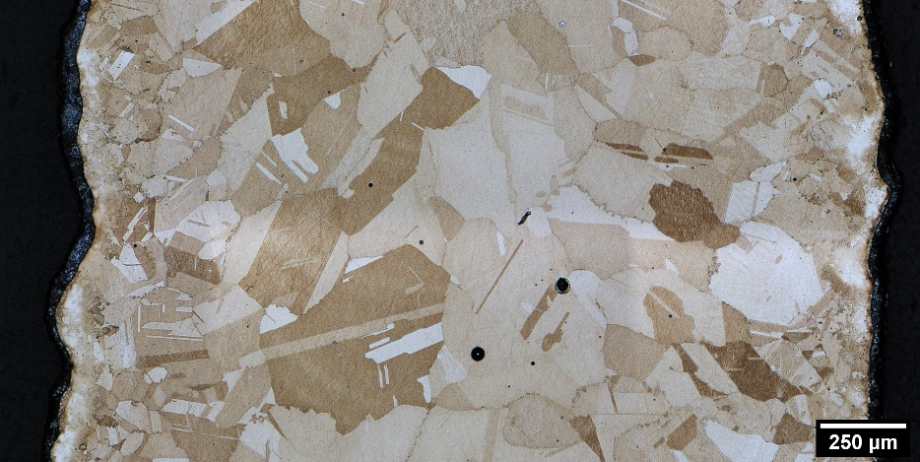
Final Revision Stress Relief Microstructure
1800°F 1.5h
350W
1070W
Three stress relief cycles were examined:
  1800°F/1.5h
  1950°F/1.5h
  1950°F/3h
While the 1800°F stress relief showed some recrystallization in the 350W and 1070W, both 1950°F stress relief cycles exhibited significant recrystallization in all parameters that were examined
  This behavior is tied to adjustments in composition from initial to final revision
Few high aspect ratio grains were observed in the 1950°F cycles
No appreciable grain growth was observed with the longer stress relief cycle
1950°F 1.5h
1950°F 3h

Slide 8
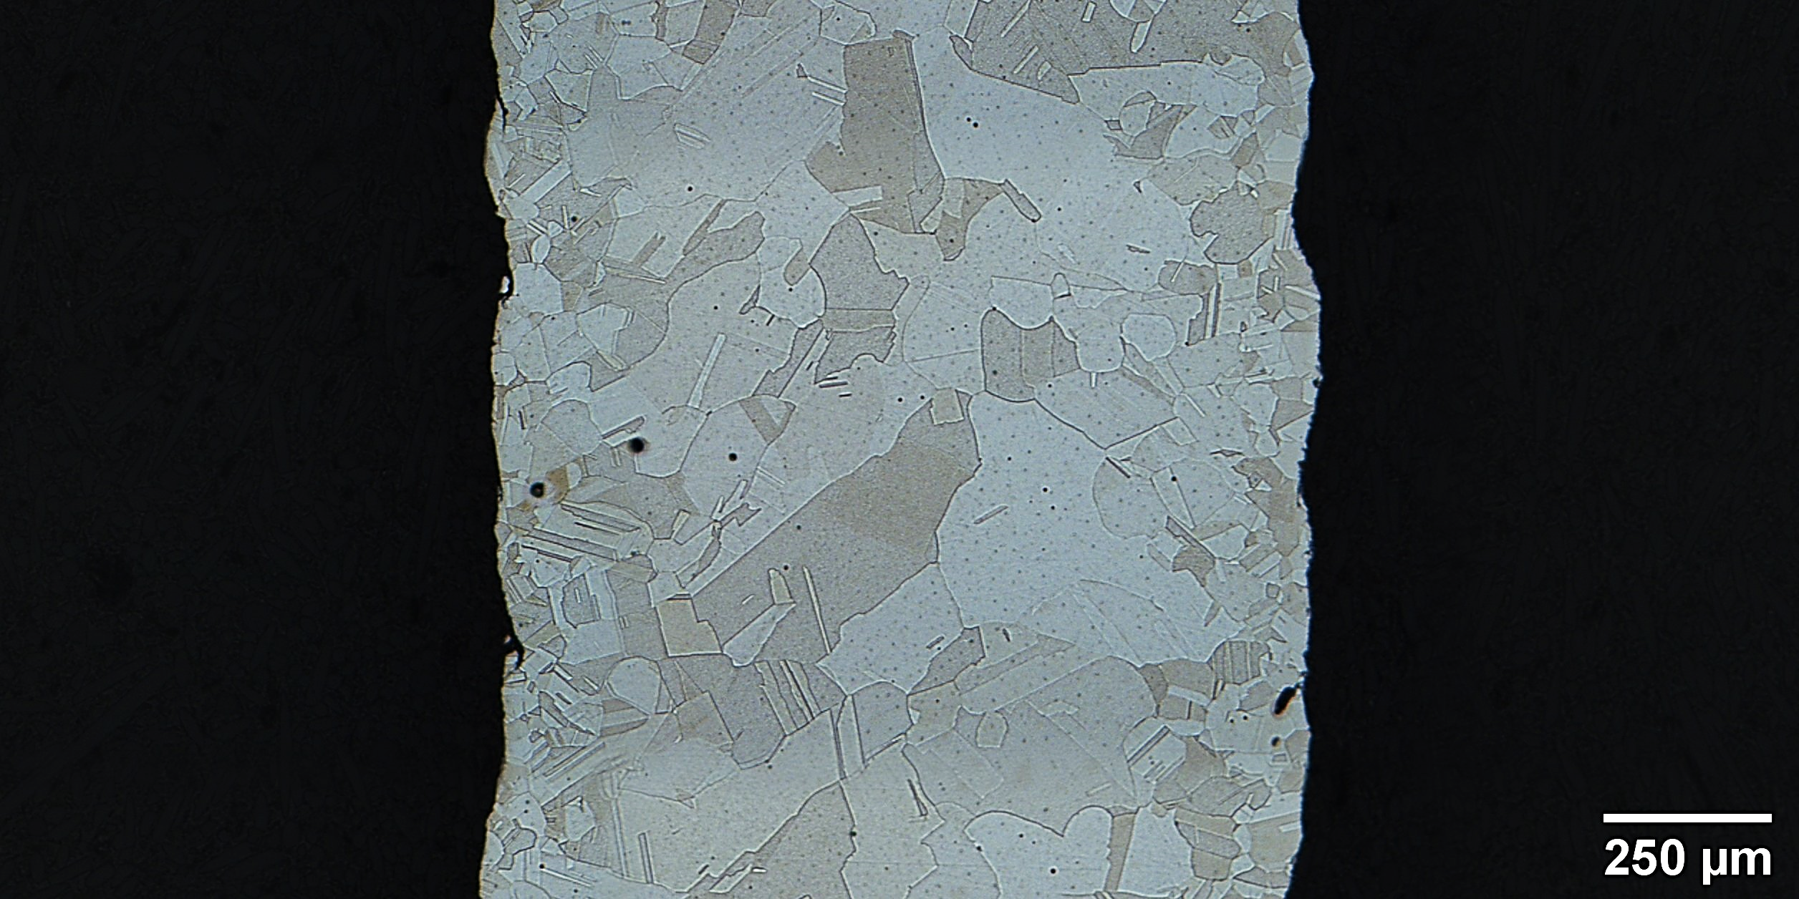
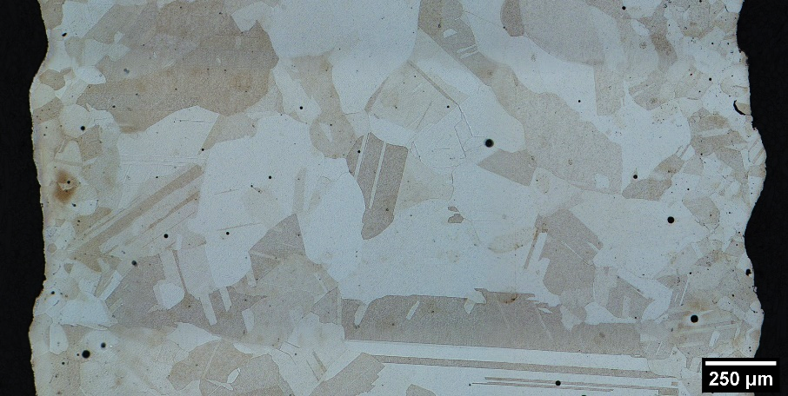
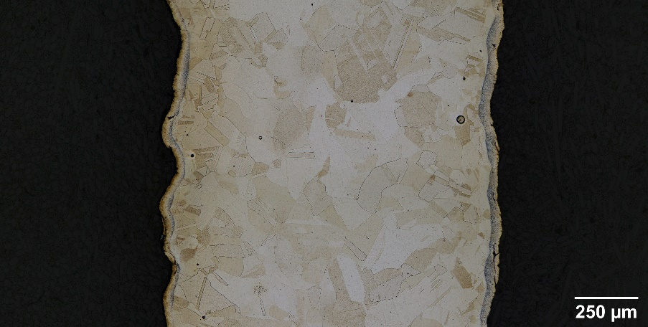
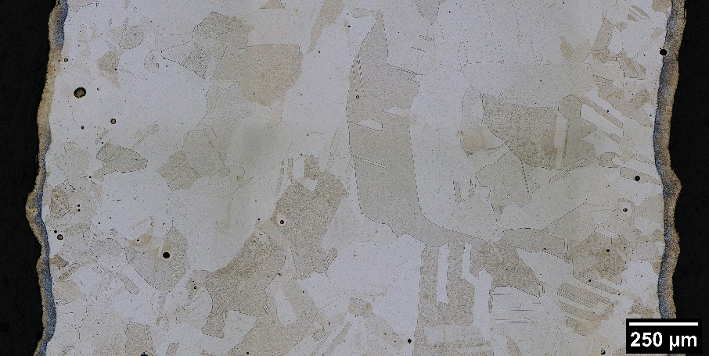
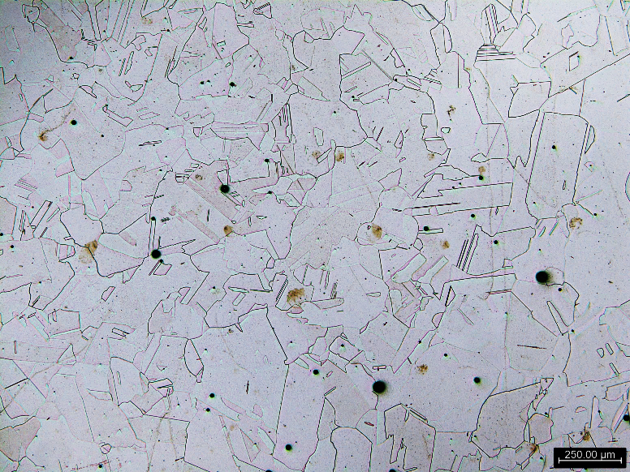
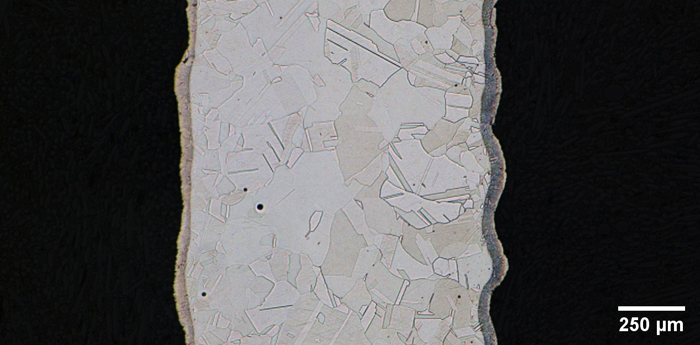
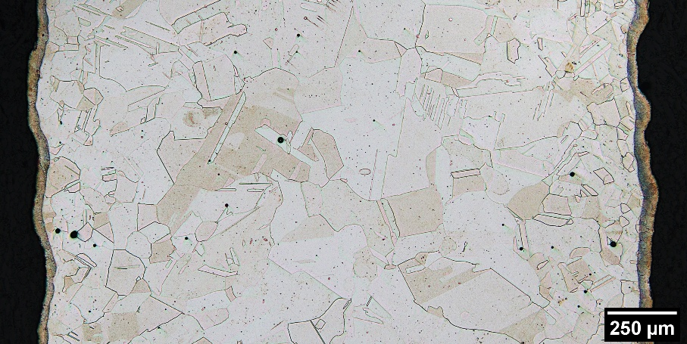
DED NASA HR-1 R3 Homogenized Microstructure
SR 1800F/1.5h Hom 2125F/3h
350W
1070W
Combinations of the stress relief cycles and varying times on homogenization were examined to see the impacts on the grain structure and Ti segregation
All of the 2125°F homogenization cycles the grain structures appeared to remain stable with slight grain growth with changes in homogenization times.
Higher stress relief temperatures before homogenization produced slightly finer grain structures that are helpful for mitigating Ti segregation
SR 1950F/1.5h Hom 2125F/3h
2620W
SR 1950F/1.5h Hom 2125F/6h
SR 1950F/1.5h Hom 2125F/6h

Slide 9
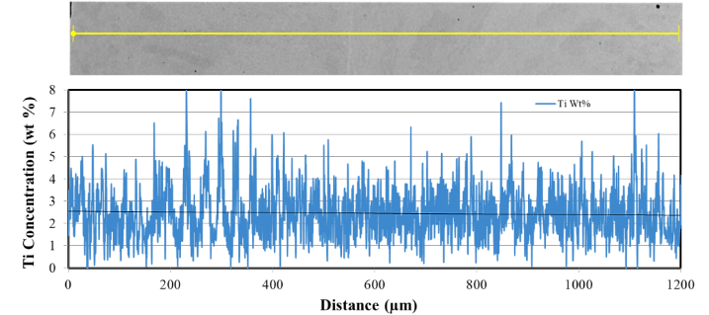
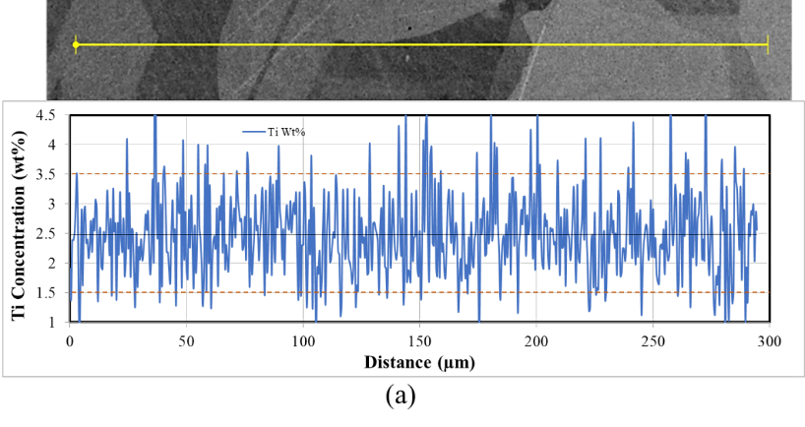
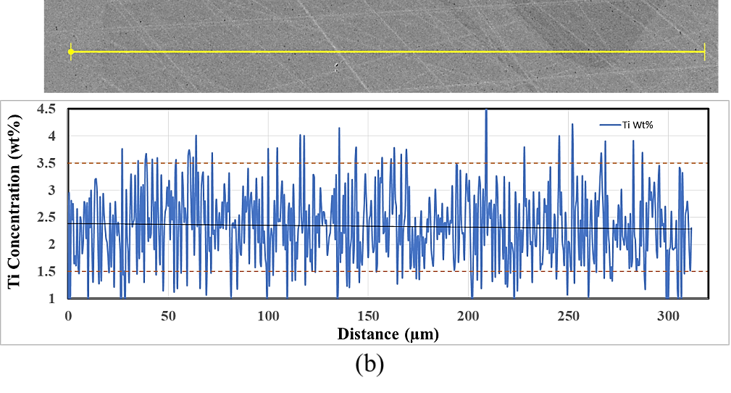
Reduction of Ti Segregation Through Homogenization
As-Built
In the as-built condition, Ti content peaked over 8 wt% regularly in different areas of samples. Nominal range would be 1.5-3.5 wt%
After 2125F/6h homogenization, peaks in Ti fluctuations typically were in the range of 3-3.5 wt% with some reaching 4 wt% in the higher laser power samples
After 12h long homogenization, the highest peaks generally stay below 3.5 wt% in the higher laser power
The slight reduction did not justify use of a 12h homogenization, thus the 6h homogenization is practical for use in DED NASA HR-1
SR 1800F/1.5h Hom 2125F/3h
SR 1800F/1.5h Hom 2125F/6h

Slide 10
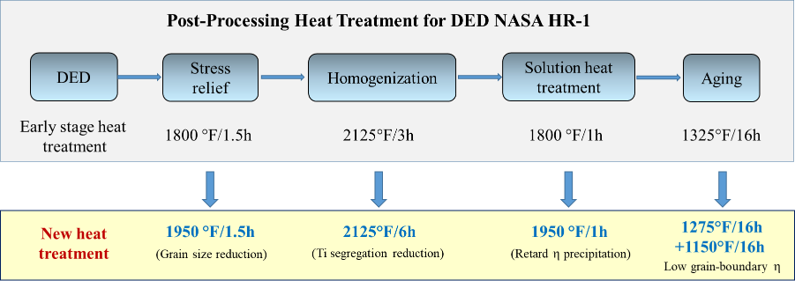
Heat Treatment Adjustments
After observations in heat treatment development, adjustments have been made to previous recommended thermal cycles for DED NASA HR-1. For applications requiring higher strengths, the single step aging at 1325°F may be used
Various mechanical testing to compare to previous testing shown and to expand characterization of the mechanical properties of DED NASA HR-1 has been performed or in work
  Testing in air from cryo to elevated temperatures, high pressure GH₂ (RT), and GHe (RT)

Slide 11
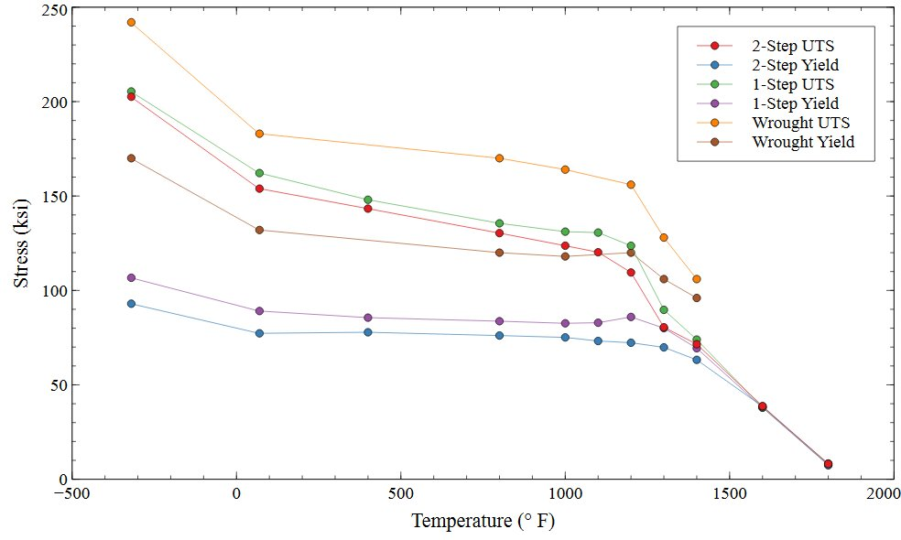
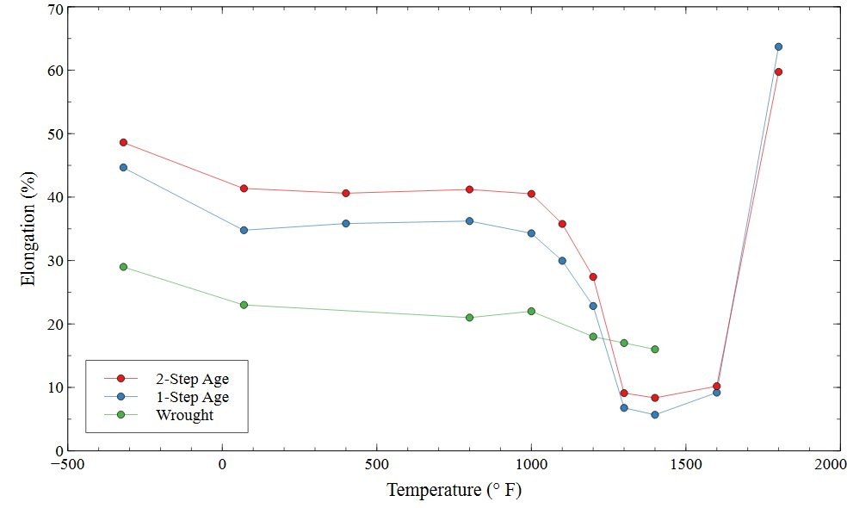
LP-DED NASA HR-1 Tensile Results
All the samples were 1070W round bars subjected to the same stress relief, homogenization, and solution treatment previously baselined
Two aging cycles were tensile tested in temperatures ranging from LN2 to 1800F: 1325F/16h (1-Step) and 1275F/16h furnace cooled to 1150F/16h (2-Step)
The two sets of data had similar trends to each other and to the wrought material with the tensile strengths significantly dropping around 1200F which is considered the maximum recommended operating temperature for the alloy
Powder reuse was examined at RT for 1x and 2x reused powder and at 1200F for 1x reused powder. No significant effects of powder reuse were observed

Slide 12
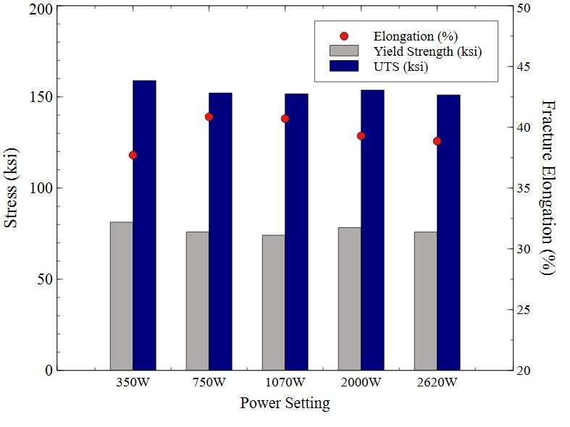
LP-DED NASA HR-1 Parameter Study Tensile
A test series looking at the effects of different LP-DED parameters was done in collaboration with Auburn University
Samples were heat treated using the thermal cycles developed at NASA MSFC with a 2-Step Age
The 350W parameter set was observed to have slightly higher strengths due to the finer grain size and a slightly lower average fracture elongation
All other parameter sets were consistent with one another in tensile strengths
Similar trends have been observed for 625 and JBK-75
Laser Power | Average UTS (ksi) | Average Yield (ksi) | Average Elongation (%)
350W | 158.91 | 81.3 | 37.71
750W | 152.11 | 75.94 | 40.86
1070W | 151.63 | 74.17 | 40.71
2000W | 153.7 | 78.29 | 39.29
2620W | 151.06 | 75.89 | 38.86
N. Shamsaei, A. Soltani-Tehrani, P. Chen, C. Katsarelis, P. Gradl, S. Shao, Additive Manufacturing Letters, DRAFT 2022 “Laser Powder Directed Energy Deposition (LP-DED) NASA HR-1 Alloy: Laser Power and Heat Treatment Effect on Microstructure and Mechanical Properties”

Slide 13
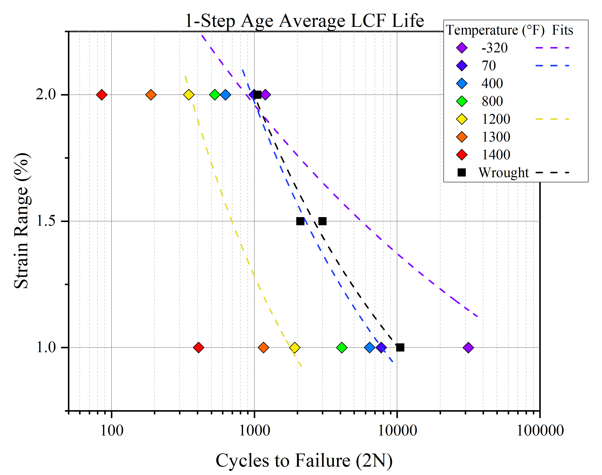
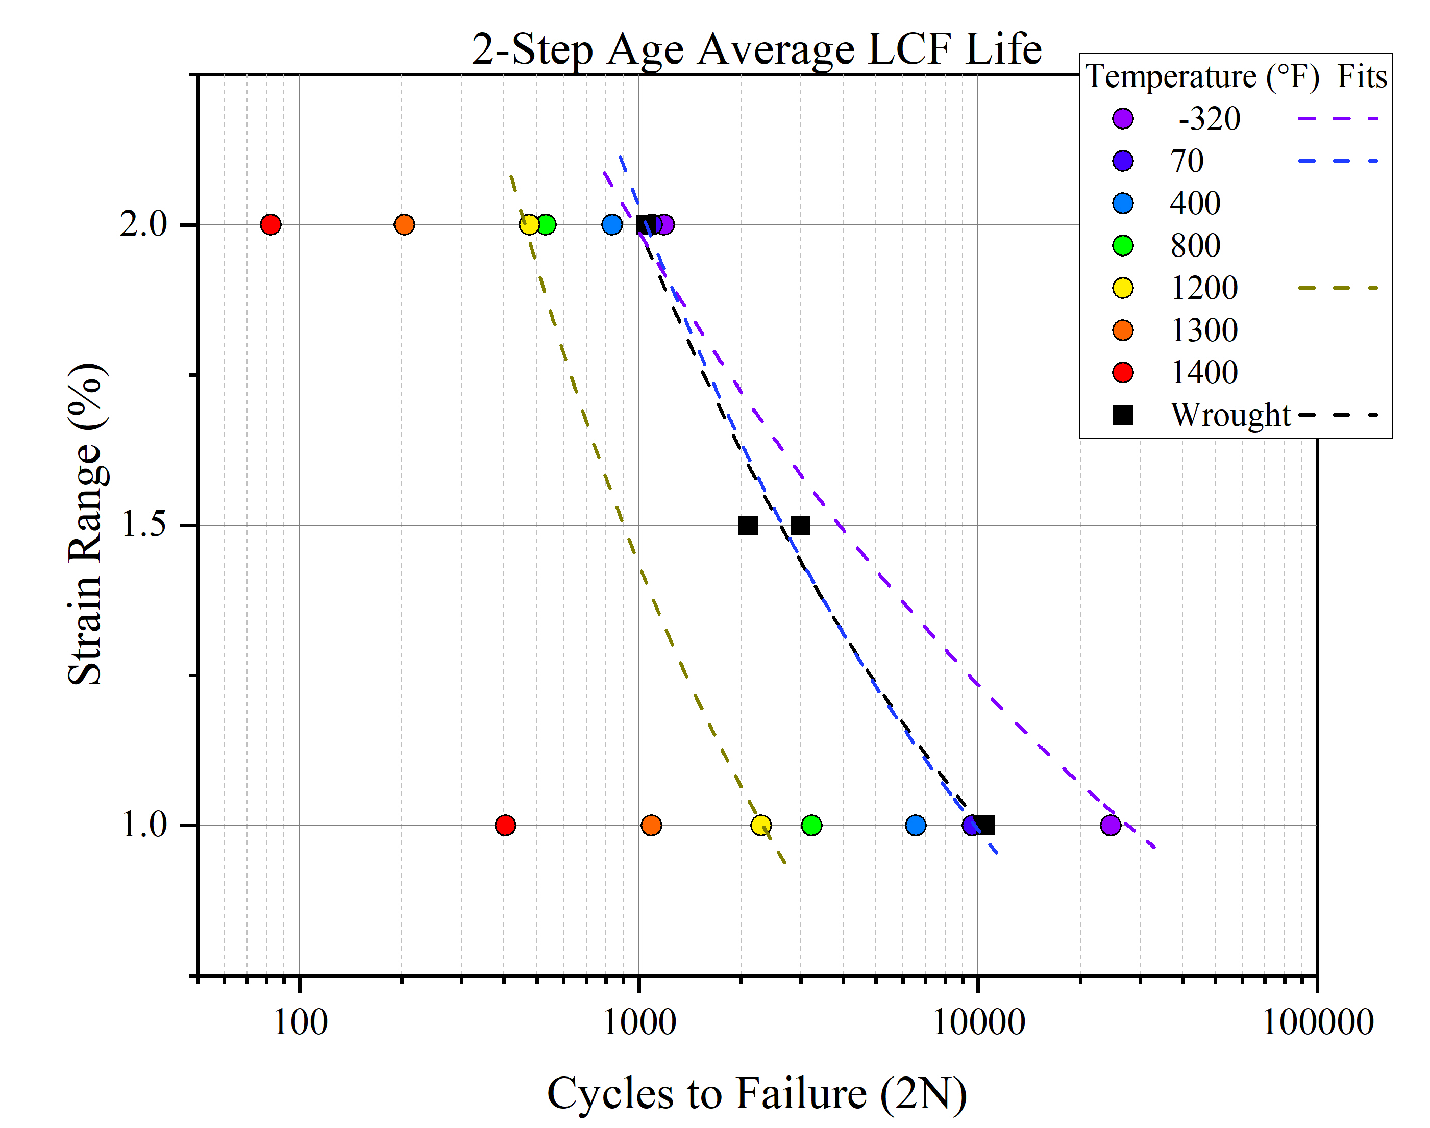
LP-DED NASA HR-1 LCF Results
LCF tests at 1% and 2% total strain and R=-1 were performed at temperatures ranging from -320°F (LN2) to 1400°F
The 2-step aging cycle tended to have improved fatigue life over the 1-step age at most temperatures tested for both strain ranges, however the fatigue life converged more above 1200°F
No significant impact of 1x or 2x powder reuse on LCF properties was observed for any temperatures tested
At room temp, both aging cycles had similar LCF behavior to wrought NASA HR-1 in GHe (historical data)

Slide 14
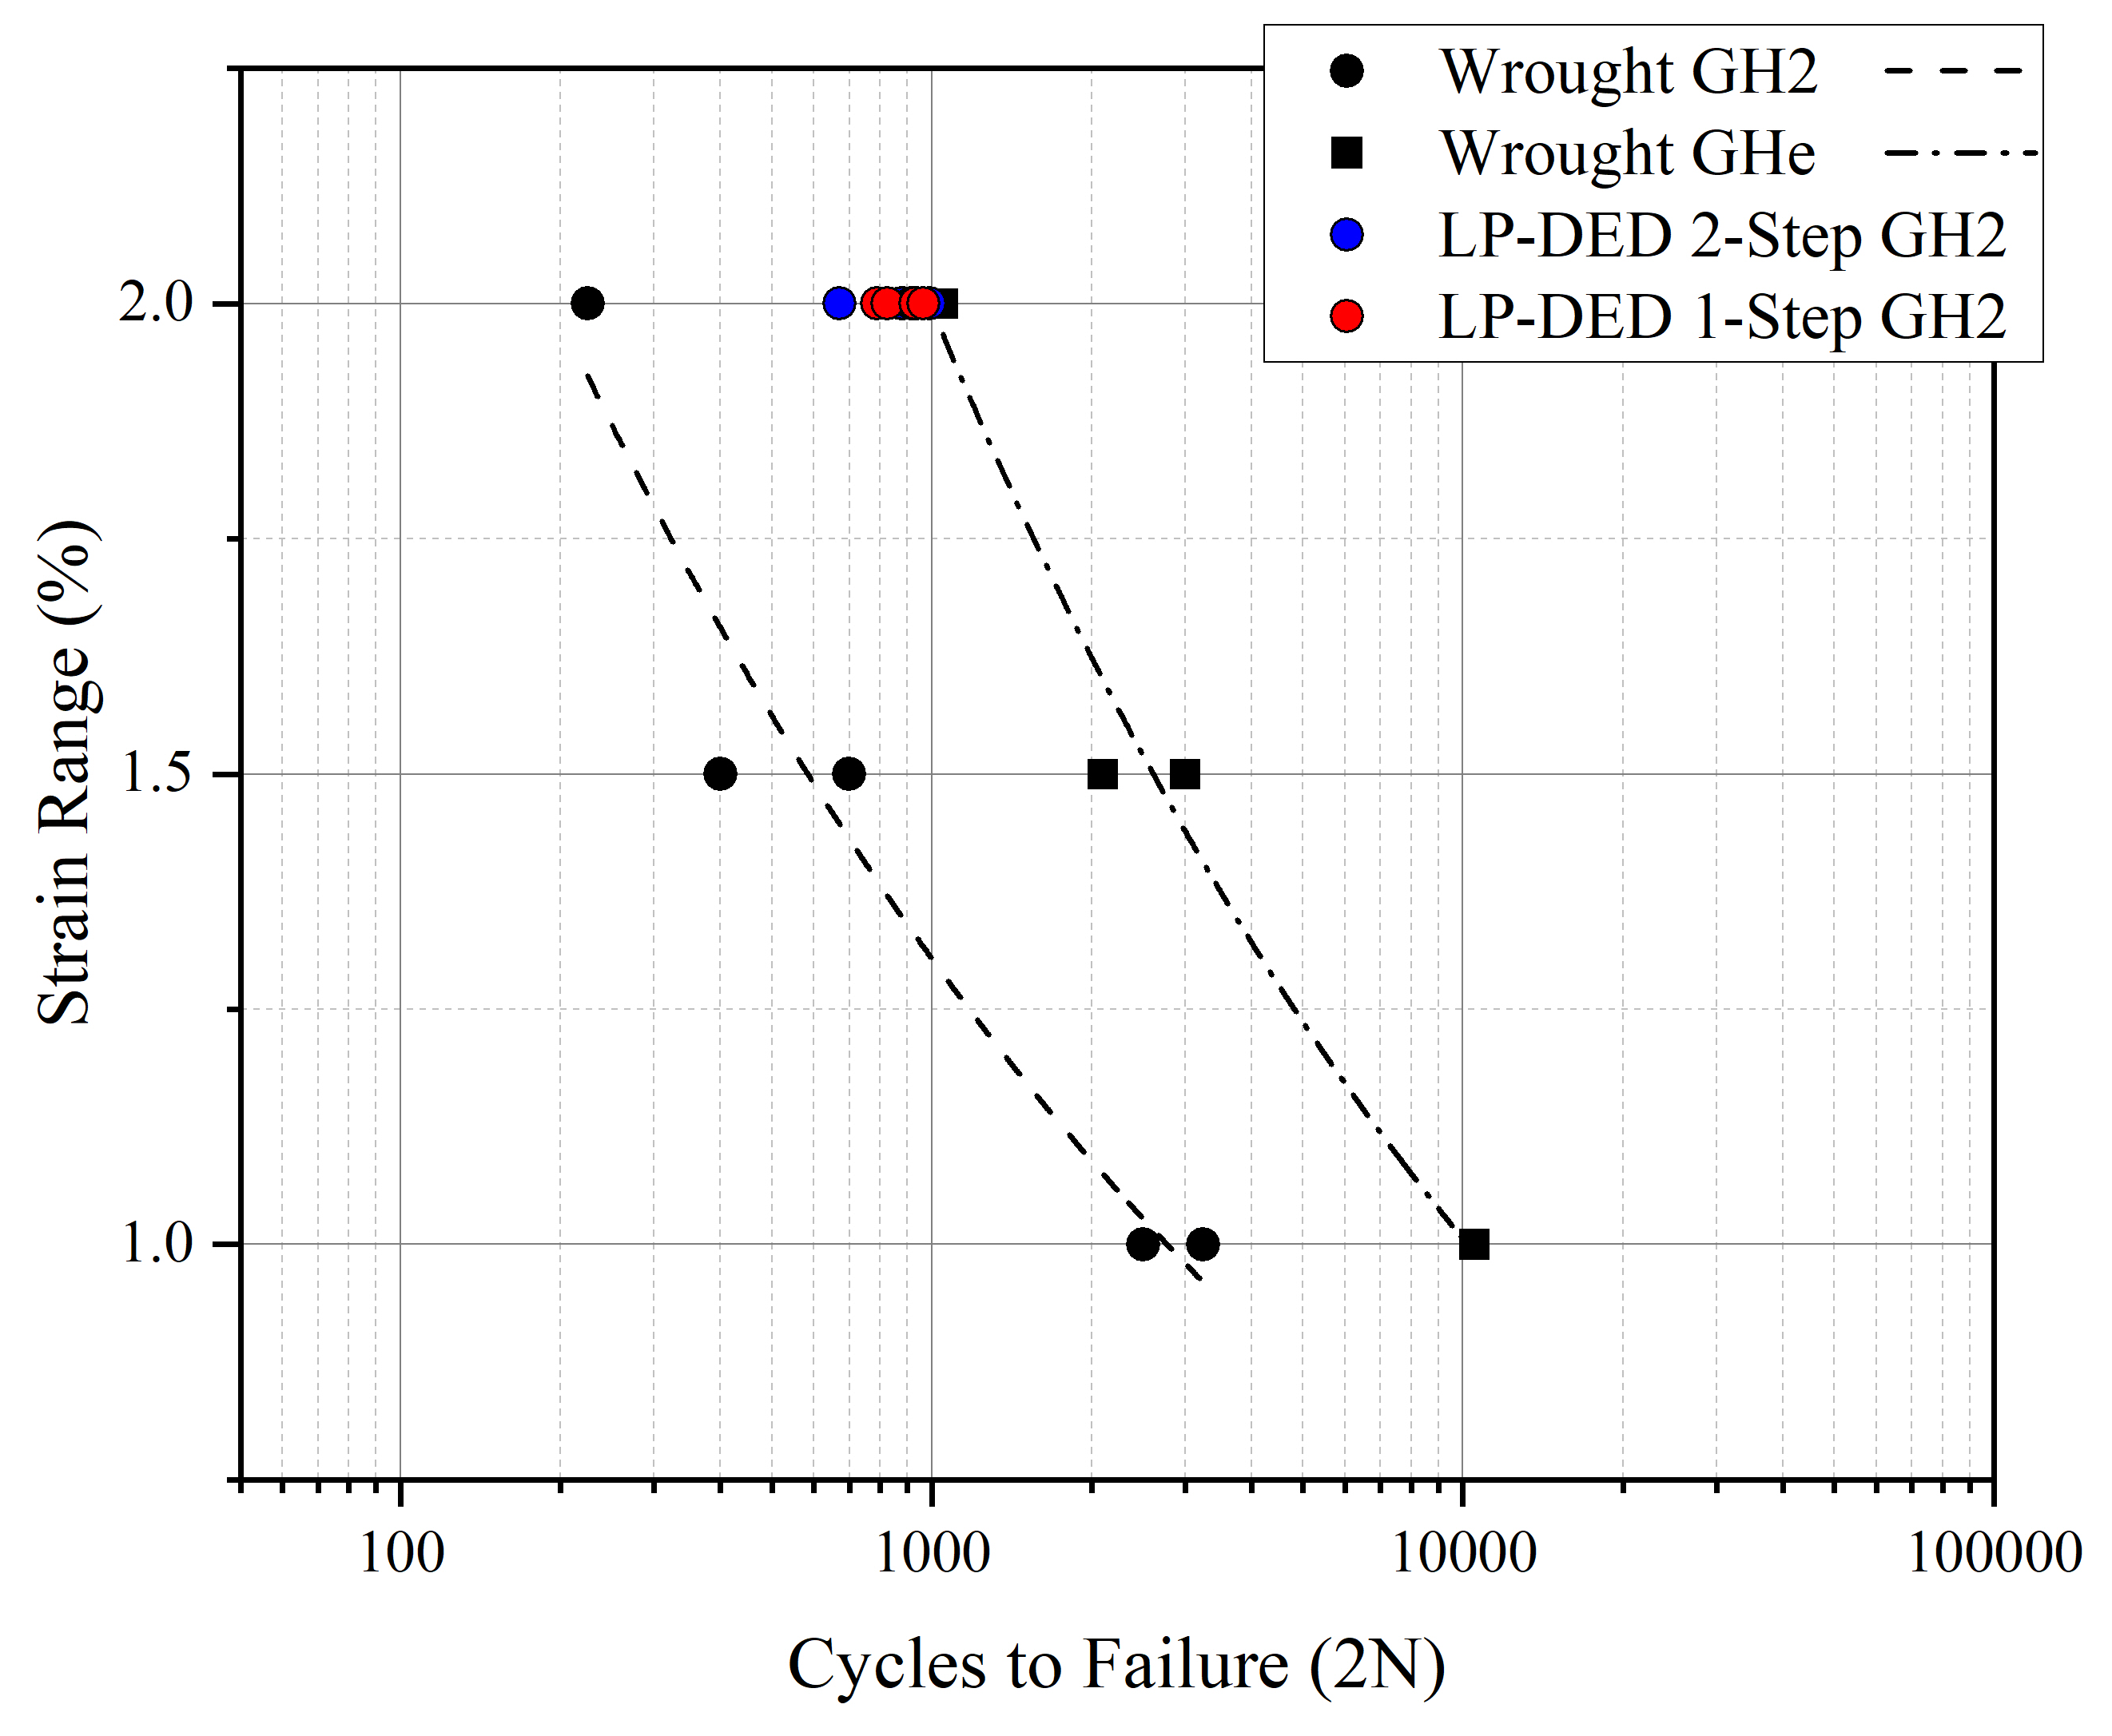
LP-DED NASA HR-1 GH2 LCF
LCF testing in 5ksi GH2 was performed on LP-DED NASA HR-1 at 2% strain range and R=-1
For both aging cycles, the LCF life was comparable in GH2 at 2% strain and was much higher than the wrought material in GH2
The LP-DED material has similar LCF life to wrought in 5ksi GHe
Both aging cycles achieved LCF life generally within scatter of the data in air at room temperature
  Average cycles to failure around 800-1000 cycles for both aging cycles in GH2

Slide 15
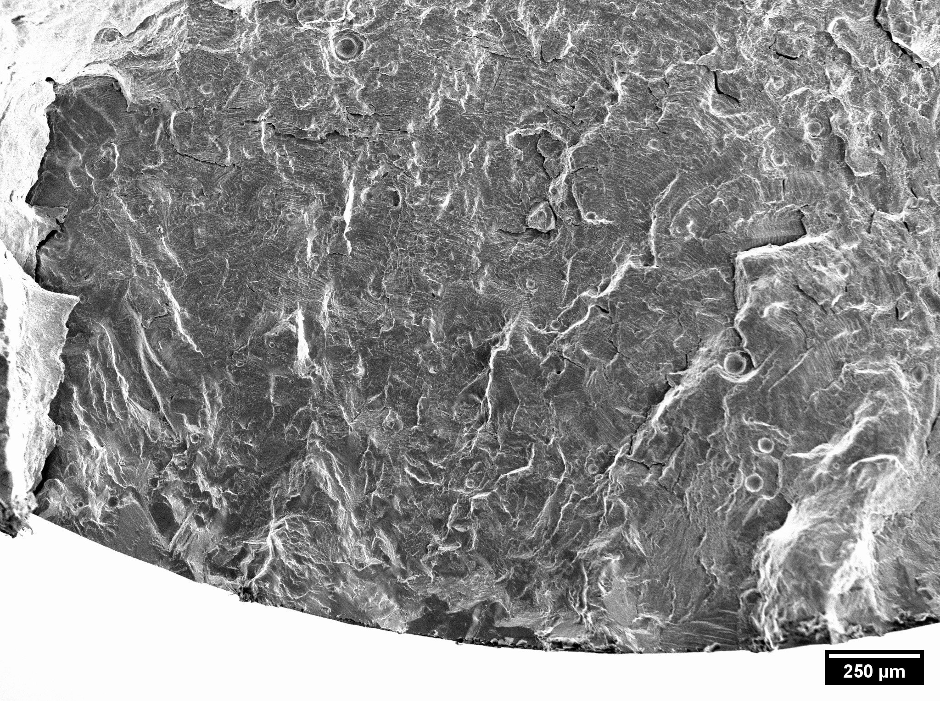
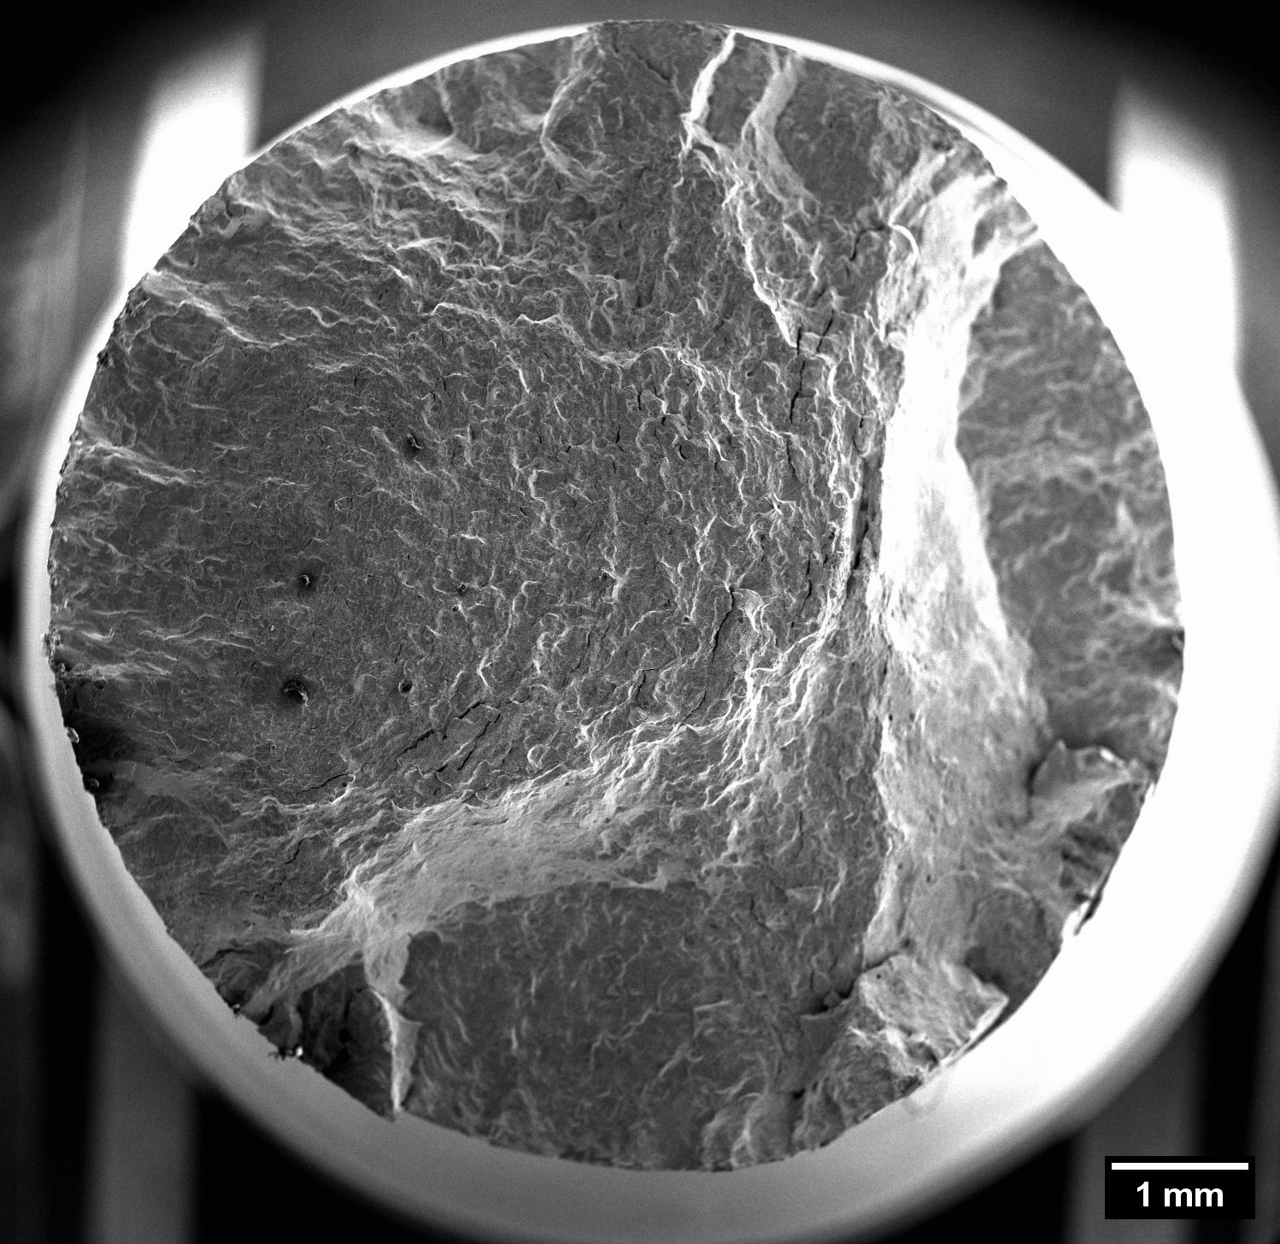
Fractography 1-Step Age LCF GH2
Main crack initiation region
Propagation region
Propagation region
Crack initiation region
Fast fracture region
Propagation region
Multiple crack fronts initiate at the surface in 3 different areas with the top left dominating the propagation across the fracture. The final overload connects the 3 crack planes
Striations observed throughout the fracture surface indicate ductile behavior continues in GH2 environment
Crack initiation region

Slide 16
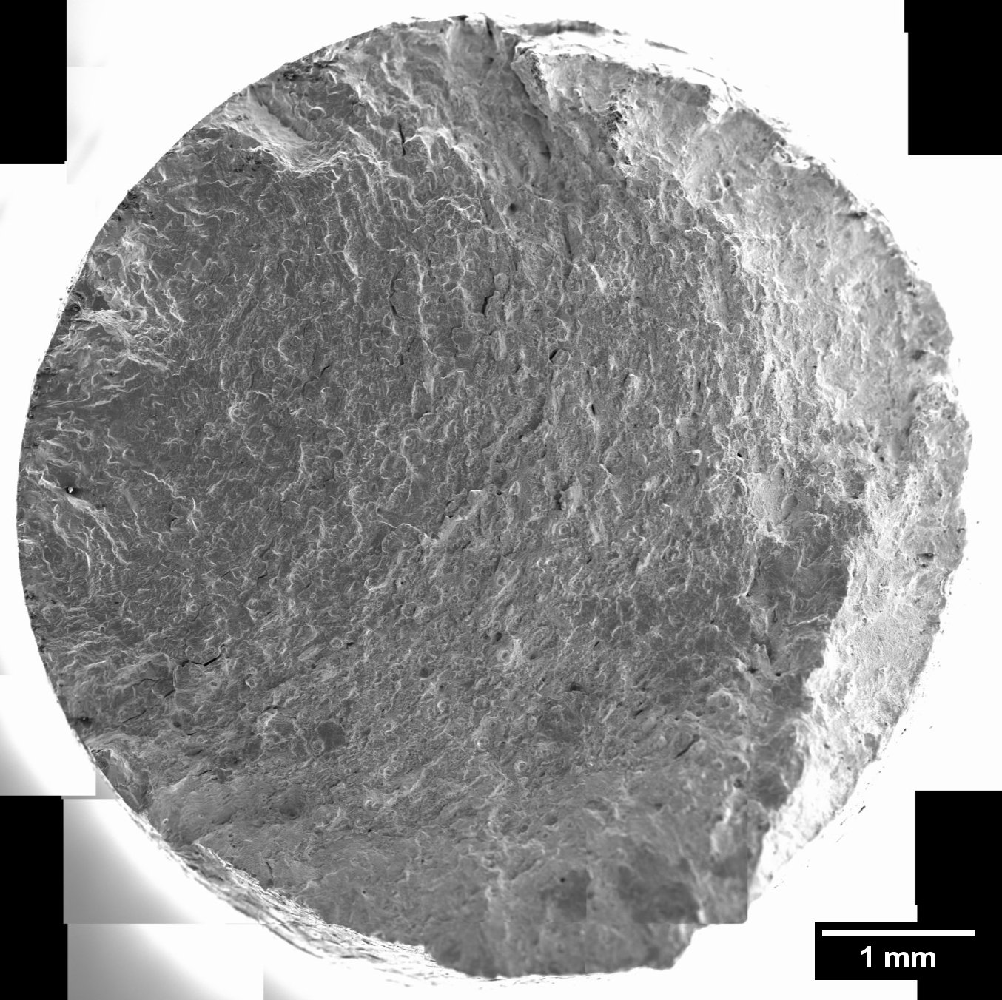
Fractography 1-Step Age LCF Comparison
Air
Initiation region
GH2
Crack initiation region
Propagation region
Propagation region
Propagation region
Crack initiation region
Fast fracture region
Fast fracture region
Propagation region
Fast fracture region
Crack initiation region
The air tested specimen had a single crack front while one crack connected with two others in the GH2 specimen upon overload
No signs of brittle behavior in GH2 specimen

Slide 17
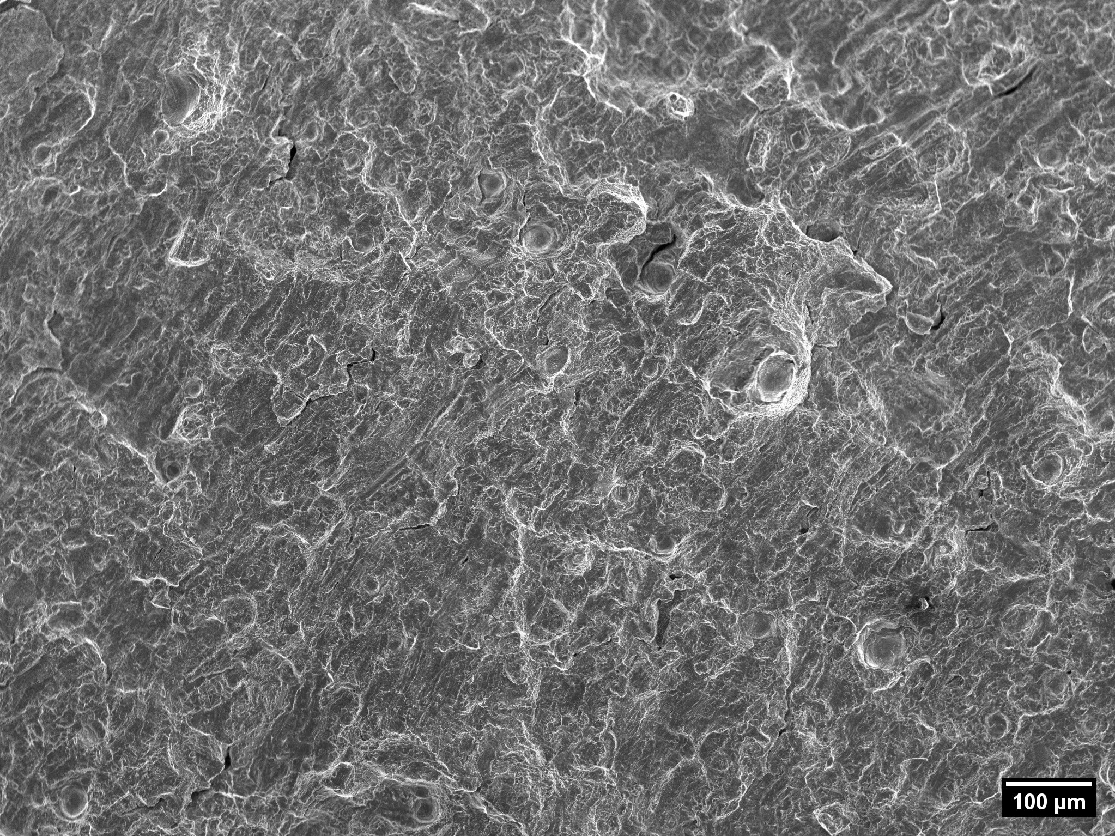
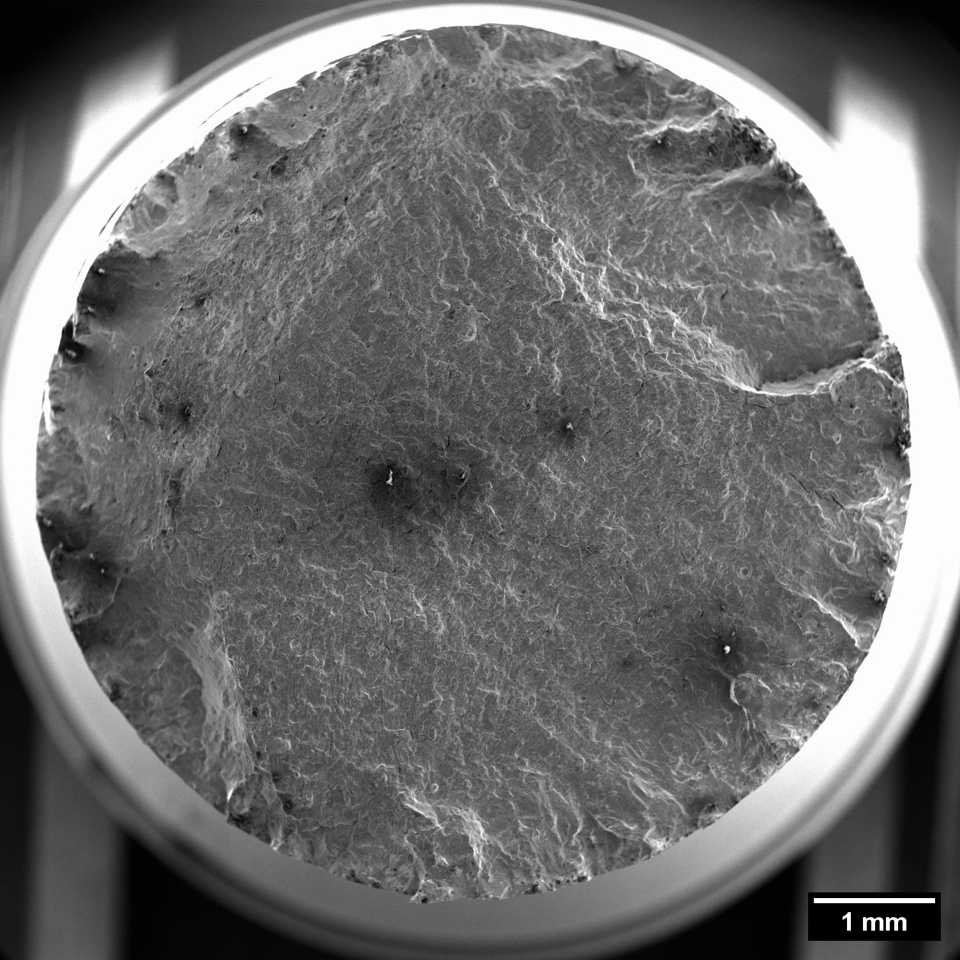
Fractography 2-Step Age LCF GH2
Crack initiation region
Fast fracture region
Propagation region
Typical fatigue fracture with surface-initiated crack
Striations observed in fracture surface indicate ductile behavior
No brittle behavior observed in fracture surface
Crack initiation region

Slide 18
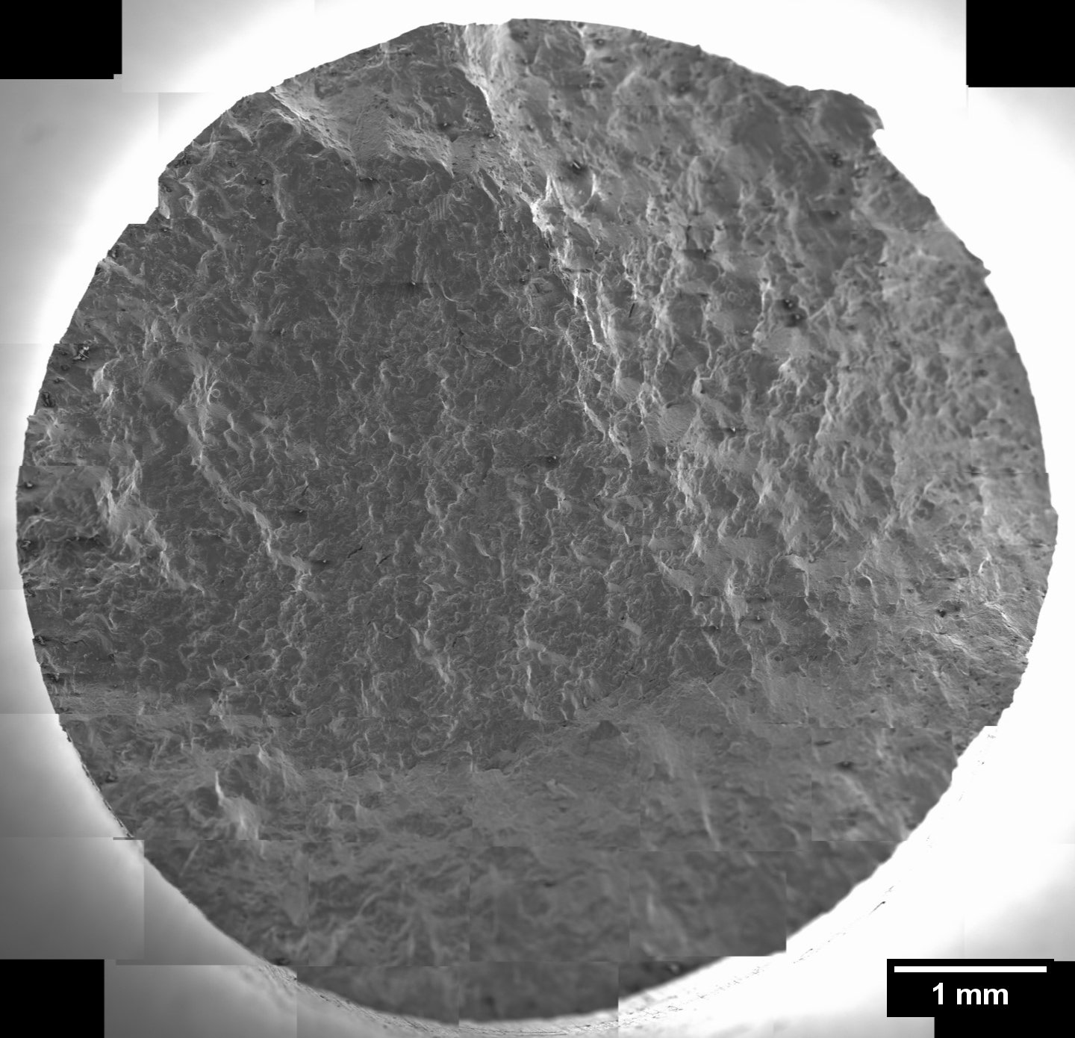
Fractography 2-Step Age LCF Comparison
Air
GH2
Fast fracture region
Propagation region
Fast fracture region
Propagation region
Fast fracture region
Crack initiation region
Overall, samples from both air and GH2 testing displayed similar ductile fatigue fracture behavior

Slide 19
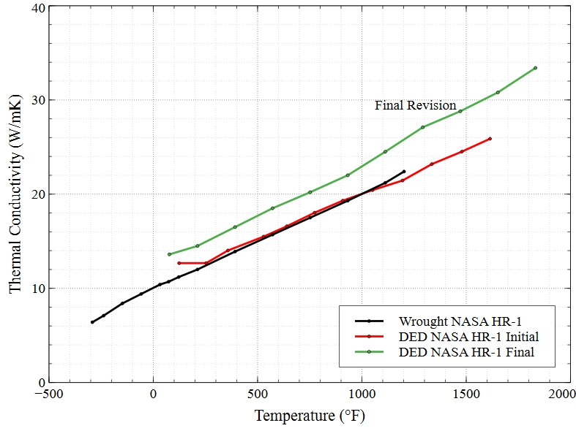
Thermal Conductivity
Thermal conductivity testing was performed to compare to wrought
The initial revision of LP-DED NASA HR-1 was similar in conductivity to wrought
Adjustments to the powder composition for the final revision improved the conductivity 15-20% over wrought and the initial revision

Slide 20
Summary and Future Work
Desirable microstructures and mitigated Ti segregation from the LP-DED process were able to be produced for NASA HR-1 to optimize for applications
LP-DED NASA HR-1 has been shown to have similar trends in strength and ductility to wrought, but strengths were lower and ductility was higher for LP-DED material
  LCF behavior is comparable to the wrought material in air and LP-DED NASA HR-1 has a much smaller debit in LCF life in GH2 compared to wrought
  GH2 tensile testing currently underway and further GH2 LCF testing being planned
Adjustments in powder composition to improve microstructure and performance also improved the thermal conductivity of the material

Slide 21
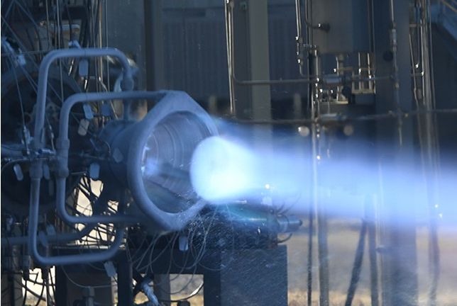
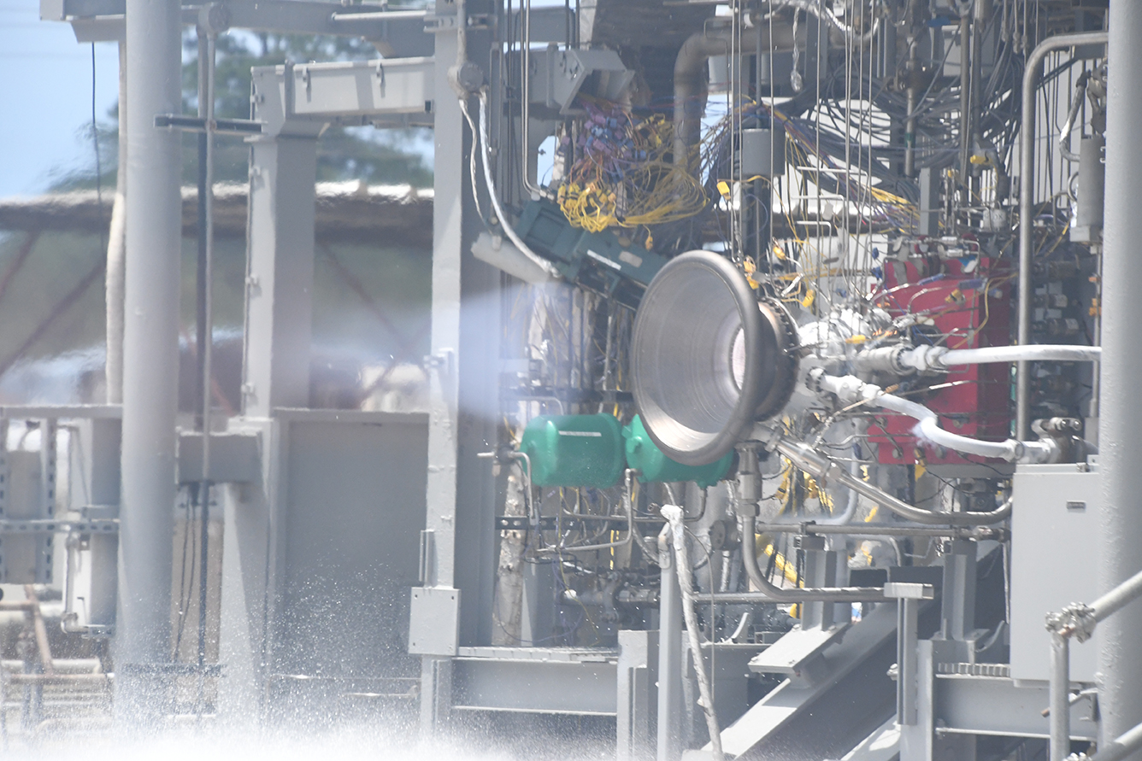
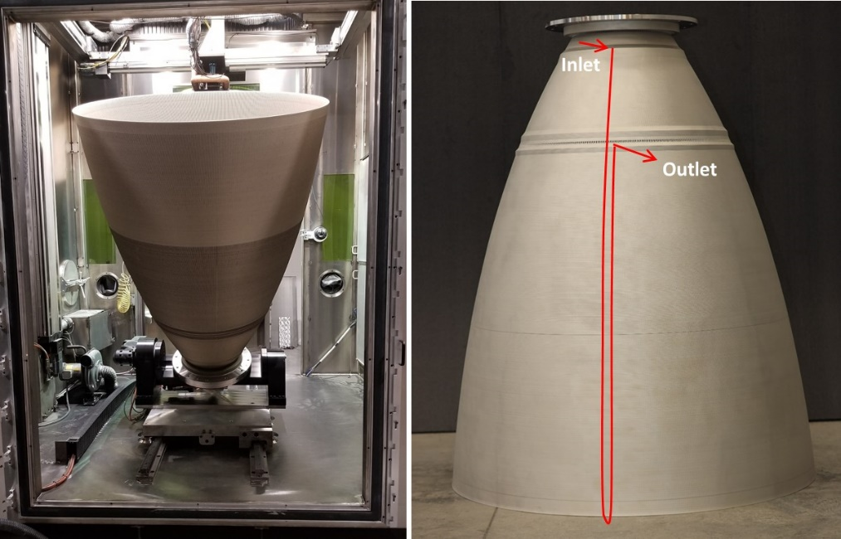
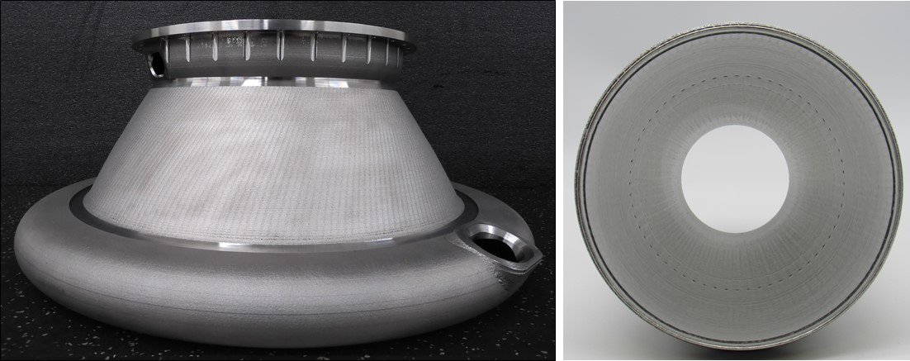
Questions?

