Slide 1
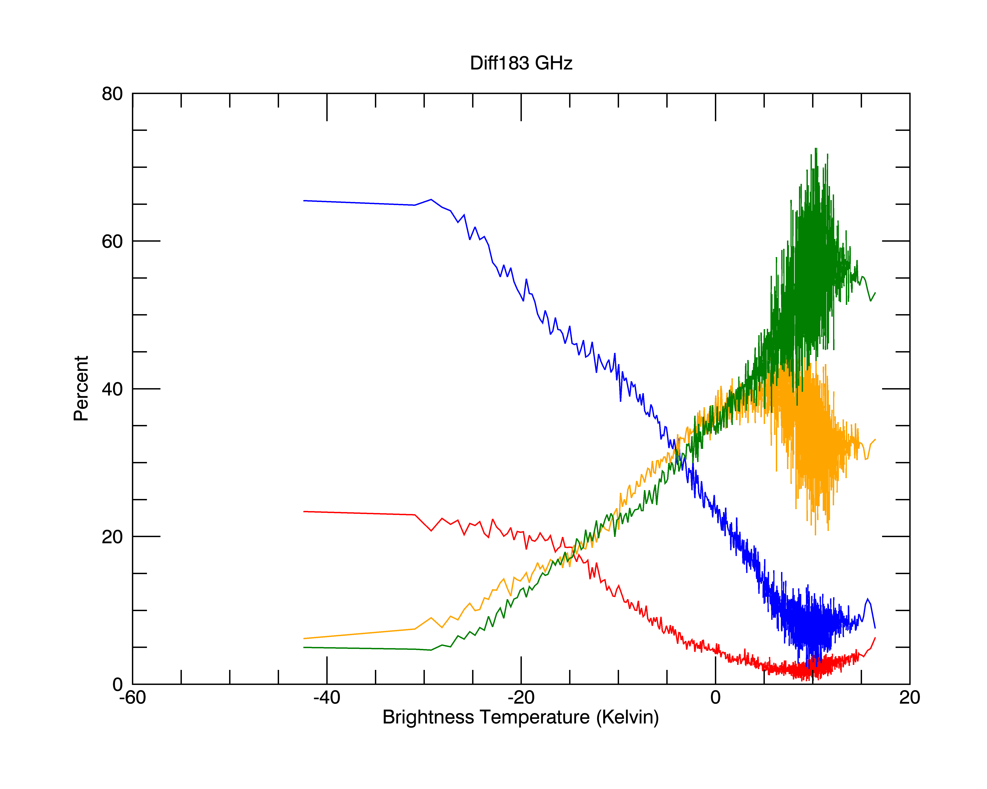
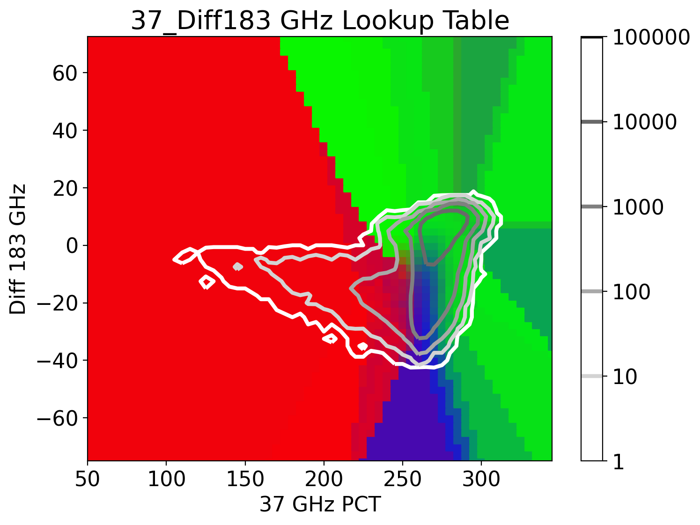
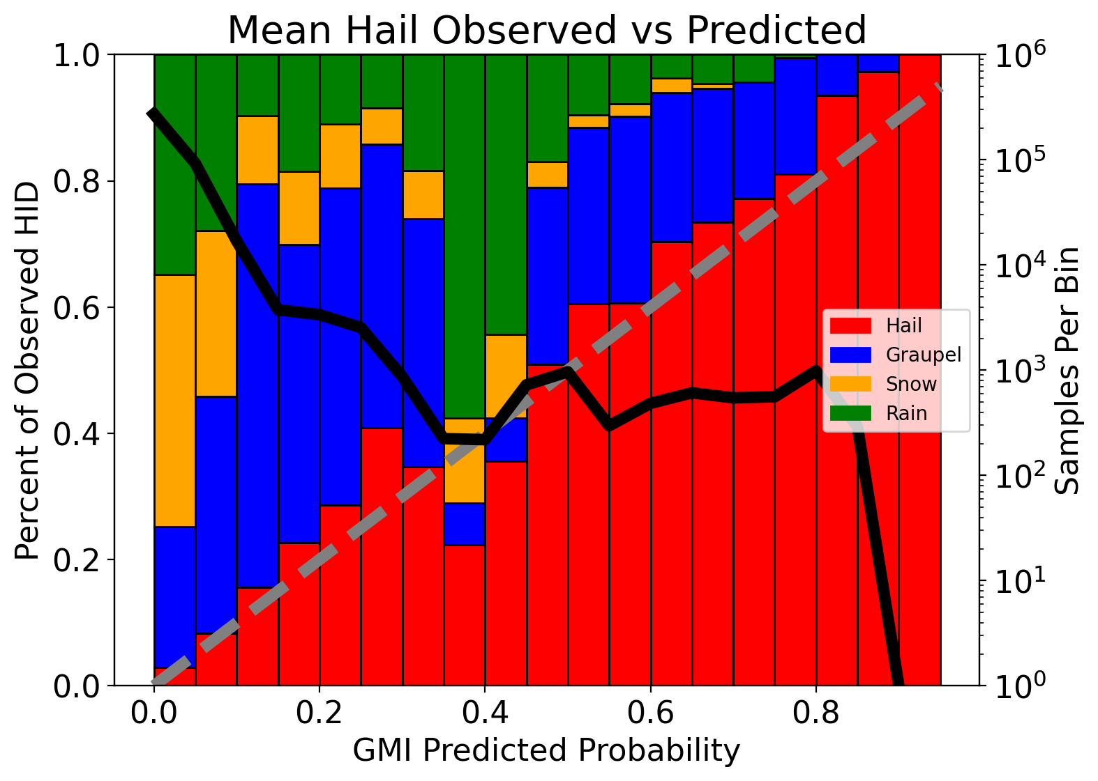
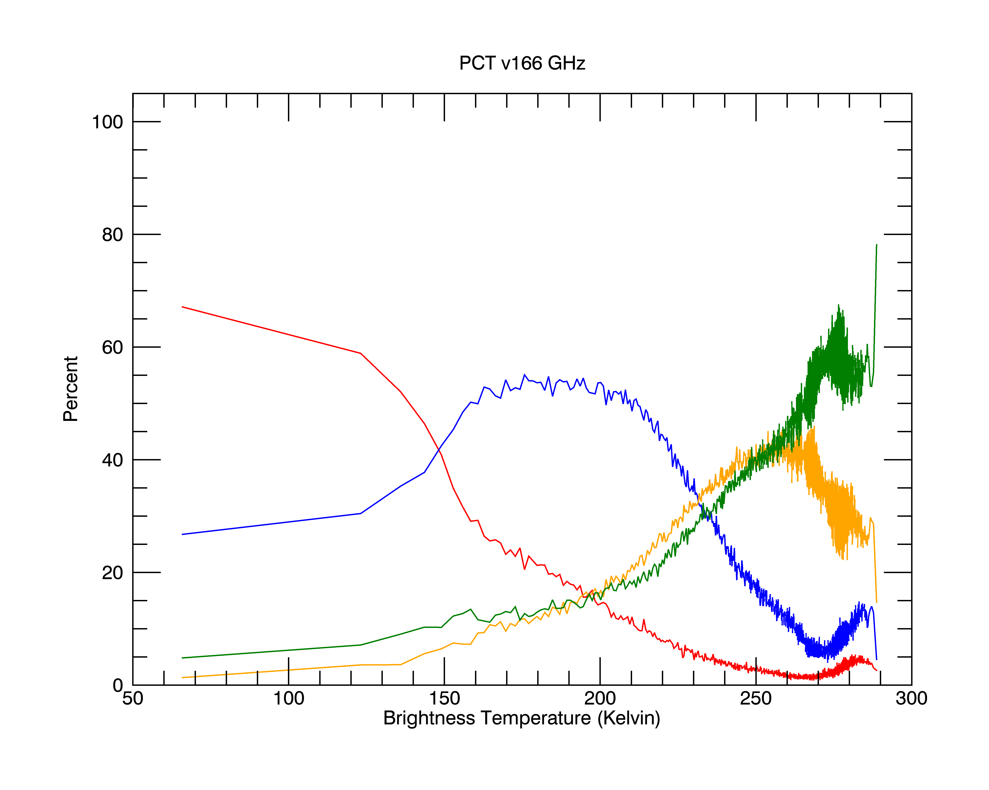
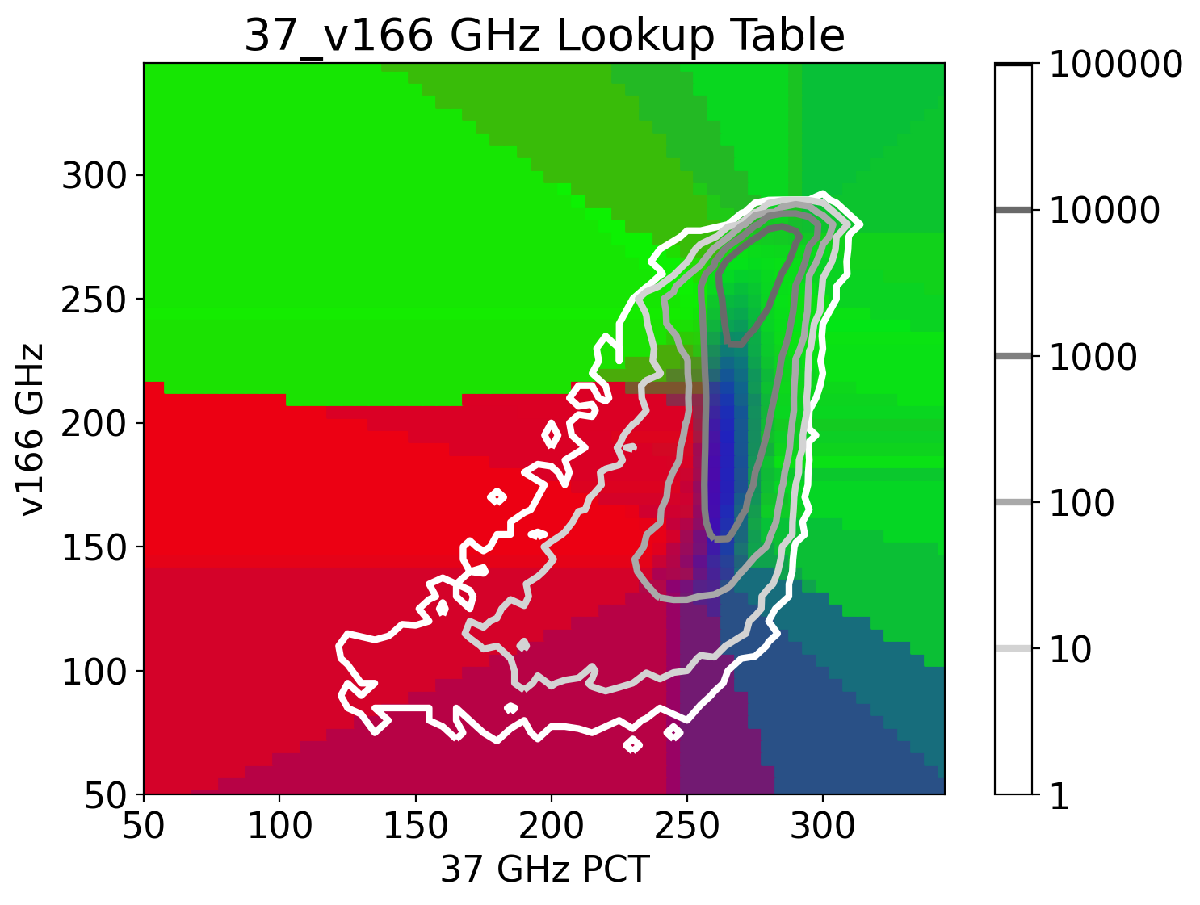
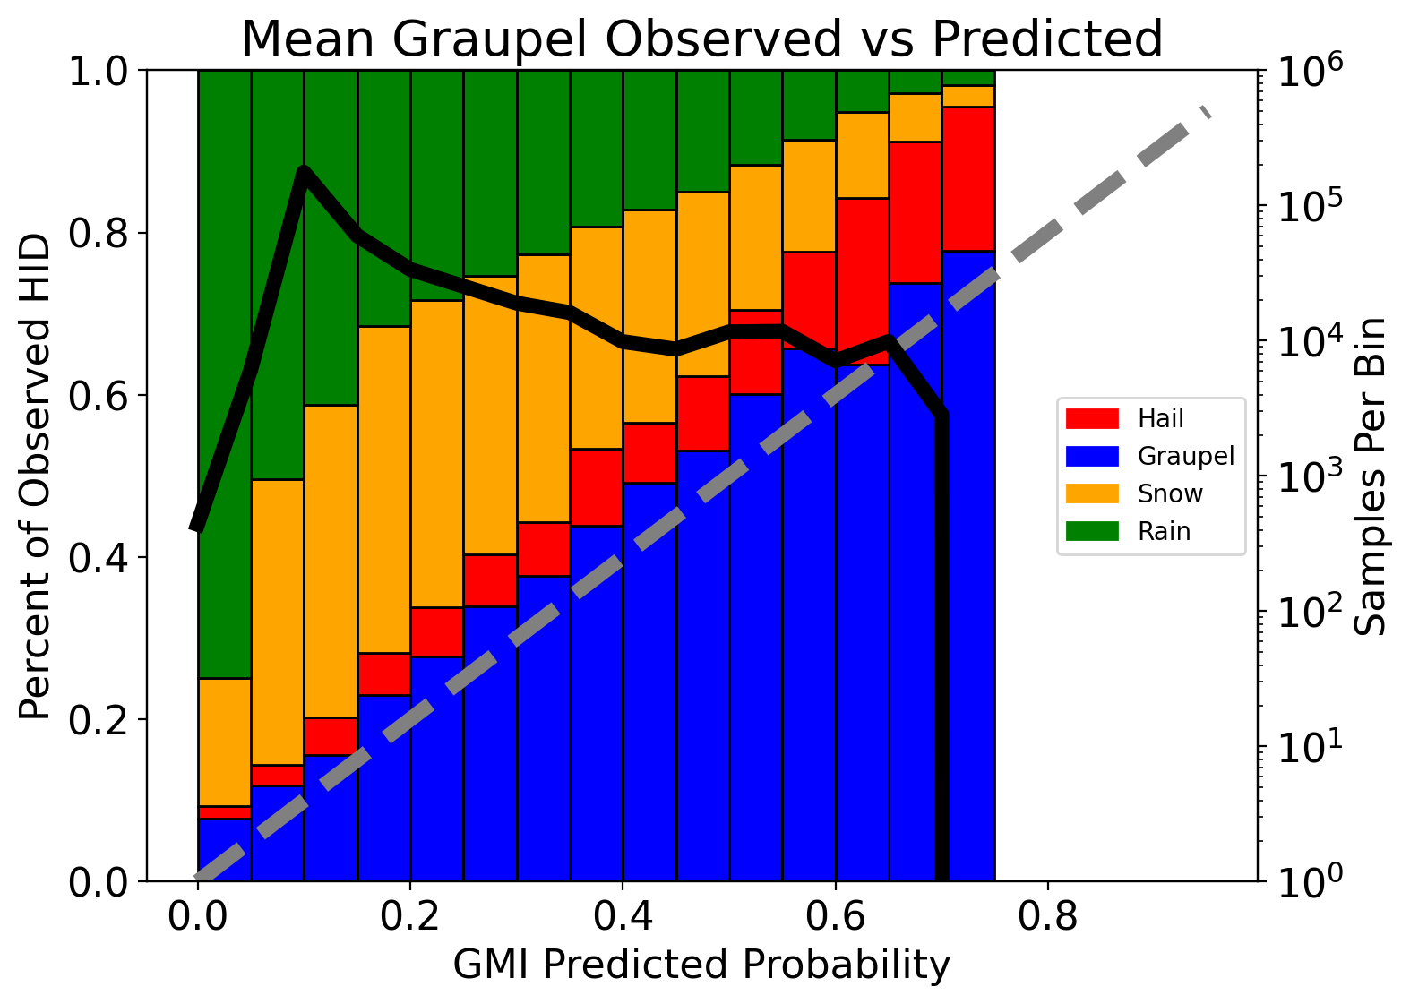
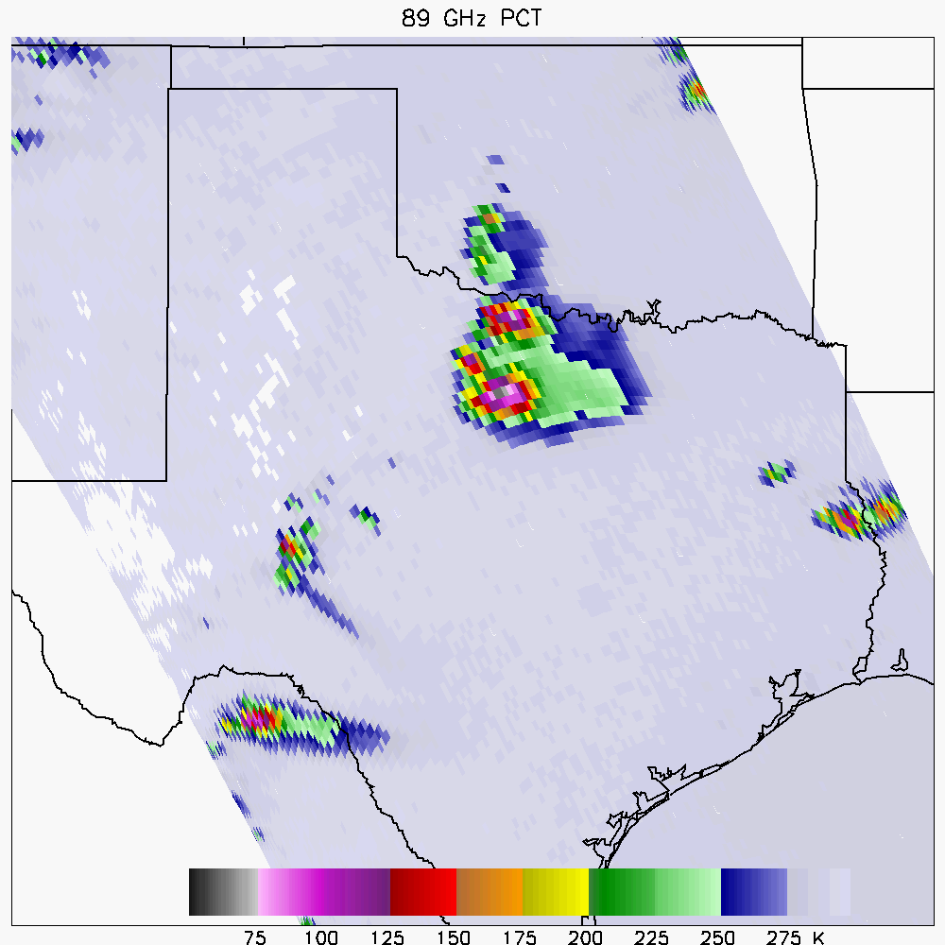
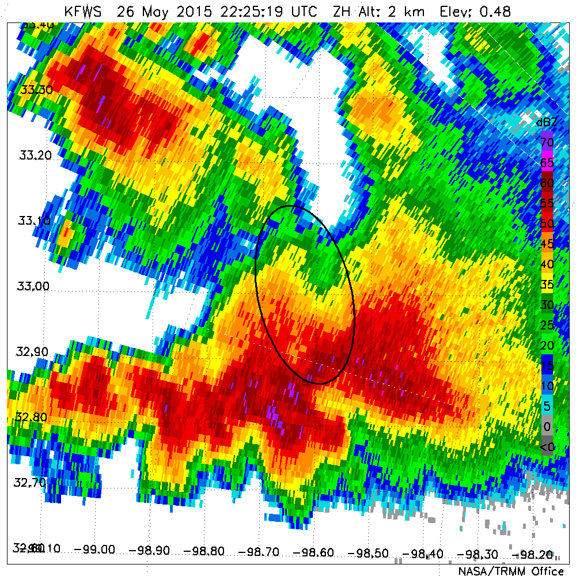
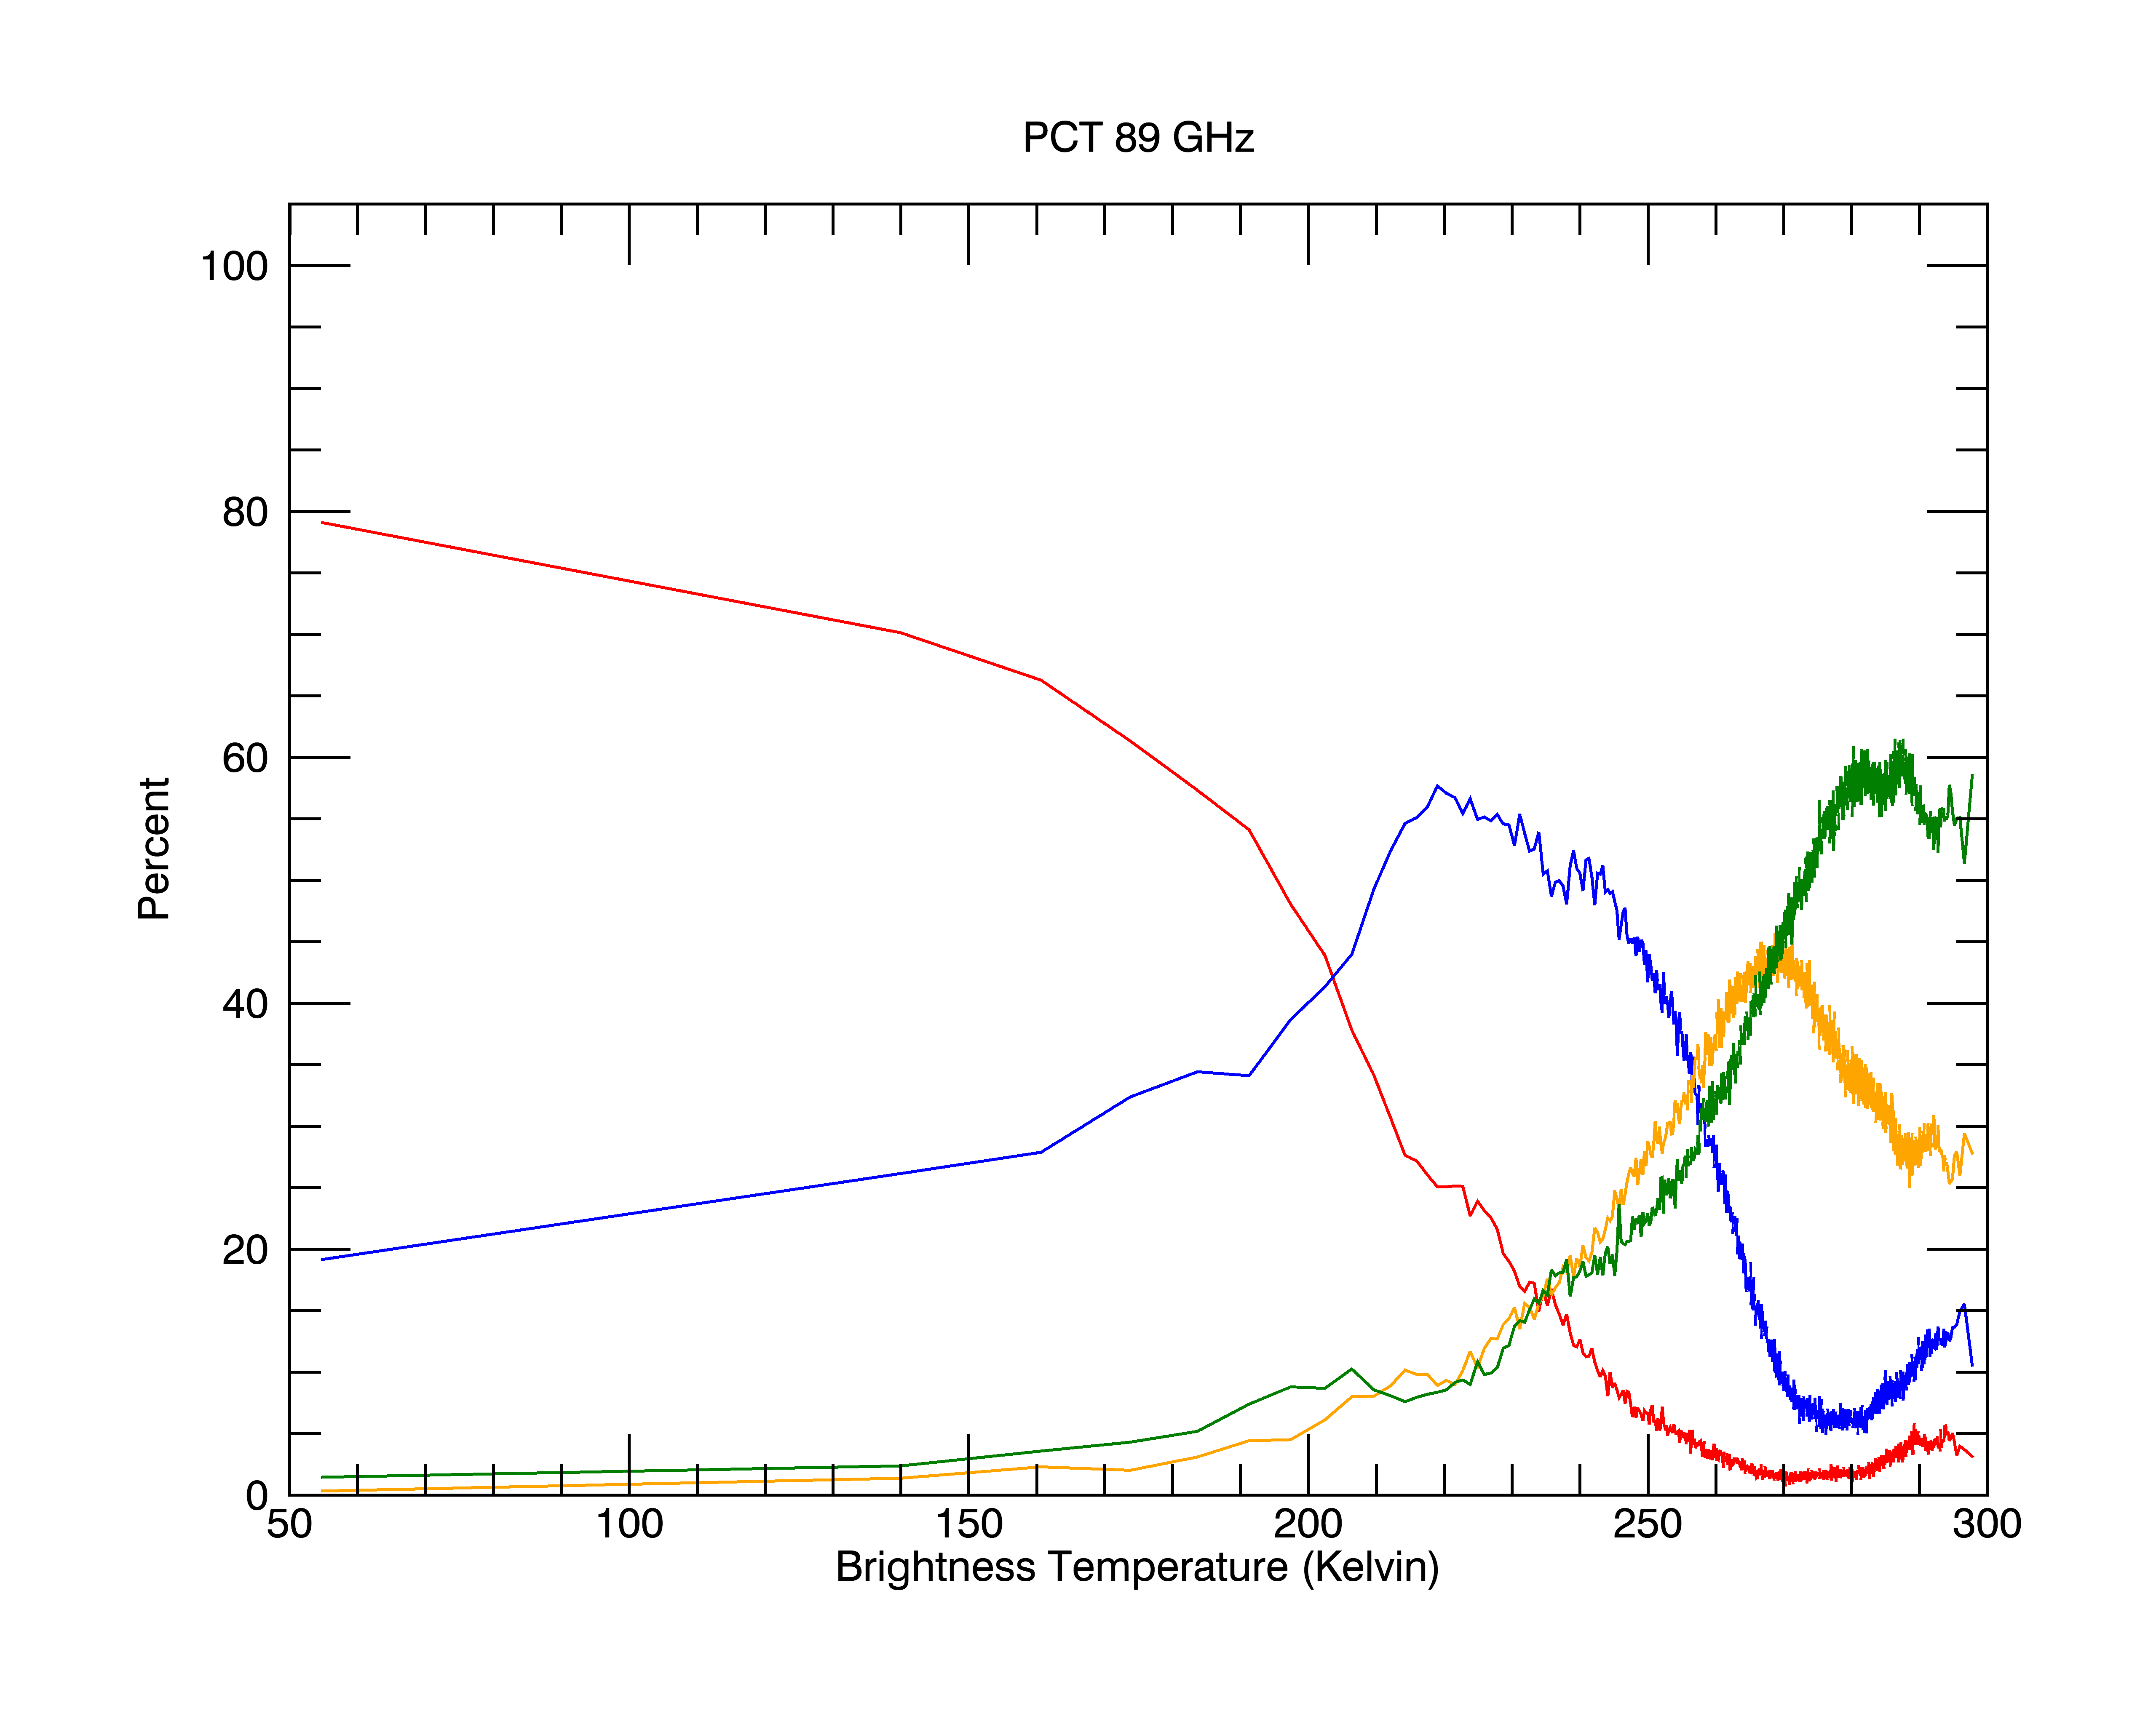
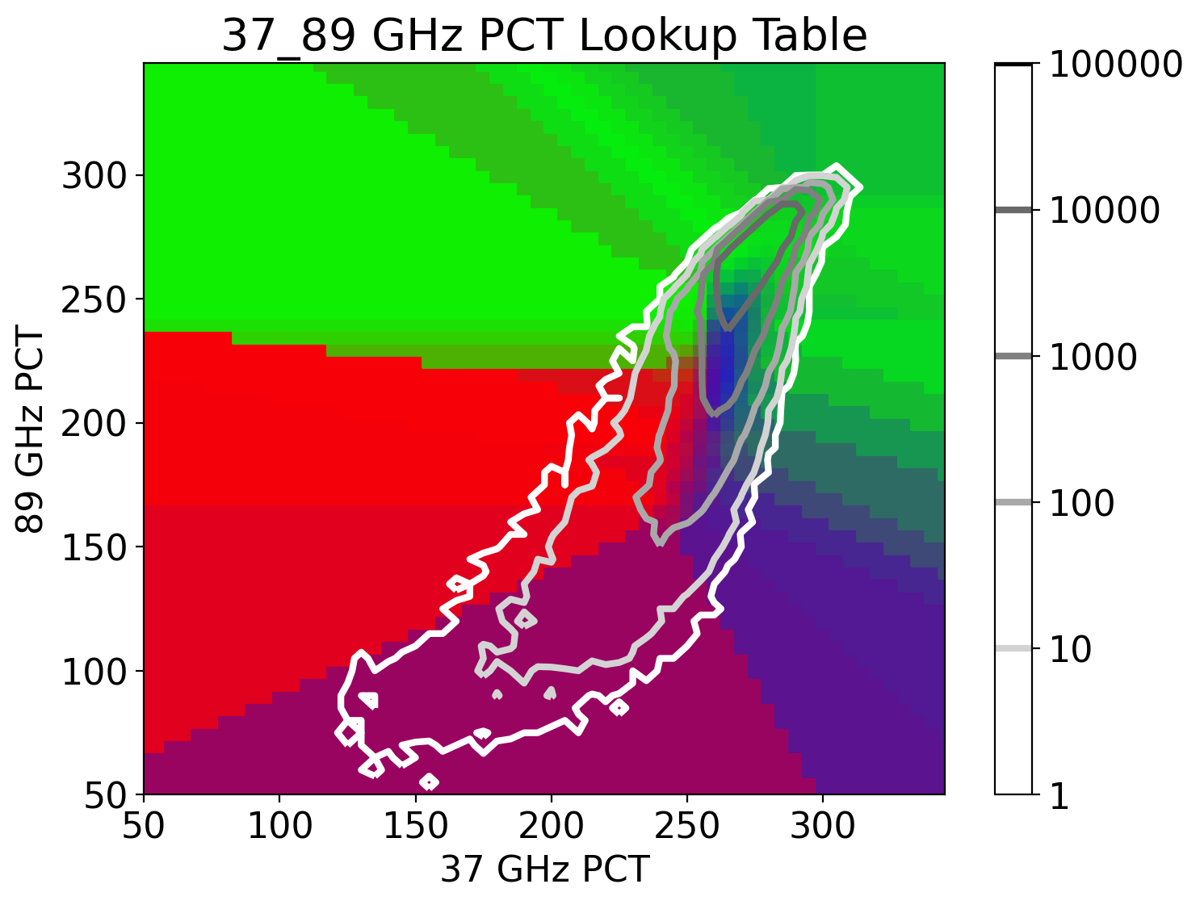
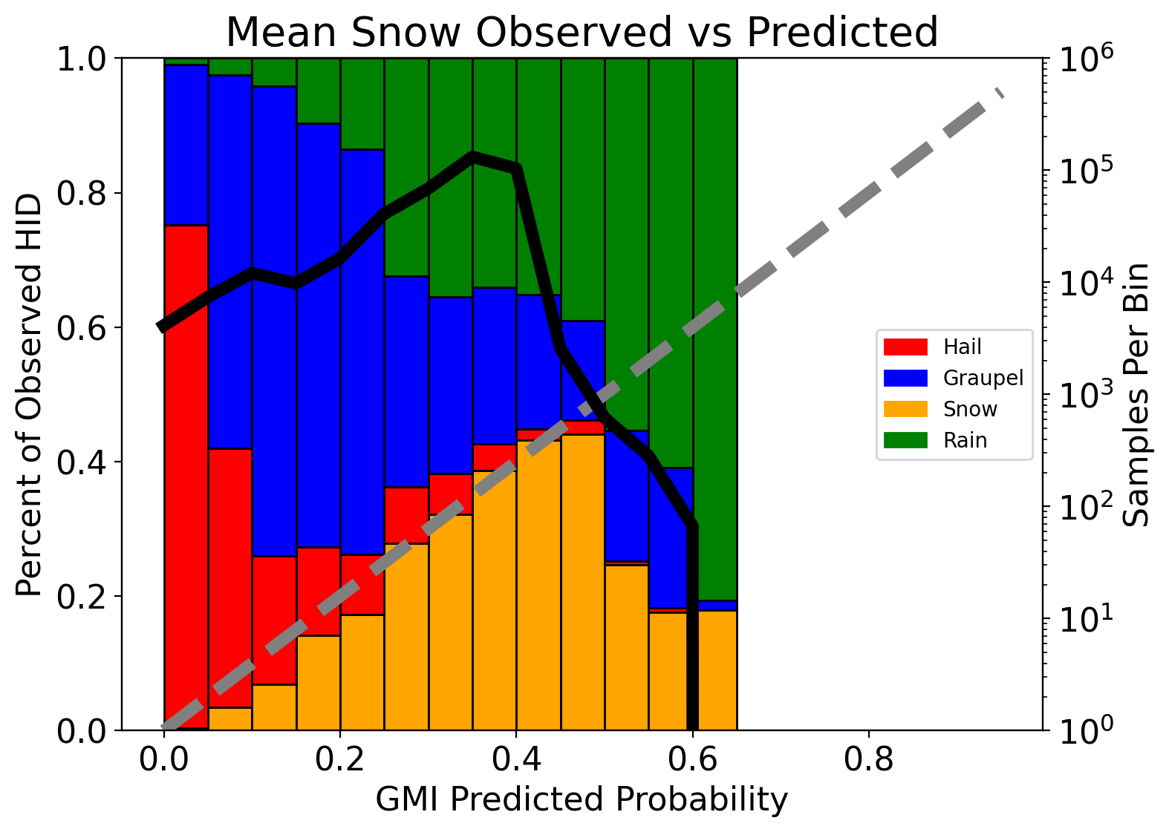
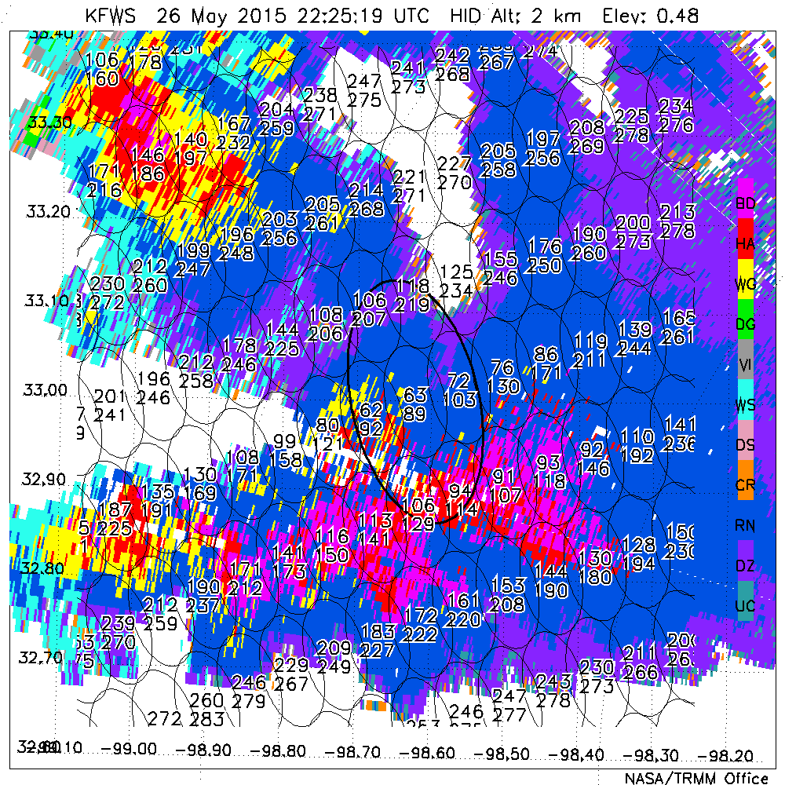
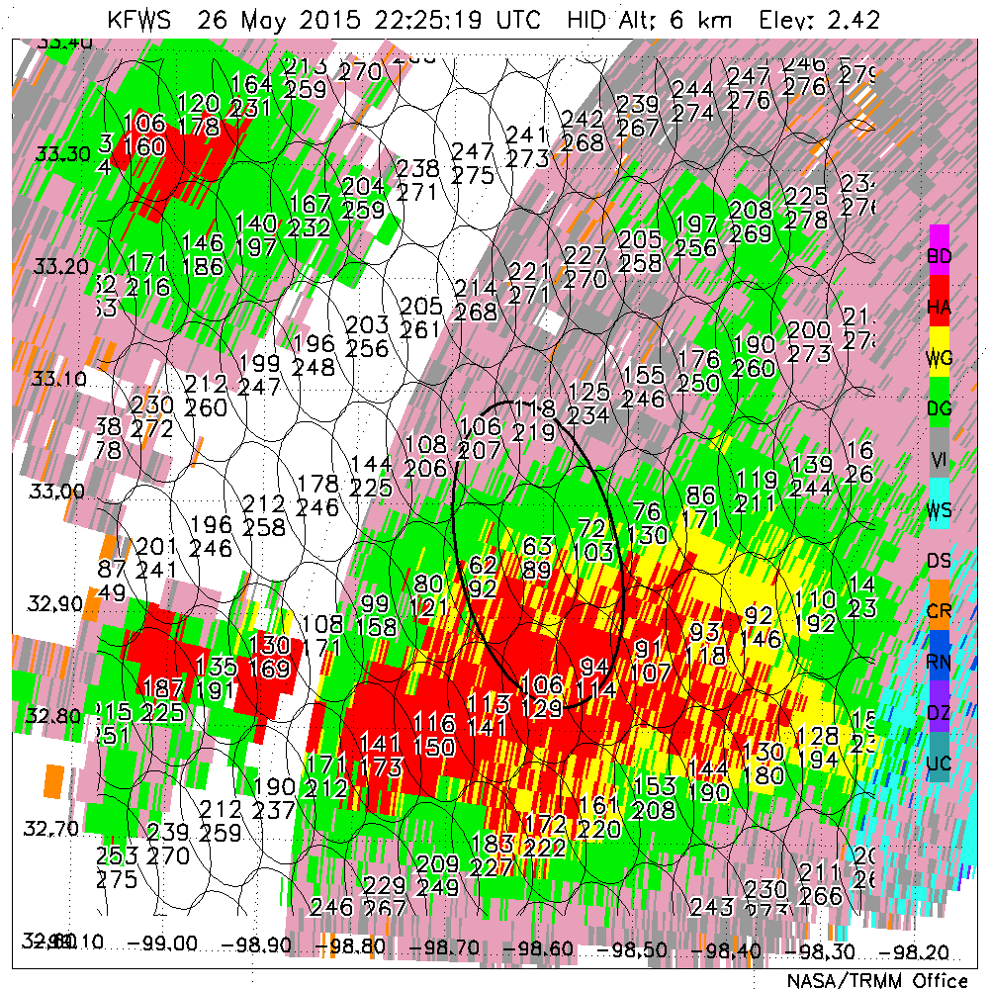
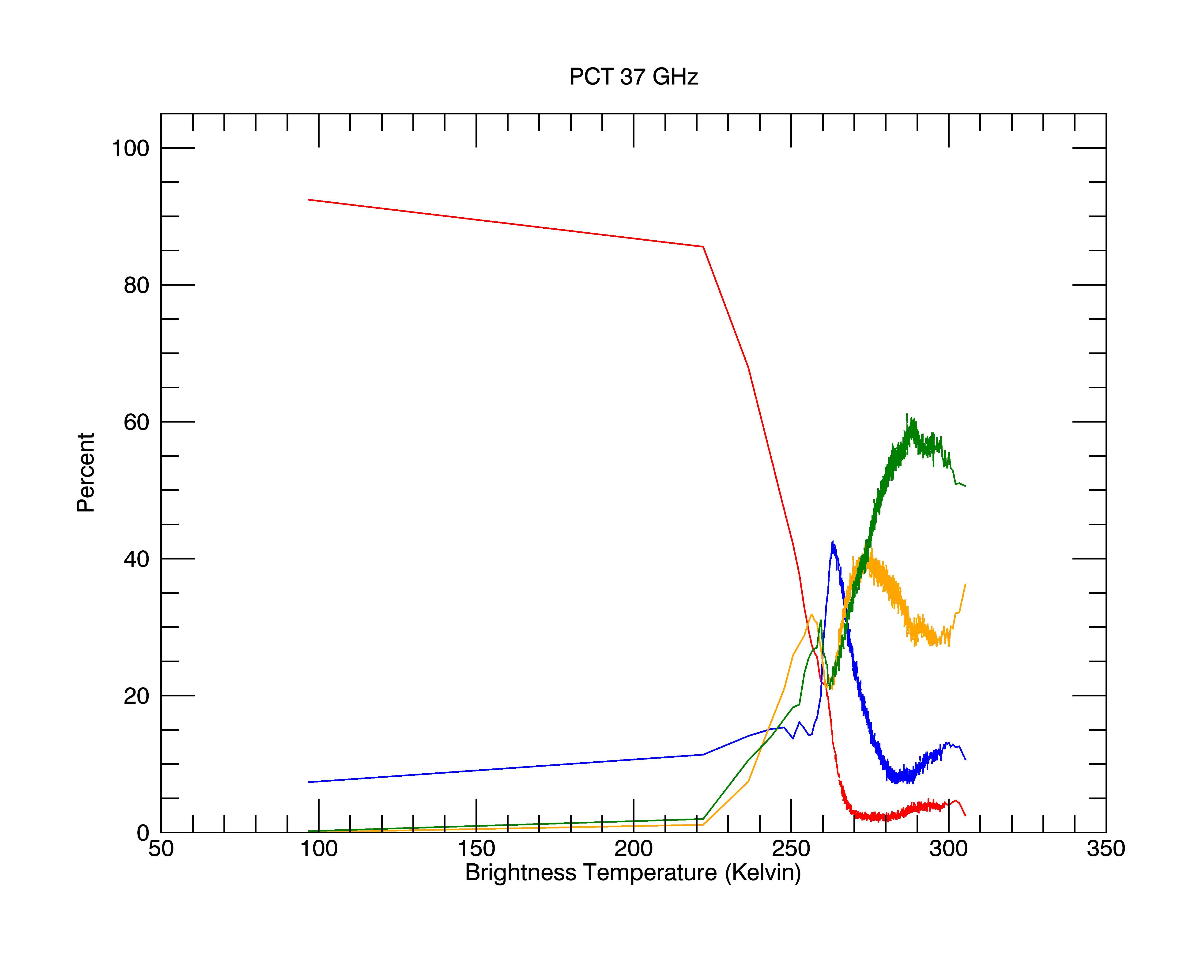
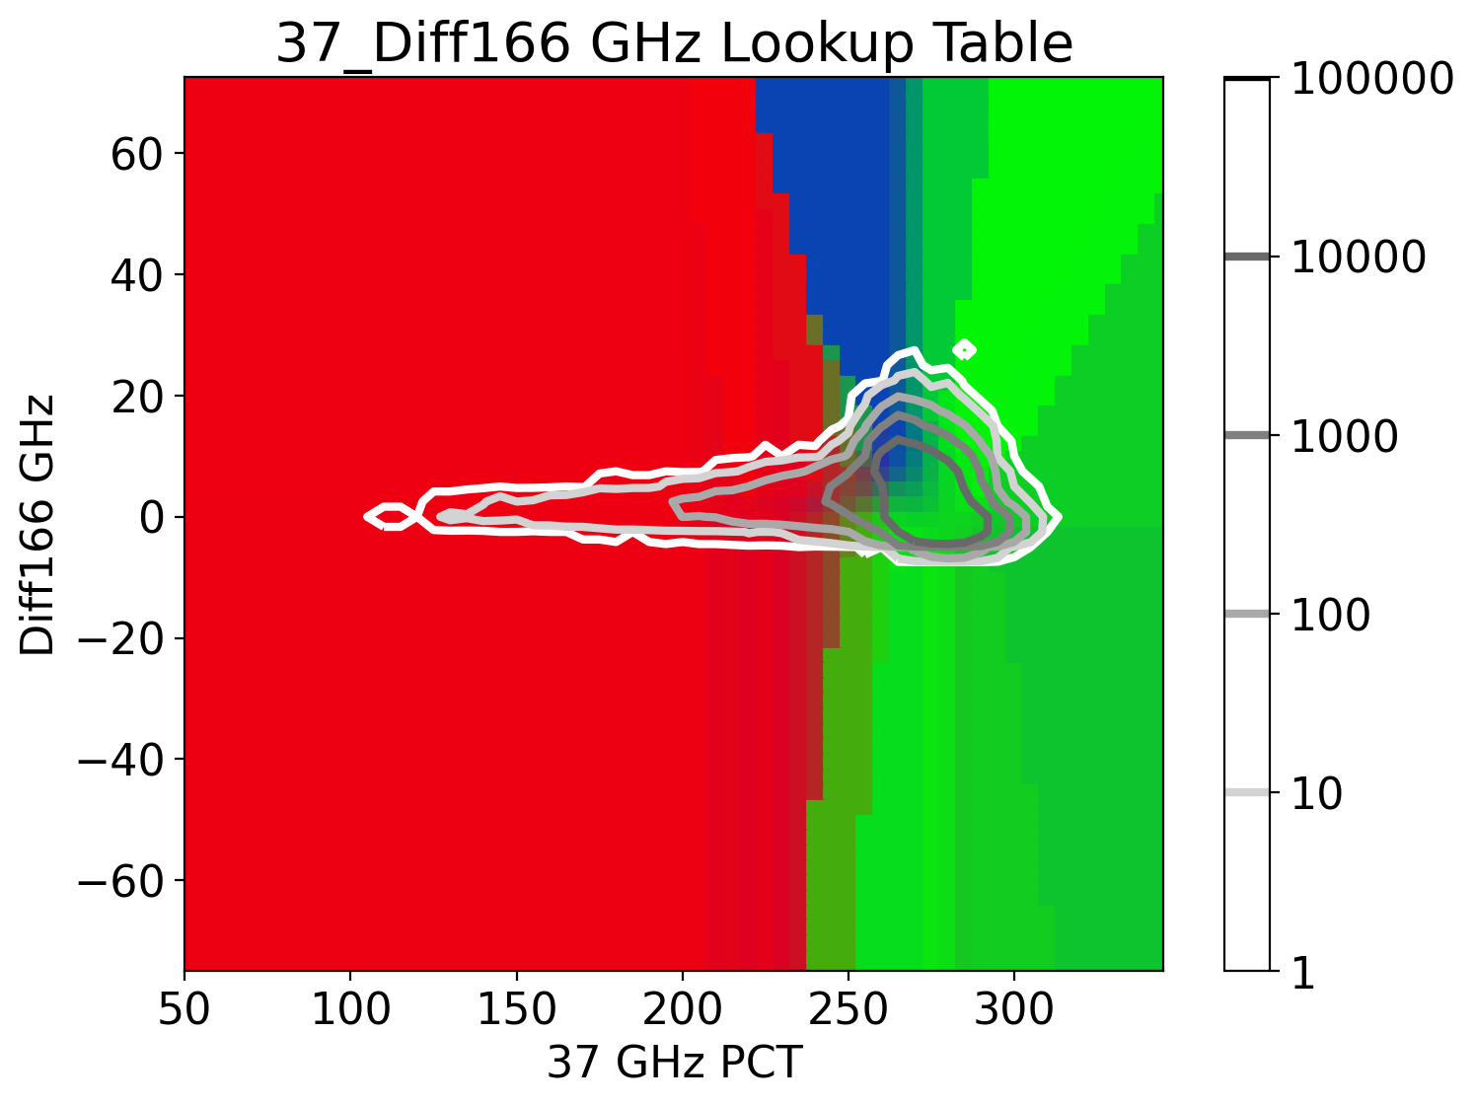
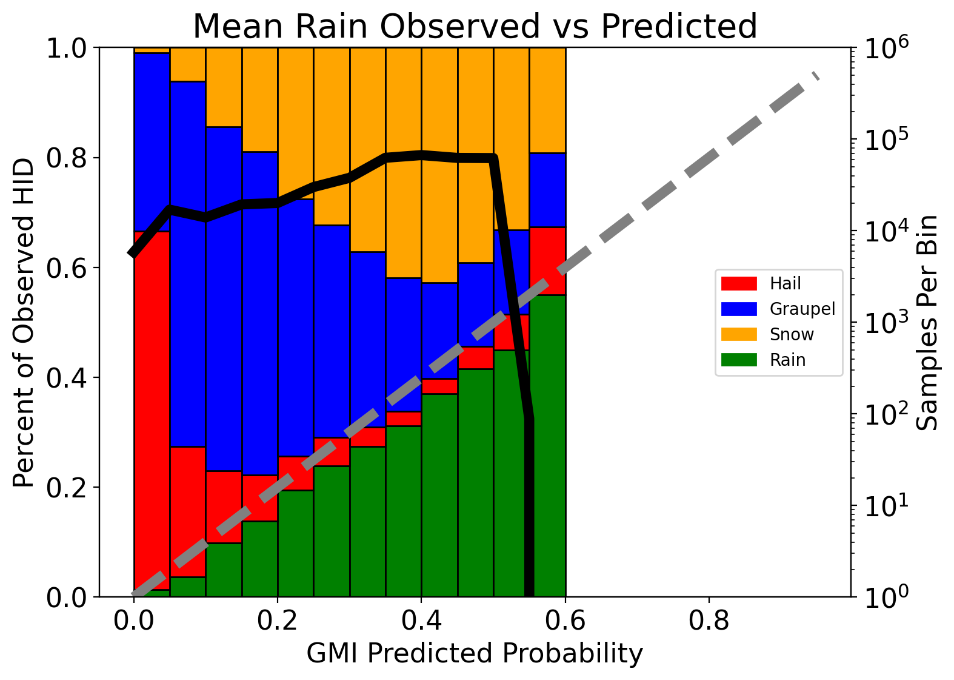
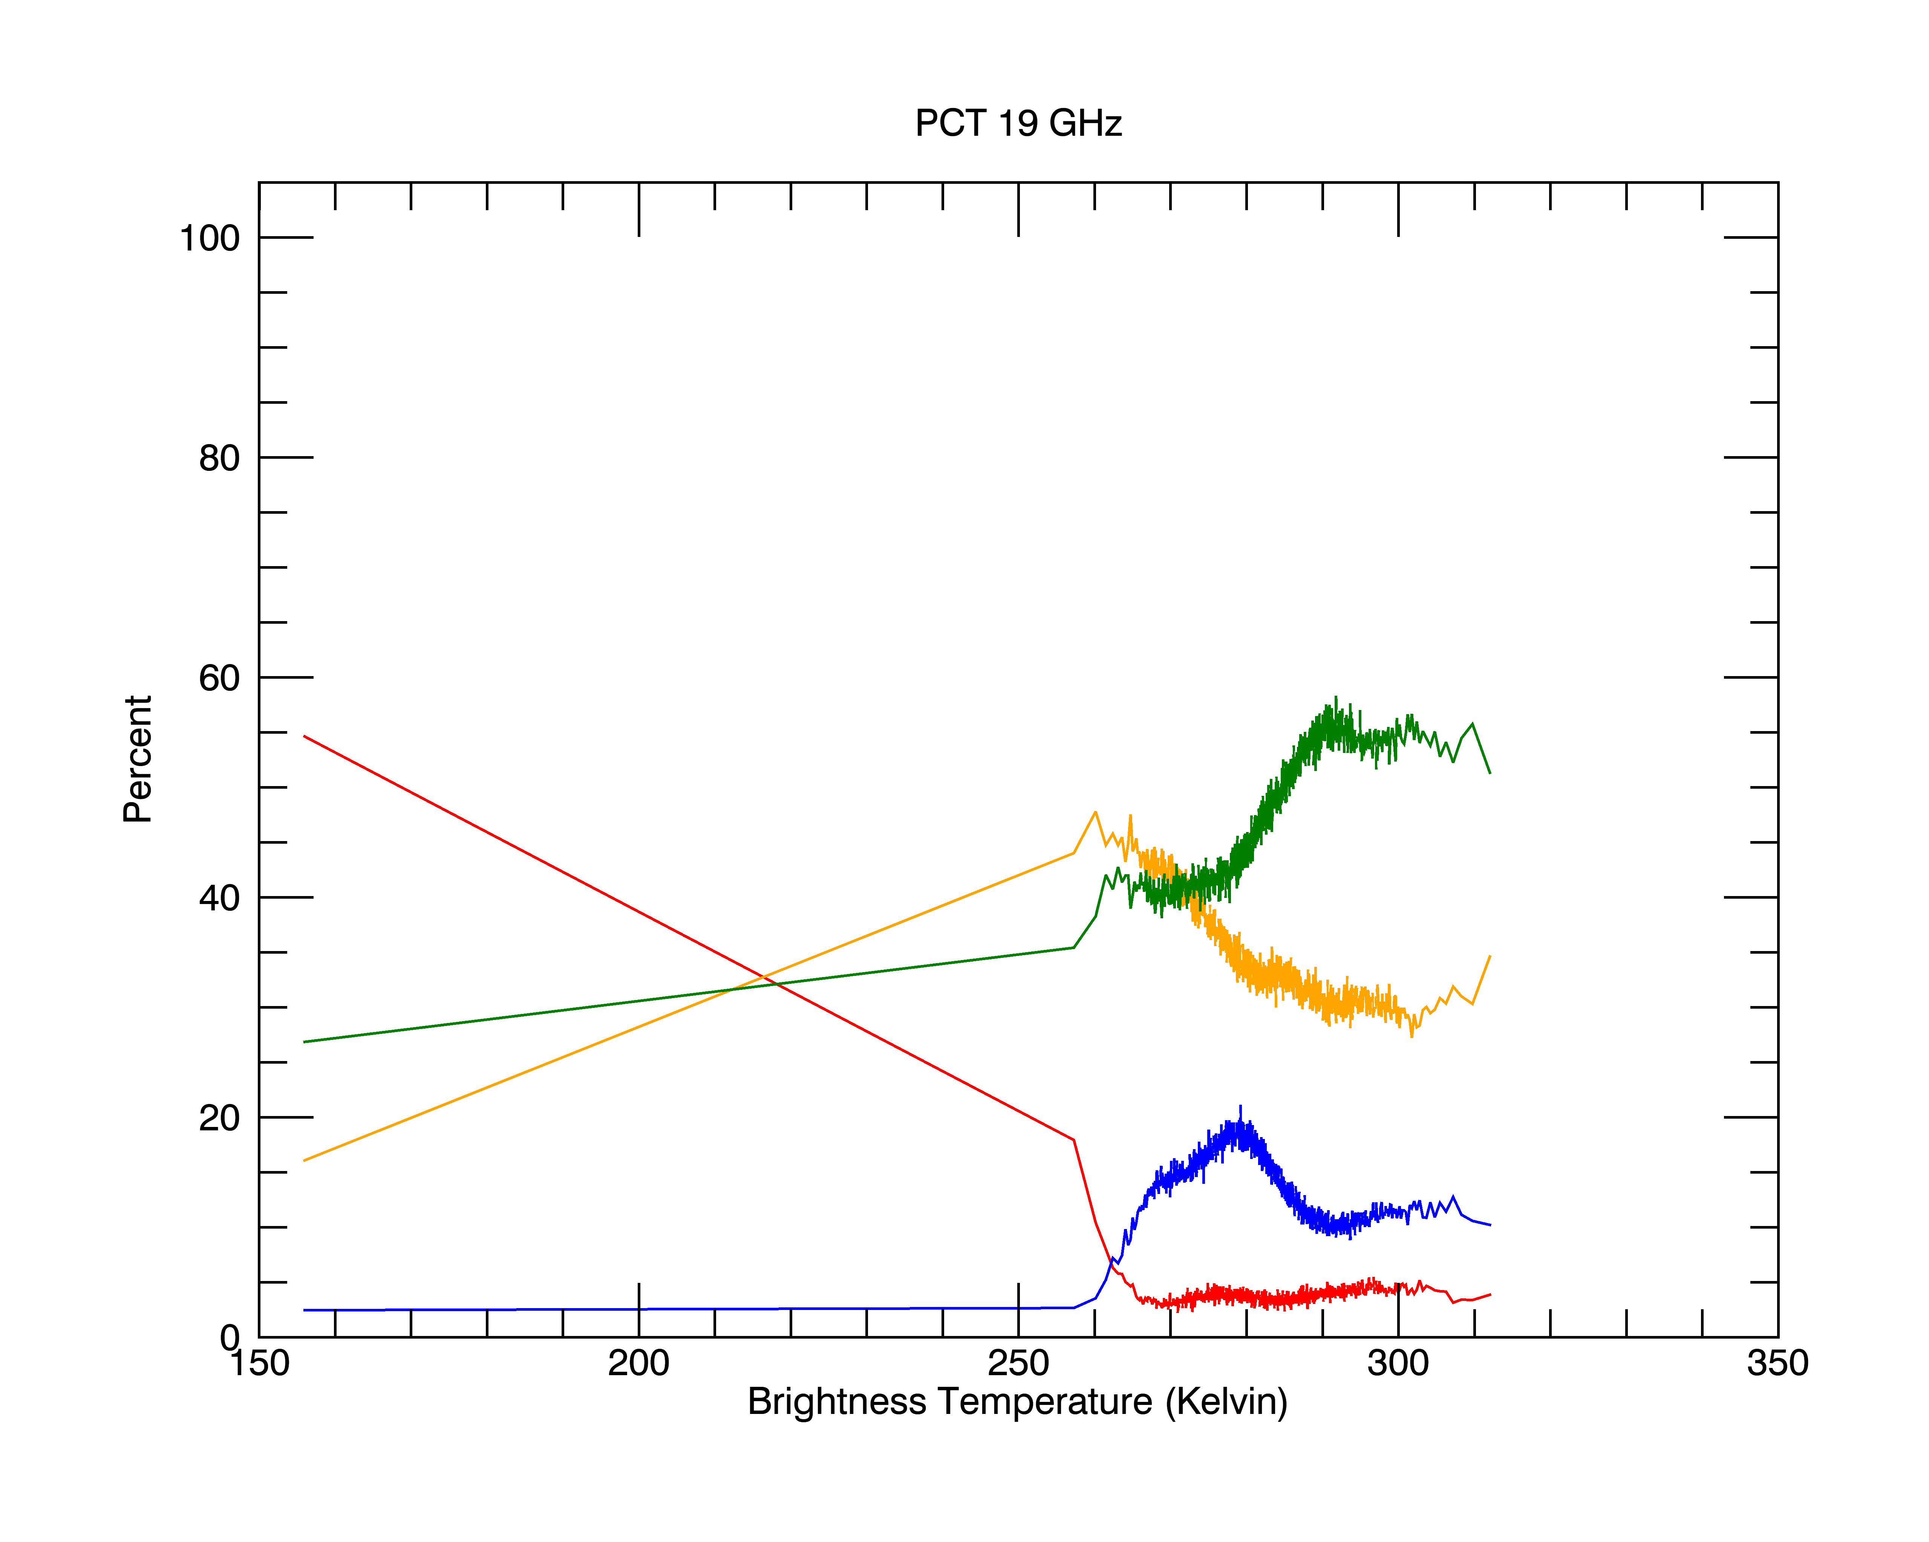
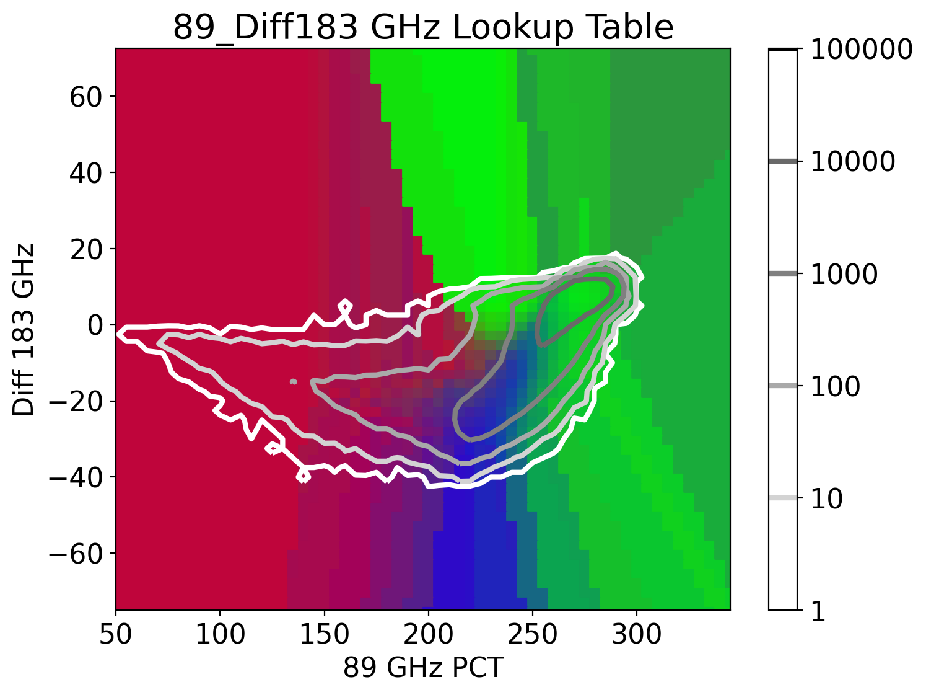
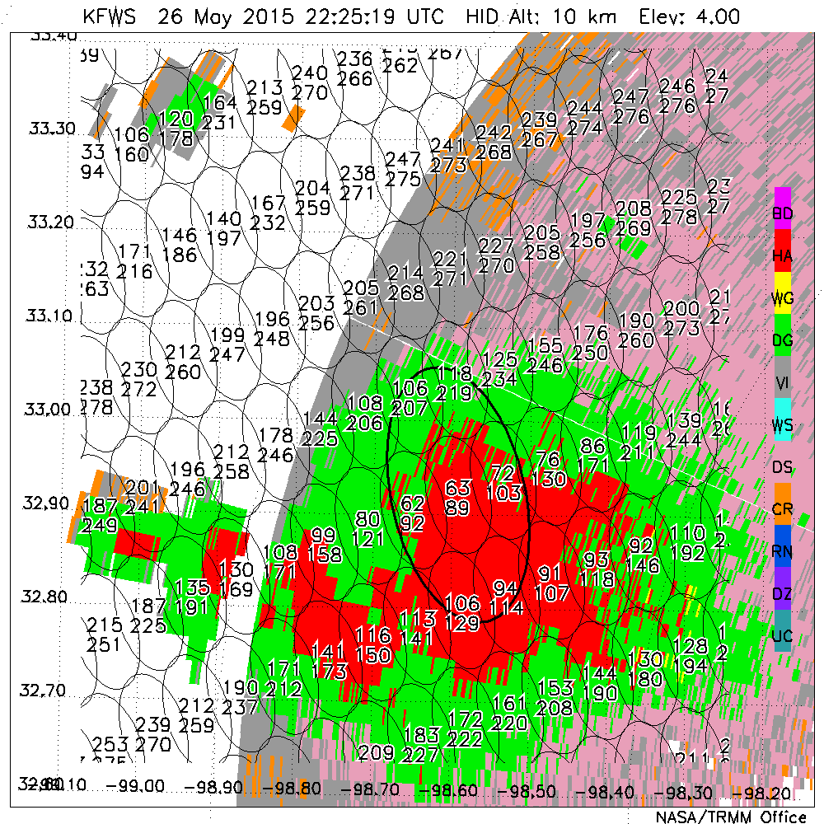
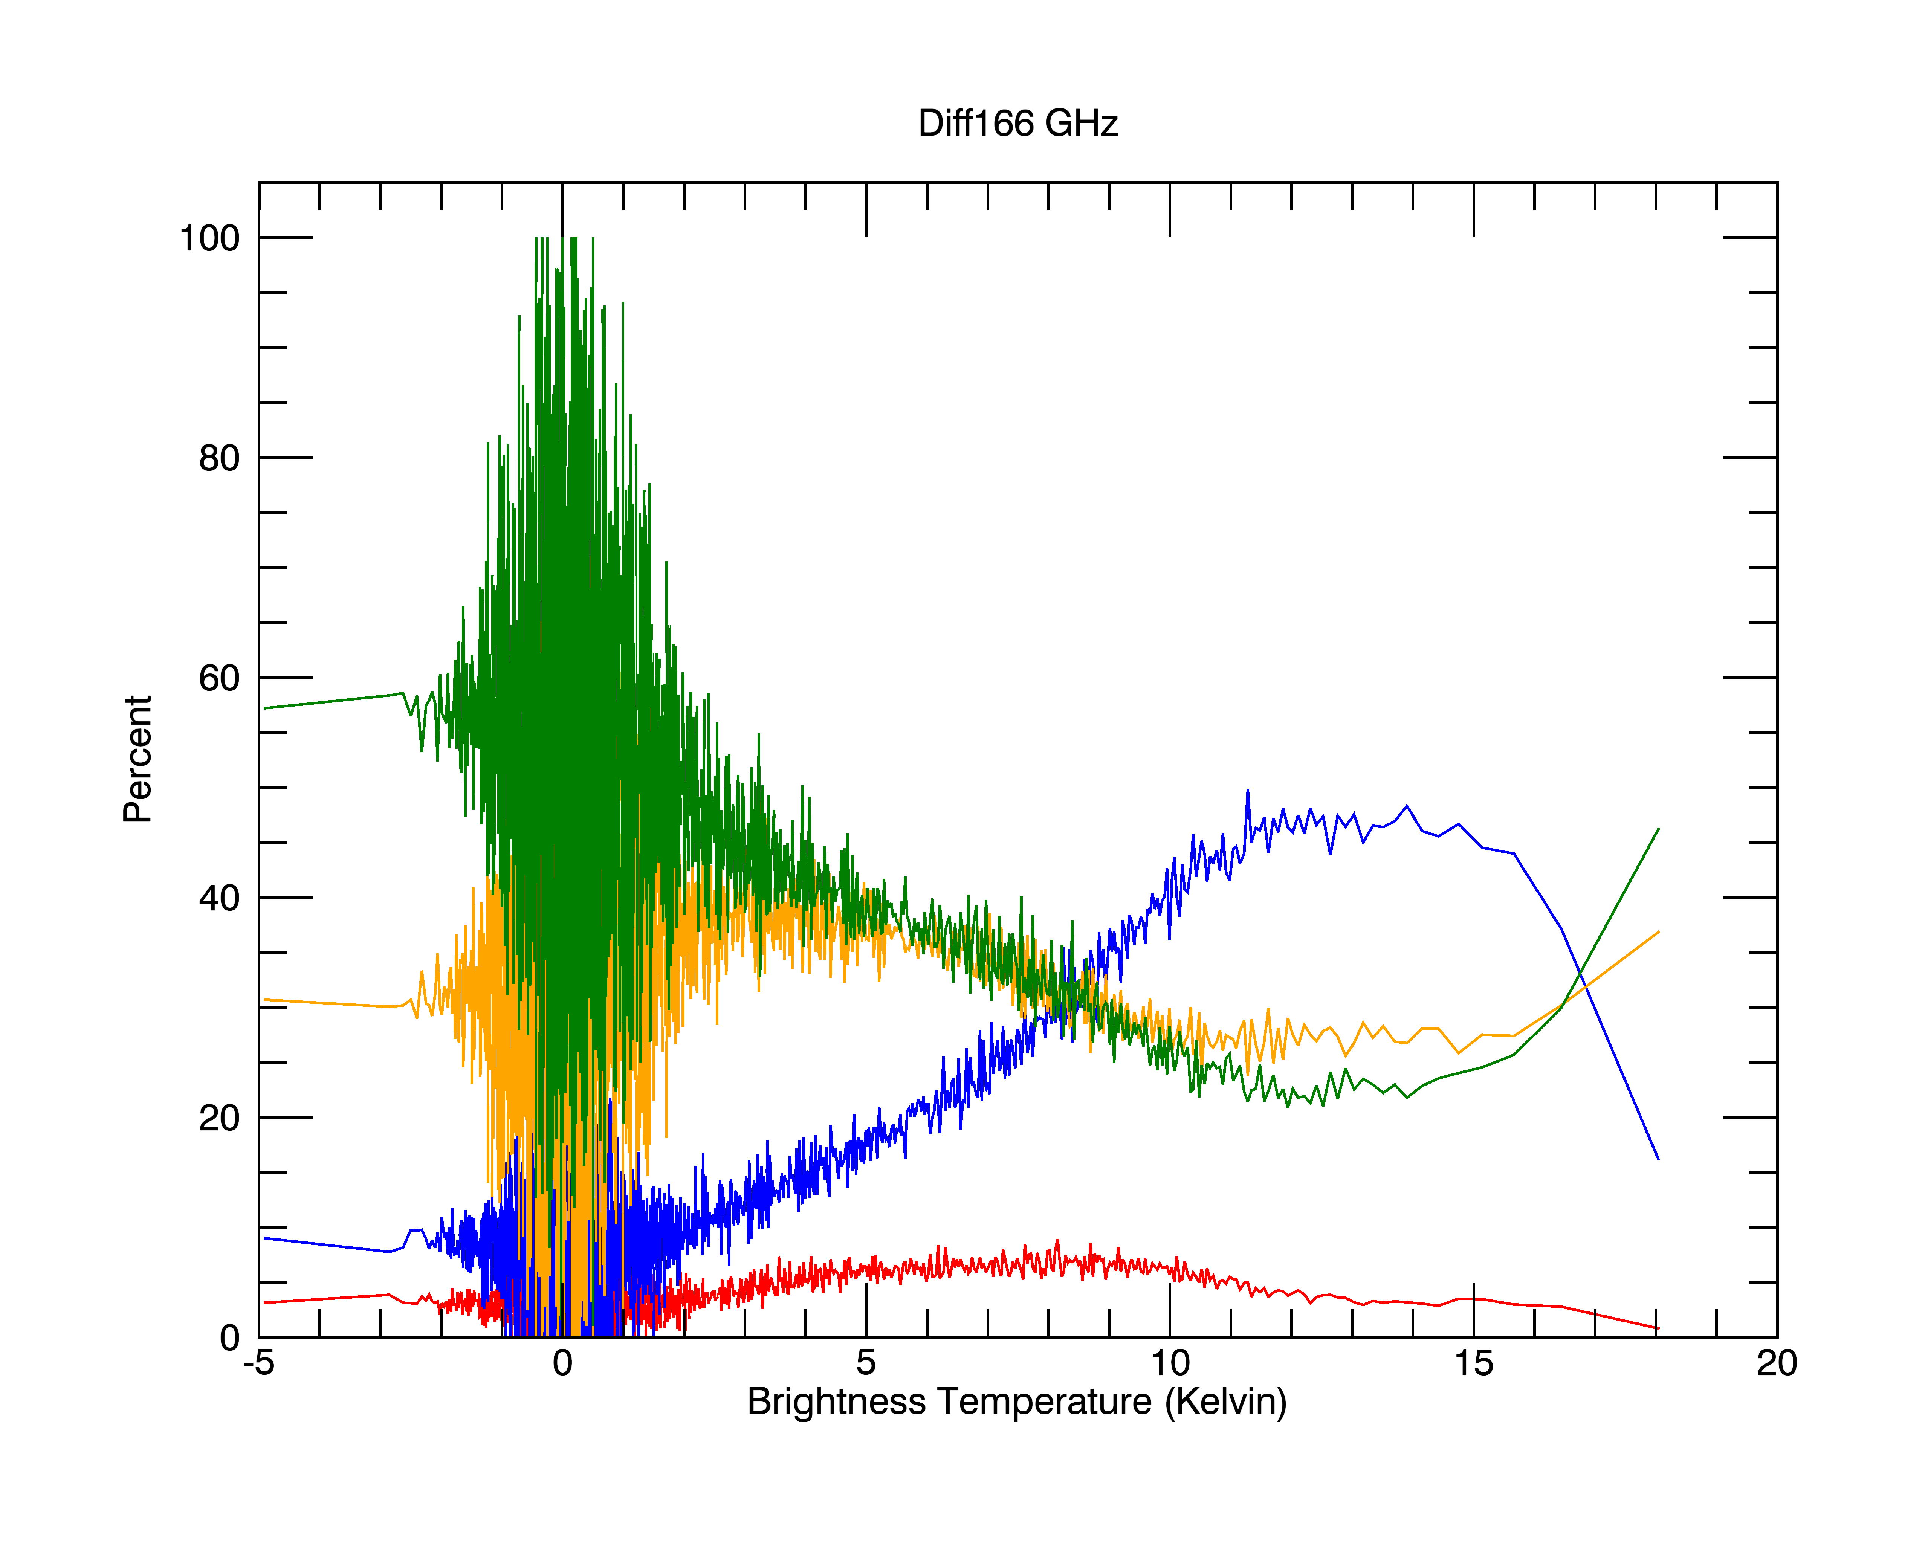
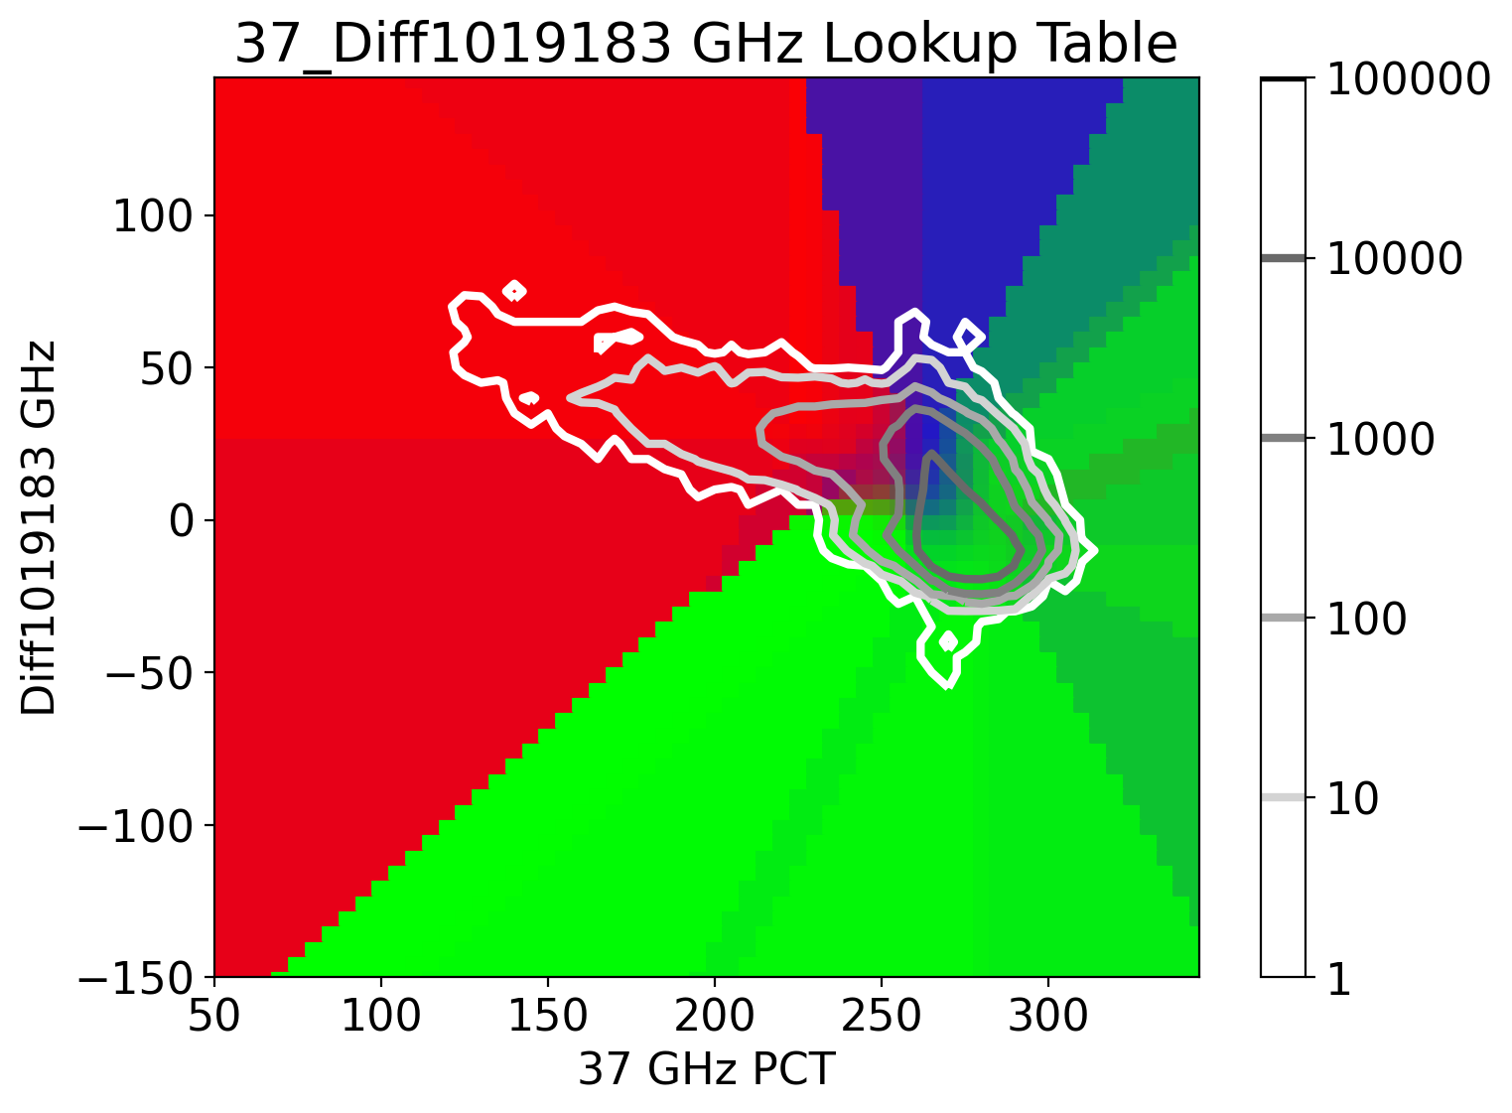
Empirical Hydrometeor Type Identification from GMI Brightness Temperature Measurements
Daniel J. Cecil, NASA Marshall Space Flight Center, Daniel.J.Cecil@nasa.gov
Michael Solomon, University of Alabama – Huntsville, mbs0025@uah.edu
Motivation / Goal:
Brightness temperatures (TB) from GMI and related sensors contain information about the types and amounts of precipitation particles in a column.
Approaches like GPROF or machine learning are good for providing precipitation estimates and other quantified information, but it can be difficult to understand why / how a given set of TBs traces to a given retrieval solution. Outlier TBs that are not well-represented in a training sample can lead to dubious solutions.
Our goal is to use the scattering signatures at multiple frequencies to determine whether hail is present, or otherwise graupel, or otherwise snow, or otherwise liquid rain without a substantial precipitation ice component. (A hierarchical approach is employed, so a prediction of hail can include the presence of all other categories, but a prediction of snow implies a lack of graupel or hail, and a prediction of liquid rain implies a lack of any detectable precipitation ice.)
Approach:
Construct straightforward lookup tables between TBs from multiple channels and hydrometeor types that were retrieved from ground-based dual-polarization radars (GPM Validation Network). Training data are limited to precipitating pixels.
Extend lookup tables to all parts of TB parameter-space.
If there is precip, which hydrometeor types are suggested by the TB?
2-d lookup tables (color shading), and PDFs (line contours
Training and validation data are limited to precipitating pixels.
(183.3 +/- 7 GHz) – (183.3 +/- 3 GHz)
Large negative values indicate graupel or hail, positive values indicate a lack of high-density ice
In the lookup tables, each combination of TB or Polarization Corrected Temperature (PCT) from two or more channels is mapped to a percentage likelihood of hail, graupel, snow, or rain.
For plotting purposes, snow and rain are both assigned green before these percentages are loaded into an rgb color table.
A blue shade indicates high probability of graupel without hail.
A red shade indicates a high probability of hail (which almost always includes graupel and the other HIDs elsewhere in the footprint).
A purple shade indicates mixed likelihoods of hail or graupel.
Bluish-green indicates mixed likelihoods of graupel or other HIDs, without hail.
Green shades indicate snow or rain, with low probability of graupel or hail.
We extrapolate from empirically-derived probabilities, to fill out parts of the parameter space that are poorly sampled. This leads to also filling out parts of the parameter space that are not physically credible for precipitation.
We’ve tested several lookup tables, and settled on six that give reasonably good performance (with some differing attributes between them). Some are better at distinguishing hail-vs-graupel, some are better at distinguishing graupel-vs-snow, or snow-vs-rain.
For each GMI pixel, we compute the probabilities of each HID type, and average those probabilities from each of the six lookup tables.
*Diff1019183=
(PCT10-PCT19) -
(V183.3+/-7 – V183.3+/-3)
When retrieval predicts a given HID, how often is it observed? How often are the other HIDs observed?
Graupel
We test retrieval performance by checking how often a given HID is observed by the VN, as a function of its predicted probability. For example, among all retrievals where we predict a 30% probability of hail, 30% of those GMI pixels should have hail (and 70% should belong to other HID categories).
A perfect retrieval would have the red bars align with the 1-to-1 lines at right.
Underpredictions: bottom bars are above the 1-to-1 line.
Overpredictions: bottom bars are below the 1-to-1 line.
The verification plots here are based on taking the mean probabilities from all six lookup tables for each pixel. We also generate similar plots for individual lookup tables.
For most of the lookup tables, pixels that are predicted to have a very low probability of hail turn out to mostly be identified as having snow or rain. Pixels predicted to have a medium or high probability of hail turn out to mostly be identified as having hail or graupel (TOP RIGHT PLOT).
Pixels predicted to have low probability of graupel have high probability of rain, medium probability of snow.
Pixels with a predicted high probability of snow turn out to often have rain (with no snow signature) instead, but sample size is small.
Hail
Snow/Ice
Rain
166 GHz V
Very low values -> Hail or Gruapel
Intermediate (150-230 K) -> more likely graupel
Very high values -> Rain
Hail
Rain
89 GHz PCT for an example storm near Fort Worth, TX
26 May 2015
Radar reflectivity from KFWS WSR-88D radar
Graupel
Snow/Ice
Oval denotes a 19-GHz GMI footprint of interest
89 GHz PCT
Very low values -> Hail or Gruapel
Intermediate (210-250 K) -> more likely graupel
Very high values -> Rain
Hail
Rain
Graupel
Snow/Ice
Hydrometeor types from KFWS radar at 2 km elevation.
GMI 89 GHz (top) and 37 GHz (bottom) PCT are printed for each pixel.
Hydrometeor types from KFWS radar at 6 km elevation.
GMI 89 GHz (top) and 37 GHz (bottom) PCT are printed for each pixel.
Hail
37 GHz PCT
Low values -> Hail. 37 GHz gives the best hail-vs-graupel distinction.
Intermediate (~260 K) -> more likely graupel
Very high values -> Rain
Rain
Graupel
Snow/Ice
*Diff166=
V166-H166
19 GHz PCT
Good for identifying large hail (not shown here), but the polarimetric-radar-based hydrometeor identification used here includes smaller (several mm diameter) hail that may melt while falling.
We take Hydrometeor Type (HID) from GPM Validation Network at each altitude, matched to GMI pixels.
Assign that pixel (and its associated TBs in all channels) as Hail if hail is present at any altitude. Hail is red in these plots.
Next check for graupel (yellow and green in these plots). Assign the GMI pixel and TBs as graupel if graupel is present in the column, but hail is not.
Next check for snow and other ice (gray, light blue, and pink shades in these plots).
Last, check for liquid rain without ice precipitation elsewhere in the column (dark blue and purple).
Hydrometeor types from KFWS radar at 10 km elevation.
GMI 89 GHz (top) and 37 GHz (bottom) PCT are printed for each pixel.
Hail
Our approach rarely has greater than about 60% confidence in predicting snow or liquid rain (i.e, without accompanying graupel or hail), and rarely has greater than 75% confidence in predicting graupel without accompanying hail.
Rain
Snow/Ice
Graupel
166 GHz V-H Polarization Difference
Near zero -> Rain or snow
Large values -> more likely graupel
From individual lookup table results (not shown here):
The 37+89 GHz lookup table and 37+Diff166 lookup table have a surprisingly high number of rain pixels (10-20%) where the predicted probability of hail is very high (>70%)… we would expect those to be dominated by hail and graupel instead of hail and rain.
The 89+Diff183 lookup table fails to produce any very high probabilities of hail in our validation set. This channel combination is better for identifying graupel, but not distinguishing it from hail.
Rain
Graupel
The GMI pixel this example is centered on has predominately rain at 2 km elevation (the lowest radar level), hail and graupel at 6 km elevation, and mostly the hail HID at 10 km elevation. It is assigned to the Hail category. Its 89 GHz PCT is 63 K, 37 GHz PCT is 89 K.
Snow/Ice
Hail

Slide 2
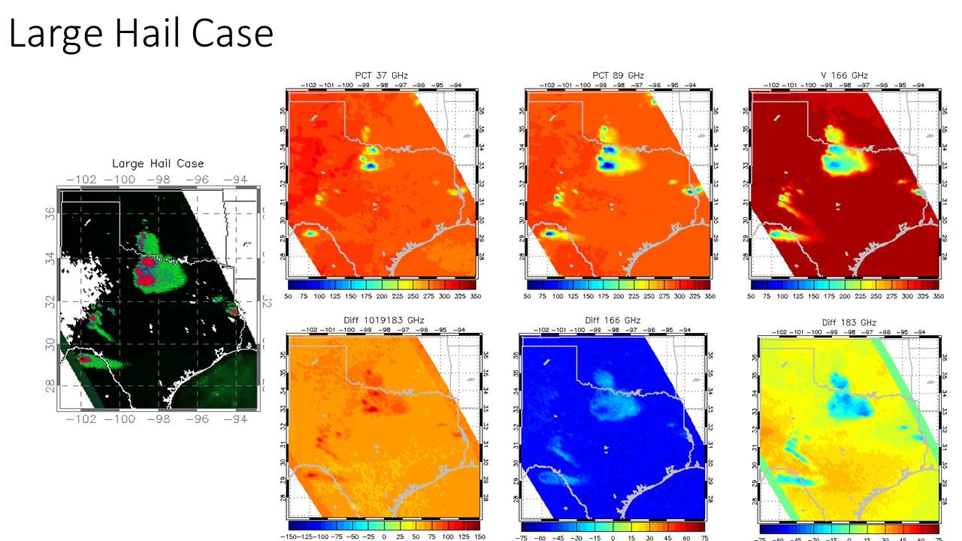
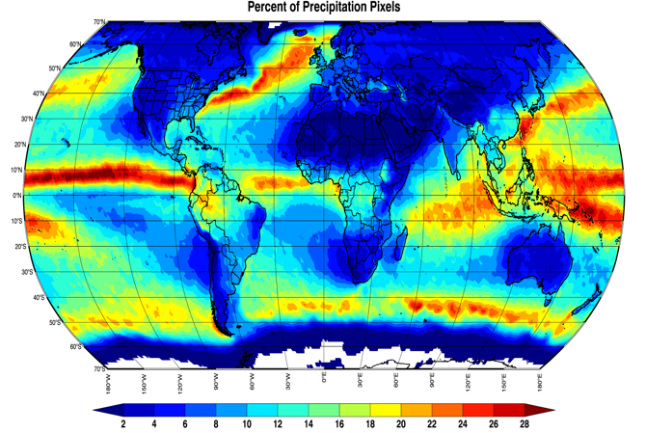
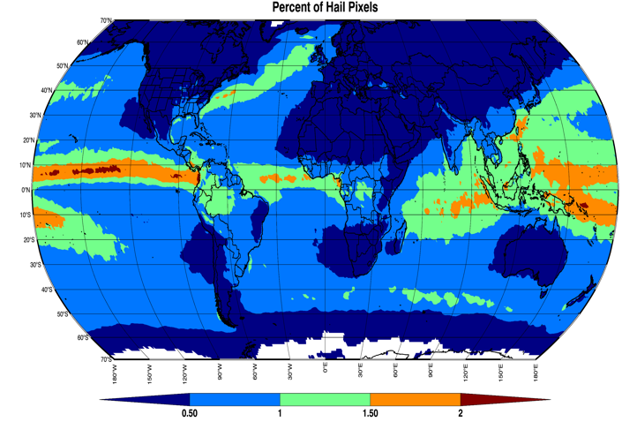
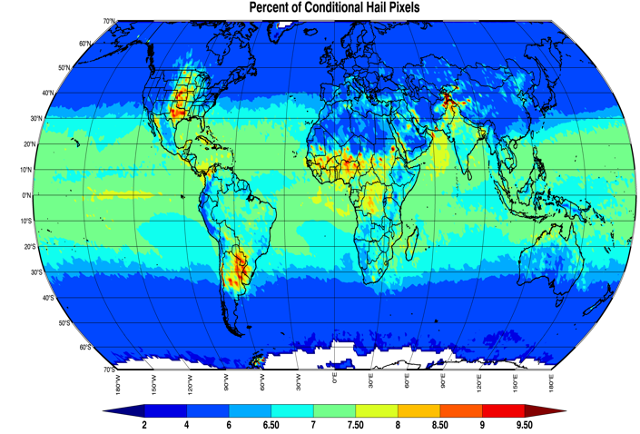
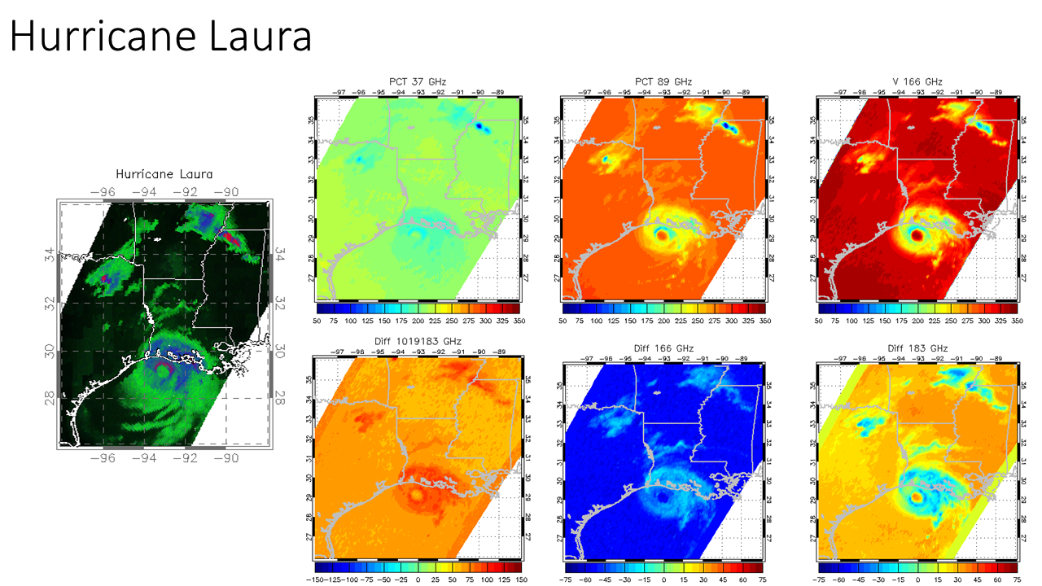
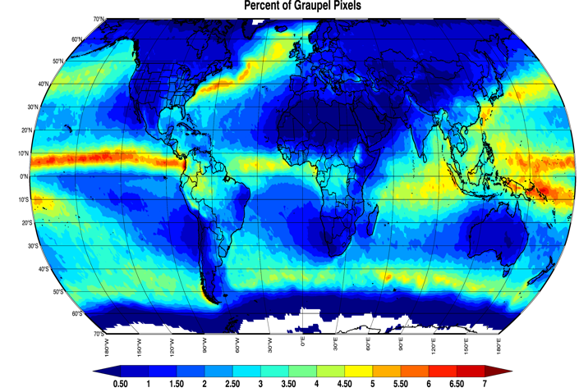
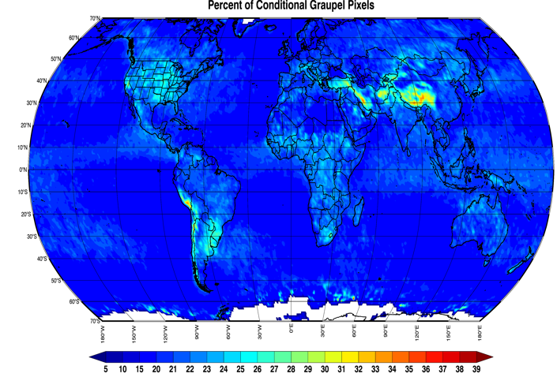
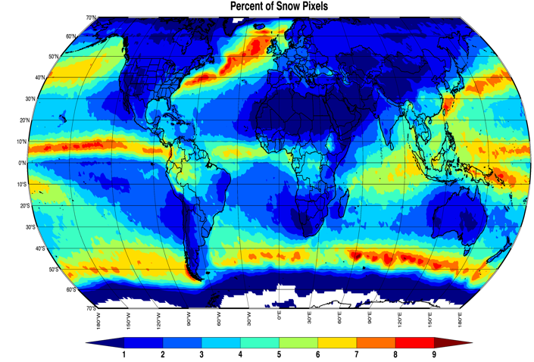
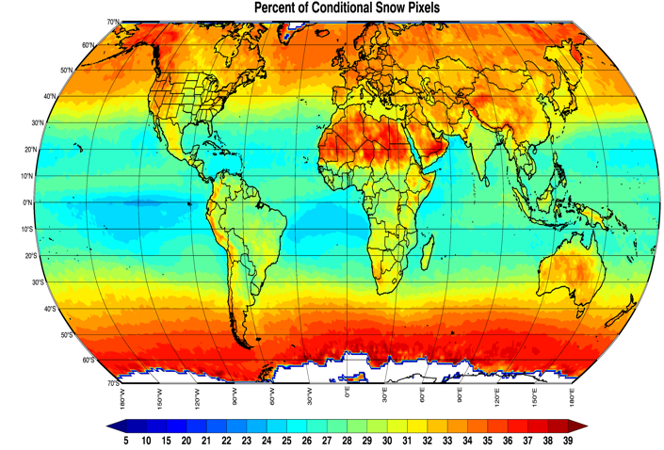
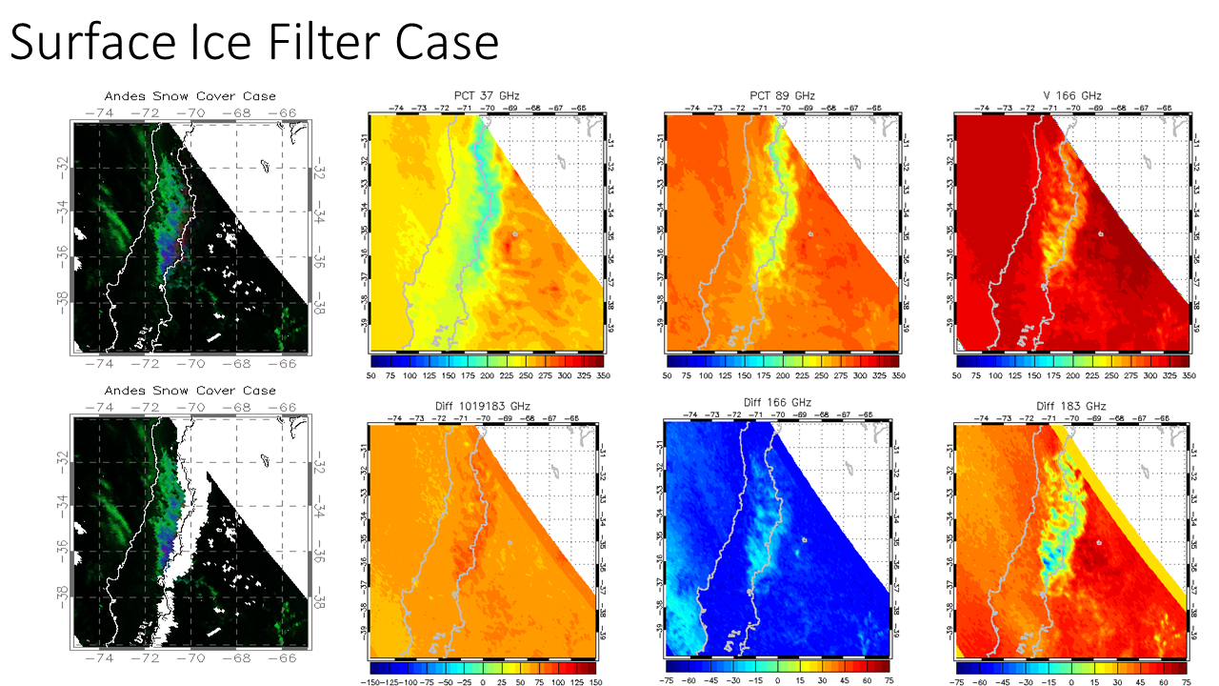
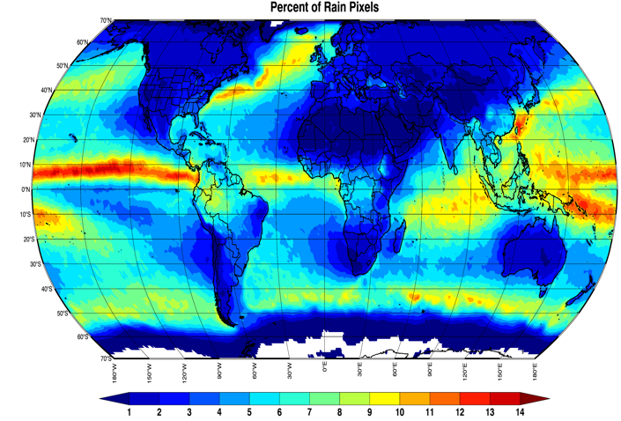
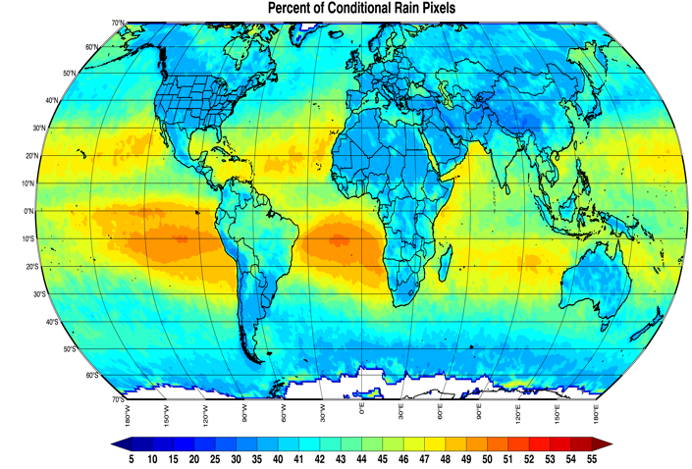
LEFT:
Total occurrence of each HID, accumulating the percentage HID probabilities from each GMI pixel. The plots are dominated by regions that receive frequent precipitation.
We might overestimate hail occurrence in some high-precip regions by accumulating a large number of low probability events.
Based on verification (bar plots), graupel is under-predicted and liquid rain over-predicted.
RIGHT:
Conditional probability of each HID, when precipitation is occurring (according to GPROF).
The top two plots highlight regions known to receive more hail and graupel.
The high percentage of rain and snow pixels located over generally arid locations is due to the conditional precipitation requirement.
Surface temperature > 5°C is used to screen out surface snow/ice.
Large Hail Case: Example
of severe hail over Northern Texas. GMI-Predicted HID and the brightness temperatures used for prediction. Lowest measured temperatures match the predicted hail locations.
Hurricane Laura: Note the difference between the red (or purple) shading in the eyewall and in the storms located over Northern Mississippi.
The brightness temperatures also show much colder values in the Mississippi storms than in the hurricane.
Ice/Snow Cover Filter:
The top HID plot does not include any filtering. The lower plot removed pixels with two-meter temperature < 5°C. This removes many pixels identified as hail/graupel or a mix of the two, and is applied for the climate maps.

