Slide 1
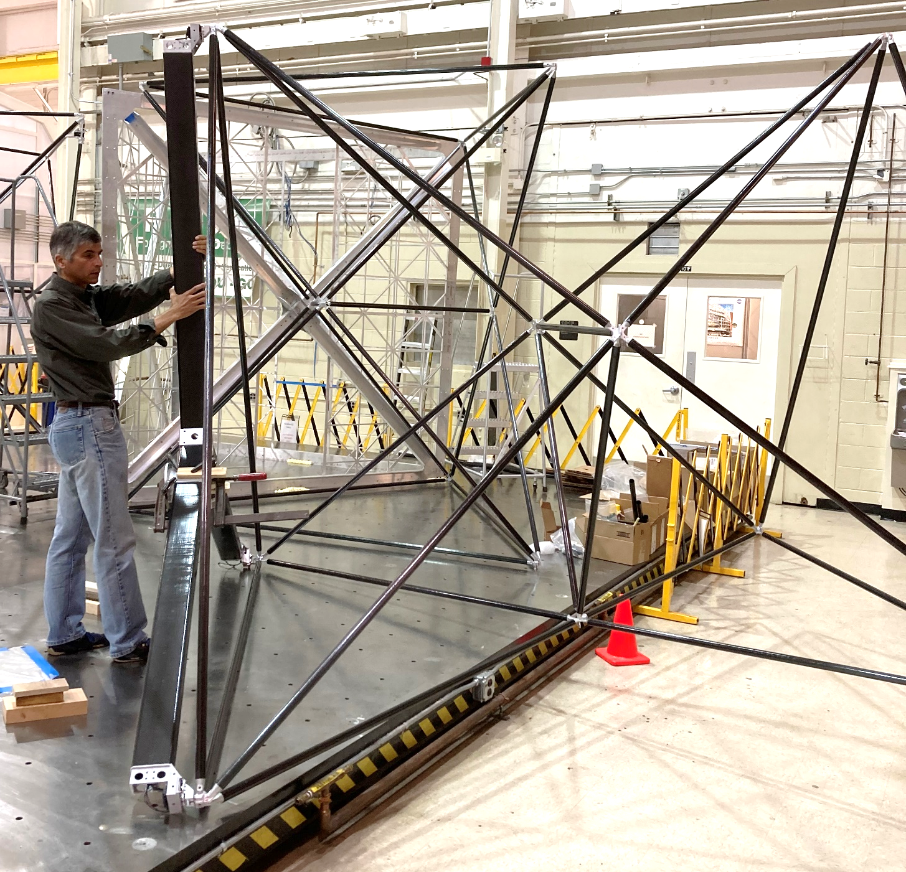
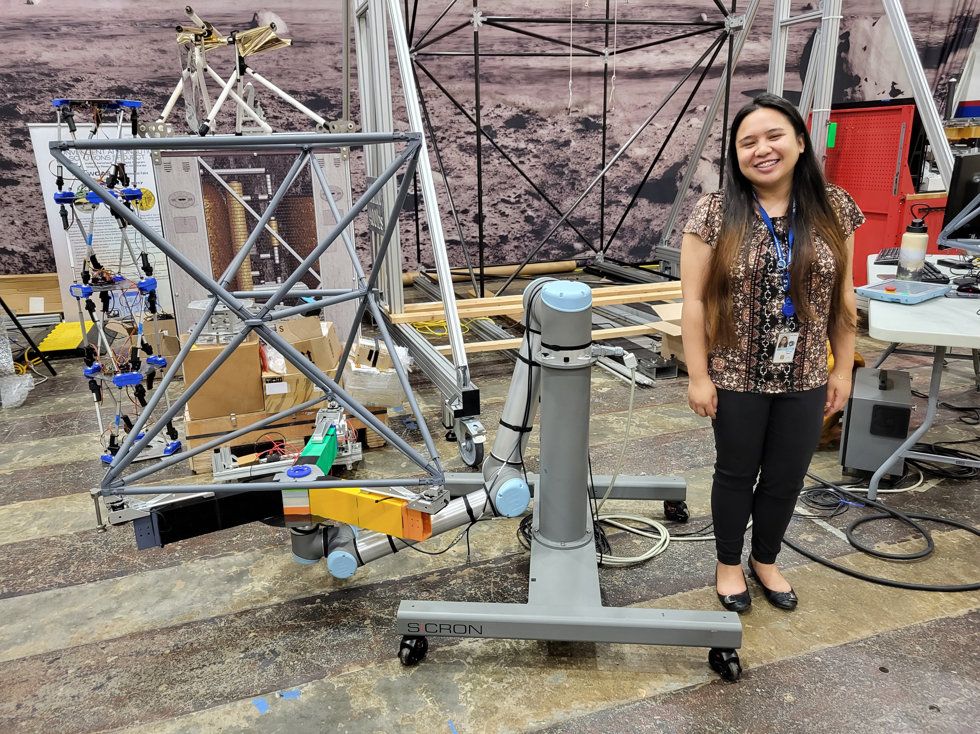
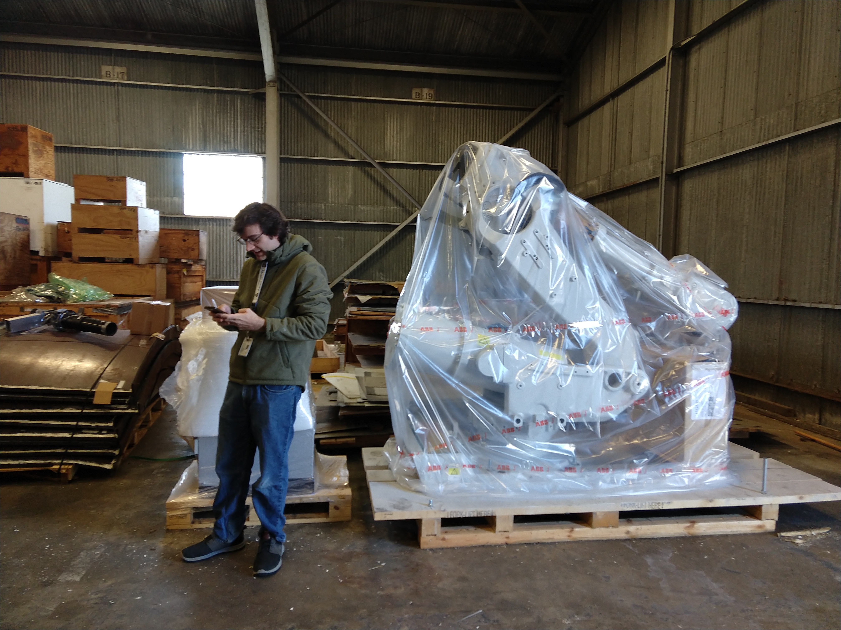
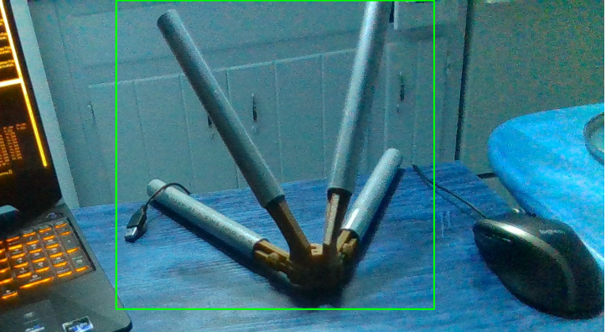
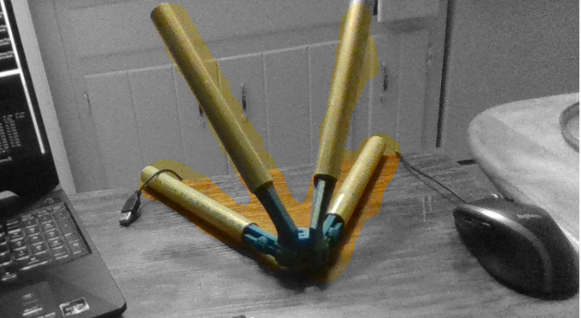
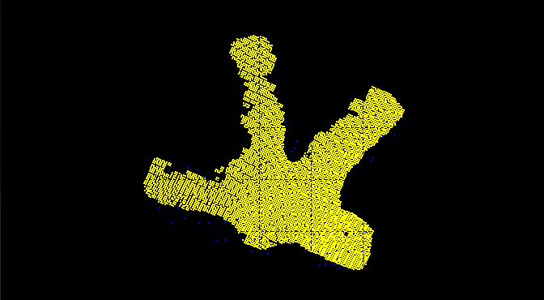
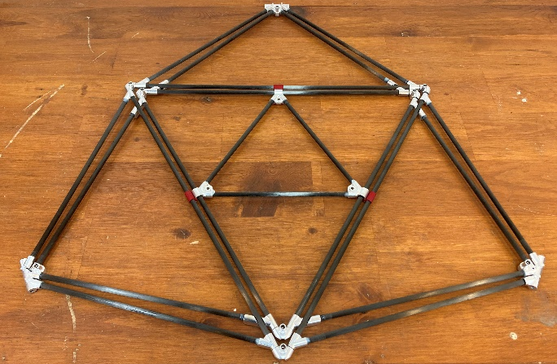
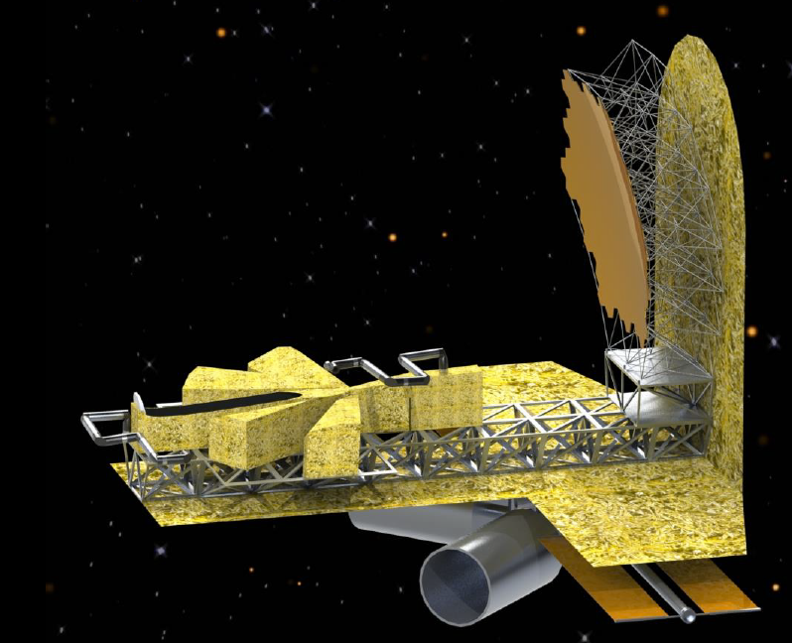
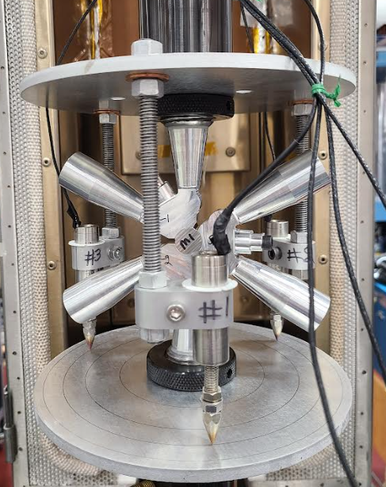
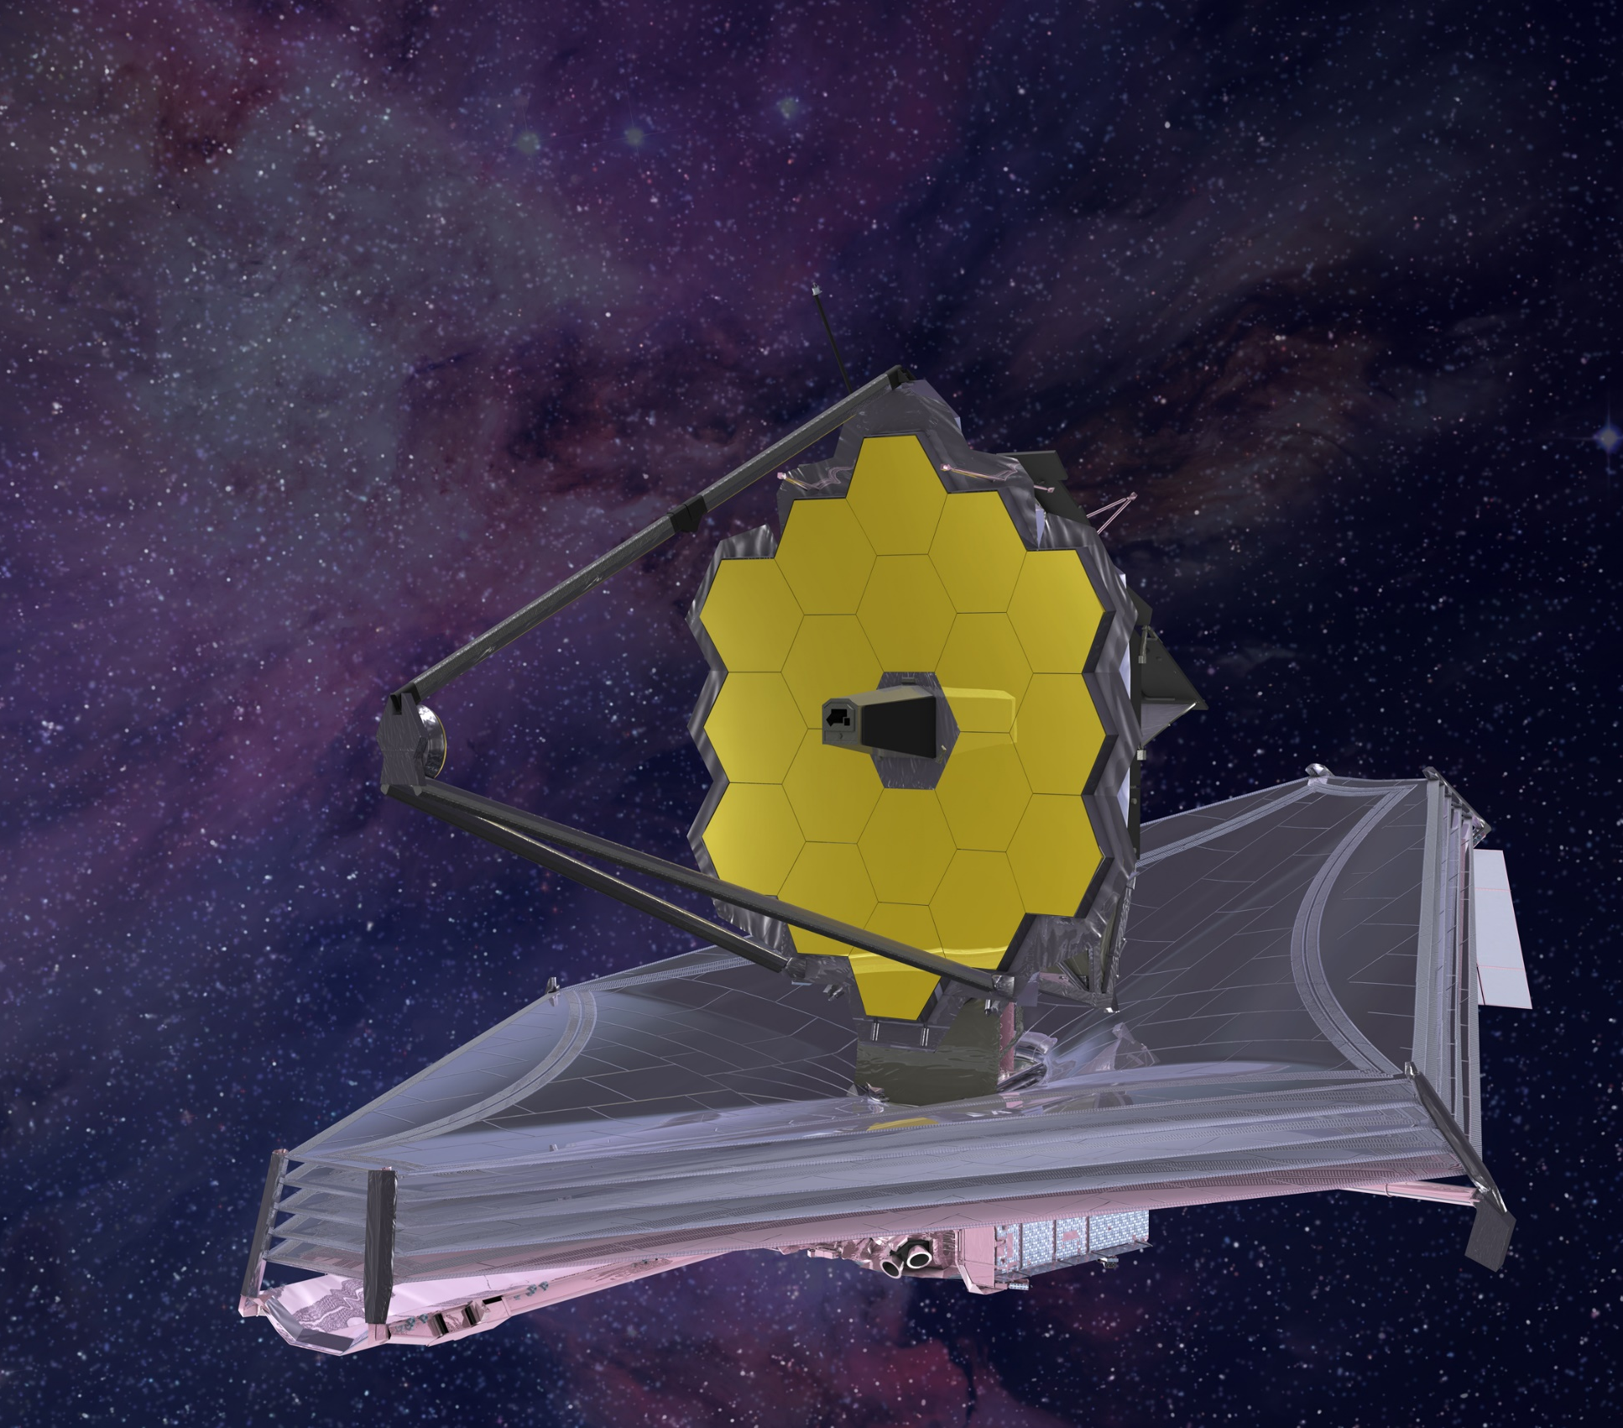
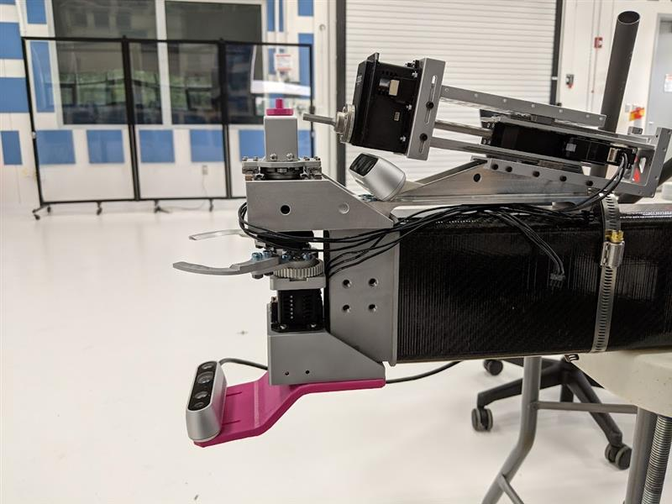
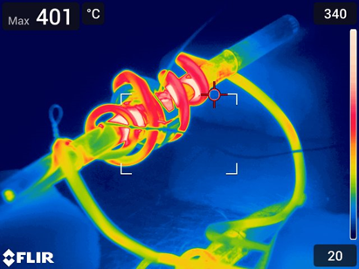
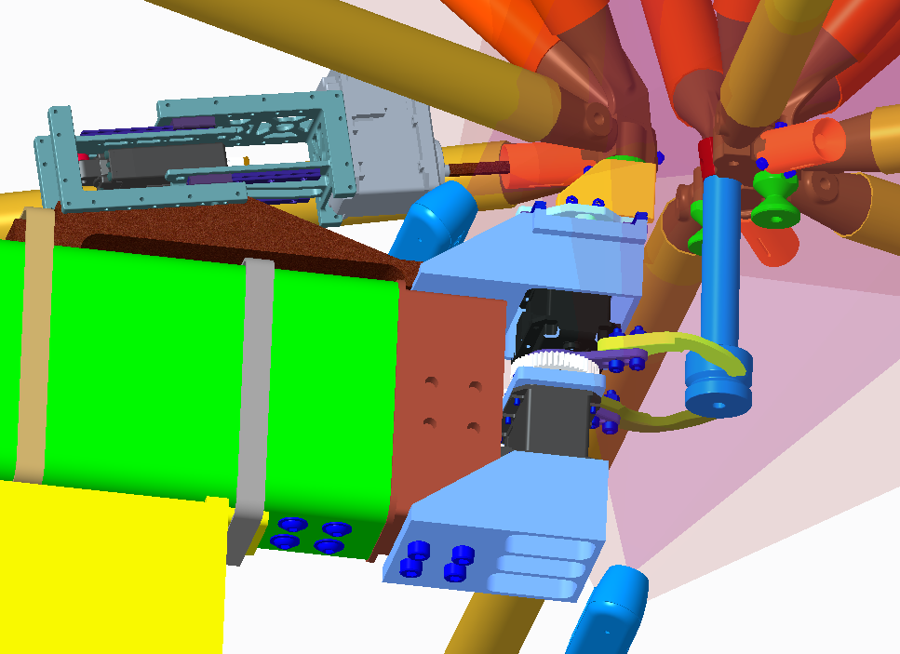
Precision Assembled Space Structure (PASS)
NASA Langley Research Center
The goal of PASS is to assemble a 20-meter-diameter, doubly-curved backbone structure suitable for a space telescope mirror.
Tri-Truss units
Subscale testing
Full-scale robot arm
The fundamental structural unit of composite tubes, manufactured with high precision in an assembly frame.
Bounding Box | Mask | Point Cloud
The structure will be autonomously assembled from Tri-Truss units by multiple cooperative robots using tools with onboard metrology
Stowable unit development
Structural testing and modeling
Requirement-driving case
James Webb Space Telescope: 6.5 m
Bolt driver
Camera
Grapple fingers
In-Space Assembled Telescope study: 20 m
Grapple
post
Capture post
Capture fingers grasp capture post for final alignment
Reversible thermal adhesive bonding (infrared image)
Electronics box
Camera
james.h.neilan@nasa.gov
Contact: olive.r.stohlman@nasa.gov

