Slide 1
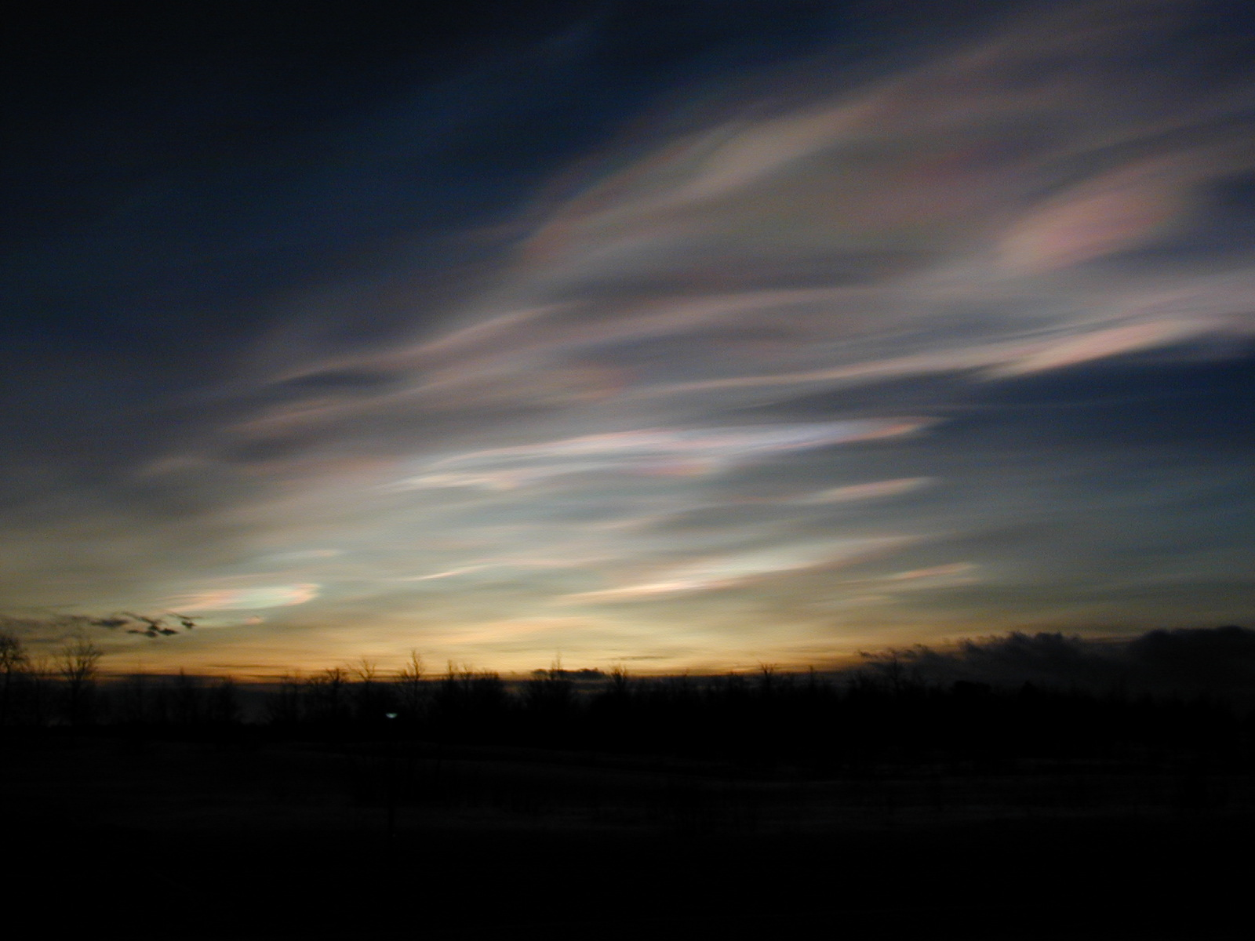
Improved Characterization of PSC Processes Derived from a Third-Generation
CALIOP and MLS Detection and Composition Classification Algorithm
Michael Pitts¹, Lamont Poole², Alyn Lambert³, Thibault Vaillant de Guélis⁴, Ines Tritscher⁵, Andrew Orr⁶, Simon Alexander⁷, and Lars Hoffmann⁵
¹NASA Langley Research Center, Hampton, Virginia; ²Space Systems LLC, Hampton, Virginia; ³Jet Propulsion Laboratory, Pasadena, California; ⁴Science Systems and Applications, Incorporated, Hampton, Virginia;
⁵Forschungszentrum Jülich, Jülich, Germany; ⁶British Antarctic Survey, NERC, Cambridge, UK; ⁷Australian Antarctic Division, Kingston, TAS, Australia
Kick-Off Meeting, Forschungszentrum Jülich
16-18 November 2022, Jülich, Germany

Slide 2
Project Summary
We will continue to advance the understanding of PSC processes through a unique combination of data from the CALIOP on the CALIPSO satellite and the MLS on the Aura satellite, in conjunction with supporting meteorological information and detailed modeling studies. The key objectives are:
  Adapt and optimize the 2D-McDA feature detection algorithm for CALIOP PSC detection.
  Develop an improved PSC composition and particle characterization algorithm that will utilize multiple parameters (e.g., CALIOP 532-nm parallel and perpendicular scattering ratios, CALIOP 1064-nm total scattering ratio, MLS HNO₃ and H₂O, ambient temperature, and temperature histories) in a Bayesian statistical approach.
  Produce and archive a third-generation (GEN3) CALIOP PSC product using the algorithms developed in (1) and (2).
  Investigate possible trends in PSC occurrence and composition over the entire CALIOP data record and through further comparisons with the SAM II PSC record from 1979-1989.
  Guide and validate the implementation of a mountain-wave parameterization scheme in the UM-UKCA CCM through detailed comparisons with CALIOP PSC products.

Slide 3
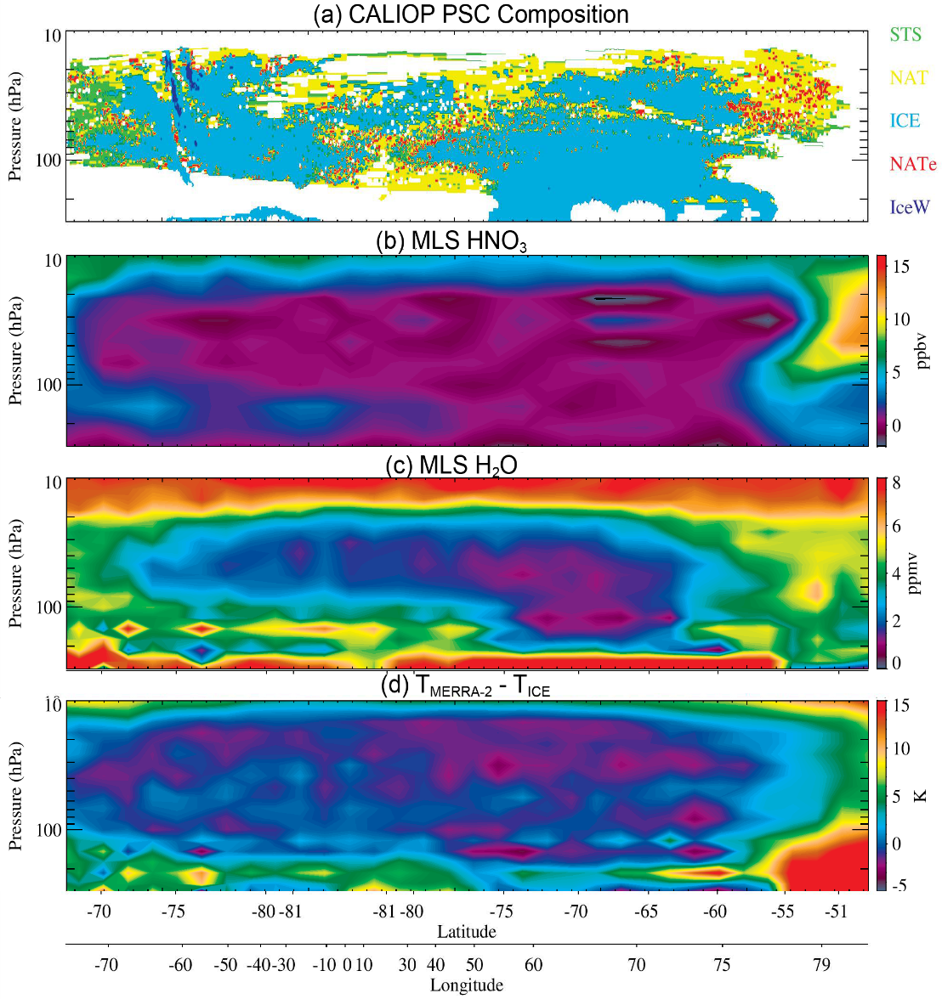
Strong Synergy Between MLS and CALIOP
The Gen3 algorithm will take advantage of the strong synergy between MLS and CALIOP for PSC studies. Since the Aura and CALIPSO spacecraft flew in formation as part of the afternoon “A-Train” satellite constellation from June 2006 until September 2018, the MLS and CALIOP measurements are nearly co-located in space and time, providing a unique view of PSC processes. The value of combining these co-located measurements for PSC analyses is illustrated in Figure 1 where panel (a) shows a CALIOP v2 PSC composition curtain and panels (b, c) show the Aura MLS HNO₃ and H₂O along the same orbit track. The strong correlation between the lidar and gas species measurements is clear. The MLS H₂O and HNO₃ data can also be used to calculate thermodynamic parameters such as the equilibrium formation temperatures of ice, T_{ice} (panel d), and nitric acid trihydrate (NAT), T_{NAT}.
Figure 1. (a) CALIOP PSC composition curtain along orbit track on 17 July 2008; (b-c) MLS HNO₃ and H₂O along the orbit track; (d) T_{MERRA-2} - T_{ice} along this orbit track.

Slide 4
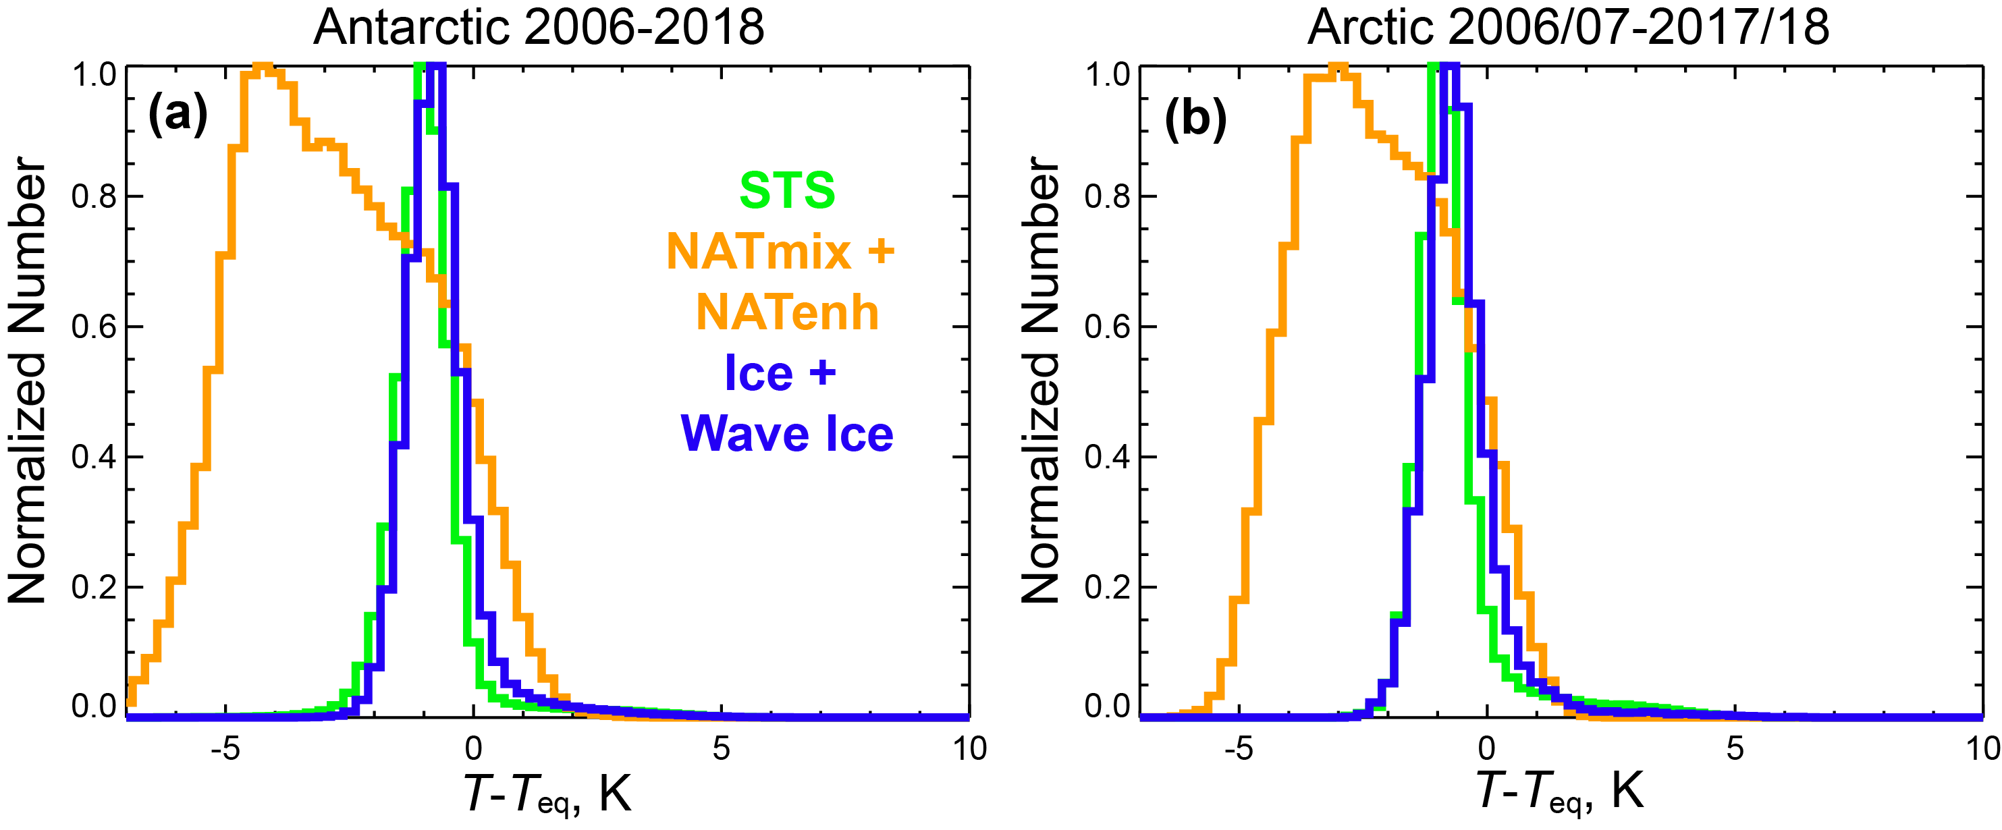
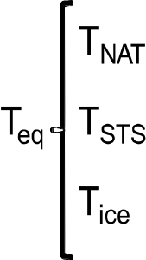
Strong Synergy Between MLS and CALIOP (2)
Combined analyses of the near-simultaneous and co-located CALIOP and MLS measurements also provide valuable insight into PSC formation and growth kinetics. Figure 2 shows histograms of CALIOP PSC observations by composition as a function of T–T_{eq} calculated using MLS gas-phase H₂O and HNO₃ data. Both supercooled ternary solution (STS) and ice PSCs are observed near thermodynamic equilibrium with the gas phase, as expected from theoretical considerations. However, the histogram of NAT mixture PSCs is bimodal in nature, with one mode near T_{NAT} and a second mode at lower temperatures about 3-4 K below T_{NAT} (or ≈ T_{STS}). Examining temperature histories along back trajectories from CALIOP observation points, Pitts et al. (2013) showed this bimodality is likely a consequence of different exposure times of air parcels to temperatures below T_{NAT}.
Figure 2. Histograms of CALIOP v2 PSC observations by composition at 21 km altitude from 13 Antarctic and 12 Arctic winters as a function of T – T_{eq}.

Slide 5
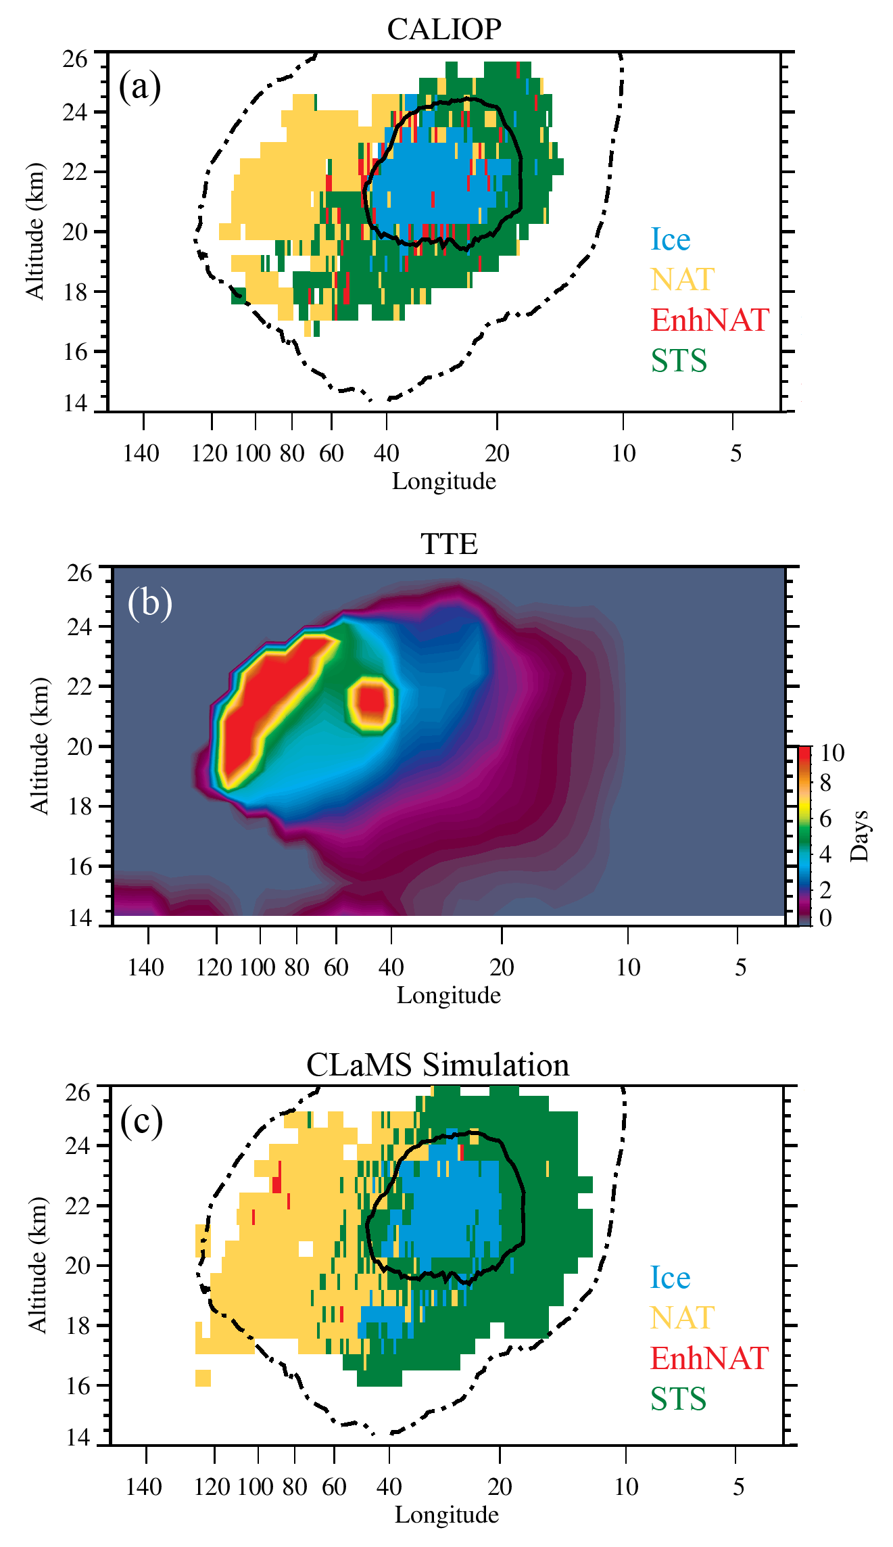
Strong Synergy Between MLS and CALIOP (3)
A key input to the Gen3 composition algorithm will be the air parcel temperature histories at each of the collocated CALIOP/MLS measurement locations. The strong connection between PSC composition and the temperature threshold exposure (TTE ≡ total time in days that an air parcel has remained consistently below T_{NAT}) is illustrated in Figure 3 where panel (a) shows a CALIOP PSC scene from the Arctic with the particle composition color-coded based on the v2 classification scheme with contours of T_{ice} (solid line) and T_{NAT} (dashed line) overlaid on the image for context. The scene consists of a core region of ice PSCs surrounded by regions of STS above and below and a region of NAT mixtures to the left of the ice core. Panel (b) shows the TTE calculated along the back trajectories ending at the CALIOP/MLS measurement locations. Locations within the region identified as NAT have large TTEs (> 4 days) that allow the NAT particles to grow sufficiently large to dominate the lidar optical signal. On the other hand, corresponding TTEs in the STS region are much shorter and any NAT particles present in this region would likely be small and masked (optically) by the STS droplets.
Figure 3. (a) CALIOP v2 PSC classification for a single satellite orbit on 18 January 2010. (b) Corresponding TTE calculated along back trajectories ending at the CALIOP measurement locations. The solid and dashed lines in panels (a) enclose the regions with temperatures below T_{ice} and T_{NAT}, respectively.

Slide 6
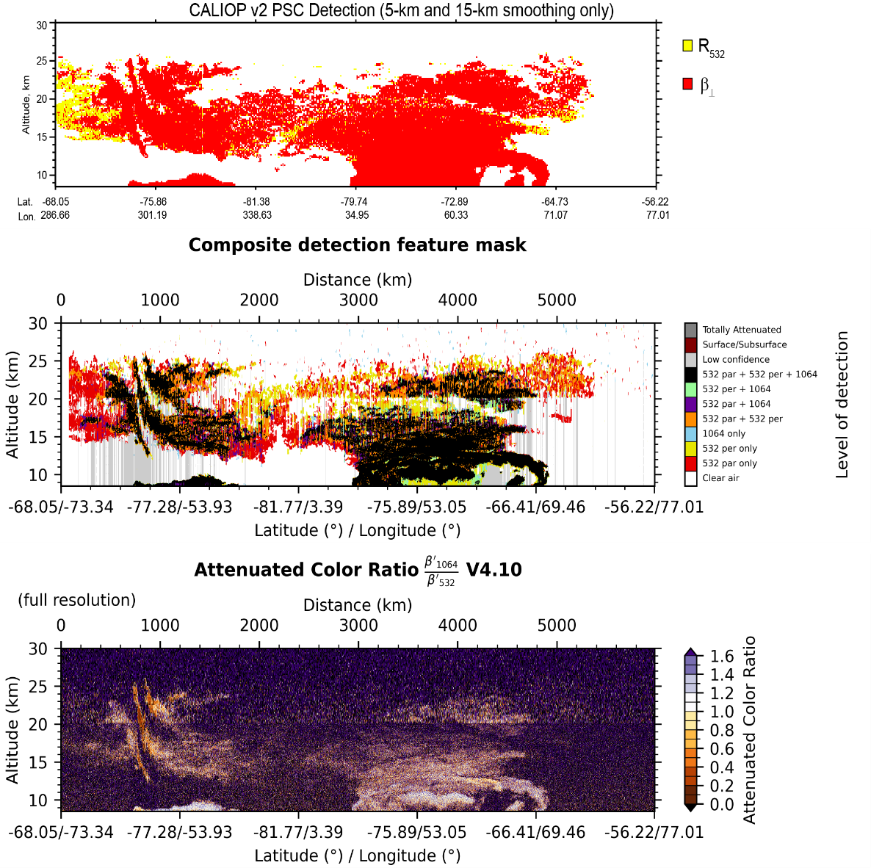
Two-Dimensional Multi-Channel PSC Detection Algorithm
We will adapt and optimize a new, more robust two-dimensional and multi-channel detection algorithm (2D-McDA, see Vaillant de Guélis et al., 2021) for detection of PSCs in our Gen3 algorithm. This context-sensitive feature finder algorithm is applied to a 2D lidar "scene"; i.e., to the image formed by many successive lidar profiles, and detects those features as outliers relative to the expected molecular backscatter component in all three CALIOP channels: 532 nm parallel, 532 nm perpendicular, and 1064 nm total. Figure 4a,b show the CALIOP v2 feature detection in the 17 July 2008 PSC scene and a first attempt (with no optimization) at detecting features with 2D-McDA along the same orbit track. Some portions of the PSC scene are detected with 2D-McDA using only the 532-nm channels (red, yellow, and orange points in Figure 4b), but the large regions color-coded in black show that additional information comes through incorporating the 1064-nm channel. Comparison with the v2 composition curtain in Figure 1a shows the primary composition of the black color-coded regions of the scene in Figure 4b is ice – for the synoptic-scale features - or wave ice for the three narrow, nearly vertical features near the left edge of the scene. Figure 4c shows the attenuated color ratio (β’₁₀₆₄/ β’₅₃₂). This ratio is significantly smaller in the wave ice clouds than in the synoptic scale ice PSCs, indicating that the 1064-nm data may provide additional information on the wave ice particle size distribution as an input to the Gen3 composition and particle characterization algorithm.
Figure 4. (a) CALIOP v2 PSCs detected using R₅₃₂ and β_{532, ⊥} along a 17 July 2008 orbit track; (b) Features detected by 2D-McDA along the same track, color-coded by CALIOP channel(s) used; (c) CALIOP measured attenuated color ratio (β’₁₀₆₄/ β’₅₃₂) along the same track.

Slide 7
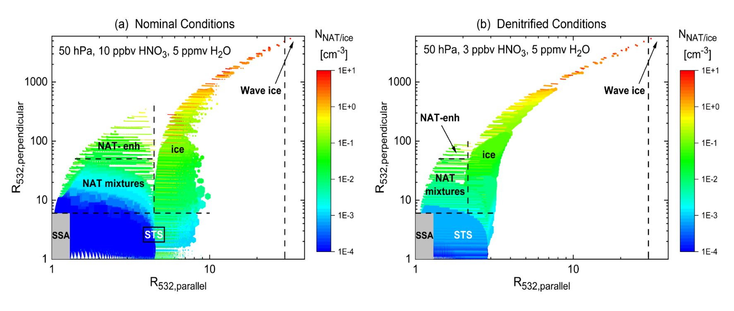
Multi-Parameter Composition and Particle Characterization
The R_{532, ⊥}, R_{532, ∥}, and R₁₀₆₄ lidar parameters used for PSC detection in 2D-McDA will be directly incorporated into the composition classification algorithm. Figure 5a shows temperature-dependent theoretical optical calculations plotted in the new R_{532, ⊥} vs. R_{532, ∥} optical coordinate system for non-equilibrium mixtures of SSA or STS droplets and NAT or ice particles under nominal stratospheric conditions. Utilizing the 2D-McDA coordinates (R_{532, ⊥} vs. R_{532, ∥}) instead of the v2 coordinates (β_{532, ⊥} vs. R₅₃₂) will allow for a cleaner separation between spherical and non-spherical particles since only the latter contribute to increases in R_{532, ⊥}. Figure 5b shows analogous optical calculations for denitrified conditions. Note that the parameter space occupied by STS and the NAT mixtures is considerably smaller than that for non-denitrified conditions, illustrating the essential role that knowledge of HNO₃ and H₂O abundances from the collocated MLS observations will have in establishing the boundary between NAT (and enhanced NAT) mixtures and ice PSCs in the Gen3 algorithm.
Figure 5. CALIOP Gen3 PSC theoretical optical calculations at 50 hPa for (a) nominal levels of HNO₃ and H₂O; and (b) denitrified conditions.

Slide 8
Chemical Lagrangian Model of the Stratosphere (CLaMS)
The R_{532, ⊥}, R_{532, ∥}, and R₁₀₆₄ lidar parameters used for PSC detection in 2D-McDA will be directly incorporated into the composition classification algorithm. Figure 5a shows temperature-dependent theoretical optical calculations plotted in the new R_{532, ⊥} vs. R_{532, ∥} optical coordinate system for non-equilibrium mixtures of SSA or STS droplets and NAT or ice particles under nominal stratospheric conditions. Utilizing the 2D-McDA coordinates (R_{532, ⊥} vs. R_{532, ∥}) instead of the v2 coordinates (β_{532, ⊥} vs. R₅₃₂) will allow for a cleaner separation between spherical and non-spherical particles since only the latter contribute to increases in R_{532, ⊥}. Figure 5b shows analogous optical calculations for denitrified conditions. Note that the parameter space occupied by STS and the NAT mixtures is considerably smaller than that for non-denitrified conditions, illustrating the essential role that knowledge of HNO₃ and H₂O abundances from the collocated MLS observations will have in establishing the boundary between NAT (and enhanced NAT) mixtures and ice PSCs in the Gen3 algorithm.
Figure 6. CLaMS simulation of PSCs for the CALIOP orbit on 18 January 2010.

Slide 9
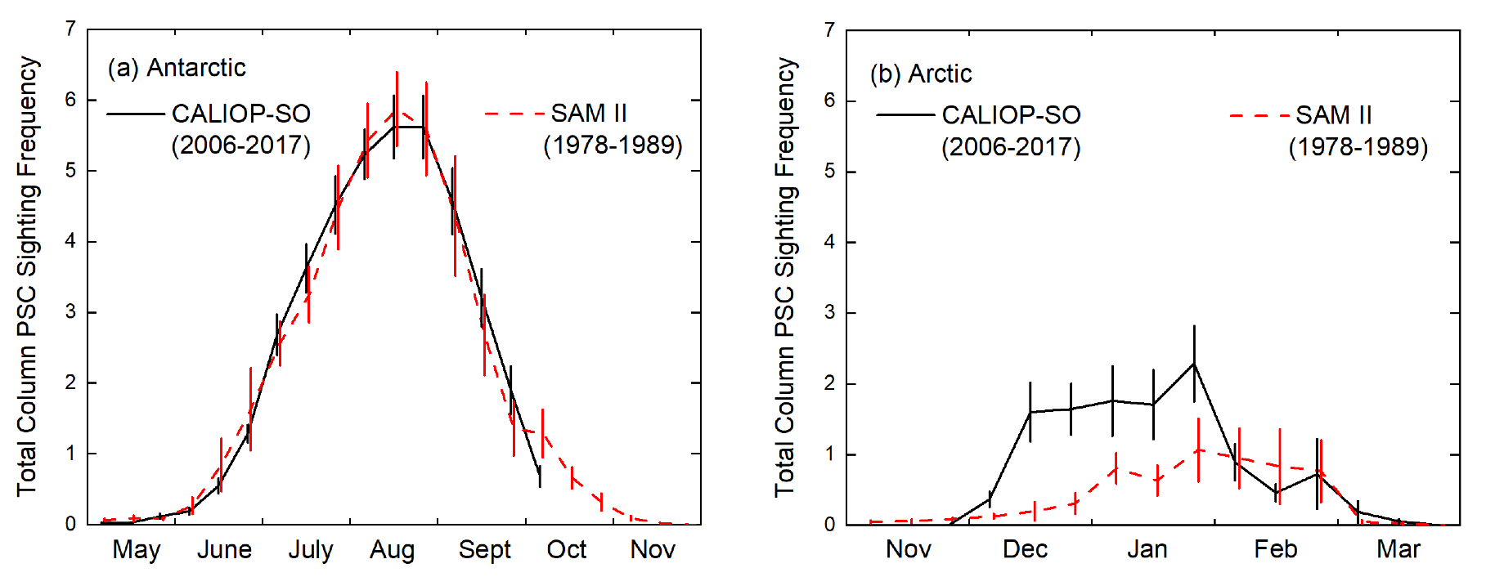
Multi-Decadal Trends in PSCs
Comparison of PSC sighting frequencies from CALIOP and the Stratospheric Aerosol Measurement (SAM) II solar occultation instrument (Tritscher et al., 2021) showed that over decadal timescales, Antarctic PSC coverage is very similar between the CALIOP (2006-2017) and SAM II (1979-1989) eras, whereas there appears to have been a systematic increase with time in Arctic PSC occurrence in December and January (see Figure 7).
We will extend the CALIOP/SAM II trend analyses to include the full CALIOP data record and further investigate the apparent upward trend in Arctic PSCs. In addition, we will also examine the 15+ year CALIOP PSC record itself for indications of trends in other PSC characteristics such as composition. We will also investigate potential drivers of any observed trend. For example, is there observational evidence of an increase in polar stratospheric water vapor and/or decrease in temperature? Is the CALIOP Arctic PSC record consistent with findings in the recent von der Gathen et al. (2021) and Feng et al. (2021) studies?
Figure 7. (a) Antarctic and (b) Arctic PSC column occurrence frequencies for CALIOP and SAM II along with 1-σ uncertainties in the means.

Slide 10
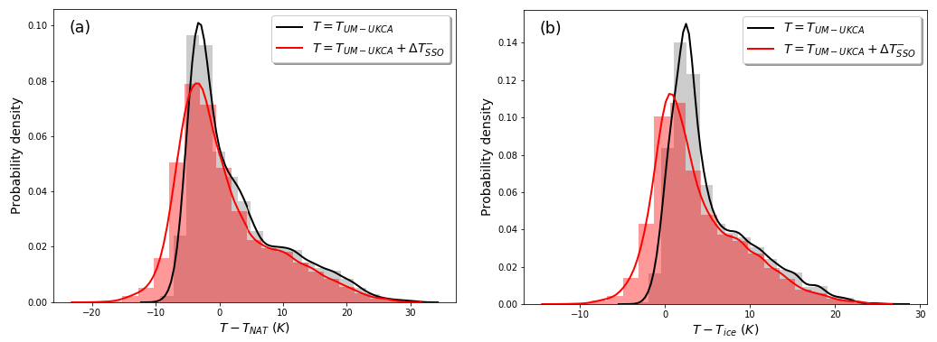
Modeling the Effects of Mountain-Wave-Induced PSCs
Orr et al. (2020) showed that the inclusion of a mountain-wave parameterization scheme into the UM-UKCA CCM had a significant impact on the frequency and magnitude of temperature perturbations below T_{NAT} and T_{ice} (see Figure 8) and resulted in considerable improvements to the simulated polar ozone chemistry and climate. Building on this work, we will expand the investigations of the impact of mountain wave PSCs on ozone destruction with the UM-UKCA model to include vortex-wide processes and into the Arctic where mountain wave forcing is particularly important. The Gen3 CALIOP PSC products will serve as the primary validation tool to evaluate and guide the implementation of the PSC parameterization in the model.
Figure 8. Comparison of the probability distributions of the temperature differences (K) for (a) T - T_{NAT} and (b) T - T_{ice} over the Antarctic Peninsula in the UM-UKCA CCM, where T is the temperature computed with the mountain-wave-induced stratospheric cooling included (red line) and not included (black line) at an altitude of 20.4 km for the combined months of May to October.

Slide 11
References
Feng et al. (2021) Arctic ozone depletion in 2019/20: Roles of chemistry, dynamics and the Montreal Protocol, Geophys. Res. Lett., 48, https://doi.org/10.1029/2020GL091911, 2021.
Grooß et al. (2014) Nitric acid trihydrate nucleation and denitrification in the Arctic stratosphere, Atmos. Chem. Phys., 14 (2), 1055–1073, doi:10.5194/acp-14-1055-2014, 2014.
McKenna et al. (2002a) A new Chemical Lagrangian Model of the Stratosphere (CLaMS): 1. Formulation of advection and mixing, J. Geophys. Res., 107, 4309, doi: 10.1029/2000JD000114, 2002a.
McKenna et al. (2002b) A new Chemical Lagrangian Model of the Stratosphere (CLaMS): Part II Formulation of chemistry-scheme and initialisation, J. Geophys. Res., 107, 10.1029/2000JD000 113, 2002b.
Orr et al. (2015) Inclusion of mountain wave-induced cooling for the formation of PSCs over the Antarctic Peninsula in a chemistry-climate model, Atmos. Chem. Phys., 15, 2015.
Orr et al. (2020) PSCs initiated by mountain waves in a global chemistry-climate model: A missing piece in fully modelling polar stratospheric ozone depletion, Atmos. Chem. Phys., 20, 12,483-12,497, 2020.
Pitts et al. (2013) An assessment of CALIOP polar stratospheric cloud composition classification, Atmos. Chem. Phys., 13, 2975-2988, 2013.
Spang et al. (2016) A multi-wavelength classification method for polar stratospheric cloud types using infrared limb spectra, Atmos. Meas. Tech., 9 (8), doi:10.5194/amt-9-3619-2016.
Tritscher et al. (2019) Lagrangian simulation of ice particles and resulting dehydration in the polar winter stratosphere, Atmos. Chem. Phys., 19, 543–563, doi: 10.5194/acp-19-543-2019.
Tritscher et al. (2021) Polar Stratospheric Clouds: Satellite Observations, Processes, and Role in Ozone Depletion, Rev. Geophys., https://doi.org/10.1029/2020RG000702, 2021.
Vaillant de Guélis et al. (2021) Two-dimensional and multi-channel feature detection algorithm for the CALIPSO lidar measurements, Atmos. Meas. Tech., 14, 1593-1613, doi:10.5194/amt-14-1593-2021, 2021.
von der Gather et al. (2021) Climate change favours large seasonal loss of Arctic ozone, Nature Commun., 12, 3886, https://doi.org/10.1038/s41467-021-24089-6, 2021.

