Slide 1


Open and Collaborative Science
SatSummit, 2022
Dr. Rahul Ramachandran
Manager | Inter-Agency Implementation and Advanced Concepts Team (IMPACT)
Senior Research Scientist | Earth Science Branch (ST11)
Marshall Space Flight Center/NASA
Huntsville, Alabama 35812, USA

Slide 2
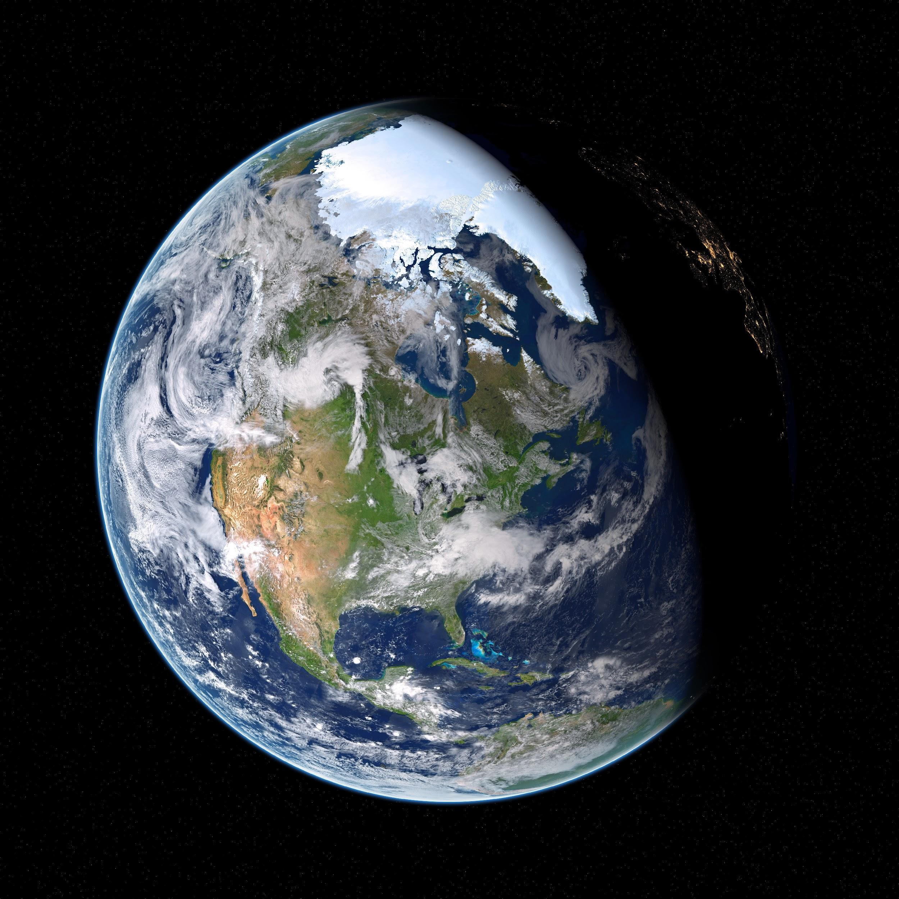
Open Science Definition(s)
Open science definitions
Open science is the idea that scientific knowledge of all kinds be openly shared as early as is practical in the discovery process (Narrow)
Open science can be defined as any activity that covers anything about the future of knowledge creation and dissemination (Broad)
“open science as a collaborative culture enabled by technology that empowers the open sharing of data, information, and knowledge within the scientific community and the wider public to accelerate scientific research and understanding”
- Ramachandran, R., Bugbee, K., & Murphy, K. J. (2021). Moving from Open Data to Open Science. Earth and Space Science, (Gold Access Journal), Wiley Publication
https://www.pexels.com/photo/astronomy-cosmic-cosmos-dark-355935/

Slide 3
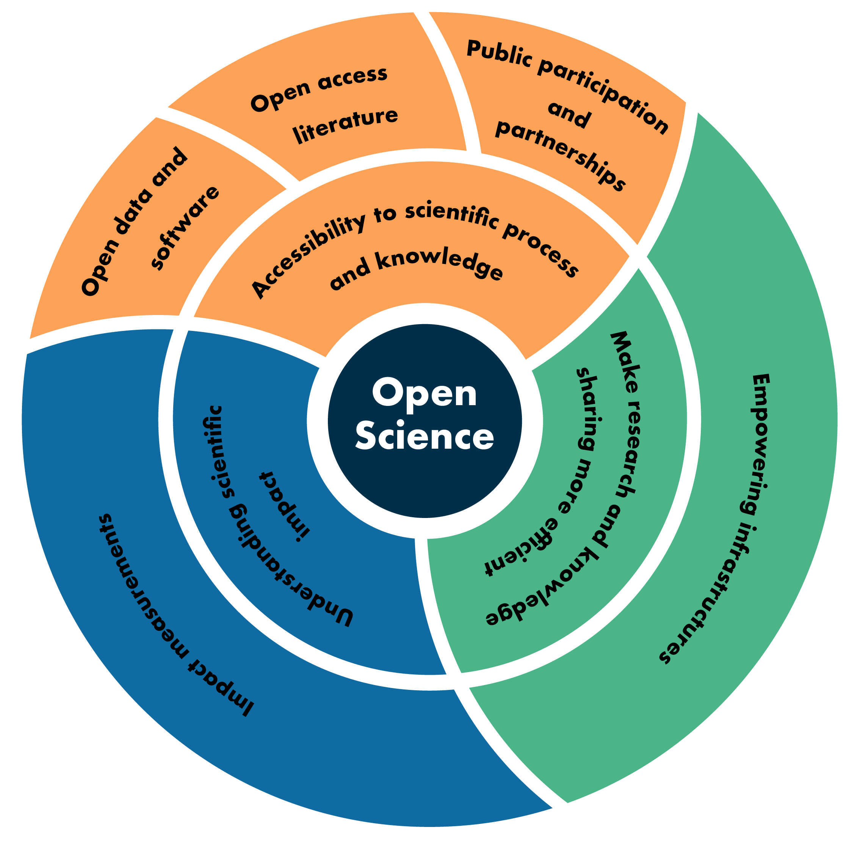
Open Science Areas
Accessibility to science
Science as a way of thinking
Science as a body of knowledge
Efficient research processes and knowledge dissemination
Cyberinfrastructure to support science
Collaborations
Understanding scientific impact

Slide 4




NASA’s Open-Source Science Initiative
Unlocking the full potential of a more equitable, impactful, efficient, scientific future
Policy development, education, compliance tools
Updating NASA science policies on scientific information to better enable the activation of open science (eg. SPD-41a)
Core Services for Science Discovery
Developing core data and computing services to enable open science
ROSES Elements
Supporting open-source software, tools, frameworks, libraries, platforms, and training with over $5 million dollars in grants per year
Community Building & Partnerships - Transform to Open Science (TOPS)
Accelerating adoption of open science and expanding participation of marginalized communities in science
Builds on concepts from open-source software, expanding participation in developing code, applying to the scientific process to accelerate discovery by openly conducting science from project initiation through implementation.

Slide 5
2023 Year of Open Science
High level visibility
Conference | Date | Size | BPS | PDS | Helio | Earth | Astro | HUGS*
AGU Fall | Dec | 25K | x | x | x | x | x
AMS/AAS | Jan | 6K |  |  | x | x
AAAS | Mar | 9K | x | x | x | x | x
LPSC | Mar | 2K |  | x
EGU | Apr | 18K | x | x | x | x | x
AAS | Jun | 3K |  | x | x |  | x
IGARSS | Jul | 3K |  |  |  | x
Soc. Asian Sci&Eng | Oct | 3K |  |  |  |  |  | x
Amer. Indian Sci&Eng | Oct | 2K |  |  |  |  |  | x
SACNAS | Oct | 6K |  |  |  |  |  | x
ASGSR | Nov | 1K | x
AGU Fall | Dec | 25K | x | x | x | x | x
Targeted workshops | May/Sep | 200 |  |  |  |  |  | x
Totals |  | ~100K | 5 | 6 | 6 | 6 | 5 | 4
Publications, articles, working TOPS into HQ comms
Announce new open science awards
Announce recognition of open science activities
Conferences
Targeting domestic meetings (EGU only exception)
TOPS representation at NASA booth, town halls, OpenCore workshop, high-visibility in society comms and at conference
We will also be at other meetings - eg. AAS winter with TOPS champions organizing activities and workshops (with support)
Virtual cohorts
Learners who complete part of OpenCore will be followed up with and enrolled in virtual cohorts to encourage completion
Summer schools
3-4 institutions funded to run 6-8 weeks of OpenCore / Science Team summer schools - train entire science teams in 1 week.
Targeted workshops
In-person, with strong outreach to historically underrepresented communities to learn open science and build community
*HUGS- historically underrepresented groups

