Slide 1
The Laser Interferometer Space Antenna (LISA): Current plans and prospects for quantum sensing in future space-based gravitational wave observatories
Jeff Livas
ªNASA-GSFC, 8800 Greenbelt Rd, Greenbelt, MD-20771, USA;
NASA Quantum Sensing Workshop
Sep 29, 2022

Slide 2
Space-based GW Now
LISA
  ESA led mission with NASA contributions
  Targeting mission adoption in 2023
  for launch in 2035, operating 4-10 years.
China
  Multiple missions under consideration
  LISA "clone" possible in 2030s
2020 Decadal
  Strong endorsement of LISA
  Strong endorsement of multi-messenger science objectives
  NASA asked for no recommendation on future GW missions and got none.

Slide 3
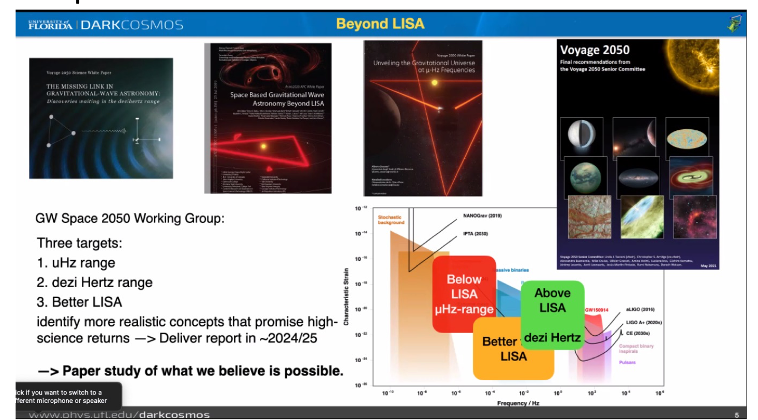
GW Space 2050
Slide Credit: Guido Mueller

Slide 4
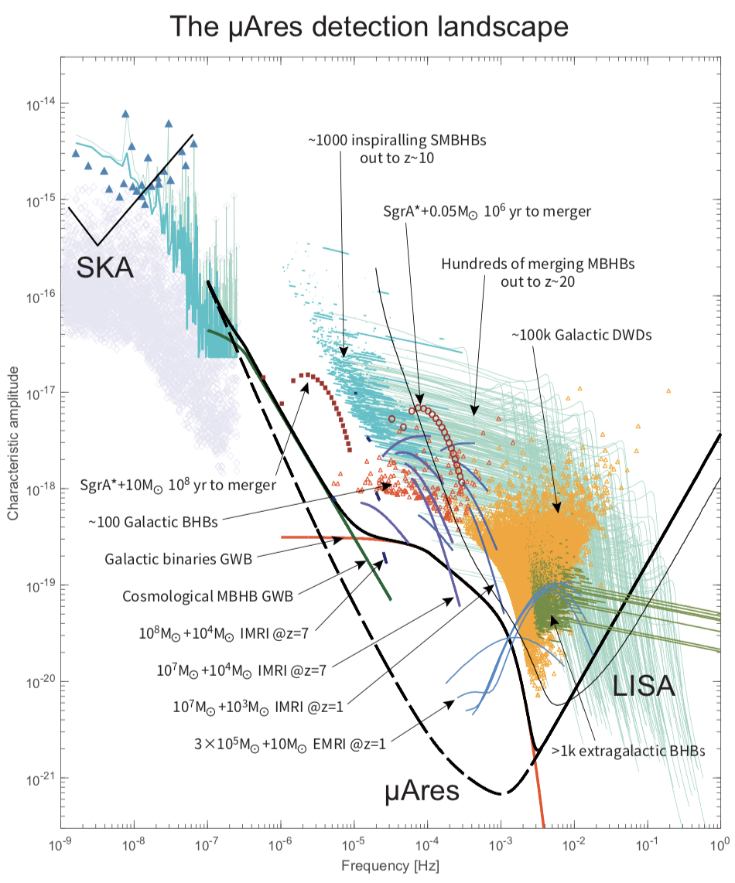
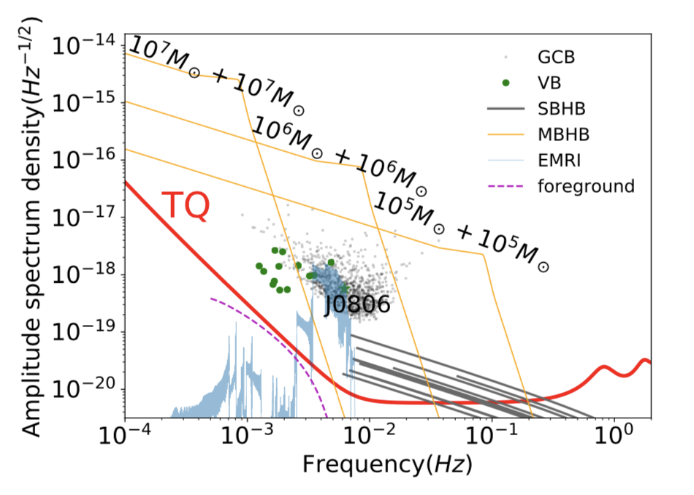
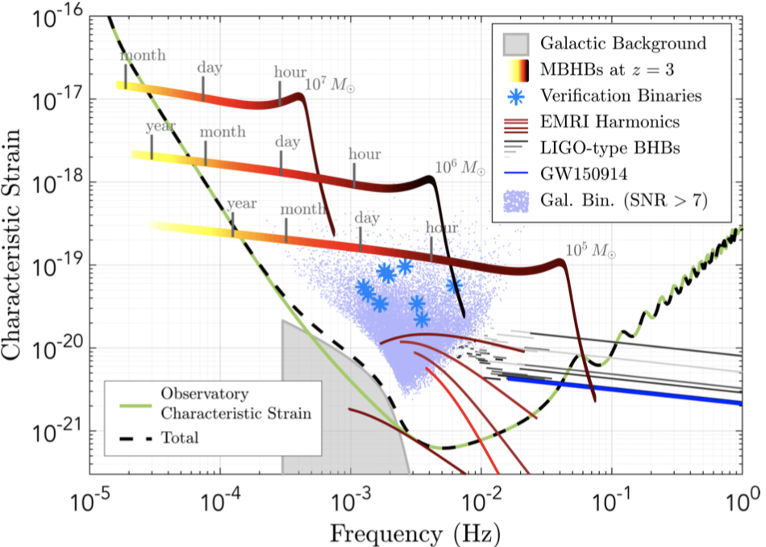
Some mHZ-GW science directions beyond LISA
天琴(Tian Qin): A Chinese
mission targeting a higher
frequency band
µARES: A sketch concept
proposed for ESA’s Voyage2050
study, targeting lower band.
LISA: Selected ESA Project
with 20-25% US contribution.
Well-studied science case

Slide 5
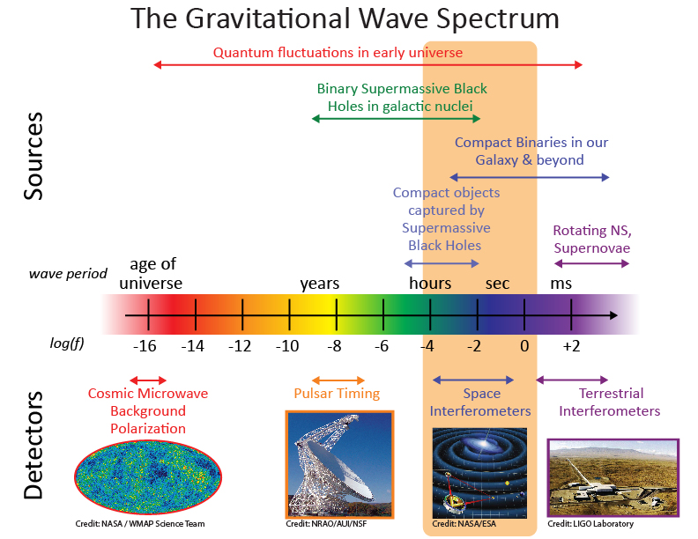
LISA Science Context
Why is LISA important?
Space-based measurement of gravitational waves (GW) is complementary to ground-based GW observatories
Rich array of sources both long-lived and transient
Observations with electromagnetic counterparts (ground and space) offer more complete understanding of the astrophysics
Sources are very high energy and therefore an important part of the Universe’s origin and evolution

Slide 6
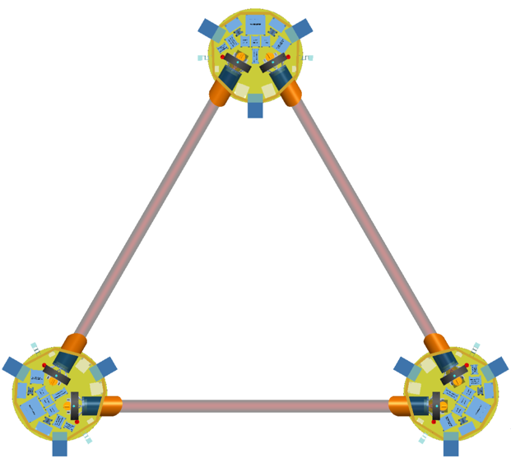

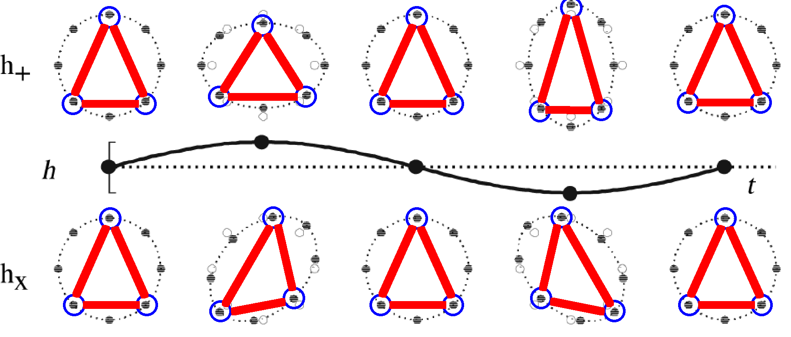

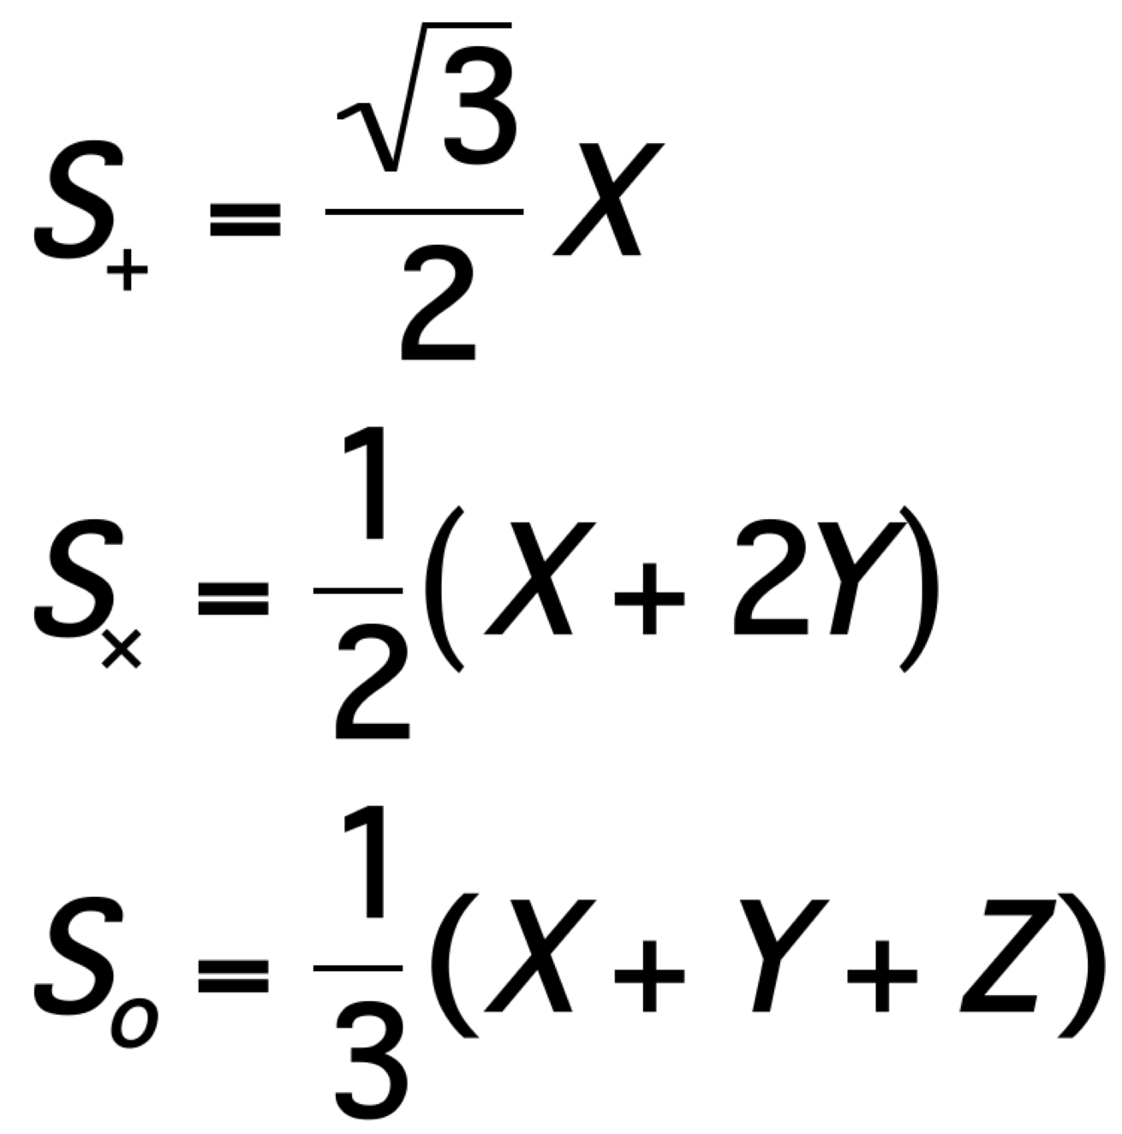
LISA Mission Summary
Mission Design
Three satellites in an equilateral triangle formation with arm lengths of ~2.5 million km.
Any two arms of this triangle represent a Michelson-type interferometer.
Gravitational waves deform space-time and can be detected as a change in the length of the interferometer arms (~ 10 pm/Hz^{1/2}).
Baseline 4 year lifetime + 6 years goal
    Limited by communications bandwidth
LISA Layout
Z
GW polarization
2.5 million km
+
X
“plus”
“cross”
“sagnac”
X
Y
Constellation Response
Heliocentric orbit
plus
2.5 X 10⁶ km
cross
sagnac: No GW response. Allows noise measurement.
Constellation Triangle rotates once per year as it orbits
Notes:
The Sagnac mode is not sensitive to gravitational waves and is analgous to blocking the aperture for an optical telescope making images of the sky. It allows a measurement of the noise floor.

Slide 7
LISA Mission Timeline
Date | Milestones
October 2013 | The “Gravitational Universe” selected as the science theme for the 3rd ESA flagship mission (L3)
June 2016 | LISA Pathfinder reports Sub-Femto-g test mass acceleration performance
October 2016 | Call for L3 mission proposals
June 2017 | Selection of LISA as L3 with a nominal 2034 launch
May 2018 | (ESA) Phase A kick-off
2018-2021 | LISA mission Phase A
Oct 2020 – Oct 2021 | Phase A Extension
<end 2021 | Formulation Review and Phase A end
>2021 | Mission Phase B
Nov 2023 | Mission Adoption
Adoption | Mission Implementation (Phase B2/C/D)
~2035 | Nominal Launch
Launch | Science operations (4 year baseline)
We are here
Need to show EDU TRL-6 at adoption

Slide 8
Inter-Spacecraft Distance Measurement
Test-mass to test-mass measured in 3 parts:
  2 × test-mass to spacecraft measurements (short-arm: LPF tests this)
  1 × spacecraft to spacecraft interferometer (long-arm)
  total separation = d₁ + d₁₂ + d₂
Spacecraft 1
d₁₂ = ~ 1-5 x 10⁶ km
Spacecraft 2
Optical Bench
Optical Bench
~ 1W Tx
~100 pW Rx
Proof Mass
Proof Mass
d₁
d₂
LO
Tx
Tx
LO
Main interferometer
telescopes
Quad photodetector
~ 0.5 m
~ 0.5 m

Slide 9
Mission Sensitivity Limits
Frequency noise → TDI
Tilt-to-length → post processing, jitter reduction
Shot noise – more laser power

Slide 10
Naïve quantum limit
Balance laser power against back-reaction forces
For LISA, required power is large

Slide 11
Possible Quantum Sensing Applications
Squeezed light
Atomic Interferometry
Better clocks

Slide 12
Atomic Interferometry
Brief concept overview

Slide 13
Clock Technology
Plot showing state of the art, with references, plus a plot for future performaance

Slide 14
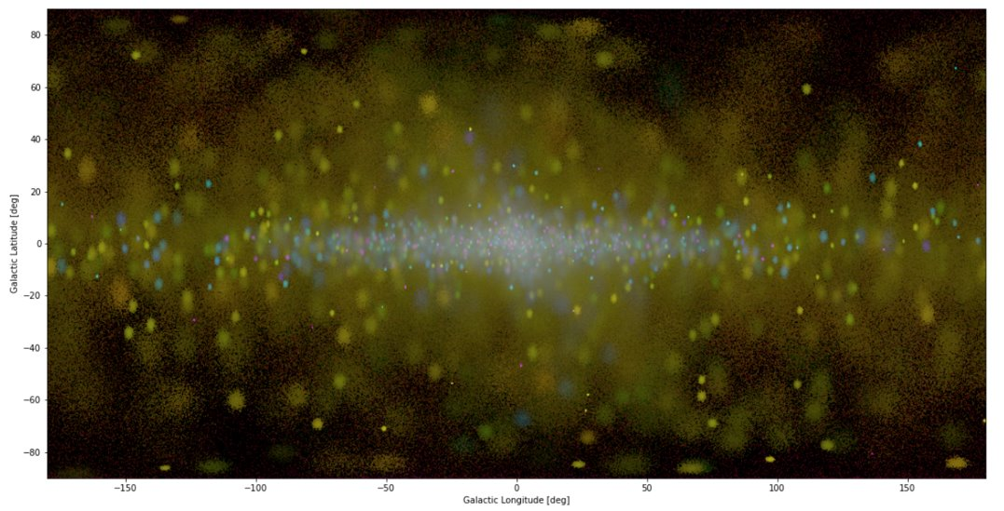
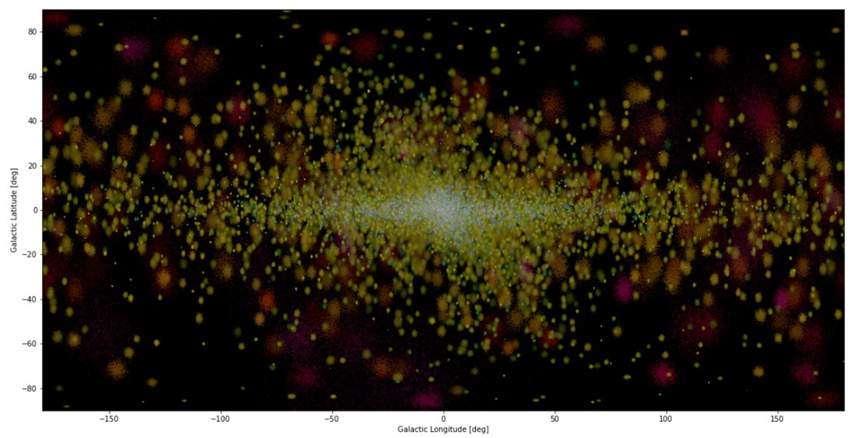
Our focus direction: GW Imaging
Dramatically improve resolution!
Science:
  Accurate localization is key to integration with EM astronomy!
  E.g. ’A binary merged’ —> ‘That binary merged!’
How: Instrument needs large spatial extent.
  —> Expand/enrich the constellation
  Also avoid expensive core technology changes from LISA
Milky Way with LISA (simulated)
Milky Way with 10x LISA resolution (simulated)

Slide 15
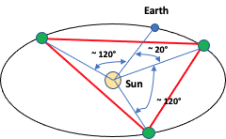
Work so far
Earth
~ 20°
2021 Reaching Beyond study
  Developed a list of sketch mission concept “directions”
  Started a Potential-Science Traceability Matrix
  Started set of tools for evaluation
2022 IRAD
  Refinement of the above for a formal publication (in prep)
Sun
Earth
~ 40°
Sun

Slide 16
Summary
Current Mission is ESA L3 with nominal launch date mid-2030’s
Expect spectacular science results
  Experience suggests best results are unexpected
  Space-based observatories will complement ground-based
  Multimessenger observations will be important
Sensitivity is limited by non-fundamental technical noise
  Mitigation strategies are well understood
Opportunities for improvements based on quantum sensing techniques are possible but require development

