Slide 1

Ruggedized Infrared Camera
Inventors: Jarret Bone, Jonathan Pryor, Brent Beabout, Jeremy Myers

Slide 2
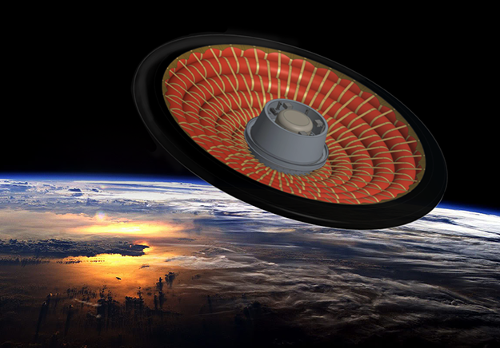
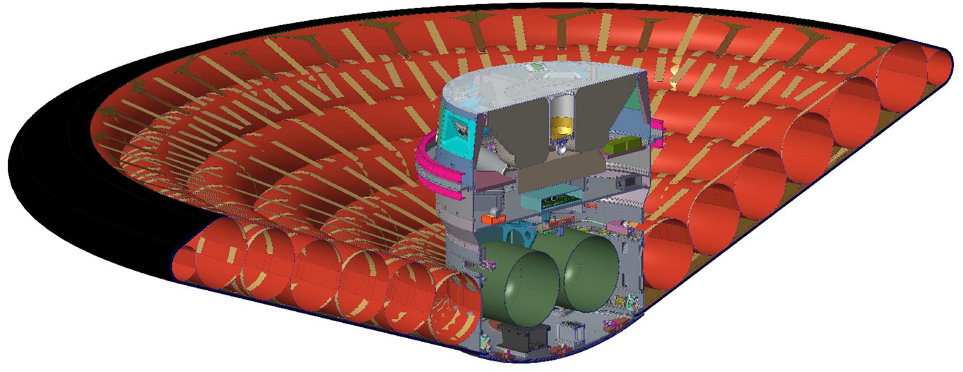
Camera’s Use
LOFTID/HIAD (Low-Earth Orbit Flight Test of an Inflatable Decelerator) is a NASA mission to test an inflatable reentry heat shield
Imagery was required to monitor the effectiveness of the shield during reentry
Our Camera Pod

Slide 3
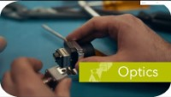

Slide 4
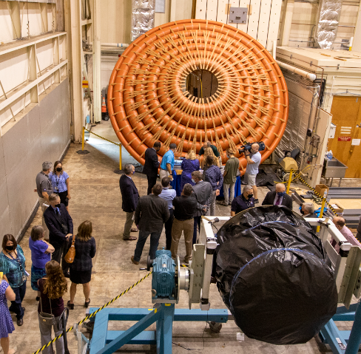
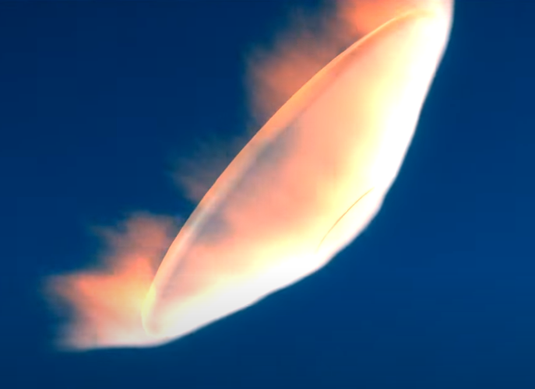
Problem Statement
Commercially sourced miniature IR camera with our unique requirements did not exist
Requirements included:
  Small size and mass
  Passively cooled
  Rugged connector and wire harness
  Moderate shock and vibration environments
  EMI

Slide 5
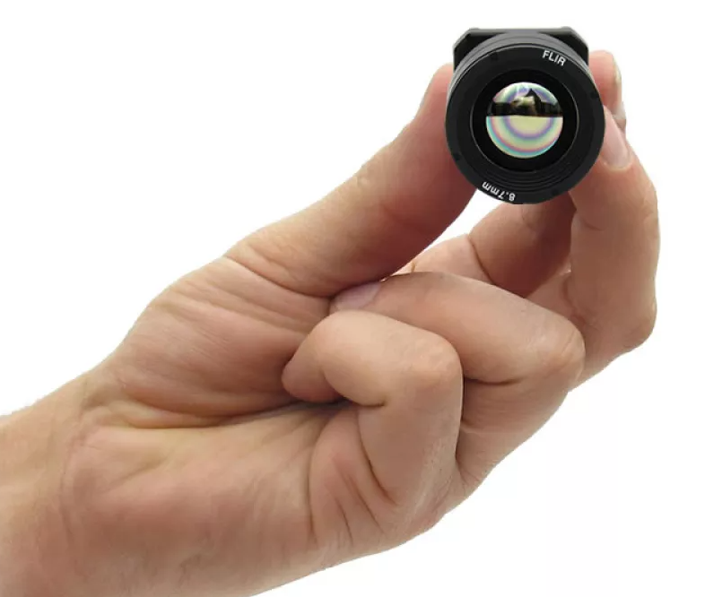
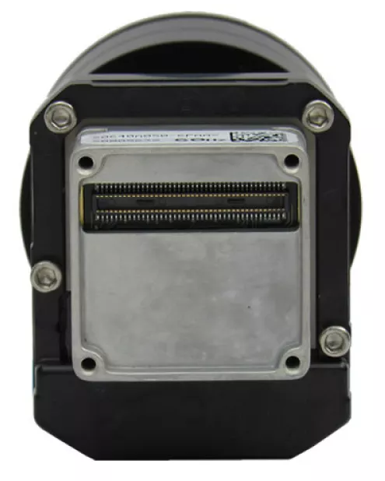
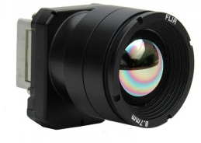
Solution
The Boson 640 met our imaging requirements, and we decided that a repackaging effort would be needed
The repackaging focused on passive thermal conduction, shock and vibe mitigation

Slide 6
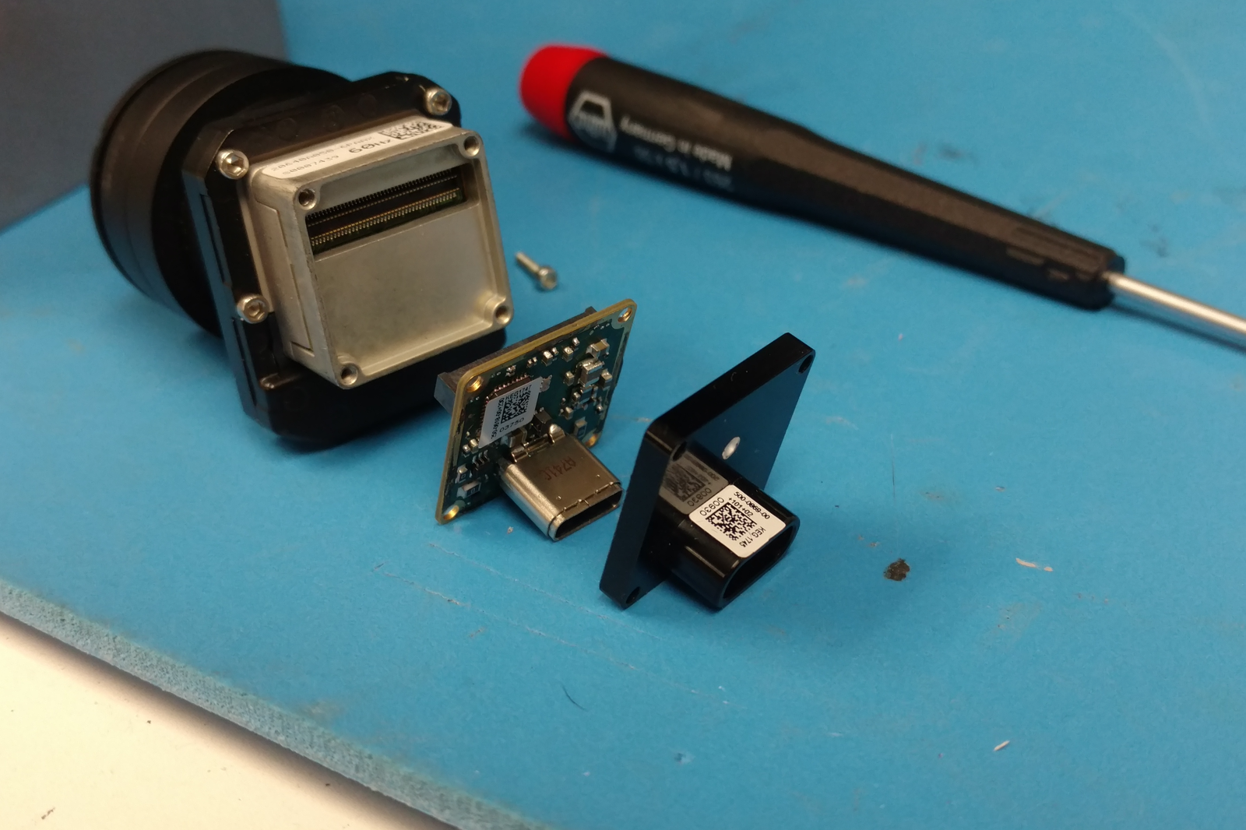
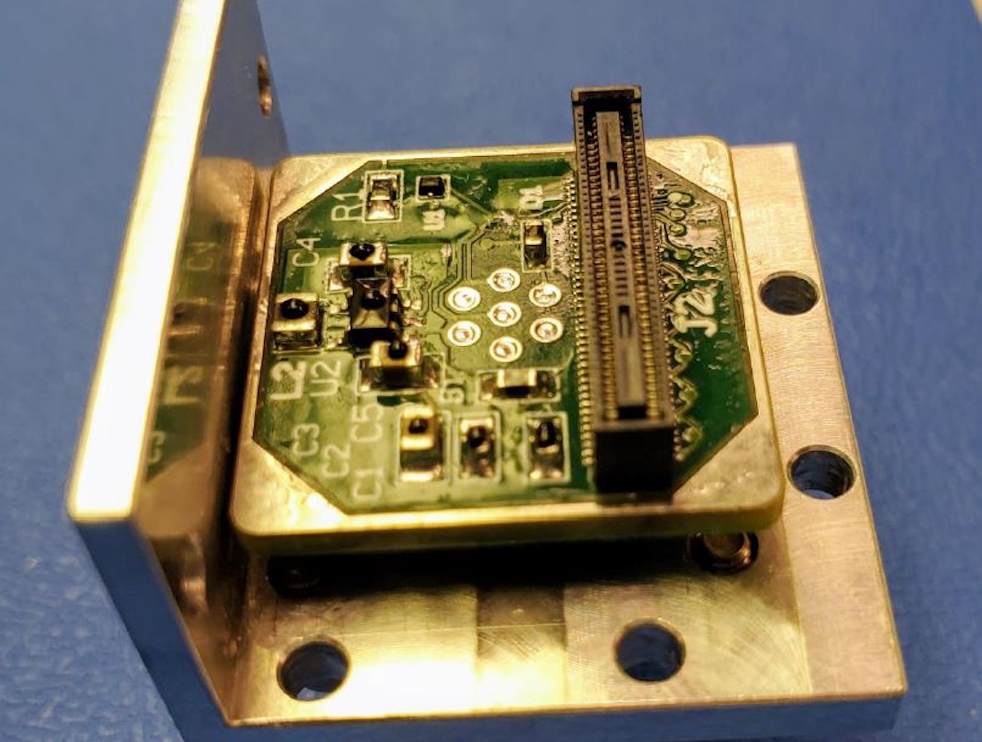
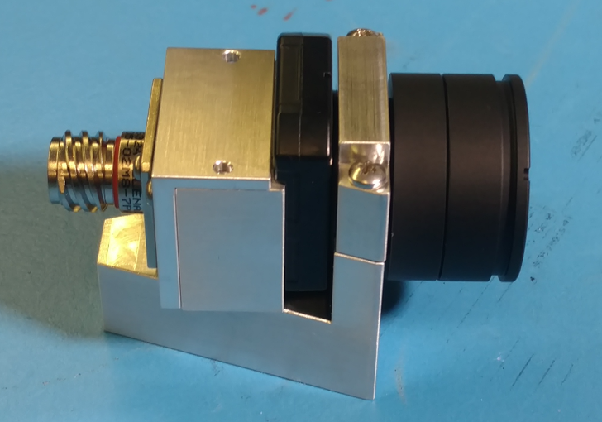
Build Process and Cost
Stock Boson 640 was partially disassembled and reinstalled into custom housing with custom interface board
Cost of custom camera is approximately $10,000

Slide 7
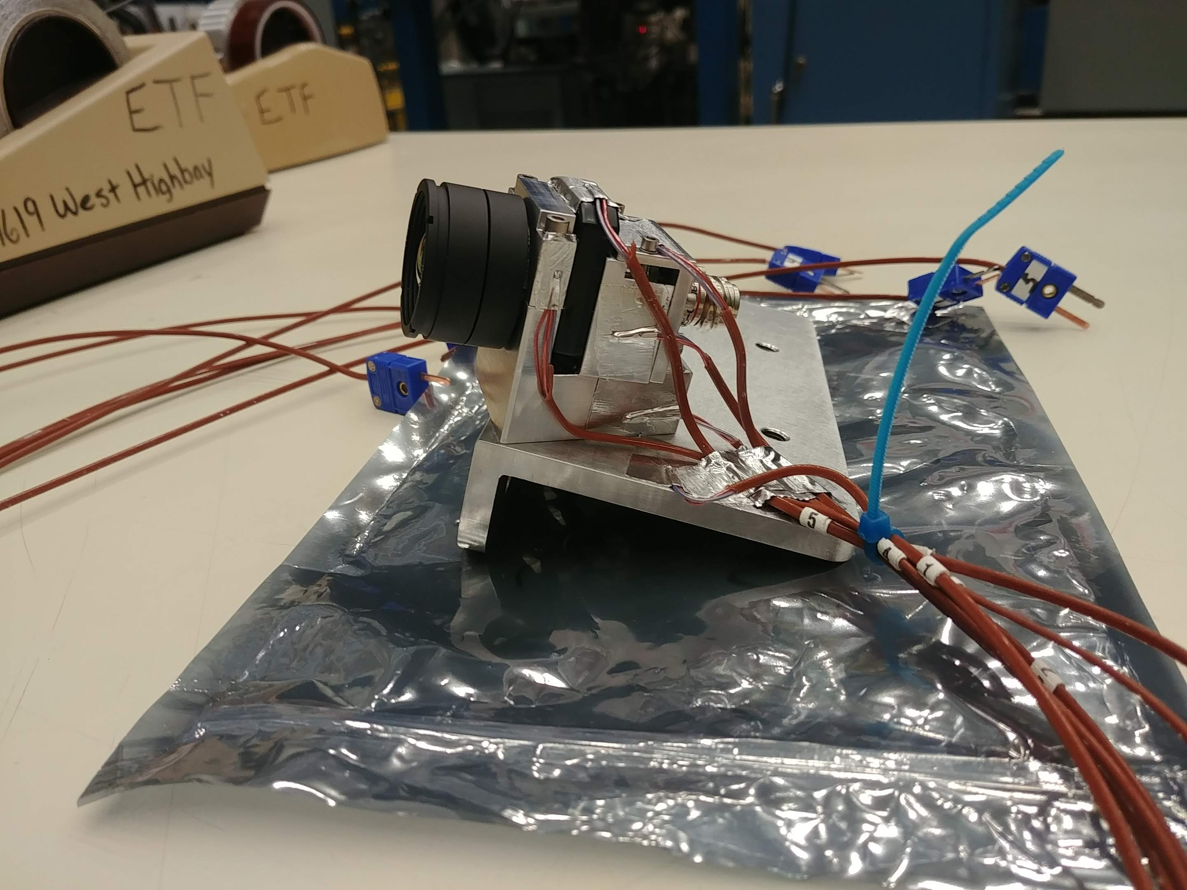
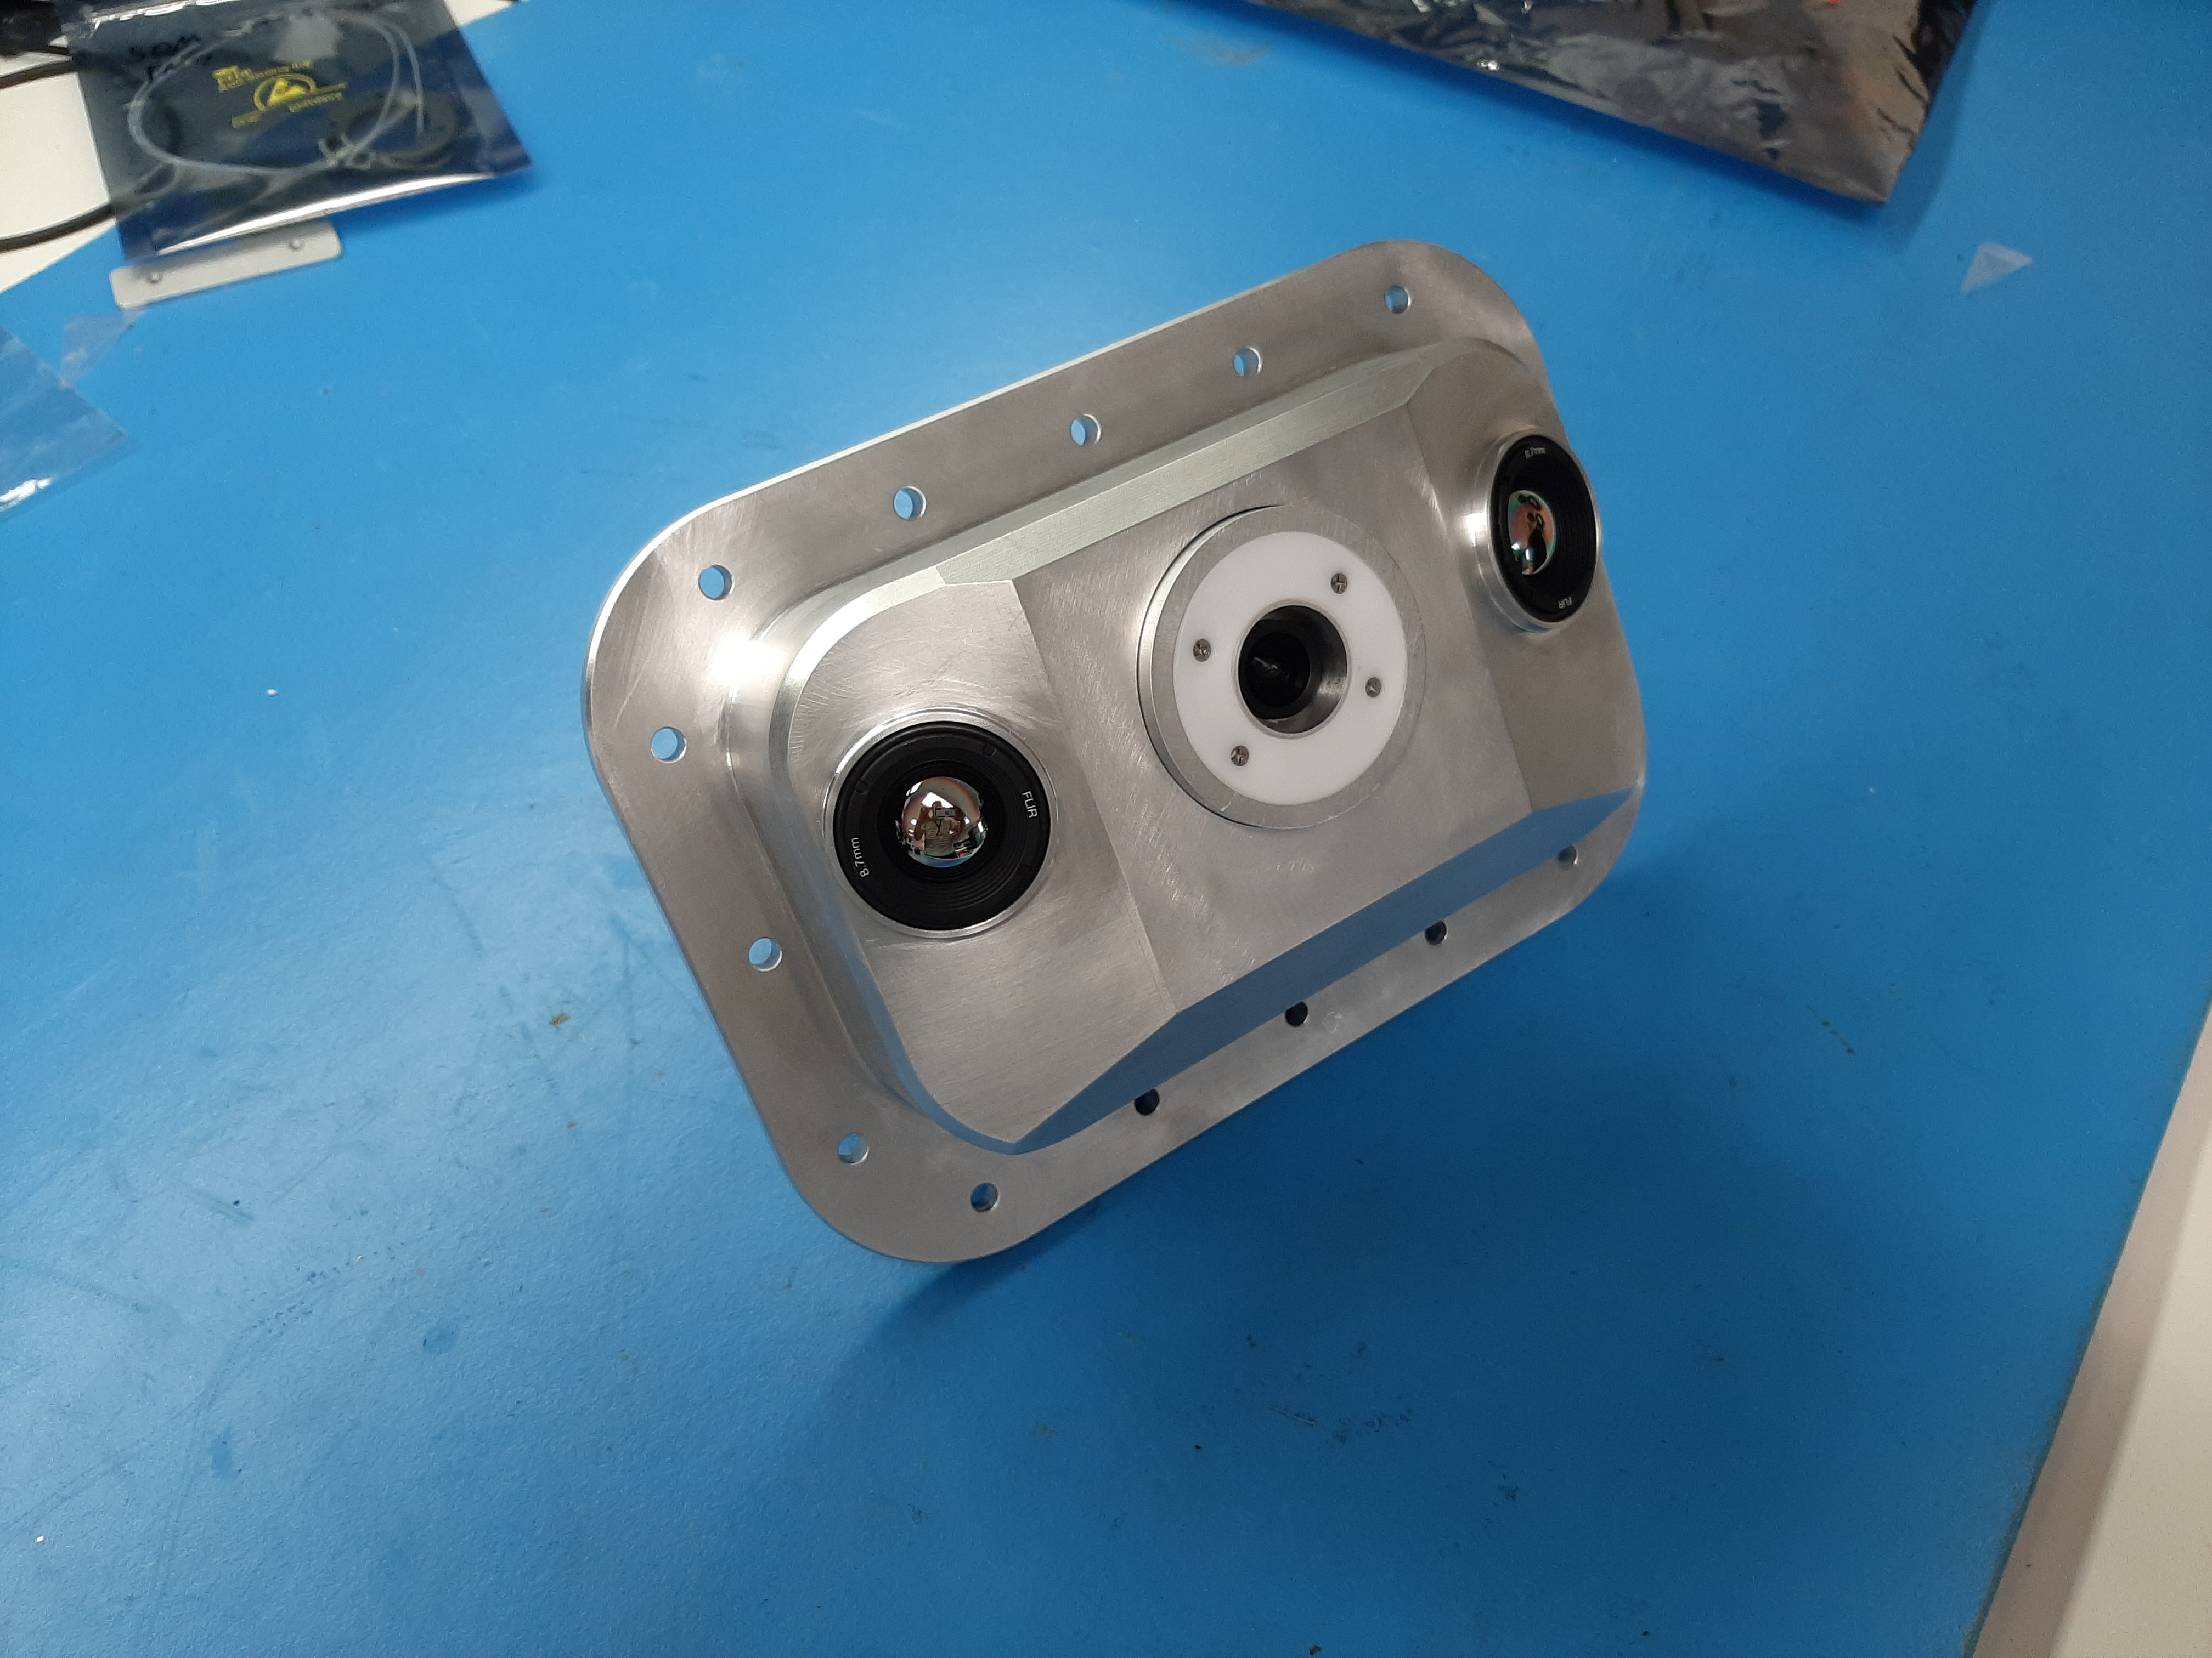
Testing
After assembly, several environmental tests were performed
  Thermal vacuum
  Vibe testing
  Radiation testing

Slide 8
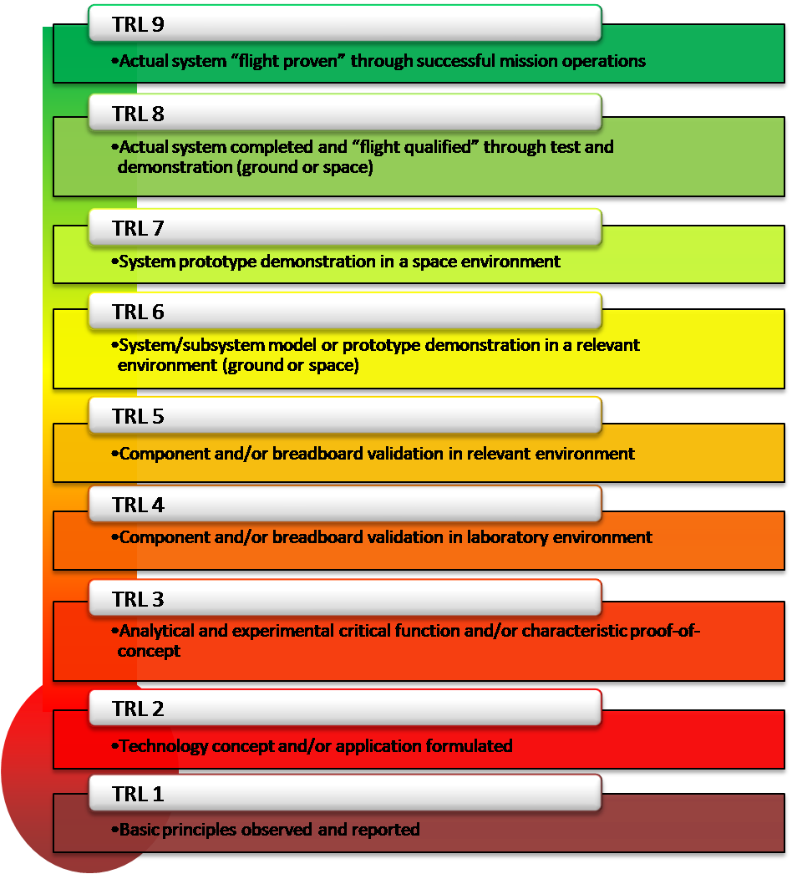
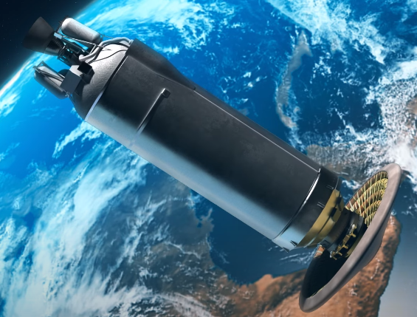
Technology Readiness Level
Cameras are installed in the vehicle and the mission is scheduled to fly November 1st 2022
Cameras are at TRL 8, will be 9 by end of this year

Slide 9


NASA Technology Transfer Portal
technology.nasa.gov/patents
https://software.nasa.gov/

Slide 10
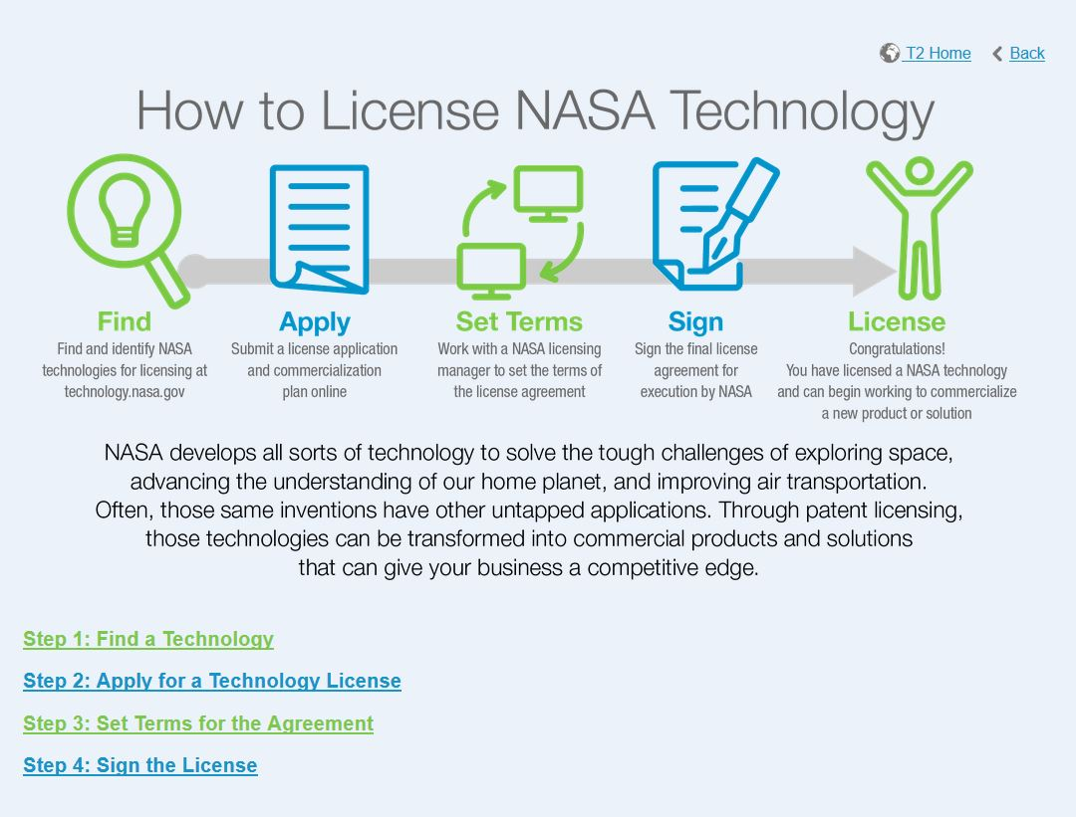
1. Standard Commercial License
Available in Exclusive and Nonexclusive.
2. Evaluation License
Cost $2,500 and last 1 year.
3. Startup License
For companies less than 24 months old and zero upfront fees.

Slide 11
Questions
NASA Marshall Space Flight Center
Technology Transfer Office
Ruggedized Infrared Camera
Visit the link below to license the technology. https://technology.nasa.gov/patent/MFS-TOPS-108
Have questions or comments after the presentation? Feel free to contact us!
Phone: (202) 358-7432
E-mail: Agency-Patent-Licensing@mail.nasa.gov

