Slide 1
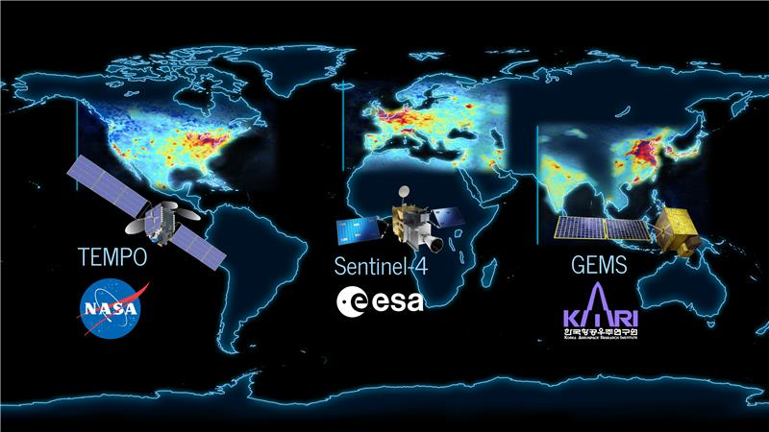
Summer 2023 offers the first opportunity for measurements over the North American component of the Geostationary Air Quality Constellation.
Update on TEMPO from Xiong Liu later this morning!

Slide 2

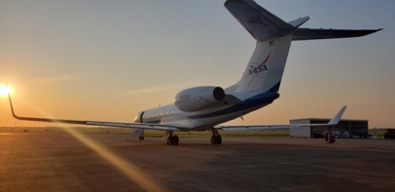
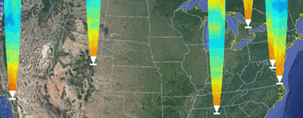
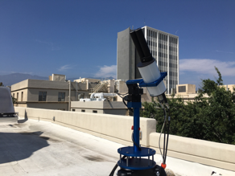
ynergistic
In June-August 2023, STAQS seeks to integrate TEMPO satellite observations with traditional air quality monitoring to improve understanding of air quality science and increase societal benefit.
EMPO
Study philosophy:
Build an integrated observing system consisting of ground-, airborne-, and satellite-based platforms and air quality models.
Prioritize repeated systematic sampling in a predefined domain during morning, midday, and afternoon times over at least 4 days in each primary target areas.
Assemble a collaborative research team through leveraging multiple activities occurring in summer 2023 with federal and academic partners.
ir
uality
cience
Includes deployment of airborne and ground-based remote sensing observations
G-V: GCAS + HSRL2
G-III: AVIRIS-NG + HALO
Pandora
TOLNet
Annual average of TROPOMI NO₂ overlaid with the currently planned primary sampling domains during STAQS within the TEMPO field of regard (black outline).

Slide 3
STAQS Science Objectives
Using the integrated multi-perspective point of view from satellite-, airborne-, and ground-based instruments:
Evaluating TEMPO level 2 products geo-physically, spatially, and temporally
Interpreting the temporal and spatial evolution of air quality events tracked by TEMPO
Improving temporal estimates of anthropogenic and biogenic trace gas and GHG emissions
Assessing the benefit of assimilating TEMPO data into chemical transport models
Linking air quality patterns to socio-demographic data

Slide 4
STAQS Team and POCs
Laura Judd (Airborne Lead)
John Sullivan (Ground Lead/TOLNet PI)
Scott Janz (GCAS PI)
John Hair (HSRL2 PI)
Taylor Shingler (HSRL2 co-lead for STAQS)
Amin Nehrir (HALO PI)
Robert Green (AVIRIS-NG PI)
Ian McCubbin (AVIRIS-NG STAQS Liason)
Tom Hanisco (NASA Pandora Project PI)
Paul Walter (Sonde-lead)
Barry Lefer (Program Manager)
Gao Chen (Data Manager)
Michael Shook (Data Manager)

Slide 5
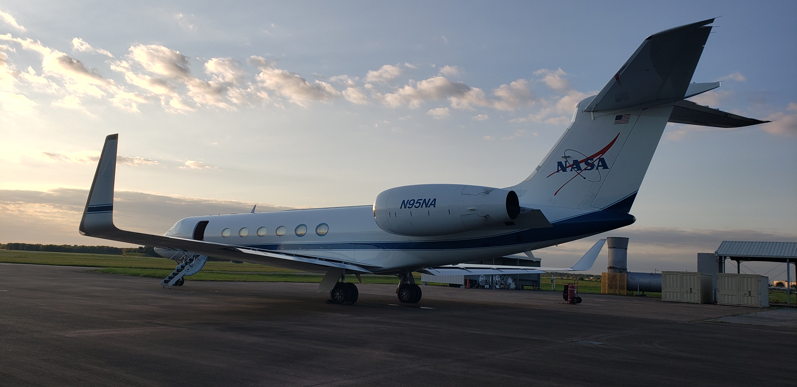
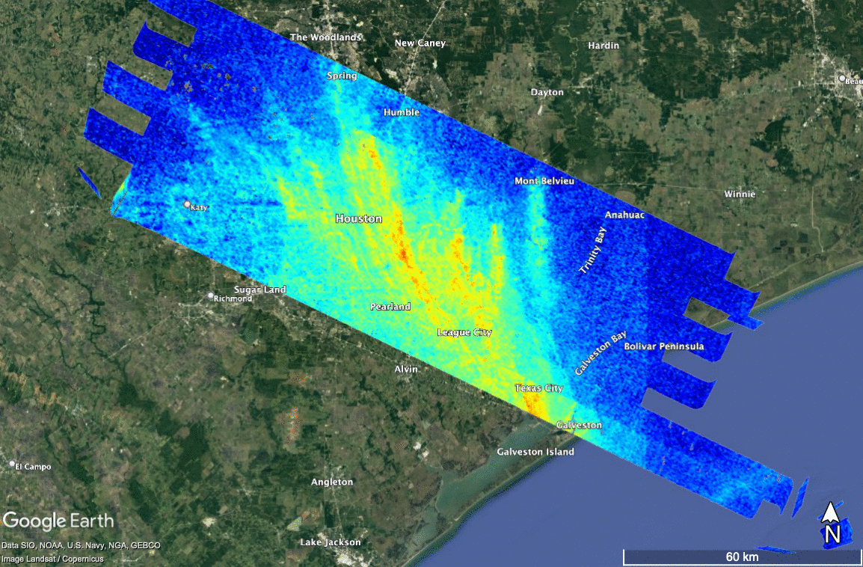
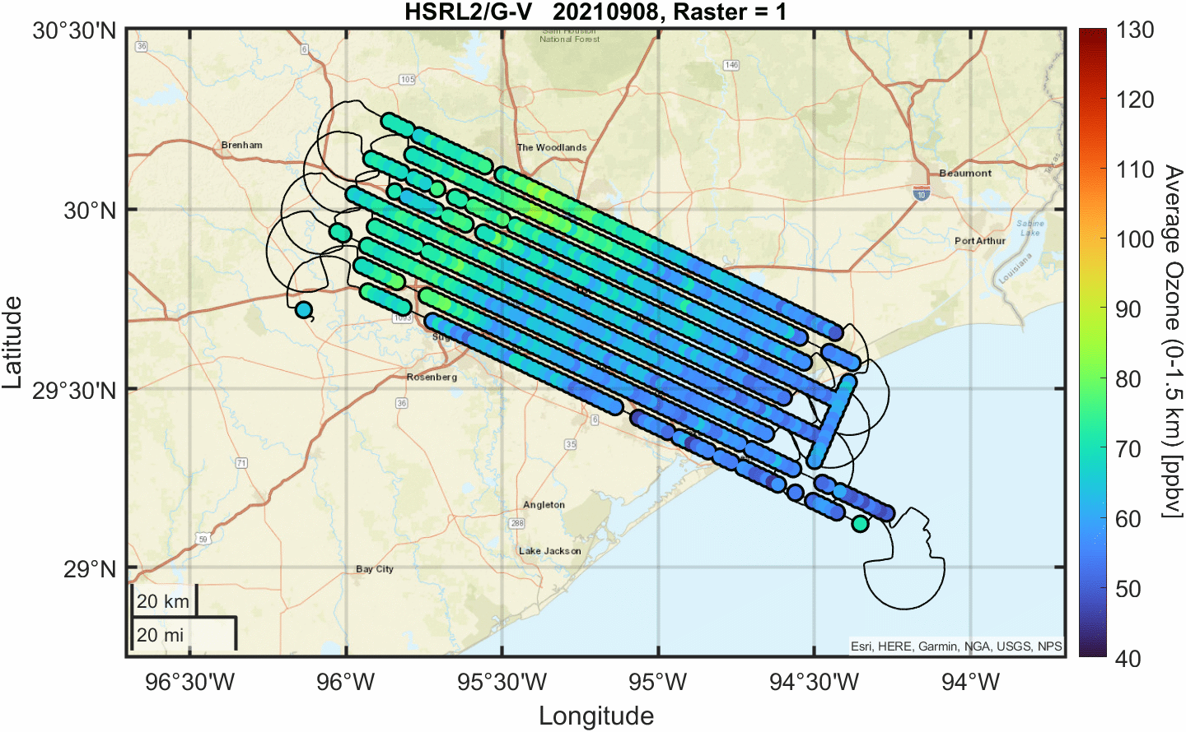
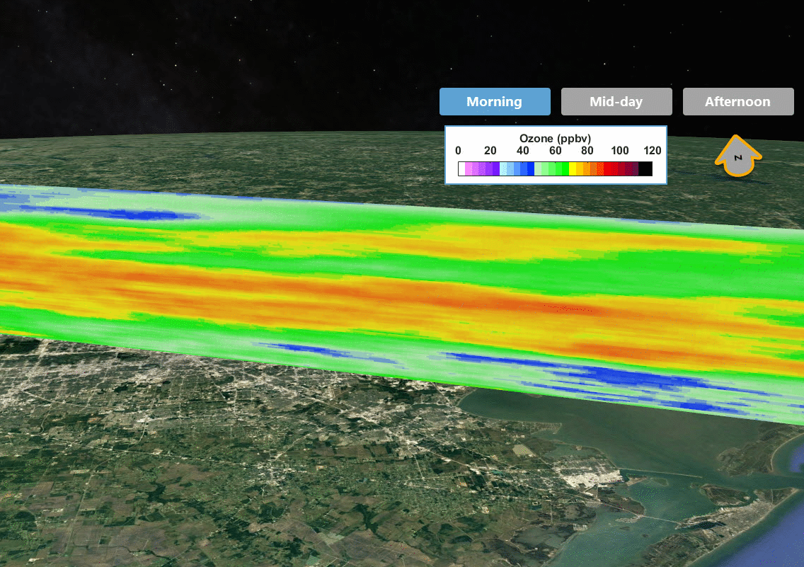
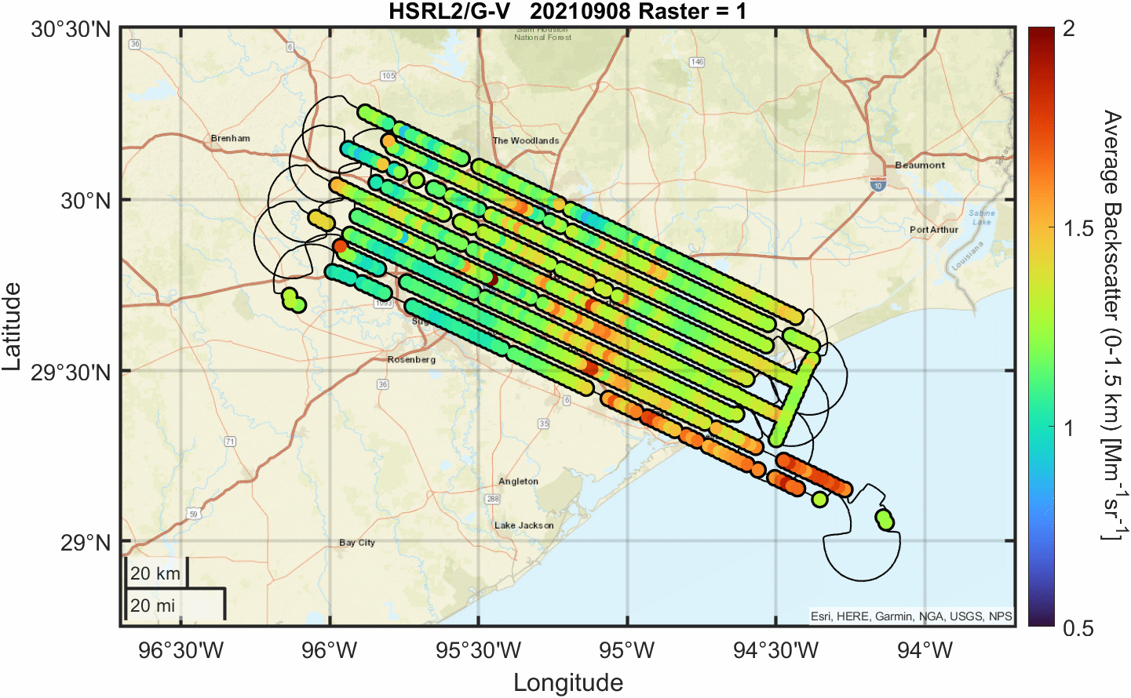
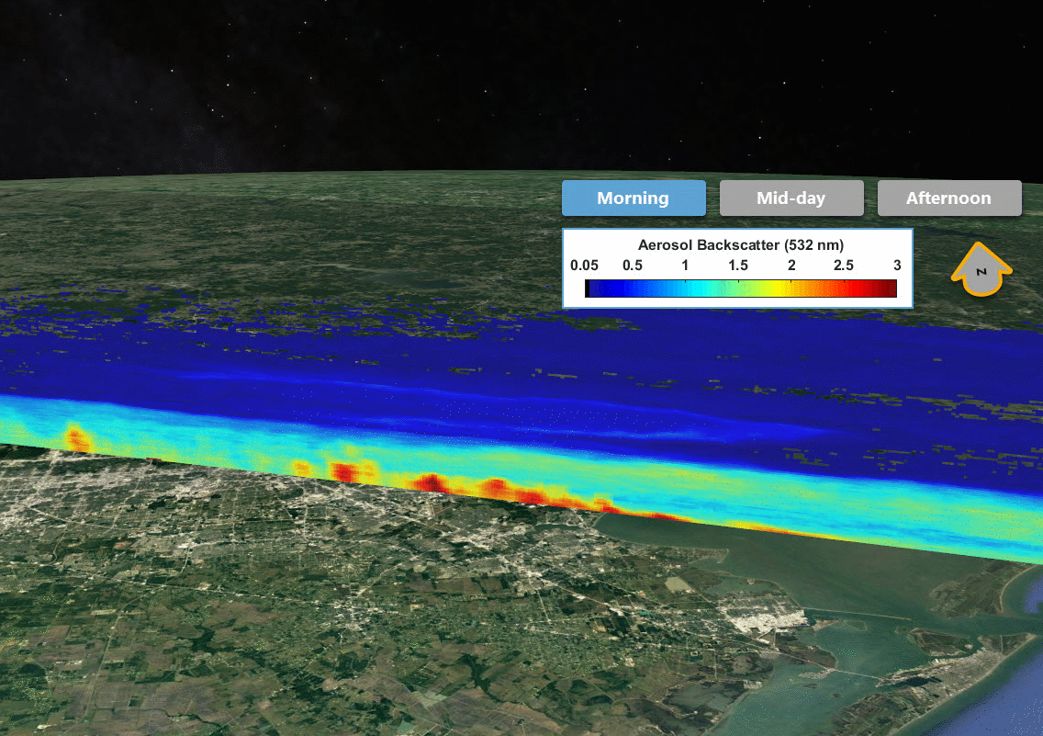
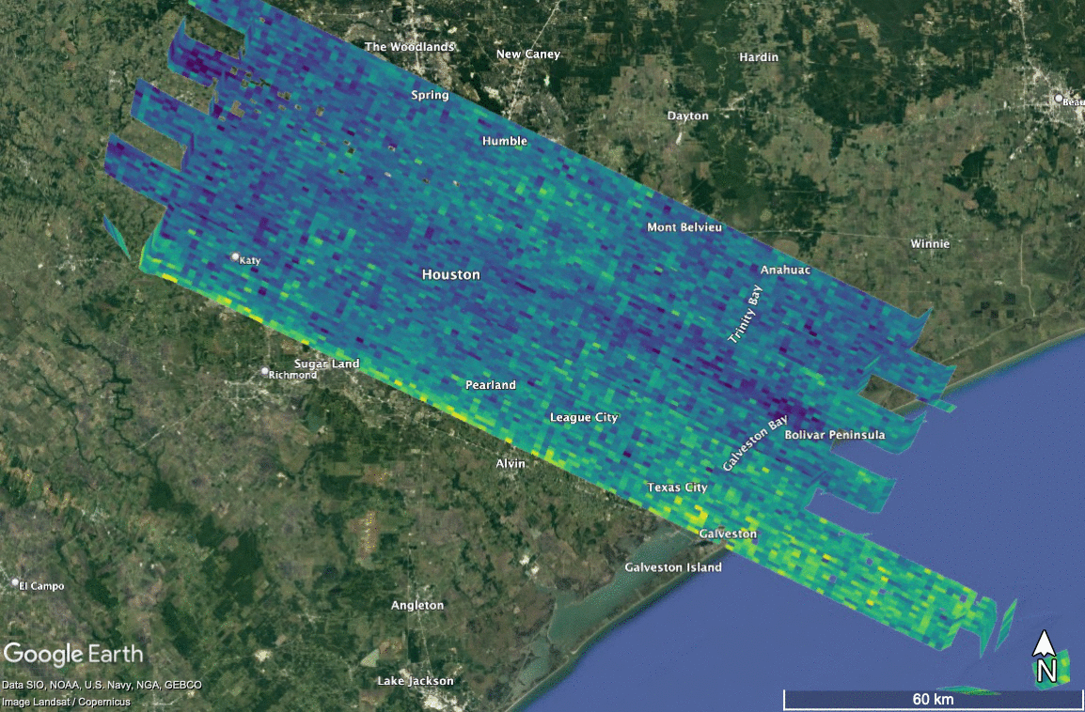
STAQS Airborne Perspective: G-V
Visualizing chemical weather: example from TRACER-AQ with GCAS + HSRL2
NO₂
Ozone
Ozone Vertical Profile
Additional
HSRL2 Products:
532 nm Aerosol Depolarization
Ratio of Aerosol Depolarization (532/355nm)
Lidar Ratio (532 nm)
Backscatter Angstrom Exponent (532/355 nm)
Aerosol Type
Mixed layer height
HCHO
Backscatter
Backscatter Vertical Profile
Spatial scales of these measurements reveal information about these pollution that cannot be captured by a satellites.
The temporal sampling strategies give us a glimpse of the future with hourly view expected from TEMPO.

Slide 6
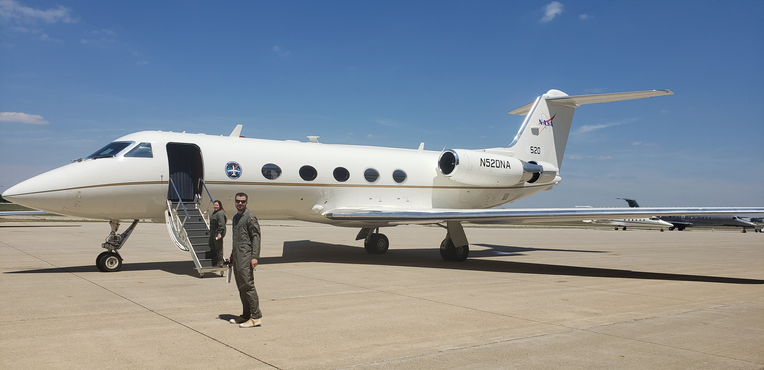
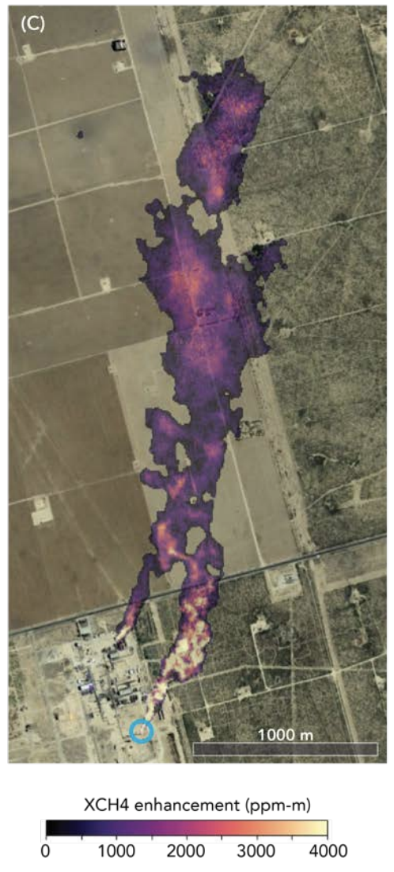
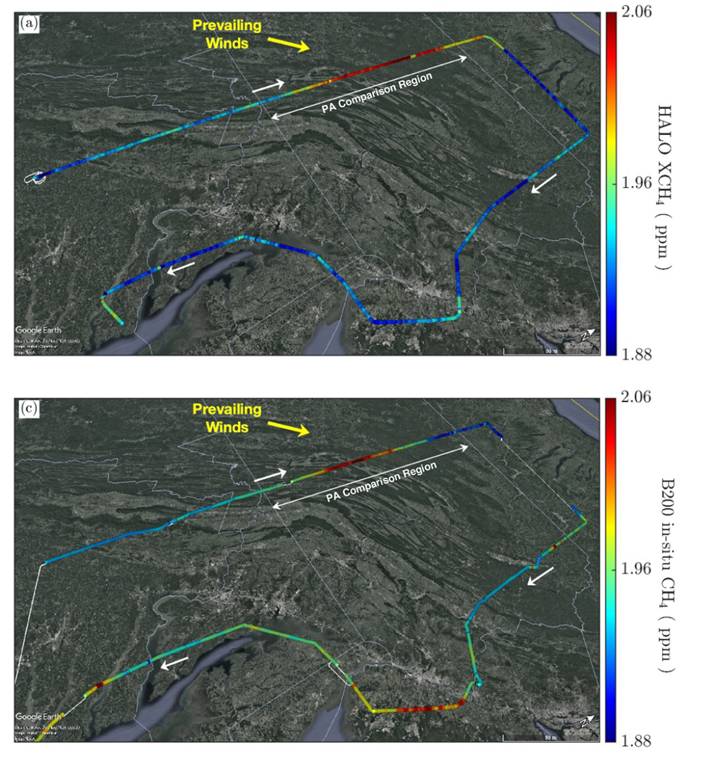
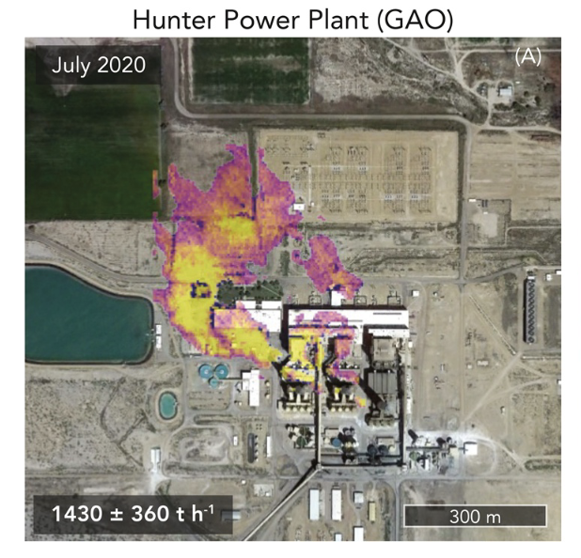
STAQS Airborne Perspective: G-III
Adding synergistic perspectives between air quality and greenhouse gases with HALO and AVIRIS-NG
Cusworth et al., 2021: https://doi.org/10.1021/acs.estlett.1c00173
Methane emissions for sources > 10s kg/hour
CO₂: very large point sources (e.g., power plants, refinery)
CH₄ from gas processing plant
CO₂ from power plant
Cusworth et al., 2021: https://doi.org/10.1029/2020AV000350
Barton-Grimley et al., 2022: https://doi.org/10.5194/amt-15-4623-2022
Notes:
https://pubs.acs.org/doi/10.1021/acs.estlett.1c00173

Slide 7
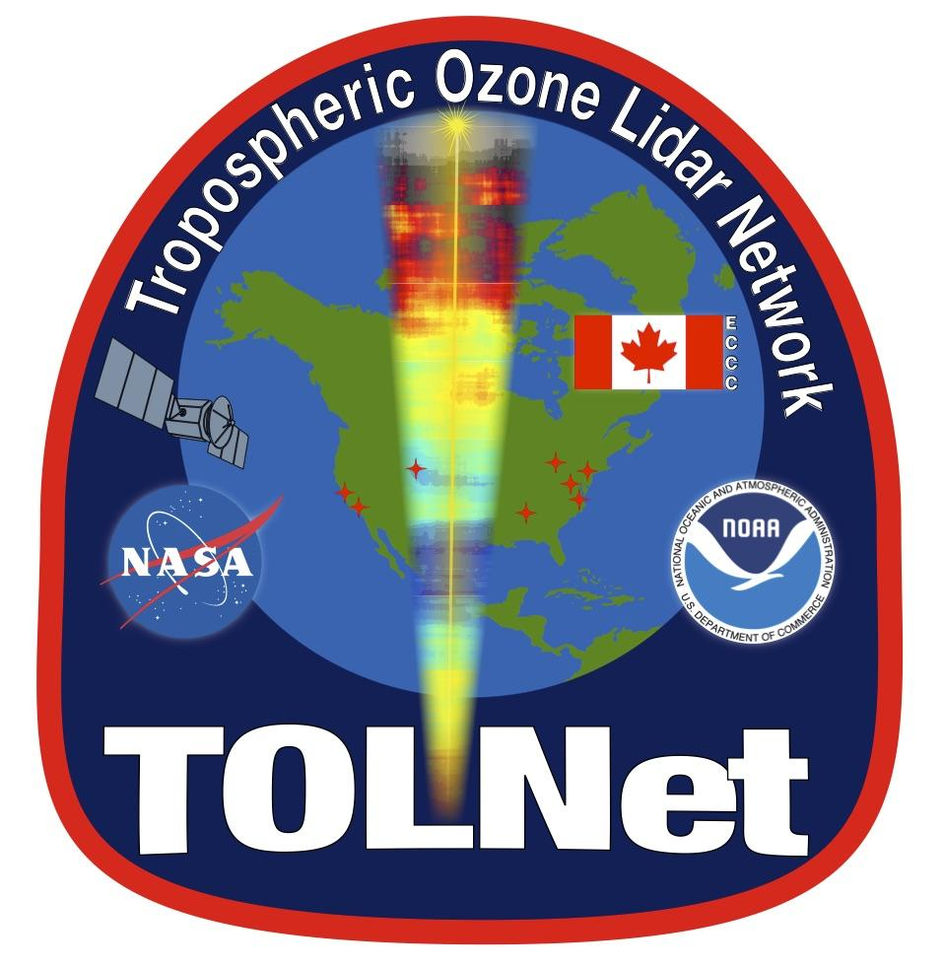
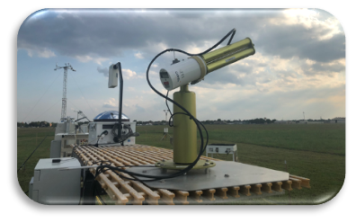
STAQS Ground Perspective
Ground Support Platforms for STAQS include TOLNet, Pandora and Ozonesondes (similar to TRACER-AQ-examples below).
Enhanced ground-based monitoring on September 9th revealed information about the vertical profiles of pollution that cannot be captured by a satellites.
Synchronous sonde, Pandora and lidar sampling strategies reveal the multi-species complexity of vertical chemical transport
NASA TOLNet 20210909
Courtesy A. Kotsakis
Ozonesondes ~20UT 20210909
TRACER-AQ is a NASA-led air quality mission, leveraging DOE’s TRACER study, with main partners in air quality management from the Texas Commission on Environmental Quality (TCEQ) observing pollution from aircraft, boats, mobile labs, and ground sites.
Notes:
—> Demonstrating new observing approaches: The combination of passive NO2 and HCHO observations with active remote sensing of ozone and aerosols are enabling a more complete visualization of chemical weather.
This slide shows this with the TRACER-AQ payload which really turned out to be a game changer for air quality airborne remote sensing. These measurements provide an unmatched spatial resolution of measurements of ozone and aerosols and the ingredients needed chemically create these harmful pollutants. The speed/endurance of the Gulfstream aircraft at NASA have amplified the amount of scientific data we can collect during these airborne missions. This will accelerate the use of data collected under the TEMPO mission during the 2023 STAQS deployment and ASIA-AQ under their TEMPO sister/GEMS.

Slide 8
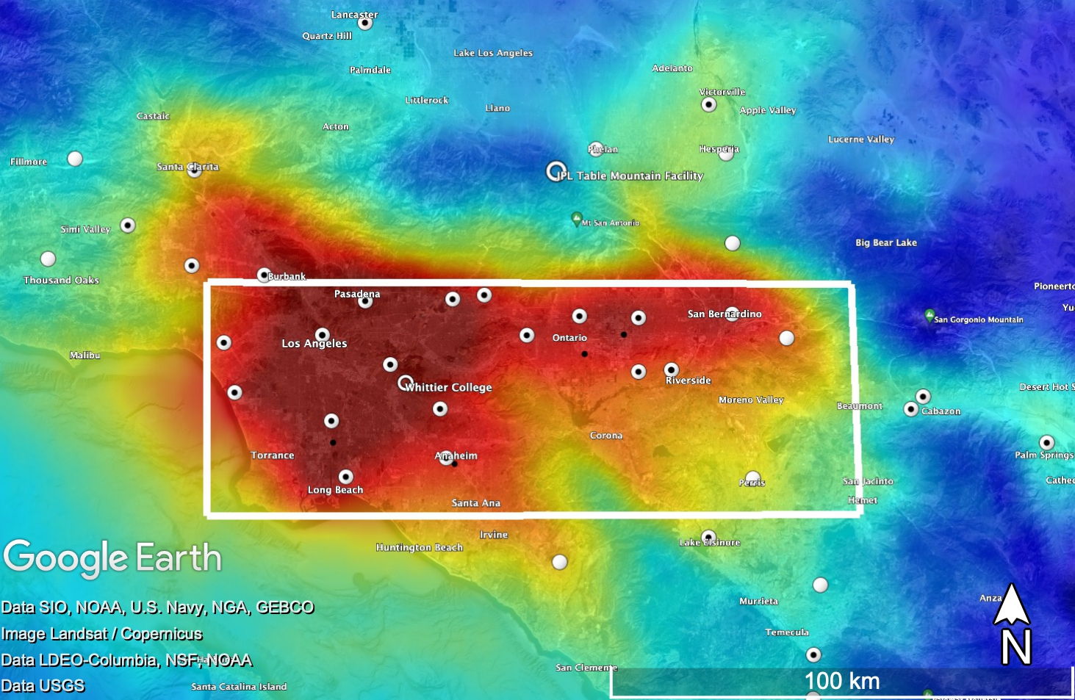
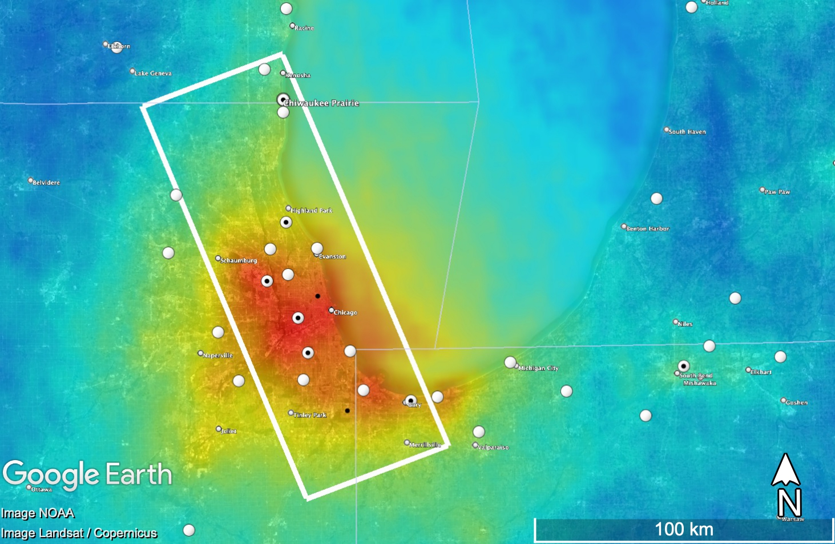
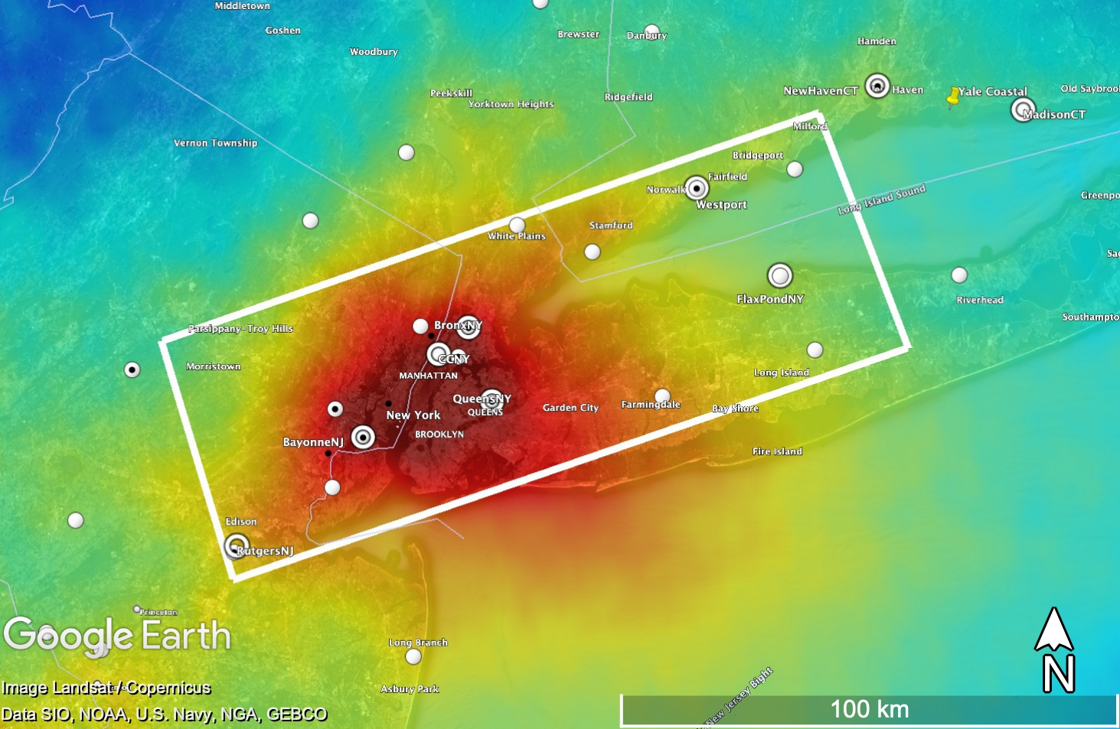
STAQS Mapping
Boxes represent initial areas that could be sampled in each region every 2.5 hours. Aim for the final area would be to optimize emission sources and ground-site mapping.
Priority is systematic sampling of the same area with the GV 3x per day (morning-midday-afternoon) and GIII 2x per day (morning-afternoon)
Opportunity targets will be considered secondarily and include extended legs to hit additional ground sites or source regions, cross sectioning the raster between rasters aiming for hitting ground sites at a new viewing/solar geometry,.
More detailed flight planning details on Thursday
Box: 2.5 hour raster
White open circles: Pandora
White closed circles: Ozone monitors
Dark dots: NO₂ monitors
Yellow arrow: TOLNET
Los Angeles
Chicago
New York City
Notes:
https://pubs.acs.org/doi/10.1021/acs.estlett.1c00173

Slide 9
STAQS Schedule
Gulfstreams:
Integration: ~June 1
Los Angeles Flight Window: June 19-July 7 (10-day window/4 flight days)
Dayton, Ohio for East coast cities: July 30-August 29th (one month window/8+ flight days)
G-V: 120 Science Hours (~ 13 flight days/one 9 hours flight per day)
G-III: 104 Science Hours (~ 13 flight days/two 4-hour flights per day)
Aiming for at least 4 days in each primary target city.
TOLNet:
NYC systems Aiming for a 5 week window from mid-July through end of August. Timing TBD based on TEMPO’s launch and consideration for other missions. Sonde efforts align with this timeline. UAH system schedule is still TBD but will at the very least align with the NYC window.
Pandora:
Leveraging existing Pandoras in PGN including the potential for new ones in Los Angeles through Increasing Participation of Minority Serving Institutions in Earth Science Division Surface-Based Measurement Networks selections

Slide 10
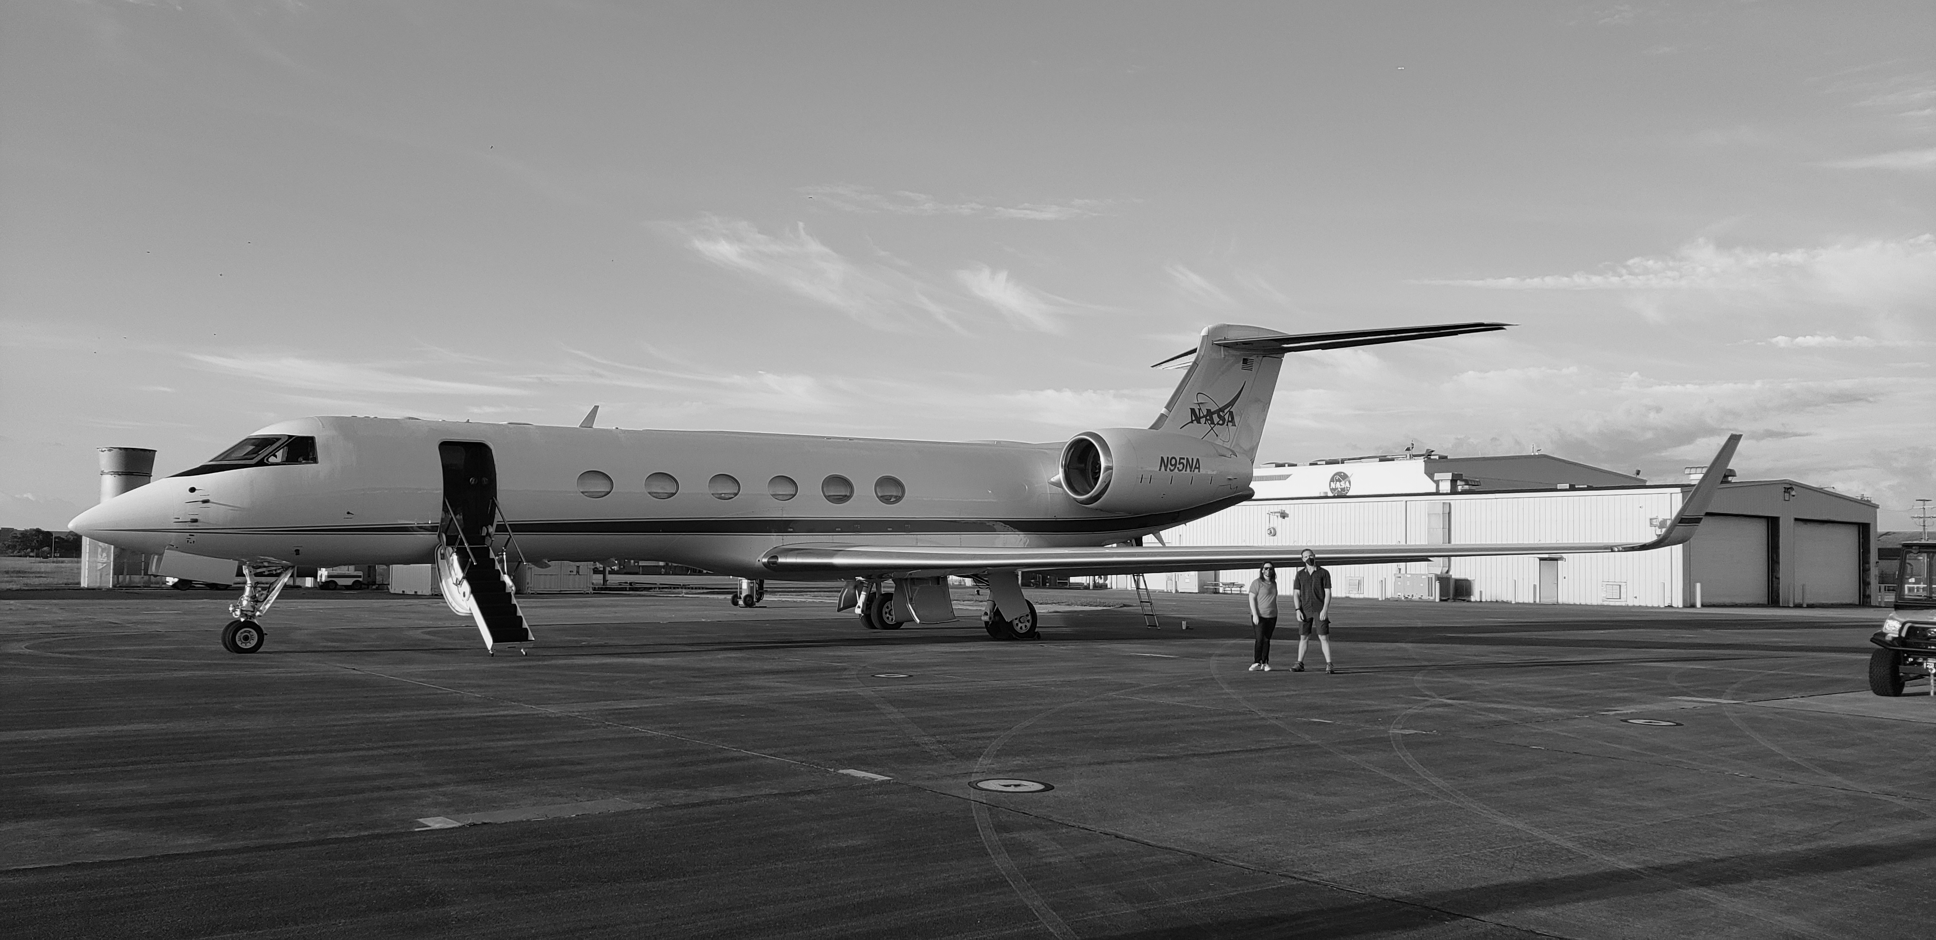
Looking forward to working together next summer!
Contact:
John Sullivan (john.t.sullivan@nasa.gov)
Laura Judd (laura.m.judd@nasa.gov)

