Slide 1
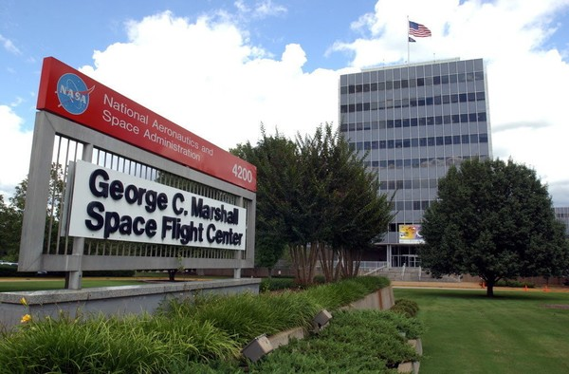
John Rogers
ET40
17-20 October 2022
Beyond Gravity Single Launch Payload Accommodations Shock Testing
Email: john.p.rogers@nasa.gov
Phone number: 216-801-3467

Slide 2
Background on Launch Vehicle
Testing Objectives
Description of Test Article
Test Equipment and Instrumentation
Test Performance and Results

Slide 3
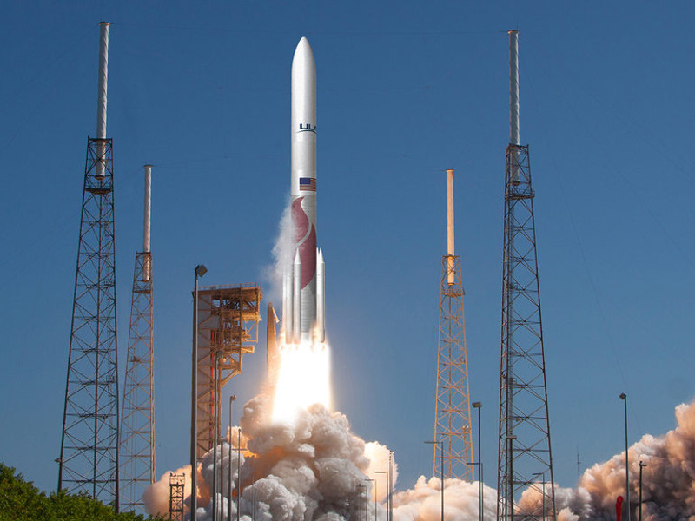
Vulcan Centaur is a two-stage heavy-lift launch vehicle
Designed to meet launch demands for the U.S. government’s National Security Space Launch (NSSL) program
The NSSL program ensures access to space by the Department of Defense (DOD) (including the U.S. Space Force) and National Reconnaissance Office (NRO).
It will launch the Peregrine lunar lander in 2022 under NASA’s CLPS program
An artist's rendering of the Vulcan Centaur rocket - ULA
Notes:
Vulcan Centaur is a two-stage heavy-lift launch vehicle currently being developed by United Launch Alliance (ULA) to meet launch demands for the U.S. government’s National Security Space Launch (NSSL) program. This program ensures access to space by the Department of Defense (including the U.S. Space Force) and National Reconnaissance Office (NRO). It is also responsible for launching the Peregrine lunar lander in 2022 under NASA’s CLPS program. Vulcan Centaur builds on technologies developed for the Atlas V and Delta IV rockets and is the first complete launch vehicle designed by ULA. It utilizes a combination of Blue Origin’s BE-4 liquid methane / LOX engines, up to six Northrop Grumman GEM-63XL solid rocket boosters (SRBs) for the booster stage, and the new Centaur V upper stage powered by Aerojet Rocketdyne RL10-C engines. These two powerful stages will give the Vulcan Centaur launch vehicle the payload capacity it needs to meet NSSL requirements and replace the Atlas V and Delta IV Heavy in future missions.

Slide 4
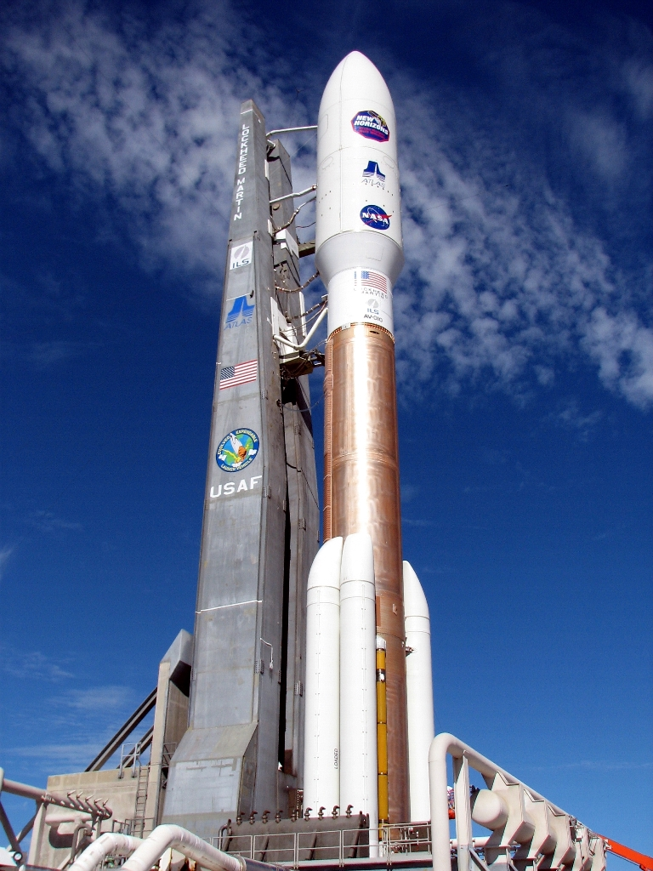
Vulcan Centaur builds on technologies developed for the Atlas V and Delta IV rockets
It consists of two powerful stages giving it the payload capacity to meet NSSL requirements and replace the Atlas V and Delta IV Heavy in future missions.
Incorporates the new Centaur V upper stage powered by Aerojet Rocketdyne RL10-C engines.
Atlas V Rocket - ULA
It utilizes Blue Origin’s BE-4 liquid methane/LOX engines and up to six Northrop Grumman GEM-63XL solid rocket boosters (SRBs)

Slide 5
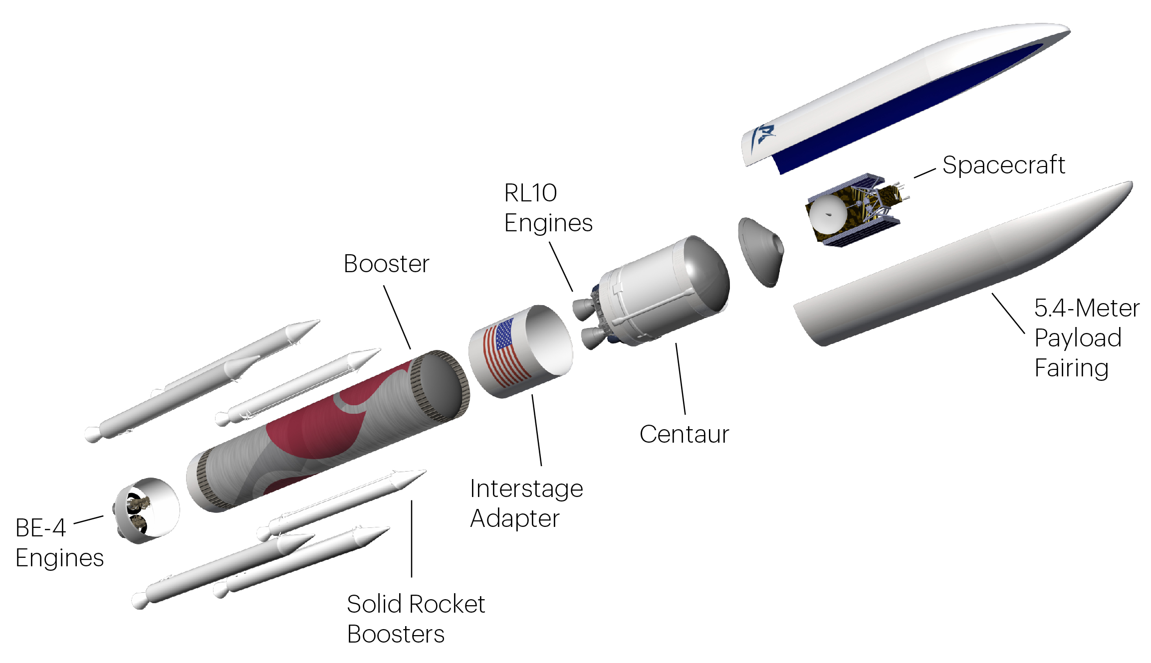
Scope of Testing - Centaur V upper stage, specifically components from Beyond Gravity
Beyond Gravity is responsible for the inter-stage adapter (ISA) and payload accommodations (PLA) development
ISA - connects the Vulcan first stage to the Centaur V upper stage
PLA - everything forward of the LH2 skirt including 1-2 launch vehicle forward adapter’s (LVFA) payload adapter fittings (PAF) and a short 15.5m-long version of the payload fairing (PLF).
Notes:
The scope of testing was limited to the Centaur V upper stage, specifically components delivered by the Swiss technology group Beyond Gravity. Beyond Gravity is responsible for the inter-stage adapter (ISA) and payload accommodations (PLA) development. The ISA is a cylindrical structure that connects the Vulcan first stage to the Centaur V upper stage. The PLA is composed of everything forward of the Centaur V LH2 skirt, including one or two payload adapter fittings (PAF) installed on the launch vehicle forward adapter (LVFA) (depending on the launch configuration) and a short, 15.5m-long version of the payload fairing (PLF). On the lower portion of the PLF, between the PLF and the LVFA, the horizontal separation system (HSS) provides the means for separating the PLF from the Centaur V vehicle. It uses frangible joints to cause separation and a series of spring packs to clear stage to a safe distance apart. The PLA has two different configurations – multi launch (ML) and single launch (SL) – depending on the number of satellites being launched. In the ML configuration, there are two PAF as opposed to the one PAF in the SL configuration. The HSS and PLA subsystems are examined exclusively during the shock test described­.

Slide 6
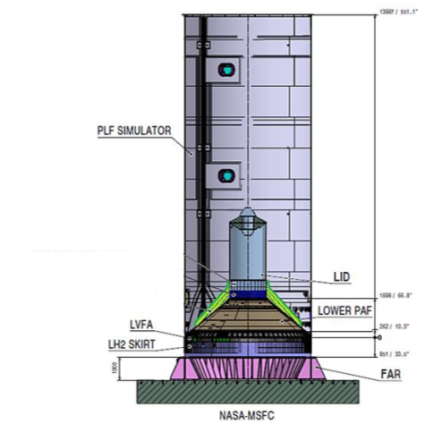
Focus of test - Horizontal Separation System (HSS), and PLA subsystems
HSS, between the PLF and the LVFA, separates the PLF from the Centaur V vehicle
HSS uses frangible joints to cause separation and spring packs to clear stage to a safe distance apart
Two PLA configurations – multi launch (ML) and single launch (SL), depending on the number of satellites
Diagram of the PLF Simulator
ML configuration - two PAF, SL configuration – one PAF

Slide 7
Background on Launch vehicle
Testing Operations
Description of Test Article
Test Equipment and Instrumentation
Test Performance and Results

Slide 8
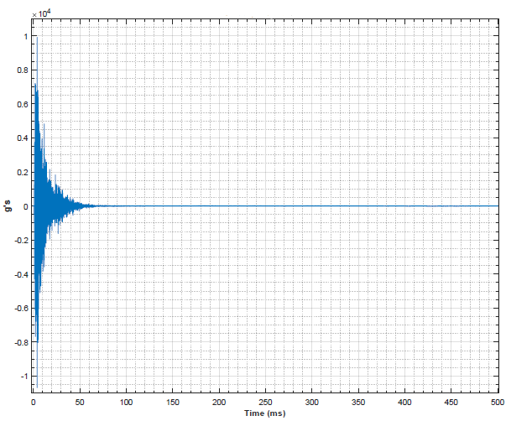
ULA and Beyond Gravity provided five main objectives to qualify a successful SL configuration separation test
Validating component level shock environments for qualification testing.
Validating shock attenuation and environment at the Standard Interface Specification (SIS) interface (Spacecraft to Launch Vehicle Interface) and payload interfaces.
Shock Impulse Time History Example
Notes:
The SL configuration separation test includes recording shock propagation of the second stage induced by the proper separation of the HSS from the PLF. ULA and Beyond Gravity engineers provided five main objectives to qualify a successful test. These objectives are:
Validating component level shock environments for qualification testing. The shock levels recorded throughout the PLF simulator will be used to validate payload components withstanding in flight shock environments caused by the separation of the Payload Fairing. Payloads on the Centaur V vehicle need to be tested at appropriate shock levels to ensure flight readiness. Shock propagation data throughout the LVFA and PAF is required to accurately test and qualify payloads for flight readiness. Activating the HSS to separate the PLF from the LVFA and measuring the time history of this separation at hundreds of relevant positions throughout the PLF and PLA stack will provide the data needed to shock test future payloads. Post processing the time history to the shock response spectrum (SRS) is commonly performed to validate test articles for withstanding shock events. This objective is deemed successful if sufficient and accurate shock data throughout the PLF and LVFA is gathered during the HSS separation and used to validate shock predictions at each component under qualification testing.
Validating shock attenuation and environment at the Standard Interface Specification (SIS) interface (Spacecraft to Launch Vehicle Interface) and payload interfaces. Launch vehicle payloads must be shock tested based on the dynamic rocket environment seen during stage separations to ensure survivability. Shock levels should be optimized to prevent destruction of expensive customer hardware in flight as well as to certify that the payload survives its ascent. This objective is considered to be a success if sufficient and accurate shock data is collected during the HSS separation and used to validate payload flight hardware, which includes any internal and external structures forward and aft of the HSS on launch vehicle, for Centaur V launch.
Characterizing separation event dynamics. The shock dynamics during the separation must coincide with theoretical predictions in order to validate an accurate flight profile. This profile will be used to better understand the dynamics of the separation event during flight. Acceleration and displacement are recorded during the HSS separation event using accelerometers, high-speed cameras and lasers at various positions along the PLF. This objective is marked as successful if sufficient and accurate data is recorded to fully characterize the separation event dynamics, including translational, vertical and radial displacements, as well as rotation rates and timing. PLF kinematic parameters were computed and compared to predictions to validate HSS functionality. There were no influencers to displacement besides HSS spring pack.
Recording physical separation data to compare to measurements made during flight. Physical testing of new models validates historical testing environments. This provides accurate predictions of structural dynamics during actual flight separation. This objective is accomplished if acceleration and displacement data along pertinent locations throughout the PLF and LVFA during the HSS separation event is recorded for comparison to predictions made from historical testing.
Verifying no contact between the PLF and flight hardware during separation. Contact between the PLF and LVFA during the HSS separation may cause loss of second stage functionality as well as damage to the flight hardware. It can also saturate recorded data rendering it useless. Blue dye is placed at pertinent locations of the LVFA stringers and PLF inner stiffener for clearance detection, allowing visual inspection of HSS clearance to be done any time before and after testing. The PLF aft end displacements in proximity of HSS are measured to characterize the PLF radial deformation during separation. The objective is met if, during the HSS separation event, there is no blue dye transferred from the LVFA stringer to the PLF or from the PLF inner stiffener to the HSS outer flare, no contact between the PLF and its support structure which can influence recorded data, and there is sufficient and accurate recorded data to characterize the PLF radial displacement.

Slide 9
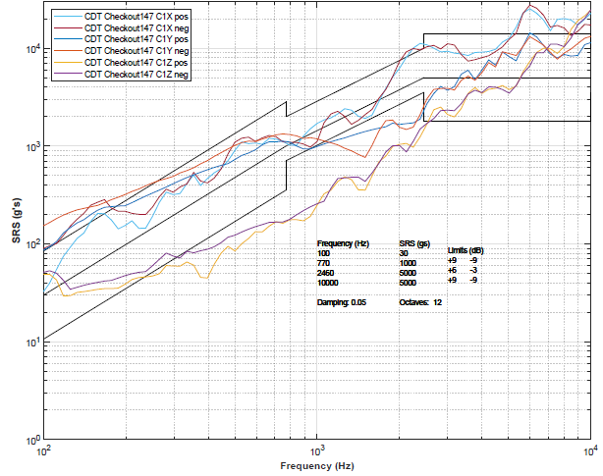
Shock dynamics during separation must coincide with theoretical predictions for accurate flight profile validation
3. Characterizing separation event dynamics
4. Recording physical separation data to compare to measurements made during flight
5. Verifying no contact between the PLF and flight hardware during separation
Shock Impulse SRS Example
Notes:
Characterizing separation event dynamics - The shock dynamics during the separation must coincide with theoretical predictions in order to validate an accurate flight profile. This profile will be used to better understand the dynamics of the separation event during flight. Acceleration and displacement are recorded during the HSS separation event using accelerometers, high-speed cameras and lasers at various positions along the PLF. This objective is marked as successful if sufficient and accurate data is recorded to fully characterize the separation event dynamics, including translational, vertical and radial displacements, as well as rotation rates and timing. PLF kinematic parameters were computed and compared to predictions to validate HSS functionality. There were no influencers to displacement besides HSS spring pack.
Recording physical separation data to compare to measurements made during flight. Physical testing of new models validates historical testing environments. This provides accurate predictions of structural dynamics during actual flight separation. This objective is accomplished if acceleration and displacement data along pertinent locations throughout the PLF and LVFA during the HSS separation event is recorded for comparison to predictions made from historical testing.
Verifying no contact between the PLF and flight hardware during separation. Contact between the PLF and LVFA during the HSS separation may cause loss of second stage functionality as well as damage to the flight hardware. It can also saturate recorded data rendering it useless. Blue dye is placed at pertinent locations of the LVFA stringers and PLF inner stiffener for clearance detection, allowing visual inspection of HSS clearance to be done any time before and after testing. The PLF aft end displacements in proximity of HSS are measured to characterize the PLF radial deformation during separation. The objective is met if, during the HSS separation event, there is no blue dye transferred from the LVFA stringer to the PLF or from the PLF inner stiffener to the HSS outer flare, no contact between the PLF and its support structure which can influence recorded data, and there is sufficient and accurate recorded data to characterize the PLF radial displacement.

Slide 10
Background on Launch Vehicle
Testing Objectives
Description of Test Article
Test Equipment and Instrumentation
Test Performance and Results

Slide 11
Components connecting to the HSS were physically modelled
Test Stack - accurate Centaur V interface, PLA and LVFA stiffness, mass and physical dimensions
Sensors were attached throughout model for data recording purposes.
A 13.5m-long cylindrical section simulated the ogive section of the PLF
LVFA - flight equivalent but stringers were modified
PAF - flight equivalent but structurally irrelevant and mass negligible parts were omitted.
LH2 skirt - used for connection purposes and to simulate the LVFA to Centaur V interface
Diagram of the PLF Simulator
Diameter of 22ft and height of 46ft.
Notes:
The main objective of this test was to measure the shock propagation throughout the flight equivalent models of the PLA and LVFA during a successful HSS separation event. Performing a separation on a mock-up of the Centaur V rocket is expensive in cost and time, so only the components connecting to the HSS were of necessity to physically model. Parameters of importance for this test stack include accurate Centaur V interface, PLA and LVFA stiffness, mass and physical dimensions. The fully assembled test stack had a diameter of 22ft and height of 46ft. Sensors were attached throughout the flight model for data recording purposes. The model section representing the PAF was flight equivalent, although structurally irrelevant and mass negligible parts were omitted. The LVFA was mostly flight equivalent, except the locations of the stringer were modified. The LH2 skirt was used mainly for connection purposes and to simulate the LVFA to Centaur V interface. A 13.5m-long cylindrical section simulated the ogive section of the PLF because the ogive section is not relevant for shock propagation in the payload and does not provide any additional stiffness. The remaining ogive section mass was accounted for in the model by the load introduction device (LID) mounted on the PAF forward interface and a cross beam fixed to the top of the PLF. The rest of the PLF simulator was modeled to be the same as the flight PLF.
The facility adapter ring (FAR) is a component used to secure large test articles to the ground for rigidity. The FAR was used to attach the LH2 skirt to the test location floor. This LH2 skirt connection models the flight boundary conditions of the Centaur V second stage. The HSS, located within the LVFA, provides the separation mechanism for the SL configuration test. The LVFA, which is connected to the PAF, was interfaced to the LH2 skirt. The PLF simulator was attached on its bottom to the LVFA,
The LID fixture simulates the mass of the flight payload. C-adapters were used to mount the LID fixture on top of the PAF forward interface. A crossbeam, which accounts for the mass of the omitted ogive section of the PLF, was located near the ceiling of the high bay. This beam held the cable of the catching system and was used to support the entire PLF assembly.

Slide 12
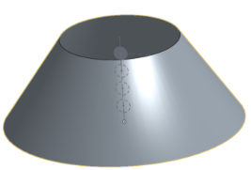
The Load introduction device (LID) fixture simulates the mass of the flight payload
C-adapters were used to mount the LID fixture on top of the PAF forward interface
A crossbeam located near the high bay ceiling, held the catching system cable and supported the entire PLF assembly
Crossbeam and LID accounts for the omitted ogive section mass
Generic design of FAR
The facility adapter ring (FAR) secured the LH2 skirt to the ground for rigidity, modeling flight boundary conditions of the Centaur V second stage.
Diagram of Crossbeam Above Cylinder Section
Notes:
The LID fixture simulates the mass of the flight payload. C-adapters were used to mount the LID fixture on top of the PAF forward interface. A crossbeam, which accounts for the mass of the omitted ogive section of the PLF, was located near the ceiling of the high bay. This beam held the cable of the catching system and was used to support the entire PLF assembly.
The remaining ogive section mass was accounted for in the model by the load introduction device (LID) mounted on the PAF forward interface and a cross beam fixed to the top of the PLF. The rest of the PLF simulator was modeled to be the same as the flight PLF.
The facility adapter ring (FAR) is a component used to secure large test articles to the ground for rigidity. The FAR was used to attach the LH2 skirt to the test location floor. This LH2 skirt connection models the flight boundary conditions of the Centaur V second stage. The HSS, located within the LVFA, provides the separation mechanism for the SL configuration test. The LVFA, which is connected to the PAF, was interfaced to the LH2 skirt. The PLF simulator was attached on its bottom to the LVFA,

Slide 13
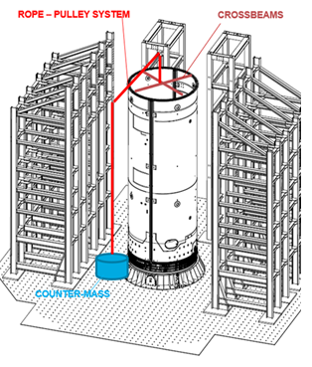
A catching system was implemented to hold the PLF above the LVFA following the separation event
A 4500kg counterweight pulled up on the PLF using a cable pulley system and cross beam until its motion was halted with an air brake
Nine towers surrounded the PLF with bumpers attached to prevent any swinging and damage of the PLF following separation.
Total travel – constrained to a few feet.
Simulated flight condition – 1g
Diagram of the catching system used for testing
Notes:
CATCHING SYSTEM AND IMPLEMENTATION
A catching system was implemented to hold
Figure 1: Diagram of the PLF Simulator used for testing.
the PLF above the LVFA following the separation event. This protected the PLF and LVFA from contacting each other as well as providing accurate shock data from solely the separation event. The catching system consisted of a structure supporting a 4500kg counter mass connected by a cable pulley system to the upper crossbeam of the PLF.
Figure 2: Diagram of the catching system used for testing
As soon as the separation event occurred, and the PLF moved upward to a defined height passed the separation plane, the counter mass was engaged to pull the PLF away from the floor. This counter mass had activation height, which included system elasticity, to allow for proper flight conditions to be experienced on the test article before the catching system activated. During the separation event, the test stack was exposed to a simulated flight condition of 1g before the catching system took effect. The counterweight pulled up on the PLF until its motion was halted with an air brake, as it approaches the limits of its travel. Total travel of the simulator was constrained to within a few feet. A shock dampening mechanism was placed between the counter mass and the PLA to counteract any shock experienced as the catching system and the initiation of the air brake. Nine towers surrounded the PLF with bumpers attached to prevent any swinging and damage of the PLF following separation. These towers were also used to support the PLF following testing when it was craned away from the facility.

Slide 14
Background on Launch Vehicle
Testing Objectives
Description of Test Article
Test Equipment and Instrumentation
Test Performance and Results

Slide 15
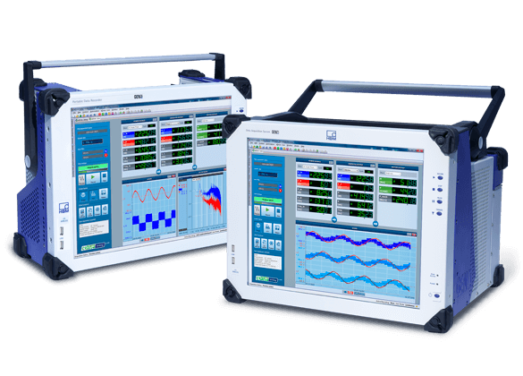
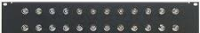
360 shock accelerometers were placed throughout the simulator
Accelerometers were used to measure shock propagation through the PLF, payload interface, and other component location.
Accelerometers specified up to 200,000 G load capacity were used in the area closest to the HSS.
General HBM DAQ system
Generic BNC patch panel
HBM hardware can handle 300+ channels all operating at 250 kHz,
All accels were connected to a chassis containing patch panels connecting to the Hottinger Baldwin Messtechnik GmbH (HBM) data acquisition (DAQ) system
Perception software was used to record the time history of the shock event data
Notes:
TEST EQUIPMENT AND DATA AQUISITION
One of the main objectives of this separation test was to record shock propagation throughout the PLF and PLA stack. 360 shock accelerometers were placed in relevant locations throughout the simulator to measure how the shock propagates through the PLF, into the payload interface and through essential flight component locations. These accelerometers were specifically chosen and placed based on the expected G loads. Accelerometers specified up to 200,000 G load capacity were used in the area closes to the HSS. All accelerometers were connected with microdot extension cables and BNC cables, routed off the PLF, and into patch panels attached to the chassis containing the Hottinger Baldwin Messtechnik GmbH (HBM) data acquisition (DAQ) system to organize all the connections. The HBM hardware can handle 300+ channels all operating at 250,000 Hz, providing an exceptional data collection ability necessary for fully understanding the shock environments experienced throughout the vehicle. Perception software was used to record all the data from the shock event for post processing into an SRS environment.
Additional instrumentation was also required to support objectives of the test. General accelerometers with a low G load capacity were used solely to provide event timing information for reference when analyzing shock data and not measuring shock response. Laser transducers capable of .1mm resolution when operating at 3200Hz, over a +-20mm radial range, and +-50mm axial range, were used to measure the trajectory of 8 points along the HSS circumference. This provided precise measurements over a small range immediately following separation. To support the laser data, visual targets on the PLF simulator were tracked with high-speed cameras to provide further insight into separation dynamics. They also provided more views of the testing for later analysis.. Clearance detection was accomplished by application of engineering blue dye on outer surface of LVFA stiffeners and inner face of PLF spring bracket stiffener, allowing visual inspection of any sort of interferences during the separation. Finally, rope tension preload, counter mass acceleration, and hold down and release mechanism (HDRM) activation currents were all measured and synced with the HSS firing signal to ensure correct catching system functionality and provide accurate timing consistent across all sensors.
Additional instrumentation was also required to support objectives of the test. General accelerometers with a low G load capacity were used solely to provide event timing information for reference when analyzing shock data and not measuring shock response. Laser transducers capable of .1mm resolution when operating at 3200Hz, over a +-20mm radial range, and +-50mm axial range, were used to measure the trajectory of 8 points along the HSS circumference. This provided precise measurements over a small range immediately following separation. To support the laser data, visual targets on the PLF simulator were tracked with high-speed cameras to provide further insight into separation dynamics. They also provided more views of the testing for later analysis.. Clearance detection was accomplished by application of engineering blue dye on outer surface of LVFA stiffeners and inner face of PLF spring bracket stiffener, allowing visual inspection of any sort of interferences during the separation. Finally, rope tension preload, counter mass acceleration, and hold down and release mechanism (HDRM) activation currents were all measured and synced with the HSS firing signal to ensure correct catching system functionality and provide accurate timing consistent across all sensors.

Slide 16
Background on Launch Vehicle
Testing Objectives
Description of Test Article
Test Equipment and Instrumentation
Test Performance and Results

Slide 17
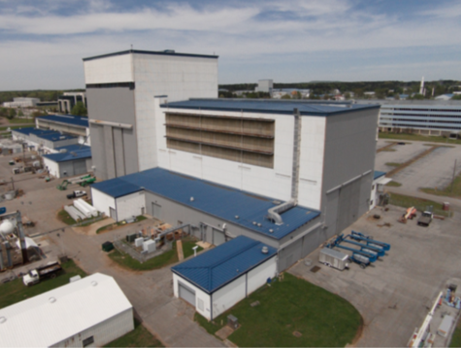
Testing was performed on May 14, 2021, at NASA’s Marshall Space Flight Center (MSFC) in the high bay of building 4619
All objectives for this SL stage separation test were met
No further PLA SL configuration testing is necessary at this time
MSFC Bldg. 4619 – Separation Test Location
A program developed by MSFC personnel was used to post-process the raw time data and transform it into SRS environment
The SRS plots substantiated theoretical predictions, validating component testing regimes
Notes:
The HSS was examined to ensure that separation would take place without any obstructions or attachment issues. The catching system was also examined to verify that any damage to either of the two stages as well as corruption of shock data would be prevented. The functionality of the sensors, cables, and HBM system were individually verified before the separation test. The functionality of each sensor and cable assembly connecting to the HBM were also verified to ensure proper signals were being seen by the HBM. Slack on the cables connecting to the HBM were ensured so that when the separation occurred, the cable assemblies would not be pulled apart by the separation of the two stages.
Testing was performed on May 14, 2021, at NASA’s Marshall Space Flight Center (MSFC) in the high bay of building 4619. The HSS was successfully activated without any issues. The catching system functioned as intended and prevented any damage to test article, connection between the PLF and flight hardware, and spoiling of shock data. All sensors successfully gathered data in sync with the HSS firing signal. The HBM hardware and perception software received and recorded time data throughout the entire separation event. A program developed by MSFC personnel was used to post-process the raw time data and transform it into SRS environment. This program was also used to calculate the velocity and acceleration of the HSS at each sensor location, thus allowing characterization of the separation event. The SRS plots substantiated theoretical predictions, validating component testing regimes. Safety of all personnel and test equipment were maintained throughout the test preparation and separation event.
All objectives for this SL stage separation test were met. This test is regarded successful by ULA and Beyond Gravity personnel. No further PLA SL configuration testing is necessary at this time.

Slide 18
Questions, recommendations, comments
Notes:
Questions:
1. Is it possible to have a rotation (preferably after first rotation to get general idea of a department) where a person shadows a team lead/supervisor/ chief of department in order to learn about managerial side?
Comments / Recommendations
1. Three month rotation may be ideal in certain areas, but may not be enough time to learn details of work done.
2. Rotation should be emphasized to be in completely different department from department-who-hired.
3. Bringing in snacks for all coworkers is a good method of building initial comradery.
Comments/Future Plans :
1. Work in budget office to learn about monetary and business/budget side of NASA
2. Possibly EM 32 Additive Manufacturing detail (further down the line)
3. Provide significant contributions in ET40

