Slide 1
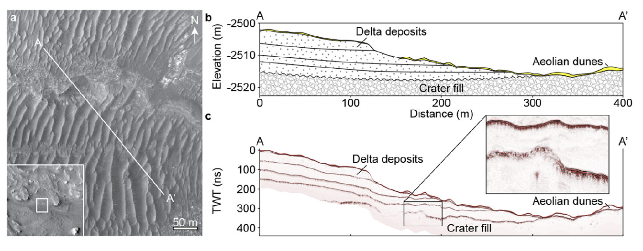
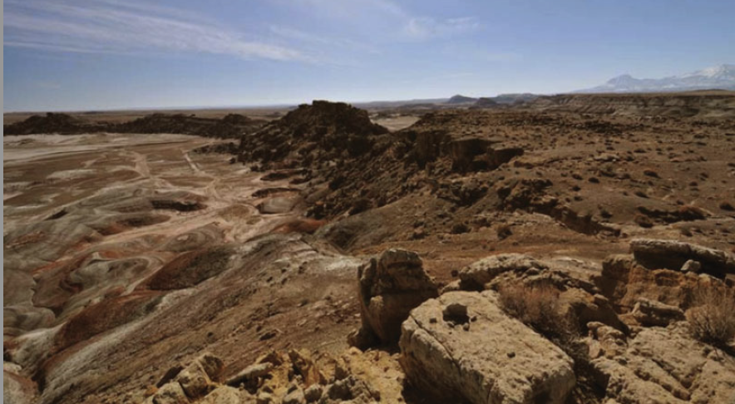
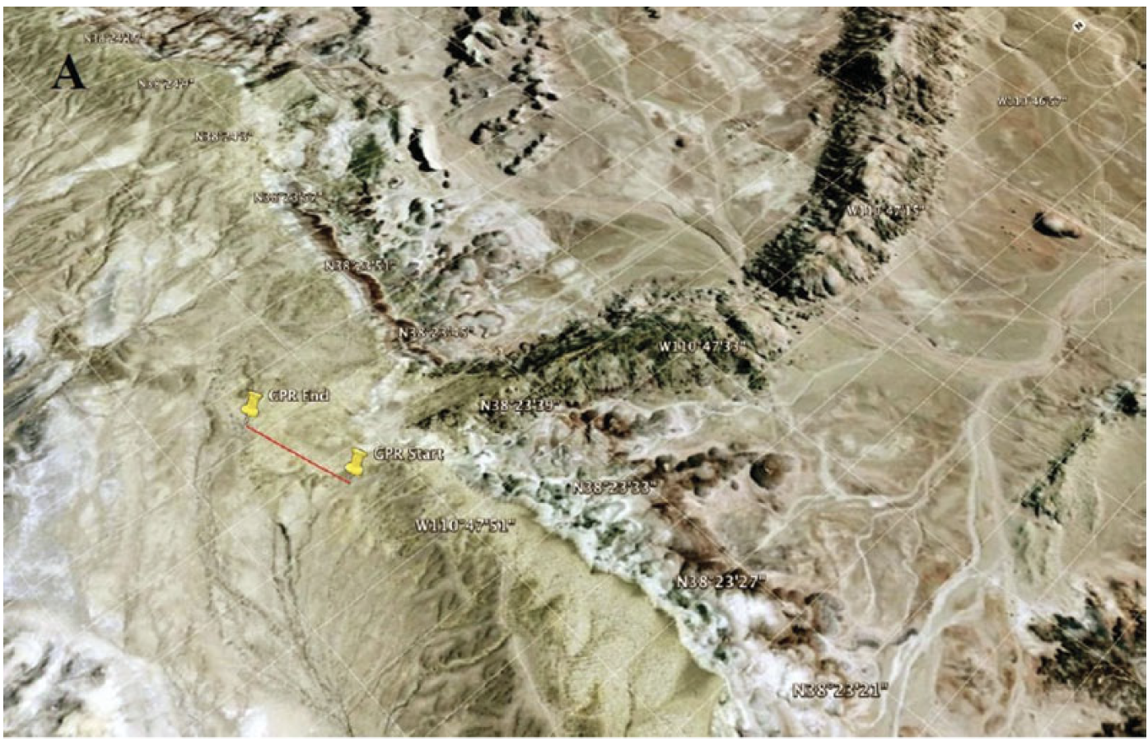
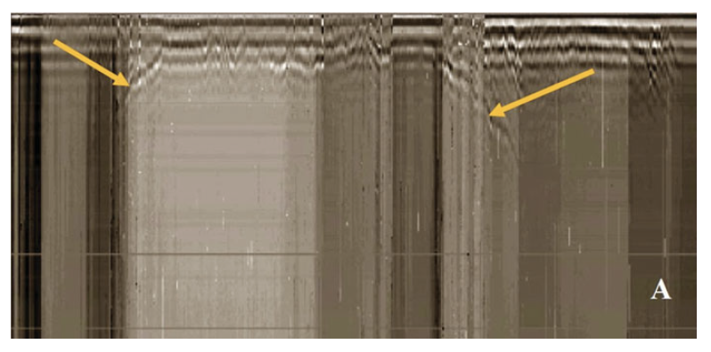
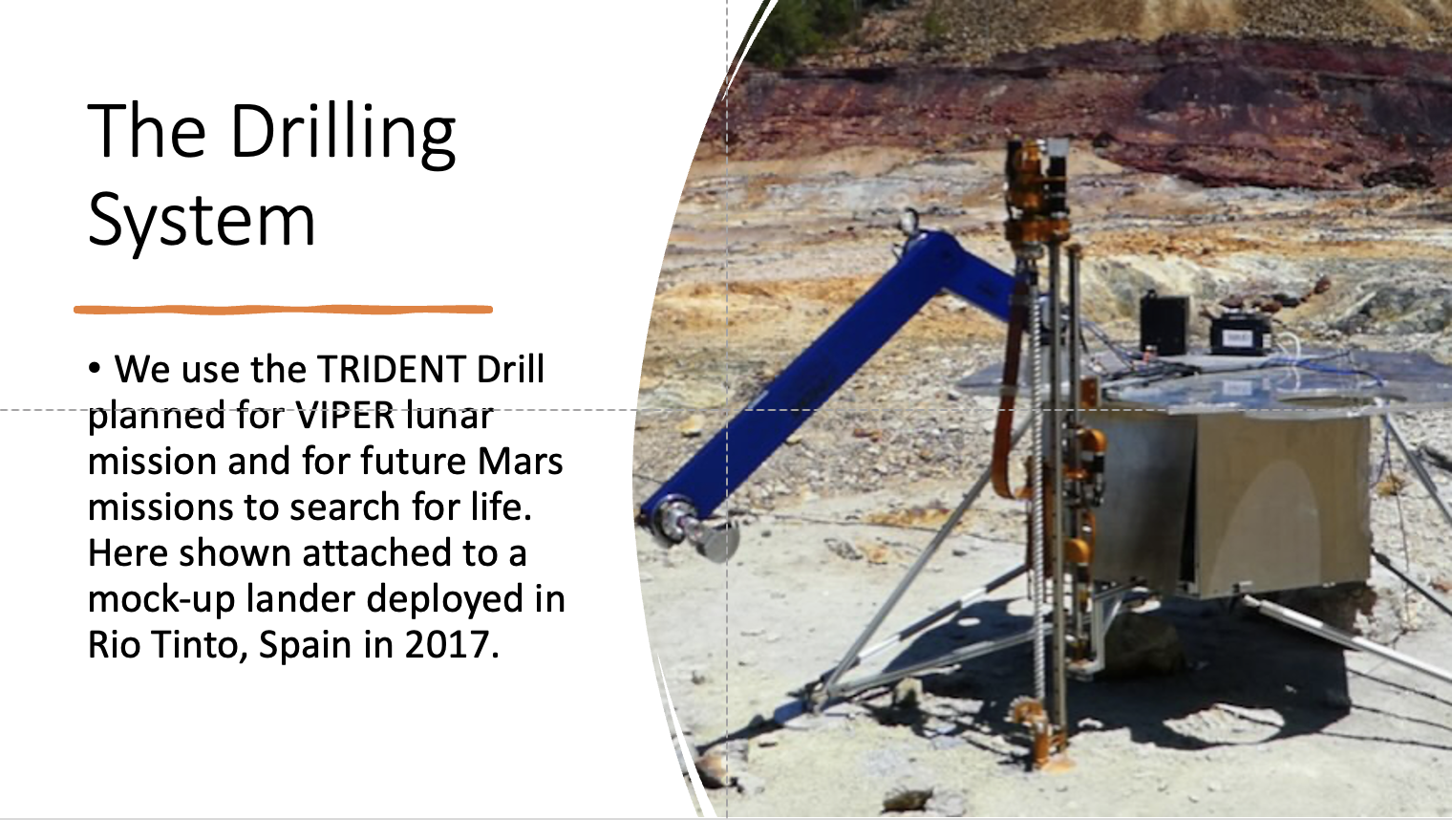
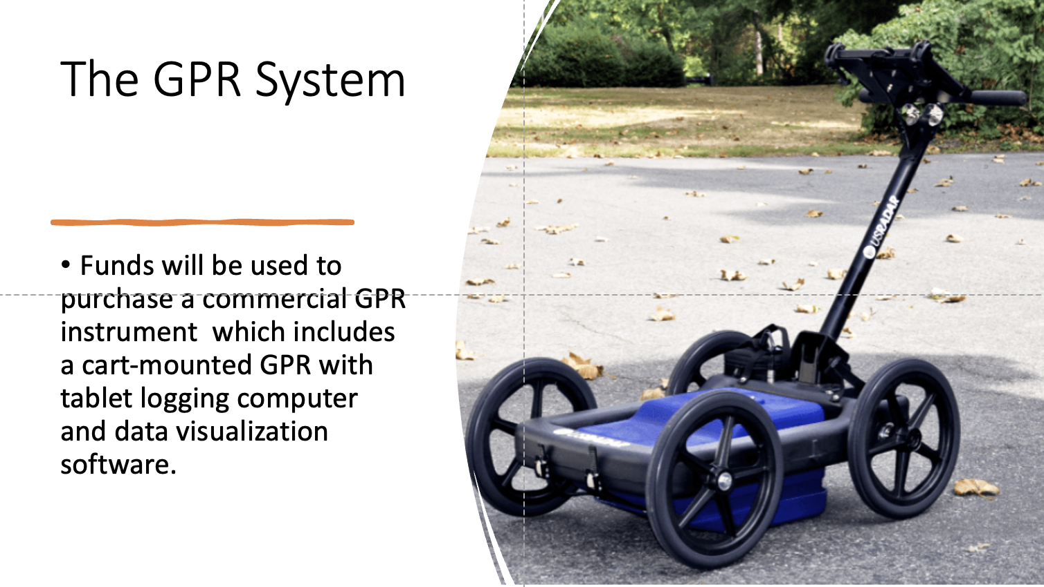
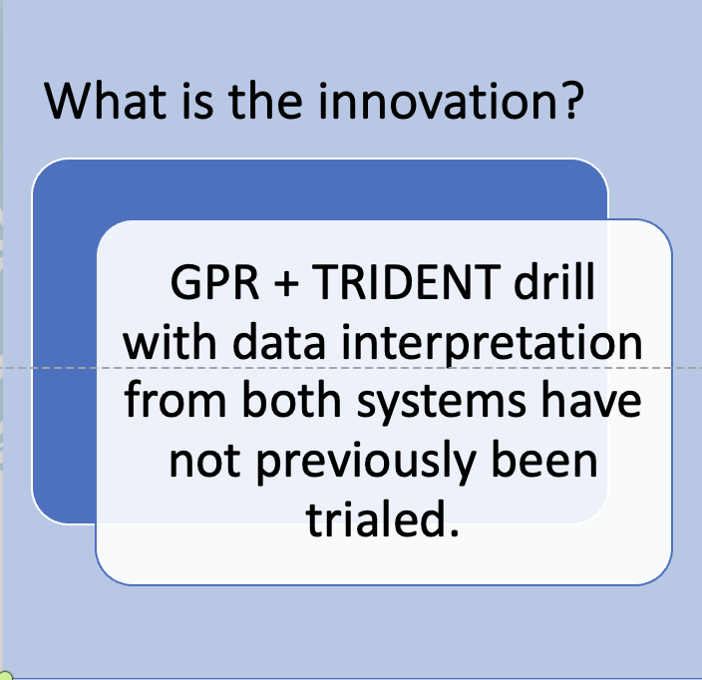
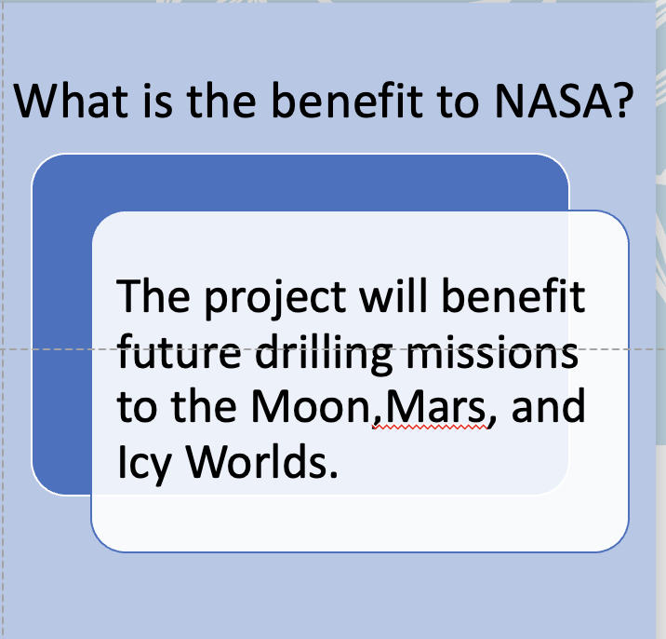
2022 Innovation Fair – Drilling + GPR Field Survey
Project Lead: Carol Stoker (ARC-STT) carol.stoker@nasa.gov
Key Contributors: Brian Glass (Code TI) provides TRIDENT drill, Terry Stevenson (Code TI) drill engineer, Heather Smith (Code ST) GPR operator
Project Summary and Objectives: Ground Penetrating Radar is a method for imaging subsurface structure in geology. RIMFAX, a GPR instrument, is on the Perseverence Rover now operating on Mars. A GPR instrument is also part of the European ExoMars rover payload. GPR can be used together with drilling where GPR predicts the subsurface structure and drilling is used to sample it. Drill data also provides information on subsurface structure. We plan to obtain a commercial GPR system and use it in field work to help characterize the subsurface and optimize locations for drilling. The drilling will be accomplished with a flight prototype TRIDENT drill. TRIDENT will be used on the moon on the Prime-1 and VIPER missions. Drill data and GPR data about subsurface structure will be compared. Deliverables are a report showing the area surveyed, the drill and GPR data acquired, and how they compare.
Ground Penetrating Radar is used to map subsurface structure.
Example: GPR Interpretation from Prior Work by the PI
(Clark and Stoker, 2011 International Journal of Astrobiology)
Radargram produced by the scan. Arrows point to edges of the subsurface channel structure.
This figure shows (left) a traverse across a delta deposit on Mars, (right top) the subsurface structure of the deposit, (right bottom) a modeled radargram of the traverse. Credit. Figure from Hamran et al. 2020, Space Science Reviews.
This view shows an exhumed inverted channel where it meets a mesa and disappears subsurface. Line shows approximate location of the GPR scan.
Google Earth image showing location of GPR scan of subsurface channel deposits (red line).
Other Information
Project Type: Mission
Implementing organization: Space Science Division
Implementation plan:
• Purchase GPR system, learn to use and interpret the data.
• Select field site for Drill+GPR tests.
• Perform the field tests.
• Compare the Drill and GPR data of subsurface structure
• Write a summary report
The field work will be part of the Drilling on GIFT (DIG) ISFM-funded work being planned for FY 23 in collaboration with the Goddard Instrument Field Tests (GIFT) ISFM. The DIG project is led by the Space Science Division in collaboration with the Information Technology Division.
Budget Request: $25K (used to purchase GPR system)
Deliverables: A final report describing field location, GPR data acquired, drill data acquired, and comparison between them.

