Slide 1
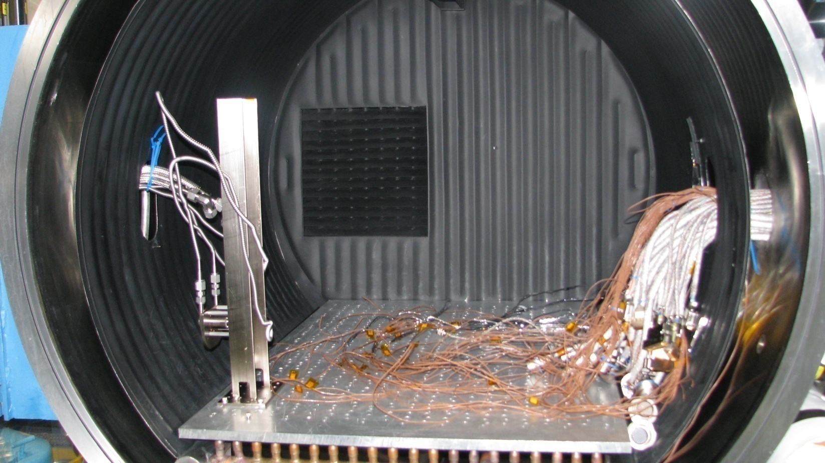
Bakeout Workshop
Glenn Rosecrans, KBR, Inc.
Therese Errigo, NASA GSFC
John Canham, Peraton, Inc.
2022 Space Simulation Conference – Bakeout Workshop Tutorial

Slide 2
Agenda
Outgassing and
Outgassing Certifications
What is Outgassing?
Why does it matter?
Why do we have to bakeout materials if they pass the ASTM E595 Screening test?
How to measure outgassing rates…QCM
How to model chamber
How to use mass transport analysis
Optimizing tests and project bakeout plans to minimize contamination risks, chamber costs, and schedule risks
Isothermal TV tests vs. Non-Isothermal Tests
Case Study
MMS SwRI Harness Bakeout
Measuring Big Blue background
  Bake to 3%/hr @ program bake temp
  Lower to HW cert temp
  Calculate transformation factor
Measuring the Flight Hardware
  Evaluate methodology
  High rates encountered
  Review IS harness contribution to total mass flux
  Negotiate change based on analysis
  Project savings due to this test design
2022 Space Simulation Conference – Bakeout Workshop Tutorial

Slide 3
Acronym listing
ASTM American Society for Testing and Materials
BO Bakeout
CQCM cryogenic QCM
CVCM Collected Volatile Condensed Material
Ebox electronic box
EC effusion cell
ESA European Space Agency
DF delta frequency
DDF delta delta frequency
GSE ground support equipment
GSFC Goddard Space Flight Center
HW hardware
Hz Hertz
IS instrument suite
IEST Institute of Environmental Sciences and Technology
MSFC Marshall Space Flight Center
MLI multi-layer insulation
NASA National Aeronautics and Space Administration
NVR non-volatile residue
OGR outgassing rate
OSAM1 On-Orbit
QCM Quartz Crystal Microbalance
QTGA QCM Thermo-Gravimetric Analysis
RH relative humidity
RTV room temperature vulcanizing
SC Spacecraft
SPEC specification
STP standard temperature and pressure
T Temperature
TML Total Mass Lost
TQCM temperature-controlled QCM
TV thermal vacuum
UV ultraviolet
VF view factor
VOC volatile organic compound
WVR Water Vapor Regained
On slide 45
ADP Axial Double Probe
ASPOC Active Spacecraft Potential Control
DES Dual Electron Spectrometer
DIS Dual Ion Spectrometer
EDI Electron Drift Ion Detector
EIS Electron Ion Spectrometer
FEEPS Fly’s Eye Energetic Particle Sensor
HPCA Hot Plasma Composition Analyzer
Mag Magnetometer (sensor)
MMS Magnetic Multiscale Spacecraft
OSR optical solar reflector
SA solar array (panel)
2022 Space Simulation Conference – Bakeout Workshop Tutorial

Slide 4
Who? What? Why?
Flight and Ground Support Equipment (GSE) hardware have requirements levied in Contamination Control Plans to measure the hardware outgassing rate.
Mass transport analyses are performed to assess contamination risks to optics, detectors, and thermal surfaces.
Conduct outgassing rate verifications in Thermal Vacuum (TV) chambers, while obtaining low space-like vacuum pressure, either as a tack onto a Thermal validation test or separate TV test.
Bakeouts help expedite the release of volatile molecules from the bulk material. Typically, performed at maximum survival temperature of the hardware.
Certification enables the chance to validate that the outgassing rate had been achieved at the hardware’s predicted hot operating temperature.
2022 Space Simulation Conference – Bakeout Workshop Tutorial

Slide 5
Molecular Depositions Affect
Hardware Performance and Science
  Absorption (reduction in transmission, reflectance in optical or sensors wavelength of interest)
  Scattering (dependent upon deposition pattern and wavelength)
  Sticking of mechanical mechanisms (Lube loss, too much?)
  Corrosion during ground operations (if incompatible with substrate)
  Changes in polarization states of electromagnetic energy (acts as a thin film)
  Attenuation or stopping of ionizing radiation before it reaches detectors
  Localized increase in pressure resulting in catastrophic failure of high voltage components (corona discharge)
2022 Space Simulation Conference – Bakeout Workshop Tutorial

Slide 6
Outgassing Sources - NVR and Bulk Offgassing
Non-Volatile Residue (NVR) is a condensed film or a contact transferred molecular film
On the ground, NVR or Molecular Film deposits result from two phenomena:
  Contact with a contaminated or contaminating surface or material — for example, fingerprints, adhesive tape residues, lubricants, residues from manufacturing processes, greases, silicones, bare hands, etc.
  Condensation of airborne molecular organic contamination
    Many materials in our environment give off volatile (gaseous) organic compounds (VOC). Examples include: paint, adhesives, machine lubricating greases, engine exhausts, solvents, plasticizers in plastics.
    VOCs can condense and form an NVR film on a surface whenever their concentration in the air is too high or whenever they come in contact with a cool condensing surface. Examples, include films on windows after painting and condensation on mirrors in shower
2022 Space Simulation Conference – Bakeout Workshop Tutorial

Slide 7
Outgassing Sources – NVR, Offgassing, Outgassing
Not many contamination sensitive industries have the same level of concern for molecular contamination as the satellite industry
    Strong solvents and commercial cleaning agents usually cannot be used to remove contaminants unlike other industries where such strong agents can be used.
    Time to integrate satellites is very long (months, even years) as compared to most other contamination sensitive hardware
    Sensors used in satellites can be sensitive to levels of contamination in the angstrom (1E-10 m, 1E-4 um) range
In vacuum, NVR / molecular films result when materials outgas from one surface and deposit onto another, usually cooler, surface. Contaminants inside electronic boxes for example can outgas and exit through openings and deposit on colder surfaces.
2022 Space Simulation Conference – Bakeout Workshop Tutorial

Slide 8
Molecular Outgassing and Deposition:
A Few Mechanisms
Diffusion limited outgassing molecule
Source
Solar UV
Increases outgassing
Increases deposition
Polymerizes deposits
Non-outgassing molecule at temperature T
Rough Surface
Higher electrical potential
Higher surface area
Both increase deposition
Surface
Contamination
Collector
Contamination sensitive surface
If temperature collector < temperature source, deposition occurs
If UV light or chemical attraction, deposition enhanced
If temperature of collector is increased, evaporation processes occur and “self” cleaning ensues, but some residue may remain
Backscatter causes
Self-contamination
2022 Space Simulation Conference – Bakeout Workshop Tutorial

Slide 9
Project Contamination Analysis
Determining the Outgassing Budget
The project contamination analyst creates a 3-dimensional model of a spacecraft and calculates the allowable outgassing rates for surfaces and assemblies to ensure that the allowable outgassing deposition rates for contamination sensitive surfaces are not exceeded. Factors considered include:
  Outgassing properties of the materials of construction
  Temperatures of surfaces
  Presence of environments that accelerate or decelerate outgassing rates or enhance or reduce deposition rates (UV light, ionizing radiation, atomic oxygen, etc.)
  Geometry (lines of sight, probability of secondary reflections)
  High density sources or environments with high level of atmospheric gases (relative to hard vacuum – e.g., low Earth or Martian orbits)
The result of this analysis is a comprehensive outgassing budget for all elements in a spacecraft
  Outgassing rates are to be measured in Thermal Vacuum by a Quartz Crystal Microbalance (QCM)
2022 Space Simulation Conference – Bakeout Workshop Tutorial

Slide 10
Translating the Budgeted Outgassing Rate into an Thermal Vacuum Test QCM Rate
The required budgeted rate usually cannot be directly translated into a QCM* rate. It MUST be adjusted by the contamination analyst for the following factors:
  Thermal conditions in the chamber (Isothermal test/Cold or Hot wall test/Non-isothermal surfaces, etc)
    Need size/location/and temperature of surfaces that are not isothermal with respect to the flight hardware
  Variability of temperature conditions in the chamber
  Vacuum pumping efficiency of the chamber
  View factor of the QCM to the item under test
  Source (item under test) and collector (QCM) temperatures
  Chamber and GSE background and factors that affect the background (increases in background due to outer shell walls heating from ambient room temperature increasing, for example)
* Quartz Crystal Microbalance (QCM) – mass deposited on its external piezoelectric crystal which changes the frequency of the crystal from the protected baseline crystal.
2022 Space Simulation Conference – Bakeout Workshop Tutorial

Slide 11
Why Materials Outgassing Test Data is
NOT a Substitute for Outgassing Certification
ASTM E595 Standard Test
  Standard test developed in 60’s to address stability of materials in vacuum. Uses 125ºC temperature to “age” materials and predict long term performance…..Guideline…Screening technique
  Test Method Overview
    Expose sample to 50% RH, 25ºC, standard atmospheric pressure for 24 hrs
    Weigh Sample
    Place in Effusion Cell (EC)
    Heats 3 samples to 125ºC for 24 hours in vacuum chamber to <1E-6 torr
    Outgassed mass condenses on disk outside orifice of EC at 25ºC
    Remove samples from chamber
    Weigh sample to determine Total Mass Loss (TML) and weigh mass on disk to determine Collected Volatile Condensed Material (CVCM)
    Re-expose sample to 50% RH, 25ºC, standard atmospheric pressure for 24 hrs
    Re-weigh sample to determine percent of Water Vapor Regained (WVR)
  Pros: Cheap ($500), quick, large database of materials (1000’s of samples)
  Cons: 125ºC is higher than normal operation, 25ºC is warmer than many modern contamination sensitive surfaces, only one data point (have no idea if material is finished outgassing or will continue indefinitely)
2022 Space Simulation Conference – Bakeout Workshop Tutorial

Slide 12
Outgassing Testing –
Test Description (cont’d)
ASTM E1559
Test developed recently (in the late 80’s) to address disadvantages of the ASTM E595 test
Test Overview
    Expose to 50% RH, 25ºC, and standard temperature and pressure (STP)
    Weigh Sample
    Place sample in Effusion Cell
    Heat sample to temperature that represents actual use temperature for desired time. Can also do two stage – high temp to simulate bakeout and low temp to simulate actual use.
    Use at least 3 TQCMs to measure condensable mass at 3 different temps (specified by user – usually cryo (-160ºC), at -20ºC, and then ~10ºC below cold operating temp of sensitive surface)
    Run test for 2-4 days or longer, if needed.
    Perform QCM Thermogravimetric Analysis (QTGA), by gradual warm up of the QCMs.
    Remove sample from chamber.
    Weigh sample to determine exsitu total mass loss (TML); insitu TML is essentially the mass condensed on the cryogenically controlled QCM (CQCM).
Pros: Simulates actual use thermal profiles, permits determination of kinetics constants for use in mass transport analysis, possibility for many types of additional analysis, including QTGA/reemission rate of the condensates
Cons: Expensive ($2500+, depending on length of test), database of materials data that is often mission specific
Raw and some processed data available from various vendors and NASA centers (Nusil technologies, OSI, and GSFC, MSFC)
2022 Space Simulation Conference – Bakeout Workshop Tutorial

Slide 13
Understanding ASTM-E595 Test Data
Databases:
  GSFC online at https://outgassing.nasa.gov
  MSFC (special permission required to access online)
  ESA (https://esmat.esa.int)
  MAPTIS (https://maptis.nasa.gov)
Data has to be understood in context of test parameters:
  Meeting TML <1.0% and CVCM <0.1% is a screening guideline.
  CAN ONLY USE DATA FOR MATERIALS THAT WERE MIXED (Mix ratio) and CURED (time, temperature, vacuum) in the same way you plan on using it
    If you don’t see your mix ratio’s, cure schedule, primers in the list, you need to submit the material for analysis
  Some materials have low outgassing rates but will continue to outgas high molecular weight species for a long time. Species will stay on surfaces on which they land for a long time. Kapton (polyamide) is about 100 hours. Silicone about 4000 hours!
  MSFC-SPEC-1443 uses an optical witness sample (OWS) as the VCM collector for in-situ % changes in reflectance for near UV wavelengths.
2022 Space Simulation Conference – Bakeout Workshop Tutorial

Slide 14
Sample ASTM-E595 Test Data
 | TML % | CVCM % | WVR % | Unknown % (example)
Spec Guideline | 1.0 | 0.1
Clean Material if not CRYO apps | .9 | .01 | .89 | 0.0 Epotek silver filled epoxy
Clean but..high unknown | .15 | .01 | 0.0 | .14 Wire insulation, fluorocarbon
Silicone RTV566, Data good, material is not | .2 | .02 | 0.04 | 0.0 RTV566
Questionable for CC crit apps. | .9 | .09 | .20 | .61 Orings,viton
October 17, 2022
2022 Space Simulation Conference – Bakeout Workshop Tutorial
14

Slide 15
Total Mass Loss (TML) Behavior
October 17, 2022
2022 Space Simulation Conference – Bakeout Workshop Tutorial
15

Slide 16
Containing Bakeout Costs and
Preventing Schedule Slips 1/3
Bakeout costs for critical flight hardware requires 24/7 support:
$2-3000 per day for small chambers
$3-6000 per day for medium chambers
$6-10000 per day for larger chambers
Later in schedule that unplanned bakeout is required the more expensive: Bakeout cost + cost of marching army twiddling thumbs while bakeout continues = snowball effect, if is a critical path subassembly
Try to design out problems when designing flight and vacuum GSE hardware – e.g., silicone gaskets, organics that are thick (diffusion limited)), seal or contain (over tape), or try to bake them out at lowest level of assembly at highest temperature possible to minimize total system level vacuum time.
Example: complex, well-sealed motors were to be installed in a system that cannot be baked at high temperature;
  Motors contained materials with unacceptable outgassing rates.
  Knowledge from another program that it takes a long time to bake at high temperature
  Possible mitigations for situations like this: Bake motors out at lowest possible level of assembly and out of critical path. Open up housing to increase venting. Change out materials of concern.
2022 Space Simulation Conference – Bakeout Workshop Tutorial

Slide 17
Containing Bakeout Costs and
Preventing Schedule Slips 2/3
Have a TV chamber pre-close check list to ensure success and avoid costly chamber cleanups or damage to sensitive hardware:
  Verify that chamber and GSE were certified clean prior to test (may need pre-test background to calculate outgassing rate of hardware)
    Background needs to be stable and of lesser magnitude than QCM delta frequency rate you are seeking to measure
  Verify that all polymers are fully cured (typically 5-7 days)
  Verify that all materials are vacuum stable and free of problem contaminants (oils, greases, silicones, molecular films, etc.)
  Check for items that should not be part of the test
    Ink pens, gloves, insects (it has happened!), plastics, etc.
  Check that protective cap is off of the QCM sensor
  Make sure that the heat sink for QCM was operating properly during chamber certification test. The more sensitive the measurement the more stable the heat sink needs to be.
2022 Space Simulation Conference – Bakeout Workshop Tutorial

Slide 18
Containing Bakeout Costs and
Preventing Schedule Slips 3/3
  Make habit of keeping large, expensive chambers clean
    Bakeout “dirty” items in cheaper smaller chambers that may not need to be manned 24/7
    Create a tent/bagged enclosure within the shroud and vent outgassing to cold plates/traps so entire chamber doesn’t get contaminated
    Certify chambers before and after tests. Have a minimum lab standard. If project contaminates the chamber, make them pay to clean it. If no post certification is performed, then next project will have to pay.
    Use cold plates or other traps to permit determination of chemical species. Some contaminants worse than others – silicones for example.
    Use QCMs in addition to RGAs. RGAs typically (affordable ones) are not as sensitive as QCMs to small quantities of particular condensable materials.
  Chamber only use oil free vacuum pumps/non-silicone gaskets and lubricants
    for critical subsystems and instruments w/optics
2022 Space Simulation Conference – Bakeout Workshop Tutorial

Slide 19
Outgassing Rate?
Molecular Outgassing rate (Mass lost is really in vapor phase and lost at the molecular level)
  Looking for mass loss rate change in terms of:
    Mass loss per time (grams/sec, g/s)
    Mass loss per surface area per time (g/cm²/sec), or
    Mass loss per source mass per time (g/s/kg or ng/s/kg)
    Total mass lost is in terms of grams (g), milligrams (mg), or micrograms (ug)
  Use the method specified by the analyst. Don’t change method without consulting with the analyst.
2022 Space Simulation Conference – Bakeout Workshop Tutorial

Slide 20
How?
How do we recommend baking out the HW?
  Bakeout box (BOB), Very isothermal
    small items, don’t overload BOB; for large systems use a “tent” enclosure!
  Hot shroud (HS), Isothermal
    Typical, most preferred method for bakeouts
  Hot baseplate/platen (HB), variable shroud
    Requires extra calculations and possibly some ducting methods
Complications in measuring lost mass
  BOB, concentrated flow, may overwhelm QCM
  HS, have other GSE to account for chamber
  HB, Chamber interior never heated & need to position QCM to have decent view of hardware. Cooler surfaces in chamber become collectors. Ambient room temperature can cause release of previously collected materials on chamber walls.
2022 Space Simulation Conference – Bakeout Workshop Tutorial

Slide 21
Isothermal Test Pro’s
Usually easiest to model and get accurate rate
Lowest risk of residual contamination in the event that there are contamination sensitive surfaces on the item under test
Analysis is simplified: simple mass balance equation:
  Mass generated = mass lost, when in equilibrium
    Mass lost = mass exiting through pump + mass condensed on cold (thermally accommodating ) surfaces + mass deposited onto the QCM + any other mass sinks (all Mass collections areas)
    Mass exiting through pump is a function of the conductance of the pump. This can be calculated in two ways:
      Calculate physical conductance of pumping system – get orifice sizes, length of tubes/pipes, pumping efficiency of pump, etc.
      Take QCM measurements with same source conditions (preferably empty chamber that has reached a steady background) but different parameters – that is every surface area can act as a collector (turn scavenger plate on or off)
2022 Space Simulation Conference – Bakeout Workshop Tutorial

Slide 22
Isothermal Test – Set-up
All surfaces the same temperature except QCM, QCM cooling lines, scavenger plate (SP), cold finger (CF) and resp. cooling lines
  If using an internal shroud, make sure it does not have significant cold spots
    Typically, all temps on the should be within 10 degrees of each other, BUT for critical measurements this range may have to be further refined
    Don’t forget about doors – often they are not temperature controlled. Add a heater plate or put a thin layer of metal or even MLI that will couple with the chamber and create an essentially isothermal environment
    Also watch out for extensions and other areas that do not have active heating but a view of the chamber. Getting an accurate pre-test background is even more important.
  If using a bakeout box one needs to make sure that it had a clean post previous test and that it was also truly isothermal. The QCM needs to be positioned carefully and the position given to the analyst. The box vent should go to a cold plate to trap effluent and keep the chamber clean.
2022 Space Simulation Conference – Bakeout Workshop Tutorial

Slide 23
Monitoring Apparatus
Thermo-electric Quartz Crystal Microbalance (TQCM)
  Collects fraction of material outgassed (crystal is a ~1/4” in diameter)
    Molecular Mass is condensed onto a surface cooler than tested element
      QCM crystal, typical set point is -20ºC, but can be lower
      QCM heat sink, if not thermally isolated
      Vacuum chamber walls (not shroud)
      Exits through to pump
      QCMs can be “cleaned” baked off after gain of 10KHz above baseline and reset to continue collecting
      15 MHz crystal Mass sensitivity typically is 1.96e-9 g/cm²/Hz (~2 ng/cm²/Hz), can take up to 50,000 Hz or ~32 ug (0.03 mg), but crystal response starts getting negatively affected and may Zero out! It may recover by bakeout or need a physical (delicate) cleaning.
      2 US vendors: QCM Research (now owned by Elecsys LLC) and Crystal Tek Corp. (previously Faraday Industries)
      QCM Controllers output data in text/log files which can imported into Excel spreadsheet, for analysis, plotting. Also there are visual displays.
2022 Space Simulation Conference – Bakeout Workshop Tutorial

Slide 24
Bakeout Box Test
Bakeout box, drives HW temp
  Must know vent area
  Must know QCM crystal area (typ. 0.317 cm²)
  Must know QCM collection rate without hardware
    Bake system with all GSE, no flight hardware
    QCM faces into box from outside
    Determines effect of box and backstreaming
  Subtract background rate from total rate
    Now have hardware collection rate
2022 Space Simulation Conference – Bakeout Workshop Tutorial

Slide 25
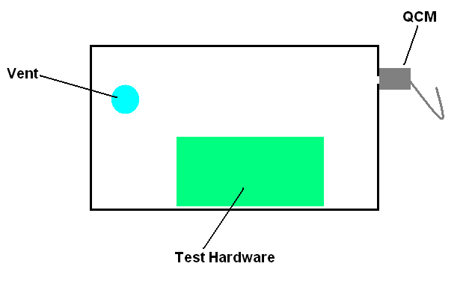
Bakeout Box Configuration
2022 Space Simulation Conference – Bakeout Workshop Tutorial

Slide 26


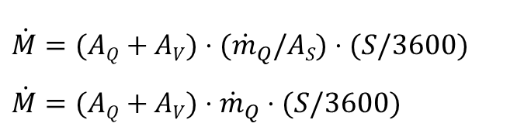
Bakeout Box Test OGR
Outgassing rate ( )
  Converted to terms of gram/sec, g/cm²/sec, or g/s/kg
  , QCM collection rate (Hz/hr) is fraction of total outgassing rate (minus background)
  A_{V} is vent area, A_{Q} is QCM area, A_{S} is source surface area (in terms of cm²)
  S is QCM Mass Sensitivity (g/cm²/Hz)
$$\dot{M}=(AQ+AV)⋅(\overset{}{{\dot{m}}_{Q}/AS)⋅(S/3600)} \\ \dot{M}=(AQ+AV)⋅\overset{}{{\dot{m}}_{Q}⋅(S/3600)}$$
g/cm²/sec
g/sec
2022 Space Simulation Conference – Bakeout Workshop Tutorial

Slide 27
Hot Shroud Test
Hot wall/shroud isothermal test
  Must know Mass Collections Areas (MCA)
    Actually more than pump (can include Cold Plate (CP) or Scavenger Plate (SP) & Cryocoils
    If shell is cold then add up all exit areas to cold pump shell, including pump exit.
  Estimate your Source Surface Areas (SSA)
    MLI is just one side of layup
    Electronic box is 5 sided, which accounts for internal PWBs
    Complex hardware or mostly metallic fixture, look to tally only polymeric materials.
  Must know QCM collection rate without hardware
    Bake system with all GSE, no flight hardware
    QCM has diffuse view of chamber
    Determines effect of chamber
  Subtract background rate from total rate
    Now have hardware collection rate
2022 Space Simulation Conference – Bakeout Workshop Tutorial

Slide 28
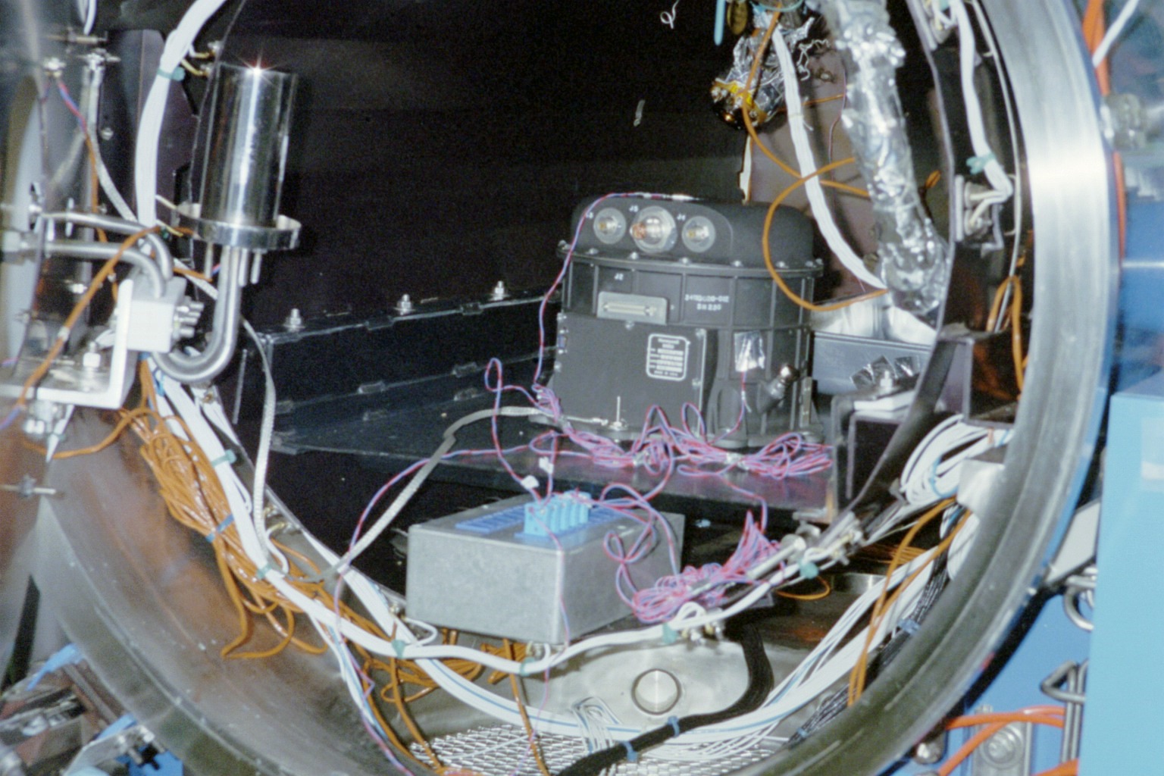
Hot Shroud
Note: ebox unpowered sitting on shelf, just TCs attached, QCM in back
2022 Space Simulation Conference – Bakeout Workshop Tutorial

Slide 29
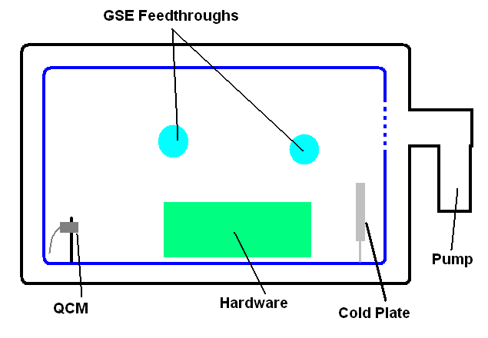
Hot Shroud Test
2022 Space Simulation Conference – Bakeout Workshop Tutorial

Slide 30
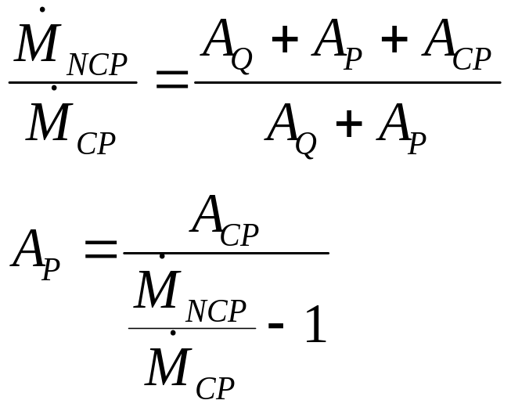
Hot Shroud Test
Acquisition of Effective Pump(ing) Area (A_{p})
  Can be determined during background/ pre-cert measurements
  Run deposition phases with cold plate (CP) and without cold plate (NCP)
2022 Space Simulation Conference – Bakeout Workshop Tutorial

Slide 31
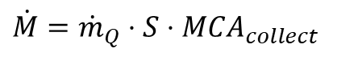
Hot Shroud Test
Subtract QCM background (Hz/hr) from QCM collection rate m_{Q} with hardware (Hz/hr)
Now have hardware only collection rate (g/hr)
A_{collect} is the total mass collection area, including QCM, effective pump area, and cold plate if used during hardware bakeout
$$\dot{M}={\dot{m}}_{Q}⋅S⋅{MCA}_{collect}$$
2022 Space Simulation Conference – Bakeout Workshop Tutorial

Slide 32
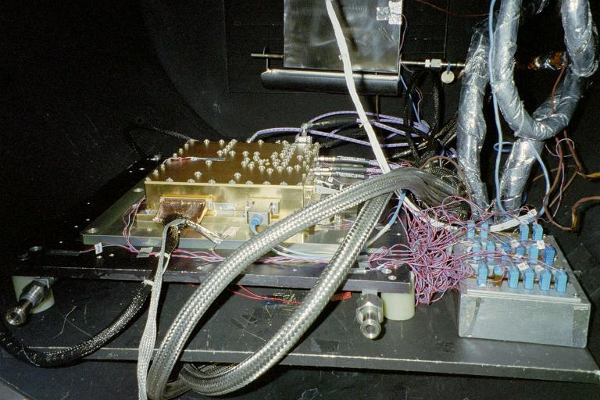
Non-Isothermal Test
Heated Baseplate/Platen
Payload sitting on a GN2 temp-controlled platen (not hooked yet). Payload
will be functional, with RF wires connected. QCM is hanging overhead. Cold/
Scavenger Plate is located in the back.
2022 Space Simulation Conference – Bakeout Workshop Tutorial

Slide 33


Hot Baseplate/Platen
Shroud wall temps typically cold. HW driven to hot & cold temps by platen.
QCM temp typically warmer than Shroud walls
QCM gain is based on view factor to outgassing hardware. Based on Source area, angular view and distance. Hand calculated or through TRASYS.
$$\dot{M}=(OGR∗VFs−r)/(S/3600)$$
where: = mass rate received by receiver- QCM (Hz/hr),
OGR_{s} = Outgassing rate of source (g/cm²/sec), and
VF_{s-r} = Nusselt Sphere Form Factor (view factor)
S = mass sensitivity of QCM (1.96 E-9 g/cm²/Hz)
1/3600 = time conversion from sec to hr.
2022 Space Simulation Conference – Bakeout Workshop Tutorial

Slide 34
Bakeout effectiveness 1/2
Outgassing rate follows kinetic characteristics
  “high” vacuum (<1e-5 torr pressure) helps draw molecules from hardware.
  Air oven bakes really only aid in thin film cures of paints and volatile materials (i.e. alcohols) and helping accelerate epoxies cures (drying out water)
  Follows a Power decay in the short term at BO temps and then exponential decay as bulk (non-gaseous species) material becomes depleted based on activation energy and polymers rearrange.
2022 Space Simulation Conference – Bakeout Workshop Tutorial

Slide 35
Bakeout effectiveness 2/2
High vacuum in bake outs only minimizes the back scatter of molecules emitted from the surface due to stagnation of gas flow at the surface. The stagnant gas reflects some of the emitted materials back to the surface and some diffuse outward.
Atmospheric (low vacuum) bake outs with GN2 purge minimizes stagnant gas over the surface as it removes the molecules that are emitted by the surface.
    Using this technique as a pre-bake exposure for gear motors, which has questionable materials, to help reduce outgassing under lower vacuum levels.
Evolution of molecules from a surface are dependent upon the coverage of the molecules at the surface and the rate of replenishment through diffusion and the loss from evaporation.
In cases (with hardware or instruments that have) long aspect ratio holes or tubes, purged atmospheric pressure bakeouts are significantly more efficient than high vacuum bake outs as the entrained molecules move further when entrained in the gas flow.
2022 Space Simulation Conference – Bakeout Workshop Tutorial

Slide 36
Bakeout criteria
Bakeouts can be based on time and/at temperature
  i.e. BO hardware 48 hrs at 80C and drop to cert temp. QCM data is collected but is necessarily the driving requirement
Bakeouts can be based on the “deceleration” of outgassing or rate of rate change in terms of Hz/hr/hr or based on percentage change.
  i.e. BO hardware until the QCM delta delta frequency (Δ Δ F) is <5 (to 10) Hz/hr/hr for 4 consecutive or averaged over 4 hours.
  i.e. BO hardware until the QCM delta frequency (ΔF) has achieved a <3% change for 4 hours. (DF_{t2}-DF_{t1})/DF_{t2} *100
  Bakeouts can be levied as some combination of criterial
  i.e. BO hardware until the QCM delta delta frequency is <5 Hz/hr/hr for 4 consecutive (or averaged over 4 hours) and for a minimum of 48 hrs or maximum of 72 hrs.
2022 Space Simulation Conference – Bakeout Workshop Tutorial

Slide 37
Magnetospheric Multiscale Spacecraft (MMS)
Test Example
Big Blue chamber at Southwest Research
  Used to bake flight hardware for MMS
Program requirements:
  Bake at 90°C for 48 hours
  Lower to 45°C
  Monitor until outgassing rate wrt QCM at -20C until delta frequency (Hz/hr) meets equivalent goal of < 5 ng/sec-kg of component mass
2022 Space Simulation Conference – Bakeout Workshop Tutorial

Slide 38
MMS Case Study
Big Blue Configuration
Typical hot wall test. Note feed-throughs at sides and vent at rear of chamber.
2022 Space Simulation Conference – Bakeout Workshop Tutorial

Slide 39
Big Blue Configuration
QCM on post at left side of chamber
Feedthrough for QCM cables, cooling lines behind QCM mounting post
Wiring harness feedthrough on right is empty, but hole in shroud still present.
GSE are part of the chamber background
Shroud is warm and covers most of the vacuum chamber shell, so negligible effect from cooler shell.
All extra hardware is part of the effective pump area
2022 Space Simulation Conference – Bakeout Workshop Tutorial

Slide 40
QCM Collection with and without Cold Plate
2022 Space Simulation Conference – Bakeout Workshop Tutorial

Slide 41
Big Blue Characterization
Average ratio of QCM rates is 25.5/4.9 = 5.18
A_{P} (effective area of the pump) found by test to be 952 cm²
Total area is A_{Q} + A_{P}
S is 1.96 ng/cm²-Hz
Use hardware collection rate equation to calculate the rate
Correction factor is 0.508 ng/Hz to convert QCM rate to hardware rate (~5 Angstroms/Hz)
2022 Space Simulation Conference – Bakeout Workshop Tutorial

Slide 42
Big Blue Limits
OGR limit for harness is 5 ng/sec-kg
  Harness mass ~5 kg
  Upper OGR limit is 25 ng/sec
Correction factor is 1828 ng/hz
Total pump area is 952 cm²
  3980 cm² if cold plate used
Maximum QCM collection rate is 49.2 Hz/Hr
Add background of 25.5 Hz/hr
Total max. allowable QCM collection rate is 74.7 Hz/Hr, or rounded to 75 Hz/hr.
2022 Space Simulation Conference – Bakeout Workshop Tutorial

Slide 43
Setting Limits
How are mass transport modeling OGR limits set?
Use spacecraft mass transport analysis to evaluate impingements to critical surfaces
Assume all material sticks unless it is problem
Then evaluate amount that might stick at operating temperatures
2022 Space Simulation Conference – Bakeout Workshop Tutorial

Slide 44
Setting Limits for MMS
Total internal SC outgassing estimated at 387 ng/sec (3.9E-7 g/sec) at beginning of life (BOL)
Total mass inside bus was ~390 kg
IS harness mass was ~25kg
  IS harness only 6.5% of total mass
Increased outgassing for multi-layer insulation (MLI) leaks and vent emissions is very small
  If allowance increased from 1 ng/sec-kg to 5, increase outgassing by 2.3%
  This is extremely small increase (see table next page)
2022 Space Simulation Conference – Bakeout Workshop Tutorial

Slide 45
Setting Limits
Critical surface | Predicted molecular gain | Primary sources (Approximate %)
Star Tracker Baffles | <2 Å | ADP (90%), Mag Boom (10%)
HPCA grid aperture | <16 Å (avg 4 nodes) | Leaky MLI (80%), Solar cells (20%)
EDI grid aperture | <10 Å (avg 4 nodes) | Leaky MLI (70%), SDP (15%), Solar Array (15%)
DES & DIS apertures | <2 Å | Leaky MLI (50%), Solar cells (50%)
EIS apertures | <2 Å | Leaky MLI (80%), SDP (20%)
ASPOC sensors | <7 Å | Leaky MLI (80%), SDP(10%), Bus vent (10%)
FEEPS sensors facing toward bus | <40 Å (1 node) | Bus Vent (80%), SA (10%), Leaky MLI (10%)
FEEPS sensors facing side and from bus | <4 Å (avg 5 nodes) | Leaky MLI (60%), Mag booms (25%), Bus MLI (5%)
Solar Cells | <5 Å | Leaky MLI (80%), Self-SA cells (20%)
Radiators, OSRs on ID and SC deck | <2 Å | ADP (90%), MLI (10%)
Sep Gold rings | <2 Å | ADP (70%), Bus MLI (20%), Mag Boom (10%)
2022 Space Simulation Conference – Bakeout Workshop Tutorial

Slide 46
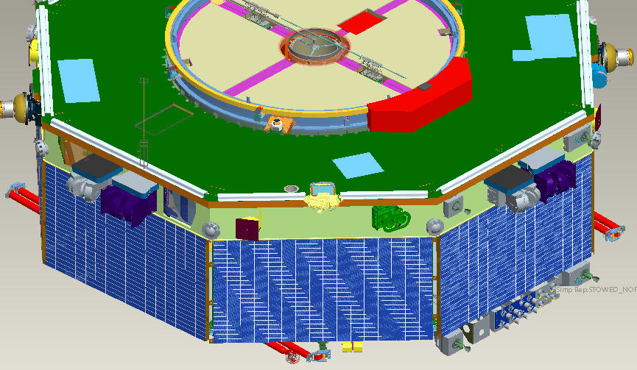
Setting limits
2.3% is negligibly small for MLI leaks
Amount somewhat larger if one of the FEEPS (Fly’s Eye Energetic Particle Sensor) located near the bus vent
  90% of impingement from BUS Vent or MLI leaks
  Deposition range
  <10-40 Angstrom
  Dependent on VF
  To sources.
  Saved numerous
  Days in TV time,
  Thus helped with
  Integration schedule
FEEPS
Vent
2022 Space Simulation Conference – Bakeout Workshop Tutorial

Slide 47
Links and Discussion
GSFC ASTM E595 data base
  https://outgassing.nasa.gov
Other material sites listed on slide 13
Discussion/questions
2022 Space Simulation Conference – Bakeout Workshop Tutorial

