Slide 1
You need a plan to make Space Suits
September 2022
Launch Point Leadership
Amy Ross, NASA Johnson Space Center

Slide 2
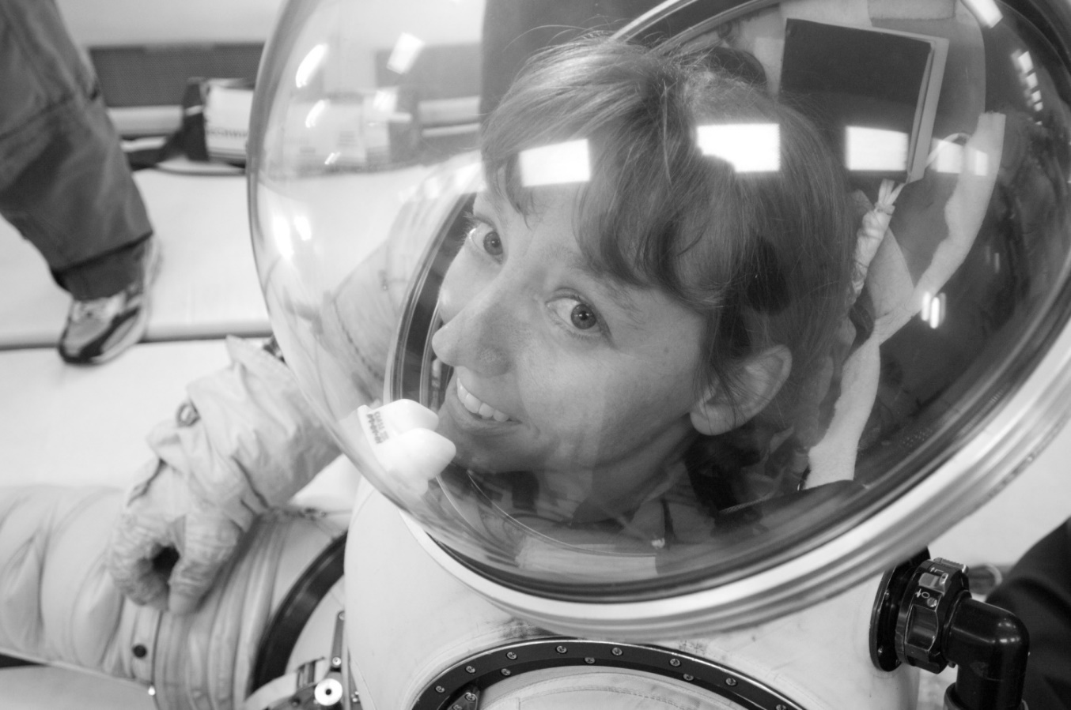
Context
Design Thinking from inside space suits:
  31 years at NASA Johnson Space Center
    Most of that on the Advanced Space Suit Development team
      Led the team for 16 years
  Certified the current series of gloves (Phase VI) being used for Extra-Vehicular Activity (EVA)
  Have been in 12+ different suits
    1-g, 1/6th-g, 1/3rd-g
    Neutral Buoyancy Laboratory (NBL), Reduced Gravity Aircraft
  Lead suit engineer for a decade of desert analog suit test
  First person to do a lunar gravity suit run in the NBL

Slide 3
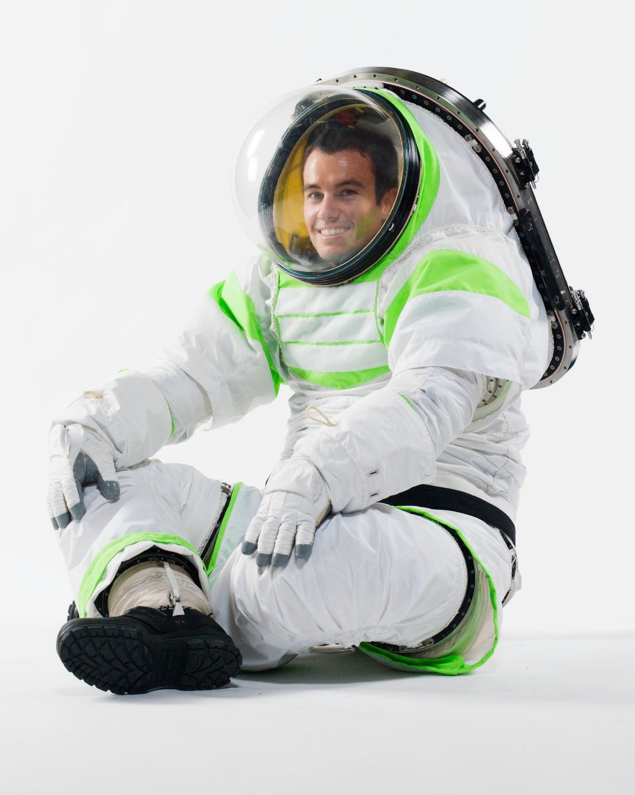
Inherently Human-centered System
Literally, the human is in the
center
of the system!

Slide 4
Full Disclosure
Design Thinking is a new term to me, but I’ve used the concept behind it over my entire career
Human-centered/centric design was a new term to be at one point
The design process that I’ve used at NASA, when done appropriately for EVA equipment, works the same way. Let me explain..

Slide 5
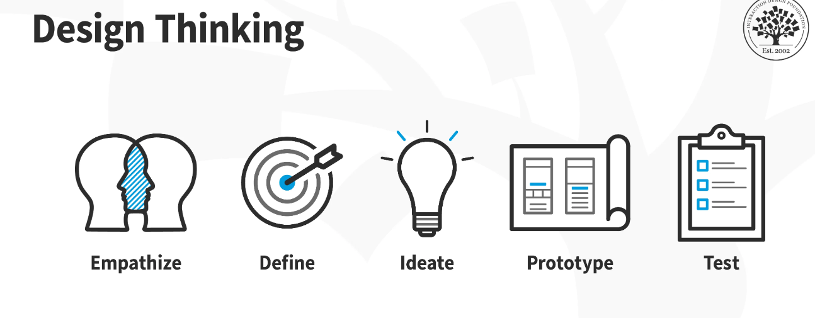
Design Learning
Design thinking is a non-linear, iterative process that teams use to understand users, challenge assumptions, redefine problems and create innovative solutions to prototype and test. Involving five phases—Empathize, Define, Ideate, Prototype and Test—it is most useful to tackle problems that are ill-defined or unknown
What is Design Thinking? | Interaction Design Foundation (IxDF) (interaction-design.org)
© Interaction Design Foundation, CC BY-SA 3.0

Slide 6
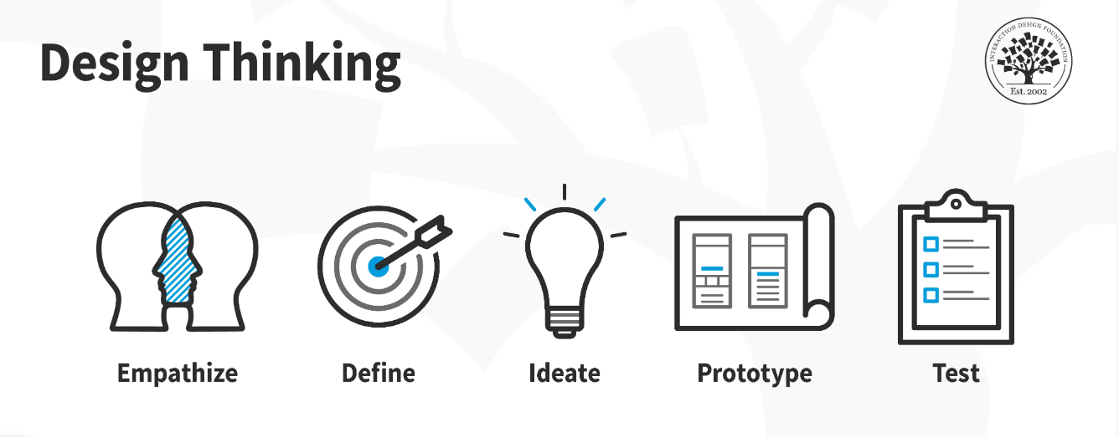
Design Thinking
What is Design Thinking? | Interaction Design Foundation (IxDF) (interaction-design.org)
© Interaction Design Foundation, CC BY-SA 3.0

Slide 7
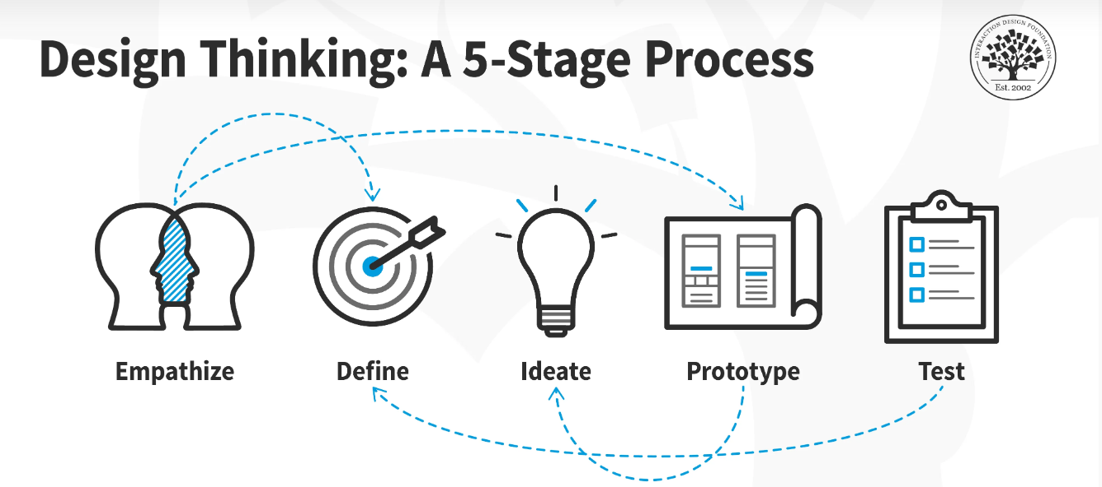
Compare/contrast this:
What is Design Thinking? | Interaction Design Foundation (IxDF) (interaction-design.org)
© Interaction Design Foundation, CC BY-SA 3.0

Slide 8
..with the NASA model
Design
Fabrication and
Certification
Flt
Processing
Need
Requirements
Review
Flight!
Training
Test

Slide 9
Design Thinking compared with
© Interaction Design Foundation, CC BY-SA 3.0
What is Design Thinking? | Interaction Design Foundation (IxDF) (interaction-design.org)
Design
Fabrication and
Certification
Flt
Processing
Flight!
Need
Requirements
Review
Training
Test
Notes:
Overtime, as different emphases have come and gone, I’ve found that this basic design approaches is open to incorporating:
e.g. Human-centered design

Slide 10

The Power of Having a Plan
It is easy to get lost when attempting to solve
  a hard problem
  a big problem
  a big, hard problem
Both of these visualizations give you a plan
The plan is a tool for you to use as best meets your needs
  It is flexible, not rigid
No matter what model you are using, it is human-centered if you make it that way
Notes:
For me, there is no other way to design space suits, so I made it the culture of the team. Many of us want to fly in space anyway, so this isn’t hard to get space suit engineers to do.

Slide 11
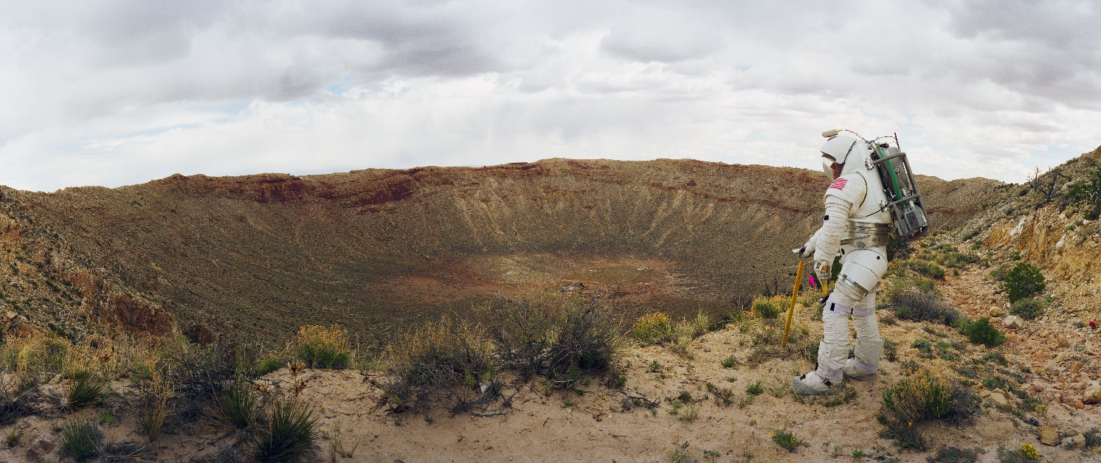
I’m going to share examples of how I’ve used the steps of Design Thinking at NASA for space suit design

Slide 12
Empathize
What’s the need from the user’s perspective?
Notes:
Our crew members are our customers

Slide 13
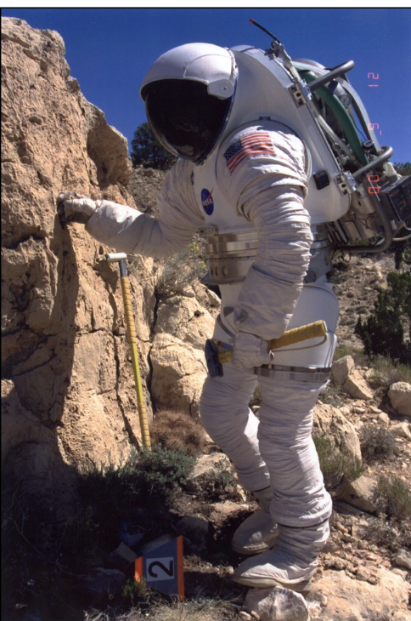
An Example of Empathizing
I am an engineer, not a geologist.
When astronauts go to the Moon and Mars they will do geology..in a space suit.
I needed to learn to think more like a geologist . . in a space suit.

Slide 14
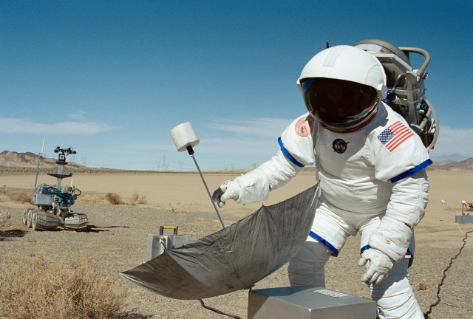
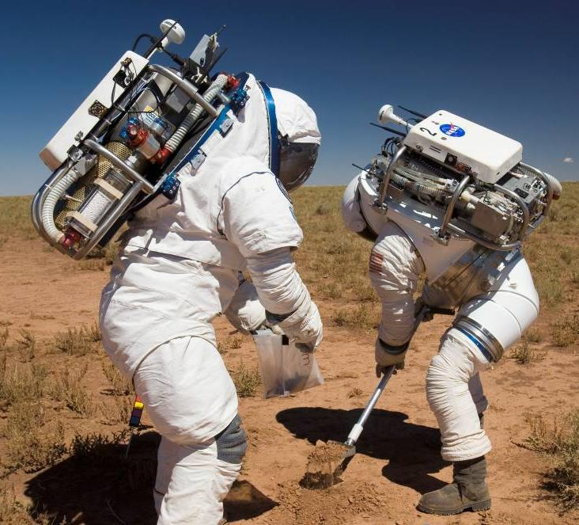
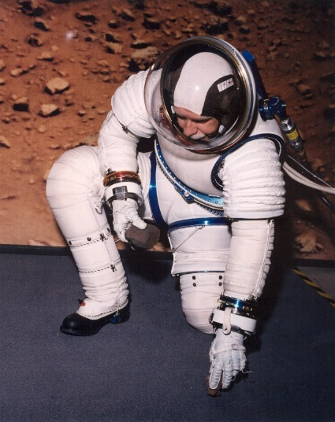
Geologists being geologists..in space suits.

Slide 15
The Rewards of Actively Empathizing
We learned about when mobility geologist want and the suits didn’t provide
We learned about what tools they use and how some of them needed to be modified (hand straps, carrying tools on a rover/robot)
We learned about how geologists take data and that we needed to develop new strategies.
We learned that robots need to move faster and listen better.
We learned that lights that illuminate where you are about to step are the most important when walking in the dark.
.
.
BOTTOM LINE: We now understood our goal and objectives as requirements MUCH better!
Notes:
We also took Field Geology training, like they provide for the astronauts.
This can be a lot more simple. If trying to design better gloves, wear winter gloves to take away some of your tactility and attempt to do a task. If trying to understand what your computer system needs to do
Lower fi empathy exercises
I have hundreds of pages of reports, subjects notes, observations, recommendations, evaluations…

Slide 16

Take Aways About Empathy
Be active and concrete about being empathetic
  Sitting in a conference room and talking only gets you so far, which isn’t very far
Bringing in others (e.g. your customer or people closer to their experience) can be beneficial
Empathy helps you understand what you are trying to really do
Notes:
You don’t get better at understanding geologist in the office.

Slide 17
Define
Let’s agree on what we are trying to accomplish
Notes:
Can talk about what degree you are solving the problem – gold plating

Slide 18

Personal Example of Define
3 friends and I agreed to go on ‘vacation’ together
The surprise came when we began planning our ‘vacation’
So what does ‘vacation’ mean to you?
  Friend 1 – local and budget conscious
  Friend 2 – luxury hotel/resort, room service
  Friend 3 – road trip to see sights
  Me – DISNEY!
Documenting your requirements and getting stakeholder consensus, gets everyone on the same page
Notes:
Include what you learned from empathy
Suit design is predicated on where you are going and what you are doing (crew survival vs planetary vs. micro g)

Slide 19
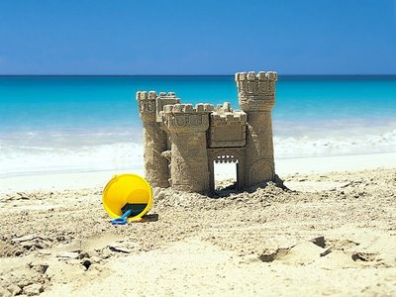
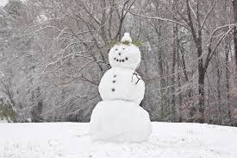
Define
NASA manages the requirements
  Changes from the baseline are agreed to by the group managed so there is 1 version everyone uses.
Industry may have different strategies, but the goal is the same→ Everyone needs to be working to the same vision
Notes:
Levels of requirements

Slide 20
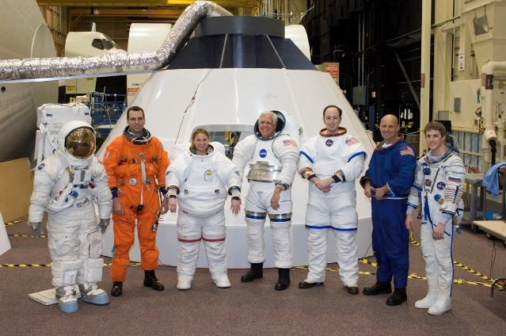
There are different Space Suits for a Reason

Slide 21
Ideate
What are we going to create?

Slide 22


Ideate
This can come in a lot of forms, such as:
  Brainstorming
  Trade Studies
  Market surveys
  Observation of nature and other fields
Utilize your diversity
  A variety of backgrounds and experiences helps
The ‘idea’ people in your company
can excel here
Listen to your introverts
An open mind is required
This is iterative with Prototyping
Notes:
Individual vs Group brainstorming
Talk about Pete and his sailing experience; Ben and his car racing; Edward and his model making; hockey
Interns

Slide 23
Ideate as Brainstorming
What does ‘Brainstorming’ mean to you?

Slide 24
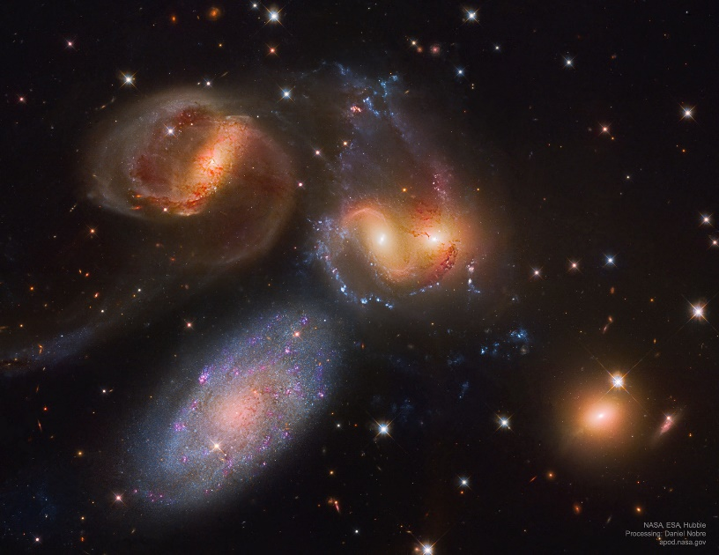

My Brainstorming Lessons Learned
When I think of brainstorming:
  You want to first diverge
    You put off converging to later
  There is a place for identifying the negatives, but it isn’t the first step in evaluating concepts
Brainstorming requires a respectful and open environment best done with a skilled facilitator
The goal is to get thoughts on the table.
Note: NASA does not endorse
this book or method. I’m stating
that I have used it.
Notes:
Engineers are good at jumping at why something won’t work. Focusing on the negative stifles.
There are studies that say beginning with individual brainstorming before meeting in a group is more productive.

Slide 25
Prototyping
What does our idea look like when we make it?

Slide 26
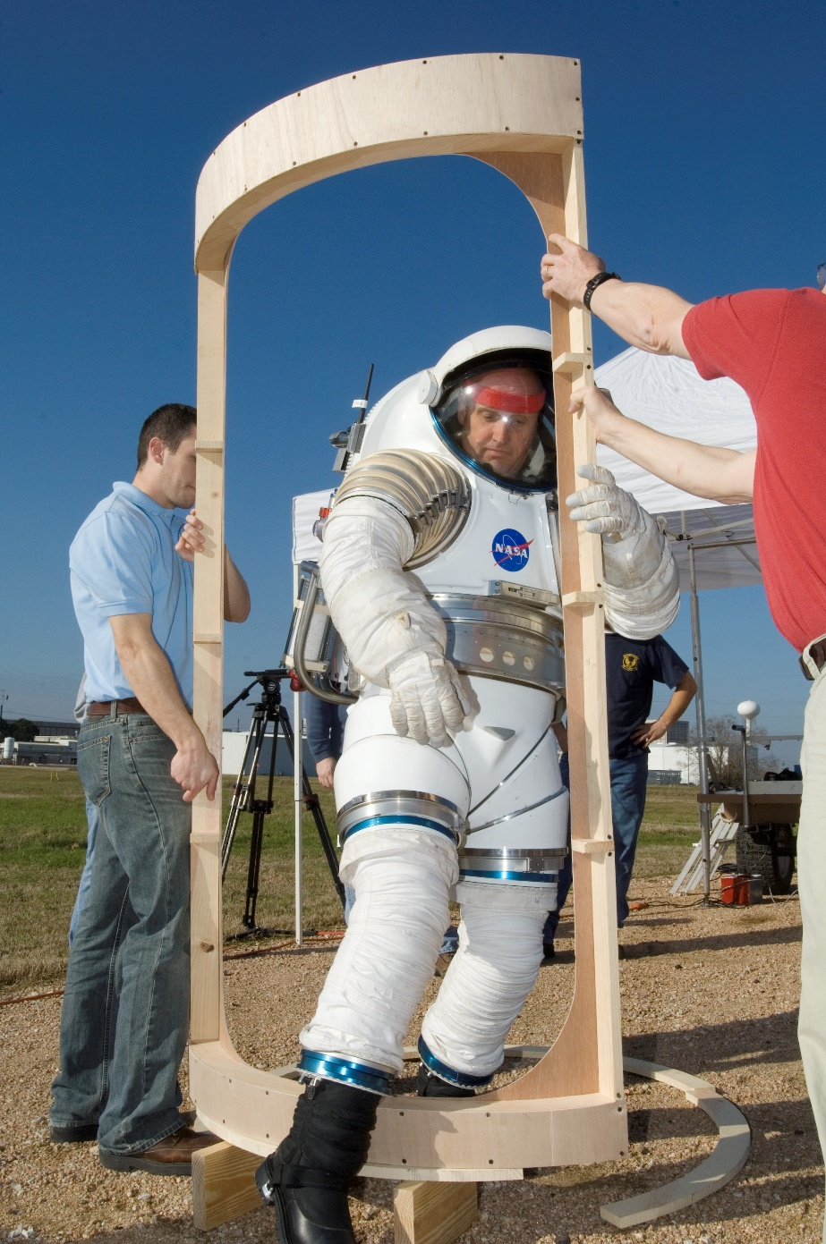
Prototyping
This is iterative with Ideate
At NASA this leads to the preliminary and final design phases
Notes:
Meat on bones

Slide 27
Making Your Ideas Real
Prototyping let’s you move from the ‘thinking’ phase to the ‘making’ phase
Crawl before you walk prototyping
  Start with prototypes that are quick, easy, and inexpensive
  I’ve started with cardboard or foam core before moving to plywood
  You can just look at one aspect versus the entire system if that helps to make a decision
If you are having trouble picking between options, evaluating a prototype can give you a first cut idea of which is the better performer
Notes:
AKA – getting off the dime

Slide 28
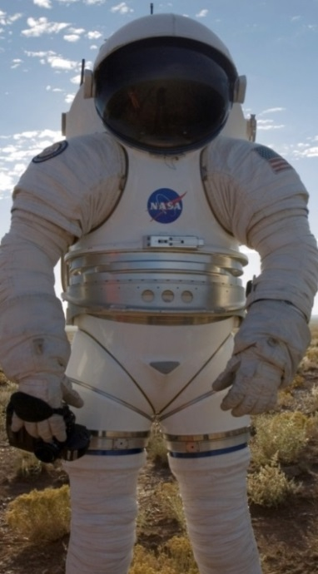
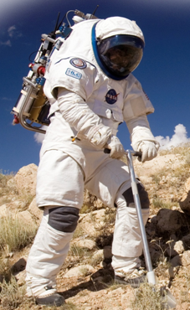
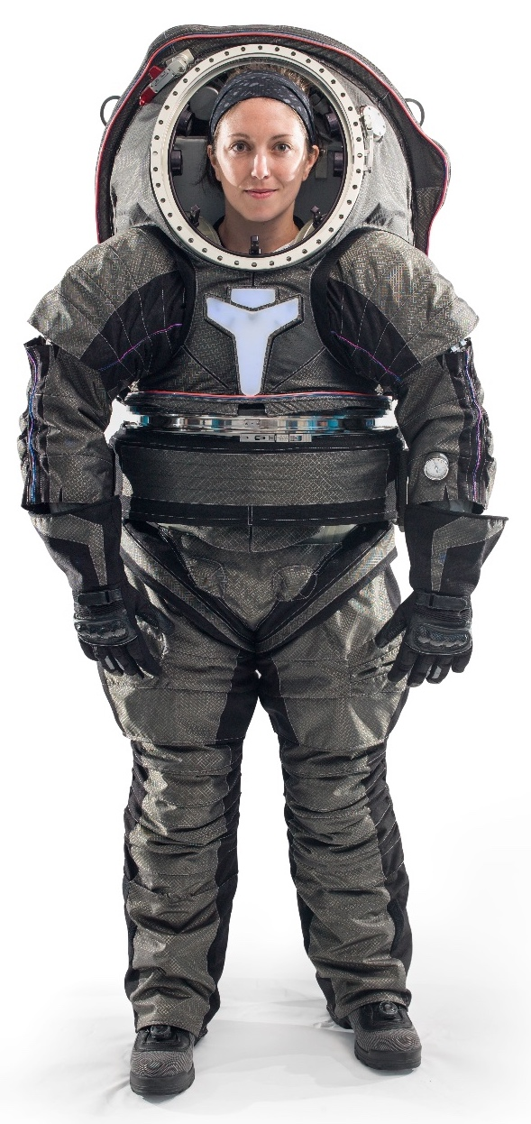
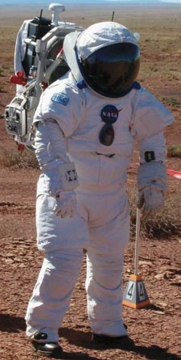
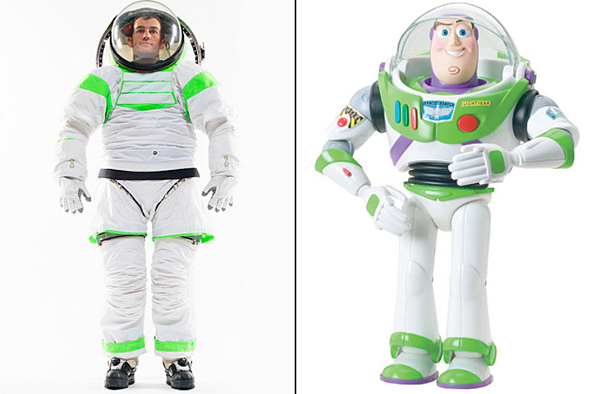
Space Suit Prototypes
Mark III
REI-Suit
Z-2
WEI-Suit
Z-1

Slide 29
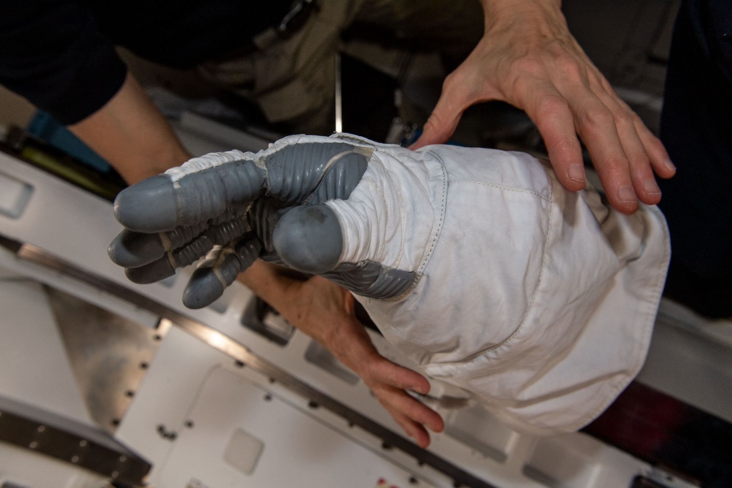
Not a Prototype, but..
Phase VI Glove came from:
  10 years of development
  2 vendors
  A dozen + prototypes
  Iteration between prototyping and test

Slide 30
Test
Did what we create accomplish what we intended to accomplish?

Slide 31
Test
Personally, I find testing to be a tool across all stages of the design process as I’ve used it.
  As the design matures, you want to keep checking, via test, that you are being successful
However, qualification [will this thing do the job I meant it to do and the user needs it to do?] testing comes at the end of both NASA’s and the Design Thinking process.
Before fielding a design/product, you need to be confident it works.
For space suits, and most products, I’m not successful until I have customer buy-in
Notes:
I can’t fly a suit until I have customer buy-in

Slide 32
We do A LOT of testing!

Slide 33
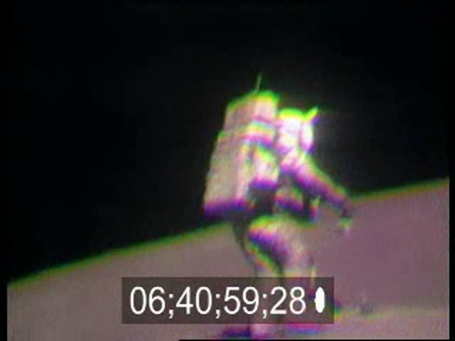
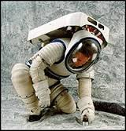
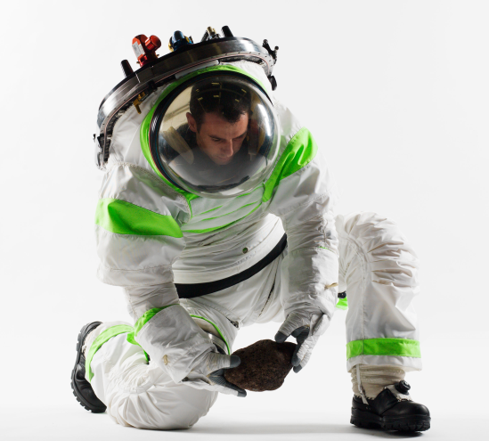
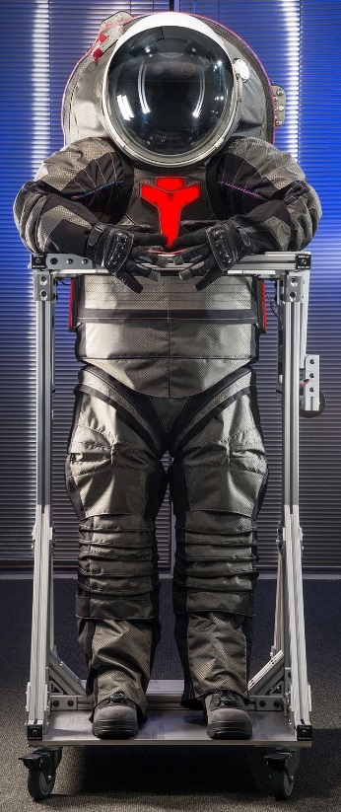
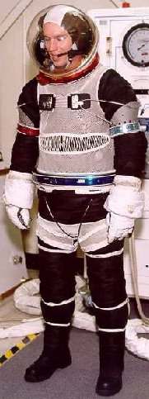
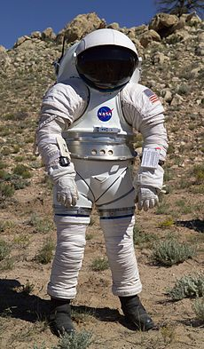
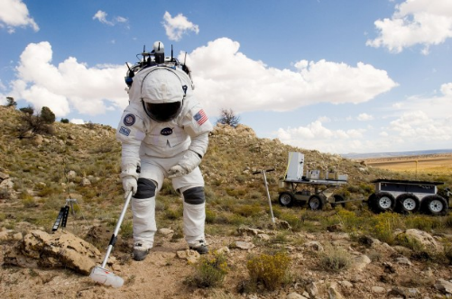
Extensive Space Suit Testing
80’s
90’s
00’s
10’s
2016
60’s
Time
Notes:
You’d think we’d have figured out HITL testing, but it is complicated.
Suit is a combination of all of the accumulated knowledge from 20 years of suit prototypes and mobility joint concepts
Hard Upper Torso – Used for advanced interfaces and accurate structure, EMU and Mark III
Shoulder – External Link Rolling Convolute shoulder, previously used on ZPS and Mark III
Helmet – Elliptical Dome Helmet for increased shoulder mobility and downward visibility, previously used on REI-suit
Waist – Rolling Convolute waist, previously used on Mark III
Hip - Two bearing hip with Ad-ab convolute used to create a natural gait, previously used on Z-1
Boots – Wolverine over-boot with dual adjustable indexing features, new

Slide 34
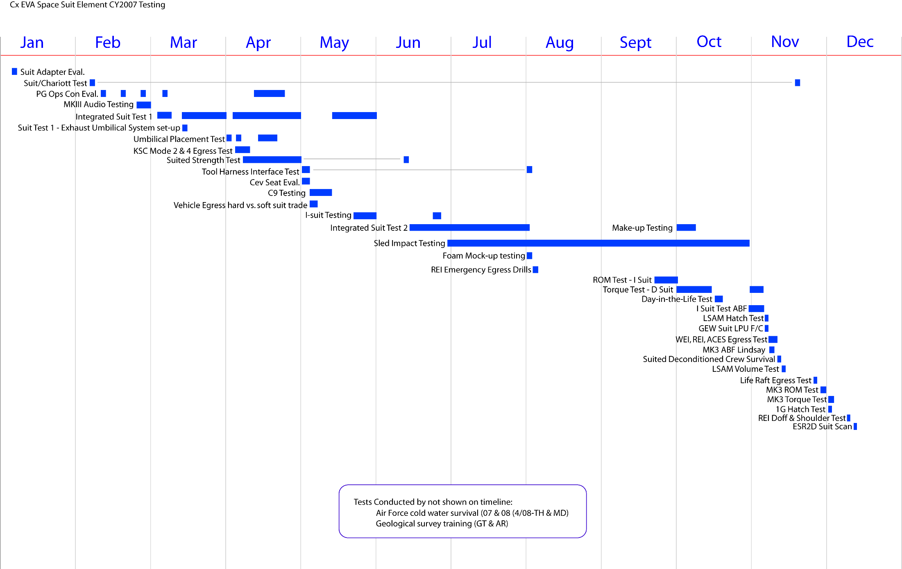
2007 Test Timeline
Notes:
Lots of testing—has to work

Slide 35
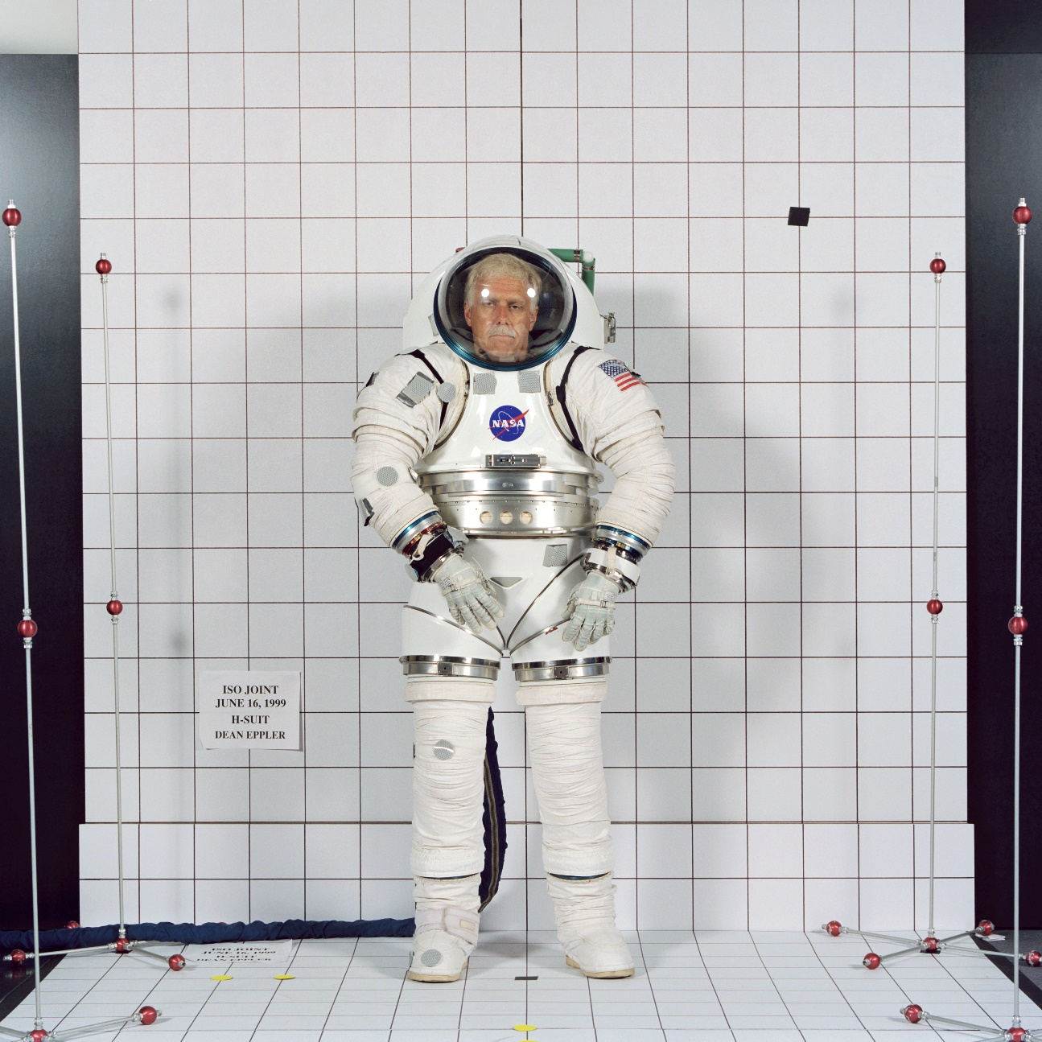
Range of Motion Photogrammetry

Slide 36
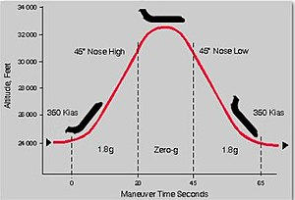
Reduced Gravity Aircraft = Partial Gravity Testing

Slide 37
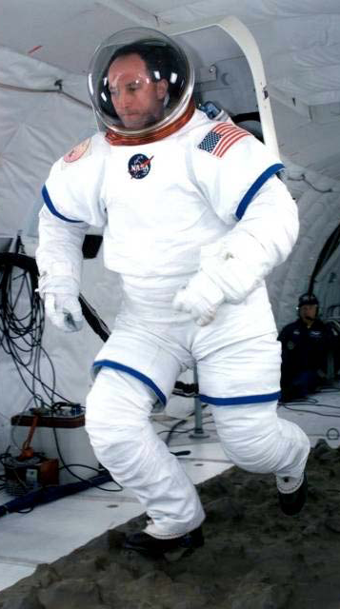
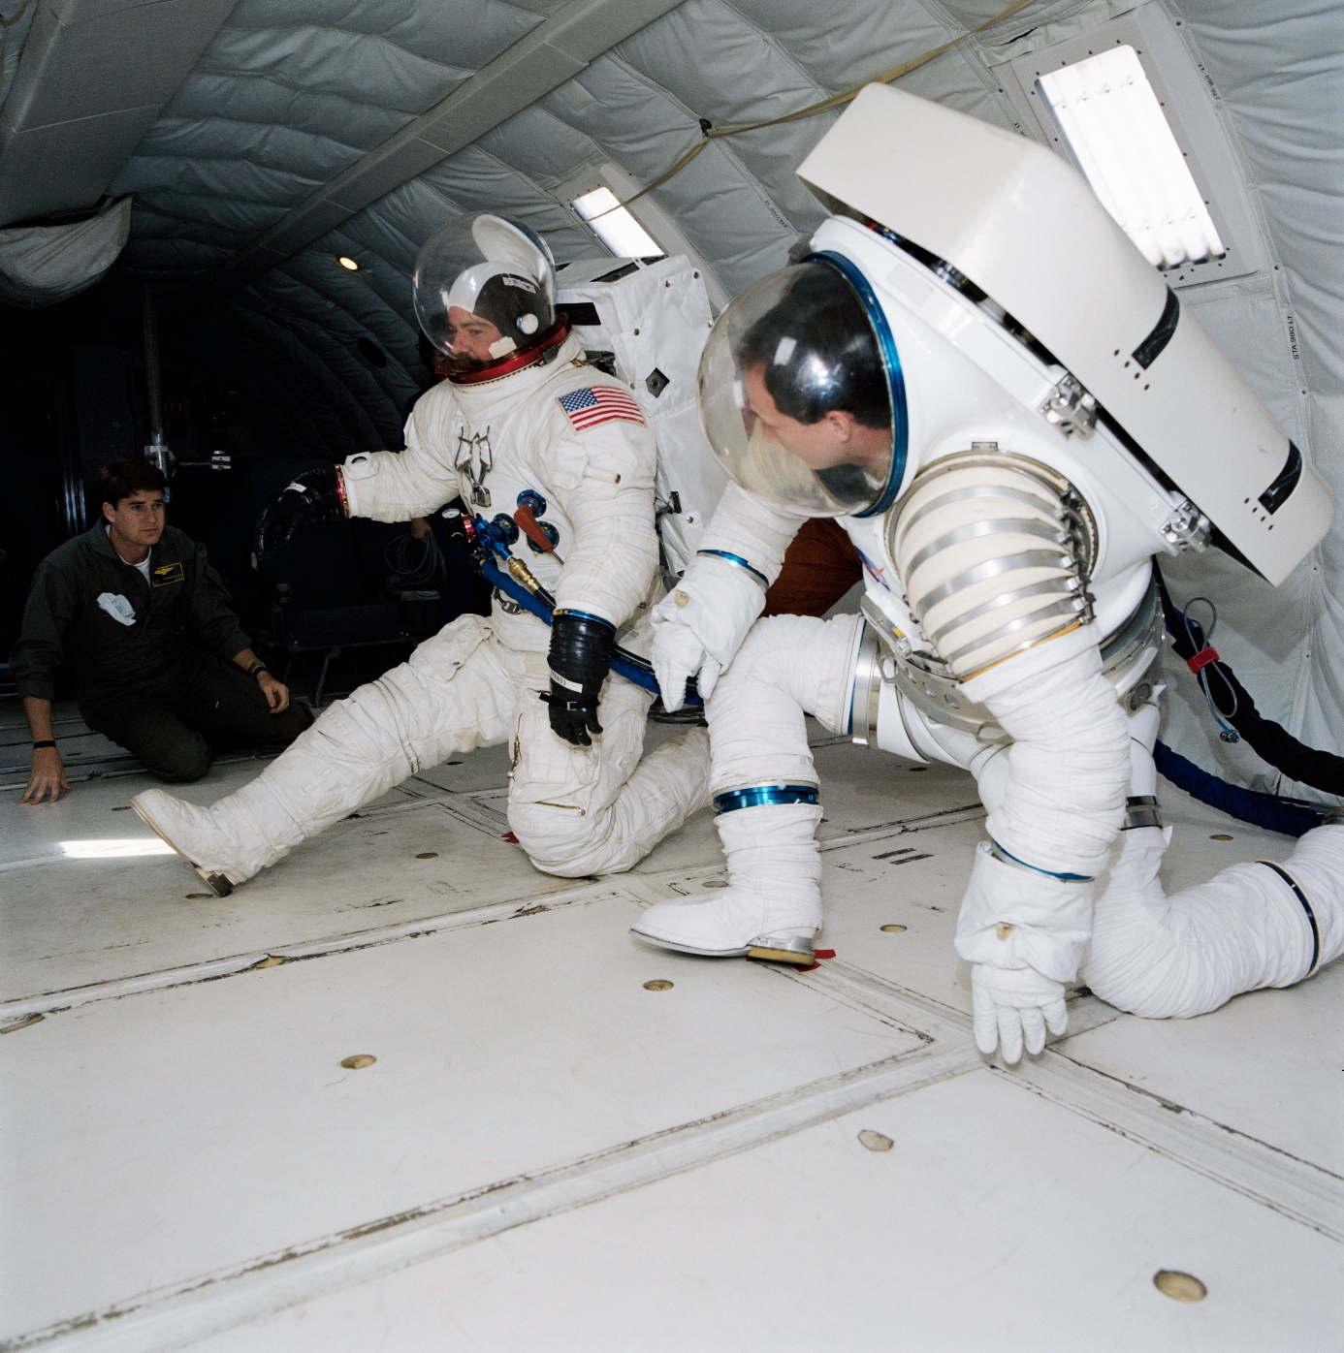
Partial Gravity Translation and Mobility

Slide 38
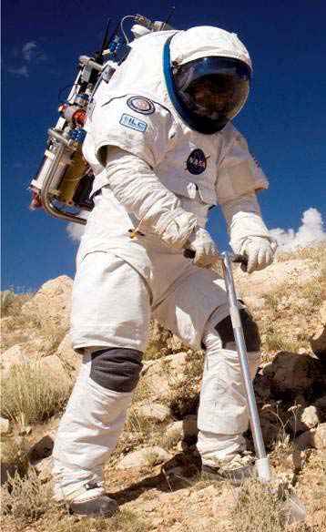
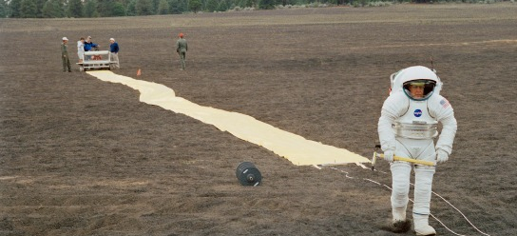
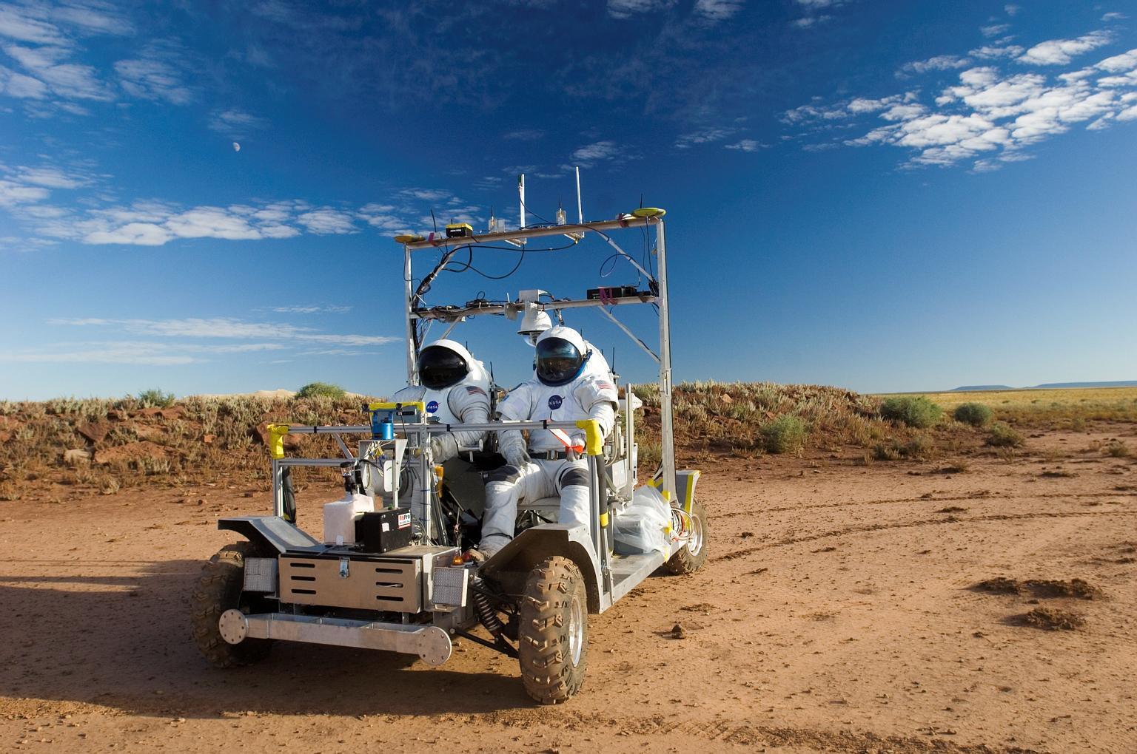
Desert RATS

Slide 39
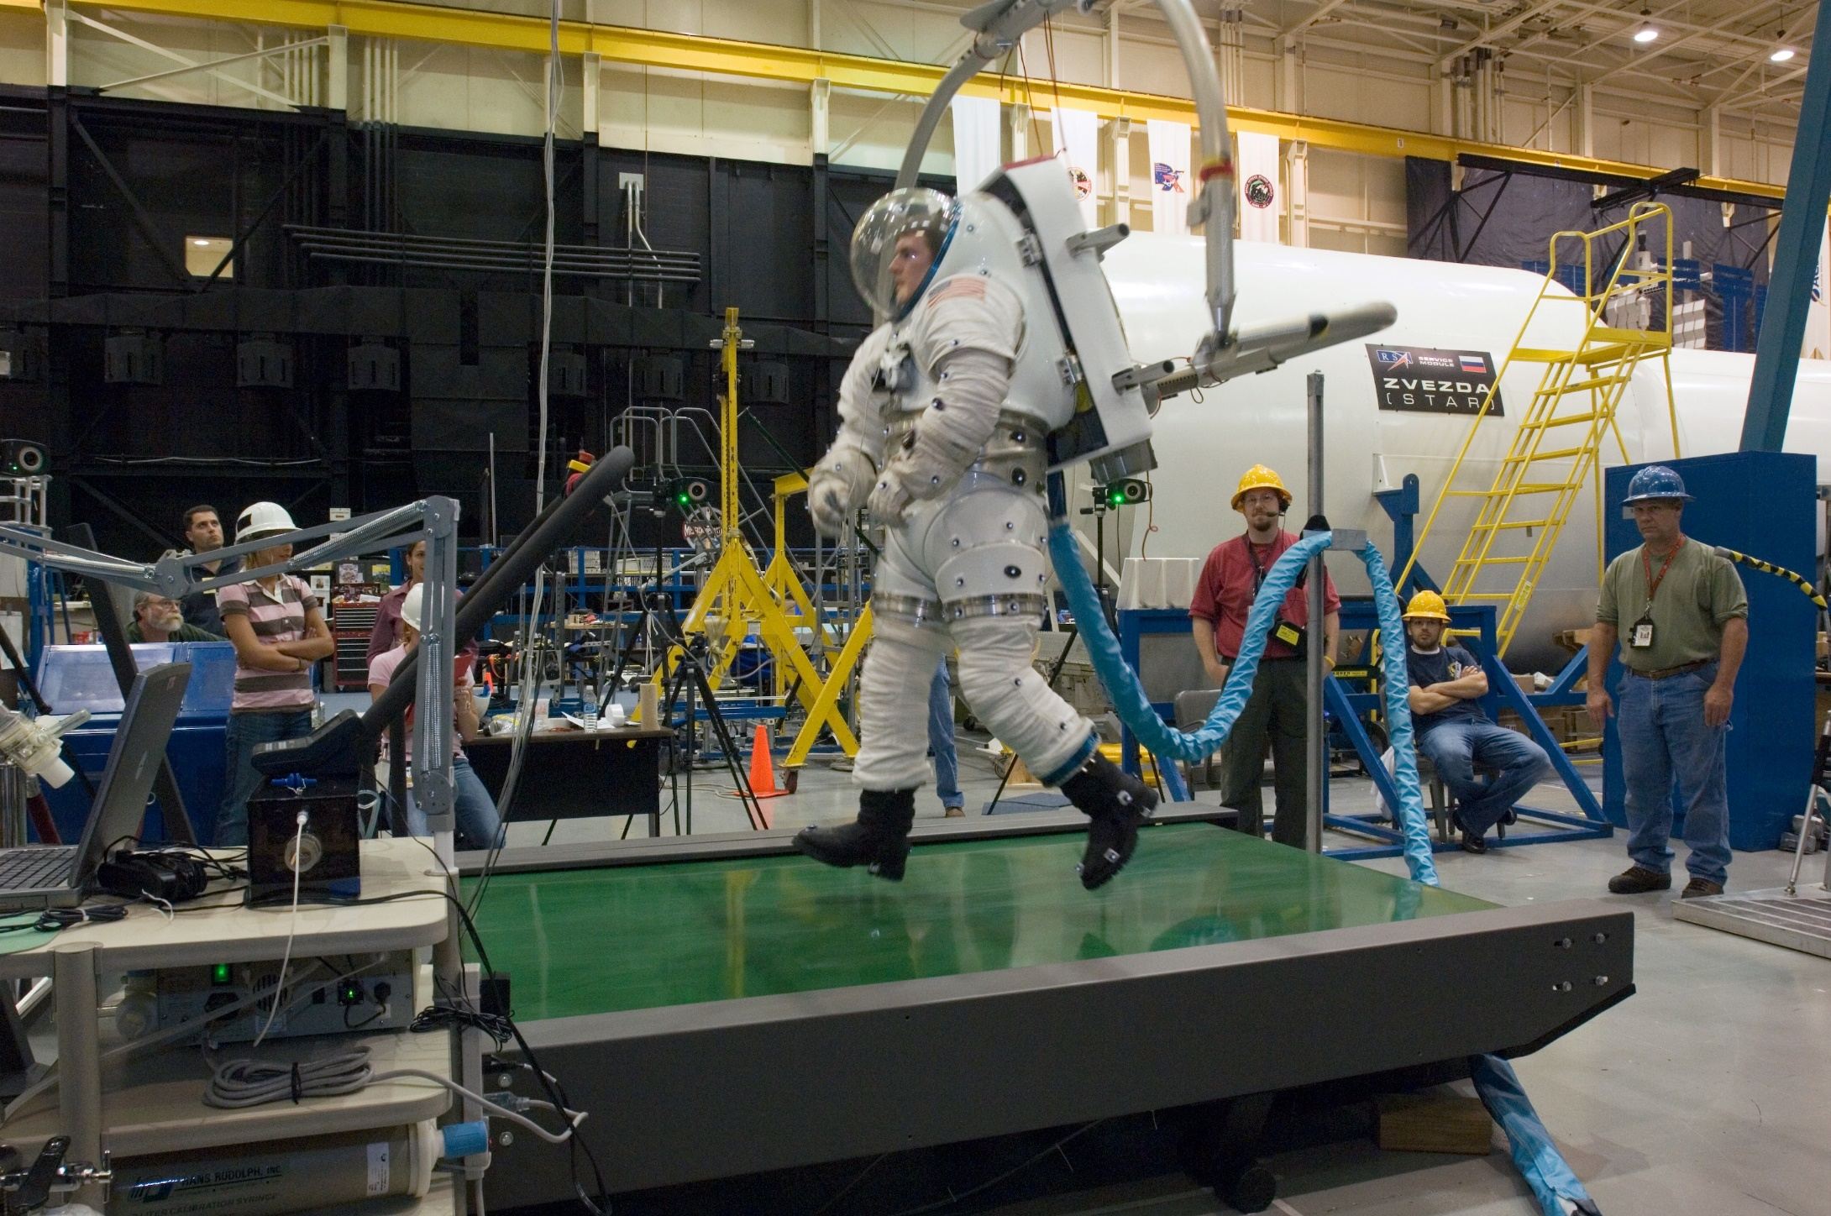
Testing

Slide 40
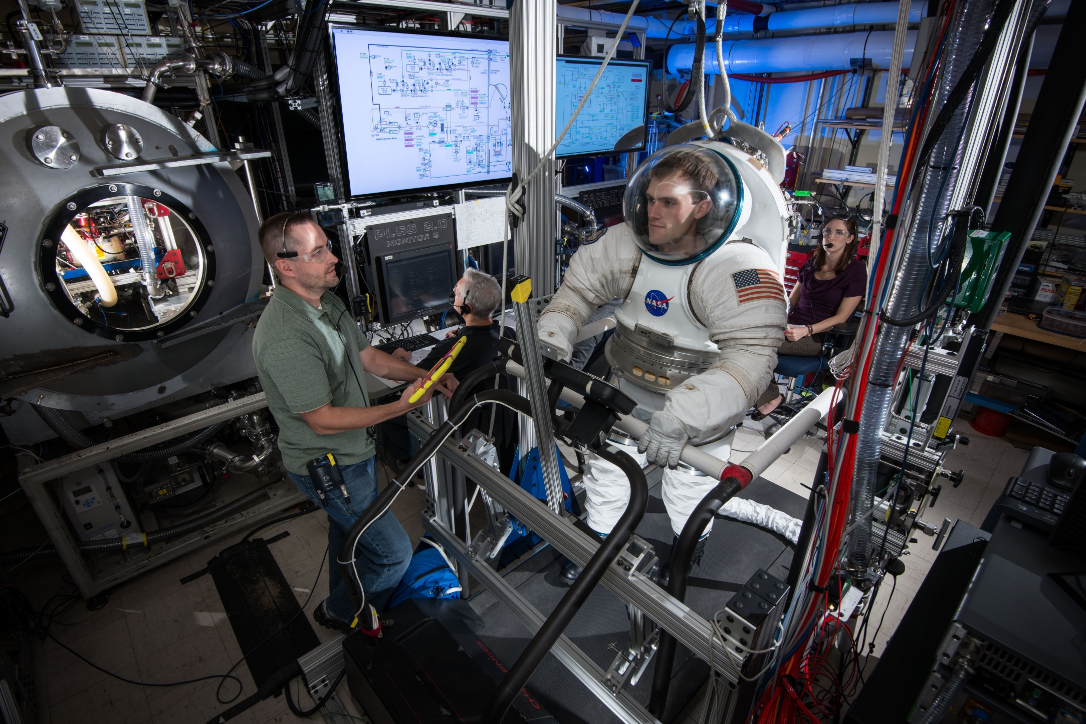
Testing

Slide 41
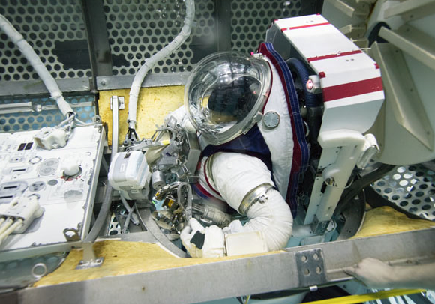
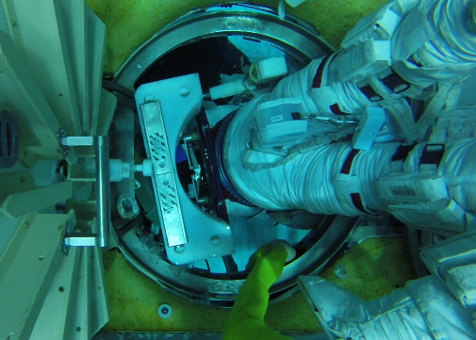
Z-2 NBL Runs
Notes:
19 runs

Slide 42
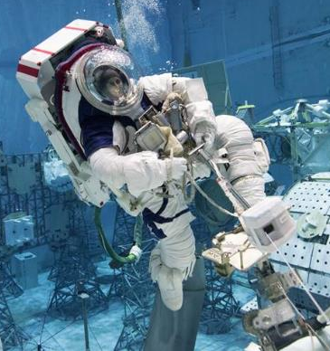
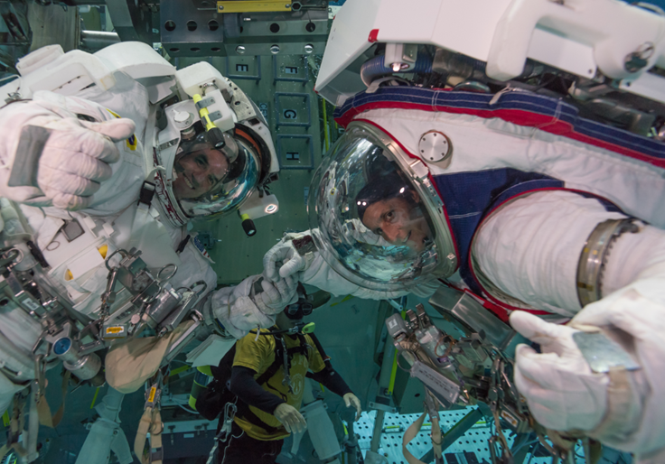
Z-2 NBL Runs

Slide 43
Design Thinking
The steps of Design Thinking provide a framework to approach design challenges
  There is power in having a plan!
Starting with understanding your customer and their needs helps you to stay focused on your customer as a priority
Through human-centered design NASA has created..
What is Design Thinking? | Interaction Design Foundation (IxDF) (interaction-design.org)
© Interaction Design Foundation, CC BY-SA 3.0

Slide 44
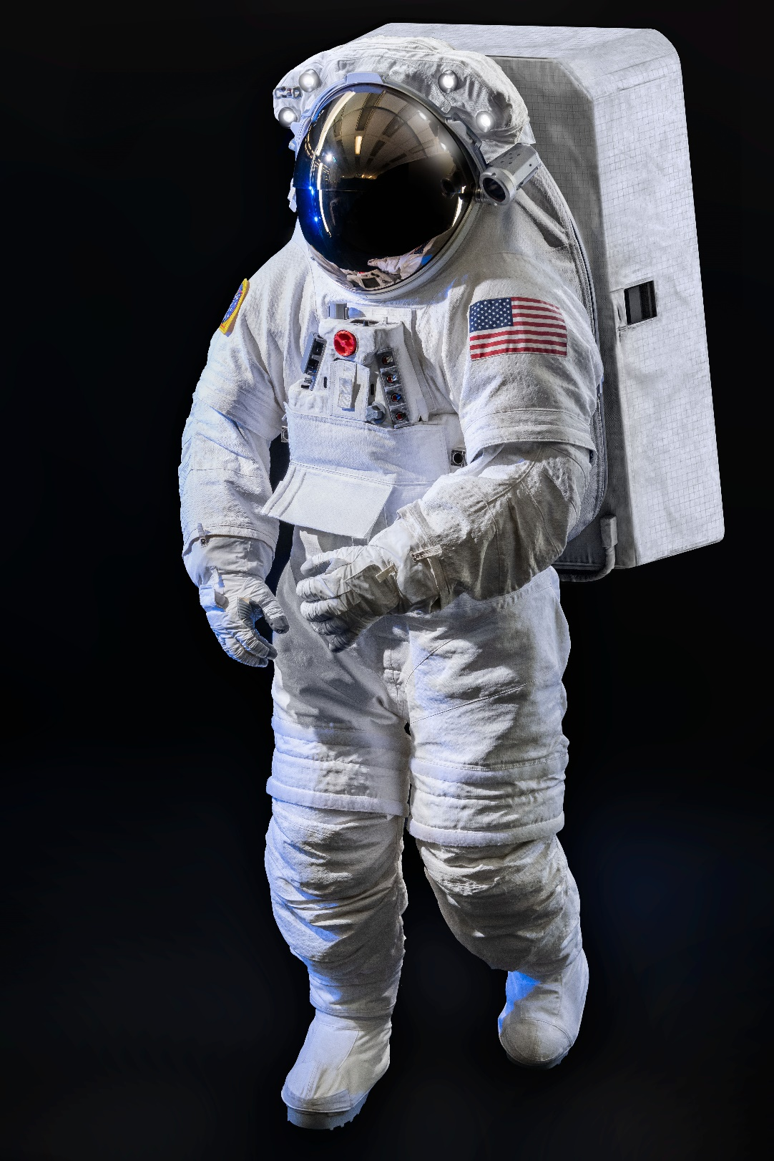
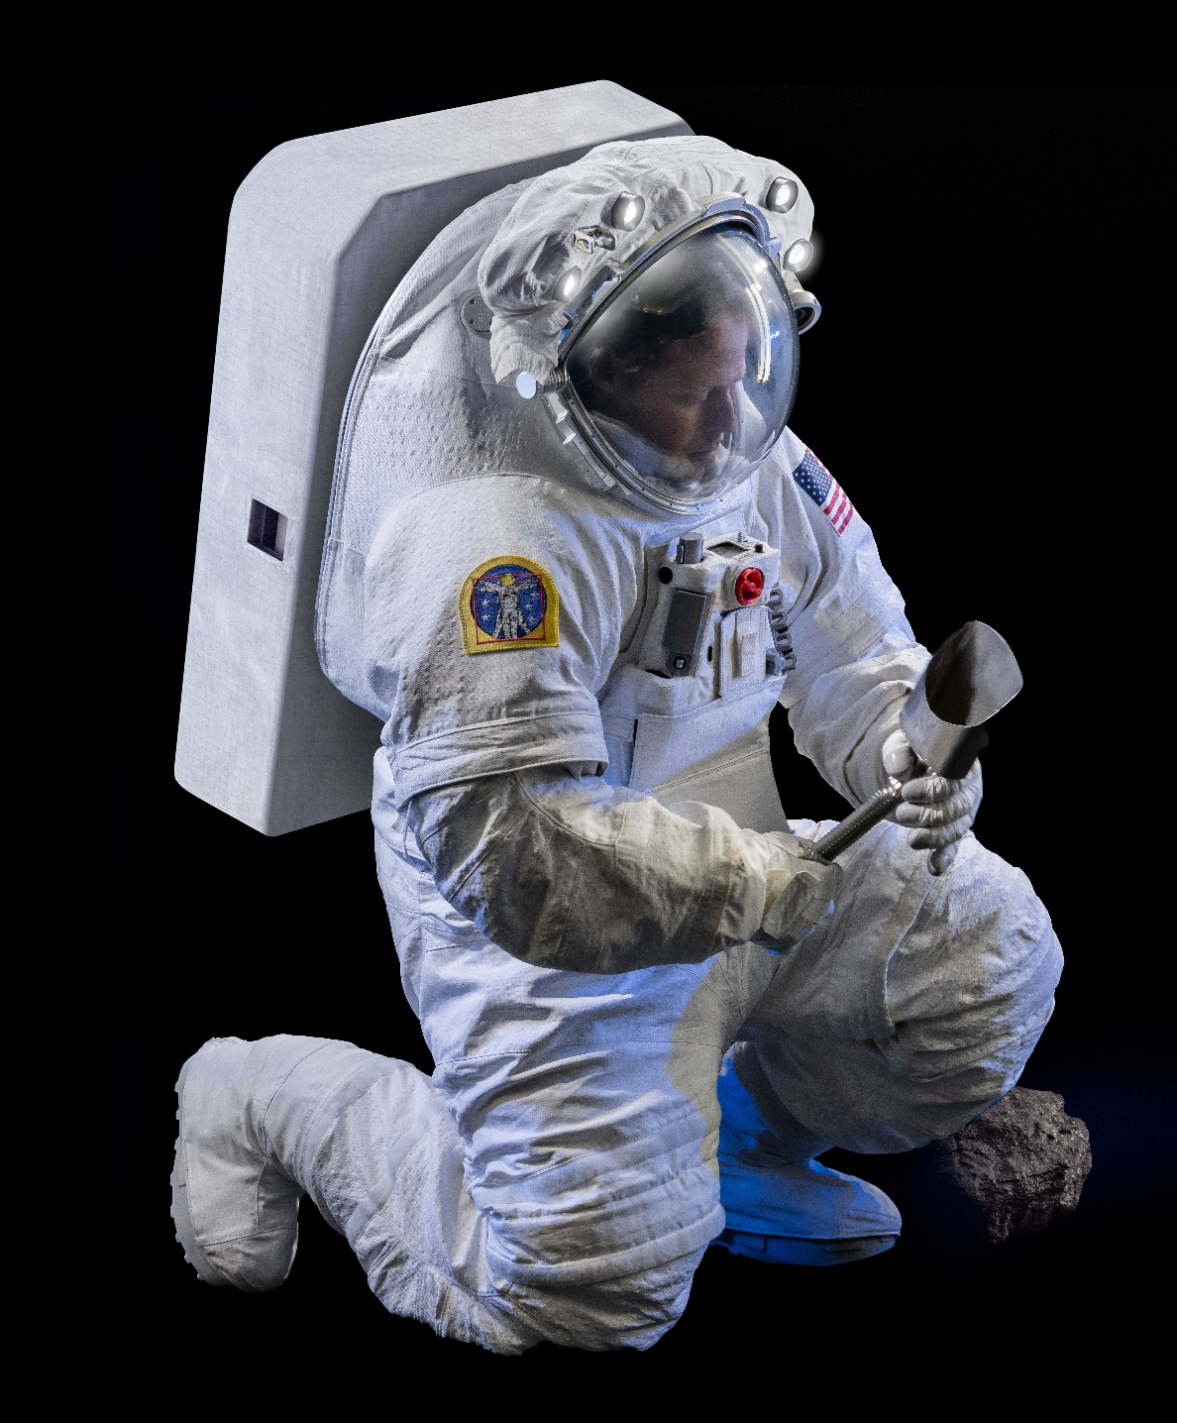
xEMU

Slide 45
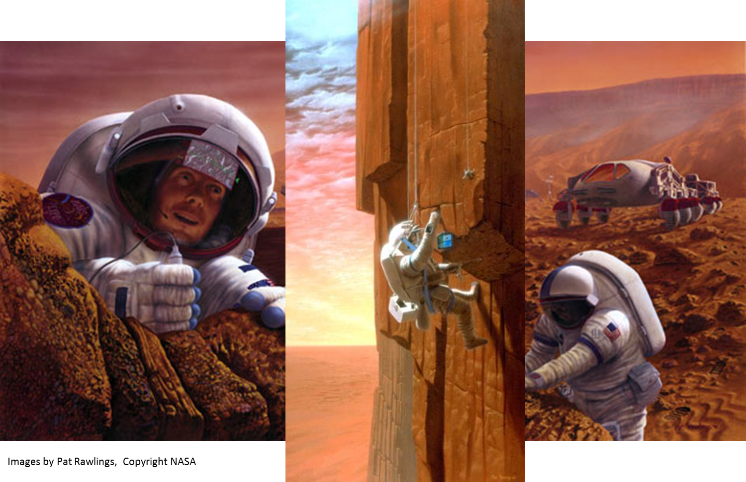
What’s next?

Slide 46
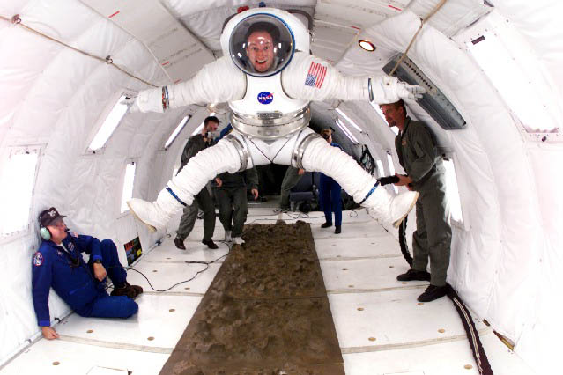
Questions?

Slide 47
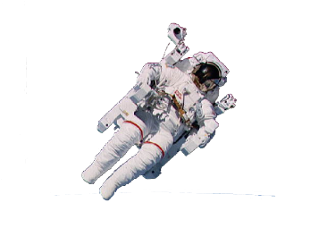
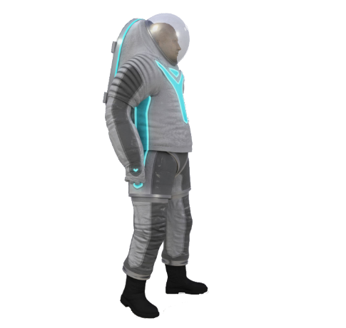
A Space Suit is..
Space Suits Provide 3 Basic Functions For EVA Astronauts:
1
First, in conjunction with a portable life support system, the space suit maintains the physiological well-being of the astronaut
  Supplying oxygen for pressurization, breathing, and ventilation
  Provide carbon dioxide and metabolic heat removal
2
Secondly, the space suit provides protection against the hazards of the particular EVA environment
  Thermal extremes
  Meteoroid and orbital debris
  Radiation conditions
  Abrasion and sharp edges
  Sand, dust, and rocks
3
Finally, the space suit incorporates various mobility joint systems to enable the astronaut to perform EVA tasks in the pressurized condition
  Includes both dual-axis and single axis joints and bearings
In essence, the space suit is a
small spacecraft in itself
Notes:
Why I have a job

Slide 48
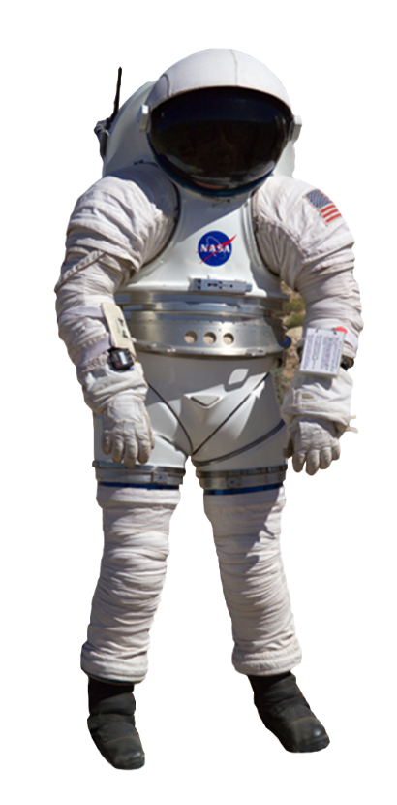
What Does a Planetary Walking Suit Look Like?
Rear-entry
Helmet angled and shaped for wide field view, including downward visibility
Hard or soft torso, briefs and hip
Waist bearing and flexion/extension joints
Hip mobility joint system with 2 or more bearings and features for adduction/abduction
Softgood arms and knees
Walking boots with an ankle flexion/extension joint and ankle bearing
Environmental protection garment that addresses dust,
  Durability with UV radiation exposure,
  Thermal protection in a low atmospheric pressure,
  Durability with exposure to products of chemical react

