Slide 1

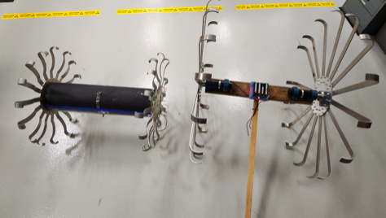
Lunar Marvin Compact CLIPS Innovative Rover
Project Lead: Marc Murbach (ARC-RS) Marcus.S.Murbach@nasa.gov
Key Contributors: Seth Schisler,
The development of a unique 2wheel concept that was briefly demonstrated in the Atacama desert (Chile) for a Mars mission concept (hence, MARVIN: MARs Vehicular Innovator).
Small rovers, traditionally, have 4-6 wheels of small diameter and therefore, very low ground clearance. By using the deployable wheels/struts, early indication was that the concept provided a) high ground clearance, per size of the rover, b) ease of the cylindrical packaging (the struts deploy radially outward), c) facile means of dropping the rover to the surface.
The development of a high-ground clearance nano-rover, with ease of interface/surface deployment, and based on currently evolving nano-satellite transceivers – may be a very attractive science instrument mobility platform. The cylinder can be either rolled off of the CLIPS landing platform, or placed on the surface. The spring force from each wheel/strut, and low lunar gravity, allows the rover to ‘pick itself up from its knuckles’ and begin ambulation.
Deliverable: The primary goals would be to a) build the next generation MARVIN platform with fully stowable wheels, b) demonstrate the ease of lunar surface emplacement, c) involve the nano-sat modular subsystems (and radiation tolerant for 1 lunar day), d) include the phase 1 lunar surface sensor interface.
The key innovation is to take advantage of various nano-sat subsystems (in development or being actively tested in LEO) – with a remarkably efficient, deployable mobility concept: the Lunar MARVIN.
Budget Requested: $25, 000.00
The proposal addresses key areas of interest to NASA (and Ames) lunar exploration concepts and capabilities: nano-satellite subsystems, advanced COM (currently the team is working with GSFC/GRC on Luna Net and Cognitive Radio), AI/ML applications with autonomous operations, and lastly – a very novel nano-rover capability.

