Slide 1
An Introduction to Uncertainty Quantification: Transitioning from Research to Practice
Jim Warner¹, Patrick Leser¹, Joel Sills Jr.²
¹ Langley Research Center, NASA, Hampton, VA
² Johnson Space Center, NASA, Houston, TX

Slide 2
What is Uncertainty Quantification (UQ)?
“All models are wrong,
but some are useful”
George E.P. Box
  So how wrong might our models be?
  (When) are they useful from an engineering perspective?
  And how confident are we in their predictions?
UQ provides a framework for answering these questions and making our models useful.

Slide 3
What is Uncertainty Quantification (UQ)?
“…the science of identifying, quantifying, and reducing uncertainties associated with models, numerical algorithms, experiments and predicted outcomes…” Smith, R. C. Uncertainty Quantification Theory, Implementation, and Applications. 2013.
Imbue our models with what we know, what we don’t know, and to what degree we don’t know it in order to get a more complete picture of what we’re modeling.

Slide 4
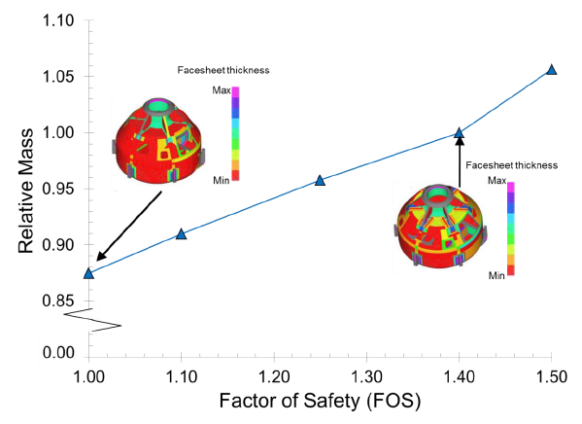
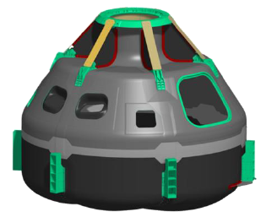
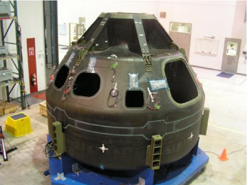
Motivating Example: Reliability-Based Design
Probabilistic Design Case Study – Composite Crew Module
Demonstrated significant mass savings (~12.5%) were possible at the expense of reduced (but quantified) reliability using probabilistic methods
Showed a factor of safety of 1.4 resulted in extremely small failure probability (1 in ~10M)
Identified many practical challenges with UQ: configuration/model management, estimation of input parameter uncertainty, computational expense, etc.
  Scotti, et al. Probabilistic Design Case Study – Composite Crew Module. NESC-RP-10-00611. 2010.

Slide 5
Transitioning from Research to Practice
There is a learning curve for successfully applying UQ in practice
Many parallels between UQ and finite element analysis
  Garbage in → garbage out!
  Beginners can “press play” and create nice plots but expertise and experience is required to formulate approaches to messy, real-world problems;

Slide 6
Today’s Goals & Points of Emphasis
Provide enough information to know what to ask/search for if interested in applying UQ
  Broad overview of the main concepts; listing common references, software, methods for further study
  Understand “what/why/when", not necessarily “how”
Provide two practical examples of UQ applied to NASA projects

Slide 7



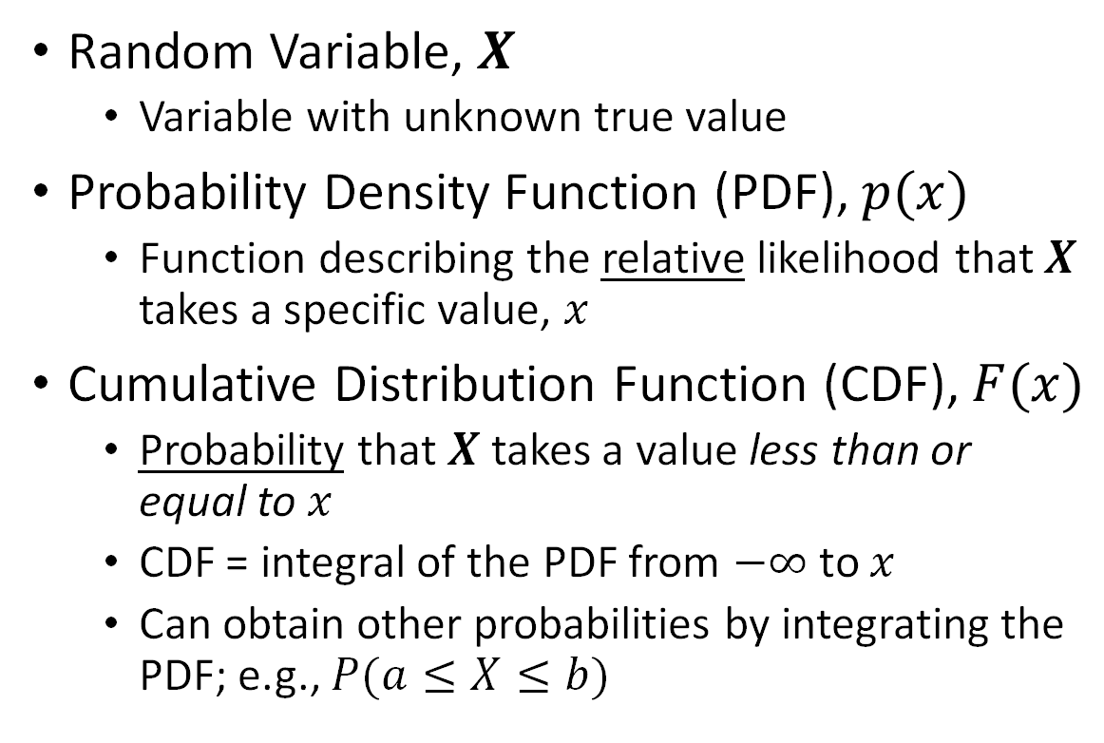



Quick Review of Terminology
$$p(x)$$
PDF
Random Variable, $X$
  Variable with unknown true value
Probability Density Function (PDF), $p(x)$
  Function describing the relative likelihood that $X$ takes a specific value, $x$
Cumulative Distribution Function (CDF), $F(x)$
  Probability that $X$ takes a value less than or equal to$x$
  CDF = integral of the PDF from $−∞$ to $x$
  Can obtain other probabilities by integrating the PDF; e.g., $P(a≤X≤b)$
More likely
Less Likely
a
b
$$x$$
$$F(x)$$
CDF
1
$$F(b)$$
$$F(a)$$
0
a
b
$$x$$

Slide 8
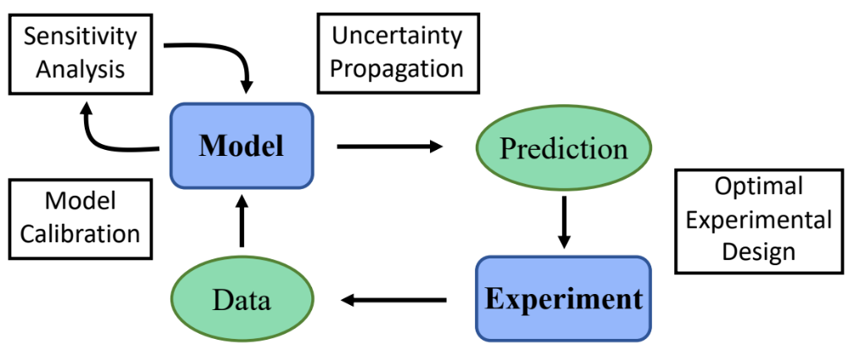
UQ Concepts
(Computational)

Slide 9
UQ Concepts

Slide 10
UQ Concepts: Uncertainty Propagation
Uncertainty Propagation
  Uncertainty propagation feeds quantified input uncertainties through our model to produce probabilistic predictions

Slide 11








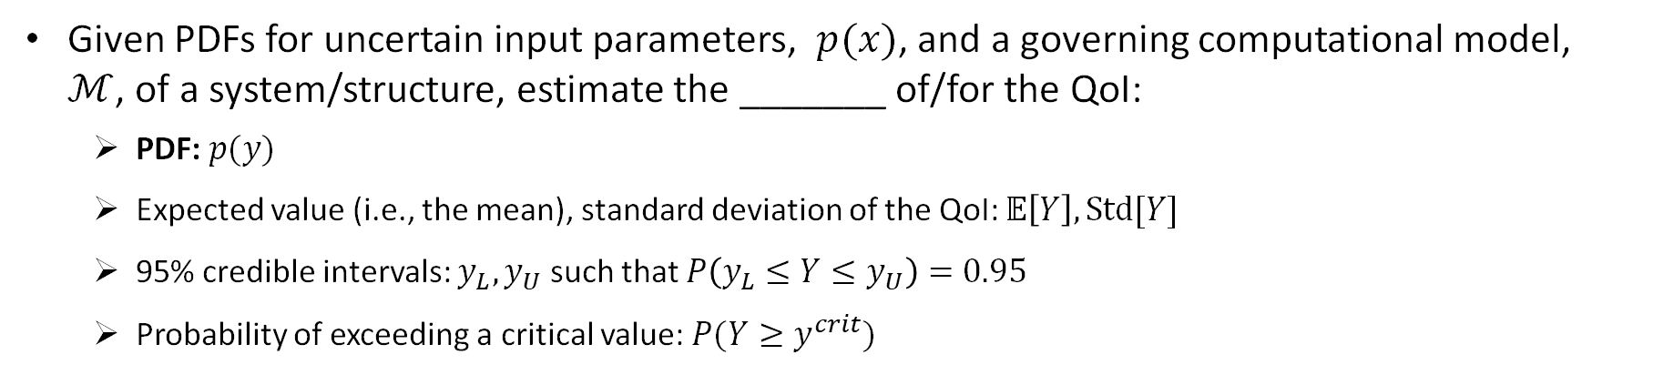
Uncertainty Propagation
Input Parameters
Computational Model
Quantity
of Interest (QoI)
e.g.,
Loading,
Material properties,
Geometry
e.g.,
Max. stress
Modal frequencies
$$ℳ\left(x\right)=y$$
e.g., Finite element analysis
Given PDFs for uncertain input parameters, $p(x)$, and a governing computational model, $ℳ$, of a system/structure, estimate the _______ of/for the QoI:
  PDF: $p(y)$
  Expected value (i.e., the mean), standard deviation of the QoI: $𝔼\left[Y\right], Std[Y]$
  95% credible intervals: $y_{L}, y_{U}$ such that $P\left(y_{L}≤Y≤y_{U}\right)=0.95$
  Probability of exceeding a critical value: $P(Y≥y^{crit})$

Slide 12


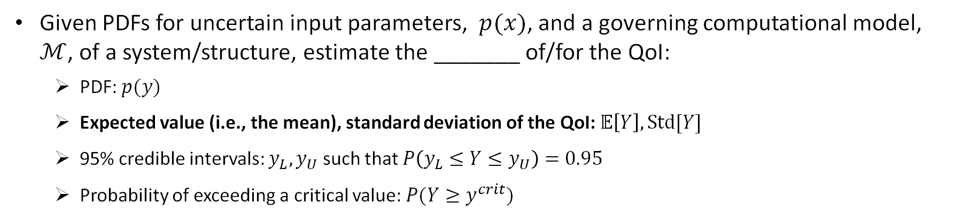
Uncertainty Propagation
Input Parameters
Computational Model
Quantity
of Interest (QoI)
e.g.,
Loading,
Material properties,
Geometry
e.g.,
Max. stress
Modal frequencies
$$ℳ\left(x\right)=y$$
$$𝔼\left[Y\right]$$
e.g., Finite element analysis
$$Std[Y]$$
Given PDFs for uncertain input parameters, $p(x)$, and a governing computational model, $ℳ$, of a system/structure, estimate the _______ of/for the QoI:
  PDF: $p(y)$
  Expected value (i.e., the mean), standard deviation of the QoI: $𝔼\left[Y\right], Std[Y]$
  95% credible intervals: $y_{L}, y_{U}$ such that $P\left(y_{L}≤Y≤y_{U}\right)=0.95$
  Probability of exceeding a critical value: $P(Y≥y^{crit})$

Slide 13


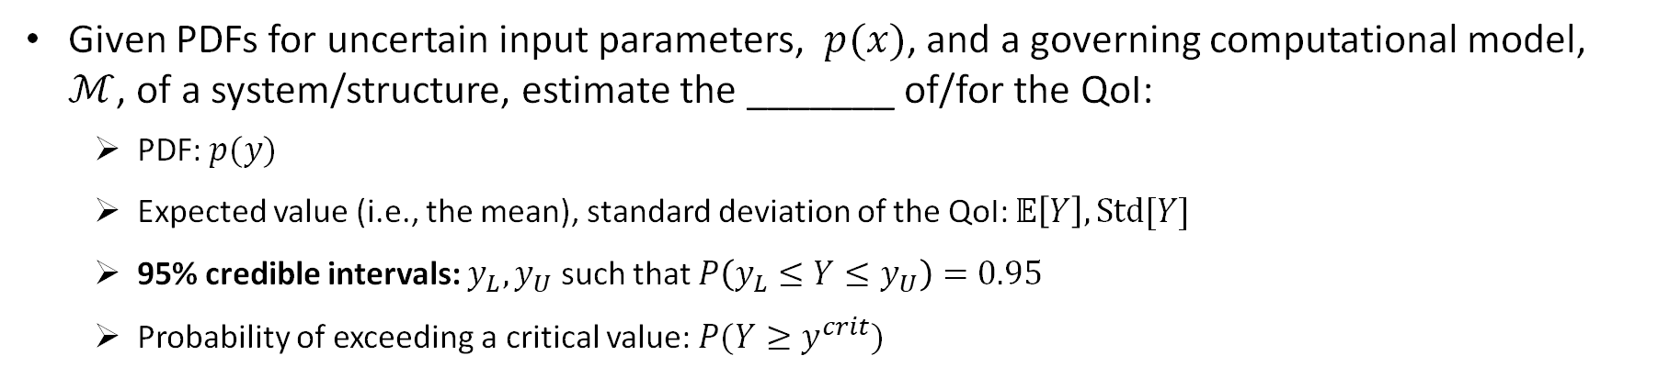
Uncertainty Propagation
Input Parameters
Computational Model
Quantity
of Interest (QoI)
e.g.,
Loading,
Material properties,
Geometry
e.g.,
Max. stress
Modal frequencies
$$ℳ\left(x\right)=y$$
e.g., Finite element analysis
$$y_{L}$$
$$y_{U}$$
Given PDFs for uncertain input parameters, $p(x)$, and a governing computational model, $ℳ$, of a system/structure, estimate the _______ of/for the QoI:
  PDF: $p(y)$
  Expected value (i.e., the mean), standard deviation of the QoI: $𝔼\left[Y\right], Std[Y]$
  95% credible intervals: $y_{L}, y_{U}$ such that $P\left(y_{L}≤Y≤y_{U}\right)=0.95$
  Probability of exceeding a critical value: $P(Y≥y^{crit})$

Slide 14


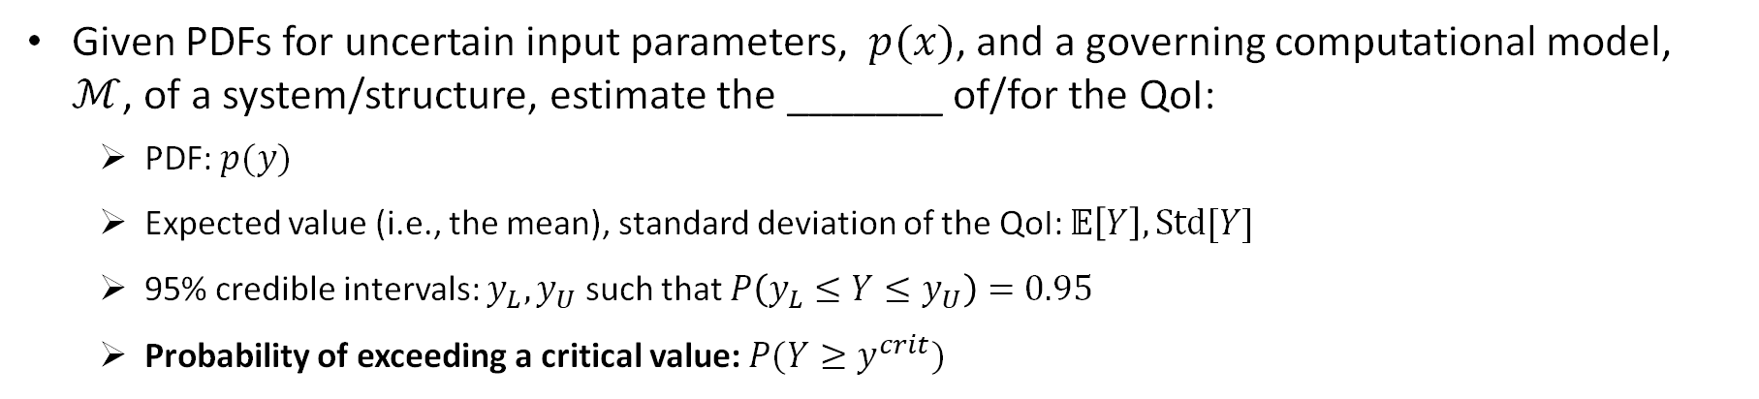
Uncertainty Propagation
Input Parameters
Computational Model
Quantity
of Interest (QoI)
e.g.,
Loading,
Material properties,
Geometry
e.g.,
Max. stress
Modal frequencies
$$ℳ\left(x\right)=y$$
$$y^{crit}$$
e.g., Finite element analysis
$$P(Y≥y^{crit})$$
Given PDFs for uncertain input parameters, $p(x)$, and a governing computational model, $ℳ$, of a system/structure, estimate the _______ of/for the QoI:
  PDF: $p(y)$
  Expected value (i.e., the mean), standard deviation of the QoI: $𝔼\left[Y\right], Std[Y]$
  95% credible intervals: $y_{L}, y_{U}$ such that $P\left(y_{L}≤Y≤y_{U}\right)=0.95$
  Probability of exceeding a critical value: $P(Y≥y^{crit})$

Slide 15



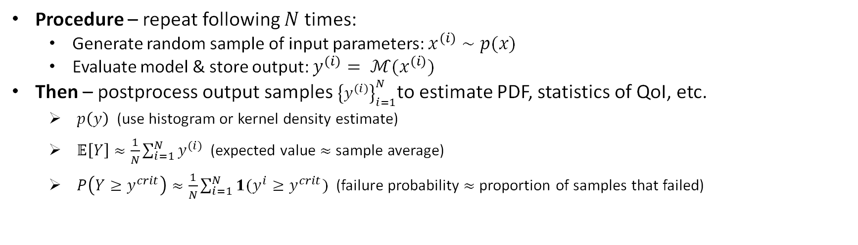
Monte Carlo (MC) Simulation
Input Parameters
Computational Model
Quantity of Interest (QoI)
$$ℳ\left(x\right)=y$$
Procedure – repeat following $N$ times:
  Generate random sample of input parameters: $x^{(i)}∼p(x)$
  Evaluate model & store output: $y^{(i)}= ℳ(x^{(i)})$
Then – postprocess output samples ${\left\{y^{(i)}\right\}}_{i=1}^{N}$to estimate PDF, statistics of QoI, etc.
  $p\left(y\right)$ (use histogram or kernel density estimate)
  $𝔼\left[Y\right]≈\frac{1}{N}\sum_{i=1}^{N}{y^{(i)}}$ (expected value $≈$sample average)
  $P\left(Y≥y^{crit}\right)≈\frac{1}{N}\sum_{i=1}^{N}{1(y^{i}≥y^{crit})}$ (failure probability $≈$proportion of samples that failed)
Indicator function: = 1 if True, = 0 if False

Slide 16

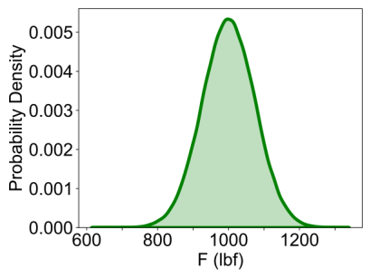

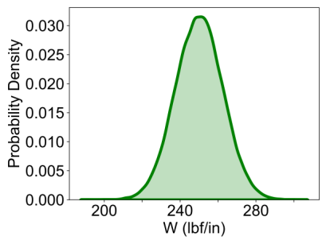
MC Example: Beam with Random Loading
L = 36 in
E = 10⁷ psi
I = 1.33 in⁴
Input Parameters
Computational Model

Slide 17
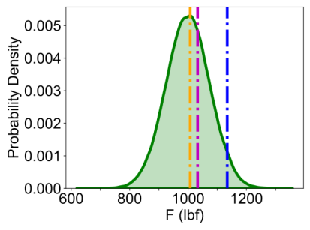
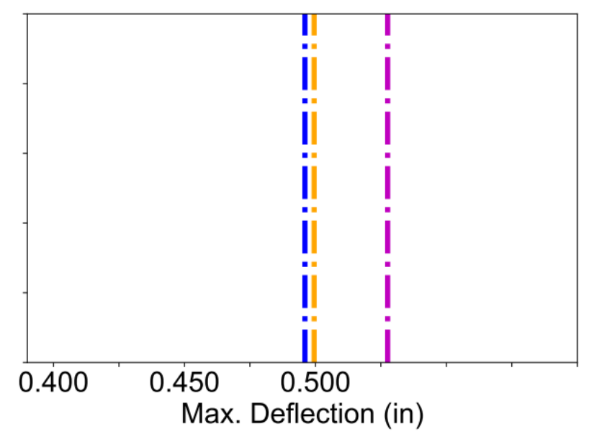
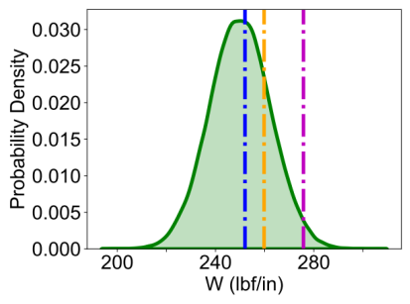
MC Example: Beam with Random Loading
L = 36 in
E = 10⁷ psi
I = 1.33 in⁴
Input Parameters
Quantity of Interest (QoI)
Computational Model
Model predictions for three randomly drawn inputs
0.550

Slide 18
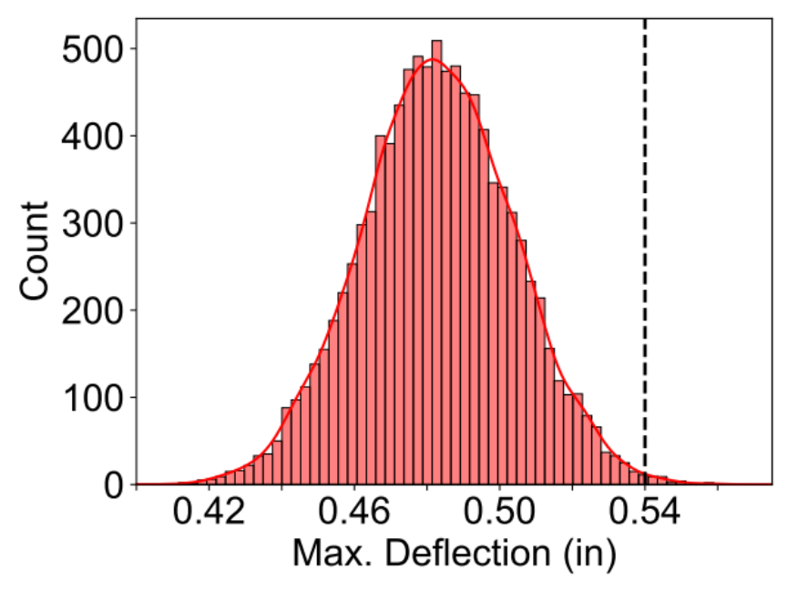


MC Example: Beam with Random Loading
L = 36 in
E = 10⁷ psi
I = 1.33 in⁴
Input Parameters
Quantity of Interest (QoI)
Computational Model
$$p(Δ_{max})$$
Failure threshold
Monte Carlo simulation for N=10,000 random samples
in

Slide 19


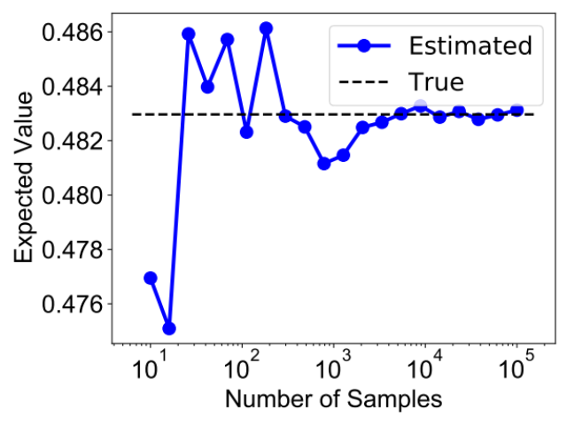
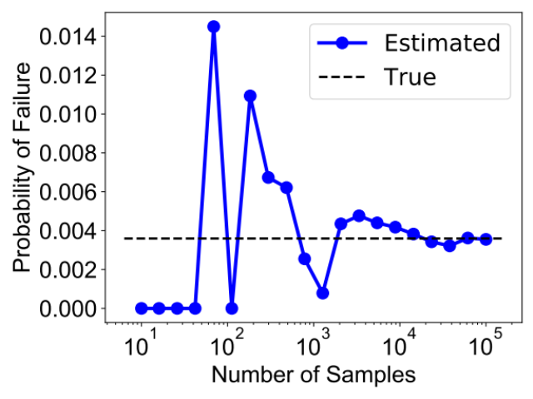
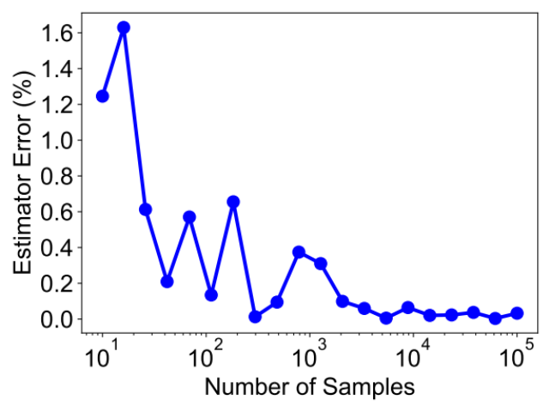
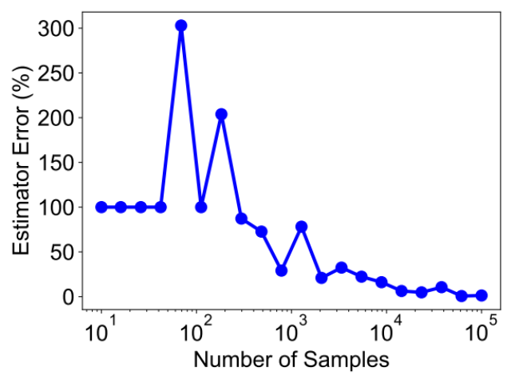
MC: Convergence
Convergence rate is on order of $\frac{1}{\sqrt{N}}$ (via Central Limit Theorem) and is independent of input dimension
Rare event (e.g., probability of failure) estimators require significantly more samples for accuracy
Notes:
Mention Central Limit Theorem implication: As the number of input samples, regardless of their type of distributions, the expected value of output of the model is going to asymptotically approach a Gaussian or normal distribution.
Also note: convergence rate is on the order of 1/sqrt(N) regardless of input PDF as well, but input PDF would affect the constant of proportionality.

Slide 20
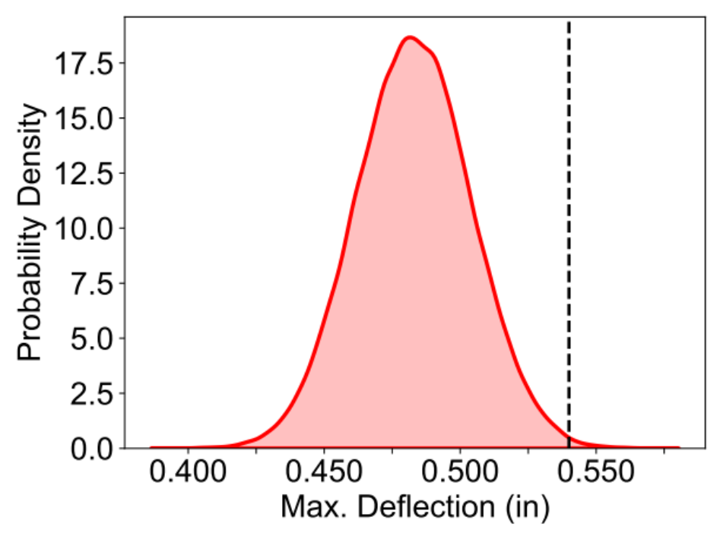
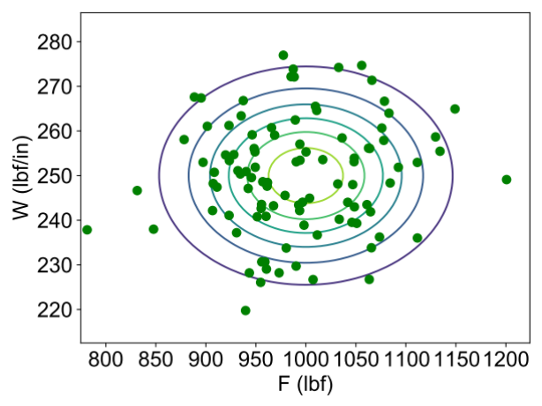
MC: Effect of Correlated Inputs
Joint PDF of loads
Correlation = 0
Marginal PDFs of loads
Failure Threshold
Monte Carlo simulation
Uncorrelated
No correlation:

Slide 21
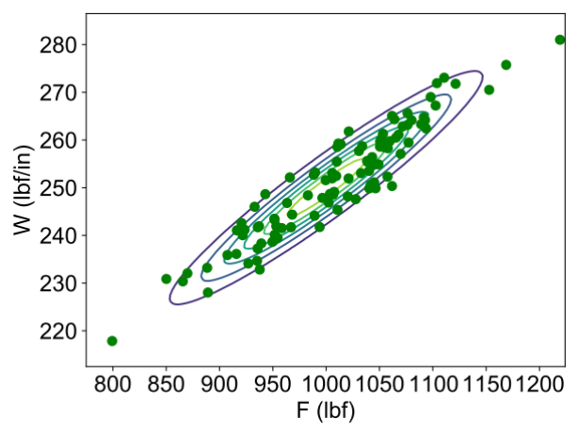
MC: Effect of Correlated Inputs
Joint PDF of loads
Correlation = 0
Marginal PDFs of loads
Failure Threshold
Monte Carlo simulation
Uncorrelated
Correlation = 0.95
Correlated
No correlation:

Slide 22
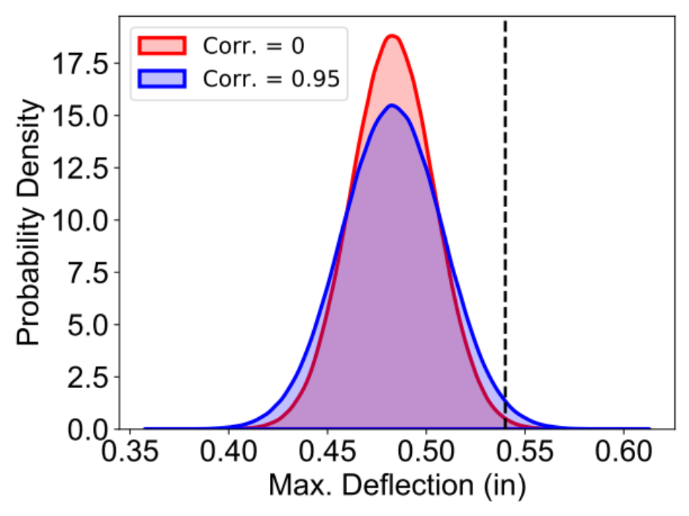
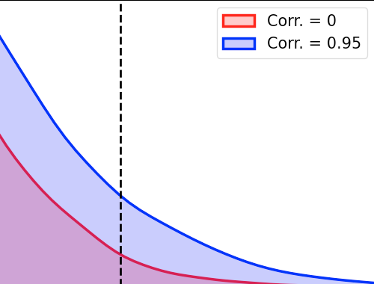
MC: Effect of Correlated Inputs
Joint PDF of loads
Correlation = 0
Marginal PDFs of loads
Failure Threshold
MC simulation
Uncorrelated
Correlation = 0.95
Correlated
Loads more likely to take extreme values together
No correlation:
With correlation:
Correlated load case is over 4X more likely to fail
Important to quantify correlations; failure to do so can lead to undetected non-conservatism

Slide 23
MC Takeaways
  Non-intrusive, general-purpose, and relatively simple approach for propagating uncertainty through models
    But can be challenging/infeasible in practice when models are expensive
  Exhibits provable convergence at a known rate, regardless of input dimension
  Improperly specifying input uncertainty (e.g., parameter correlations) can have a significant impact on results
So how do we quantify input uncertainties?
Make estimates based on expert judgement
Use available data to infer uncertainty directly

Slide 24
UQ Concepts: Model Calibration
Model Calibration
  Model calibration explicitly quantifies model input uncertainties using experimental data (can be used to improve or update initial assumptions)

Slide 25

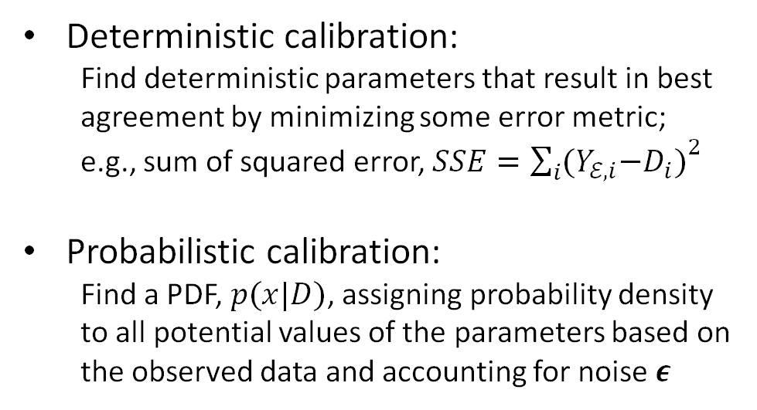

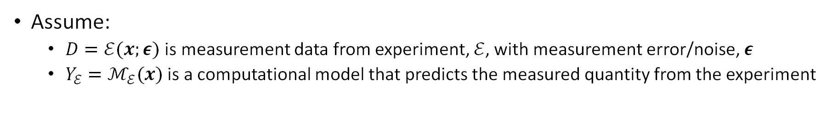


Deterministic vs. Probabilistic Calibration
Assume:
  $D=ℰ(x;ε)$ is measurement data from experiment, $ℰ$, with measurement error/noise, $ε$
  $Y_{ℰ}=ℳ_{ℰ}(x)$ is a computational model that predicts the measured quantity from the experiment
Deterministic calibration:
  Find deterministic parameters that result in best agreement by minimizing some error metric;
  e.g., sum of squared error, ${SSE=\sum_{i}{{(Y}_{ℰ,i}−D_{i})}}^{2}$
Probabilistic calibration:
  Find a PDF, $p(x|D)$, assigning probability density to all potential values of the parameters based on the observed data and accounting for noise $ε$
Y
$$x^{∗}$$
$$x$$
$$t$$
Y
$$x$$
$$t$$

Slide 26
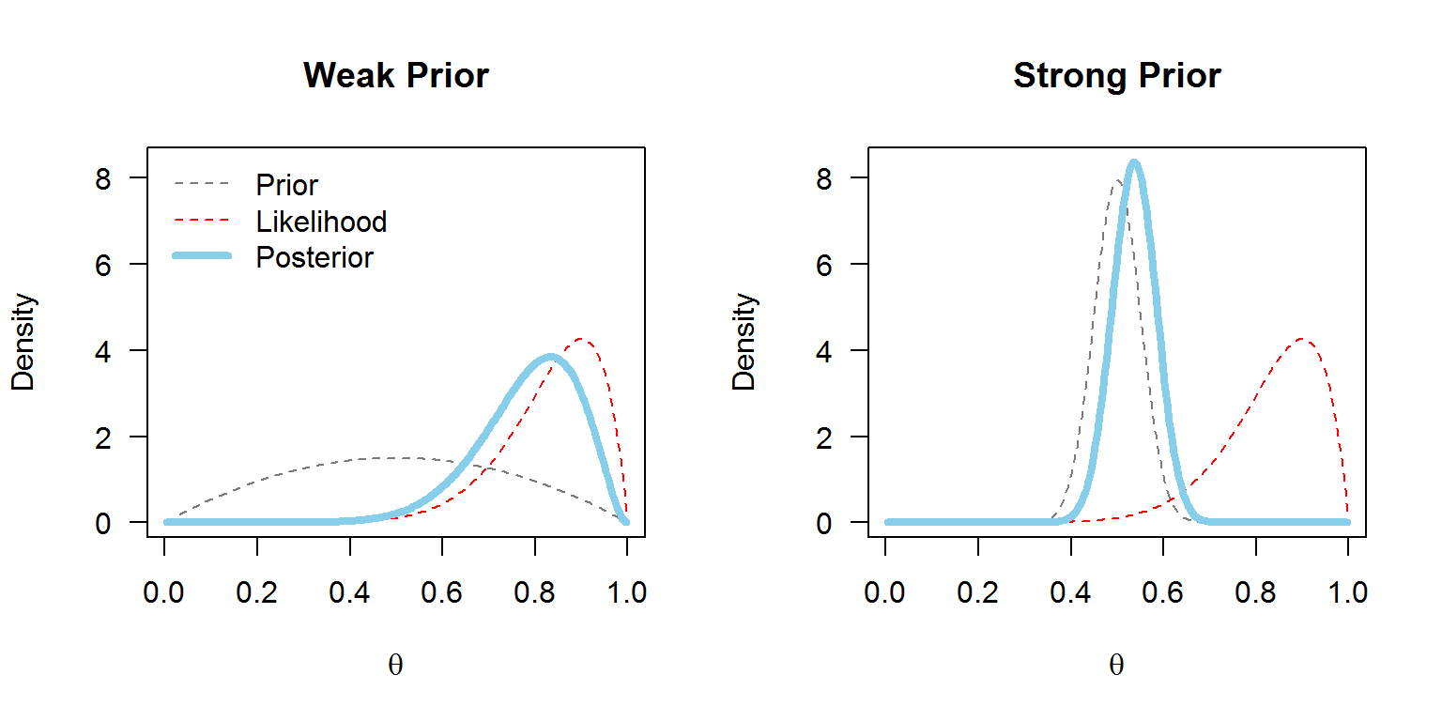
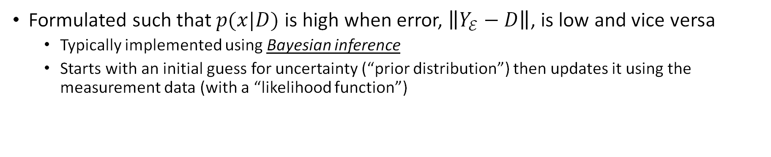
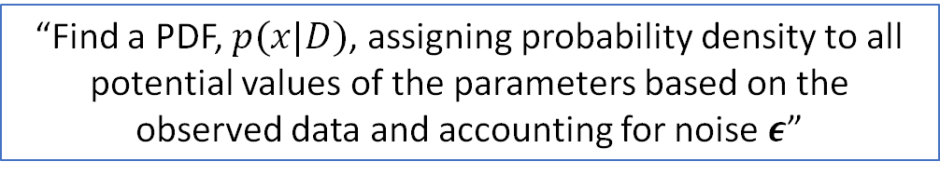
Probabilistic Calibration
How does this work in practice?
“Find a PDF, $p(x|D)$, assigning probability density to all potential values of the parameters based on the observed data and accounting for noise $ε$”
Formulated such that $p(x|D)$ is high when error, $\left\|Y_{ℰ}−D\right\|$, is low and vice versa
  Typically implemented using Bayesian inference
  Starts with an initial guess for uncertainty (“prior distribution”) then updates it using the measurement data (with a “likelihood function”)
Weak/non-informative prior
Strong prior
Prior
Likelihood
Posterior
Probability
Probability
x
x

Slide 27
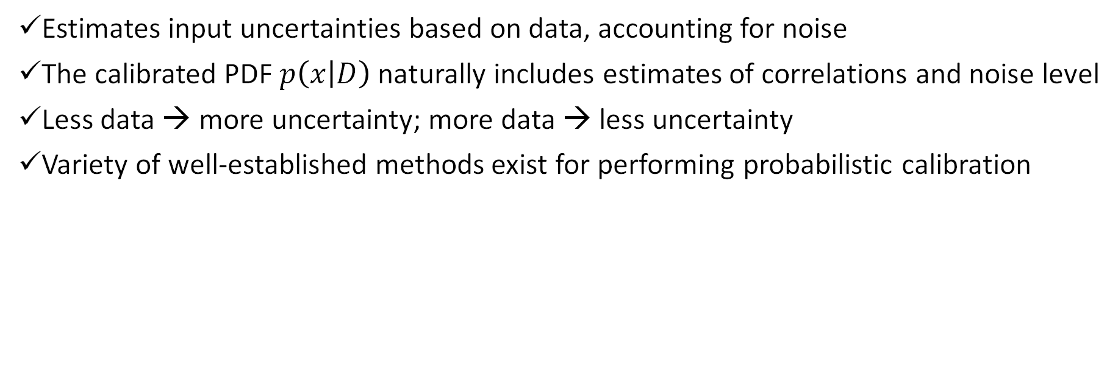
Probabilistic Calibration Takeaways
Estimates input uncertainties based on data, accounting for noise
The calibrated PDF $p\left(x | D\right)$ naturally includes estimates of correlations and noise level
Less data → more uncertainty; more data → less uncertainty
Variety of well-established methods exist for performing probabilistic calibration
Some notable caveats:
  Requires specific expertise/experience
  Prior distribution specification more nuanced than you may expect
  Computationally expensive relative to deterministic calibration

Slide 28














UQ Concepts: Surrogate Modeling (AKA response surfaces, reduced order models, …)
  Overcoming computational burden when the model is expensive
High-Fidelity
Input
Training Data
Simulation
Output
Training Data
Offline
Machine Learning
Gaussian processes
Neural networks
Polynomial Chaos
….
…
…
Surrogate
Orders of magnitude computational speedup possible
Online
Model
Notes:
Aka reduced order modeling aka response surface aka

Slide 29
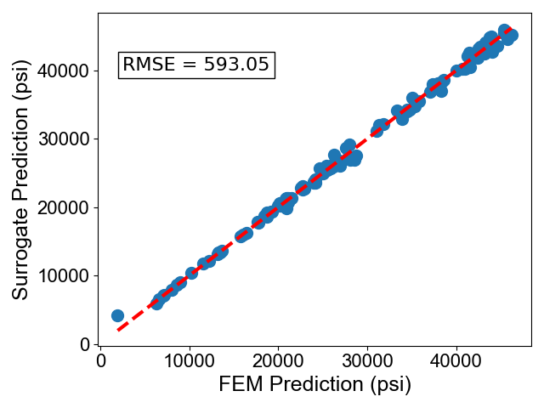






Surrogate Model Validation
Regardless of the method used for surrogate modeling, the most important step is validating a trained model before using for UQ
Always create a separate dataset for testing that is not used for training
If surrogate model error is not negligible, it can be factored into total uncertainty when making probabilistic predictions
Training
Testing
Compare predictions on test data to the original model
(M < T)
…
…
…
…

Slide 30

UQ Concepts: Model Discrepancy
“All models are wrong,” but our objective is to make them useful
  Physics never perfectly represented → capture the important parts!
In some cases, missing physics can lead to significant model discrepancy
  Significant meaning model form errors are on the same order as other sources of uncertainty
  Can often be identified as a violation of assumptions about the noise in the measurements during calibration
  Often results from a model not matching the as-built system
Y
Linear Model
“True” nonlinear function
$$x$$
Notes:
Mismatch from as built system ex: stiffening members with incorrect dimensions and/or in the wrong locations

Slide 31
UQ Concepts: Model Discrepancy
“All models are wrong,” but our objective is to make them useful
  Physics never perfectly represented → capture the important parts!
In some cases, missing physics can lead to significant model discrepancy
  Significant meaning model form errors are on the same order as other sources of uncertainty
  Can often be identified as a violation of assumptions about the noise in the measurements during calibration
Potential consequences:
  Biased estimates of physical parameters
  Invalidated inverse problem formulation
  Inaccurate estimates of uncertainty, especially when extrapolating

Slide 32
UQ Concepts: Model Discrepancy
“All models are wrong,” but our objective is to make them useful
  Physics never perfectly represented → capture the important parts!
In some cases, missing physics can lead to significant model discrepancy
  Significant meaning model form errors are on the same order as other sources of uncertainty
  Can often be identified as a violation of assumptions about the noise in the measurements during calibration
Potential consequences:
  Biased estimates of physical parameters
  Invalidated inverse problem formulation
  Inaccurate estimates of uncertainty, especially when extrapolating
Remedies:
  Implement an advanced calibration method to attempt to learn the discrepancy
  Build a better model (using insights from UQ analysis); Ensure the model matches the as-built hardware as close as possible

Slide 33
UQ Concepts: Sensitivity Analysis
Sensitivity Analysis
  Sensitivity analysis identifies the most influential system parameters to properly focus effort/resources in a probabilistic analysis

Slide 34
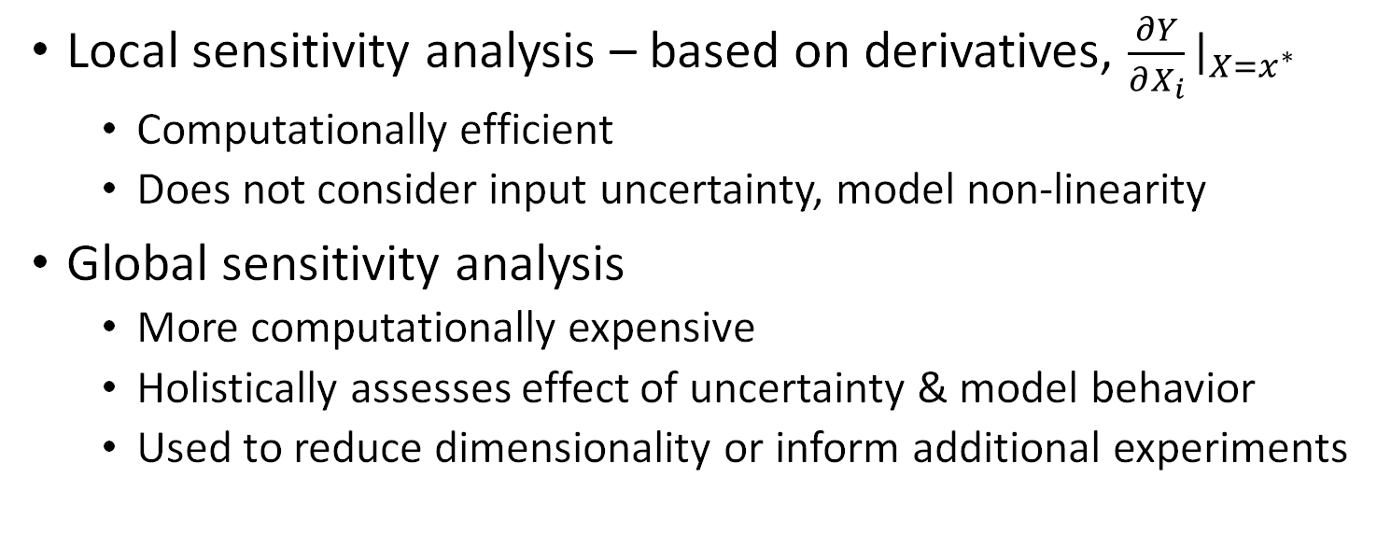
Sensitivity Analysis Overview
How uncertainty in the output of a model can be apportioned to different sources of uncertainty in the model input*
Y
Local sensitivity at x* is small
Local sensitivity analysis – based on derivatives, $\frac{∂Y}{∂X_{i}}{\left.​\right|}_{X=x^{∗}}$
  Computationally efficient
  Does not consider input uncertainty, model non-linearity
Global sensitivity analysis
  More computationally expensive
  Holistically assesses effect of uncertainty & model behavior
  Used to reduce dimensionality or inform additional experiments
x*
X_{i}
Sensitivity
Input 4
Input 3
Input 1
Input 2
*Global sensitivity analysis. The primer. Andrea Saltelli. 2007.

Slide 35
Some Practical Examples
Accounting for model form uncertainty in the modal analysis of NASA spacecraft
Estimating the reliability of a spacesuit assuming astronaut falls on the lunar surface
Note: these examples are presented for purposes of demonstration; the reliability estimates provided here are not reflective of the true values for these projects

Slide 36
Nonparametric Variation (NPV) Method
Takes a much broader view of what can be wrong with model
  Does not vary physical parameters
  Randomly varies mass and/or stiffness matrices (Wishart)
  Can be applied to either Hurty/Craig-Bampton (HCB) matrices or system modal matrices
Nominal Solution
Parameterized Solutions
Random matrices in vicinity of nominal
All valid matrices
Johnson, D.; Kammer, D.; Blelloch, P.; and Sills J.: “Uncertainty Models for the Hybrid Parametric Variation Method of Uncertainty Quantification,” NASA/TM 20220010939, July 2022.

Slide 37
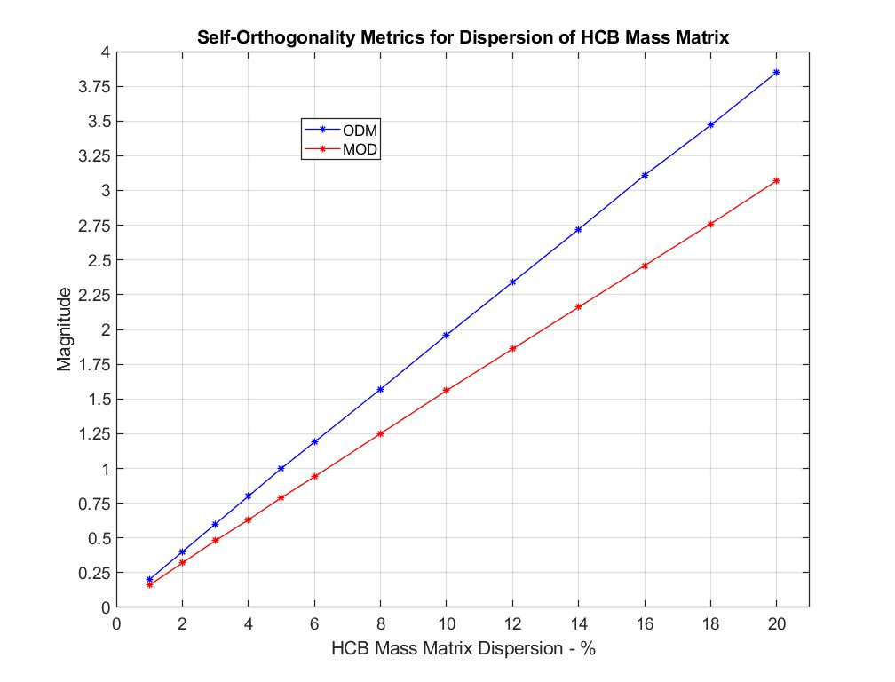
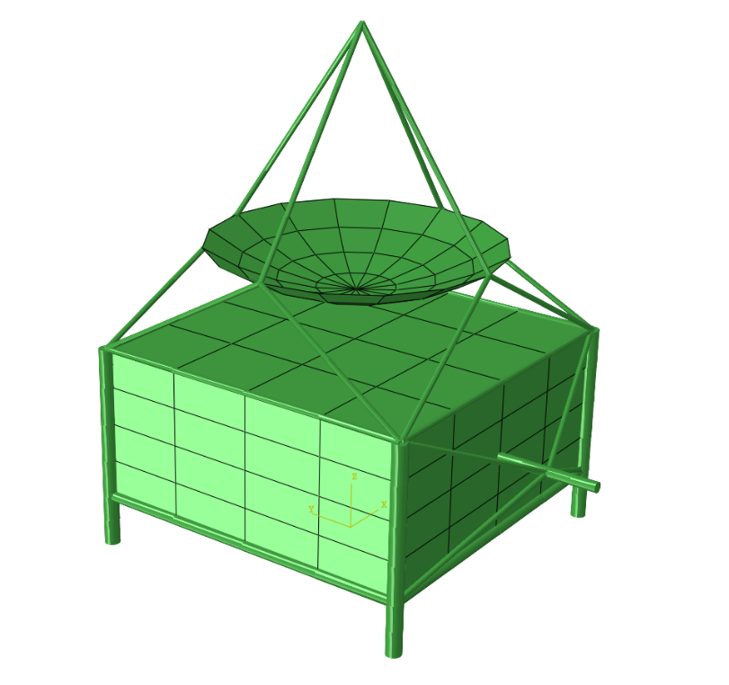


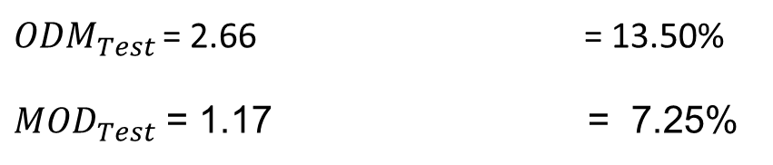
Academic Problem with Known Solution
Test data simulated by applying a parametric and model-form variation to baseline model of a generic spacecraft (GSC).
Determine mass matrix dispersion by matching random mode most probable self-orthogonality (SO) metric value from Monte Carlo to Test mode SO metric value.
Both metrics vary linearly with respect to assumed mass dispersion.
$${δM}_{HCB}$$
${ODM}_{Test}$ = 2.66 = 13.50%
${MOD}_{Test}$ = 1.17 = 7.25%
Off-diagonal mass
$${δM}_{HCB}$$
Mean off-diagonal
ODM overestimates mass uncertainty.
Saturates cross-orthogonality metric used for stiffness matrix dispersion.
Johnson, D.; Kammer, D.; Blelloch, P.; and Sills J.: “Uncertainty Models for the Hybrid Parametric Variation Method of Uncertainty Quantification,” NASA/TM 20220010939, July 2022.
37

Slide 38

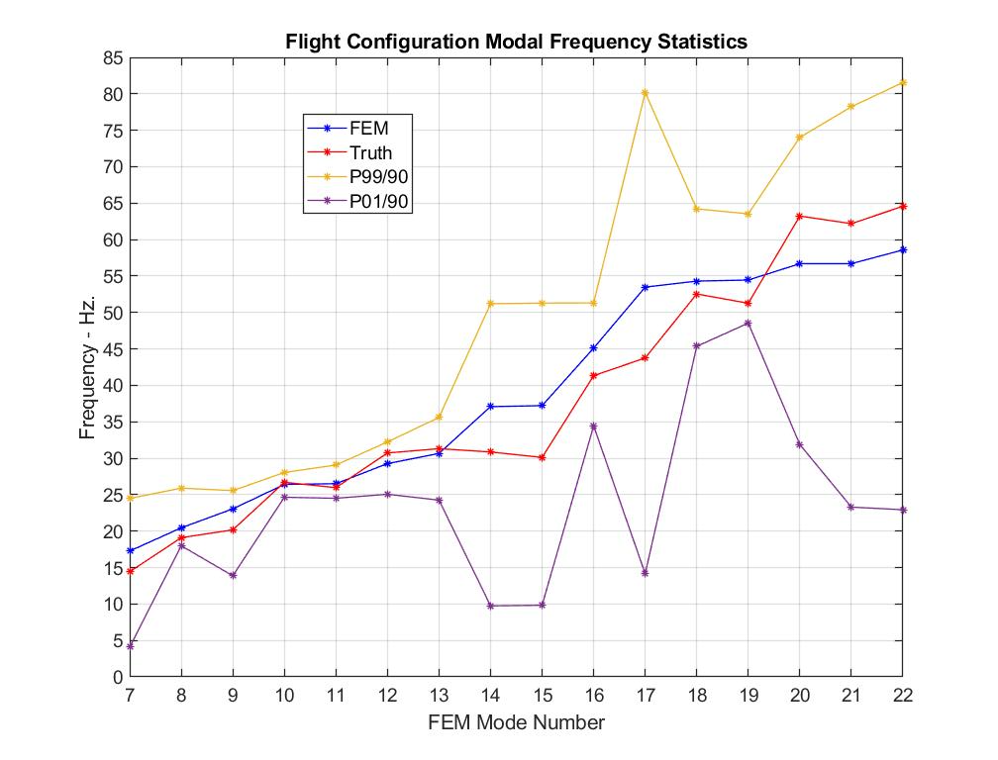
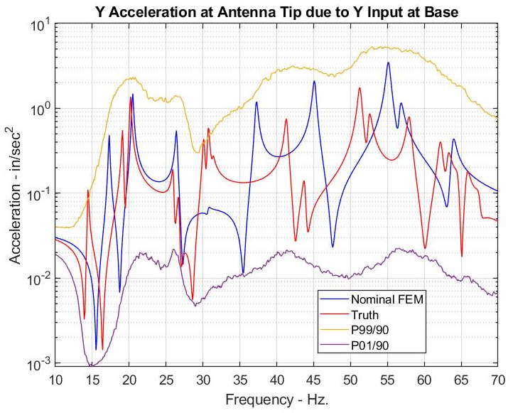


HPV Full Uncertainty Model Procedure Applied to GSC
Uncertainty model based on simulated test data:
${δM}_{HCB}$= 7.25%
${δK}_{HCB}$= 8.25%
HCB mass matrix dispersion
HCB stiffness matrix dispersion
Fixed-interface eigenvalues
Identified uncertainty model covers test frequencies and typical acceleration frequency response in P98/90 envelope.
Johnson, D.; Kammer, D.; Blelloch, P.; and Sills J.: “Uncertainty Models for the Hybrid Parametric Variation Method of Uncertainty Quantification,” NASA/TM 20220010939, July 2022.

Slide 39
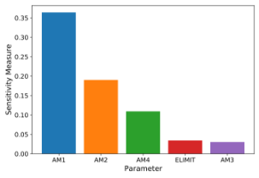
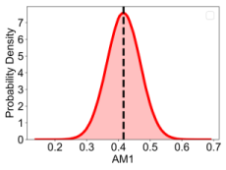
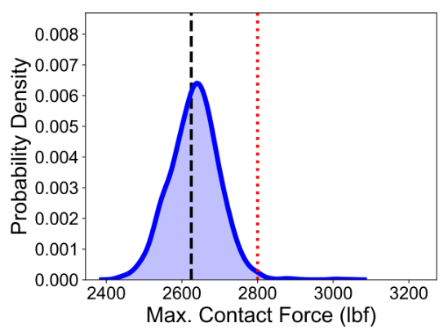
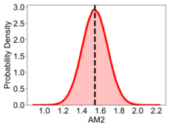
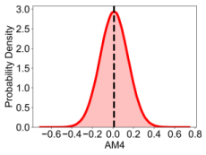
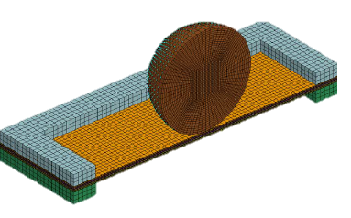
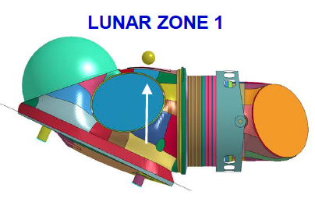
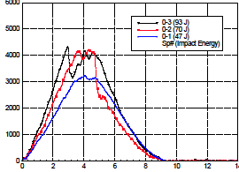
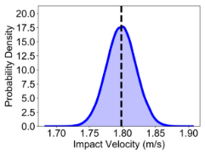
Z-2 Spacesuit Reliability Analysis
UQ Workflow Applied to Z-2 Spacesuit Reliability
Sensitivities
Material Parameters
Z-2 Design
Sensitivity Analysis
Component Model
Inputs
Impact Model
Output
Model Calibration
Reliability
Material Model
Max. Impact Force
Failure Threshold
Impact Load
Probability of failure
Impact Velocity
Impact Test Data
Uncertainty Propagation
Notes:
Point out

Slide 40
Z-2 Spacesuit Reliability Analysis
Given: candidate design, component/impact models, test data, assumed impact load & failure criteria
Estimate: Z-2 impact reliability
UQ Workflow Applied to Z-2 Spacesuit Reliability
Sensitivities
Material Parameters
Z-2 Design
Sensitivity Analysis
Component Model
Inputs
Impact Model
Output
Model Calibration
Reliability
Material Model
Max. Impact Force
Z-2 fails if:
Max. impact force > 2800lbf
Failure Threshold
Impact Load
Probability of failure
Impact Velocity
Impact Test Data
Uncertainty Propagation
Notes:
Point out

Slide 41
Z-2 Spacesuit Reliability Analysis
Given: candidate design, component/impact models, test data, assumed impact load & failure criteria
Estimate: Z-2 impact reliability
UQ Workflow Applied to Z-2 Spacesuit Reliability
Sensitivities
Material Parameters
Z-2 Design
Sensitivity Analysis
Component Model
Inputs
Impact Model
Output
Model Calibration
Reliability
Material Model
Max. Impact Force
Failure Threshold
Impact Load
Probability of failure
Impact Velocity
Impact Test Data
Uncertainty Propagation
Notes:
Point out

Slide 42
Z-2 Spacesuit Reliability Analysis
Given: candidate design, component/impact models, test data, assumed impact load & failure criteria
Estimate: Z-2 impact reliability
UQ Workflow Applied to Z-2 Spacesuit Reliability
Sensitivities
Material Parameters
Z-2 Design
Sensitivity Analysis
Component Model
Inputs
Impact Model
Output
Model Calibration
Reliability
Material Model
Max. Impact Force
Failure Threshold
Impact Load
Probability of failure
Impact Velocity
Impact Test Data
Uncertainty Propagation
  1) Applied sensitivity analysis to identify the most influential material model parameters to focus on for the remaining UQ analysis
Notes:
Point out

Slide 43
Z-2 Spacesuit Reliability Analysis
Given: candidate design, component/impact models, test data, assumed impact load & failure criteria
Estimate: Z-2 impact reliability
UQ Workflow Applied to Z-2 Spacesuit Reliability
Sensitivities
Material Parameters
Z-2 Design
Sensitivity Analysis
Component Model
Inputs
Impact Model
Output
Model Calibration
Reliability
Material Model
Max. Impact Force
Failure Threshold
Impact Load
Probability of failure
Impact Velocity
Impact Test Data
Uncertainty Propagation
  2) Used model calibration to quantify uncertainty in material parameters from impact test data
Notes:
Point out

Slide 44
Z-2 Spacesuit Reliability Analysis
Given: candidate design, component/impact models, test data, assumed impact load & failure criteria
Estimate: Z-2 impact reliability
UQ Workflow Applied to Z-2 Spacesuit Reliability
Sensitivities
Material Parameters
Z-2 Design
Sensitivity Analysis
Component Model
Inputs
Impact Model
Output
Model Calibration
Reliability
Material Model
Max. Impact Force
Failure Threshold
Impact Load
Probability of failure
Impact Velocity
Impact Test Data
Uncertainty Propagation
  3) Used uncertainty propagation to estimate reliability given material/impact load uncertainty
    Reliability $≈$ 99.3% (demonstration purposes only)
    Quantified material uncertainty resulted in >10% variability in predicted max. contact force
Notes:
Point out

Slide 45
Common UQ Pitfalls
Using solutions that are not converged (e.g., not enough samples for Monte Carlo)
Assuming all input parameters are independent/uncorrelated to simplify an analysis
Failing to validate a surrogate model (or validating using the same data it was trained on)
Not accounting for significant model discrepancy / model form uncertainty

Slide 46
Relevant NASA References
Kammer, D.; Blelloch, P.; and Sills, J.: “Test-Based Uncertainty Quantification and Propagation Using Hurty/Craig-Bampton Substructure Representations,” in IMAC, Orlando, FL, 2019.
Kammer, D.; Blelloch, P.; and Sills, J.: “Variational Coupled Loads Analysis using the Hybrid Parametric Variation Method,” in IMAC, Houston, TX, 2020.
Kammer, D.; Blelloch, P.; and Sills, J.: “SLS Integrated Modal Test Uncertainty Quantification using the Hybrid Parametric Variation Method," in IMAC, 2021.
Kammer, D.; Blelloch, P.; and Sills, J.: “Probability Bounds Analysis Applied to Multi-Purpose Crew Vehicle Nonlinearity,” in IMAC, Orlando, FL, 2022.
Sills, J.; Blelloch, P.; and Kammer, D.: “NESC Peer Review of Exploration Systems Development (ESD) Integrated Vehicle Modal Test, Model Correlation, Development Flight Instrumentation (DFI) and Flight Loads Readiness,” NESC-RP-16-01110, NASA/TM−20210009733. 2021.
Warner, J. E.; Leser, P. E.; Leser, W. P.; Cole, D. A.; and Bomarito, G. B.: “Assessing Next-Gen Spacesuit Reliability: A Probabilistic Analysis Case Study”, NASA/TM–20210019495. 2021.
Johnson, D.; Kammer, D.; Blelloch, P.; and Sills J.: “Uncertainty Models for the Hybrid Parametric Variation Method of Uncertainty Quantification,” NASA/TM 20220010939, July 2022.

Slide 47
Further Reading
Uncertainty Quantification (general)
  Smith, R. C. Uncertainty Quantification Theory, Implementation, and Applications. 2013. [Textbook]
  Roy, C. J. and Oberkampf, W. L. A comprehensive framework for verification, validation, and uncertainty quantification in scientific computing. 2010.
Uncertainty Propagation
  Rubinstein, R. Y. and Kroese, D. P. Simulation and the Monte Carlo Method., 2016.
  Ditlevsen, O. and Madsen, H. O. Structural Reliability Methods. 2007 [Textbook] (Free PDF download available)
Model Calibration
  Kennedy, M. C. and O’Hagan, A. Bayesian calibration of computer models. 2002.
  Haugh, M. B., A Tutorial on Markov Chain Monte-Carlo and Bayesian Modeling. 2021.
Surrogate Modeling
  Alizadeh, R. et al. Managing computational complexity using surrogate models: a critical review. 2020.
  Gramacy, R. B. Surrogates: Gaussian Process Modeling, Design and Optimization for the Applied Sciences. 2020.
  Sudret, B. et al. Surrogate models for uncertainty quantification: An overview. 2017.
Model Discrepancy
  Brynjarsdóttir, J. and O’Hagan, A. Learning about physical parameters: The importance of model discrepancy. 2014
  Soize, C. A nonparametric model of random uncertainties for reduced matrix models in structural dynamics. 2000.
Sensitivity Analysis
  Saltelli, A. Global sensitivity analysis. The primer. [Textbook] (Free PDF download available)
  Plischke, E. et al. Global sensitivity measures from data. 2013
Software
  Dakota: uncertainty quantification software by Sandia: https://dakota.sandia.gov/
  SALib: open-source Python library for sensitivity analysis https://github.com/SALib/SALib
  Scikit-learn: open-source Python library for machine learning (surrogate modeling): https://scikit-learn.org/stable/

Slide 48
Backup

Slide 49
Philosophical Points
Types of uncertainty:
  Aleatory uncertainty – uncertainty due to inherent variability or randomness of a physical phenomenon
    E.g., Variability of material properties in manufactured parts; variation in environmental load
  Epistemic uncertainty – uncertainty due to a fundamental lack of knowledge or simplifying model assumptions, missing physics, measurement bias, etc. that could theoretically be reduced with additional resources/effort
    Ex: the geometry of a specific manufactured part; numerical error from a coarse mesh
Two schools of thought:
  Bayesian: probability represents degree of belief of the analyst and can be used to model both aleatory & epistemic uncertainties
  Frequentist: probability represents the frequency of occurrence and therefore is not appropriate for epistemic uncertainties; instead intervals with no associated likelihood/PDF should be used.
“The Bayesian perspective is… natural for model uncertainty quantification since it provides densities that can be propagated through models.” Smith, R. C. Uncertainty Quantification Theory, Implementation, and Applications. 2013.

Slide 50
Experiments, Models, Simulations & UQ
Physical Experiment
Example sources of uncertainty
Model Formulation
Model calibration and validation
Probability Density
Sensor error
Quantity of interest
Mathematical Model
Numerical Simulation
Probabilistic
Quantity of interest
Prediction
Input parameter uncertainty
Discretization error
Model Verification
Uncertainty quantification (UQ): the quantification of the effect of various sources of error (from model, simulation, experiment) on a predicted quantity of interest
Model verification: the process of quantifying the accuracy of simulation codes used to implement mathematical models (i.e. are we solving the equations correctly?)
Model validation: the process of determining the accuracy with which mathematical models represent the physical processes of interest (i.e. are we solving the correct equations?)
Smith, R. C. Uncertainty Quantification Theory, Implementation, and Applications. 2013.

Slide 51
Model Discrepancy Details
Model validation / model discrepancy / model form uncertainty
  One approach: calculate validation error metric at series of points in validation domain & build regressor to estimate model form uncertainty in application domain [1]
References
  Roy, C. J. and Oberkampf, W. L. A comprehensive framework for verification, validation, and uncertainty quantification in scientific computing. 2010.
    Model-form uncertainty estimation + extrapolation (images above)
  Kennedy, M. C. and O’hagan, A. Bayesian calibration of computer models. 2002
    Bayesian approach to treating model discrepancy
  Sills, J. NESC-RP-16-01110, NASA/TM-2021-0009733. 2021.
    Non-parametric variation approach for model form uncertainty for dynamics.
Validation metric based on experiment/simulation CDFs [1]
Validation vs. Application Domains [1]

Slide 52


Important Areas Not Covered
Mixed & Imprecise Probability Methods
  Philosophy: aleatory (irreducible/stochastic) uncertainty is modeled with probability distributions, epistemic (reducible/ignorance) uncertainty is modeled with intervals with no associated probability
  Solution approach: double loop Monte Carlo simulation
    Repeat: select possible epistemic variable values from intervals, perform standard Monte Carlo simulation for aleatory variables; Then: identify min/max CDFs to create P-Box solution
  Provides estimates in the form of intervals:
    P(y < 5) = [0.2, 0.7]; Probability of failure = [0.97, 0.9999]
  Simple, efficient compromise: use worst case values for epistemic variables & use standard Monte Carlo
    Can be challenging to identify “worst case” values for large numbers of epistemic uncertainties and complex failure criteria
References
  Roy, C. J. and Oberkampf, W. L. A comprehensive framework for verification, validation, and uncertainty quantification in scientific computing. 2010.
  Ferson, S. and Ginzburg, L. R. Different methods are needed to propagate ignorance and variability. 1996
Input Parameters
Computational Model
Quantity of Interest (QoI)
Aleatory
Epistemic
P-Box
CDF
Width reflects level of ignorance
e.g., FEM Model

Slide 53
FoS- vs. Reliability-Based Design
Traditional Design Based on FoS
Reliability-Based Design
Factor of Safety
Knockdown factor
Resistance
Load
Failure Probability
Margin
Probability Density
Calculated
Calculated
Load
Resistance
Load or Resistance
FoS Shortcomings
  Determined empirically, not necessarily based on physics/mathematics
    Inconsistencies observed from program to program; between NASA and other external organizations
    Difficult to specify for new vehicle types, materials, and environments
  May be sequentially applied by multiple teams
    Can be costly, conservative, inefficient
  Does not provide measures of reliability from the design process
Images adapted from Raju et al. White Paper on Factors of Safety. NASA/TM-2009-215723

Slide 54
FoS- vs. Reliability-Based Design
Traditional Design Based on FoS
Reliability-Based Design
Factor of Safety
Knockdown factor
Resistance
Load
Failure Probability
Margin
Probability Density
Calculated
Calculated
Load
Resistance
Load or Resistance
Reliability-Based Design
  Classical structural reliability assumes load & resistance are independent, Gaussian distributions and yields a simple analytical formula for probability of failure
  The resistance (strength) distribution can be determined directly from A/B-basis properties
  For practical problems, more general UQ methods are often needed to estimate the load (stress) distribution or the probability of failure (P[L > R]) directly – the focus of today’s slides
Images adapted from Raju et al. White Paper on Factors of Safety. NASA/TM-2009-215723

Slide 55
SimTools: In-House Software for Automating Simulations
Specify:
Number of input samples/combinations
Number of simulations to run in parallel
Number of processors to run each simulation on
Output metrics to compute & store
Produces:
Processed input/output dataset
High Performance Computing Cluster Scheduling
Postprocessing & Data Management
Input Distributions or bounds
Prob
Param1
Prob
Inputs
CPU
CPU
CPU
CPU
Outputs
Param2
AM1 | … | VEL
12.4 | … | 1.0
14.3 | … | 1.4
… | … | …
13.1 | … | 1.1
4
F-max | E-Max
1.2e3 | 5.4e3
1.8e3 | 4.9e3
… | …
1.6e3 | 5.8e3
1
Prob
Param3
2
Prob
CPU
CPU
CPU
CPU
Impact Velocity
…
3
Nominal FEM model
x | y | x | k | d | e | 3
1 | 2 | 3 | 5 | 2 | 5 | 3
3 | 3 | 3 | 2 | 2 | 2 | 3
3 | 2 | 2 | 2 | 2 | 2 | 2
0 | 9 | 8 | 6 | 5 | 4 | 3
CPU
CPU
CPU
CPU
Example: Needed to run 200 suit simulations for different inputs; Ran 15 simulations at a time on 10 processors each
  Performed 1+ years of serial computation time in around 1 week of wall time
Outputs
Inputs

