Slide 1
An Algorithm for Statistical Audibility Prediction (SAP) of an Arbitrary Signal in the Presence of Noise
Menachem Rafaelof
National Institute of Aerospace at NASA Langley Research Center
Contributors
Andrew Christian and Matthew Boucher
NASA Langley Research Center
Audio Engineering Society (AES)
153rd Convention, New York
October 19-20, 2022
Workshop #13

Slide 2
Outline
The need for predicting audibility
Challenges and Basic Approach
SAP
  Basics (specific loudness and d-prime)
  Algorithm steps
Performance validation at low frequencies
Ongoing
  Hearing below the level of the masker, high frequency signals and binaural hearing
Demonstration and a task for this audience
  Helicopter over NYC
  SUI drone over UPS truck
  Distributed Electric Propulsion (DEP) vehicle over box truck
M. Rafaelof and K. Wendling, “An Algorithm for Statistical Audibility Prediction (SAP) of an Arbitrary Signal in the Presence of Noise” J. Audio Eng. Soc., vol. 69, no. 9, pp. 672–682, (2021 September). DOI: https://doi.org/10.17743/jaes.2021.0021
NASA LAR-19736-1: patent pending
Notes:
Publication in JAES
Patent pending

Slide 3
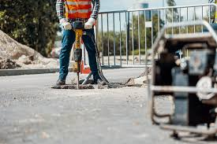
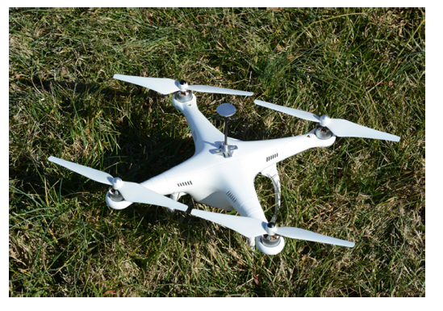
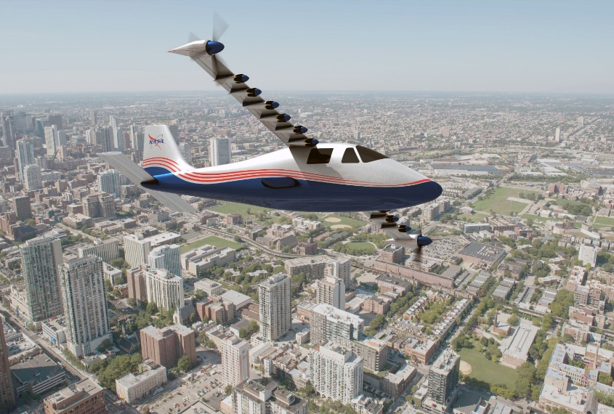
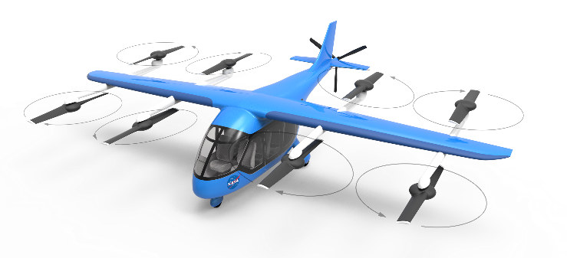
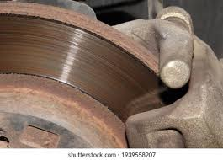
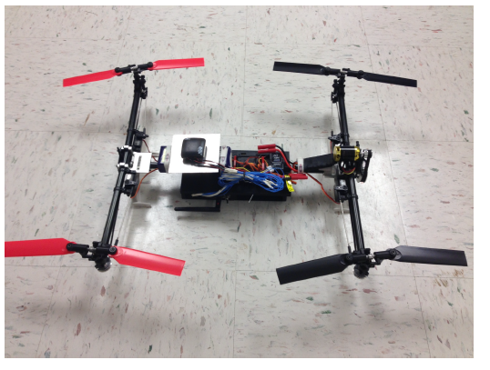
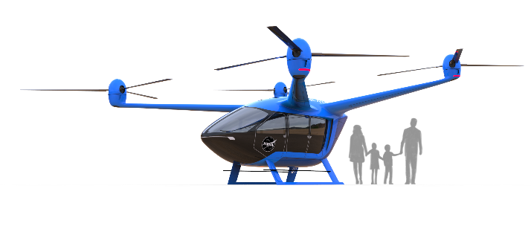

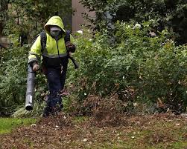
The need for predicting audibility
Avoid intrusive or annoying sounds
Unmanned Arial vehicles (UAs)
Urban Air Mobility (UAM) vehicles
Other sources
Assure audibility
Alarms, telephone ring tone, speech, music over a given ambient noise. etc.
Some benefits:
A common method for virtual assessment of any sound in presence of another sound
Explaining root cause for audibility vs. time and/or frequency
As an effective noise metric (hot topic – e.g., AES standards SC-04-09 )

Slide 4
Challenges and Basic Approach
A flexible algorithm to predict the audibility of a given signal in presence of masker.
Deal with any combination of a signal and a masker:
Variation with time, level, frequency, bandwidth, envelope, modulation, etc.
The model must capture the complex function of the auditory system at the periphery and higher levels
Nonlinear with both level and frequency
Frequency masking
Feedback and focus and tracking of the signal
Detection below the level of the masker
Uncertainty
Binaural hearing attributes
Δ
Basic Approach: Reliance on the model of loudness
Nonlinear sensitivity with level and frequency
Nonlinear to change in level (Δ)
Absolute threshold of hearing
Δ
Notes:
The impact of the BW of masker above CB BW.
Binaural attributes/cues
Signal and masker locations
Redundancy vs. recruitment

Slide 5
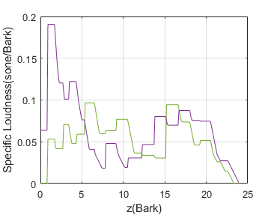
Specific Loudness
Sound Pressures vs. time
(FF/DF)
H_{outer}
H_{METF}
H_{AF}
Excitation Pattern
Compression &
Spec. Loudness
Total
Loudness vs. time
internal noise/excitation
FF/DF – Free/Diffuse Field
H_{outer} – Transfer function to eardrum
H_{METF} – Transfer function, eardrum to differential pressure across Basilar Membrane (BM)
H_{AF} – Auditory Filter (AF) bank
specific loudness at two different time instances for a sample sound
Specific loudness is the estimate of the strength of sound perceived through different AFs.
SAP method relies on the specific loudness of the signal and the masker to estimate audibility as it occurs; i.e., with time and frequency.
Notes:
Must explain AFs

Slide 6
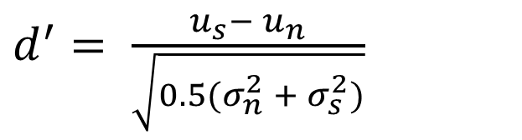
d-prime or sensitivity
Specific loudness* is assumed to capture “observations” through individual auditory filters. As such, observations arise with a specific probability from either the signal or the masker. According to Signal Detection Theory (SDT), the problem of discrimination (or detection) is a statistical question which relies on testing of statistical hypotheses.
Define sensitivity as:
Pr
$d^{′}= \frac{u_{s}{− u}_{n}}{\sqrt{0.5(σ_{n}^{2}{ + σ}_{s}^{2})}}$
σ_{n}
σ_{s}
u
u
x
n
s
with
u_{s} and u_{n} - mean of AF response for signal and noise
σ_{s} and σ_{n} - standard deviation of response for signal and noise
masker
signal
d’ measures the mean difference of two distributions normalized to their common standard deviations
* viewed as capturing internal response

Slide 7
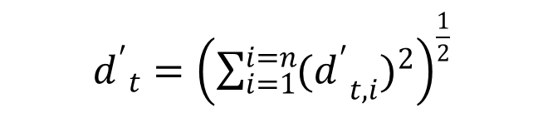
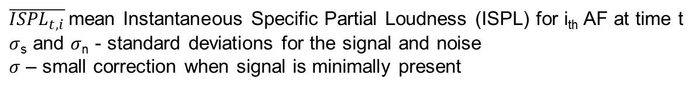
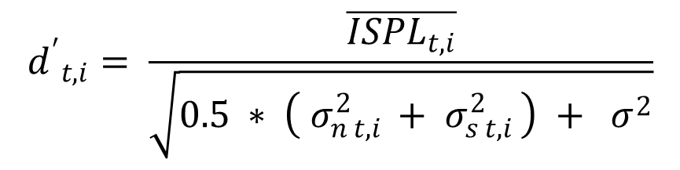
SAP Model
1. Compute specific loudness vs. time for the signal and masker as inputs (at the observer)
2. Compute d-prime (sensitivity) within each AF for time span dt:
$${d^{′}}_{t,i}= \frac{\overline{{ISPL}_{t,i}}}{\sqrt{0.5 ∗ \left({ σ}_{n t,i }^{2} +{ σ}_{s t,i }^{2}\right) + σ^{2}}}$$
specific
loudness
time
$\overline{{ISPL}_{t,i}}$ mean Instantaneous Specific Partial Loudness (ISPL) for i_{th} AF at time t
$σ$_{s} and $σ$_{n} - standard deviations for the signal and noise
$σ$ – small correction when signal is minimally present
dt=1sec
sliding
window
AF
frequency
3. Compute overall enhanced sensitivity at time t when/if many auditory filters are involved:
${d^{′}}_{t}={\left(\sum_{i=1}^{i=n}{{{{(d}^{′}}_{t,i})}^{2}}\right)}^{\frac{1}{2}}$
for i = 1, 2, 3, … n=39 AFs
Root Sum of Squares (RSS)

Slide 8
Performance Validation
Low frequency tones and a tone complex

Slide 9
Performance Validation (pure tones)
Signal tone frequencies: 55, 120 and 200Hz
Masker: nominal spectral level of 31 dB/Hz and 40-250Hz
Test method: adaptive 3-Alternative Forced Choice
Number of test subjects: 9
A
B
C
time
P(c) = 79.4%
Hacker and Ratcliff tables
d’=1.61
3AFC Trial Sequence.
Teal: narrow band noise masker
Green: signal
subject response
under adaptive 3AFC test process
Rafaelof, M., Christian, A.W., Shepherd, K.P., Rizzi, S.A., and Stephenson, J.H.,
"Audibility of Multiple, Low-Frequency Tonal Signals in Noise," NASA TM-2019-220398, September 2019.

Slide 10
Performance Validation (pure tones)
See common legend
SAP predictions:
Dark blue trace is the mean value of d’
Light blue traces represent the upper and lower %95 limits of the mean = mean -/+ z*SE
assuming normally distributed d’ and computing variance for 1sec long moving window
SE = sqrt(variance)
z = 1.96, the 97.5 percental point of the normal distribution
Shaded lighter blue represent the range to the upper and lower %95 limits of the mean
Notes:
C:\Users\mrafaelo\Documents\SAP 2022\SAP II work\dprime_2022.m
Selected_case = 1, 2 & 3
AmbiantNoise = 0

Slide 11
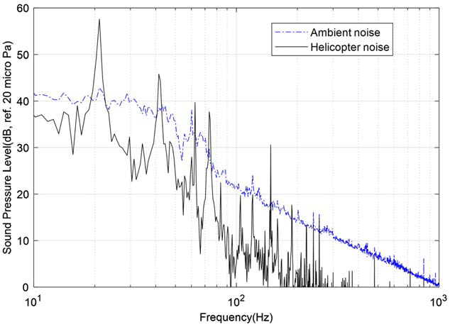
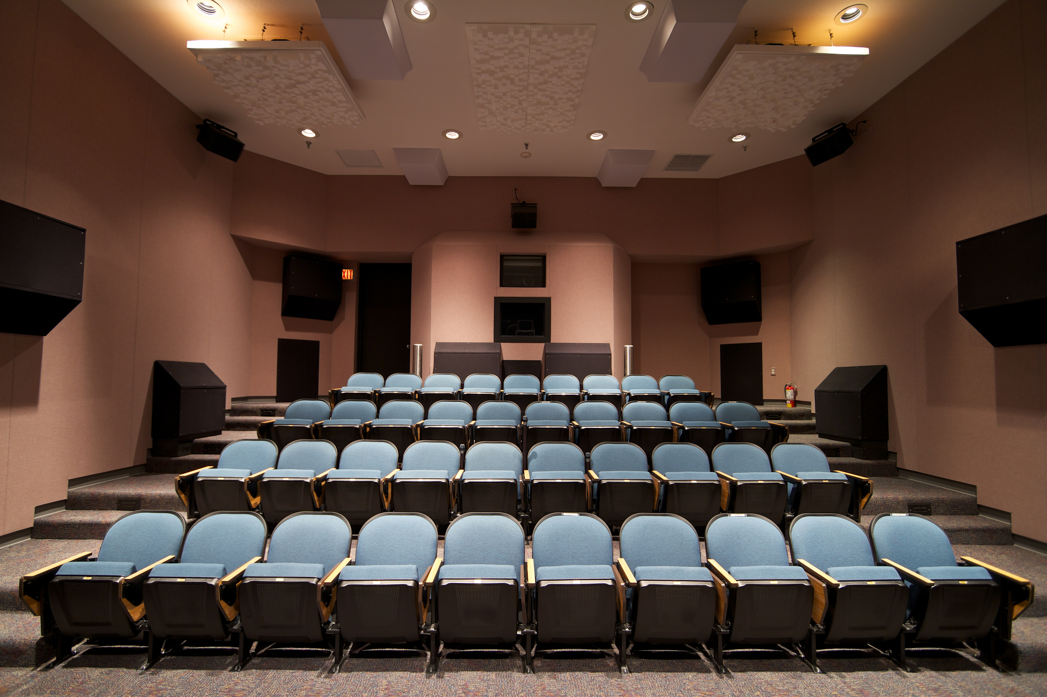

Performance Validation (complex tone)
Signal: fly-in noise by a civilian helicopter
Masker: urban environment ambient noise
Test method: 3-Alternative Forced Choice
Test subjects: 40
Test location: four seats, Exterior Effects Room (EER)
Approach: Source fly-in noise has been sampled 150 times throughout its range; i.e., from completely inaudible to fully audible. This sampling resulted in 150 snippets (800msec in duration) which were presented randomly to subjects over the ambient noise as part of 3AFC test process.
$${\text{P}\text{(}\text{c}\text{)}}_{snippet}= \frac{\# of correct responses}{total \# of responses}$$
Hacker and Ratcliff tables
d’_{snippet}
t
A
B
C
3AFC intervals: green represents the source snippet sound randomly presented over persisting masker (gray).
Notes:
Note the BW of the masker

Slide 12
Performance Validation (complex tone)
Mean subject response data for 36 subjects
Front row: seat 1 and 2
Back row: seat 3 and 4
Notes:
'C:\Users\mrafaelo\Documents\SAP 2022\SAP II work\dprime_2022.m
Run four times for each seat recordings. Save predictions
for plot uses
plot_with_confInterval() for SAP predictions
plot_responses_with_confInterval () for subject response data
used 3msec averaging of seat recording data
Run
C:\Users\mrafaelo\Documents\SAP 2022\SAP II work\ICHIN3a_complex_tone_AS350\plot d' resutls\PlotAS350.m
To merge seat data and to include subject response data

Slide 13
Ongoing Work
Accounting for the detection of the signal below the level of the masking noise
Binaural hearing
  Potential improvement due to binaural redundancy vs. current assumption of recruitment
  The introduction of phase difference (Binaural Masking Level Differences) below 1600Hz
Increase in MT due to increased masker bandwidth past the bandwidth of CB
Higher frequency signals (2023)
  Head shadow effect; i.e., different SNRs at ears
1, 2 & 3 : Potential factors explaining earlier detection by subjects

Slide 14
Detection of the signal below the level of the masking noise
Approach:
Rely on audibility data in literature for pure tones to check predictions
Establish a correction to account for the ability for detection below the level of the masking noise

Slide 15
Hearing below the level of the masker
Subject test data*
Masked Threshold (MT) data gathered for pure tones with different frequencies in presence white noise.
Seven curves for seven different noise levels
The level of test tone just masked by white noise of different density levels as function of test-tone frequency.
*source: Figure 4.1 (pp. 62), Psychoacoustics Facts and Models Hugo Fastl and Eberhard Zwicker 3rd edition

Slide 16
Hearing below the level of the masker
Difference between empirical data in Figure 4.1 and predictions by SAP assuming d’ = 1 for many pure tones*.
difference (dB) =
Tone MT – SAP prediction
This data points to nonlinear sensitivity of detection with frequency
However, mostly, independent of the level.
*39 test tones for each curve
Notes:
'C:\Users\mrafaelo\Documents\SAP 2022\Mask Threshold Project’
Compute_dprime_MTs_SAP.m

Slide 17
Hearing below the level of the masker
Difference between empirical data in Figure 4.1 and predictions by SAP method expressed as a change in d’.
A single d’ correction curve, independent of level, vs. frequency.

Slide 18
Hearing below the level of the masker
SAP Mask Threshold predictions with different ramping-level tones (*) in presence of the same maskers as before.
Pending validation with real data.
*source: Figure 4.1 (pp. 62), Psychoacoustics Facts and Models Hugo Fastl and Eberhard Zwicker 3rd edition

Slide 19
Demonstration
A task for this audience:
Try to consider d’ as a simple noise metric that could gauge intrusiveness or annoyance.
Please provide comments.
d’ as a noise metric: derived from instantaneous value of d’ vs. time.
  Peak or rms value of d’ or log(d’) for single events
  Integrated value of d’ or log(d’) with respect to time for cumulative effects

Slide 20

Helicopter --- NYC
speech
car horn
banging events

Slide 21
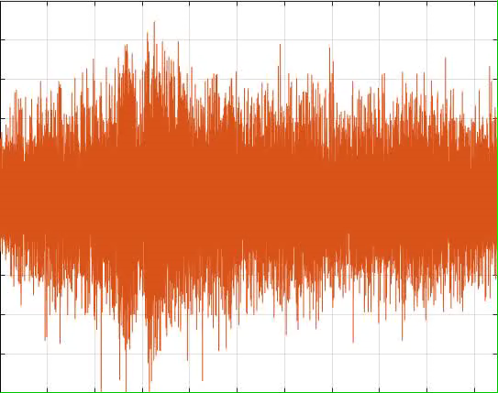
Helicopter --- NYC
Notes:
C:\Users\mrafaelo\Documents\SAP 2022\AES 2022 talk

Slide 22
SUI drone --- UPS truck

Slide 23
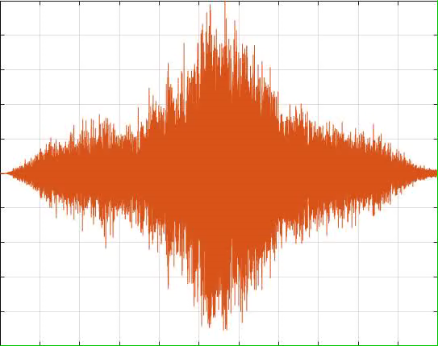
SUI drone --- UPS truck

Slide 24
Distributed Electric Propulsion (DEP) --- box truck
Notice envelope

Slide 25
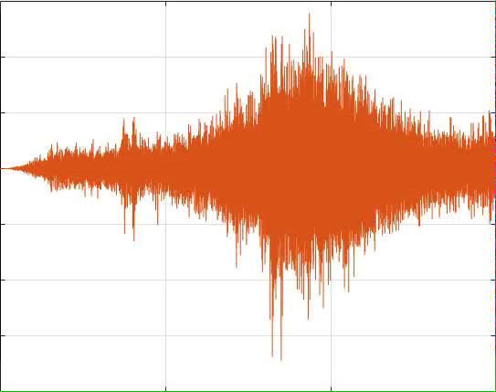
Distributed Electric Propulsion (DEP) --- box truck

Slide 26
Conclusions
A new modeling approach has been developed based on the hypothesis that audibility is more accurately discerned within individual auditory filters.
The main attributes of this approach are the prediction of audibility vs. time and frequency, which is essential for achieving high prediction accuracy while enabling the user to identify root cause(s) for audibility. Another attribute of SAP is the ability to predict audibility at a desired probability or sensitivity (d’).
While validation samples were restricted to low-frequency sound, existing data for both discrete tones and complex tones with changing spectrum illustrate the performance of SAP in terms of its prediction accuracy.

Slide 27
Acknowledgment
Thanks to NASA’s Revolutionary Vertical Lift Technology (RVLT) project for supporting this work https://www.nasa.gov/aeroresearch/programs/aavp/rvlt
Thank You

