Slide 1
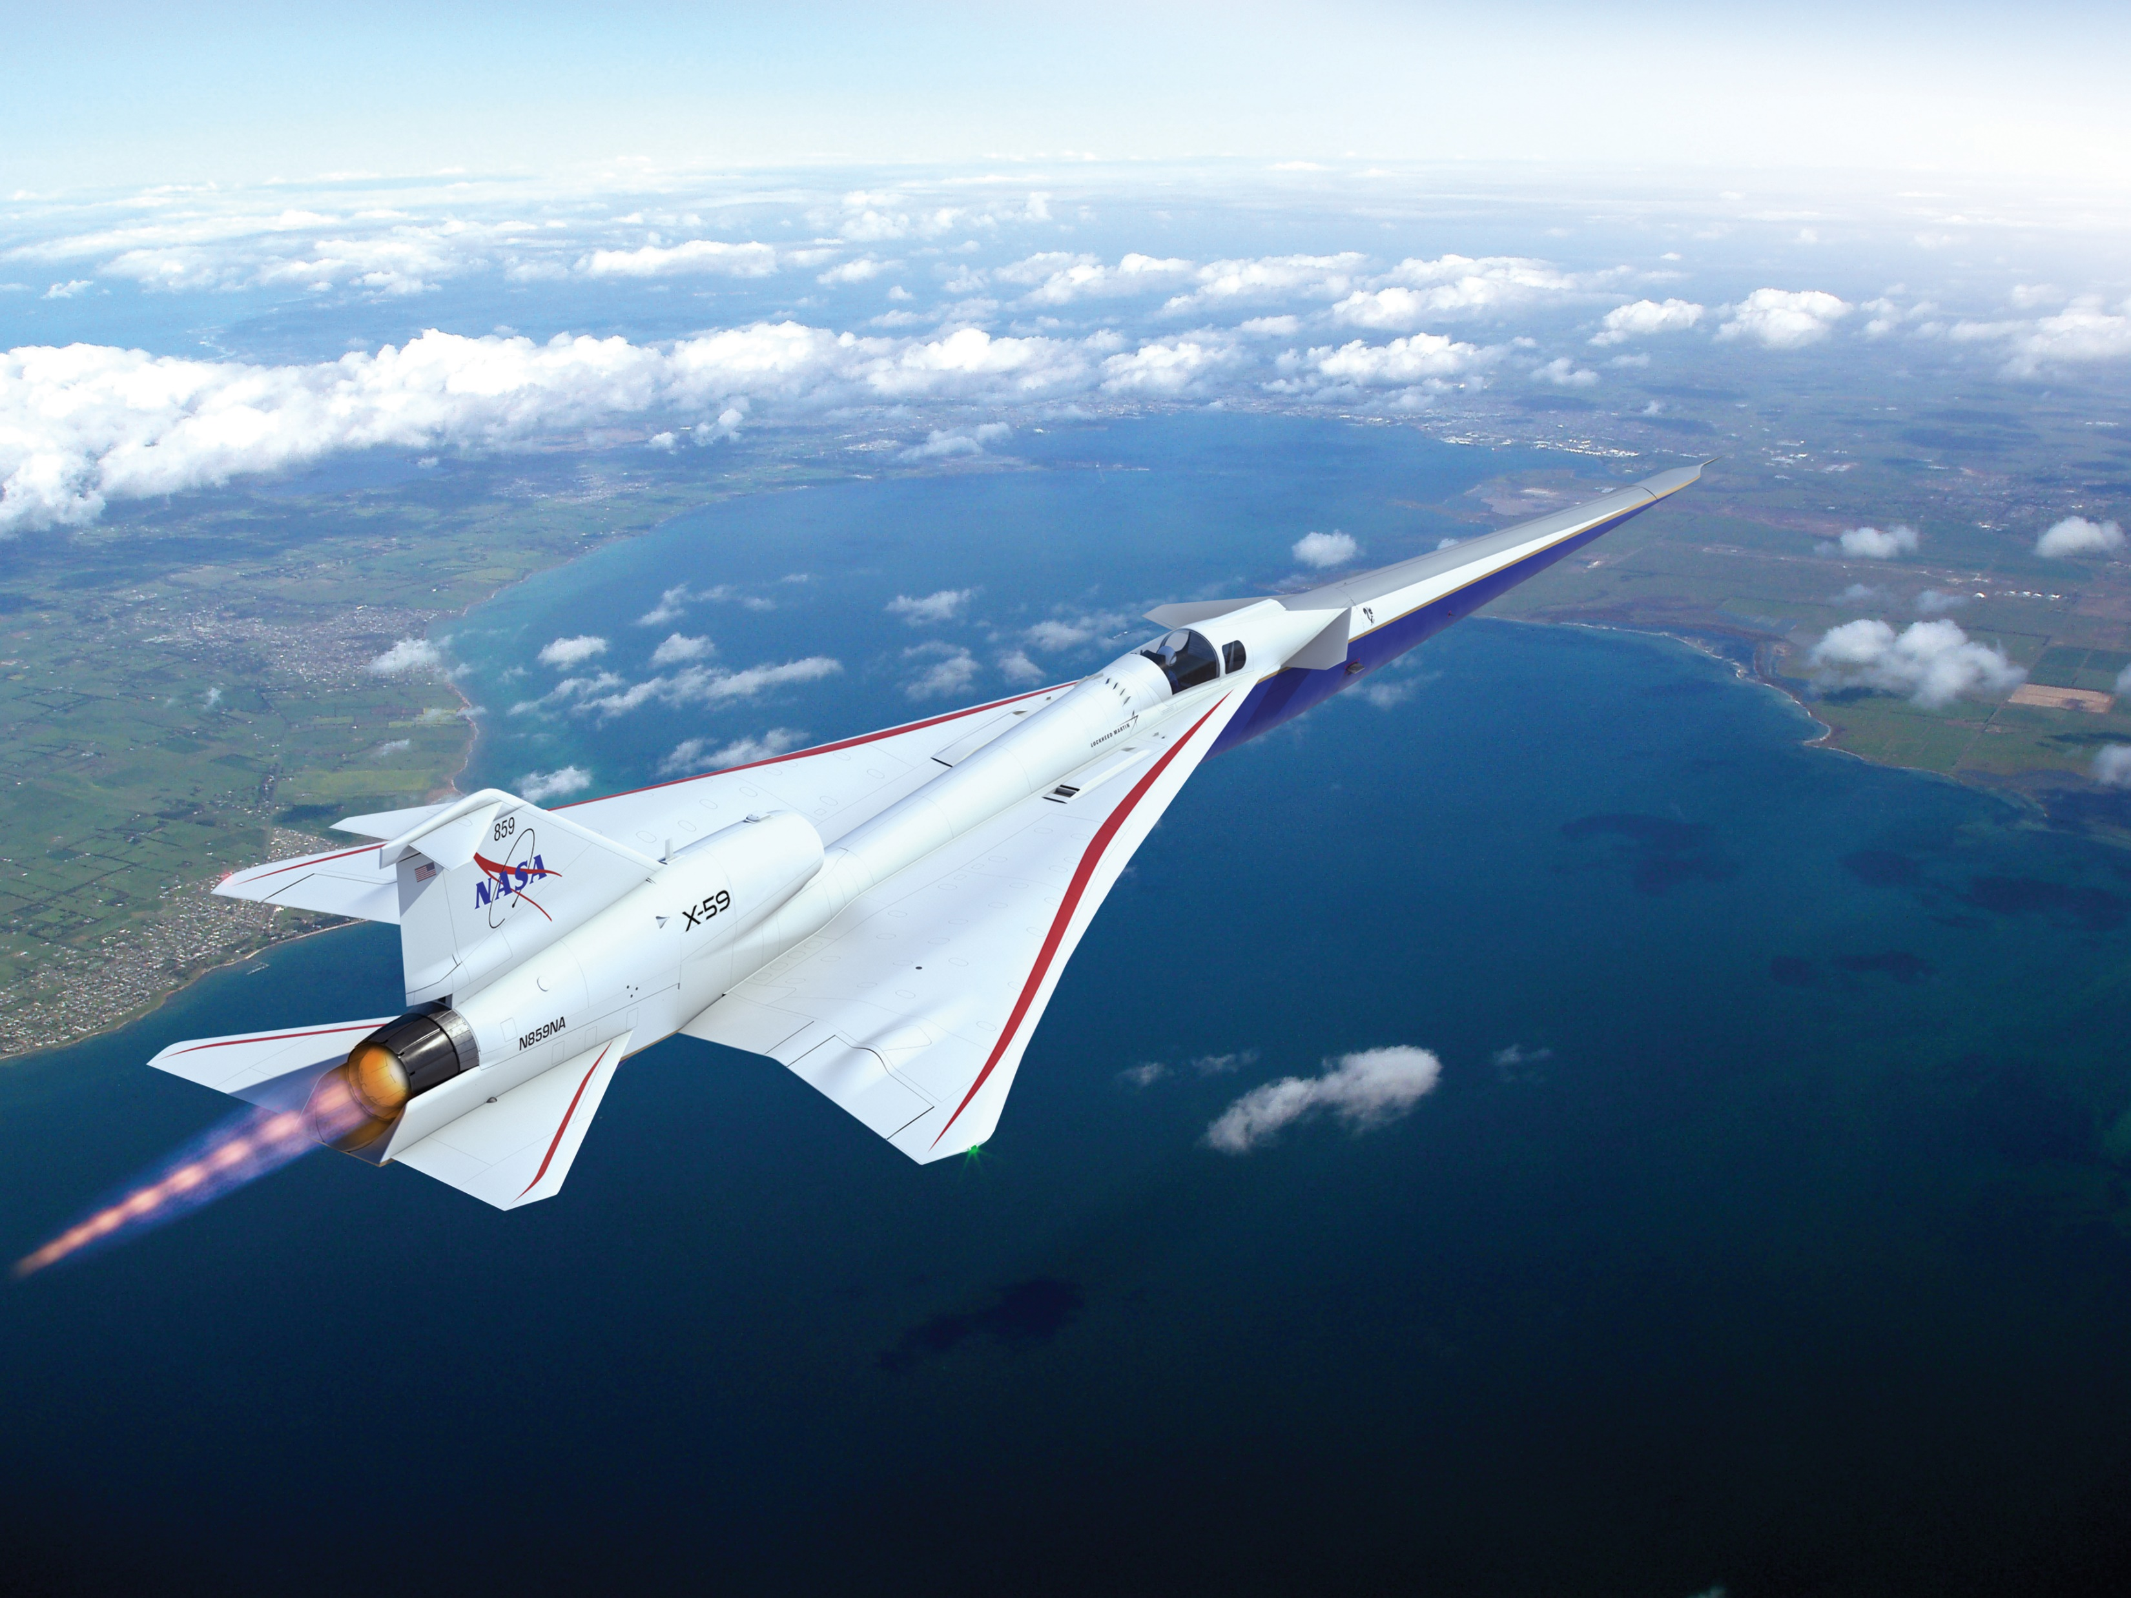
NASA’s
Quesst Mission Status
Will Doebler
Penn State CAV Workshop
October 18, 2022
Notes:
Hi I’m Will Doebler from NASA Langley Research Center and today I’ll be giving some information about opportunities at NASA and the status of our Quesst Mission.
I’d also like to acknowledge several others at NASA who have contributed to this presentation including the members of NASA’s community test planning and execution teams, and our branch heads Ran Cabell and Mike Doty

Slide 2
Outline
My background
Acoustics at NASA
Opportunities for students and graduates
NASA Quesst Mission
Background: civil supersonic transportation prohibition
X-59 low-boom aircraft
Mission phases
Current status
Challenges
Notes:
First I’ll give a little information on my background and path to working at NASA. Then I’ll give some information about what acoustics research is going on at NASA Langley and how you may be able to join our team. Finally I’ll talk about the Quesst mission that I’m currently supporting, whose goal is to help enable civilian supersonic air transportation worldwide

Slide 3
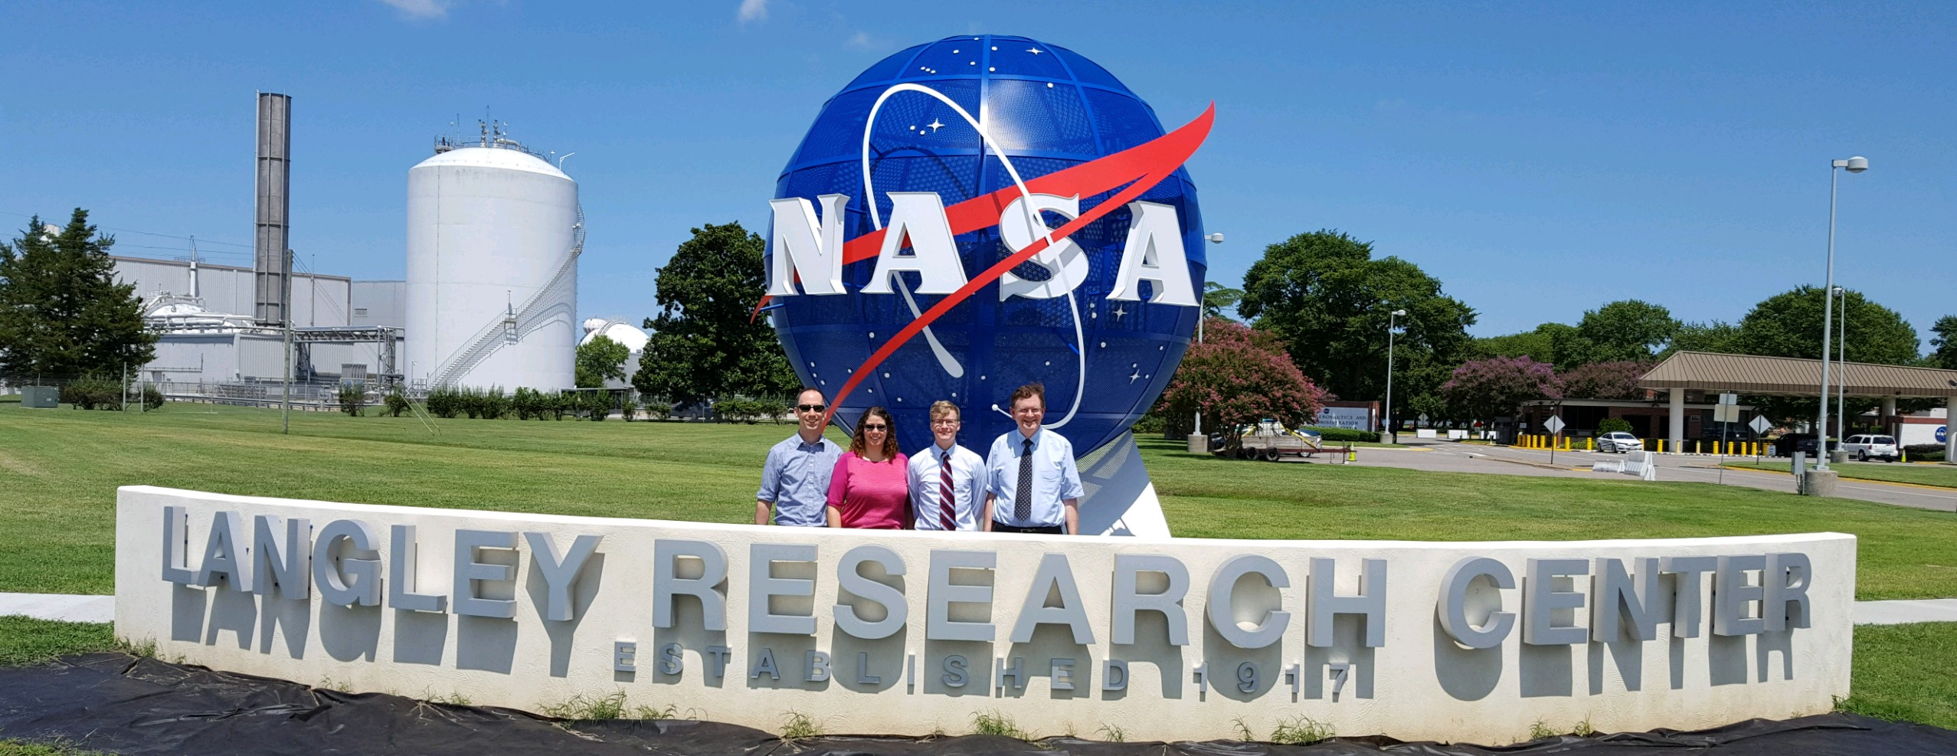
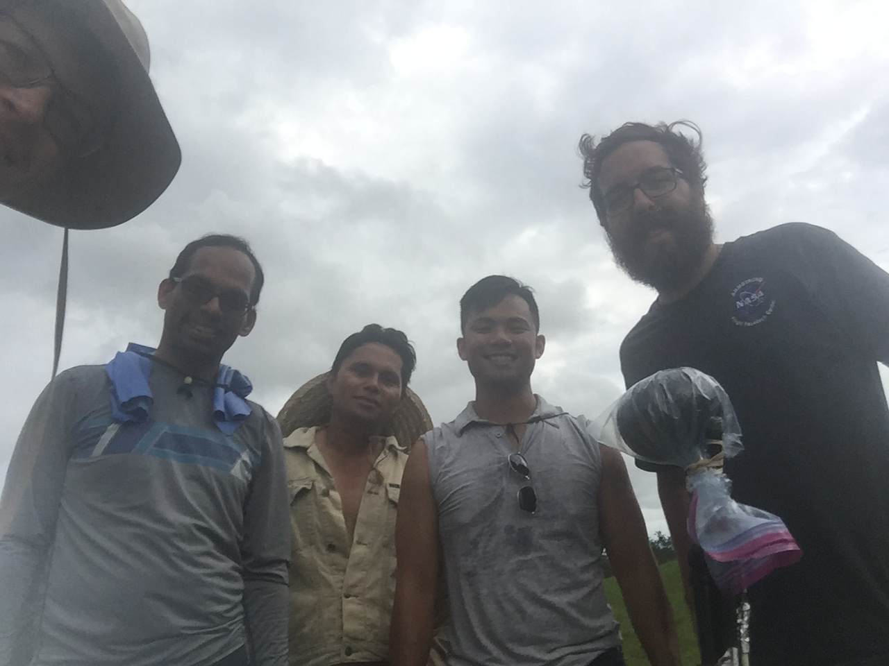
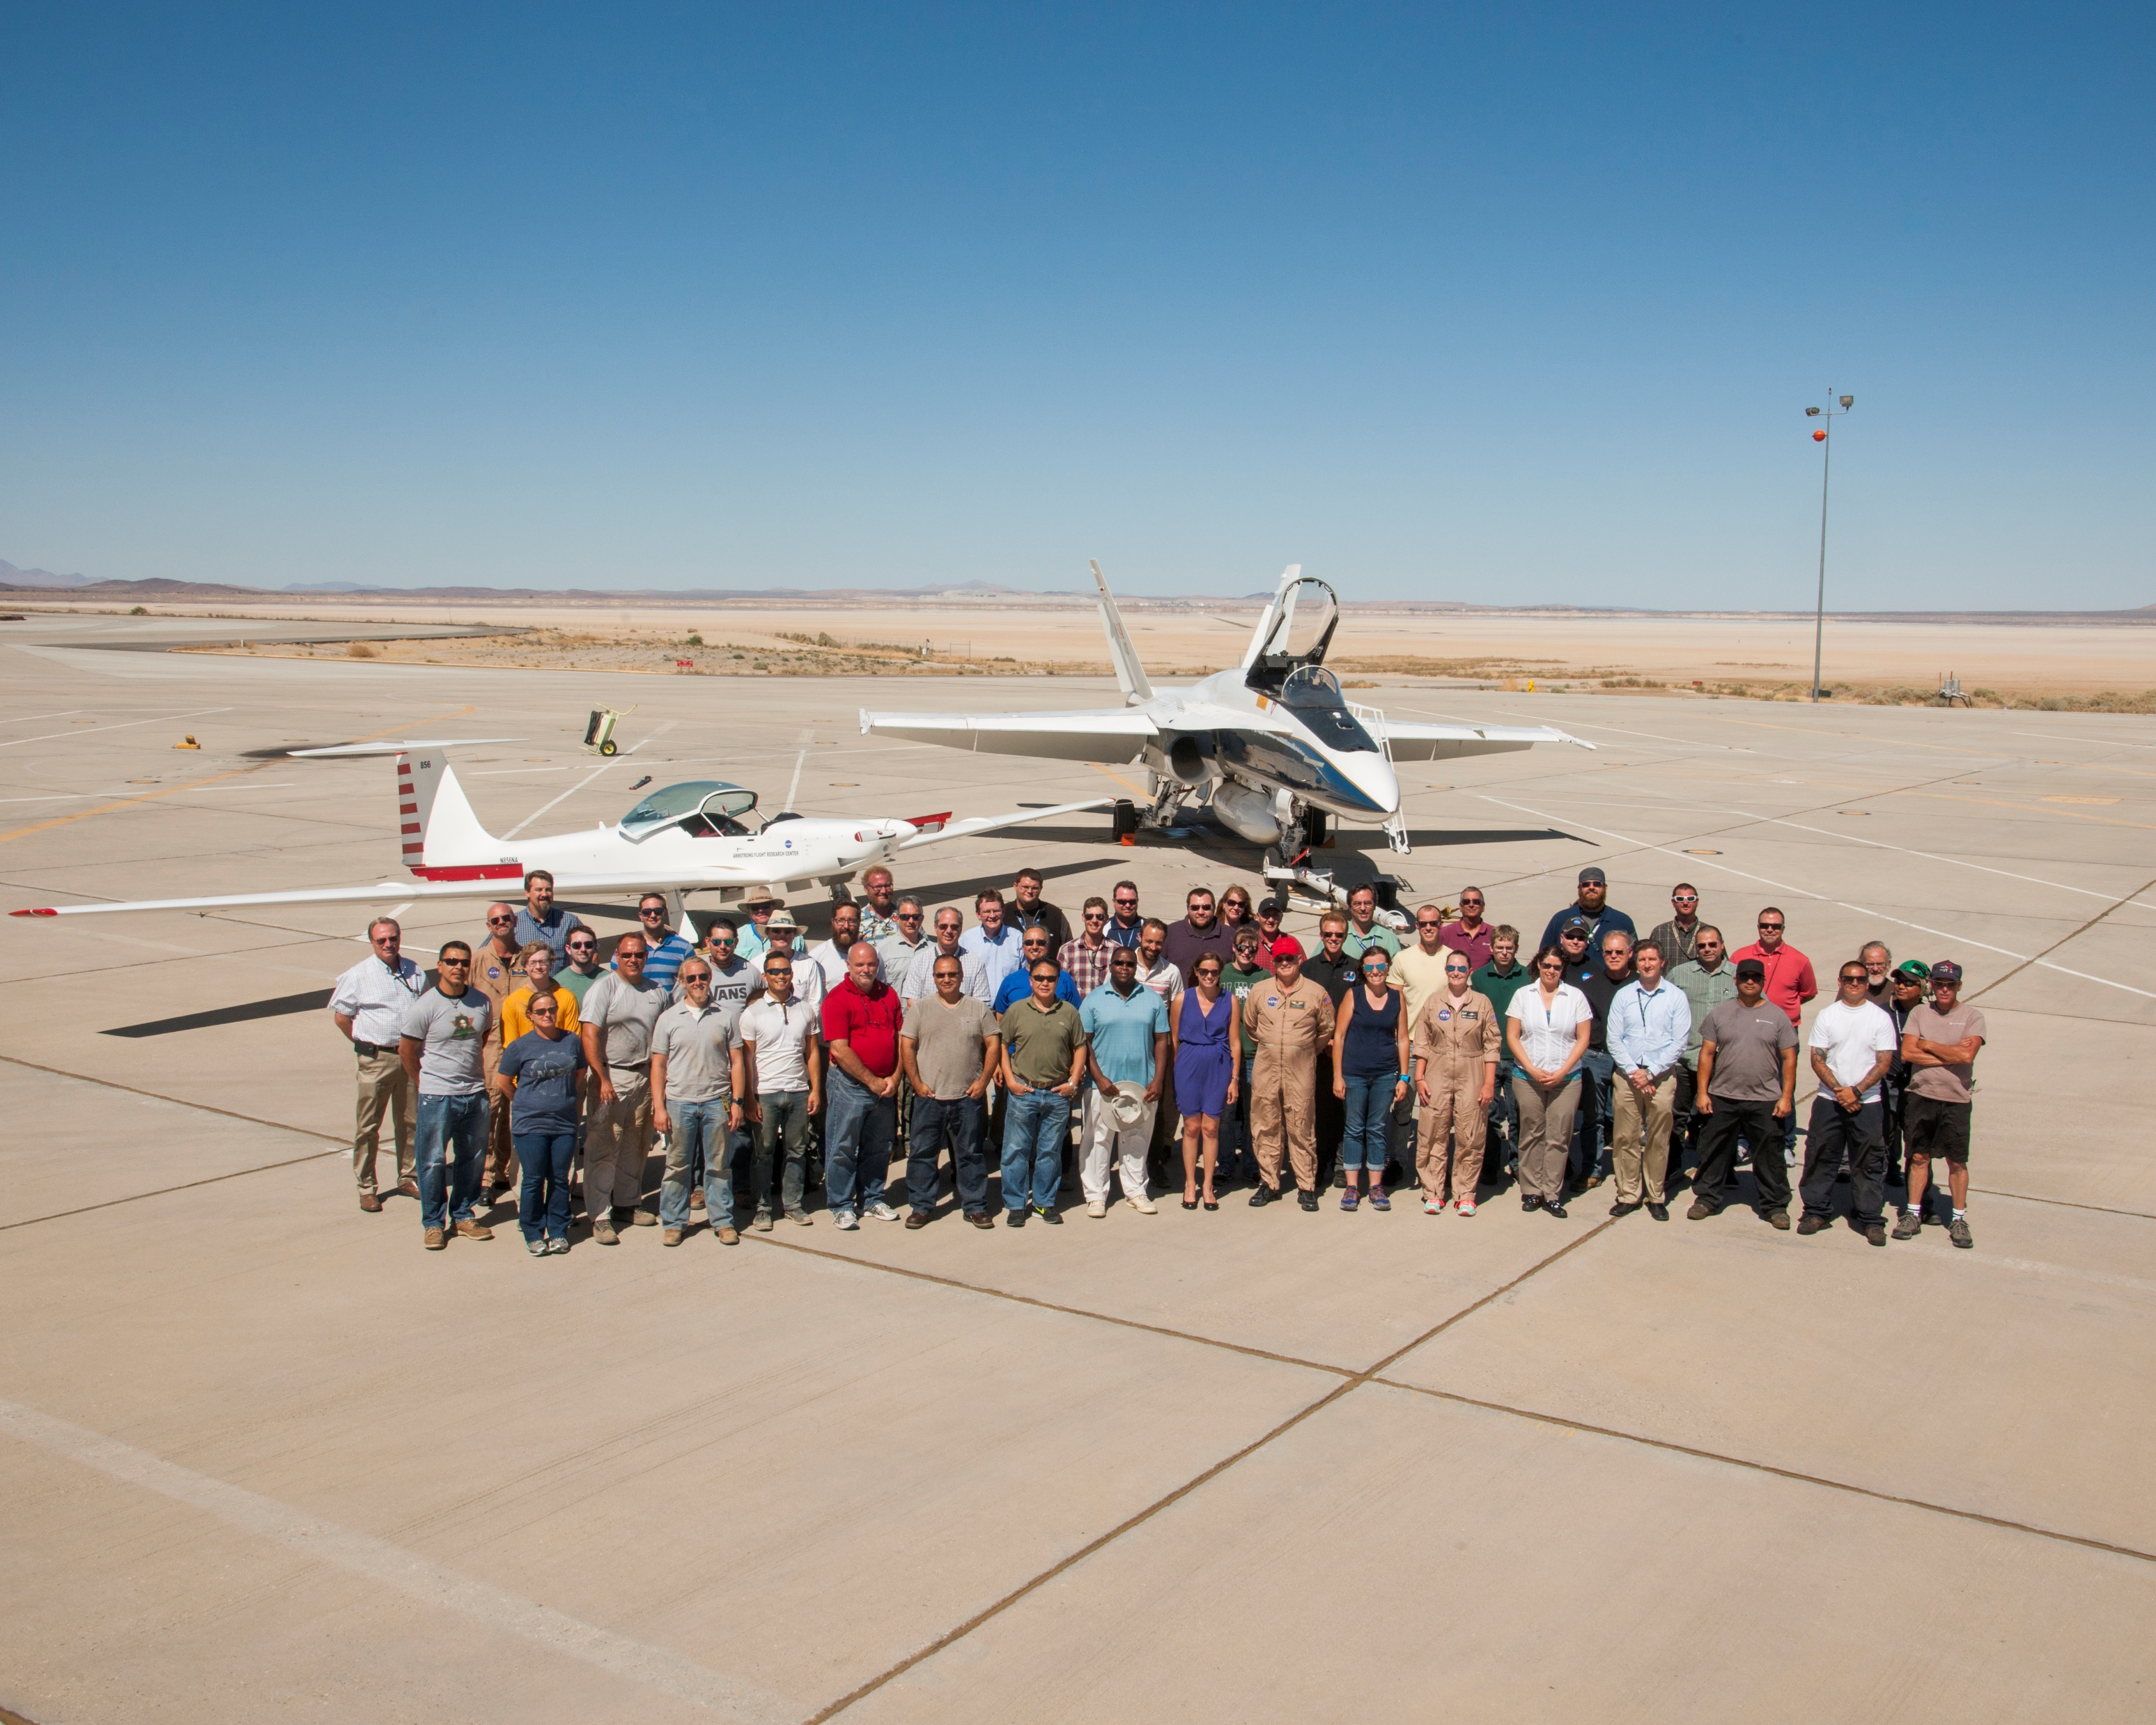
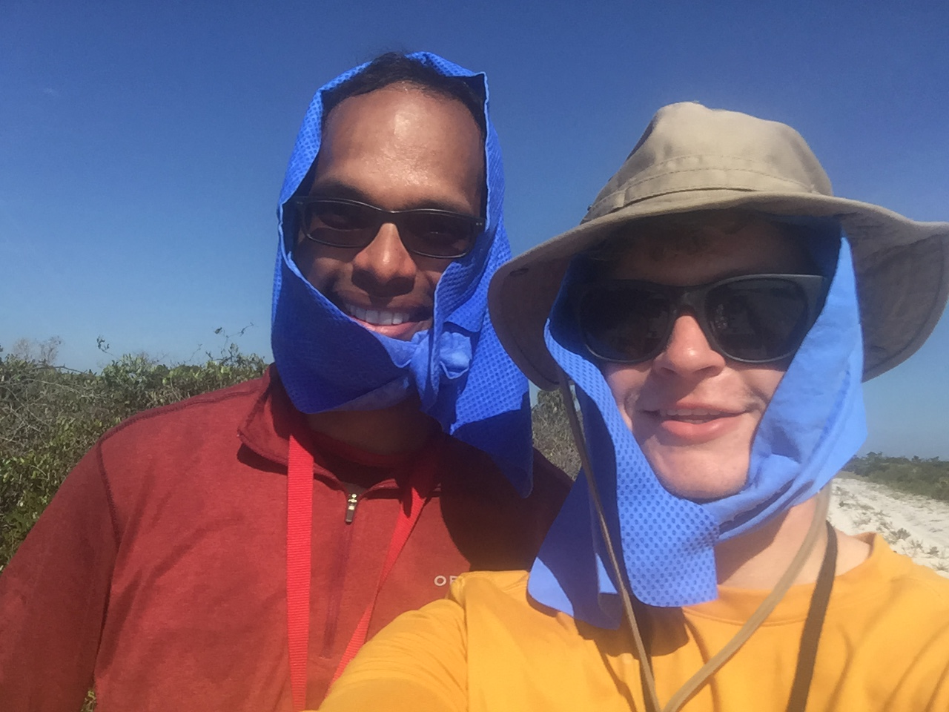
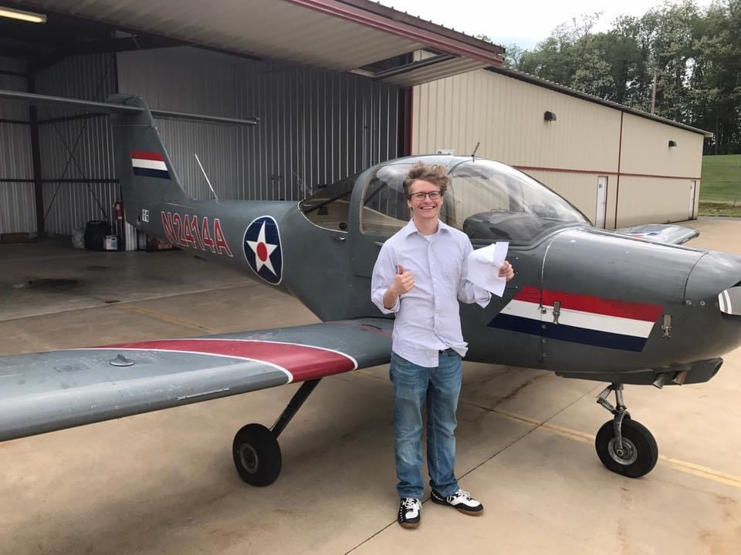
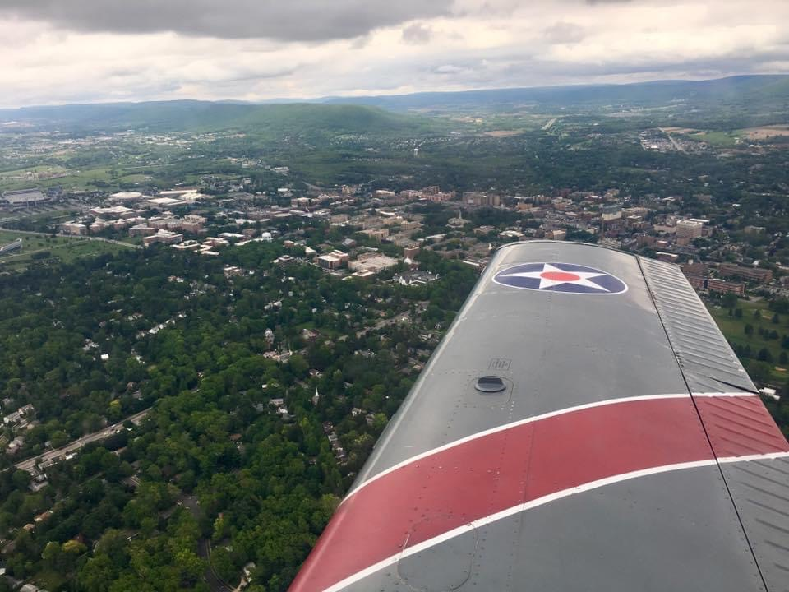
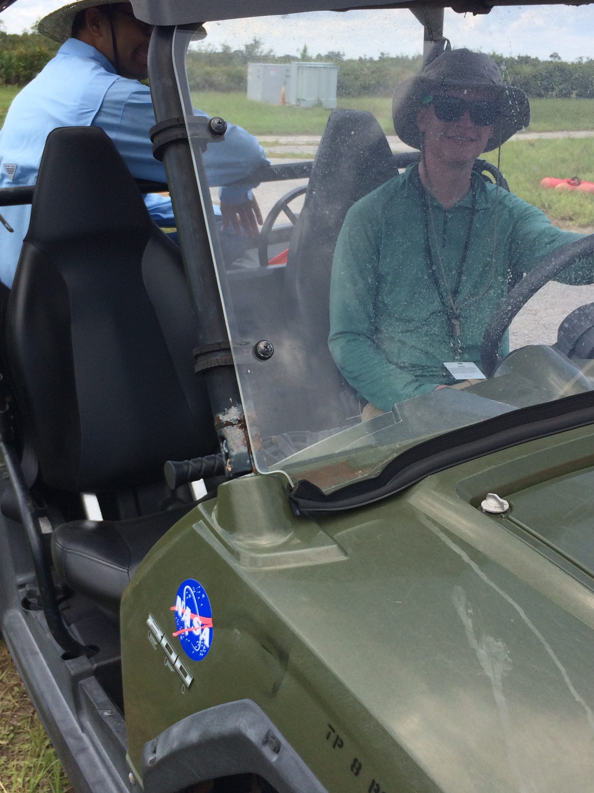
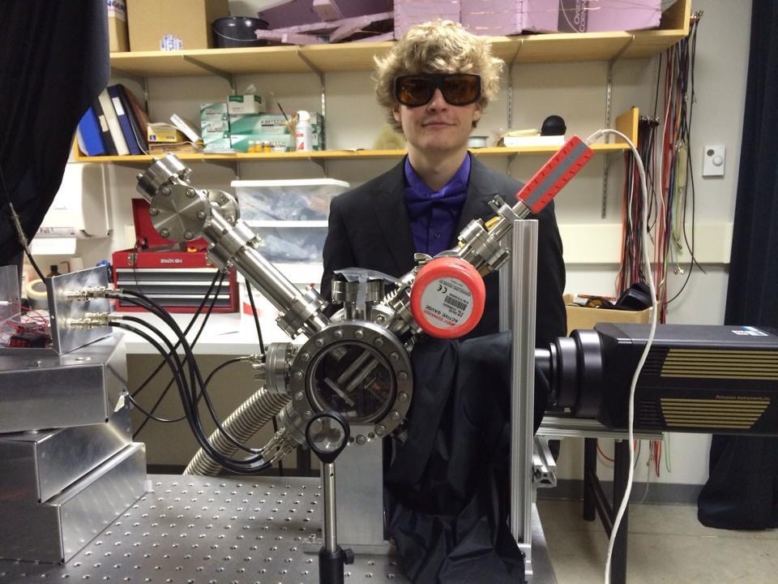
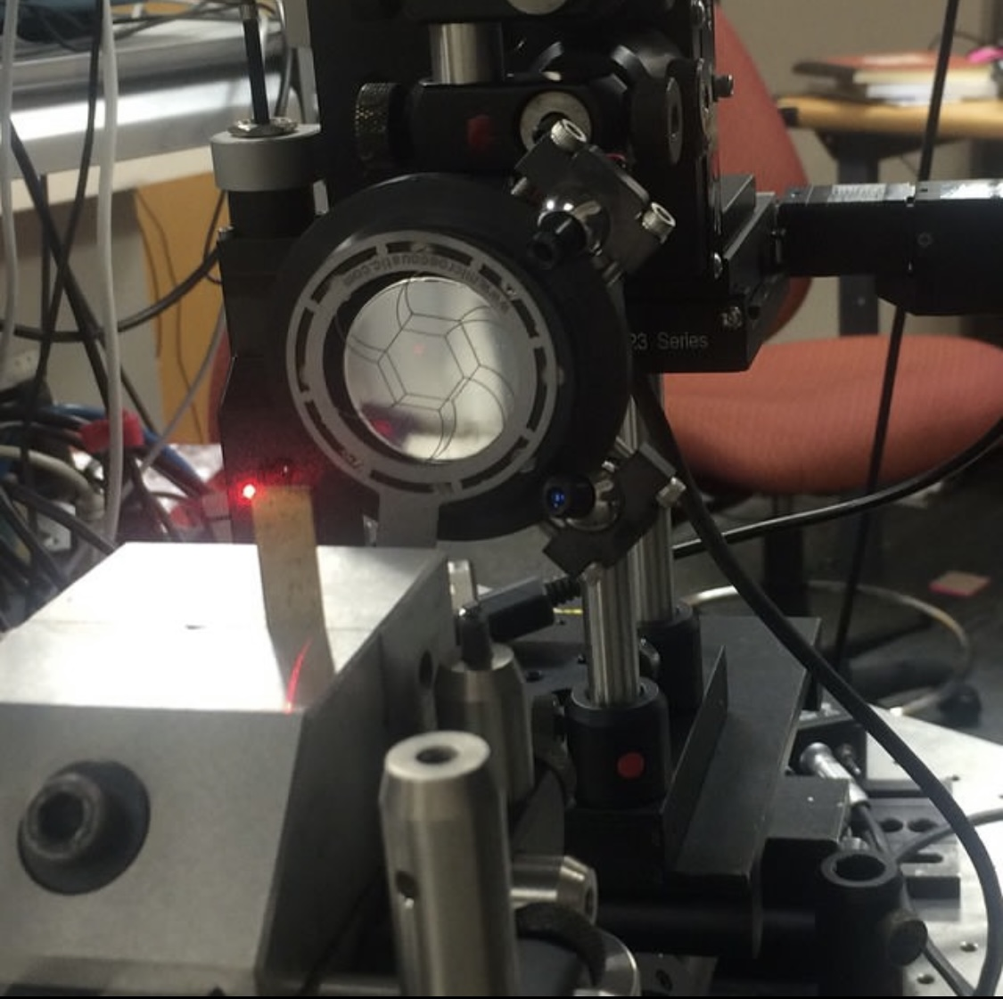
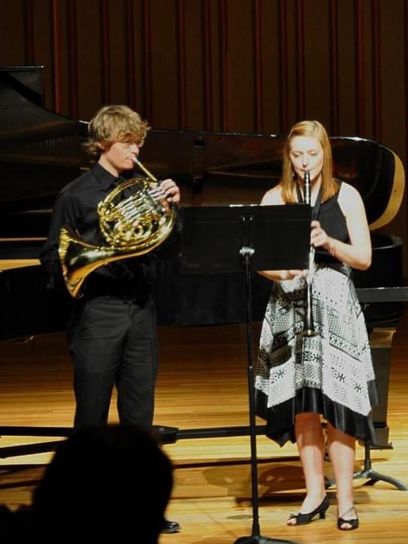
About Me
Research Aerospace Engineer, Structural Acoustics Branch NASA Langley Research Center, Hampton, VA
Sonic boom research
Working on PhD in Acoustics from PSU via NASA Advanced Degree Program with Dr. Sparrow
Recently started full-remote work from Saint Paul, MN
M.S. in Acoustics from Penn State, Dec. 2017
Supported FAA Ascent Program 2015-2016
NASA Fellowship 2016-2018 included spending summer at NASA Langley
Summer Intern at Naval Surface Warfare Center, Port Hueneme, CA
Automatic speech recognition performance in noisy environments for augmented reality ship repair tasks
B.A. in Physics from Gustavus Adolphus College, Saint Peter, MN
Air-coupled ultrasound research for jet turbine blade crack detection
Ion trap lab building a mass spectrometer
Grew up in northwestern Indiana
Notes:
Some information about me – My job title is Research Aerospace Engineer and I do acoustics research in the structural acoustics branch at NASA Langley. I recently started working fully remote from Minnesota. I am also pursuing my PhD from Penn State through NASA’s Advanced Degree Program, which I will talk more about later. Prior to starting at NASA I was still pursuing my PhD at Penn State first supporting the FAA Ascent Program researching sonic boom deturbulization. I am very grateful to Dr. Sparrow for sending me out to NASA Armstrong for about a week to support acoustic measurements of sonic booms for NASA research flight test program called SonicBAT, Sonic Booms in Atmospheric Turbulence. We set up microphones in the hottest part of the days in the Mohave desert including the Eigenmike we borrowed from SPRAL.
An email blast went out to the students advertising a fellowship position opening at NASA Langley so I applied. The Fellowship was a really great experience for me and it included spending a summer at NASA Langley in Virginia where I got to know the team and management. During the fellowship I found out a position would be opening and I would need a Master’s degree to be considered, so I ended up writing a thesis.
All these flight-related research opportunities made me interested in flying myself. Did you know you can take lessons just up the road at the University Park airport? There’s the campus off the wing of the airplane.
Before grad school I had a summer internship at a naval base in California investigating automatic speech recognition platforms. And I went to Gustavus Adolphus College in MN for my bachelors in physics. I got to do various research activities there, and a lot of my time was spent playing French horn in band and orchestra. Music is part of what got me interested in acoustics.

Slide 4
Outline
My background
Acoustics at NASA
Opportunities for students and graduates
NASA Quesst Mission
Background: civil supersonic transportation prohibition
X-59 low-boom aircraft
Mission phases
Current status
Challenges
Notes:
Alright enough about me. Let’s move on to the NASA Acoustics opportunities

Slide 5
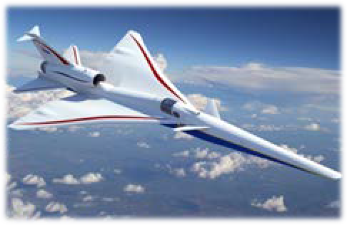
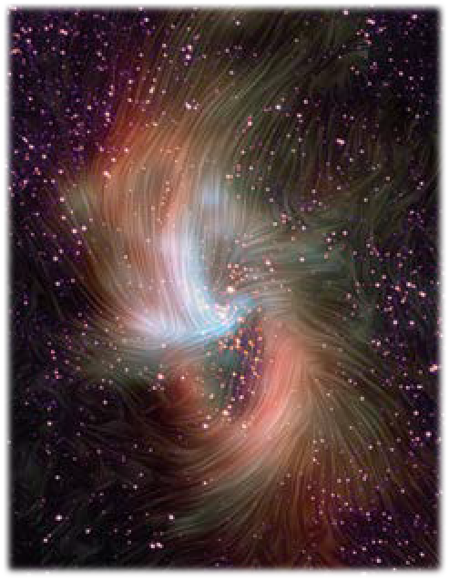
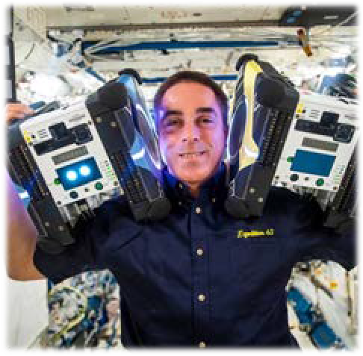
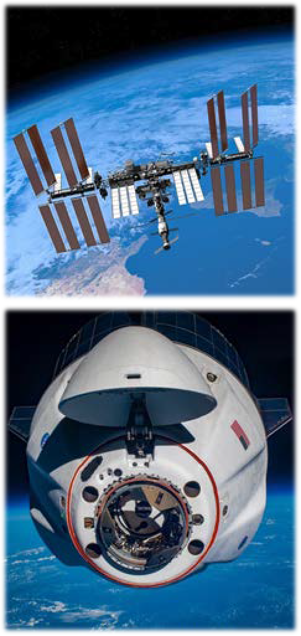
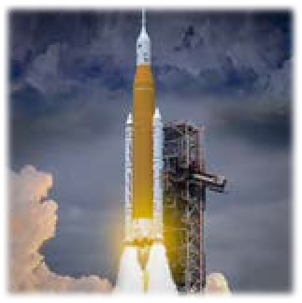
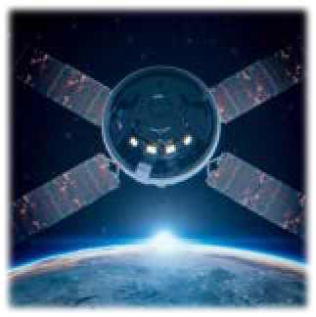
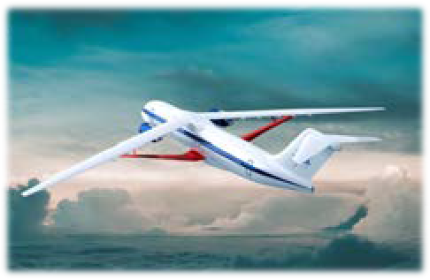
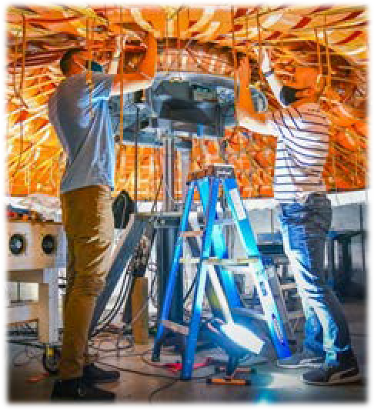
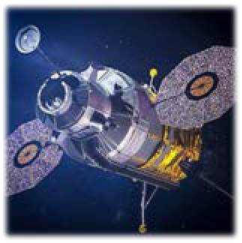
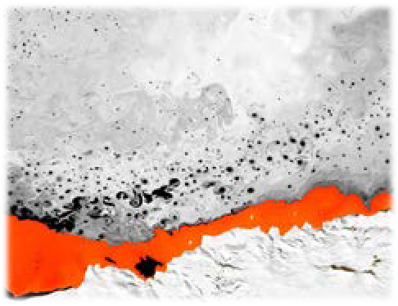

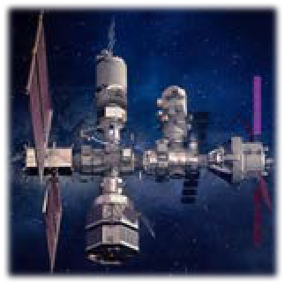
NASA Mission Directorates
Aeronautics Research
Science
Space Technology
Space Operations
Exploration Systems Development
Transform Aviation through R&D
Understand the Sun, Earth, and Universe
Develop and transfer revolutionary technologies
Launch and Space Operations
Moon to Mars Exploration
Adapted from ntrs.nasa.gov/citations/20220013091
Notes:
NASA is divided into 5 Mission directorates. Aeronautics, Science, Space Technology, Space Operations, and Exploration Systems Development.
NASA is of course typically associated with space research, and I know what you’re thinking – there is not a whole lot of sound in space. But the aeronautics research mission directorate focuses on several acoustics related projects here on earth for terrestrial aviation.

Slide 6
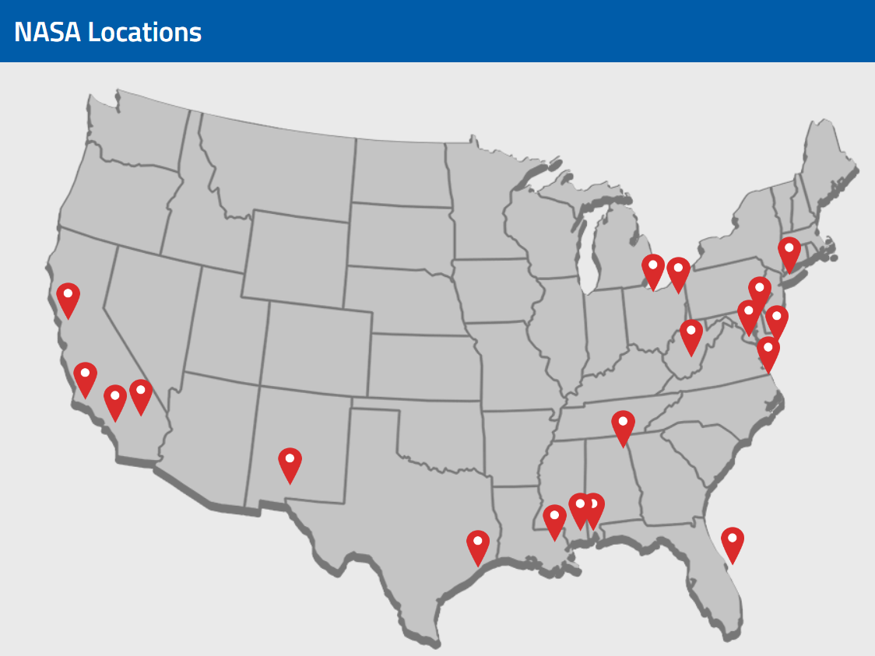
NASA Langley Research Center
Notes:
NASA has many research, spaceflight and assembly facilities across the country, and NASA Langley is in Hampton, VA.
Much of the work is done with teams spanning multiple locations. On my team, we also regularly work with NASA employees from Armstrong and Ames in California as well as some from NASA Glenn in Ohio. NASA also supports contractors who work all over the globe.

Slide 7
Acoustics at NASA Langley
Structural Acoustics Branch
Aeroacoustics Branch
Notes:
NASA Langley has two acoustics branches with slightly different expertise. I work in the Structural Acoustics Branch, and our sister branch is the Aeroacoustics Branch. Their websites are listed here in case you want to dive into additional detail on any of the topics I will outline on the next slide.

Slide 8

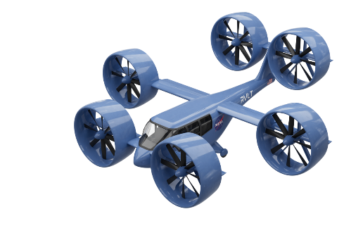
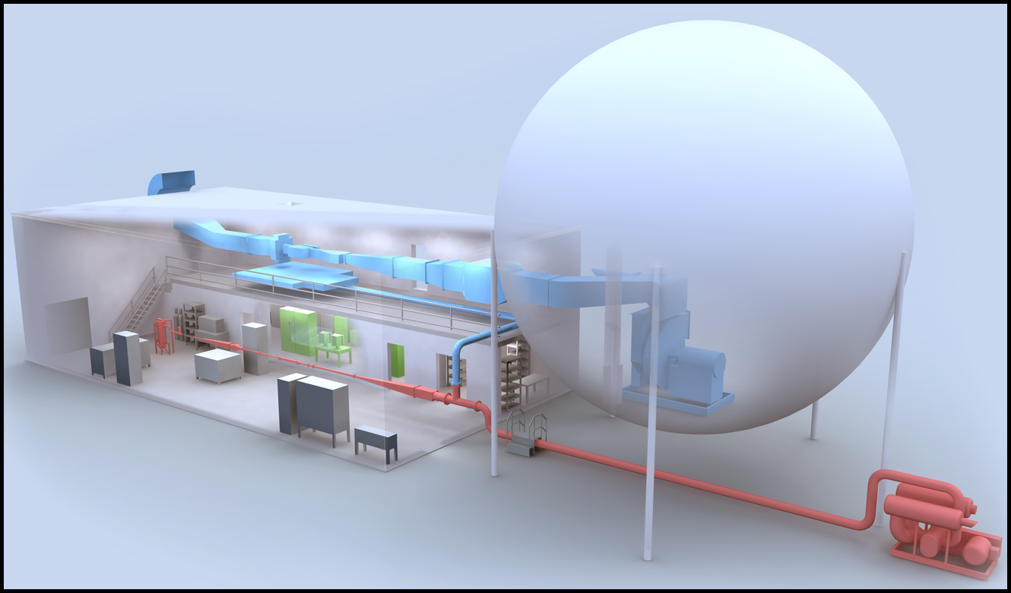
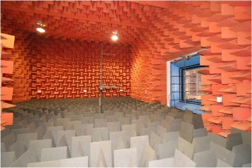
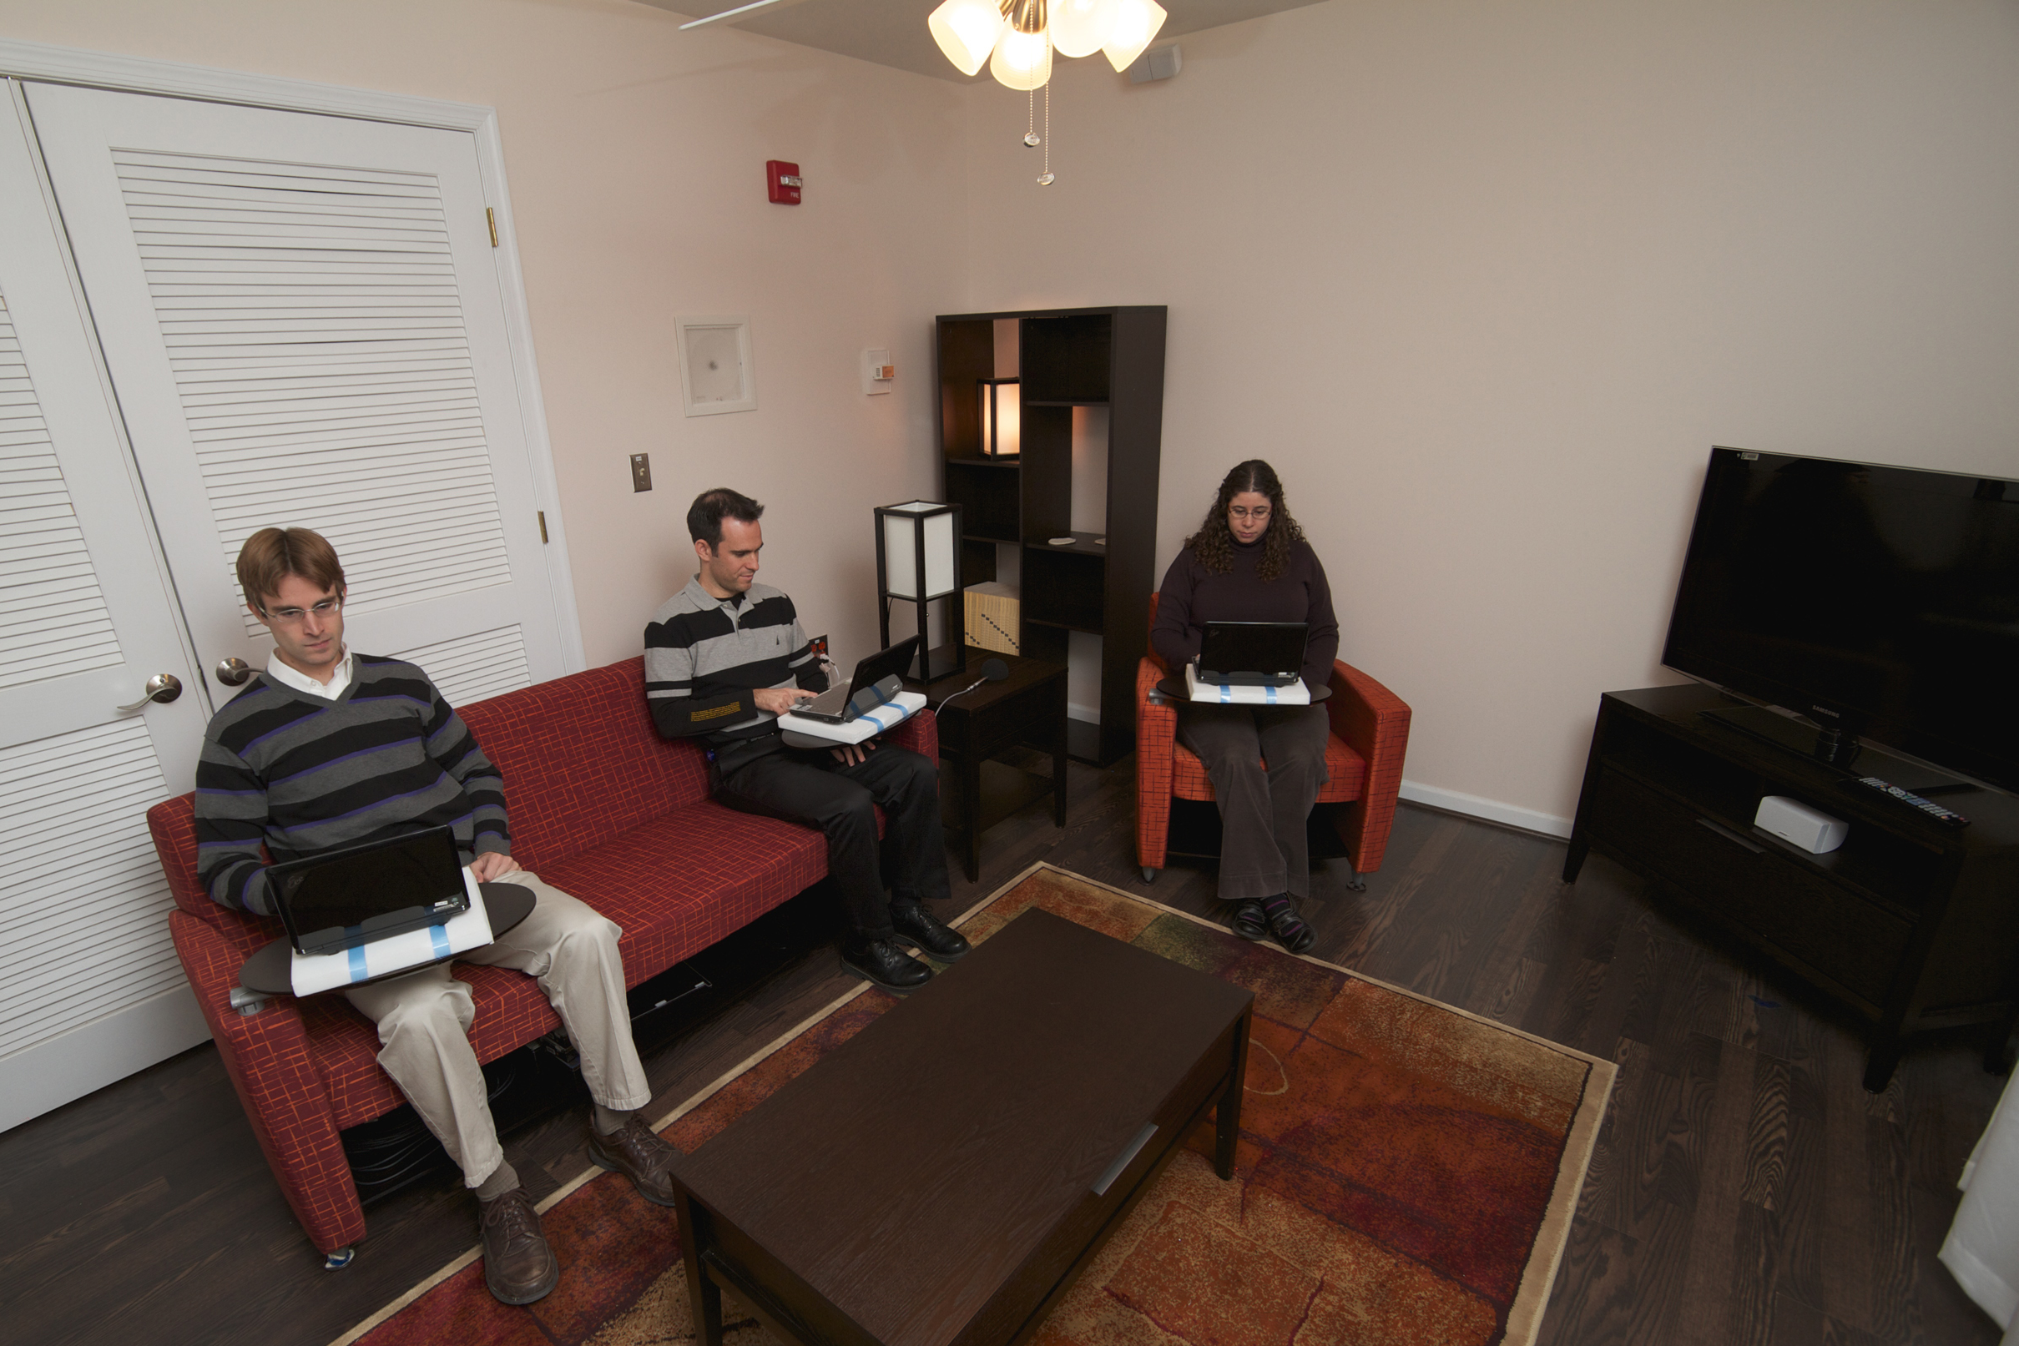
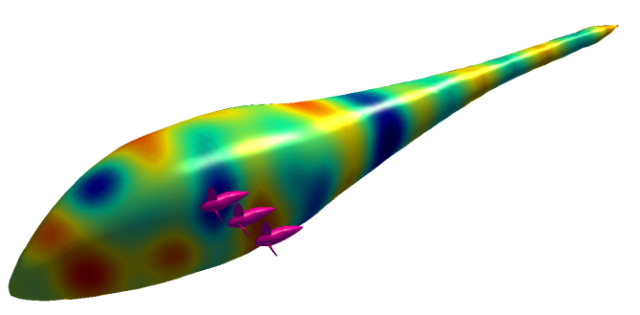
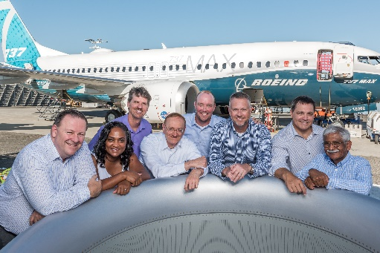
Structural Acoustics Branch
stab.larc.nasa.gov
Understand and mitigate the impact of noise on people and structures
Auralization
Realistic aircraft sounds from predictions or measurements
Major Facilities Used
SALT (anechoic chamber, reverberant chamber)
Liner Technology Facility
Psychoacoustics
Human response to sound;
community response to aviation noise
Noise Control Technologies
Acoustic Liners
Active noise control
Adaptive structures
Exterior Effects Room
Interior Effects Room
Sound/structure Interactions
Notes:
The structural acoustics branch aims to understand and mitigate the impact of noise on people and structures. There are four main categories of research expertise in our branch – psychoacoustics, auralization, sound/structure interaction, and noise control.
For psychoacoustics, we research human perception of sound and community noise. Two of our branch’s facilities support this. The exterior effects room is a multiseat psychoacoustics laboratory where aircraft or other sounds is played over an array of loudspeakers. The emerging topic of urban air mobility or small personal rotorcraft and the noise they generate is of particular interest to our branch, and a lot research is being done in that area.
The interior effects room is an interesting lab space that looks just like a home living room, but is instrumented with a more than 30 subwoofers in order to accurately recreate the sound from supersonic aircraft.
The auralization team creates realistic aircraft sounds from predictions and measurements, which are often played back in the exterior effects room for psychoacoustics studies.
Our noise control technologies team supports several projects. The Liner Technology Facility is used to test the noise reduction qualities of jet engine acoustic liners in laboratory conditions. The noise reduction research has influenced products that are currently flying today. Others in the branch support active noise control, adaptive structures, and effects of sound on structures such the effect of rotor noise on aircraft bodies.

Slide 9
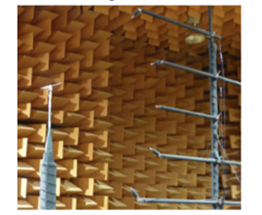
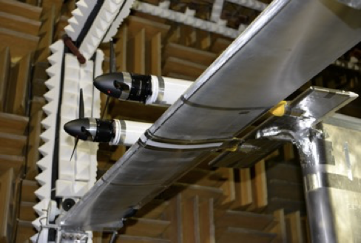
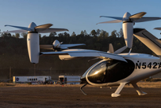
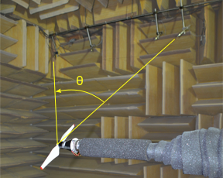
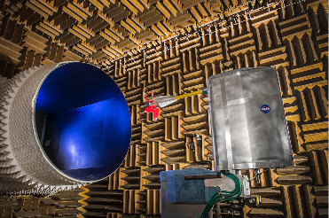
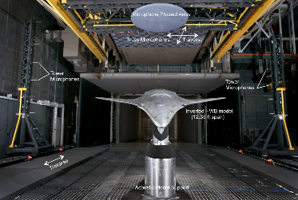
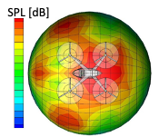
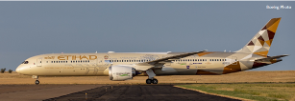
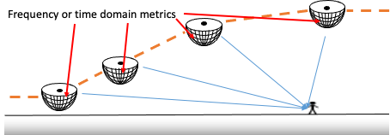
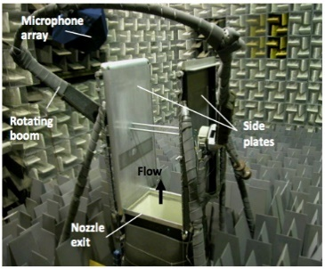
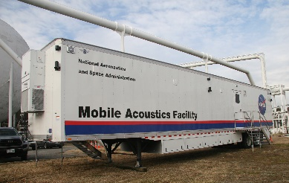
Aeroacoustics Branch
aab.larc.nasa.gov
Understand and accurately predict the noise from any air vehicle configuration.
Define and demonstrate concepts for air vehicle noise reduction.
Subsystem Level Measurements
Full Vehicle Measurements
Major Facilities Used
Small Hover Anechoic Chamber
Low Speed Aeroacoustic Wind Tunnel
Source Noise Experiments
14x22 Acoustic Mode
System Noise
Source Noise Predictions
Propulsion-Airframe Aeroacoustics
Quiet Flow Facility
Mobile Acoustics Facility
Notes:
The aeroacoustics branch aims to understand and accurately predict the noise from any air vehicle configuration as well as to define and demonstrate concepts for air vehicle noise reduction.
Six of their expertise areas are sour noise experiments, subsystem measurements, full vehicle measurements, source predictions, system noise, and propulsion-airframe acoustics.
Researchers work in several wind tunnels measuring noise from various propellers at the subsystem level, but they also get to take the mobile acoustics facility out to the field and measure noise from vehicle flyovers. From these and other prediction tools they create accurate directional source noise predictions for use in determining noise at the ground.
Between the two branches there is very likely a place where your interests match NASA’s.

Slide 10
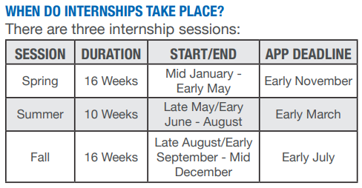
NASA Opportunities for Students and Graduates
intern.nasa.gov
Internships
Fellowships
2016: $50k (M.S.) or $55k (PhD) per year
Pathways Program
Minimum 16 weeks on-site at NASA
usajobs.gov
Employment
2022: Starting at $66k for M.S. and $80k for PhD + annual bonus. Support for work-life balance:
13 days paid time off + 10 federal holidays, 13 days paid sick leave, 12 weeks paid parental leave
Health & life insurance, up to 5% matching retirement contribution plus pension
Flexible work hours, telework arrangements, and conference travel support may also be possible
NASA Advanced Degree Program
Covers tuition and books to complete Master’s and PhD programs after being hired
Notes:
There are many opportunities for students and graduates at NASA. The primary channels are through the intern.nasa.gov website and the federal job website, usajobs.gov.
NASA internships are available in three separate sessions each year. The spring session’s deadline is quickly approaching the first week of November, so check that out soon if you’re interested.
The intern.nasa.gov also has information on available fellowships, which in 2016 paid out about 50k per year to M.S. students and about 55k per year to PhD students. These numbers are from 2016, but these were pretty good rates at that time I think.
“Pathways Interns typically follow a cooperative education model, where you’ll alternate between working at NASA and going to school until you graduate. The biggest opportunity that comes to Pathways Interns is the chance to be noncompetitively converted to a full-time position after you complete your initial Pathways appointment. This gives you the chance to transition directly into a full-time job without having to reapply.”
There may soon be openings in both the acoustics branches at NASA Langley, so be on the lookout for a the call for applicants. The starting salaries for fresh MS students is 66k and the starting salary for phd is 80k. 13 days paid time off plus the 10 federal holidays. 13 paid sick days. Recently the parental leave program was overhauled to allow 12 weeks paid time off for both parents. You get access to the federal insurance rates, up to 5% matched retirement contributions as well as an additional life long pension. We have flexible work hours and telework arrangements, and you may also be supported to travel to fun conferences like this one.
Last, after being hired and working for 1 year you are eligible to apply for the NASA Advanced Degree Program, which pays tuition and books toward MS and PhD degrees.
AS&ASTAR Fellowship 2016 terms
• Fellowship Stipend: $25,000 (Master’s) / $30,000 (Doctoral)
• Tuition Offset and Fees: $10,000
• CBRE Allowance: $8,000
• Health Insurance Allowance: $1,000
• Faculty Adviser Allowance: $4,500
• Fellow Professional Development Allowance: $1,500

Slide 11
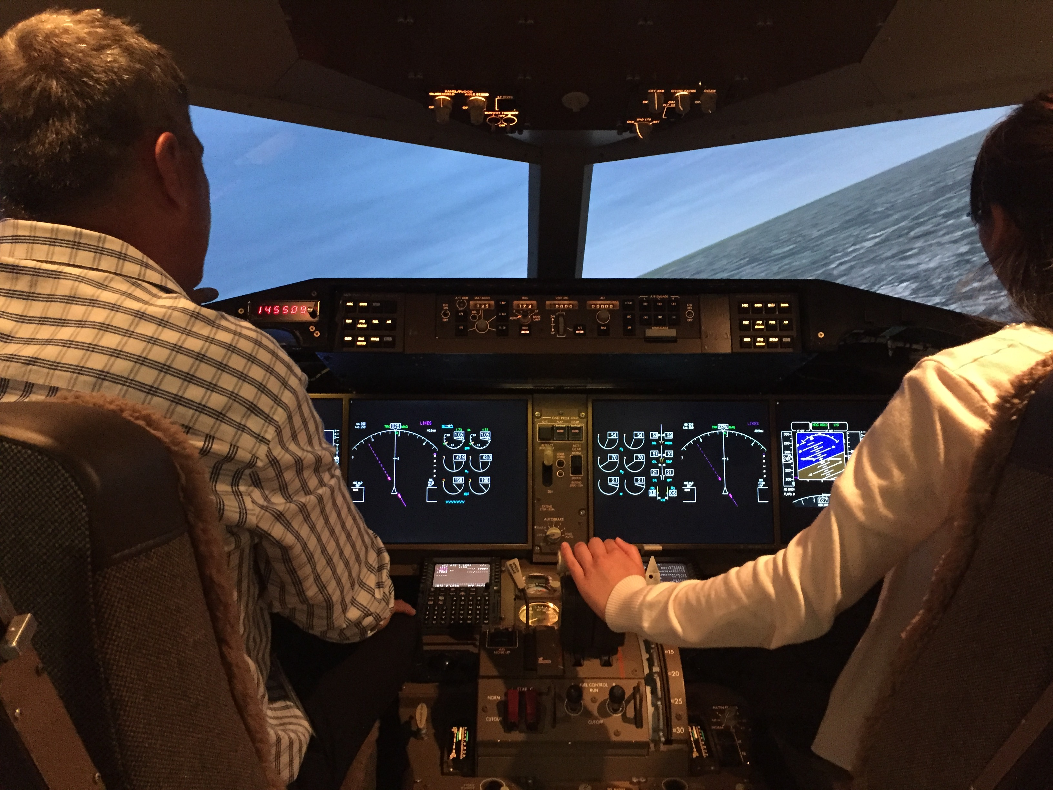
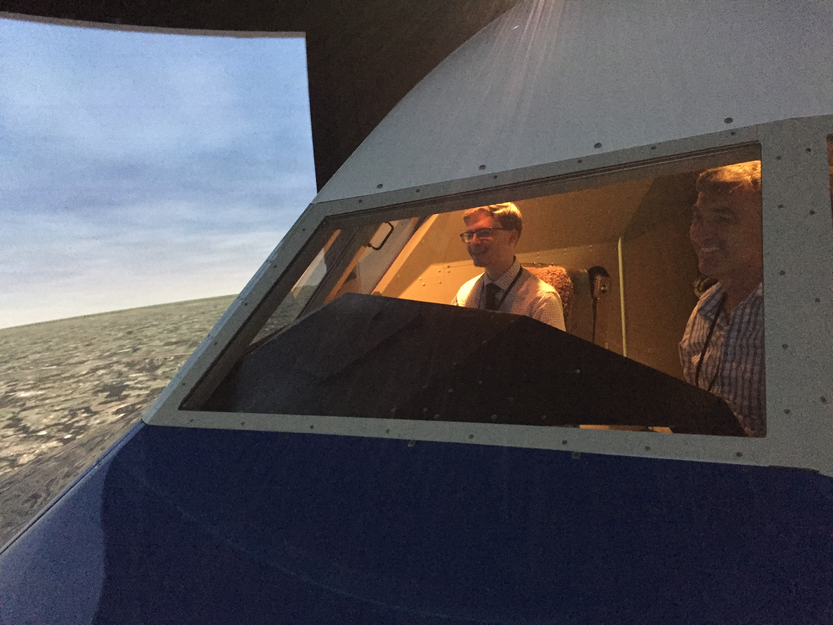
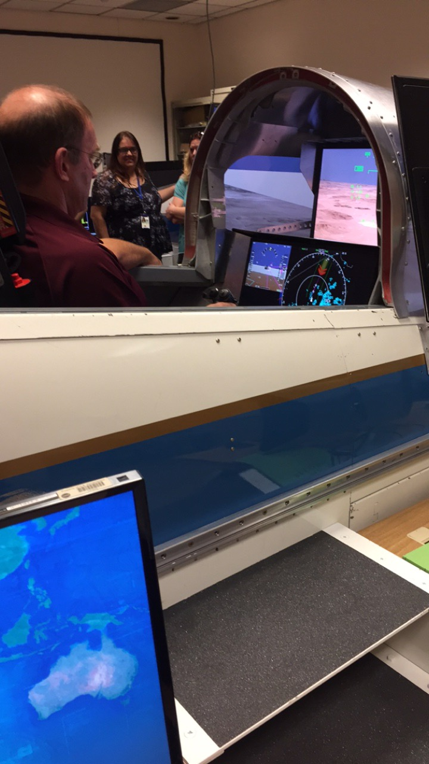
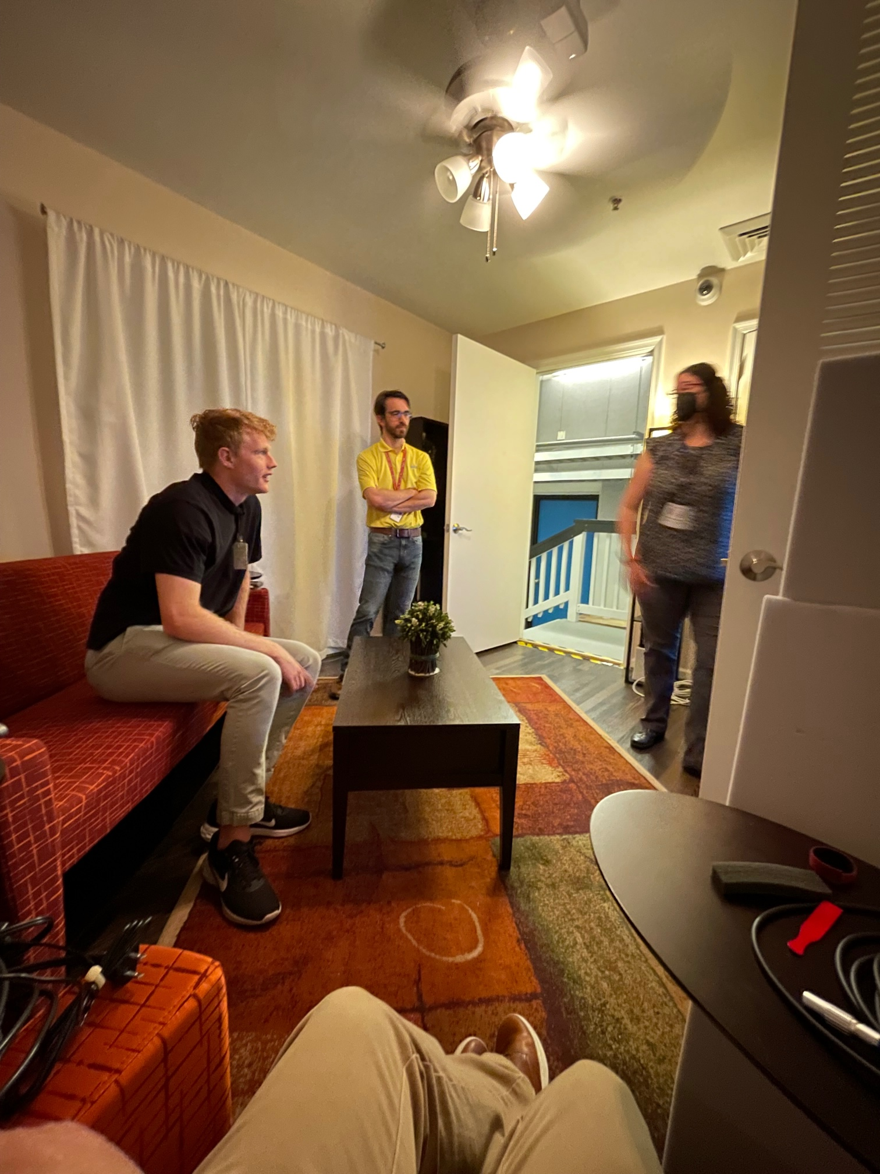
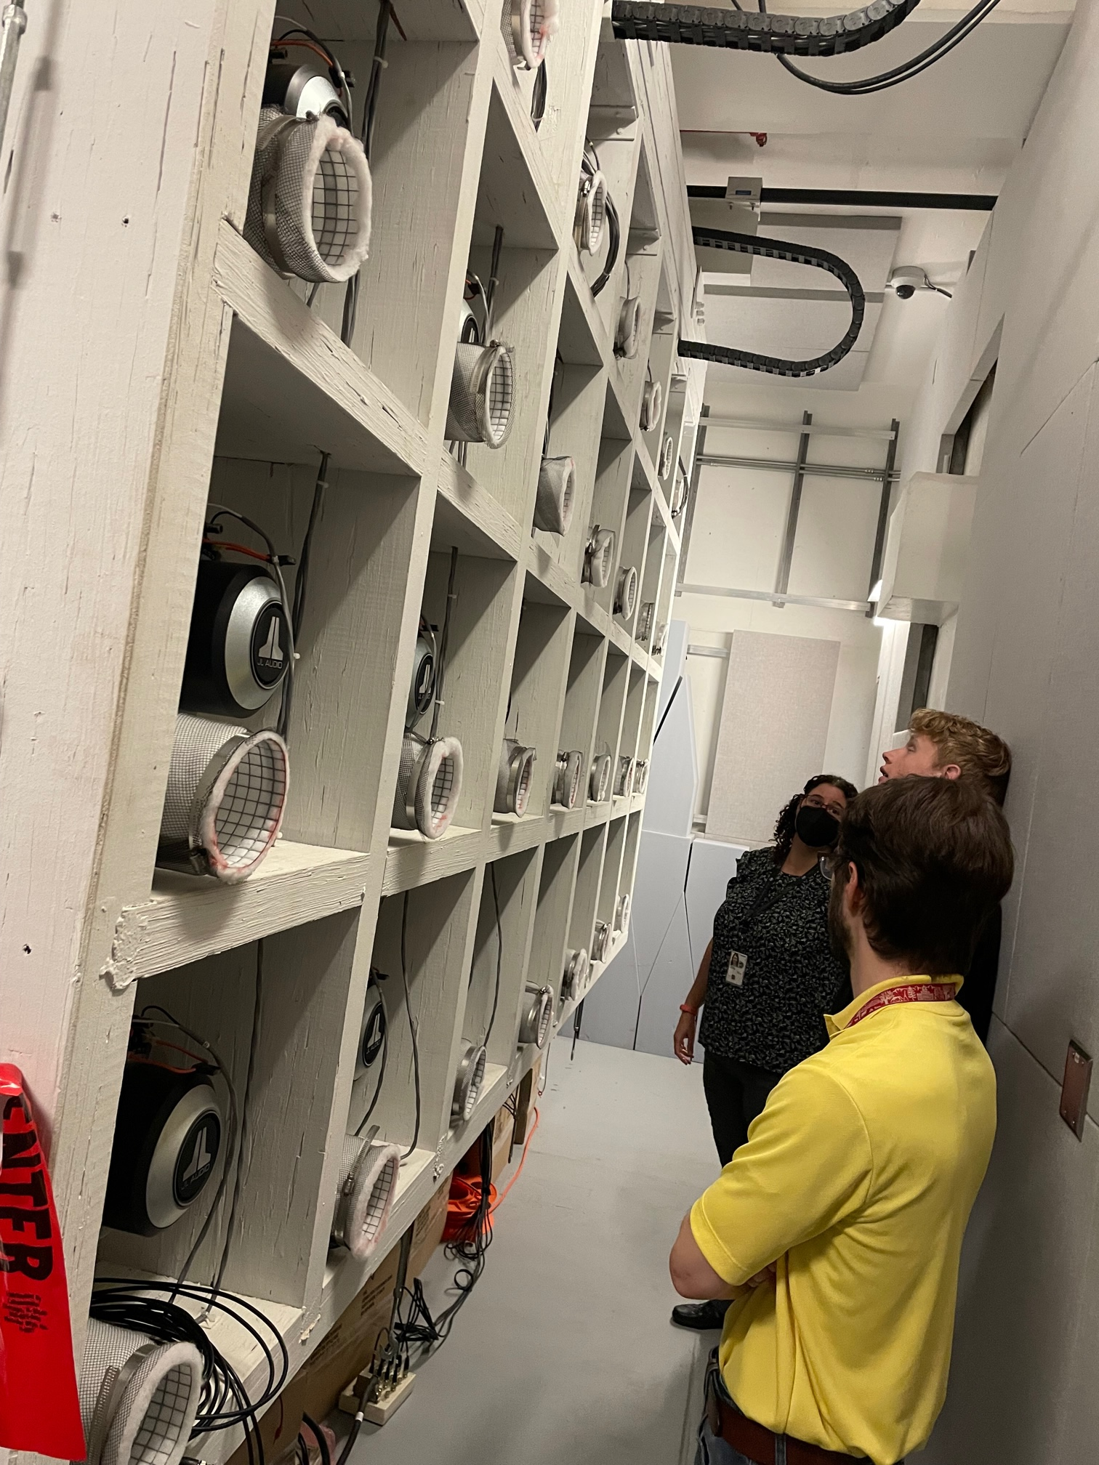
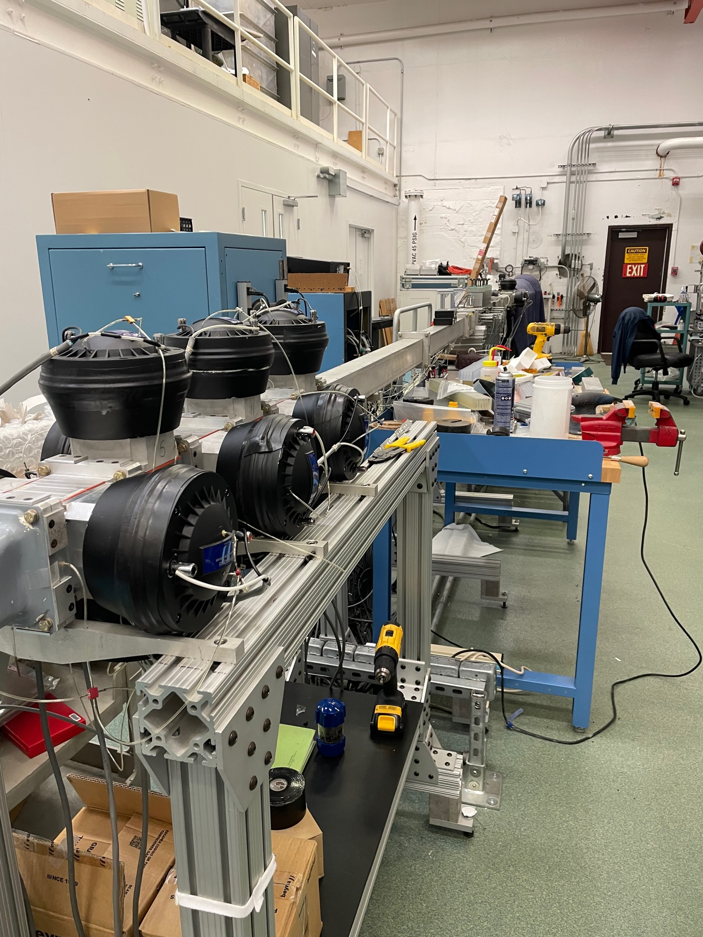
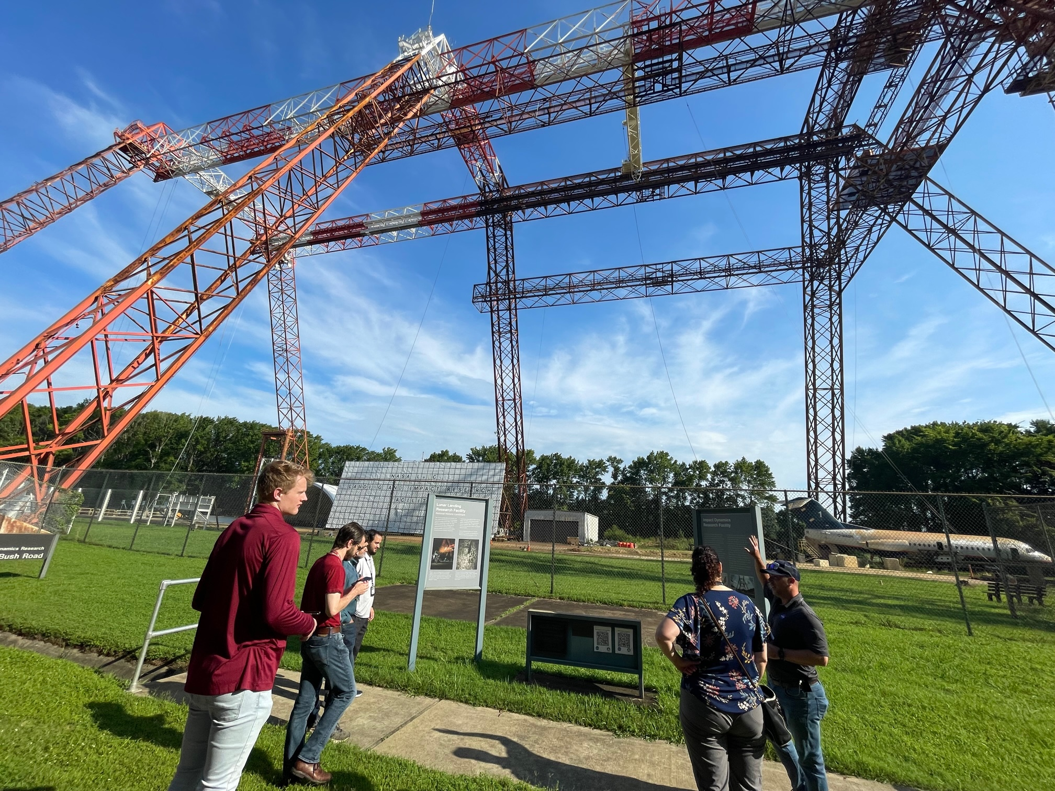
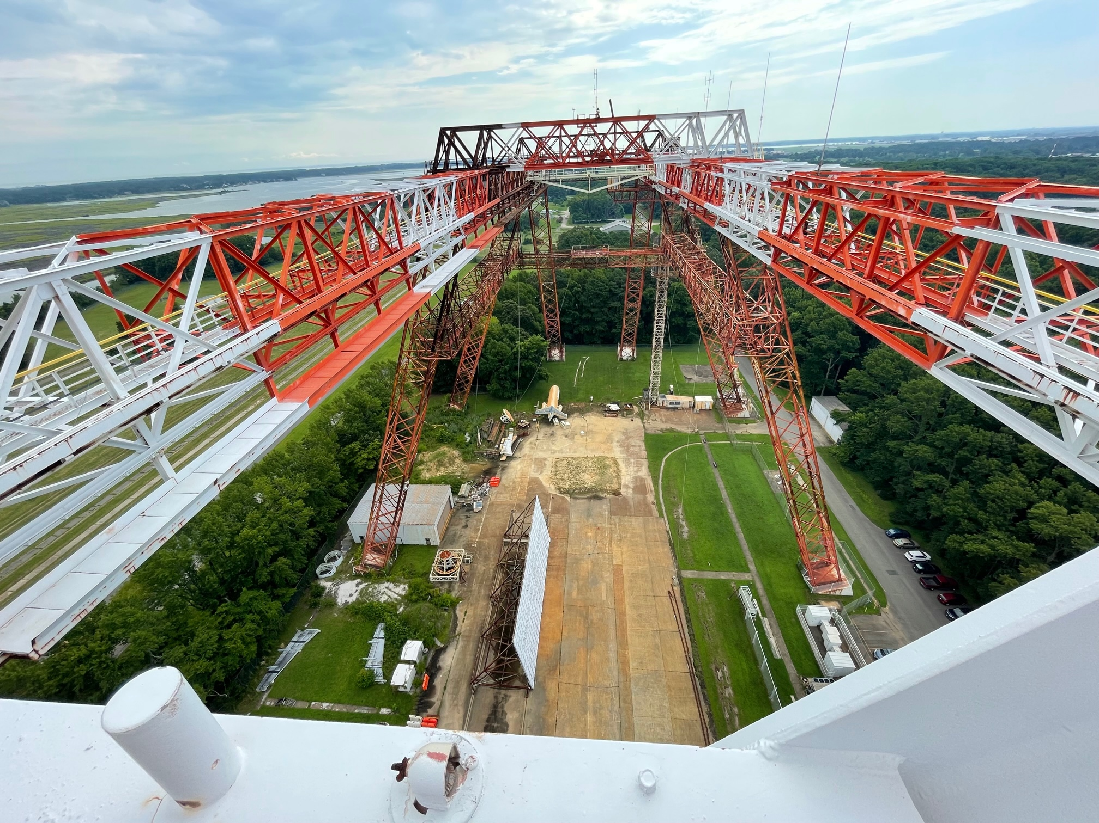
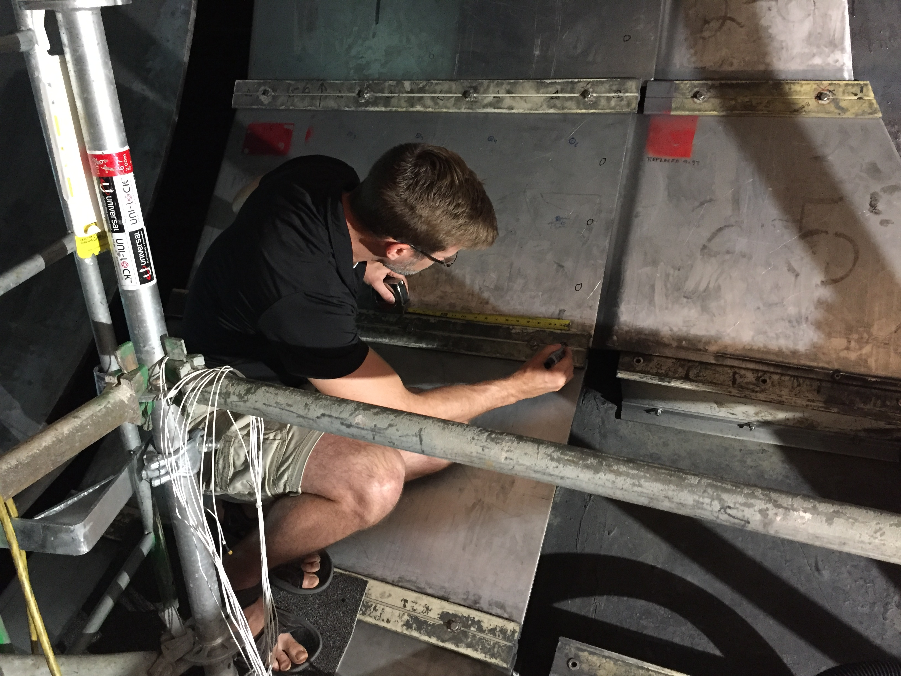








What do opportunities at NASA Langley look like?
Virtual or Hybrid
Notes:
Once you are on board, you might get to experience lots of unique facilities across NASA. There are collection of flight simulators. There is the towering gantry facility where the apollo astronauts trained and is now used for crash testing of air and spacecraft. There are many wind tunnels of varying size and speed. Maybe you’ll find a virtual or hybrid opportunity that interest you. Maybe you’ll be working as usual and your colleague will ask you to help instrument a wind tunnel with vibrometers. Maybe you love noise reduction and want to contribute to quieter air transportation. Or if psychoacoustics is of interest to you, we have the facilities for you to explore.

Slide 12
Outline
My background
Acoustics at NASA
Opportunities for students and graduates
NASA Quesst Mission
Background: civil supersonic transportation prohibition
X-59 low-boom aircraft
Mission phases
Current status
Challenges

Slide 13







Supersonic Flight and Sonic Boom: A Brief History
1947 First supersonic flight
Sonic boom a novelty
1950s Rapid development of supersonic military aircraft
Noise and damage concerns
1960s Supersonic commercial aircraft proposed
Community studies determine sonic boom exposure is unacceptable
1973 US federal ban, international limits
1976 – 2003 Concorde commercial service
Supersonic operations only over the ocean
2003 DARPA-NASA Shaped Sonic Boom Demonstration
First flight demonstration of sonic boom “shaping” theory
2018 – 2026 NASA Quesst Mission First flight demonstration of low noise supersonic design
Community studies to gauge public reaction
Bell X-1
F-100
XB-70
Concorde
SSBD
X-59
Notes:
Supersonic flight has been around for 75 years.
In the 1960s supersonic commercial aircraft were proposed, and several major community studies occurred. Supersonic aircraft were flown over communities and a social survey was conducted to learn how the community responded to sonic booms. The results of the tests showed that conventional sonic booms were too loud to be acceptable.
In 1973 commercial supersonic flight was banned overland.
From 1976—2003 Concorde flew passengers supersonically over water, but had to slow down over land.
Presently, NASA’s Quesst mission is building a low noise supersonic experimental aircraft, the X-59, to enable survey data collection from the public on reactions to low noise supersonic overflight.

Slide 14

The vision for commercial supersonic flight
Overland Flight Restrictions based on unacceptable sonic boom noise are viewed as the main barrier to this vision
An emerging potential market has generated renewed interest in civil supersonic aircraft
Evidenced by the appearance of several commercial programs despite lack of standards for en route noise or landing and takeoff noise
National Research and Policy agencies play a central role in developing the data needed for the regulation change that is essential to enabling this new market
The vision of the Supersonics Community is a future where fast air travel is available for a broad spectrum of the traveling public
Future supersonic aircraft will not only be able to fly overland without creating an “unacceptable situation” but compared to Concorde and SST will be efficient, affordable, and environmentally responsible
Credit :Lockheed Martin
14
Notes:
NASA’s vision is a future where fast air travel is broadly available to the traveling public. Future supersonic aircraft will fly overland without creating loud, disruptive sonic booms. They will also be efficient, affordable, and environmentally responsible, especially compared to Concorde.
The main barrier to this vision is the restriction on overland supersonic flight.
Research agencies like NASA and policy agencies like the FAA, play a central role in developing the data needed for new regulations that will enable the new market.

Slide 15

Overcoming the barrier to overland flight
The Quesst Mission is specifically planned to generate key data for success in NASA’s Critical Commitment to support development of en route certification standards based on acceptable sound levels
New environmental standards are needed to open the market to supersonic flight
An en route noise standard is the biggest challenge
Requires proof of new design approaches
Must replace current prohibitions
No relevant data exists to define limits
Community data from large, diverse population is a requirement
Standard must be accepted internationally
15
Notes:
One key to overcoming the barrier is the development of appropriate noise level standards.
The goal is to move away from the current speed limit, which prohibits any supersonic flight, to establishing an actual noise limit.
A regulation with a noise limit requires data to inform it.
The Quesst Mission is intended to generate and provide that data to regulators for the development of the noise standard.

Slide 16


What is the NASA Quesst Mission?
Phase 1 – Aircraft Development
In progress (FY18-23)
Design, fabricate a quiet supersonic research aircraft
Prove performance in test range flights
Prove safety for flights in normal airspace
Systematic Approach Leading to Community Testing
Phase 2 – Acoustic Validation
Preparation in progress (FY18-23), Execution FY23-24
Prove the acoustic characteristics match design targets
Detailed in-flight and ground measurements in test range
Phase 3 – Community Response Testing
Preparation in progress (FY19-23), Execution FY24-27
Conduct community tests
Select communities
Outreach and engagement (including STEM)
Obtain necessary approval
Plan surveys and recruit participants
Collect ground measurements
Notes:
NASA’s Quesst mission culminates in the collection of public survey data on reactions to low noise supersonic overflight. It’s divided into 3 phases.
Phase 1 is aircraft development of the X-59, which is currently underway. Lockeed Martin is leading the build in Palmdale, California. Phase 1 includes the design, fabrication, and ground test of the X-59. When ready, the aircraft will undergo a series of envelope expansion flights to prove the airplane is ready and safe to fly.
After that we’ll stay in the test ranges to conduct the acoustic validation, which is Phase 2. Here we’ll be proving that the acoustic signature of the airplane matches what we set out to design. We’ll conduct detailed inflight and ground measurements of the airplane’s signature in preparation for community testing.
Phase 3 is execution of the community response tests and data analysis. That phase will be executed over 2-3 years staring in 2024 and will consist of several month-long flight tests over different communities in the US and possibly abroad.

Slide 17

The X-59 Aircraft
Key requirements drive X-59 design
The acoustic signal of the X-plane must effectively replicate that of future larger supersonic commercial aircraft.
The X-plane must conduct community overflight tests using normal commercial aircraft flight maneuvers.
Design Parameters
Length: 99’ 7”
Span: 29’ 6”
Speed: Mach 1.4 (925 mph)
Altitude: 55,000 ft
Design Features
New, unique airframe design with acoustic signature shaping
Many components from existing aircraft to reduce cost
Payload capacity: single pilot/flight test instrumentation
Notes:
The X-59 aircraft is driven by the idea of meeting a minimum set of requirements to accomplish the mission. The acoustic signal must replicate a future, larger aircraft. We must be able to operate the airplane using normal flight maneuvers that would be expected for commercial supersonic aircraft.
This is a new and unique airframe design to accomplish the signature shaping, but it uses many components from existing aircraft to reduce cost. It’s a research aircraft, so the payload is just a single pilot plus flight test instrumentation.

Slide 18



X-59 Aircraft Development Status
Lockheed Martin is the lead for manufacturing
Major airframe components mated
Systems installation and checkout in progress
NASA supplied systems delivered
Engine delivered
Ground testing in Texas
First flight in the next few months
GE F414 engine
Simulator with External Vision System (XVS)
Manufacturing progress at Lockheed-Martin
Notes:
Here are some images of the airplane in fabrication. Some systems are supplied by NASA such as the External Vision System, which enables forward vision without a forward facing canopy window. The airplane is powered by an existing fighter aircraft engine. The aircraft underwent ground testing in TX in the spring and is back in California for the finishing touches. The target for its first flight is in the next few months.

Slide 19


Just how quiet will the NASA X-59 be?
PL (dB)
W. Doebler and J. Rathsam, Proc. Mtgs. Acoustics 36, 040005 2019.
19
Notes:
Psychoacoustic research on sonic booms has shown that the Perceived Level decibel scale correlates well with human perception of impulsive sonic booms. This is different than other decibel scales that work well for continuous noise such as A-weighted sound level. Simplifying slightly, the Perceived Level metric computation process is more complex than other metrics that have a single frequency weighting curve. For PL, the weighting of each frequency band changes depending on the loudness of the band, and after weighting the bands a band summation process occurs finally resulting in the PL value.
To put values of PL in context, the conventional sonic booms from Concorde or other traditional loud sonic-boom-generating aircraft were on the order of 105 dB Perceived Level, which is comparable to nearby thunder or a car door slam from inside the car. These types of sounds can be very startling when you are not expecting them.
By contrast, X-59’s sonic thump is designed to be 75 dB, which is comparable to distant thunder, or a car door slam from across the street.

Slide 20

How large is the noise exposure region from a supersonic overflight?
Notes:
As the aircraft flies supersonically, it drags a so-called “carpet” of impulsive sound behind it that can be 20 to 50 miles wide depending on the altitude and weather.
A 50 mile wide carpet across a flight path that is hundreds or thousands of miles long can encompass many millions of people, especially away from areas typically associated with aviation or transportation noise.
That’s one reason why it is important to collect survey data from a large and geographically diverse population.

Slide 21





Scaling up the NASA community surveys from lab-scale to national-scale
Human response and annoyance, particularly indoors, is the key concern.
Quiet Supersonic Flights 2018
Galveston, Texas
Laboratory Tests
Small Community Test
Large Community Test
Tests of increasing complexity have provided preparation and confidence
Ready to take the next step with flight testing over very large communities
Notes:
NASA has conducted laboratory psychoacoustics tests, community noise survey tests in small communities, and risk reduction community noise survey tests in larger communities. These tests of increasing complexity show, in general, that NASA is ready to collect noise and survey data to aid in development of a noise limit. These earlier tests have prepared NASA to take the next step with flight tests over very large communities.
The next slide shows an example noise dose – perceptual response from these small and larger community tests, although it should be noted that these community tests were for reducing risk for the Quesst Mission, not necessarily to estimate the national dose-response data that will be provided to regulators.

Slide 22


Dose-Response Curves from Past NASA Tests
Large Community Test
Small Community Test
J. Lee, et al. J. Acoustical Soc. Am., 147:2222, 2020.
Notes:
This plot shows sample dose response curves resulting from previous NASA community tests. The x-axis shows noise dose in terms of Perceived Level (PL) in decibels. The y-axis shows percent of highly annoyed responses.
The first thing to note is the high degree of scatter in the data, which is typical of social survey data.
The second thing is that in both tests, 75 dB is associated with a very low percent highly annoyed. Although it is important to note that the goal of neither of these risk reduction community tests were to resolve a nationally representative dose-response curve.
As a matter of practicality, the sonic boom community tests have all been “panel surveys,” in which a panel of survey participants responds multiple times. It simply is not practical to recruit a member of the public and then only request a single response, especially when responses are needed promptly after each overflight. A consequence of having panel studies is the need for statistical models that account for the correlation among multiple observations from the same person.
The Quesst Mission goal is to produce an accurate and precise dose-response curve that is representative of the nation

Slide 23


Exposure Design and Estimation – Key Challenges
Estimating exposure level across a large area: combining predictions with measured levels
Estimating meteorological conditions across the survey area
Automating acoustic data acquisition (and transmission) and exposure estimation methods
Acquiring acoustic data with low signal-to-noise ratio (low sonic boom loudness relative to ambient noise)
Placing acoustic sensors to accommodate uncertainty due to variability in weather and ambient noise
Strategies to address challenges include:
Development and testing of rapid, automated methods of exposure estimation based on acoustic and meteorological sensor data
Hardware/software testing and validation of remote operation and robustness during LBFD Phase 2
Notes:
There are challenges in data collection for both axes of the dose-response curve.
Starting with the noise dose estimation, we will be collecting noise data across a large survey area with limited numbers of ground recording equipment. The large test area means the noise monitors will not be attended, and will remain in the field for the duration of the test. Automatic triggering based on the aircraft position is in development, and automatic functionality tests are built into the noise monitors.
Finding the boom signal in the noise can be challenging, and boom finding algorithms are being developed based on synthetic datasets. So far, a replica correlator seems to be the way to go.
The noise dose estimation procedure will combine measured noise levels from the sparse noise monitors along with physics-based predictions of sonic booms using NASA’s PCBoom software. The approach may be similar to data assimilation procedure that is used in weather forecast models.

Slide 24

Survey Design and Analysis – Key Challenges
Deliberate sample design to enable nationally representative results from a limited number of community studies
Automation of survey response acquisition and processing to support X-59 deployment pace
Large-scale participant geolocation processing
Statistical analysis approaches for multiple responses per participant (typically 1 per participant)
Creating effective survey when unable to mask its purpose
Strategies to address challenges include:
Testing/validation of survey methods and instruments through small-scale studies
Testing of automated processing methods to achieve target levels of usable/valid survey data
Notes:
The vertical axis of the dose-response curve also has its challenges.
The ultimate goal is to have a dose-response curve that is nationally representative. To do this we need a nationally representative sample of survey participants. Since the X-59 has limited flight hours and it cannot be flown out of all US airports, this limits the sampling frame to people who live within the X-59’s range of some larger airports and military bases. An approach to locate nationally representative communities within the land area available to the X-59 is being developed. Random address-based sampling will be used in these nationally representative areas. After the test, post-weighting of the data can enable national representativeness if the sampling procedure is imperfect.
The timing and budget allow just 5 community tests, so choosing the locations of these 5 tests is another important decision in order to claim national representativeness.
We also need prompt responses to the sonic boom events, so we opt for a web-based survey. Internet access is not available in all households, but it is on the rise.
It is also a challenge to model the dose-response curve itself. In the past studies, there have been few reports of high annoyance, which is creates a model fitting challenge. Accounting for correlation between survey responses from an individual complicates the modeling efforts.
Compared to previous tests, we will have more participants and increased test duration. We anticipate being able to model the community response data with this approach. The subsequent challenge is combining the data from the 5 community tests. Should they be pooled or modeled separately, for example.

Slide 25
Summary
Quesst Mission
The X-59 will soon be flying over several US communities
Noise dose and perceptual response data will be collected to inform potential new supersonic aircraft noise certification standards
We are in the planning stage and are working to solve several testing challenges
Many opportunities for students and graduates at NASA – be sure to apply!
intern.nasa.gov
usajobs.gov

Slide 26
nasa.gov/quesst
william.j.doebler@nasa.gov

