Slide 1

Digital Elevation Map Parametric Error Analysis Pipeline using Corresponding NAC Images
Chris Gnam, Carolina Restrepo, Andrew Liounis (NASA Goddard)
POC: Christopher.gnam@nasa.gov
3rd Space Imaging Workshop
October 10-12th, 2022

Slide 2
DEM Quality Evaluation Framework
We want to evaluate Digital Elevation Map (DEM) quality, specifically as it relates to Terrain Relative Navigation (TRN) performance
Issue:
  TRN performance best evaluated by simulating truth reference trajectory
  Simulated scenario means simulating the navigation images (via GIANT)
  This is not, by itself, a good metric of DEM quality, since we are simulating both the true images and the predicted navigation templates, from various synthetic DEMs
Solution: Have two approaches
  Perform a sensitivity analysis on each DEM by comparing it to multiple NAC images and determining how much error could exist within the DEM
  Perform monte carlo analysis of the navigation performance by applying deformations to the DEM by randomly sampling those error bounds

Slide 3
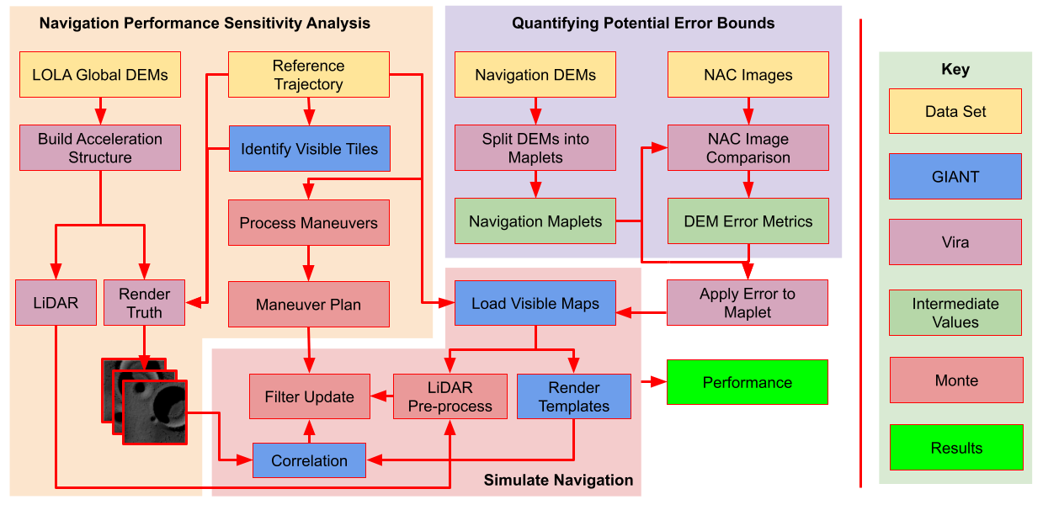
DEM Quality Analysis Framework

Slide 4
DEM Quality Analysis Framework

Slide 5
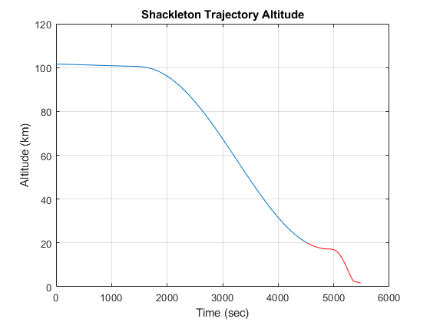
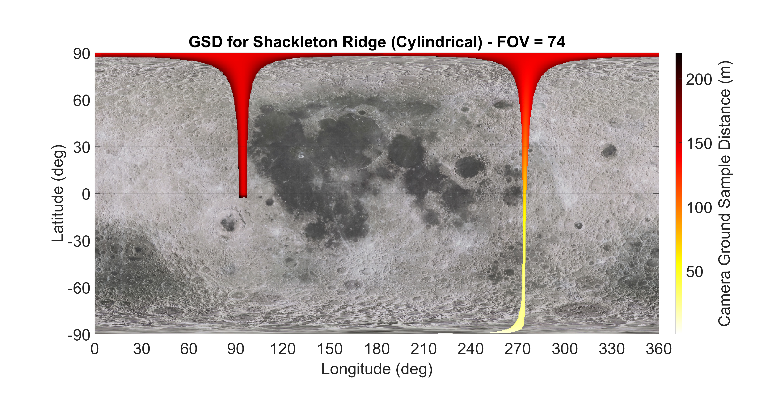
Reference Descent Trajectory

Slide 6
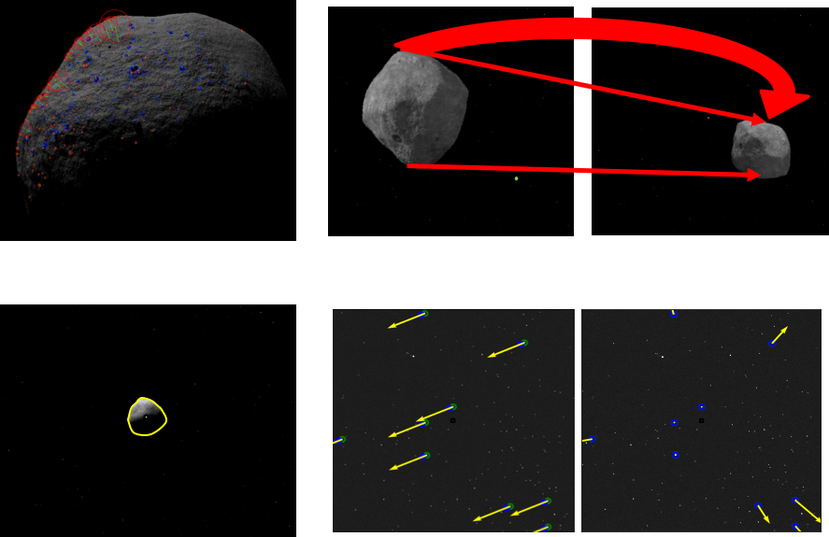


Goddard Image Analysis and Navigation Tool (GIANT) and Vira Path Tracer
GIANT: Developed by Goddard for Image Processing, Rendering, and Navigation
Vira: Developed by Goddard for rendering large datasets
Source: Advancements in Optical Navigation Capabilities. Retrieved from https://techport.nasa.gov/view/93240

Slide 7
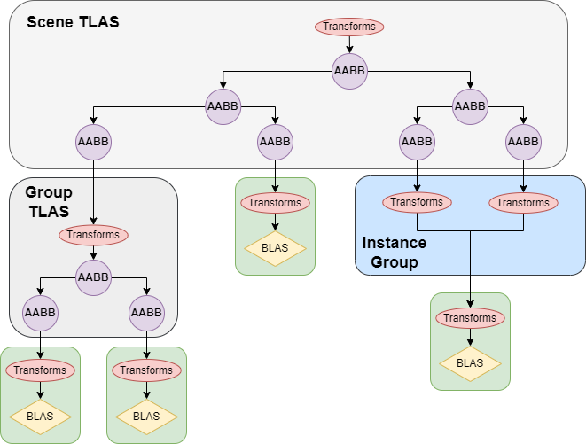
Vira Path Tracing Architecture
Tiered Acceleration Structure
  Top Level Acceleration Structure (TLAS) is BVH of AABBs
  Base Level Acceleration Structure (BLAS) is a Bounding Volume Hierarchy (BVH) of primitives (triangles)
Object AABBs can be loaded before geometry, allowing geometries to be loaded as needed

Slide 8

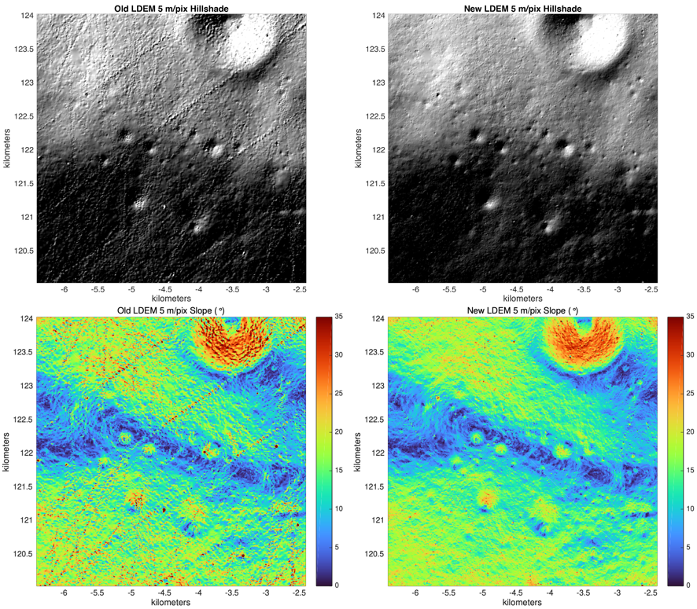
Passive TRN Techniques
Image-on-Map
Image is captured and identified on a large Reference Map
Maps-on-Image
Image is captured and small “maplets” are found within it
Reference Map
True Terrain
Reference Map
Image Captured
Notes:
Measurements are only as good as the reference map.

Slide 9
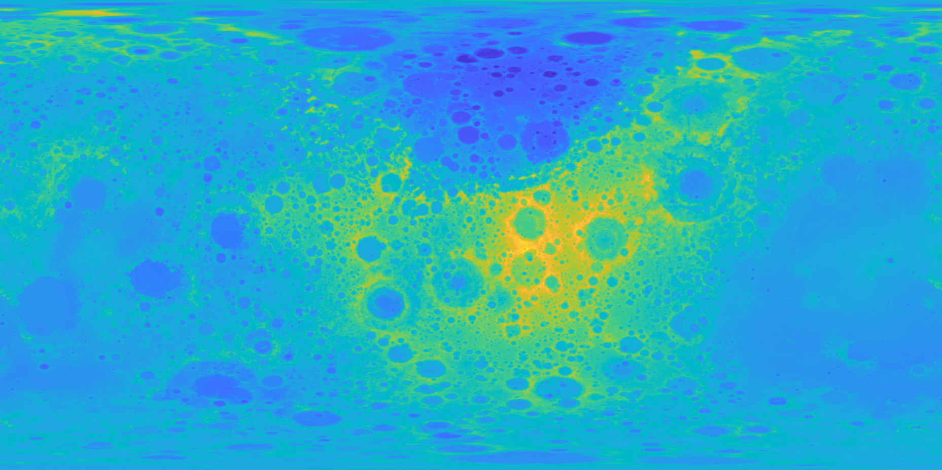
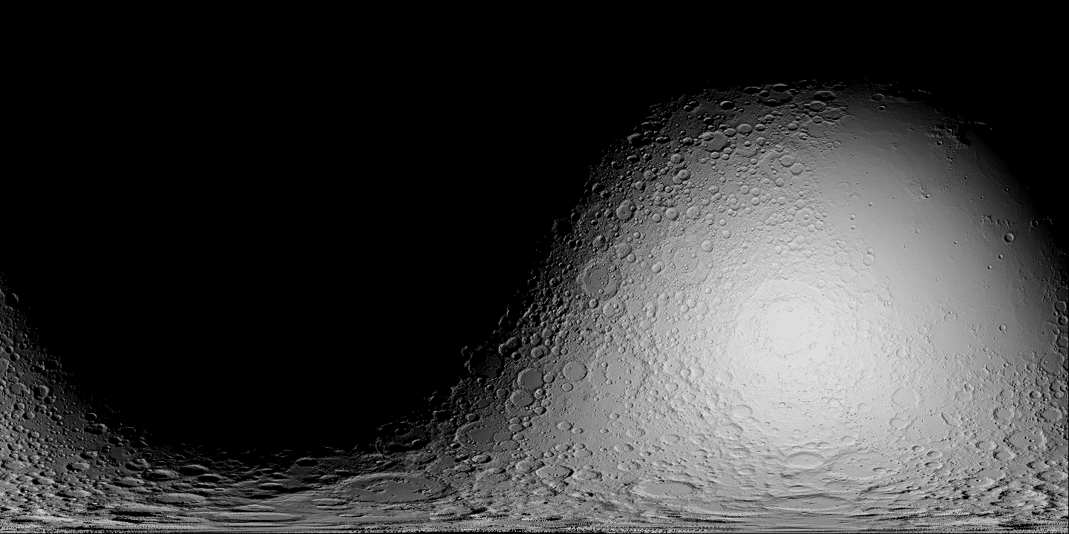
Rendering Reference Maps
Can natively ingest GeoTIFF digital elevation maps to be used for baking illumination reference maps, or for rendering images from a camera
LOLA GDR LDEM4 Digital Elevation Map
Rendered Illumination Map

Slide 10
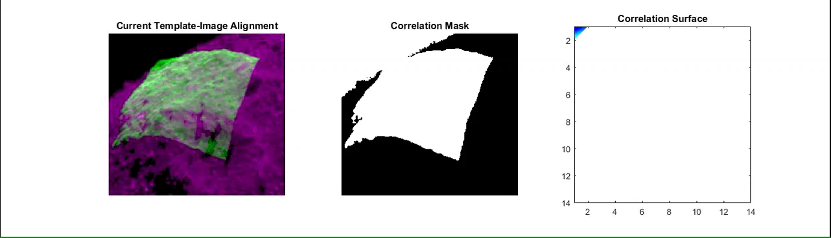
Template Matching
GIANT Rendered Templates (or Vira Rendered Reference Map) are registered with collected images using cross correlation
Depiction of GIANT’s cross-correlation based image registration from the OSIRIS-REx Mission

Slide 11
Reference Descent Trajectory

Slide 12
Reference Descent Trajectory

Slide 13
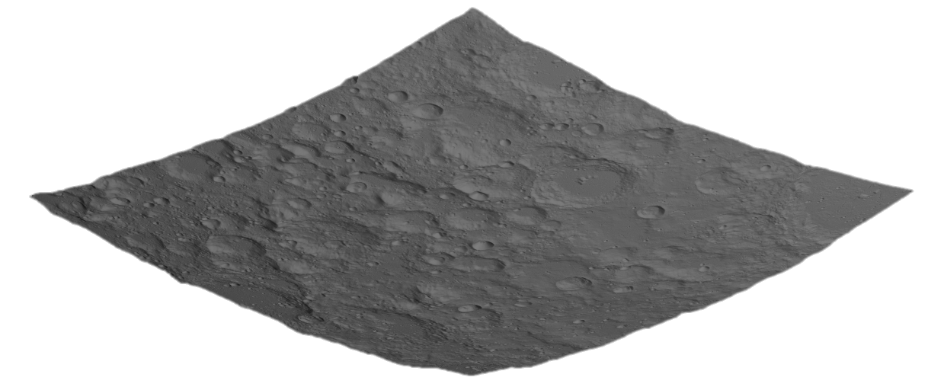
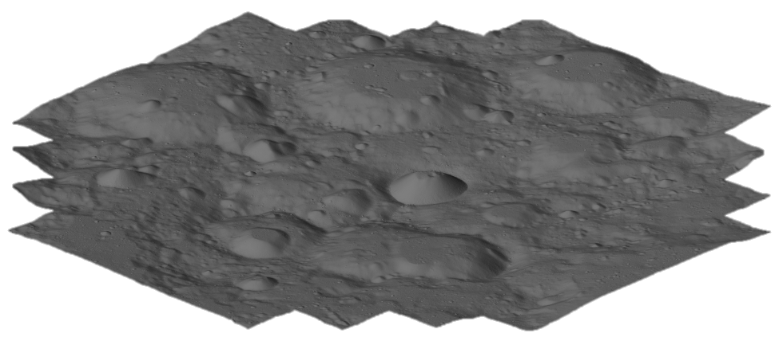
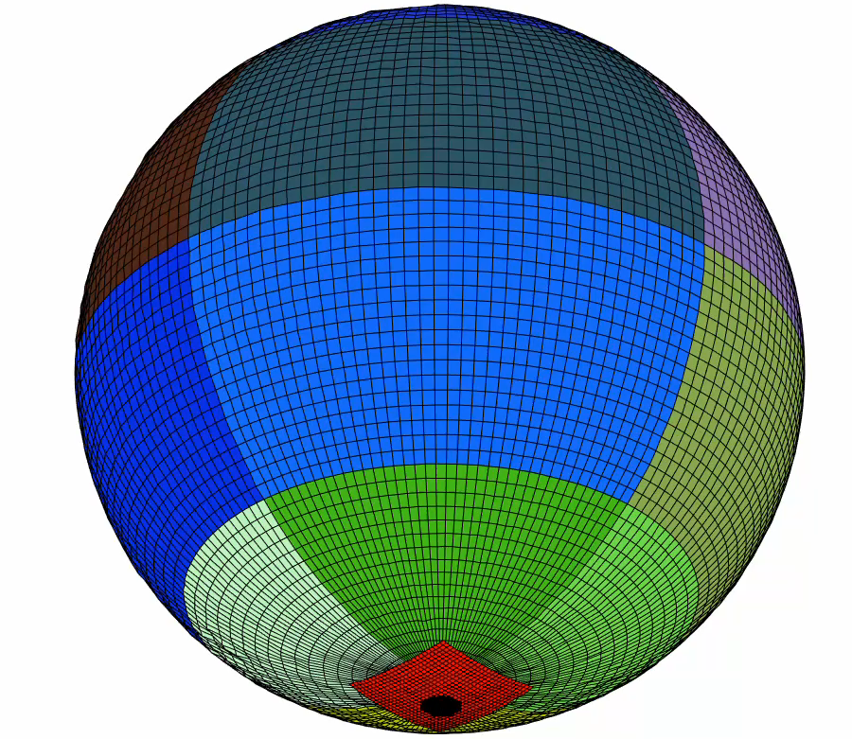
Digital Elevation Maps to Consider
Lunar Orbiter Laser Altimeter Gridded Data Records (LOLA GDR) Cylindrical Projection Maps
LuNaMaps created Stereographic Projection Maps of south pole
Main Priority is south pole:
  80S (20 meters per pixel)
  87S (5 meters per pixel)

Slide 14
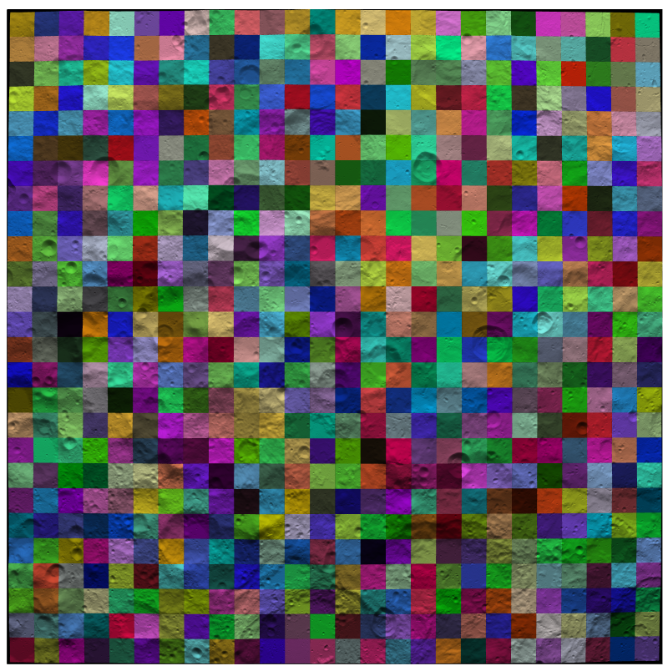
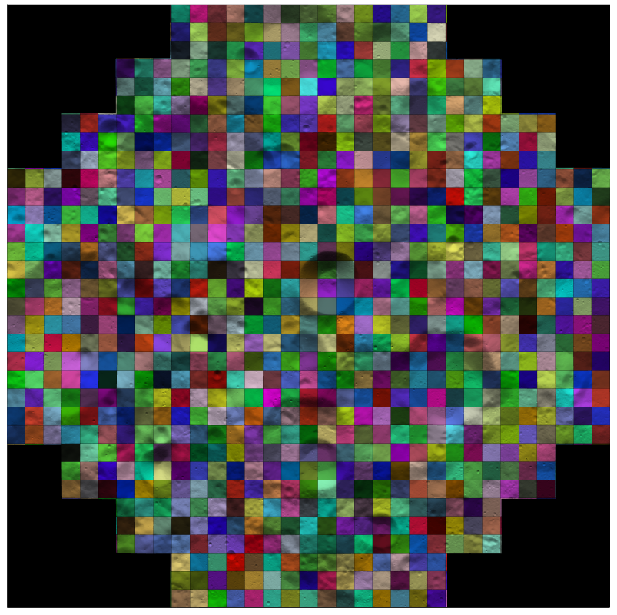
Tiling of South Pole Stereographic DEMs

Slide 15
DEM Quality Analysis Framework

Slide 16
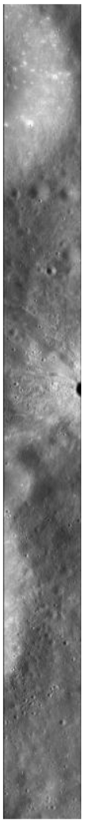
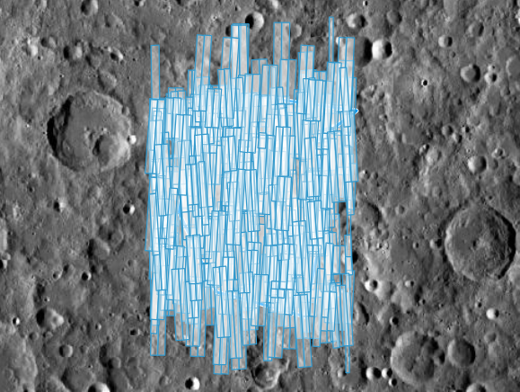
NAC Images
Lunar Reconnaissance Orbit Camera (LROC) Quick Map tool allows for easy selection of images taken by Narrow Angle Camera Right and Left (NAC-R and NAC-L)
For a given DEM we wish to evaluate, can simply request NAC images collected over that region of the lunar surface
  LROC Observation M1112998800L

Slide 17
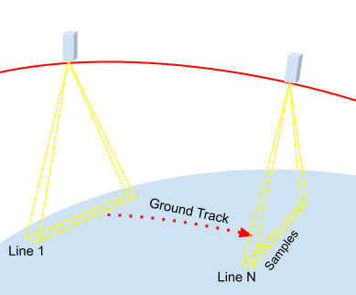
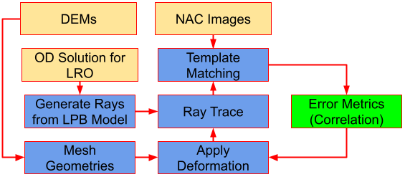
NAC Camera Model
Linear Pushbroom Model (LPB) Implemented into GIANT
  Currently adding support for USGS CSM camera models
Applying Transformations to DEMs to obtain “bounds” for what kinds of errors may exist

Slide 18
Deformations applied to DEMs
Deformation Types
  Individual Pixel heights
  Scale
  Smoothing – Using a gaussian kernel (or similar) to smooth out heights across DEM
  Skew – Stretch DEM coordinates in different directions
  Shift – Globally shift the DEM in multiple directions
  Rotation – Apply small rotation to DEM
  Low Frequency Noise – Add slowly varying continuous noise to the DEM

Slide 19
In progress and Future Work
Finalize support for the USGS CSM camera models.
Process a small portion of the surface using entire suite to gain insight into which types of distortions to focus on.
Identify regions of interest to apply technique to.
Use results to seed sensitivity analysis whereby the impact of distortions on navigation performance can be studied.
Will be presenting all results for this, and navigation sensitivity analysis, at SciTech

