Slide 1
The Machine Learning Showroom
OCIO Data Science Summit - November 15, 2022
Note: This presentation
does NOT contain any CUI
or classified information.
Marina Dunn (marina.m.dunn@nasa.gov)
David Na (david.s.na@nasa.gov)
Douglas Trent (douglas.m.trent@nasa.gov)
Data Science Services (DSS)
Information, Data, & Analytics Services (IDAS)

Slide 2
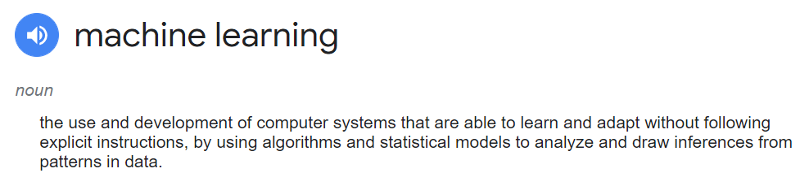
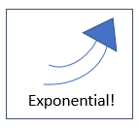
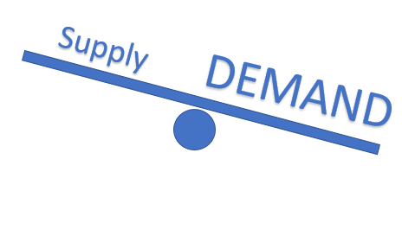
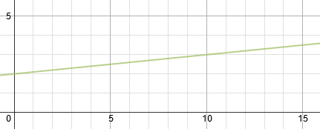
Machine Learning – Problem Definition
ML Growth (Exponential)
Technical Capability (Sevilla, 2021)
Business Opportunity (Fortune Business Insights, 2022)
NASA Adoption of Machine Learning (Azari, 2020)
NASA Data Science Skills (Linear)
IDAS:
Data Science as a Service (DSaaS)
Scalable solutions
Notes:
Machine Learning (ML) defined as programs that learn on their own, drawing inferences from patterns in the data. Used here broadly, from simple regression to deep learning, from early exploratory data analysis to data visualization.
ML is growing exponentially, in technical capability, in business opportunity, and in adoption by NASA. Yet the growth of NASA’s Data Science skill set is linear.
Solving the ML supply/demand imbalance with scalable Data Science as a Service (DSaaS) solutions is a focus of the new IDAS DSS organization.

Slide 3
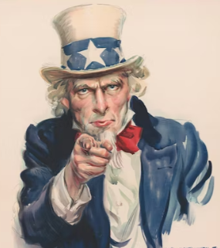

ML Skill Gap - Approach
How to manage the ML Supply/Demand gap?
-> Citizen Data Scientists
A Call to Arms
Credit: Unsplash.com
What if there were a place …?
  Guidance: User guide, Digital assistant,
  Training resources, FAQs, Contacts
  Help yourself: Code examples, NASA Use cases,
  GitLab repository
  Help each other: Community board,
  Stack Overflow Q&A
Give a man a fish and
you feed him for a day.
Teach a man to fish,
and you feed him
for a lifetime.
Credit: Stable Diffusion
Notes:
Approach is to create a corp of NASA Citizen Data Scientists to help fill the ML supply/demand gap and disseminate ML across NASA.
Goal of ML Showroom is to empower NASA engineers and scientists to adopt ML into their projects and experiments:
Guidance to see which ML models fit their use case and how to apply
Ready-to-run code examples to help themselves
Community resources to help each other.

Slide 4
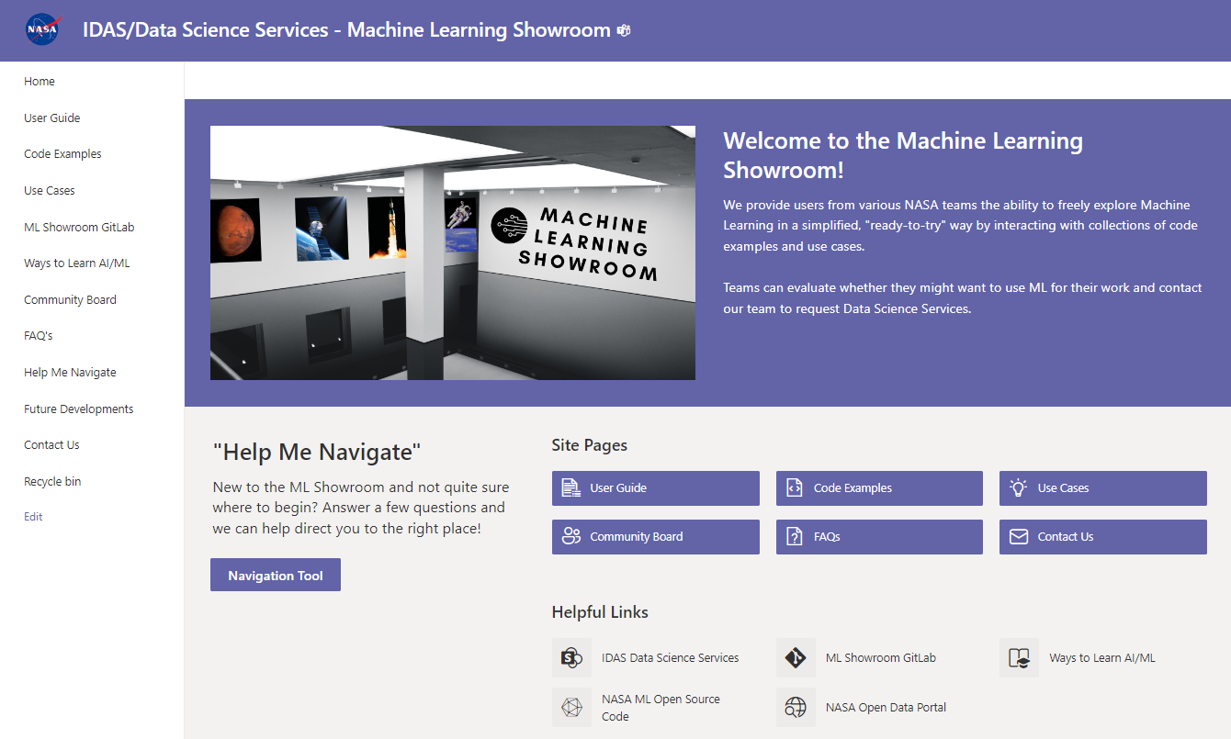
Machine Learning Showroom - Solution
View & Run ML code examples
and use cases …
From your laptop
From your browser
https://nasa.sharepoint.com/teams/IDASMachineLearningShowroom/SitePages/Home.aspx
Notes:
The ML Showroom launches today (November 15, 2022).
All code examples and NASA Use cases are downloadable to your computer. Step-by-step instructions show you how to set up a local environment for Python and Jupyter notebooks.
Code can also be run from your browser, without any need for a login account, or license, or elevated privileges, or NAMS request.
All NASA personnel are welcome to use the ML Showroom free of charge.

Slide 5
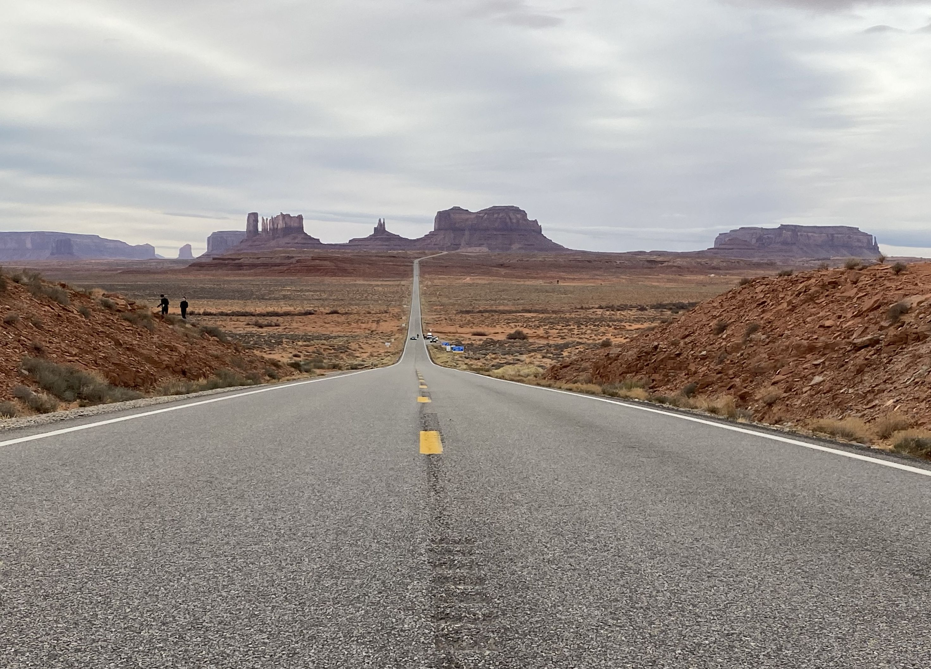
Take a Test Drive
Machine Learning Showroom
Fall 2022 internship project
Funding from Agency Digital Transformation
Photo by Doug Trent
Test Drive Scenario 1
Likely limited or no experience with Machine Learning
May or may not have data/project in mind
Likely has many questions, may not know where to start
Test Drive Scenario 2
Prior knowledge/use of Machine Learning
Likely has data/project already in mind
May already want to request IDAS services
Notes:
The showroom was assemble from scratch in less than three months as an intern project funded by Agency Digital Transformation.
The brilliant intern is Marina Dunn, engineering grad student at UC Riverside. The internship co-mentors are David Na and Douglas Trent.

Slide 6

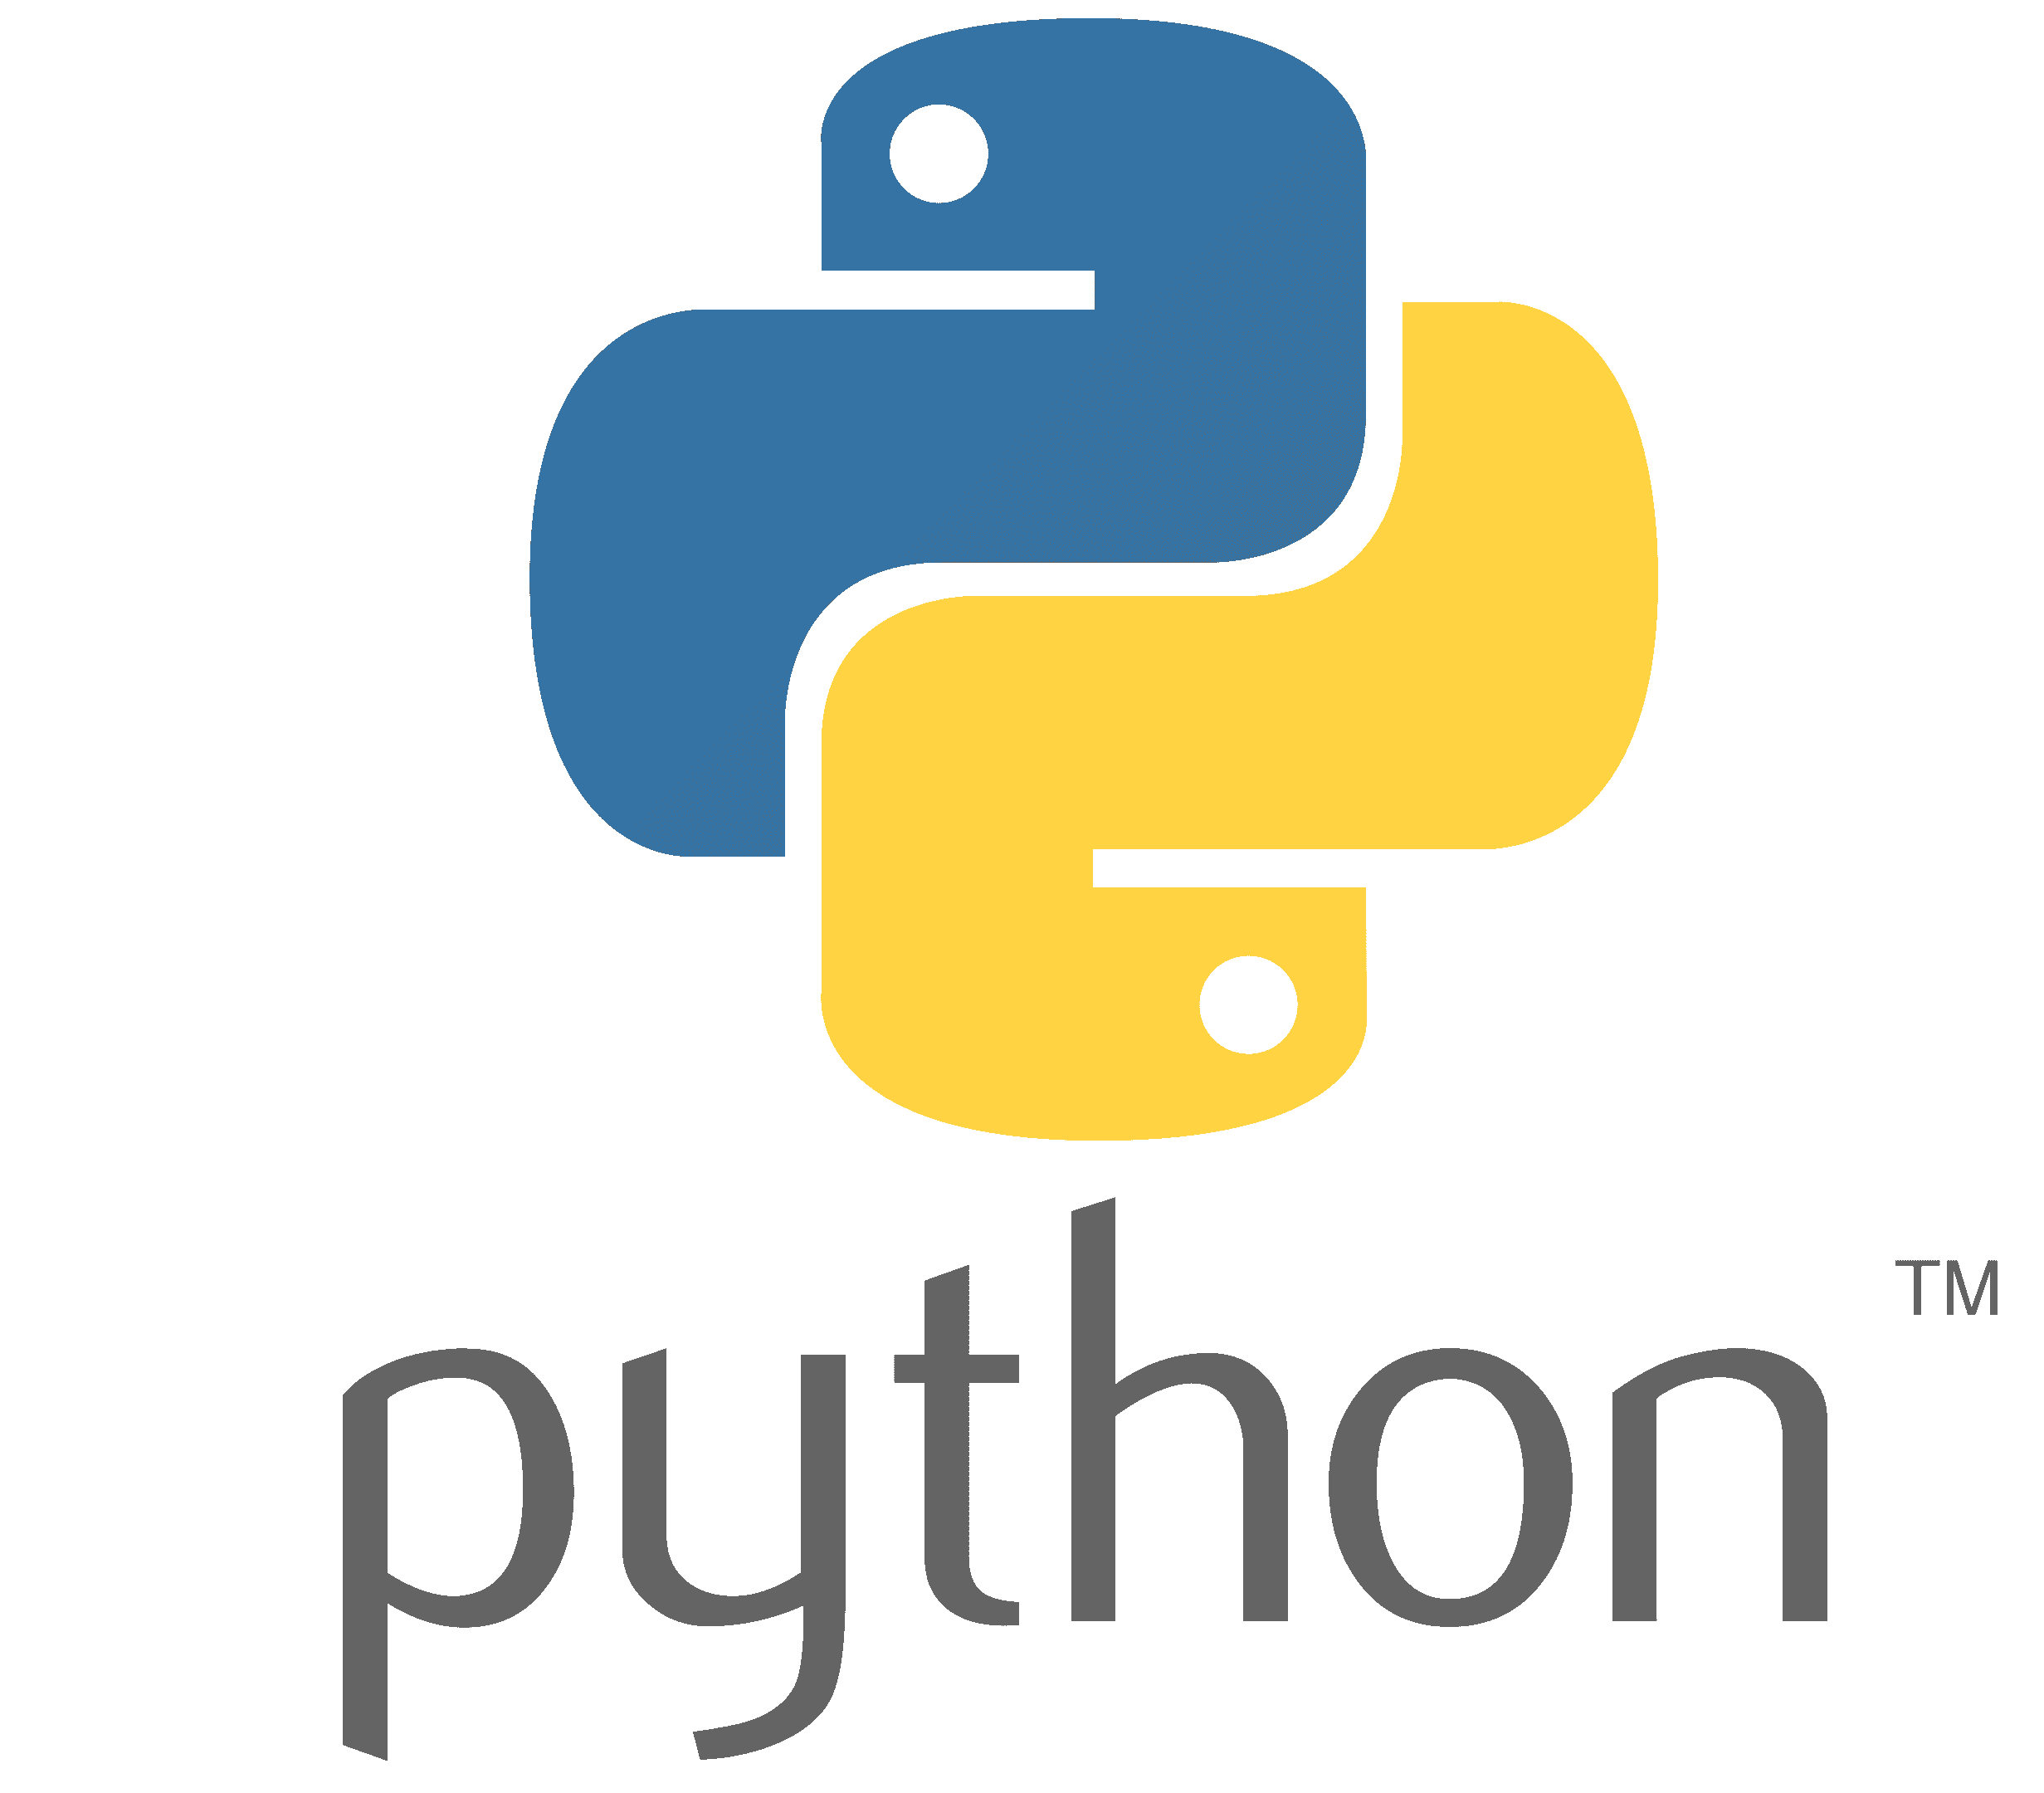
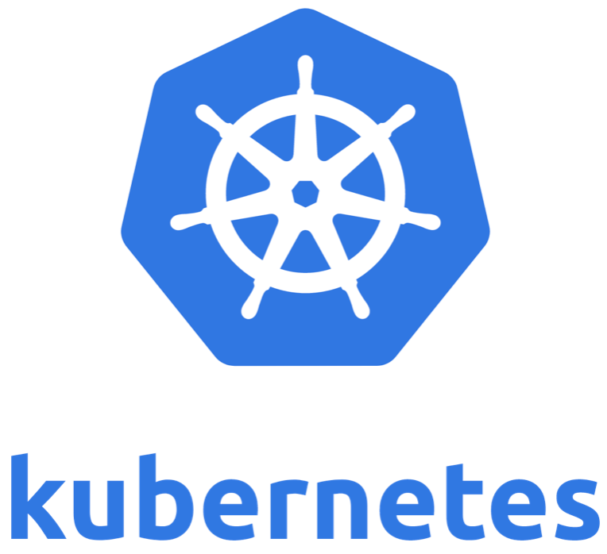
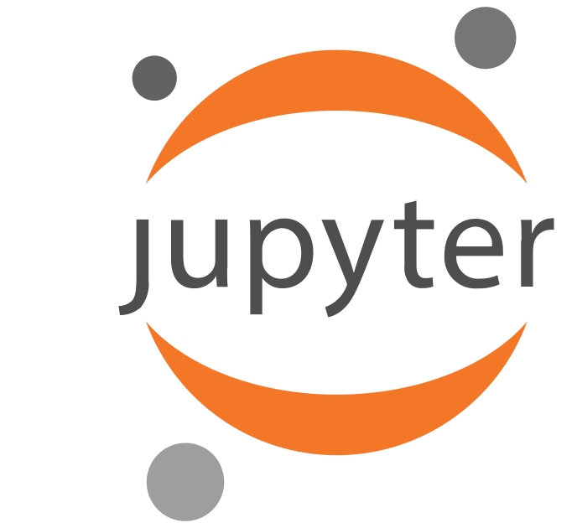
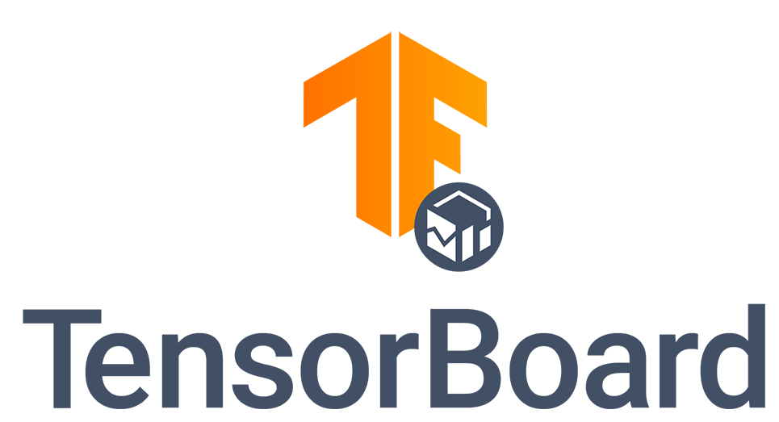
Coming Attractions
  GCP Web Server
  Single sign-on enabled
  Free of Charge
  Open to all NASA
  Read + Write access to code
  Persistent Memory storage
  Support for user uploaded data
  Limitations:
  CPU-Only (no GPU cores)
  RAM Memory limitation
  Intended for trial-based use
Trade names and trademarks are used in this report for identification only.
Their usage does not constitute an official endorsement, either expressed
or implied, by the National Aeronautics and Space Administration
Notes:
Coming attraction: Persistent coding environment (as part of showroom)
Free of charge, open to all NASA; limited to CPU-only (no GPU cores)
Modifiable code, can supply own data, save results, pick up where you left off

Slide 7
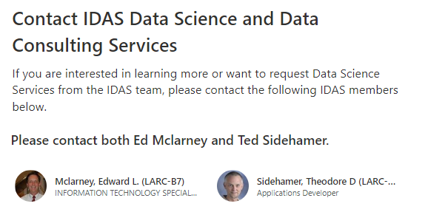
Showroom to Production
Interested in applying machine learning to your data?
IDAS - Data Science Services team will provide all project scoping, development support and consultation
Scalable cloud-enabled solutions across all major cloud platforms
Notes:
Easy transition to full DSS services and support
How prospects engage a DSS consultant, to scope work and estimate project cost
Open for Q&A

Slide 8
Q & A
Any Questions?

Slide 9
References
Azari, A. R., Biersteker, J. B., Dewey, R. M., Doran, G., Forsberg, E. J., Harris, C. D. K., Kerner, H. R., Skinner, K. A., Smith,
A. W., Amini, R., Cambioni, S., Da Poian, V., Garton, T. M., Himes, M. D., Millholland, S., & Ruhunusiri, S. (2020, July 29).
Integrating machine learning for planetary science: Perspectives for the next decade. arXiv.org. Retrieved November 9,
2022, from https://arxiv.org/abs/2007.15129
Fortune Business Insights. (2022) Machine learning (ML) market size, share & covid-19 impact analysis, by component
(solution, and services), by Enterprise Size (smes, and large enterprises), by deployment (cloud and on-premise), by
end-user (healthcare, retail, it and Telecommunication, BFSI, Automotive and transportation, advertising and media,
manufacturing, and others), and Regional Forecast, 2022-2029. Machine Learning Market Size, Share, Growth & Trends.
Retrieved November 9, 2022, from https://www.fortunebusinessinsights.com/machine-learning-market-102226
Sevilla, J., & Vilalobos, P. (2021, June 19). Parameter counts in machine learning. AI Alignment Forum. Retrieved November
9, 2022, from ttps://www.alignmentforum.org/posts/GzoWcYibWYwJva8aL/parameter-counts-in-machine-learning
Graphics Licenses
Unsplash: Free-to-use License
Stable Diffusion: Creative ML Open RAIL-M

