Slide 1
NASA’s Moon to Mars Autonomous Habitat Status
October 2022
Scott B. Tashakkor, P.E., NASA-MSFC

Slide 2
Topic Outline
What is NASA’s Moon to Mars Campaign?
What is needed for deep space habitats?
Limitations/constraints on Space Hardware and Software
Current status and Future

Slide 3
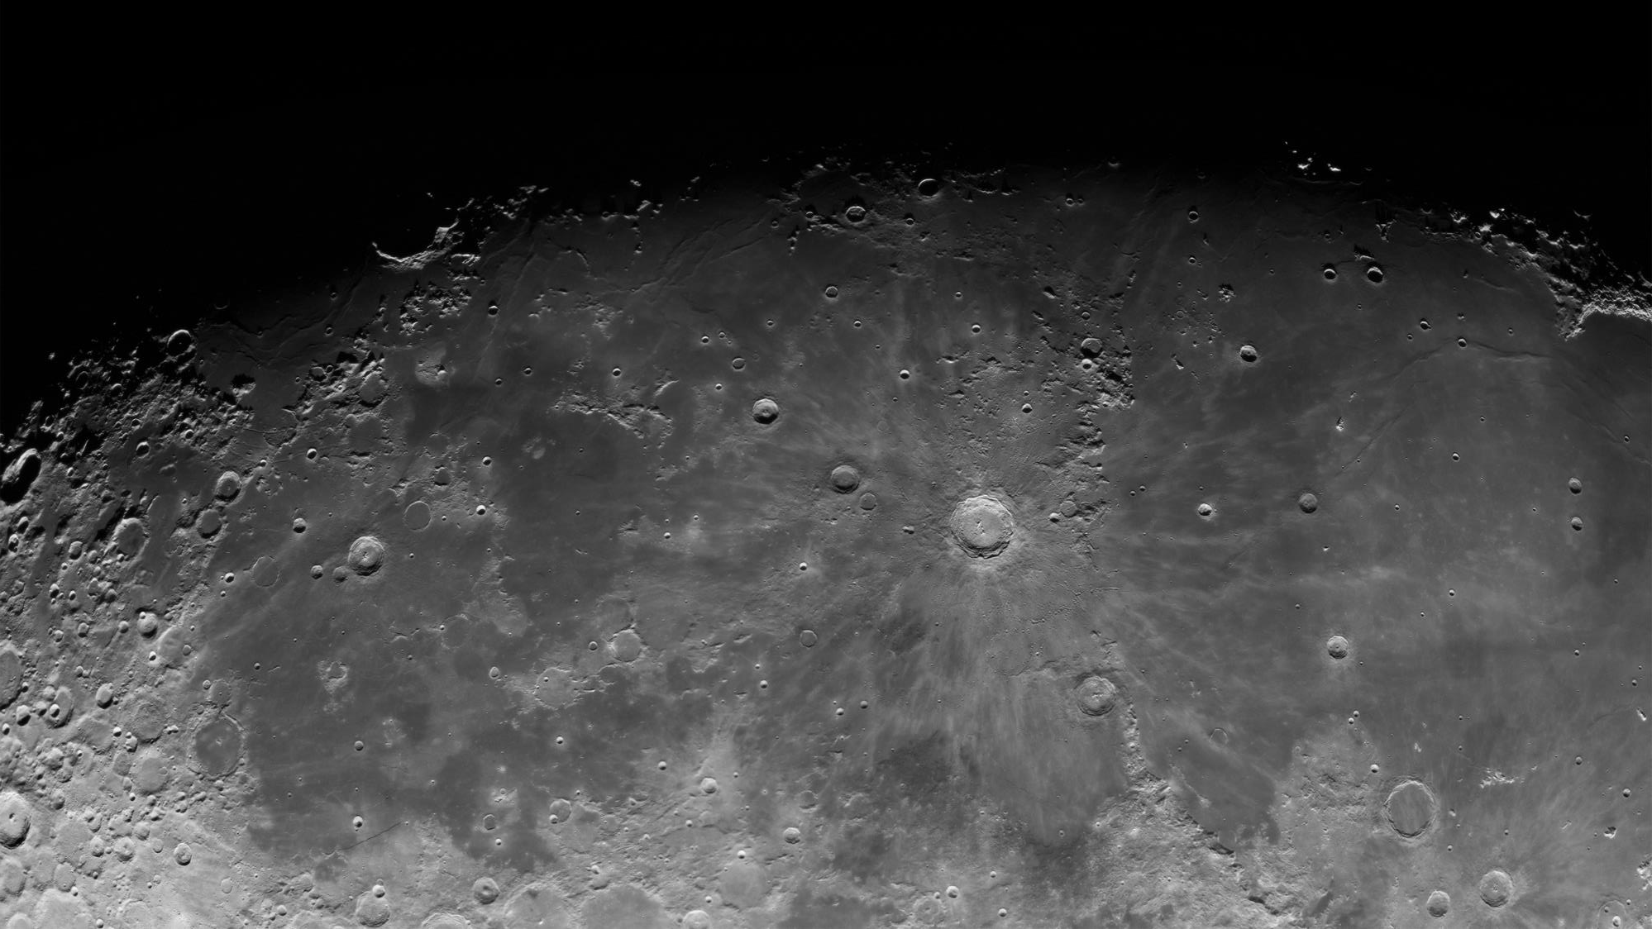
Exploration of the Moon

Slide 4
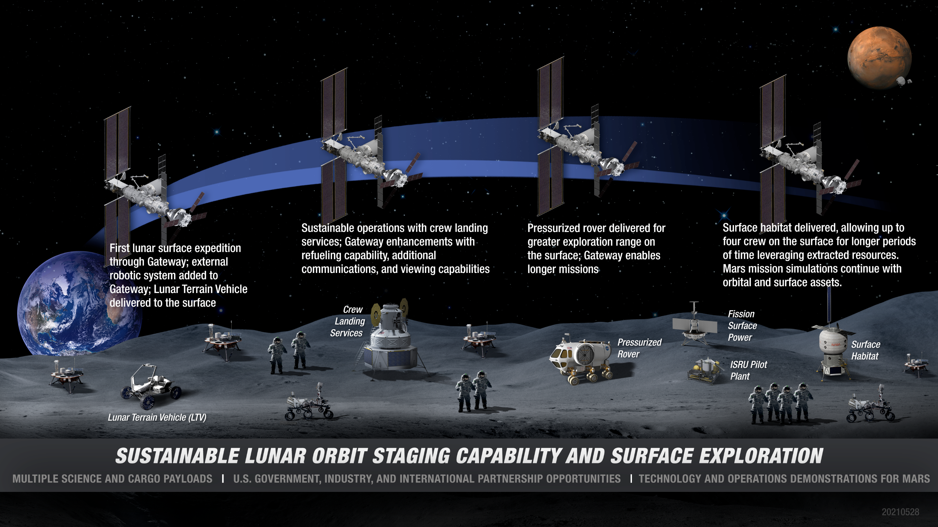
Artemis Base Camp | Buildup

Slide 5
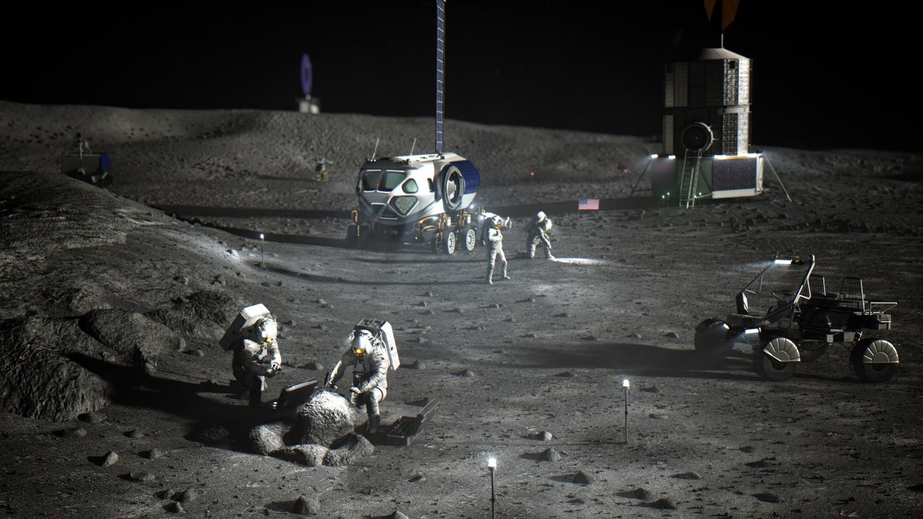
Artemis Base Camp | Sustained Human Lunar Presence
The Sustained Lunar Presence segment includes all activities on or around the Moon that contribute to both the establishment of a sustained human lunar presence and to risk reduction for human Mars exploration.
Establishes a basic set of infrastructure that spans core functions
  Access
  EVA
  Mobility
  Habitation
  Power
  Communication and Navigation
  ISRU
Concept illustration

Slide 6
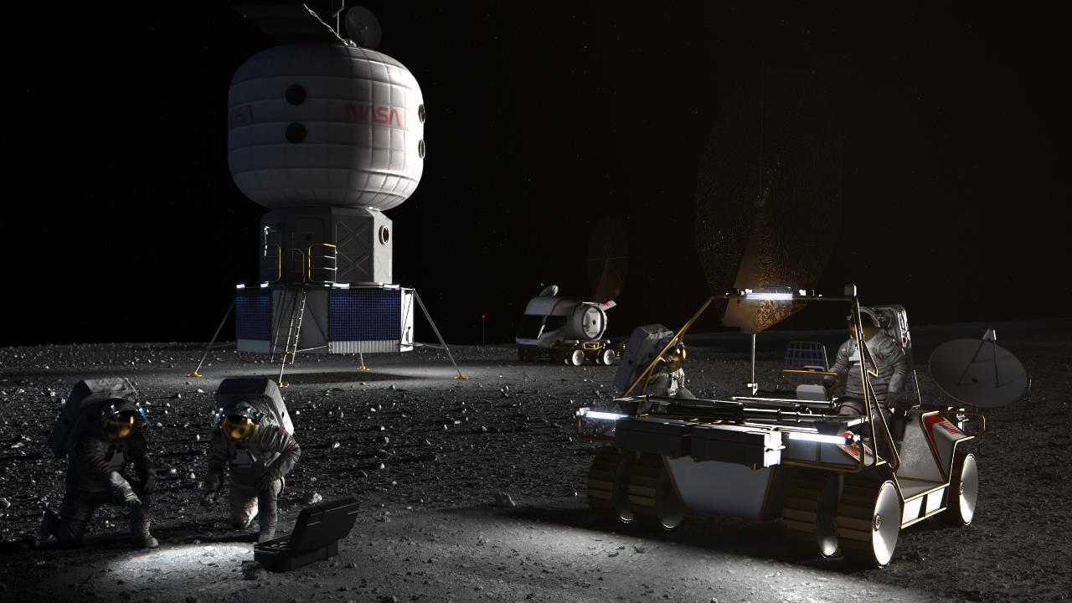
LUNAR SURFACE HABITAT

Slide 7
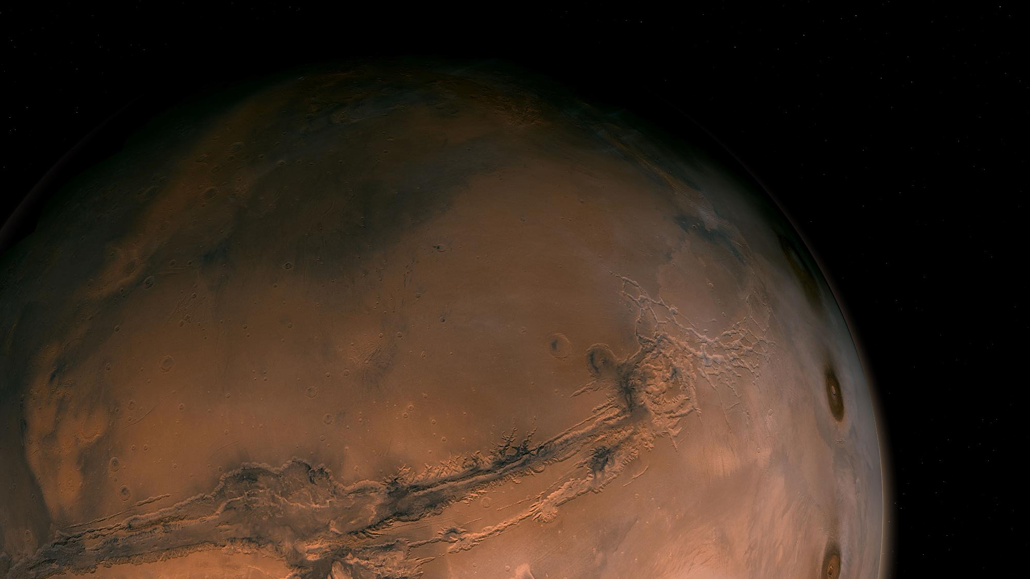
Exploration of Mars

Slide 8
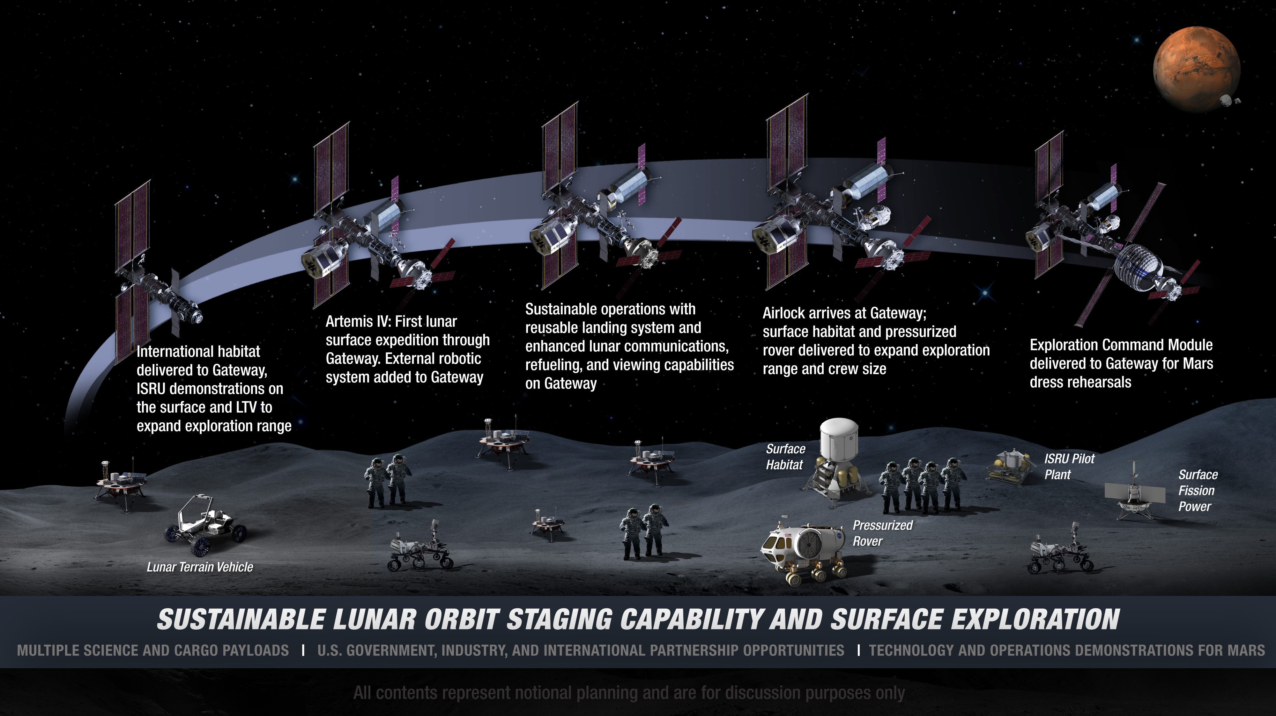

: Extending Lunar Missions to Prepare for Mars

Slide 9
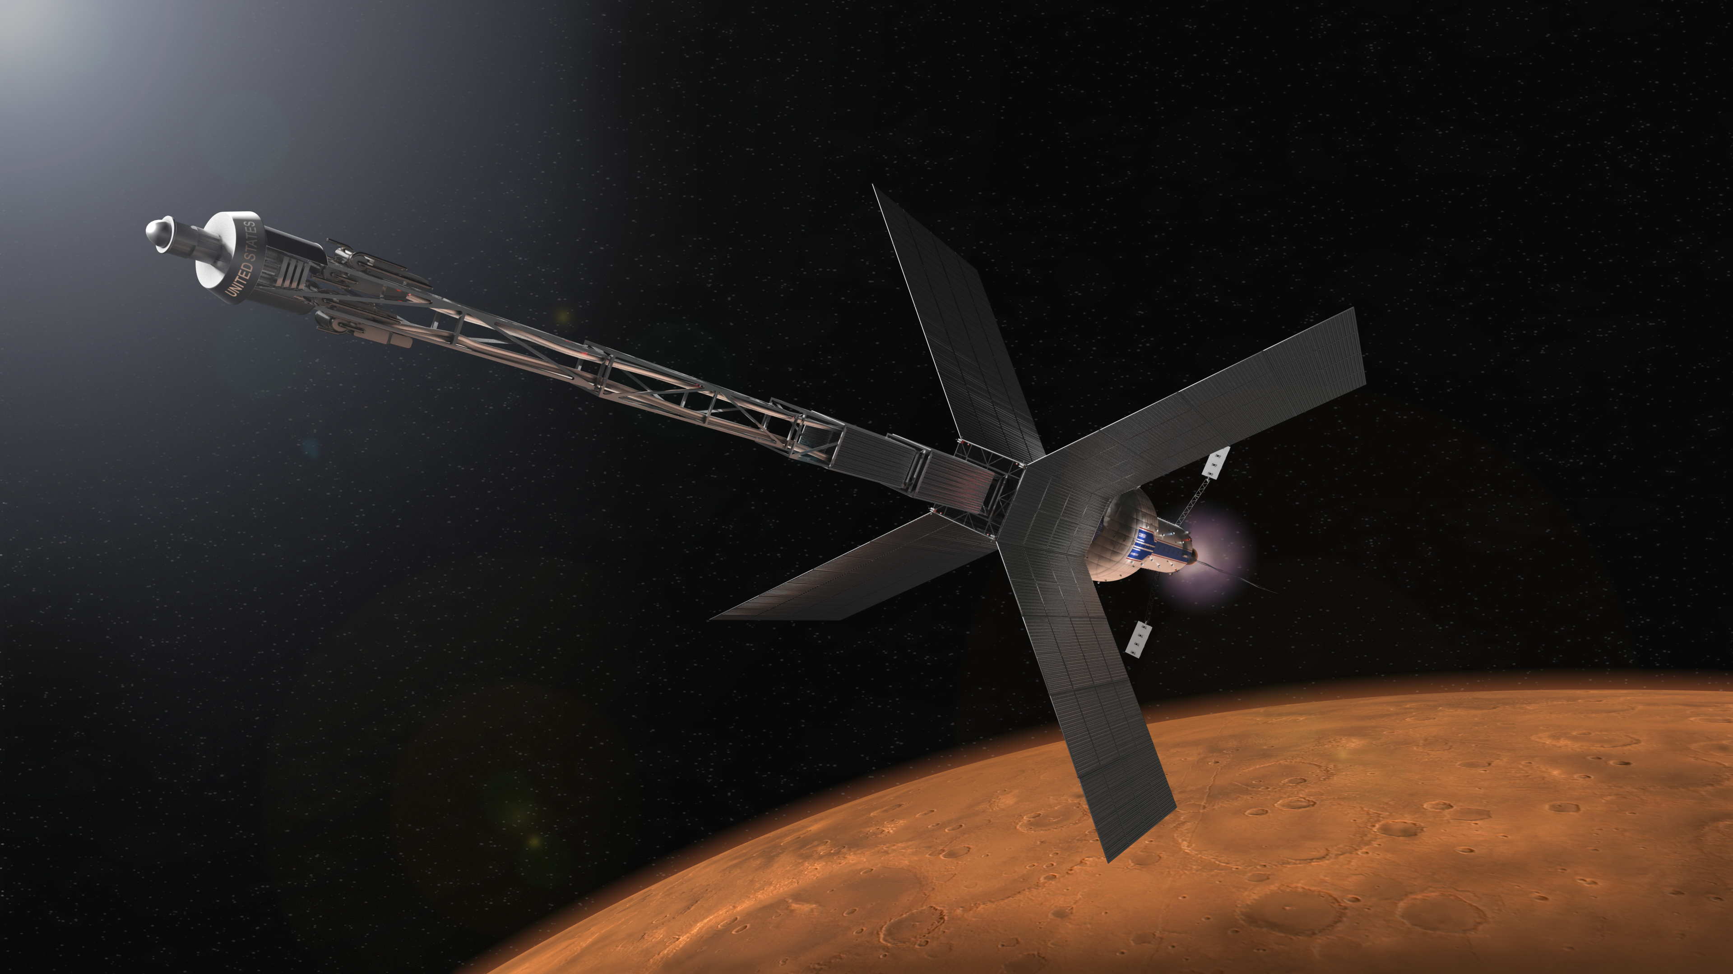
MARS TRANSIT HABITAT

Slide 10
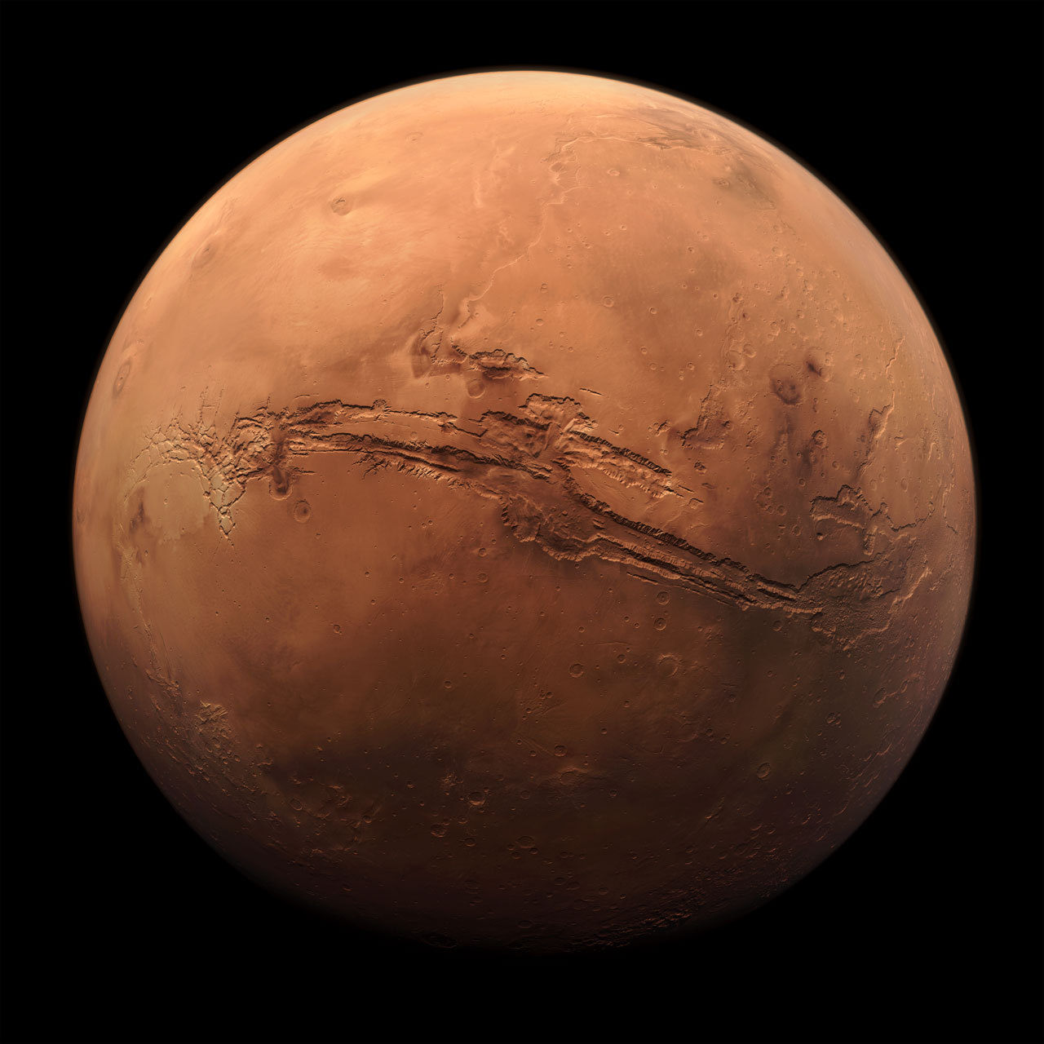
Transit Habitat Challenges
No spares resupply chain during transit
Logistics storage capacity for mission
Waste management and trash management in transit
Advanced Oxygen Recovery
Long duration shakedown (>600 days)
Radiation & Micrometeorites/Object Debris (MMOD) protection
Communication delays
Ability to recover from major habitation failures
Human health and performance for long duration missions
Safe haven capability
Notes:
Image: https://solarsystem.nasa.gov/internal_resources/3841

Slide 11
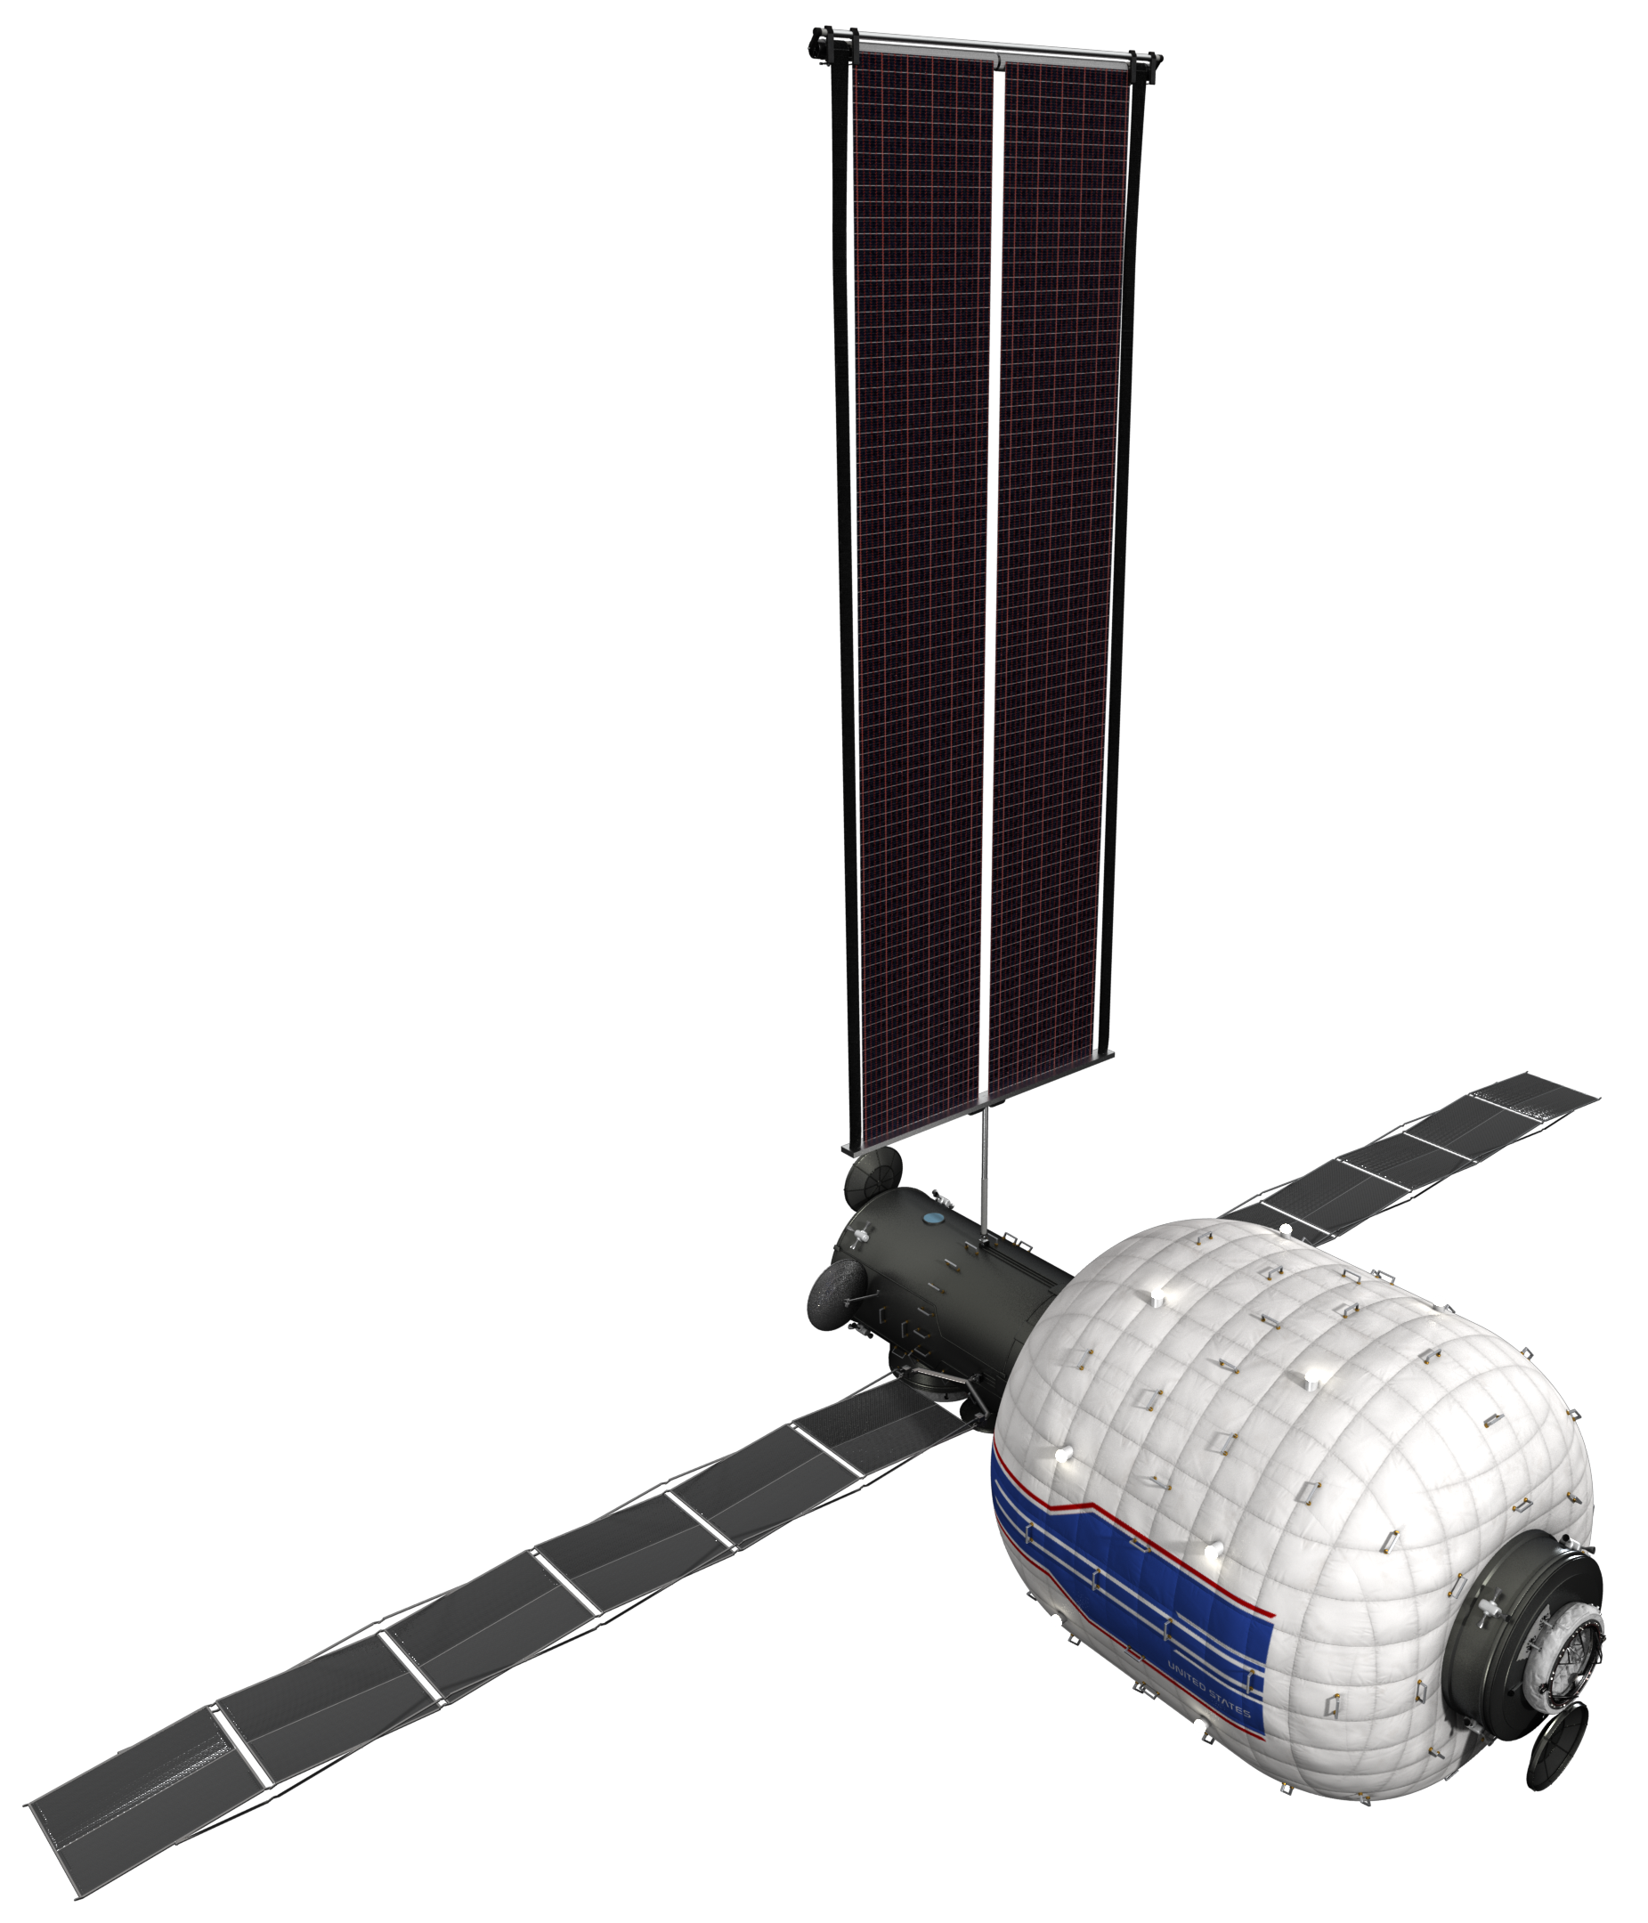
Autonomous Systems & Robotics
NASA’s Objectives in Autonomous Systems & Robotics (ASR) for Human Spaceflight
All future human spacecraft need to be monitored and maintained during uncrewed periods to protect the vehicle and increase utilization
Artemis architecture includes robotic deployment, surface mobility, and ISRU
Autonomous systems and robots capable of efficient human interaction preserve valuable crew time for high-priority exploration and science activities
Capability Needs for Human Spaceflight Exploration
Earth-Independent Operations
Ability to recover from major habitation failures (real-time troubleshooting, fault identification/recovery (FIDR), ontologies/relational databases)
Ability to recover from major medical situations (real-time troubleshooting, step-by-step crew guidance, ontologies/relational databases)
Perform routine maintenance – enables uninterrupted operation during long comm delays and minimizes ground support infrastructure (step-by-step crew guidance, robotic assistance)
Uncrewed Operations
Maintain nominal operation of internal/external systems for months to years (self-maintainable systems, robotic assistance)
Remotely operated intra-vehicular robotics for maintenance and utilization (planning, scheduling, execution)
Payload/Mission Operations
Perform routine activities (planning, scheduling, execution, anomaly detection)
Human health and performance for long duration missions
Support up to NASA-STD-3001 Level of Care V, including the ability to perform basic surgical care, dental care, life support services, medical images (data integration and analysis, step-by-step guidance, data storage)
Facilitate private medical calls and handling of crew medical data (data storage, security/privacy)
Notes:
Comm-delays, self-sufficiency
Processing power/reliability
Bound the operations (ie robotics, software, …)

Slide 12
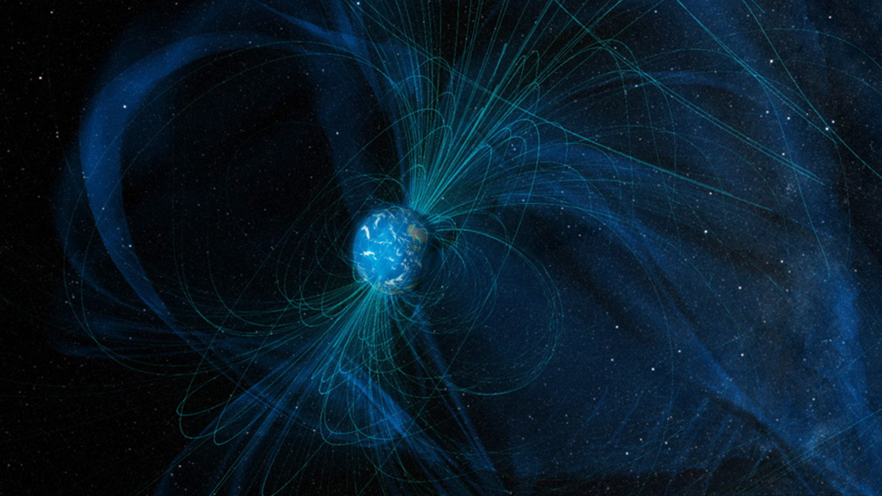
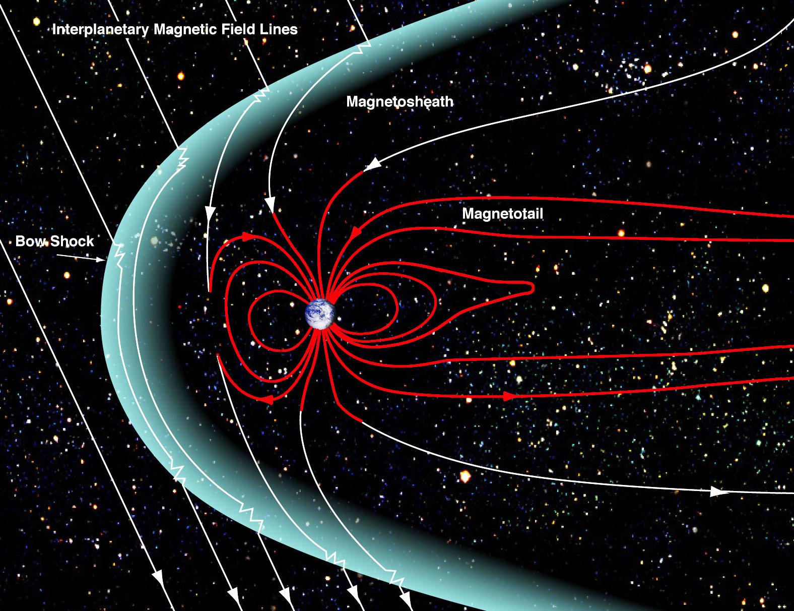
Earth’s Magnetosphere
Provides Radiation protection
Computer Hardware and Software make many assumptions from this
  Processors are under 10 nanometers
    Sheet of paper ~100,000 nanometers
    HEPA filters ~0.3 um (300 nanometers)
Notes:
A magnetosphere is that area of space, around a planet, that is controlled by the planet's magnetic field. The shape of the Earth's magnetosphere is the direct result of being blasted by solar wind. The solar wind compresses its sunward side to a distance of only 6 to 10 times the radius of the Earth. A supersonic shock wave is created sunward of Earth called the Bow Shock. Most of the solar wind particles are heated and slowed at the bow shock and detour around the Earth in the Magnetosheath. The solar wind drags out the night-side magnetosphere to possibly 1000 times Earth's radius; its exact length is not known. This extension of the magnetosphere is known as the Magnetotail. The outer boundary of Earth's confined geomagnetic field is called the Magnetopause. The Earth's magnetosphere is a highly dynamic structure that responds dramatically to solar variations.
Credit: NASA/Goddard/Aaron Kaase

Slide 13
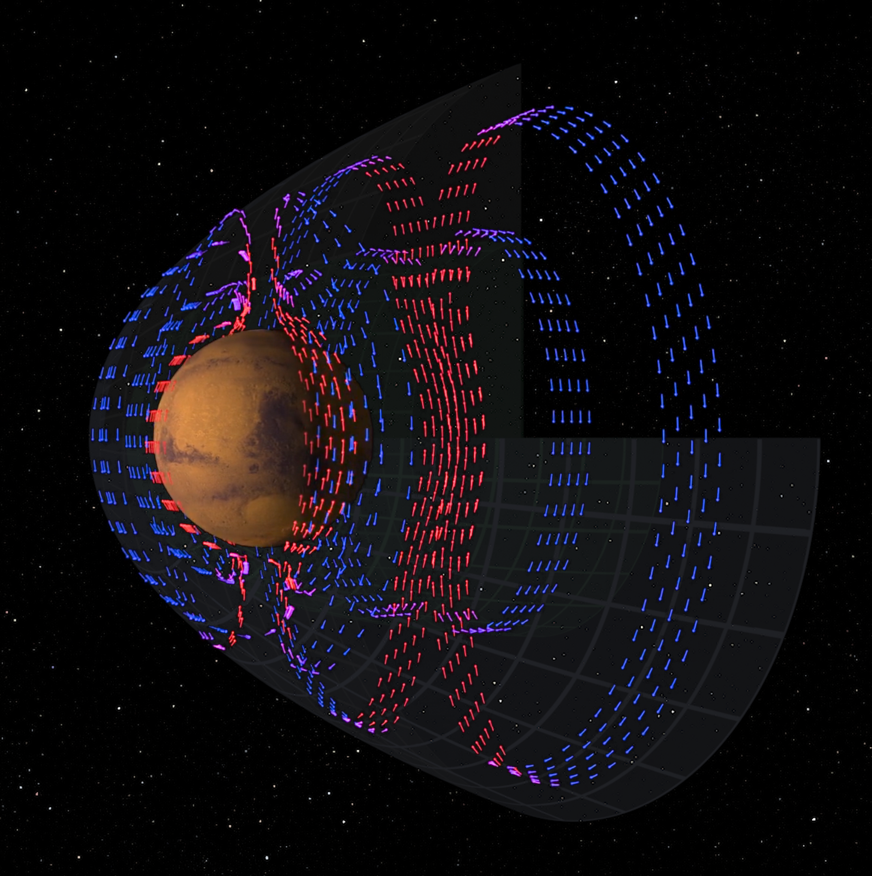
Mars Magnetosphere
Mars has a weaker Magnetosphere
  Induced from interaction between solar winds and induced electric currents
In transit no radiation protection
  Radiation damages hardware
  Radiation causes Single event upsets (SEUs)
Via MAVEN Spacecraft

Slide 14
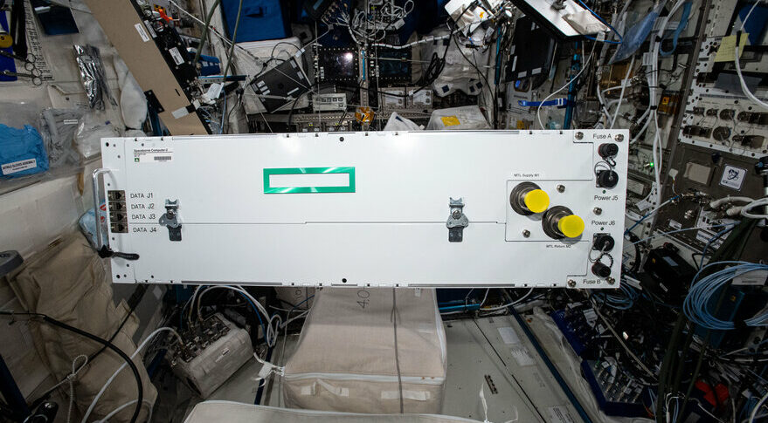
Radiation Hardening
Radiation tolerant processors
  Generations behind
  Single core and < 1.5 GHz
  JWST RAD750
    150 nm, 200 MHz
  Underclocking
  Physical protection
Redundancies
  Voting, self-checking pairs, multiple network planes
SpaceBourne-2 from HPE
Testing of high-performance computers
Orion uses PowerPC 750FX

Slide 15
Software
NASA utilizes NPR 7150.2 Rev D
  Space systems are class A and class B
Need to be deterministic in hard real-time systems
  Machine Learning is non-deterministic and statistical
Cost of failures due to bugs much higher
Mitigate SEUs
Provide dissimilar redundancy to prevent common cause failures
Autonomous software must handle microgravity effects
No reliance on Earth systems (time, GPS, operators, …)

Slide 16
Status and Future
Working under NASA’s NextStep Appendix A
  Still in preformulating stages
Writing of requirements for the habitats
  No limitations on innovation
Research of technologies
  Looking for partners, development, and demonstrations
  Verifications/tools

Slide 17


Slide 18
Questions?

