Slide 1
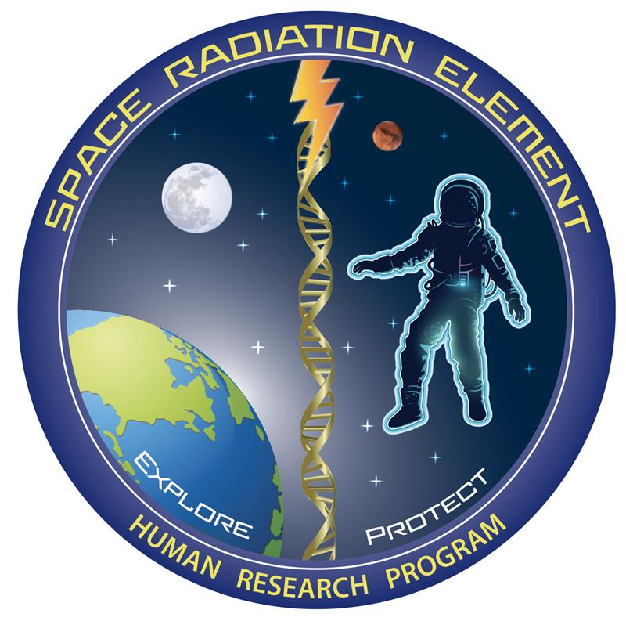


Outcomes of a mini technical interchange meeting concerning the risk of
cardiovascular disease from exposure to space radiation
Janapriya Saha¹, Brock Sishc², Janice Zawaski³, and Robin Elgart⁴
¹Leidos Inc. Houston, TX, ²Aegis Aerospace Inc. Houston, TX, ³NASA Johnson Space Center, Houston, TX, ⁴University of Houston, Houston, TX.
Contact: Janapriya.saha@nasa.gov or jsc-hrp-space-radiation-element@mail.nasa.gov
Key focus questions to characterize CVD RISK
Background
Key questions and knowledge gaps were made available for participants to review and provide inputs. The discussion board is still open and can be found by scanning the QR code below.
Cardiovascular disease during or post long-durations missions:
Is there a true threshold dose?
Any recent evidence in support or against 0.5 Gy threshold?
What is the impact of dose-rate and/or fluence?
Is there an impact of acute, fractionated, or chronic exposure on risk estimates?
Is the latency of CVD development/manifestation dependent on the dose?
Does radiation exposure impact CVD incidence, progression, or both?
Are there differences between GCRSim vs single-ion results?
Mechanisms involved in CVD development:
What are the critical targets in the heart and vasculature?
  Endothelial cell dysfunction, mitochondrial dysfunction, valves/valvular disease, microvascular injury/damage, etc.?
What is the role of inflammation?
Is the effect due to radiation-induced perturbed homeostasis or is it directly induced by space radiation?
Can inflammatory responses and associated markers predict risk of CVD?
What contribution do accelerated aging, clonal hematopoiesis of indeterminate potential (CHIP), and/or epigenetics make to radiation-associated CVD pathogenesis?
Best approaches to model propagation of mutations such as CHIP and epigenetic modifications in response to charged particles and/or combined stressors?
The NASA Human Research Program’s (HRP) Space Radiation Element (SRE) funds research to characterize and mitigate adverse health outcomes from exposure to space radiation to enable deep space exploration and sustained human presence in space.
Damage to the cardiovascular system has been observed after exposure to clinically relevant doses of ionizing radiation. However, an association between lower radiation doses and cardiovascular disease (CVD) remains controversial, and questions pertaining to dose thresholds, radiation quality and dose-rate effects, and gaps in characterizing the mechanisms and major pathways of CVD remain.
To solicit new ideas for characterizing and mitigating this risk, the SRE is organizing a series of miniature technical interchange meeting (Tiny-TIM) that provide a venue for HRP-funded investigators and thought leaders to present ongoing work and engage in open discussion on relevant topics. The initial Tiny-TIM: Upping the Ante on Characterizing and Mitigating Cardiovascular Disease Risk from Space Radiation Exposure, held at the NASA HRP Investigators’ Workshop (IWS) earlier this year, consisted of two 90-minute sessions; the first focused on current knowledge of CVD risk from space radiation exposure, and the second focused on innovative ideas, and newer approaches and techniques to accelerate research. The second session was followed by an open, spirited discussion amongst peers on the current issues impeding the characterization of CVD risk. SRE leadership facilitated the discussion using a set of pressing questions and gaps in knowledge that need to be addressed by the scientific community. This poster presents the outcomes of the Tiny-TIM, along with proposed future workshops and the SRE’s other initiatives.
Session Details
Session I: Current State of Knowledge of CVD Risk from
NASA-Funded Studies
Chairs: Candice Tahimic and Janapriya Saha
1. Introduction. Saha J. Introduction to the Tiny-TIM format, overview of purpose, speakers, and key questions.
2. Galactic cosmic radiation exposure caused small changes in cardiac tissue in male and female CD1 mice. Nemec-Bakk A. et al. Effects of GCRsim exposure on cardiac function, collagen deposition, and immune cell markers evaluated in 6-months old male and female CD1 mice.
3. Proteomic signatures of space radiation induced cardiovascular degeneration. Bowles D. et al. GCR exposure exhibited highly perturbed cornification, keratinization, and mitochondrial pathways. Together, the heart and plasma proteomics data are suggestive that space radiation exposure may contribute to the development of cellular changes leading to cardiac dysfunction as well as thrombosis during spaceflight
4. Longitudinal evaluation of cardiac function and structure in C57BL/6J mice after gamma and space-type radiation exposure. Brojakowska A. et al. Outcomes of gamma-rays and GCRsim exposures on cardiac structure and function in 3-months old male C57BL/6J (WT) mice.
5. Comparison of the effect of simulated weightlessness combined with space radiation on the occurrence of cardiac disease using two strains of rats. Lenarczyk M. et al. Effects of simulated weightlessness combined with space radiation (GCRsim) on the occurrence of cardiac disease in two strains of rats.
6. Risk of exposure induced death associated with clonal hematopoiesis of indeterminate potential for mars mission scenarios. Werneth C. et al. Using a relative risk model to examine the increased REID estimates associated with CHIP status in astronauts for different Mars mission scenarios.
Session II: New Innovative and Advanced Approaches
Chairs: Agnieszka Brojakowska and Janapriya Saha
1. Pilot Study of Imaging and Serum Biomarkers to Predict and Identify Early Cardiac Injury From Radiation Exposure. Lin S. et al. Cardiovascular impairment and associated biomarkers in patients with cardiac exposure to ionizing radiation during radiotherapy (RT) for cancer treatment will help in translating detection and quantification of radiation cardiotoxicity during spaceflight.
2. Cardiovascular Responses to Simulated Spaceflight: Molecular Signatures and Surrogate Outputs to Measure CVD Risk. Tahimic C. et al. Elucidating molecular signatures of cardiovascular performance across doses of simulated galactic cosmic radiation (5-ion GCR) at early and late timepoints post-exposure in an astronaut age-matched rodent model.
3. MicroRNA Based Countermeasures Mitigate Health Risks Associated With Space Radiation and Microgravity. Beheshti A. et al. Data on a circulating microRNA (miRNA) signature that can be an optimal biomarker for health risk and has potential to be utilized as a countermeasure to mitigate the damage caused by the space environment by utilizing a human 3D microvascular tissue model.
4. TRISH Overview of Research Utilizing Tissue Chips, iPSCs and 3D Organoid Cultures. Donoviel D. Overview of the Tissue Radiation (TRAD) initiative.
Outcomes and Conclusions
Major discussion points:
Suitability of rodents for adequate characterization of CVD from space radiation and translation to humans? Concerns regarding extensive use of susceptible models, high non-space relevant doses, fat content of animal feed, physiological differences, etc. Although rodent models typically don’t progress to full blown CVD as in humans, it indicates a potentially major limitation of the model in representing humans and not an indication of a lack of risk. Rodent experiments are important; however, the results should not be treated as a direct measure or risk and severity in humans.
  Enthusiastic support for the use of larger animals such as mini-pigs to characterize CVD risk from space radiation. There was also suggestion of re-visiting the use of non-human primates with better animal welfare protocols, however, number of animals for adequate power will always be the limiting factor with large animal models due to cost constraints
Microgravity and probably also sleep stress and social isolation, etc. (combined stressors) need to be incorporated to truly characterize the cardiovascular effects from spaceflight.
Longer time course monitoring of cardiovascular structure and function is needed to better characterize cardiac effects as heart tissue compensates for damage for a long time.
Support for studying common mechanisms and pathways across biological systems, especial cardiovascular and the central nervous systems to interrogate more holistic effects rather than individual systems.
  CHIP mutations, circadian cycles, micro-RNAs, non-coding RNAs, epigenetic modifications.
Persistent inflammation and accelerated aging are important drivers of CVD initiation and progression and may be sex-specific and possibly driven by upstream mitochondrial dysfunction.
Potential Strategies
Improved cell-based and animal models
Integration of omics approaches
Tissue Avatars
Biomarker inclusion in risk analysis
Targeted integration of epidemiology and biology
Future opportunities
To maximize funding and output, the SRE plans to organize a follow-up tiny-TIM at HRP IWS 2023 focused on investigation of common mechanisms and pathways. Discussion on how to best execute relevant studies, feasibility, and possible limitations will be solicited from the scientific community via a panel discussion. Initial thoughts include a multi-center-type program, where experiments are executed at a central hub and funded investigators are provided access to tissue/blood samples at various stages of the experiment for testing initiation and progression of CVD, CNS decrements, and/or carcinogenesis.

