Slide 1
Advancing GPCP Products to Version 3.2
George J. Huffman (1), Ali Behrangi (2), Robert F. Adler (3), David T. Bolvin (1,4), Eric J. Nelkin (1,4), Guojun Gu (3),
Mohammad Reza Ehsani (2)
1: NASA Goddard Space Flight Center, Greenbelt, MD
2: University of Arizona, Tucson, AZ
3: University of Maryland, College Park, MD
4: Science Systems and Applications, Inc., Lanham, MD
george.j.huffman@nasa.gov
supported by the NASA Making Earth Science Data Records for Use in Research Environments (MEaSUREs) program

Slide 2
Advancing GPCP Products to Version 3.2
Other GPCP-related presentations
Tuesday
4.06 Eric Nelkin – Introducing the GPCP Version 3.2 Daily Precipitation Dataset
5.01 Ali Behrangi – High Latitude Precipitation Analysis and Considerations in the Latest GPCP products (V3.2)
Wednesday
9.01 Robert Adler – Inter-annual Variations of Tropical Ocean Rainfall—Differences Among Satellite Estimates
9.05 Guojun Gu – Interdecadal Variability and Trends in Global Precipitation During the Satellite Era
George J. Huffman (1), Ali Behrangi (2), Robert F. Adler (3), David T. Bolvin (1,4), Eric J. Nelkin (1,4), Guojun Gu (3),
Mohammad Reza Ehsani (2)
1: NASA Goddard Space Flight Center, Greenbelt, MD
2: University of Arizona, Tucson, AZ
3: University of Maryland, College Park, MD
4: Science Systems and Applications, Inc., Lanham, MD
george.j.huffman@nasa.gov
supported by the NASA Making Earth Science Data Records for Use in Research Environments (MEaSUREs) program

Slide 3
1. Building the new GPCP Dataset
We wanted to improve on GPCP Version 2
• finer spatial resolution
• stronger quality control and validation
• better treatment of the high latitudes
• revised TOVS/AIRS intercalibration
• revised gauge undercatch correction (work in progress)
• next-generation uncertainty estimates (work in progress)
• precipitation phase estimates
To provide a Climate Data Record (CDR)-like data set, we prioritize
• consistent inputs
• careful inter-sensor calibration
• consistent processing over the entire record

Slide 4
2. Monthly Product Inputs and Algorithms (1/2)
SSMI, SSMIS
• GPROF2010V2 – Kummerow (Colorado State Univ.)
• METH – Chiu (George Mason Univ.)
• only a single 6 a.m./p.m. satellite is used at a time to avoid varying time-of-day biases
TOVS, AIRS-IR
• Susskind cloud volume – Susskind (NASA/GSFC, retired)
GridSat
• PERSIANN CDR – Hsu (Univ. of California Irvine)
• uses month-to-month scaling to GPCP V2.3
1985
1995
1980
1990
2000
2005
2010
2015
SSMI F08
SSMI F11
SSMI F13
SSMIS F17
TOVS soundings
AIRS-IR soundings
GridSat (geo-IR)
GPCC Full Analysis (gauge)
GPCC Monitoring Analysis (gauge)

Slide 5
2. Monthly Product Inputs and Algorithms (2/2)
GPCC gauge analysis – Becker (Deutscher Wetterdienst / GPCC)
• Full Product as far as it reaches
• Monitoring Product thereafter
• undercatch-adjusted with blended Legates-Wilmott and Fuchs monthly climatological coefficients
TRMM Composite Climatology (TCC) – Adler (Univ. of Maryland)
Merged CloudSat/TRMM/GPM climatology (MCTG) – Behrangi (Univ. of Arizona)
1985
1995
1980
1990
2000
2005
2010
2015
SSMI F08
SSMI F11
SSMI F13
SSMIS F17
TOVS soundings
AIRS-IR soundings
GridSat (geo-IR)
GPCC Full Analysis (gauge)
GPCC Monitoring Analysis (gauge)

Slide 6
3. V3.2 Monthly Data Field Computations
Precipitation
• 58ºN-S
• 1992-present: PERSIANN CDR histogram-adjusted using GPROF at the 3-hourly scale, calibrated to monthly METH, then calibrated with TCC/MCTG climatology blend
• 1983-1991: PERSIANN CDR adjusted using monthly climatological (1993-2008) GPROF relationship
• higher latitudes
• calibrated TOVS/AIRS-IR (globally) adjusted to the MCTG
Precipitation error computed as in V2 (Huffman 1997)
Precipitation phase
• specification of liquid phase from Sims and Liu (2015)
• uses MERRA-2 reanalysis surface T, RH, pressure
Quality Index
• “equivalent gauges” computed from error (Huffman 1997)

Slide 7
4. Summary of Upgrades from V2.3 Monthly to V3.2
• spatial grid shifted from 2.5º to 0.5º
• consistent GEO-IR Tb datasets, expand area of use from 40ºN-S to 58ºN-S
• upgraded PMW and IR algorithms
• consistent AIRS-IR record
• shifted calibration from AIRS-to-TOVS to improved TOVS-to-AIRS-IR
• added modern climatological calibrators (TCC over 20ºN-S, MCTG outside 35ºN-S, blended cross-over in between)
• new data fields: probability of liquid phase, Gauge Relative Weighting, Quality Index
• substitute climatological Fuchs gauge undercatch coefficients for Legates-Wilmott over Eurasia above 45ºN

Slide 8
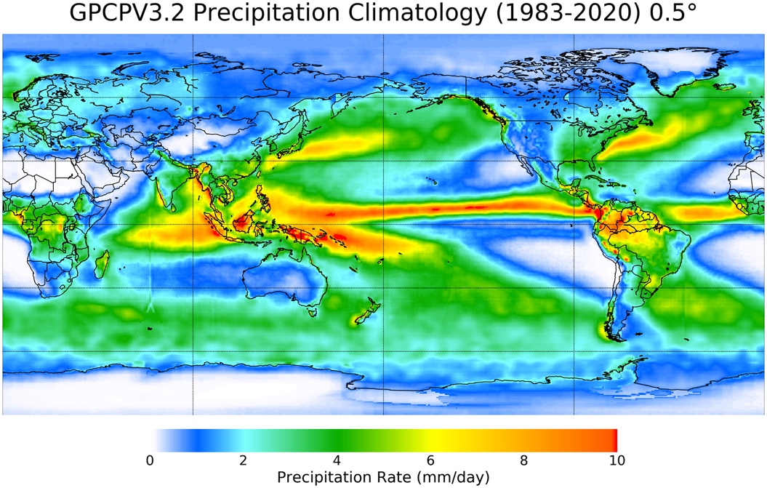
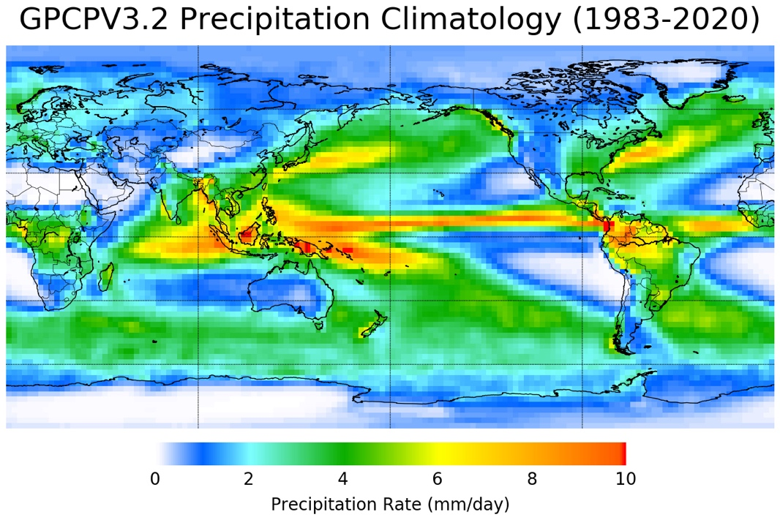
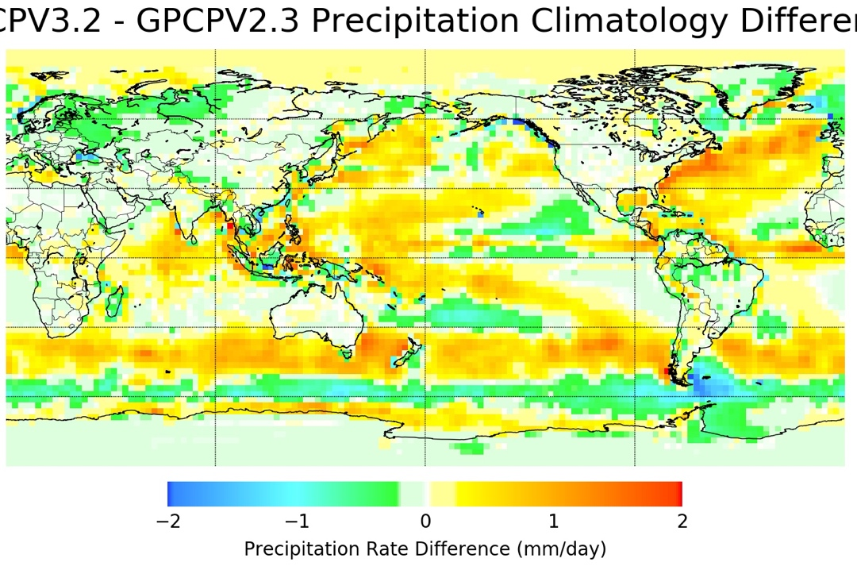

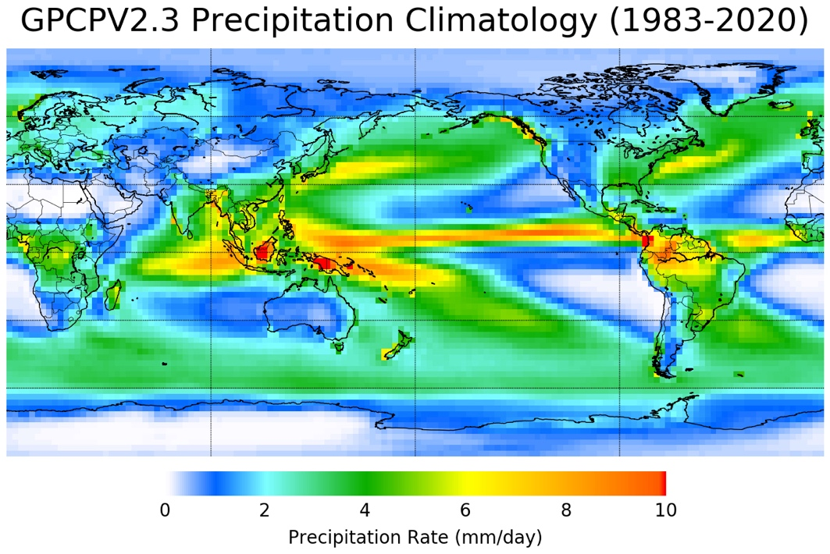
5. V3.2 Climatology (1/2)
Gauges tend to dominate land areas in both V2.3 and V3.2
V3.2 tends to be higher over oceans
• largest increases in storm tracks
• decrease around 60ºS in V3.2 improves a perceived V2.3 issue
• increase in polar regions driven by CloudSat (in MCTG)
Full-resolution V3.2 (top left) shows some artifacts due to the IR in the Indian and Atlantic Oceans
[D. Bolvin (SSAI; GSFC)]

Slide 9
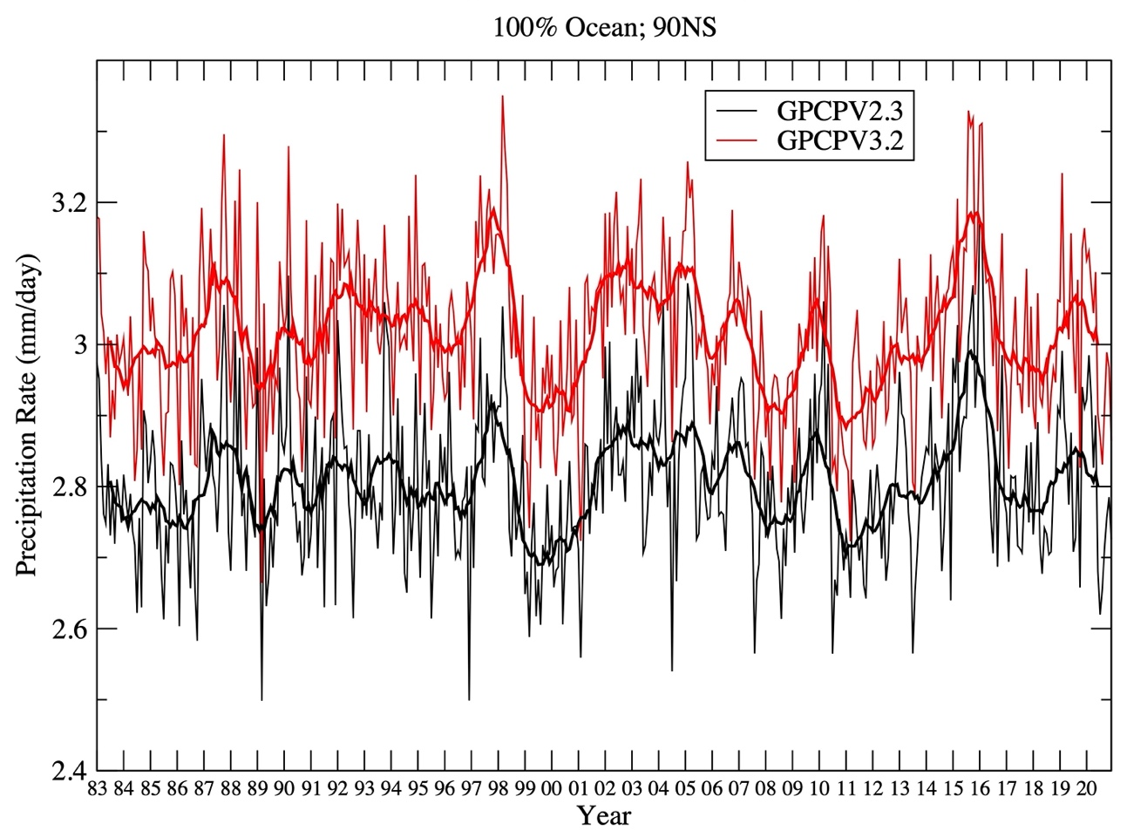
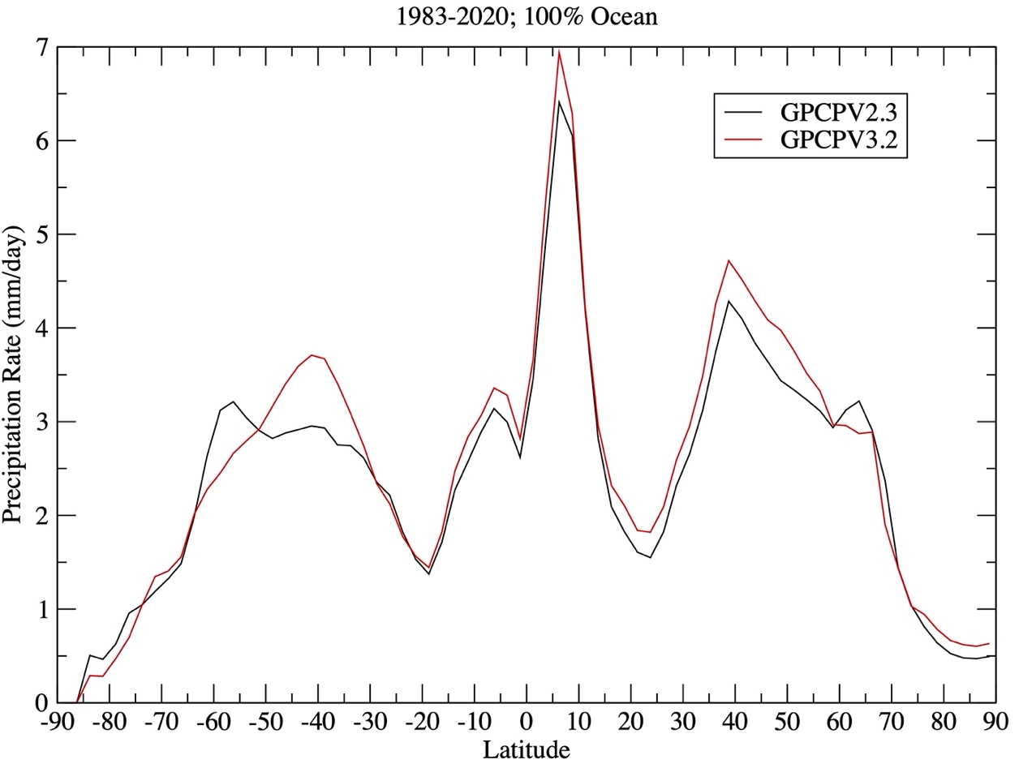
5. V3.2 Climatology (2/2)
The global ocean time series for V3.2 largely matches that of V2.3 but is higher
• interannual variation in the tropics is governed by METH in both
• calibration by TCC and MCTG sets the mean increase in V3.2
The zonal profiles are similar, with the biggest difference in the Southern Ocean considered an improvement in V3.2
[D. Bolvin (SSAI; GSFC)]

Slide 10
6. V3.2 Daily Product Approach
The inputs are:
• Integrated Multi-satellitE Retrievals for GPM (IMERG)
• TOVS, AIRS-IR daily: Susskind cloud volume
• GPCP V3.2 Monthly
Approach:
• average IMERG (originally 0.1º, ½ hr) up to 0.5º daily
• histogram-calibrate TOVS, AIRS-IR to IMERG
• use IMERG in the band 55º N-S and IMERG-calibrated TOVS/AIRS at higher latitudes
• this is done for simplicity; future versions will use IMERG at all latitudes
• “feather” the IMERG-AIRS difference just outside 55º to reduce seams
• scale the Daily to (approximately) sum to the Monthly product
Period of record is June 2000 – December 2020 (currently)

Slide 11
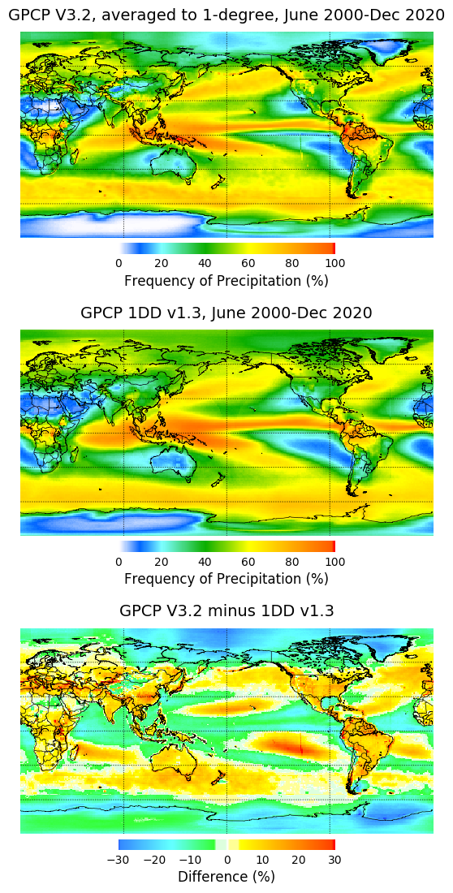
7. V3.2 Daily Product Frequency of Occurrence
Climatological amounts for the Dailies just follow the corresponding Monthly
Climatological frequencies for the Dailies are different
• V3.2 averaged to 1º to match V1.3 resolution
• V3.2 higher(lower) over ocean for lower(higher) values
• V3.2 mostly higher over land
• V3.2 lower in polar regions
• both V1.3, V3.2 use daily (somewhat different) TOVS/AIRS in “high latitudes” with occurrence calibrated to the “low latitudes” at a mid-latitude point
• the low latitude edge is 40º(55º)N,S for V1.3(V3.2)
• both are highly approximate
• will AVHRR-based retrievals improve confidence?
V3.2
V1.3
(1DD)
difference
[E. Nelkin (SSAI; GSFC)]

Slide 12
8. V3.2 Data Fields
Monthly – 8 data fields
• merged satellite-gauge precipitation estimate (mm/d)
• merged satellite-gauge precipitation random error estimate (mm/d)
• satellite-only precipitation estimate (mm/d)
• satellite source field (IR, IR/TOVS/AIRS blend, TOVS/AIRS)
• undercatch-corrected gauge analysis precipitation (mm/d)
• probability of liquid phase (%)
• only 60º N-S before 1992
• gauge relative weighting
• Quality Index (equiv. gauges)
Daily – 2 data fields
• satellite precipitation estimate (mm/d)
• probability of liquid phase (%)

Slide 13
9. Final Comments
GPCP Version 3.2 is designed for
• new satellite retrievals
• higher user expectations
• upgrades in dataset formats and archiving
• continued CDR standards
• consistency: submonthly (approximately) add up to the monthly values
Monthly and daily datasets are posted at GES DISC
• V3.2 monthly DOI: 10.5067/MEASURES/GPCP/DATA304
• V3.2 daily DOI: 10.5067/MEASURES/GPCP/DATA305
• landing pages give access to data and documentation
• interactive analysis available through https://giovanni.gsfc.nasa.gov/giovanni/

Slide 14
Additional slides

Slide 15
2a. TCC / MCTG Ratio Blending Scheme
These “climatologies” are based on shorter records
• TCC at low latitudes
• MCTG at middle and high latitudes
TCC and MCTG don’t quite match in the transition zone, so we blend across the zone 20º-35º N and S
TCC Zone
Capped MCTG Zone
(ºN)

