Slide 1
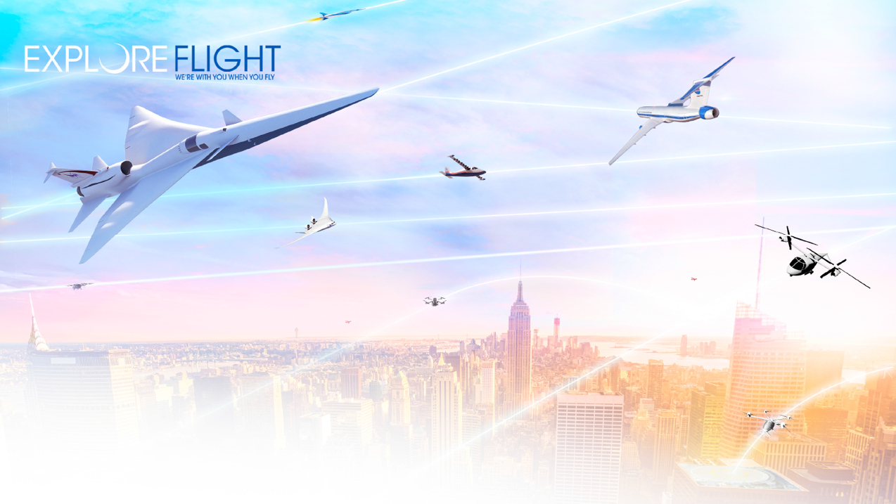

National Aeronautics and Space Administration
Future Airspace Operations
Parimal Kopardekar, PhD (PK)
Director, NASA Aeronautics Research Institute
Parimal.H.Kopardekar@nasa.gov
Royal Aeronautical Society Conference, October 2022
www.nasa.gov

Slide 2

Airspace “System”
Should be Ready
when Vehicles
are Ready
Need
Image credit: NATS

Slide 3
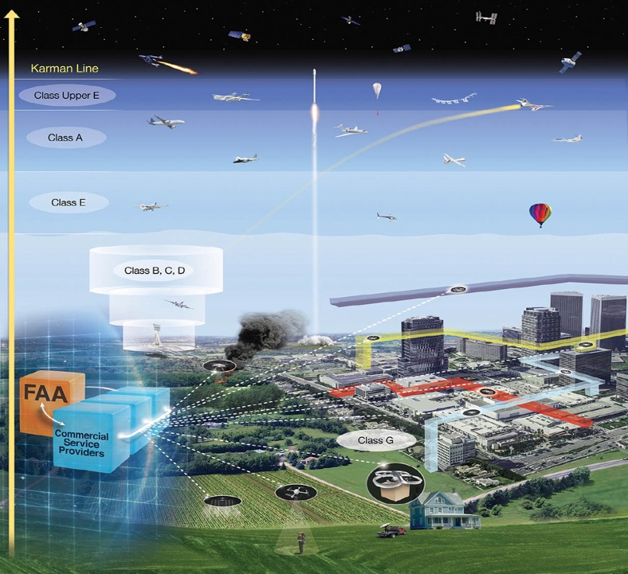

Slide 4
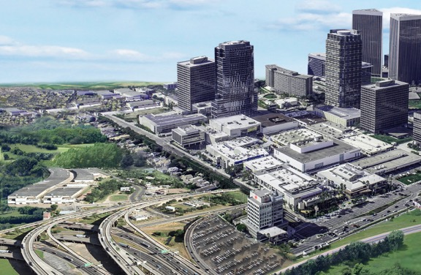
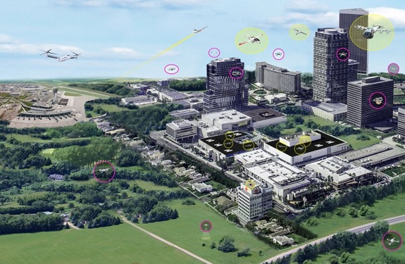
Big Picture
One mile of surface transportation takes you one mile, whereas one mile of aviation land can take you anywhere
Vector 1: Driver/Environmental Considerations
Society and transportation could change
• Quieter, faster, and farther
• No need to congregate into higher density geographical areas
• Connects businesses without congestion
• More integrated living: business, residential, and recreational

Slide 5

Big Picture
One mile of surface transportation takes you one mile, whereas one mile of aviation land can take you anywhere
Vector 2: Enablers
New technology needs to be embraced
IOT, Digitization, Electrification, autonomy, and AI/ML
Vector 3: Drivers/Need
Diversity, density, volume, complexity will continue to increase
Commercial space
UAS of all sizes
Self-flying aircraft
UAM/AAM
Current aviation operators

Slide 6
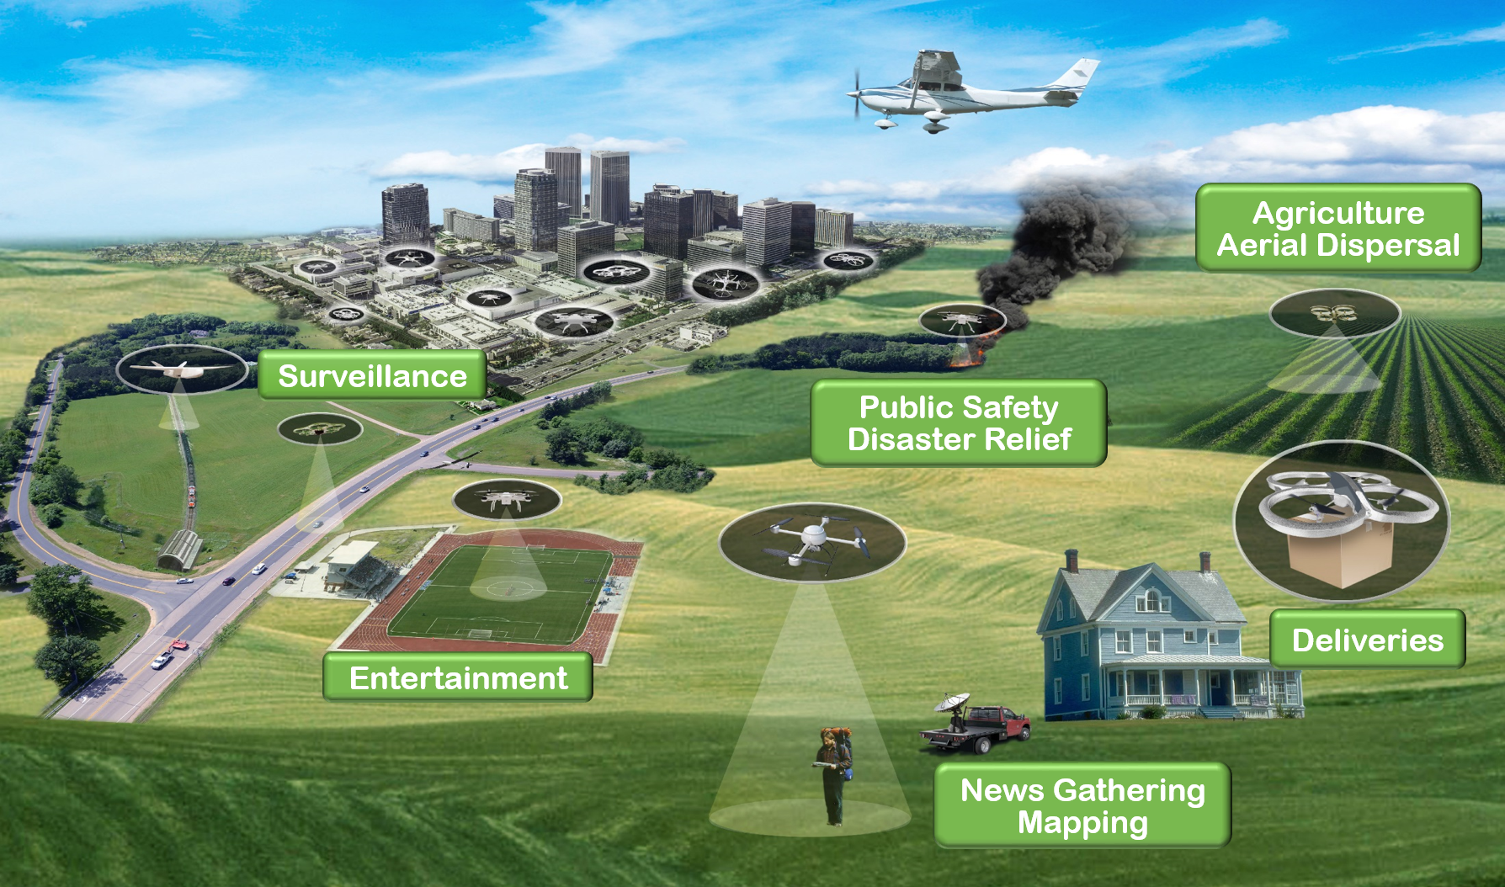
Lessons Learned from Successful Unmanned Aircraft System Traffic Management

Slide 7

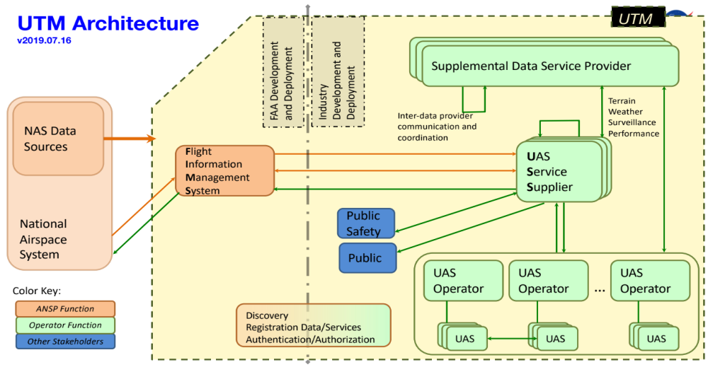
Cooperative (share and care)
Intent-sharing
Digital: data exchanges among operators
Standardized application protocol interfaces
Air/ground integrated
Service-oriented architecture
Role for third-parties
Management by exception
Unmanned Aircraft System Traffic Management (UTM) - Attributes

Slide 8
Next Steps

Slide 9
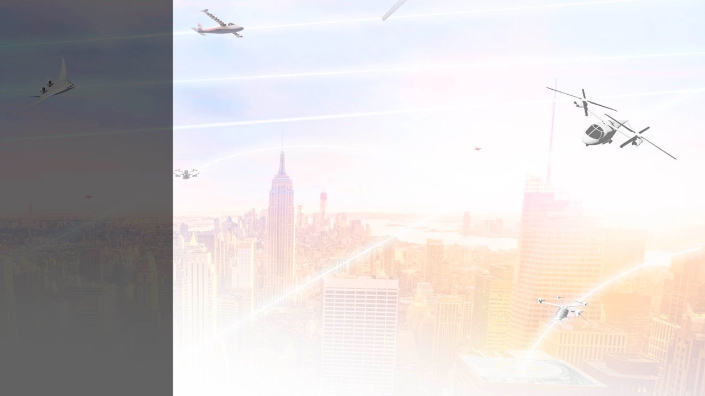




Planning for future
UTM-inspired-ATM (digital, cooperative,
intent sharing, service-oriented architecture, etc.)
Enabling
Future
Airspace
Operations
Revisiting flight information exchanges
Digital, intent sharing, CNS, etc.
Revisiting roles and responsibilities federated, management by exception
Revisiting separation minima
new technology with higher precision
Kopardekar P., Spring 2020
ATCA Magazine

Slide 10




Using technologies to reduce weather induced delays
Machine learning and artificial intelligence
Enabling
Future
Airspace
Operations
Enabling increased local and regional operations
Benefits societal change
Enabling better disruption management
Primary focus on large-scale disruptions
Developing architecture, information integration, automation and roles and responsibilities
Dynamic: Performance, risk, and demand based
Kopardekar P.,
Spring 2020 ATCA Magazine

Slide 11


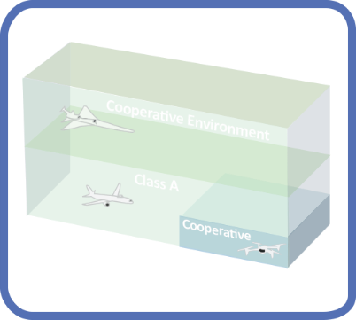
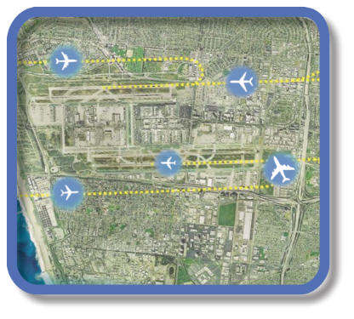

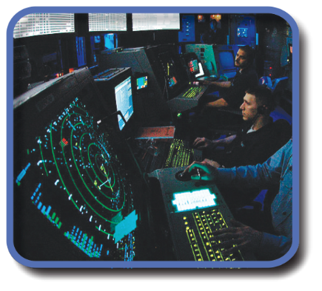
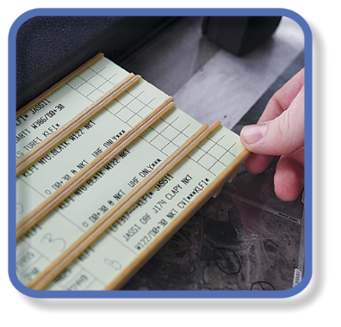




Evolution of Airspace Operations and Safety
+ Complexity, scalability,
and dynamic adaptation
+ Service oriented
architecture for
tailored mission
oriented services
+ Efficiency and
proactive planning
+Density
Safety
S-curves
Highly-Automated
ML/AI – based dynamic, robust
performance and safety
Trajectory
Know & exchange
current and planned a/c positions
Collaborative
Connected,
performance-based,
collaborative ATM
Radar
Know the current and estimate planned a/c positions
Machine-to-machine
interactions and humans collaborate
Procedural
Estimate the current and planned a/c positions
Introduces 3rd-party
service providers
Digital Transformation of ATM
Human-centered safety monitoring, assessment and mitigation
Automated in-time safety
monitoring and alerting services
Integrated predictive risk
mitigation across domains
Automatically-assured adaptive
in-time safety threat management
Human-centered safety monitoring, assessment and mitigation
Epoch 1
Epoch 2
Epoch 3
Epoch 4
(~2035)
Epoch 5
(~2045)

Slide 12
Transition to UTM-inspired Airspace Traffic Management
Current ATM
UTM-inspired-ATM
All services are provided by FAA
Services are provided FAA and third parties
Human address off-nominal situations and contingencies to ensure safety
Automation addressed off-nominal situations and contingencies to ensure scalability while maintaining safety
Very little interaction among users and third parties
Users collaborate/cooperate for efficiency, preferences for flights into constraints resources
Human at the epicenter of information integration
Every data for every vehicle moves through FAA systems
Management by clearances
Each change is focused on domain-specific system
Automation at the epicenter of information integration
New paradigm: Digital, connected ecosystems, third-party applications, service-oriented architecture
Management by exception
Focus on Total System Performance
NASA’s Role: Architecture, services definition, roles/responsibilities, performance of aircraft and airspace system technologies

Slide 13

Manage by Exception Everywhere
Performance-based
Leverages UTM paradigm in entire airspace—from ground to heavens!
Scalability everywhere
Image credit: NATS

Slide 14
Embracing Innovation in Aviation while Respecting its Safety Tradition
Parimal.H.Kopardekar@nasa.gov
Work for NASA, we will give you space to grow!
Usajobs.gov

Slide 15

Integrated, service-oriented architecture with modular implementation for real-time use to serve users
Disruptions, off-nominal conditions, and contingencies managed by automation
Automation to create solutions for Total System Performance (e.g., safety, risk, efficiency, resiliency, scalability )
Continuous common situation awareness for all users and providers by going digital
Airspace System Must Continue
to Evolve with
Relatively Quicker Cycles

Slide 16







Revisit visual and instrument flight rules: electronic/digital flight rules to promote cooperative traffic management
Airspace Operations Transformation Approach
Question current assumptions – which
limit user flexibility and system capacity, and conduct research to set system characteristics and requirements
Revisit separation minima as ”track and locate” accuracy is consistent and more precise with GPS instead of radar
Revisit architecture, and roles and responsibilities to move towards federated, service-oriented, manage by exception system for scalability
Revisit management of large-scale disruptions: use more data driven, integrated, machine learning based approaches
Revisit how routine weather-related delays are managed: use predictive and machine learning based algorithms
Enable regional and local operations by accommodating local considerations about vertiports and surroundings
Revisit integrated arrival/departure/surface movement, runway lengths and flows in/out of airports/vertiports with increasingly quieter electrified aircraft

