Slide 1
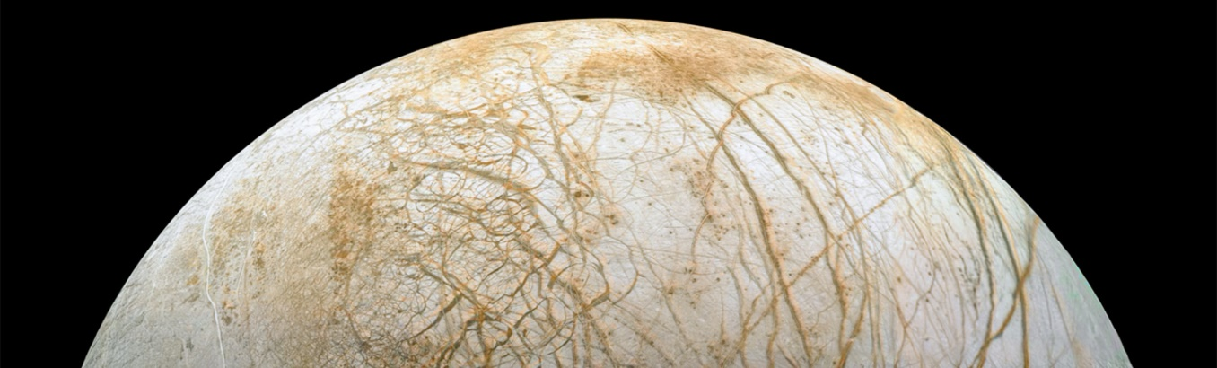
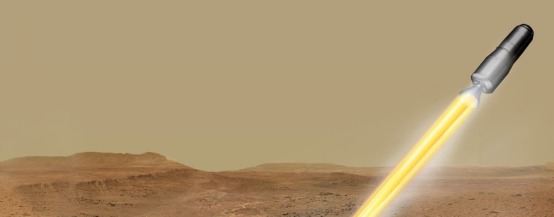

Planetary Protection at Marshall Space Flight Center
Chelsi D. Cassilly, Ph.D.
Jacobs Space Exploration Group/ESSCA
Space Environmental Effects Team
Nonmetallic Materials and Space Environmental Effects Branch
NASA/MSFC/EM41
Chelsi.D.Cassilly@nasa.gov
Planetary Protection in Practice– 18 October 2022
Notes:
Europa Image: NASA (Europa Stunning Surface | NASA Image and Video Library)
MAV Image: NASA (Mars Ascent Vehicle Launching with Samples (Artist's Concept) | NASA Image and Video Library)

Slide 2
Agenda Topics
Microbial Identification in Cleanrooms
Microbial Enumeration of Spacecraft Materials
Space Environmental Effects on Microbial Survival
Manufacturing Credit for Bioburden Reduction

Slide 3
Planetary Protection at MSFC
PP is relatively new at MSFC
Largely engineering and application focus
Primary missions/projects with PP involvement at MSFC:
  Mars Ascent Vehicle (Sample Retrieval Lander)
  Europa Lander Mission Concept
  Human Landing System
  Space Launch System
MSFC PP-relevant basic science to advance field and fill knowledge gaps

Slide 4
Microbial Identification in Cleanrooms
Keeping spacecraft clean post-bioburden reduction is a major challenge in PP
Cleanrooms help but can be sources of contamination
Characterizing cleanroom microbes to understand:
  Resistance to cleaning methods
  Contamination risk to a targeted planetary body

Slide 5
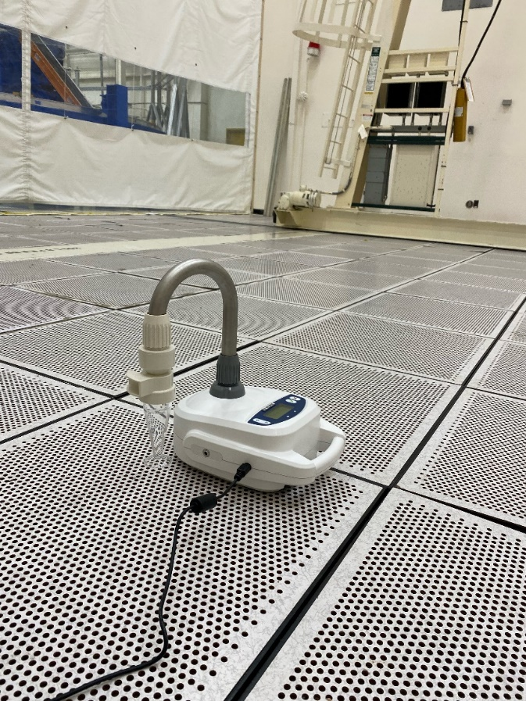
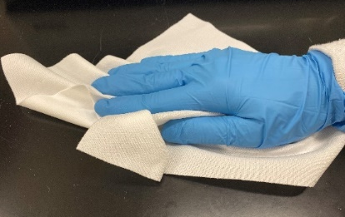
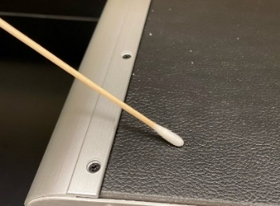
Microbial Identification in Cleanrooms
Jacobs Technology, Innovations, and Process Improvement (TIPI) Innovation Seed Grant
Sampled air and surfaces of four MSFC cleanrooms of various ISO cleanliness levels
  Wipes
  Air
  Swabs

Slide 6
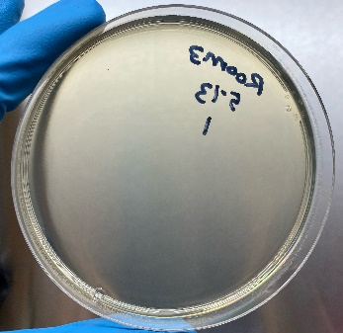
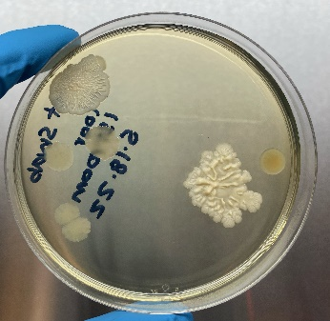
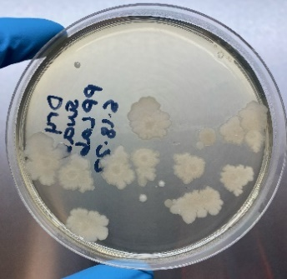
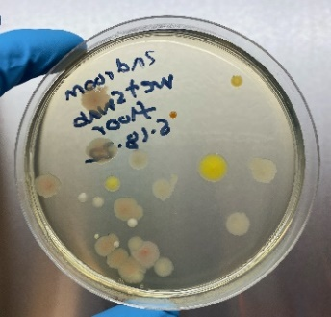
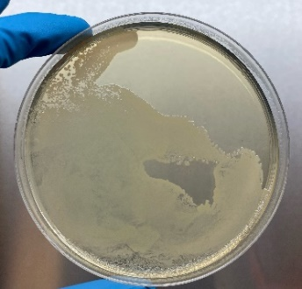
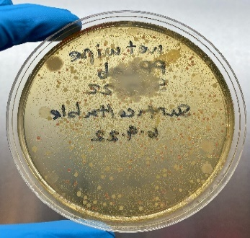
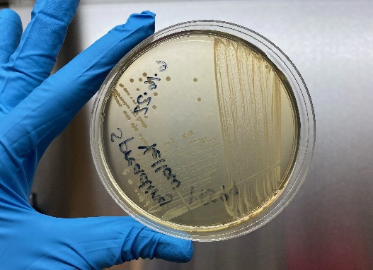
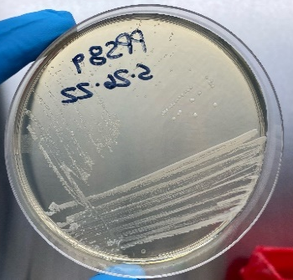
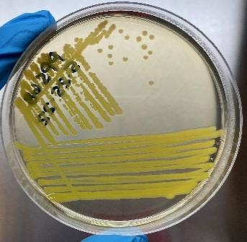
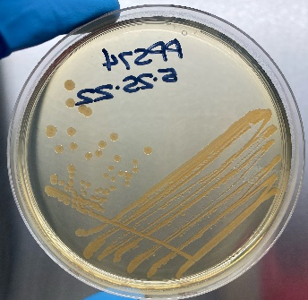
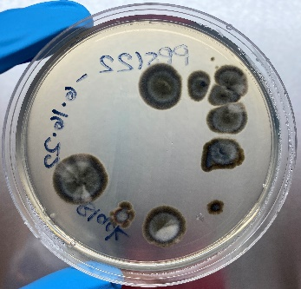
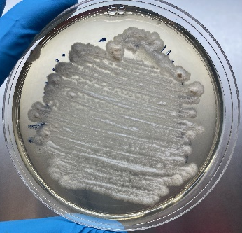
Microbial Identification in Cleanrooms
Resulted in a microbial library which includes ~100 isolates

Slide 7
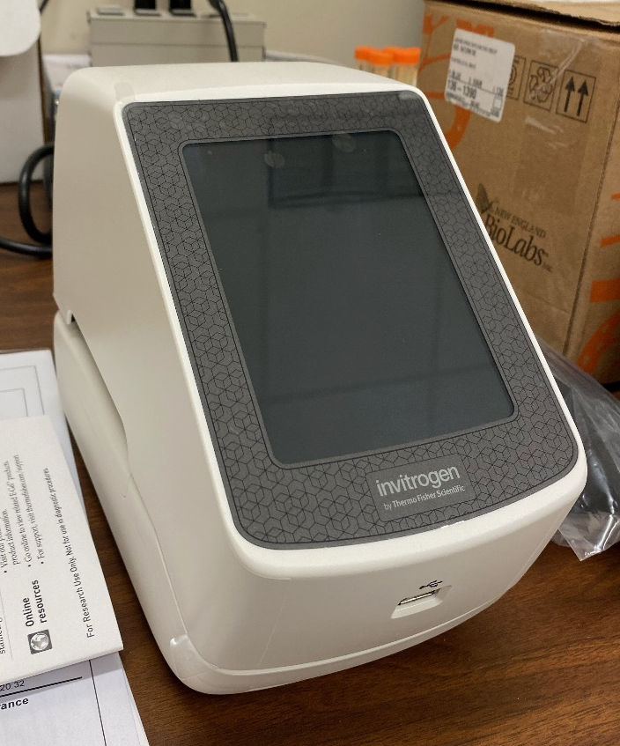
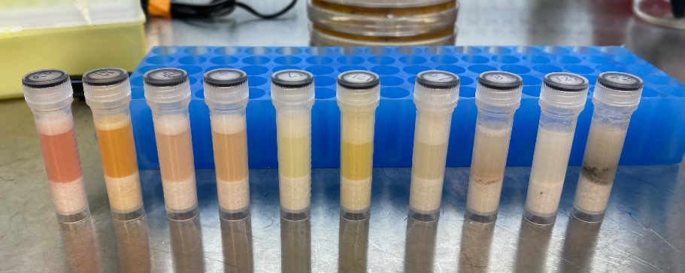
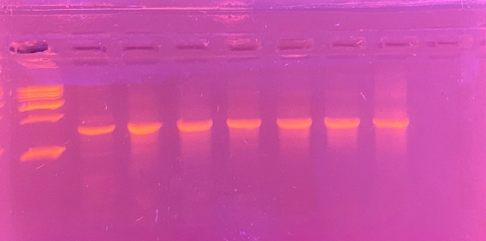
Microbial Identification in Cleanrooms
Current: sequence the 16S rRNA gene or ITS region of the 18S rRNA gene for bacterial and fungal isolates

Slide 8
Microbial Enumeration of Spacecraft Materials using Destructive Assays
Some materials and missions have bioburden reduction limitations
  Material incompatibility
  Material integrity
  Unknown risks
Often relies upon NASA conservative values
Understanding microbial contamination of common spacecraft materials may help define risk better

Slide 9
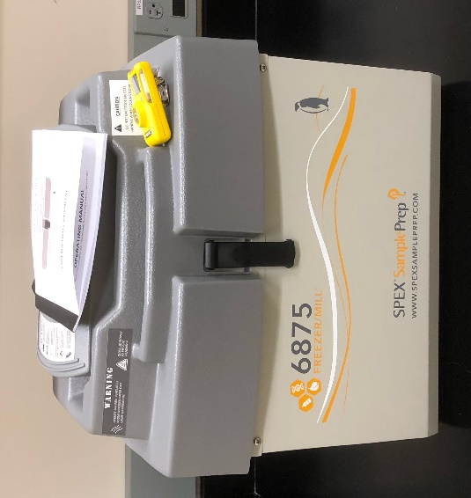
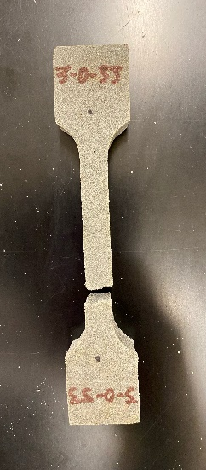
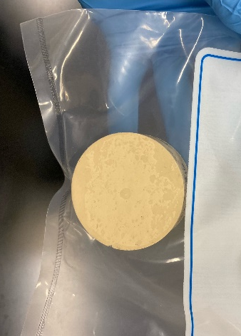
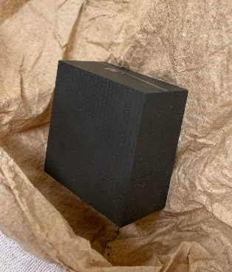
Microbial Enumeration of Spacecraft Materials using Destructive Assays
MSFC Tech Excellence Funding with ER62
Collected nonmetallic spacecraft materials
Sometimes challenging to cut materials cleanly!

Slide 10
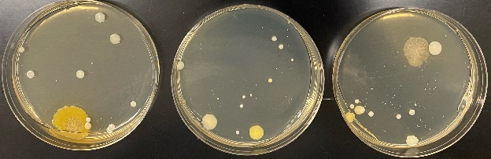
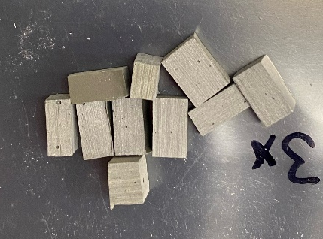
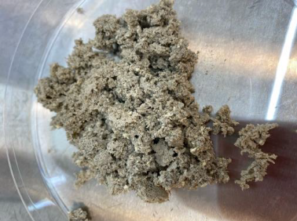
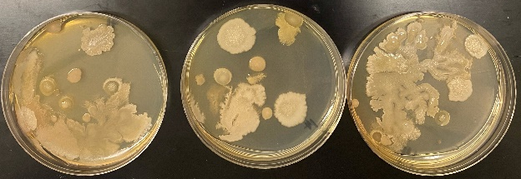
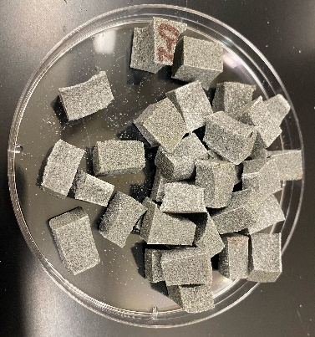
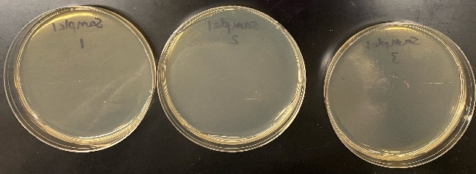
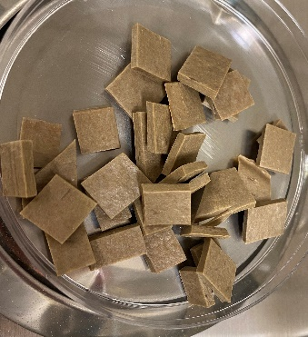
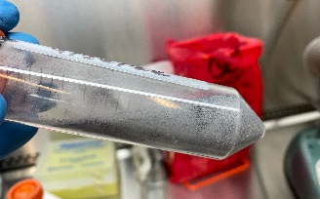
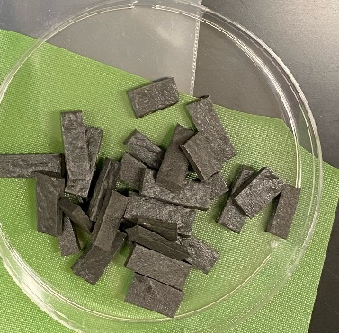
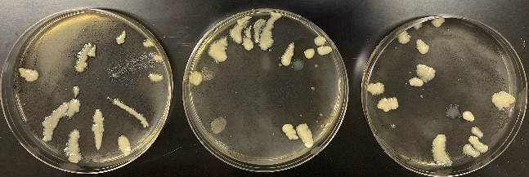
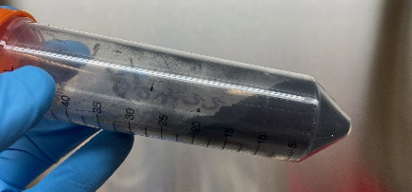
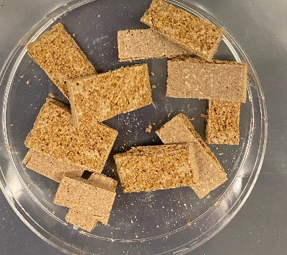
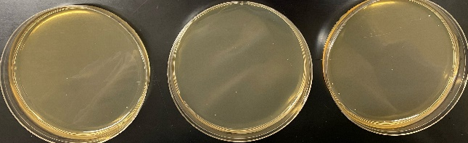
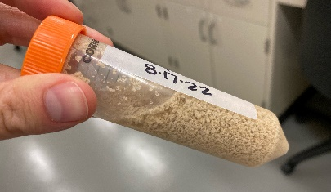
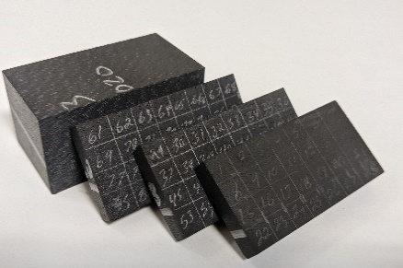
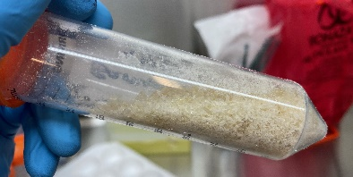
Microbial Enumeration of Spacecraft Materials using Destructive Assays
Notes:
Over 100 microbial isolates collected from materials

Slide 11
Microbial Enumeration of Spacecraft Materials using Destructive Assays
Future: Eventual molecular identification of over 100 microbial isolates from a variety of materials

Slide 12
Space Environmental Effects on Microbial Survival
NASA is interested in how the space environment impacts microbes:
  Could it reduce bioburden?
  Could it trigger resistance mechanisms?
Relevant to PP but also may impact human health on long duration missions (lunar, Martian)
  How do space environments impact mutation and survival of microbes/pathogens?

Slide 13
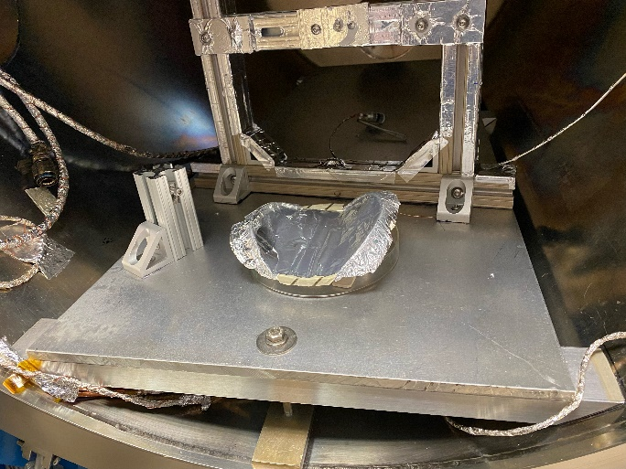
Space Environmental Effects on Microbial Survival
Space Environmental Effects Team in the Materials and Processes Lab (EM41) at MSFC
Determine impacts of variables on Bacillus atrophaeus spores:
  Temperature fluxes
  Ionizing radiation
  Ultraviolet radiation
  Vacuum

Slide 14
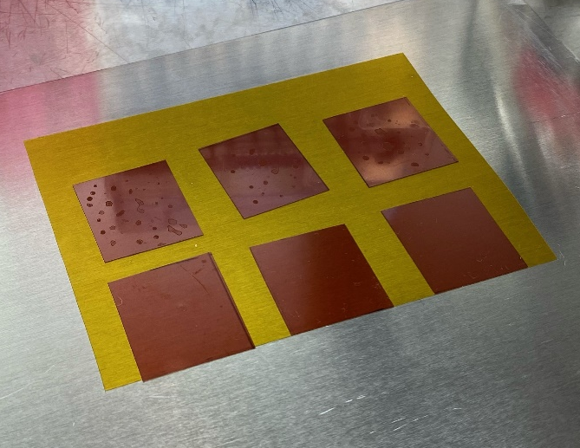
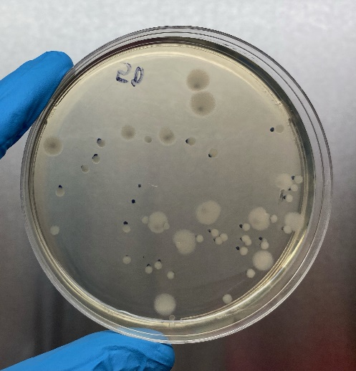
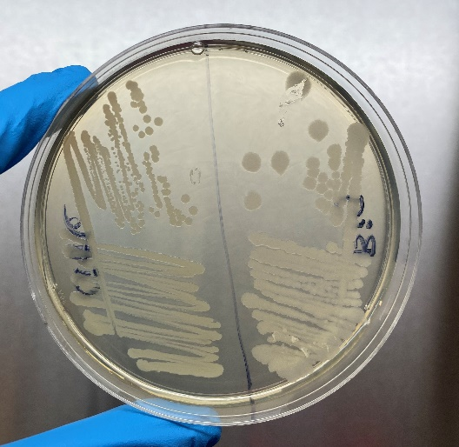
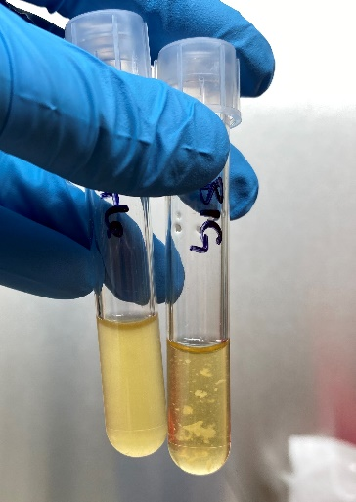
Space Environmental Effects on Microbial Survival
UV promoted strange phenotype
Radiation reduced survival
Future: submitted grant for additional funding to continue
Ionizing radiation (Rad) from a proton source (60 Mrad equivalent dose in 1 cc H₂O), approximately 0.1% of Bacillus atrophaeus spores remain viable when compared with an untreated control (n = 3).

Slide 15
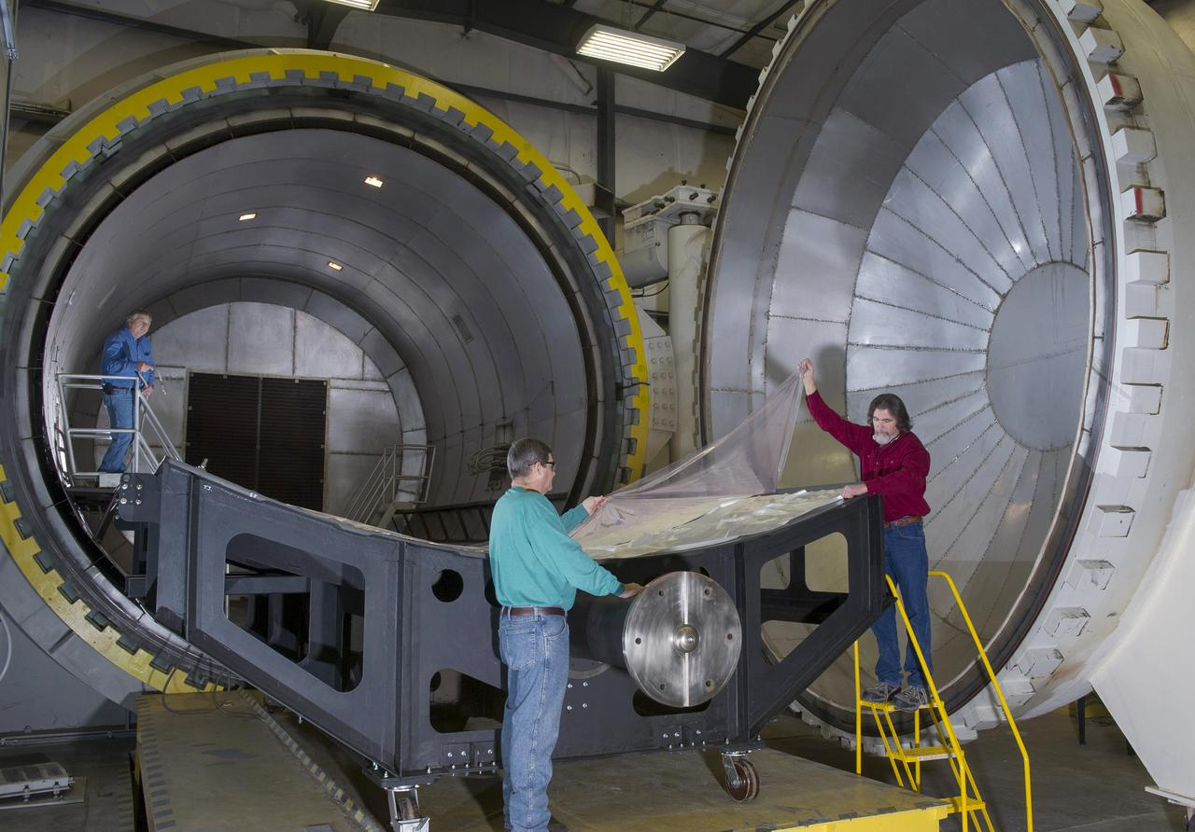
Manufacturing Credit for Bioburden Reduction
Two main methods of bioburden reduction at NASA
  Heat Microbial Reduction (HMR)
  Vapor Hydrogen Peroxide (VHP)
Manufacturing credit?
  NASA ROSES grant
Credit: ESA
NASA/MSFC
Notes:
Image: 18' X 20' AUTOCLAVE | NASA Image and Video Library
NASA PPO has approved use of VHP as a low-temperature sterilization modality, for simple surfaces, with specifications for time, rate, and H₂O₂ concentration levels. Complex geometries (e.g., vented boxes and electronic chassis inside the warm electronics box of a rover), however, require further directions. Thus, an additional study aims to describe the effect of VHP on electronic materials, materials with different configurations, solder joints, etc. Work has also begun for developing a portable VHP system that can be used locally (e.g., at the site of hardware integration in a cleanroom or on the launch pad).

Slide 16
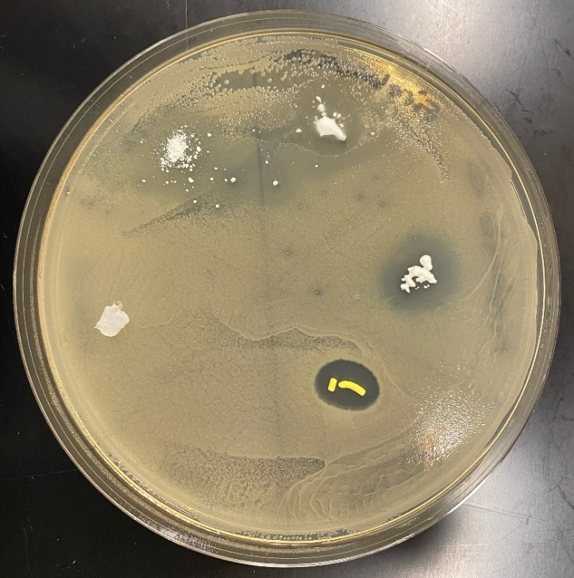

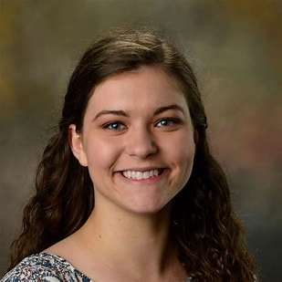

Manufacturing Credit for Bioburden Reduction
Antimicrobial activity of material additives
  What is the active molecule?
  Is this batch-reproducible?
  Could these materials be contaminated by production processes?
Natalie Williams presented data: #7026
Prof. Mark Liles
Natalie Williams

Slide 17


Manufacturing Credit for Bioburden Reduction
Assess manufacturing cure processes
  Are cure processes hot enough and long enough to sterilize all the way through materials?
  Future: prepare inoculated insulation lay up
Prof. Mark Liles
Natalie Williams

Slide 18


Acknowledgements
Jacobs/ESSCA
  Ashley Penton (EM41)
  Heather Morris (ST23)
  Samantha Marcella (EM31)
NASA MSFC
  Mary Nehls (EM41)
  Dr. Precious Mitchell (ER62)
  Todd Schneider (EM41)
  Dr. Peter Bertone (ST12)
  Dr. Erin Hayward (EM41)
  Jason Vaughn (EM41)
  Patrick Lynn (EM41)
Auburn University
  Prof. Mark Liles
  Natalie Williams

