Slide 1

Phase-change Reconfigurable Optical WavEfront Synthesis System (PROWESS)
Kiumars Aryana
ADMSB (Advanced Measurements and Data Systems Branch)
NASA Langley Research Center
Advisor: Dr. Hyun Jung Kim
1
October 26th, 2022

Slide 2
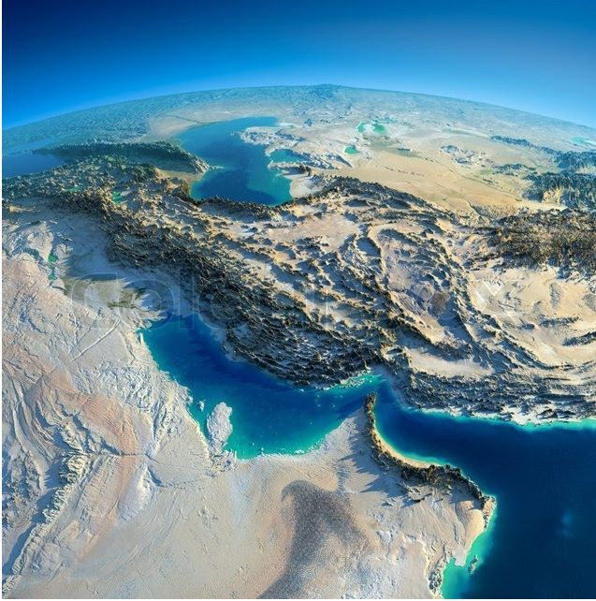

About me…
Joined NPP since July 2022
Iran
Turkey
University of Virginia
Miami University
University of Birjand
-Mechanical & Aerospace Engineering
-Mechanical & Manufacturing Engineering
-Mechanical Engineering
Ph.D.
M.Sc.
B.Sc.
Expertise
Nanoscale Thermal Transport
Light-matter Interactions
Phase Change Materials
Nanophotonics
2

Slide 3
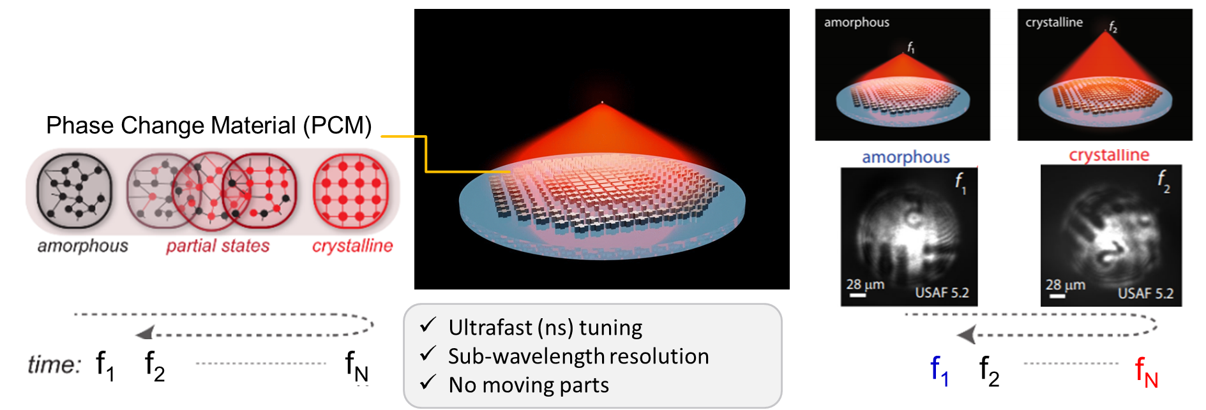
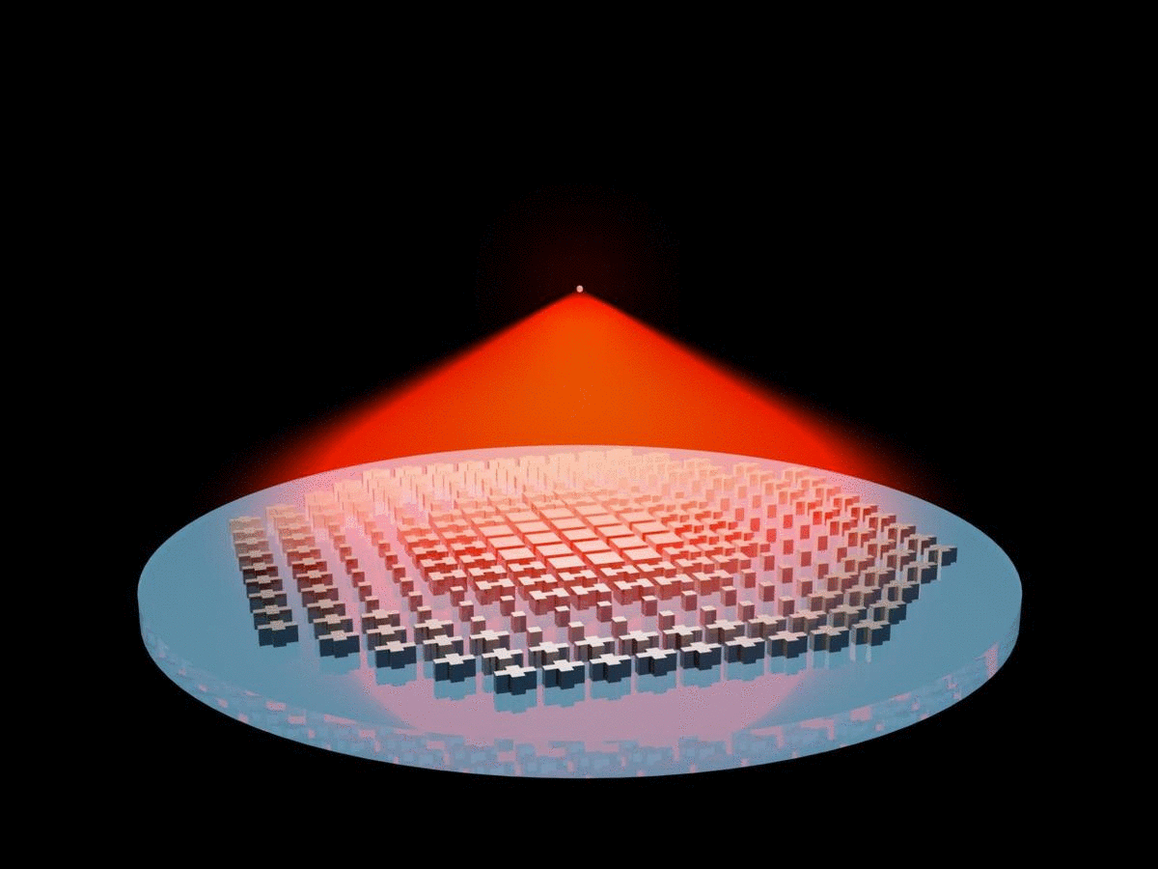
PROWESS Approach & Innovation
Diffraction-limited, crosstalk-free reconfigurable imaging
f2
f1
Fast tuning using heater pulse
Sub-wavelength resolution
No moving parts

Slide 4
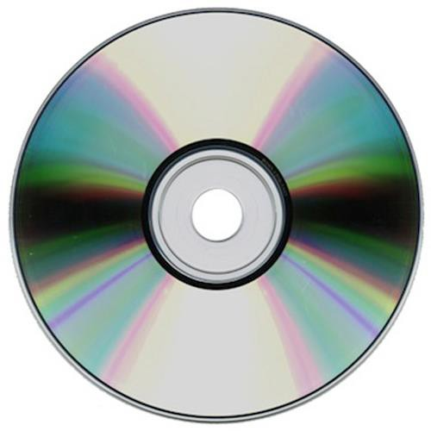
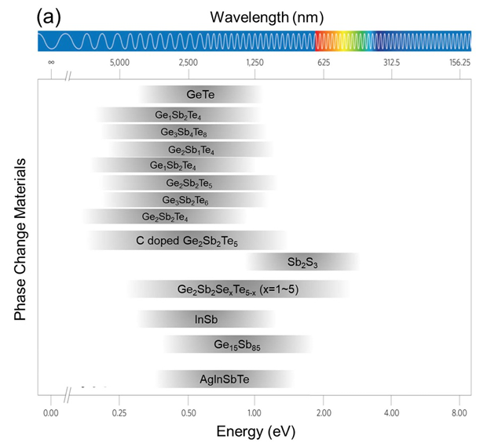
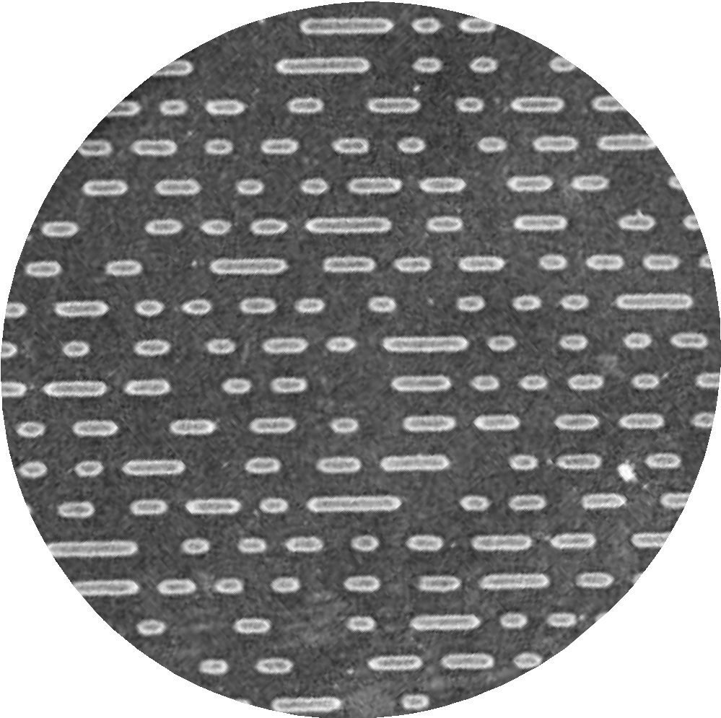
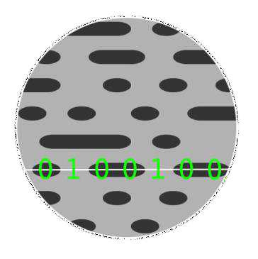
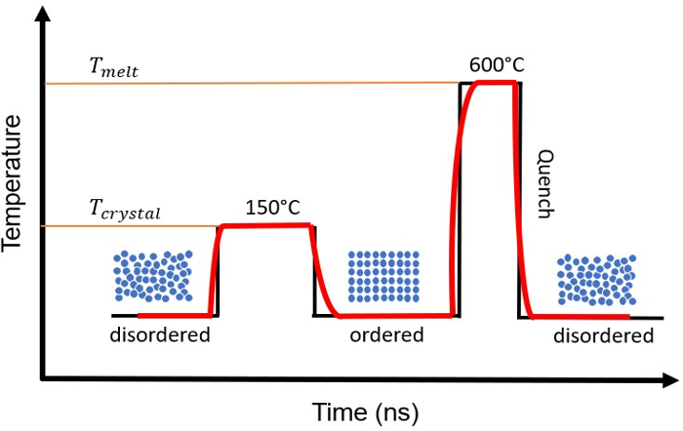
Phase Change Materials – Core of the Technology
Rewritable DVD
Journal of Physics: Photonics 3.2 (2021) 024008
4

Slide 5
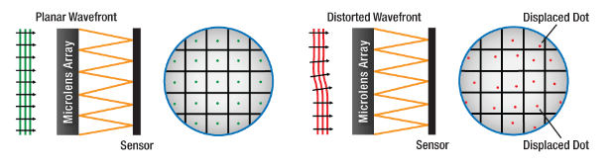
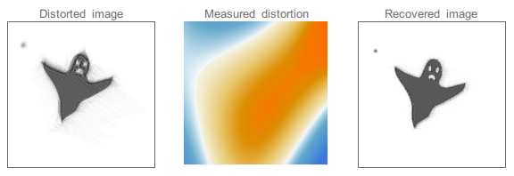
PROWESS Applications towards NASA’s Missions
Mission Need
Metasurface-based optics capable of generating actively-tunable, arbitrary optical wavefronts at ultrafast speeds, with sub-wavelength resolution, and without moving parts.
Jacopo Bertolotti, CC0, via Wikimedia Commons.
5
Notes:
Active wavefront control is a critical concept in a variety of optical systems, and the ability to on-the-fly tailor an optical wavefront has far-reaching implications.
Wavefront correction is currently limited to reflective technologies such as deformable mirrors that are bulky, expensive, and mechanically complex.
Other methods of tailoring optical wavefronts have been explored, such as plenoptic imaging; however, these are fixed configurations that must be tailored for targeted applications and require computationally expensive image processing.

Slide 6
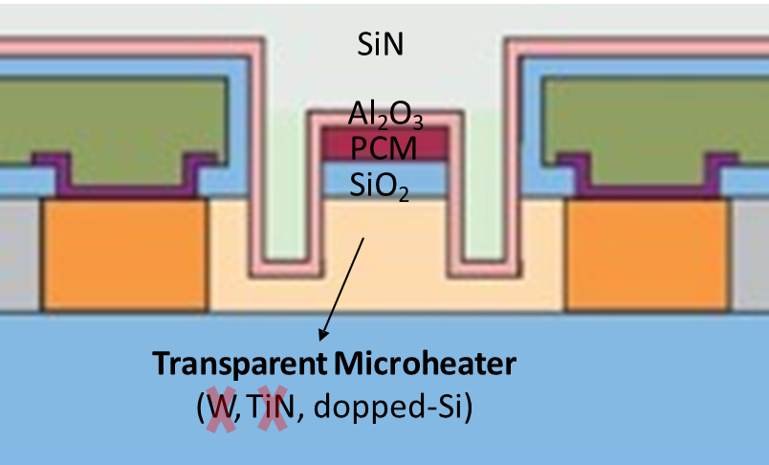
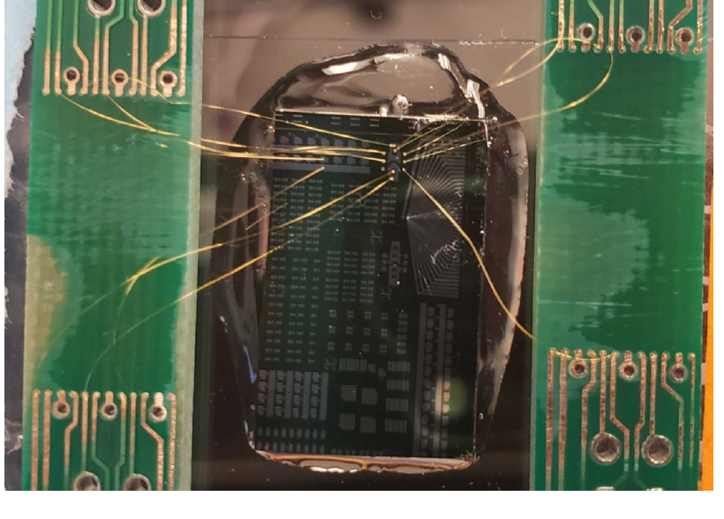
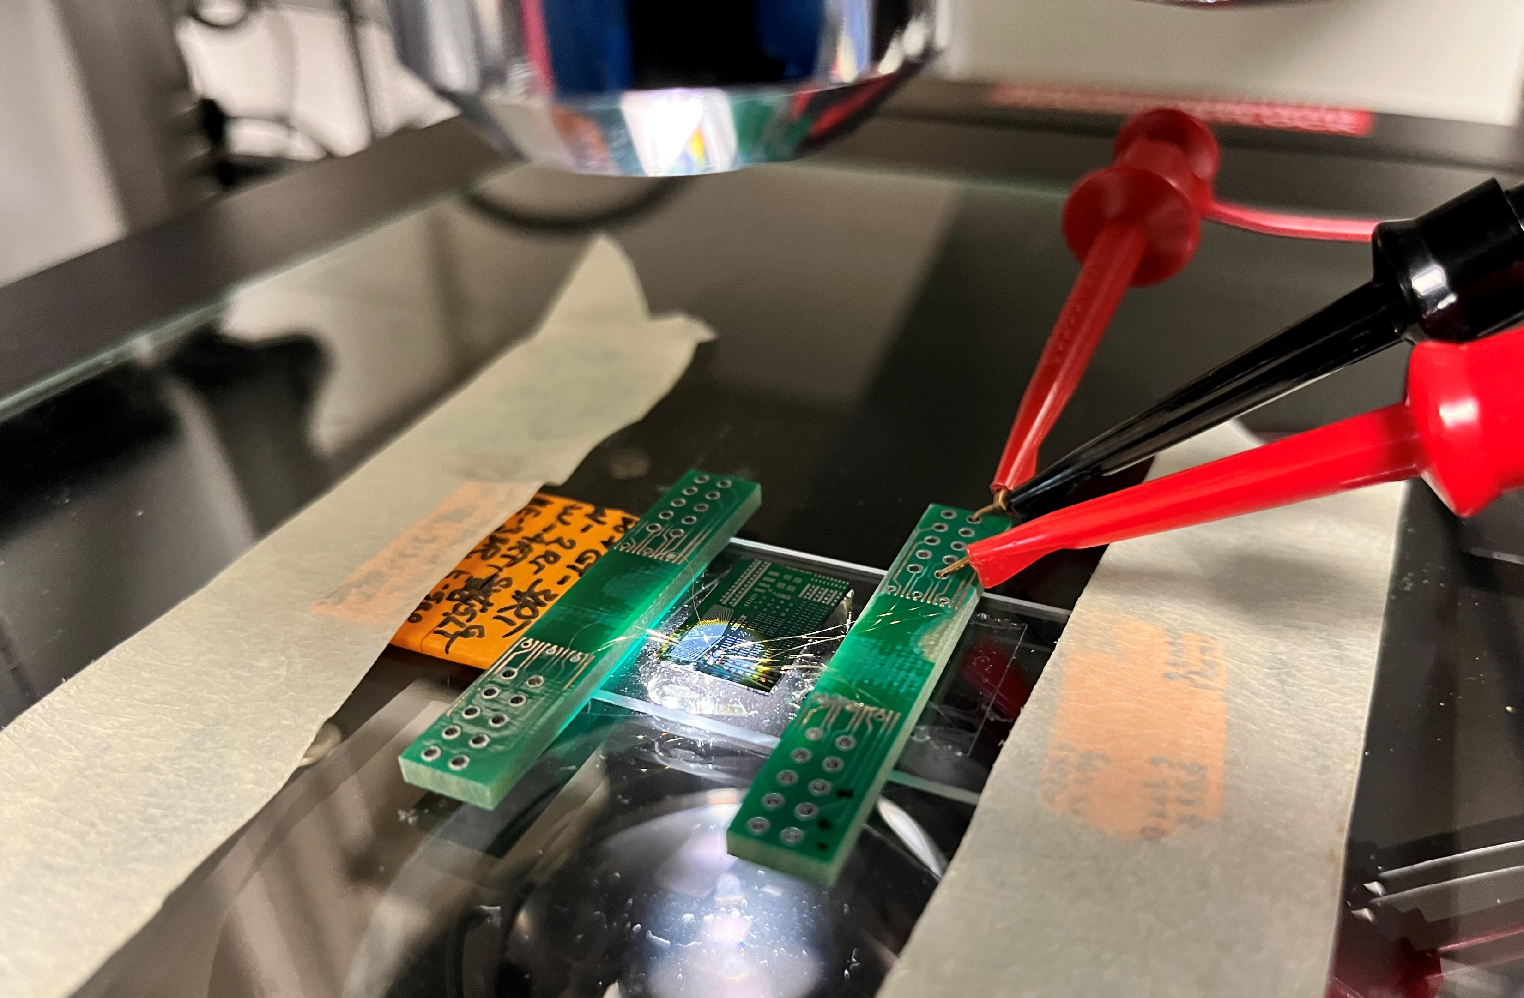
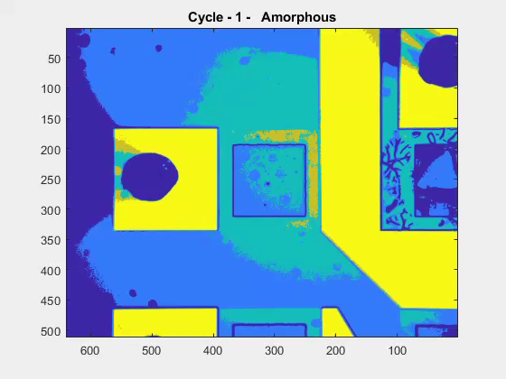
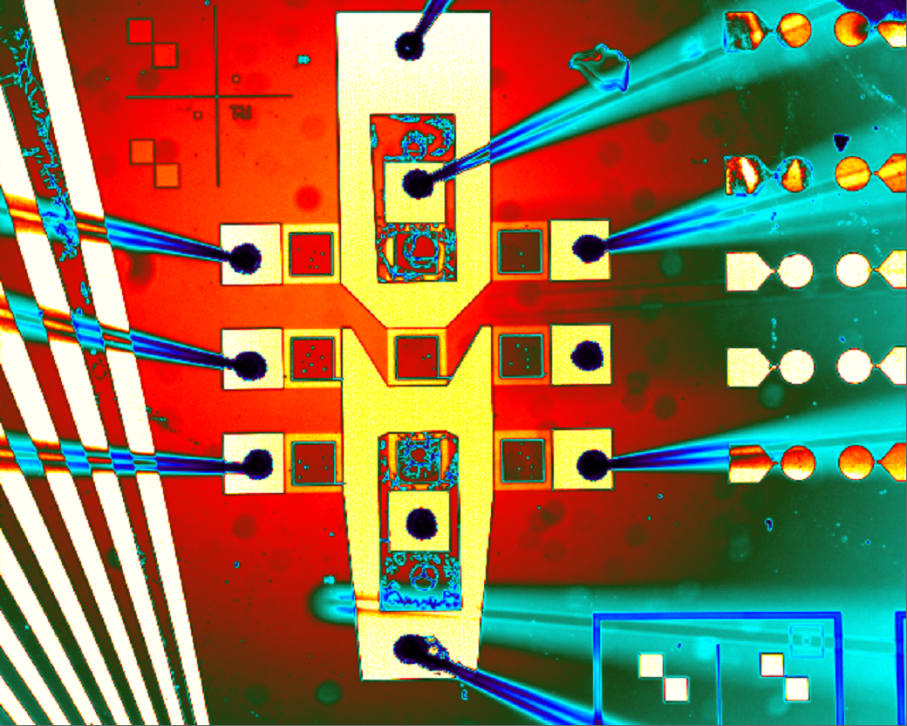
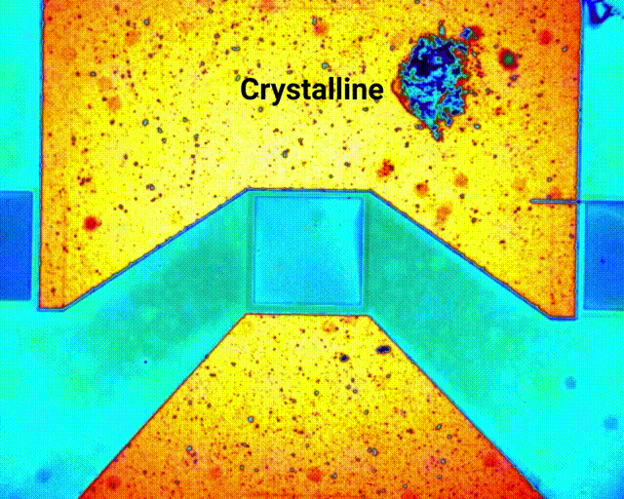
PROWESS Progress
Device design (GSST)
3 x 3 device fabrication
Evaluate the performance
Longer lifetime from
lesson learned
2nd version of PROWESS
Lifetime testing – IR image
6

Slide 7
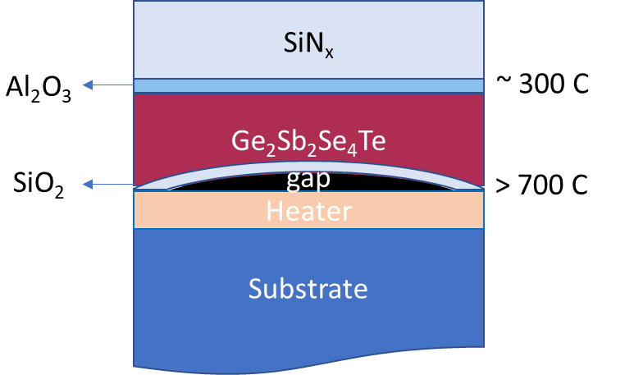
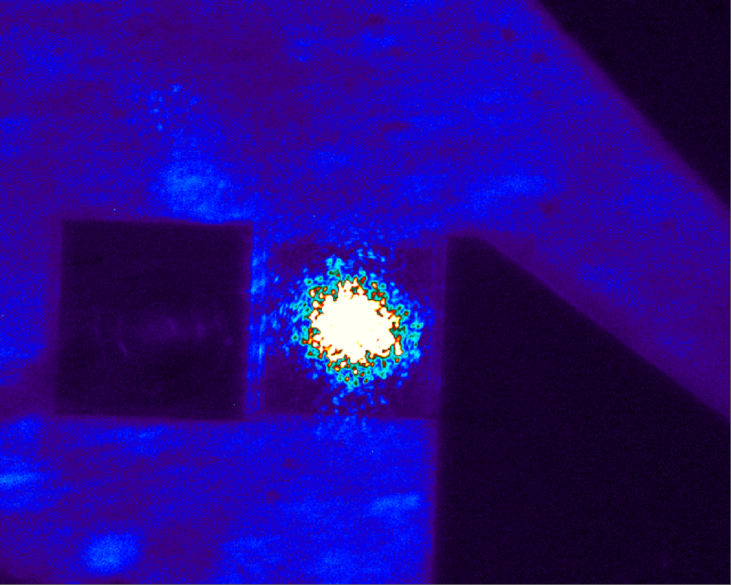
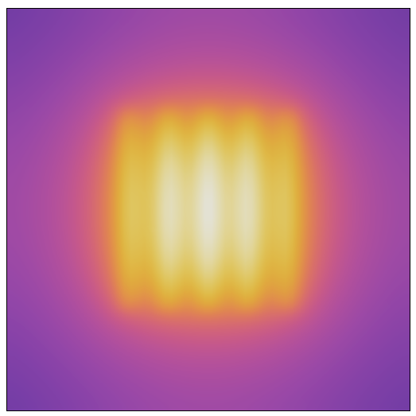
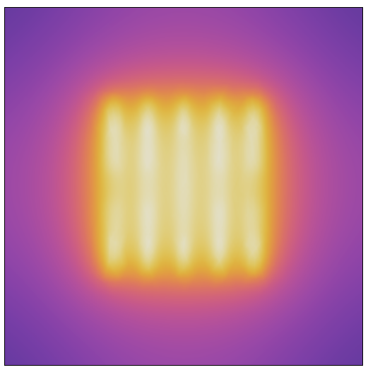
Next Steps
3-months
6-months
1-year
Beam steering
2-years
k-space filter demo
10×10 array of PCM
Heater Design Optimization
Material Design Optimization
100×100 array of PCM
Imaging with distorted wavefront
1000×1000 array of PCM
Imaging at 1550 nm
Heater Design
100 um
PCM
7

Slide 8
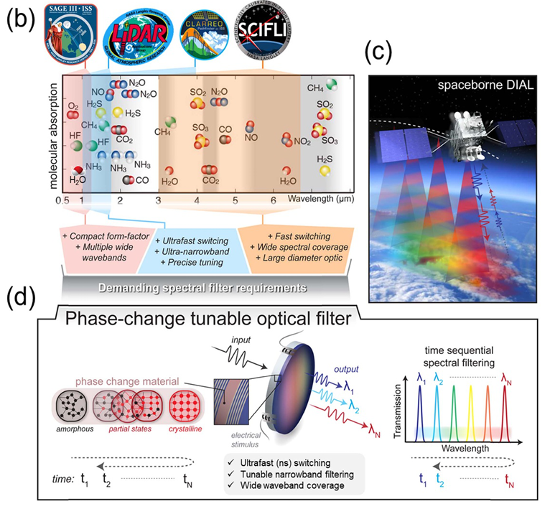
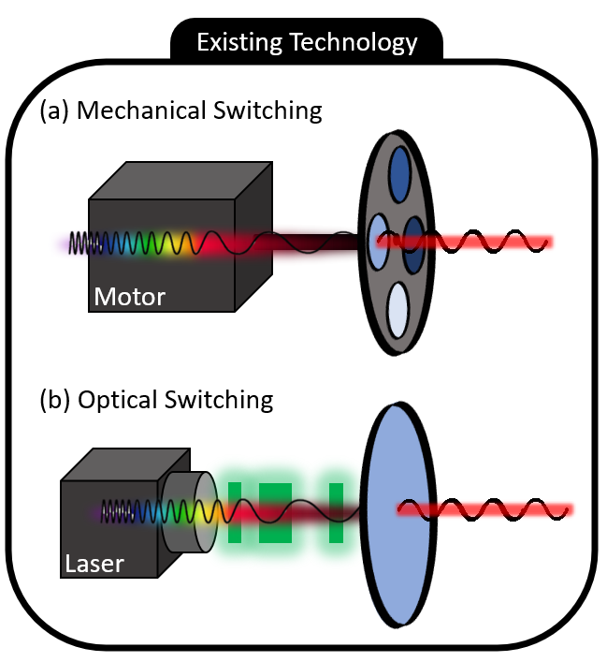
PCM-based Reconfigurable Optics (a case study)
8

Slide 9
NASA LaRC Team
MIT Team
Booz Allen Hamilton
Dr. HJ Kim
WM Humphrey
S Bartram
S Borg
Prof. J Hu
Dr. T Gu
CC Popescu
KP Dao
Dr. MN Julian
Thank You
9

