Slide 1
Spoof Plasmon Sensing for NDE Applications
William C. Wilson¹ and Katelyn R. Brinker²
¹Nondestructive Evaluation Sciences Branch, NASA Langley Research Center, Hampton, VA, USA
²Electrical and Computer Engineering Dept., Iowa State University, Ames, IA, USA

Slide 2

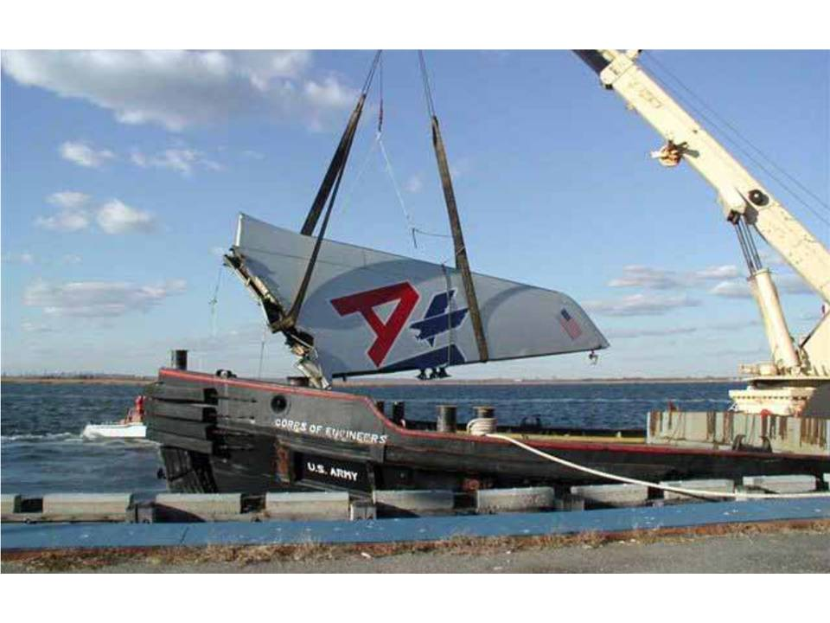
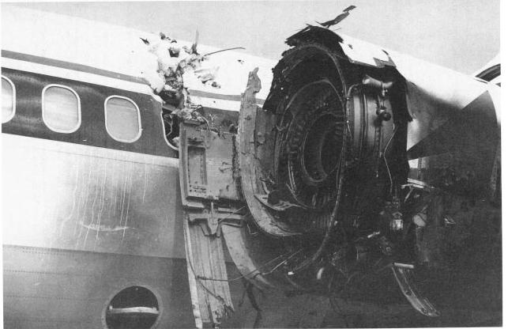

Motivation
Need for Improved Aviation Safety
Can we detect changes in the structure before this happens?
Forward fuselage, Aloha Airlines (1 person killed)
Vertical Tail, American Airlines Flt 587 (265 killed)
Engine, Delta Flight 1288 (2 people killed)
U.S. Forest Service C-130, near Walker, CA (3 killed)
Notes:
We would like to use Structural Health Monitoring to determine if there is a problem before someone gets onboard an aircraft.
Data from the FAA and the NTSB have shown that subsystem and component failures together contribute to 24% to onboard fatalities and are the underlying factors in many of the 26% of loss of control accidents.
Alleviating future accidents such as these is the motivation for NASA’s Aviation Safety Program.
We are

Slide 3
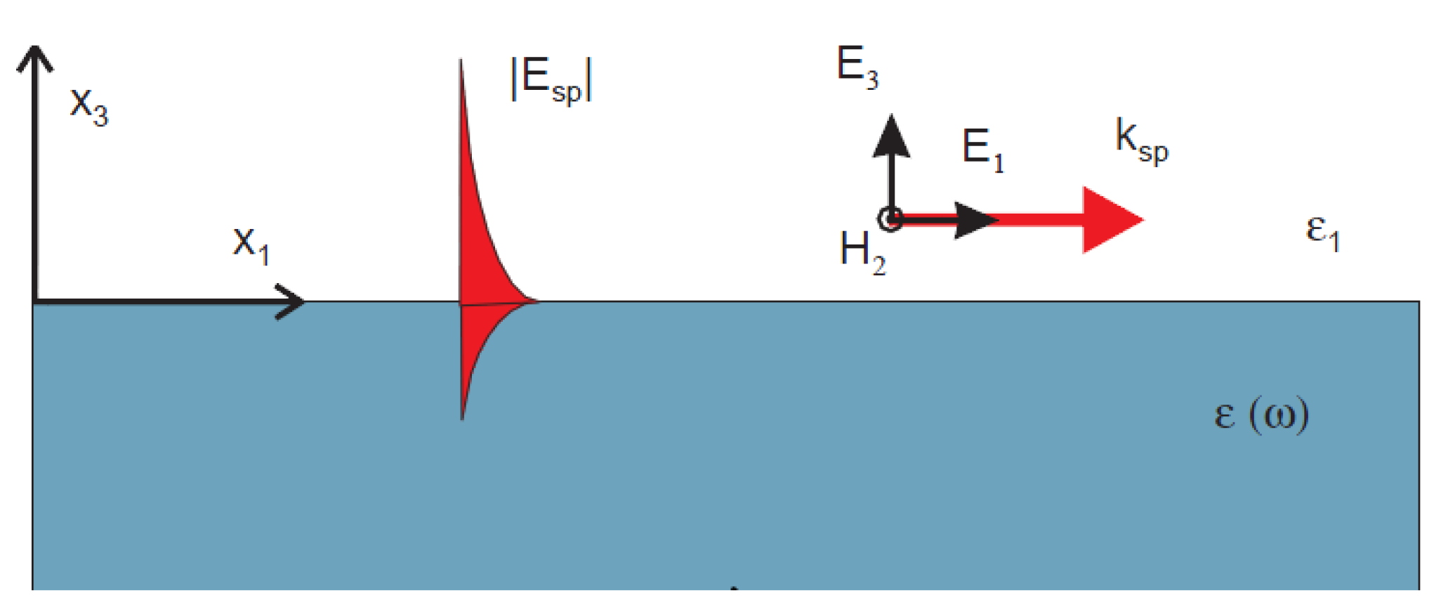


Introduction to Plasmons
Plasma
Region
$$ω_{sp}=\frac{ω_{plasma}}{\sqrt{2}}$$
Light line
Infrared Region
Frequency (Hz)
}
Visible Region
Surface
Plasmon
Polaritons
$$υ_{Limiting}$$
}
Surface Spoof Plasmon Polaritons
Microwave Region
Wavevector k_{x}(m⁻¹)
Surface plasmon polaritons (SPPs), which are electromagnetic excitations propagating at the interface between a dielectric and a conductor, evanescently confined in the perpendicular direction to the propagation direction.
While SPPs are found in infrared and optical frequencies, they do not exist naturally in lower frequency range, in which the metal behaves as a perfect conductor (PEC). Hence, the SPPs are generally not found in terahertz and microwave frequencies.
Spoof surface plasmon polaritons (SSPPs) which have similar characteristics as SPPs were proven to exist in lower frequencies such as terahertz and microwave frequencies on a plasmonic metamaterial.
[1] T. Y. Fung, "The Study of Spoof Surface Plasmon Polartions (SSPPs) on a Hybrid Waveguide in Microwave Frequencies" PhD thesis, Dept. of physics, National University of Singapore (NUS), 2015, pp 1-53.

Slide 4
Background
Y
Spoof plasmon polaritons are EM surface waves that exhibit a non-radiative mode where the energy of the mode is concentrated at the interface, and it decays exponentially from the interface between a dielectric and a metal [2].
The spoof plasmon polaritons act as a series chain of microwave cavity resonators. “Any array of cavities with subwavelength geometry that individually support a resonance, such as a waveguide mode, can be used as a metamaterial structure that will support a surface wave.” [2]
X
Z
E
A
d
L
H
Plasmonic Metamaterial
Microwave resonators can be described using basic electrical properties such as the electrical impedance.
Anything that is placed within the grooves of the plasmon grating will affect the impedance due either to the change of the cavity shape and/or a change of the dielectric coefficient.
Our hypothesis is that any material added to the ideal grating will cause changes in the impedance, and that these changes can be used to indicate defects in manufacturing if the changes are caused by the addition of unintentional metal during manufacturing.
[2] E. M. G. Brock, "The Lateral Confinement of Microwave Surface Waves," PhD, Dept. of Physics and Astronomy, Univ. of Exeter, pp. 1-190, 2013.

Slide 5
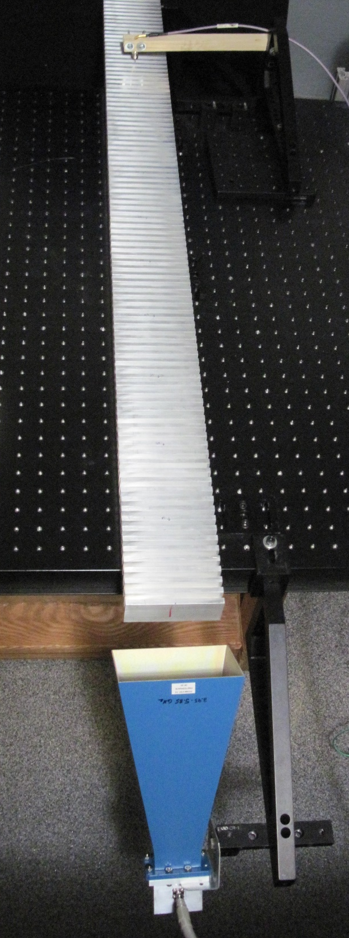
Test Setup
Wire Coaxial Antenna
(Receiver)
1m
Defect location
31mm
Aluminum (T6061)
Horn Antenna
(Transmitter)
45°
Test setup for spoof plasmon polaritons showing the horn antenna, wire coaxial antenna, and grooved test specimen.

Slide 6
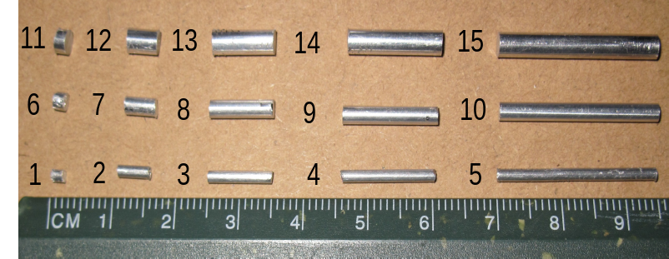
Simulated Defects
Simulated Defects: solid aluminum wires that are 2, 5, 10, 15, and 25 mm long and are 1.6, 2.3, and 3.1 mm in diameter.
Simulated Defect (wire)
6.35mm
6.35mm
38.1mm
19.05mm
1212.8m
101.6mm
Test specimen, aluminum (T6061), with Al wires to simulate defects.

Slide 7
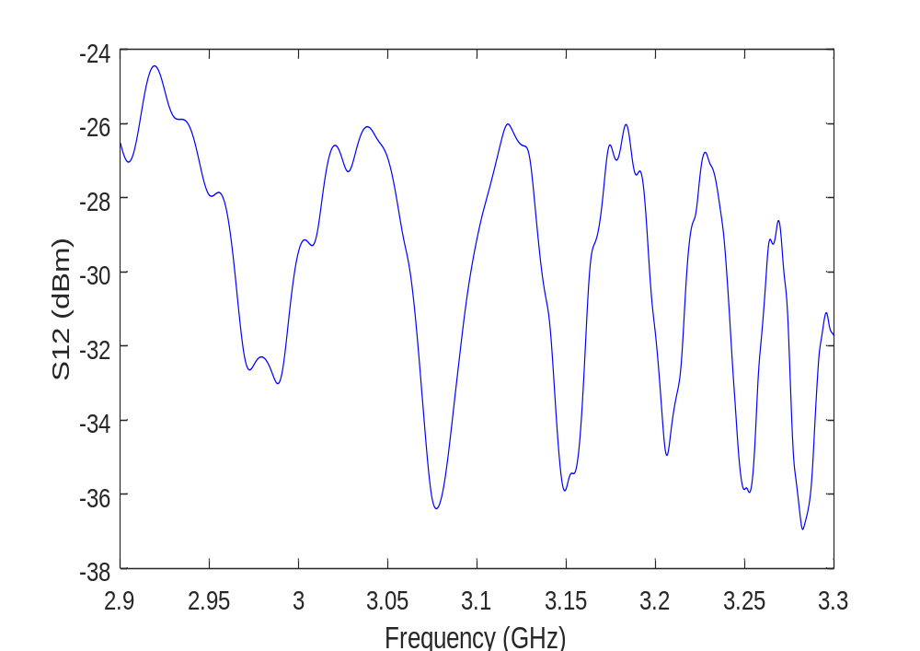
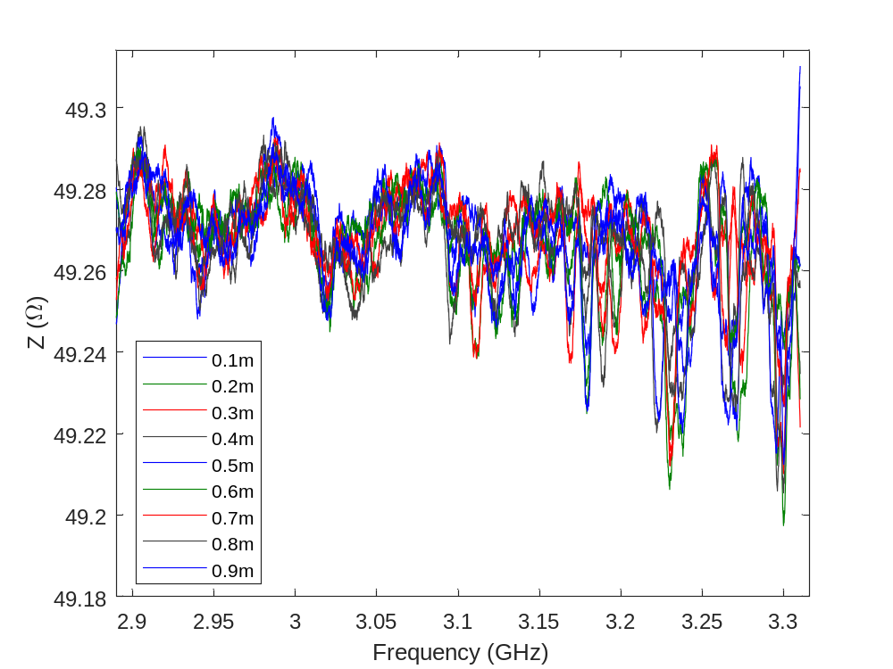
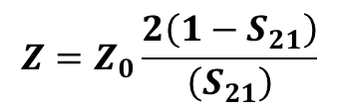
EM Response
S₂₁ (dBm)
The S₂₁ response without any simulated defects.
The impedance with a simulated defect of 1.6 mm dia., 2mm long, aluminum wire placed at 9 different distances along the test specimen.
$$Z=Z_{0}\frac{2\left(1−S_{21}\right)}{\left(S_{21}\right)}$$
Notes:
Here is the raw S21 response, however it does not change very much. We have found that there was a larger change in the delta in impedance. We tried several methods for reducing the dimensionality, spectral centroid, principal component analysis, correlation, however none of this methods produced results that are better than a simple summation of the delta impedance.

Slide 8
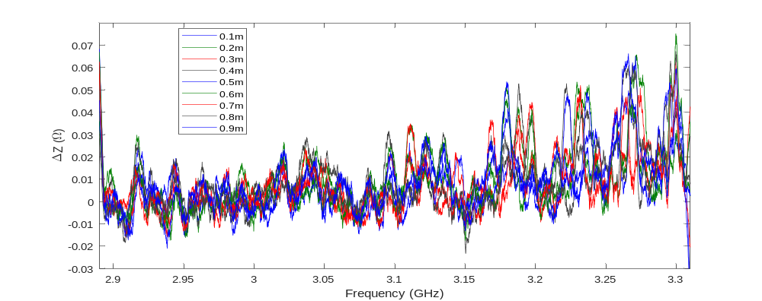

EM Response
The delta impedance for a simulated defect of 1.6 mm dia., 2mm long, aluminum wire placed at 9 different distances along the test specimen.
$$ΔZ=Z_{i}−{Znd}_{i}$$
Notes:
Here is the raw S21 response, however it does not change very much. We have found that there was a larger change in the delta in impedance. We tried several methods for reducing the dimensionality, spectral centroid, principal component analysis, correlation, however none of this methods produced results that are better than a simple summation of the delta impedance.

Slide 9
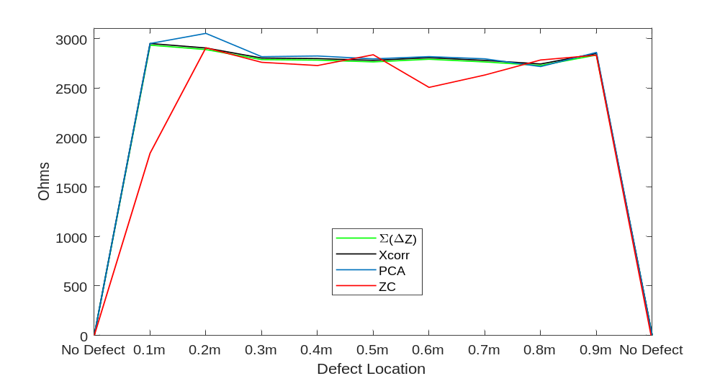
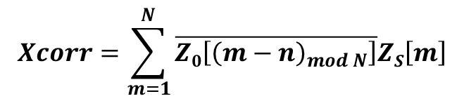


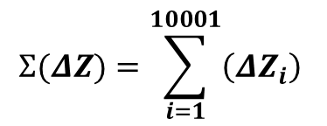
Dimensionality Reduction
$$Σ(ΔZ)=\sum_{i=1}^{10001}{\left({ΔZ}_{i}\right)}$$
Z$C=\frac{\sum_{n=1}^{N}{f_{n}Z_{n}}}{\sum_{n=1}^{N}{f_{n}}}$
$$Xcorr=\sum_{m=1}^{N}{\overline{Z0\left[{\left(m−n\right)}_{mod N}\right]}ZS\left[m\right]}$$
PCA = eig((1 / n) * ((Z$−\overline{Z}$) * (Z$−\overline{Z}$)'))

Slide 10
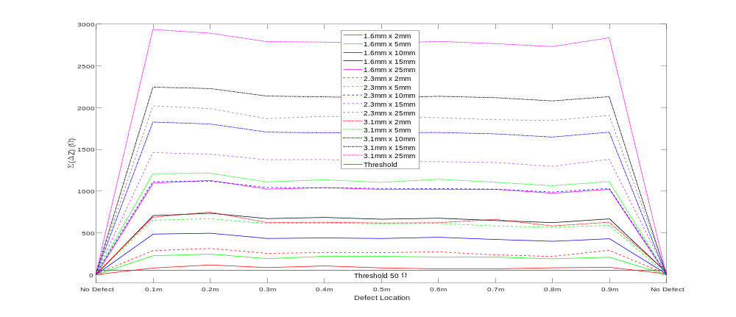
Defect Detection using Spoof Surface Plasmons
The sum of the change (delta) impedance with wires segments simulating defects at multiple locations.
The black line represents the threshold for defect detection (50).
The simulated defects are Al wires that are 1.6, 2.3, and 3.1 mm in diameter, and are 2, 5, 10, 15, and 25 mm in length.

Slide 11
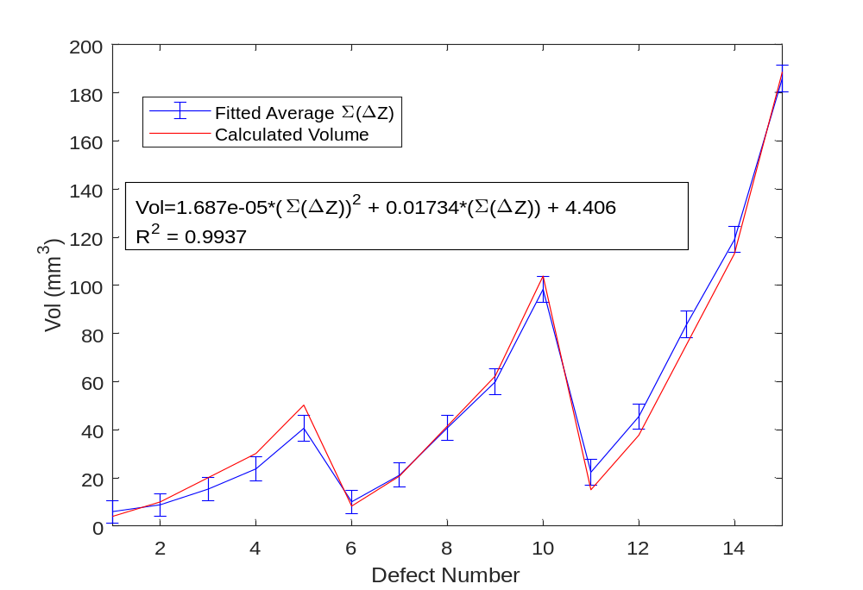
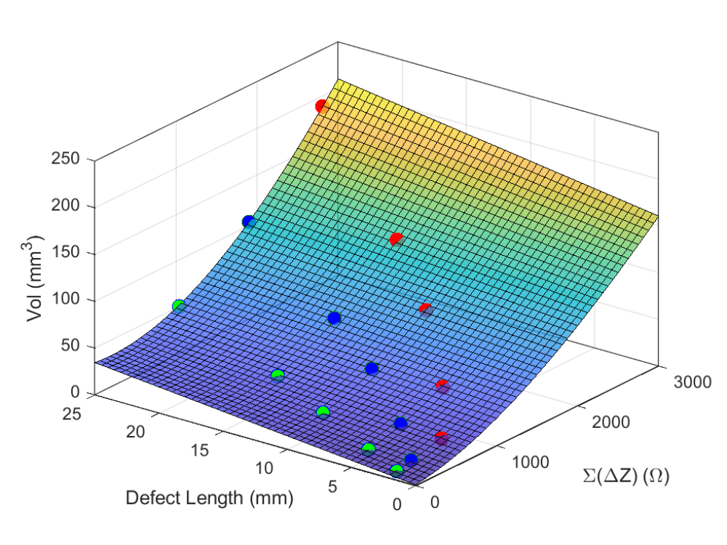
Volume Estimation
1.6 mm Dia.
2.3 mm Dia.
3.1 mm Dia.
The fitted average sum of delta values for all 15 defect cases, and the fitting equation. The error bars represent one standard deviation.

Slide 12
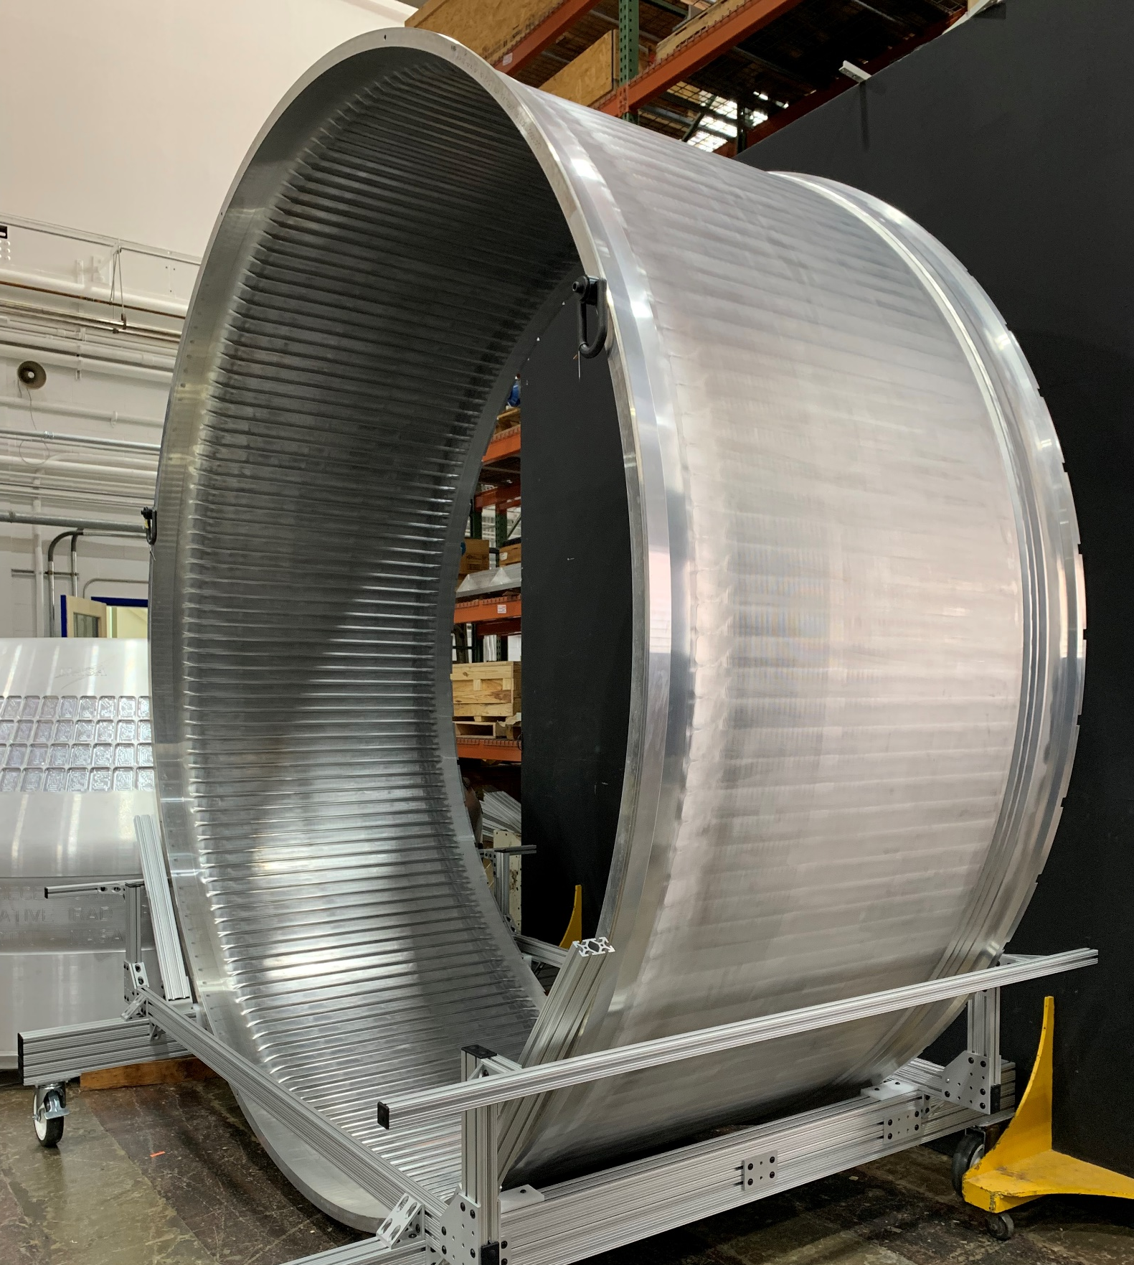
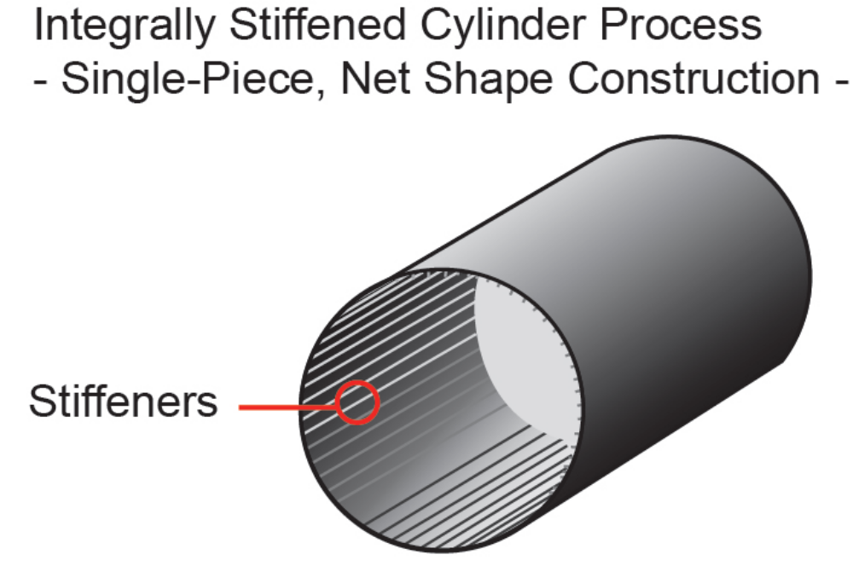
End Application - Faster Fuselage Manufacturing
Advanced Air Transport Technology (AATT) project is exploring the use of metallic integrally stiffened cylinder (ISC)
Significant reduction in cost, weight, and manufacturing time.
Reduction in part count and eliminating lap joints and rivets (fasteners).

Slide 13
Conclusions
Spoof plasmon polaritons for defect detection have been demonstrated using simulated defects (wires placed in a grooved metal surface).
The sum of the change in the impedance across all frequencies has been utilized as the indication for detecting the different sizes of simulated inclusions.
A threshold value of 50 Ω has been proposed for detection of these inclusion type defects.
In addition, it was shown how the technique can be used to estimate the volume of the defect.
Future work will investigate voids and cracks to determine if the technique will detect more defects types.

Slide 14
Funding/Partnership Opportunities
NASA Research Opportunities (NRAs)
Grants & Contracts
  http://nspires.nasaprs.com/
Small Business Innovation Research (SBIR) Small Business Technology Transfer (STTR)
  http://sbir.gsfc.nasa.gov/
  Z4.05 Nondestructive Evaluation (NDE) Sensors, Modeling, and Analysis
Space Act Agreements (SAA)
  Partnerships with and without exchange of funds

Slide 15
Auxiliary Slides

Slide 16
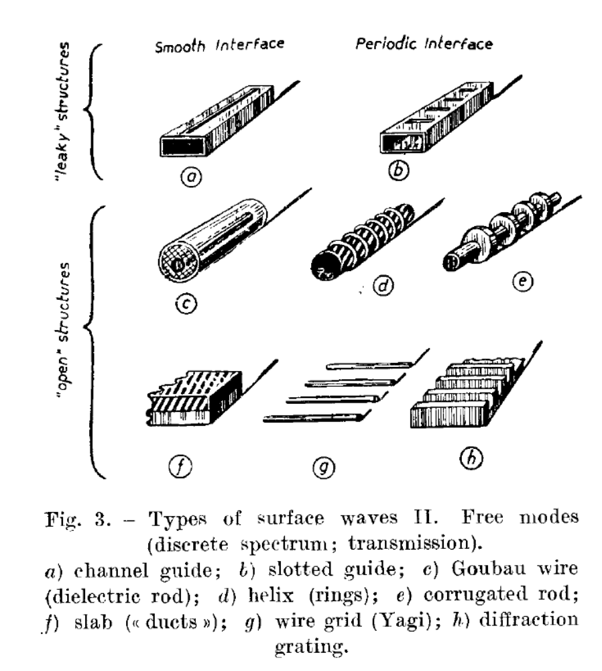
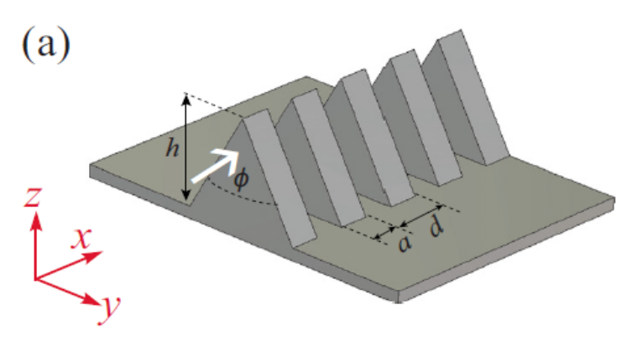
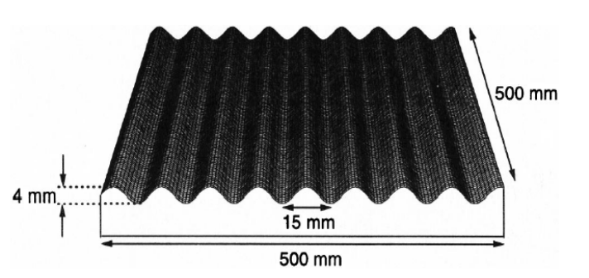
Periodic Structures Supporting Spoof Plasmons
Surface waves can be supported on a variety of shapes including slotted structures, wires on cylinders, discs on cylinders and even planar structures.
Corrugations can be rectangular, triangular, trapezoidal, rounded, etc.
F. J. Zucker, "Theory and Applications of Surface Waves," Il Nuovo Cimento, vol. 9, no. 3, pp. 450-473, 1952.

