Slide 1
SPACE ROS: ARCHITECTURE ROADMAP
Contributors:
Paul Tompkins, Blue Origin
Austin Probe, NASA
Amalaye Oyake, Blue Origin
Will Chambers

Slide 2
Overview
Statement of Objectives
Driving Reference Applications
Technology Need
NASA Taxonomy
Community Input
Deployment Configurations
Middleware Solutions
Space ROS Deployment
Benchmarking
Benchmarking Objectives
Test Matrix Summary
Space ROS Development
Governance
License
Pull Request Acceptance
Community Guidelines

Slide 3
Statement of Objectives
Develop a space-certifiable and reusable robotic framework
Designed to meet flight software standards: Designed to be aligned with NASA so that it could be adopted for a Class A Mission
Memory Safety
Deterministic Performance
Static analysis
System Testing
Support characteristic space robotics applications
Enable rapid development of new robotic capabilities
Enable reuse of capabilities between missions

Slide 4
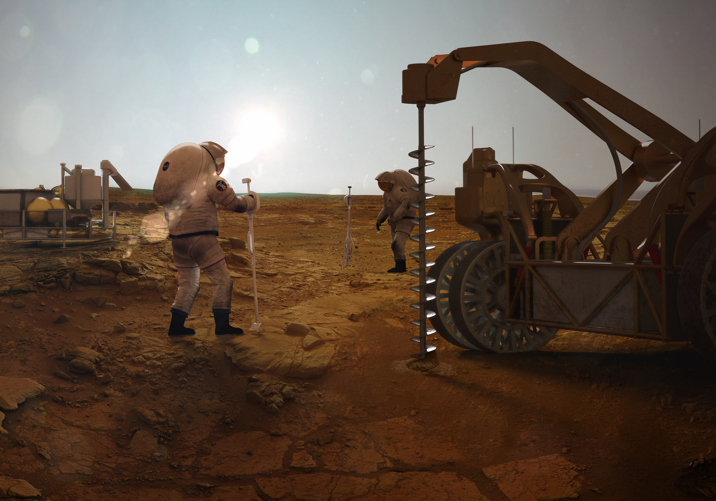
Maintenance & Repair
Flying Robots
Future Robotic Systems
Positioning Systems
Mining & Excavation
Human Controlled Robotics
Spacecraft Autonomy
Distributed
Edge
Computing
Future Surface
Habitats
Collaboration
Networks & Communications
Teleoperation
Autonomy
S/W Control
Framework
ISRU
OSAM
Rovers
Toward a Common In-Space Command, Control, Communications and Compute Infrastructure

Slide 5
Driving Reference Applications
A set of reference applications act as a litmus test for:
Early assessment of existing (and missing) ROS features for space
Identifying the driving attributes of Space ROS to achieve “typical” / projected space robotic systems
Objectives:
Establish a systematic approach to specifying space robotics applications that motivate the definition of essential Space ROS features
Identify a set of space robotics applications that collectively motivate the majority of features we hope Space ROS to embody
This package:
Proposes an application spec template for uniform treatment of candidate applications
Provides preliminary specifications for a number of space robotics applications
With a first round of feedback, we can expand concepts more thoroughly

Slide 6
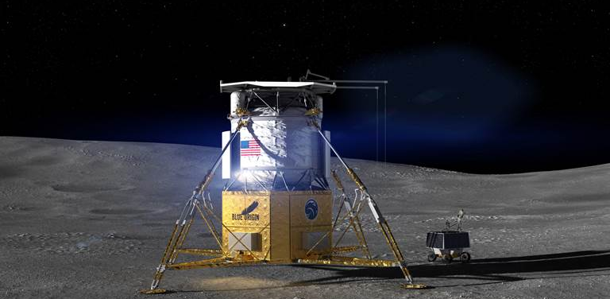
Surface: Cargo Offloading
Technical Attributes
Perception
Payload location/segmentation
Lander structure perception
Surface characterization
Planning
Manipulator trajectory planning
Payload surface placement planning
Manipulation
Payload grapple
Payload translation under gravity and dynamics
Payload surface placement amongst terrain features
Control and Coordination
Earth-based human supervision
Interleaved lander and robotics tasks (e.g. payload umbilical and mechanical release)
Possible payload health monitoring before/during/after crane operation
Communication
Crane-Lander: hardline (serial, Ethernet)
Payload-Lander: hardline (via severable umbilical)
Lander-Mission Control: RF
EXTENSION: Payload-Crane (via grapple fixture?)
Description
Robotic lift, translation and placement of cargo from lander deck to surface
Key Elements
Robotic Crane
Lander
Payload(s)
Mission Control (Earth)

Slide 7
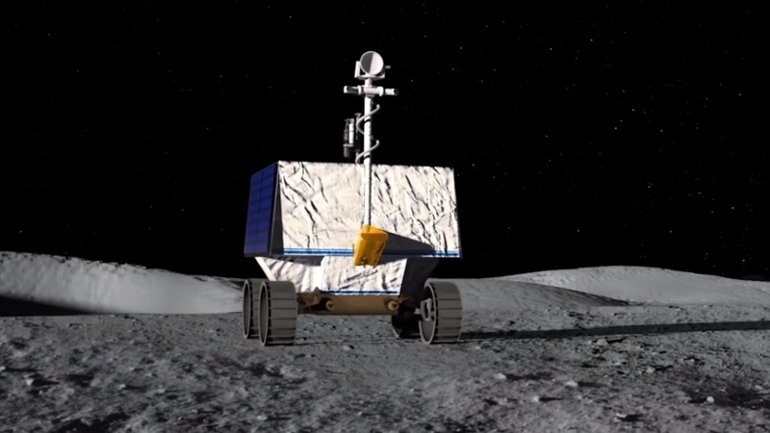
Surface: Resource Prospecting
Technical Attributes
Perception
Natural terrain characterization (traversability) in low light (lunar)
Detection of suitable drive paths and sampling sites
Novel feature/signal detection
Planning
Traversal planning considering remote sensing (resource maps), lighting, communications
Activity planning considering battery state of charge, intended activities and resource costs
Mobility
Control under rover kinematics and surface terramechanics
Terrain obstacle avoidance
Instrument, manipulator and/or drill placement
Manipulation
Possible active regolith interaction (scooping, scraping)
Drilling / subsurface access
Control and Coordination
Earth-based human supervision
Rover, instrument, manipulator and/or drill coordinated control
Communications
Prospector-Instruments: hardline (serial, Ethernet)
Prospector-Drill: hardline (serial, Ethernet)
Prospector-Mission Control: RF (direct-to-Earth)
Prospector-Comm Relay: RF
Comm Relay-Mission Control: RF
Description
Mobile survey to characterize regions for amenability for later resource extraction
Key Elements:
Mobile robotic resource prospector
Instruments
Drill
Orbital (or surface) communications relay(s)
Mission Control (Earth)

Slide 8
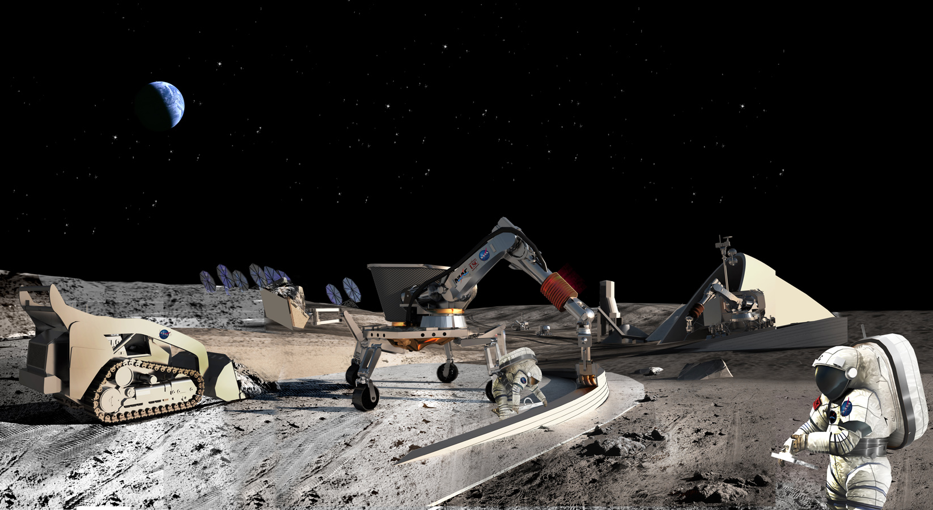
Surface: Site Preparation
Technical Attributes
Perception
Site characterization, including terrain volumetric assessments
Terrain mechanical resistance, mass
Other robot detection
Planning
Robot team-based excavation, deposition and leveling planning
Local route planning
Activity planning considering battery state of charge, intended activities and resource costs
Mobility
Control under rover kinematics and significant surface interactions
Terrain obstacle avoidance
Tool / manipulator placement and control under motion
Control and Coordination
Robot team coordination (loose and potentially tight coordination)
Earth-based human supervision
Communication
Robot-Robot: RF / WiFi
Robot-Mission Control: RF
Description
Terrain preparation and foundational construction in support of advanced surface operations, including:
Landing
Habitat emplacement
In-situ resource utilization
Key Elements
Robotic Regolith Movers (robot team; TBD composition and roles)
Mission Control

Slide 9
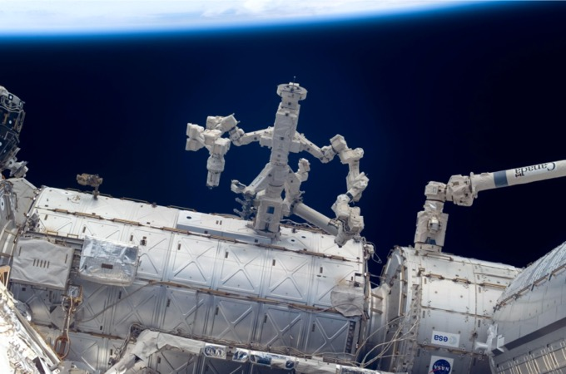
Surface: Orbital Station Unpressurized Robotics
Technical Attributes
Perception
Proprioception (self-configuration)
Obstacle detection (module hulls, visiting vehicles, external payloads and equipment, astronauts)
Force/moment detection (contact)
Planning
Arm trajectory planning
Task planning
Mobility
Control under arm kinematics, base contact and payload mass properties
Station obstacle avoidance
Manipulation
Closed-chain grappling/initial contact, ungrappling
Free-flyer grappling/initial contact, release
Maneuvering “payloads” under arm kinematics and joint payload/station/arm contact avoidance, force and torque limits
Emergency halt in face of unexpected contact or resistance
Control and Coordination
Earth-based human supervision
Direct human control
Station GNC coordination (collaborative mode switching, motion control, fault response)
Visiting vehicle coordination (collaborative mode switching, motion control, fault response)
Communications
Station-Manipulator: hardline
Station-Visiting Vehicle: RF and/or hardline (state-dependent)
Station-Crew Workstation: hardline
Station-ORU: hardline (via standard quick connect/disconnect interface)
OPTIONAL: ORU-Manipulator (for health monitoring/status)
Station-Mission Control: RF
Description
External (unpressurized) service tasking in support of orbital space station operations
Key Elements
Station Modules
Visiting Vehicles
Orbital Replacement Units
Mission Control
Crew Workstation

Slide 10
Technology Need

Slide 11
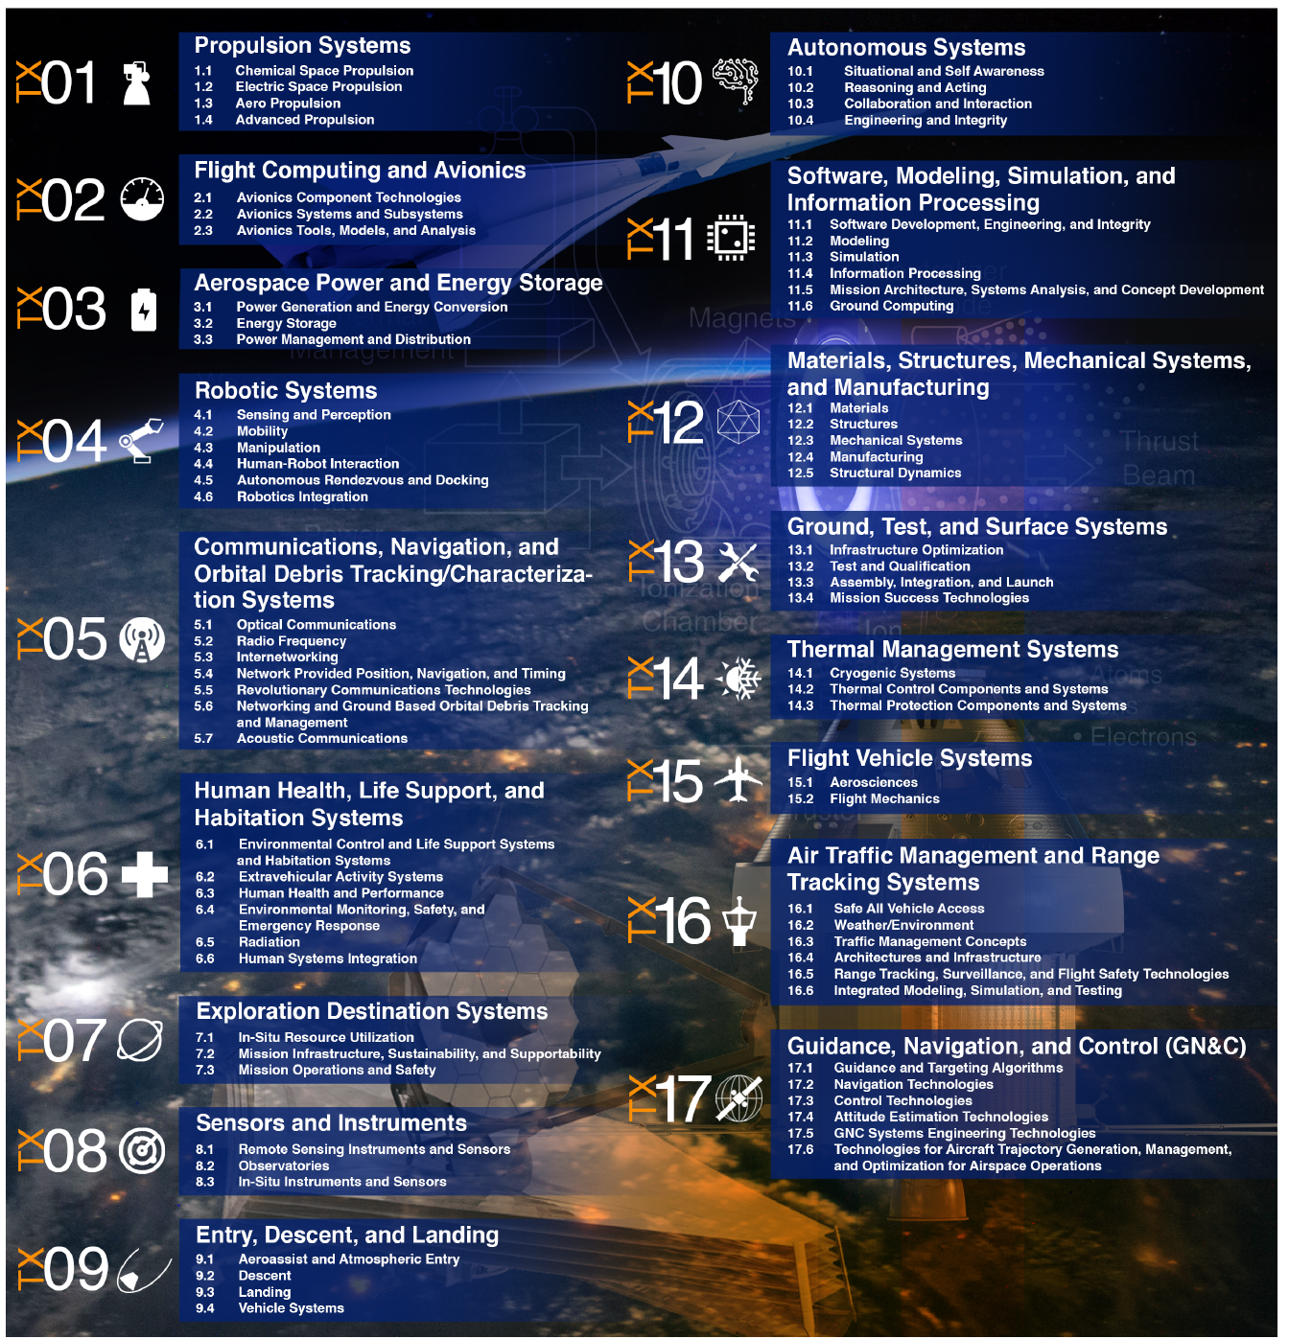
NASA Technology Taxonomy - Overview
https://www.nasa.gov/offices/oct/taxonomy/index.html
This taxonomy identifies, organizes, and communicates technology areas relevant to advancing the agency’s mission.
Provides a structure for articulating the technology development disciplines needed to enable future space missions
We identify several of the NASA Technology areas where Space ROS can have the most meaningful impact

Slide 12
NASA Technology Taxonomy - 04 Robotic Systems

Slide 13
NASA Technology Taxonomy - 07 Exploration Destination Systems

Slide 14
NASA Technology Taxonomy – 10 Autonomous Systems

Slide 15
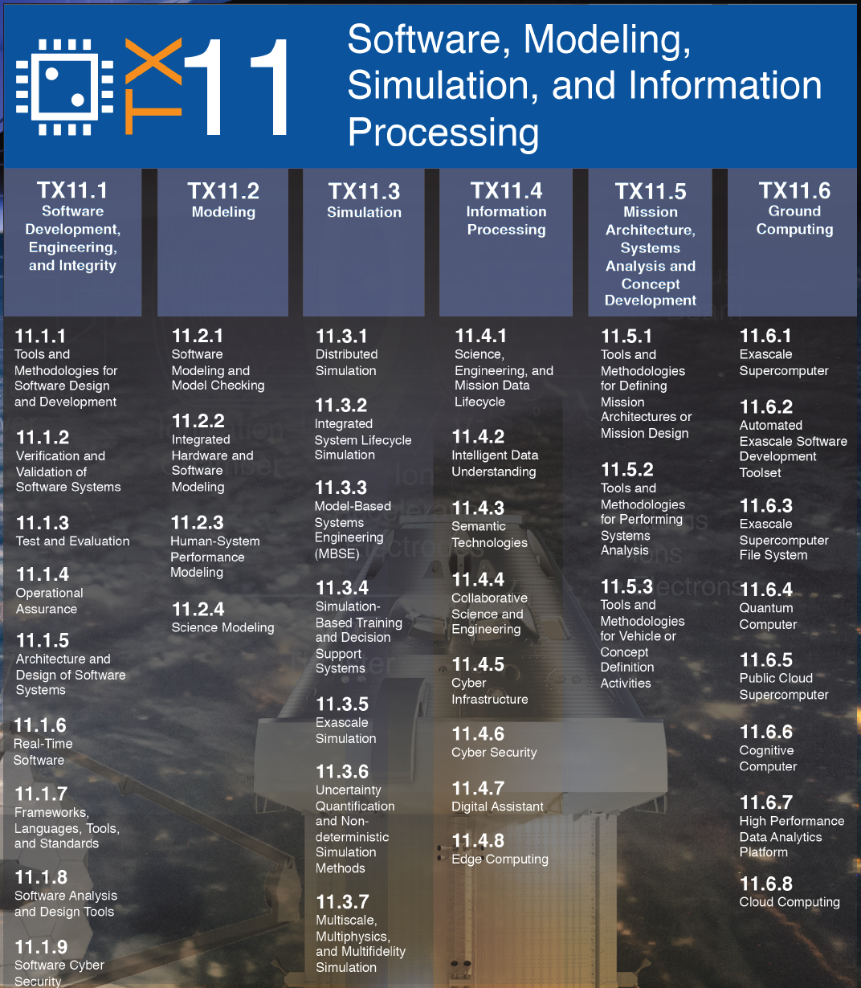
NASA Technology Taxonomy – 11 Software, Modeling, Simulation

Slide 16
Community Feedback
NASA solicited feedback on the Space ROS concept from the space robotics and autonomy community
Responses were received from 30 companies, universities, and individuals

Slide 17
RFI Takeaways: Statistics

Slide 18
RFI Takeaways: Statistics

Slide 19
RFI Takeaways: Statistics

Slide 20
RFI Takeaways: Statistics

Slide 21
RFI Takeaways: Space ROS
There is significant interest in a version of ROS2 that is capable of supporting space systems and robotics
Operating in a resource constrained environment is critical
Interactions with embeded systems is a concern for many respondents
Security is important to organizations working with the DoD
Documentation and examples are a key to adoption
A significant portion of respondents are interested in supporting the development community

Slide 22
RFI Takeaways: ROS Packages
The RFI requested what ROS packages would be valuable to the community
The following packages were mentioned in two or more responses
Package | Votes | Package | Votes | Package | Votes
tf2 | 11 | ament_index_cpp | 2 | Rclcpp | 2
ros_control | 6 | rostopic | 2 | image_geometry | 2
MoveIt | 6 | Eigen | 2 | diagnostic_updater | 2
RViz | 5 | interactive_markers | 2 | Rclcpp_action | 2
urdf | 5 | angles | 2 | kdl | 2
xacro | 5 | Pluginlib | 2 | gazebo_ros_pkgs | 2
robot_localization | 4 | joint_state_publisher | 2 | gazebo_msgs | 2
Gazebo | 4 | Rosidl_default_generators | 2 | geometry_msgs | 2
image_transport | 4 | rtabmap | 2 | Nav_msgs | 2
cv_bridge | 3 | behavior_tree | 2 | Visualization_msgs | 2
Std_msgs | 3 | Builtin_interfaces | 2
Sensor_msgs | 3 | rqt | 2
Trajectory_msgs | 3 | tracetools_test | 2
rosbag | 2 | PCL | 2
Dynamic_reconfigure | 2 | Robot_state_publisher | 2
Rcutils | 2 | camera_info_manager | 2

Slide 23
Architecture Concepts

Slide 24
Space ROS App Definition
Pub/Sub Interface
Executes one or more system functions
Multiple communications interfaces
Comprised of several packages
Apps can leverage support package to provide more standardized FSW app implementation (template)
Space ROS App
App Specific Functionality
Server Endpoints
Services
Actions
Standard App Support
Application Type | Description
Node App | Space ROS App that communicates solely with the message Space ROS message bus
Interface App | Provides a Space ROS compliant interface to an embedded sensor/system. Can be used to provide an abstraction to the underlying system
Bridge App | Bridges Space ROS to other middleware implementations Could be mission agnostic and auto-generated
App
Lifecycle
Alerts /
FDIR
Client Connections
Logging
Cmd/Tlm
Support
Space ROS App Packages
Hardware Interface
Domain Algorithms
Space ROS Standard App Support
Hardware Interface
Domain Algorithms
Space ROS Core
Space ROS Core

Slide 25
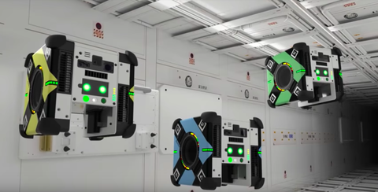
Standalone vs. Federated vs. IMA
Space ROS is a software framework designed to be deployed across a wide set of use cases.
There are a number of ways Space ROS could be deployed:
Standalone
Federated: Loosely coupled with another framework (such as cFS)
Integrate Modular Avionics (IMA) : Tightly integrated within the same computing using with another framework

Slide 26
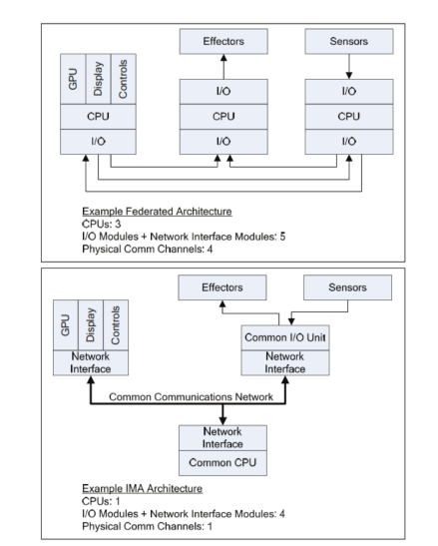
Standalone vs. Federated vs. IMA
Standalone: A single unit that encapsulates the entire system functionality and uses Space ROS may increase mass because it is its own physical payload but will require Space ROS to meet the validation requirements for the mission independently.
Federated: an independent unit encapsulates Space ROS communicates with the Avionics. This may increase mass because it is its own physical payload but reduces V&V from the flight software team.
IMA: a unit that is tightly integrated with the underlying Flight Software will impose some V&V work on the flight software team, but may save mass, because the compute capability lives in the centralized flight software computer.

Slide 27
Deployment Configuration Types
Space ROS Deployment
Avionics
Augmented System
Single Vehicle
Multi Vehicle
Integrated
Shared

Slide 28
Augmented System Overview
Integrated Avionics
Shared Avionics
Bus Avionics
Bus Avionics
Space ROS System 1 Avionics
Bus Middleware Apps
Space ROS Apps
Bus Middleware Apps
Space ROS System 1 Apps
App 1
App 2
…
App N
App 1
App 2
…
App N
App 1
…
App 1
…
App 2
Space ROS System N Avionics
App 2
…
Bridge App
…
Bridge App
Space ROS Apps
Space ROS System N Apps
App N
App 1
App 2
…
App N
App N
App 1
App 2
…
App N

Slide 29
Augmented System App Architecture
Space ROS
Bridge
App
Space ROS
Subsystem
Mngt / Utility
Apps
Bus
App
Space ROS
Node
App
Space ROS
Node
Apps
FSW Middleware Message Bus
Space ROS Message Bus
Radio
App
Bus
Interface App
Payload
App
Space ROS
Interface
App
Bus
Interface App
Payload
Interface
App
Space ROS
Interface
App
Radio
Sensor /
System
Payload
Sensors / Systems
Sensor /
System
Payload
Sensors / Systems
Ground Link

Slide 30
Single Vehicle System Overview
Integrated Avionics
Shared Avionics
Bus Avionics
Bus Avionics
Space ROS System 1 Avionics
Space ROS
Bus Apps
Space ROS Apps
Space ROS
Bus Apps
Space ROS System 1 Apps
App 1
App 2
…
App N
App 1
App 2
…
App N
App 1
…
App 1
…
App 2
Space ROS System N Avionics
App 2
…
Space ROS Apps
…
Space ROS System N Apps
App N
App 1
App 2
…
App N
App N
App 1
App 2
…
App N

Slide 31
Single Vehicle System App Architecture
Space ROS
Subsystem
Space ROS
Subsystem
Mngt / Utility
Apps
Reusable, mission agnostic apps
Space ROS
Bus Node
Apps
Space ROS
Node
App
Space ROS
Node
Apps
Space ROS
Node
App
Space ROS
Node
Apps
Subsystems include
Payloads
i.e robot arm
Bus Interfaces
i.e. Electrical Power System
Space ROS Message Bus
Radio
App
Space ROS
Interface
App
Space ROS
Interface
App
Space ROS
Interface
App
Space ROS
Interface
App
Radio
Sensors / Systems
Sensors / Systems
Sensors / Systems
Sensors / Systems

Slide 32
Multi Vehicle System Description
Peer to Peer comms via RF link
Use Cases
Heterogenous middleware environment
Intervehicle communications via Multi Agent Interface Language
Space ROS message domain does not extend beyond single vehicle
Space ROS only
Space ROS message domain extends beyond single vehicle
Mixed?

Slide 33
Multi Vehicle System Description
Intervehicle Comms via RF
Spacecraft 2
Augmented System
Ground Comms
Space ROS Subsystem 1
Apps
Bus Software
Apps
Spacecraft 1
No Space ROS Present
Radio App
…
Space ROS Subsystem N
Apps
Bus Software
Apps
Radio App
…
Spacecraft N
Single Vehicle Space ROS
Bus Apps
Space ROS Subsystem 1
Apps
Radio App
Ground Station

Slide 34
Ground-only Space ROS System Overview
Ground Subsystem
Flight Subsystem
Ground Data System
Flight Subsystem
Space ROS Ground Subsystem 1
Ground Software Apps
Space ROS Apps
Middleware
Bus Apps
Middleware System 1 Apps
App 1
App 2
…
App N
App 1
App 2
…
App N
App 1
App 1
…
App 2
App 2
…
Bridge App
Space ROS Ground Subsystem 2
…
App N
Space ROS Apps
Middleware System N Apps
App N
…
Radio App
…
App 1
App 2
App N
App 1
App 2
App N
Telem and Cmd Server
Radio
Ground Station

Slide 35
Shared Space ROS Ground and Flight System Overview
Ground Subsystem
Flight Subsystem
Ground Data System
Flight Subsystem
Space ROS Ground Subsystem 1
Ground Software Apps
Space ROS Apps
Space ROS
Bus Apps
Space ROS System 1 Apps
App 1
App 2
…
App N
App 1
App 2
…
App N
App 1
App 1
…
App 2
…
App 2
…
Bridge App
Space ROS Ground Subsystem 2
…
App N
Space ROS Apps
Space ROS System N Apps
App N
…
Radio App
…
App 1
App 2
App N
App 1
App 2
App N
Telem and Cmd Server
Radio
Ground Station

Slide 36
Shared Ground and Flight System App Architecture
Space ROS
Ground System
Space ROS
Subsystem
Space ROS
Flight System
Mngt / Utility
Apps
Mngt / Utility
Apps
Mngt / Utility
Apps
Reusable, mission agnostic apps
Space ROS
Node
App
Space ROS
Bus Node
Apps
Ground Software
Apps
Space ROS
Bus Node
Apps
Space ROS
Node
App
Space ROS
Node
Apps
Space ROS
Node
Apps
Space ROS
Node
App
Space ROS
Node
Apps
Space ROS Message Bus
Ground Software Message Bus
Space ROS Message Bus
Space ROS
Bridge
App
Radio
App
Space ROS
Interface
App
Space ROS
Interface
App
Space ROS
Interface
App
Space ROS
Interface
App
Space ROS
Interface
App
Space ROS
Interface
App
Tlm and Cmd Server
Radio
Sensors / Systems
Sensors / Systems
Sensors / Systems
Sensors / Systems
Data Stores / Servers
Sensors / Systems
Ground Station

Slide 37
Space ROS used for Testing and Simulation
Ground Subsystem
Flight Subsystem
Ground Data System
Flight System Testing and Simulation
Flight Subsystem
Space ROS Apps
Ground Software Apps
App 1
App 2
…
App N
Middleware
Bus Apps
Middleware System 1 Apps
…
Bridge App
App 1
App 2
…
App N
App 1
App 1
App 2
…
App 2
Ground System Testing and Simulation
…
…
Bridge App
App N
Space ROS Apps
Middleware System N Apps
N
Radio App
App N
App 1
App 2
…
App N
App 1
App 2
…
App N
Telem and Cmd Server
Radio
Ground Station

Slide 38
Space ROS Benchmarking

Slide 39
Benchmarking Objectives
We are working to evaluate the build of Space ROS under development to:
Characterize Space ROS performance
Processor Utilization
Memory
Network throughput
QoS Metrics
Compare Performance to other frameworks using Ames Distributed Space Autonomy Suite
Compare to NASA cFS with reimplemented applications for Autonomy and Navigation
Space-like targets
X86 Architecture e.g. Unibap iX5-100
ARM Architecture e.g. ZCU-102

Slide 40
Benchmarking Test Matrix Summary
A full test matrix has been developed for evaluating Space ROS in both a containerized development environment and in a processor-in-the-loop environment on target hardware including:
Test Description | Metric Recorded | Metric Details
Message passing tests using but a fully connected and linear mesh network with: Ideal, 10% loss, 50% loss, and 90% loss, 100 ms latency and 500 ms latency network configurations | Deployed Application Size | DSA Apps + SpaceROS Compiled File Size
 | CPU Utilization | SpaceROS CPU Utilization, max, min, mean, variance
 | Memory Usage | SpaceROS Memory Utilization, max, min, mean, variance
 | Topic Latency | Latency between nodes reward and assignment messages, max, min, mean, variance
 | Inter Container Latency | Latency between AUTO nodes Auto Sat State Message
 | Inter Container Packet Loss | Number of AUTO Sat State Messages not received.
 | Total State Messages Ignored | When a message is delayed to long it is just ignored so this combined both dropped packets and ones whose latency was too large.

Slide 41
Space ROS Community

Slide 42
Space ROS Community Governance
Space ROS will seek to leverage ROS
Space ROS trademarks being transferred to Open Robotics
Following ROS2 Governance Guidelines: https://docs.ros.org/en/galactic/Governance.html
Space ROS will form a Technical Steering Committee (TSC) to prioritize feature selection
Member slots available in exchange for TBD FTE support (e.g. 0.5 FTE-1 FTE)
Membership is available to organizations and missions
Space ROS will attend relevant community events to advertise and seek community input
e.g. ROS Con, FSW Workshop

Slide 43
Governance and Post ACO Operations
Technical Steering Committee
Volunteers to identify priorities and features
Looking to identify members of government and industry groups to serve as members
Project Manager x1
Interfaces with the community manages pull requests
Testing and Continuous Integration Management x2
Maintains testing and V&V infrastructure
Supports maintaining compatibility with ROS2
Technical Steering Committee
NASA
ESA
LSIC
etc.
Project Manager
Test/CI
Test/CI

Slide 44
Space ROS Public Working Group
We are proposing a working group meeting separate from the ACO effort to integrate external partners into Space ROS development
Companies and organizations who have expressed interest in supporting development
Companies and organizations who responded to the RFI
Allow for Will Chambers to maintain involvement
Open Questions?
Meeting cadence
How quickly to invite new people

Slide 45
Space ROS Community Pull Request Acceptance Policy
TSC identifies pull requests for inclusion
Pull requests must Space ROS testing requirements
Tooling for tests will be included in the repositories
Static analysis testing
Full DRM based scenario testing
TSC will identify what features from ROS2 can be incorporated into Space ROS and provide prioritization

Slide 46
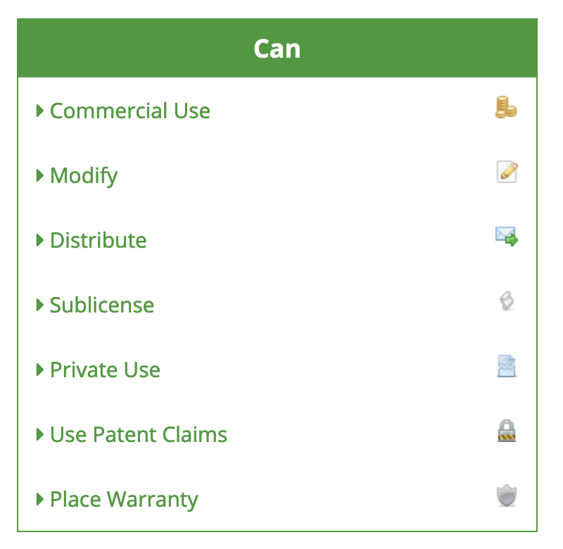
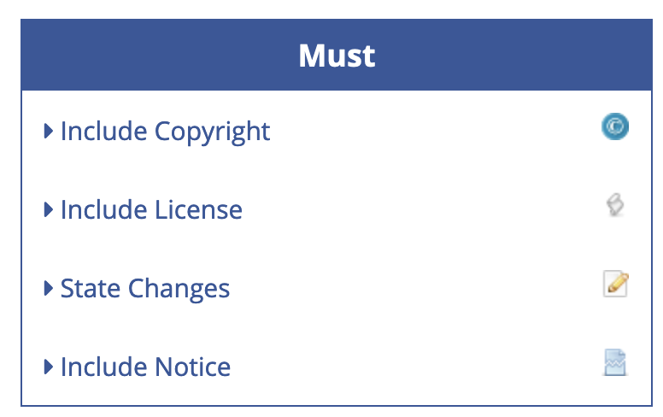
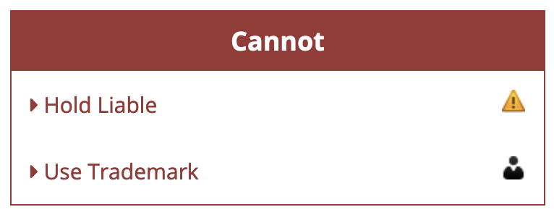
License
Space ROS will adopt ROS2 licenses
Largely Apache 2.0 and Space ROS will continue to
Permissive
Commercially Useable
Some Creative Commands and BSD licenses for tools and documentation

Slide 47
Acknowledgments
This work was funded as a collaborative effort between NASA Goddard Space Flight Center, Ames Research Center, Johnson Space Center, and Blue Origin

