Slide 1
In Space Manufacturing Portfolio Overview
Christopher Roberts

Slide 2
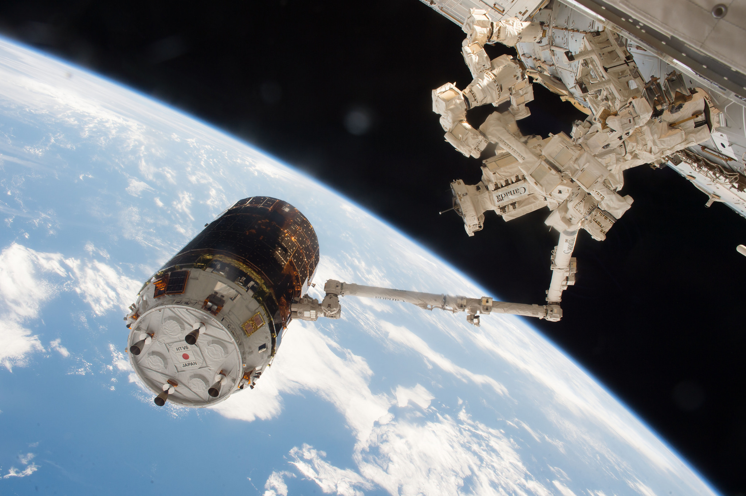
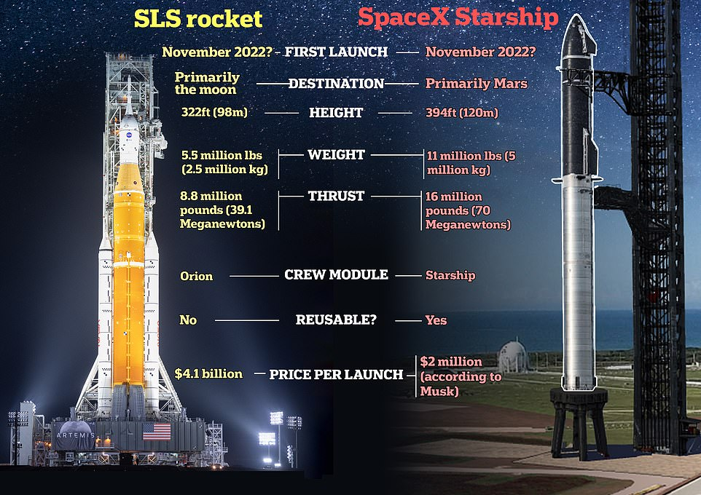
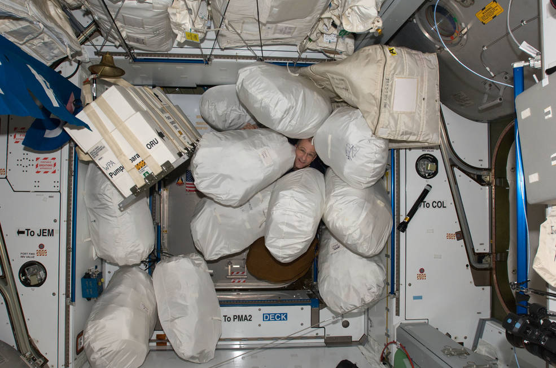
Why?
Cargo Delivery to ISS
(image credit NASA)
https://www.dailymail.co.uk/sciencetech/article-11290893/How-Elon-Musks-Starship-stacks-against-NASAs-SLS.html
Trash Management on ISS
(image credit NASA)

Slide 3
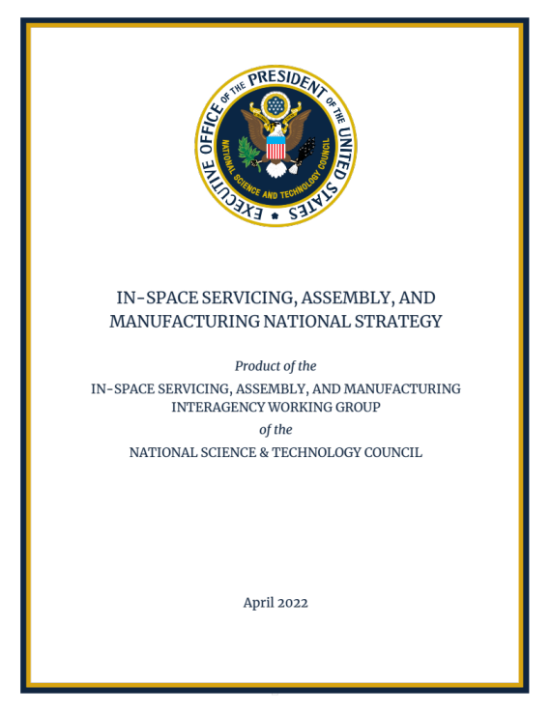
Why?
“ISAM capabilities can create the foundation for sustainable operations and serve as a strategic enabler to spur U.S. scientific and technological innovation, ensure the freedom to operate, and preserve the use of space for future generations.”
In-Situ Resource Utilization
In-Space Serving, Assembly, and Manufacturing
In-Space Manufacturing
Upstream & Downstream Supporting Services
Adapted from In-Space Manufacturing-2022 Industry Survey
Erik Kulu
Notes:
Add in Ven diagram

Slide 4




Portfolio Overview
Focus on making living and working in space sustainable, reducing Operations cost.
Metal/Multi-Material Manufacturing
Outfitting for Habitats
Environmental and Health Sensors
Energy Storage
Medical Devices
Food and Pharma
Modular Excursion Devices
Textiles
Electronics Manufacturing
Curtis Hill
Outfitting
Rachel Bardsley
Multi-Materials (Metals) Manufacturing
Christopher Roberts
Recycling & Reuse
Alexander Blanchard

Slide 5
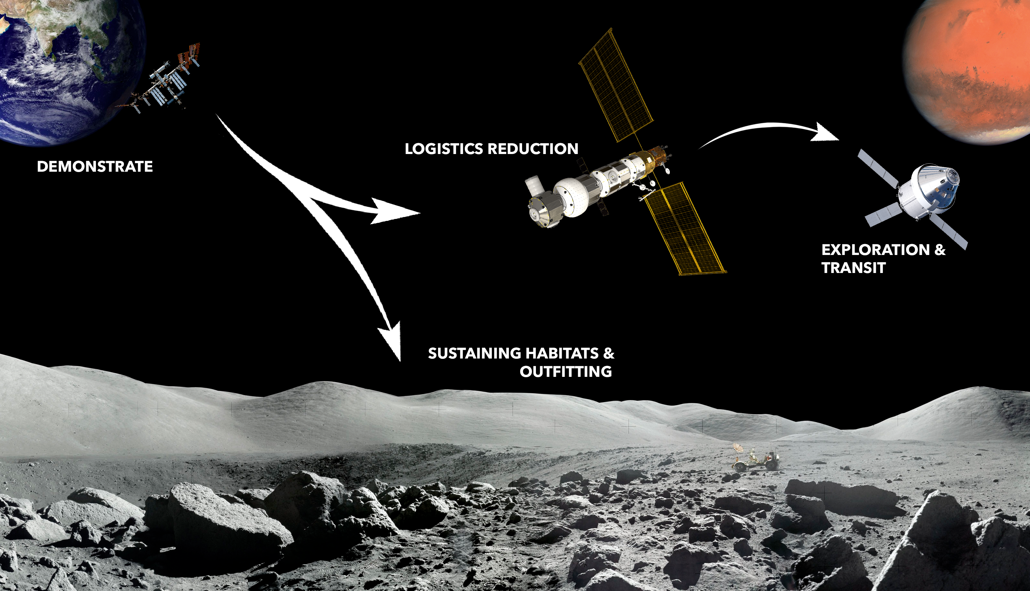
In Space Manufacturing Strategy
COMMERCIALIZATION
& MARKET DEVELOPMENT

Slide 6
Structure
James Stott
Portfolio Manager
Lucian Ivan
Deputy Portfolio Manager
Vacant
Chief Engineer
Frank Leadbetter
Senior Technical Advisor
David Mcintosh
Lead Systems Engineer
Bob Gower
Scheduler
Lynne Ellett
Resource Analyst
Lierin Pociask
Project Coordinator
Christopher Roberts
ODMM PI & Portfolio PI
Curtis Hill
ODME PI
Alexander Blanchard
Recycling and Reuse PI
Rachel Bardsley
Outfitting
EM Support Personnel
Ian Hanson
Erin Lanigan

Slide 7
Partnerships’/Collaborators
Academic
University of Louisville
University of California Berkley
University of Nebraska
University of Alabama Huntsville
Appalachian State
Auburn University
Boise State
Georgia Tech
California Tech
Iowa State University
University of Miami
Florida A&M University
Oregon State
West Virginia University
Youngstown University
University of El Paso
University of Wisconsin
University of Wyoming
University of Delaware
NASA Centers
Marshall Space Flight Center
Ames Research Center
Johnson Space Center
Kennedy Space Center
Goddard Space Flight Center
Air Force Research Center
Jet Propulsion Laboratory
Glenn Research Center
Industry
Techshot
Redwire Space
Cornerstone Research Group
NextFlex
nScrypt
Multi3D
LambdaVision
Faraday Incorporated

Slide 8
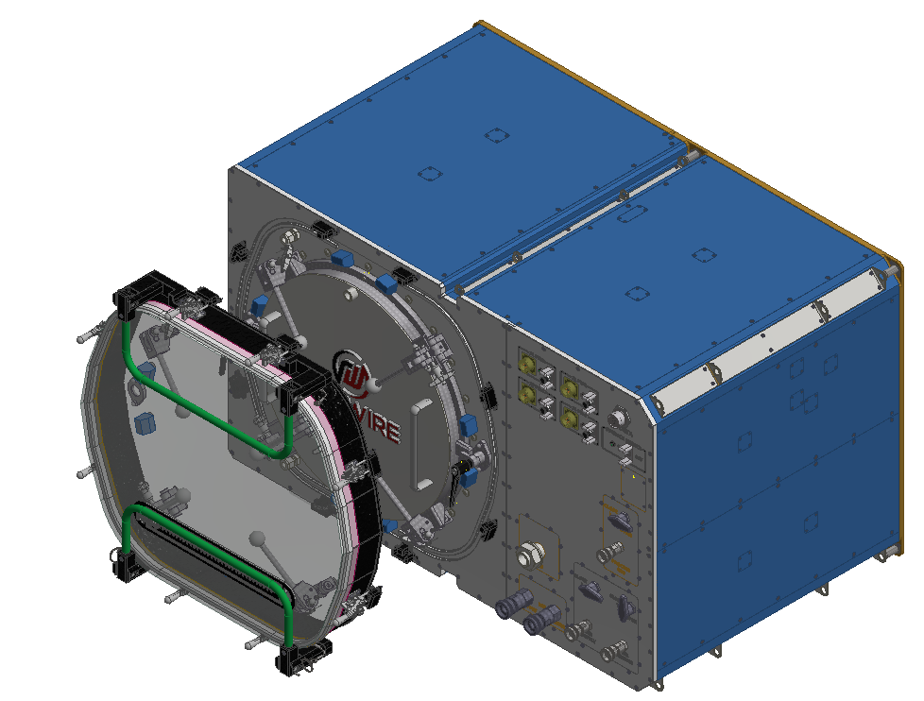
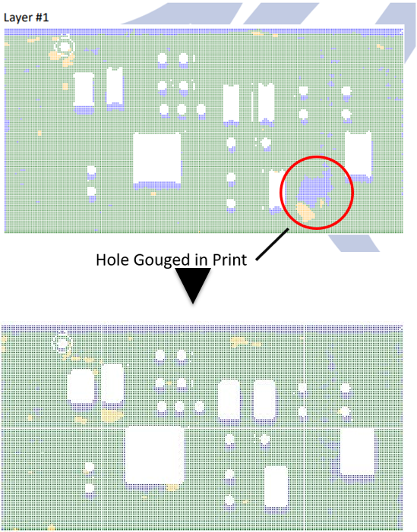
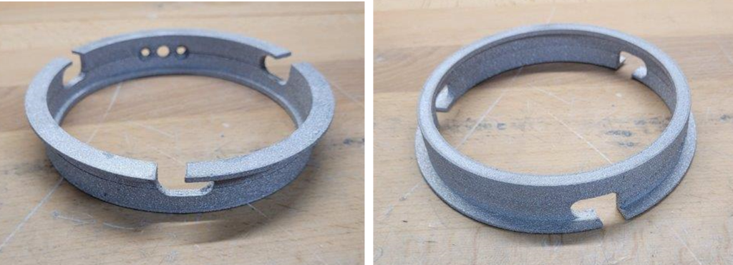
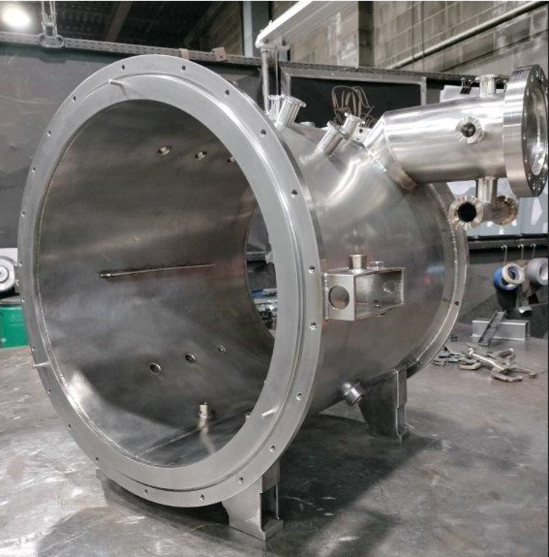
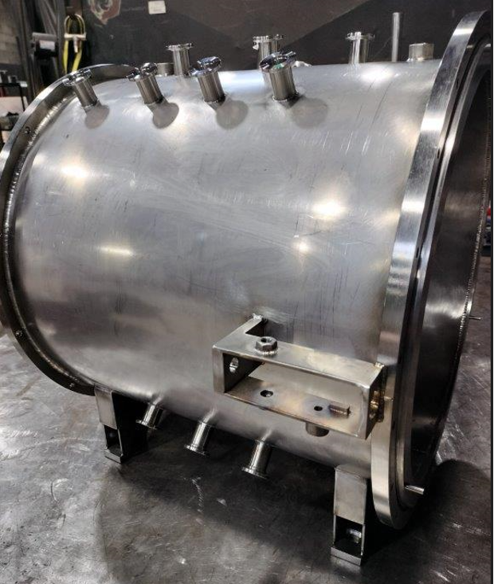
On Demand Manufacturing Of Multi-materials
Goal: Demonstrate metals additive manufacturing in microgravity and characterize the impact of microgravity.
Sub Projects:
    Outfitting: Develop the capability to manufacture on-demand utilities, furnishings, tools, etc. for off-earth habitation including the use of In-Situ Resources.
    Recycling and Reuse: Develop the capability to recycle and reuse materials into useable feedstocks for in-space, on-demand manufacturing.
CAD of Revised furnace module (top). Furnace module hotzone during manufacturing.
Image courtesy of Techshot a Redwire company (bottom).
Space Suit Wrist Disconnect manufactured by FabLab. Image courtesy of Techshot a Redwire company.
Illustration of inspection and remediation. Image courtesy of Techshot a Redwire company.

Slide 9
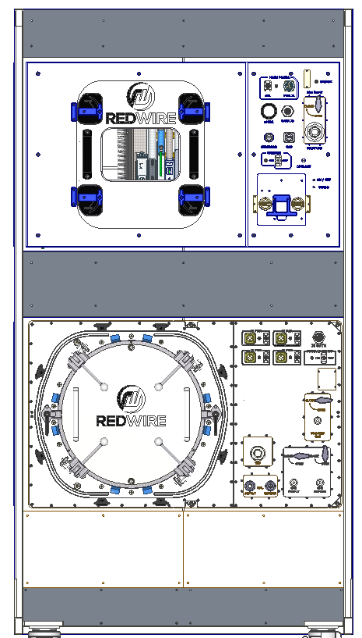
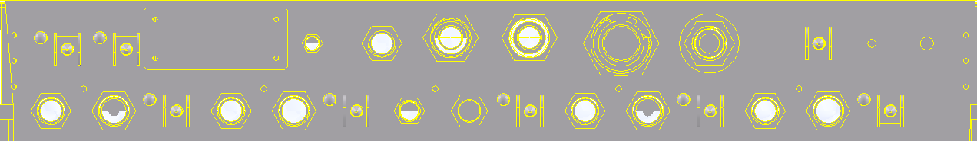
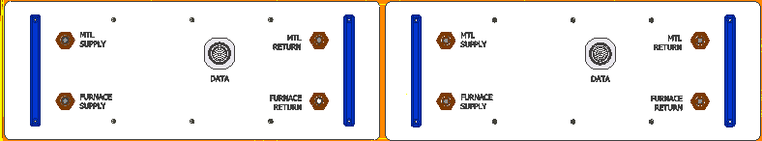

Overview of FabLab
Advanced Toolplate:
    Printing of Metal and Polymer Parts
    Finish Milling
Inspection Subsystem
    Defect Detection and Remediation
Environmental Control
    FOD capture system
Electronics Manufacturing
    Smart Pumps, Directed Energy, Pick and Place, etc.
Avionics and Control
Print Module
Full Payload
Glovebag concept for FOD control
Part Transfer Box for transport between modules
Remote Commanding for limited crew interaction
Compatible with science investigations beyond the ISM project
Furnace Module
Sintering of Metal Parts
Brazing of Assemblies
Avionics and Controls
Process Gas Drawer
Provides Argon to Furnace Module

Slide 10
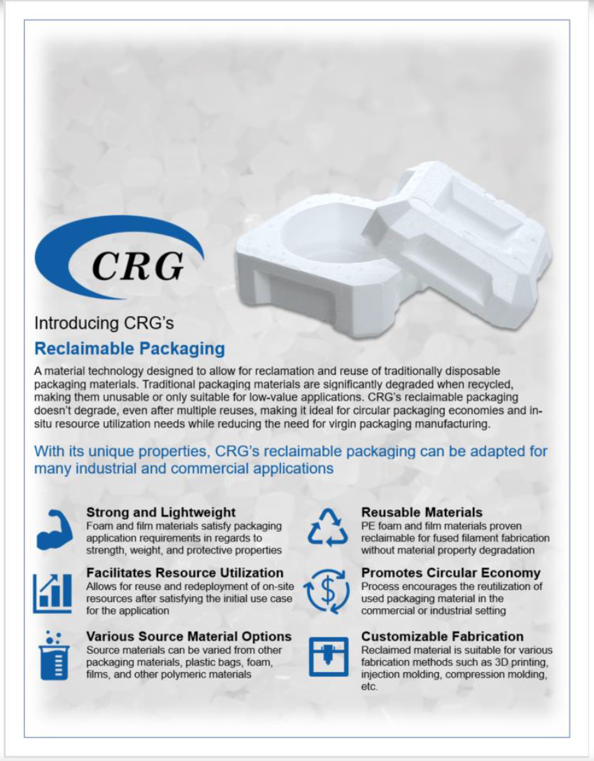
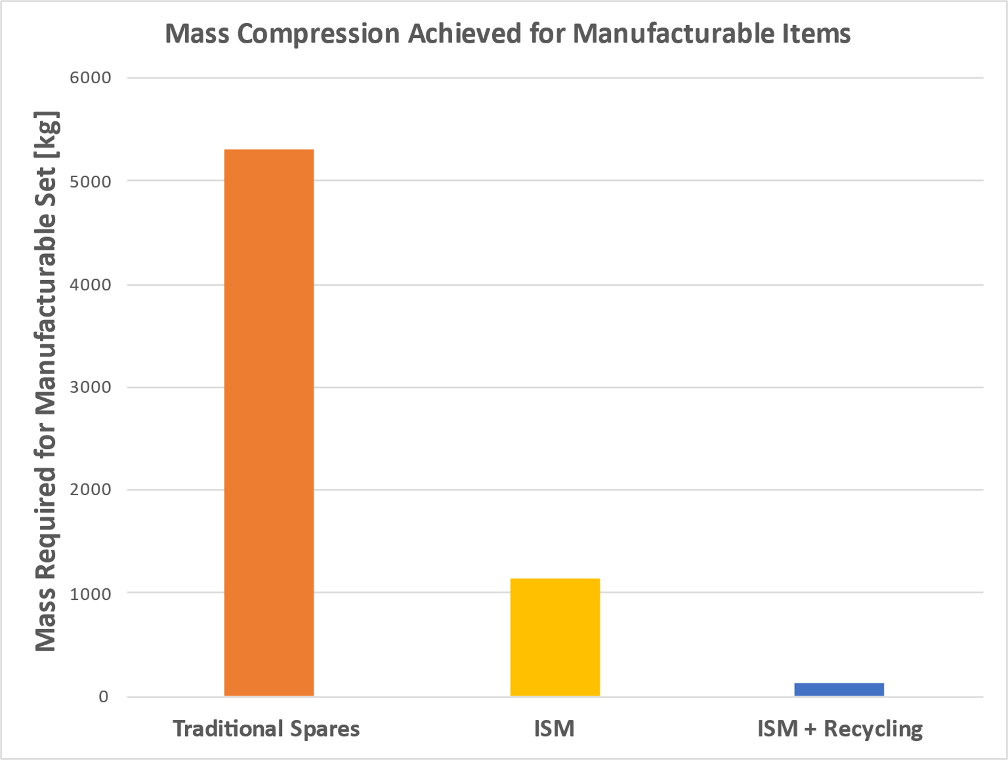
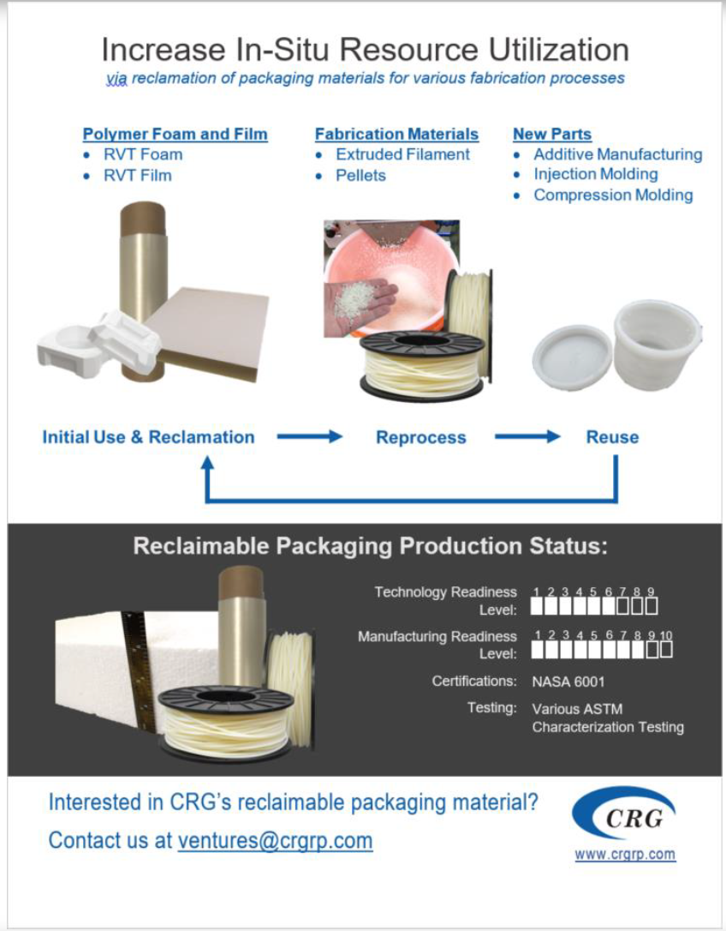
Recycling and Reuse
Fundamental Assumption: Payloads are designed to be maintainable/manufacturable with ISM systems
-78.3%
-97.7%
Andrew Owens and Olivier De Weck. "Systems Analysis of In-Space Manufacturing Applications for the International Space Station and the Evolvable Mars Campaign", AIAA SPACE 2016, AIAA SPACE Forum, (AIAA 2016-5394)
Notes:
Goal: Demonstrate recycling and reuse technologies in microgravity and characterize the impact of microgravity.
Primary Technology Development Efforts
Reversible Thermosetting (RVT) Materials from Cornerstone Research Group
Technical Capabilities:
Development of recyclable packaging materials and processes
Development of in-process monitoring technologies for filament feedstock production
Demonstration of regolith/polymer blend printing on orbit
Demonstration of a closed-loop recycling ecosystem of flexible thermoplastic polyurethane material
Redwire Regolith Print:
Technology demonstration for the feasibility of 3D printing regolith/polymer blends in low gravity environments
Completed a flight experiment in August ’21

Slide 11
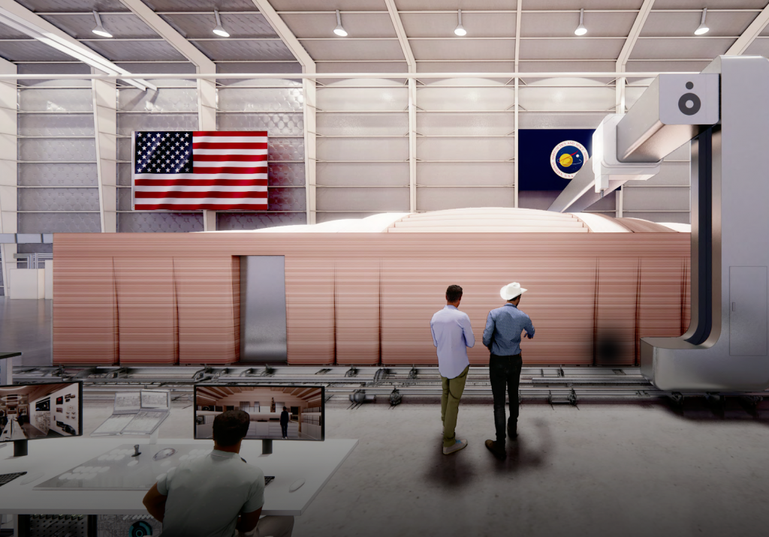
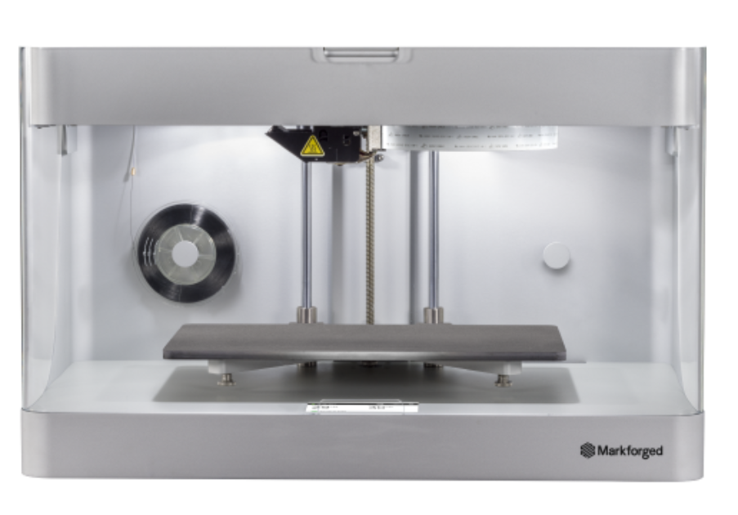
Outfitting
CHAPEA
Provided 3D printer and scanner for crew analogue
Goal: Understand crew interaction with manufacturing systems.
Image Credit: ICON
Image Credit: Markforged
Notes:
Marked forged printer

Slide 12
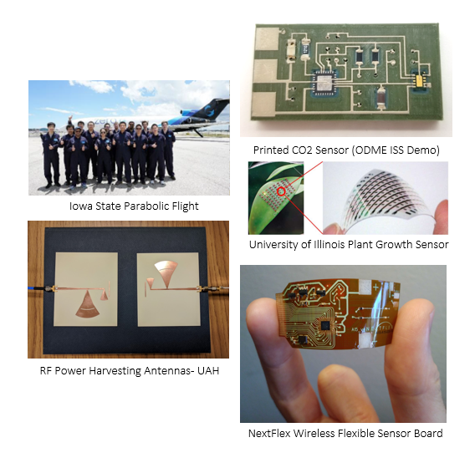
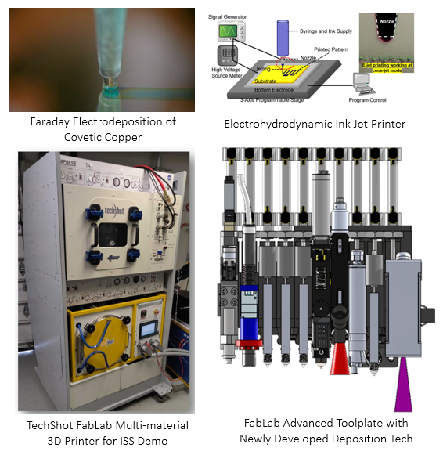
On Demand Manufacturing Of Electronics
Goal: Develop and demonstrate on demand printing of electronics in microgravity and characterize the impact of microgravity.
Notes:
Primary Technology Development Efforts
On-Demand Manufacturing of Electronics (ODME) develops systems for building crew and structural monitoring systems and sensors in orbit.
Advanced Toolplate Integration of ODMM FabLab Printer
Technical Capabilities
Development of Multilayer Technology for Flexible Electronics
Development of Thin Film Technology for Microgravity
Development of In-Situ Verification Technology
Development of ODME Flight Demo for ISS
Thin-film deposition TRL/MRL development- Multiple suborbital zero gravity parabolic flights. STMD Flight Opportunities funded these flights.
ODME completed a project-controlled milestone for Thin-Film Deposition Technologies Evaluation during FY21.
On-demand printed power generation and energy storage devices- These include printed RF power harvesting antennas (UAH), printed thermoelectric devices (Boise State), printed wearable bio-fuel cell generators (Cal Tech), and multiple supercapacitor technologies for energy storage (Georgia Tech, Auburn, NASA ARC).
On-demand printed sensor technologies- These include radiation sensors (Georgia Tech), strain sensors for structural health monitoring and plant growth monitoring (Florida A&M University, West Virginia University, University of Illinois), wireless sensors for crew health monitoring and printed cortisol sensors (Georgia Tech, Cal Tech, NASA ARC).
NextFlex flexible wireless crew health sensing device “AstroSense”- The Potentiostat communications interface and the preliminary electrical and mechanical design is complete. https://www.nextflex.us/story/nasa-astrosense-in-space-manufacturing-multi-material-fabrication-with-printed-electronics/
Passive wireless sensing technology- Auburn University is developing passive wireless sensing technology for ODME, including the printing of semiconductor devices.
Multi-layer technology development- Auburn University year 2 development of process recipes for assembly of flexible printed electronic devices. Extensive mechanical and electrical testing of these devices to verify mechanical and electrical performance has been accomplished. Auburn University year 3 encapsulation development canceled due to GCD budget reduction.
FabLab Advanced Toolplate- ODMM and ODME pooled resources to redirect the development of the FabLab Advanced Toolplate after the reduction of budget from GCD.
ODME is developing new tools for the Advanced Toolplate to include newly developed deposition technologies. The EHD (Electrohydrodynamic) Ink Jet and Electrodeposition of Covetic materials tools are in development for FY23 integration into Advanced Toolplate.
Flight Opportunities is funding suborbital flight testing of the Advanced Toolplate and newly developed tools. These parabolic flights will be in May 2023.
Technology Maturation and Strategic Planning:
Space Foundry- small business development of plasma jet thin film deposition technology. This technology was developed by ODME through SBIR phase 1, phase 2, and phase 3 awards. ODME and Flight Opportunities collaborated on two separate suborbital flight campaigns to advance the TRL of this technology. This technology has potential for ARTEMIS, Lunar on surface manufacturing, solar panels, as well as potential disinfecting applications on ISS.
Multi3D- ODME and Multi3D are developing a new, novel feedstock for 3D printing of electronics. This collaboration came from a DARPA conference where ODME was identified as a potential user. ODME is working with the EC REALM project for fabrication of new RFID housing designs for evaluating this material. In testing the 3d printed housings with the material, it turns out to be performance equivalent to machined aluminum housings with 47% of the weight of the Al housings.
Building Coalitions:
Auburn University new Space Manufacturing Center- ODME’s partnership in 3D printing of additive electronics with the new Space Manufacturing Center. Auburn has purchased a $14M building in Research Park and are developing the scope of areas that it will cover, but additive manufacturing in general and in-space manufacturing of additive electronics in specific are a big part of the plan.
ATOMIC NSF consortium- ODME participated as a primary government partner in the establishment of a new NSF University consortium with Penn State, Boise State, and Rice University. This new NSF consortium is named ATOMIC (CENTER FOR ATOMICALLY THIN MULTIFUNCTIONAL COATINGS) and is for the development of high-performance thin film coatings, including electronics and sensors.
Leading Technology Impacts:
Flight testing of thin film deposition systems- ODME had extensive collaboration and support from STMD Flight Opportunities in FY22 for the evaluation of Thin Film Deposition systems and testing in zero gravity through Suborbital Parabolic Flights. ODME was funded by Flight Opportunities for a total of four series of parabolic flights this year. This was a large contributor in advancing the TRL/MRL of this ODME technology.
https://www.nasa.gov/centers/armstrong/features/microgravity-testing-advances.html
InSPA In-Space Applications- ODME involvement in InSPA projects is leading to the commercialization of manufacturing in low earth orbit. For example, the thin layer by layer manufacturing of retinal implants by LambdaVision is leading to lower cost, higher volume manufacturing of retinal implants to cure macular degeneration. Redwire is developing fabrication capabilities for printed semiconductors through and InSPA project.
Iowa State University Parabolic Flights- The ISU Parabolic Flights allowed 14-15 students at Iowa State to gain invaluable experience in performing printing experiments in zero gravity. This will allow students to start a pathway to engineering or space sciences, gain valuable experience in teamwork in stressful environments, and accomplish many results for technology maturation.
NASA Space Technology Graduate Research Opportunities (NSTGRO) Fellowship Program-
NSTGRO fellowship researcher Alexandra Marnot from Georgia Tech University is developing regolith inks and low temperature printing processes. This past summer, she printed her regolith inks at -30 degrees C. in MSFC cold chambers.
NSTGRO fellowship researcher Mark Ciappesoni from University of Miami is developing on-demand printed infrared (IR) sensors for in-space manufacturing. He was able to successfully develop designs and materials to print prototype devices this past summer.
NASA 2020 Early Career Faculty- ODME is mentoring and collaborating with NASA 2020 ECF20 autonomous plant growth sensing. ODME is collaborating on the implementation of wireless communications with these sensors with Dr. Ying Diao at the University of Illinois.
Established Program to Stimulate Competitive Research (EPSCoR)-
EPSCoR intern John Burke from West Virginia University is developing a flexible conductive ink for printing a wide range of strain and structural health monitoring sensors. He was able to successfully develop and print an ink formulation this past summer.
University Project Collaborations started (FY22):
7 NASA Centers, 6 public or private companies, and 17 different universities.
Project Summary:
The ODME project is developing technologies for the hardware required to on-demand electronics and sensors in a microgravity environment.
ODME has engaged multiple research universities and private companies to collaborate in the development of the hardware, materials, and processes required for the microgravity demonstration on the ISS.
The parallel development of sensor devices for a wide range of mission requirements as well and the power generation and energy storage devices to allow these sensors and printed electronics devices to be able to operate without batteries or external power.

Slide 13
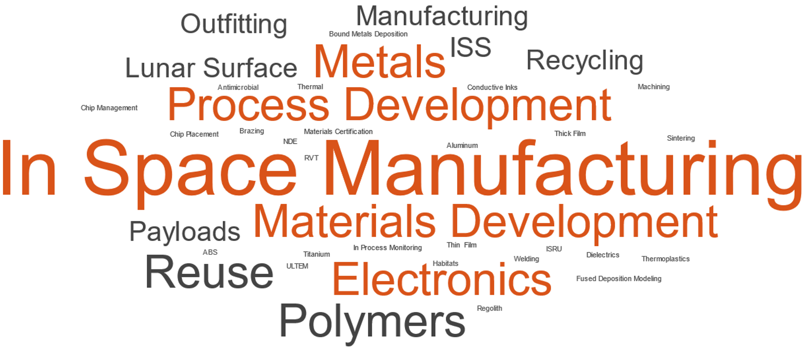
Areas of Current Interest

Slide 14
Future Work
Currently developing the Technical Maturation Plan
Manufacturing systems for sparing and outfitting in lunar and transit environments
  Design for Manufacturing and Human Factors
Process Development: Welding, Brazing, Heat Treating, Post Processing, Recycling
Materials Development: Customized alloys (i.e. no heat treatment), recyclable materials
Enable Industry & Develop the Industrial Base

