Slide 1

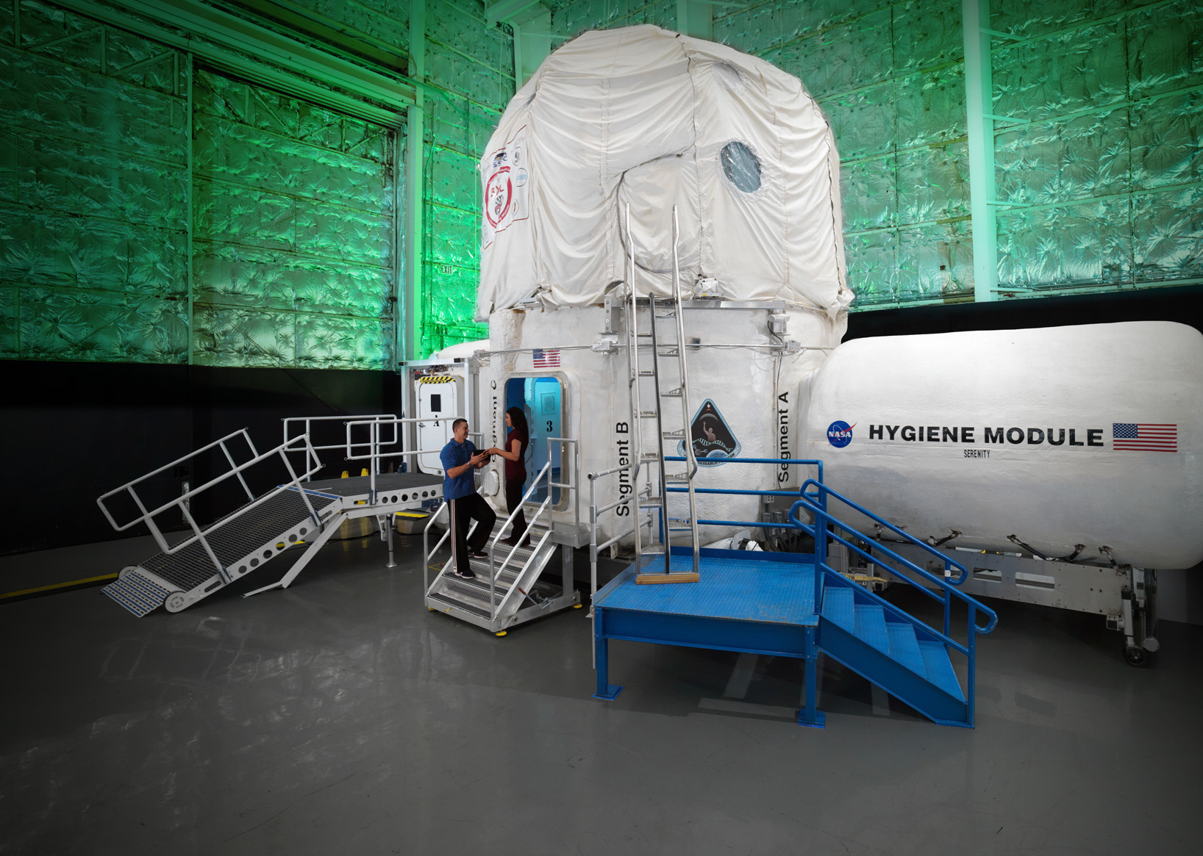

HERA Update
Sara Whiting, PhD

Slide 2
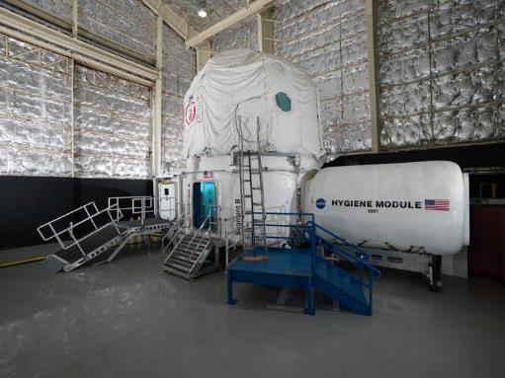
Human Exploration Research Analog
Two-story, four-port habitat unit. Cylindrical with a vertical axis, and connected to a simulated airlock and hygiene module
Missions implemented for the sole purpose of human research in an isolated, confined, and controlled environment

Slide 3
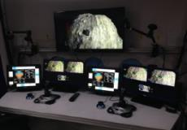
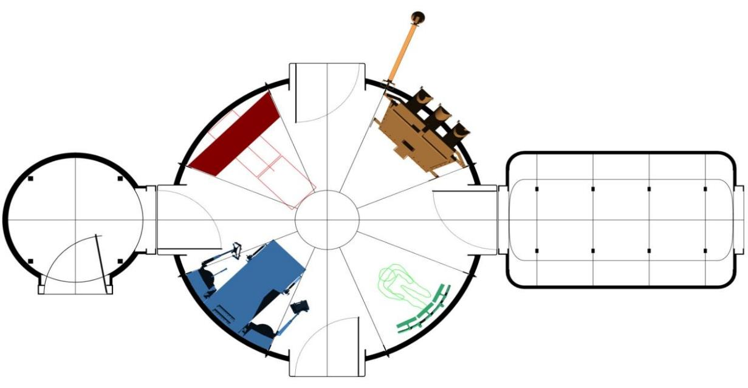
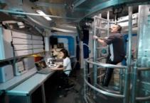
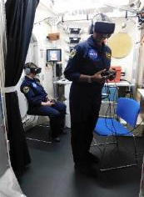
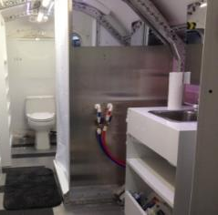
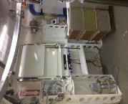
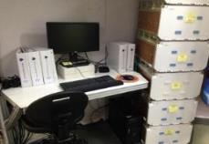
HERA – Level 1
47’ (14.3 m)
Medical Science Station
19.3’ (5.9 m)
Flight
Deck
13.25’ (4.0 m)
8.5’ (2.6 m)
Hygiene Module
Airlock
Core
Toilet
Sink
Shower
To porch and ramp
Maintenance Workstation
Operations Console
Hygiene Module

Slide 4

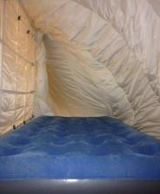
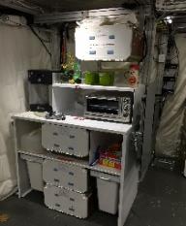
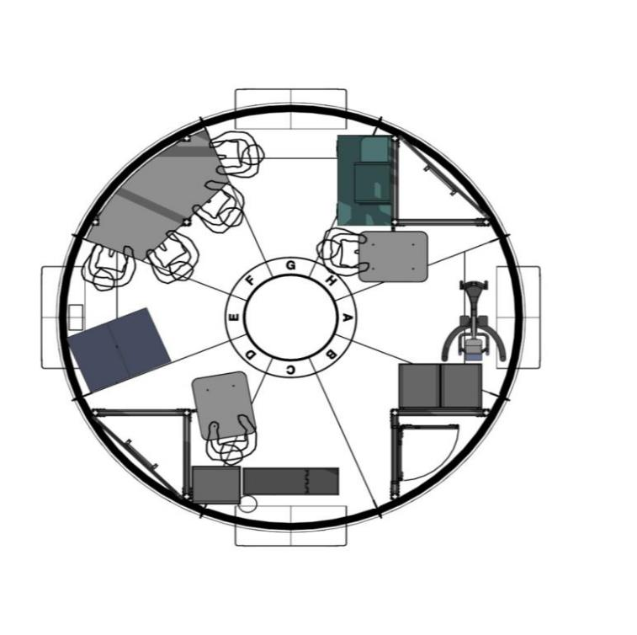
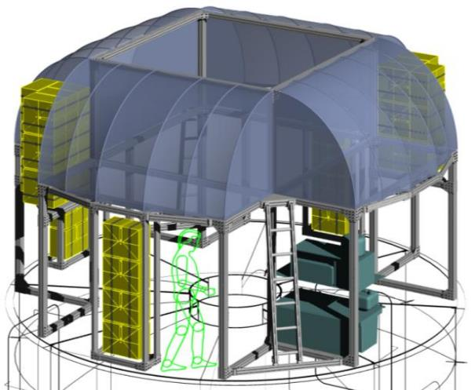
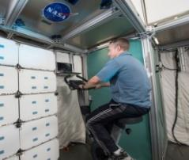
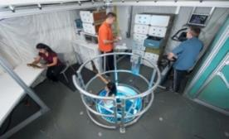
HERA – Level 2 & Loft
Galley
Wardroom table
Crew Quarters
Crew Quarters
Aerobic exercise device
2nd floor
Loft

Slide 5
HERA Campaigns
Campaign = integrated set of studies completed in a series of 4 identical missions
4 analog crewmembers per mission; Campaign N = 16
 | Year(s) | Mission Duration | Theme(s)
Campaign 1 | 2014 | 7-days | Objective/Unobtrusive Team and Bmed monitoring
Campaign 2 | 2015 | 14-days | Objective/Unobtrusive Team and Bmed monitoring
Campaign 3 | 2016 | 30-days | Enabling Technologies: Mass Reduction Food Bars, Playbook planning/execution tool,
Campaign 4 | 2017/2018 | 45-days | Chronic partial sleep restriction & CMs: Dynamic Lighting, Enhanced Diet
Campaign 5 | 2019/2020 | 45-days | Reduced habitable volume and privacy

Slide 6

Campaign 6
C6 Themes: Human Systems Integration & crew autonomy with communication delays
Mission 1 | Oct. 1 – Nov. 15, 2021 | Mission 3 | May 27 – July 11, 2022
Mission 2 | Jan. 28 – March 14, 2022 | Mission 4* | Delayed: Jan. 27 – March 13, 2023 *UAE observing mission operations
16 Studies; 9 new
Promoting behavioral health, cognitive, sensorimotor and immune function using guided imagery to augment exercise. PI: Richard Simpson
Measure and Manage Trust in Virtual Assistants. PI: John Lee
Quantifying Crew Task Performance for Human-Robotic Systems. PI: Christine Fanchiang
Multimodal Electronic Procedures Countermeasures for Autonomous Crews. PI: Stephen Robinson
Performance Enhancement Through Multi-Modal Stochastic Resonance. PI: Allison Anderson
Crew Autonomy through Self-Scheduling. PI: Jessica Marquez
Multimodal human-automation communication for augmenting human situation awareness. PI: Leia Stirling
Virtual Assistant for Spacecraft Anomaly Treatment. PI: Daniel Selva
Enhancing Situation Awareness of Automated Procedures using Adaptive Multimodal Augmented Reality Displays. PI: Debra Schreckenghost

Slide 7
Campaign 7
 | Ingress | Egress
Mission 1 | Sep. 29, 2023 | Nov. 13, 2023
Mission 2 | Jan. 26, 2024 | March 11, 2024
Mission 3 | May 10, 2024 | June 24, 2024
Mission 4 | Aug. 23, 2024 | Oct. 7, 2024
Preparation:
  Fall/Winter 2022: Defining campaign themes
  January 2023: Candidate crew applications due
  February 2023: Ground personnel training begins
  Jan. – April 2023: Hardware/Software integration
UAE Collaboration:
  7 studies
  2 UAE subjects per mission (1 prime, 1 backup)
  Experience with science integration, mission planning, and ground support operations
~16 Studies (final complement pending)

