Slide 1
Subgroup 3 (Human Response and Metrics) Briefing
Siddhartha Krishnamurthy (NASA), Yahia Ismail (Supernal)
UAM Noise Working Group Meeting
October 20, 2022

Slide 2
Presentations Delivered to Subgroup 3 Since Last UNWG Meeting
May 25: “Towards a Psychoacoustic Assessment of Novel Aircraft Concepts,” Antonio T. Martinez, University of Salford, Manchester.
June 22: “Human Response Studies at NLR,” Roalt Aalmoes, Royal Netherlands Aerospace Center.
July 27: “Preliminary evaluation of transportation noise masking UAV noise,” Judith Rochat, Cross-Spectrum Acoustics, Inc.
If you would like to deliver a presentation to Subgroup 3, please let Siddhartha Krishnamurthy (siddhartha.krishnamurthy@nasa.gov) and Yahia Ismail (yahia.ismail@supernal.aero) know.

Slide 3
Subgroup 3 White Paper Recommendations to Discuss at Today’s (Oct 20, 2022) UNWG Meeting
Comprehensive evaluation of metrics that supplement the day-night average sound level be performed for communicating community noise impact of UAM vehicle noise.
(To be reported out in afternoon) Until early entrants are fielded, and community noise studies can be performed, laboratory studies be performed to help inform how different the annoyance to short-term exposure of UAM vehicle noise is from that of existing aircraft noise sources. Assessments can then be made to determine the sensitivity of noise exposure estimates to changes in the metric or to its level.

Slide 4
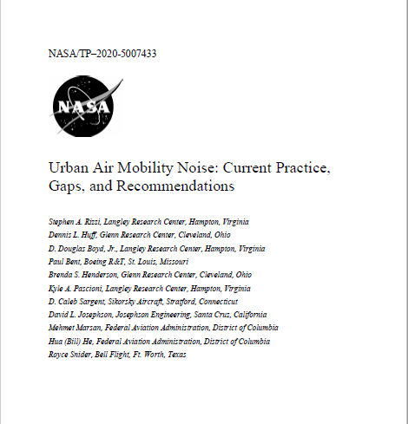
UAM Vehicle Noise Human Response Study
UNWG white paper recommended human response study to understand community variation in noise perception
Study Goals:
  Assemble a wide range of UAM vehicle sounds for use in human response studies.
  Create a rich human response database
  Provide insights into human response to UAM vehicle
NASA will develop and utilize a remote psychoacoustic testing capability for this study
¹S. A. Rizzi, D. L. Huff, D. D. Boyd, Jr., P. Bent, B. S. Henderson, K. A. Pascioni, D. C. Sargent, D. L. Josephson, M. Marsan, H. He and R. Snider, "Urban Air Mobility Noise: Current Practice, Gaps, and Recommendations," NASA/TP–2020-5007433, October 2020.

Slide 5
Phases of UAM Vehicle Noise Human Response Study
Remote Feasibility Test (Currently Being Administered, Oct 15 - 22)
  Objectives:
    Identify potential issues with using remote test platform before the Implementation Phase.
    Compare results with previous in-person test.
    Determine if providing a verbal setting/location context produces annoyance response change.
    Rank sounds by their annoyance response.
    Compare responses from different geographic locations.
  Details explained in previous UNWG meetings. Email siddhartha.krishnamurthy@nasa.gov for more information.
Implementation Phase: UAM Vehicle Noise Perception
  Human response to UAM vehicle noise in different urban soundscapes

Slide 6
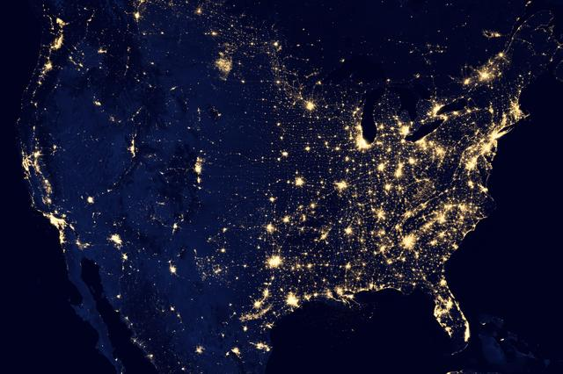
Feasibility Test Subjects
86 test subjects geographically distributed across the United States of America.
Subject divided by into East/West regions so that there are equal number of subjects in each region.
Test subject eligibility criteria:
  At least 18 years of age
  No known hearing impairments
  Not aviation noise subject matter expert
  Have internet and web browser access
  Have over-the-ear headphones
  Male:Female ratio: 26:17 (1.529)
Subjects use their own computers and headphones to take test remotely.
West
East

Slide 7
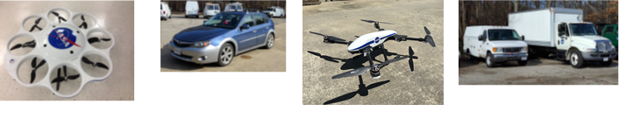
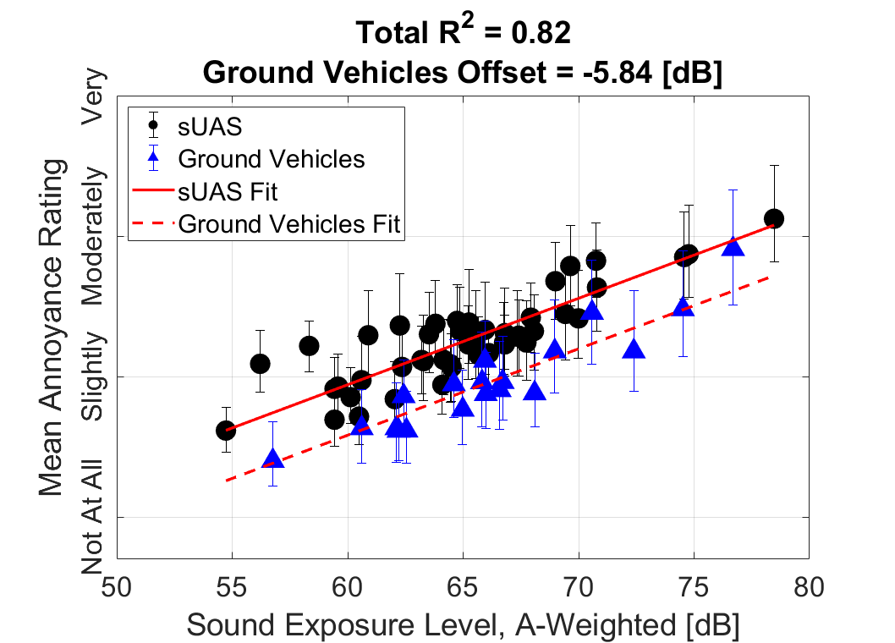
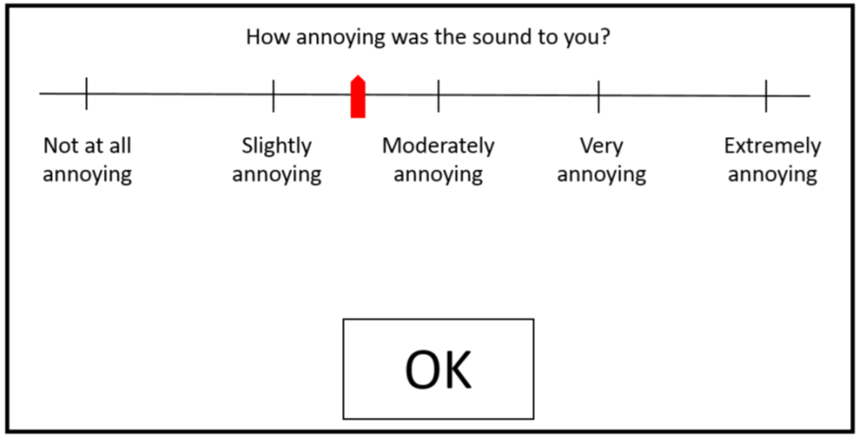
Feasibility Test Stimuli
Compare responses to sUAS and ground vehicle sounds with previous in-person responses² to same stimuli
²Christian, Andrew W. / Cabell, Randolph. “Initial Investigation into the Psychoacoustic Properties of Small Unmanned Aerial System Noise,” AIAA AVIATION Forum, Paper 4051, June 5-9, Denver, CO, USA, 2017.

Slide 8
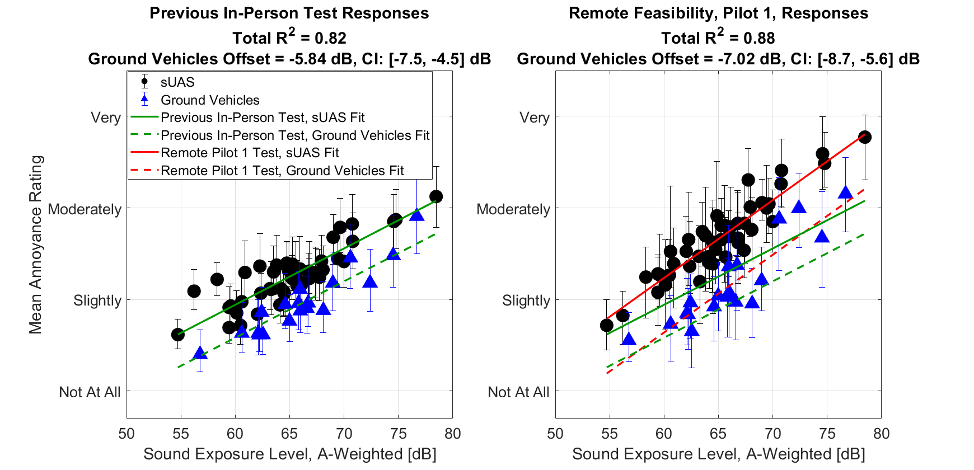
Pilot Test Results
Remote Feasibility Test, Pilot, appears to have replicated difference between sUAS and Ground Vehicle noise responses
10 Test Subjects
NOTE: These are pilot test results and cannot be considered conclusive.
38 Test Subjects

Slide 9
Second Pilot Test
Second pilot test was anticipated to be given to UNWG participants
Due to delays in getting remote test platform available for public, UNWG participants will be provided the remote Feasibility Test after the actual remote Feasibility Test is completed, likely October 31 – November 2.

Slide 10
Remote Feasibility Test, Coordinated Tasks
Separate technical and administrative tasks had to coordinate to form remote Feasibility Test.
Calibration Method Development and Validation
Remote Test Platform Audio Testing and Validation
Pilot Testing
Context Question Development
Software Requirements and Approval
Paperwork Reduction Act Approval
Remote Test Software Development
Remote Feasibility Test
NASA Amazon Web Services Access
Tutorial Videos Generation and Editing
Test Interface Text Selections
Stimuli Selection and Generation
Test Deployment through NASA Amazon Web Services
Post-Test Survey Question Generation
Institutional Review Board Approvals
Test Subject Recruitment
Paperwork Reduction Act Approval
Post-Test Survey Question Generation
Defining Test Subject Regions
NASA Privacy Impact Approvals

Slide 11
Contributors to Remote Feasibility Test
UNWG Subgroup 3 Participants
NASA Revolutionary Vertical Lift Technology Project Management: Susan Gorton, Benny Lunsford, Noah Schiller
Structural Acoustics and Aeroacoustics Branch Management: Ran Cabell, Mike Doty
NASA Technical Direction Notice C2.01.023 Regular Participants:
  Analytical Mechanics and Associates, Inc.: Bob Stephens, Erin Thomas, Syed Rizvi, Kathleen Drummond, Ericka Meacham
  Arup: Ryan Biziorek, Jeff Berg, Andrew Nguyen, Arman Ayrapetyan, Devin Bean
  HMMH: Joe Czech, Dillon Tannler, Christopher Emma, Michael Chandonnet, Arnav Pamidighantam
  Westat: Jonathan Wivagg, Eric Jodts
  NASA: Steve Rizzi, Aric Aumann
  NASA Amazon Web Services: Scott Lee, Dawayne Pretlor, Amanda Dawson
NASA Langley Aeroacoustics and Structural Acoustics Branch Members
Others throughout NASA: Ryan Roark (Langley), Claire Little (HQ), Bill Edwards-Bodmer (HQ), Martha Brown (Langley), Matthew Hayes (Langley), Ally Olney (Langley), David Meade (Langley), David Cordner (Langley), Andrew Denio (Marshall), Michael Guerin (Langley), Cory Gilbert (Langley)

Slide 12
Remote Feasibility Test Results
Preliminary results are planned to be published in Advanced Air Mobility Noise session at NOISE-CON 2023, joint with SAE International’s Noise and Vibration Conference
Additional papers from UNWG participants requested for Advanced Air Mobility Noise session: https://www.sae.org/binaries/content/assets/cm/content/attend/2023/nvh/23_nvc_call_for_papers.pdf.
  Abstracts submission website for above conference closes at the end of this (October) month. You may submit abstract directly to siddhartha.krishnamurthy@nasa.gov after end of October, and the abstract will then be routed to the conference staff. You may ignore posted Oct. 10 deadline for this session.
  Please try to submit abstracts to siddhartha.Krishnamurthy@nasa.gov before end of November 2022.

Slide 13
Research Goals for Implementation Phase (Phase 2) of UAM Vehicle Noise Human Response Study
  How much of a buffer zone around a vertiport is needed for sounds to be acceptable/not annoying?
  What are the annoyance response differences to single event UAM vehicle flyover noise when the noise appears among different ambient soundscapes?
  What are the annoyance response differences to single event UAM vehicle flyover noise among geographically distinct communities?
  How different is the annoyance to short-term exposure of UAM vehicle noise from that of existing aircraft noise sources?

Slide 14
Questions?

Slide 15
Image References
Slide 6:
  Image of United States of America at night from NASA Image and Video Library, NASA ID: GSFC_20171208_Archive_e001590.
Slide 7:
  sUAS pictures, ground vehicle pictures, and test question prompt from “Initial Investigation into the Psychoacoustic Properties of Small Unmanned Aerial System Noise.” 23rd AIAA/CEAS Aeroacoustics Conference, AIAA Aviation Forum, Denver, CO, June 5-9 2017, Paper Number 4051, 2017. NASA NTRS Document ID 20170005870.
  Annoyance response plot generated by presenters.
Slide 8:
  Annoyance response plot generated by presenters.

