Slide 1
Spacecraft &
Vehicle Systems Department
Angelia Walker
Marshall Partnerships Forum
October 2022

Slide 2
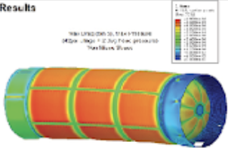
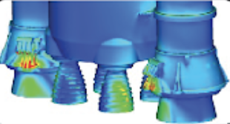
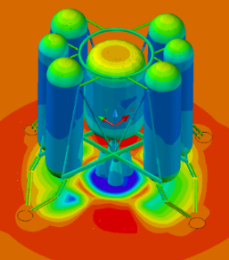
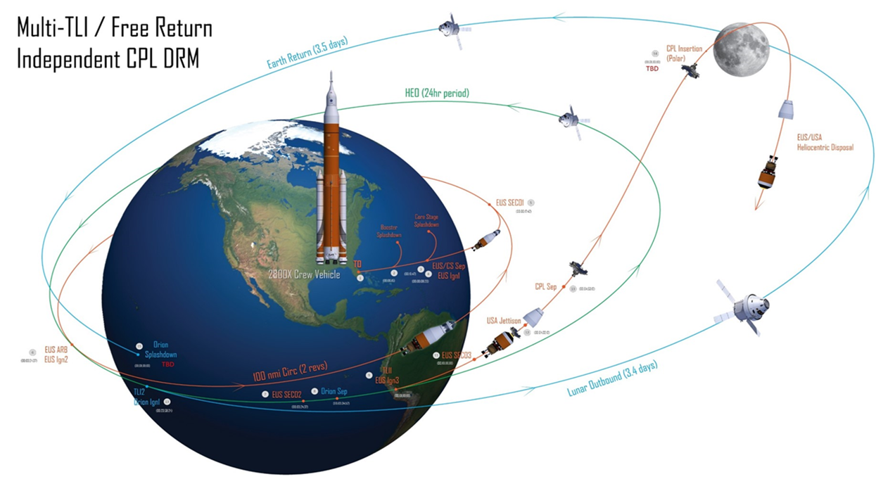
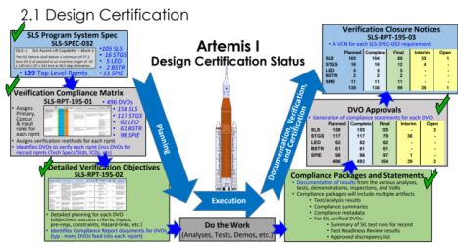
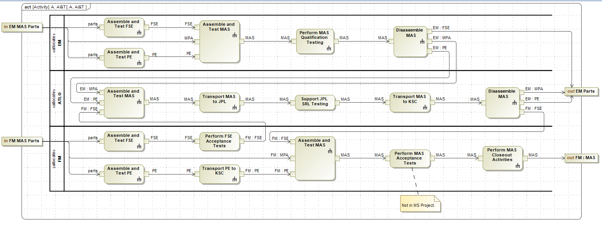
Spacecraft and Vehicle Systems Department
Capabilities to Enable Tomorrow’s Missions
Large Scale Systems Design and Analysis Expertise:
Structural Design and Strength Analysis
Loads, Dynamics, Vibration and Shock
Induced Environments Characterization including:
  Aerodynamics, Aerothermodynamics, Plume Induced, Blast and Debris, Thermal
Guidance Navigation and Control across All Flight Regimes
Systems Health Management
Natural Environments Characterization
Systems Engineering and Integration and Product Life-Cycle Management
Model Based Systems Engineering and Design
Integrated Systems Analysis including:
  Human Factors/Human Systems Engineering with
  Virtual Environments/Full-scale and subscale mockups
  Mass Properties

Slide 3
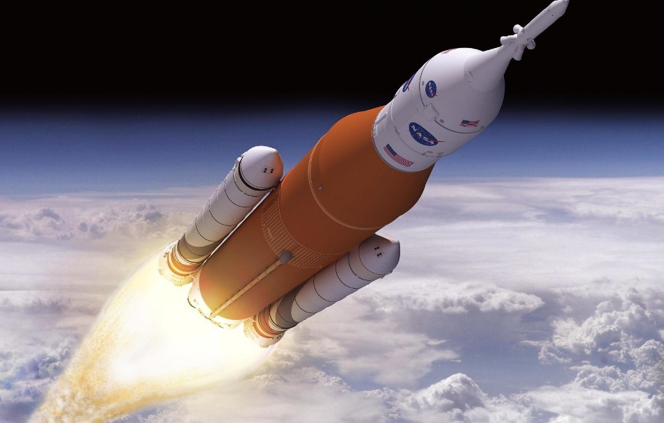
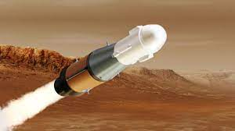
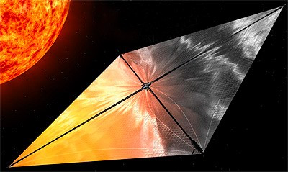
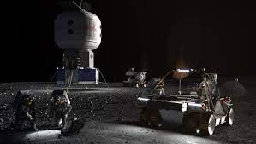
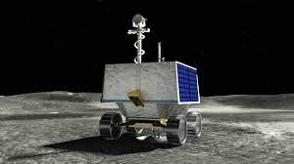
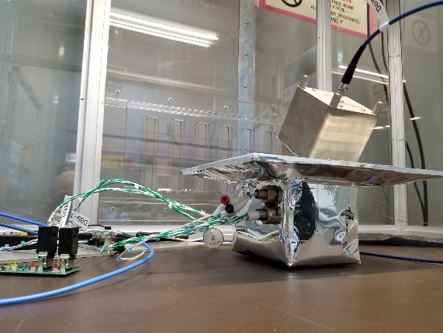
Spacecraft and Vehicle Systems Department
Capabilities to Enable Tomorrow’s Missions

Slide 4
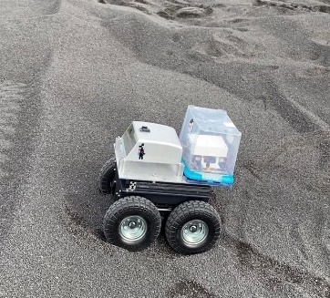
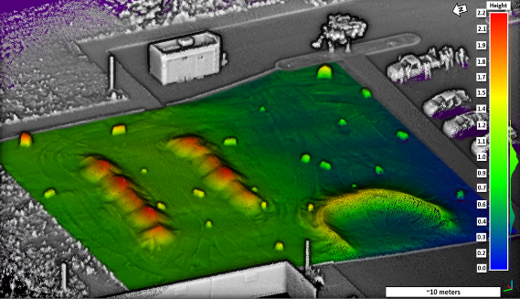
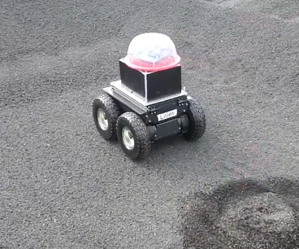
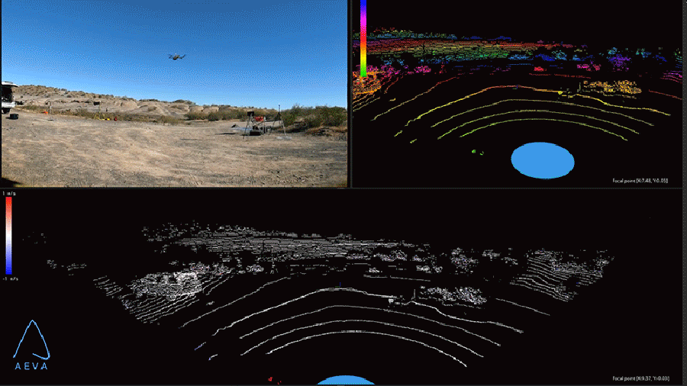
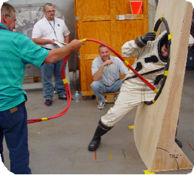
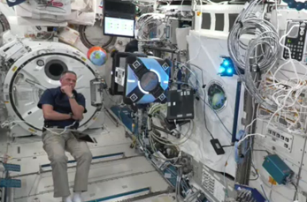
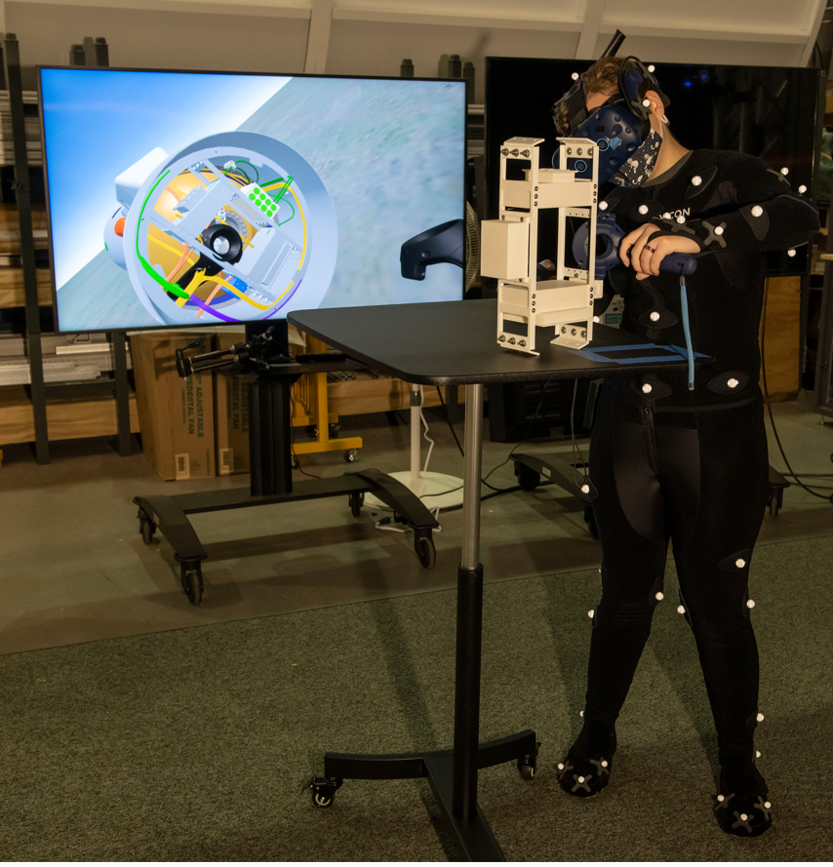
Spacecraft and Vehicle Systems Department
Capabilities to Enable Tomorrow’s Missions
Innovative Solutions to Solve the Challenges of Tomorrow
Advanced Guidance Systems
  Micro Video Guidance Sensor
  GPS Denied Navigation
Regolith Field for Lunar Surface Systems Demonstrations
Structural Damping Devices
Motion Magnification for Structural Response Evaluations
Virtual Environment Laboratory integrated with Full-scale and Sub-scale Hardware Mockups

