Slide 1

Enabling Innovation With Safety
Aaron Dutle
NASA Langley Research Center
10-26-2022

Slide 2
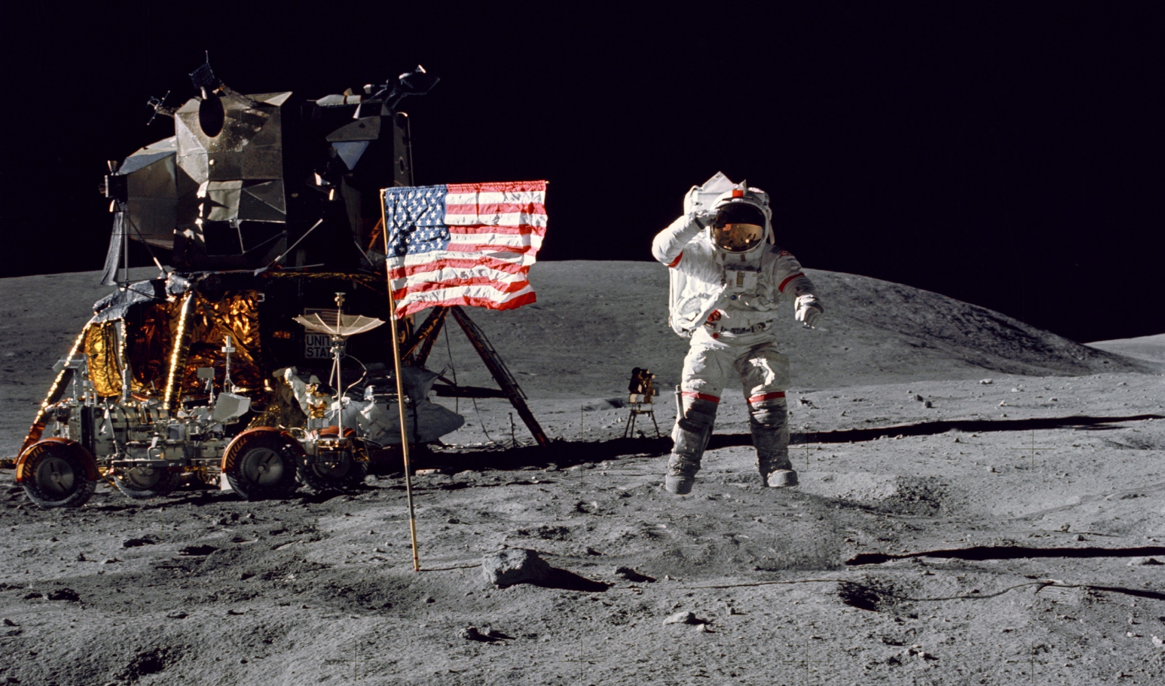
The NASA everyone knows

Slide 3
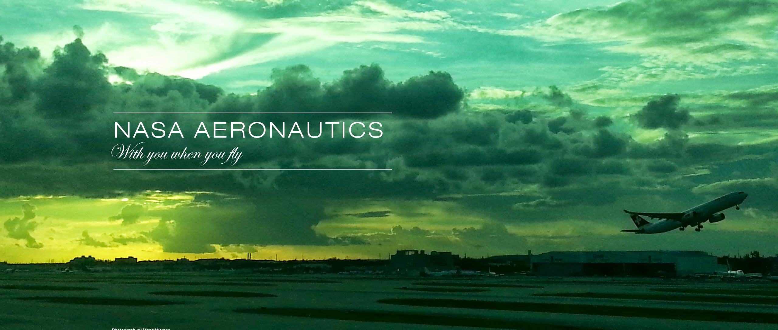
Our First “A” is for Aeronautics

Slide 4
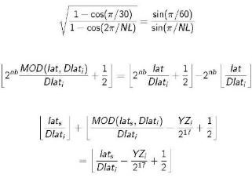
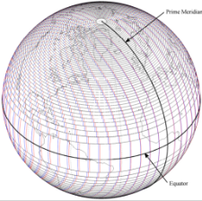
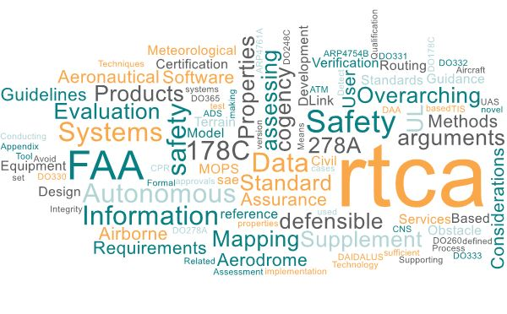
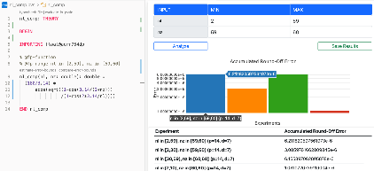

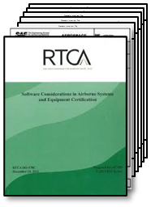
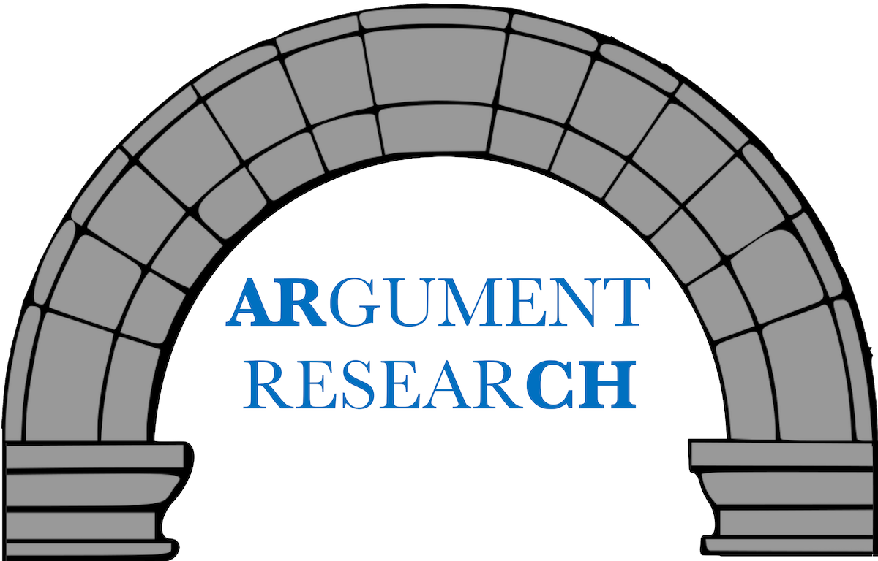
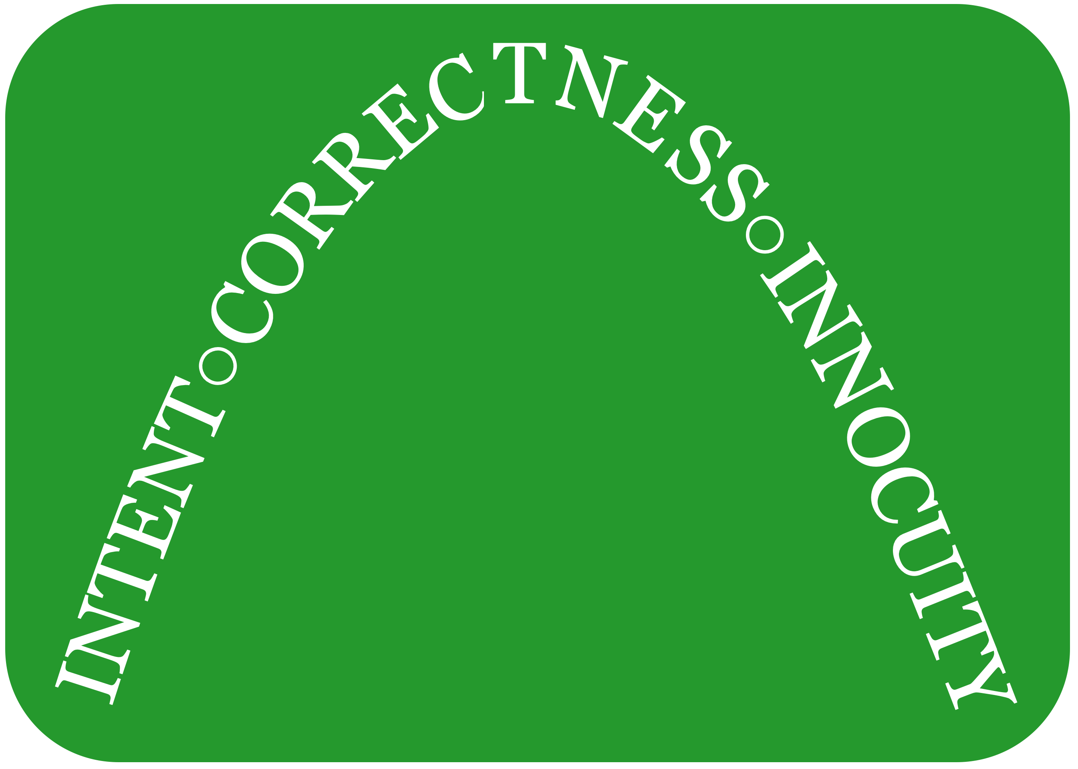
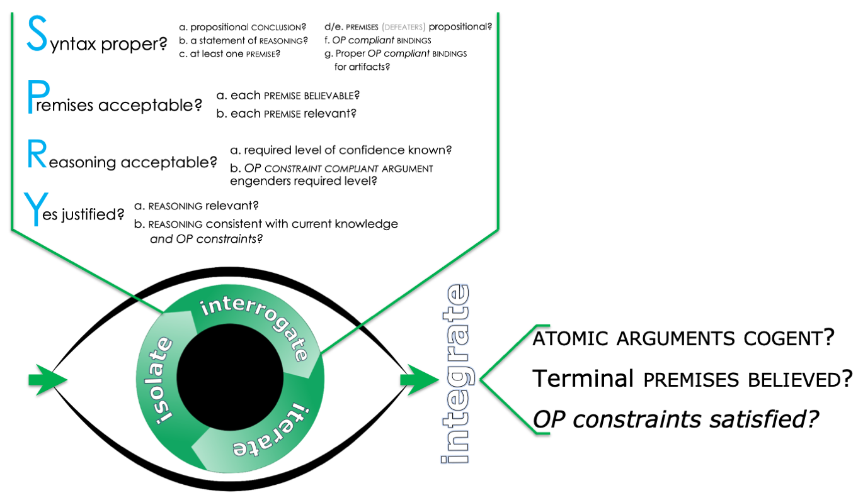
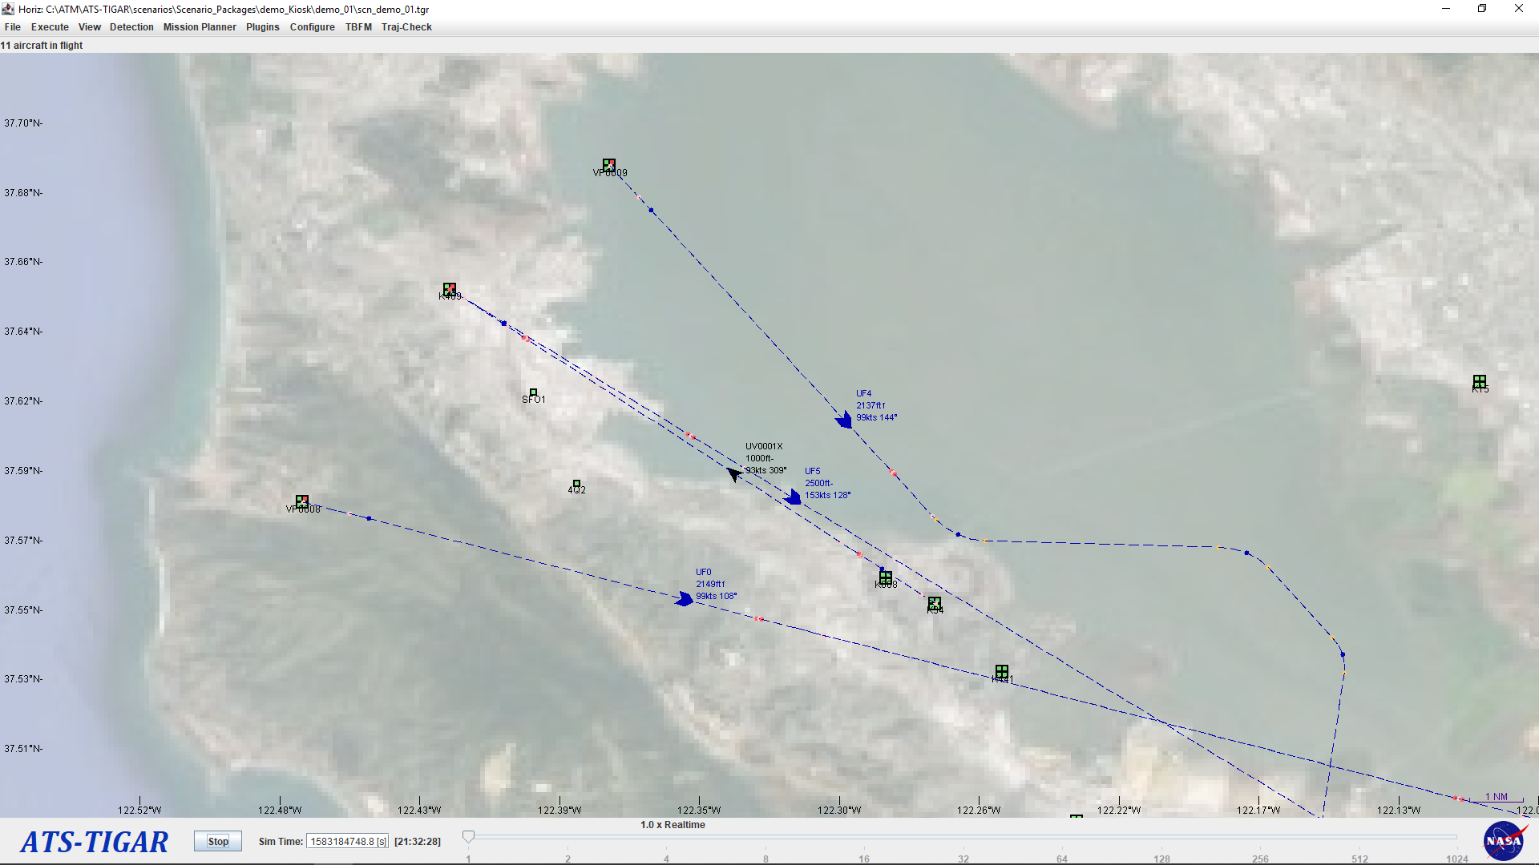
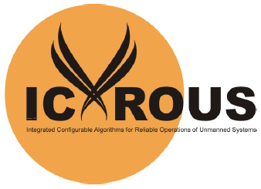
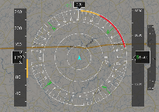
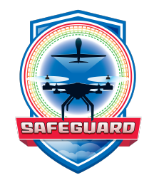
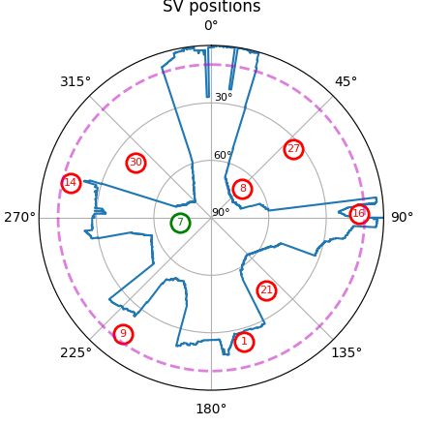
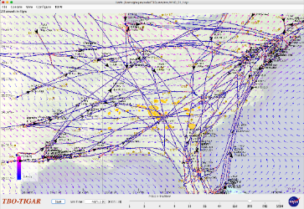
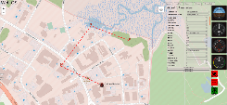
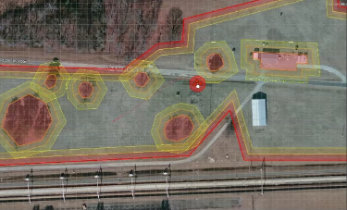
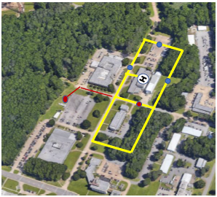
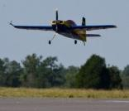
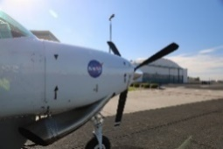
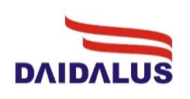
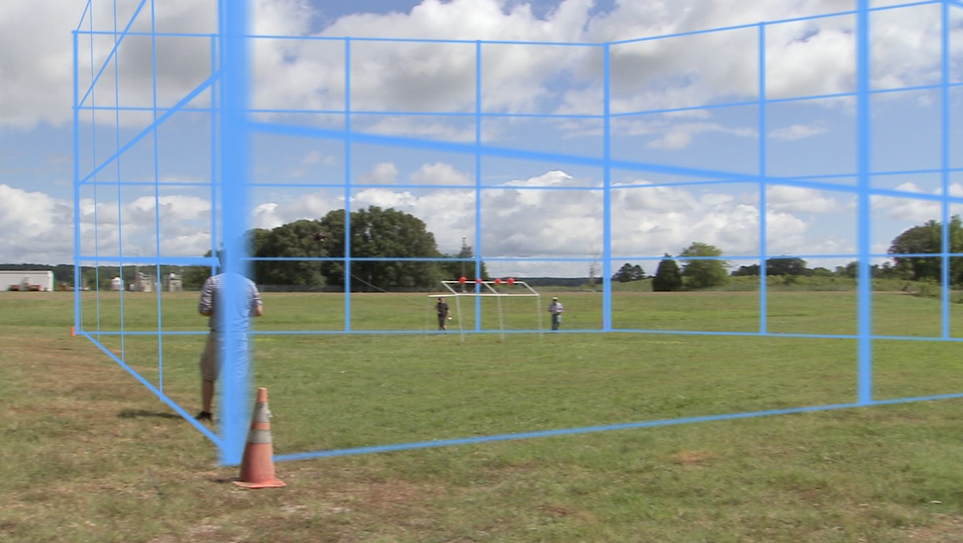
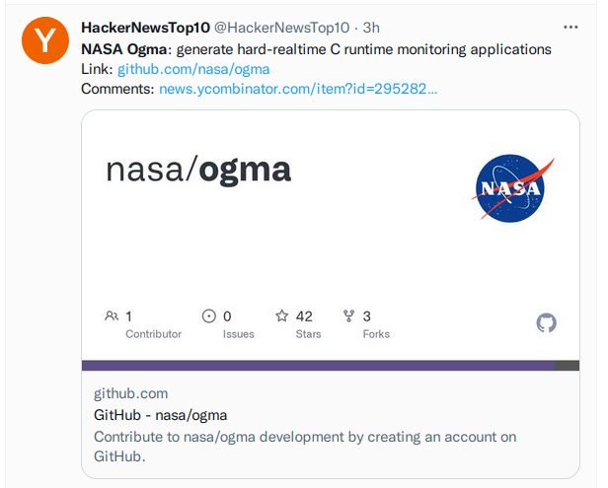
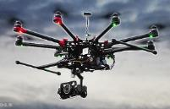
Safety-Critical Avionics Systems Branch
Maps Data: Google ©2021
Safety assessment and assurance frameworks
Over 20 civil aviation standards and guidelines have D320 involvement
RTCA DO-365 Detect and Avoid
RTCA DO-260 ADS-B / TIS-S
RTCA DO-178C SW Considerations
RTCA DO-333 Formal Methods Supp.
RTCA DO-276C Terrain & Obst. data
RTCA DO-272D Aerodrome Mapping
…
Work in progress
SAE ARP4754B Development A/C Systems
UL 4600 Standard for Safety for the Evaluation of Autonomous Products
SAE ARP4761A Guidelines and Methods for Conducting the Safety Assessment Process on Civil Airborne Systems and Equipment
...
Application and advancement of formal methods for specifying and verifying correctness and safety properties
Architectural and runtime V&V for assuring system-level integrity
sUAS flight campaigns to validate environmental assumptions and test blended design and operational assurance paradigms
NavQ
DANTi
Maps Data: Google ©2021
Maps Data: Google ©2021
Highly-assured algorithms for aerospace applications
Maps Data: Google ©2021
Notes:
SCASB develops and applies new concepts, algorithms, methods, and tools for specifying, designing, verifying, validating, and assuring the safety of software-intensive systems used in safety-critical aerospace applications
Core capabilities include the development and implementation of:
Advanced tools and methods for formal specification and verification, automated deduction, and runtime verification of critical algorithms and operations
Methodologies and technologies to assure software is safe, data integrity is guaranteed, and certification is practicable
Analytical, architectural, algorithmic, and runtime proficiency to ensure the integrity of cyber-physical systems
Techniques for testing and evaluating key safety-critical technologies
Expertise needed in the following areas:
- Positioning and navigation systems
- Aviation standards and certification
- Embedded system programming (including COTS autopilots)
- Formal analysis of safety-critical algorithms and software
- Automated deduction, static analysis, and run-time verification
- System safety and safety arguments

Slide 5

Detect & Avoid Alerting Logic for Unmanned Systems
Notes:
The software system developed in the SCASB to provide situational awareness and maneuver guidance for unmanned aircraft.

Slide 6
See and Avoid
Michael Huerta, Former Administrator, Federal Aviation Administration¹:
A bedrock principle of aviation is see and avoid. And if you don’t have a pilot on board the aircraft, you need something that will substitute for that, which will sense other aircraft, and we can ensure appropriate levels of safety.
NASA helped develop a geometric well-clear definition for unmanned aircraft. Some properties:
Symmetry: Two aircraft in an encounter calculate the same well-clear status.
Local Convexity: In a non-maneuvering encounter, there is at most one time interval with a loss of well-clear.
Extensibility/Inclusion: Smaller parameter sets create a smaller (nested) volume.
Convergence: In a non-maneuvering encounter with a loss of well-clear, the interval includes the closest point of approach.
1: http://www.pbs.org/newshour/bb/drone-industry-grows-faster-flick-joystick-regulation-lags/
Notes:
See and avoid becomes sense and avoid, then detect and avoid. Short mention of well-clear and its development.

Slide 7
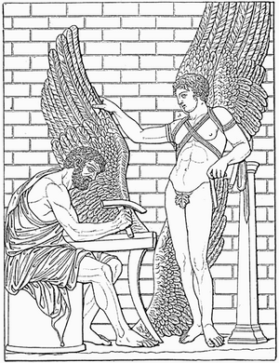
What’s in a name?
DAIDALUS is a reference to the Greek myth.
Daedalus advised Icarus not to fly too high, or his wings would melt in the sun, and not to fly too low, or his feathers would be soaked.
Image from http://www.wikipedia.org/wiki/Daedalus

Slide 8
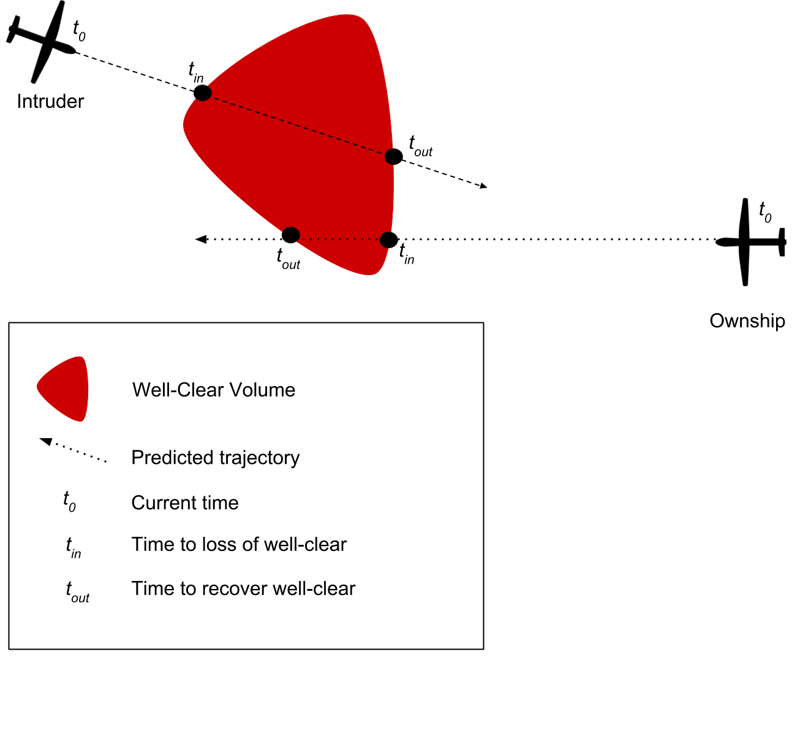
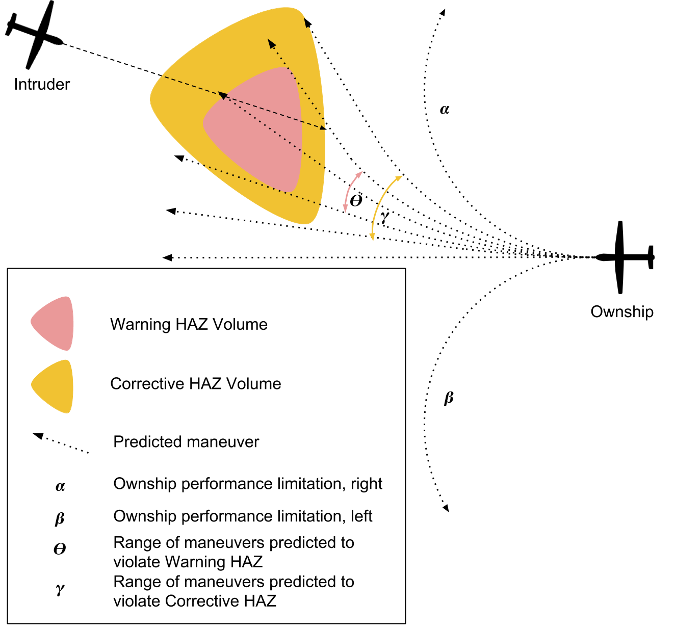
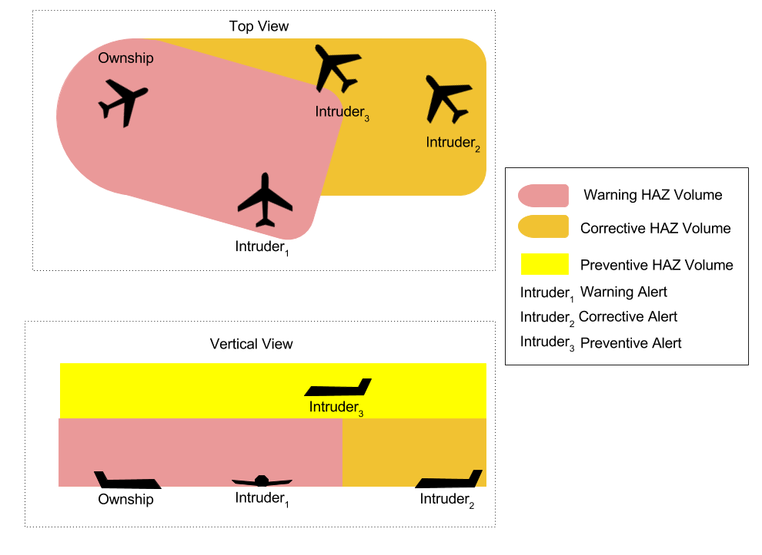
Advice from DAIDALUS
Detection determines the time interval where a loss of well-clear is predicted to occur
Maneuver Guidance finds ranges of maneuvers that lead to entering some hazard volume
Alerting computes a number indicating the severity of a potential loss of well-clear
Notes:
Provides maneuver guidance for turns, vertical speed, ground speed, and altitude. Provides different severity alerts for predicted violations of well-clear.

Slide 9
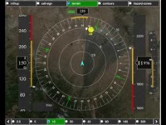
A pilot’s view from the ground

Slide 10


Where is DAIDALUS used?
As the reference implementation for Detect-and-Avoid in the US standards document maintained by RTCA special committee 228: DO-365 “Minimum Operational Performance Standards (MOPS) for Detect and Avoid (DAA) Systems.”
Internal to NASA for research and flight testing of Unmanned Aircraft.
By several government and industry partners as part of their own UAS systems.
As the DAA component of ICAROUS and Danti, NASA–developed software.

Slide 11
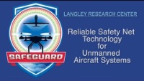

Slide 12
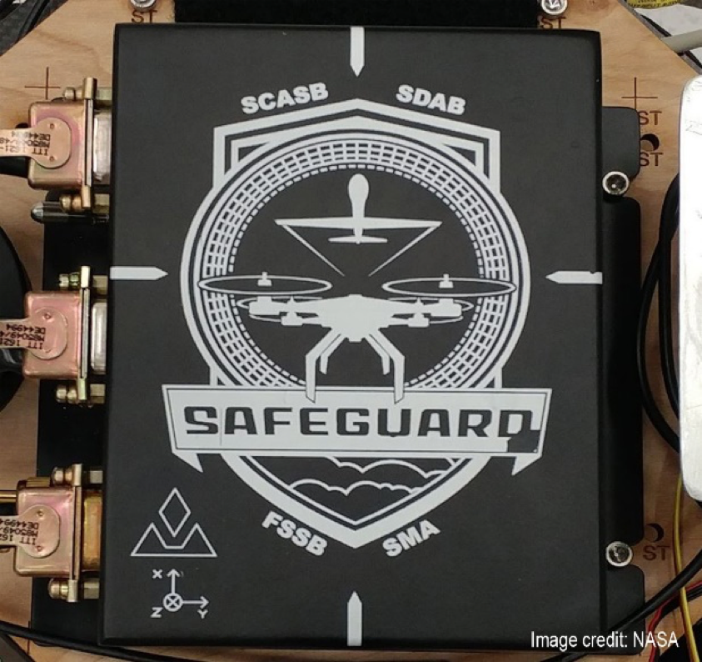
What makes Safeguard different from generic geofencing?
Independent from on-board software.
  Can be reused on different platforms, with consistent results.
  Protects against bugs, malicious actions in software updates.
  Can even be independent of the position source used.
Rigorous development and verification.
  NASA class C software, considered acceptable means of compliance by our flight safety board.
  “Formally verified mathematics…” coming up soon.

Slide 13
What do these systems have in common?
NASA-developed for uncrewed aircraft systems.
Designed to keep an aircraft away from some hazard.
Both developed using techniques from Formal Methods.

Slide 14
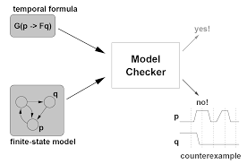
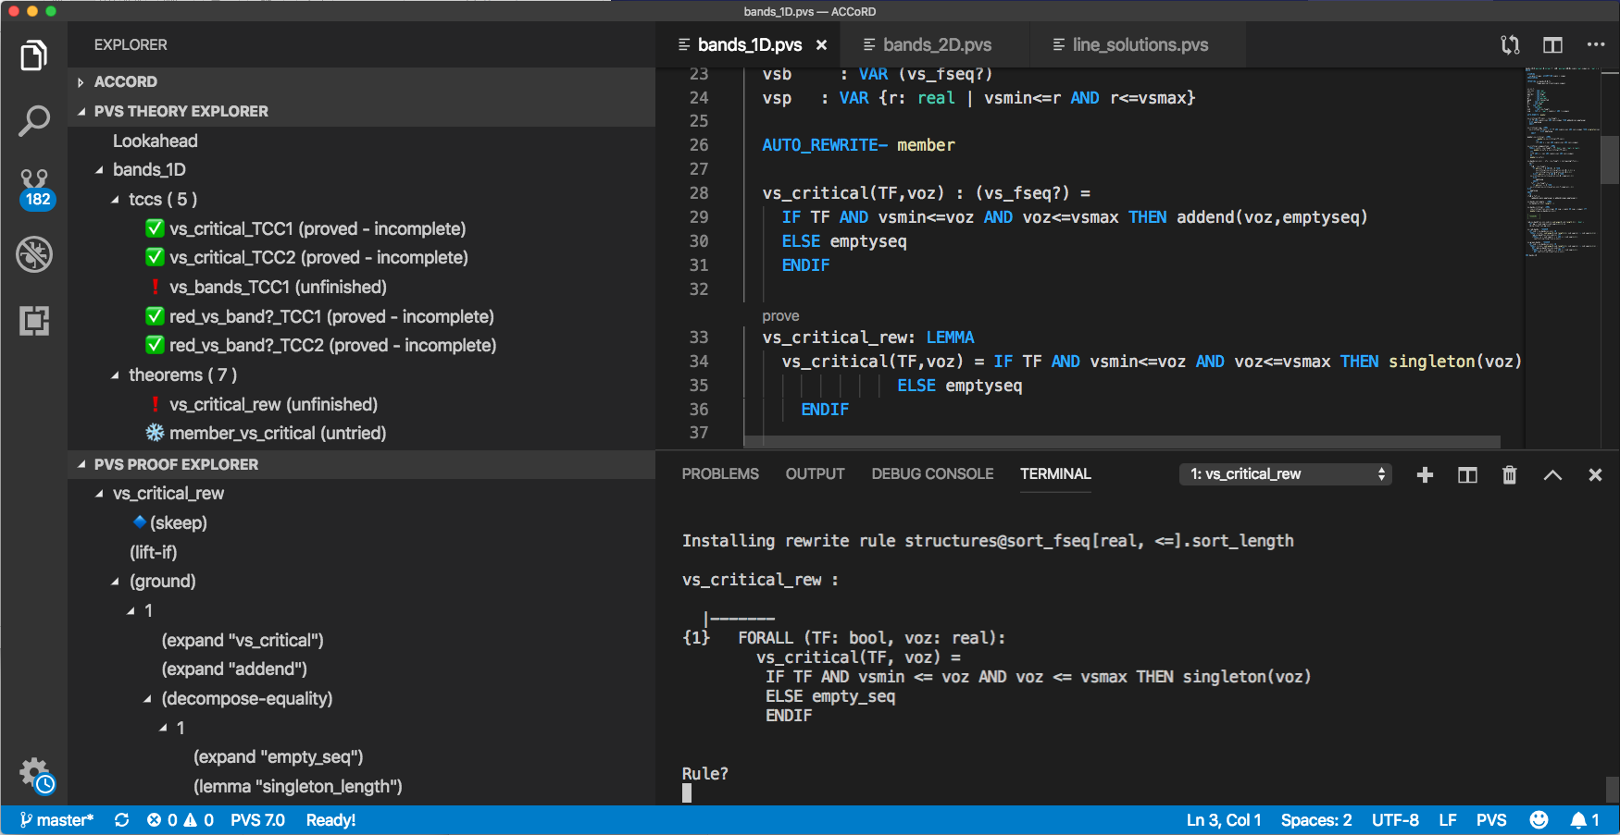
What is Formal Methods?
Formal Methods:
Mathematically rigorous techniques for verification.
Provide methods to examine ALL possible inputs.
Can establish correctness or safety properties.
Model Checking
Some Formal Methods Techniques:
Interactive theorem proving
Static analysis
Model checking
Verified compilers
Runtime verification
Requirements analysis
Interactive theorem proving

Slide 15
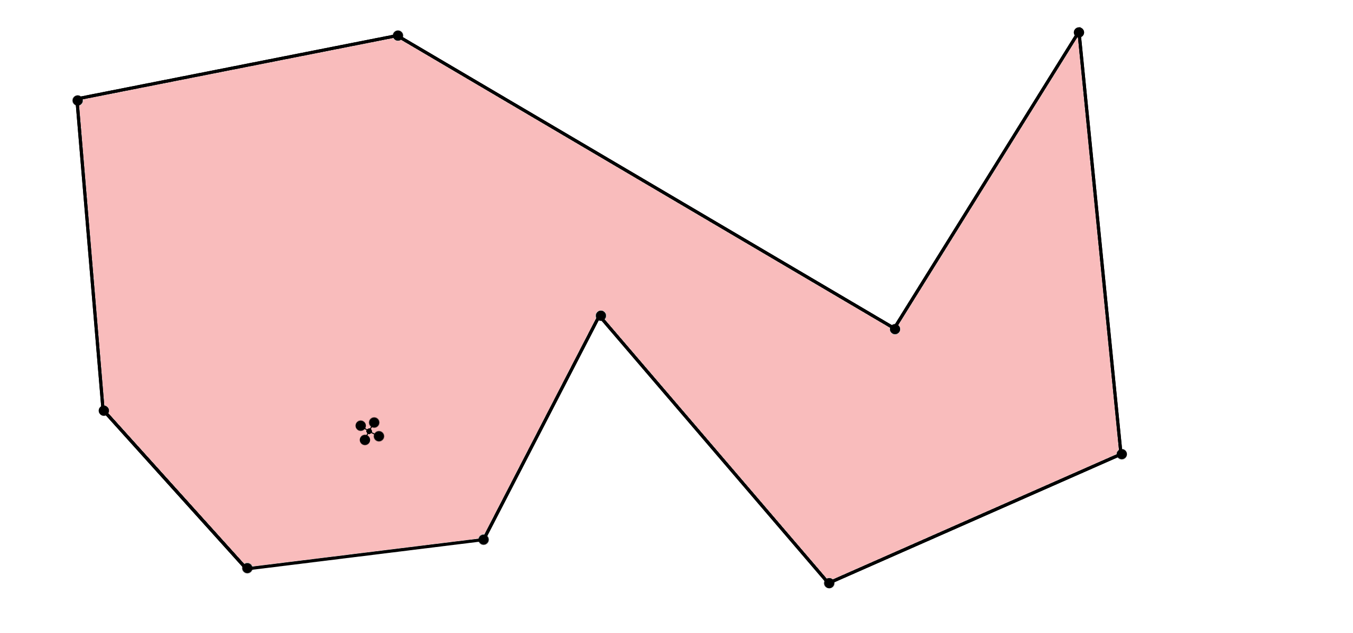
Geofencing: The point-in-polygon problem
Notes:
The basic mathematical idea behind a geo-fence.

Slide 16

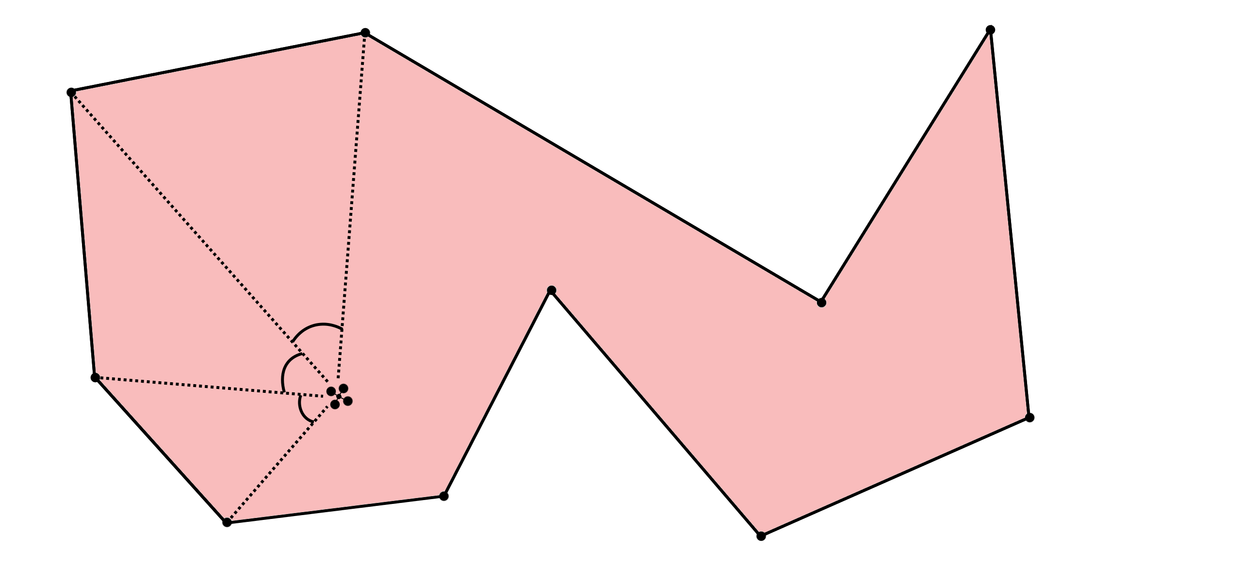
Two well-known methods:
Ray-casting:
Pick a direction and send out a ray.
Count the number of times it crosses an edge of the polygon.
Winding Number:
Travel along the edges, and add the angles formed.
Count the multiples of 360 degrees.
Notes:
Cast a ray out in any direction from the point of interest. If it crosses an odd number of times, it’s inside. If it crosses an even number of times, it’s outside.

Slide 17
Using an Interactive Theorem Prover (PVS)
Ray-casting:
Showed that the direction of the ray doesn’t change the answer.
If the point is away from the polygon, there is a ray that doesn’t hit it at all.
Winding Number:
Showed that this answer is the same as the ray-casting answer.
Equivalence of a simplified version counting quadrant crossings.
Notes:
Cast a ray out in any direction from the point of interest. If it crosses an odd number of times, it’s inside. If it crosses an even number of times, it’s outside.

Slide 18
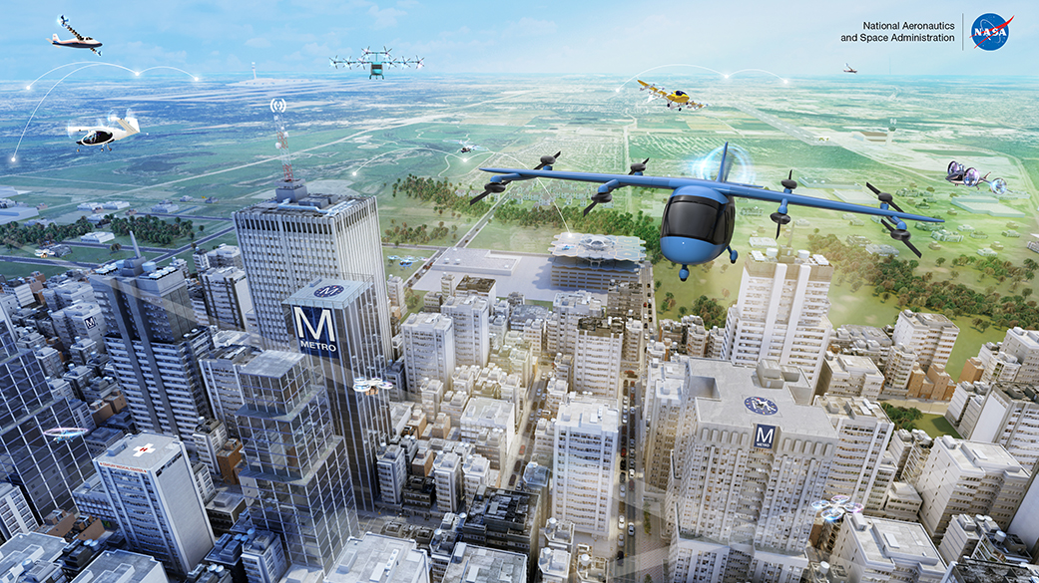
The future of Air Transportation…

Slide 19
Challenges for the future
Dependence on software
  The amount of software on aircraft has been increasing exponentially.
  Numerical error in software can have catastrophic effects.
  New types of software (AI/ML) are being created that we don’t know how to verify yet.
Autonomous aircraft
  Pilots have always been the final safety measure. What do we do without one?

Slide 20
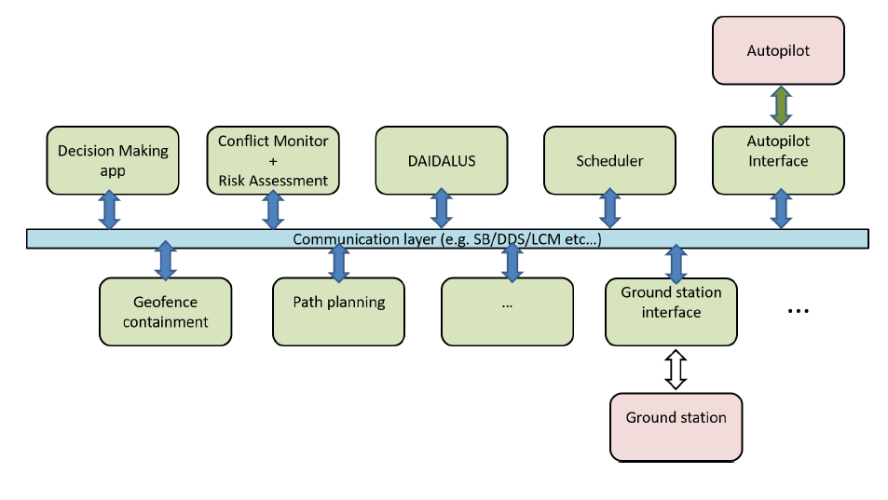
Formal Methods is part of the answer
Research in Formal Methods:
Directly verifying the behavior of Machine Learning Algorithms.
Bounding the behavior of unknown algorithms using Runtime Monitors.
Proving Safety properties of Cyber-Physical Systems.
Making software implementations robust to numerical errors.
Capturing and formalizing the requirements of a system (before and during design).
ICAROUS is a NASA-developed autonomous aircraft system. Elements in red have employed formal methods in design or verification.

Slide 21

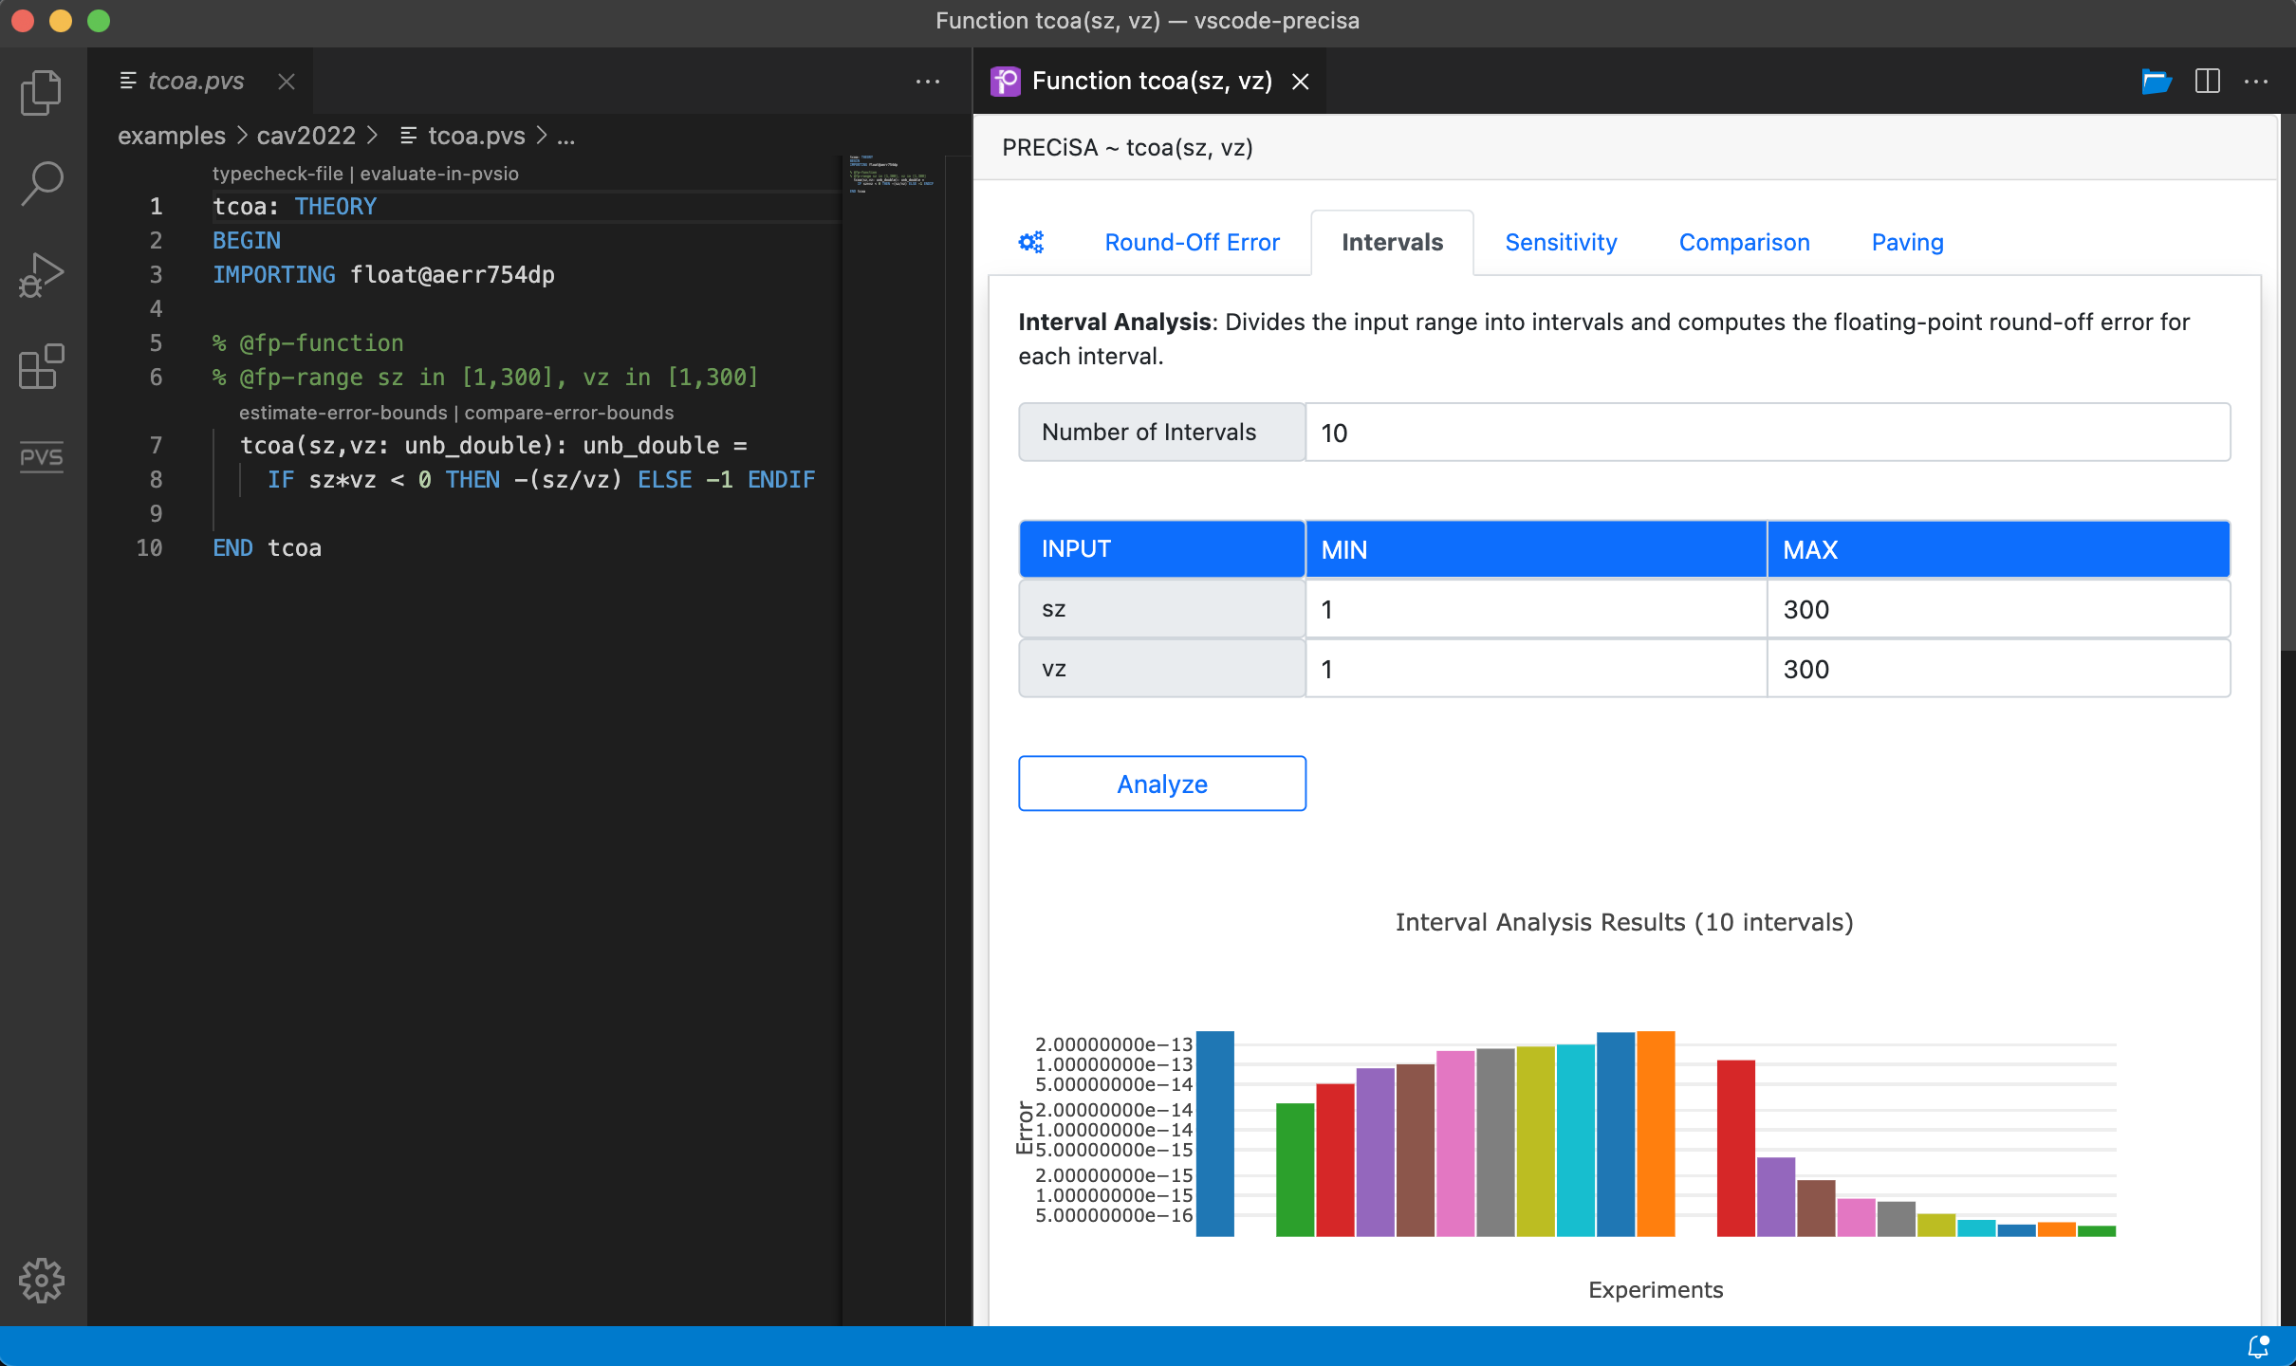
Taming numerical error
Floating-point Analysis:
Bounds accumulated error.
Identifies unstable conditionals.
Produces verifiable certificates.
VScode interface for experimentation
Program Transformation:
Creates a guard-stable version of a program in C.
Automatically verifies the correctness of the implementation.
A view of PRECiSA in VScode allowing visual analysis of the accumulated error over a range of values.

Slide 22
Runtime monitoring with the Simplex architecture
Runtime Monitoring:
Not all software can be verified before deployment.
RTM checks for unwanted behavior during operation.
Mitigation can be simple (raise alert), or complicated.
Simplex Architecture:
RTM allows switching between complex (untrusted) and simple (trusted) components.
Black Box Controller: High Performance
Verified Monitor
System Sensors
Verified Controller: Low Performance
Status:
PASS

Slide 23
Runtime monitoring with the Simplex architecture
Runtime Monitoring:
Not all software can be verified before deployment.
RTM checks for unwanted behavior during operation.
Mitigation can be simple (raise alert), or complicated.
Simplex Architecture:
RTM allows switching between complex (untrusted) and simple (trusted) components.
Black Box Controller: High Performance
Verified Monitor
System Sensors
Verified Controller: Low Performance
Status:
FAIL

Slide 24
Safety as a driver of innovation
Software systems for enhancing safety; e.g., DAIDALUS, Safeguard:
Allow safer current operations.
Assure safety of future operations.
Speed up new developments.
Enhancing safety of software systems; e.g., Floating-point analysis, Simplex RTM:
Better guarantees of behavior for quicker acceptance.
Safer behavior of untrusted systems
For more information
Formal Methods as NASA:
https://shemesh.larc.nasa.gov/fm/
Software from this talk:
DAIDALUS
https://shemesh.larc.nasa.gov/fm/DAIDALUS/
Safeguard
https://technology.nasa.gov/patent/LAR-TOPS-244
Come work with us!
https://intern.nasa.gov/

