Slide 1

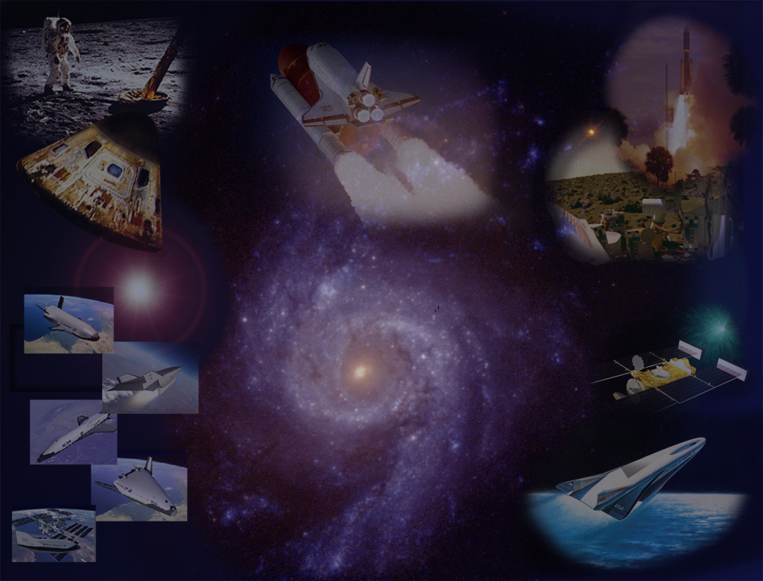
Discrete Roughness Boundary-Layer Transition at Hypersonic Conditions
Scott A. Berry
NASA Langley Research Center
UCAH Seminar Series
October 25, 2022
Cleared for Public Release
Notes:
Provides a review of several examples of ground-based boundary layer transition studies completed in support of agency programs with comparison to flight results if available

Slide 2
Presentation Focus
A review of ground-based experimental studies into discrete roughness hypersonic boundary layer transition with comparison to flight results
Presenation Outline
Background and motivation
Ground-based studies & results
Corresponding flight observations
Summary
Cleared for Public Release
Notes:
This presentation will focus on a review of some of the ground-based studies I’ve conducted during my career on discrete roughness transition, along with observations from corresponding flight experiments.

Slide 3
Background
Shouldn’t be a newsflash to anyone but: hypersonic = hot!
And hypersonic + turbulence = even hotter!
Economic impact:
Thermal management critical technology to enable hypersonic vehicle design
To counter high surface temperatures and sustained heat load
Traditionally done using thermal protection system (TPS) on Shuttle and X-43
Hot structures (X-15) including internal cooling passages (SR-71) also an option
Weight penalty associated with either using TPS or an active cooling system
Thus, BLT effects can have direct impact on vehicle size and cost (think NASP)
Mission Impact:
Vehicle aerodynamics also influenced by BLT effects
Increased drag directly reducing vehicle range
Transition location can alter control surface effectiveness
Roll/yaw increments due to asymmetric BLT (Shuttle experienced this)
Safety Impact:
Vehicle robustness could impact crew safety scenarios, for instance
Launch abort constraints (such as low AoA return to runway requirements)
Damage/repair constraints (how much surface damage is tolerable?)
Understanding boundary layer transition (BLT) is critical to hypersonic design
Cleared for Public Release
Notes:
One can make the case for the criticality of boundary transition to hypersonic vehicles from many perspectives.
Despite the general pessimism of the role of wind tunnels for transition studies, useful information can be obtained in wind tunnels and applied to flight programs.

Slide 4
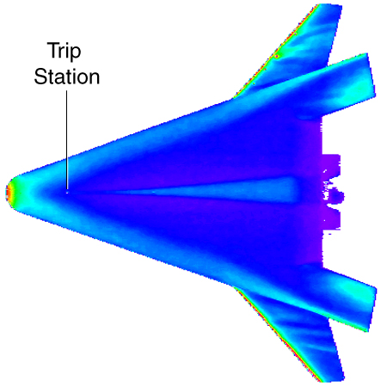
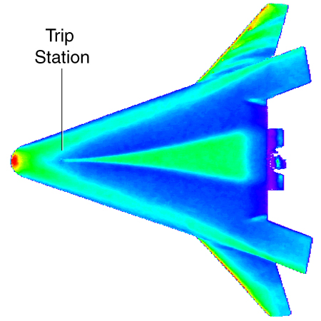
Motivation
Trip
station
Trip
station
“Incipient”
roughness
element
“Effective”
roughness
element
The problem:
Vehicle designers require reliable and timely methods for predicting when (and how) transition will occur during hypersonic flight in order to quantify its impact on the local and acreage heating environments for TPS design
A practical approach:
Until a comprehensive physics-based approach for predicting hypersonic boundary layer transition is available, vehicle designers will continue to rely heavily on empirical transition prediction strategies derived from ground-based measurements
Premise:
Present (and future) TPS technology continue to be roughness dominated
  “… roughness is such an overriding transition bypass that research can be conducted in conventional, noisy, tunnels” [Bushnell]
Cleared for Public Release

Slide 5
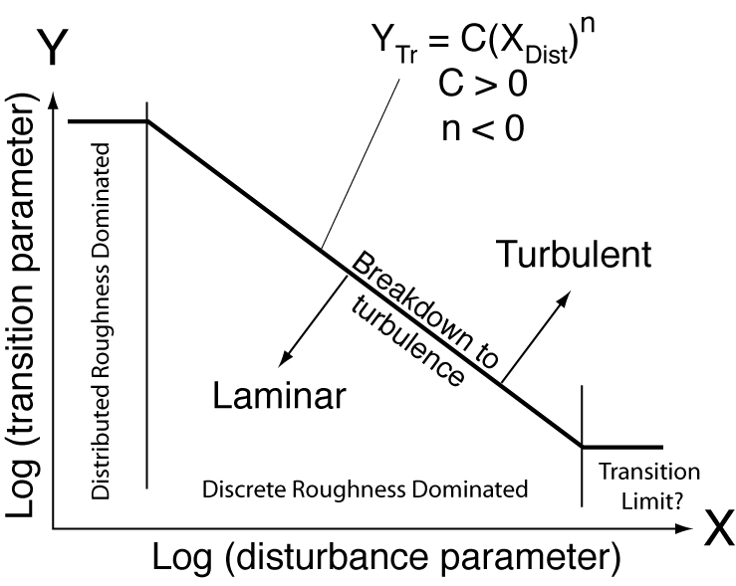
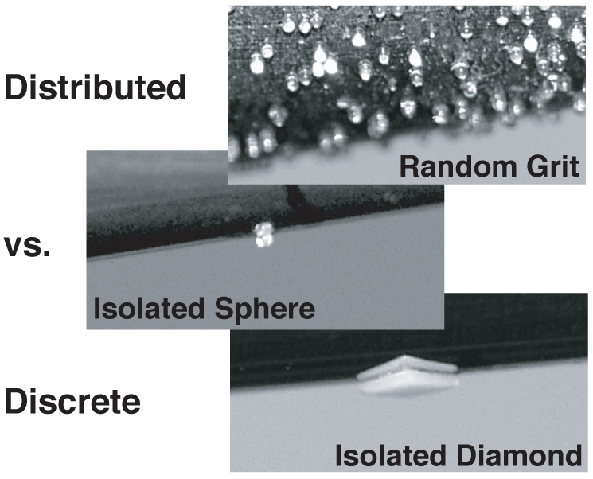
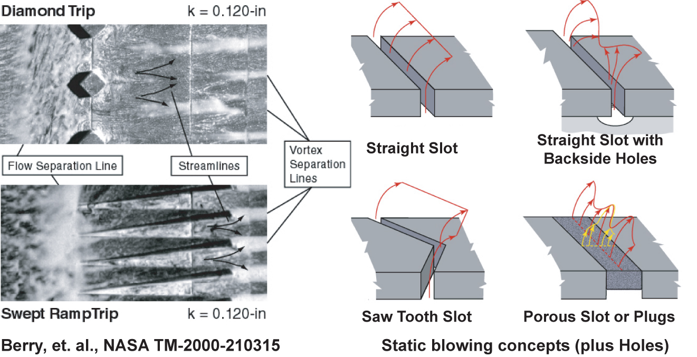
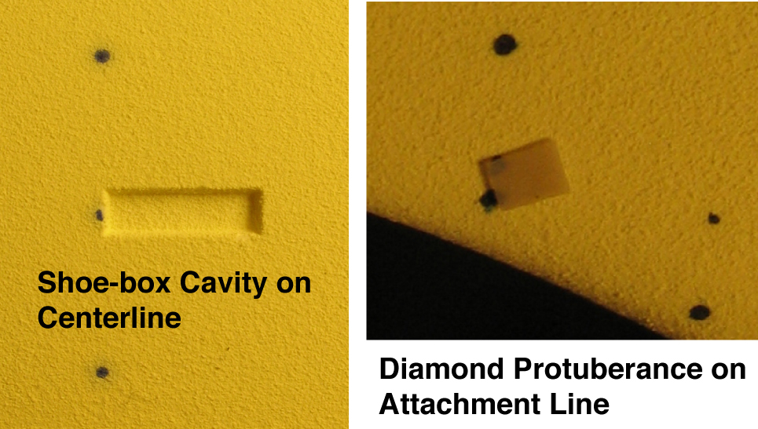
Empirically Derived Correlations
Basic Research Cone Study
Hyper-X Trip Screening Studies
Shuttle RTF Studies
Berry et al., NASA TM-2000-210315
Cleared for Public Release

Slide 6
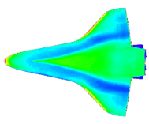
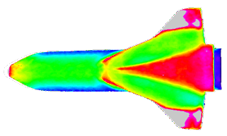
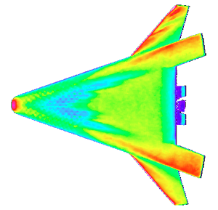
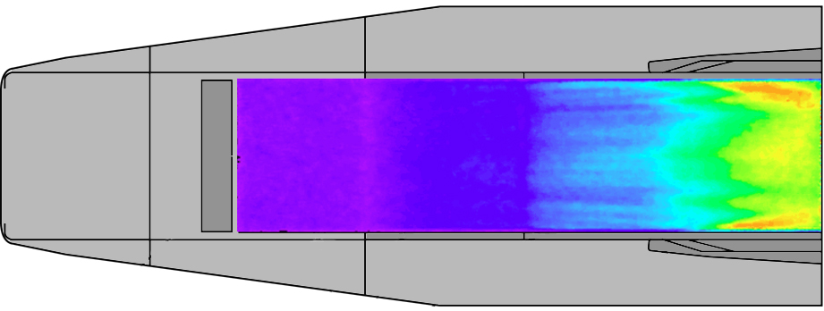
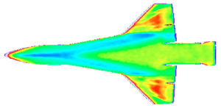
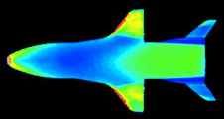
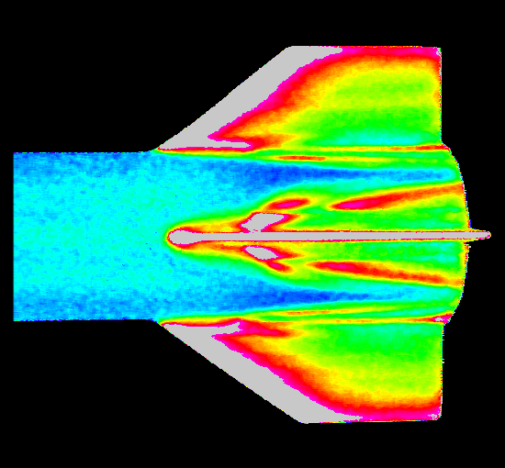
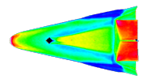
Examples of Experimental Hypersonic Transition Research at NASA LaRC
Slender (M_{e} > 4)
Moderately Blunt (1 < M_{e} < 4)
Classified
NASP 201
Shuttle
Classified
NASP 202
X-33
Phase I
X-33
Hyper-X
X-34
X-37
Missiles
X-38
Cleared for Public Release

Slide 7
VG investigation during NASP
Using layers of tape built up to act as vortex generators (VG)
Heating data (classified) showed VGs worked to trip BL
Unpublished – circa 1993
Cleared for Public Release
Notes:
Inspiration came during Morkovin workshop.

Slide 8
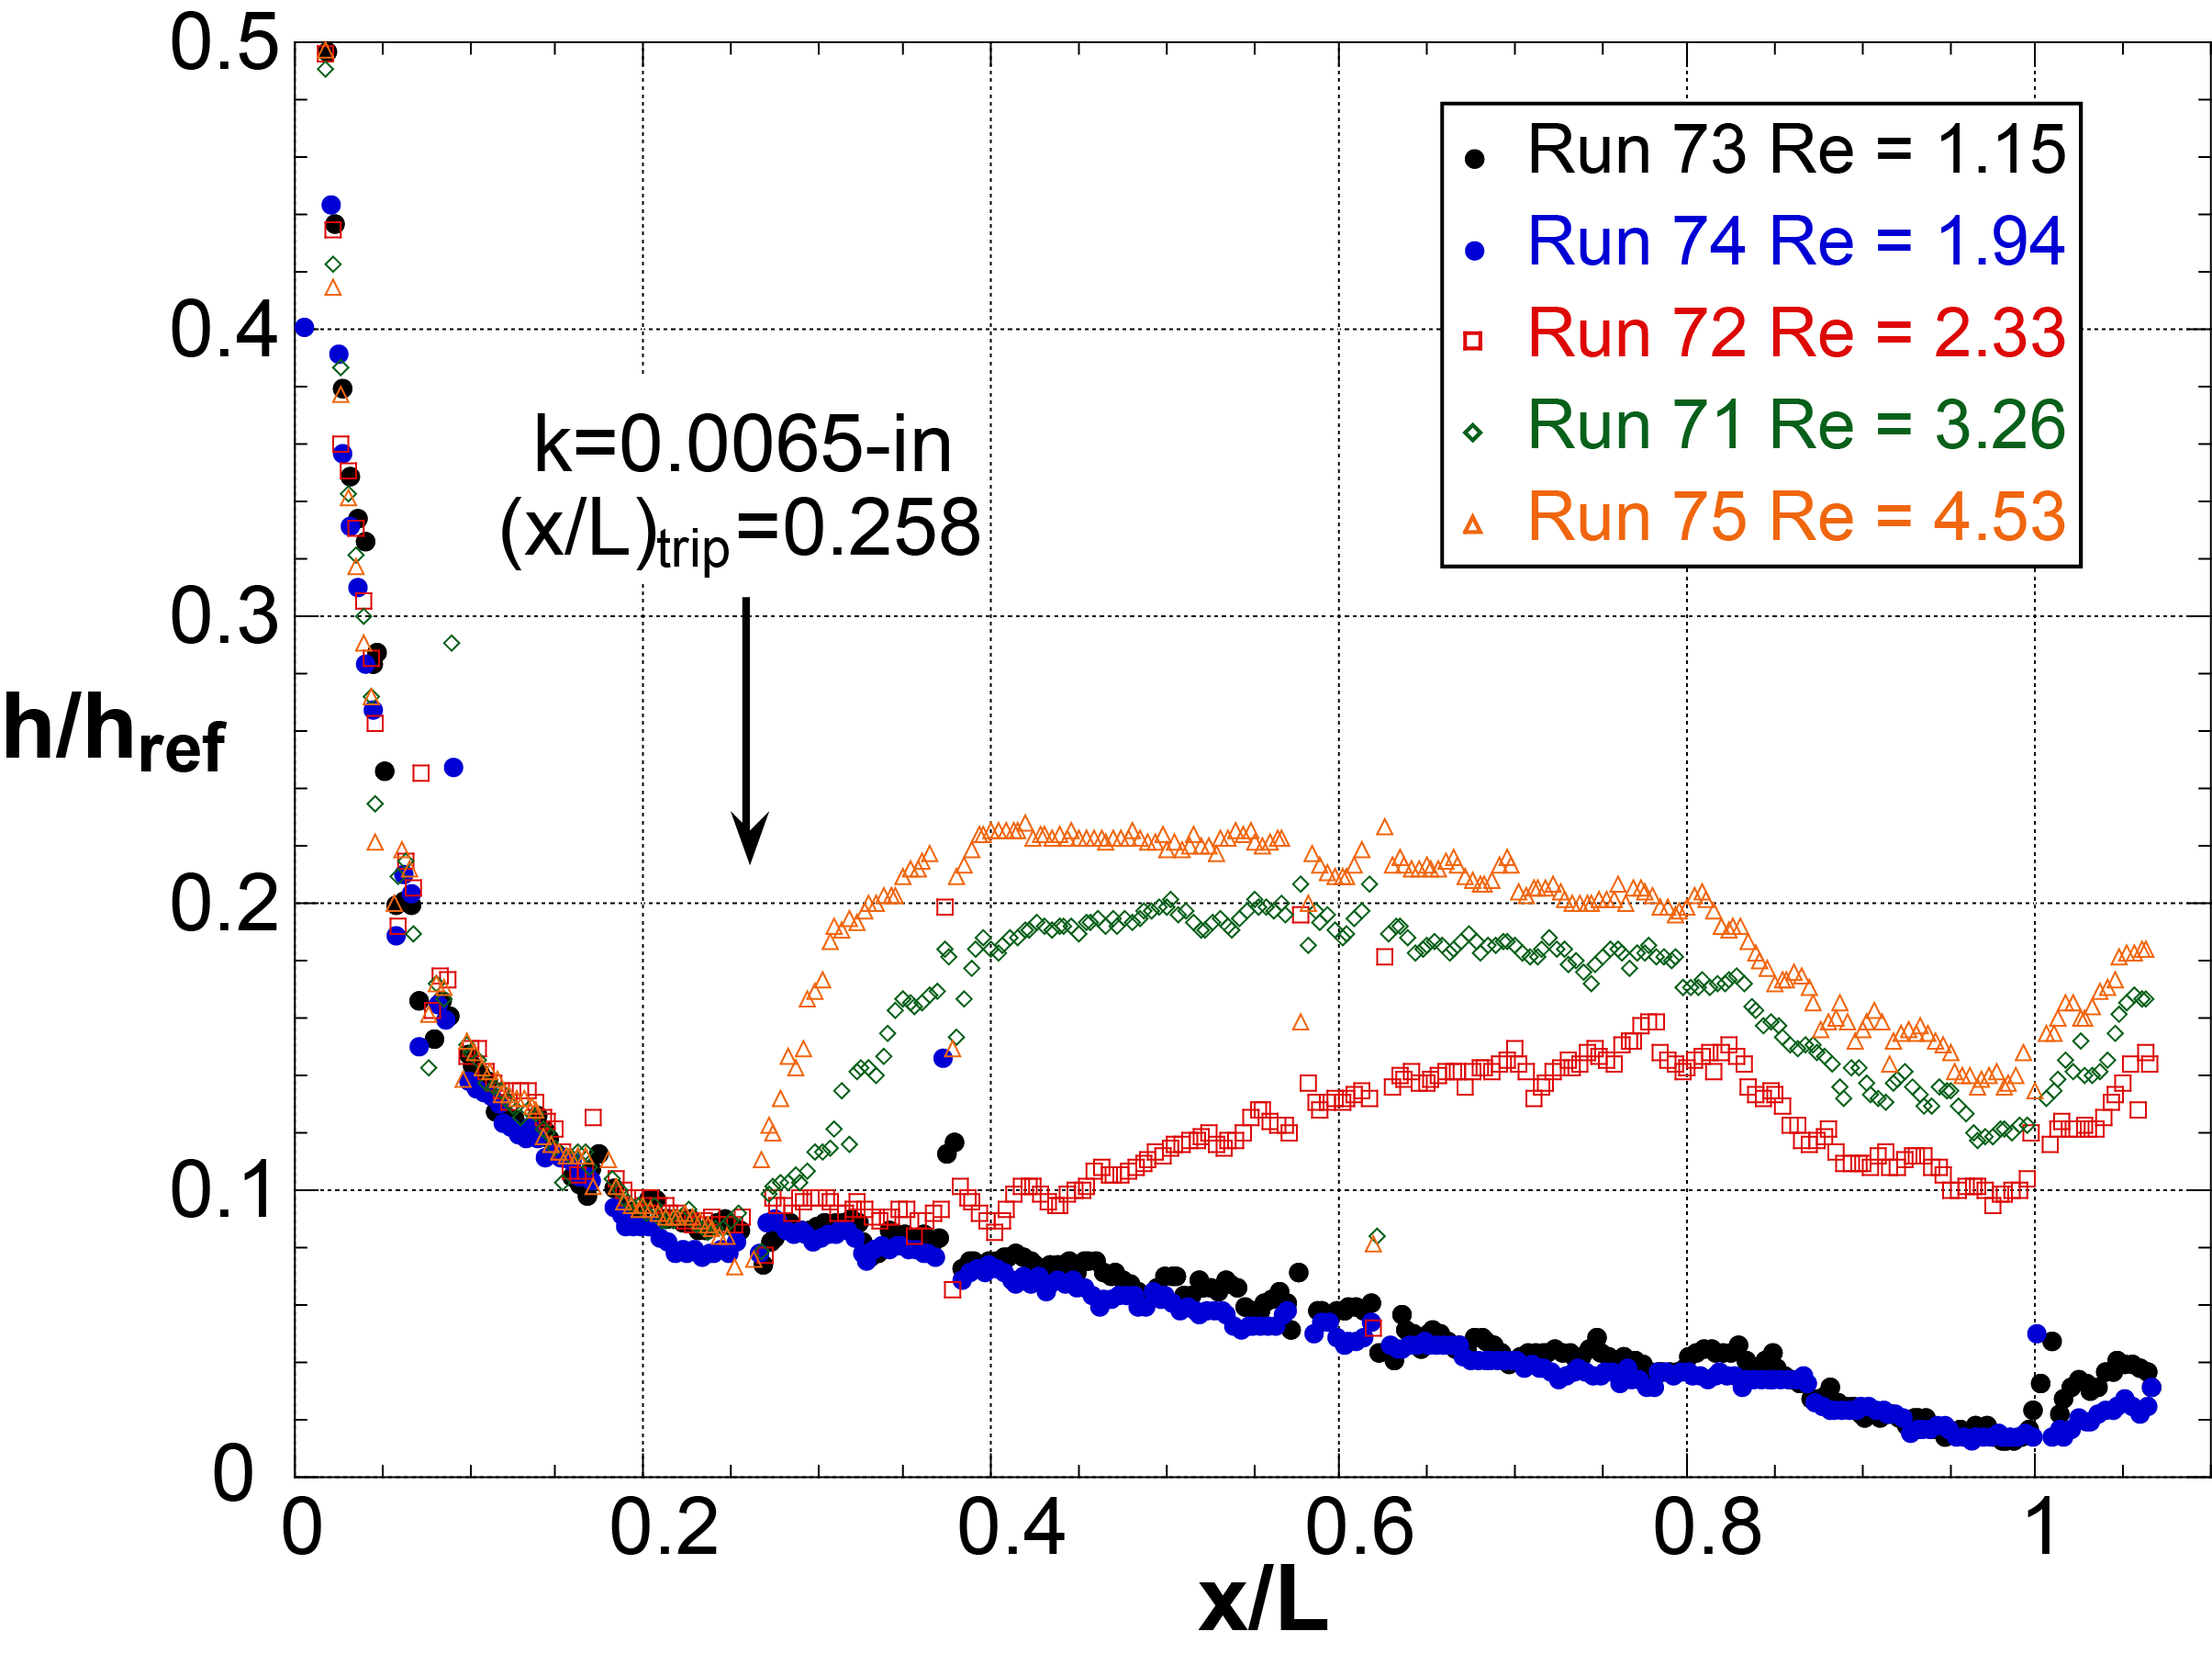
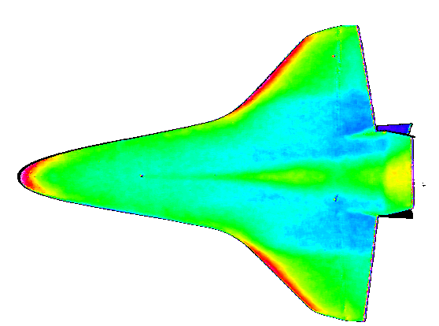
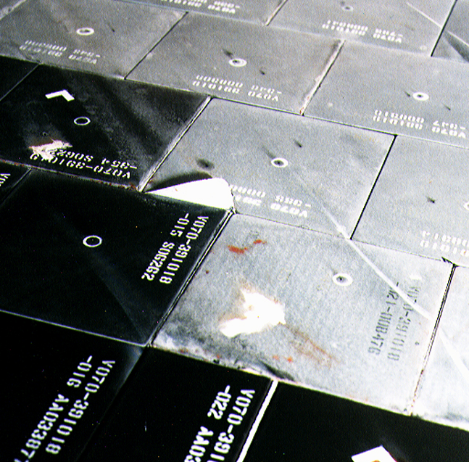
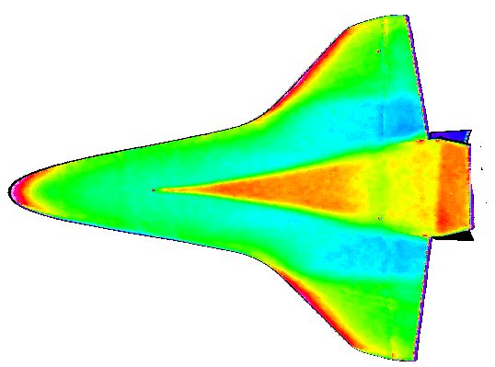
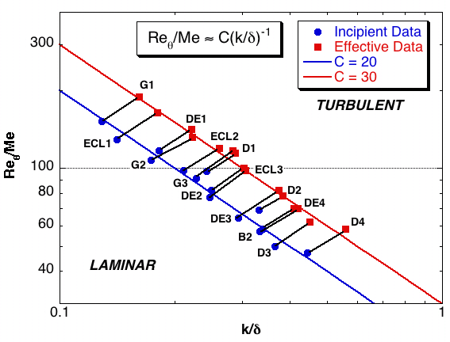
Shuttle Orbiter Asymmetric BLT Study
STS-28 Mach 18 BLT
Incipient
Gap filler
Effective
Issue: Asymmetric BLT had resulted in excessive propellant usage to correct Orbiter yaw during entry
Impact: Surface roughness correlation developed to predict boundary layer transition from isolated surface protuberances
See AIAA 97-0273
Discrete roughness correlation with BLIMP boundary layer properties
Cleared for Public Release

Slide 9
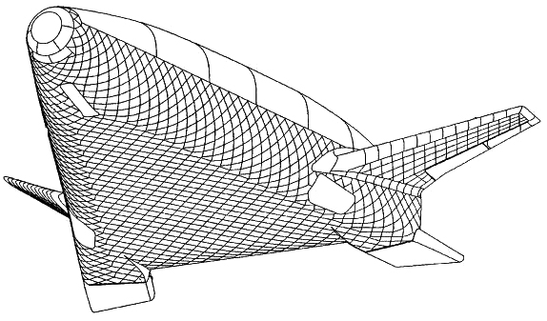
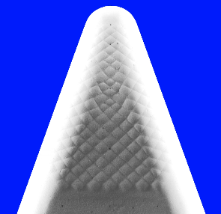
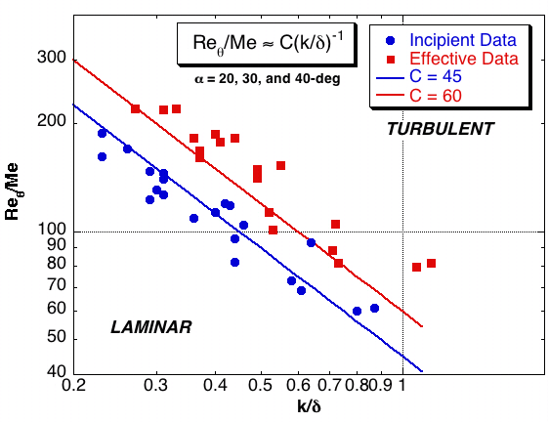
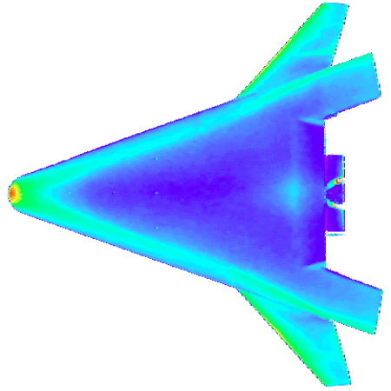
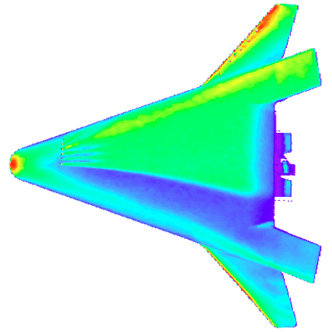
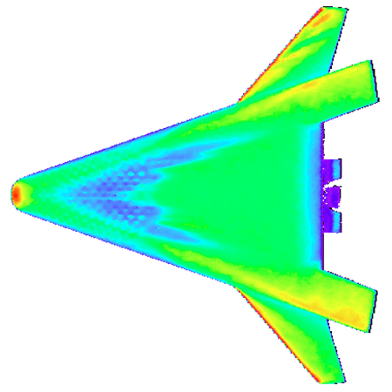
X-33 Technology Demonstrator
Issue: Proposed metallic TPS could deform (bow) during entry due to temperature gradients within individual panels
Impact: Transition correlation used by X-33 program for entry trajectory tailoring to constrain laminar heating rates to within the capability of the metallic TPS and distributed roughness (bowed panels) was found to be less effective than discrete roughness of equivalent height in promoting transition
X-33 metallic TPS panel layout
Discrete roughness correlation based on LATCH code for boundary layer properties
Cast ceramic model with panel bowing
k
Smooth
Discrete
k= 0.005-in
Bowed Panels
k= 0.008-in
Re∞ = 4x10⁶/ft
Re∞ = 3.1x10⁶/ft
Re∞ = 4x10⁶/ft
See AIAA 99-3560
Note only centerline results shown, but results applicable for attachment lines also
Cleared for Public Release

Slide 10
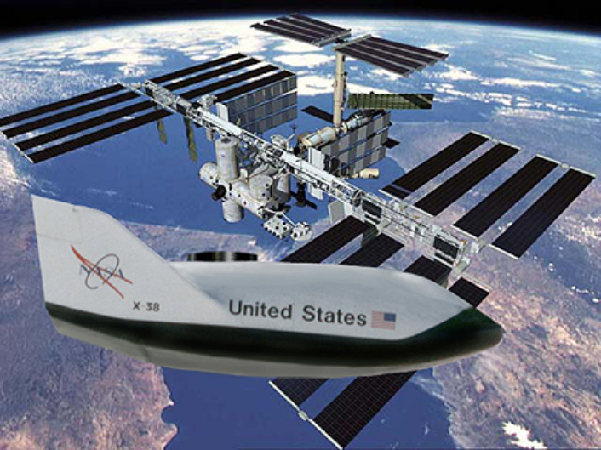
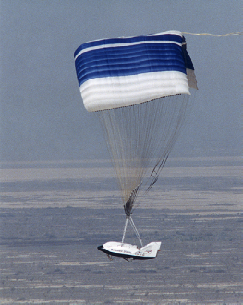



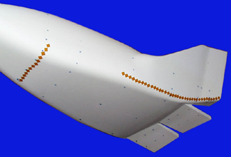

X-38 Crew Return Vehicle
Issue: Thermal margin of body flap based on fully turbulent flow which may not be representative of local peak heating.
Impact: Improvement in an engineering model used to assess the thermal margin of the X-38 body flap in the presence of a separating/reattaching transitional flow (nonlaminar but not fully turbulent).
See AIAA 2000-2685
Fin/rudder
1
Tripped (k = 0.005-in)
0.3
interface
0.25
Untripped
0.8
(Transitional)
0.2
Untripped
Normalized heating
Tripped
0.6
Normalized heating
(Turbulent)
Untripped
0.15
0.4
0.1
k = 0.005-in
Boundary Layer trips
0.2
0.05
0
0
0.5
1
0
0
0.2
0.4
0.6
0.8
1
Tripped
k = 0.005 in.
X/L
Nondimensional fin chord length
Cleared for Public Release

Slide 11
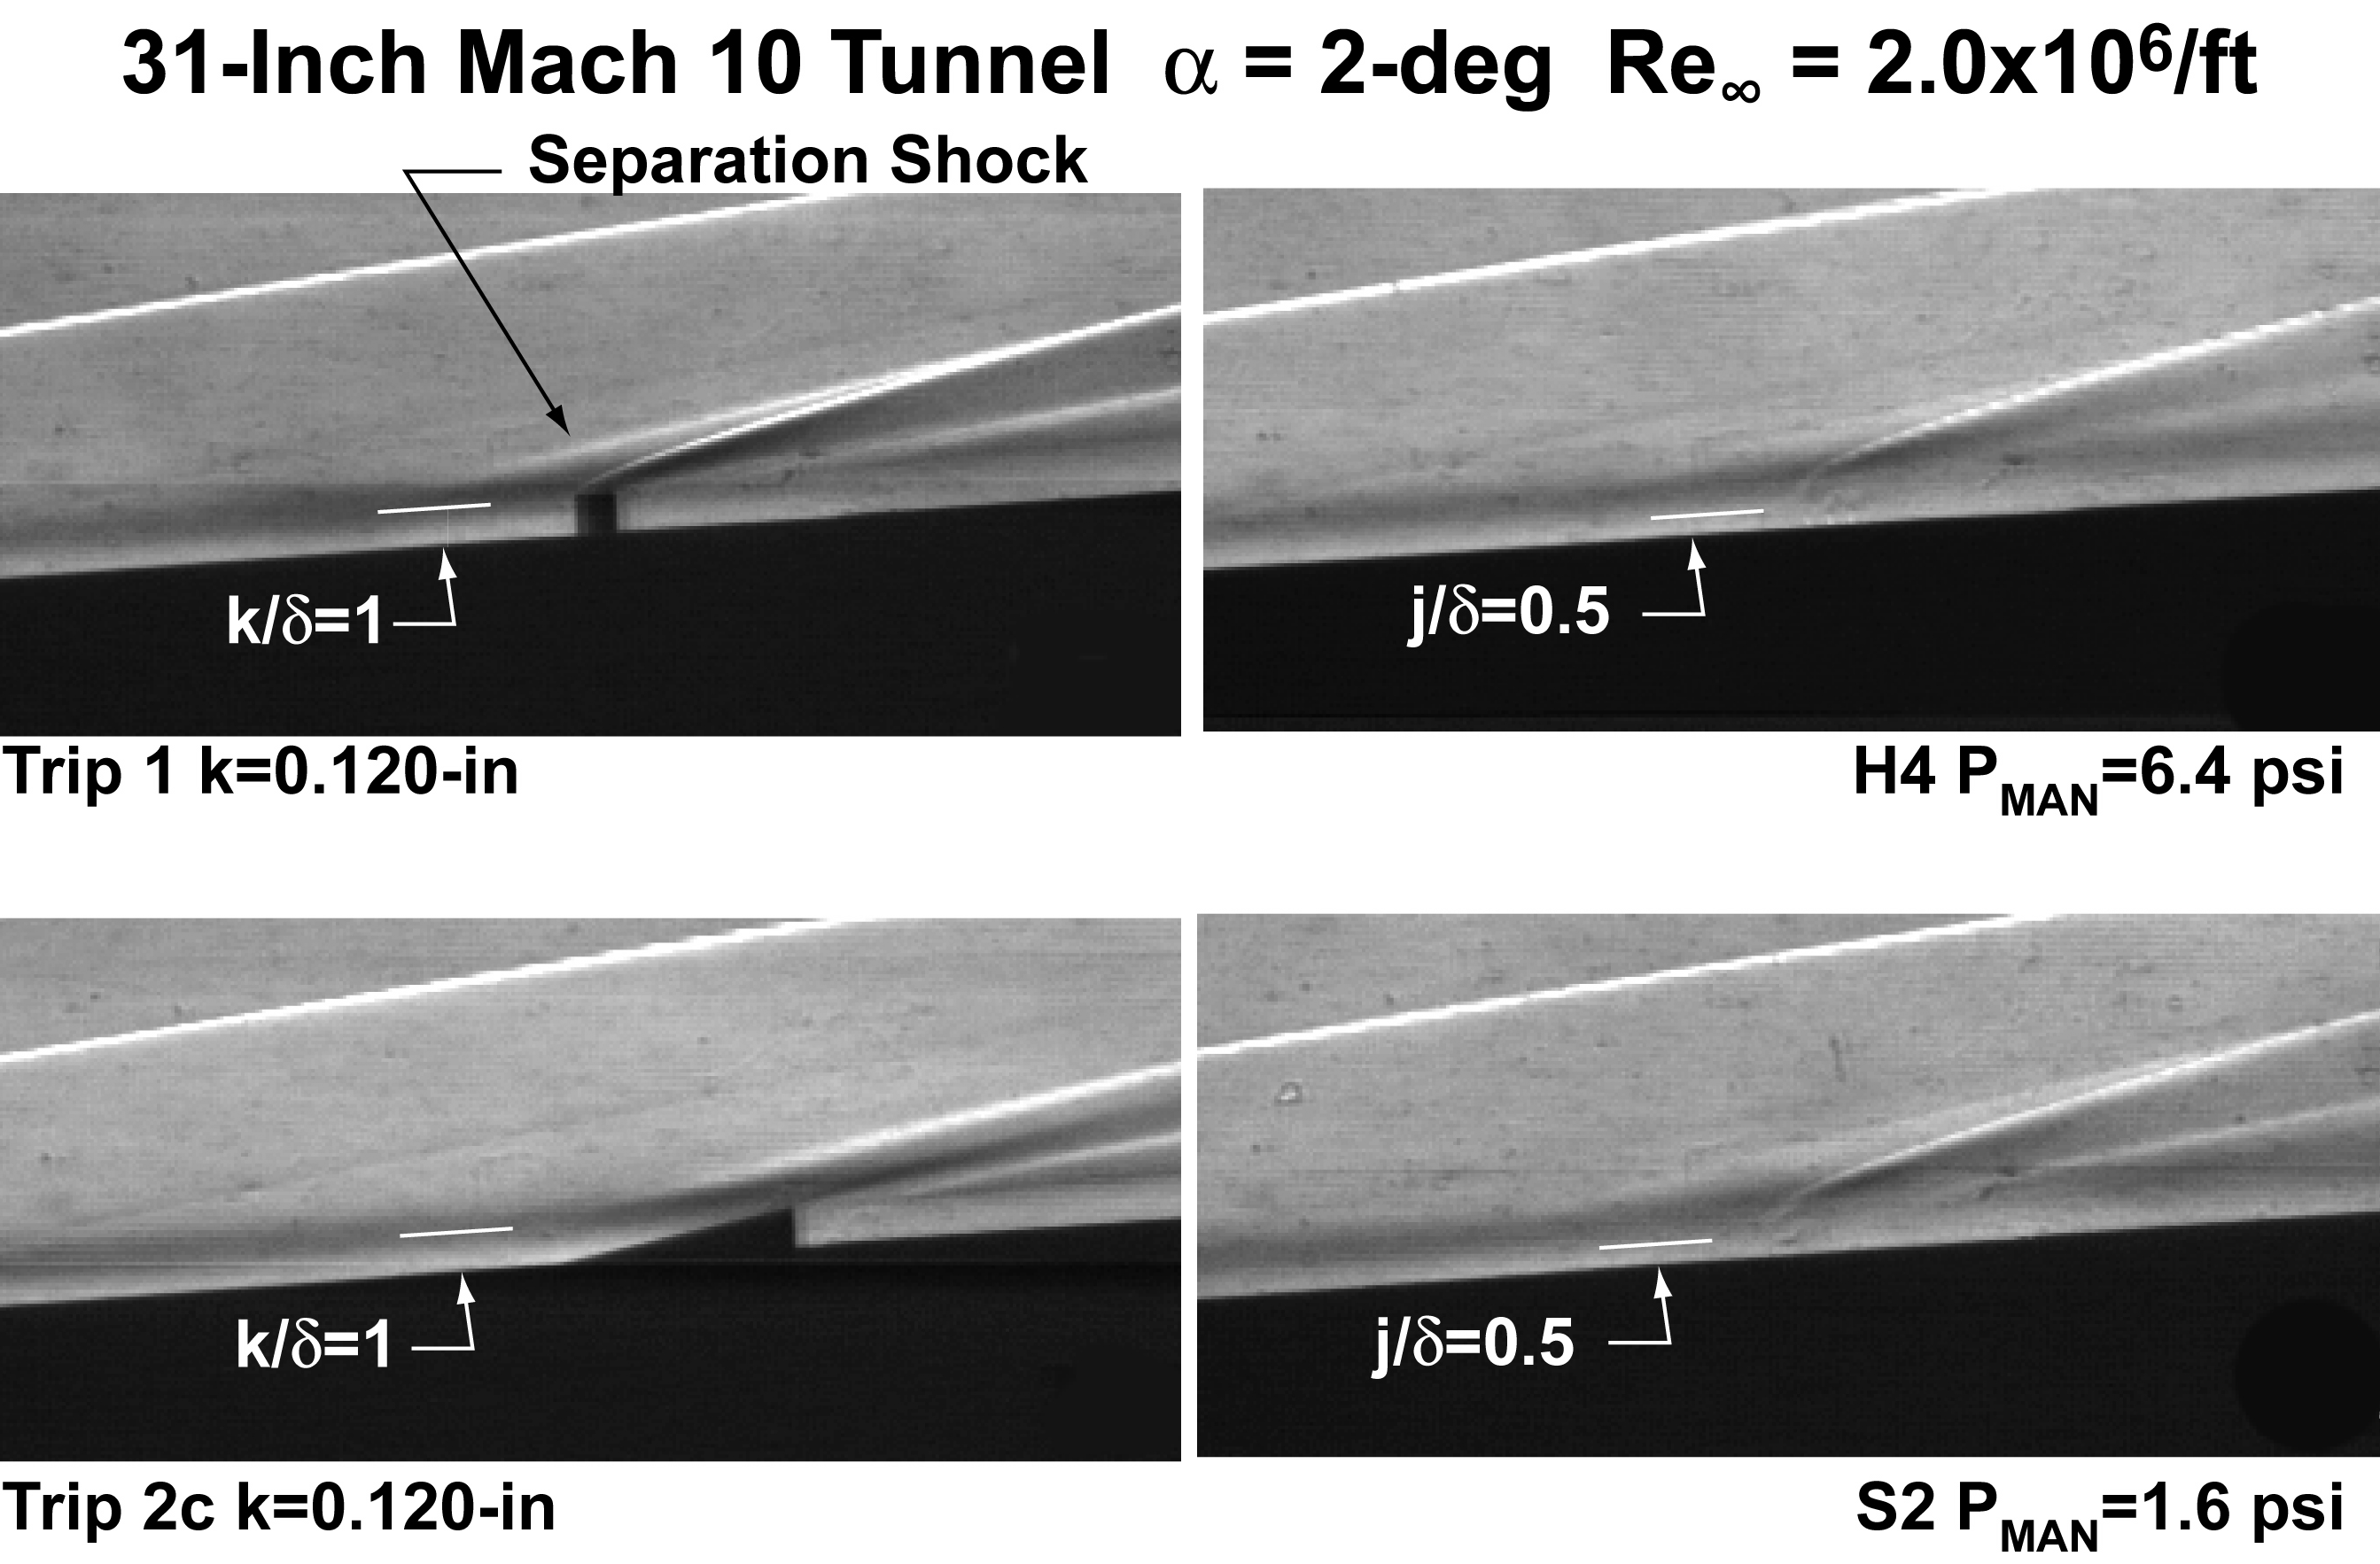
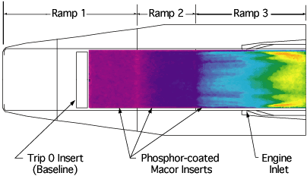
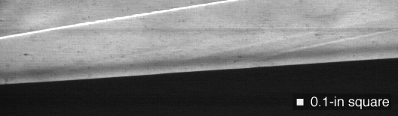
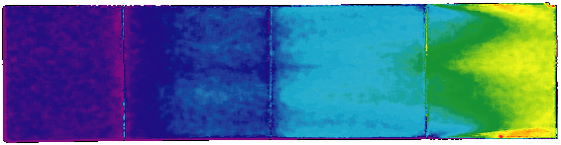
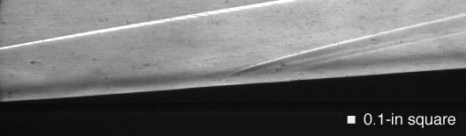
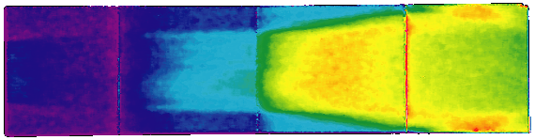
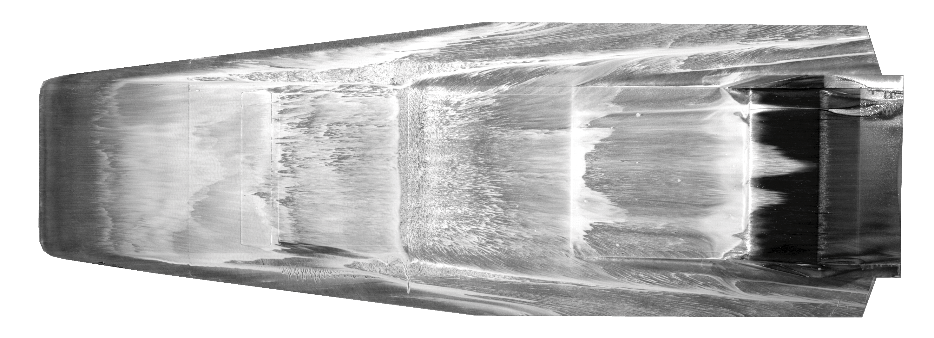
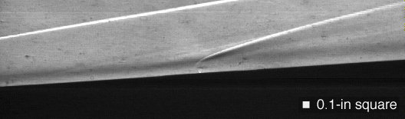
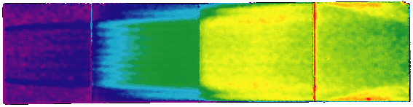
Trip Screening for Hyper-X
Issue: To improve inlet and engine performance and to provide data relevant for a full-scale scramjet powered vehicle, turbulent flow ahead of X-43 engine inlet was required
Impact: Trips for both X-43 flight vehicles were selected based on the passive results obtained (not shown, see AIAA 2000-4012) and active blowing was found to be equally effective while having smaller jet-induced shock and flow separation than corresponding discrete trips
α = 2 deg
See AIAA 2004-2246
Passive
Active
Single Row of 17 Holes (0.020-in D) with 1/8-in Spacing
Bow shock
.
.
.
.
.
.
.
.
.
.
.
.
.
.
.
.
.
Run 78
No Blowing
P
= 0.08 psi
2
Shock induced by blowing
Trip array
Run 83
P/P
= 20
2
Run 81
P/P
= 80
2
Closed-cowl
Cleared for Public Release

Slide 12
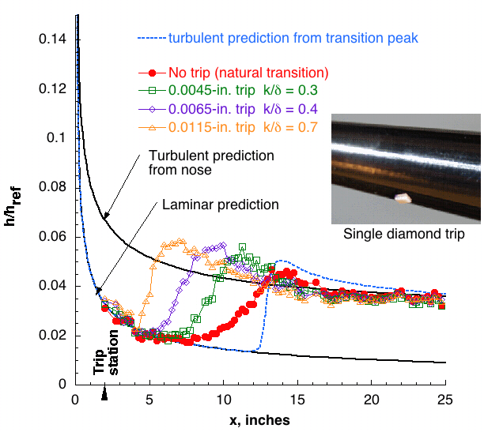
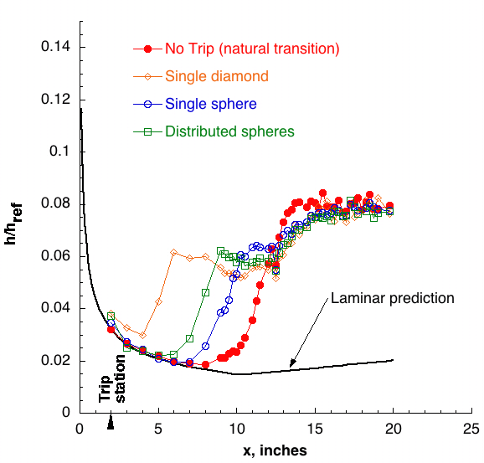
Roughness on Slender Cones
Issue: Quantification of tunnel disturbance environment and assessment of discrete versus distributed roughness
Impact: First comparison of transition onset locations between conventional and low disturbance hypersonic tunnels using common model and transition detection technique (not shown, see AIAA 2002-2743) and determination of relative trip effectiveness
Sharp Nose 5-deg Straight Cone
Mach 6 α=0 deg Re=4.4 million/ft
Sharp Nose 5-deg Flared Cone
Mach 6 α=0 deg Re=4.4 million/ft k/δ=0.7
Cleared for Public Release

Slide 13
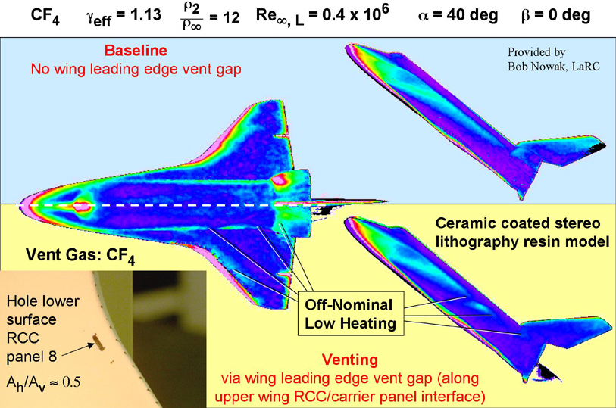
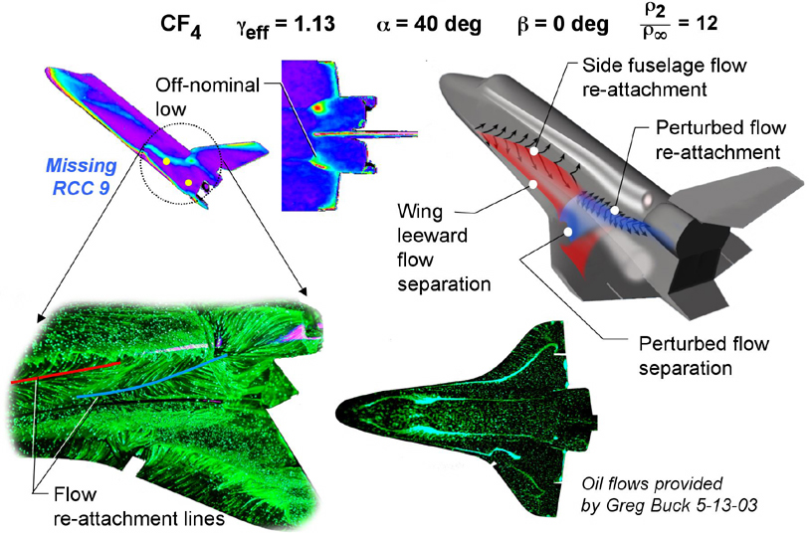
Columbia Accident Investigation (CAI)
Issue: Could asymmetric BLT from a damaged “rough” wing affected the Orbiter aerodynamics and accelerated the erosion of Columbia’s TPS tiles?
Impact: Simultaneous aerodynamic and heating measurements refuted “rough” wing hypothesis.
Impact: Closure achieved through wind tunnel tests that identified leeside flow-field perturbations (separation and reattachment) which replicated the temperature anomalies observed in Columbia data
See AIAA 2004-1387
Cleared for Public Release

Slide 14
Consistent Correlation Approach
Comparison of existing Orbiter, X-33, and X-38 BLT correlations
based on edge conditions (published in AIAA 2002-2744)
1000
Centerline Effective Transition Results
Consistent Method:
Facility
Test Technique
Computations
Computed with LATCH
TURBULENT
100
/M_{e}
LAMINAR
Correlation shown
applicable for different:
Configurations
Model α
Locations on body
Re_{θ}
10
Shuttle
α
= 40 deg
X-33
α
= 20 deg
C
eff
= 70 ± 20%
X-33
α
= 30 deg
X-33
α
= 40 deg
X-38
α
= 40 deg
1
0.1
1
10
k/
δ
Thus, for moderately-blunt vehicles, discrete roughness correlations can be used to predict transition when a consistent method is used between development and application
Cleared for Public Release

Slide 15
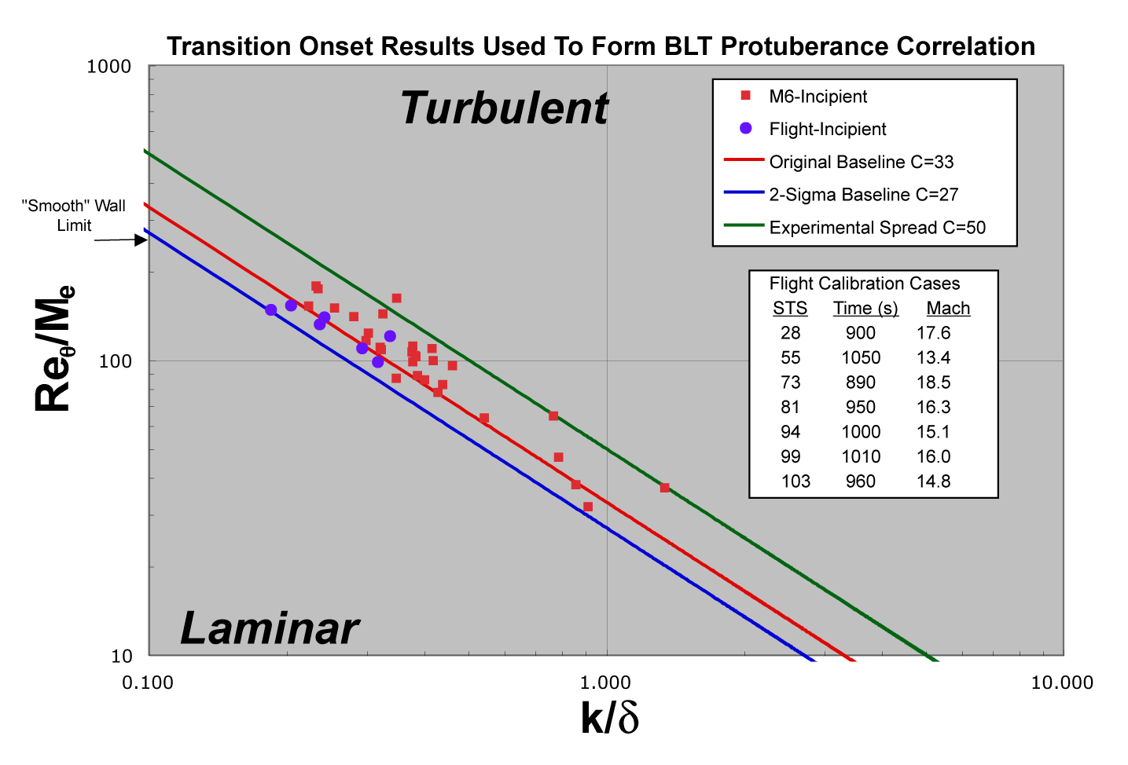
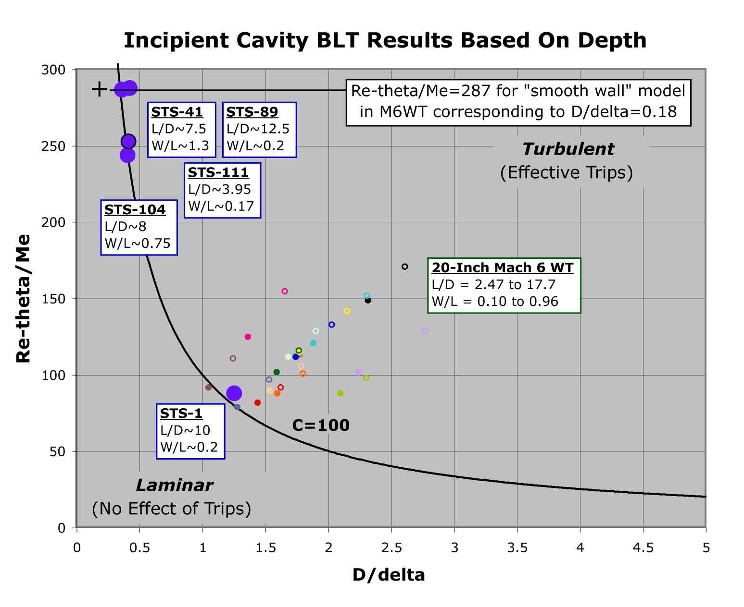
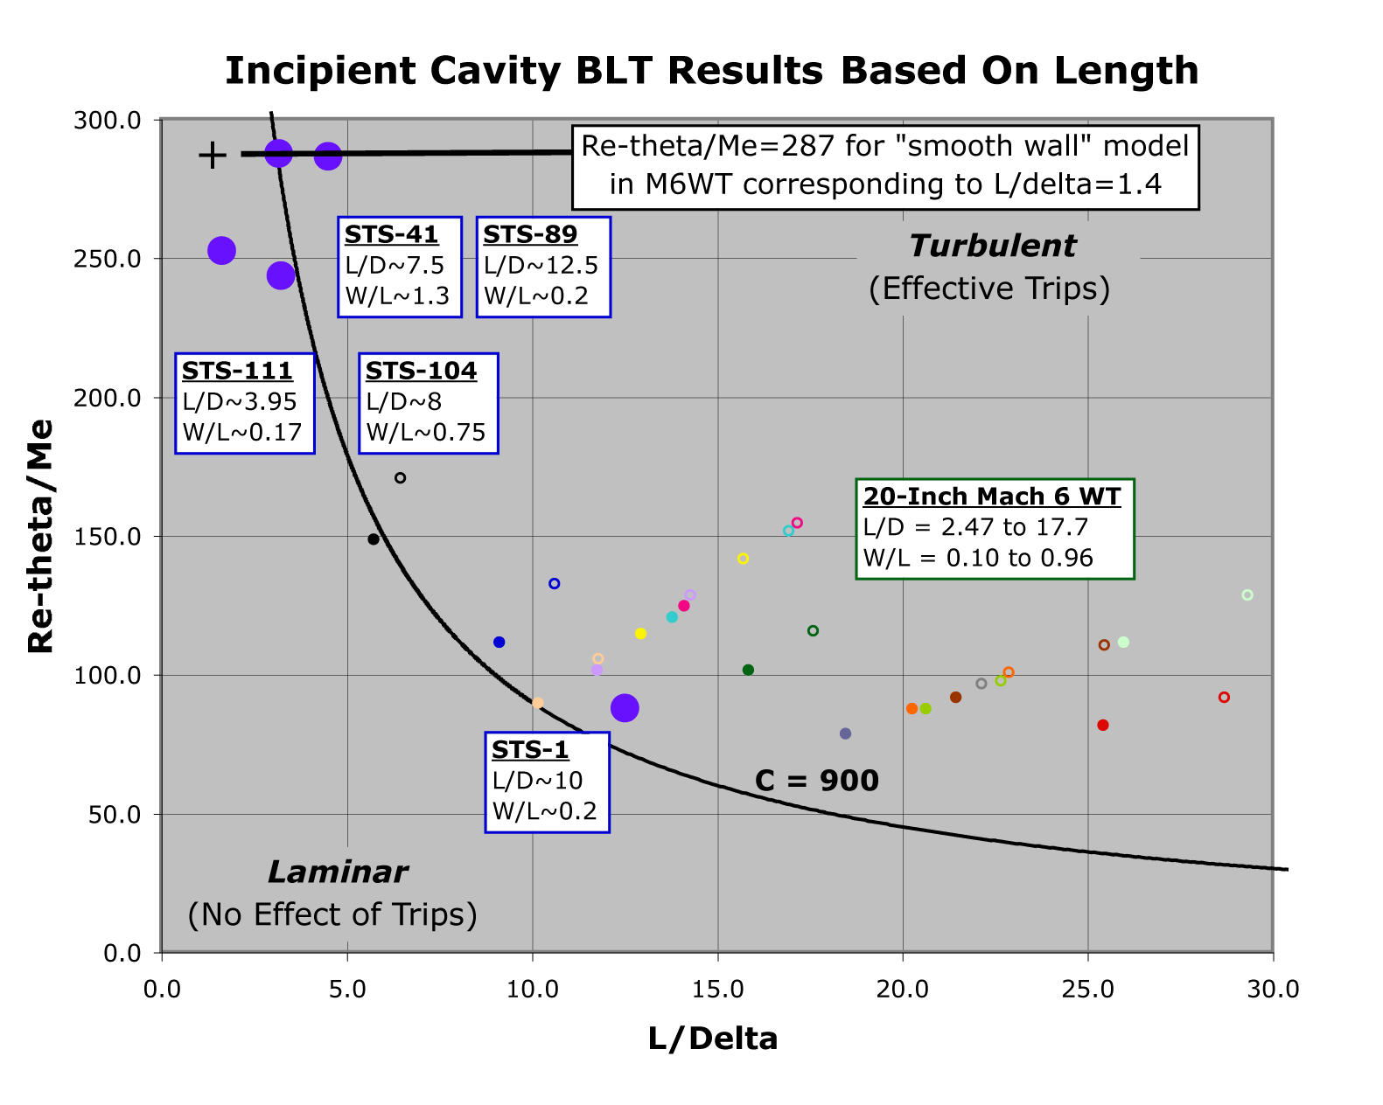
Shuttle Orbiter Return-to Flight (RTF)
Issue: If transition occurs above Mach 18, the Shuttle may experience unacceptably high internal structural temperatures
Impact: Development, in time for the first RTF mission, of Shuttle tile damage/repair thresholds that could trigger corrective action
(see AIAA 2006-2917 through 2922)
Cleared for Public Release
Notes:
For protuberances, a pretty good correlation was developed with cosideration of the flight data
For cavities, a well-behaved correlation could not be developed in time for RTF, so instead we had to rely upon conservative thresholds

Slide 16
Summary of Ground-Test Observations
Observations of similar discrete roughness transition onset and effective results on several different moderately-blunt (supersonic edge conditions) configurations
When a consistent computational approach used to correlate results, prediction of discrete roughness heights required to “trip” BL is possible
Thus, for moderately-blunt vehicles, discrete roughness correlations can be used to predict transition when a consistent method is used between development and application
For sharp configurations (hypersonic edge conditions), large trips required (on par with BL edge) to “trip” BL
Cleared for Public Release

Slide 17
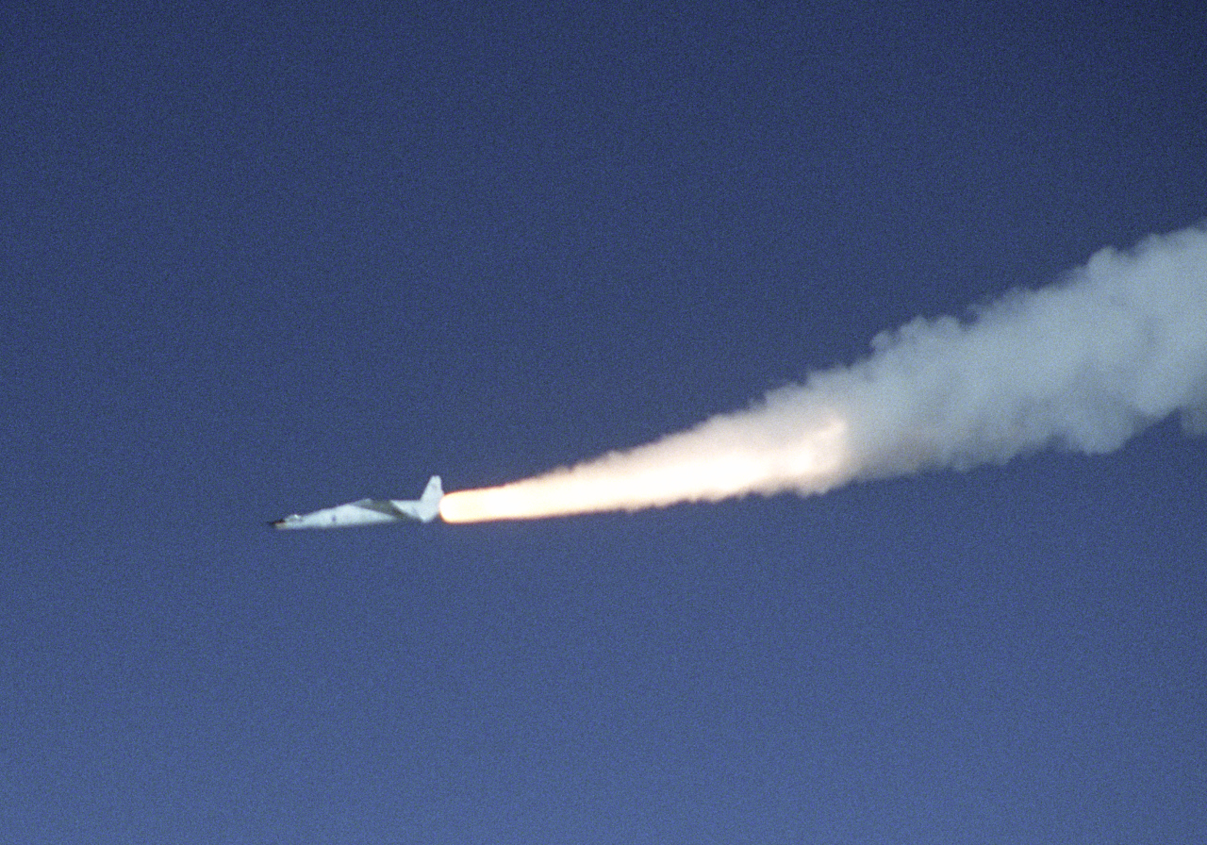

Flight
(Where the rubber meets the road!)
Hyper-X
Shuttle
Cleared for Public Release

Slide 18


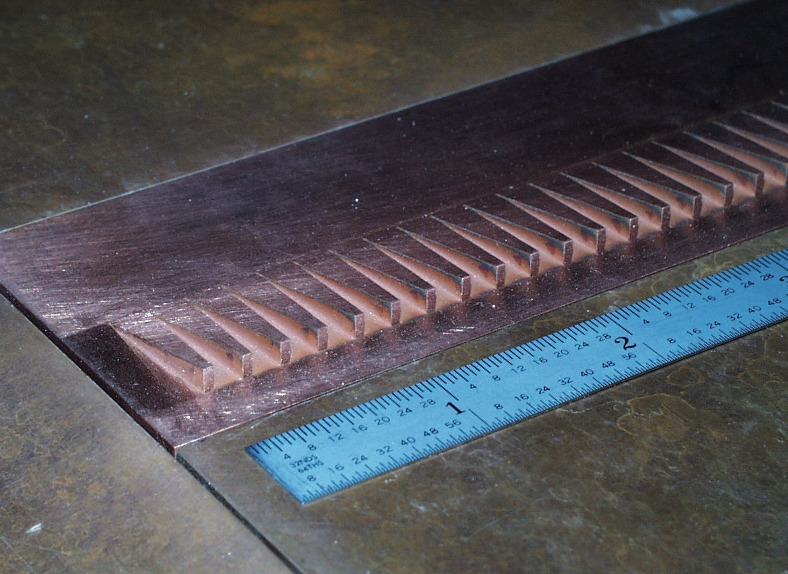
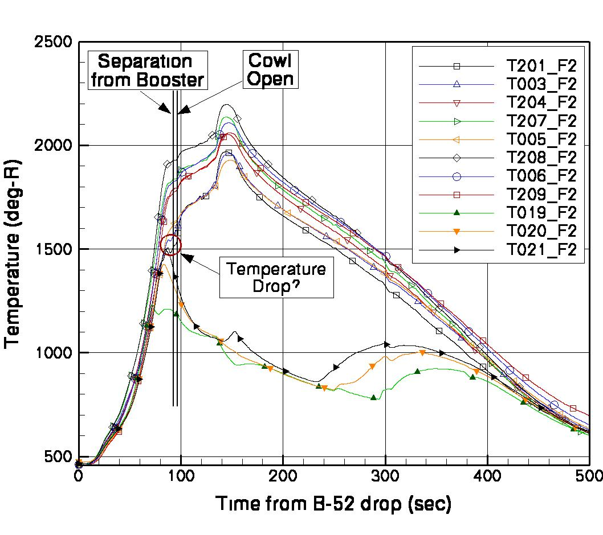
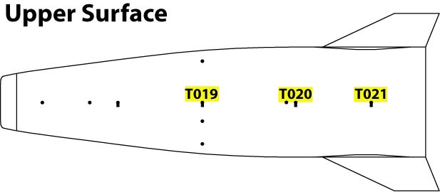
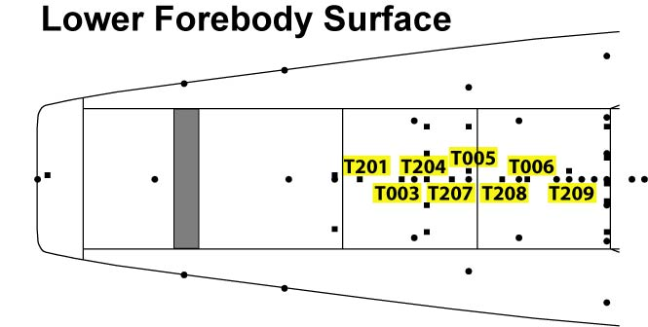
Flight 2 Measurements
Mach 7
Final trips sized for Mach 7 flight
Re_{θ}/M_{e} ≈ 300 ± 4%
From AIAA 2008-3736
Cleared for Public Release

Slide 19

Flight 3 Measurements
Mach 10
Re_{θ}/M_{e} ≈ 280 ± 6%
From AIAA 2008-3736
Cleared for Public Release

Slide 20


Return-to-Flight Overview
Columbia Accident Investigation directive to develop on-orbit TPS inspection and repair capabilities as part of the RTF effort
  Suite of tools developed/integrated to allow rapid assessment of TPS health (more on next chart)
BLT prediction based on physical mechanism approach would be ideal
  For Shuttle RTF, not ready for prime time
Most hypersonic vehicles have surfaces that by-pass natural instabilities, such as roughness (like Shuttle)
Shuttle BLT Tool developed with this in mind
  Utilized discrete roughness correlation approach
  Previously shown to capture WT trends for a variety of configurations (JSR 45.2 2008)
STS-114 exposed uncertainties with prediction of high Mach BLT, led to unprecedented repair
Shuttle BLT Flight Experiment (FE) developed to address high Mach BLT Tool uncertainties
~24,000 Black Tiles
~20,000 Gap fillers
STS-114 Repair
Shuttle offers wealth of hypersonic BLT data, with 135 missions flown
Next few charts taken from AIAA-2016-3533
Cleared for Public Release

Slide 21
Mission Support Timeline
Damage Assessment Flowchart:
Trajectory
information
Damage
information
BLT Tool required to:
  Set proper aeroheating environment for subsequent thermal & structural analysis
  Rapidly determine time of transition onset for each and every damage site (~5-20 sites)
Within a typical 2-week mission:
  Photos of TPS damage from RPM by FD3
  Initial TPS assessment by FD4
  Further analysis, as required, using the OBSS starting on FD4
  Flight cleared to continue mission by FD7 (ideal)
Input
Tools
Output
BLT Tool
Cavity
Heating
Tool
XF0002
(Legacy Body-Point
Analysis Code)
3D Thermal
Math Model
Material
Temperatures
RTV Bond
Line Tool
Bond Factor
of Safety
BLT Tool V1 ready before STS-114 (AIAA-2006-2918)
BLT Tool V2 update after STS-114 (AIAA-2010-0246)
Stress
Assessor
Tool
Structural
Margin and
Deflections
Cleared for Public Release

Slide 22


BLT Tool V2 Protuberance Correlations
Protuberance Correlation #1 (Re_{θ} approach):
Protuberance Correlation #2 (Re_{k} approach):
All Shuttle high-Mach BLT experience has been due to gap filler protrusions
  Historical earliest was at Mach 18 during STS-28 and STS-73
Use of 2 correlations during mission intended to provide method to assess uncertainty
Note, bias observed between mean of WT & flight, tool utilized flight for BLT estimation
BLT FE developed to explore protuberance correlation bias using envelope expansion:
  Incremental increase in protuberance height over 5 flights
  Is there a limit to how early BLT can occur at hypersonic (& nonequilibrium) conditions?
Cleared for Public Release

Slide 23



BLT Flight Experiment
Protuberance designed integral to TPS tile and to minimize slumping
Location on port wing selected based on:
  Consideration of TPS thermal/structural margins
  Suitability for new instrument wiring
  Regions of minimal historical debris damage
New thermocouples added/moved, as shown per flight
k = 0.25” for STS-119
= 0.35” for STS-128 & STS-131
= 0.50” for STS-133 & STS-134
Cleared for Public Release

Slide 24














HYTHIRM Shuttle Support
Hypersonic Thermodynamic Infrared Measurements (HYTHIRM)
Now SCIFLI
Mission success through rigorous planning and enhanced capabilities
Capabilities:
In Air
On Ground
At Sea
Sensor Upgrades:
Wider dynamic range
Improved signal-to-noise
Integration time controls
Mission Planning:
STS-134 Reentry 6-01-11
Missions Supported by HYTHIRM:
KSC 249
Observation
~Mach 11-5
Observation
~Mach 16-13
KSC 248
Weather Briefings
Cleared for Public Release

Slide 25



STS-119
3D Mapped HYTHIRM Image @ Mach 8.4
Flown on Discovery
HYTHIRM image @ Mach 8.4 reveals 2 BLT wedges, one from an unknown source, the other from FE
Asymmetric wedge thought to be from GF about 0.18” high, but not found (assumed fell out on runway)
BLT FE TCs reveal extent and timing of transition from 0.25” protrusion:
  Onset at t=969s (or Mach 15.6)
  Fully effective at roughly t=1045s (or Mach 13.1)
  Wedge half-angle of roughly 7 deg
Cleared for Public Release

Slide 26



STS-128
3D Mapped HYTHIRM Image @ Mach 14.7
Flown on Discovery
HYTHIRM image @ Mach 14.7 shows BLT FE wedge
TCs reveals port-side BLT at t=1040s, or Mach 13.6, thought to be from a noted forward-facing step found between tiles (~0.15” high)
BLT FE TCs reveal extent and timing of transition from 0.35” protrusion:
  Onset at t=916s (or Mach 17.3)
  Fully effective at roughly t=970s (or Mach 15.8)
  Wedge half-angle of roughly 5 deg
Cleared for Public Release

Slide 27



STS-131
3D Mapped HYTHIRM Image @ Mach 15
Flown on Discovery
HYTHIRM image @ Mach 15 shows BLT FE wedge
TCs reveals late BLT at ~t=1320s, or Mach 6.4
BLT FE TCs reveal extent and timing of transition from 0.35” protrusion (a repeat):
  Onset at t=932s (or Mach 17.3)
  Fully effective at roughly t=996s (or Mach 15.6)
  Wedge half-angle of roughly 5 deg
Cleared for Public Release

Slide 28



STS-133
3D Mapped HYTHIRM Image @ Mach 18.1
Flown on Discovery
HYTHIRM image @ Mach 18 shows BLT FE wedge
  Highest Mach observation
TCs reveals late BLT at ~t=1220s, or Mach 8.5
BLT FE TCs reveal extent and timing of transition from 0.5” protrusion:
  Onset at t=829s (or Mach 19.6)
  Fully effective at roughly t=930s (or Mach 16.9)
  Wedge half-angle of roughly 3 deg
Cleared for Public Release

Slide 29



STS-134
3D Mapped HYTHIRM Image @ Mach 6.2
Flown on Endeavour
HYTHIRM image @ Mach 6.2 shows BLT FE wedge
TCs reveals late & asymmetric BLT at ~t=1270s, or Mach 6.8
BLT FE TCs show transition onset from 0.5” protrusion (a repeat):
  Onset at t=840s (or Mach 19.4)
Cleared for Public Release

Slide 30


STS-134
Series of HYTHIRM Images showing evolution of hypersonic BLT during reentry
(c)
M=6.9 α = 33.4 deg
(e)
Other damage sites
Unprecedented detail showing flow features not observed with on-board TCs
For instance, take cavity case shown at left, based on the IR video data only:
  Onset at t=1261s (or Mach 7.1)
  Fully effective at t=1269s (or Mach 6.9)
  Wedge half-angle of ~8 deg
BLT Tool V2 prediction of Mach 8.4 based on cavity volume
Streamlines from CFD
~16 deg
L = 6-in, W = 1-in, D = ~ 0.15-in
Cleared for Public Release

Slide 31


Comparison of TC Traces
Incipient
Critical
TC#1
TC#2
Some TC traces reveal anomalous behavior due to high-Mach roll maneuvers
  Roll-reversal anomaly previously discussed in AIAA-2010-240, not well understood
Looking past anomalies, BLT onset times change systematically with trip height
  BLT onset based on TC#1 critical for comparison to correlations
  TC#2 provides similar (but delayed) trends
BLT earlier than Mach 18 (& at nonequilibrium conditions) shown possible with STS-133 and STS-134 results
Cleared for Public Release

Slide 32


Correlation Comparison
Correlation#1
Correlation#2
Both protuberance correlations shown to compare well against BLT FE data
  Corr#1 (Re_{θ}-based): within 15% of accepted correlation used for flight
  Corr#2 (Re_{k}-based): within 30% of accepted correlation used for flight
Combined analysis uncertainty of 9% based on RSS of:
  Experimental: trip height & location (<1%) and BLT onset determination (~4%)
  Computational: error of interpolating BL properties from existing database (<8%)
WT to flight bias shown to be real phenomenon, no longer attributable to uncertainties with the quality of the historical data
Cleared for Public Release

Slide 33
Shuttle Summary
Hypersonic BLT an enabling technology for future high-speed systems
Shuttle required a reliable & quick method to predict BLT
  Discrete roughness approach utilized
  Uncertainty with WT to flight bias unexplained during RTF development
BLT FE proposed to reduce uncertainties with tool predictions and improve technological “state-of-the-art”
  Limit to how early BLT can occur?
  Is WT to flight bias real?
Incremental trip height expansion resulted in systematic (& predictable) change in BLT onset times
  BLT shown to occur at Mach 19.5 (nonequilibrium conditions)
  New flight cases shown in agreement with historical calibration cases based on comparison to correlations
  WT to flight bias maintained for these well controlled results
Cleared for Public Release

Slide 34


Next Steps
Work continues to extend discrete roughness correlations shown applicable to moderately blunt (supersonic conditions at BL edge) to sharp configurations
  Recent BOLT II flight included discrete BL trips
    Flight data analysis underway with early results to be reported at SciTech23
  Wind tunnel testing completed to provide ground-based data for examinations of correlations
    Intend to look back at X-43 data as well
BOLT II @ WFF
March 21st, 2022
Test 7071 in 20” M6
July 2022
Cleared for Public Release

Slide 35
Summary
Measurement technique advancements have permitted the experimental hypersonic aerothermodynamicist to have a practical and significant impact on the design process of several space transportation vehicles
  Screening of different trip concepts for promoting turbulence ahead of scramjet inlets and down select to the Hyper-X trips for both flight vehicles
  Development of empirical hypersonic surface roughness boundary layer transition criteria shown to be applicable over a range of angle of attack and surface location for a class of Shuttle-like (moderately blunt) vehicles
  Establishment of Shuttle Orbiter TPS damage and repair threshold for prevention of high Mach number boundary layer transition
Comparison of flight measurements to the ground-based results have thus far shown reasonable but qualitative agreement
Further reduction of uncertainties with flight boundary layer prediction methodologies can be accomplished through additional flight experiments
Cleared for Public Release

Slide 36
Bibliography
AIAA 97-0273 - Boundary Layer Transition Due to Isolated Roughness: Shuttle Results From the LaRC 20-Inch Mach 6 Tunnel by Berry, Bouslog, Brauckmann & Caram
AIAA 99-3560 - X-33 Hypersonic Boundary Layer Transition by Berry, Horvath, Hollis, Thompson & Hamilton
NASA TM-2000-210315 - Forced Boundary-Layer Transition on X-43 (Hyper-X) in NASA LaRC 31-Inch Mach 10 Air Tunnel by Berry, DiFulvio & Kowalkowski
AIAA 2000-2685 - X-38 Experimental Aerothermodynamics by Horvath, Berry, Merski & Fitzgerald
AIAA 2000-4012 - Hypersonic Boundary-Layer Trip Development for Hyper-X by Berry, Auslender, Dilley & Calleja
AIAA 2002-2743 - Boundary Layer Transition on Slender Cones in Conventional and Low Disturbance Mach 6 Wind Tunnels by Horvath, Berry, Hollis, Chang & Singer
AIAA 2002-2744 - Discrete Roughness Effects on Shuttle Orbiter at Mach 6 by Berry & Hamilton
AIAA 2004-1387 - Experimental Aerothermodynamics in Support of the Columbia Accident Investigation by Horvath
AIAA 2004-2246 - Boundary Layer Control for Hypersonic Airbreathing Vehicles by Berry, Nowak & Horvath
AIAA 2006-2917 - Orbiter Return-To-Flight Entry Aeroheating by Campbell, Bourland, Bouslog, Horvath, Berry, Gnoffo, Reuther, Chao, Anderson & Picetti
AIAA-2006-2918 - Overview of Boundary Layer Transition Research in Support of Orbiter Return To Flight by Berry, Horvath, Greene, Kinder & Wang
AIAA-2006-2919 - Shuttle Damage/Repair from the Perspective of Hypersonic Boundary Layer Transition - Experimental Results by Horvath, Berry, Merski, Berger, Leichty & Schneider
AIAA-2006-2921 - Review of Orbiter Flight Boundary Layer Transition Data by McGinley, Berry, Kinder, Barnwell, Wang & Kirk
AIAA-2006-2922 - Boundary Layer Transition Results From STS-114 by Berry, Horvath, Cassady, Kirk, Wang & Hyatt
AIAA 2008-3736 - Boundary Layer Transition on X-43A by Berry, Daryabeigi, Wurster & Bittner
AIAA-2010-0246 - Orbiter Boundary Layer Transition Prediction Tool Enhancements by Berry, King, Kegerise, Wood, McGinley, Berger & Anderson
AIAA-2016-3533 - Flight Experiment Verification of Shuttle Boundary Layer Transition Prediction Tool by Berry, Berger & Horvath
Cleared for Public Release

