Slide 1



Learning From All Operations
Need-to-do not just nice-to-have
Jon Holbrook, Ph.D.
National Aeronautics & Space Administration
jon.holbrook@nasa.gov
Tzvetomir Blajev
Director Europe , Flight Safety Foundation
blajev@flightsafety.org

Slide 2
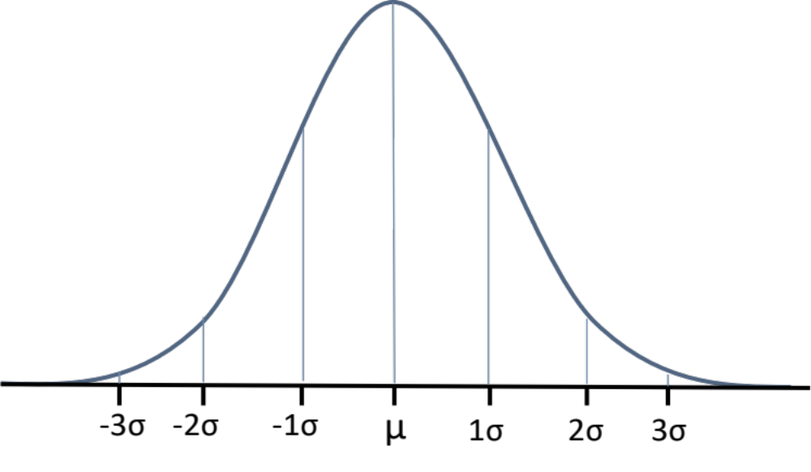
SMS – identify and mitigate safety risks
“Exceptional” events are non-representative
Infrequent events → infrequent learning
Misses “Black Swans”
Outcome-based learning
Based only on explicit knowledge
Hazard and Risk - Safety I
Learning from Excellence
Analyzing and understanding infrequent undesired events
Analyzing and understanding exceptional heroic events

Slide 3
The need to expand safety learning
Learn also from routine success
Monitor operations when everything is normal
Learn from processes, not just outcomes
Best Practices
Untapped potential
Analyzing and understanding nominal operations

Slide 4
Combine all the learning
Learning From All Operations
Timely learning from everyday work, not just exceptional work
Risk, Hazard but also Resilience and Adaption
Integrating across data types – ‘smart data’
Capture explicit but also implicit and tacit knowledge
Analyzing and understanding infrequent undesired events
Analyzing and understanding nominal operations
Analyzing and understanding exceptional heroic events

Slide 5
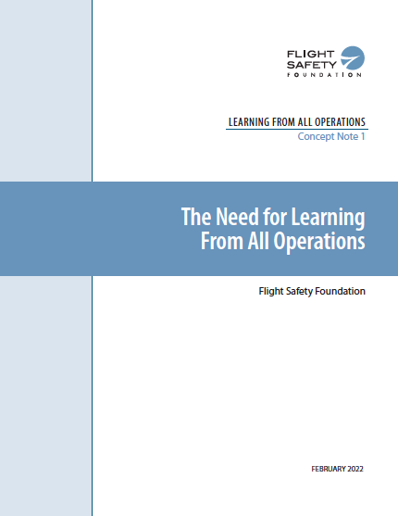
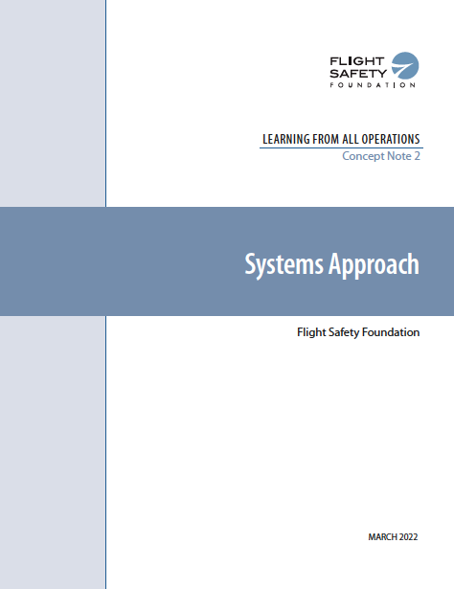

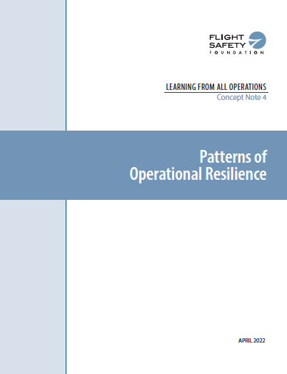
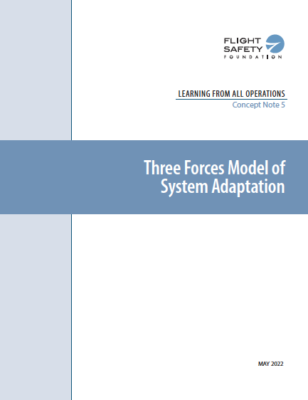
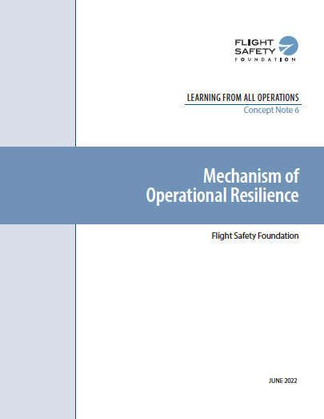
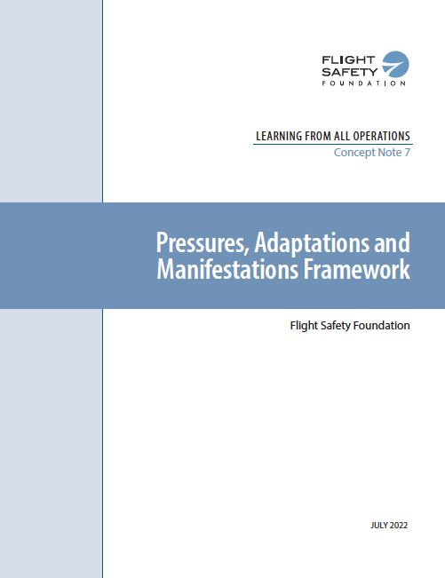
FSF – NASA Concept Notes
https://flightsafety.org/toolkits-resources/learning-from-all-operations/

Slide 6
Continuous Learning at three levels
Organisational Learning
Team Learning
Understanding and Feedback
Control and Feedforward
Individual Learning
OPERATIONS

Slide 7
Expanding on threat & error management
CONTEXT
PRESSURES
ADAPTATIONS
MANIFESTATIONS
- ALL STATES
Broader scope, including all types of pressures
Broader scope, including all types of adaptations, independent of their outcome
Broader scope, including all types of outcomes, including desired aircraft states
AND
THREATS
ERRORS
UNDESIRED AIRCRAFT STATES

Slide 8
FSF 3 forces Model
CONTEXT
Adaptation can result in a change of the system operating point from an initial operating point as a result of the cumulative field of three forces
Force 1 - Demand pressures on operations
Force 2 – Efficiency pressures on operations
Force 3 – Operating point resilience
Cumulative field resulting from the three forces

Slide 9
Force 3 - resilience
CONTEXT
Force 3 - Operating Point Resilience
Force 1 - Demand pressures on operations
Learn
Four operational resilience capabilities* affecting the system state adaptation and counterbalancing the pressures
Plan
Force 2 – Efficiency pressure on operations
Adapt
Coordinate
* Adapted from American Airlines: https://skybrary.aero/articles/trailblazers-safety-ii-american-airlines-learning-and-improvement-team

Slide 10
Pressures, adaptations and manifestations
CONTEXT
Concept Note 4
ALL MANIFESTATIONS
ALL STATES
Concept Note 5
Concept Note 6
PRESSURES
ADAPTATIONS
Remaining within the prevention space
Operational Resilience Capabilities
Demand Pressures
Plan
Recovering from critical state
AND
Coordinate
Envelope Expansion
Efficiency Pressures
Adapt
Recovering from hazardous state
Learn
Rebounding back within the safety control envelope
Safety Envelopes and Operational Limits Assumptions
Accident
Concept Note 3

Slide 11
Leveraging Existing Safety Management
Four Pillars
Safety Management Systems
Observations of work – expand to include resilience
Event investigation – expand to include safety barriers’ success
Surveys – expand to include strengths
FDM/FOQA – expand beyond exceedances to include distributions
Risk Management
Assurance
Policy
Promotion
Leadership and culture OF CONTINUOUS LEARNING

Slide 12
Margin diagram – An Example
Nearly all work activities end well
Work that precedes both successful and failed outcomes often occurs in much the same way
Continuous learning requires learning from what goes well, not just what fails
Proximity between two aircraft
Conflict-free trajectories
Conflicting trajectory
Controller Separation Assurance
Pilot TCAS Collision Avoidance
Separation Minima
Time

Slide 13
Margin DISTRIBUTION
Number of events
Observed shifts in the distribution provide information or early warnings but are undetected in the tails of the distributions
Undesired events – e.g., losses of separation between two aircraft
Margin value

Slide 14
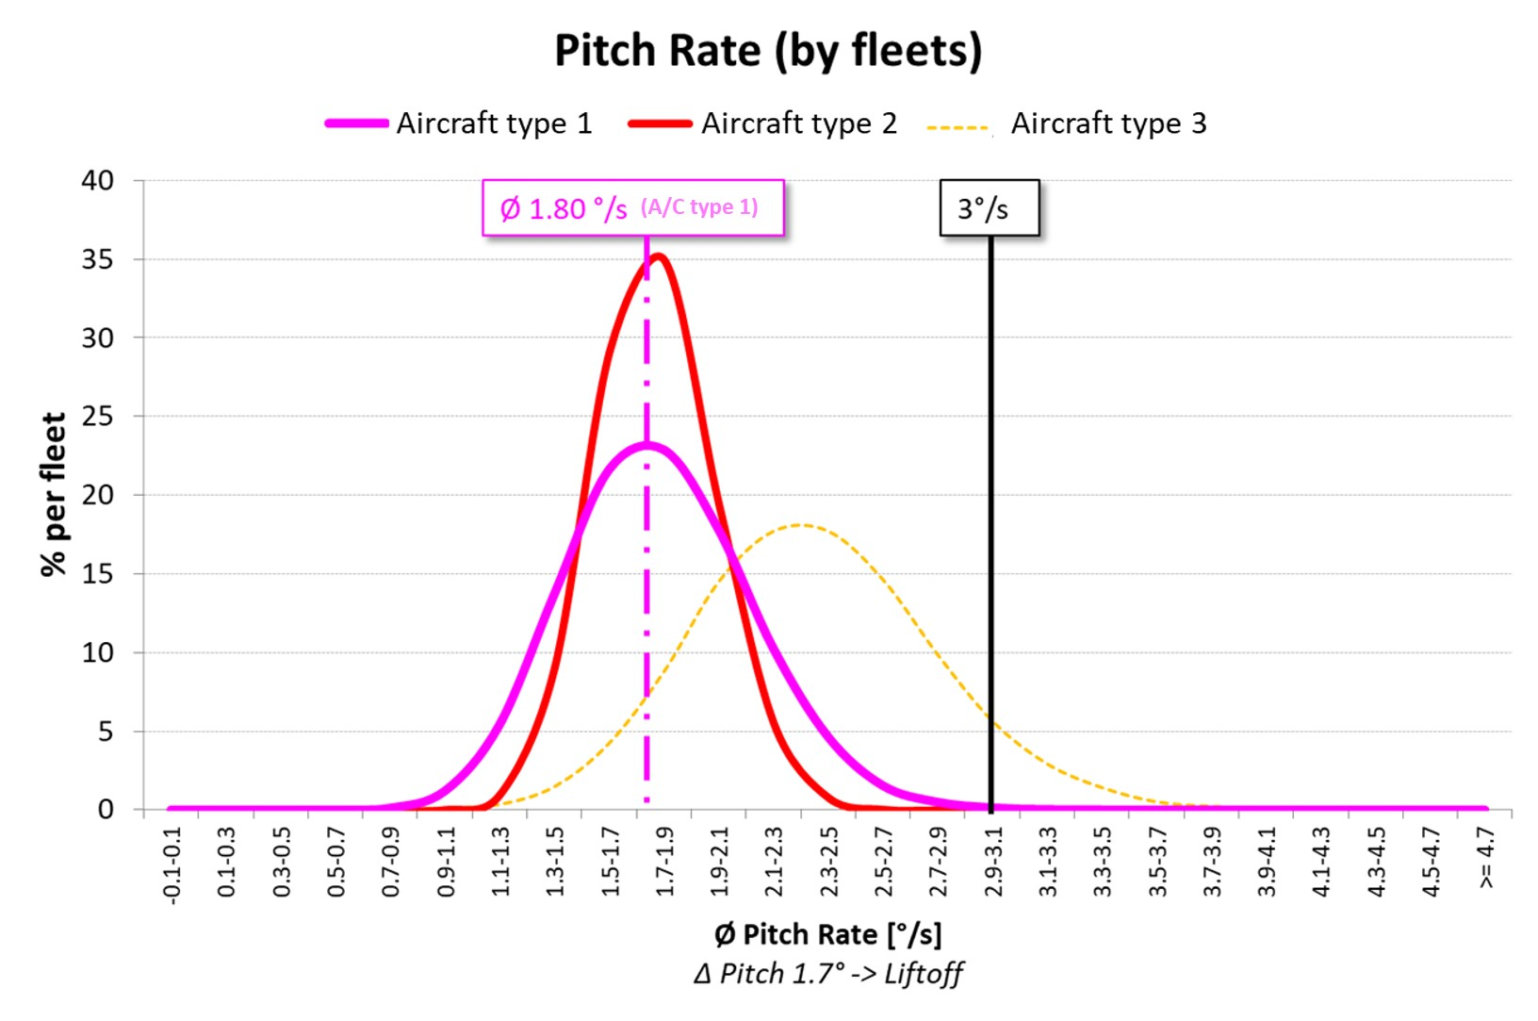
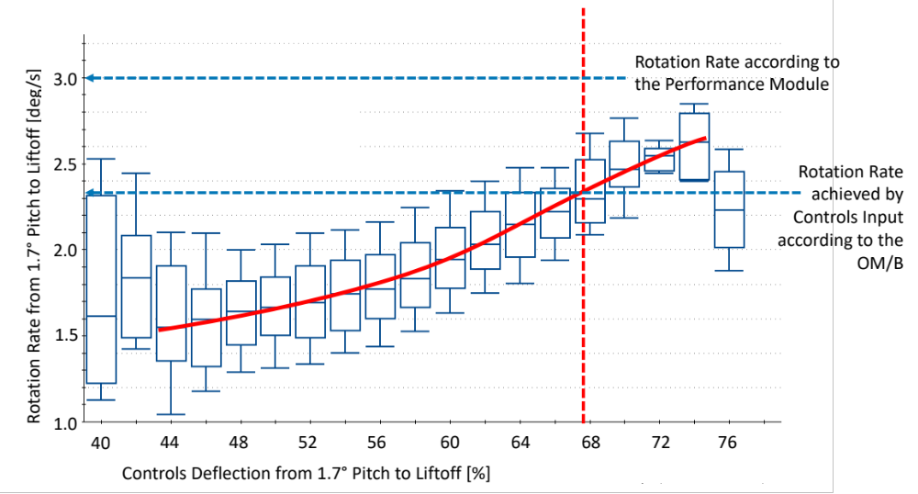
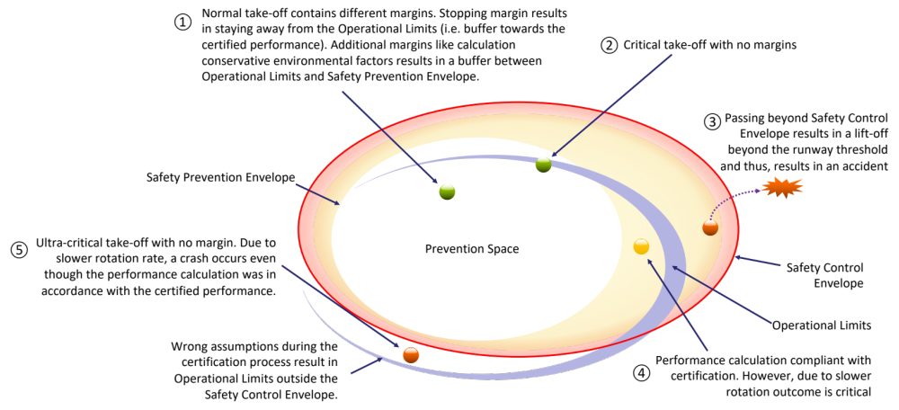
Case study – take off rotation: Problem

Slide 15
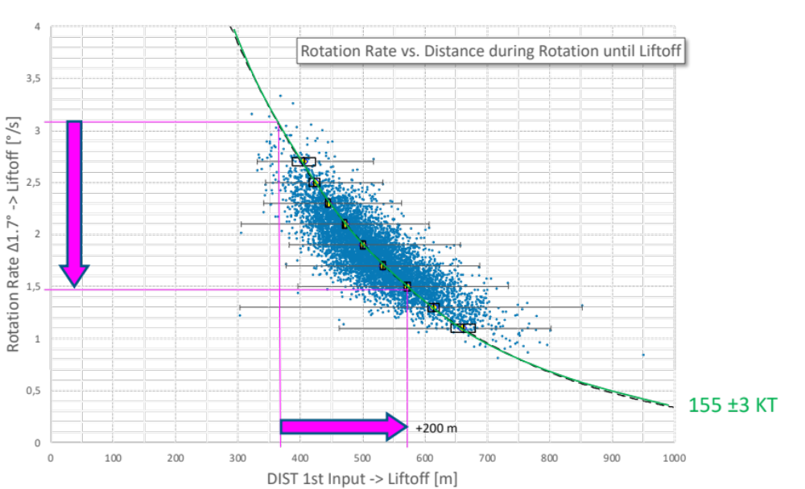
Case study – take off rotation: solution

Slide 16
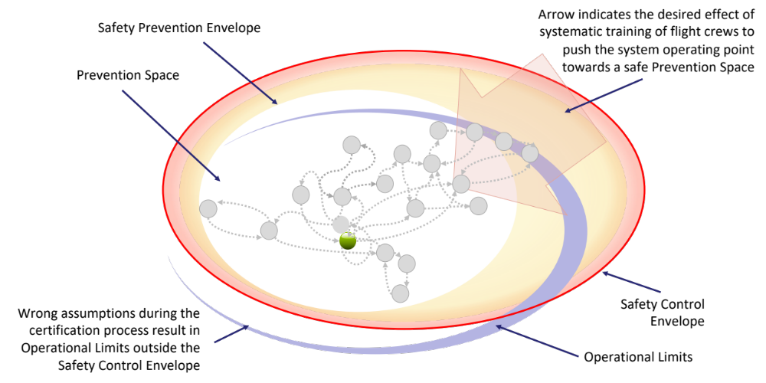
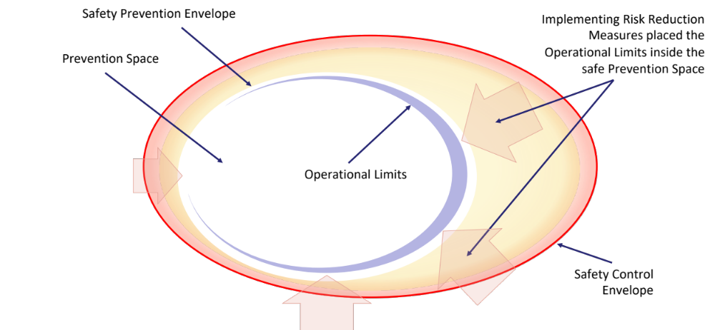
Case study – take off rotation: options

Slide 17
What is new?
Operational Resilience – more than risk management
Pressures – more than hazards/threats
Adaptations – more than errors
Manifestations – more than undesired aircraft states
Operational Limits vs. Envelopes – assumptions vs. reality
Margins, distributions – from ‘big data’ to ‘smart data’

Slide 18


Need-to-do not just nice-to-have
People do it, organizations don’t
Smart Data = insights + algorithms
“Professionals know to look at all operations to decide on a change, SMS looks only at hazards”
“We have a lot of data now, but we are not sure how to make the best use of it”
… but organizations CAN do it!

Slide 19
THANK YOU!

