Slide 1
Environmental Control and Life Support Systems – Crew Health and Performance –
Future Research Needs and Alignment
Biological and Physical Sciences Research Fall Committee Meeting – 10/20/2022
James Broyan
System Capability Leadership Team (ECLSS-CHP SCLT)
Leader

Slide 2









What are ECLSS-CHP Systems?
  The systems and technologies that keep our astronauts healthy and productive while living and working in space
  9 Capability Areas are further decomposed to capabilities and sub-capabilities to define gaps
ENVIRONMENTAL CONTROL AND LIFE SUPPORT SYSTEMS (ECLSS)
CREW HEALTH AND PERFORMANCE SYSTEMS (CHP)
(Strongly coordinated with HRP risks)
Life Support
Environmental Monitoring
Spacesuit Physiology
Crew Health Countermeasures
Radiation Protection
Fire Safety
Logistics
Exploration Medical
Food
and Nutrition
2

Slide 3









ECLSS-CHP SCLT Capability Areas and Capabilities
  Capability areas are divided into 25 technology development roadmaps
    Roadmaps capture development, tech demos, validation, reliably testing and mission infusion targets
    Roadmaps are directorate (e.g. ESDMD, SOMD, STMD) and program (EC, ISS, HRP, GCD) agnostic
  ECLSS-CHP has 87 ESDMD Capability Integration Team (CIT) recognized gaps plus numerous related gaps
ECLSS-CHP – Primary Capability Decomposition
4 ECLSS Capability Areas
Capabilities
5 CHP
Capability Areas
Capabilities
LIFE SUPPORT
    Atmosphere Management
    Water Management
    Waste Management
ENVIRONMENTAL
MONITORING
FIRE SAFETY
    Detection
    Protection
    Suppression
    Cleanup
  LOGISTICS
    Tracking
    Relocating
    Clothing
    Trash
O₂, CO₂, N₂
Humidity
Trace Chemicals
Microbes
Particles
Sound
ENVIRONMENTAL CONTROL AND LIFE SUPPORT SYSTEMS (ECLSS)
  SPACESUIT PHYSIOLOGY
  Physiological Inputs & Outputs
  ConOps/Crew Capabilities
  Informatics
  Injury & Risk Mitigation
  Atmosphere/Pre-breathe
CREW HEALTH COUNTER
MEASURES
Exercise Systems
Sensorimotor
Physiology Monitoring
Informatics
RADIATION PROTECTION
Space Weather Forecasting
Monitoring
Shielding
Health Risk Models
Biomedical CM
EXPLORATION MEDICAL
Diagnostic
Treatment
Imaging
Pharmacy
FOOD & NUTRITION
Pre-packaged
Food Resources
Dietary Tracking
Health &
Perform-
ance
CREW HEALTH AND PERFORMANCE (CHP) SYSTEMS
3

Slide 4
(Mission need)
L = Lunar surface
T = Transit to Mars
M = Mars surface
ECLSS-CHP Envisioned Future Decomposition by Capability Area
LIFE SUPPORT
ENVIRONMENTAL
MONITORING
FIRE SAFETY
  LOGISTICS
Reliable long-duration life support with Earth independent diagnostics and repair (L,T,M)
  >20% reduction in spares and installed mass (T)
  Enable single missions >800 days w/o resupply (T)
  Repeated missions with >9 months dormancy (L,T,M)
  >75% oxygen recovery at 2 mm-Hg CO₂ (T)
  High pressure oxygen recharge for EVA (L,M)
  >98% water recovery (L,T,M)
  Remove respirable lunar and Mars dust (L,M)
  Planetary protection compatible ECLSS venting (M)
Identify and quantify chemical (>12 water, >33 air) and microbial species in-flight with out sample return (L,T,M)
Ability to detect unknown constituents (T,M)
Distinguish between fire, habitat dust, and surface dust particles (L,M)
Support forward and backward planetary protection detection (both microbial and non-culture techniques) (M)
Test-verified partial gravity flammability characteristics and countermeasures (L,M)
ECLSS compatible fire suppression (L,T,M)
Reduce post fire clean-up time (L,T,M)
Common fire safety strategy across element architectures (L,T,M)
Jettison >90% of trash mass during Mars transit (T)
Mars trash disposal compatible with planetary protection (T,M)
In-flight autonomous logistics (L,T,M)
Reducing clothing and wipes mass by >50% (L,T,M)
Clothing flammability (and other non-metallics) >36% O2 (L,M)
  EVA PHYSIOLOGY
COUNTER-MEASURES
RADIATION PROTECTION
EXPLORATION MEDICAL
FOOD & NUTRITION
100% of tasks within human performance (L,T,M)
Predict and mitigate decompression sickness (L,M)
Predict and mitigate of suit or EVA injury (L,M)
6 Major physiological informatics parameters provided in-suit to enable real time self assessment or loss of communication areas (L,M)
Reduce mass and volume (L,T,M)
Maintain/monitor fitness in-flight to enable unassisted landing egress & EVA (L,T,M)
Validated lunar and Mars fitness standards (L,M)
24-hr prediction of solar storm duration and intensity to >90% (L,T,M)
High energy neutron detectors (L,T,M)
Earth independent monitoring/forecasting (T,M)
GCR shielding (T,M)
In-flight diagnostics and treatment for 100 of 120 medical risk conditions (L,T,M)
Autonomous medical
skill and & decision
support systems (T, M)
100% of nutrient stability
>5-year shelf life (T,M)
Food acceptability >90% (L,T,M)
<30% launched water content (T,M)
Exploration counter-measure in-flight nutrition intake monitoring (L,T,M)
4

Slide 5
BPS Research and development needs for SCLT envisioned futures
Requests for BPS | Synergism | ECLSS-CHP SCLT needs
Study how physical characteristics and human/crop interact in the ug and partial gravity environments; and lower pressure/higher oxygen habitats | Coordinate research, solicitations, and projects to close knowledge gaps, identify novel phenomena for technology development | Identify, characterize and mitigate the risks to life support systems human health and performance in space
Flowing gas/liquid/porous media and surface interactions Flammability, combustion physics testing and modeling in partial-g Exterior to habitat microbial transport modeling in ug and partial-g surfaces Biofilm prevention mechanisms Cryogenic gas separation Plant topics Hyperspectral imaging Moisture/multiple-growth-cycle impacts on microbiome Water/nutrient management Leafy/fruiting cultivator evals Radiation interactions with stored crew consumables/crops/crew Dust and regolith water/oxygen interactions | Multiphase flow research Lunar surface flammability/ combustion research facilities External ISS and lunar lander microbial characterization Multiyear biofilm research Use of permanently shadowed regions Novel crop development Crop health monitoring research Leafy/fruiting/microgreen cultivator evals Plant growth research facilities (media, aeroponics/hydroponics) Radiation/microgravity interactions Non-earth centric radiation monitoring/modeling/warning capabilities Chemical and physics modeling and ersatz development | Gas/liquid separator, pressure drop in 2-phase flow heat exchangers, filter performance, interior dust transport Improved flammability materials selection and reduced vehicle risk Emergency response upgrades Life support accommodations for planetary protection Improved life support dormancy Novel cabin gas separation/trace gas removal Crop/food production facilities Space radiation countermeasures Crew health countermeasure systems Exploration medical diagnostic and treatment systems Improved water and gas processing to remove new contaminant sources

Slide 6
Focus area: Multi-phase Flow Phenomena
Research needs: Flowing gas/liquid/porous media and surface interactions
Technology development supported:
  Gas/liquid separators, 2/3-phase flow pressure drop and flow distribution in packed beds, free flowing surface media beds, plant root zones, plumbing pipes, condensing heat exchangers, and filters
  Liquid distribution greatly influences air/water interface where microbial/fungal mitigation is challenging during operation and uncrewed periods
Supports NASA Moon to Mars Objectives
  AS-1LM: Characterize and monitor the contemporary environments of the lunar and Martian surfaces and orbits, including investigations of micrometeorite flux, atmospheric weather, space weather, space weathering, and dust, to plan, support, and monitor safety of crewed operations in these locations.
  AS-3LM: Characterize accessible lunar and Martian resources, gather scientific research data, and analyze potential reserves to satisfy science and technology objectives and enable In-Situ Resource Utilization (ISRU) on successive missions.
Key aspects
  Complex media, surfaces changed by biological activity over time, and partial gravity transitions
  Vehicle and crew acceleration perturbations

Slide 7
Focus area: Lunar Dust and Regolith
Research needs: Unweathered dust and regolith water/oxygen interactions inside habitats
Technology development supported:
  Ensuring robustness to air and water recycling technology to understand potential for new contaminant and interactions with processing catalysts and surfaces
  Inform novel approaches to using ISRU derived oxygen, water, and other consumables for ECLSS
Supports NASA Moon to Mars Objectives
  HBS-2LM: Evaluate and validate progressively Earth-independent crew health & performance systems and operations with mission durations representative of Mars-class missions.
  AS-3LM: Characterize accessible lunar and Martian resources, gather scientific research data, and analyze potential reserves to satisfy science and technology objectives and enable In-Situ Resource Utilization (ISRU) on successive missions.
Key aspects
  Establishing ground truth with actual range of lunar materials
  Development of chemically representative dust, regolith, ice simulates/ersatz
  Identifying new compounds or chemicals that may require detection, monitoring, and mitigation for crew health or maintaining vehicle performance
  Extensibility of basic research to crop growth media (covered under crops focus area)

Slide 8
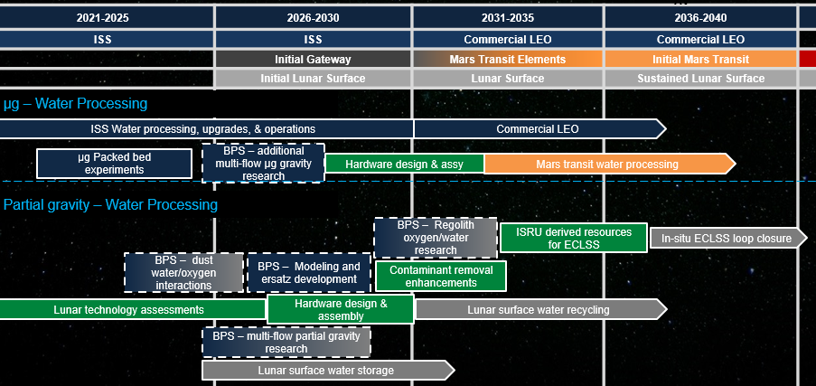

Notional Roadmap of Multiphase Flow, Dust, and ISRU Resources Research Support for Exploration Water Processing

Slide 9
Focus area: Flammability and Fire Safety
Research needs: Partial gravity testing methods, material characterization, and models
Technology development supported:
  Materials selection and vehicle construction layout standards
  Improved fire detection, suppression, and post-fire cleanup technologies
Supports NASA Moon to Mars Objectives
  PPS-2LM: Advance understanding of physical systems and fundamental physics by utilizing the unique environments of the Moon, Mars, and deep space.
  AS-6LM: Advance understanding of how physical systems and fundamental physical phenomena are affected by partial gravity, microgravity, and general environment of the Moon, Mars, and deep space transit.
Key aspects
  Complex multimedia material, charring material characterizations in range of partial gravity environments.
  Establishment of ground truth in lunar gravity and correlation of sub-orbital and ground testing analogs
  Validation of large-scale fire modeling
  Characterization of pre-combustion and post-combustion chemical and physical environments in lunar fire environments (partial-g, high oxygen concentration, low total pressure)

Slide 10
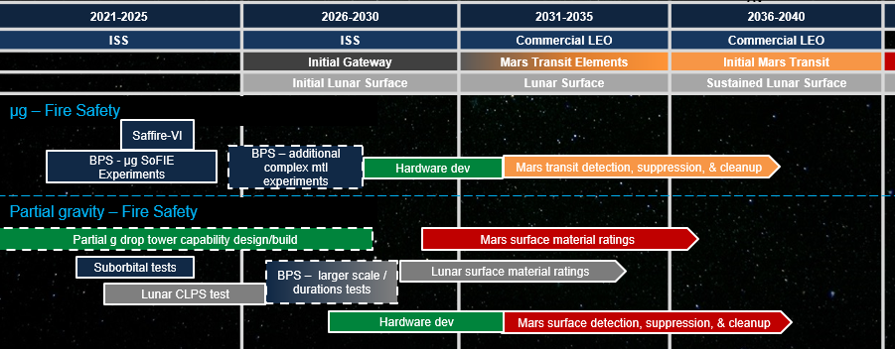
Notional Roadmap of Combustion & Fire Research Support for Exploration Fire Safety

Slide 11
Focus area: Microbial Transport, Mitigation, and Monitoring
Research needs: extravehicular microbial transport and survivable, adaption of biofilm in space environments and disrupting proliferation, stable biological life support processes
Technology development supported:
  CO2 removal, airlock, vehicle pressure relief, bacterial air filters, and spacesuit venting mitigations for planetary protection
  Life support disinfection and dormancy technologies
  Biological life support processes for partial gravity
Supports NASA Moon to Mars Objectives
  HBS-1LM: Understand the effects of short- and long-duration exposure to the environments of the Moon, Mars, and deep space on biological systems and health, using humans, model organisms, systems of human physiology, and plants.
  AS-4LM: Conduct applied scientific investigations essential for the development of bioregenerative-based, ecological life support systems
  LPS-4M: Advance understanding of the origin of life in the solar system by identifying where and when potentially habitable environments exist(ed), what processes led to their formation, how planetary environments and habitable conditions have co-evolved over time, & whether there is evidence of past or present life in the solar system beyond Earth
Key aspects
  Polymicrobial biofilms on 3D surfaces during crewed and uncrewed periods (wet/dry/nutrient variations)
  Radiation modifications and mitigation resistance modifications
  Detection of modifications and their significant on long duration missions

Slide 12
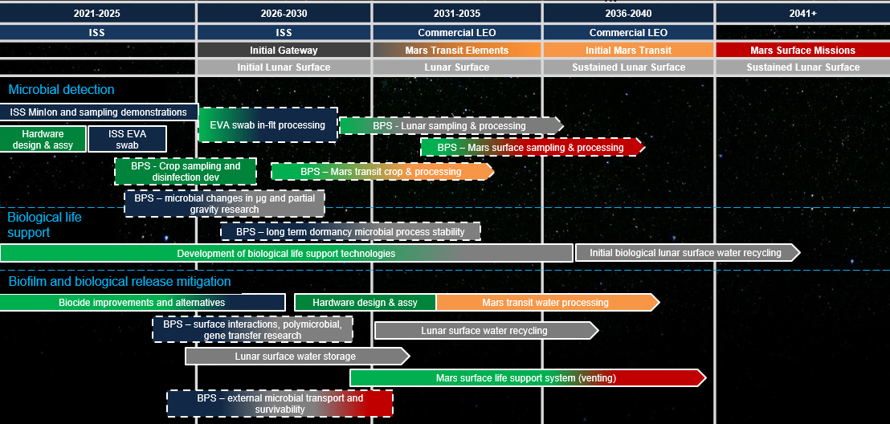
Notional Roadmap of Microbial Transport, Mitigating, and Monitoring Research Support for Environmental Monitoring, Life Support Processes, and Planetary Protection

Slide 13
Focus area: Crops, Food, and Nutrition
Research needs: adapted varieties, water & nutrient delivery, & microbiome management
Technology development supported:
  Crop production for supplement nutrition and variety on long duration lunar surface & Mars transit missions
Supports NASA Moon to Mars Objectives
  HBS-1LM: Understand the effects of short- and long-duration exposure to the environments of the Moon, Mars, and deep space on biological systems and health, using humans, model organisms, systems of human physiology, and plants.
  HBS-2LM: Evaluate and validate progressively Earth-independent crew health & performance systems and operations with mission durations representative of Mars-class missions. Key aspects
  AS-5LM: Define crop plant species, including methods for their productive growth, capable of providing sustainable and nutritious food sources for lunar, Deep Space transit, and Mars habitation.
Key aspects
  Selection of most productive range of crops based on relevant ug and partial-g environments
  Long term microbial/fungal control and moisture management over many crop cycles
  Radiation affects on stored crop supplies and crop growth
  Closing knowledge gaps on regolith screening, conditioning, and augmentation of lunar environment

Slide 14
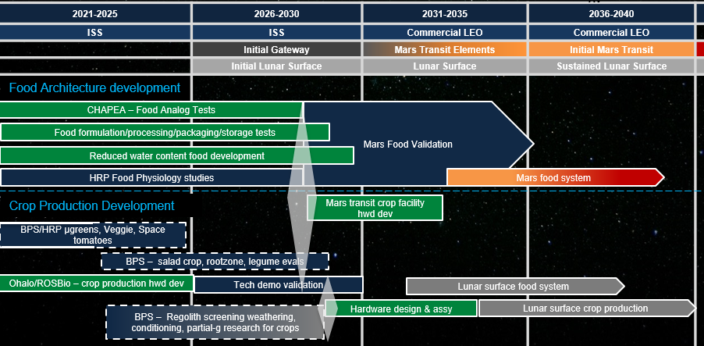
Notional Roadmap of Crop, Food, & Nutrition Research Support for Food, Nutrition, and Crew Health Countermeasures

Slide 15
Backup Charts
Sampling of relevant BPS Decadal Committee white papers
Moon to Mars Objectives most relevant to ECLSS-CHP

Slide 16
Select white papers submitted to BPS Decadal that support ECLSS-CHP
Direct support of ECLSS-CHP needs
  Challenges and Research Needs for Micro- and Partial-Gravity Fires (Lead: Ya-Ting Liao)
  Recommendations for Fire Extinguisher Research for Crewed Missions (Lead: John Easton)
  Spacecraft Materials Fire Safety (Lead: Fletcher Miller)
  Research Questions and Challenges for Improved Spacecraft Fire Detection (Lead: Claire Fortenberry)
  Solid Fuel Combustion in Partial and Micro-Gravity (Lead: Michael Gollner)
  Recommendations for Spaceflight Research to Enable Crop Plant Growth Systems for Exploration (Lead: Alexandra Whitmire)
  Spaceflight Food System: Impacts to Nutritional Adequacy, Health, Performance, and Resources in Space Exploration (Lead: Grace Douglas)
  Microbial Food Safety in Space Production Systems (Lead: Jessica Lee)
  Elevating the Use of Genetic Engineering to Support Sustainable Plant Agriculture for Human Space Exploration (Lead: Natasha Haveman)
  What to Take? When to Make? How to Break Even? Avoid Mistakes in Microbial Bio-manufacturing in Support of Human Near-to-Deep Space Exploration (Lead: Nils Averesch)
  Planetary Protection Knowledge Gaps and Enabling Science for Crewed Mars Missions (Lead: J Andy Spry)
HRP related submissions that support ECLSS-CHP needs
  Greater understanding at the fundamental science levels can lead to more targeted and efficient applied biomedical solutions
    Provides input for SCLT technology development to close exploration gaps
  Vision for the Next Generation of Spaceflight Microbiology: Human Health and Habitat Sustainability (Lead: Mark Ott)
  The Need for Biological Countermeasures to Mitigate the Risk of Space Radiation-Induced Carcinogenesis (Lead: by Broc Sishc)
  Development of Medical Capabilities & Tech for Health Monitoring, Diagnostics, & Treatment during Human Exploration Spaceflight (Lead: Shean Phelps)
  Enabling a Precision Health System for Deep Space Exploration (Lead: Corey Theriot)

Slide 17
Alignment to NASA Moon to Mars Objectives (Sept 2022 release)
NASA Moon to Mars Objectives source for the most relevant objectives listed in presentation
https://www.nasa.gov/sites/default/files/atoms/files/m2m-objectives-exec-summary.pdf

